Slide 1
Introduction to Particle Physics
Katsushi Arisaka
University of California, Los Angeles
Department of Physics and Astronomy
arisaka@physics.ucla.edu

Slide 2
Particle Physics
Purpose:
To understand the most elementary particles in nature.
To understand the most fundamental physics laws = interaction among elementary particles.
How?
Study the shortest distance = The highest energy (= the highest temperature)
The best way to understand the earliest stage of the Universe

Slide 3
Unit of Energy
In particle physics, we use “eV” (electron volt).
1 eV: The energy acquired by an electron when accelerated through a potential difference of 1 Volt.
1 eV = 1.6 x 10⁻¹⁹ Joule
= 1.6 x 10⁻¹² erg
= 11,600 ºK ~ 10⁴ ºK
Convenient units:
1 KeV = 10³ eV = 10⁷ ºK
1 MeV = 10⁶ eV
1 GeV = 10⁹ eV
1 TeV = 10¹² eV

Slide 4
Quantum Mechanics
Heisenberg’s Uncertainty Principle
Position
Momentum
Time
Energy
h : Planck Constant
fm = 10⁻¹⁵ m
Shorter Distance
Higher Energy

Slide 5
Unit of Particle Mass
From E = mc² → m = E/c²
Unit of mass is eV/c²
Buy we tend to ignore c²,
So practically eV, keV, MeV, GeV…
Example:
m_{e} = 0.511 MeV
m_{p} = 938.3 MeV
m_{n} = 939.6 MeV
m_{He} = 3727.4 MeV
Mass Differences:
m_{n} = m_{p} = 1.3 MeV
[2m_{p} + 2m_{n}] - m_{He} = 28.4 MeV
28.4 MeV /4 ~ 7 MeV
ε = 7 MeV / m_{p} = 0.007

Slide 6
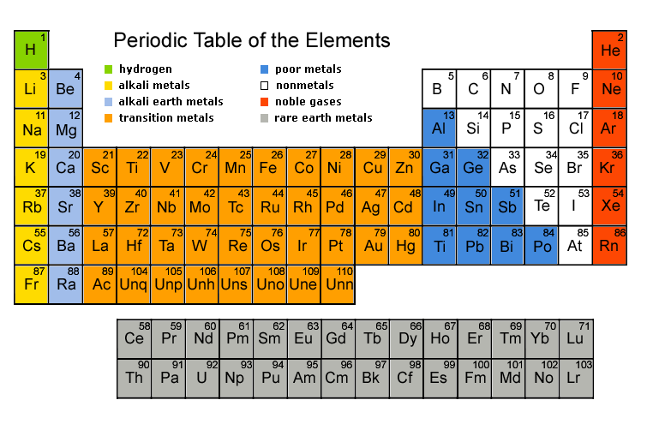
Periodic Table of Elements (~1900)

Slide 7
Historic View of Elementary Particles
Early 1900’s
Periodic Table: H, He, Li, Be…
Discovery of electrons (1887)
Discovery of protons (1914)
Discovery of neutrons (1932)
1932
Three elementary particles: e⁻, p, n
Three mejor questions
Nuclear force
Anti-Partcle
Beta-decay

Slide 8
Pauli’s Exclusion Principle
Fermi Statistics:
According to quantum mechanics, each state is occupied by one particle (Fermion). Another particle can not stay in the same state.
Degenerate matter:
All possible states are occupied.

Slide 9
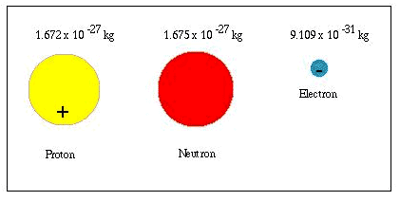
Elementary Particles (~1930)
Avogadro Number = 1 g / 1.762 x 10⁻²⁷ kg = 6 x 10²³

Slide 10
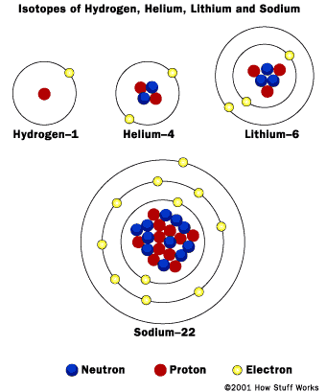
Atoms

Slide 11
Nuclear Force (Strong Interaction)
Why are nucleus bound together?
Protons are all positively charged, thus electrically impossible to bound.
Two possible ideas
Bohr: Quantum Mechanics is not valid in nucleus.
Yukawa: Quantum Mechanics OK, but a new particle is required (1934) → Meson
Discovery of meson
1937 Anderson: muon found
1947 Powell: π-meson found.
140 MeV as predicted by Yukawa.

Slide 12
Anti-Particles
Predicted by Paul Dirac in 1927.
He combined Relativity and Quantum Mechanics (advanced topic for physics major grad students!).
Negative energy state = Anti-Particle
In 1931 Anderson discovered positron: e⁺
P: Momentum
E
e⁻
mc²
e⁺
mc²

Slide 13
Feynman Diagram
Richard Feynman showed
Anti-particle = particle traveling in reverse direction in time.
Feynman Diagram:
shows interactions between particles.
Example: e⁺ + e⁻ → γ
Time
e⁻
e⁺
Position
γ
e⁻
e⁺

Slide 14
β-decay (Weak Interaction)
β-decay:
Example:
If two body decays, energy of e⁻ should be monochromatic, but continuous.
Is energy conservation violated??
1933 Fermi proposed “Neutrinos”
1956 Reines discovered neutrinos.

Slide 15
Lessons we learned
Basic Physics laws survived.
Quantum Mechanics
Relativity
Energy conservation
More fundamental particles than we thought:
Yukawa’s π-meson
Dirac’s Anti-particle
Fermi’s neutrino

Slide 16
Accelerators and Quark Model
1950-60
Accelerator invented.
More “strange particles” discovered
Just too may !?
Need to make a “new periodic table” of particles.
1961
Quark Model by Gell-Mann & Zweig
Baryon = Composite of three quarks
Meson = composite of quark & anti-quark

Slide 17
Quark Model
Proton
Neutron
u
u
u
d
d
d
+ 2/3 + 2/3 – 1/3 = 1
+ 2/3 – 1/3 – 1/3 = 0

Slide 18
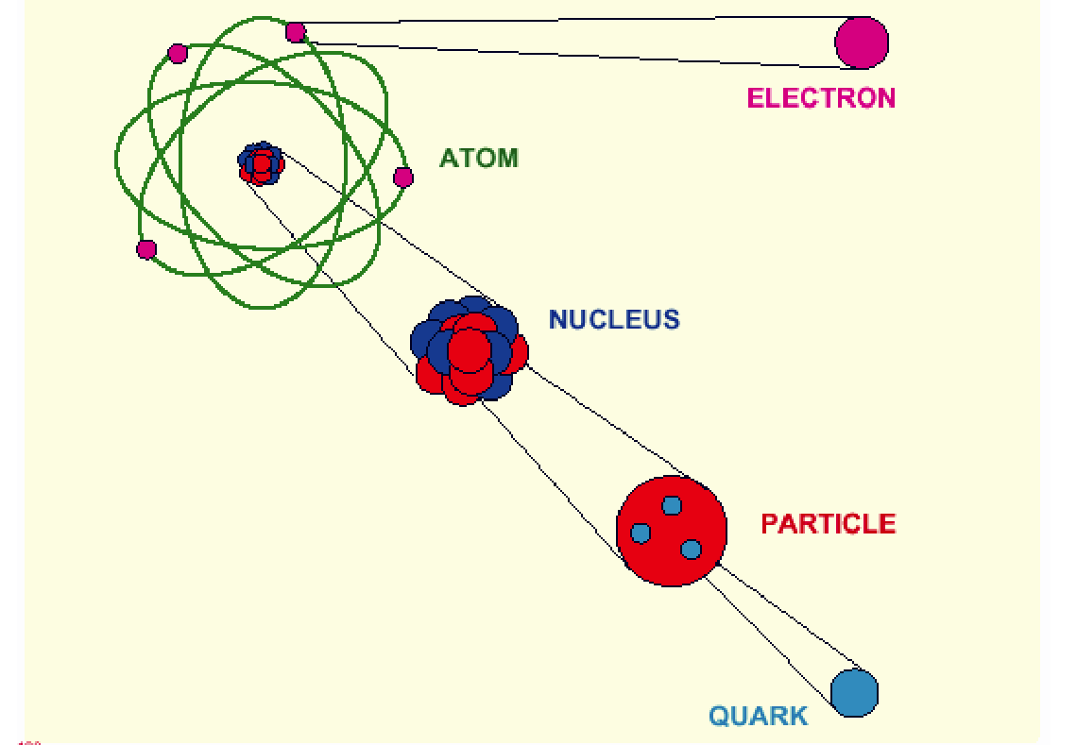
Elementary Particles (~1970)
10⁻¹⁰ m
10⁻¹⁴ m
10⁻¹⁵ m
< 10⁻¹⁸ m

Slide 19
Fermions
1973
Elementary particles : “Fermions”
Particle Anti-Particle
Quarks u u
d s d s
Leptons ν_{e} ν_{µ} ν_{e} ν_{µ}
e⁻ µ⁻ e⁺ µ⁺

Slide 20
Four Forces and Bosons
Electro-magnetic Force
mediated by photon: γ
Nuclear force (Strong Interaction)
mediated by gluon: g
Weak force (Weak Interaction)
mediated by weak bosons: W⁺, W⁻, Zº
Gravity
mediated by graviton
These mediators of forces are called “Bosons”.

Slide 21
Principle of Accelerators
When two particles are collided each other, it creates a dense package of energy.
Particle + Particle → E (energy in vacuum)
p + p, p + p, e⁺ + e⁻
If E > 2mc², a pair of particle and anti-particle with a mass m can be created.
E (energy in vacuum) → New heavy particle
+ Its anti-particle

Slide 22
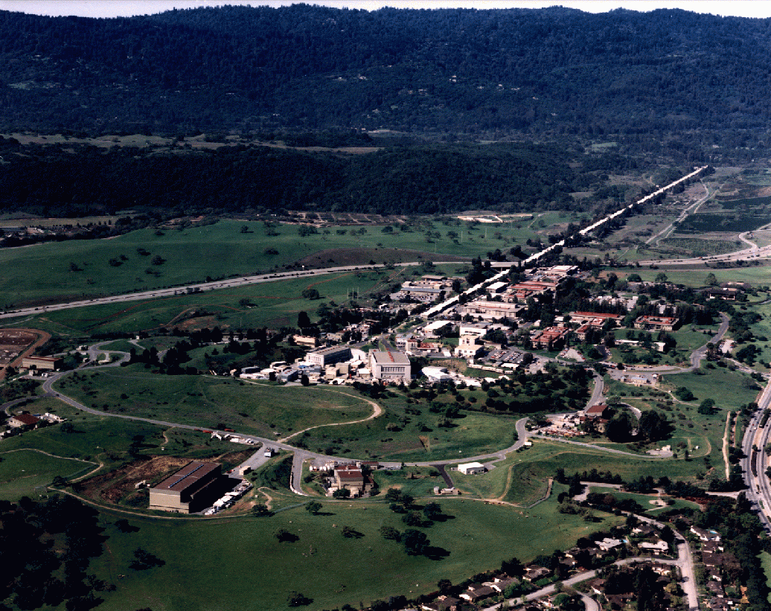
SLAC (Stanford Linear Accelerator Center)
1 mile long
e⁺ + e⁻

Slide 23
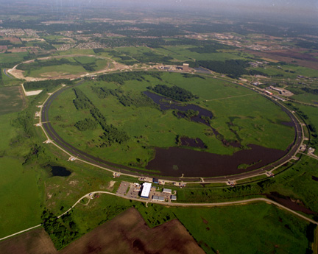
Fermi Lab near Chicago
6km Circumference
1+1=2 TeV
Proton + Anti-proton

Slide 24
Discovery of more quarks
1974 – 1994
More quarks and leptons were discovered.
1974 Ting (BNL) & Richter (SLAC) J/Ψ = cc
1975 Perl (SLAC) τ-lepton
1978 Lederman (FNAL) ϒ = bb
1994 CDF/D0 Group (FNAL) t (top quark)
All discovered at US National Labs (Many Nobels!)

Slide 25
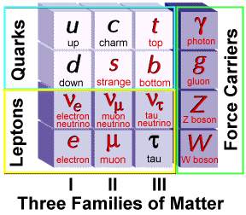
Elementary Particles
Charge
+2/3
-1/3
0
-1
Fermion Boson
Charge
0
0
0
±1
+ Anti-particles

Slide 26
Elementary Particles
Today’s Universe
Charge
+2/3
-1/3
0
-1
Fermion Boson
Charge
0
0
0
±1

Slide 27
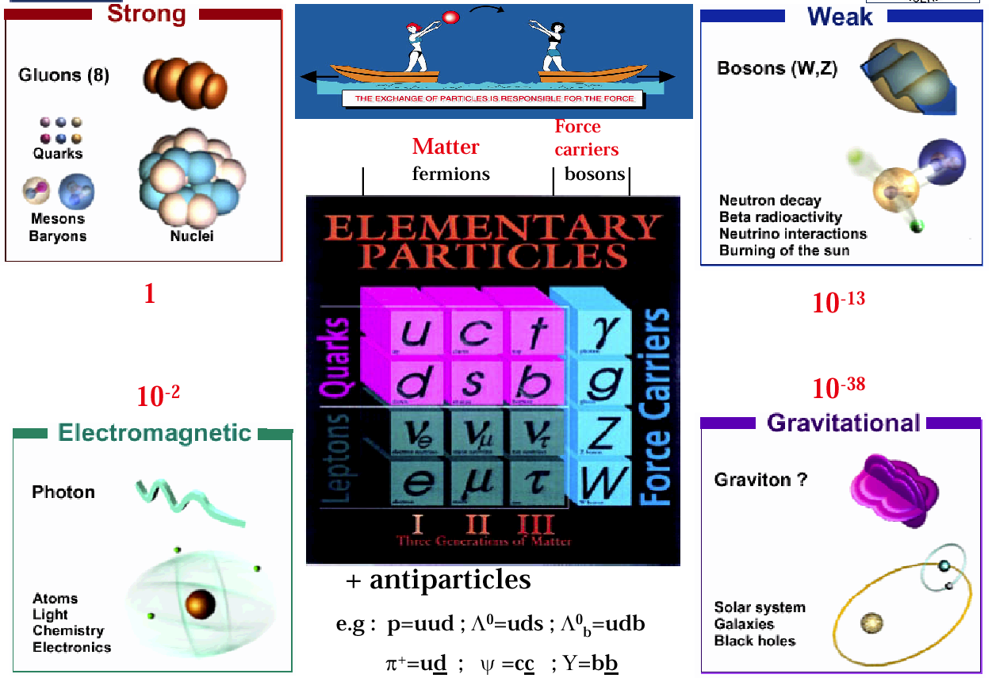
Elementary Particles and Forces

Slide 28
Power of Electric Force
Electric Force is responsible for
Electrons’ trajectory around a nuclei
Molecular structure
Structure of any life (like your body), building, bridge etc…
Structure of anything larger than a nuclei but smaller than the mountain.
How your brain works
Mechanism behind computer, TV, car etc…
…

Slide 29
Power of Gravity
Gravity is responsible for
Your staying on the ground
Trajectory of a ball
Orbit of Satellite, moon…
Formation of the solar system
Formation of the Galaxy
…
Gravity is very, very weak compared to Electric Force.
N = (Electric force) / (Gravity) = 10³⁹

Slide 30
Power of Strong Force
Strong Force is responsible for
Structure of the nuclei
How protons and neutrons are bound together
Nuclear fission
Nuclear power plant
Atomic bomb
Nuclear fusion
Sun’s energy

Slide 31
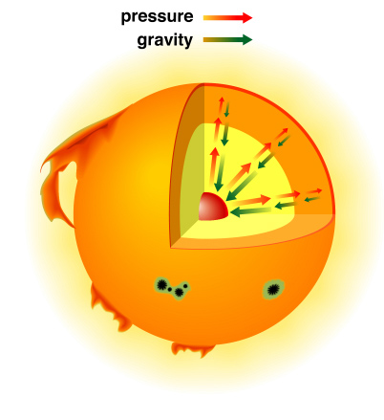
The Solar Interior
Hydrogen Gas

Slide 32
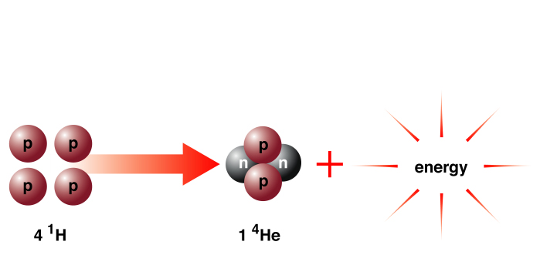
Solar Energy
E = mC²
m_{4p} > m_{He}

Slide 33
Nuclear Fusion in the Sun
p + e⁻ → n + ν
p + e⁻ → n + ν
p → p
p → p
_________________________________________
4p + 2e⁻ → (nnpp) + 2ν + Energy
H Nucleus He Nucleus

Slide 34
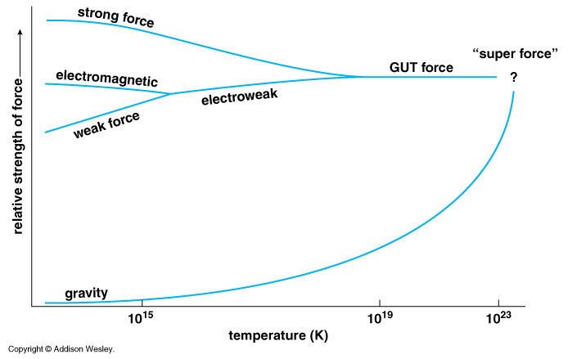
Unification of Forces
??
Electro-Weak Unification
100 GeV
10¹⁶ GeV
10¹⁹ GeV
10²⁹
10³²

Slide 35
Unification of Forces
Grand Unification
100 GeV
10¹⁶ GeV
10¹⁹ GeV
10²⁹
10³²

Slide 36
Unification of Forces
Plank Epoch
??
100 GeV
10¹⁶ GeV
10¹⁹ GeV
10²⁹
10³²

Slide 37
Hubble Deep Field
Physicists’ View of Early Universe
Fiat lux
Let there be light

Slide 38
Hubble Deep Field
Physicists’ View of Early Universe
Lorentz Invariance
Local Gauge Invariance

Slide 39
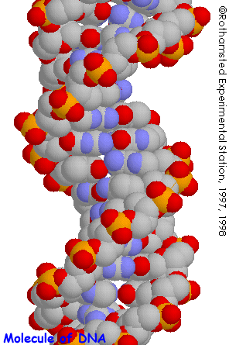
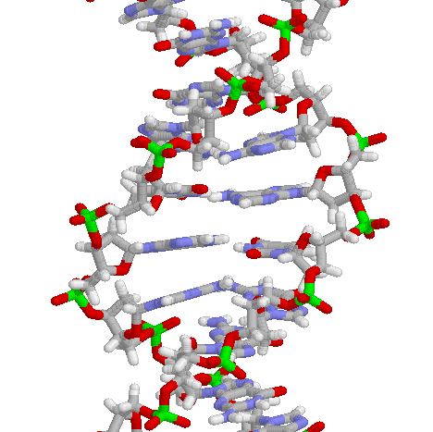
Structure of DNA

Slide 40
Symmetry Breaking
Time
0
Simple
1B years
2
3
4
b
s
µ⁻
W⁺
5
γ
c
Symmetry
Break Down
ν_{e}
τ⁺
d
6
d
Zº
τ⁻
ν_{e}
e⁺
e⁻
7
u
u
ν_{µ}
b
ν_{µ}
µ⁺
s
8
W⁺
c
9
10
11
12
Complex
13
14

Slide 41
The Beginning
Everything was the same ↔ Perfect symmetry.
All the particles are the same as photons.
All four forces are the same.
The Universe was 10 dimension.
3 Space Flattened
1 Time
3 Strong Force
6 2 Weak Compacitified
1 Electro-Magnetic

Slide 42
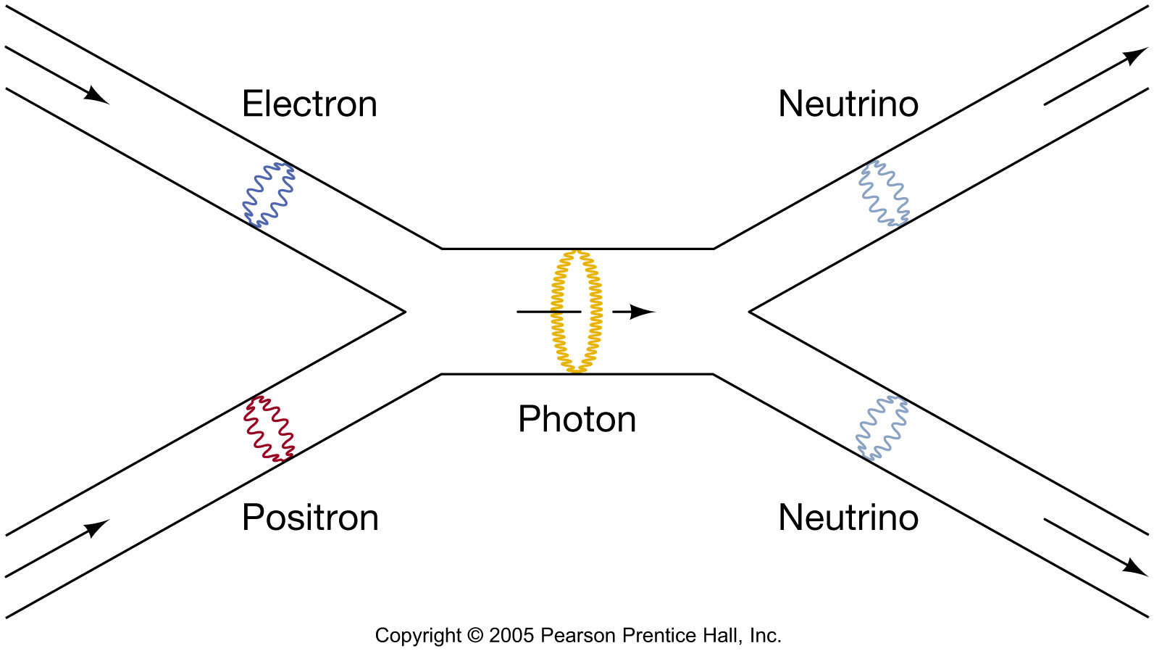
Superstring?
In the “standard model”
fundamental particles = point-like
(No internal structure)
In the “Superstring model”
Fundamental particles = loop of string
(Size < Planck scale)
e⁻
γ
e⁺
time
γ
e⁻
e⁺
time

Slide 43
Evolution of the Early Universe
Time
(sec)
Temp.
(ºK)
Energy (GeV)
Radius of Universe
(cm)
Big Bang!
10⁻⁴⁵sec
10⁻³³
10⁻⁴⁰
10³⁰
10¹⁸
10¹⁵
1
Golf Ball
10⁻³⁵
10²⁵
People
10⁻³⁰
10¹²
10⁵
Mountain
10⁻²⁵
10⁹
10⁻²⁰
10²⁰
Earth
1PeV
10¹⁰
10⁻¹⁵
10¹⁵
1TeV
1 A.U.
10⁻¹⁰
10¹⁵
10⁻⁵
1GeV
1 Light Year
1
10¹⁰
1MeV
10²⁰
10⁵ sec
1KeV
Galaxy
1 year
10⁵
10³
1eV
10²⁵
10⁶
Now
10⁹ year
10⁻³eV
10²⁸
1

Slide 44
Unification of Fundamental Forces
Time
(sec)
Temp.
(ºK)
Energy (GeV)
Fundamental
Interaction
10⁻⁴⁵sec
Planck
GUT
10⁻⁴⁰
10³⁰
10¹⁸
GUT
10⁻³⁵
10¹⁵
10⁻³⁰
10²⁵
10¹²
10⁻²⁵
Electro-Weak
10⁹
10⁻²⁰
10²⁰
1PeV
10⁻¹⁵
10¹⁵
1TeV
EW
10⁻¹⁰
10⁻⁵
1GeV
1
10¹⁰
1MeV
10⁵ sec
1KeV
Gravitation
Electromagnetic
1 year
10⁵
Strong
Weak
10³
1eV
10⁶
10⁹ year
10⁻³eV
Now
1

Slide 45
Early Universe & Unsolved Problems
Time
(sec)
Temp.
(ºK)
Energy (GeV)
The Beginning
10⁻⁴⁵sec
Planck
Plank Epoch
10⁻⁴⁰
10³⁰
10¹⁸
GUT
Grand Unification
10⁻³⁵
10¹⁵
Inflation
10⁻³⁰
10²⁵
10¹²
10⁻²⁵
10⁹
10⁻²⁰
10²⁰
1PeV
Dark Matter
10⁻¹⁵
10¹⁵
1TeV
EW
Electro-Weak Unification
10⁻¹⁰
1GeV
Quark → Hadron Phase Transition
10⁻⁵
10¹⁰
Lepton Dominant Era
1
1MeV
10⁵ sec
1KeV
1 year
10⁵
10³
1eV
10⁶
Dark Energy
10⁹ year
10⁻³eV
Now
1

Slide 46
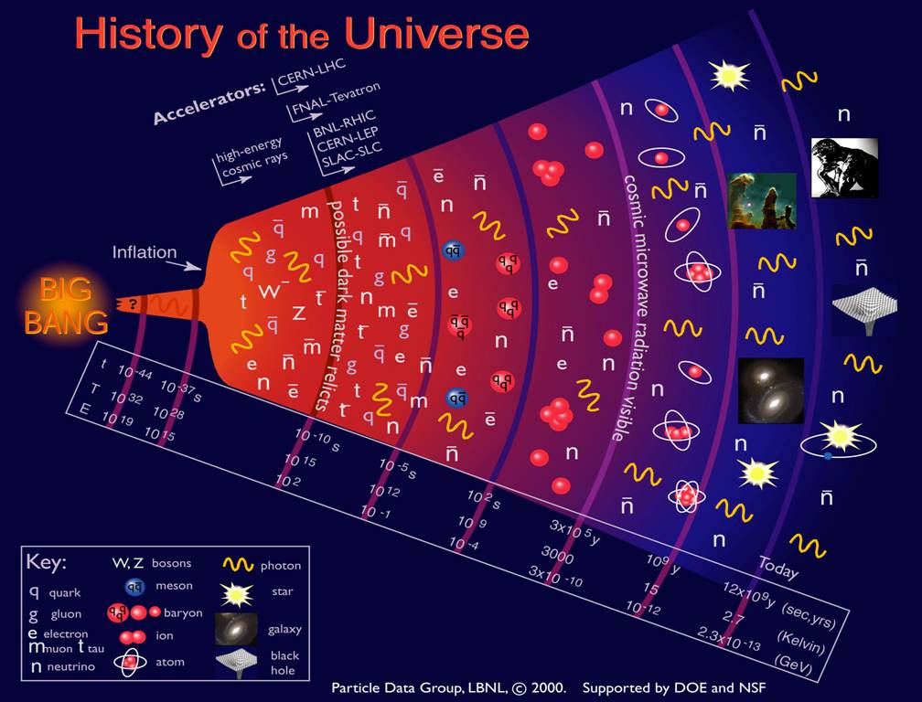

Slide 47
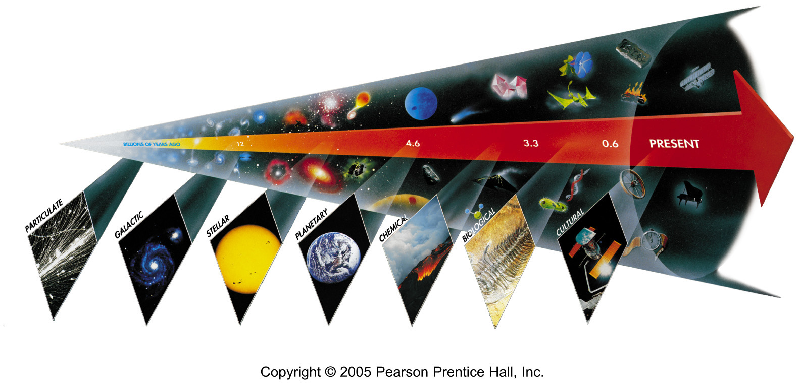
Seven Phases of Cosmic Evolution
14 billion years ago
Origin of
Particles

Slide 48
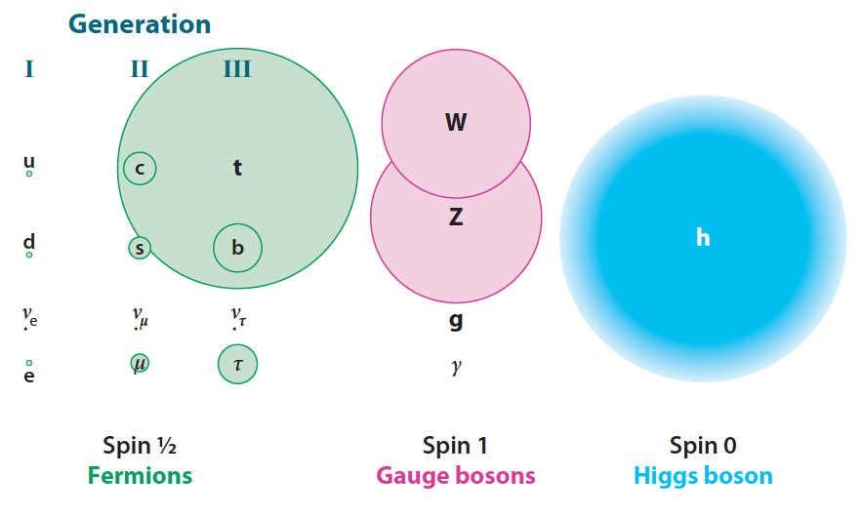
Mass of Particles (at T = 0.1 ns)

Slide 49
Mystery of the Mass (since 1970)
How to create mass from energy?
While maintaining the initial symmetry
Spontaneous Symmetry Breaking
Particle mass << Plank Mass
MeV – GeV 10¹⁹ GeV
Why so many particles (Generations) with different masses?
Energy → Mass

Slide 50
Spontaneous Symmetry Breakdown at a Dinner Table
Dinner Table
Dish
Glass of Water
by Nambu Yoichiro

Slide 51
Spontaneous Symmetry Breaking - Higgs Mechanism -
Energy
y
Vacuum
Energy
x
Mass

Slide 52
Spontaneous Symmetry Breaking - Higgs Mechanism -
Energy
y
Vacuum
Energy
x
Mass

Slide 53
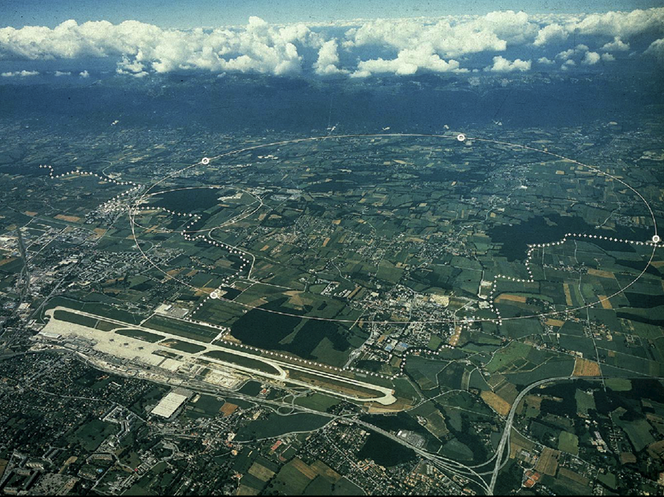
CERN and LHC in Geneva
27km Circumference
7+7=14 TeV

Slide 54
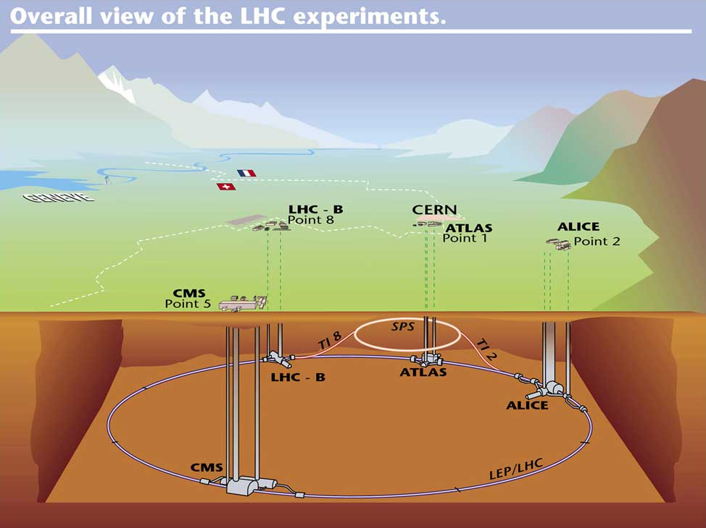

Slide 55
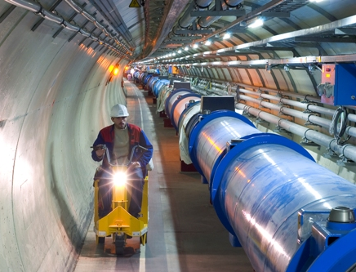
LHC Tunnel with Magnets

Slide 56
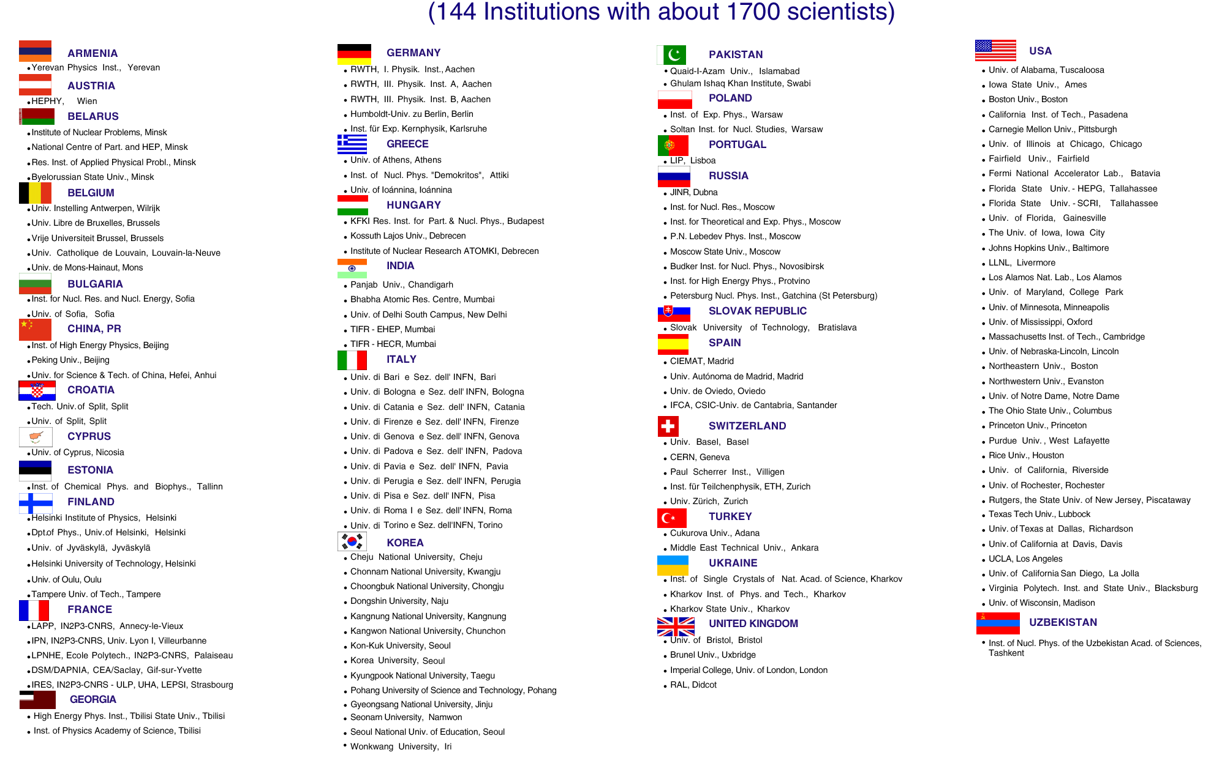
CMS Collaboration (1993 ~)

Slide 57
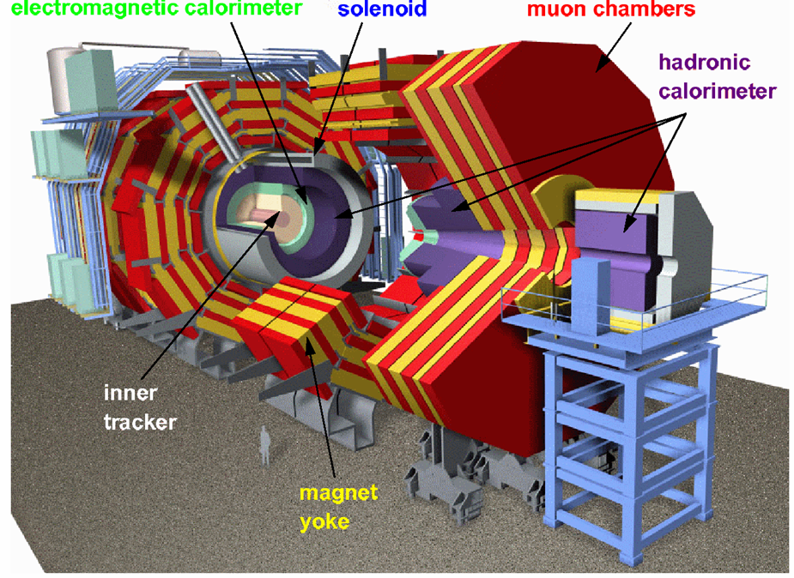
CMS

Slide 58
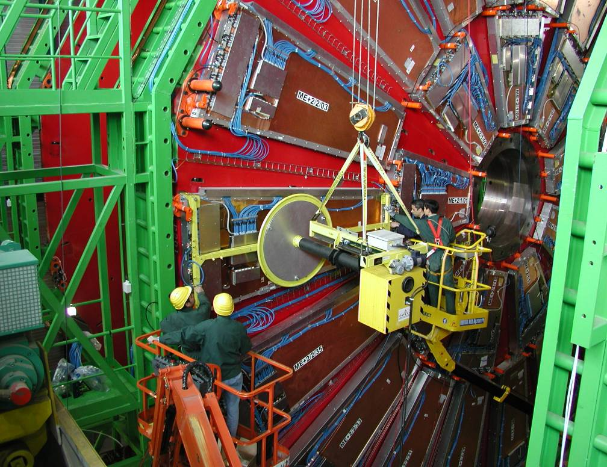
Installing muon Detectors

Slide 59
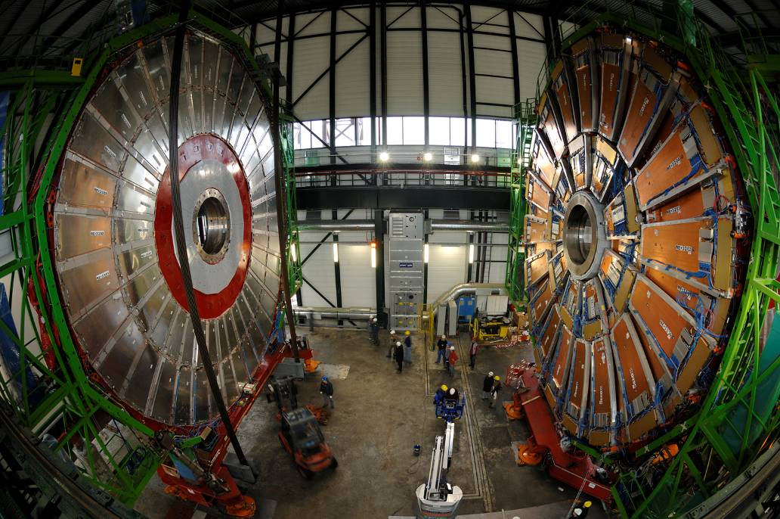

Slide 60
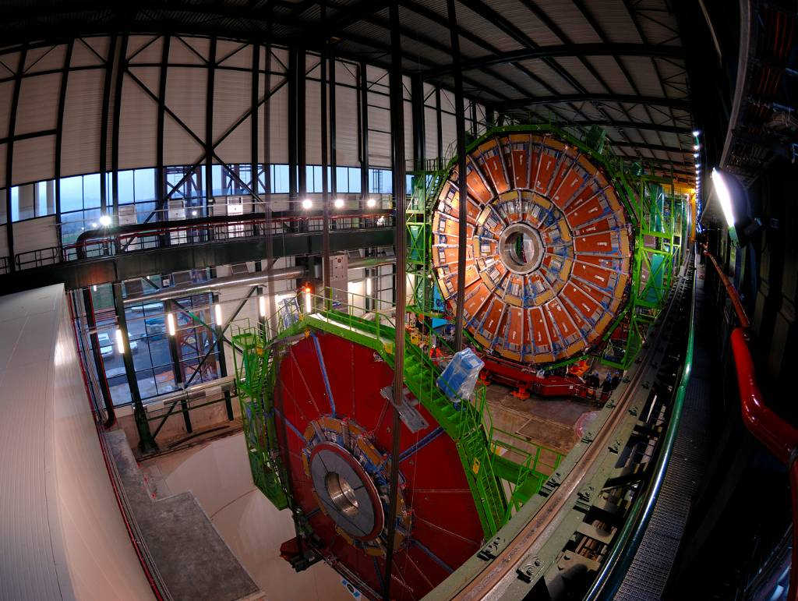

Slide 61
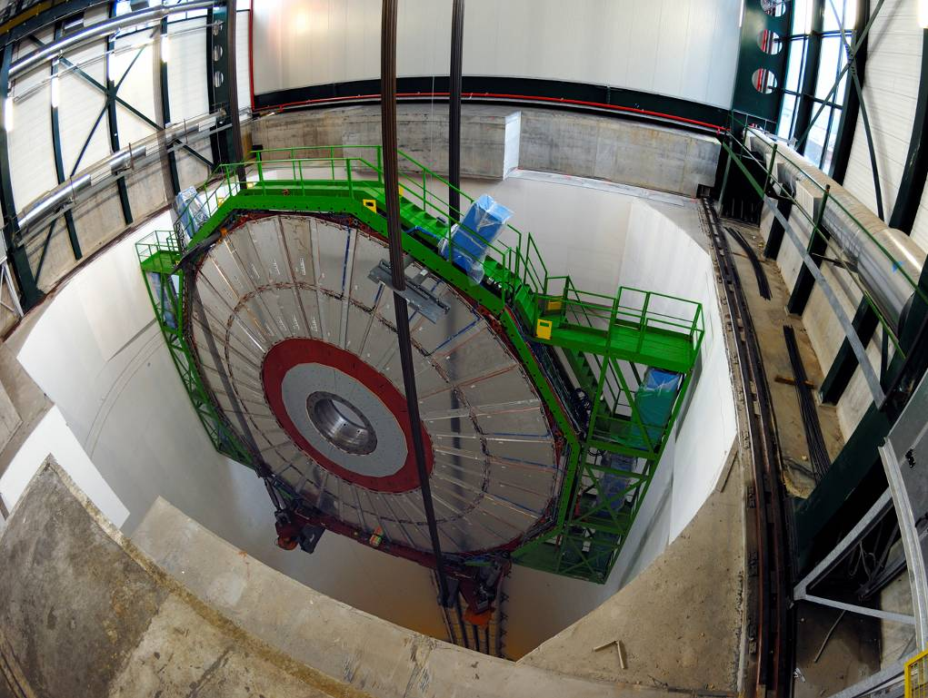

Slide 62
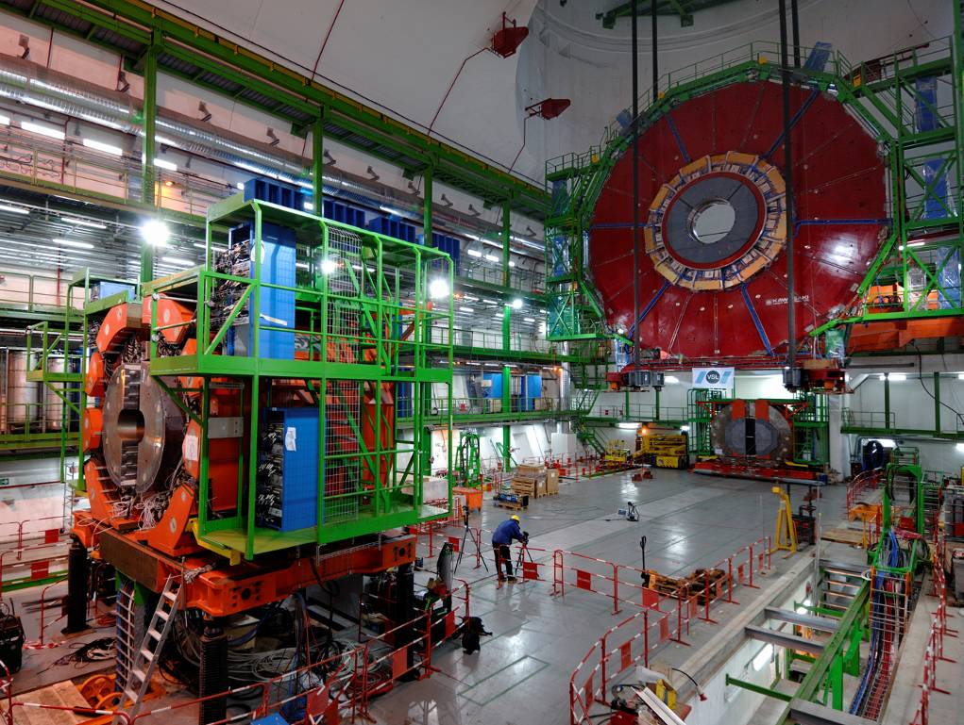

Slide 63
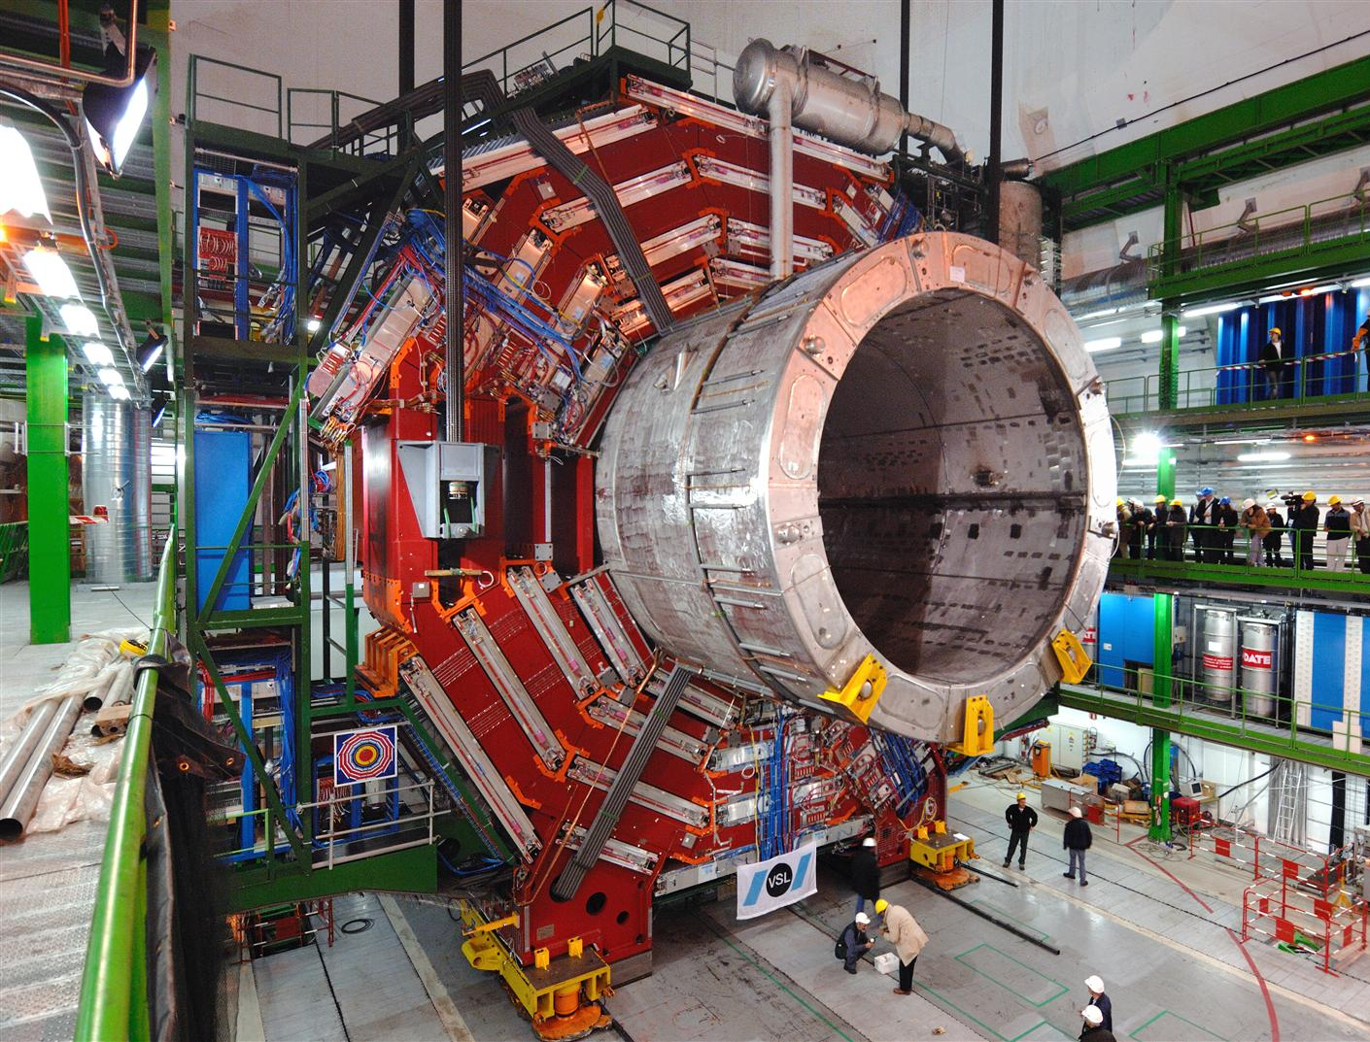

Slide 64
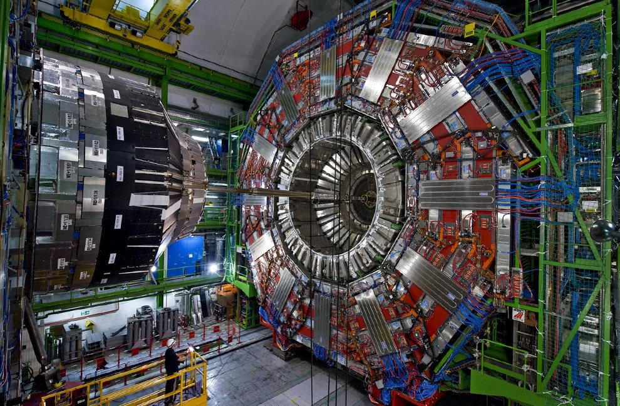

Slide 65
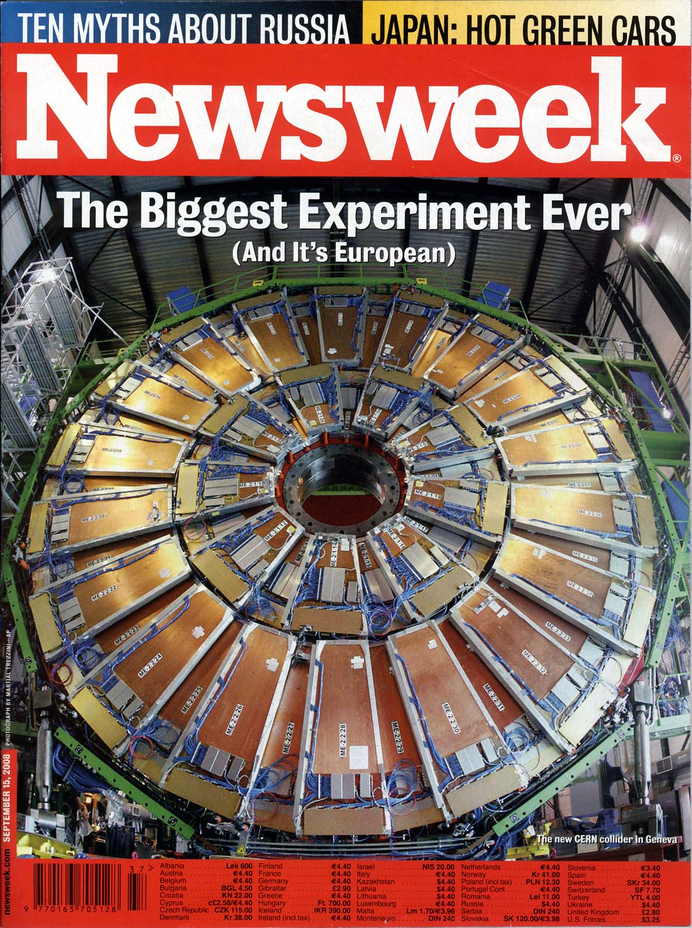
Particle detectors
constructed
at Westwood,
now at LHC, CERN
Sept 15, 2008 Issue

Slide 66
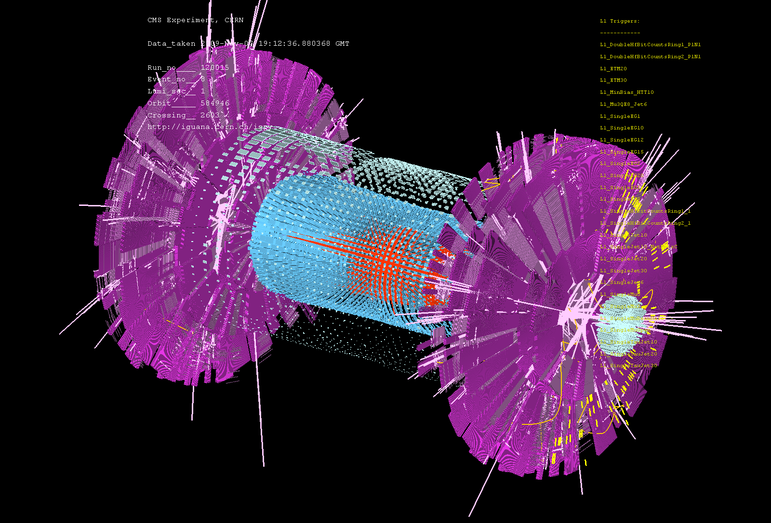
First Event at LHC – Recreation of the Big Bang! (Nov 7, 2009)

Slide 67
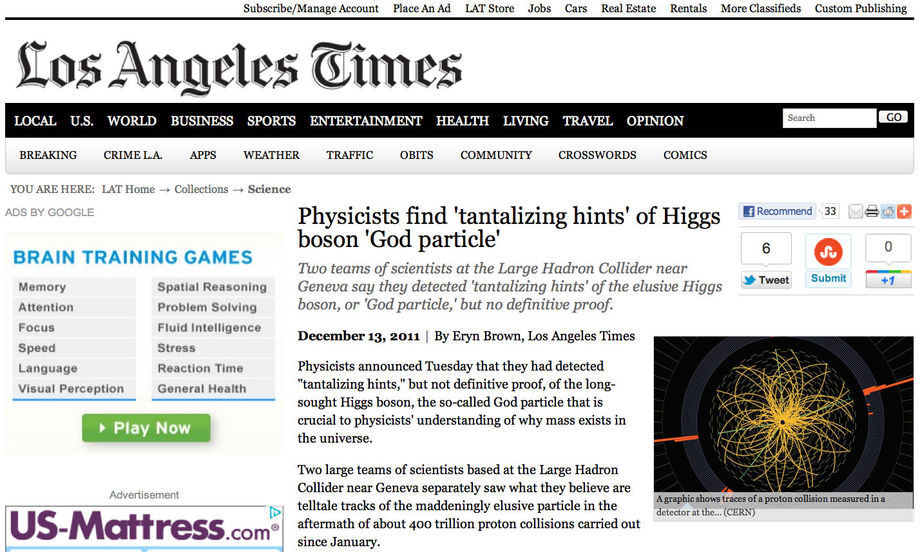
News release on July 4th !

Slide 68
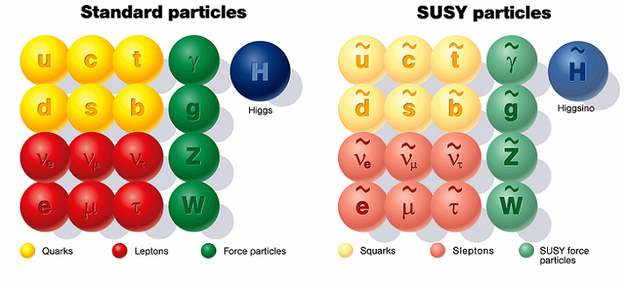
SUSY Particles and Neutralino
Spin 1/2 1 0

Slide 69
SUSY Particles and Neutralino
Super Symmetry
Neutralino
Spin 1/2 1 0 0 1/2 1/2

Slide 70
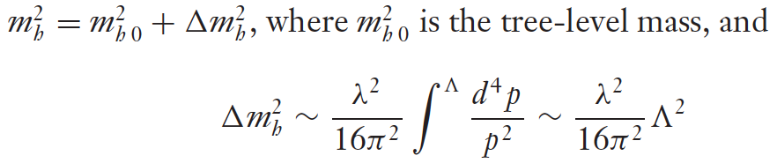

Hierarchy Problem
Higgs mass
SM :
SUSY :
or : new physics at the energy scale of Λ ~ 1 TeV

Slide 71
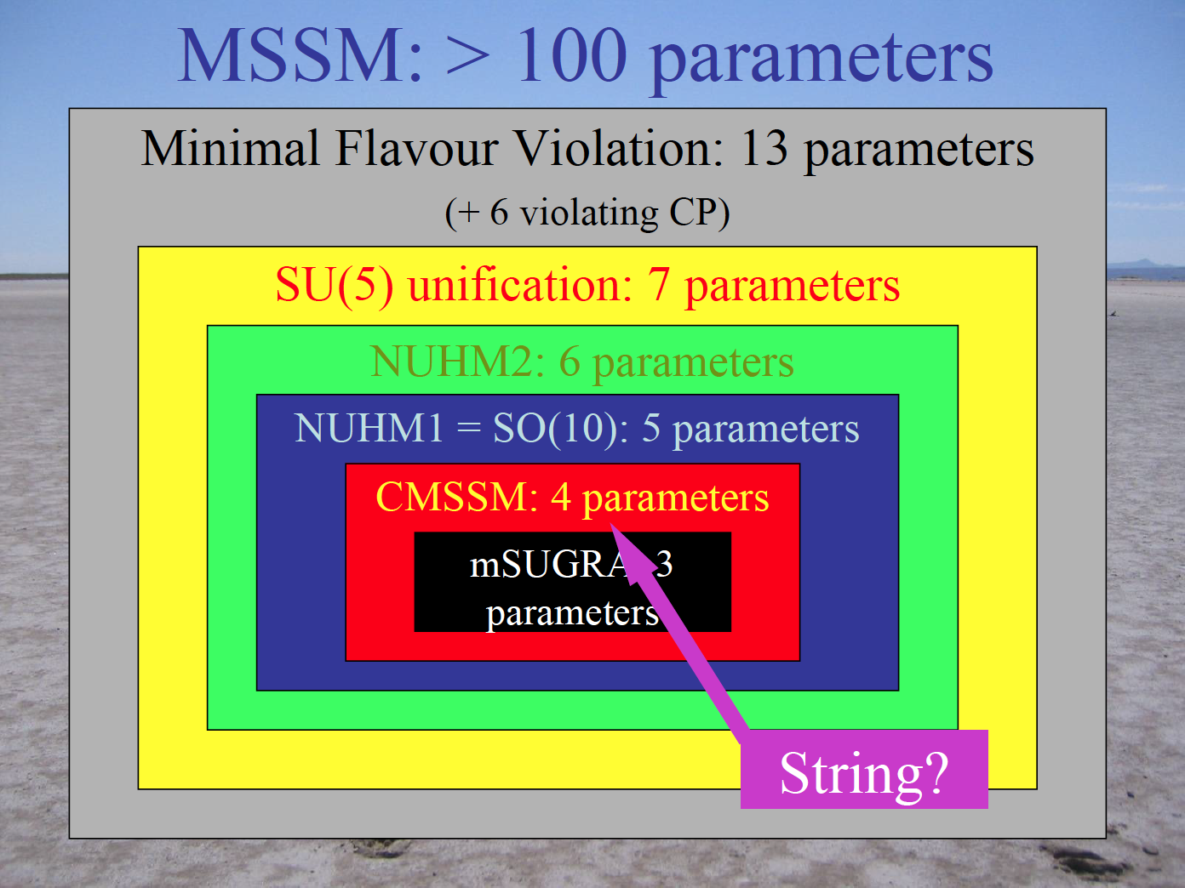
John Ellis

Slide 72
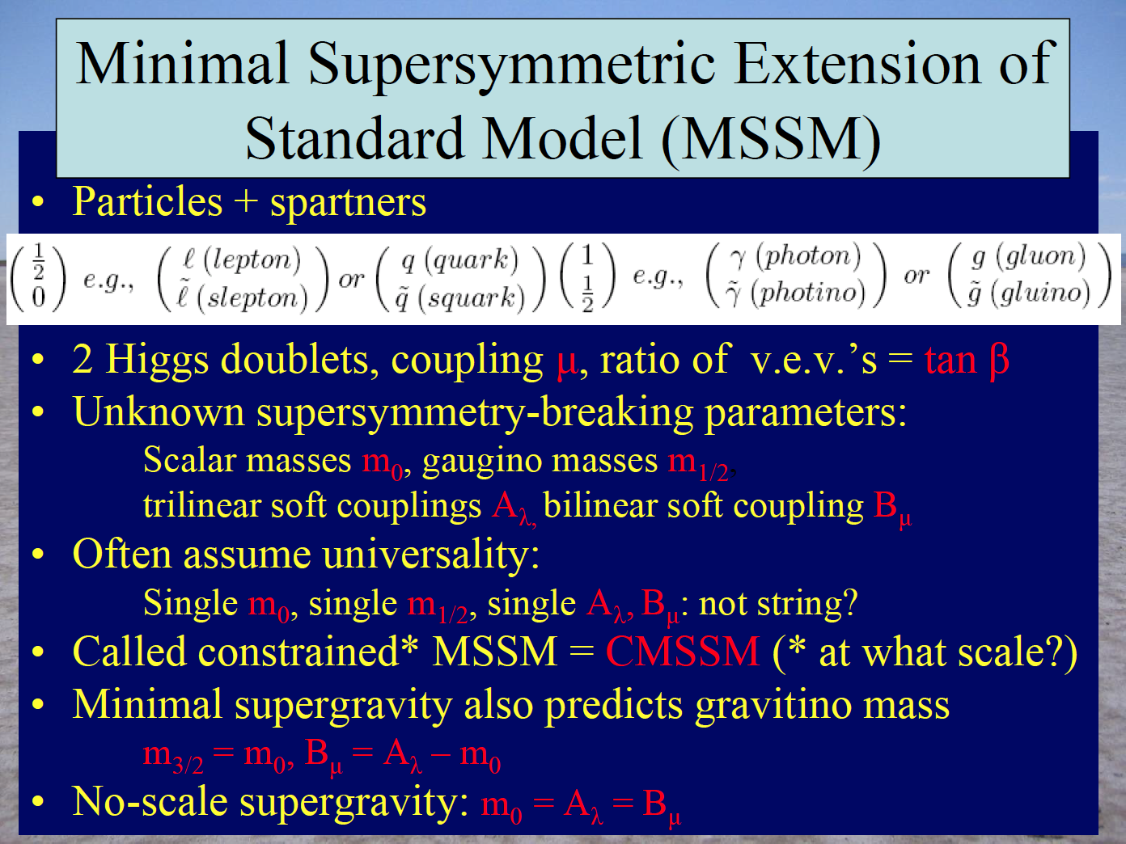
John Ellis

Slide 73
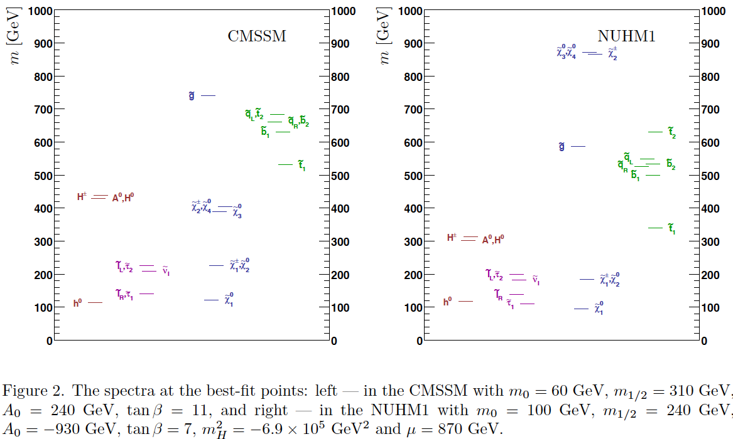
Mass Spectra at the best fit points (before LHC)
CMSSM
NUHM1
Buchmueller et al arXiv: 0808.4218

Slide 74
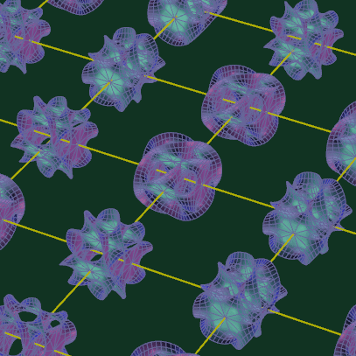
Photon
Extra
Dimensions
KK Photon
Bulk
Our 3D Space
(= Brane)

Slide 75
Origin of Mass in Extra Dimensions
E = mc² → m = E/c²
Mass can be generated as kinetic energy in extra dimensions.
Origin on mass
Dark matter is running in the extra dimensions
Gravity can escape into the extra dimensions.
Why gravity is so small
Origin of dark energy

Slide 76
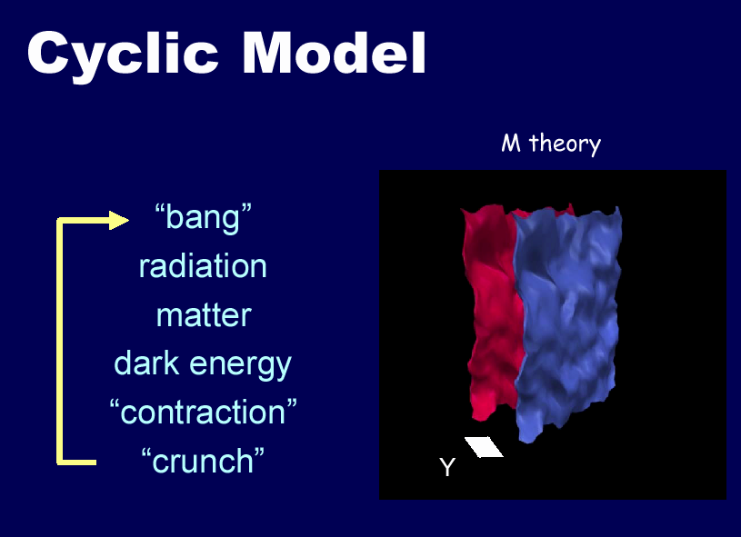
Shadow
Universe
Our
Universe

Slide 77
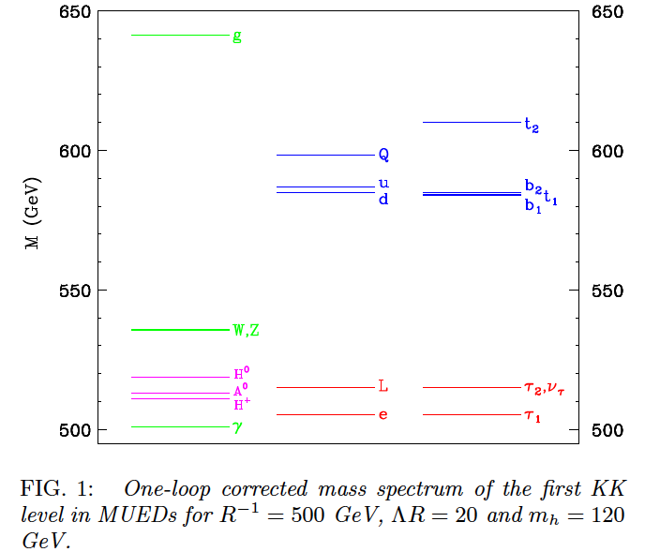
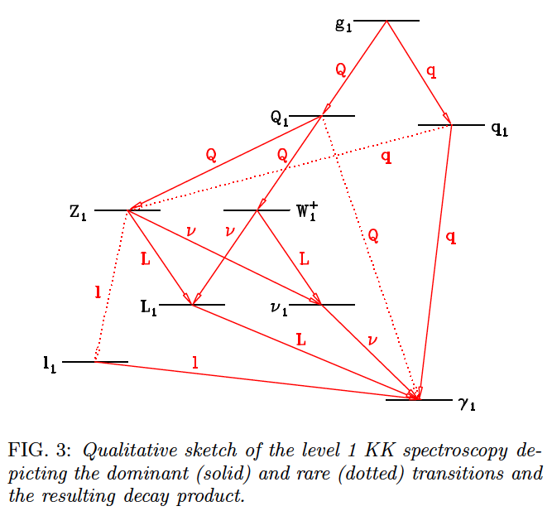
Mass Spectrum of the first KK level
Similar to the SUSY mass spectrum
Δ = (m_{l} – m_{γ})/m_{γ}
KK Photon
KK Photon
Cheng 2002 arXiv:hep-ph/0205314v1

Slide 78
Summary on “Science Cases”
XENON program (~$10M) is extremely timely and competitive to LHC (~$10B)
XENON100 ~ Current LHC
XENON1T ~ Future LHC
If new physics at 100 – 1000 GeV (as it should be), LHC and/or XENON1T will discover WIMPs.
SUSY - Neutralino
Extra Dimensions – KK photon
By combining LHC and XENON1T, we have a better chance to untangle large parameter spaces.

