Slide 1
Introduction to Cosmology
Katsushi Arisaka
University of California, Los Angeles
Department of Physics and Astronomy
arisaka@physics.ucla.edu

Slide 2
Early Univese

Slide 3
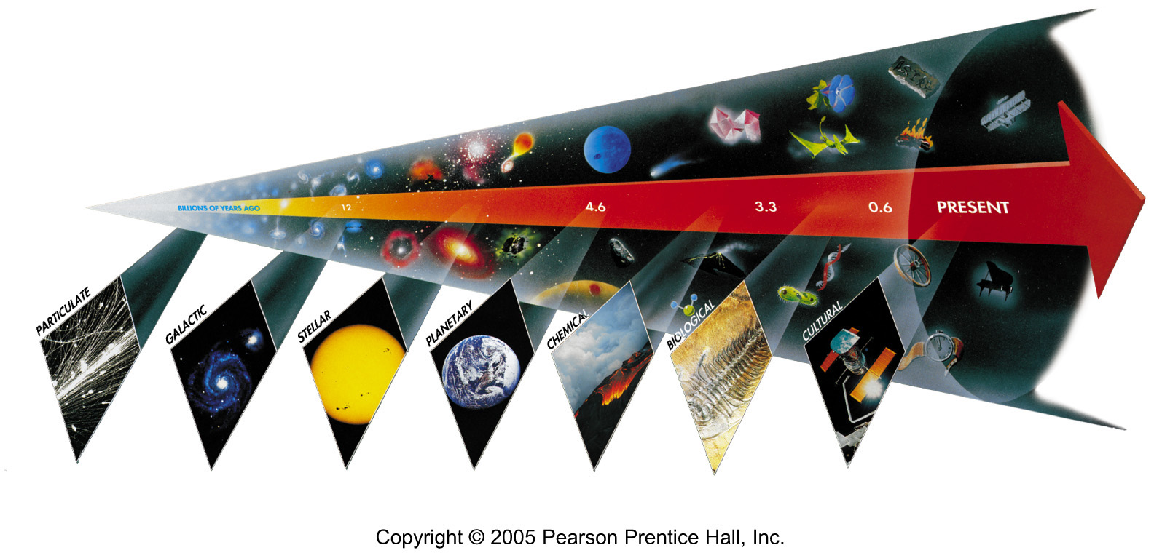
Seven Phases of Cosmic Evolution
14 billion years ago
Origin of
Particles
Origin of
Structure
Origin of
Life
Origin of
Consciousness

Slide 4
History of Life and the Human beings
Time
Big Bang!
10B years
Solar System formed
1Billion
First life on the Earth
100M
Plants, Fish…
10M
Mammals
Fossils
1Million
Homo sapiens
100,000
10,000
1,000
Jesus Christ was born.
Einstein was born.
Written Documents
100
10
You were born.
1 year
100 days
10 days
Videos, Pictures
1 day
10 hours
1 hour
You woke up this morning.
10 minutes
1 minute
You saw this viewgraph.

Slide 5
Brief History of Universe and Life
Time
0
Big Bang!
1B years
First Galaxy formed
2
3
4
5
Telescopes
6
7
8
9
Solar System formed
10
11
First life on the Earth
12
Fossils
13
Plants, Fish…
14
Homo sapiens
You were born.

Slide 6
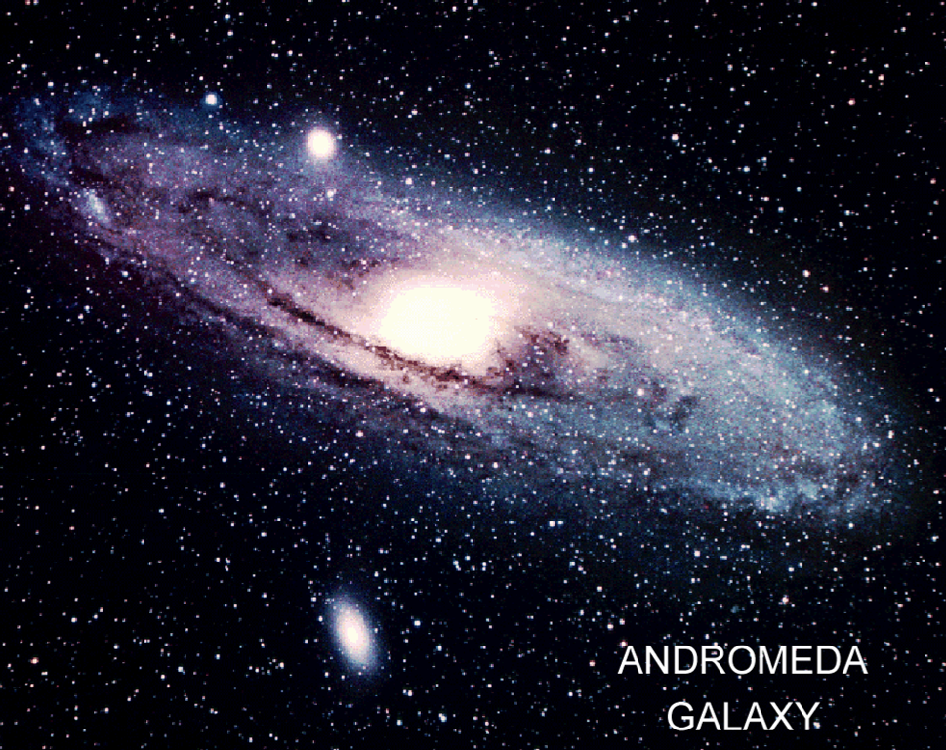
~100 Billions Stars in a Galaxy

Slide 7
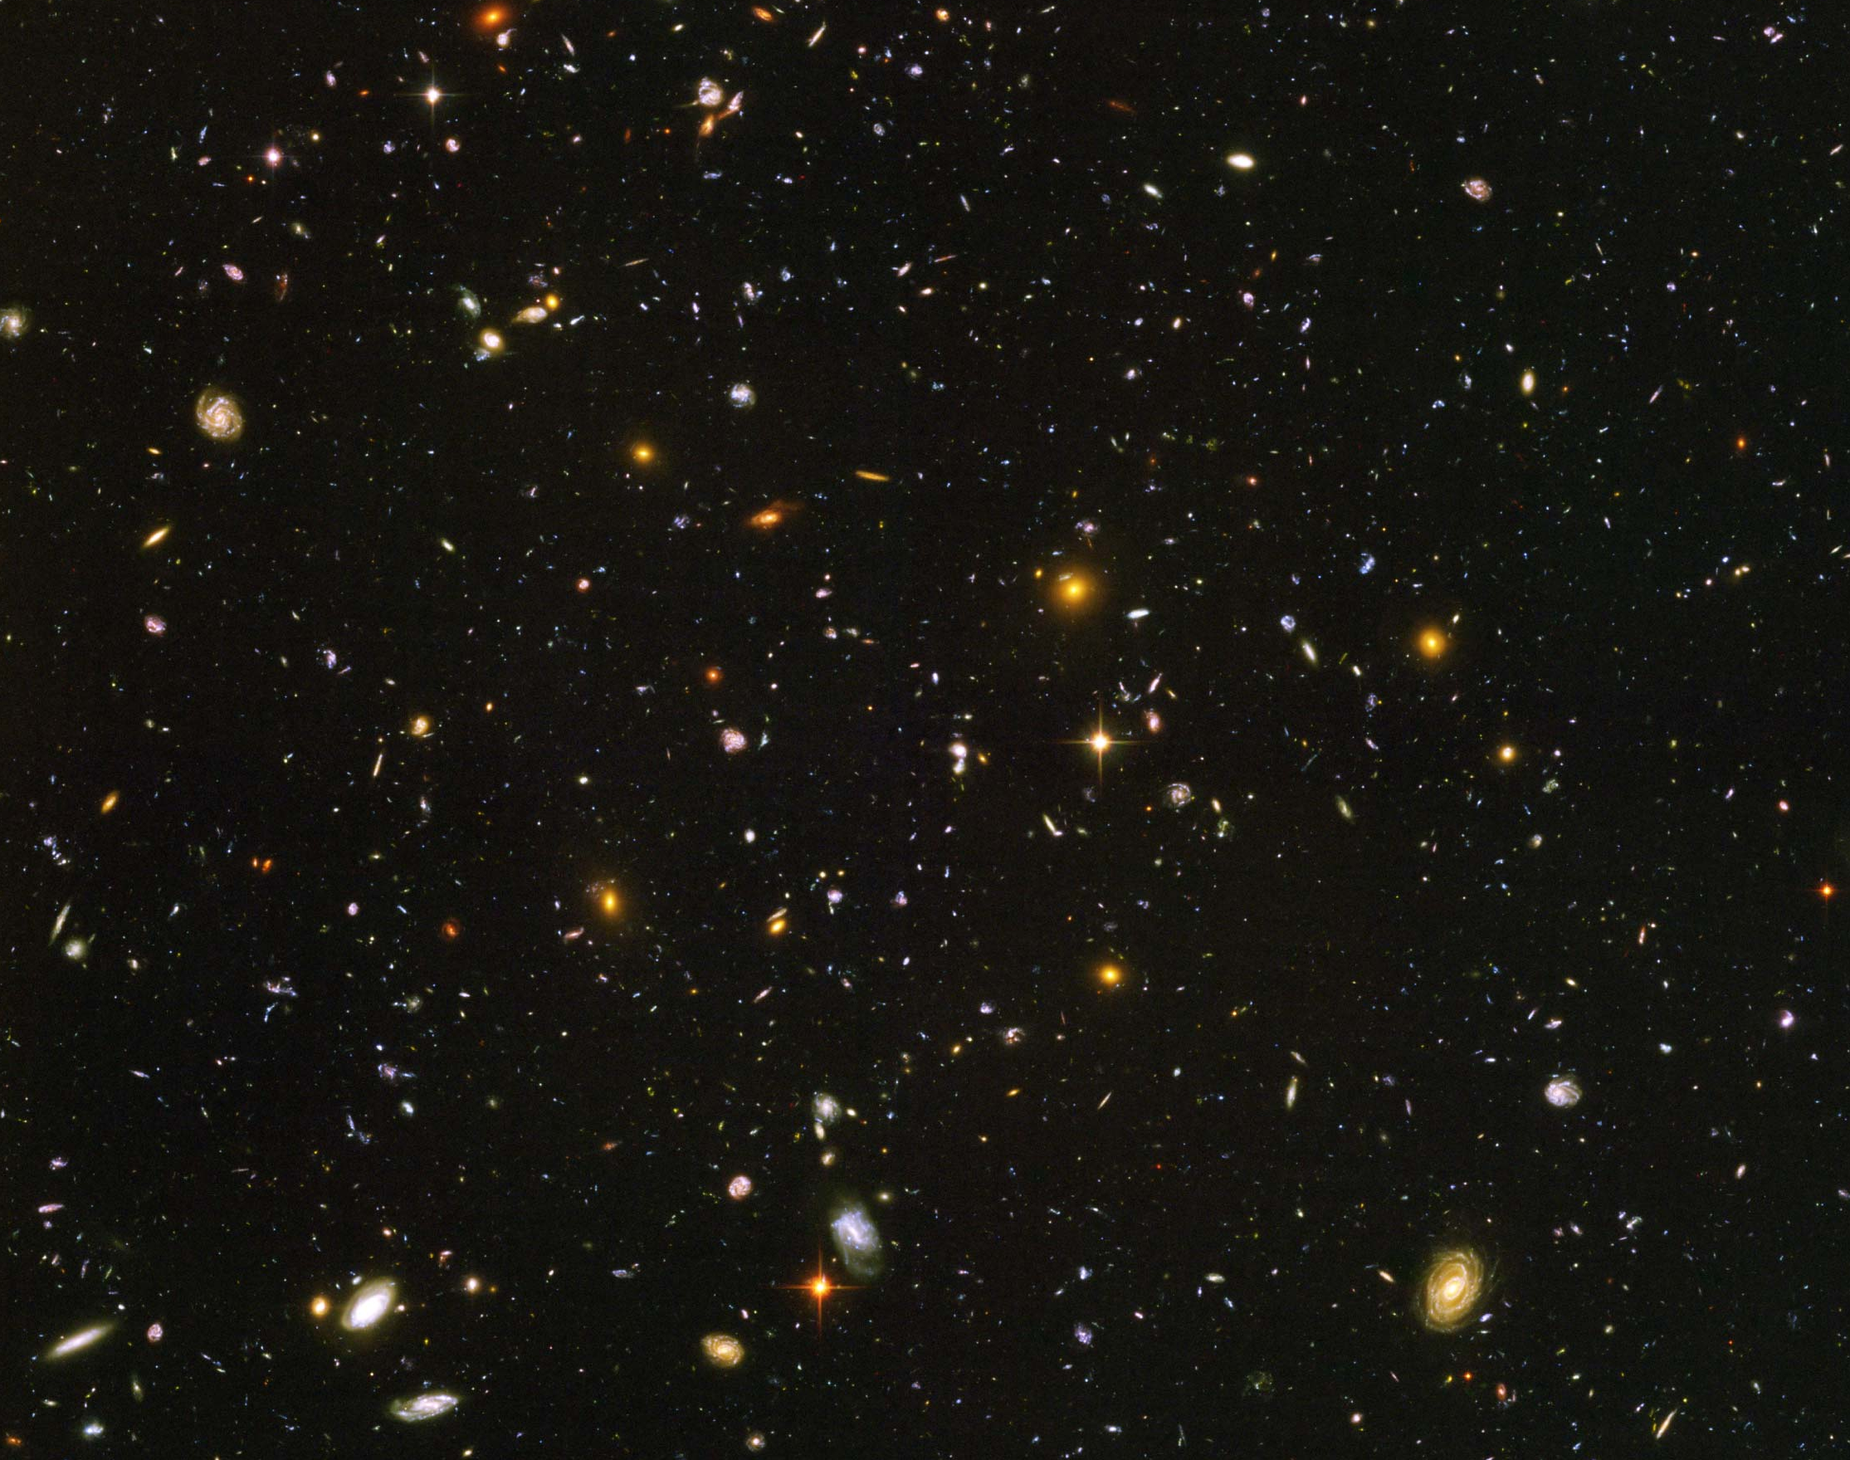
Hubble Deep Field
~100 Billion Galaxies

Slide 8
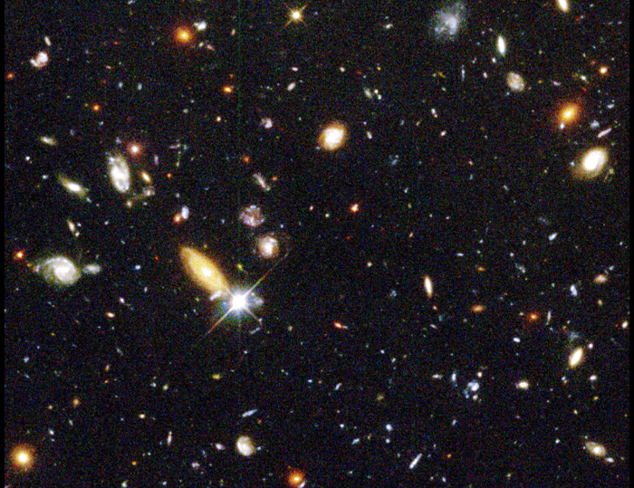
Red shift
up to ~10

Slide 9
Hubble’s Law:
Expansion of the Universe
Horizon
of Universe
Big Bang!
Sun/Earth
14 Billon
Light Years
Moving Away
at Speed of Light

Slide 10
Expansion of Universe
Size
Size of Universe
∝ √ Time
Horizon
∝ cT
Beginning
Today
Time

Slide 11
Temperature of Universe
Temperature
Temperature = 1/Size
2.7ºK
Beginning
Today
Size

Slide 12
Relation between Temperature and Time
  T: Temperature
  t : time
Temperature
130 GeV
130 MeV
1.3 MeV
130 keV
10⁻¹⁰
10⁻⁴
1
100
Time (sec)

Slide 13
Thermal Equilibrium
  If thermal energy is greater than twice the mass of particles,
  E > 2 mc²
  Photon ↔ Particle + Anti-particle
  Example:
  m_{e} = 0.511 MeV
  if E > 1.022 MeV
  γ ↔ e⁻ + e⁺
e⁻
γ
γ
e⁺
e⁺
e⁺
γ
γ
e⁻
e⁻
e⁻
e⁺

Slide 14
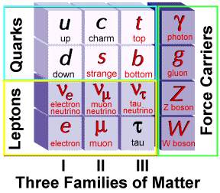
Elementary Particles
Charge
+2/3
-1/3
0
-1
Fermion Boson
Charge
0
0
0
±1
+ Anti-particles

Slide 15
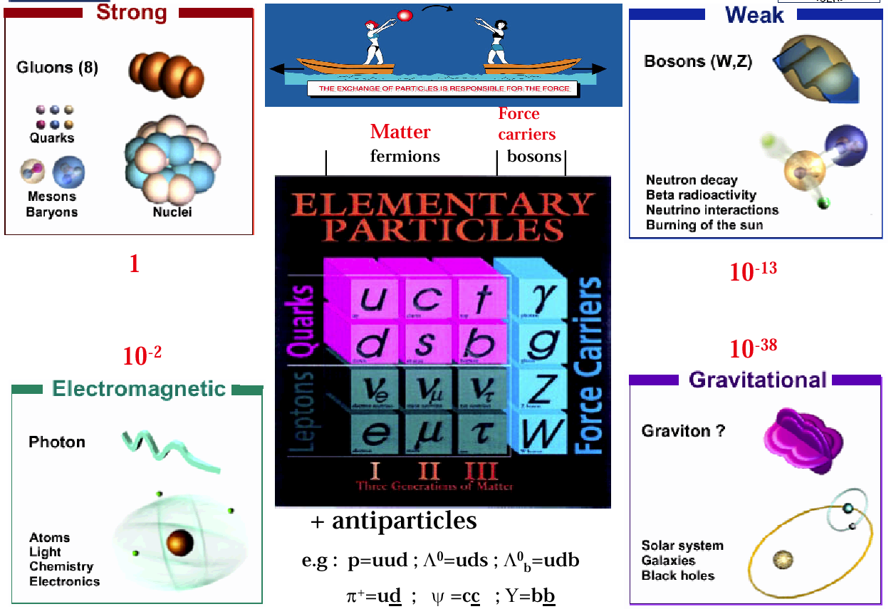
Elementary Particles and Forces

Slide 16
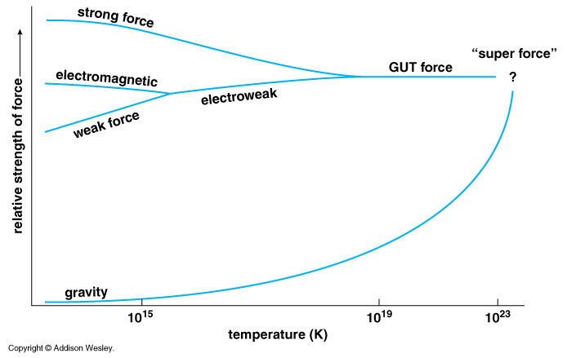
Unification of Forces (1980)
Grand Unification
100 GeV
10¹⁶ GeV
10¹⁹ GeV
10³²
10²⁹
10³²
10²⁹

Slide 17
Unification of Forces (1980)
Plank Epoch
100 GeV
10¹⁶ GeV
10¹⁹ GeV
10²⁹
10³²

Slide 18
Hubble Deep Field
Physicists’ View of Early Universe
Fiat lux
Let there be light

Slide 19
Hubble Deep Field
Physicists’ View of Early Universe
Lorentz Invariance
Local Gauge Invariance

Slide 20
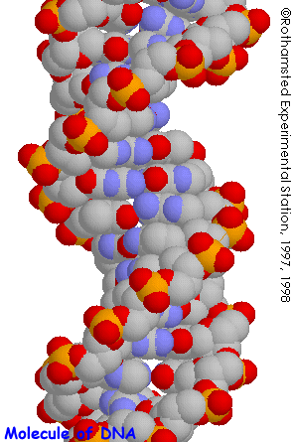
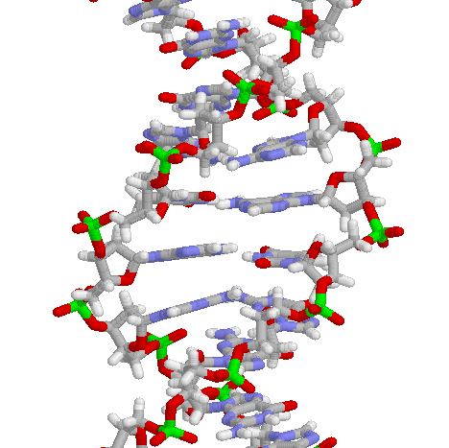
Structure of DNA

Slide 21
Symmetry Breaking
Time
0
Simple
1B years
2
3
4
b
s
µ⁻
W⁺
5
γ
c
Symmetry
Break Down
ν_{e}
τ⁺
d
6
d
Zº
τ⁻
ν_{e}
e⁺
e⁻
7
u
u
ν_{µ}
b
ν_{µ}
µ⁺
s
8
W⁺
c
9
10
11
12
Complex
13
14

Slide 22
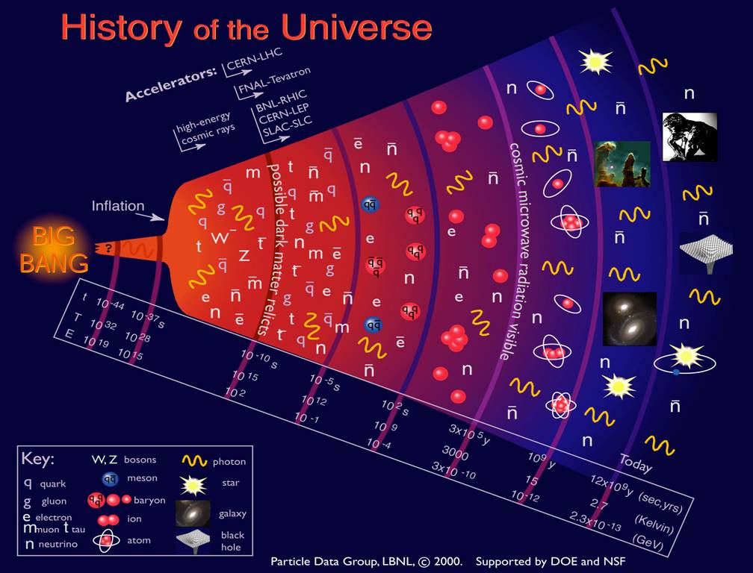

Slide 23
The Beginning
Everything was the same ↔ Perfect symmetry.
  All the particles are the same as photons.
  All four forces are the same.
The Universe was 10 dimension.
  3 Space Flattened
  1 Time
  3 Strong Force
  6 2 Weak Compacitified
  1 Electro-Magnetic

Slide 24
Cosmology

Slide 25
Expansion of Universe
Size
Size of Universe
∝ √ Time
Beginning
Today
Time

Slide 26
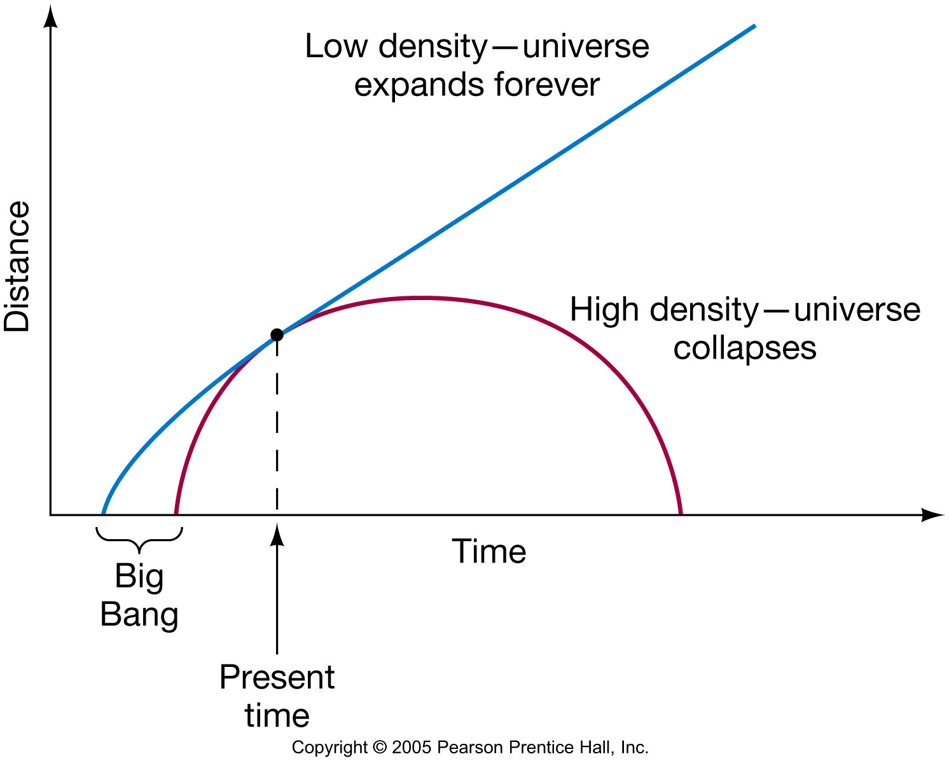
The Fate of the Cosmos
?
?

Slide 27
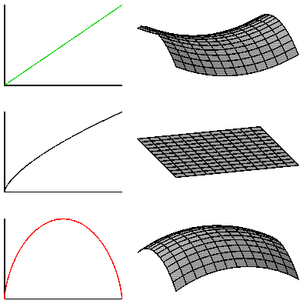
Geometry of the Universe
Open Ω<1
Flat Ω=1
Closed Ω>1

Slide 28
Temperature of Universe
Temperature
Temperature = 1/Size
3,000ºK
2.7ºK
Beginning
300,000 years
Today
Size

Slide 29
Time = 300,000 years , Temp.= 3000 ºK
All the electrons were bound by Hydrogen and Helium Nuclei. → Atoms formed.
The Universe became transparent. Photons were released. → Radiation decoupled.
Cosmic Microwave Background (CMB)

Slide 30
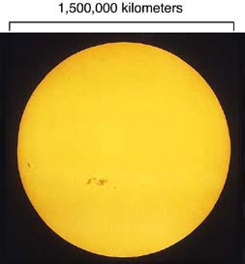
The Sun

Slide 31
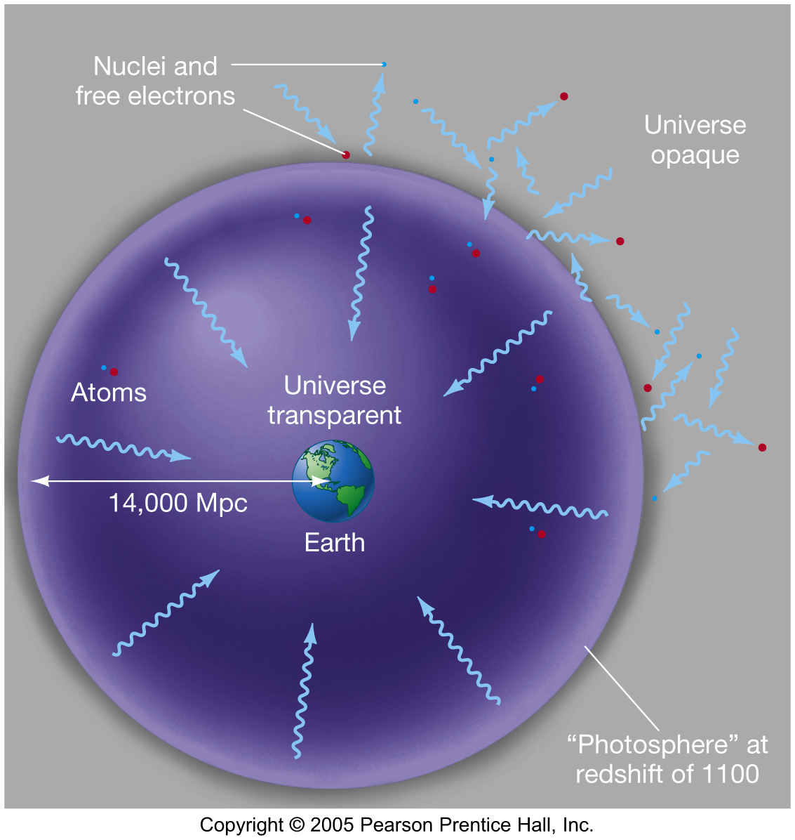
Cosmic Microwave Background

Slide 32
Cosmic Microwave Background
(Discovered in 1964)
T=300,000 years
after the Big Bang
Temperature
=3,000ºK
z=1,100
Sun/Earth
Transparent
Today:
3000ºK/1,100
=2.7ºK
Opaque

Slide 33
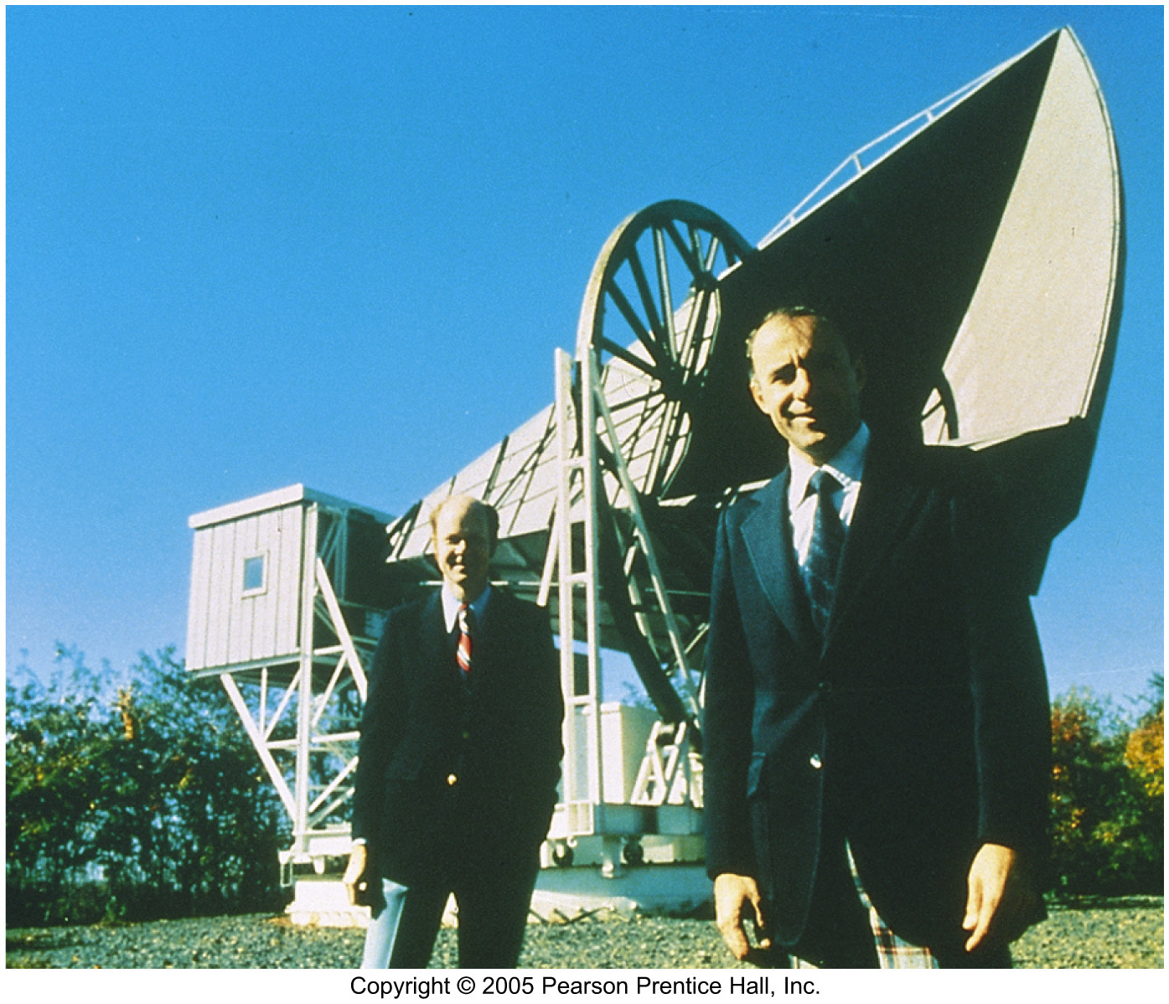
The Cosmic Microwave Background
The cosmic microwave background was discovered fortuitously in 1964, as two researchers tried to get rid of the last bit of “noise” in their radio antenna.
Instead they found that the “noise” came from all directions and at all times, and was always the same. They were detecting photons left over from the Big Bang.

Slide 34
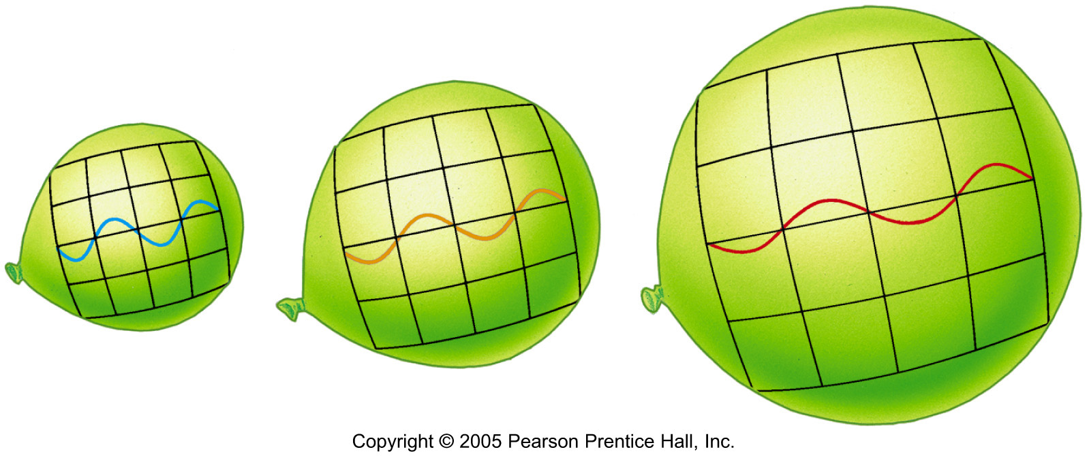
Cosmological Redshift
T = 300,000 years
3000ºK
T = 13.7 B years (Today)
3000ºK/1,100 =2.7ºK
Notes:
As the universe expands, photons of radiation are stretched in wavelength, giving rise to the cosmological redshift. In this case, as the baseline in the diagram stretches, the radiation shifts from the short-wavelength blue region of the spectrum to the longer wavelength red region. (Sec. 3.1)

Slide 35
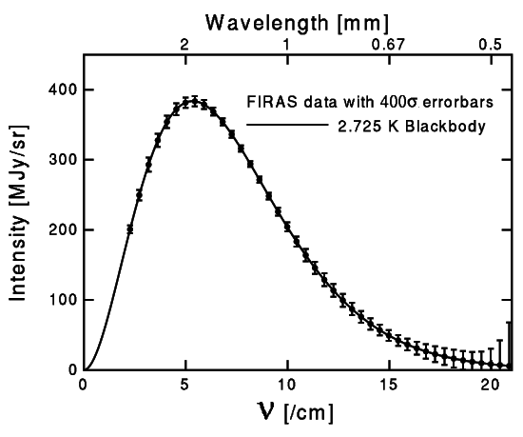
The CMB Spectrum by FIRAS

Slide 36
Inflation

Slide 37
Two Fundamental Problem of Big Bang Cosmology
Horizon Problem
  At early Universe, Size >> Horizon.
  Why is CMB so uniform in every direction?
Flatness Problem
  ⎪Ω-1⎪ grows proportional to the size of the Universe.
  Why is Ω of today close to 1?

Slide 38
Expansion of Universe
Size
Horizon
∝ cT
360º
Within 1º
Beginning
300k Years
Today
Time

Slide 39
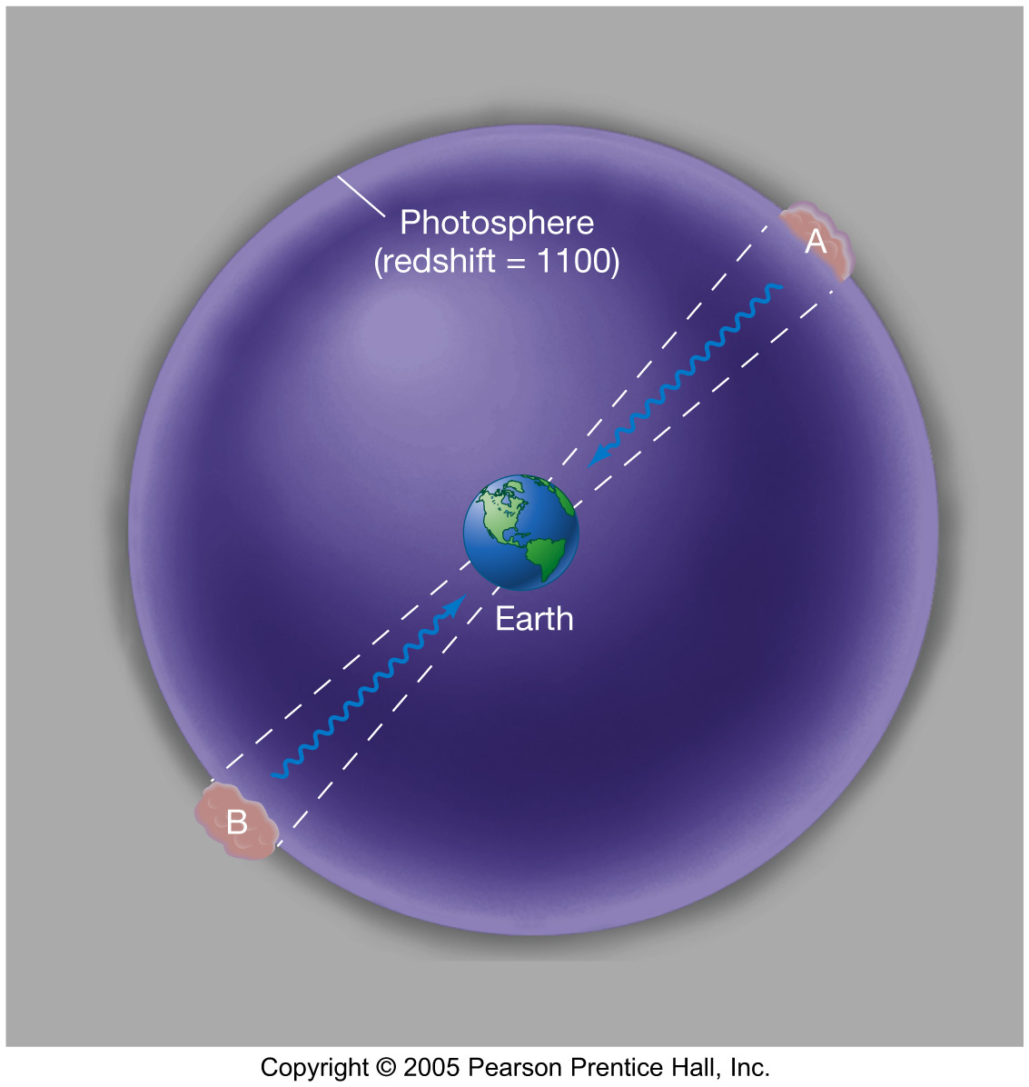
Horizon Problem
The horizon problem: When observed in diametrically opposite directions from Earth, cosmic background radiation appears the same even though there hasn’t been enough time since the Big Bang for them to be in thermal contact.

Slide 40
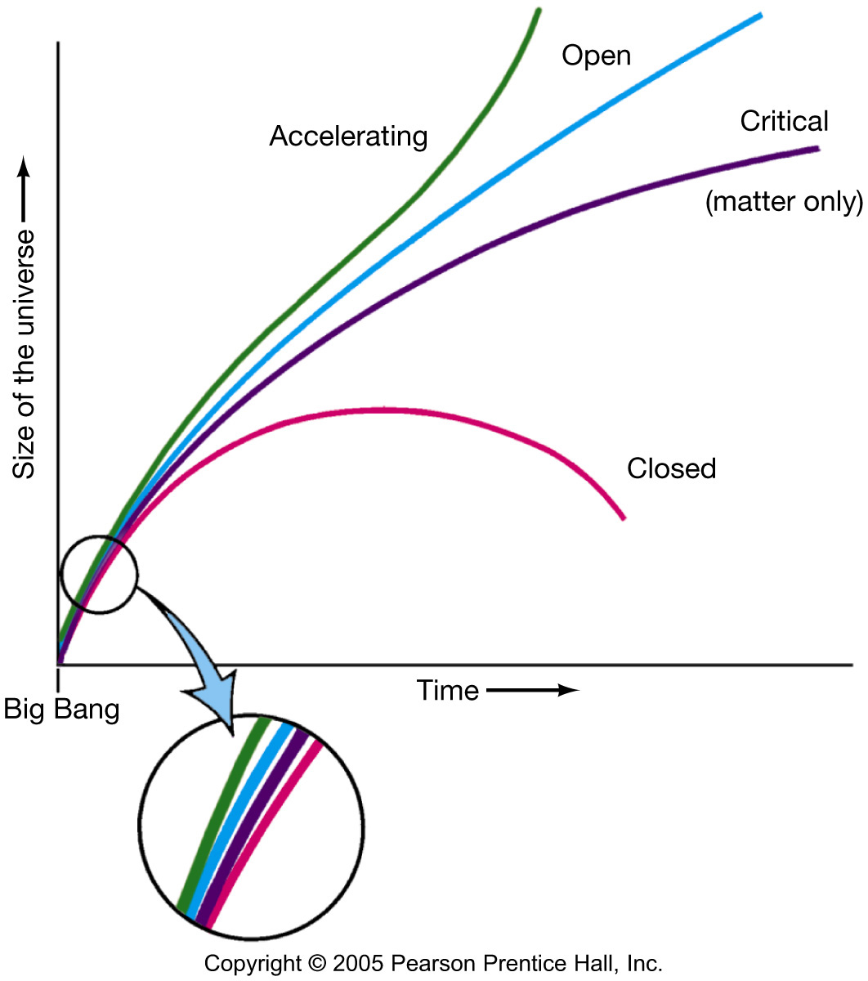
Flatness Problem
| Ω-1 | ∝ Size of Universe
The flatness problem: In order for the universe to have survived this long, its density in the early stages must have differed from the critical density by no more than 1 part in 10¹⁵.

Slide 41
Inflation in Early Universe
Size
Horizon
∝ cT
Inflation
Beginning
Today
Time

Slide 42
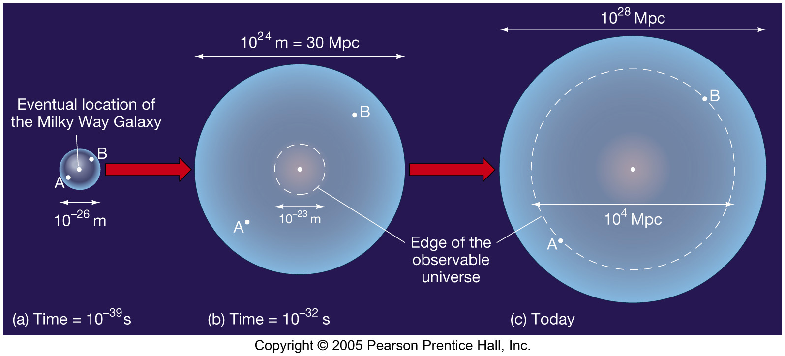
The Inflationary Universe
Inflation, if correct, would solve both the horizon and the flatness problems.
This diagram shows how the horizon problem is solved – the points diametrically opposite from Earth were in fact in contact at one time.
Inflation

Slide 43
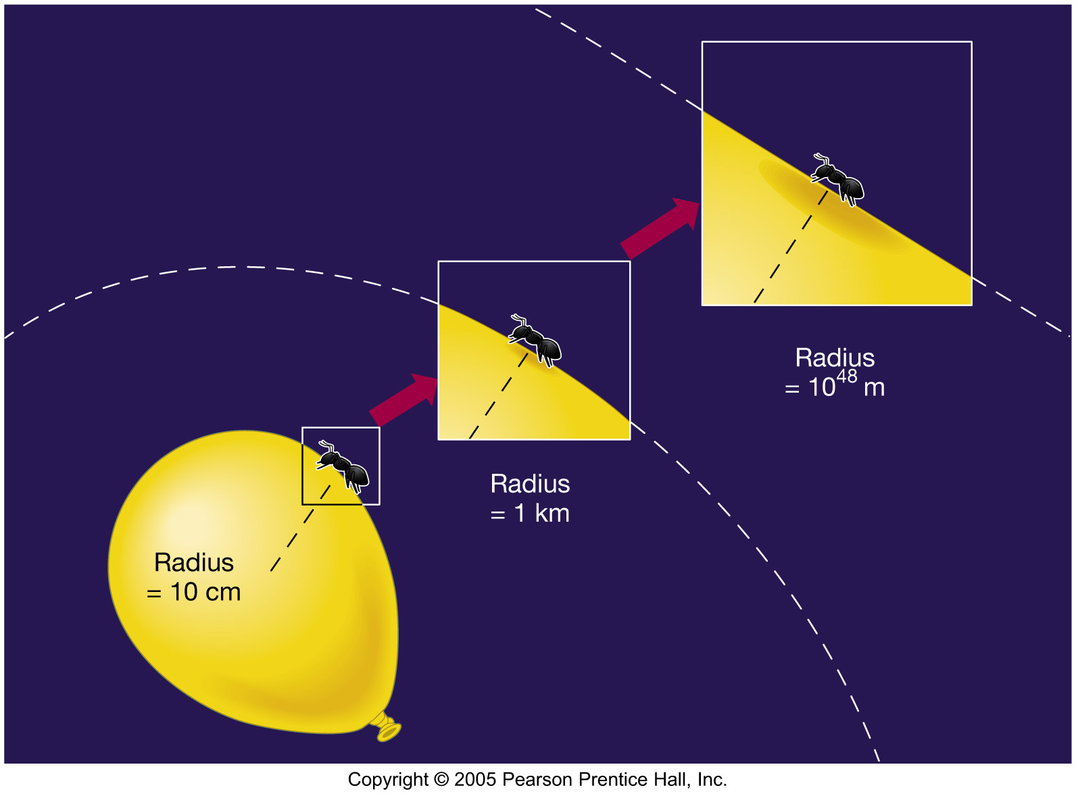
The Inflationary Universe
The flatness problem is solved as well – after the inflation the need to be exceedingly close to the critical density is much more easily met:

Slide 44
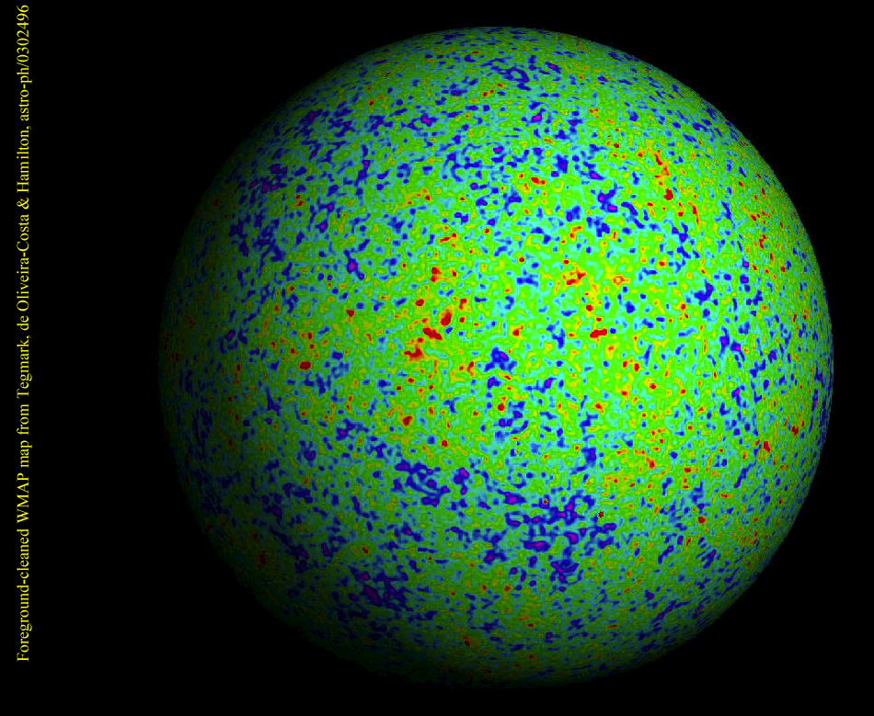
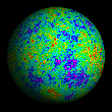
WMAP

Slide 45
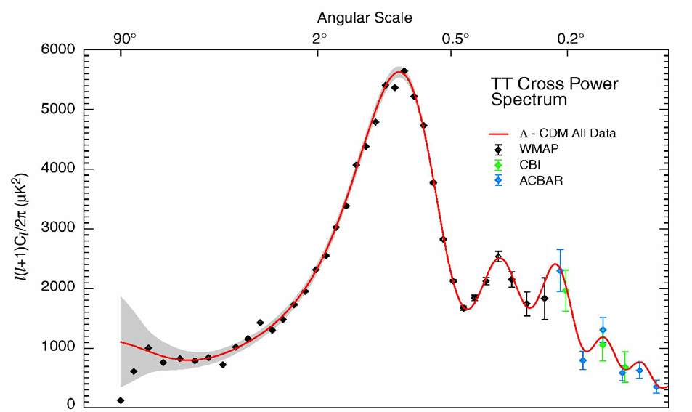

WMAP Power Spectrum
Universe is Flat.
  ⇒ Inflation

Slide 46
Geometry of the Universe
Open Ω<1
Flat Ω=1
Closed Ω>1

Slide 47
Dark Energy

Slide 48
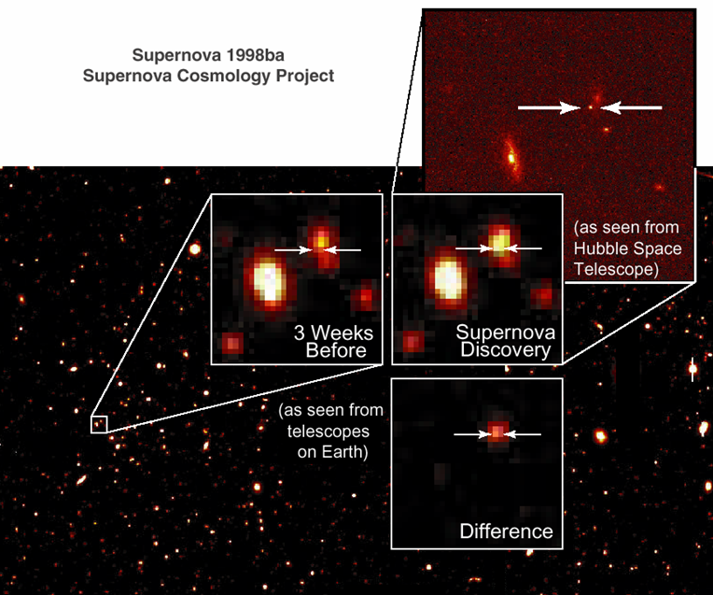
Supernova as a Standard Candle

Slide 49
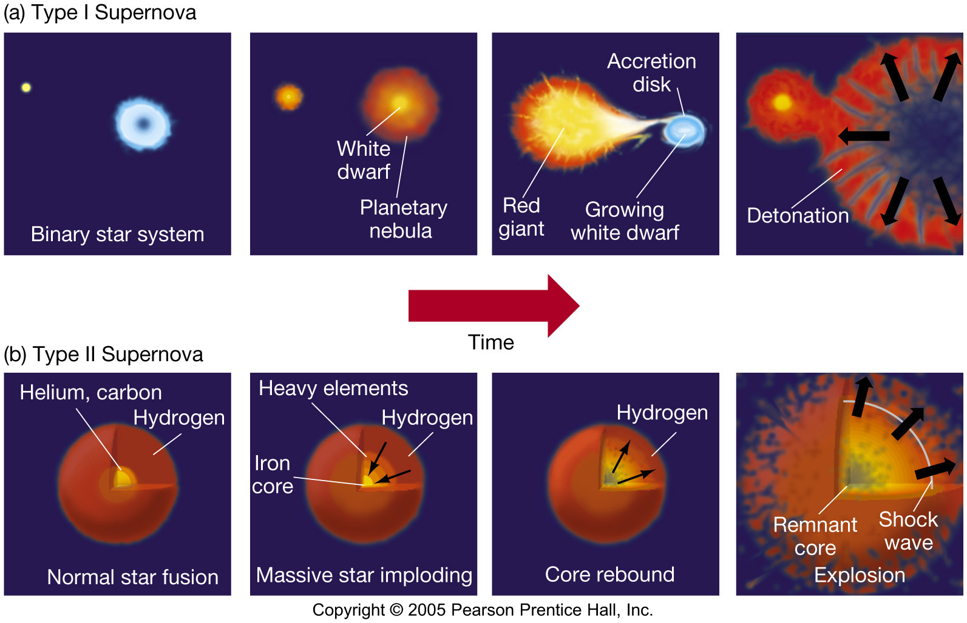
Two Types of Supernovae

Slide 50
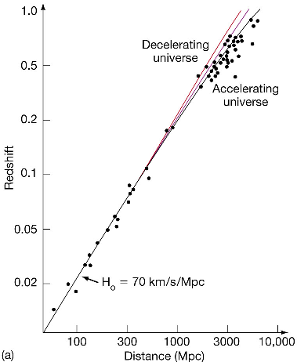
Will the Universe Expand Forever?
When we look at the data, we see that it corresponds not to a decelerating universe, but to an accelerating one.
This acceleration cannot be explained by current theories of the universe, although we do know it is not caused by either matter or radiation.
Ω_{Λ}= 0.7

Slide 51
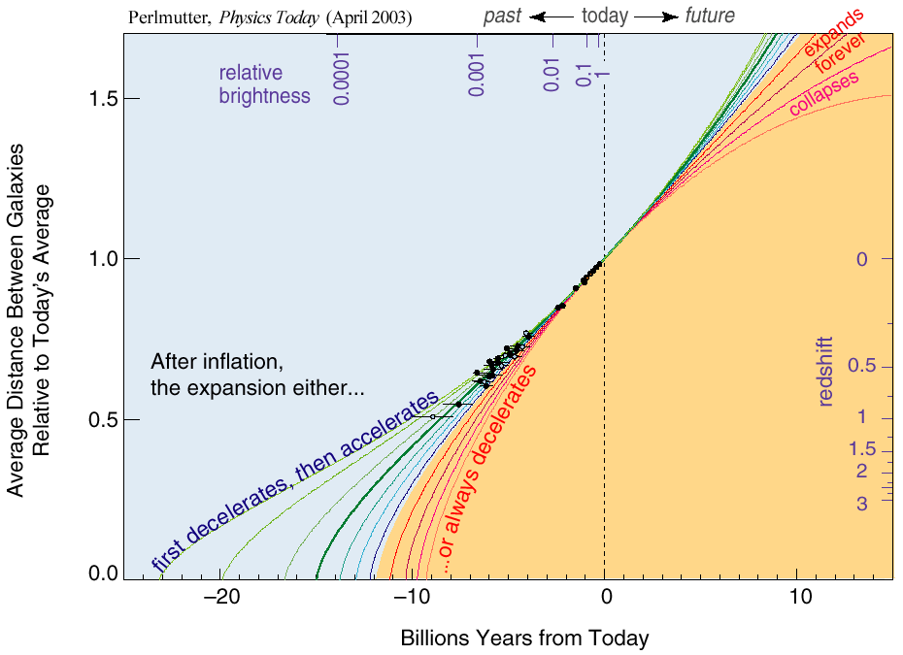
The Accelerating Universe （1998）
Ω_{Λ}= 0.7

Slide 52
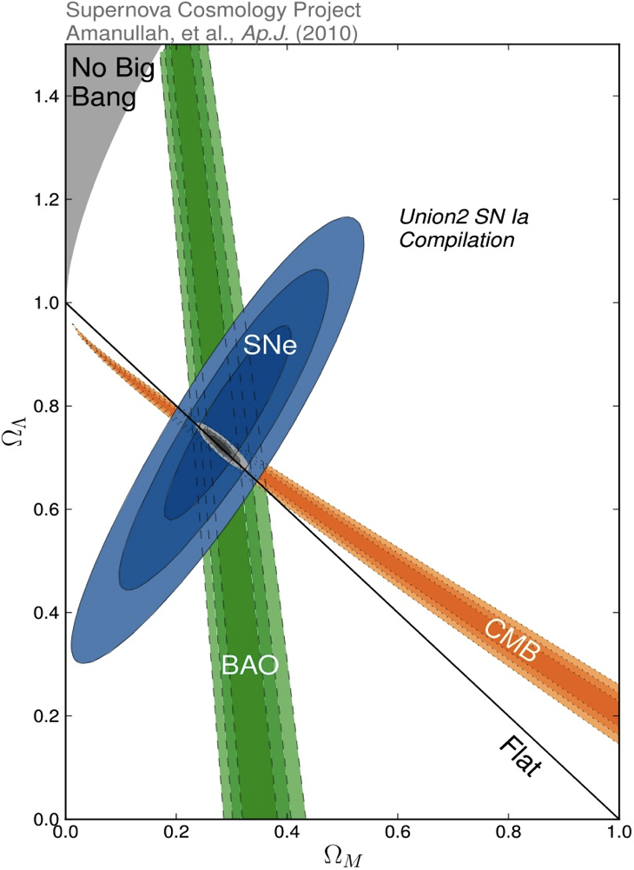
Density of Our Universe
Ω_{Total}=Ω_{Λ}+Ω_{Matter} =1.0
Universe is Flat.
  ⇒ Inflation
73% is Dark Energy.
  ⇒ Accelerating
Ω_{Λ}
  Ω_{M}= 27%
Ω_{Matter}

Slide 53
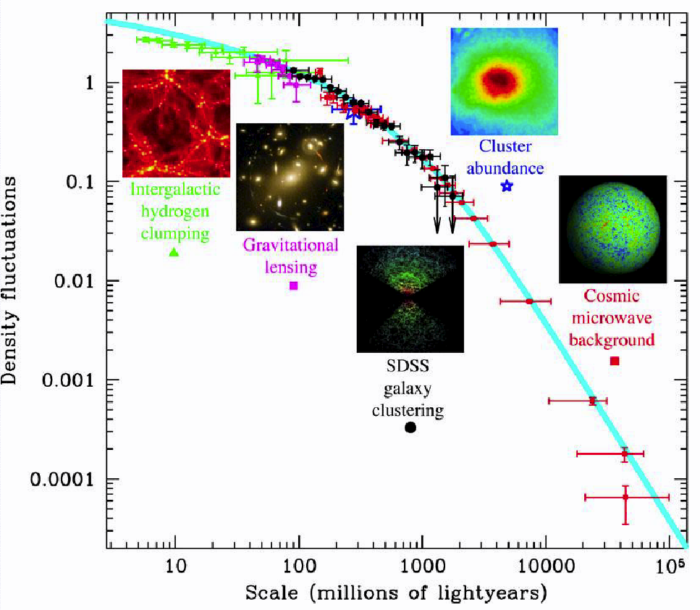
Density Fluctuations

Slide 54
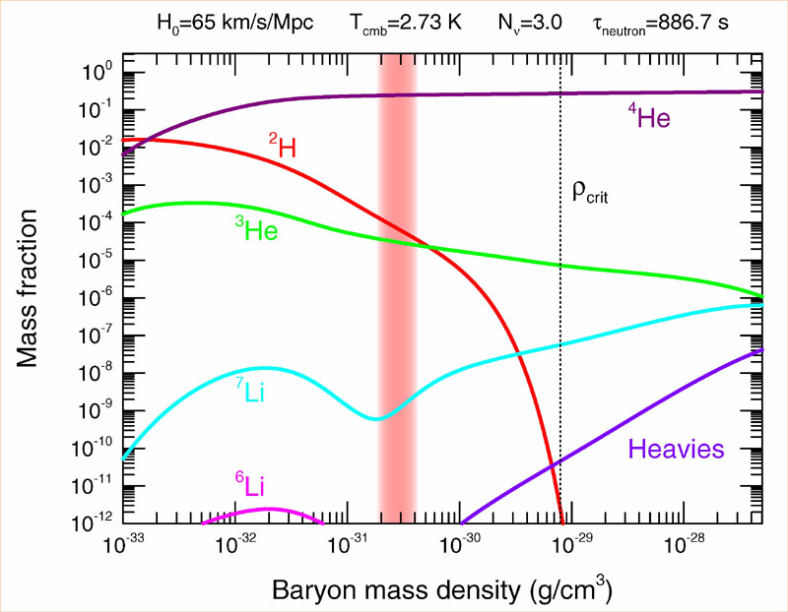
Abundance vs. Density
D
  0.03 < Ω_{Baryon}< 0.06

Slide 55
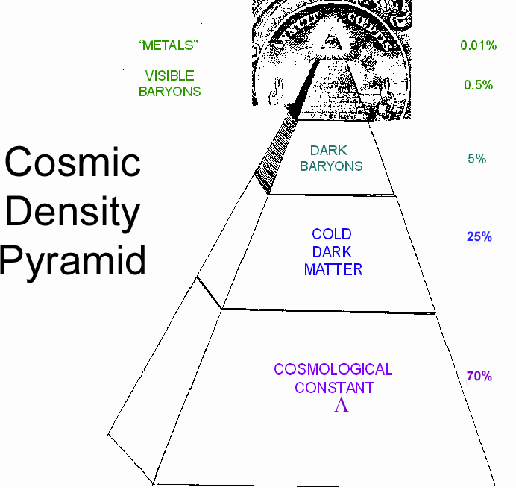
Cosmic Pyramid
Metal
0.01%
Star
0.5%
Baryonic Matter
0.5%
Gas,
Dust
5%
Dark
Matter
25%
Dark Energy
70%

Slide 56
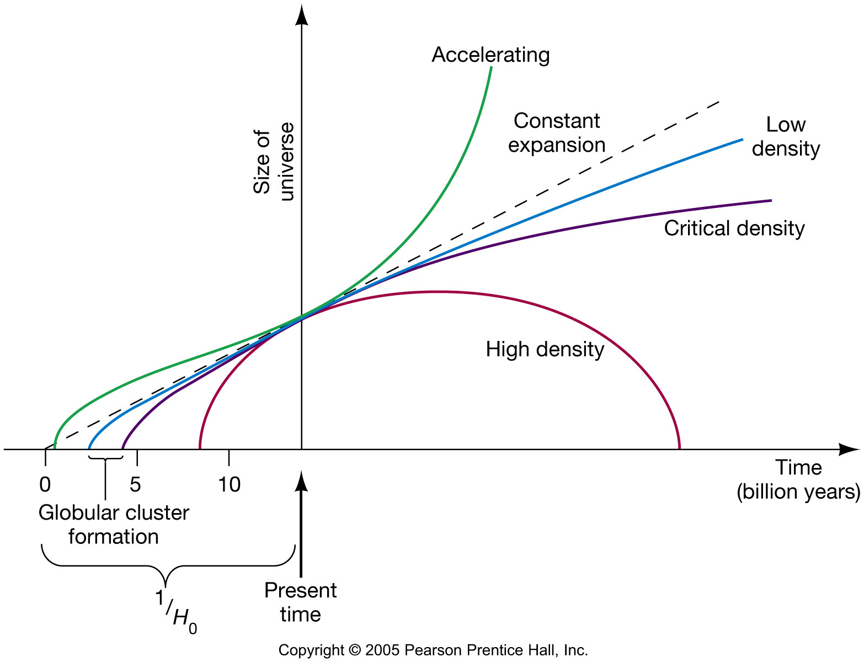
Dark Energy and Cosmology
This graph now includes the accelerating universe.
Given what we now know, the age
of the universe works out to be 13.7 billion years.

Slide 57
Dark Matter

Slide 58
What is Dark Matter?
Must be a heavy particle
  Only weakly interacting.
  Gravitationally attracted.
Candidates
  “MACHO” (Massive Compact Halo Objects)
    →Baryonic Dark Matter
  Heavy Neutrino
    →Hot Dark Matter
  “WIMP” (Weakly Interacting Massive Particle”
    →Cold Dark Matter

Slide 59
Candidate of “WIMP”
A leading candidate of WIMP is “Neutralino”
  Least-massive Super-Symmetric Particle.
Super-Symmetry is the symmetry between Fermion ↔ Boson
This symmetry was broken
  at energy around 100 GeV – 1 TeV
  at time around 10⁻¹⁰ – 10⁻¹¹ second.
Neutralinos were decoupled.
Started to be attracted each other gravitationally.

Slide 60
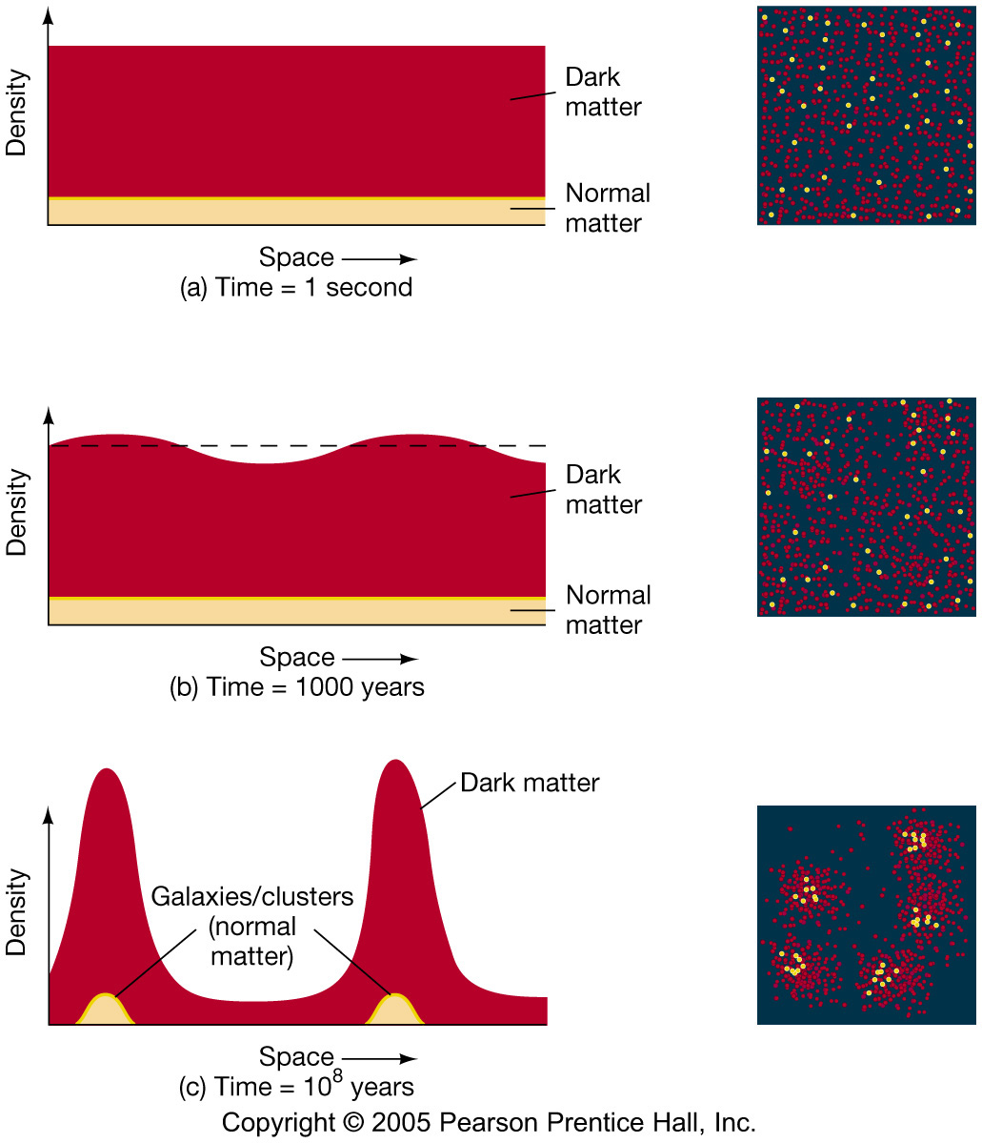
Formation of Structure by Dark Matter

Slide 61
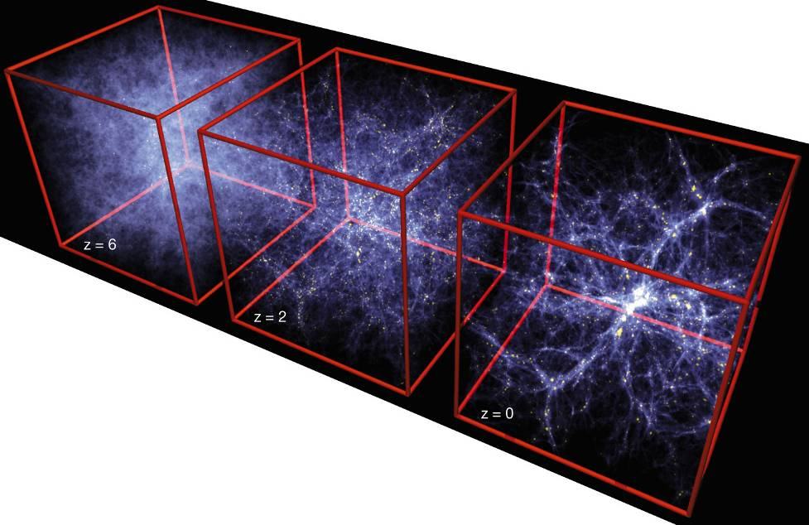
Formation of Structure in the Universe
Dark Matter is required!

Slide 63
Dark Matter is required!

Slide 65
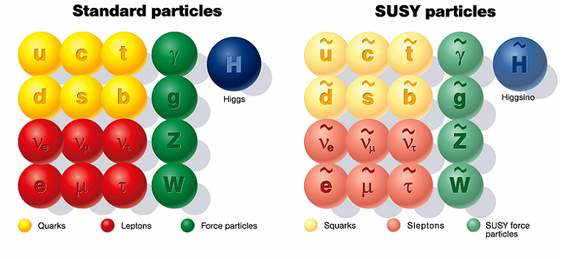
SUSY Particles and Neutralino
Spin 1/2 1 0

Slide 66
SUSY Particles and Neutralino
Super Symmetry
Neutralino
Spin 1/2 1 0 0 1/2 1/2

Slide 67
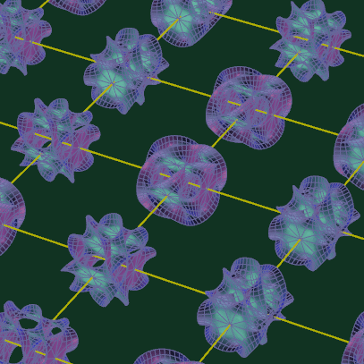
Photon
Extra
Dimensions
KK Photon
Bulk
Our 3D Space
(= Brane)

Slide 68
Origin of Mass in Extra Dimensions
E = mc² → m = E/c²
Mass can be generated as kinetic energy in extra dimensions.
    Origin on mass
    Dark matter is running in the extra dimensions
Gravity can escape into the extra dimensions.
    Why gravity is so small
    Origin of dark energy

Slide 69
Early Universe & Unsolved Problems
Time
(sec)
Temp.
(ºK)
Energy (GeV)
The Beginning
10⁻⁴⁵sec
Planck
Plank Epoch
10⁻⁴⁰
10³⁰
10¹⁸
Inflation
GUT
Grand Unification
10⁻³⁵
10¹⁵
10⁻³⁰
10²⁵
10¹²
10⁻²⁵
10⁹
10⁻²⁰
10²⁰
1PeV
Dark Matter
10⁻¹⁵
10¹⁵
1TeV
EW
Electro-Weak Unification
10⁻¹⁰
10⁻⁵
1GeV
1
10¹⁰
1MeV
10⁵ sec
1KeV
1 year
10⁵
Matter-Radiation Decoupling
10³
1eV
10⁶
Dark Energy
10⁹ year
10⁻³eV
Now
1

