Slide 1
Origin of the Universe
Katsushi Arisaka
University of California, Los Angeles
Department of Physics and Astronomy
arisaka@physics.ucla.edu

Slide 2
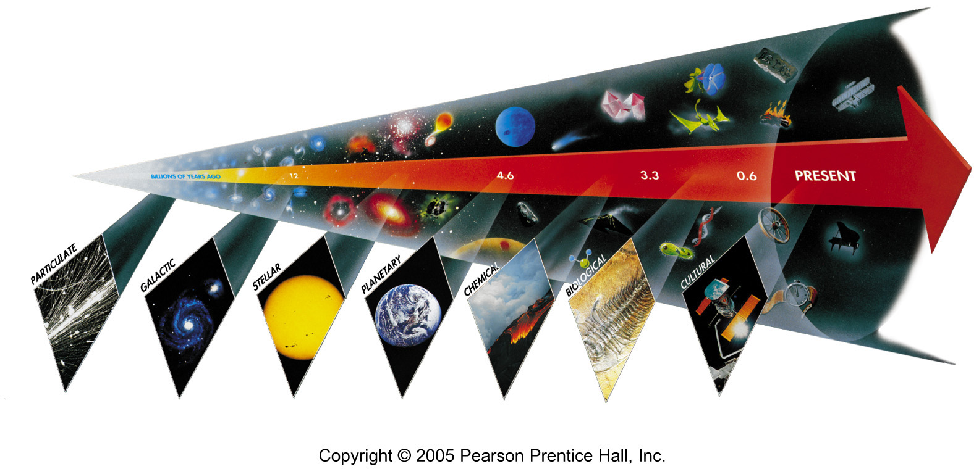
Seven Phases of Cosmic Evolution
14 billion years ago
Origin of
Particles
Origin of
Structure
Origin of
Life
Origin of
Consciousness

Slide 3
Expansion of Universe
Size
Size of Universe
∝ √ Time
Horizon
∝ cT
Beginning
Today
Time

Slide 4
Temperature of Universe
Temperature
Temperature = 1/Size
3,000ºK
2.7ºK
Beginning
300,000 years
Today
Size

Slide 5
Cosmology

Slide 6
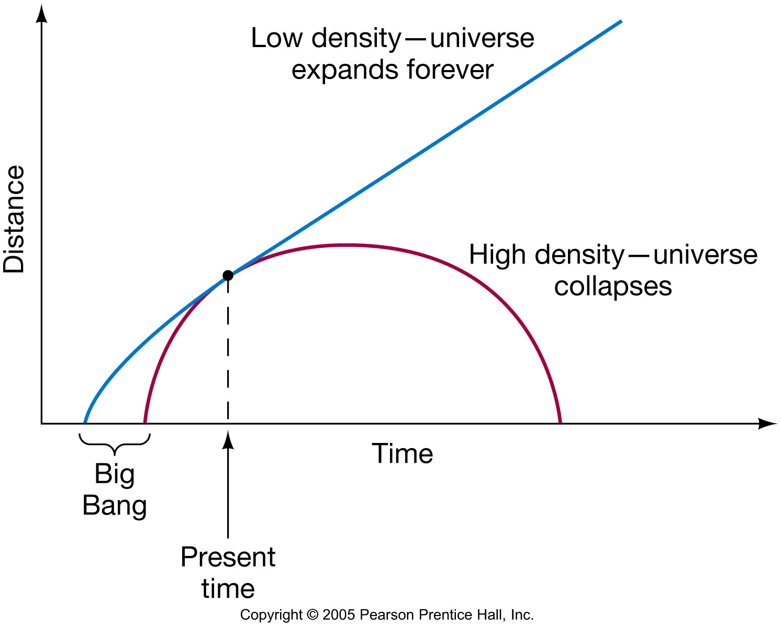
The Fate of the Cosmos
?
?

Slide 7
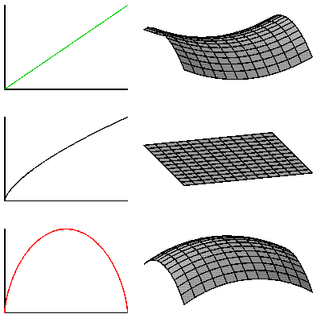
Geometry of the Universe
Open Ω<1
Flat Ω=1
Closed Ω>1

Slide 8
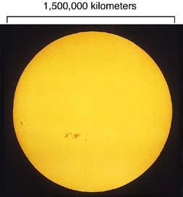

Slide 9
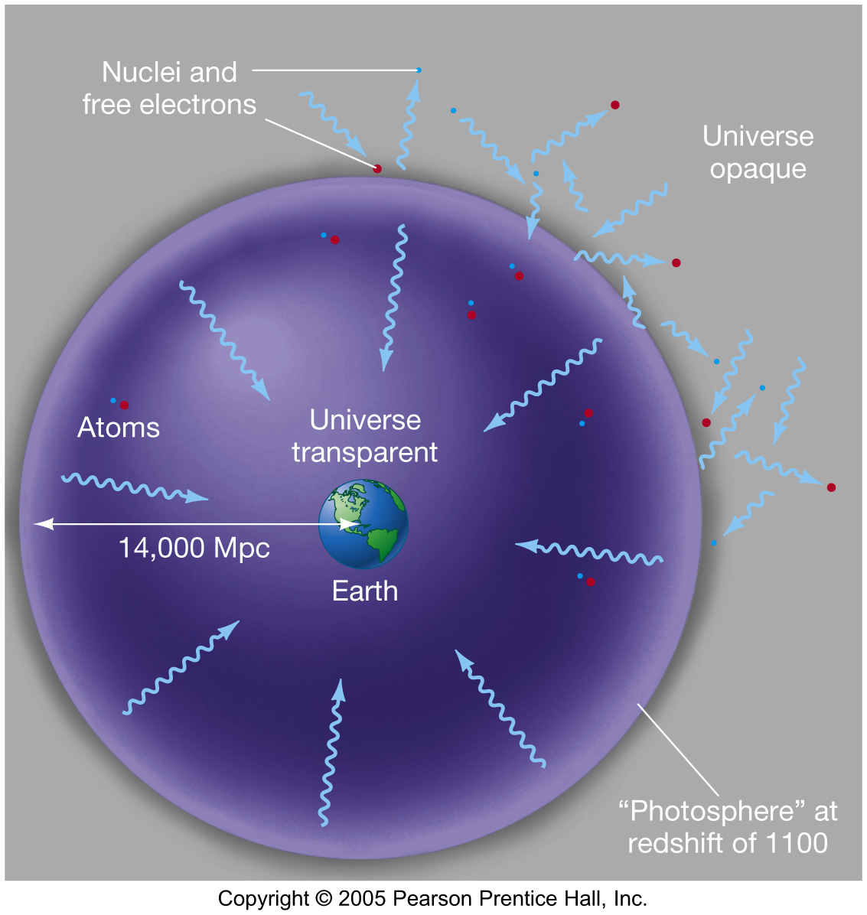

Slide 10
Cosmic Microwave Background (Discovered in 1964)
T=300,000 years
after the Big Bang
Temperature
=3,000ºK
z=1,100
Sun/Earth
Transparent
Today:
3000ºK/1,100
=2.7ºK
Opaque

Slide 11
Time = 300,000 years , Temp.= 3000 ºK
All the electrons were bound by Hydrogen and Helium Nuclei. → Atoms formed.
The Universe became transparent. Photons were released. → Radiation decoupled.
Cosmic Microwave Background (CMB)

Slide 12
Two Fundamental Problem of Big Bang Cosmology
Horizon Problem
At early Universe, Size >> Horizon.
Why is CMB so uniform in every direction?
Flatness Problem
⎪Ω-1⎪ grows proportional to the size of the Universe.
Why is Ω of today close to 1?

Slide 13
Expansion of Universe
Size
Horizon
∝ cT
Within 1º
Beginning
300k Years
Today
Time

Slide 14
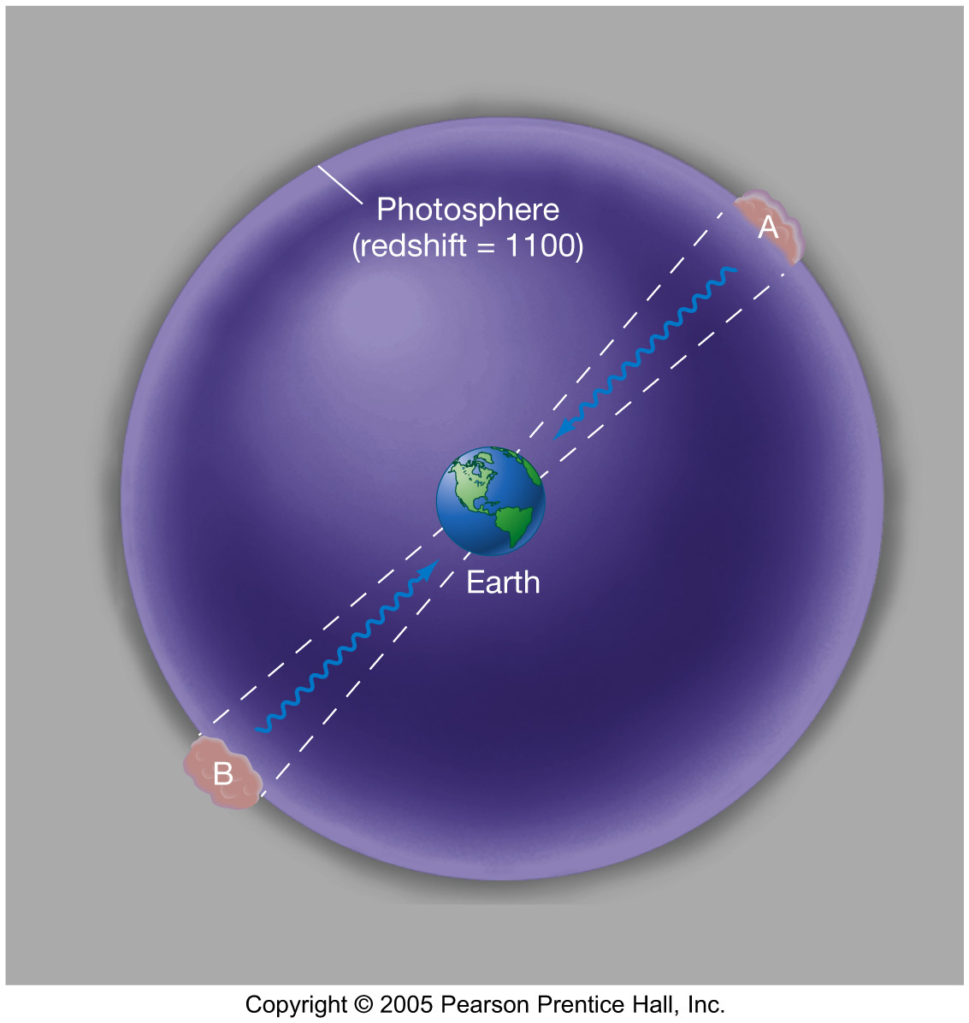
Horizon Problem
The horizon problem: When observed in diametrically opposite directions from Earth, cosmic background radiation appears the same even though there hasn’t been enough time since the Big Bang for them to be in thermal contact.

Slide 15
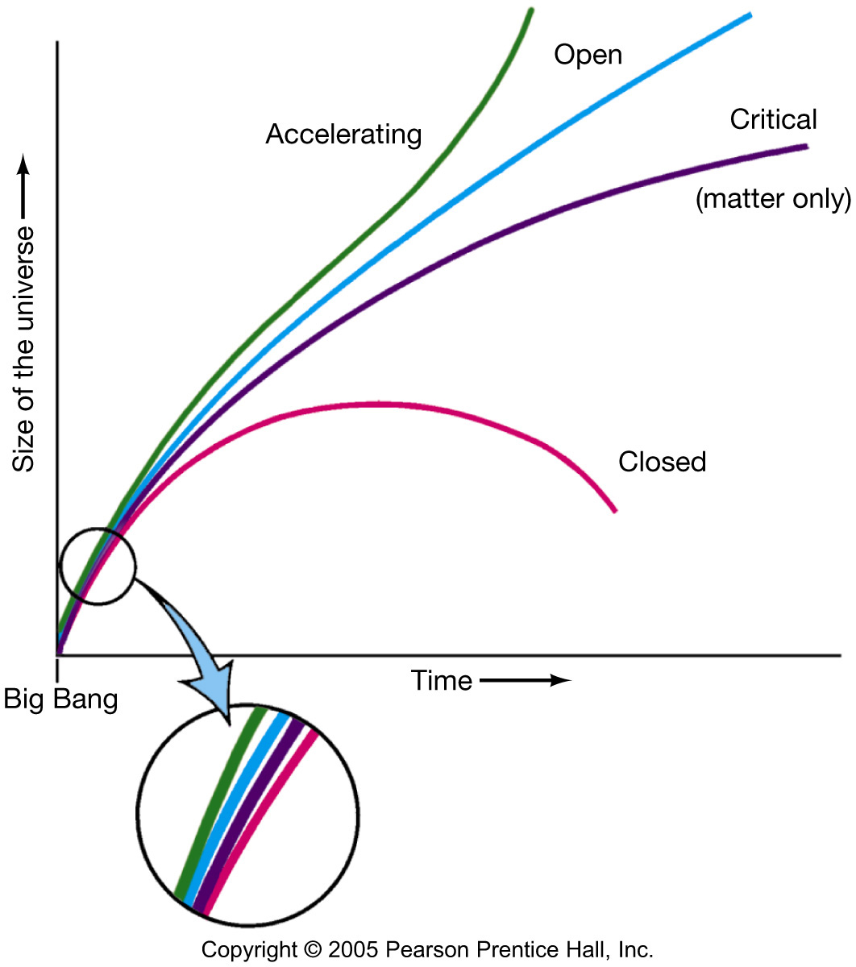
Flatness Problem
| Ω-1 | ∝ Size of Universe
The flatness problem: In order for the universe to have survived this long, its density in the early stages must have differed from the critical density by no more than 1 part in 10¹⁵.

Slide 16
Inflation in Early Universe
Size
Horizon
∝ cT
Inflation
Beginning
Today
Time

Slide 17
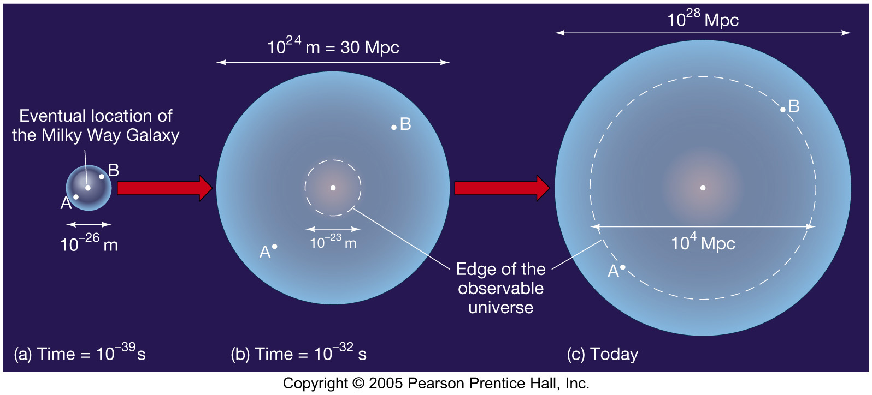
The Inflationary Universe
Inflation, if correct, would solve both the horizon and the flatness problems.
This diagram shows how the horizon problem is solved – the points diametrically opposite from Earth were in fact in contact at one time.

Slide 18
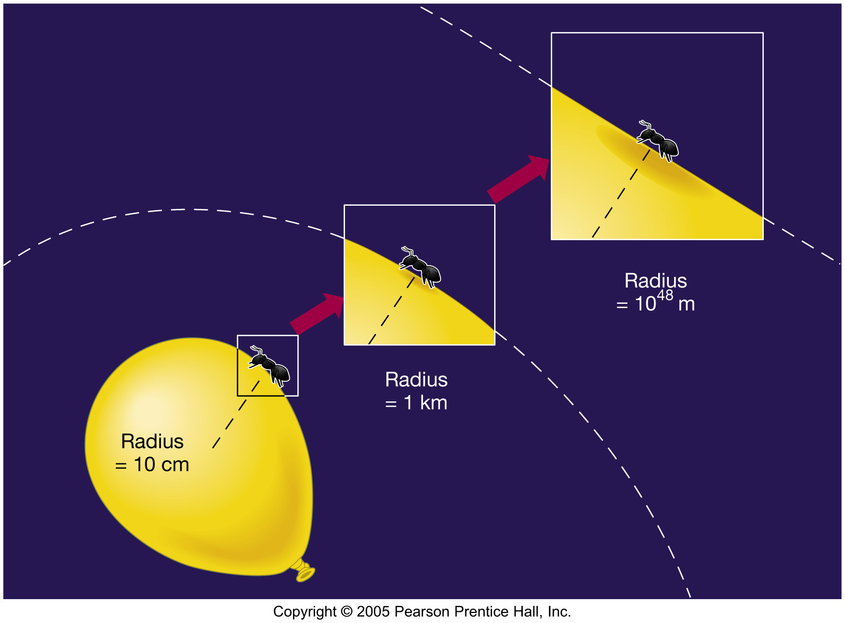
The Inflationary Universe
The flatness problem is solved as well – after the inflation the need to be exceedingly close to the critical density is much more easily met:

Slide 19
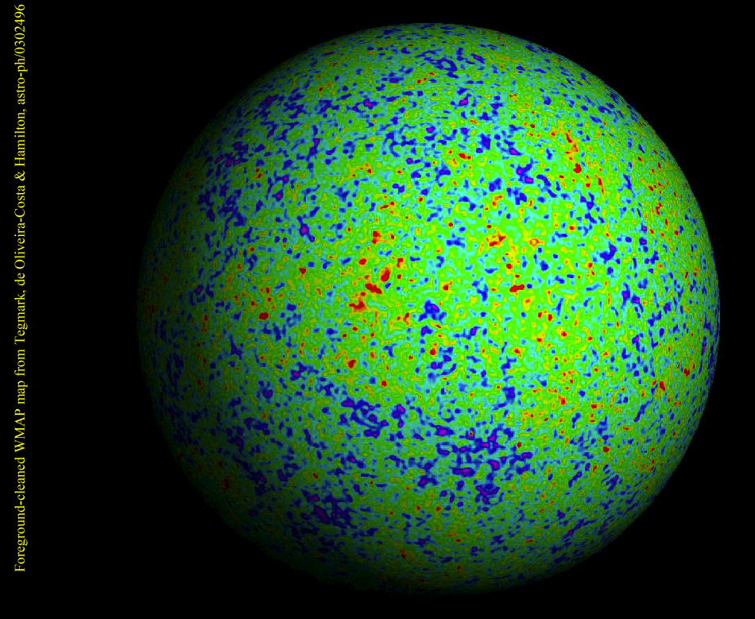
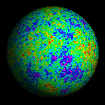
WMAP

Slide 20
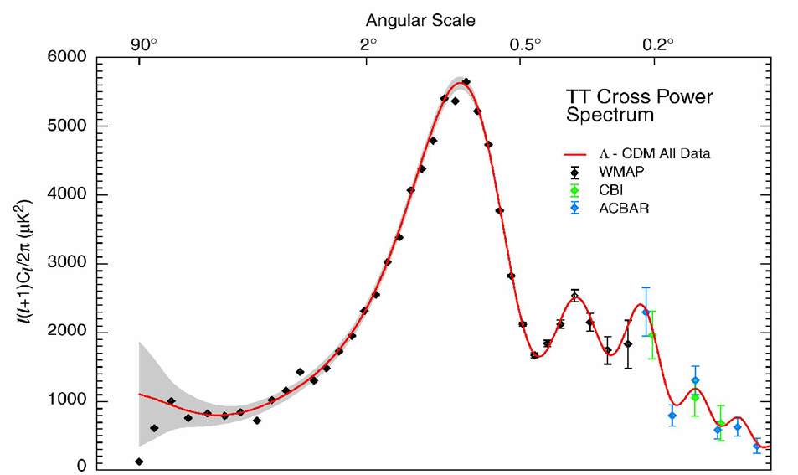

WMAP Power Spectrum
Universe is Flat.
⇒ Inflation

Slide 21
Geometry of the Universe
Open Ω<1
Flat Ω=1
Closed Ω>1

Slide 22
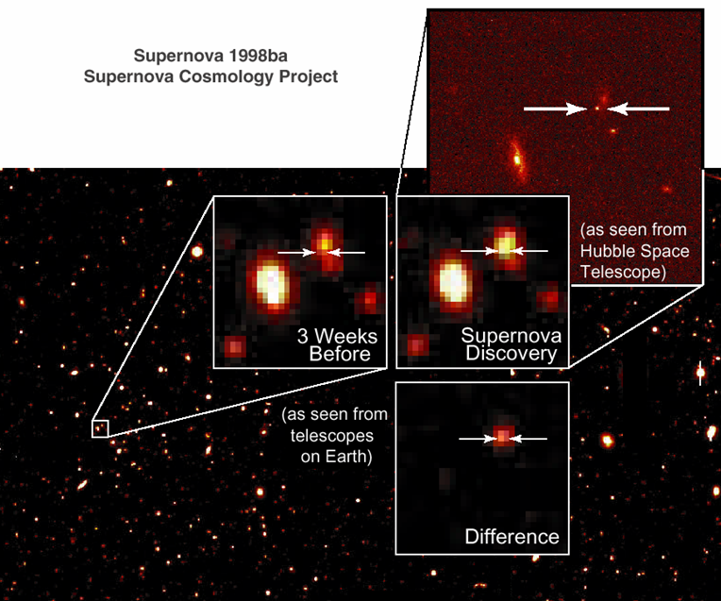
Supernova as a Standard Candle

Slide 23
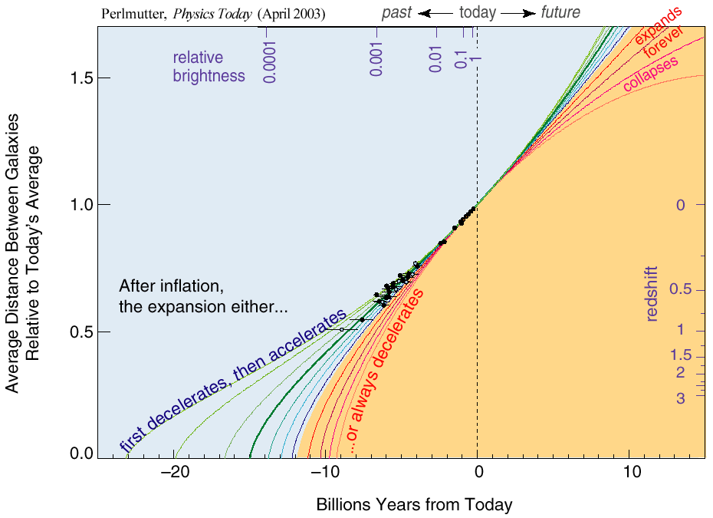
The Accelerating Universe （1998）
Ω_{Λ}= 0.7

Slide 24
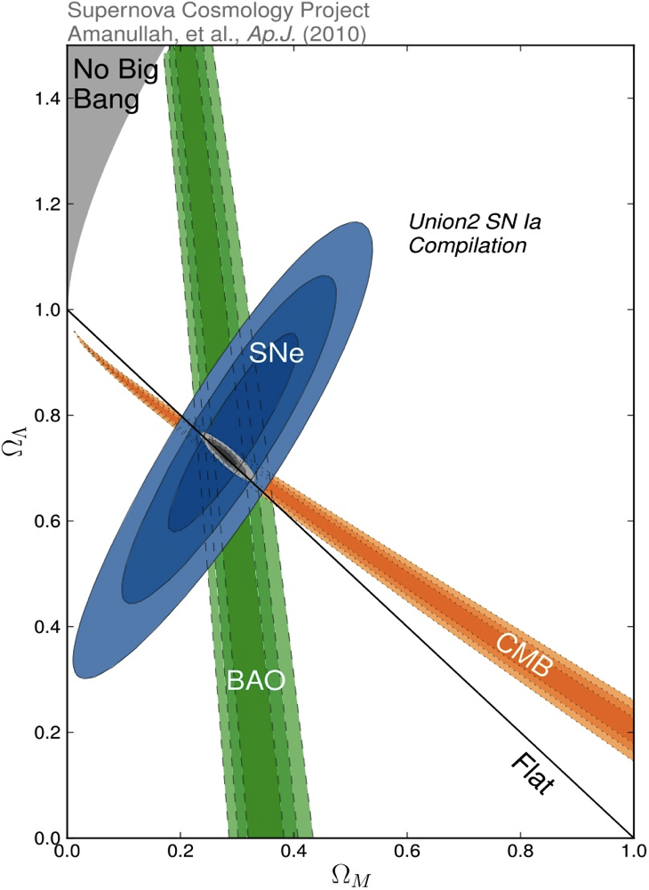
Density of Our Universe
Ω_{Total}=Ω_{Λ}+Ω_{Matter} =1.0
Universe is Flat.
⇒ Inflation
73% is Dark Energy.
⇒ Accelerating
Ω_{Λ}
Ω_{M}= 27%
Ω_{Matter} and Ω_{Λ} are two of “Just Six Numbers”
Ω_{Matter}

Slide 25
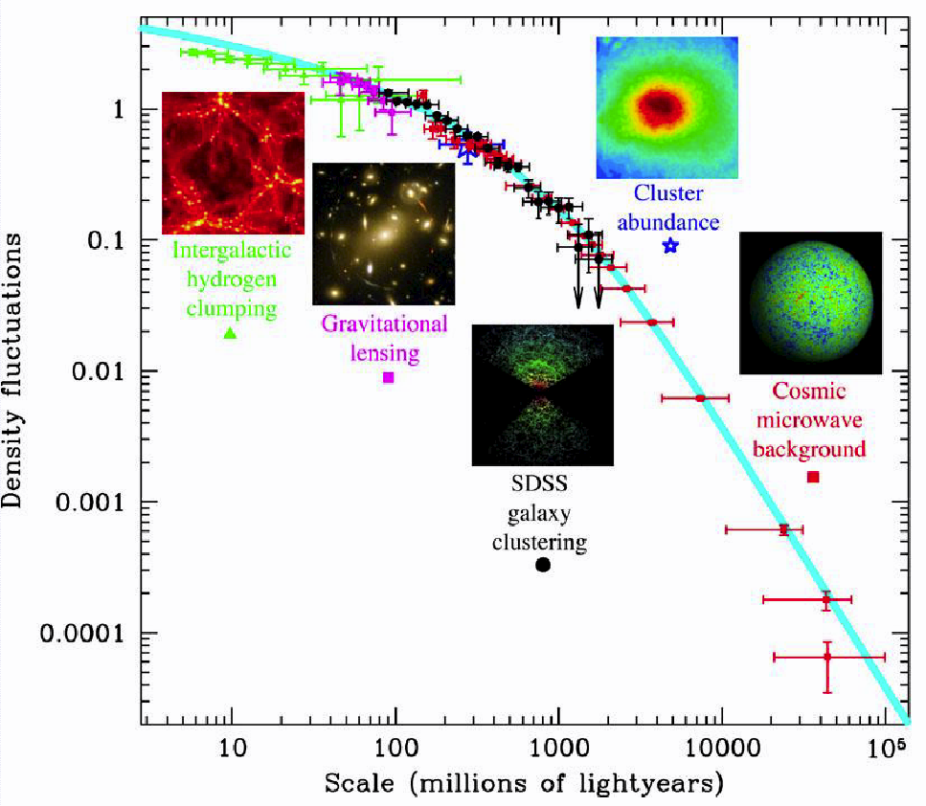
Density Fluctuations

Slide 26
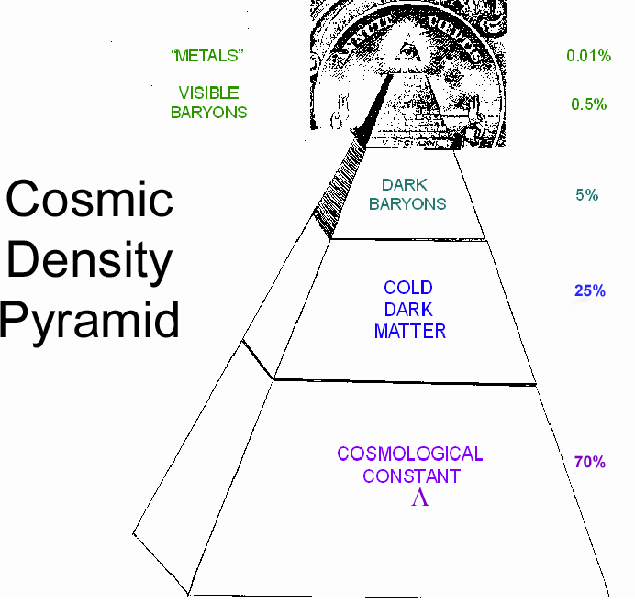
Cosmic Pyramid
Metal
0.01%
Star
0.5%
Baryonic Matter
0.5%
Gas,
Dust
5%
Dark
Matter
25%
Dark Energy
70%

Slide 27
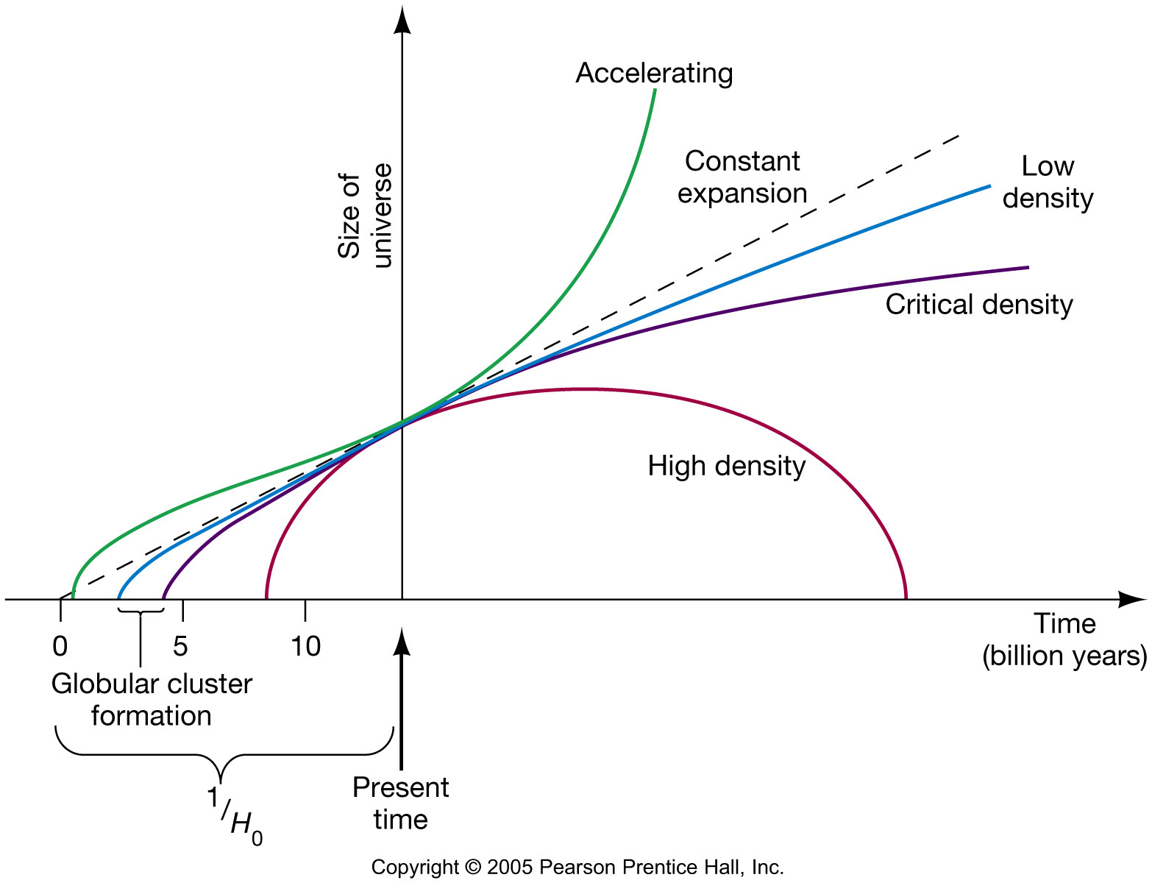
Dark Energy and Cosmology
This graph now includes the accelerating universe.
Given what we now know, the age
of the universe works out to be 13.7 billion years.

Slide 28
Particle Physics

Slide 29
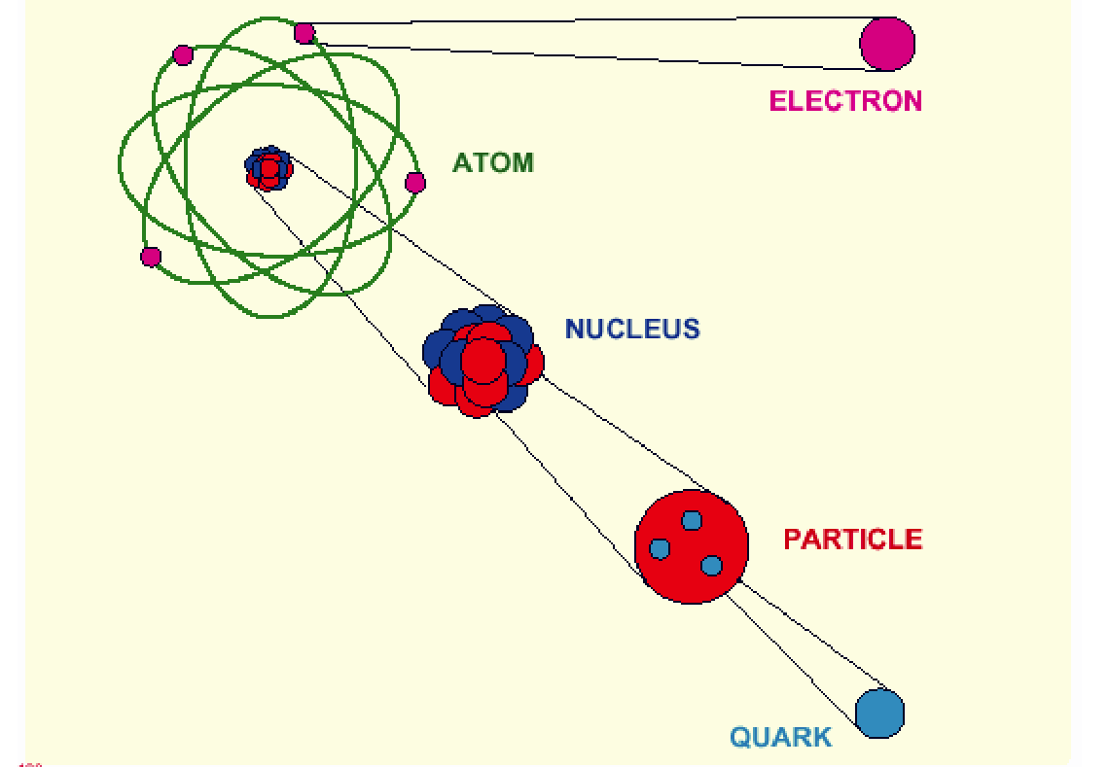
Elementary Particles (~1970)
10⁻¹⁰ m
10⁻¹⁴ m
10⁻¹⁵ m
< 10⁻¹⁸ m

Slide 30
Quark Model
Proton
Neutron
u
u
u
d
d
d
+ 2/3 + 2/3 – 1/3 = 1
+ 2/3 – 1/3 – 1/3 = 0

Slide 31
Fermions
1973
Elementary particles : “Fermions”
Particle Anti-Particle
Quarks u u
d s d s
Leptons ν_{e} ν_{µ} ν_{e} ν_{µ}
e⁻ µ⁻ e⁺ µ⁺

Slide 32
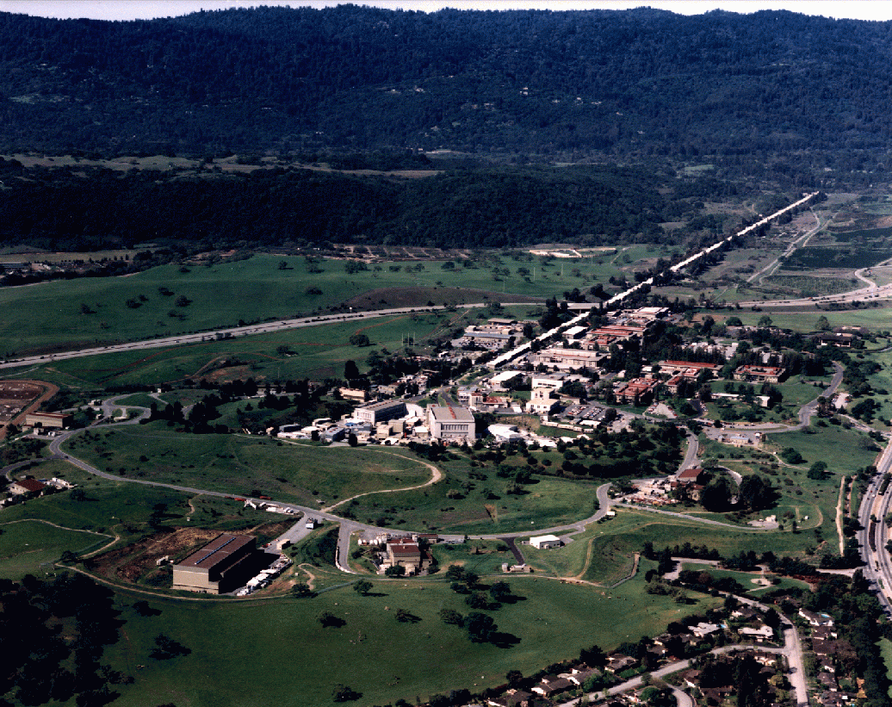
SLAC (Stanford Linear Accelerator Center)
1 mile long
e⁺ + e⁻

Slide 33
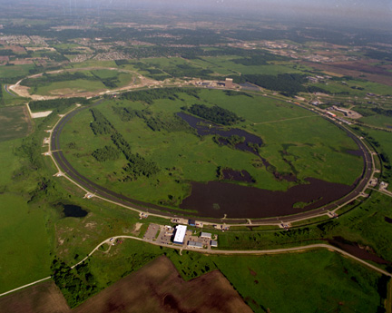
Fermi Lab near Chicago
6km Circumference
1+1=2 TeV
Proton + Anti-proton

Slide 34
Discovery of more quarks
1974 – 1994
More quarks and leptons were discovered.
1974 Ting (BNL) & Richter (SLAC) J/Ψ = cc
1975 Perl (SLAC) τ-lepton
1978 Lederman (FNAL) ϒ = bb
1994 CDF/D0 Group (FNAL) t (top quark)
All discovered at US National Labs (Many Nobels!)

Slide 35
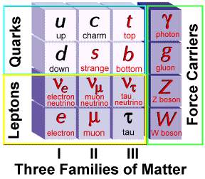
Elementary Particles
Charge
+2/3
-1/3
0
-1
Fermion Boson
Charge
0
0
0
±1
+ Anti-particles

Slide 36
Elementary Particles
Today’s Universe
Charge
+2/3
-1/3
0
-1
Fermion Boson
Charge
0
0
0
±1

Slide 37
Now Time = 14B yrs, Temp.= 2.7 ºK (3×10⁻⁴ eV)
Fermions: Ratio (in numbers)
Lepton: ν_{e} ~1
e⁻ ~4×10⁻¹⁰
Baryon: p ~4×10⁻¹⁰
n ~1×10⁻¹⁰
Bosons:
Photon: γ 1
No anti-particles
# Photon : # Baryon = 1 : ~4×10⁻¹⁰
# p = # e⁻

Slide 38
Expansion of Universe
Size
Size of Universe
∝ √ Time
Horizon
∝ cT
Beginning
Today
Time

Slide 39
Temperature of Universe
Temperature
Temperature = 1/Size
3,000ºK
2.7ºK
Beginning
300,000 years
Today
Size

Slide 40
Relation between Temperature and Time
T: Temperature
t : time
Temperature
130 GeV
130 MeV
1.3 MeV
130 keV
10⁻¹⁰
10⁻⁴
1
100
Time (sec)

Slide 41
Thermal Equilibrium
If thermal energy is greater than twice the mass of particles,
E > 2 mc²
Photon ↔ Particle + Anti-particle
Example:
m_{e} = 0.511 MeV
if E > 1.022 MeV
γ ↔ e⁻ + e⁺
e⁻
γ
γ
e⁺
e⁺
e⁺
γ
γ
e⁻
e⁻
e⁻
e⁺

Slide 42
Time = 1 sec, Temp.= 10¹⁰ ºK (1.3 MeV)
Fermions: Ratio
Lepton: ν_{e} 1
e⁻ 1
ν_{e} 1
e⁺ 1
Baryon: p ~4×10⁻¹⁰
n ~1×10⁻¹⁰
Bosons:
Photon: γ 1
γ
e⁻
γ
ν_{e}
n
ν_{e}
γ
e⁺
e⁻
p
ν_{e}
ν_{e}
e⁺
γ
Horizon
~ 3x10⁸ m

Slide 43
Time = 10⁻⁴ sec, Temp.= 10^{12 o}K (~100 MeV)
Thermal Equilibrium of Protons and Neutrons
n ↔ p + e⁻ + ν_{e}
n + e⁺ ↔ p + ν_{e}
n + ν_{e} ↔ p + e⁻
Lepton Dominant Era
Fermions: Ratio
Lepton: ν_{e} 1
e⁻ 1
ν_{e} 1
e⁺ 1
Baryon: p ~2×10⁻¹⁰
n ~2×10⁻¹⁰
Bosons:
Photon: γ 1
γ
e⁻
γ
ν_{e}
n
ν_{e}
γ
e⁺
e⁻
p
ν_{e}
ν_{e}
e⁺
γ
Horizon
~ 30 km

Slide 44
Time = 10⁻⁵ sec, Temp.= 3×10^{12 o}K (300 MeV)
Quark → Hadron Phase Transition
u-quarks and d-quarks are bound together to form protons and neutrons.
No anti-quarks
u
p
d
n
d
u
u
u
d
d
d
u
d
d
d
u
u
u
u
p
u
d
d
u
d
u
d
n
Quark-gluon Plasma
Horizon
~ 3 km

Slide 45
Time = 10⁻⁶ sec, Temp.= 10^{13 o}K (~1 GeV)
Thermal Equilibrium of Photons, Leptons and Quarks
Photon ↔ Lepton + Anti-lepton
γ ↔ e⁻ + e⁺
γ ↔ µ⁻ + µ⁺
γ ↔ ν + ν
Photon ↔ Quark+ Anti-quark
γ ↔ u + u
γ ↔ d + d
γ ↔ s + s
#photon ~ #lepton ~ #quark
s
γ
µ⁻
γ
ν_{e}
d
ν_{e}
d
γ
e⁺
e⁻
u
ν_{µ}
u
s
ν_{µ}
µ⁺
γ
Horizon
~ 300 m

Slide 46
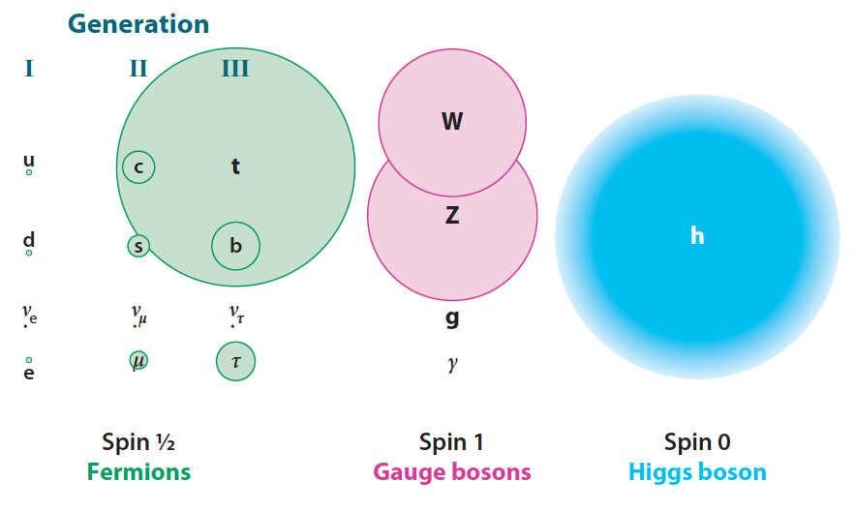
Mass of Particles

Slide 47
Elementary Particles
Universe at t = 1 µsec
Charge
+2/3
-1/3
0
-1
Fermion Boson
Charge
0
0
0
±1
+ Anti-particles

Slide 48
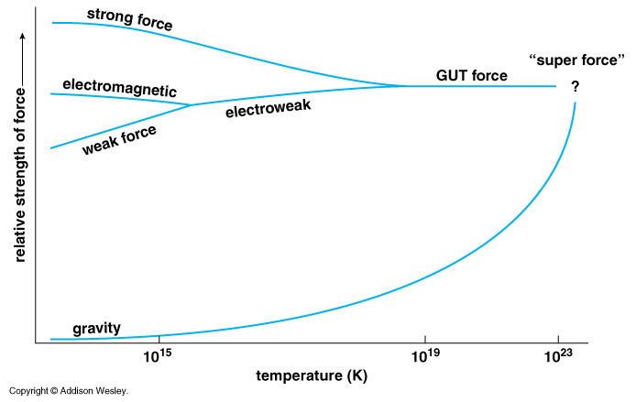
Unification of Forces
??
Electro-Weak Unification
100 GeV
10¹⁶ GeV
10¹⁹ GeV
10²⁹
10³²

Slide 49
Time = 10⁻¹⁰ sec, Temp.= 10^{15 o}K (~100 GeV)
Electro-weak Unification
Electro-Magnetic force = Weak force
The highest energy we can study by the accelerators
b
s
µ⁻
W⁺
γ
c
ν_{e}
τ⁺
d
τ⁻
ν_{e}
d
e⁺
Zº
e⁻
u
ν_{µ}
u
s
b
ν_{µ}
µ⁺
W⁺
c
Horizon
~ 3 cm

Slide 50
Elementary Particles
Universe at = 0.1 nsec
Charge
+2/3
-1/3
0
-1
Fermion Boson
Charge
0
0
0
±1
+ Anti-particles

Slide 51
Unification of Forces
Grand Unification
100 GeV
10¹⁶ GeV
10¹⁹ GeV
10²⁹
10³²

Slide 52
Time = 10⁻³⁴ sec, Temp.= 10^{29 o}K (~10¹⁶ GeV)
Grand Unification
Strong-Force = Electro-Magnetic force = Weak force
Quark = Leptons
Everything (except gravity) is unified.
Inflation might happen?
Size ~ 30 cm
Horizon
~ 3×10⁻²⁴ cm

Slide 53
Inflation in Early Universe
Size
Horizon
∝ cT
Inflation
Beginning
Today
Time

Slide 54
Unification of Forces
Plank Epoch
100 GeV
10¹⁶ GeV
10¹⁹ GeV
10²⁹
10³²

Slide 55
Time = 10⁻⁴⁴ sec, Temp.= 10^{32 o}K (~10¹⁹ GeV)
Planck Epoch
Gravitational Effect (Curvature of the space)
Quantum Mechanical effect
We can not define space-time any more at earlier stage.
< Plank Scale>
Size
~10⁻³³ cm

Slide 56
Hubble Deep Field
Physicists’ View of Early Universe
Fiat lux
Let there be light

Slide 57
Hubble Deep Field
Physicists’ View of Early Universe
Lorentz Invariance
Local Gauge Invariance

Slide 58
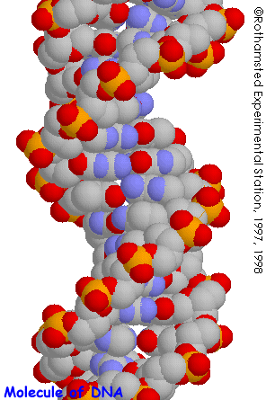
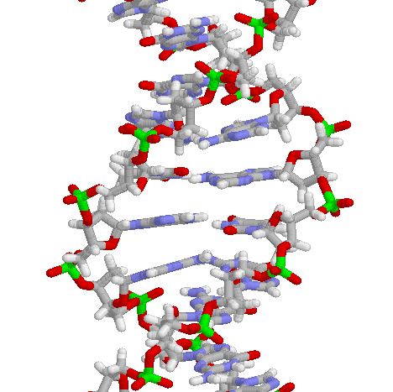
Structure of DNA

Slide 59
Symmetry Breaking
Time
0
Simple
1B years
2
3
4
b
s
µ⁻
W⁺
5
γ
c
Symmetry
Break Down
ν_{e}
τ⁺
d
6
d
Zº
τ⁻
ν_{e}
e⁺
e⁻
7
u
u
ν_{µ}
b
ν_{µ}
µ⁺
s
8
W⁺
c
9
10
11
12
Complex
13
14

Slide 60
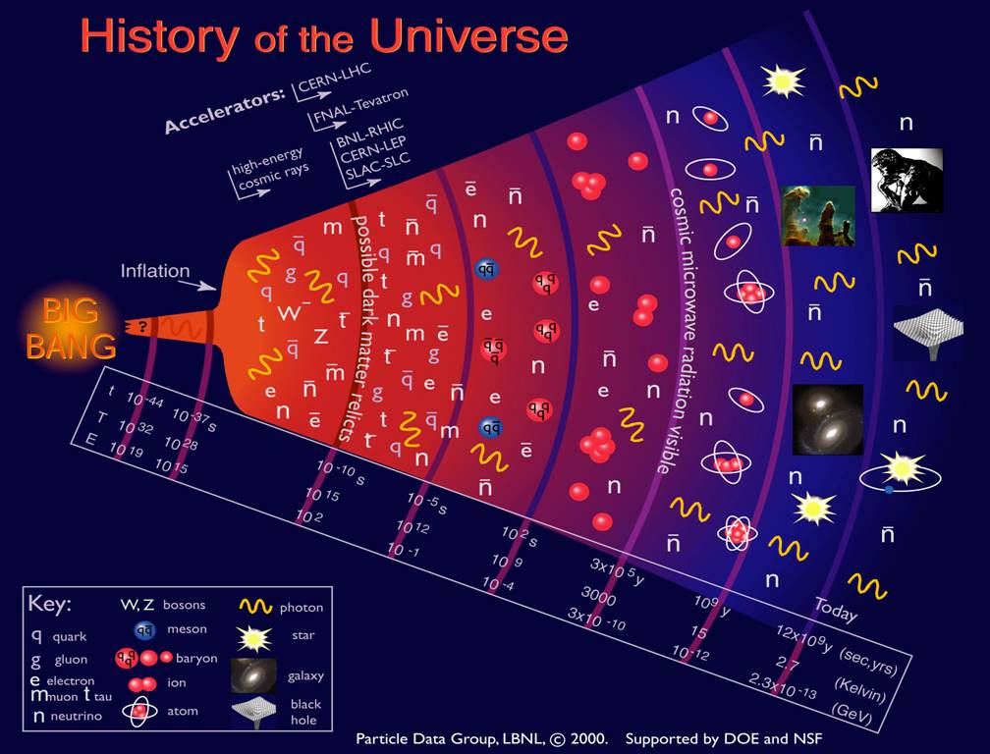

Slide 61
The Beginning
Everything was the same ↔ Perfect symmetry.
All the particles are the same as photons.
All four forces are the same.
The Universe was 10 dimension.
3 Space Flattened
1 Time
3 Strong Force
6 2 Weak Compacitified
1 Electro-Magnetic

Slide 62
Early Universe & Unsolved Problems
Time
(sec)
Temp.
(ºK)
Energy (GeV)
The Beginning
10⁻⁴⁵sec
Planck
Plank Epoch
10⁻⁴⁰
10³⁰
10¹⁸
Inflation
GUT
Grand Unification
10⁻³⁵
10¹⁵
10⁻³⁰
10²⁵
10¹²
10⁻²⁵
10⁹
10⁻²⁰
10²⁰
1PeV
Dark Matter
10⁻¹⁵
10¹⁵
1TeV
EW
Electro-Weak Unification
10⁻¹⁰
10⁻⁵
1GeV
1
10¹⁰
1MeV
10⁵ sec
1KeV
1 year
10⁵
Matter-Radiation Decoupling
10³
1eV
10⁶
Dark Energy
10⁹ year
10⁻³eV
Now
1

