Slide 1
Evolution of the Early Universe
Katsushi Arisaka
University of California, Los Angeles
Department of Physics and Astronomy
arisaka@physics.ucla.edu

Slide 2
Expansion of Universe
Size
Size ∝ √ time
Beginning
Today
Time

Slide 3
Temperature of Universe
Temperature
Temperature ∝ 1 / Size
∝ 1 / √ time
2.7ºK
Beginning
Today
Time

Slide 4
Relation between Temperature and Time
T: Temperature
t : time
Temperature
130 GeV
130 MeV
1.3 MeV
130 keV
10⁻¹⁰
10⁻⁴
1
100
Time (sec)

Slide 5
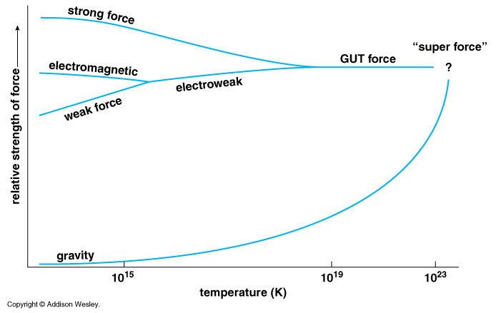
Unification of Forces
Plank Epoch
100 GeV
10¹⁶ GeV
10¹⁹ GeV
10²⁹
10³²

Slide 6
Hubble Deep Field
Physicists’ View of Early Universe
Fiat lux
Let there be light

Slide 7
Hubble Deep Field
Physicists’ View of Early Universe
Lorentz Invariance
Local Gauge Invariance

Slide 8
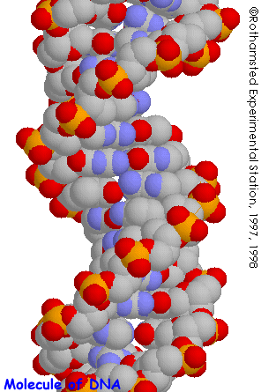
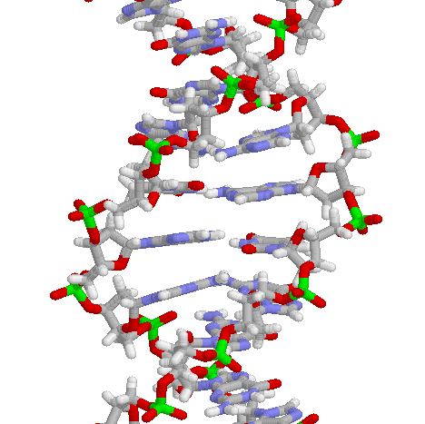
Structure of DNA

Slide 9
Symmetry Breaking
Time
0
Simple
1B years
2
3
4
b
s
µ⁻
W⁺
5
γ
c
Symmetry
Break Down
ν_{e}
τ⁺
d
6
d
Zº
τ⁻
ν_{e}
e⁺
e⁻
7
u
u
ν_{µ}
b
ν_{µ}
µ⁺
s
8
W⁺
c
9
10
11
12
Complex
13
14

Slide 10
The Beginning
Everything was the same ↔ Perfect symmetry.
All the particles are the same as photons.
All four forces are the same.
The Universe was 10 dimension.
3 Space Flattened
1 Time
3 Strong Force
6 2 Weak Compacitified
1 Electro-Magnetic

Slide 11
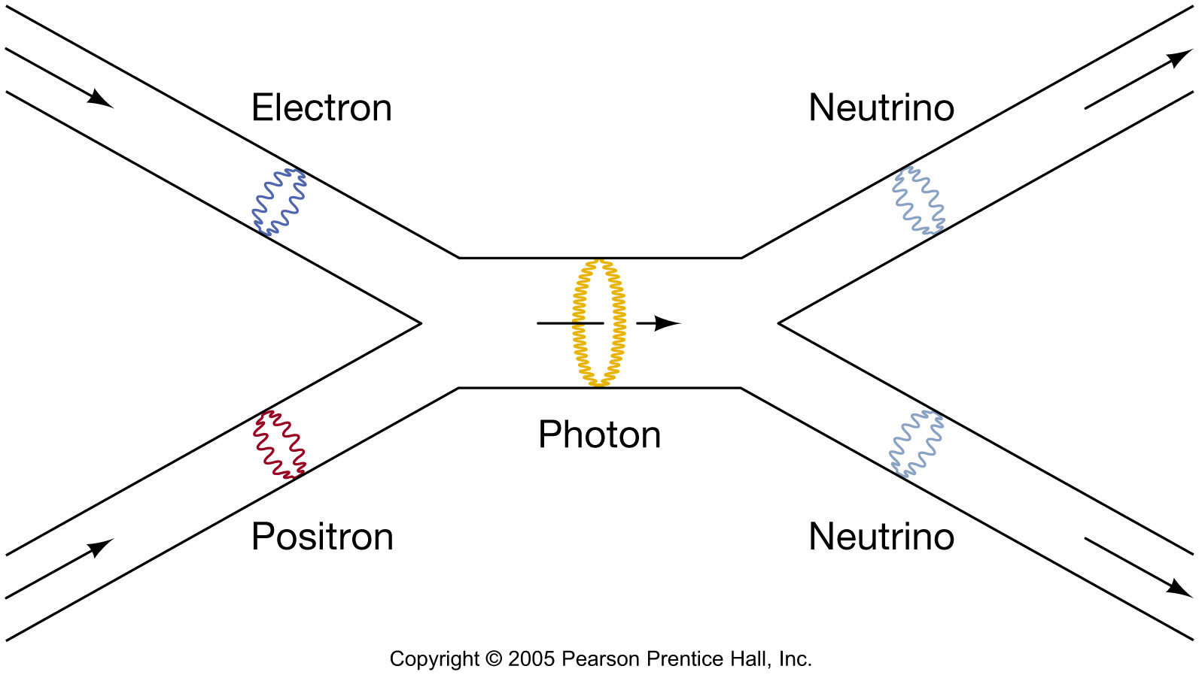
Superstring?
In the “standard model”
fundamental particles = point-like
(No internal structure)
In the “Superstring model”
Fundamental particles = loop of string
(Size < Planck scale)
e⁻
γ
e⁺
time
γ
e⁻
e⁺
time

Slide 12
Time = 10⁻³⁴ sec, Temp.= 10^{29 o}K (~10¹⁶ GeV)
Grand Unification
Strong-Force = Electro-Magnetic force = Weak force
Quark = Leptons
Everything (except gravity) is unified.
Inflation might happen?
Size ~ 30 cm
Horizon
~ 3×10⁻²⁴ cm

Slide 13
Unification of Forces
Planck Epoch
100 GeV
10¹⁶ GeV
10¹⁹ GeV
10²⁹
10³²

Slide 14
Unification of Forces
Grand Unification
100 GeV
10¹⁶ GeV
10¹⁹ GeV
10²⁹
10³²

Slide 15
Unification of Forces
??
Electro-Weak Unification
100 GeV
10¹⁶ GeV
10¹⁹ GeV
10²⁹
10³²

Slide 16
Origin of Particles and LHC

Slide 17
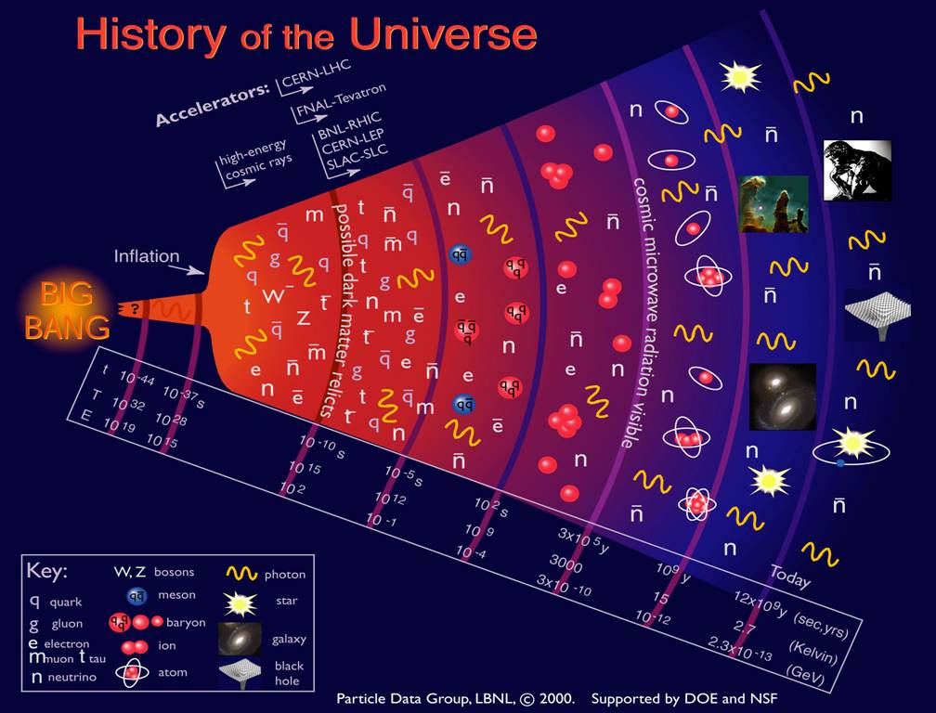

Slide 18
Symmetry Breaking
Time
(sec)
Temp.
(ºK)
Energy (GeV)
10⁻⁴⁵sec
Simple
10⁻⁴⁰
10³⁰
10¹⁸
10⁻³⁵
10¹⁵
10⁻³⁰
10²⁵
10¹²
10⁻²⁵
10⁹
Symmetry
Break Down
10⁻²⁰
10²⁰
1PeV
10⁻¹⁵
10¹⁵
1TeV
10⁻¹⁰
b
1GeV
s
µ⁻
W⁺
10⁻⁵
γ
c
10¹⁰
ν_{e}
τ⁺
1
1MeV
d
τ⁻
ν_{e}
d
e⁺
Zº
10⁵ sec
1KeV
ν_{µ}
e⁻
1 year
u
u
s
10⁵
Complex
ν_{µ}
10³
1eV
b
µ⁺
10⁶
W⁺
c
10⁹ year
10⁻³eV
1

Slide 19
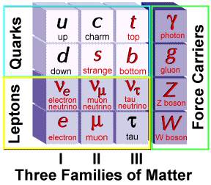
Elementary Particles
Universe at = 0.1 nsec
Charge
+2/3
-1/3
0
-1
Fermion Boson
Charge
0
0
0
±1
+ Anti-particles

Slide 20
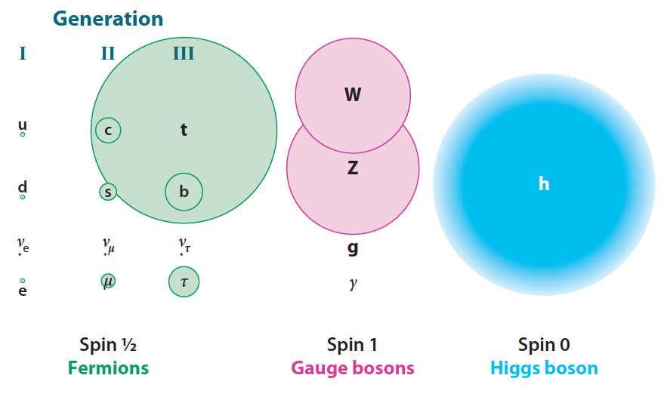
Mass of Particles (at T = 0.1 ns)

Slide 21
Time = 10⁻¹⁰ sec, Temp.= 10^{15 o}K (~100 GeV)
Electro-weak Unification
Electro-Magnetic force = Weak force
The highest energy we can study by the accelerators
b
s
µ⁻
W⁺
γ
c
ν_{e}
τ⁺
d
τ⁻
ν_{e}
d
e⁺
Zº
e⁻
u
ν_{µ}
u
s
b
ν_{µ}
µ⁺
W⁺
c
Horizon
~ 3 cm

Slide 22
Mystery of the Mass (since 1970)
How to create mass from energy?
While maintaining the initial symmetry
Spontaneous Symmetry Breaking
Particle mass << Plank Mass
MeV – GeV 10¹⁹ GeV
Why so many particles (Generations) with different masses?
Energy → Mass

Slide 23
Spontaneous Symmetry Breakdown at a Dinner Table
Dinner Table
Dish
Glass of Water
by Nambu Yoichiro

Slide 24
Spontaneous Symmetry Breaking - Higgs Mechanism -
Energy
y
Vacuum
Energy
x
Mass

Slide 25
Spontaneous Symmetry Breaking - Higgs Mechanism -
Energy
y
Vacuum
Energy
x
Mass

Slide 26
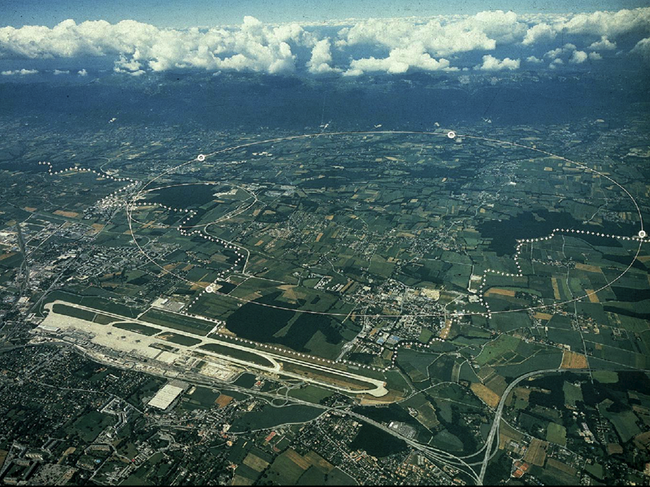
CERN and LHC in Geneva
27km Circumference
7+7=14 TeV

Slide 27
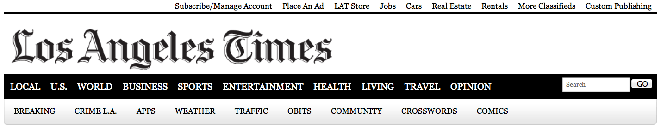
News release on July 4th at CERN

Slide 28
Unification of Fundamental Forces
Time
(sec)
Temp.
(ºK)
Energy (GeV)
Fundamental
Interaction
10⁻⁴⁵sec
Planck
GUT
10⁻⁴⁰
10³⁰
10¹⁸
GUT
10⁻³⁵
10¹⁵
10⁻³⁰
10²⁵
10¹²
10⁻²⁵
Electro-Weak
10⁹
10⁻²⁰
10²⁰
1PeV
10⁻¹⁵
10¹⁵
1TeV
EW
10⁻¹⁰
10⁻⁵
1GeV
1
10¹⁰
1MeV
10⁵ sec
1KeV
Gravitation
Electromagnetic
1 year
10⁵
Strong
Weak
10³
1eV
10⁶
10⁹ year
10⁻³eV
Now
1

Slide 29
Early Universe & Unsolved Problems
Time
(sec)
Temp.
(ºK)
Energy (GeV)
The Beginning
10⁻⁴⁵sec
Planck
Plank Epoch
10⁻⁴⁰
10³⁰
10¹⁸
Inflation
GUT
Grand Unification
10⁻³⁵
10¹⁵
10⁻³⁰
10²⁵
10¹²
10⁻²⁵
Baryogenesis
10⁹
10⁻²⁰
10²⁰
1PeV
Dark Matter
10⁻¹⁵
10¹⁵
1TeV
EW
Electro-Weak Unification
10⁻¹⁰
10⁻⁵
1GeV
1
10¹⁰
1MeV
10⁵ sec
1KeV
1 year
10⁵
Matter-Radiation Decoupling
10³
1eV
10⁶
Dark Energy
10⁹ year
10⁻³eV
Now
1

Slide 31
Inflation in Early Universe
Size
Size of Universe
∝ √ Time
Horizon
∝ cT
Inflation
Beginning
Today
Time

Slide 32
Origin of Inflation
Energy
y
Vacuum
Energy
x

Slide 33
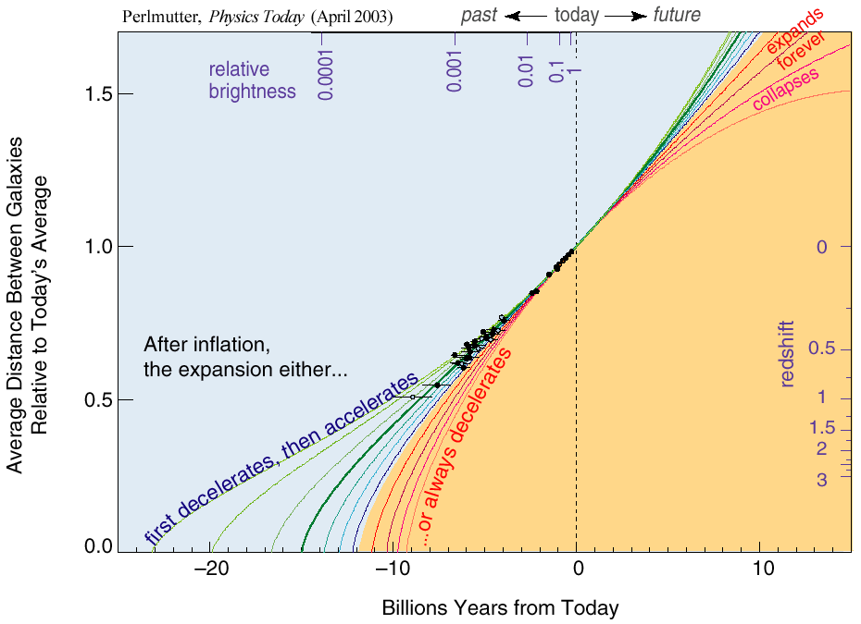
The Accelerating Universe

Slide 34
Origin of Dark Energy
Same as Inflation
Energy
y
Vacuum
Energy
x

Slide 35
The First One Second

Slide 36
Relation between Temperature and Time
T: Temperature
t : time
Temperature
130 GeV
130 MeV
1.3 MeV
130 keV
10⁻¹⁰
10⁻⁴
1
100
Time (sec)

Slide 38
Time = 10⁻⁶ sec, Temp.= 10^{13 o}K (~1 GeV)
Thermal Equilibrium of Photons, Leptons and Quarks
Photon ↔ Lepton + Anti-lepton
γ ↔ e⁻ + e⁺
γ ↔ µ⁻ + µ⁺
γ ↔ ν + ν
Photon ↔ Quark+ Anti-quark
γ ↔ u + u
γ ↔ d + d
γ ↔ s + s
#photon ~ #lepton ~ #quark
#particle ~ #anti-particle
s
γ
µ⁻
γ
ν_{e}
d
ν_{e}
d
γ
e⁺
e⁻
u
ν_{µ}
u
s
ν_{µ}
µ⁺
γ
Horizon
~ 300 m

Slide 40
Time = 10⁻⁵ sec, Temp.= 3×10^{12 o}K (300 MeV)
Quark → Hadron Phase Transition
u-quarks and d-quarks are bound together to form protons and neutrons.
No anti-quarks
u
p
d
n
d
u
u
u
d
d
d
u
d
d
d
u
u
u
u
p
u
d
d
u
d
u
d
n
Quark-gluon Plasma
Horizon
~ 3 km

Slide 41
Baryogenesis
Why did anti-particle disappear?
#Photon : #Baryon : #Anti Baryon
= 1 : ~4 x 10⁻¹⁰ : 0
Sakharov's three conditions:
Baryon number violation
Out of equilibrium
CP Violation
No clear clue yet

Slide 42
Time = 10⁻⁴ sec, Temp.= 10^{12 o}K (~100 MeV)
Thermal Equilibrium of Protons and Neutrons
n ↔ p + e⁻ + ν_{e}
n + e⁺ ↔ p + ν_{e}
n + ν_{e} ↔ p + e⁻
Lepton Dominant Era
Fermions: Ratio
Lepton: ν_{e} 1
e⁻ 1
ν_{e} 1
e⁺ 1
Baryon: p ~2×10⁻¹⁰
n ~2×10⁻¹⁰
Bosons:
Photon: γ 1
γ
e⁻
γ
ν_{e}
n
ν_{e}
γ
e⁺
e⁻
p
ν_{e}
ν_{e}
e⁺
γ
Horizon
~ 30 km

Slide 43
The First One Second

Slide 44
Relation between Temperature and Time
T: Temperature
t : time
Temperature
130 GeV
130 MeV
1.3 MeV
130 keV
10⁻¹⁰
10⁻⁴
1
100
Time (sec)

Slide 45
Thermal Equilibrium
If thermal energy is greater than twice the mass of particles,
E > 2 mc²
Photon ↔ Particle + Anti-particle
Example:
m_{e} = 0.511 MeV
if E > 1.022 MeV
γ ↔ e⁻ + e⁺
e⁻
γ
γ
e⁺
e⁺
e⁺
γ
γ
e⁻
e⁻
e⁻
e⁺

Slide 46
Time = 10⁻⁶ sec, Temp.= 10^{13 o}K (~1 GeV)
Thermal Equilibrium of Photons, Leptons and Quarks
Photon ↔ Lepton + Anti-lepton
γ ↔ e⁻ + e⁺
γ ↔ µ⁻ + µ⁺
γ ↔ ν + ν
Photon ↔ Quark+ Anti-quark
γ ↔ u + u
γ ↔ d + d
γ ↔ s + s
#photon ~ #lepton ~ #quark
s
γ
µ⁻
γ
ν_{e}
d
ν_{e}
d
γ
e⁺
e⁻
u
ν_{µ}
u
s
ν_{µ}
µ⁺
γ
Horizon
~ 300 m

Slide 47
Elementary Particles
Universe at t = 1 µsec
Charge
+2/3
-1/3
0
-1
Fermion Boson
Charge
0
0
0
±1
+ Anti-particles

Slide 48
Time = 10⁻⁵ sec, Temp.= 3×10^{12 o}K (300 MeV)
Quark → Hadron Phase Transition
u-quarks and d-quarks are bound together to form protons and neutrons.
No anti-quarks
u
p
d
n
d
u
u
u
d
d
d
u
d
d
d
u
u
u
u
p
u
d
d
u
d
u
d
n
Quark-gluon Plasma
Horizon
~ 3 km

Slide 49
Time = 10⁻⁴ sec, Temp.= 10^{12 o}K (~100 MeV)
Thermal Equilibrium of Protons and Neutrons
n ↔ p + e⁻ + ν_{e}
n + e⁺ ↔ p + ν_{e}
n + ν_{e} ↔ p + e⁻
Lepton Dominant Era
Fermions: Ratio
Lepton: ν_{e} 1
e⁻ 1
ν_{e} 1
e⁺ 1
Baryon: p ~2×10⁻¹⁰
n ~2×10⁻¹⁰
Bosons:
Photon: γ 1
γ
e⁻
γ
ν_{e}
n
ν_{e}
γ
e⁺
e⁻
p
ν_{e}
ν_{e}
e⁺
γ
Horizon
~ 30 km

Slide 50
Neutron/Proton Ratio
At T << 1 GeV, m_{n} > m_{p}, therefore #n < #p
n → p + e⁻ + ν_{e}
n + e⁺ → p + ν_{e}
n + ν_{e} → p + e⁻
y
Time | T | #n/#p
10⁻⁴ sec | 130 MeV | 0.99
0.01 sec | 13 MeV | 0.9
1sec | 1.3 MeV | 0.3
0.37
1
x

Slide 51
Time = 1 sec, Temp.= 10¹⁰ ºK (1.3 MeV)
Fermions: Ratio
Lepton: ν_{e} 1
e⁻ 1
ν_{e} 1
e⁺ 1
Baryon: p ~4×10⁻¹⁰
n ~1×10⁻¹⁰
Bosons:
Photon: γ 1
γ
e⁻
γ
ν_{e}
n
ν_{e}
γ
e⁺
e⁻
p
ν_{e}
ν_{e}
e⁺
γ
Horizon
~ 3x10⁸ m

Slide 52
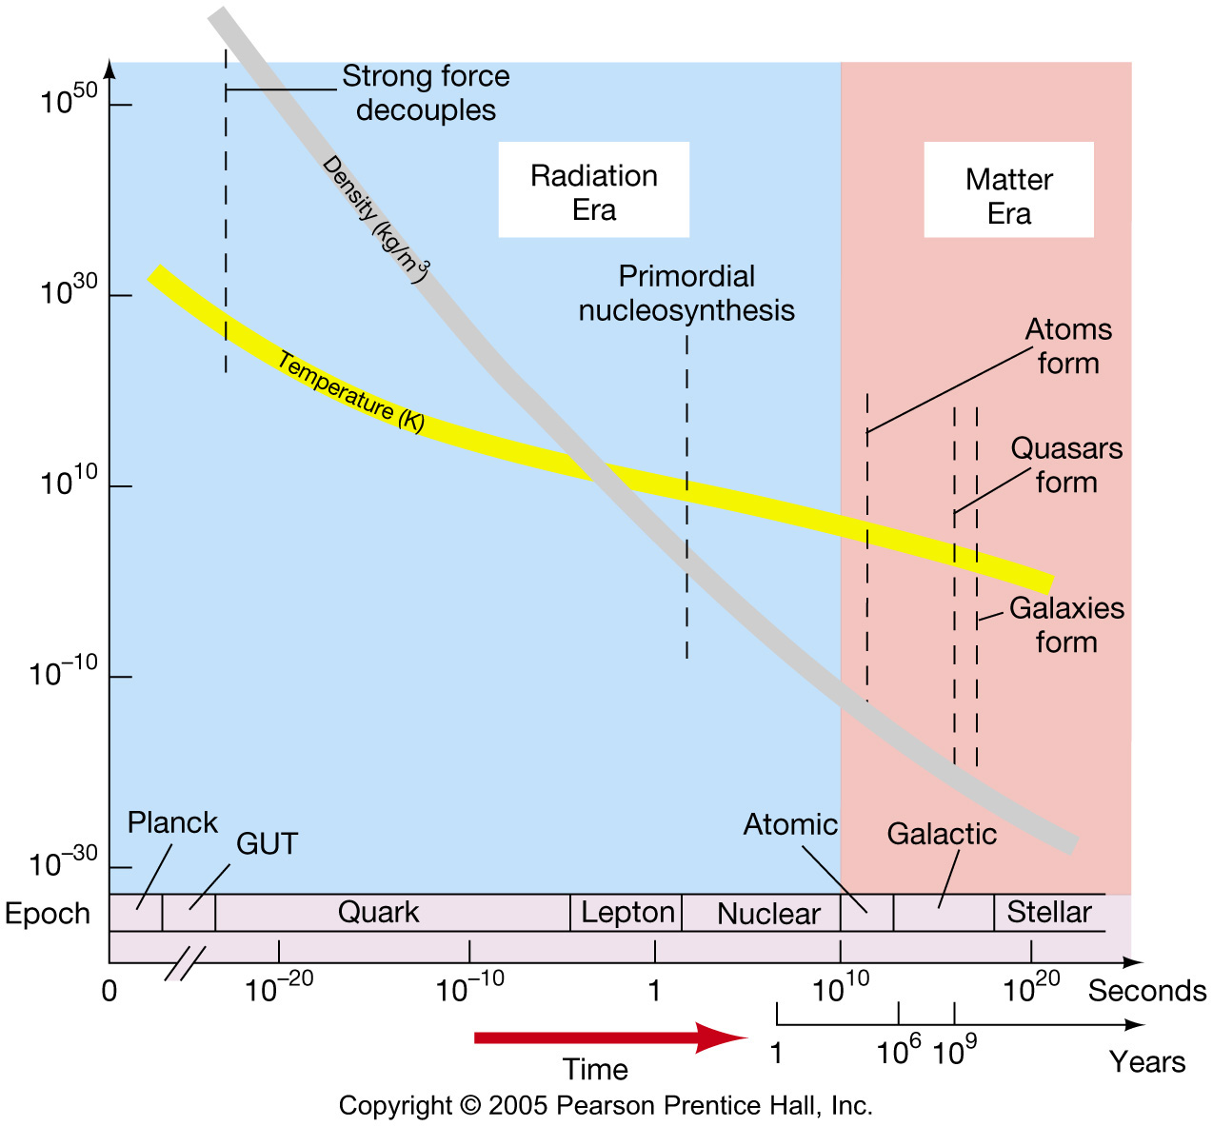
The Evolution of the Universe

Slide 53
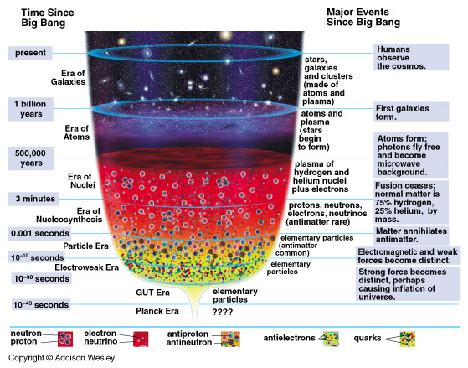
Evolution of Universe

Slide 54
The First Three Minutes

Slide 55
Time = > 1 sec, Temp.= < 10¹⁰ ºK ( <1.3 MeV)
The expansion of the Universe is so fast that neutrons have no more chance to interact with leptons (e⁺ or ν_{e}).
The only process is
n → p + e⁻ + ν_{e}
Life time = 15 minutes (900 seconds)
Neutrons slowly decay for the next 100 seconds.
#n / #p → ~0.13

Slide 56
Time ~ 100 sec, Temp.= 10⁹ ºK (130 keV)
Essentially the same particles as today.
Fermions: Ratio (in numbers)
Lepton: ν_{e} ~1
e⁻ ~4×10⁻¹⁰
Baryon: p ~4×10⁻¹⁰
n ~0.5×10⁻¹⁰
Bosons:
Photon: γ 1
No anti-particles
# Photon : # Baryon = 1 : ~4×10⁻¹⁰
# p = # e⁻

Slide 57
Time = 3 minutes, Temp.= ~10⁹ ºK (~100 keV)
Neutrons are captured by protons.
n + p → D + γ D = (pn)
D + D → ³He + n ³He = (ppn)
³He + D → ⁴He + p ⁴He = (ppnn)
Finally ⁴He is made!
But no other heavier elements.
Expansion of the Universe was too fast for other nuclear fusions!
H : ⁴He = 75% : 25 % by weight

Slide 58
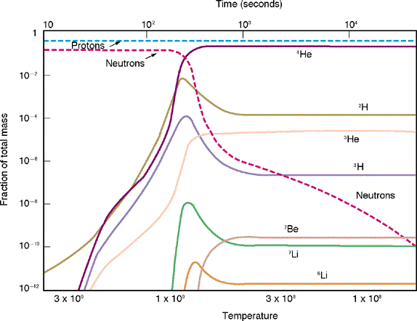
Abundance vs. Time
D

Slide 59
Baryon/Photon Ratio
Amount of ⁴He depends on the amount of photon at that time.
More Photons → D breaks to n + p
→ n decays to p
→ less ⁴He
From the amount of ⁴He and D, we can estimate
We know that #photon = 420 /cm³
0.03 < Ω_{Baryon} < 0.06

Slide 60
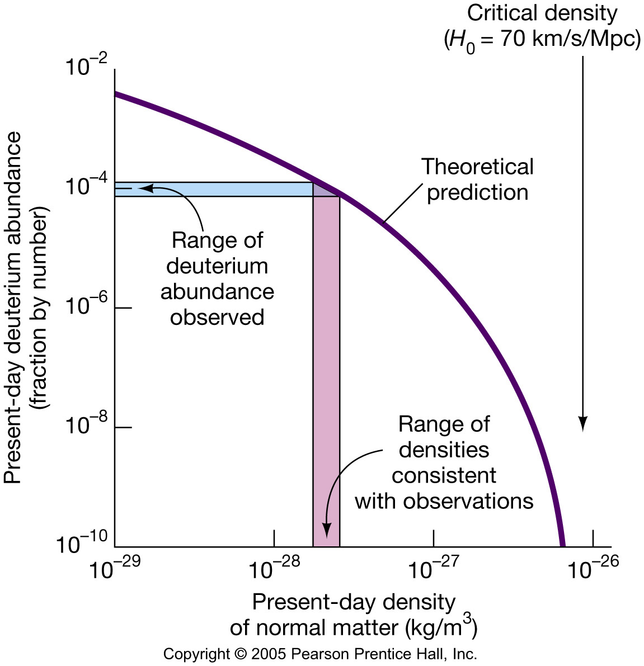
The Formation of Nuclei and Atoms
As with galaxy measurements, the total matter density determined by deuterium abundance shows that the matter density is only a few percent of the critical density.

Slide 61
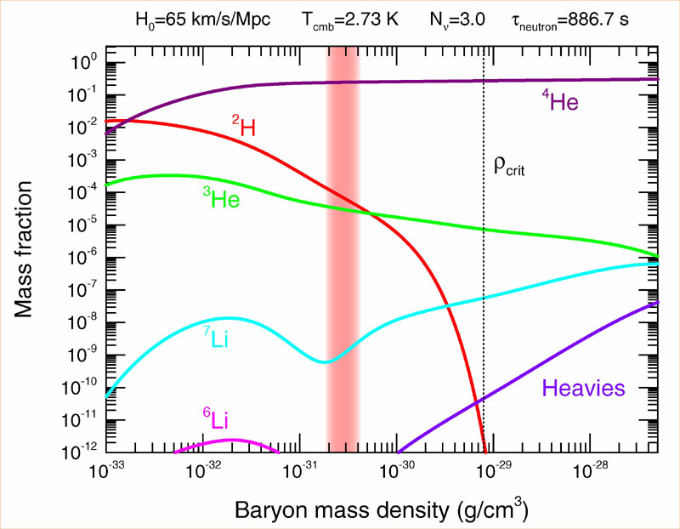
Abundance vs. Density
D
0.03 < Ω_{Baryon}< 0.06

Slide 62
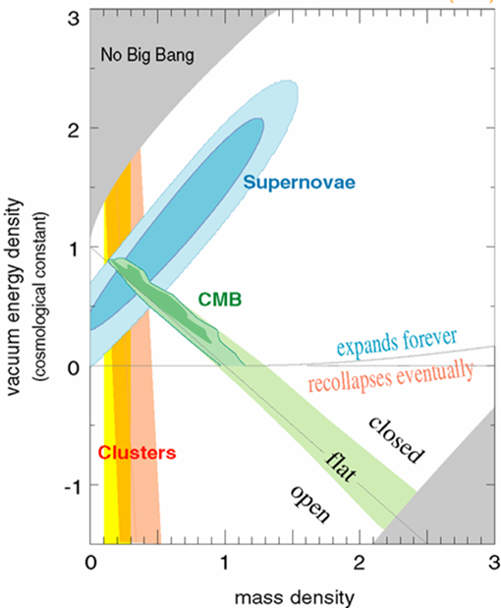
Density of Our Universe
Ω_{Total}=Ω_{Λ}+Ω_{Matter} =1.0
Universe is Flat.
⇒ Inflation
70% is Dark Energy.
⇒ Accelerating
Ω_{Λ}
Ω_{Matter}

Slide 63
Time = > 1 sec, Temp.= < 10¹⁰ ºK ( <1.3 MeV)
The expansion of the Universe is so fast that neutrons have no more chance to interact with leptons (e⁺ or ν_{e}).
The only process is
n → p + e⁻ + ν_{e}
Life time = 15 minutes (900 seconds)
Neutrons slowly decay for the next 100 seconds.
#n / #p → ~0.13

Slide 64
Time ~ 100 sec, Temp.= 10⁹ ºK (130 keV)
Essentially the same particles as today.
Fermions: Ratio (in numbers)
Lepton: ν_{e} ~1
e⁻ ~4×10⁻¹⁰
Baryon: p ~4×10⁻¹⁰
n ~0.5×10⁻¹⁰
Bosons:
Photon: γ 1
No anti-particles
# Photon : # Baryon = 1 : ~4×10⁻¹⁰
# p = # e⁻

Slide 65
Time = 3 minutes, Temp.= ~10⁹ ºK (~100 keV)
Neutrons are captured by protons.
n + p → D + γ D = (pn)
D + D → ³He + n ³He = (ppn)
³He + D → ⁴He + p ⁴He = (ppnn)
Finally ⁴He is made!
But no other heavier elements.
Expansion of the Universe was too fast for other nuclear fusions!
H : ⁴He = 75% : 25 % by weight

Slide 66
Abundance vs. Time
D

Slide 67
Baryon/Photon Ratio
Amount of ⁴He depends on the amount of photon at that time.
More Photons → D breaks to n + p
→ n decays to p
→ less ⁴He
From the amount of ⁴He and D, we can estimate
We know that #photon = 420 /cm³
0.03 < Ω_{Baryon} < 0.06

Slide 68
Abundance vs. Density
D
0.03 < Ω_{Baryon}< 0.06

Slide 69
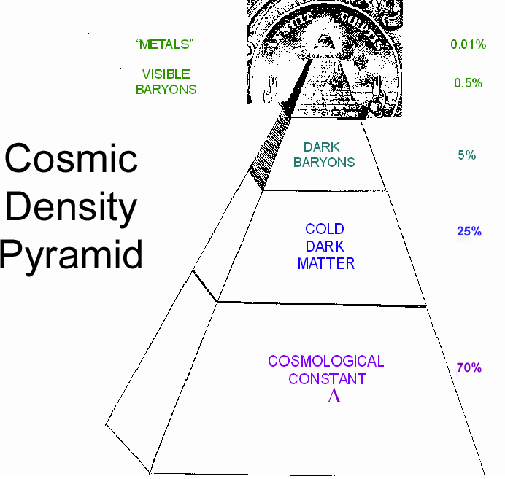
Cosmic Pyramid
Metal
0.01%
Star
0.5%
Baryonic Matter
0.5%
Gas,
Dust
5%
Dark
Matter
25%
Dark Energy
70%

Slide 70
Evolution of the Universe

Slide 72
Time = 300,000 years , Temp.= 3000 ºK
All the electrons were bound by Hydrogen and Helium Nuclei. → Atoms formed.
The Universe became transparent. Photons were released. → Radiation decoupled.
Cosmic Microwave Background (CMB)

Slide 73
Cosmic Microwave Background (CMB) Matter-Radiation Decoupling
Time
(sec)
Temp.
(ºK)
Energy (GeV)
10⁻⁴⁵sec
Planck
10⁻⁴⁰
10³⁰
10¹⁸
GUT
10⁻³⁵
10¹⁵
10⁻³⁰
10²⁵
10¹²
10⁻²⁵
10⁹
10⁻²⁰
10²⁰
1PeV
10⁻¹⁵
Time = 300,000 years
10¹⁵
1TeV
EW
10⁻¹⁰
Temperature = 3,000 ºK
10⁻⁵
1GeV
Energy = 0.3 eV
1
10¹⁰
1MeV
Z = 1,100
10⁵ sec
1KeV
1 year
10⁵
10³
Matter-Radiation
Decoupling ⇒ CMB
1eV
10⁶
10⁹ year
10⁻³eV
Now
1

Slide 74
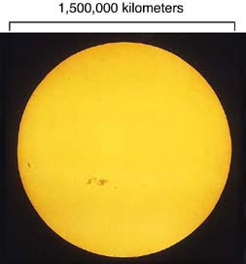

Slide 75
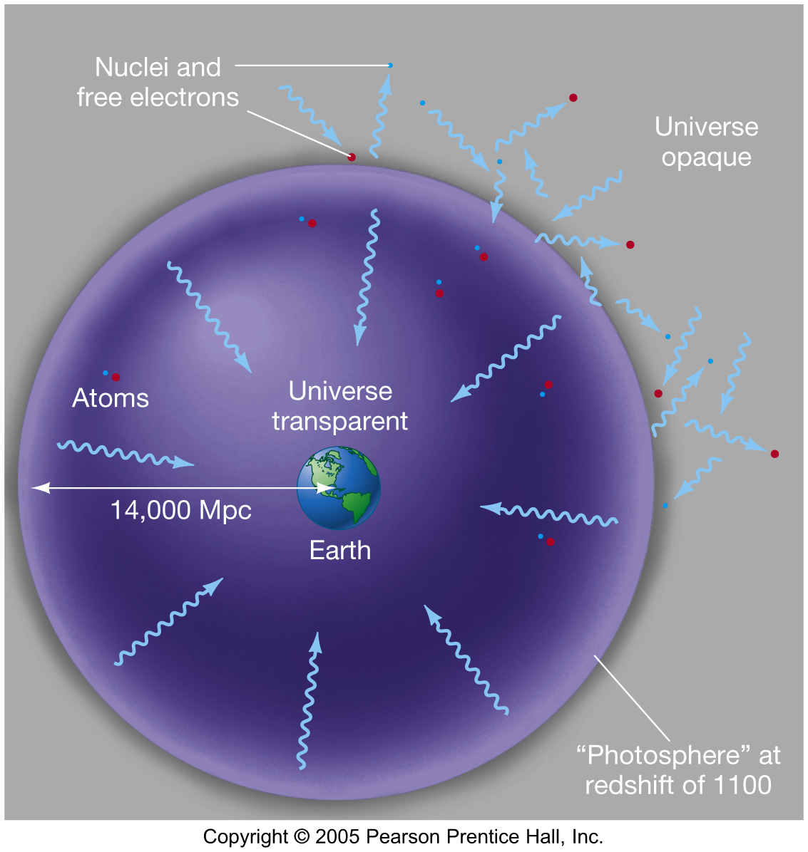

Slide 76
Cosmic Microwave Background (Discovered in 1964)
T=300,000 years
after the Big Bang
Temperature
=3,000ºK
z=1,100
Sun/Earth
Transparent
Today:
3000ºK/1,100
=2.7ºK
Opaque

Slide 77
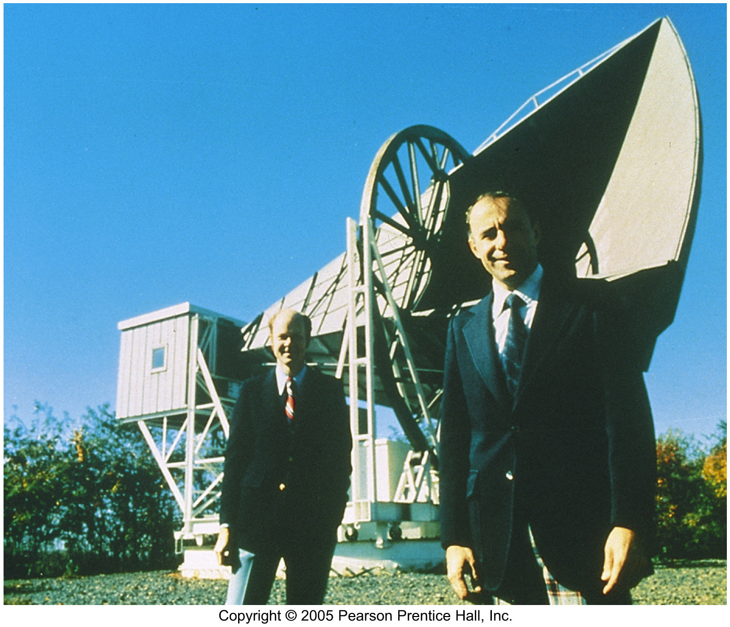
The Cosmic Microwave Background
The cosmic microwave background was discovered fortuitously in 1964, as two researchers tried to get rid of the last bit of “noise” in their radio antenna.
Instead they found that the “noise” came from all directions and at all times, and was always the same. They were detecting photons left over from the Big Bang.

Slide 78
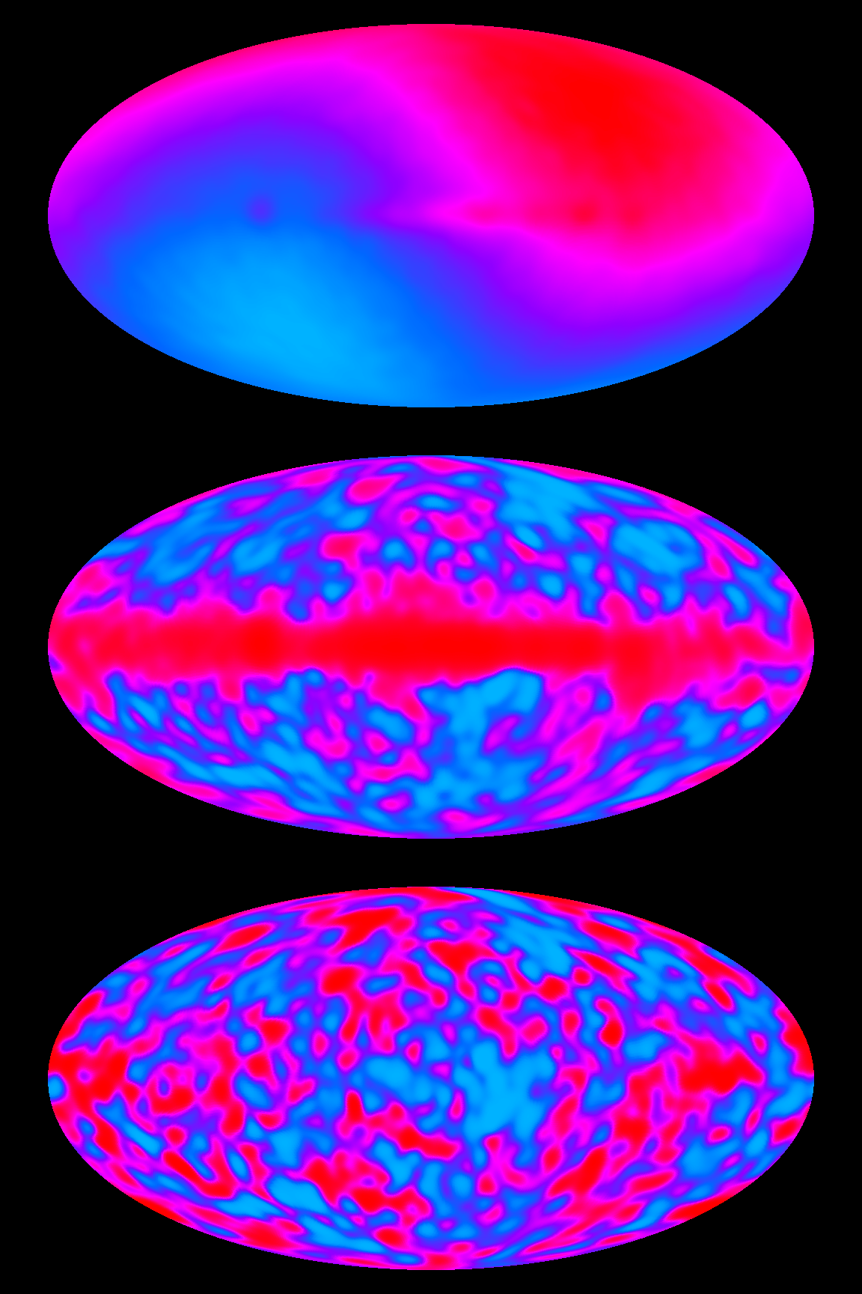
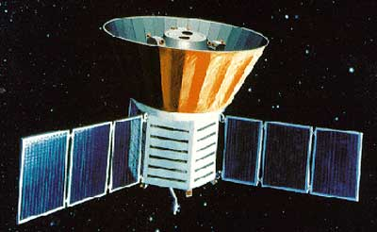
COBE Results
launched November 18, 1989

Slide 79
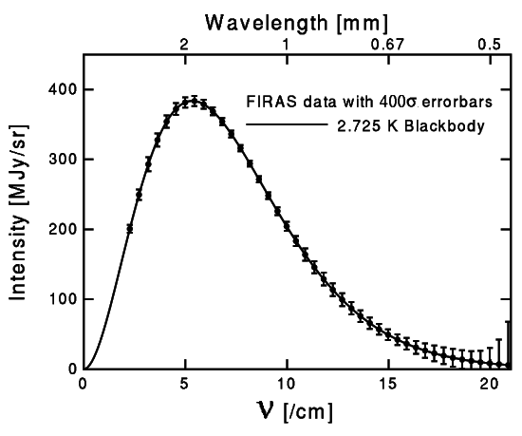
The CMB Spectrum by FIRAS

Slide 80
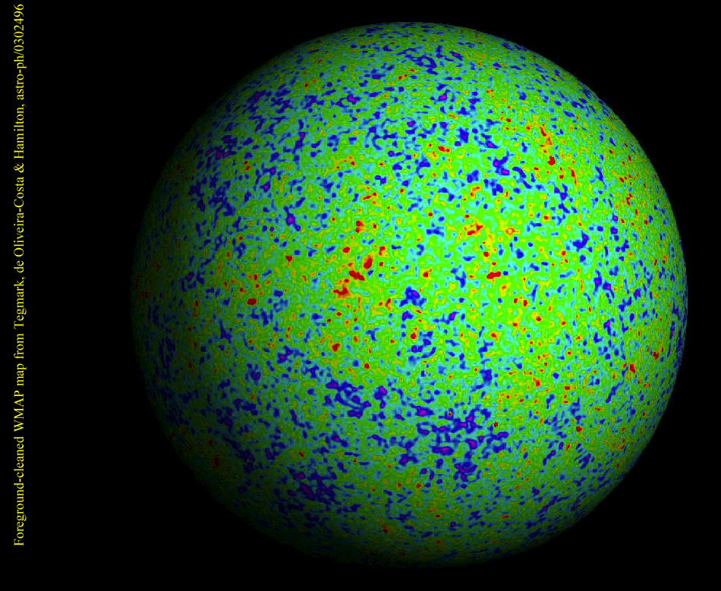
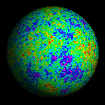
WMAP

Slide 81
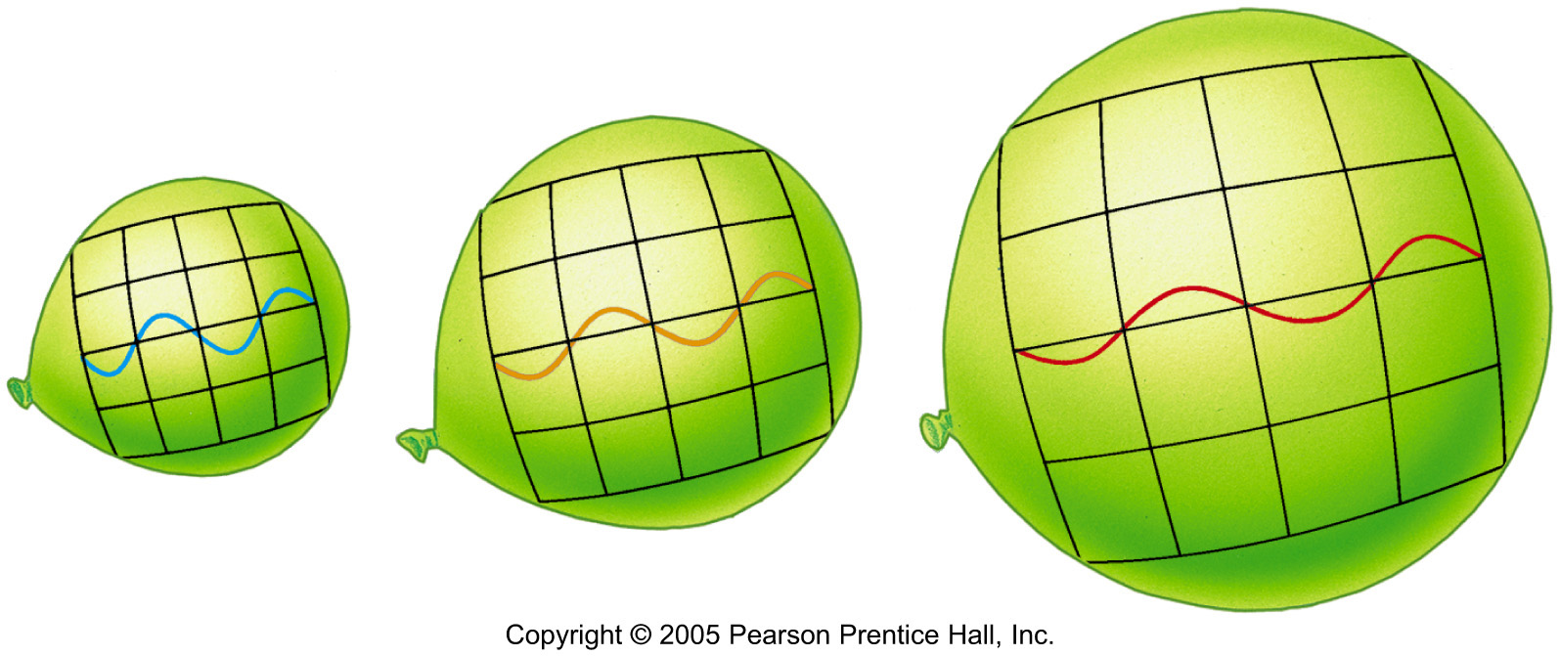
Cosmological Redshift
T = 300,000 years
3000ºK
T = 13.7 B years (Today)
3000ºK/1,100 =2.7ºK
Notes:
As the universe expands, photons of radiation are stretched in wavelength, giving rise to the cosmological redshift. In this case, as the baseline in the diagram stretches, the radiation shifts from the short-wavelength blue region of the spectrum to the longer wavelength red region. (Sec. 3.1)

Slide 83
Structure Formation
of the Universe

Slide 84
Time = 1B yrs, Temp.= 10 ºK
Galaxies formed.
Size ~ 16% of today
The furthest place we can observe by telescopes.
At least Quasers (~ Active Galacic Nuclei) were already formed.

Slide 85
Cosmic Pyramid
Metal
0.01%
Star
0.5%
Baryonic Matter
0.5%
Gas,
Dust
5%
Dark
Matter
25%
Dark Energy
70%

Slide 86
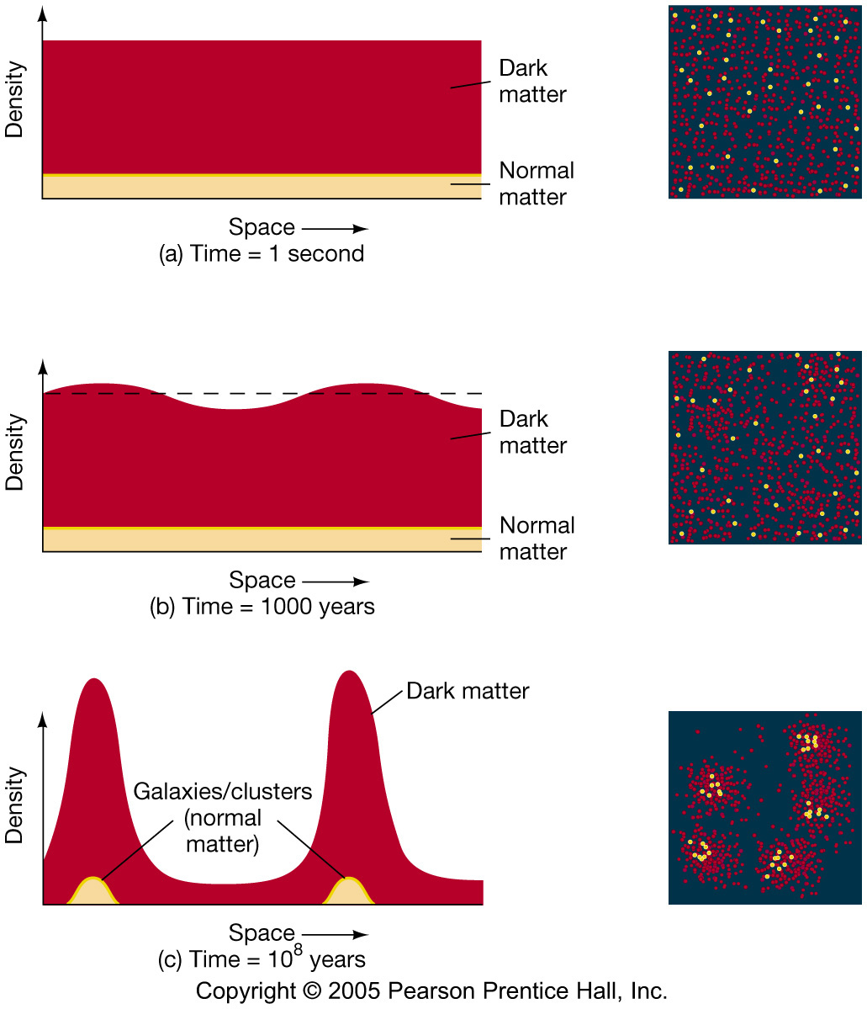
Formation of Structure by Dark Matter

Slide 87
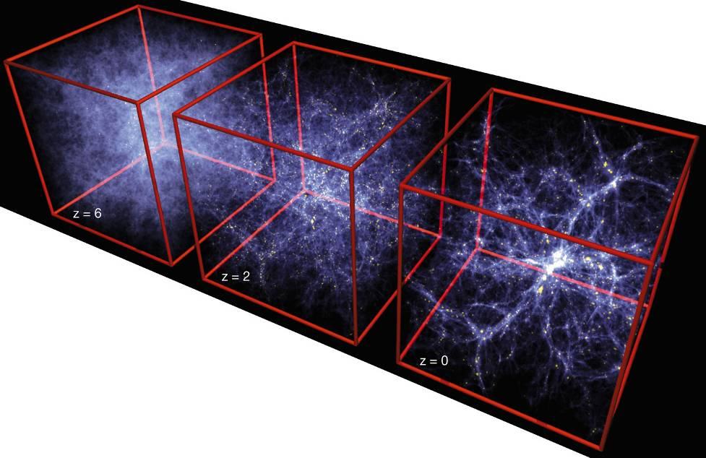
Formation of Structure in the Universe
Dark Matter is required!

Slide 88
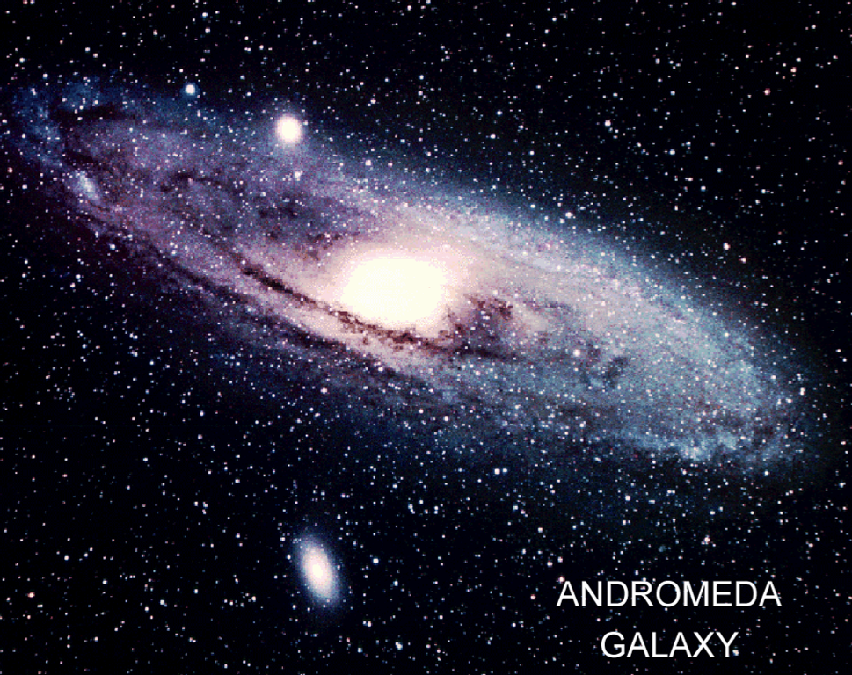
Dark Matter is required!

Slide 90
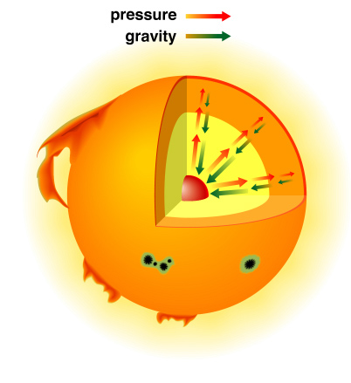
The Solar Interior
Hydrogen Gas

Slide 91
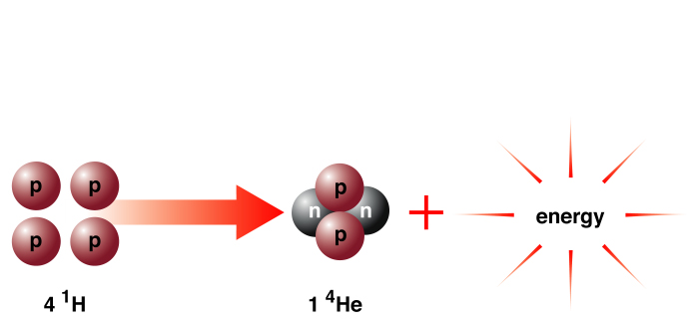
Solar Energy
E = mC²
m_{4p} > m_{He}
ε = = 0.007

Slide 92
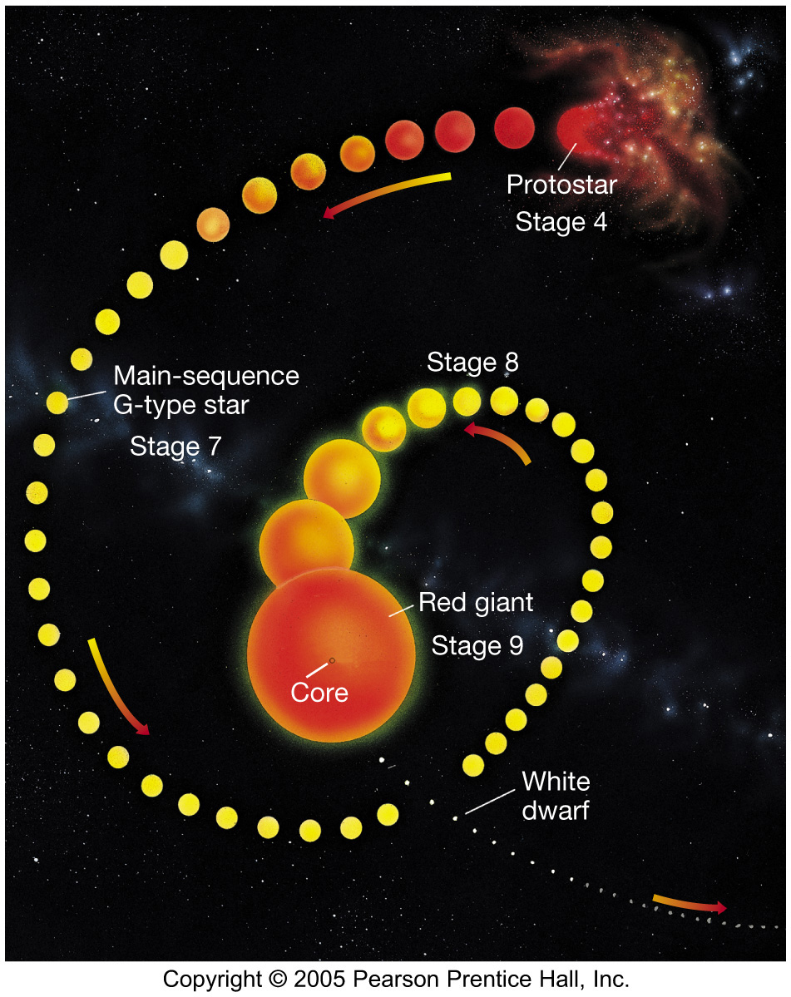

Slide 93
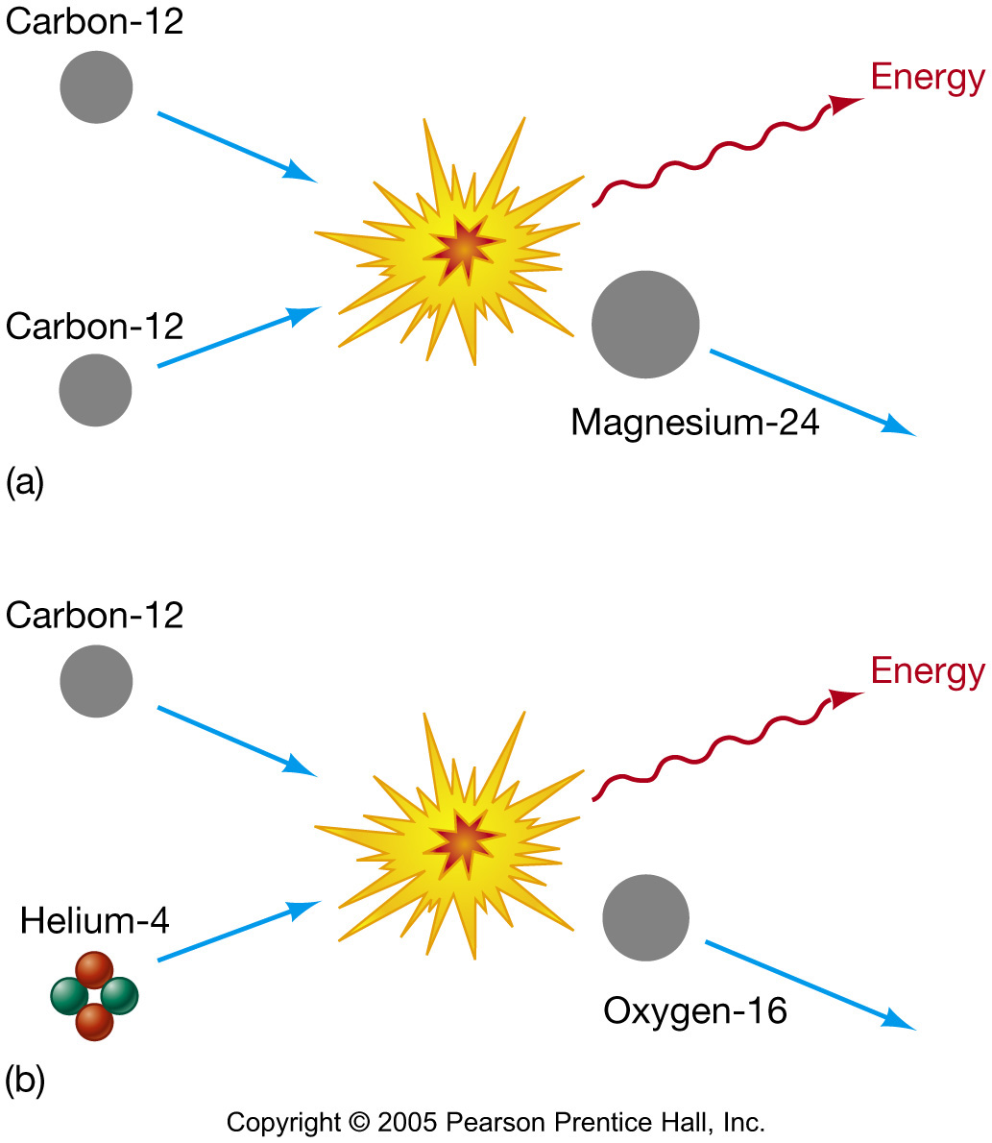
The Formation of the Elements

Slide 94
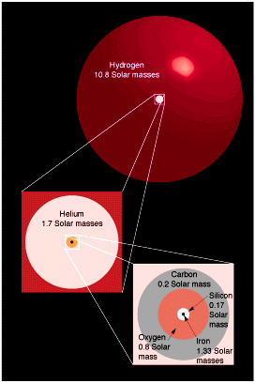
Nuclear Burning in High Mass Stars (times for a 20 M_{o} star)
Hydrogen 10⁷ yr
Helium 10⁶ yr
Carbon 10³ yr
Oxygen 1 yr
Neon
Magnesium
Silicon 1 week
Iron < 1 day

Slide 95
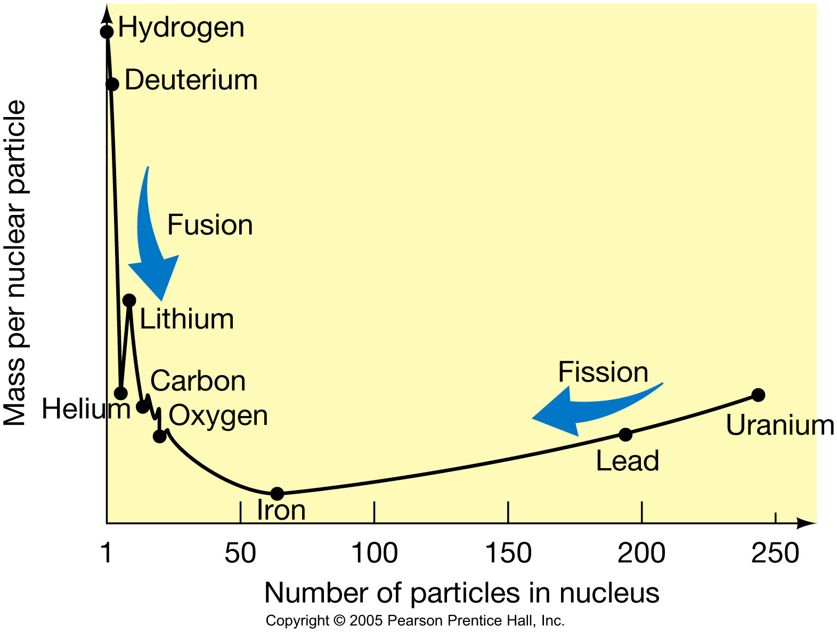
The End of a High-Mass Star
This graph shows the relative stability of nuclei. On the left, nuclei gain energy through fusion; on the right they gain it through fission.
Iron is the crossing point; when the core has fused to iron, no more fusion can take place.

Slide 96
Power of Super Novae
Within a few hours
one billion times solar luminosity
Within a few months
~ same as the Sun’s total energy during 10 billion years of life
Not only that, > 99.99 % of energy is released by neutrino within ~ 10 seconds.
First observed in 1987 by Kamiokande experiment in Japan.

Slide 97
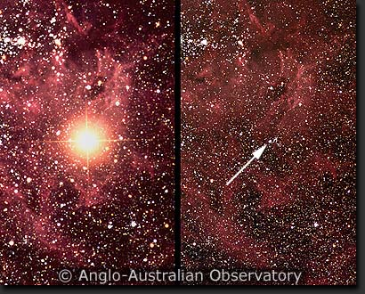
Supernova 1987A
After
Before

Slide 98
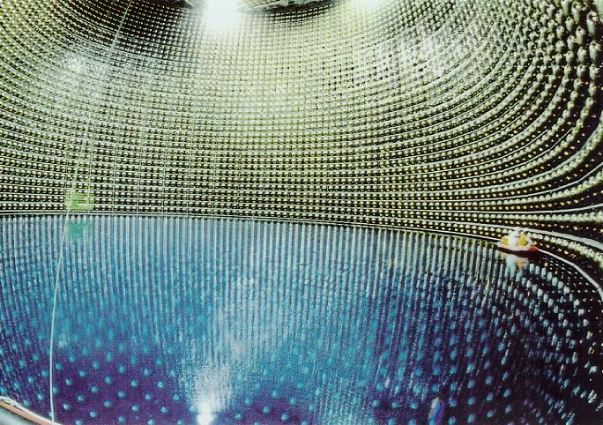
Super-Kamiokande
11,200 of 20” PMTs

Slide 99
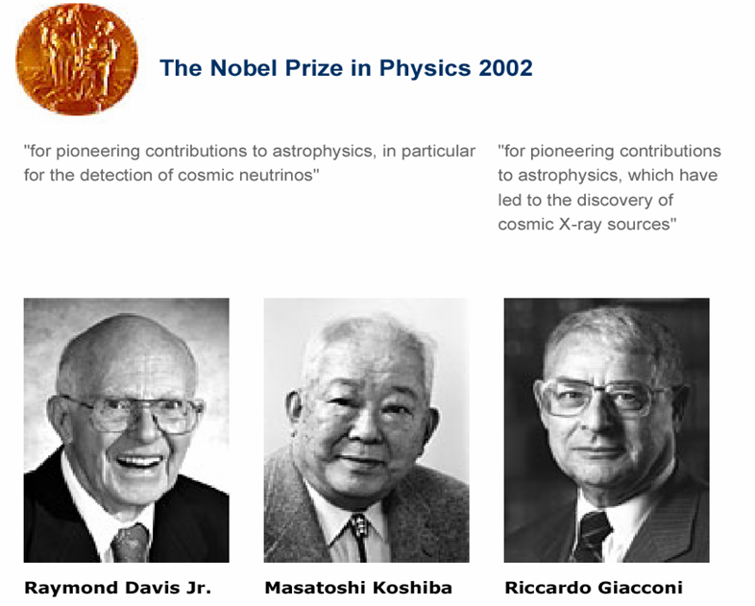
Nobel Prize in 2002

Slide 100
End Results of Stars
Initial Mass | End Results
< 8 M☺ | White Dwarf |  | < 1.4 M☺
8 – 20 M☺ | Type II Supernova | Neutron Star | 1.4 – 3 M☺
> 20 M☺ |  | Black Hole | > 3 M☺

Slide 101
Pauli’s Exclusion Principle
Fermi Statistics:
According to quantum mechanics, each state is occupied by one particle (Fermion). Another particle can not stay in the same state.
Degenerate matter:
All possible states are occupied.

Slide 102
Degenerate Matter
White Dwarf ( < 1.4 M☺)
Carbon Core
Electrons are tightly packed
Neutron Star (1.4 M☺– 3 M☺)
Neutrons are tightly packed
Black Hole ( > 3 M☺)
Gravity wins
e⁻
e⁻
e⁻
e⁻
e⁻
e⁻
e⁻
n
n
n
n
n
n
n

Slide 103
Origin of Elements
Hydrogen, Helium
From “Big Bang”
Carbon – Oxygen – Iron
From “Nuclear fusion” at massive stars (> 8 M_{sun} )
Heavier than Iron (Cu, Au, Pt, Pb…)
From “Supernovae”

Slide 104
Origin of Life
We are made from “stardust”

Slide 105
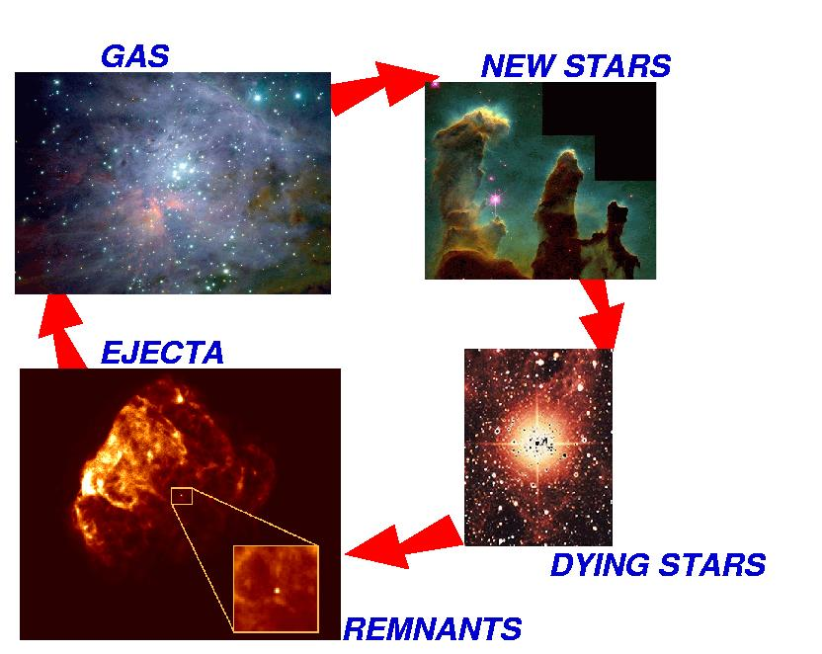
Star’s Life Cycle
Big Bang! (14 B years ago)
Sun (4.6 B years ago)

Slide 106
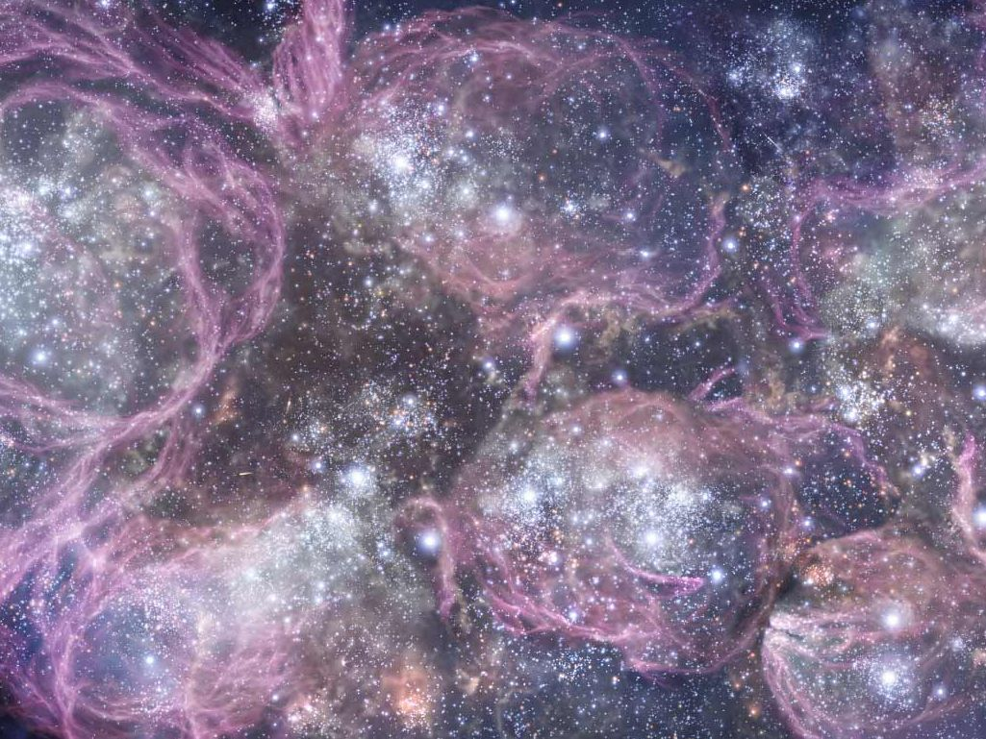

Slide 107
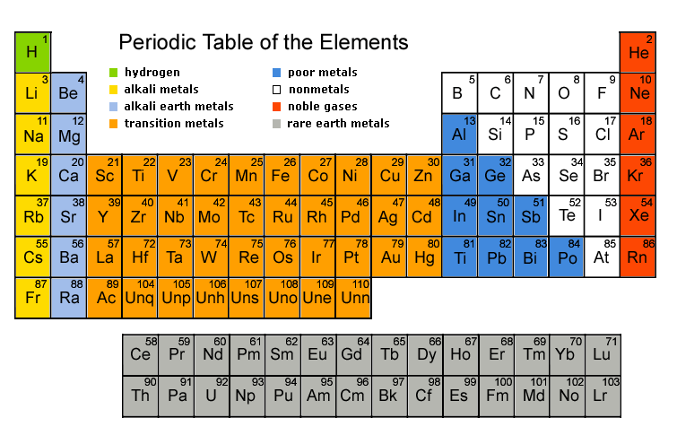
Periodic Table of Elements

Slide 108
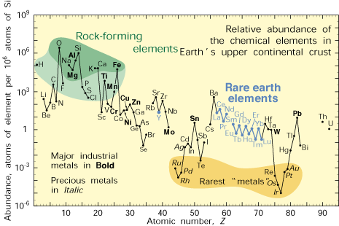
Abundance of Elements

Slide 109
Now Time = 14B yrs, Temp.= 2.7 ºK (3×10⁻⁴ eV)
Fermions: Ratio (in numbers)
Lepton: ν_{e} ~1
e⁻ ~4×10⁻¹⁰
Baryon: p ~4×10⁻¹⁰
n ~0.5×10⁻¹⁰
Bosons:
Photon: γ 1
No anti-particles
# Photon : # Baryon = 1 : ~4×10⁻¹⁰
# p = # e⁻

Slide 111
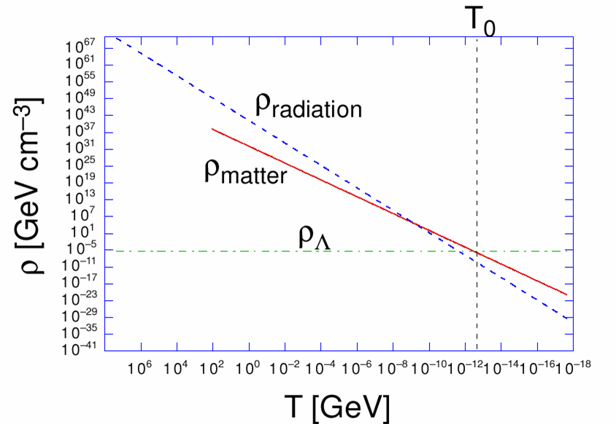
Cosmic Triple Coincidence
Why Now?
astro-ph/000511

Slide 112
Cosmic Coincidence
Time
(sec)
Temp.
(ºK)
Energy (GeV)
10⁻⁴⁵sec
α_{Gravity} ≈ α_{Strong} ≈ α_{EM} ≈ α _{Weak}
Planck
10⁻⁴⁰
10³⁰
10¹⁸
GUT
10⁻³⁵
10¹⁵
10⁻³⁰
10²⁵
10¹²
10⁻²⁵
10⁹
10⁻²⁰
10²⁰
1PeV
10⁻¹⁵
10¹⁵
1TeV
EW
10⁻¹⁰
10⁻⁵
1GeV
1
10¹⁰
1MeV
10⁵ sec
1KeV
1 year
10⁵
10³
1eV
10⁶
Ω_{Rad} ≈ Ω_{ν} ≈ Ω_{CDM} ≈ Ω_{B} ≈ Ω_{Λ}
10⁹ year
10⁻³eV
Now
1

Slide 113
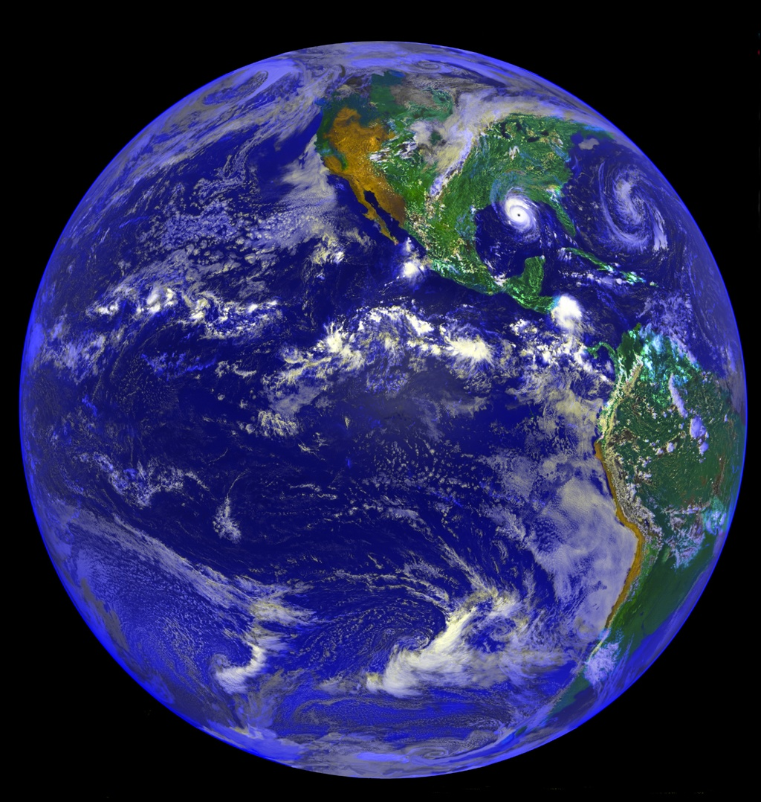
Why are we here?

Slide 114
Anthropic Principle
Observations of the physical universe must be compatible with the conscious life that observes it.
It explains why the universe has the age and the fundamental physical constants necessary to accommodate conscious life.

Slide 115
Are there more than
one Universe?

Slide 116
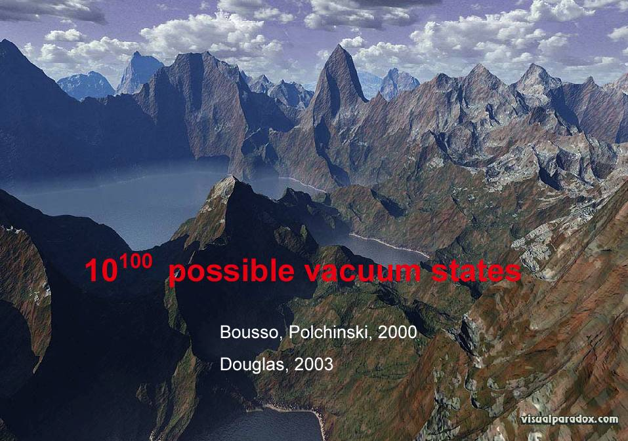
Prediction by String Theory

Slide 117
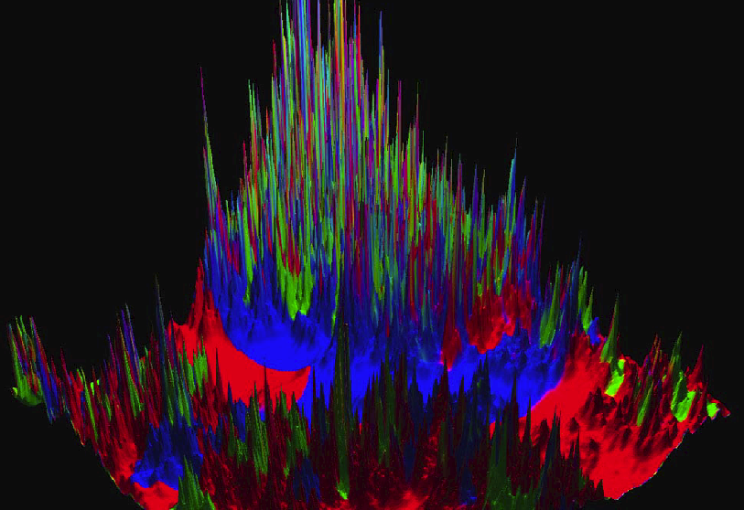
Linde’s Multiverse by Chaotic Inflation

Slide 118
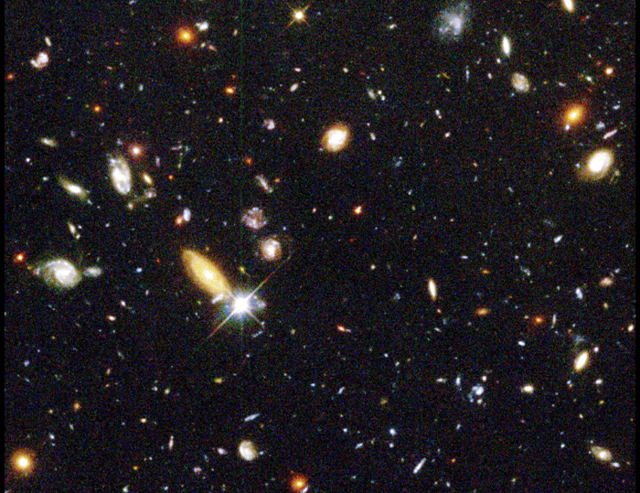
There may be ~100 Billion Universes.

