Slide 1
The Origin of Consciousness
Katsushi Arisaka
University of California, Los Angeles
Department of Physics and Astronomy

Slide 2
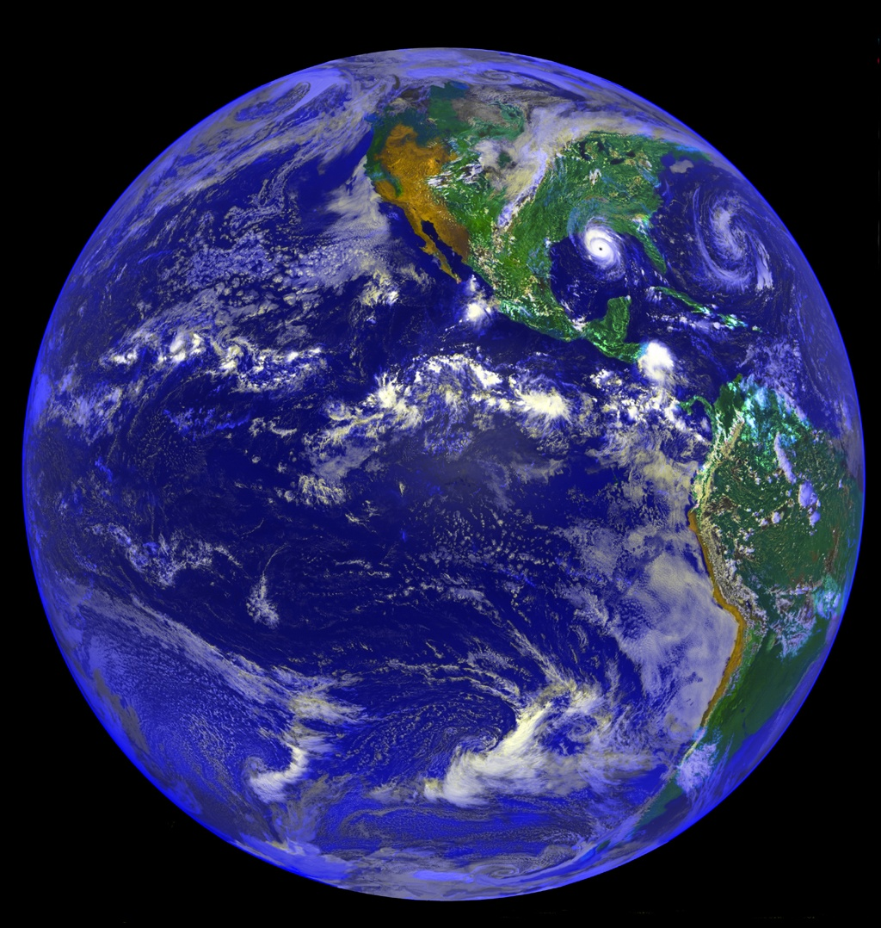
Why are we here?

Slide 3
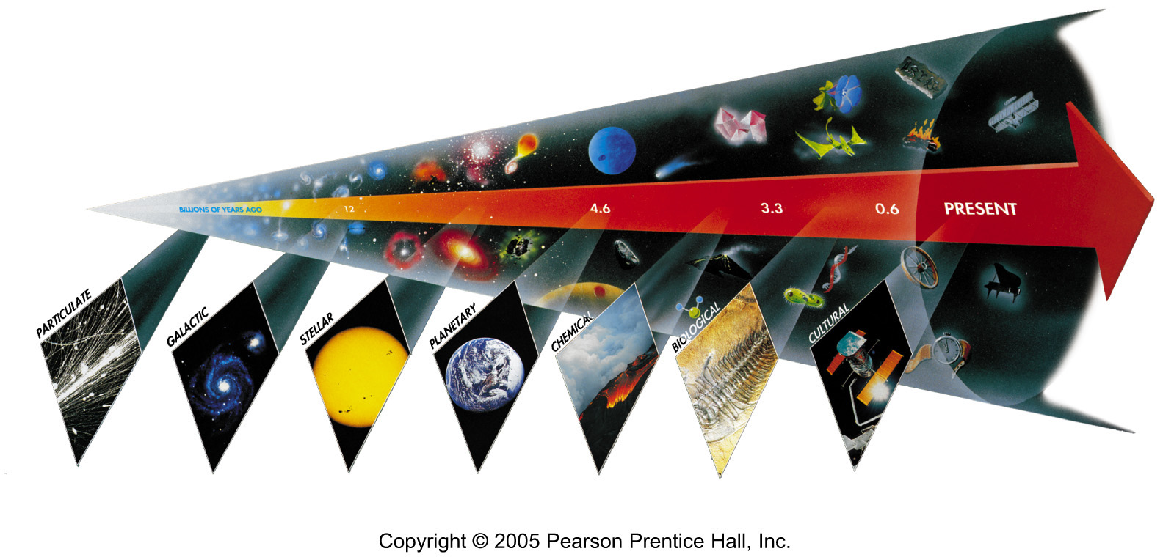
Seven Phases of Cosmic Evolution
14 billion years ago
Origin of
Particles
Origin of
Structure
Origin of
Life
Origin of
Consciousness

Slide 4
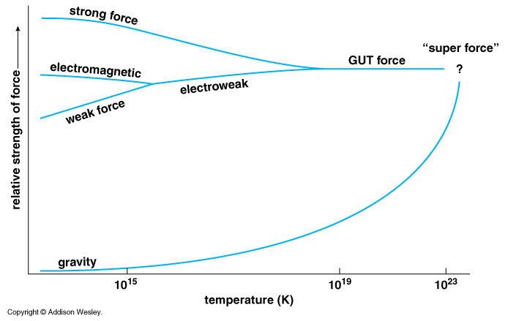
Unification of Forces
Planck Epoch
100 GeV
10¹⁶ GeV
10¹⁹ GeV
10²⁹
10³²

Slide 5
Hubble Deep Field
Physicists’ View of Early Universe
Fiat lux
Let there be light

Slide 6
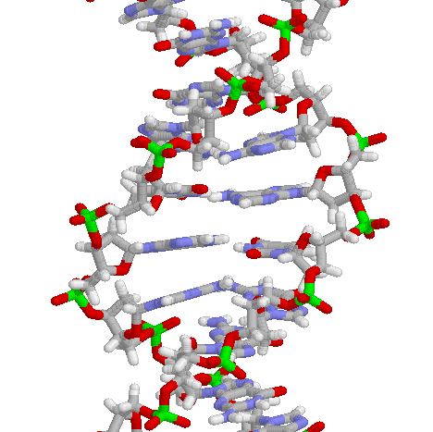
Symmetry Breaking
Time
0
Simple
1B years
2
3
4
b
s
µ⁻
W⁺
γ
5
ν_{e}
c
Symmetry
Break Down
τ⁺
d
τ⁻
ν_{e}
6
d
e⁺
Zº
u
ν_{µ}
e⁻
7
u
s
8
b
ν_{µ}
µ⁺
W⁺
c
9
10
11
12
13
Complex
14

Slide 7
Seven steps of cosmic evolution
Spontaneous Symmetry Breaking
14B years ago
Accelerator
Telescope
Microscope

Slide 8
Origin of Consciousness

Slide 9
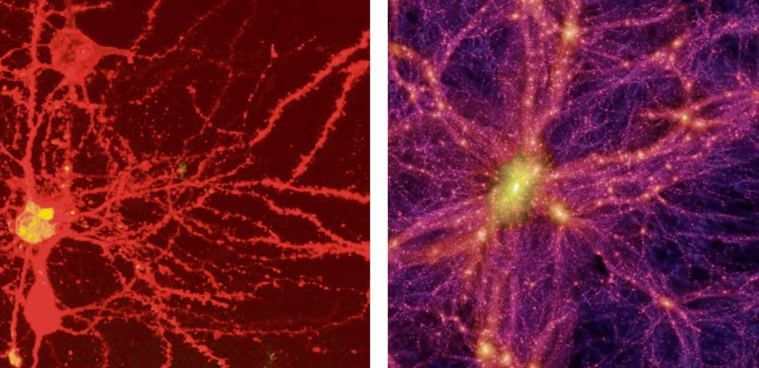
Brain Universe
100 Billions Neurons
100 Billions Galaxies
New York Times 8/21/2006

Slide 10
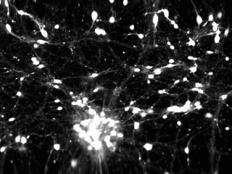
Ca²⁺ Signal in cultivated Rat’s Brain by Confocal Microscope
Andrew Charles (Neurobiology)
15 frame/sec

Slide 11
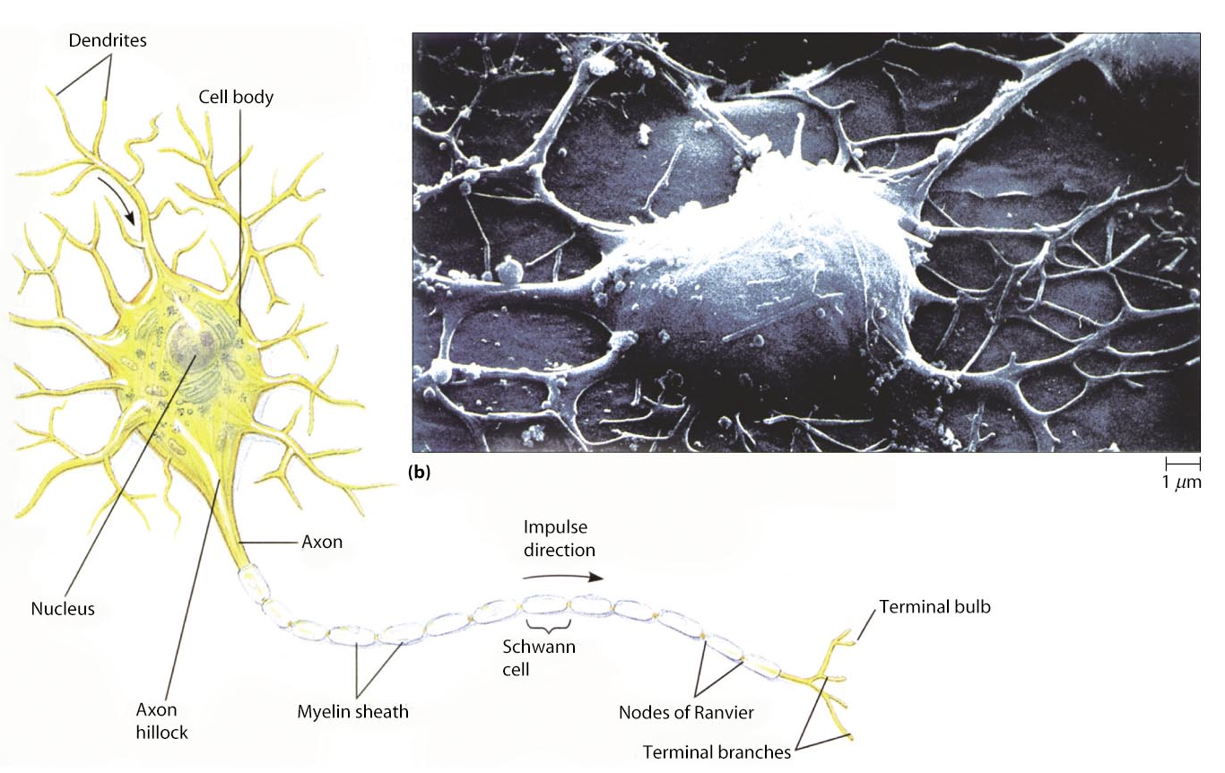
Neurons
Each Neuron has ~1,000 connections (10¹¹ x 1000 = 10¹⁴）
~micrometer scale

Slide 13
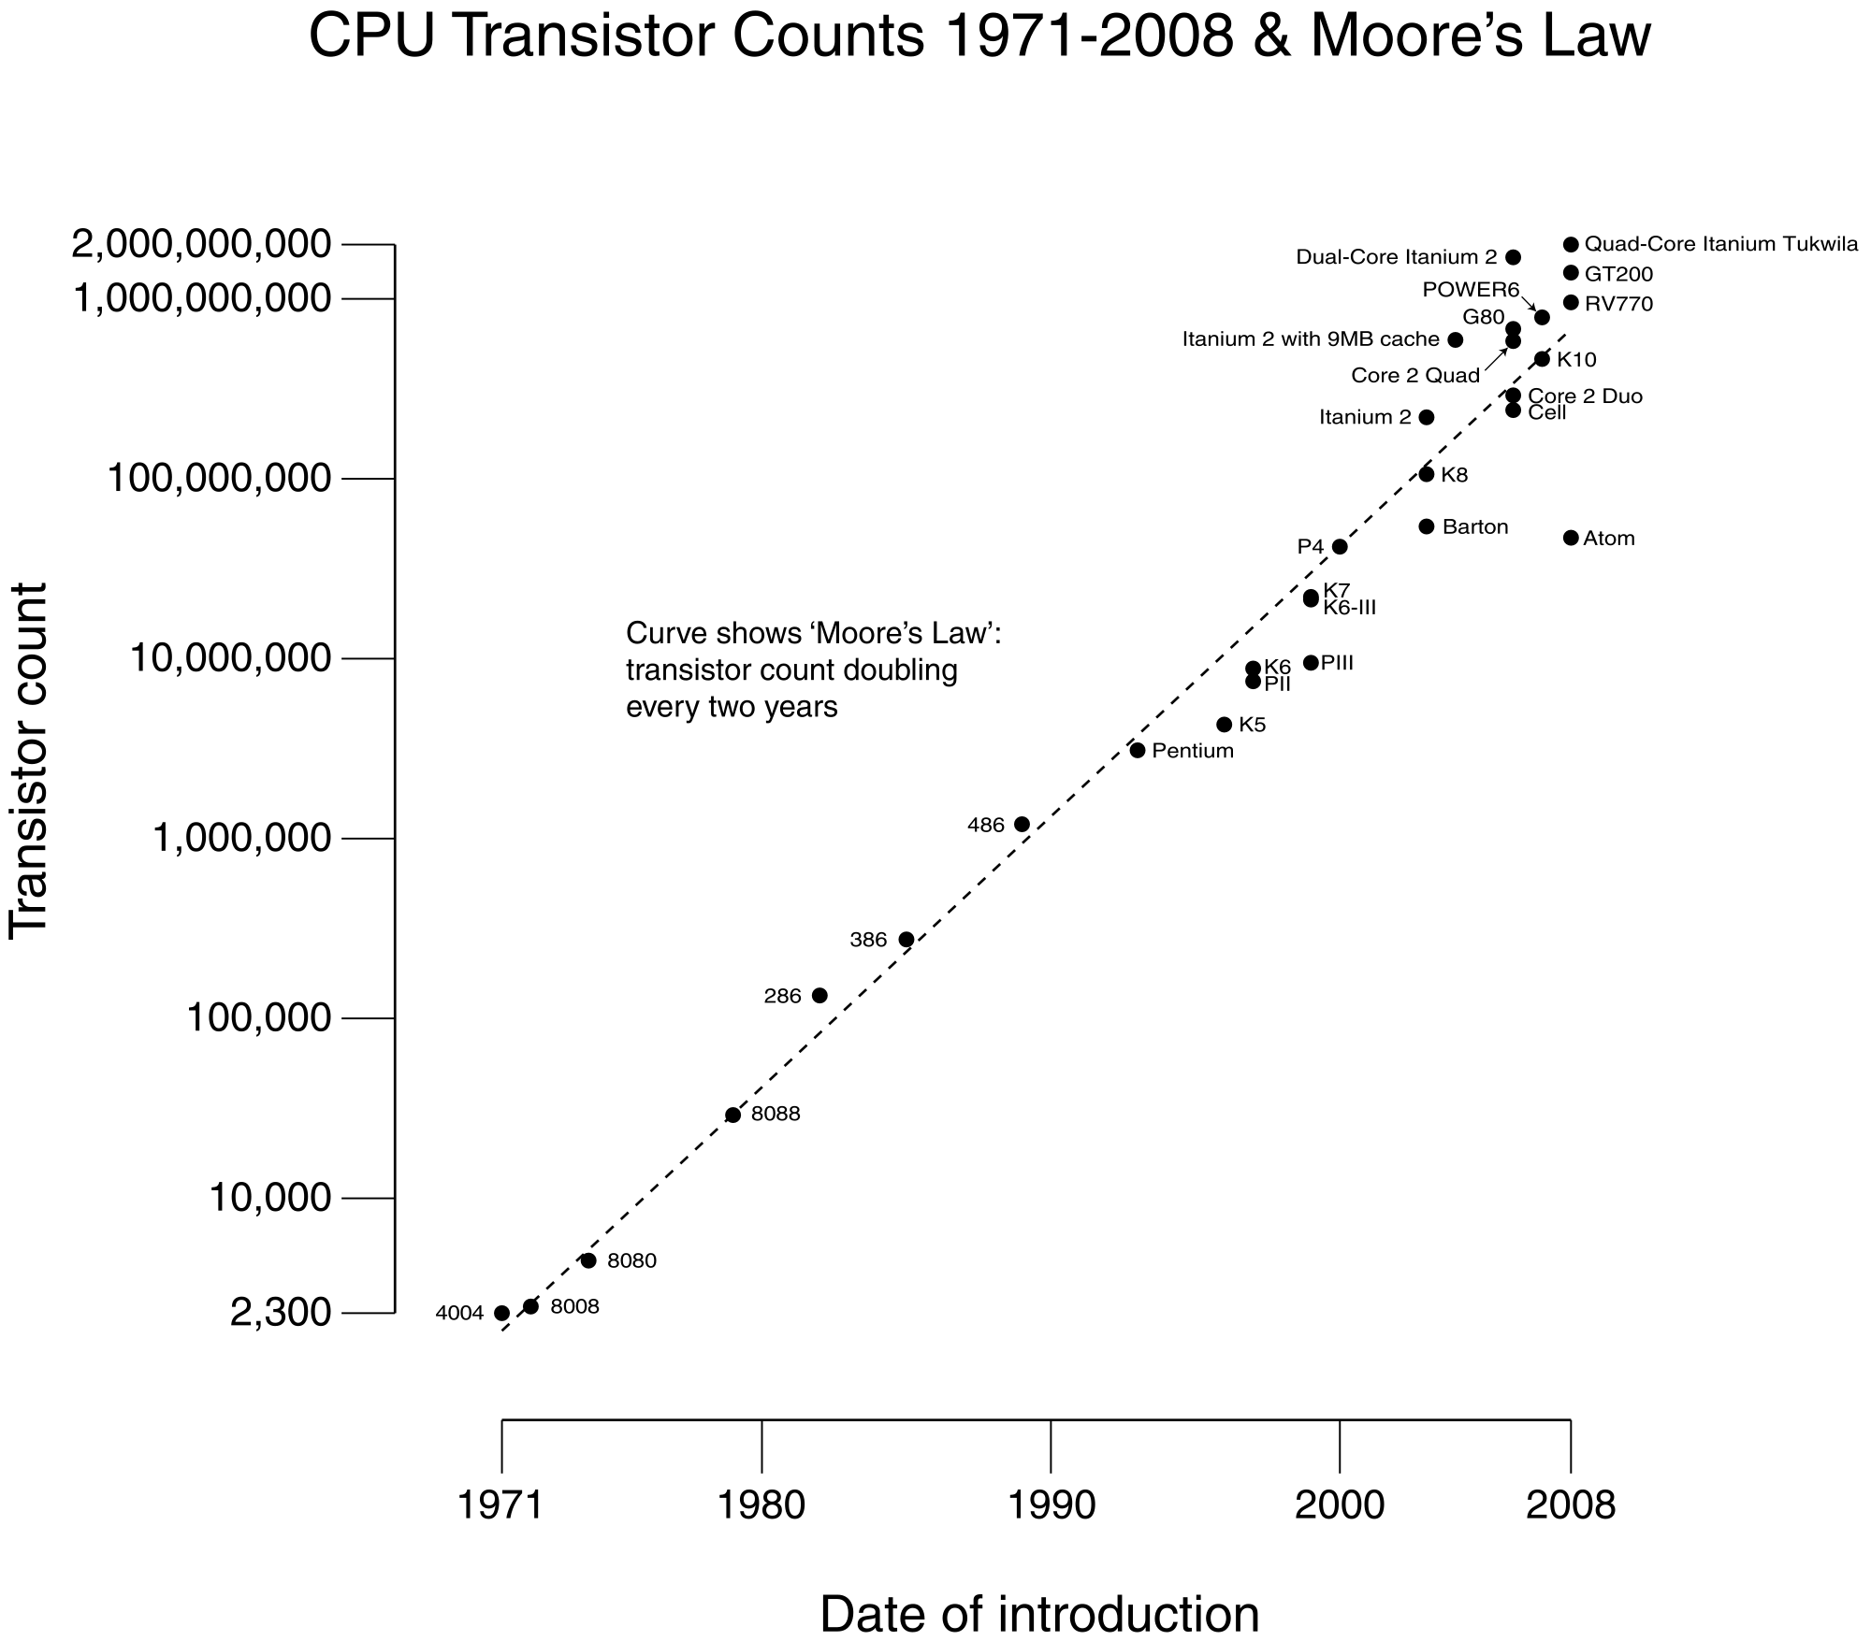
“Moore’s Law” Transistors in Computer
Watson
Watson
#CPUs : 2880 CPU
(~ 10¹² Transistors)
Speed : 3.5 GHz
RAM : 16 TByte

Slide 14
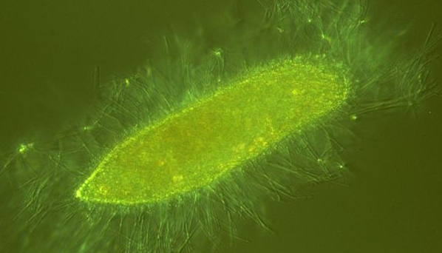
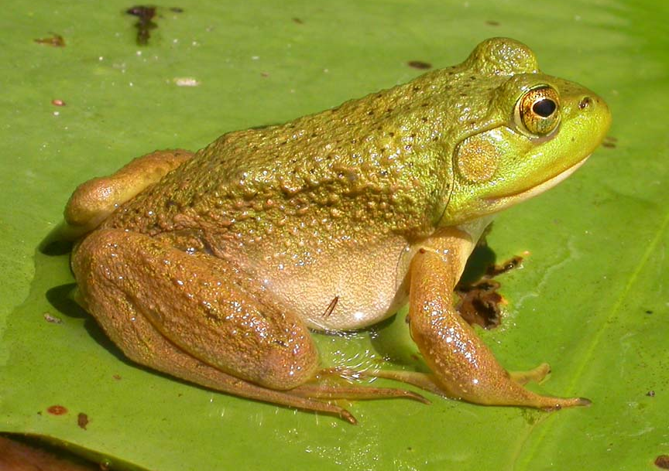
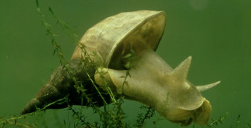
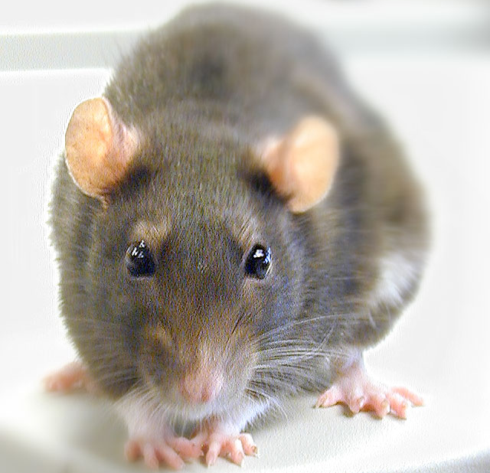
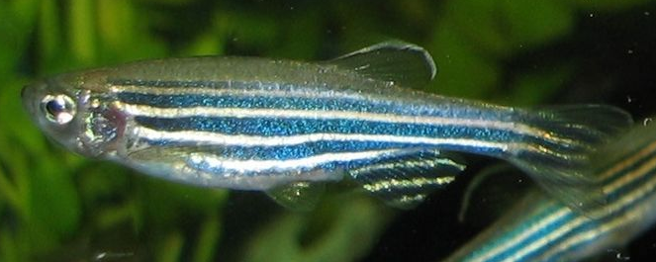
From No Brain to Big Brain
Paramecium (Single Cell)
Bullfrog (~10⁷ neurons)
Lymnaea (~1,000 neurons)
Zebrafish (~10,000 neurons)
Rat (~10⁸ neurons)

Slide 15
Neurons in Brain
Human
Rat
Flog
Human
~ 10¹¹ neurons
~ 10¹⁴ connections
Speed : 1 kHz
Fish

Slide 16
Computer vs. Brain
 | Computer (Watson) | Human Brain
Key Unit | Transistor | Neuron
No. of units | ~ 10⁹ (~10¹²) | ~ 10¹¹
Connection | Copper Wire | Axon + Dendrite
No. of Connections | ~ 10¹⁰ (~10¹³) | ~ 10¹⁴
Signal Carrier | Electrons | Ions (Na+, Ca+, K+)
Clock Speed | ~ 1 GHz | ~ 1 kHz
Method | Sequential | Parallel Processing

Slide 17
Neural Networks for Breathing
~300 neurons in rat’s brain (pre-Botzinger Cells) responsible for breathing
Nature by Naohiro Koshiya (1999)
Jack Feldman (Neurobiology)

Slide 18
How to speed up microscopes
All the existing microscopes are limited by the narrow bandwidth of readout.
  Just one channel of FADC (Flash Analog to Digital Converter) running at 10 – 50 MHz
  So-called Video Rate (30 frame/sec)
The first step is to adopt multiple channels of FADC for massive parallel processing.
  Like high energy experiments (such as LHC)
  In addition, we need Single Photon Sensitivity with high Quantum Efficiency.

Slide 19
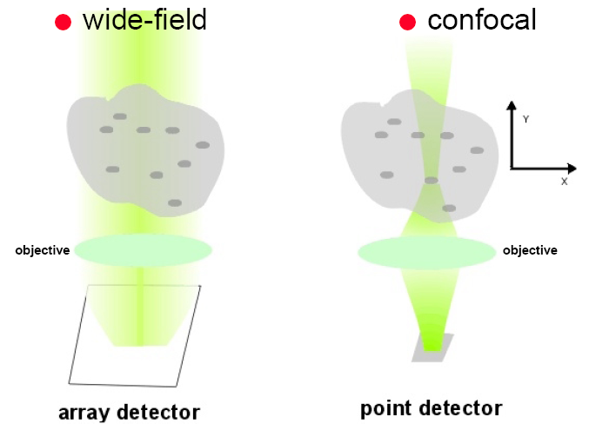
Principle of High-speed Bio Imaging
Wide Field
Confocal
Sample
Sample
Pinhole
CCD + FADC (10 – 50 MHz)
PMT + FADC (10 – 50 MHz)
CMOS [ FADC (50 MHz) * 100 ]
[ HAPD + FADC (1 GHz) ] * 64

Slide 20
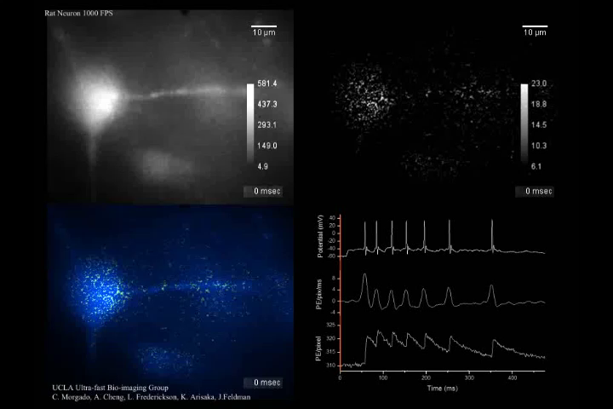
High-speed Ca²⁺ Imaging of pre-Botzinger Cells of Rats
Prof. Jack Feldman (Neurobiology)
(1, 000 frame/sec)

Slide 21
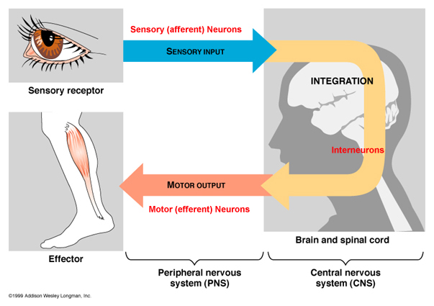
Sensory Input and Decision Making in Brain

Slide 22
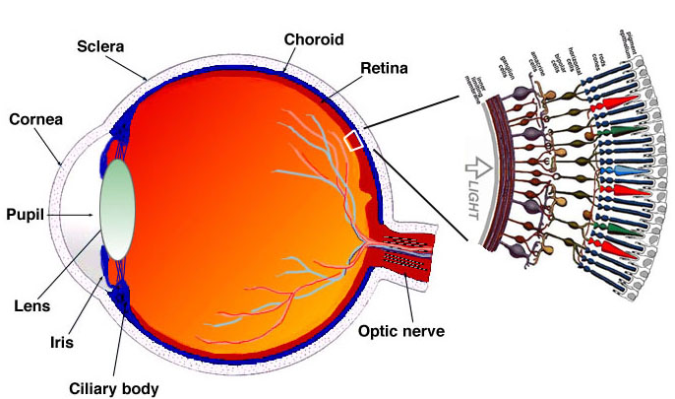
Human Eyes
~100M photo receptors
540M years ago（Cambria explosion）

Slide 23
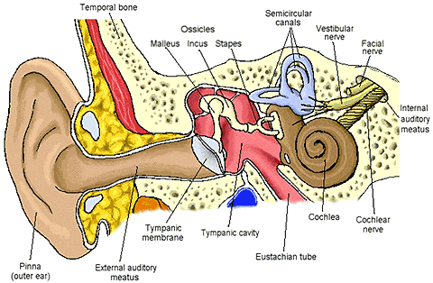
Human Ears
~10,000 Hair Cells
~50M years ago

Slide 24
Anatomy of Inner Ear
Dolores Bozovic (Physics)
Human auditory system
Cross-section of the cochlear
Hair bundle
Molecular mechano-transduction machinery
Meredith LeMasurier and Peter G. Gillespie, Neuron, Vol. 48,2005

Slide 25
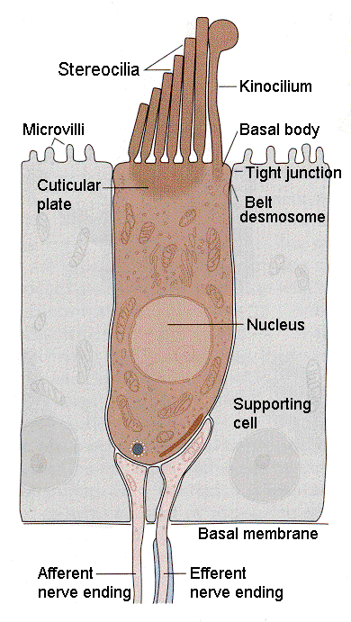
Simultaneous observation of entire process
Mechanical Motion
Ca²⁺ Intake
Action Potential Propagation
in Hair Cell
Receptor in Synapse
Action Potential Propagation
Into Dendrite

Slide 26
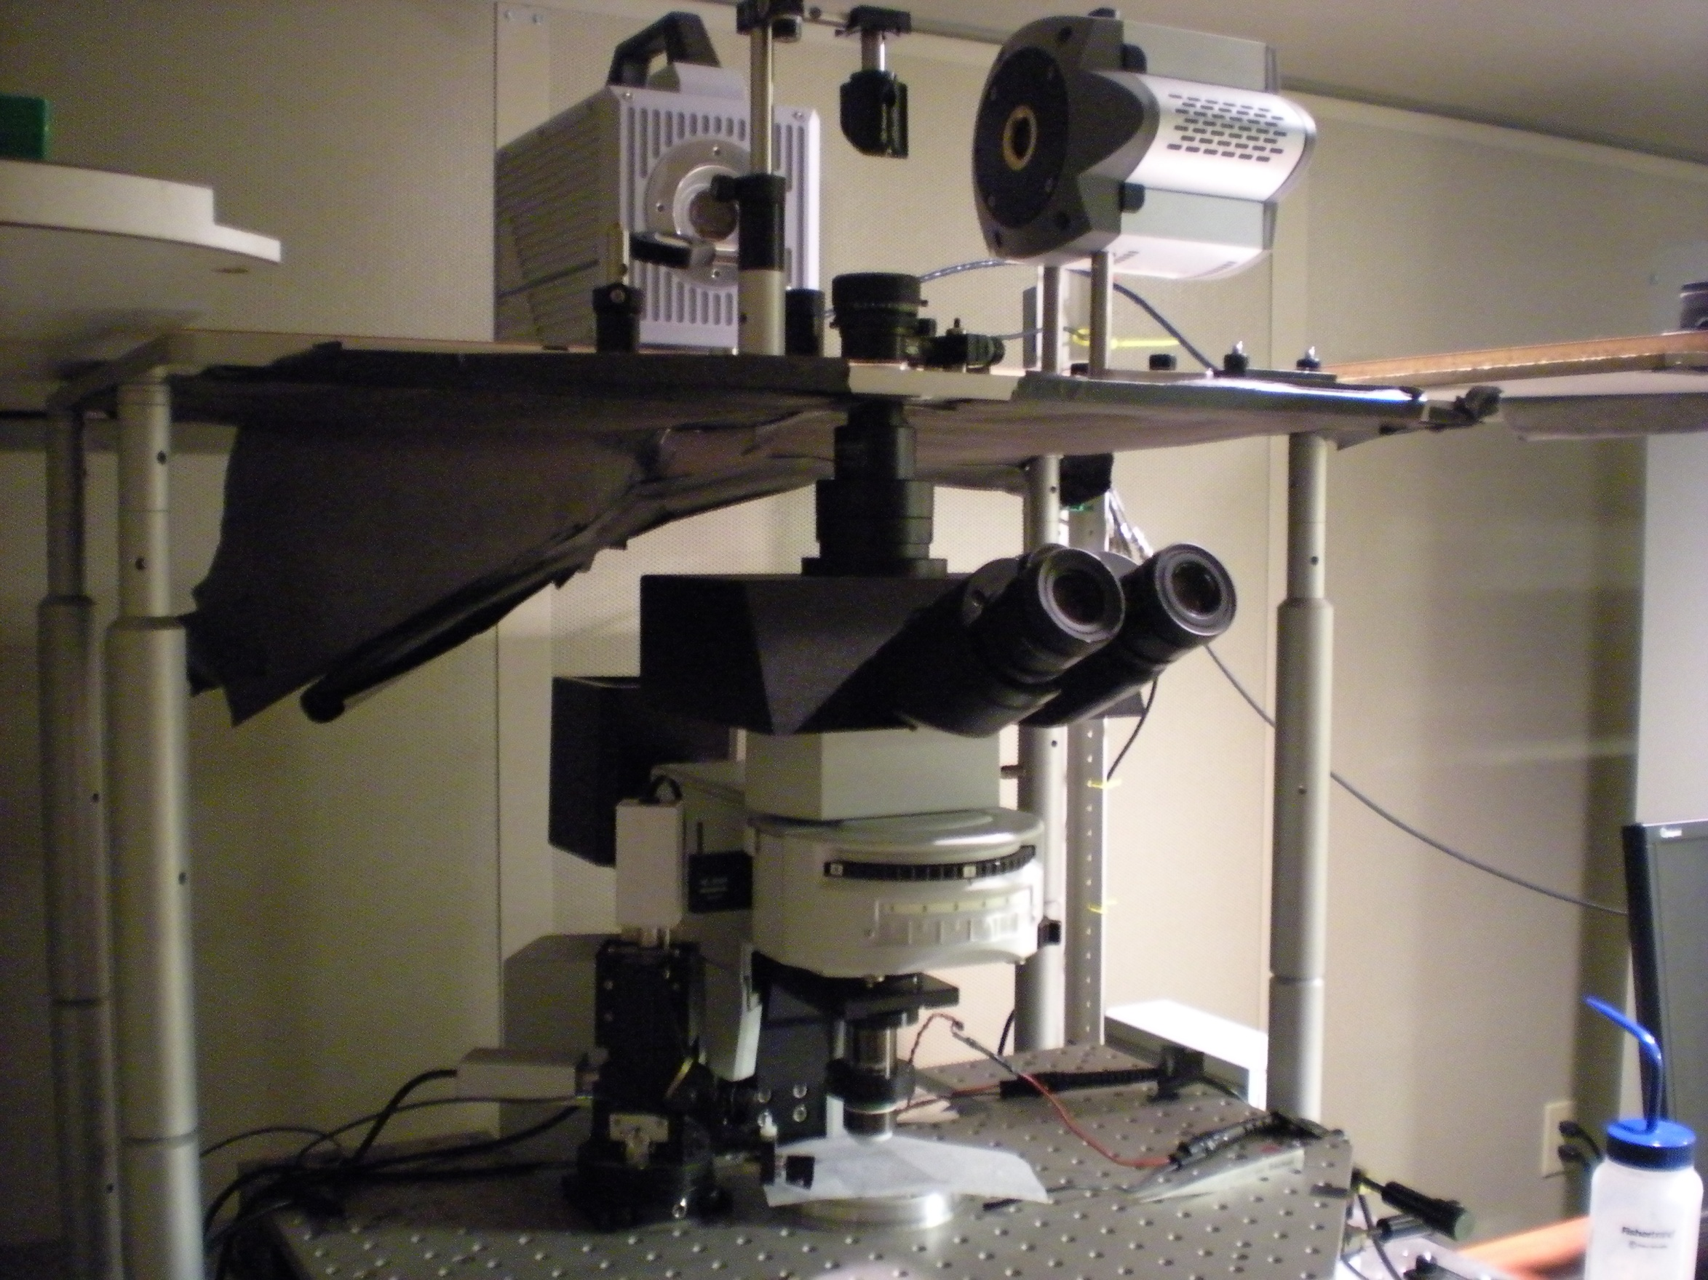
CMOS Camera
(Photron SA-1)
EMCCD Camera
(Andor iXon 897)
Microscopes
Objective
Dolores Bozovic’s Lab (Physics)

Slide 27
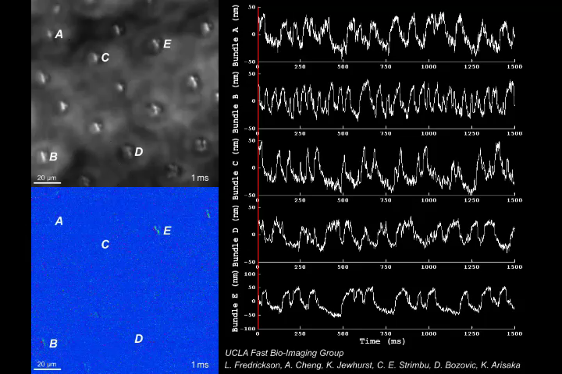
Mechanical Motion of Hair Cells in Inner Ear
Prof. Dolores Bozovic (Physics)
(1, 000 frame/sec)

Slide 28
Mystery of Hearing
Extremely wide dynamic range in amplitude.
  10⁶ compressed to 100
  Smallest amplitude is 0.3 nm
Extremely wide frequency range.
  20 Hz – 20 kHz
    Dynamic range of 1000
    Corresponding to 10⁶ in k
  Selectivity of 0.2%
    up to 5 kHz
  How can the brain handle up to 20 kHz?
    miss match to the speed of action potential of 1 kHz

Slide 29
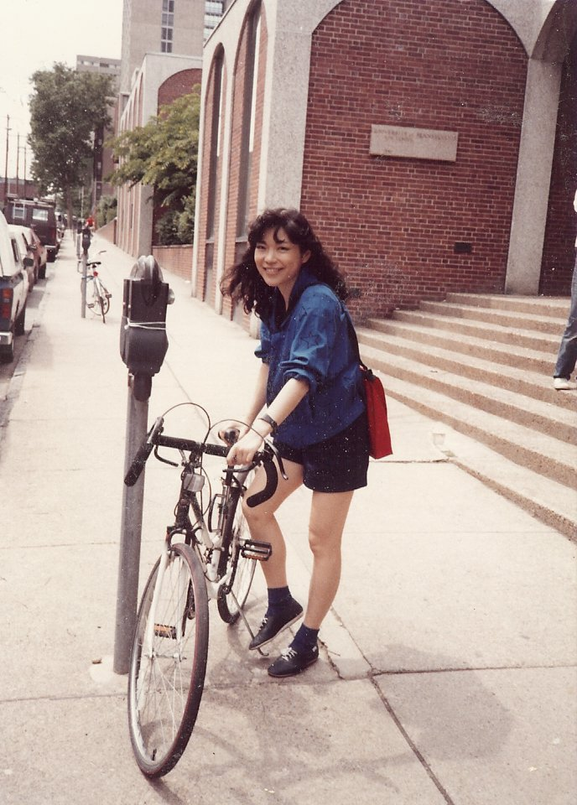
How can I recognize a woman so far away?
Genetically encoded?
Learning and memory?

Slide 30
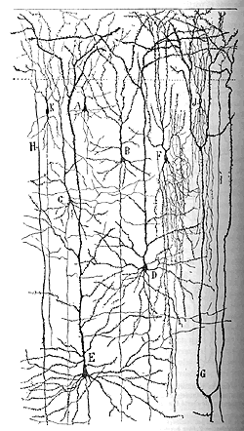
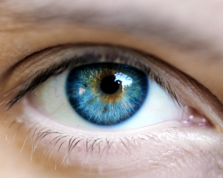
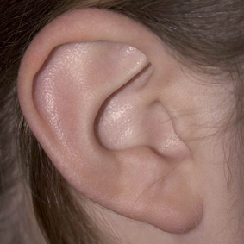
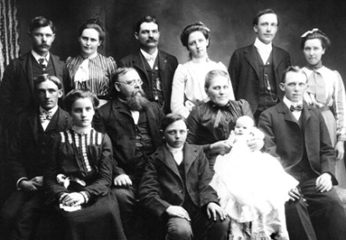

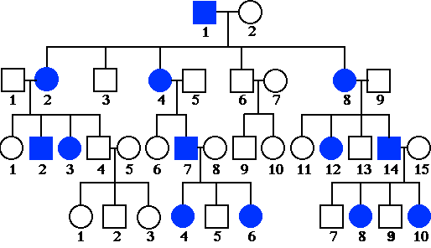
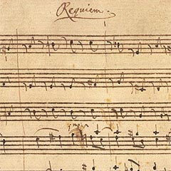

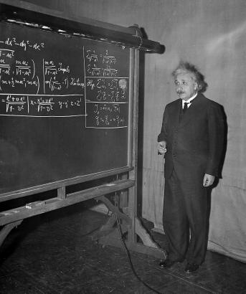
Nature vs. Nurture
Nature
Nurture

Slide 31
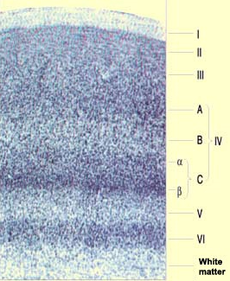
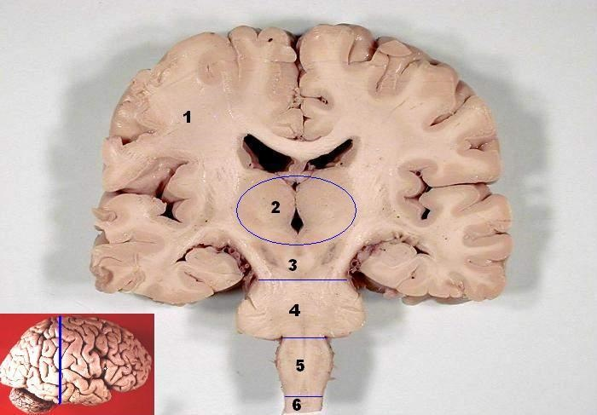
The Cerebral Cortex
Conscious
7
2/3
4
5
Unconscious
6
Thalamus
Subcortical areas

Slide 32
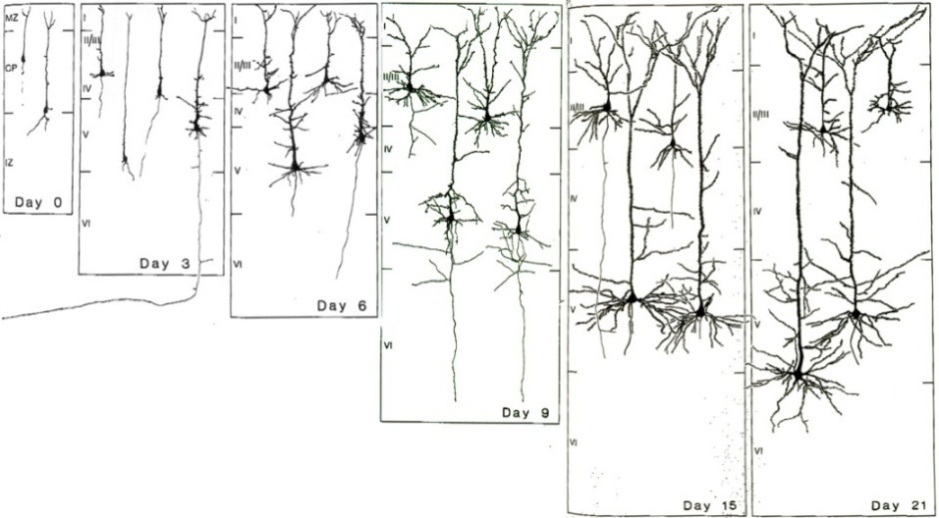
Assembly of rat’s cortical circuits during development
How/when do neurons establish networks? → Symmetry Breaking
Carlos Portera-Cailliau (Neurology)
Miller, 1981

Slide 33
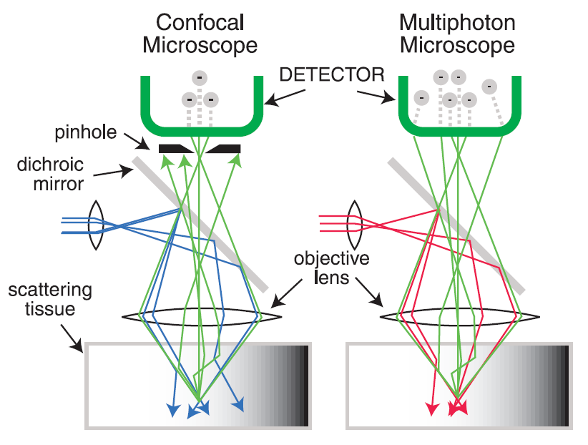
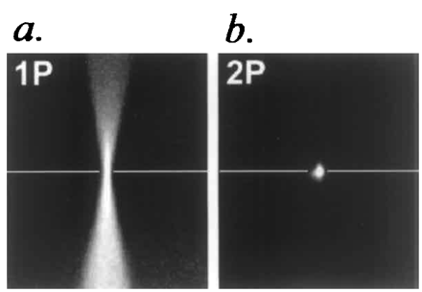
Mutiphoton Microscope
Conventional
Confocal
Two Photon Excitation
500 – 600 nm
500 – 600 nm
440 nm
880 nm

Slide 34
Principle of High-speed Bio Imaging
Wide Field
Confocal
Sample
Sample
Pinhole
CCD + FADC (10 – 50 MHz)
PMT + FADC (10 – 50 MHz)
CMOS [ FADC (50 MHz) * 100 ]
[ HAPD + FADC (1 GHz) ] * 64

Slide 35
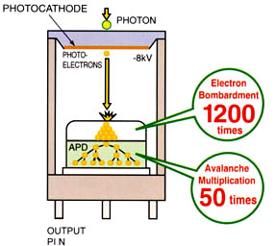
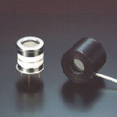
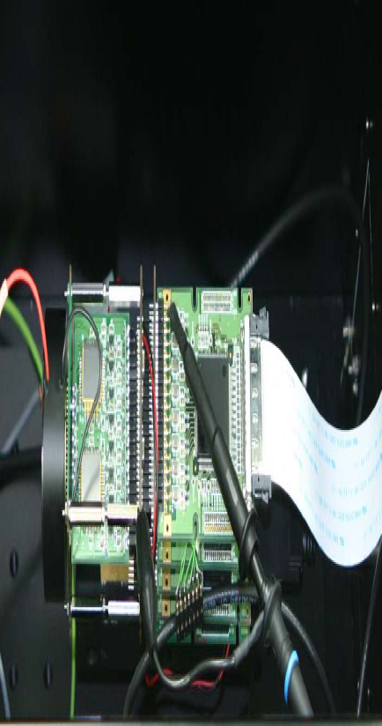
Hamamatsu Hybrid APD
Single Channel HAPD
64 Channel HAPD
+ Readout
Motohiro Suyama
(Hamamatsu)
Xavier Michalet
Shimon Weiss
(Chemistry)

Slide 36
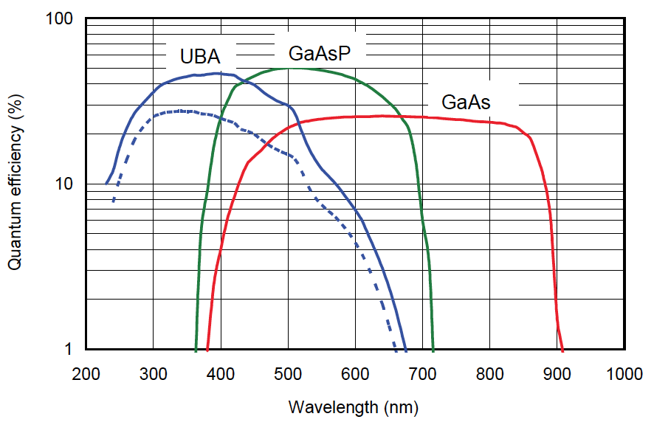
Quantum Efficiency of UBA, GaAsP and GaAs
50% QE

Slide 37
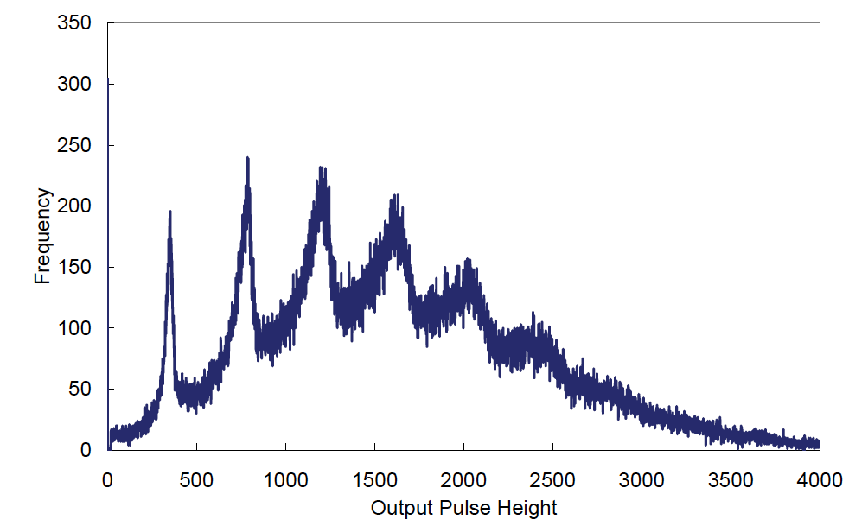
1, 2, 3 … Photo-electron Distribution
True photon counting
2
3
4
1
5
6 Photo-electrons

Slide 38
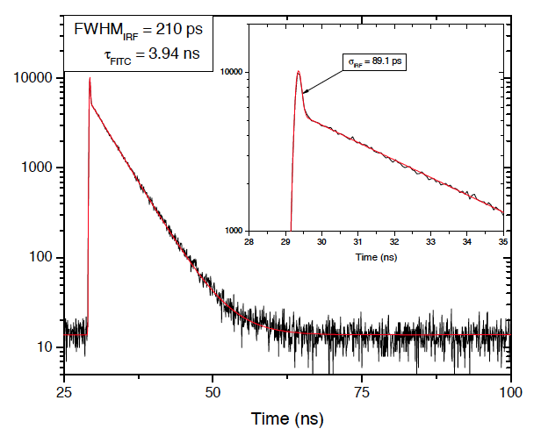
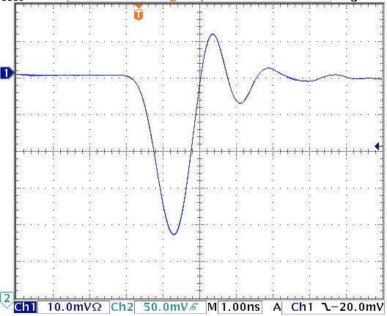
Decay Time Measurement by HAPD
Pulse Shape
Decay Time
FWHM = 1.5 ns
Time Resolution = 80 psec
No after pulse

Slide 39
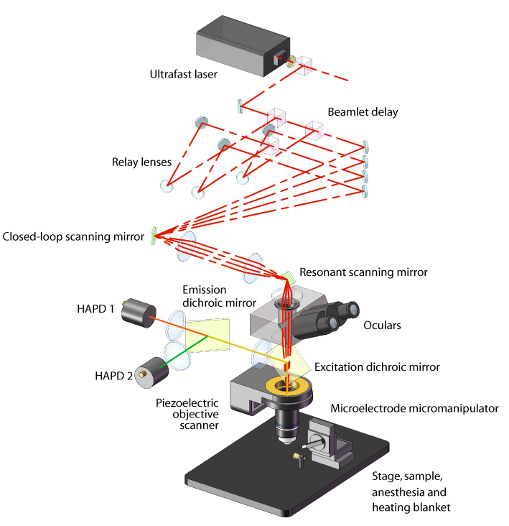
Spatio-Temporal Excitation-Emission Multiplexing (STEM) Microscope
80 MHz
(100 fs pulse)
Adrian Cheng (Physics)
Carlos Portera-Cailliau (Neurology)
4 Beams
240 frame/sec
0 ns
+3 ns
+6 ns
+9 ns
1 kHz
16 kHz
HAPD #1
HAPD #2

Slide 40
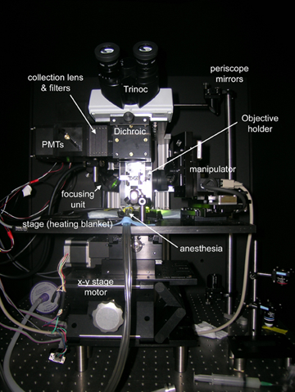
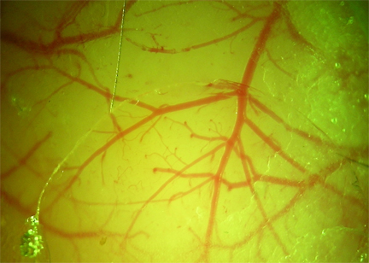
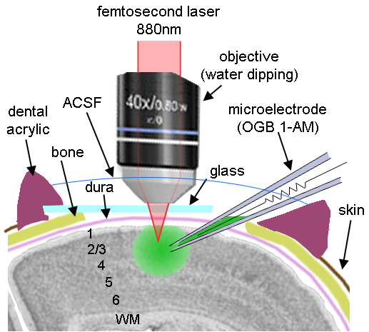
In vivo calcium imaging of neuronal activity

Slide 41
150 μm deep
Adrian Cheng
(Physics)
Tiago Goncalves,
Peyman Golshani,
Carlos Portera-Cailliau (Neurology)
3D Structure of
Barrel Cortex
of Mouse

Slide 42
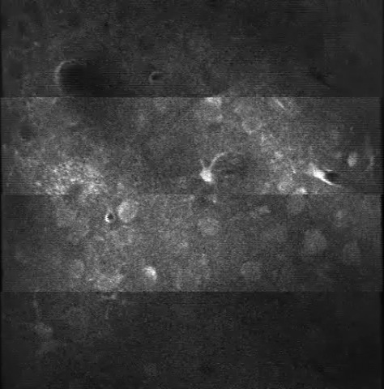
In vivo calcium imaging of Barrel Cortex of Mouse
Beam 1
(0 ns)
Barrel Cortex
Layer 2/3
150 μm deep
240 fps
Raw Data
(x3 faster
than real)
Beam 2
(+3 ns)
Beam 3
(+6 ns)
Beam 4
(+9 ns)
300 μm

Slide 43

In vivo calcium imaging of Barrel Cortex of Mouse
Barrel Cortex
Layer 2/3
150 μm deep
After averaging
(x3 faster
than real)
58 neurons
(~100 billons neurons
in our brain)
300 μm

Slide 44
In vivo calcium imaging of layer 2/3 neurons in barrel cortex with STEM
Adrian Cheng (Physics)

Slide 45
90 μm
120 μm
150 μm
180 μm
Adrian Cheng
(Physics)
Tiago Goncalves,
Peyman Golshani,
Carlos Portera-Cailliau (Neurology)
3D Structure of
Barrel Cortex
of Mouse

Slide 46
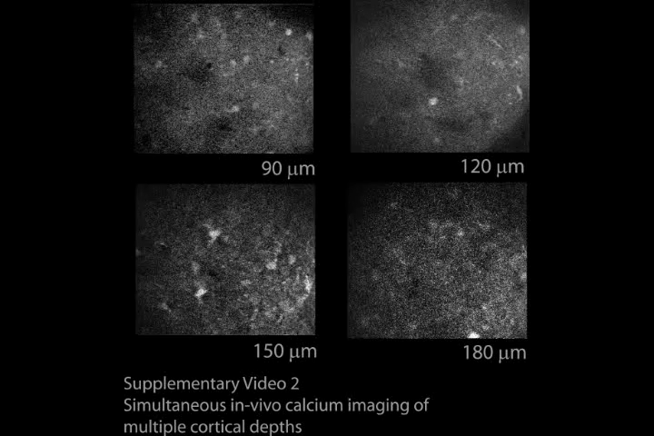
Simultaneous in vivo calcium imaging in 4 axial planes
Barrel Cortex
Layer 2/3
60 fps
(x3 faster
than real)
Beam 1
Beam 2
Beam 3
Beam 4

Slide 47
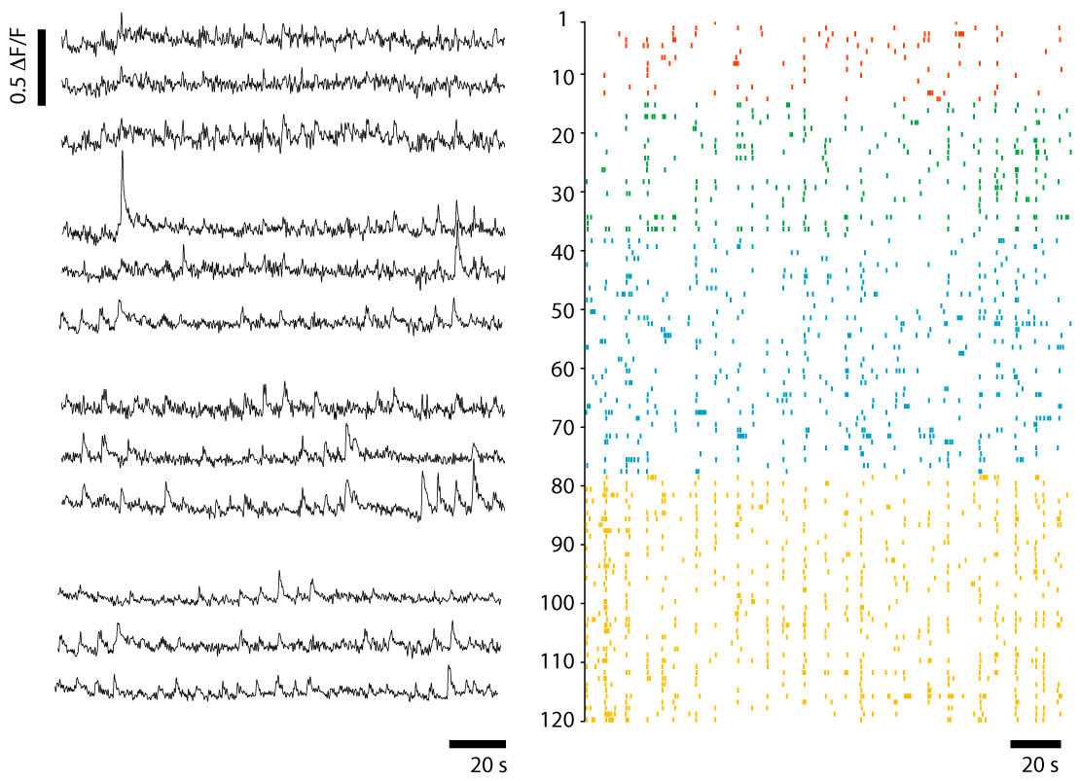
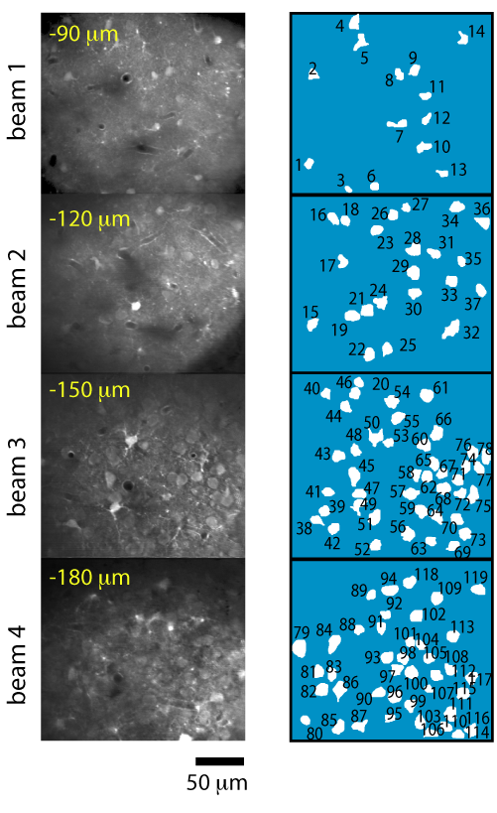
Simultaneous in vivo calcium imaging of neuronal activity in 4 axial planes with STEM
Adrian Cheng (Physics)

Slide 48
UCLA Newsroom on January 11, 2011

Slide 49
Block Diagram of Multi-beam Confocal Microscope
64 ch Photon Detector
8 ch Digitizer x 8
4 ch DAQ System x 16
FADC
FADC
FPGA
CPU
FADC
Fiber
Bundle
Encoder
Box
64 ch
HAPD
Pre
Amp
FADC
Memory
FADC
FADC
FPGA
CPU
Dichroic Filter
Box
FADC
FADC
Memory
Beam
Splitter
Ti:Sa Laser
xyz
Beam
Scanner
Timing
Position Controller
Objective Lens
10 TB
RAID
Sample Scanner

Slide 50
Future Directions
- Virtual Reality -

Slide 51
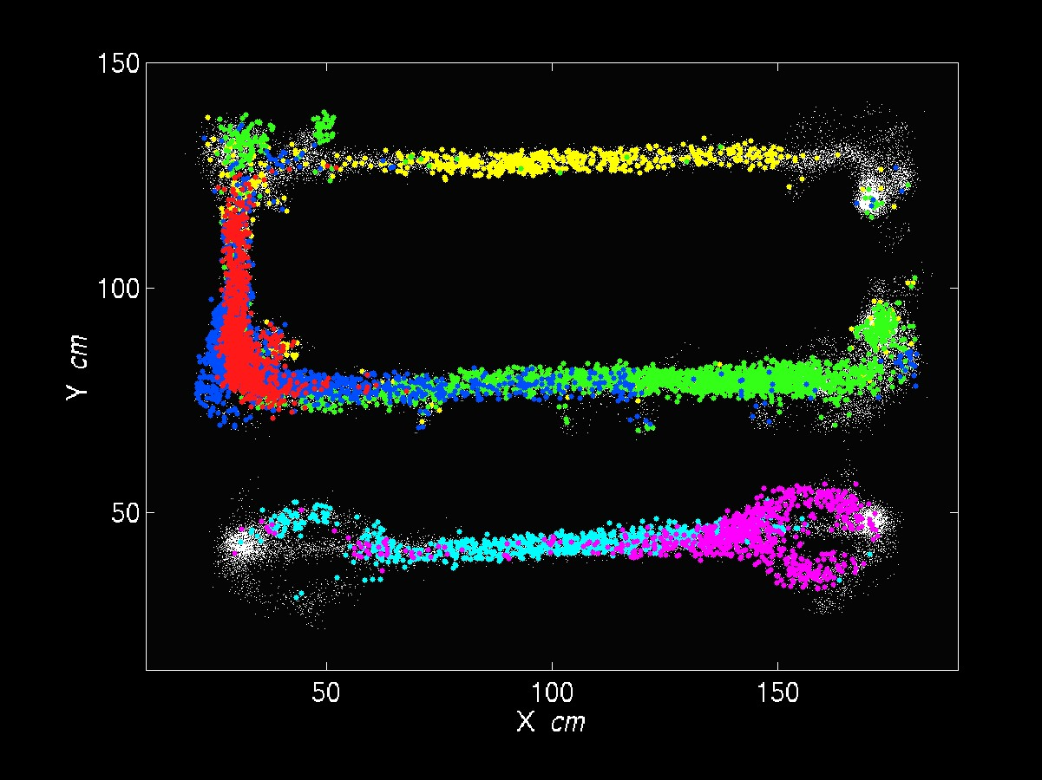
Activity of (excitatory) pyramidal neurons in CA1 depends on rat’s position: place cells
Mayank Mehta (Physics, Neurology)
Hippocampus has a cognitive map of space

Slide 52

Learning and Memory by Hippocampus
Motion Direction
After learning
Before learning
Mayank Mehta (UCLA)

Slide 53
Origin of the Brain
Brains were evolved for animals to predict necessary motions for survival.
  Find preys
  Escape away from predators
  Find mates for sex
A brain “consciously” makes the best decision at a given time.
Complex activities of brains are the results of evolution of life.

Slide 54

Virtual Reality Experiment on Awake Rats
Olfactory
Stimulator
Mayank Mehta
(Physics)
funded by Keck
Foundation ($1M)

Slide 55

A rat running in a Virtual Reality

Slide 56



Optogenetic Excitation of Neurons
Karl Deisseroth (Stanford)
Excitation by
Channelrhodopsin-2
(ChR2)
Inhabitation by
Halorhodopsin
(NpHR)

Slide 57
Outer world vs. Inner word
Outer world : Five senses → Manipulate by Virtual Reality
  Vision
  Sound
  Touch
  Smell
  Taste
Inner world → Manipulate by Photo Excitation of single neurons
  Neural network in brain
Establish direct link between Inner world & Outer world
  Control outer world – Virtual reality
  Control inner world – Neural reality

Slide 58
The Origin of Consciousness
Our brains are making enormous parallel processing “unconsciously” all the time.
  Image processing
  Language
  Recognition of space-time
“Consciousness” is merely the outcome of the decision making processes which have been performed unconsciously.
  Language and logics are just left-over from the past.
  We realize what we said only after we spoke.

Slide 59
Summary

Slide 60
Seven Phases of Cosmic Evolution
14 billion years ago
Origin of
Particles
Origin of
Structure
Origin of
Life
Origin of
Consciousness

Slide 61
Four Major Science
Origin of Particles
Particle Physics
Origin of Universe
Cosmology
Origin of Life
Molecular Biology
Origin of Consciousness
Neurophysics

Slide 62
Future of Ultra High-speed Bio Imaging
Origin of Life:
  Networks of molecules in/on a cell
  Competition against Brownian : 10 – 100 nm / 1 msec
Origin of Consciousness:
  Neural networks
  Action potentials: 1 msec
> 1,000 frame/sec with nano second time stamp.
  Gated Image Intensified CMOS
  Super-PIAS (GHz Photon-counting Imager)
  6D Imaging by Streak-CMOS Camera

Slide 63
Concluding Remarks
“Life” is a complex system in 4 dimensional space-time.
  Emergent property
  Strongly interacting
Countless “spontaneous symmetry breakings” during the evolutional and developing process of life
Fully controlled experiments by “Virtual Reality” under way.
  Outer world (environment) vs. Inner world (brain)
“Ultra high-speed optical imaging” may reveal the fundamental principle of the brain function such as consciousness.

