Slide 1
Trends, Needs and Dreams in Astro-Physics
Katsushi Arisaka
University of California, Los Angeles
Department of Physics and Astronomy
arisaka@physics.ucla.edu

Slide 2
Talk Outline
Astro-Physics
Cosmology
High-energy Particle Astro-physics
Experiments
Ongoing
Future
Photo-detectors
Demands
New Detectors on Horizon
Dream Detectors

Slide 3
Talk Outline
Astro-Physics
Cosmology
High-energy Particle Astro-physics
Experiments
Ongoing
Future
Photo-detectors
Demands
New Detectors on Horizon
Dream Detectors

Slide 4
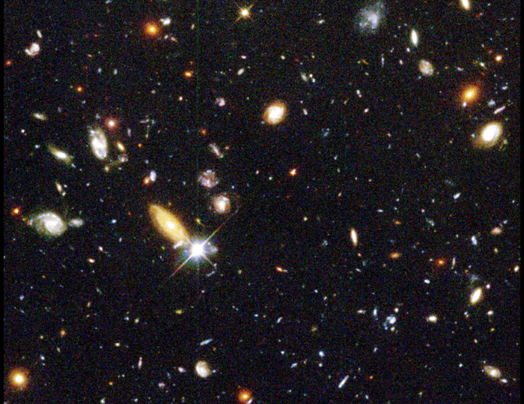
Hubble Deep Field
~100 Billion Galaxies
Red shift up to 10

Slide 5
Evolution of the Early Universe
Time
(sec)
Temp.
(ºK)
Energy (GeV)
Radius of Universe
(cm)
Big Bang!
10⁻⁴⁵sec
10⁻³³
10⁻⁴⁰
10³⁰
10¹⁸
10¹⁵
1
Golf Ball
10⁻³⁵
10²⁵
People
10⁻³⁰
10¹²
10⁵
Mountain
10⁻²⁵
10⁹
10⁻²⁰
10²⁰
Earth
1PeV
10¹⁰
10⁻¹⁵
10¹⁵
1TeV
1 A.U.
10⁻¹⁰
10¹⁵
10⁻⁵
1GeV
1 Light Year
1
10¹⁰
1MeV
10²⁰
10⁵ sec
1KeV
Galaxy
1 year
10⁵
10³
1eV
10²⁵
10⁶
Now
10⁹ year
10⁻³eV
10²⁸
1

Slide 6
Tools to explore the Early Universe
Time
(sec)
Temp.
(ºK)
Energy (GeV)
10⁻⁴⁵sec
10⁻⁴⁰
10³⁰
10¹⁸
10⁻³⁵
10¹⁵
10⁻³⁰
10²⁵
10¹²
10⁻²⁵
10⁹
10⁻²⁰
10²⁰
1PeV
10⁻¹⁵
10¹⁵
1TeV
10⁻¹⁰
10⁻⁵
1GeV
Accelerator
1
10¹⁰
1MeV
10⁵ sec
1KeV
1 year
10⁵
10³
1eV
10⁶
Telescope
10⁹ year
10⁻³eV
1

Slide 7
Unification of Fundamental Forces
Time
(sec)
Temp.
(ºK)
Energy (GeV)
Fundamental
Interaction
10⁻⁴⁵sec
Planck
GUT
10⁻⁴⁰
10³⁰
10¹⁸
GUT
10⁻³⁵
10¹⁵
10⁻³⁰
10²⁵
10¹²
10⁻²⁵
Electro-Weak
10⁹
10⁻²⁰
10²⁰
1PeV
10⁻¹⁵
10¹⁵
1TeV
EW
10⁻¹⁰
10⁻⁵
1GeV
1
10¹⁰
1MeV
10⁵ sec
1KeV
Gravitation
Electromagnetic
1 year
10⁵
Strong
Weak
10³
1eV
10⁶
10⁹ year
10⁻³eV
Now
1

Slide 8
Hubble Deep Field
Physicists’ View of Early Universe

Slide 9
Symmetry Breaking
Time
(sec)
Temp.
(ºK)
Energy (GeV)
10⁻⁴⁵sec
Simple
10⁻⁴⁰
10³⁰
10¹⁸
10⁻³⁵
10¹⁵
10⁻³⁰
10²⁵
10¹²
10⁻²⁵
10⁹
10²⁰
Symmetry
Break Down
10⁻²⁰
1PeV
10⁻¹⁵
10¹⁵
1TeV
10⁻¹⁰
10⁻⁵
1GeV
1
10¹⁰
1MeV
10⁵ sec
1KeV
1 year
10⁵
10³
Complex
1eV
10⁶
10⁹ year
10⁻³eV
1

Slide 10
Relics from the Earliest Universe
Time
(sec)
Temp.
(ºK)
Energy (GeV)
10⁻⁴⁵sec
Big Bang
Planck
10³⁰
10¹⁸
Gravitational Wave
10⁻⁴⁰
GUT
GUT Particle
10⁻³⁵
10¹⁵
10⁻³⁰
10²⁵
10¹²
10⁻²⁵
10⁹
10⁻²⁰
10²⁰
1PeV
10⁻¹⁵
10¹⁵
1TeV
EW
Neutralino
(Cold Dark Matter)
10⁻¹⁰
10⁻⁵
1GeV
1
10¹⁰
1MeV
Relic Neutrino
(Hot Dark Matter)
10⁵ sec
1KeV
1 year
10⁵
10³
CMB
1eV
10⁶
10⁹ year
10⁻³eV
Now
1

Slide 11
CMB : Matter-Radiation Decoupling
Time
(sec)
Temp.
(ºK)
Energy (GeV)
10⁻⁴⁵sec
Planck
10⁻⁴⁰
10³⁰
10¹⁸
GUT
10⁻³⁵
10¹⁵
10⁻³⁰
10²⁵
10¹²
10⁻²⁵
10⁹
Time = 300,000 years
10⁻²⁰
10²⁰
1PeV
Temperature = 3,000 ºK
10⁻¹⁵
10¹⁵
1TeV
Energy = 0.3 eV
10⁻¹⁰
EW
1GeV
Z = 1,100
10⁻⁵
1
10¹⁰
1MeV
10⁵ sec
1KeV
1 year
10⁵
10³
Matter-Radiation
Decoupling ⇒ CMB
1eV
10⁶
10⁹ year
10⁻³eV
Now
1

Slide 12
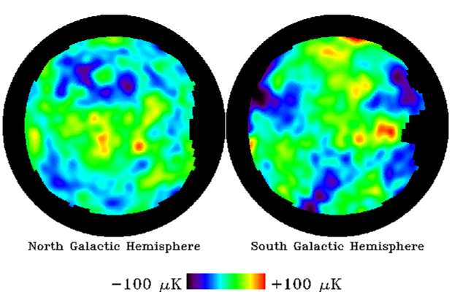
CMB Anisotropy by COBE DMR

Slide 13
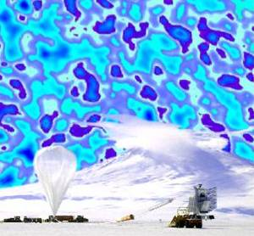
CMB Anisotropy by Boomerang

Slide 14
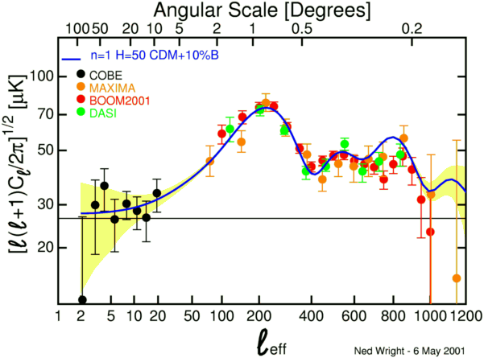
Recent Results of CMB Anisotropy

Slide 15
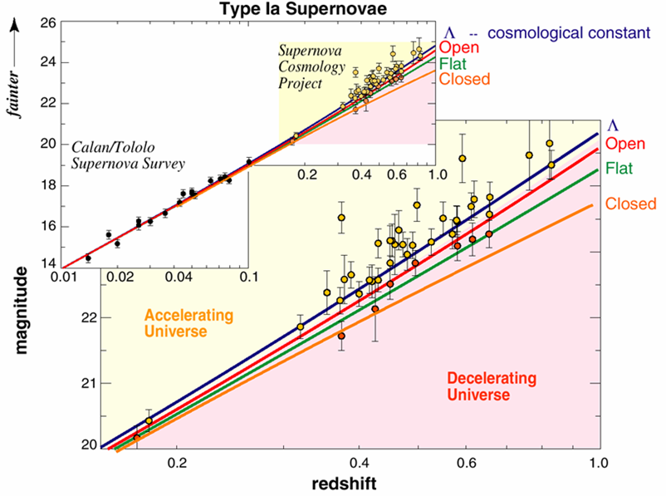
The Accelerating Universe

Slide 16
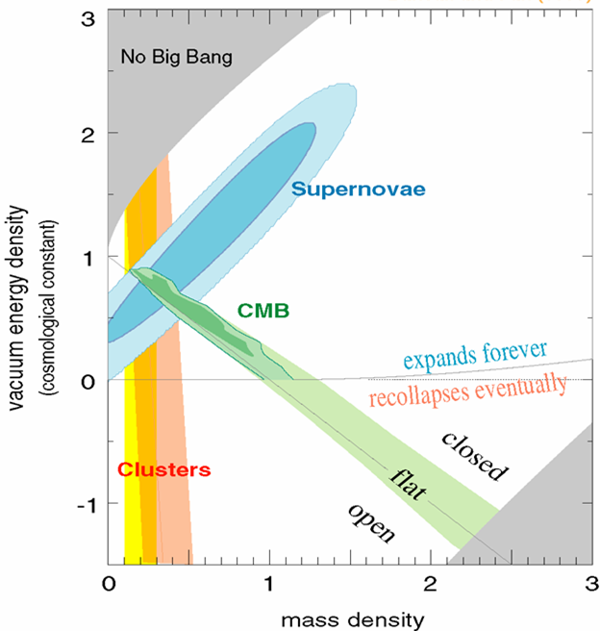
Density of Our Universe
Ω_{Λ}
Universe is Flat.
⇒ Inflation
70% is Dark Energy.
⇒ Accelerating
Ω_{Matter}

Slide 17
Talk Outline
Astro-Physics
Cosmology
High-energy Particle Astro-physics
Experiments
Ongoing
Future
Photo-detectors
Demands
New Detectors on Horizon
Dream Detectors

Slide 18
Relics from the Earliest Universe
Time
(sec)
Temp.
(ºK)
Energy (GeV)
10⁻⁴⁵sec
Big Bang
Planck
10⁻⁴⁰
10³⁰
10¹⁸
Gravitational Wave
GUT
10⁻³⁵
10¹⁵
GUT Particle
10⁻³⁰
10²⁵
10¹²
10⁻²⁵
10⁹
10⁻²⁰
10²⁰
1PeV
10⁻¹⁵
10¹⁵
1TeV
EW
Neutralino
(Cold Dark Matter)
10⁻¹⁰
10⁻⁵
1GeV
1
10¹⁰
1MeV
Relic Neutrino
(Hot Dark Matter)
10⁵ sec
1KeV
1 year
10⁵
CMB
10³
1eV
10⁶
Dark Energy
10⁹ year
10⁻³eV
Now
1

Slide 19
The Extreme Universe
Time
(sec)
Temp.
(ºK)
Energy (GeV)
10⁻⁴⁵sec
Big Bang
Planck
10⁻⁴⁰
10³⁰
10¹⁸
GUT
10⁻³⁵
10¹⁵
10⁻³⁰
10²⁵
10¹²
10⁻²⁵
Gamma Ray Burst
10⁹
10⁻²⁰
10²⁰
Active Galactic Nuclei
1PeV
10⁻¹⁵
Supernova
Neutron Star
Black Holes
10¹⁵
1TeV
EW
10⁻¹⁰
10⁻⁵
1GeV
1
10¹⁰
1MeV
10⁵ sec
1KeV
1 year
10⁵
10³
1eV
10⁶
10⁹ year
10⁻³eV
Now
1

Slide 20
Messengers from the Universe
Photons
Visible, Infrared, UV
X-rays, Gamma-rays
Micro-wave, Radio
Charged Particles
Ultra High Energy Cosmic Rays
Anti-particles
Neutrinos
Solar-neutrino, Supernova
Relic Neutrino
Dark Matter
Gravitons
not covered
in this talk

Slide 21
Messengers from the Universe
Photons
Visible, Infrared, UV
X-rays, Gamma-rays
Micro-wave, Radio
Charged Particles
Ultra High Energy Cosmic Rays
Anti-particles
Neutrinos
Solar-neutrino, Supernova
Relic Neutrino
Dark Matter
Gravitons

Slide 22
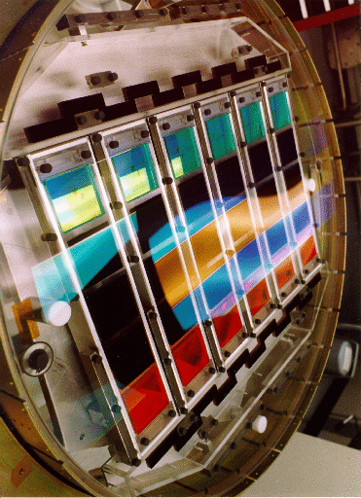
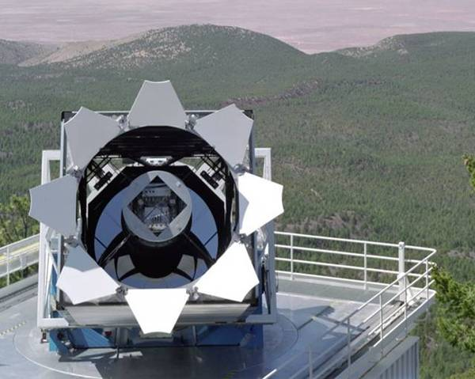
SDSS (Sloan Digital Sky Survey)
2.5m Diameter
3º x 3º FOV
f/2.25
30 x 4Mega-pixel CCD
Focal Plane

Slide 23
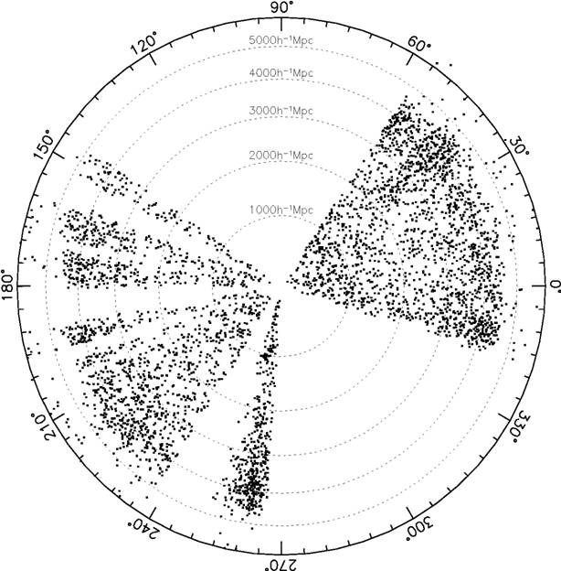
SDSS Early Data Release
Goal:
500 sq. degree of the sky.
14 million objects.
Spectra for 50,000 galaxies
5,000 quasars.
Distance record-holder

Slide 24
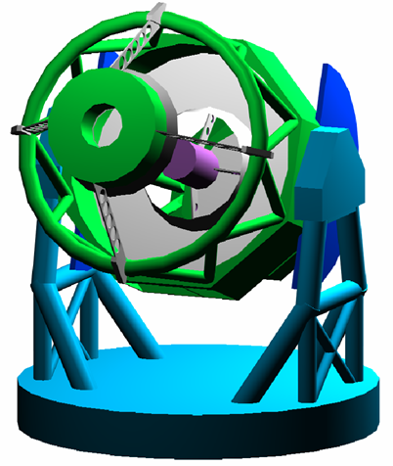
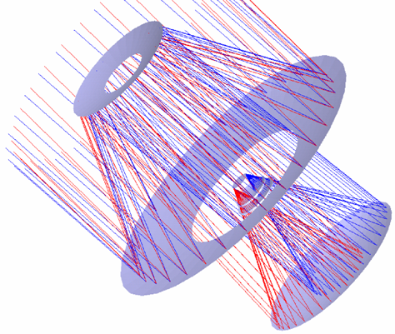
LSST (Large-aperture Synoptic Survey Telescope)
8m Diameter
3º x 3º FOV
f/1.2, 50cm Focal plane
1.4Giga-pixel CCD

Slide 25
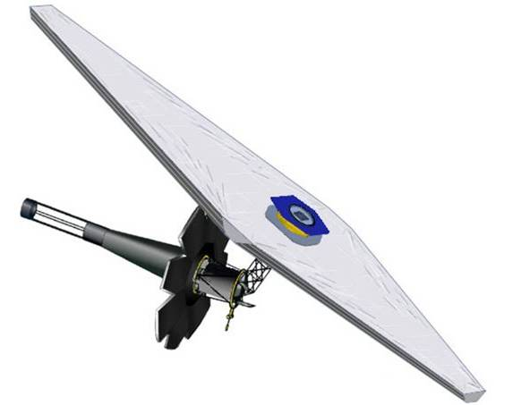
NGST (Next Generation Space Telescope)
Mirror Diameter: ~6.5 m
FOV: 4’ x 4’
Wavelength: 0.6-28 μm
Orbit: L2 point
Payload mass: ~3000 kg
Mission duration: 5-10 years
GSFC Design

Slide 26
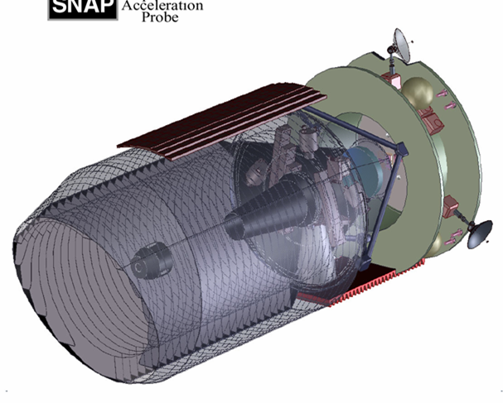
SNAP (SuperNova Acceleration Probe)
Mirror Diameter: 2 m
FOV: 1º x 1º
Wavelength: 0.35-1 μm
IR Photometry: 10’x10’, HgCdTd
IR Spectroscopy: 2”x2”

Slide 27
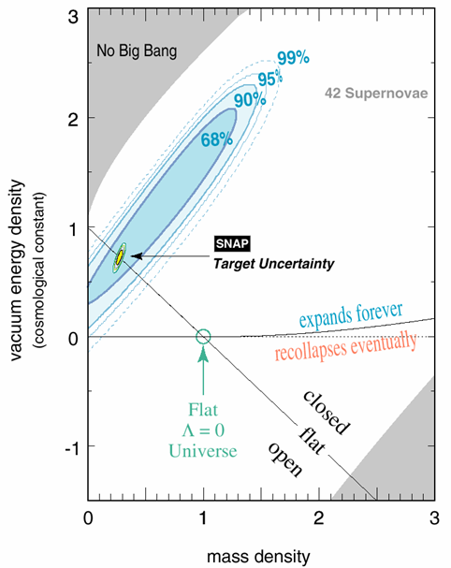
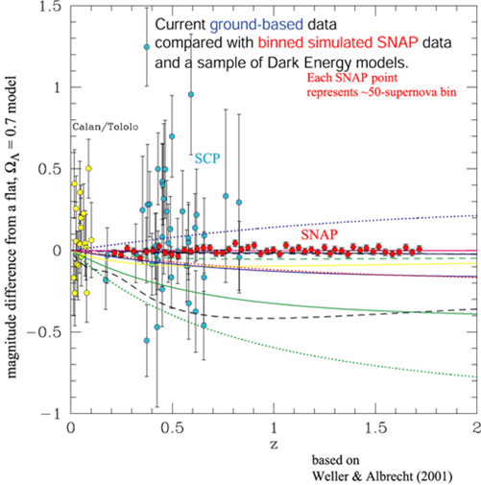
SNAP – Dark Energy Sensitivity

Slide 28
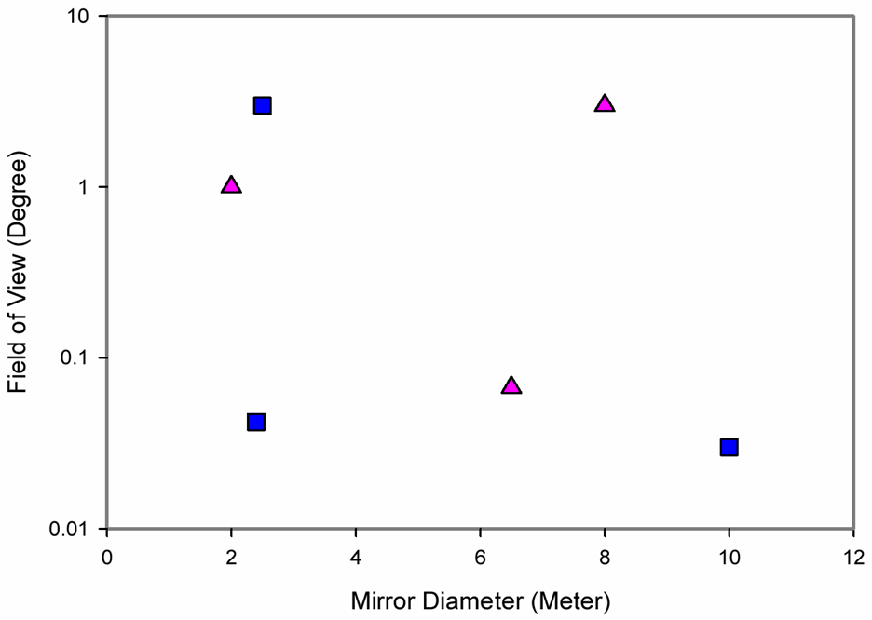
Deep Sky Survey by Telescopes
Larger Mirror
Larger FOV
SDSS
LSST
SNAP
Ground
Space
NGST
HST
Keck

Slide 29
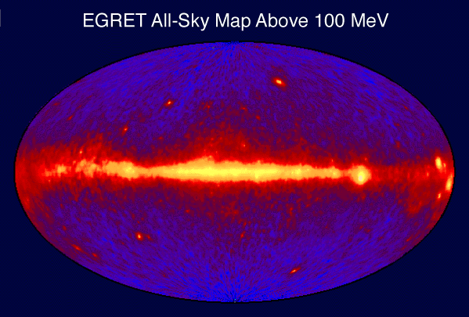
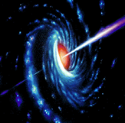
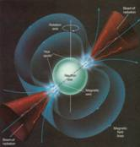
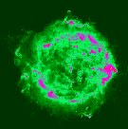
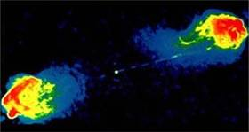
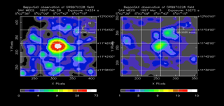
The Extreme Universe
AGN
Pulsar
SNR
Radio
Galaxy
GRB

Slide 30
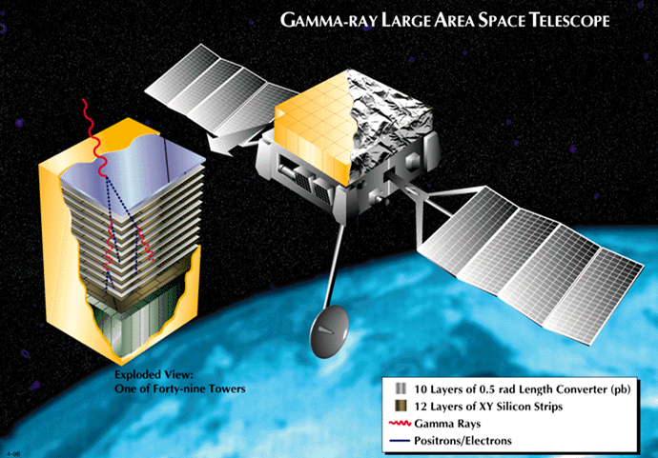
GLAST - Gamma Ray Sky Survey
Si Strip
CsI +
Photo Diode

Slide 31
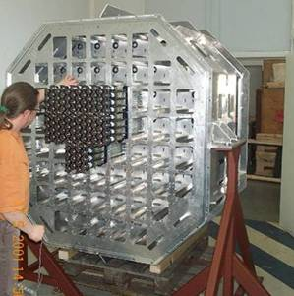
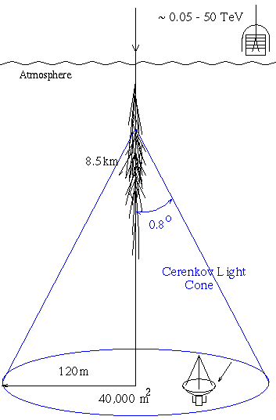
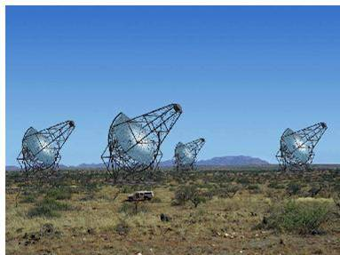
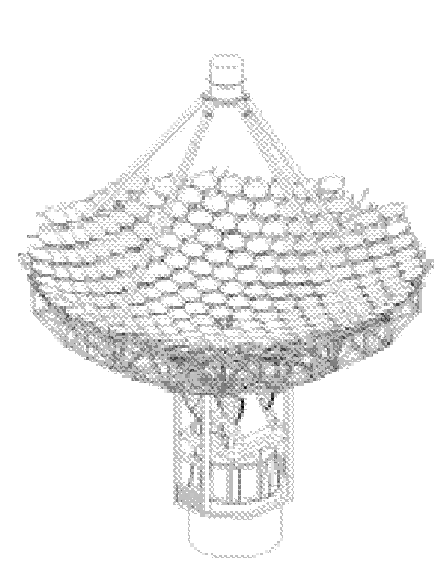
Gamma ray Telescopes
VERITAS
HESS
10m Diameter
~500PMT/Camera
4-7 Telescopes
80 m

Slide 32
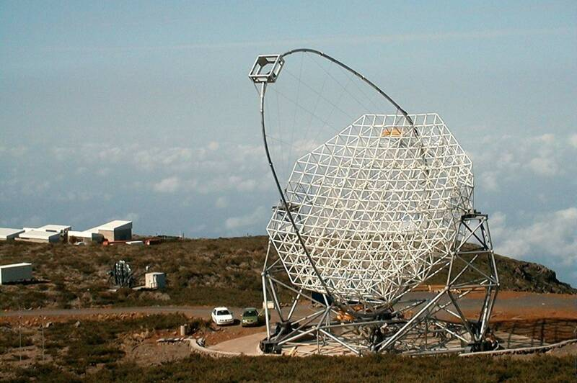
MAGIC under Construction
17m mirror
3.6º FOV
600 PMTs
Upgrade to GaAsP HAPD

Slide 33
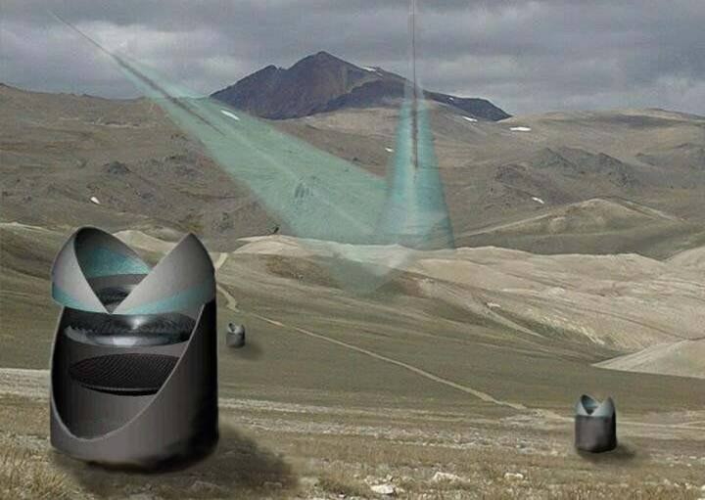
γ-ray Wide-FOV Telescope
>3m diameter
>30º FOV
Mega pixel

Slide 34
Messengers from the Universe
Photons
Visible, Infrared, UV
X-rays, Gamma-rays
Micro-wave, Radio
Charged Particles
Ultra High Energy Cosmic Rays
Anti-particles
Neutrinos
Solar-neutrino, Supernova
Relic Neutrino
Dark Matter
Gravitons

Slide 35
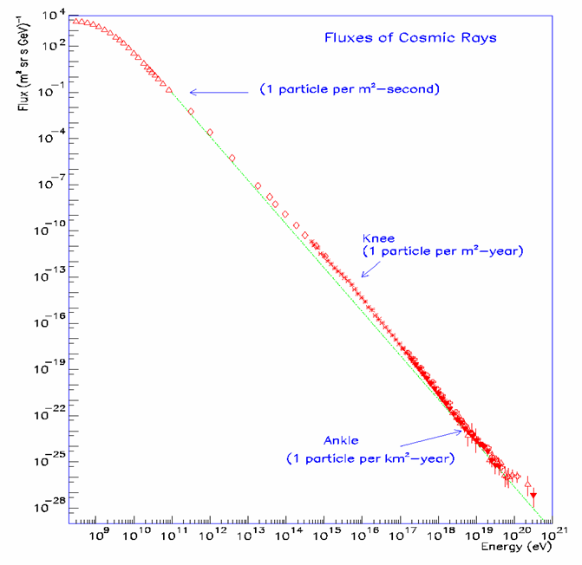
Energy Spectrum of Cosmic Rays
Energy Spectrum ~ E⁻³
The spectrum extends beyond 10²⁰eV
Beyond 10²⁰eV, Flux is only one particle per km²-century
1TeV

Slide 36
Tools to explore the Early Universe
Time
(sec)
Temp.
(ºK)
Energy (GeV)
10⁻⁴⁵sec
10⁻⁴⁰
10³⁰
10¹⁸
10⁻³⁵
10¹⁵
10⁻³⁰
10²⁵
10¹²
10⁻²⁵
10⁹
10²⁰
UHE Cosmic Rays
10⁻²⁰
1PeV
10⁻¹⁵
10¹⁵
1TeV
10⁻¹⁰
10⁻⁵
1GeV
Accelerator
1
10¹⁰
1MeV
10⁵ sec
1KeV
1 year
10⁵
10³
1eV
10⁶
Telescope
10⁹ year
10⁻³eV
1

Slide 37
Why is 10²⁰eV so special?
Nearly impossible to accelerate beyond 10²⁰eV by nature. → Top-down Mechanism?
Protons can travel straight at E>10²⁰eV. → Charged-Particle Astronomy
Protons can not travel beyond ~50Mpc at E> 5 x 10¹⁹eV due to interaction with CMB. → ZGK Cut-off

Slide 38
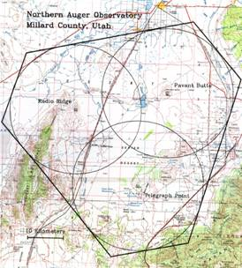
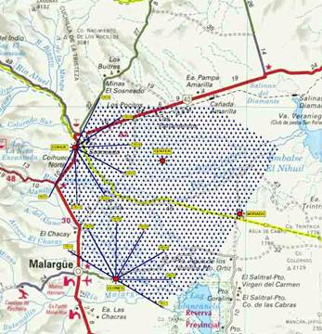
Pierre-Auger Observatory
Northern Auger
in Utah
N
Southern Auger
in Argentina
S
50km

Slide 39
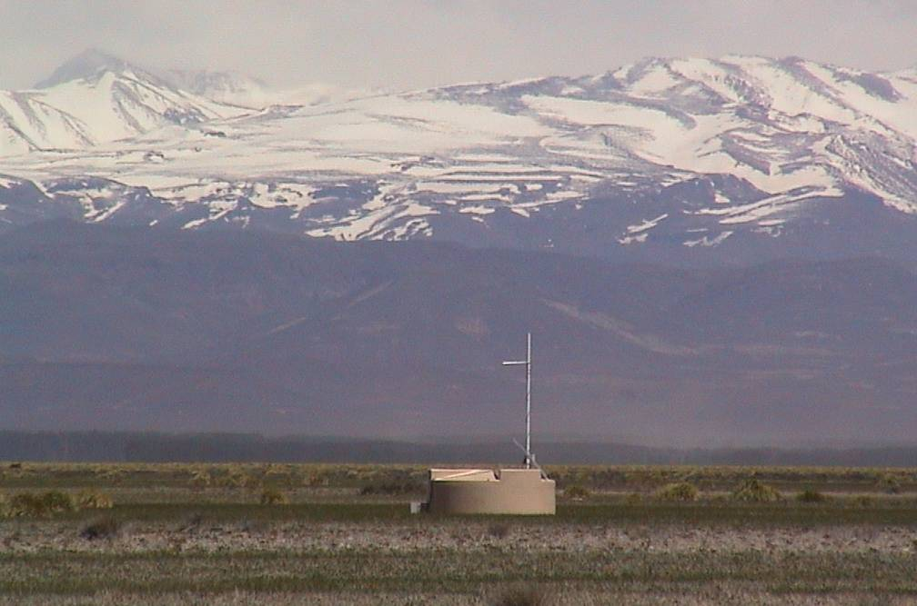
Surface Detector and the Andes
1,600 Water Tanks x 3 PMTs = 4,800 of 9” PMTs

Slide 40
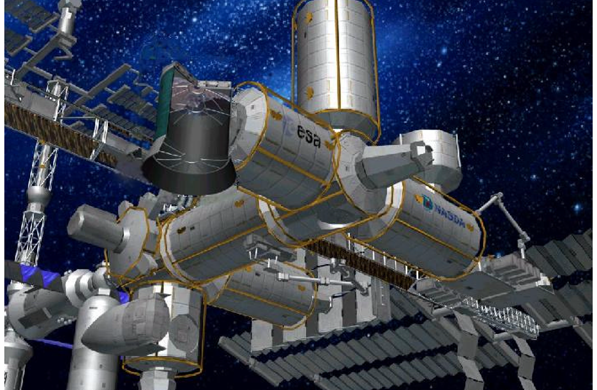
EUSO on International Space Station
EUSO

Slide 41
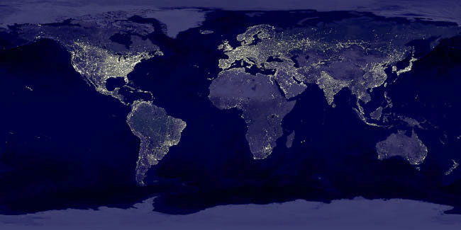
Night Sky

Slide 42
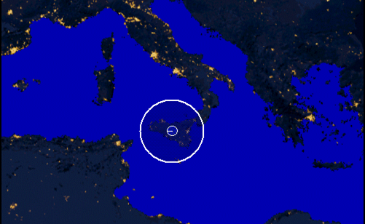
EUSO vs. Pierre-Auger
Pierre-Auger
EUSO
~400km

Slide 43
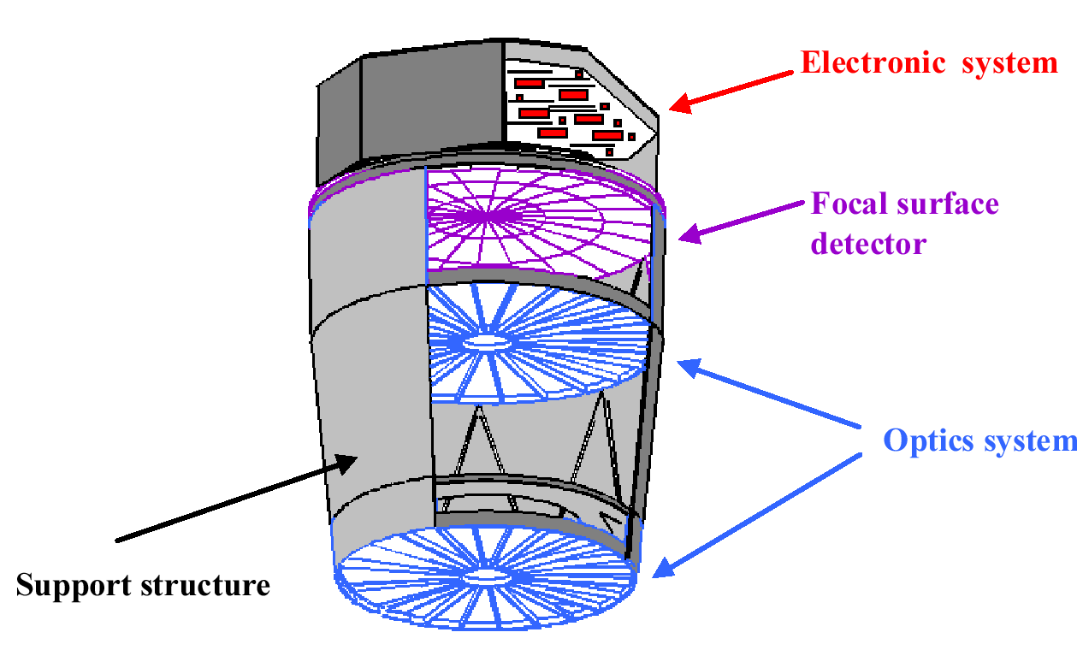
EUSO Detector
2.5m Diameter
60º FOV
f/1.25
Hamamatsu
R7600-M16/64
250k Pixel

Slide 44
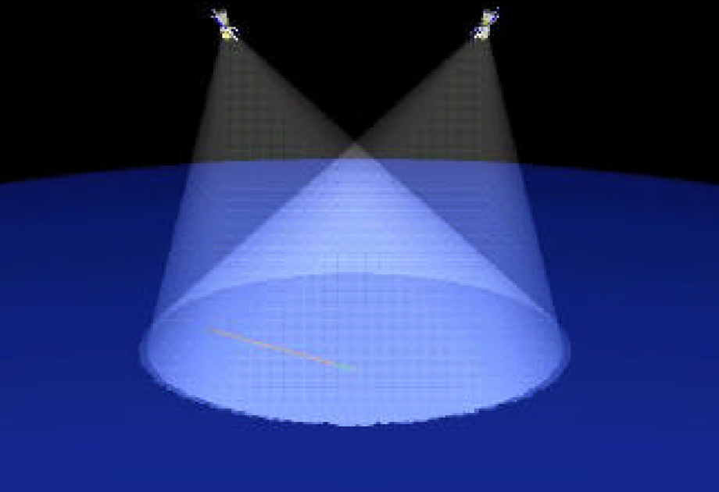
OWL Stereo View from Space
~1,000km
~1,000km

Slide 45
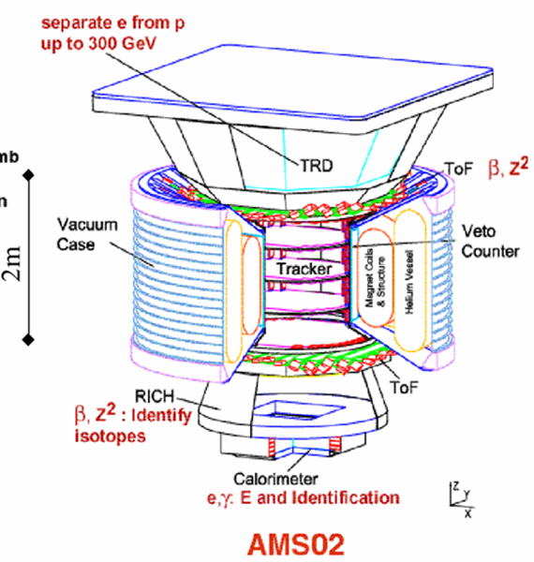
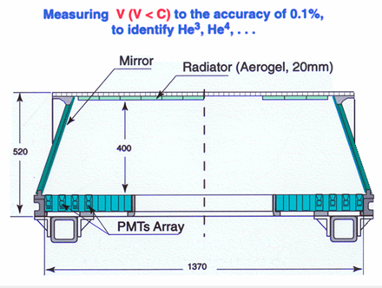
AMS - Anti-Matter Search
RICH uses Multi-anode PMT
Hamamatsu R7600-M16
14k Pixel

Slide 46
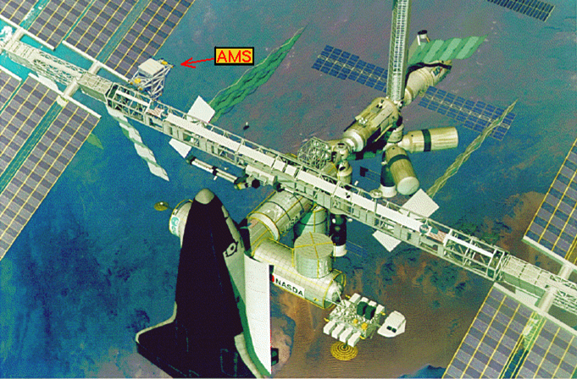
AMS on International Space Station

Slide 47
Messengers from the Universe
Photons
Visible, Infrared, UV
X-rays, Gamma-rays
Micro-wave, Radio
Charged Particles
High Energy Cosmic Rays
Anti-particles
Neutrinos
Solar-neutrino, Supernova
Relic Neutrino
Dark Matter
Gravitons

Slide 48
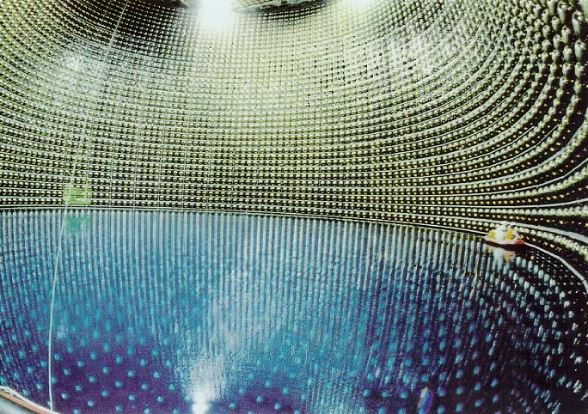
Super-Kamiokande
11,200 of 20” PMTs
Expected to resume end of
this year with 50% PMTs

Slide 49
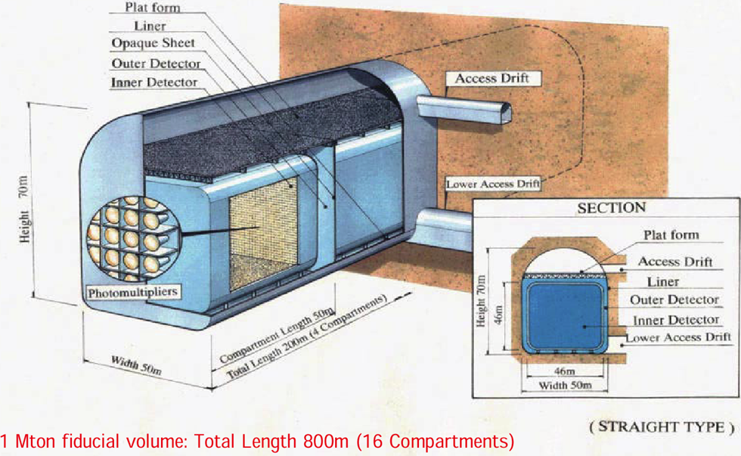
Future: Hyper-K/UNO
~200k of 20” PMTs

Slide 50
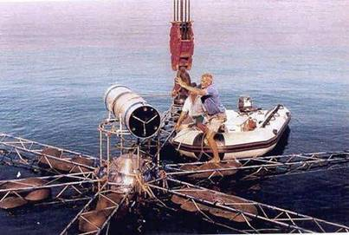
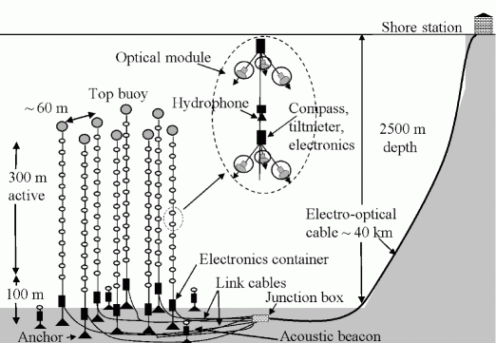
NESTOR and ANTARES
ANTARES
NESTOR

Slide 51
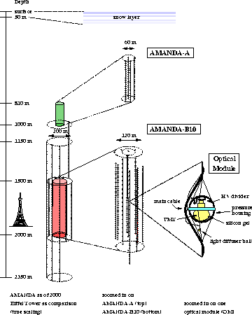
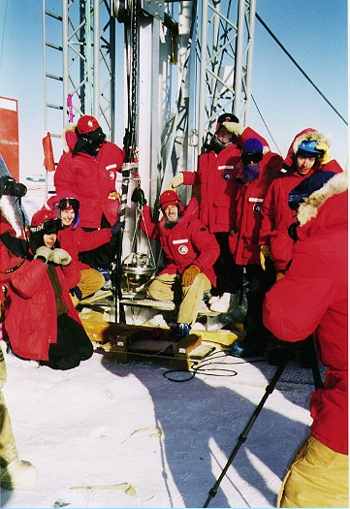
AMANDA

Slide 52
ICECUBE
10 TeV Muon Event
AMANDA-II
60 PMTs/string x 80 strings
= 4,800PMTs
1 km

Slide 53
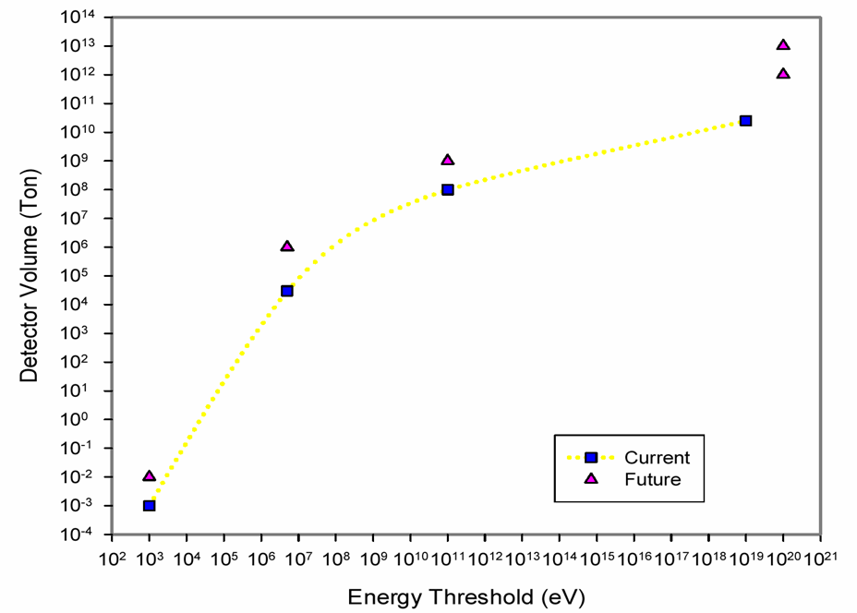
Detection of Cosmic Radiation
Larger Volume
Lower Threshold
OWL
EUSO
ICECUBE
Pierre-Auger
Hyper-K
AMANDA
Cosmic Ray
Neutrino
Super-K
Zeplin
Dark Matter
CDMS

Slide 54
Talk Outline
Astro-Physics
Cosmology
High-energy Particle Astro-physics
Experiments
Ongoing
Future
Photo-detectors
Demands
New Detectors on Horizon
Dream Detectors

Slide 55
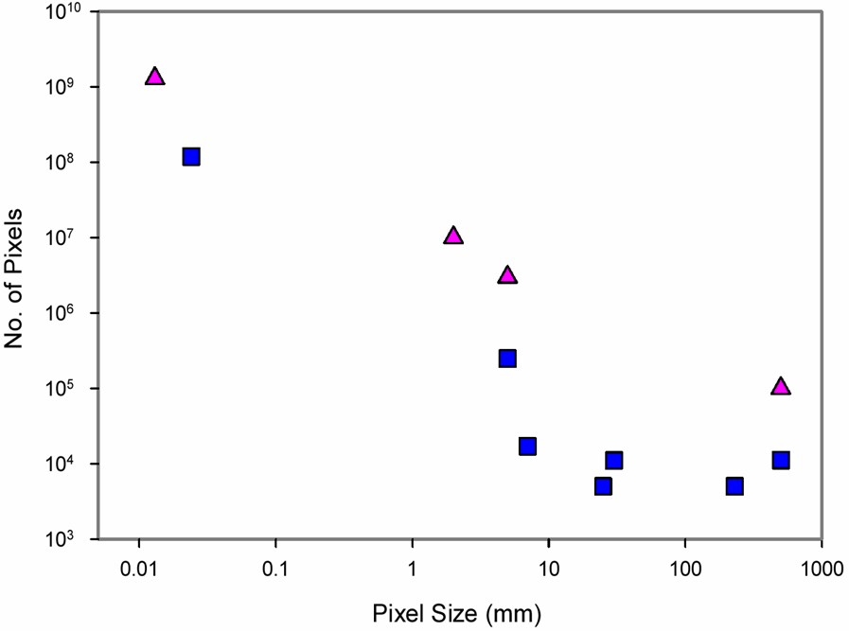
Photon Detector
LSST
More Pixels
Better Sensitivity
SDSS
OWL
CCD
γ Wide FOV
Hyper-K
PMT
EUSO
Auger-FD
Super-K
AMS
VERITAS
Auger-SD

Slide 56
Demands on Photon Detectors
Giga-Pixel CCD
Sky Survey
Mega-Pixel (1-5mm), Photon Counting
EUSO/OWL, Wide-FOV γ-ray Telescope
Large Area (>50cm), Photon Counting
Neutrino, Proton decay
Time-resolving Imaging
Transient Phenomena
Low Costs!

Slide 57
Demands on Photon Detectors
Giga-Pixel CCD
Sky Survey
Mega-Pixel (1-5mm), Photon Counting
EUSO/OWL, Wide-FOV γ-ray Telescope
Large Area (>50cm), Photon Counting
Neutrino, Proton decay
Time-resolving Imaging
Transient Phenomena
Low Costs!

Slide 58
New Detectors on Horizon
Vacuum
Multi-Pixel HPD DEP
Flat Panel PMT Hamamatsu, Burle
Silicon MCP Nano-science
New Photo Cathode
Solid State
Silicon PMT Russia
STJ ESTEC
TES Stanford

Slide 59
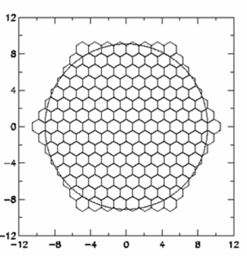

DEP Hybrid Photodiode (HPD)
Baseline design for LHC-b RICH
8cm diameter
61 Pixel, (5mm view)

Slide 60

Energy Resolution
QE as high as possible. ( > 30% )
C_{ol} as close as 100% ( > 0.9 )
ENF as close as 1.0 ( < 1.2 )
G >> ENC (~1000e⁻) ( >> 10⁴ )
N_{BG} << N_{γ} ( << 1 )

Slide 61
Energy Resolution
APD
HPD
PMT
Photo Diode
Poisson Limit

Slide 62


Hamamatsu Flat Panel PMT
64 Pixels

Slide 63

Burle Flat PMT
2 inch Square
Ceramic Case
Dual MCP-PMT
4 anodes, uniformity < 2:1
Maximum Gain ~ 1 x 10⁶
by Paul Hink

Slide 64

Silicon MCP
~7µm pores
>75% open area
Diamond coated
Gain > 1,000
Glass MCP
Si MCP
By O. Siegmund, U.C. Berkeley

Slide 65

Semiconductor Photo-cathode
InGaN
by Hamamatsu

Slide 66






Silicon Photomultiplier
by P. Buzhan, B. Dolgoshein et. al.
Gain~10⁶
ENF=1.0
DQE~10%

Slide 67



Superconducting Tunneling Junctions (STJ)
Developed by ESTEC, ESA
Detect Photon by Photon:
Energy < 0.1 eV
Time < 1 nsec
Position < 10 μm
Energy resolution

Slide 68



Transition Edge Sensor (TES)
The Astrophysical Journal, 563:
221È228, 2001 December 10
R. Romani ,et al.
20 x 20 μm²

Slide 69

Crab Pulsar observed by TES

Slide 70
Mega-Pixel TES/STJ
Detect Photon by Photon:
Energy < 0.1 eV
Time < 1 nsec
Position < 10 μm
Ultimate Photon Detector!

Slide 71
Dream Team for Astro-Physics
CCD: ~10μm 1G pixels
STJ: ~20μm 1M pixels
HAPD: ~1mm 1K pixels

Slide 72
Multi-pixel Hybrid APD
Glass Window (1mm^{t})
InGaN Photo Cathode
APD Array
(32 x 32 = 1024 Pixel)
Ceramic Case
Readout Electronics
LV
Optical Fiber for
Signal Readout
HV
47.6mm
50.5mm
1.4mm Pixel Size, 1.5mm Pitch
32 x 32 = 1,024 Pixels
QE ~ 50% at 350 ~ 400nm
Gain ~10⁵

Slide 73
Katsushi’s Dream Telescope
Ground & Space-based 2π observatory:
20m diameter mirror
30º FOV, f/0.8
0.1arcsec pixel size
1Tera pixels
Photon counting
1nsec time resolution
0.01eV energy resolution

Slide 74
Concluding Remarks
Where did we come from? Where are we going?
The answer is still hidden in the dark side of the Universe which only more advanced photo-detectors can see.
Time is now to develop dream detectors!

Slide 75
Can “your photo-detector” see the dark side of this picture?

