Slide 1
“Absolute” Calibration of PMT
Katsushi Arisaka
University of California, Los Angeles
Department of Physics and Astronomy
arisaka@physics.ucla.edu

Slide 2
Talk Outline
Introduction: Principle of PMT
NIST Standard Silicon Photodiode
Uncertainties, Concerns Specific to PMTs
Suggestions and Proposal to our Community

Slide 3
Talk Outline
Introduction: Principle of PMT
NIST Standard Silicon Photodiode
Uncertainties, Concerns Specific to PMTs
Suggestions and Proposal to our Community

Slide 4
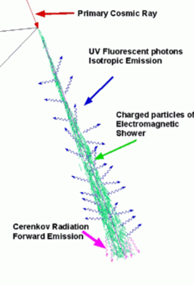
Emission, Propagation and Detection of Fluorescent Photons
Air Fluorescence Detector
Emission
Propagation
Detection

Slide 5
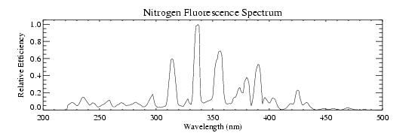
Emission Spectrum of Nitrogen Fluorescence
337nm
313nm
357nm
391nm
From HiRes

Slide 6
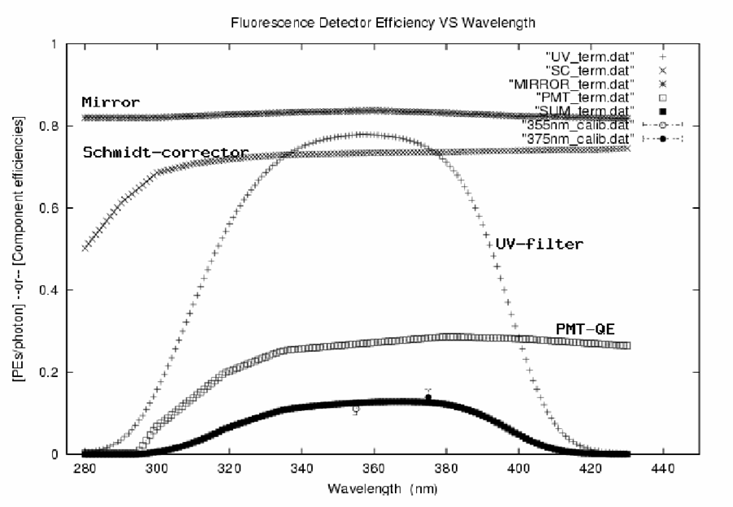
Photon Detection Efficiency of Auger FD
Mirror
Schmidt Corrector
UV-Filter
PMT QE
Convoluted Efficiency
GAP 2002-029

Slide 7
Principle of PMT
How PMT Works
Fundamental Parameters of PMT
Quantum Efficiency (QE)
Photoelectron Collection Efficiency (C_{ol})
Gain (G)
Excess Noise Factor (ENF)
Energy Resolution (σ/E)
How to Measure These Parameters
Some Remarks

Slide 8
Structure of Linear-focus PMT
Photo Cathode
Second Last
Dynode
First Dynode
QE
δ₁
N_{γ}
C_{ol}
δ₃
Photons
δ_{n}
δ₂
Glass Window
Mesh Anode
Last Dynode

Slide 9
Quantum Efficiency (QE)
Definition:
How to measure:
Connect all the dynodes and the anode.
Supply more than +100V for 100% collection efficiency.
Measure the cathode current (I_{C}).
Compare I_{C} with that of PMT with known QE.

Slide 10
Collection Efficiency (C_{ol})
Definition
How to measure
Measure the Cathode current (I_{C}).
Add 10⁻⁵ ND filter in front of PMT.
Measure the counting rate of the single PE (S).
Take the ratio of S×1.6×10⁻¹⁹ ×10⁵/I_{C}.

Slide 11
Detective Quantum Efficiency (DQE)
Definition:
Often confused as QE by “Physicists”
How to measure:
Use a weak pulsed light source (so that >90% pulse gives the pedestal.)
Measure the counting rate of the single PE (S).
Compare S with that of PMT with known DQE.

Slide 12
Gain (G_{P})
Definition by Physicists:
How to measure:
Use a weak pulsed light source (so that >90% pulse gives the pedestal.)
Measure the center of the mass of Single PE charge distribution of the Anode signal (Q_{A}).
Take the ratio of Q_{A}/1.6×10⁻¹⁹ .
(δ_{i} = Gain of the i-th dynode)

Slide 13
Gain (G_{I})
Definition by Industries:
How to measure:
Measure the Cathode current (I_{C}).
Add 10⁻⁵ ND filter in front of PMT.
Measure the Anode current (I_{A}).
Take the ratio of I_{A}×10⁵/I_{C}.
(δ_{i} = Gain of the i-th dynode)

Slide 14
Anode Signal (E)
Definition:
(by Industries)
(by Physicists)
(N_{γ} = No. of Incident Photons)
(N_{pe} = No. of Photo-electrons)

Slide 15
Energy Resolution (σ/E)
In ideal case:
In reality:
QE Quantum Efficiency
C_{ol} Collection Efficiency:
ENF Excess Noise Factor (from Dynodes)
ENC Equivalent Noise Charge (Readout Noise)

Slide 16
Excess Noise Factor (ENF)
Definition:
In case of PMT:
How to measure:
Set N_{pe} = 10-20 (for nice Gaussian).
Measure σ/E of the Gaussian distribution.
ENF is given by

Slide 17
Remarks
Don’t try to estimate N_{pe} or N_{γ} from σ/E !
(Assuming ENC is negligible.)

Slide 18
Resolution of Hybrid Photodiode (HPD)
HPD can count 1, 2, 3… PE separately.
ENF=1.0
But it is still suffering from poor QE.
We can never beat the Poisson statistics !
1 pe
NIM A 442 (2000) 164-170
Pedestal
2 pe
3 pe
4 pe
500
200
300
400
600
ADC Channel

Slide 19
Typical Values and Resolution of Various Photon Detectors
 | QE | C_{ol} | δ_{i} | ENF | G | ENC | σ/E
Ideal | 1.0 | 1.0 | 1000 | 1.0 | 10⁶ | 0 | √1/N
PMT | 0.3 | 0.9 | 10 | 1.3 | 10⁶ | 10³ | √4/N
PD | 0.8 | 1.0 | - | 1.0 | 1 | 10³ | √1.4/N+(1000/N)²
APD | 0.8 | 1.0 | 2 | 2.0 | 100 | 10³ | √3/N+(14/N)²
HPD | 0.3 | 0.95 | 1000 | 1.0 | 10³ | 10³ | √3/N+(3/N)²
HAPD | 0.3 | 0.95 | 1000 | 1.0 | 10⁵ | 10³ | √3/N

Slide 20
Energy Resolution vs. N_{γ}
APD
HPD
PMT
Photo Diode
Poisson Limit

Slide 21
Talk Outline
Introduction: Principle of PMT
NIST Standard Silicon Photodiode
Uncertainties, Concerns Specific to PMTs
Suggestions and Proposal to our Community

Slide 22
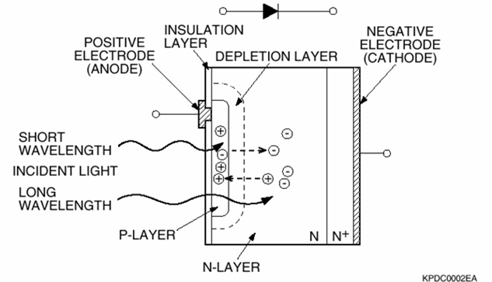
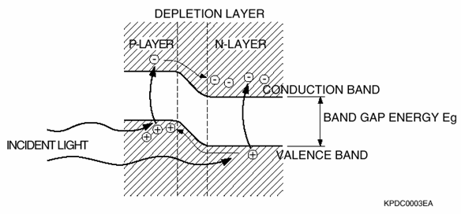
Principle of Silicon Photodiode
Gain = 1.0
QE ~ 100%
Extremely Stable
Large Dynamic Range

Slide 23
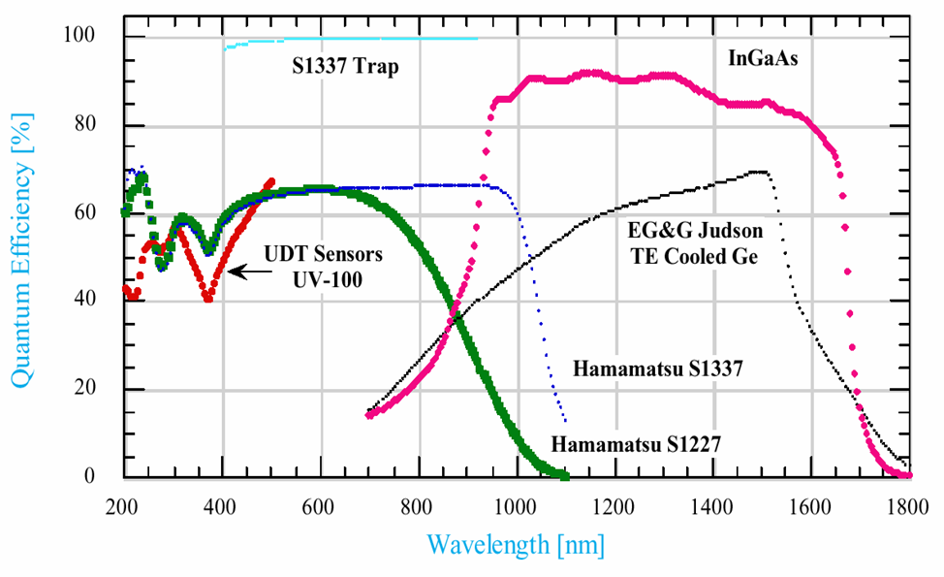
Quantum Efficiencies of NIST Standards (Si, InGaAs and Ge photodiodes)

Slide 24
Propagation Chain of Absolute Calibration of Photon Detectors
Standard Light Beam
Cryogenic Radiometer
Laser(s)
Trap Detector
Monochromator(s)
Pyroelectric Detector
NIST
NIST standard UV Si PD
Light Beam
Scattered Light
Dome Reflector
US
UV LED
Xe Lamp
Laser(s)
NIST standard UV Si PD
Reference PMT
Atmospheric Fluorescence
Particle Beam
Cosmic-ray Events
PMTs in Telescopes

Slide 25
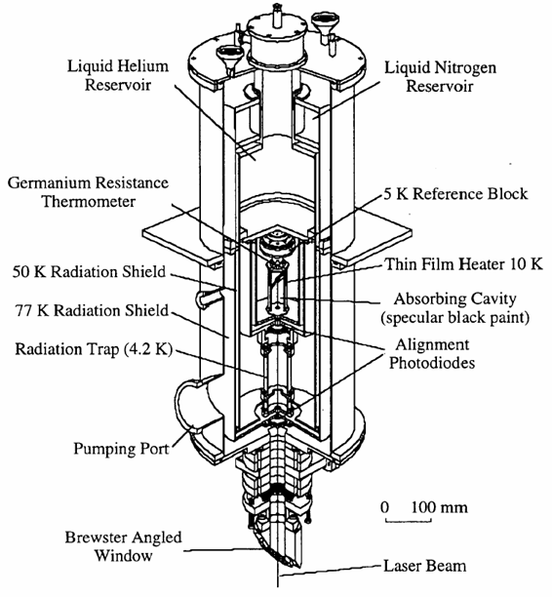
NIST High Accuracy Cryogenic Radiometer (HACR)
Shoot a laser to a black body of 4.2ºK.
Balance heat by electrical power which produces resistive heating.
Uncertainty is 0.021% (at 1mW).

Slide 26
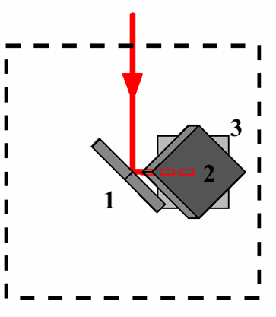
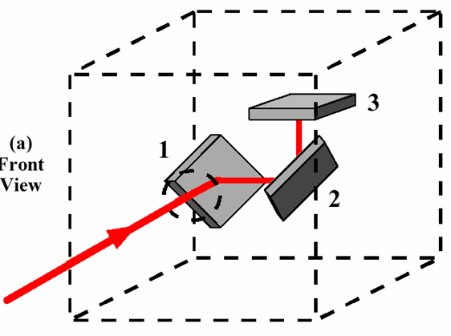
Trap Detector
~99.5% efficiency of trapping.
Uncertainty is 0.05%.
Front View
Bottom View

Slide 27
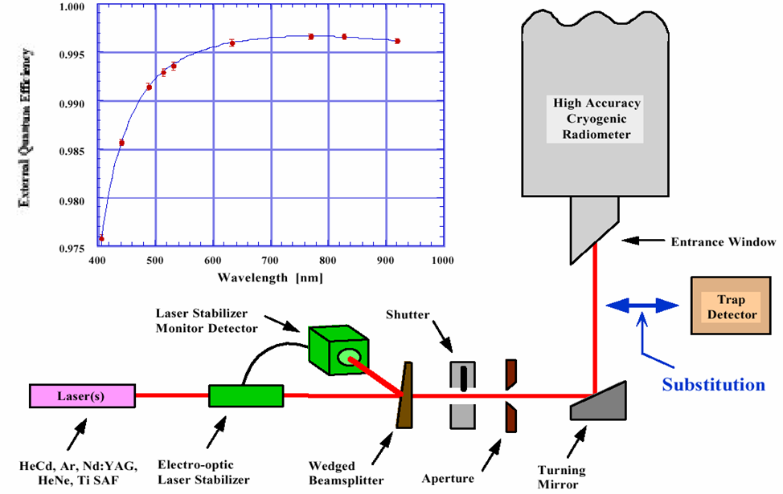
Scale transfer by substitution method with the HACR

Slide 28
Propagation Chain of Absolute Calibration of Photon Detectors
Standard Light Beam
Cryogenic Radiometer
Laser(s)
Trap Detector
Monochromator(s)
Pyroelectric Detector
NIST
NIST standard UV Si PD
Light Beam
Scattered Light
Dome Reflector
US
UV LED
Xe Lamp
Laser(s)
NIST standard UV Si PD
Reference PMT
Atmospheric Fluorescence
Particle Beam
Cosmic-ray Events
PMTs in Telescopes

Slide 29
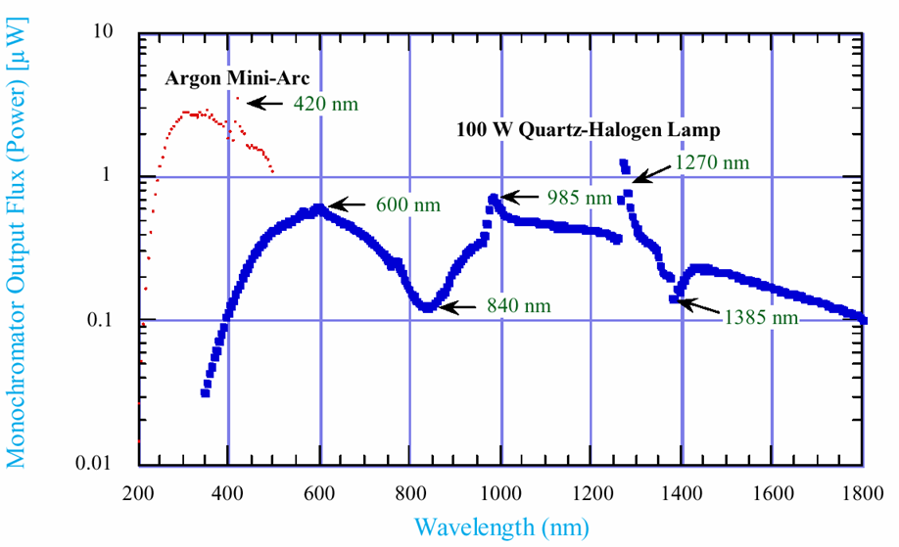
Spectral output flux of the UV and visible to near-IR monochromators

Slide 30
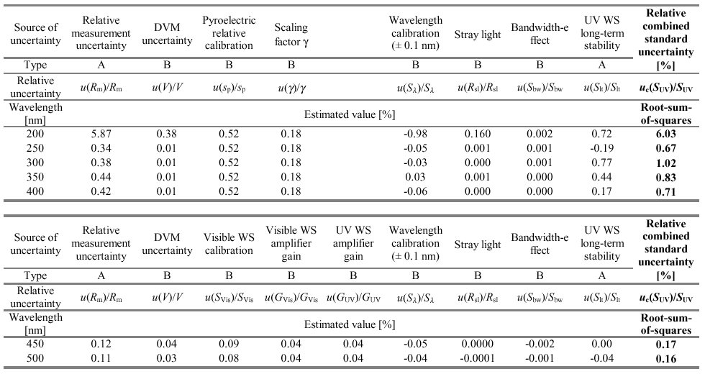
UV Working Standard Uncertainty
Transfer from Pyroelectric (relative) and Scaling with Visible WS (absolute).

Slide 31
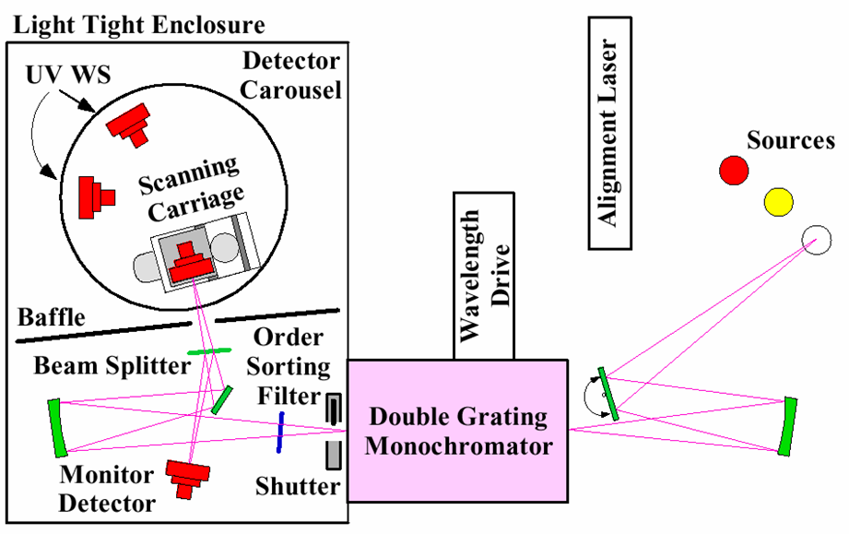
Ultraviolet Spectral Comparator Facility (UV SCF)

Slide 32
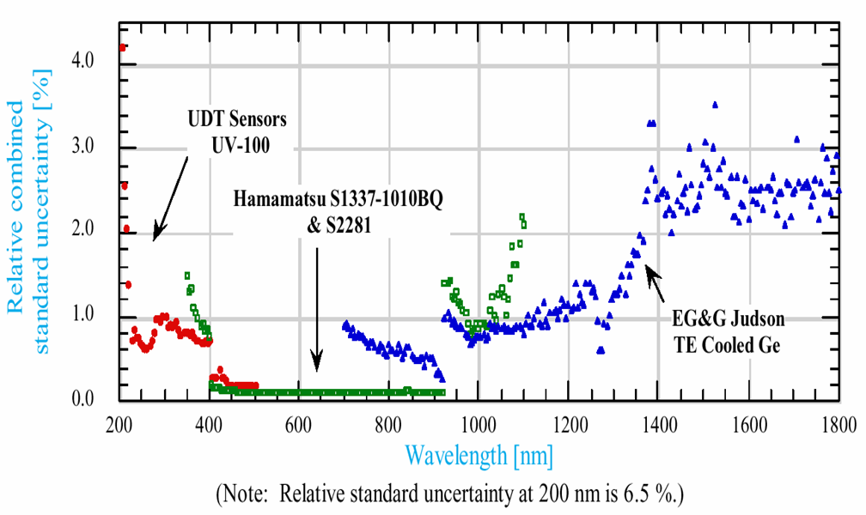
Transfer to test (customer) detectors relative combined standard uncertainty

Slide 33
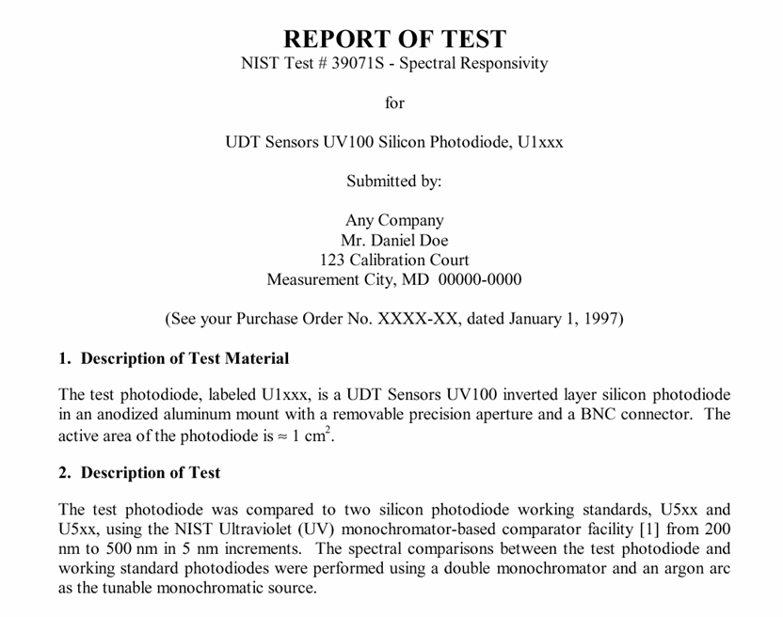
Example of “Report of Test”

Slide 34
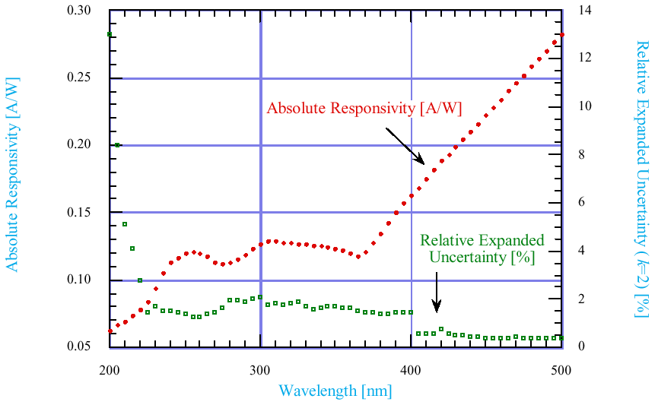

Absolute Spectral Responsivity of Silicon Photodiode U1xxx
2σ(%)
S=
λ=

Slide 35
Propagation Chain of Absolute Calibration of Photon Detectors
Standard Light Beam
Cryogenic Radiometer
Laser(s)
Trap Detector
Monochromator(s)
Pyroelectric Detector
NIST
NIST standard UV Si PD
Light Beam
Scattered Light
Dome Reflector
US
UV LED
Xe Lamp
Laser(s)
NIST standard UV Si PD
Reference PMT
Atmospheric Fluorescence
Particle Beam
Cosmic-ray Events
PMTs in Telescopes

Slide 36
Talk Outline
Introduction: Principle of PMT
NIST Standard Silicon Photodiode
Uncertainties, Concerns Specific to PMTs
Suggestions and Proposal to our Community

Slide 37
Uncertainties Specific to PMTs
PMTs are not perfect. There are many issues to be concerned:
Cathode and Anode Uniformity
Wave Length Dependence of QE
Photon Incident Angles
Effect of Magnetic Field
Non Linearity
Temperature Dependence
Long-term Stability

Slide 38
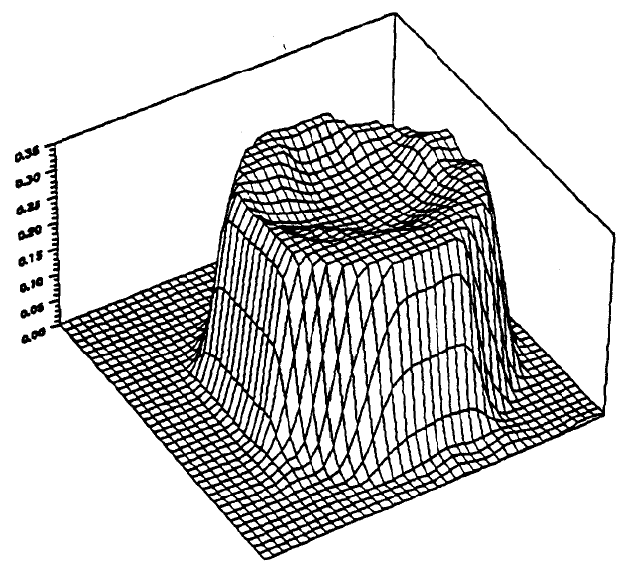
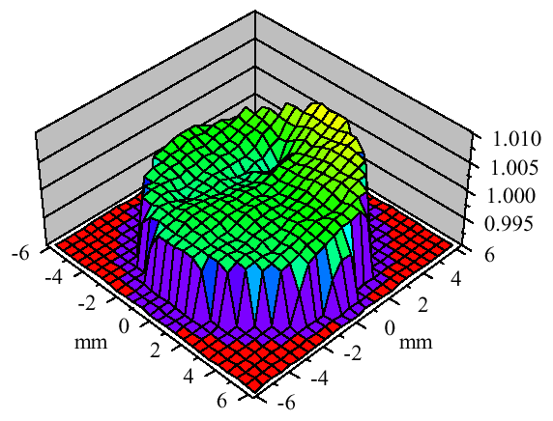
Cathode Uniformity and Area Correction
HiRes PMT
(Photonis XP3062)
4cm
NIST SiPD
(UDT UV100)
5mm
at λ=350nm
by HiRes (D.J. Bird et al.)

Slide 39
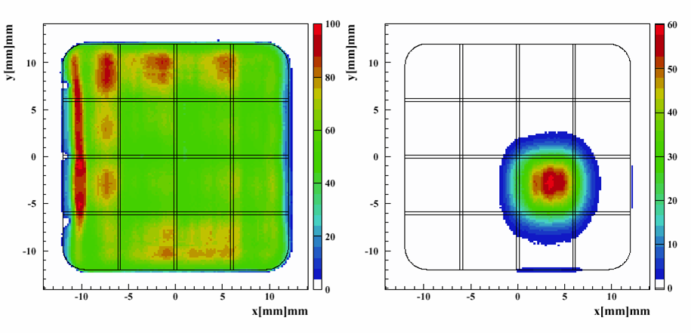
Sensitivity Map of 16-Pixel PMT for EUSO (R8900-M16F-S12)
Total Sum of 16 Pixels
Signal on One Pixel
by RIKEN/EUSO Focal Surface Subgroup

Slide 40
Typical QE of HiRes PMTs (Photonis XP3062)
355nm
337nm
370nm
420nm
YAG Laser
YAG Laser
N₂ Laser
UV LED
S_{KB}
Measured by Photonis

Slide 41
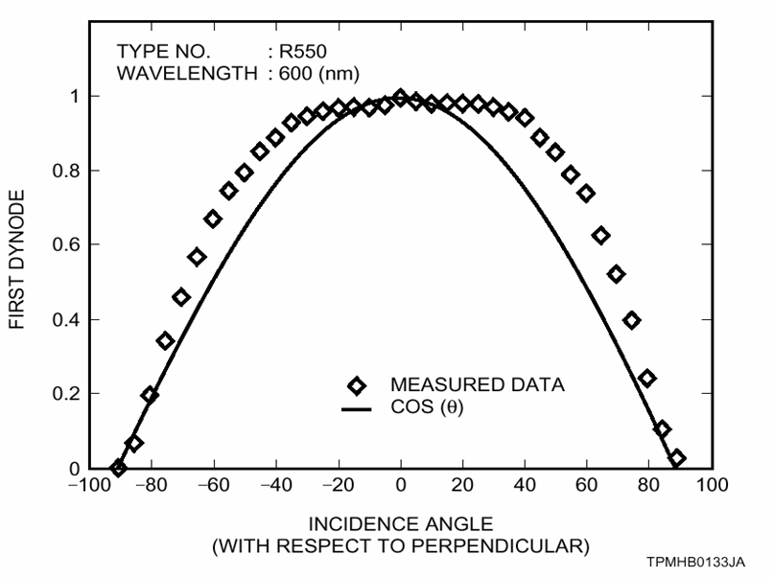
Typical Angle Dependence of QE
Telescope
From Hamamatsu PMT Handbook

Slide 42
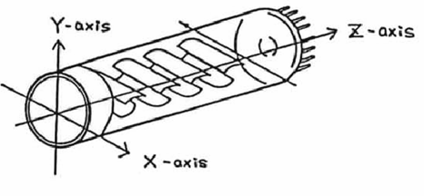
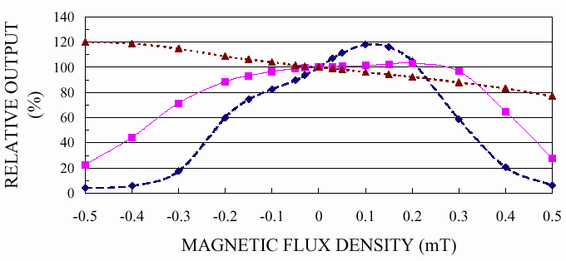
Effect of Magnetic Field on Liner-focus 2” PMT
Hamamatsu 2” PMT (R7281-01)
z
y
x
Earth B-Field

Slide 43
Linearity of ETL 8” PMT
at UCLA PMT Test Facility

Slide 44
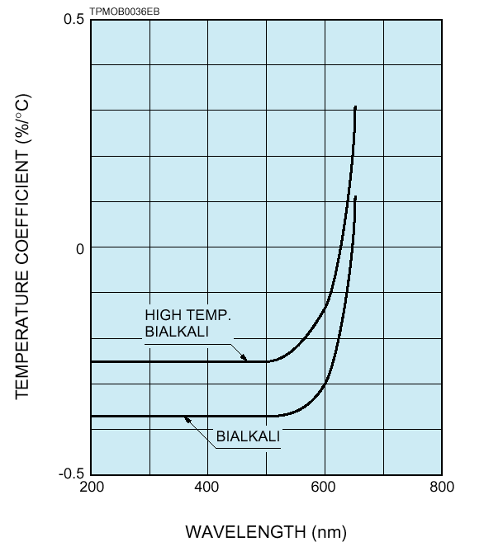
Typical Temperature Coefficients of Anode Sensitivity
-0.4%/ºC
From Hamamatsu PMT Handbook

Slide 45
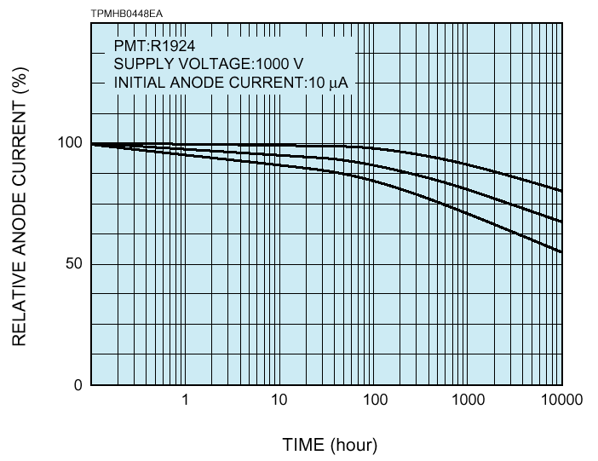
Typical Long-term Stability
From Hamamatsu PMT Handbook

Slide 46
PMT vs. Silicon Photo Diode
Source of Systematic Error | Si PD | PMT | Systematic Uncertainty
(Absolute) Quantum Efficiency | ~0.7 | 0.2-0.3 | 3%
Wave-length Dependence of QE | ±1% | ± 10% | 5%
Cathode Uniformity | ±1% | ±10% | 5%
Photo-Electron Collection Efficiency | 0.99 | 0.8-0.95 | 10%
Gain | 1.0 | 10⁵⁻⁷ | 5%
Voltage Dependence of Gain | None | ∝HV⁶ | 3%
Anode (Gain) Uniformity | ±1% | ±30% | 10%
Effect of Earth Magnetic Field | None | ±10% | 10%
Temperature Dependence | None | -0.4%/ºC | 3%
Incident Angle Dependence | ±1º | ±30º | 10%
Intensity Correction (ND filter) | 1 | 10⁻⁵ | 5%
Area Correction | 5mm φ | 5cm φ | 5%
Non Linearity | None | ±5% | 3%
Rate Dependence | None | ±5% | 3%
Long Term Stability | Stable | ±5%/year | 5%
Total Systematic Uncertainty | 1% |  | 25%

Slide 47
Talk Outline
Introduction: Principle of PMT
NIST Standard Silicon Photodiode
Uncertainties, Concerns Specific to PMTs
Suggestions and Proposal to our Community

Slide 48
UCLA PMT Test Facility
15 years of experience to develop and evaluate new PMTs.
KTeV CsI Calorimeter ¾” & 1½” Linear-focus
CDF Shower Max Multi-pixel (R5900-M16)
Auger SD 8-9” Hemispherical
We can measure:
(Absolute) Quantum Efficiency
Collection Efficiency
Gain and Dark Current vs. HV
Single PE Distribution
Excess Noise Factor
Cathode and Anode Uniformity
Dark Pulse Rate and After Pulse Rate
Temperature Dependence
Non Linearity

Slide 49
Proposal to Evaluate PMTs from HiRes, Auger-FD and EUSO at UCLA
We propose to evaluate the sample PMTs from:
Auger-FD
HiRes
EUSO
Beam Tests
Reference PMTs
We plan to add more equipments to measure:
Effect of Magnetic Field
Photon Incident-angle Dependence
Long-term Stability
…
Mutual Comparison

Slide 50
How to Minimize Systematic Uncertainties
Don’t try to measure QE, Collection Efficiency and Gain separately.
Just measure all three together (with a mirror, UV filter etc. as well). ⇒ “End-to-end Calibration”
Prepare the “absolutely-calibrated” light source.
Make sure that the “absolutely-calibrated” light source has the same characteristics as cosmic-ray fluorescence signals.
Same wave length
Same angular distribution on the PMT surface
Uniform over the PMT surface
Same pulse width and intensity
Calibrate in situ, monitor external environment.
Same (Earth) magnetic field
Same temperature
Same supplied HV

Slide 51
How to Minimize Systematic Uncertainties at Beam Tests
Don’t try to measure QE, Collection Efficiency and Gain separately.
Just measure all three together (with a mirror, UV filter etc. as well). ⇒ “End-to-end Calibration”
Prepare the “absolutely-calibrated” light source.
Make sure that the “absolutely-calibrated” light source has the same characteristics as beam test fluorescence signals.
Same wave length
Same angular distribution on the PMT surface
Uniform over the PMT surface
Same pulse width and intensity
Calibrate in situ, monitor external environment.
Same (Earth) magnetic field
Same temperature
Same supplied HV

Slide 52
Propagation Chain of Absolute Calibration of Photon Detectors
Standard Light Beam
Cryogenic Radiometer
Laser(s)
Trap Detector
Monochromator(s)
Pyroelectric Detector
NIST
NIST standard UV Si PD
Light Beam
Scattered Light
Dome Reflector
US
UV LED
Xe Lamp
Laser(s)
NIST standard UV Si PD
Reference PMT
Atmospheric Fluorescence
Particle Beam
Cosmic-ray Events
PMTs in Telescopes

Slide 53
How to absolutely calibrate the PMTs in Telescope
Prepare a stable light source and an “absolutely calibrated photon detector”.
Measure the “absolute photon flux” from the light source, going into the real telescope by the calibrated photon detector above.
Measure the PMT output signal (ADC counts) in the telescope.
Constantly monitor the relative change of the photon intensity from the calibration light source.

Slide 54
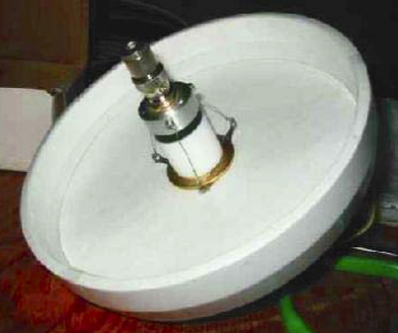
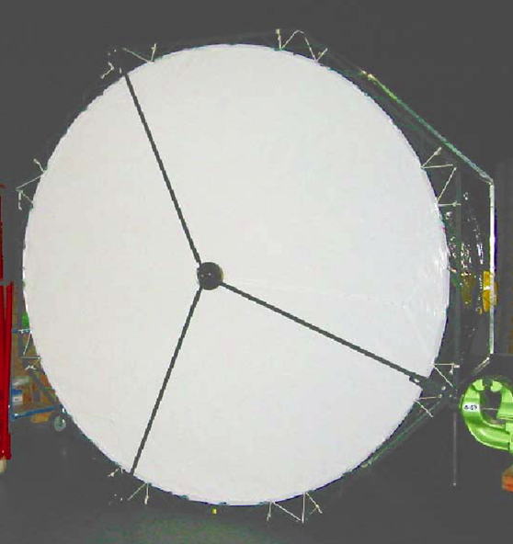
Light Source for Auger-FD
Drum (2.5m φ, 1,4m deep)
UV LED
Light Source (15cm φ)
By Jeff Brack

Slide 55
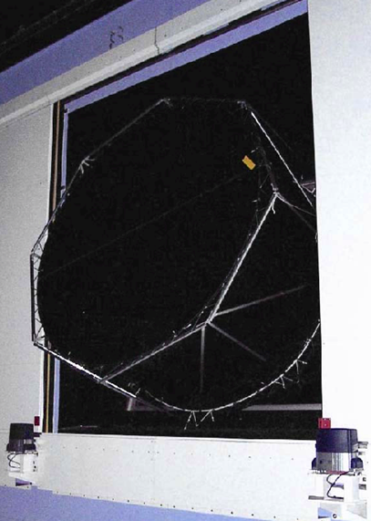
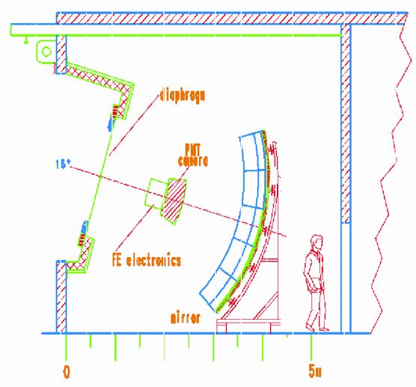
Drum mounted at the aperture of Bay 4 at Los Leones

Slide 56
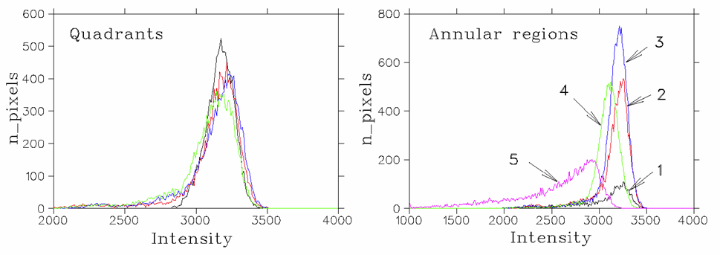
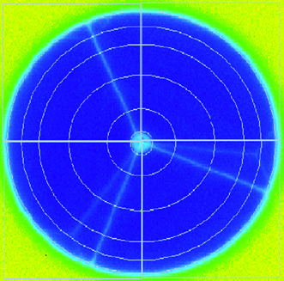
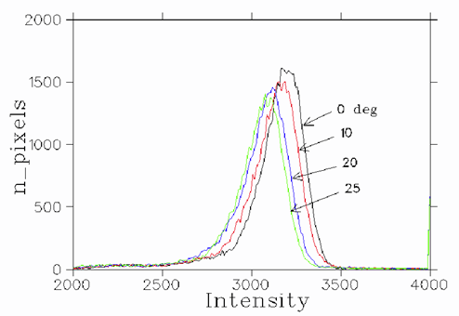
Uniformity of lights emitted from the Drum
By Jeff Brack

Slide 57
Systematic Uncertainty after End-to-end Calibration
Source of Systematic Error | Si PD | PMT | Sys. Uncertainty Before After
(Absolute) Quantum Efficiency | ~0.7 | 0.2-0.3 | 3% | 3%
Wave-length Dependence of QE | ±1% | ± 10% | 5% | 5%
Cathode Uniformity | ±1% | ±10% | 5% | -
Photo-Electron Collection Efficiency | 0.99 | 0.8-0.95 | 10% | -
Gain | 1.0 | 10⁵⁻⁷ | 5% | -
Voltage Dependence of Gain | None | ∝HV⁶ | 3% | 3%
Anode (Gain) Uniformity | ±1% | ±30% | 10% | 3%
Effect of Earth Magnetic Field | None | ±10% | 10% | -
Temperature Dependence | None | -0.4%/ºC | 3% | -
Incident Angle Dependence | ±1º | ±30º | 10% | 3%
Intensity Correction (ND filter) | 1 | 10⁻⁵ | 5% | 5%
Area Correction | 5mm φ | 5cm φ | 5% | 5%
Non Linearity | None | ±5% | 3% | 3%
Rate Dependence | None | ±5% | 3% | 3%
Long Term Stability | Stable | ±5%/year | 5% | 5%
Total Systematic Uncertainty | 1% |  | 25% | 12%

Slide 58
Conclusion
Absolute calibration of PMT (in Lab) is absolutely nontrivial. Don’t try it.
The most important is to develop the absolutely calibrated “standard candle” which exactly mimics the physics signal.
Then calibrate your telescope in situ.

Slide 59
Acknowledgements
Special thanks go to
Jeff Brack (Pierre Auger FD)
Stan Thomas (HiRes)
Hiro Shimizu (EUSO)
Yoshi Ohno (NIST)
Yuji Yoshizawa (Hamamatsu)
and Kai Martens for giving me this opportunity.
This talk is available at
http://www.physics.ucla.edu/~arisaka/hires/
pmt_calibration.pdf (2.6M)
pmt_calibration.ppt (3.3M)

