Slide 1
Summary of Beaune 2005
Katsushi Arisaka
University of California, Los Angeles
Department of Physics and Astronomy
arisaka@physics.ucla.edu

Slide 2
Outline
Focus on big picture:
New trend on scientific applications
Demands, specs on detectors
Major new technology
Fair comparison of detectors
My apologies for not including:
UV, X and direct Gamma detection
Readout electronics, systems
Friday’s talks

Slide 3
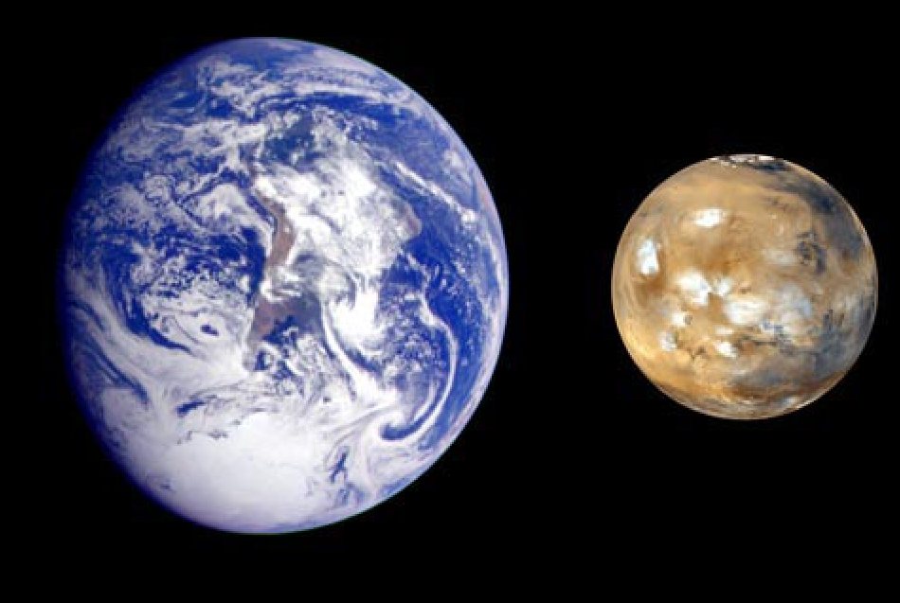
Why are we here?
F. Rocard

Slide 4
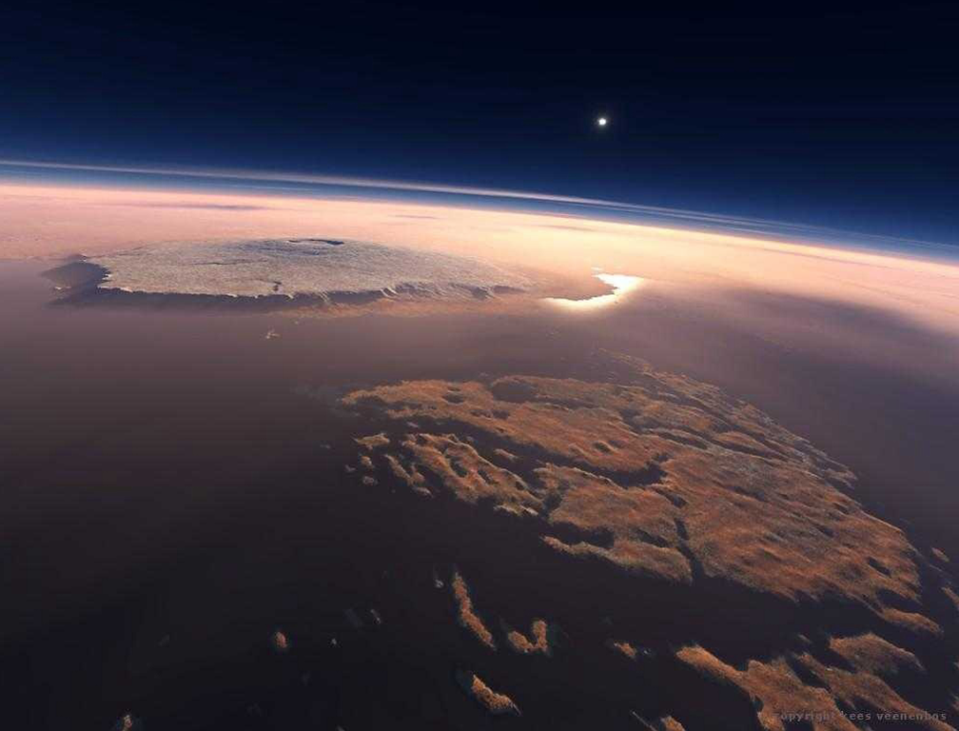
Are we alone?
F. Rocard

Slide 5
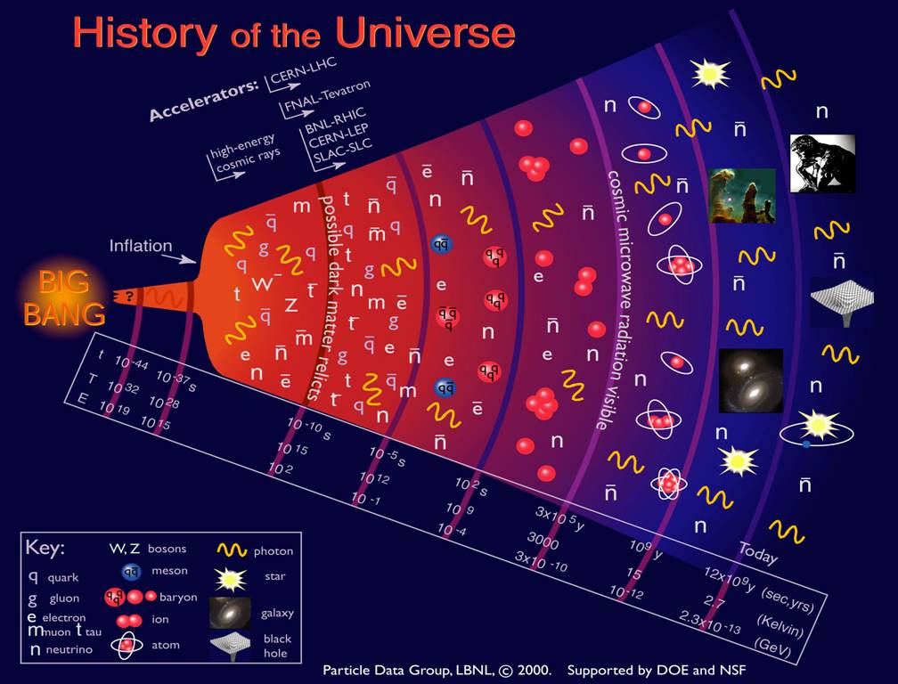

Slide 6
Science of 21st Century
Why are we here?
Origin of Ourselves
Origin of Life
Origin of the Solar System
…
Origin of the Universe
What is the most fundamental law in nature?
We rely on weak, fast photon signals.

Slide 7
Scientifics Applications
High Energy
Particle Astrophysics
Bio and Medical Imaging

Slide 8
High Energy
LHC
B-Factory etc.
ILC

Slide 9
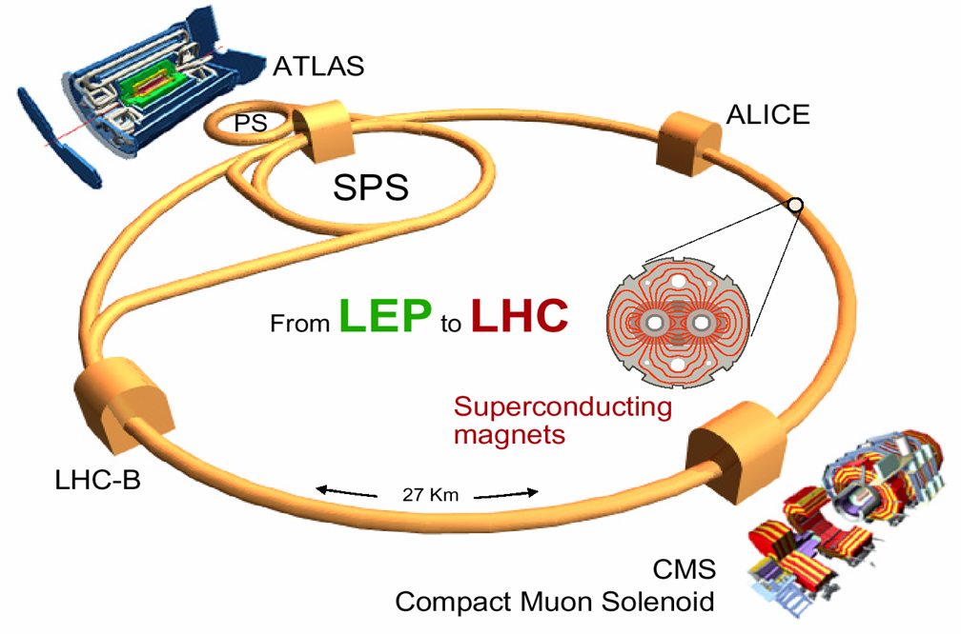
Large Hadron Collider (LHC)
Expected to start in 2008.

Slide 10
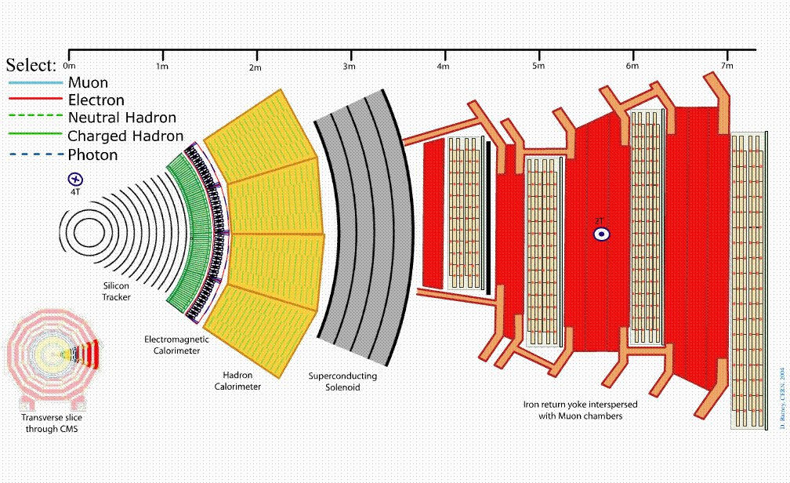
CMS Detector under 4 Tesla
EM
Hadron
4 Tesla
APD
HPD

Slide 11
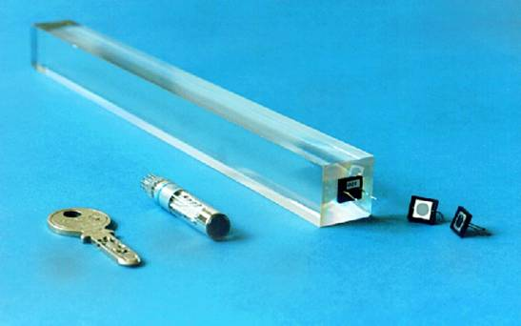
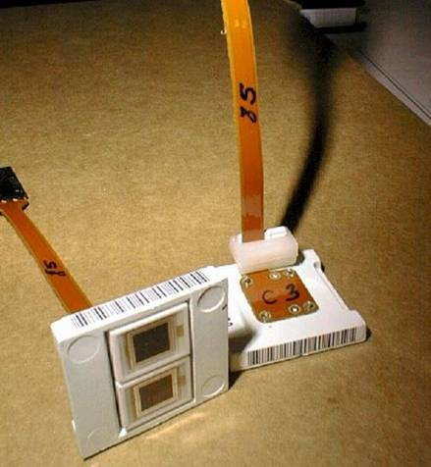
APD’s for CMS ECAL (HPK) (Beaune 2002)
Delivery from Hamamatsu started last year: ~37 000 APD`s delivered so far
Today’s APD is a result of about 10 years R&D with (EG&G and) Hamamatsu Photonics KK.

Slide 12
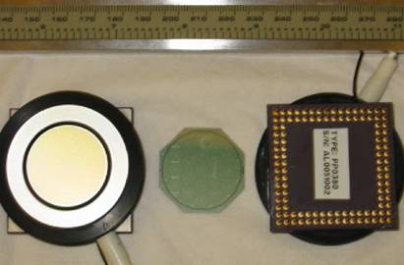
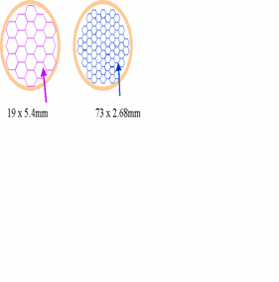
CMS HCAL Multi pixel HPD (DEP)
(Beaune 2002)
Photocathode (-10 kV)
Fiber-Optic
Window
3.4 mm
e
Ceramic feedthrough
PIN Diode
array
19 channel pixel layout
pixel size: 5.4 mm flat-flat
gap between pixels: 0.04 mm

Slide 13
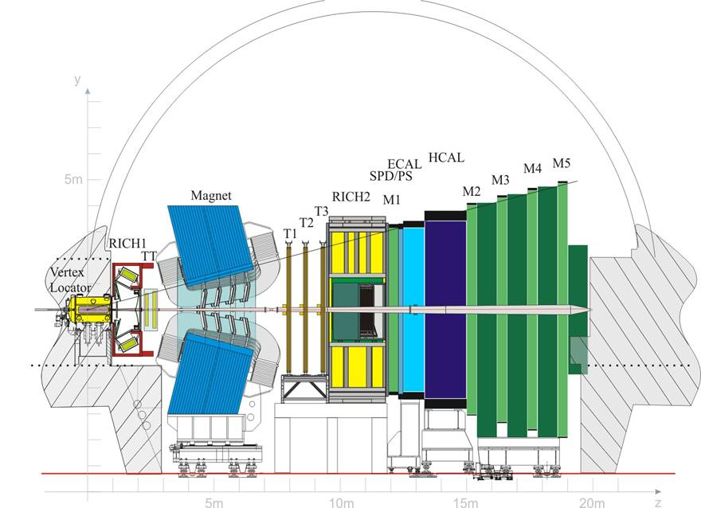
LHCb experiment
T. Gys

Slide 14
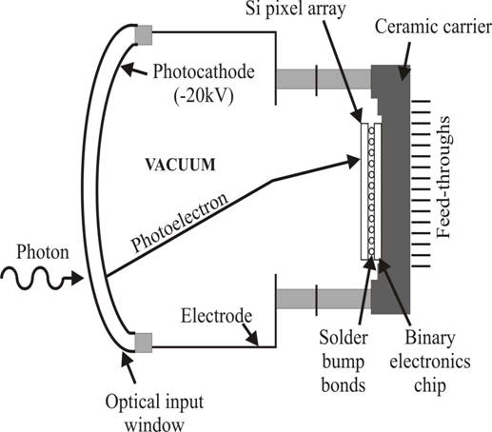
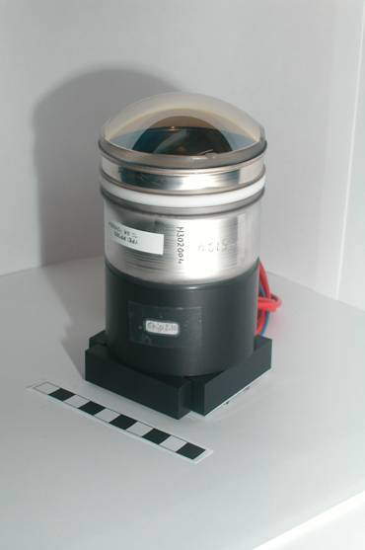
The pixel HPD by DEP
Advantages of this hybrid, pixel structure:
low noise: excellent resolution of single photoelectrons
high channel number/density
DEP, The Netherlands
K. Wyllie

Slide 15
Belle Spectrometer - PID
Large solid angle detector
at the KEKB e⁺ e⁻ collider
Particle identification:
TOF
dE/dx
ACC: threshold aerogel Cherenkov counter
P. Krizan

Slide 16
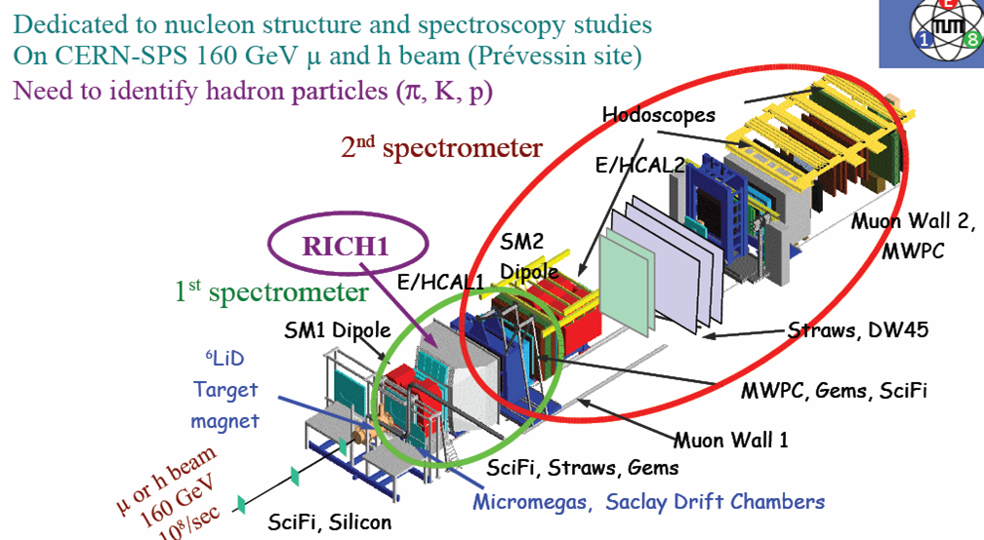
COMPASS at CERN
D. Neyret

Slide 17
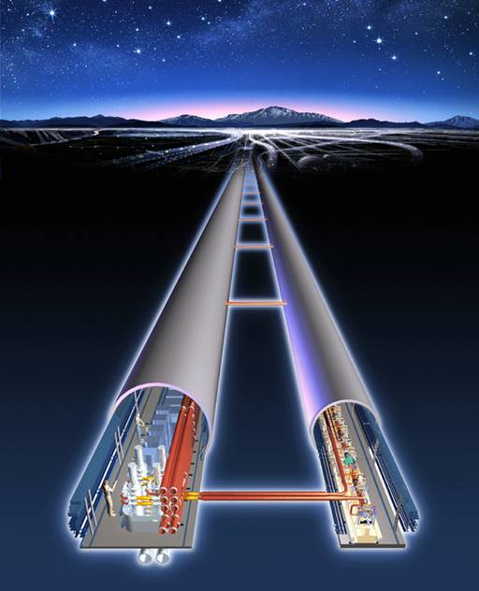
International Linear Collider
Electron/Positron collider .
Expandable, energies 0.5TeV to 1.5TeV.
10X larger than the Stanford Linear Accelerator.
Two detectors.

Slide 18
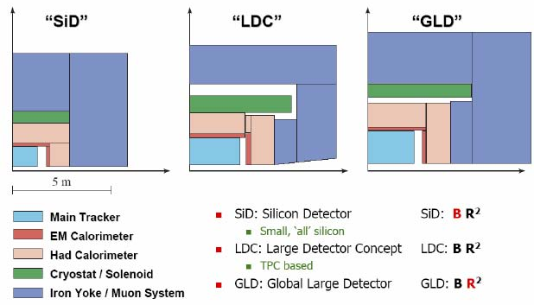
ILC Detector Concepts
5Tesla
2Tesla
D. Chakraborty

Slide 19
Particle Astrophysics
(Eckart Lorenz)

Slide 20
Multi-Messenger Exploration of Energy Frontiers
Energy Frontier of Particle Physics, Cosmology and Astronomy
Earliest Universe: Inflation, Planck Scale …
Extreme Universe: AGN, GRB, SN …
Need for Multi-Messenger Approach
Gamma ray Hess, MAGIC, GLAST …
Charged Particle Auger, EUSO …
Neutrino Super-K, Icecube…
Gravitational Wave LIGO, VIRGO, LISA …
Anti-Matter AMS, BESS…
Dark-Matter CDMS, Edelweiss …

Slide 21
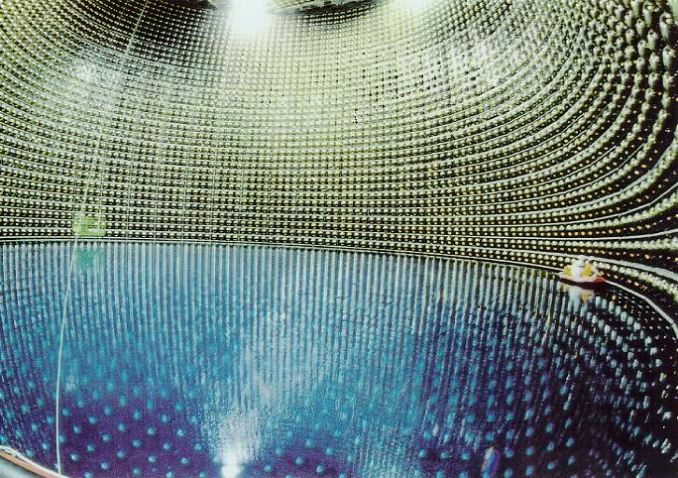
Super-Kamiokande
11,200 of 20” PMTs

Slide 22
Hyper Kamiokande, UNO
H. Nakayama

Slide 23
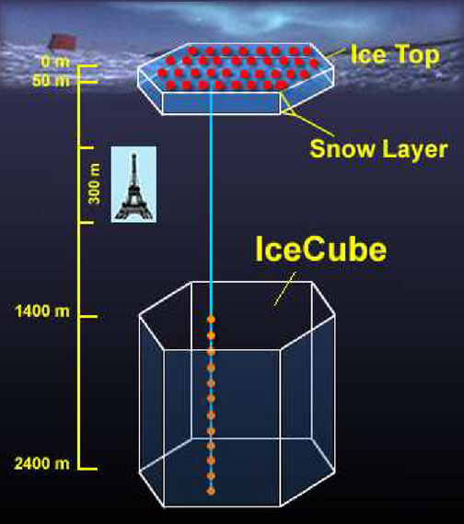
ICECUBE
60 PMTs/string x 80 strings
= 4,800PMTs
1 km

Slide 24
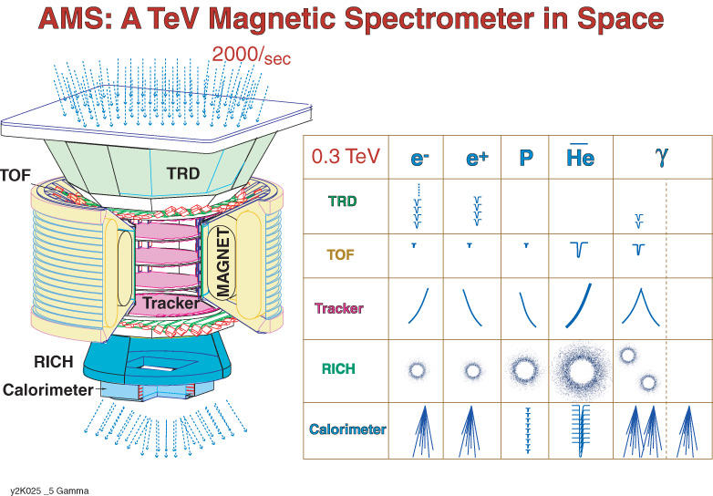
AMS - Anti-Matter Search
G. Paic

Slide 25
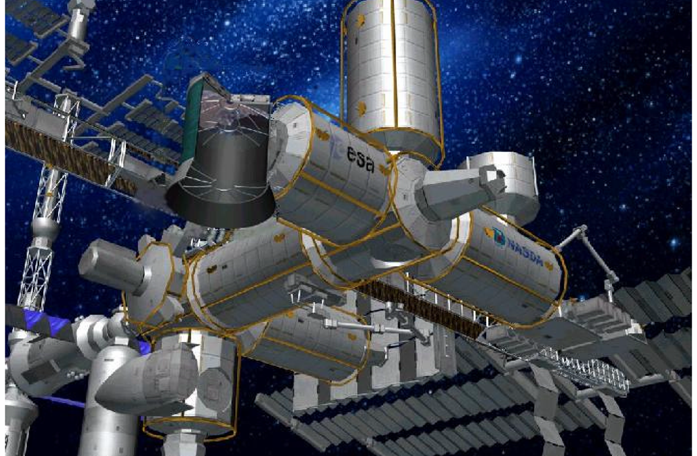
EUSO on International Space Station
EUSO
A. Petrolini

Slide 26
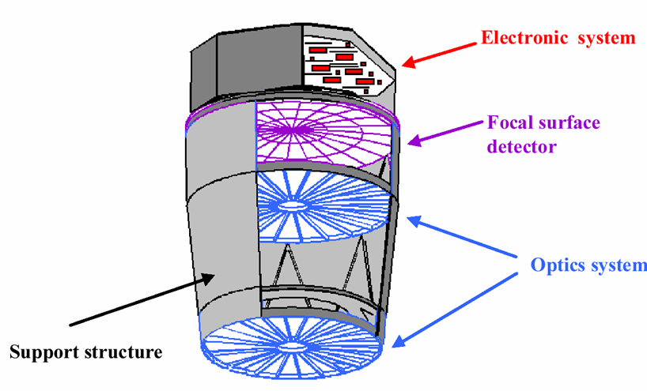
EUSO Detector
2.5m Diameter
60º FOV
f/1.25
Hamamatsu
R7600-M36
250k Pixel
A. Petrolini

Slide 27
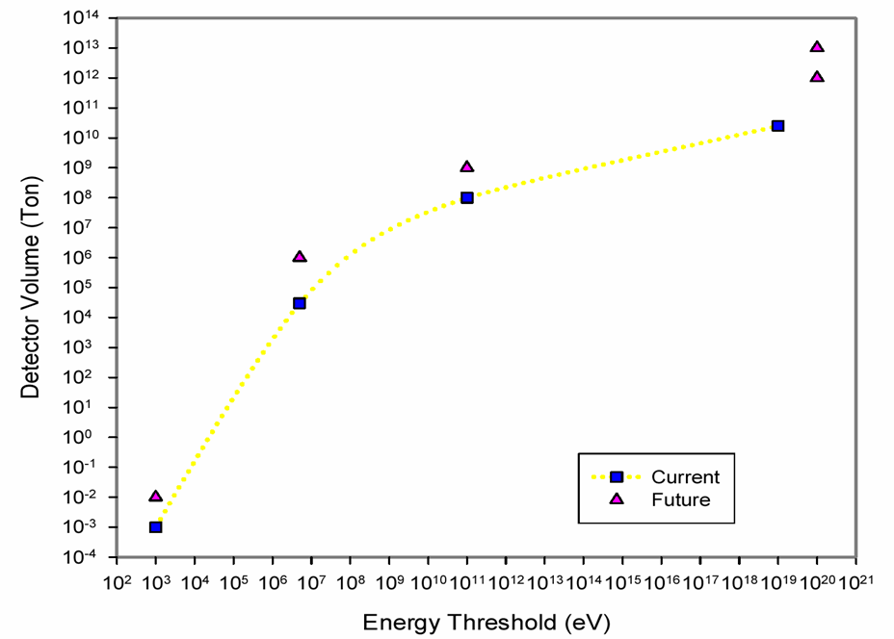
Detection of Cosmic Radiation
Larger Volume
Lower Threshold
OWL
EUSO
ICECUBE
Pierre-Auger
Hyper-K
AMANDA
Cosmic Ray
Neutrino
Super-K
Zeplin
Dark Matter
CDMS

Slide 28
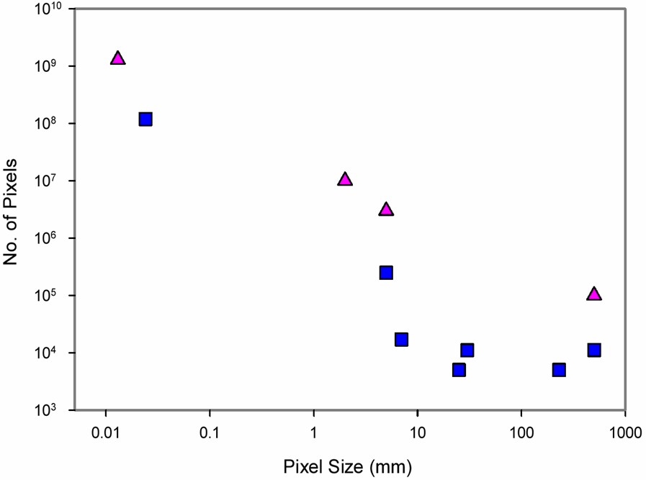
Photon Detector
LSST
More Pixels
Better Sensitivity
SDSS
OWL
CCD
γ Wide FOV
Hyper-K
PMT
EUSO
Auger-FD
Super-K
AMS
VERITAS
Auger-SD

Slide 29
Bio/Medical Imaging
SPECT & PET
Molecular Imaging

Slide 30
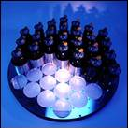
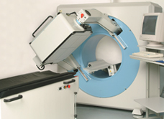
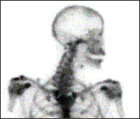
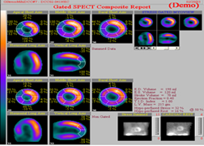
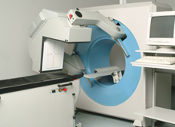
γ-Camera Today
Workhorse of nuclear medicine
Improvements:
Large imaging area (up to 91 PMTs)
Square & rectangular imaging FOV
Variety of configurations for specific needs
Digital signal processing → improved ΔE & Δx
Multiple heads
Rotating gantry for tomography (SPECT)
Bone scan
Cardiac SPECT imaging
512 x 512 HRLE Collimator (190 cpm/µCi)
^{99m}Tc Sestamibi 64 × 64 matrix 48 45-sec steps
Gated 8 frames/R-R
HRGP Collimator (250 cpm/µCi)
http://www.is2research.com/
R. Lecomte

Slide 31
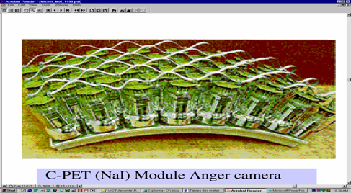
Anger Camera
Adam et al, J Nucl Med 42:1821-30, 2001
Large continuous NaI(Tl) bars
C-PET Module
Inexpensive
Isotropic spatial resolution
~5 mm FWHM
High energy resolution
Efficient scatter rejection
Poor stopping power
Limited count rate / high dead time
Excellent spatial resolution possible by reducing crystal thickness at the expense of sensitivity (Green et al)
Count rate performance can be improved by:
Local triggering
Slotted surface / Detector granularity
Faster scintillator
R. Lecomte

Slide 32
Crystals
Crystals | Density (g/cm³) | Light yield (ph/MeV) | Decay time (ns) | Maximum Emission lenght (nm) | ΔE/E (FWHM) PMT read-out
 |  |  |  |  | 662 keV ** | 140 keV
NaI:Tl | 3.67 | 41000 | 230 | 410 | 5.6 % | 8.5 %
CsI: Na | 4.51 | 40000 | 630 | 420 | 7.4 % | 9.5 %
CsI:Tl | 4.51 | 66000 | 800÷6×10³ | 550 | 6.6 (PMT)/ 4.3 (SDD) | 14 %
LaCl₃ :Ce | 3.79 | 49000 | 28 | 350 | 3.8 % | 8.0* %
LaBr₃ :Ce | 5.3 | 63000 | 26 | 380 | 2.8 % | 5.8 %
Bi₄Ge₃O₁₂ (BGO) | 7.1 | 9000 | 300 | 480 | 9.0 % | --
Lu₂SiO₅:Ce (LSO) | 7.4 | 26000 | 40 | 420 | 7.9 % | 18 %
Gd₂SiO₅:Ce (GSO) | 6.7 | 8000 | 60 | 440 | 7.8 % | 22 %
YAl O₃:Ce (YAP) | 5.5 | 21000 | 30 | 350 | 4.3 % (APD) | 20 %
** from C.W.E. van Ejjk Phys. Med. Biol. (2002) 85-106 * Expected values
R. Pani

Slide 33
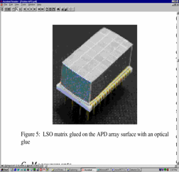
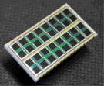
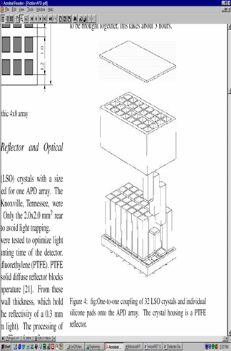
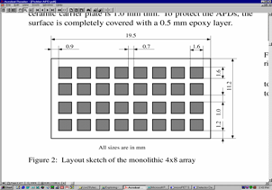
Individual Coupling & Independent Processing
Munich APD PET (MADPET II)
Pichler et al,
IEEE MIC 2000
4 × 8 APD Array (Hamamatsu Photonics)
2 × 2 × 6 mm³ LSO individually coupled
b ~ 0 mm → Intrinsic FWHM ~ 1.2 mm
PTFE
LSO
Good packing fraction
Poor light collection
3M foil
R. Lecomte
APD array

Slide 34
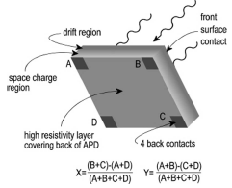
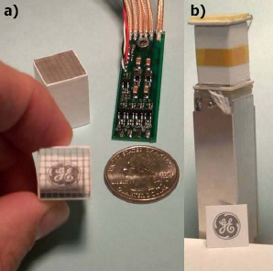
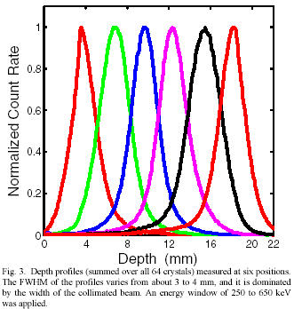
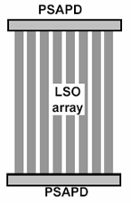
Dual APD Readout
PS-APD Module
Burr et al, IEEE NSS/MIC 2003
1.65 × 1.65 × 22 mm³ MLS crystals
8 × 8 array on dual 14 × 14 mm² PS-APDs
~ 3 mm FWHM DOI resolution
R. Lecomte

Slide 35
Intrinsic Spatial Resolution of PET Scanners
R. Lecomte

Slide 36
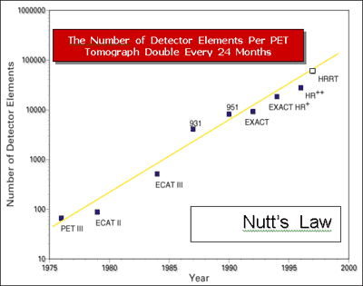
Nutts’ Law
R. Lecomte

Slide 37
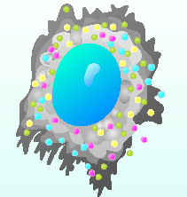
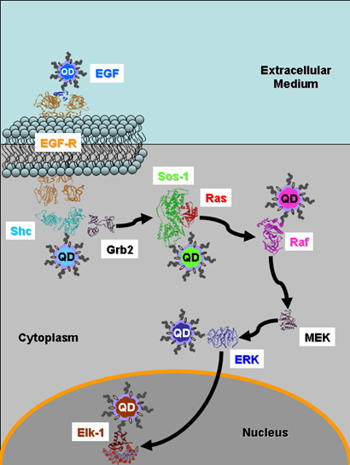
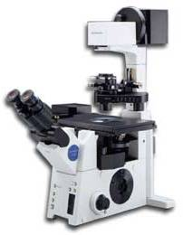
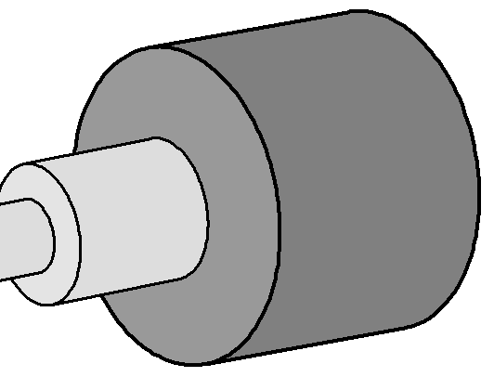
Single Molecule Imaging
It will permit to track multicolor qdot-labeled proteins in live cells virtually background-free
The H33D detector attaches to a standard fluorescence microscope
The H33D capabilities will allow protein-protein interaction, protein trafficking at the single-molecule level to be followed with nanometer resolution and arbitrary time-resolution
H33D
Laser
X. Michalet

Slide 38
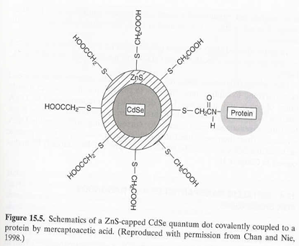
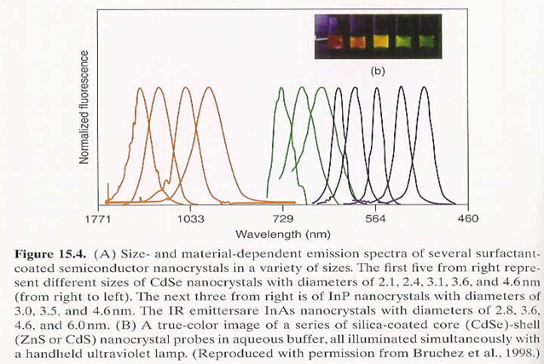
Emission of Quantum Dot
CdSe
InAs
InP
4.6nm
2.1nm

Slide 39
Schematic of the H33D detector
Sample excitation
(Laser)
~ ns
Sample emission
(dye, quantum dot)
h
ν
t (100 ps) + T (20 ns)
Photocathode
e
-
~ ps
MCP 1
…
X + Y + T = 3D
MCP n
XDL or XS Anode
e
-
cloud
Y
High spatial resolution: 100 um
High temporal res. : 100 ps
High throughput: 50 MHz
= H³
X
H33D = Heed = Attention, Notice
X. Michalet

Slide 40
General Requirements
Various Sizes
Large Area > 30 cm
Neutrino, Proton decay…
Coarse Pixel 1-5 mm
RICH, Tile Calorimeter, EUSO, PET…
Imaging < 100 μm
Astronomy, Single Molecule…
High Speed
TTS < 1 nsec
Rate > 1 MHz
Single Photon Counting
(Insensitive to Magnetic Field)
Los Cost !

Slide 41
New Developments on Detectors
Gaseous
PMT
Hybrid
Solid State

Slide 42
Gaseous Detector
(Amos Breskin)

Slide 43
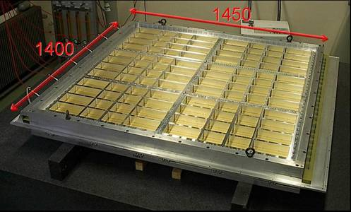
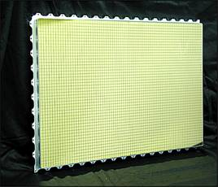
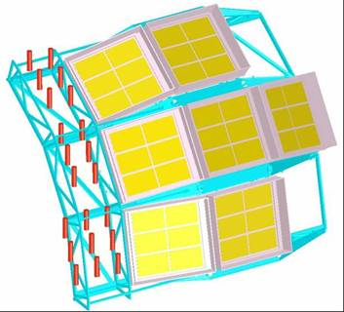
CERN-ALICE CsI-RICH
RICH: Ring Imaging Cherenkov UV-detectors for particle identification
1 element: 400 x 600 mm²
~2m²
HMPID 1st MODULE!
Single arm detector, radial distance of 4.9 m
|η| < 0.9, 5% of barrel acceptance
Proximity focusing (80 mm gap), 15 mm C₆F₁₄
radiator, 7 modules each with 6 CsI PC
Total active area ~12 m²
FEE: Gassiplex 0.7 μ, noise 1000 e⁻
CsI-RICH:
ALICE, HADES, COMPASS, J-LAB….
ALICE-RICH: 12m²
Amos Breskin

Slide 44
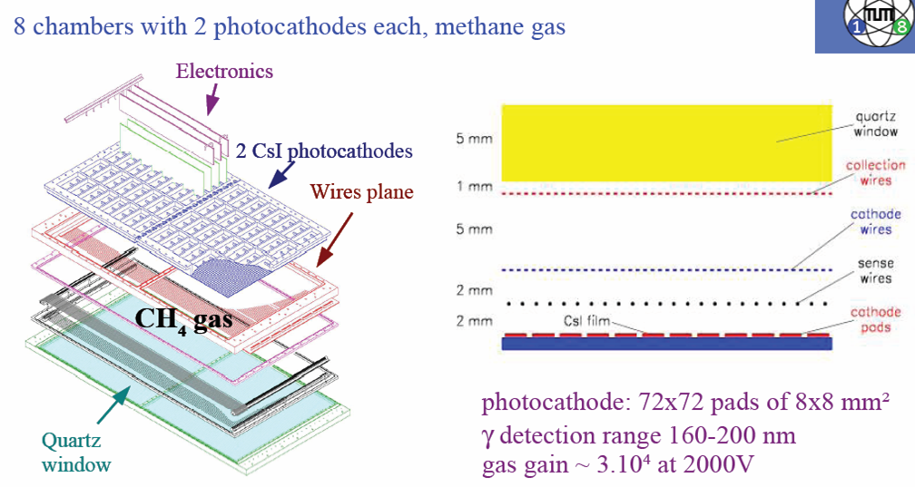
COMPASS RICH
D. Neyret

Slide 45
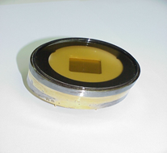
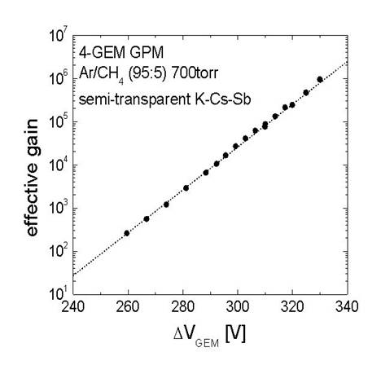
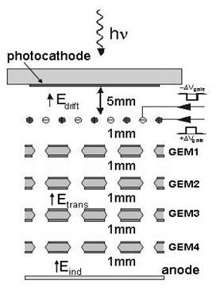

Gated GPM for visible light
GAIN: 100-1000 in DC mode (ion feedback limit)
~10⁶ in ion-gating mode
Ion gating
DC
A breakthrough!
A. Breskin et al. Physics/0502132
Amos Breskin

Slide 46



Ion Back-flow Reduction: Reversed-MHSP
MHSP: 2-step gain & some ion blocking
R-MHSP: hole-gain & ion defocusing
from successive multiplier*
∗ R-MHSP: Roth, Vienna 04
R-MHSP
Ion blocking:
Breskin et al. physics/0502132
Veloso et al. physics/0503237
C
Α
+
Simulations:Oleg Bouianov
Amos Breskin

Slide 47


A Very Flat Gaseous Imaging PM
~10mm
hν
readout
photocathode
THGEM
100x100mm² THGEM
With 2D delay-line readout
φ 0.3mm holes
Amos Breskin

Slide 48
Photomultiplier
High QE Alkali
Multi Pixel, Flat PMT

Slide 49

Hamamatsu High QE Photocathode
40
Bialkali Photocathode
New Process
35
30
25
Quantum Efficiency [%]
Standard
20
15
10
new process BEST | 37 %
new process TYPICAL | 34 %
standard typical | 27.5 %
5
ＢＧＯ
ＮaＩ(Tl)
0
200
300
400
500
600
700
800
(at 360 nm)
Wavelength [nm]
Hamamatsu / Y Yoshizaawa

Slide 50
Improved QE of Photonis 9 inch PMT
Quantum efficiency (400 nm)
- Standard: ~26%
- Improved: ~32%
+ 19%
Quantum efficiency (600 nm)
- Standard: ~1.6%
- Improved: ~6.3%
+ 75%
Extension of the spectral sensitivity in the red region
UV
D. Dornic

Slide 51


Hamamatsu Flat Panel PMT
H8500 (2 inch square)
3 x 3 array
Pixel Size : 6 x 6 mm
500 tubes were delivered since 2002
for Medical, Radiation monitor and HEP.
Hamamatsu / Y. Yoshizaawa

Slide 52

Burle Flat MCP PMT
BURLE 85011 MCP-PMT:
multi-anode PMT with 2 MCPs
25 mm pores
bialkali photocathode
gain ~ 0.6 x 10⁶
collection efficiency ~ 60%
box dimensions ~ 71mm square
64(8x8) anode pads
pitch ~ 6.45mm, gap ~ 0.5mm
active area fraction ~ 52%
P. Krizan

Slide 53
Hybrid Detector
GaAsP HAPD
Multi Pixel
Large Area

Slide 54

HPD with 18-mm GaAsP Photocathode by Hamamatsu
Designed for MAGIC-II camera
<Parameters>
Photocathode | GaAsP (for high QE)
Cathode Size | 18 mm [old < 8 mm]
Avalanche Diode | 3 mm Silicon
Sensor shape | hexagonal 28 mm
 | 39 mm height
M. Hayashida

Slide 55

QE of GaAsP + WLS
M. Hayashida

Slide 56
Hybrid Photon Detectors (HPD)
light quantum
photocathode
Gain:
Gain is achieved in a single
dissipative step !
e
-
focusing
D
V
electrodes
silicon
sensor
+ FE
U_{C} = 20 kV → G ~ 5000
electronics
segmented
silicon
sensor
C. Joram

Slide 57


DEP Hybrid Photodiode (HPD) (Beaune 2002)
Baseline design for LHC-b RICH
8cm diameter
61 Pixel, (5mm view)
T. Gys

Slide 58

HPD pre-series (9 tubes): performance results
Item | Specification | Results
Pixel response | >95% | >99%
Min. threshold Noise | <2000e- <250e- | Typ. 1200e- Typ. 160e-
Leakage current | Typ. 1uA @ 80V bias | < 1uA
Dark count rate | Max. 5kHz/cm² | 0.03–3kHz/cm²
Ion feedback rate | Max. 10-2 rel. to signal | <10-3
P.e. detection efficiency | Typ. 85% | 79-89%
Quantum efficiency | See next picture | Generally well above specs
T. Gys

Slide 59

Multi-pixel HAPD (8x8 matrix)
43mm in diameter
Effective Area
FOP with Multialkali
16mm
15
mm
16mm
APD Format
R9503U-04-M064
8x8 Matrix (64 Pixels)
2x2 mm / Pixel
Hamamatsu / Y. Yoshizaawa

Slide 60

RMD Position Sensitive HAPD
Proximity design
14 x 14 mm² PSAPD
High gain 10⁶ to 10⁷
320 μm with ~5 photons/pulse
8 x 8 CsI:Tl, 1 mm pixel CsI:Tl imaged at 23 °C with ²⁴¹Am (60 keV).
M. McClish, K.S. Shah, R. Grazioso, J. Glodo, R. Farrell, E. Karplus, R. Benz, “A hybrid position sensitive avalanche photodiode detector for scintillation spectroscopy and imaging,“ IEEE NSS Conf. Rec. Oct. 19-25, 2003, Portland, OR.
RMD / M. McClish

Slide 61

13inch HAPD by Hamamatsu
 | 13inch | 5inch
Diameter | 332mm | 128mm
Effective area | 240mmφ | -
APD size | 5mmφ | 3mmφ
APD type | Low capacitance (~70pF) | Low capacitance (~30pF)
Bias max | 370V | 350V
HV max | +12kV | -8.5kV
H. Nakayama

Slide 62


HPD developed and built at CERN
5-inch → 10-inch
254 mm Ø, D ~ 4,
2048 channels 1mm²
bialkali photocathode
NIM A 504 (2003) 19
NIM A 518 (2004) 574-578
127 mm Ø, D ~ 2.5,
2048 channels 1mm²
bialkali photocathode
NIM A 442 (2000) 128-135
NIM A 478 (2002) 400-403
www.cern.ch/ssd/HPD
C. Joram

Slide 63


C2GT Optical Module (38cmφ)
Al coating
2 rings
C. Joram

Slide 64


Development of Other Vacuum Devices
~1960
~2000
Production Cost: < $1,000 per m²
D. Ferenc

Slide 65
Light Amplifier Concept
Scintillators + fiber optics
NO electronics in the vacuum
Resolution determined outside !!
READOUT ➔
APD array
D. Ferenc

Slide 66
Solid State Detector
APD
SiPM

Slide 67
Planar Process for APD Fabrication
Standard Wafer
Grooved Wafer
Deep Diffusion
into Si wafer,
p-n-p
Si Removal
HV
HV
Bevel Formed
Wafer Diced
R. Farrell, K.S. Shah, K. Vanderpuye, R. Grazioso, R. Myers, G. Entine “APD arrays and large-area APDs via a new planar process,” Nuc. Inst. Meth. Phys. Res. A, Vol. 442, pg. 171, 2000.
RMD / M. McClish
Notes:
Mention manual beveling being tedious and causing high cost.
Mention grooved wafer, affecting doping profile, surface passivation, diced and plated with electrodes.

Slide 68

Position Sensitive and Discrete APDs
8 x 8 mm² PSAPD
45 cm² Planar APD
RMD / M. McClish

Slide 69

Fabrication for Position Sensitivity
-HV
K.S. Shah, R. Farrell, R. Grazioso, E. Harmon, E. Karplus, “Position-sensitive avalanche photodiodes for gamma-ray imaging,” IEEE Trans. Nuc. Sci., Vol. 49, No. 4, August 2002
RMD / M. McClish
Notes:
Mention how algorithm causes a pin cushion distortion, but can be corrected in software or using a look-up table.

Slide 70




RMD APD for PET Applications
28 x 28 mm² PSAPD coupled to 7 x 7 LSO array with 3 mm pixels at –20 °C. Average energy resolution = 15.5% at 511 keV.
COUNTS
8 x 8 mm² PSAPD coupled to 6 x 6 LSO array with 1 mm pixels at 23 °C. Average energy resolution = 16% at 511 keV.
COUNTS
CHANNELS
RMD / M. McClish
Notes:
Mention image distortion and how cooling is needed for larger devices due to their increased noise from increased current leakage.

Slide 71






Silicon Photomultiplier (from Beaune 2002)
Gain~10⁶
ENF=1.0
DQE~10%
P. Buzhan, B. Dolgoshein et. al.

Slide 72

Long History of SiPM
At present many people consider that the new APDs with
inner microstructures are very easy devices. To my mind, the way to micro-pixel APDs was not easy. This development took about 20 years.
Different generations of silicon avalanche structures produced in 1983-2005.
MOS and MRS type APDs.
1983-1993.
MRS and CCD type APDs.
1994-2001.
CCD and MW type APDs.
2002- present
Z. Sadygov

Slide 73







Various SiPM
Y. Musienko, V. Saveliev

Slide 74




SiPM Layout
CPTA SiPM
General view 1x1 mm,
Common Electrode Layout,
Microcells with Quenching Mechanism,
Pulsar SiPM
(LCWS2004, M.Danilov ITEP,Moscow )
V. Saveliev

Slide 75

PE Distribution of Various SiPM
Y. Musienko

Slide 76

SiPM Performance
Detection Efficiency – Wavelength Dependent:
QE of Hamamatsu Photonic APD
Efficiency of Si-PM
UV region of SiPM
is limited by dead layers on the top of structure
Geometry
IR region of SiPM
Thickness of Dead Layer
is limited by the thickness of sensitive layer of SiPM
Thickness of Sensitive Layer
Absolute value scaling
is limited by geometry factor
The Si-PM has green light sensitivity
and total Detection Efficiency for green range of light is ~25%
V. Saveliev

Slide 77

QE of Various SiPM
Reference PMT
Y. Musienko

Slide 78
Optical Cross Talk of 1mm² SiPM
32 μm
64 μm
96 μm
128 μm
B.Dolgoshein

Slide 79
Dark Rate of 1mm² SiPM
1 MHz / mm²
B.Dolgoshein

Slide 80


Future of SiPM
Combination of the Sensors and FE Electronics in the same technology Process.
(IEEE STQE, v10, Jul-Aug, 2004,C.Niclass)
V. Saveliev

Slide 81


Large Area SiPM
SiPM 3x3 mm², 5625 pixels
Larger area (up to 10x10 mm²) is required for a number of applications:
astroparticle physics
PET
Particle physics
. . .
B.Dolgoshein

Slide 82



SiPMs in ILC Tile HCAL Prototype
Tile with milled groove for WLS and precise hole for SiPM installation
SiPMs
1156 pixels
1x1 mm²
The first HCAL prototype cassette
3
5±0.03
40 Cassettes will be required
Precise ceramic plate
E. Popova

Slide 83



Production for ALICE CRF
Akindinov et al., High-efficiency and low noise scintillation detector for ionizing particles START (Scintillation Tile with MRS APD Light ReadouT)
A. Akindinov

Slide 84


SiPM’s in space ! International Space Station: launched by 15th of April,2005
Space experiment “LAZIO”(MEPHI-INFN Collaboration)
Latitude particle flux dependence
Scientific goal:The measurement of low energy particle fluxes and radiation monitoring by apparatus,including sci tile+WLS fiber+SiPM hodoscope system
B.Dolgoshein

Slide 85
Final Comparisons
QE
TTS
Energy Resolution
Cost

Slide 86

Quantum Efficiency (Beaune 1999 )
→ 2002
→ 2005
GaAs-Blue
GaAs
Bi-Alkali
SiPM
K. Arisaka

Slide 87

Time Resolution vs. Sensitive Area (Beaune 1999 )
→ 2005
HPD
SiPM
K. Arisaka

Slide 88

Effect of Magnetic Fields (Beaune 1999 )
→ 2005
HPD
APD
SiPM
Solid
State
MCP
PMT
Linear
Focus
Metal
Channel
Fine
Mesh
CMS
K. Arisaka

Slide 89

Equivalent Noise Charge (ENC) after CRRC^{n}
A useful formula : ENC (e- rms) after a CRRC² shaper :
e_{n} in nV/ √Hz, i_{n} in pA/ √Hz are the preamp noise spectral densities
C_{tot} (in pF) is dominated by the detector (C_{d}) + input preamp capacitance (C_{PA})
t_{p} (in ns) is the shaper peaking time (5-100%)
ENC = 174 e_{n}C_{tot}/√t_{p} (δ) ⊕ 166 i_{n}√t_{p} (δ)
Noise minimization
Minimize source capacitance
Operate at optimum shaping time
Preamp series noise (en) best with high trans-conductance (g_{m}) in input transistor
=> large current, optimal size
C. De La Taille

Slide 90
Energy Resolution (σ/E)
In ideal case:
In reality:
Nγ Number of incident photons
QE Quantum Efficiency
CE Collection Efficiency:
ENF Excess Noise Factor (from Dynodes)
ENC Equivalent Noise Charge (Readout Noise)
G Gain
K. Arisaka

Slide 91
Summary Table (Beaune 1999)
 | QE | CE | δ_{i} | ENF | G | ENC | σ/E
Ideal | 1.0 | 1.0 | 1000 | 1.0 | 10⁶ | 0 | √1/N
PMT | 0.25 | 0.9 | 10 | 1.3 | 10⁶ | 1000 | √5.8/N
PD | 0.7 | 1.0 | - | 1.0 | 1 | 1000 | √1.4/N+(1400/N)²
APD | 0.7 | 1.0 | 2 | 2.0 | 100 | 1000 | √2.9/N+(14/N)²
HPD | 0.25 | 0.9 | 1000 | 1.0 | 10³ | 1000 | √4.4/N+(4.4/N)²
HAPD | 0.25 | 0.9 | 1000 | 1.0 | 10⁵ | 1000 | √4.4/N
VLPC | 0.7 | 1.0 | 1000 | 1.0 | 10⁵ | 1000 | √1.4/N
K. Arisaka

Slide 92
Summary Table (Beaune 2005)
 | QE | CE | δ_{i} | ENF | G | ENC | σ/E
Ideal | 1.0 | 1.0 | 1000 | 1.0 | 10⁶ | 0 | √1/N
PMT | 0.35 | 0.9 | 10 | 1.3 | 10⁶ | 200 | √3.8/N
PD | 0.7 | 1.0 | - | 1.0 | 1 | 200 | √1.4/N+(280/N)²
APD | 0.7 | 1.0 | 2 | 2.0 | 100 | 200 | √2.9/N+(2.9/N)²
HPD | 0.5 | 0.9 | 1000 | 1.0 | 10³ | 200 | √2.2/N+(0.4/N)²
HAPD | 0.5 | 0.9 | 1000 | 1.0 | 10⁵ | 200 | √2.2/N
SiPM | 0.7 | 0.4 | 1000 | 1.3 | 10⁶ | 1000 | √4.3/N
VLPC | 0.7 | 1.0 | 1000 | 1.0 | 10⁵ | 200 | √1.4/N
K. Arisaka

Slide 93
Resolution (over Poisson Limit) (Beaune 1999)
HPD
APD
PMT
TOF
RICH
Hardon
Calorimeter
EM Calorimeter
K. Arisaka

Slide 94
Resolution (over Poisson Limit) (Beaune 1999)
HPD
APD
PD
PMT
HAPD
VLPC
K. Arisaka

Slide 95
Resolution (over Poisson Limit) (Beaune 2005)
APD
PD
SiPM
PMT (35% QE)
G-APD
HPD (50% QE)
HAPD
VLPC
K. Arisaka

Slide 96

Market Price (Beaune 1999 )
→ 2005
HPD?
Silicon
SiPM?
K. Arisaka

Slide 97
Katsushi’s Dream Detector
(at Beaune 1999, 2002)
Glass Window (1mm^{t})
Solid State Photo Cathode
APD Array
(32 x 32 = 1024 Pixel)
Ceramic Case
Readout Electronics
LV
Optical Fiber for
Signal Readout
HV
47.6mm
50.5mm
1.4mm Pixel Size
32 x 32 = 1,024 Pixels
QE ~ 50% at 350 ~ 500nm
Gain ~10⁵

Slide 98
Katsushi’s Dream Detector
(at Beaune 2005)
Glass Window (1mm^{t})
Solid State Photo Cathode
APD Array
(1024 x 1024 = 1M Pixel)
Ceramic Case
Readout Electronics
LV
Optical Fiber for
Signal Readout
HV
50.2mm
52.5mm
50 μm Pixel Size
1024 x 1024 = 1M Pixels
QE ~ 80% at 300 ~ 800 nm
Gain ~10⁵

Slide 99
Concluding Remarks
Areas of interests at Beaune 2005:
SiPM
Large area HPD
Integrated front-end electronics
Future direction will be driven by
Broader markets (outside of Physics)
Low Costs

