Slide 1
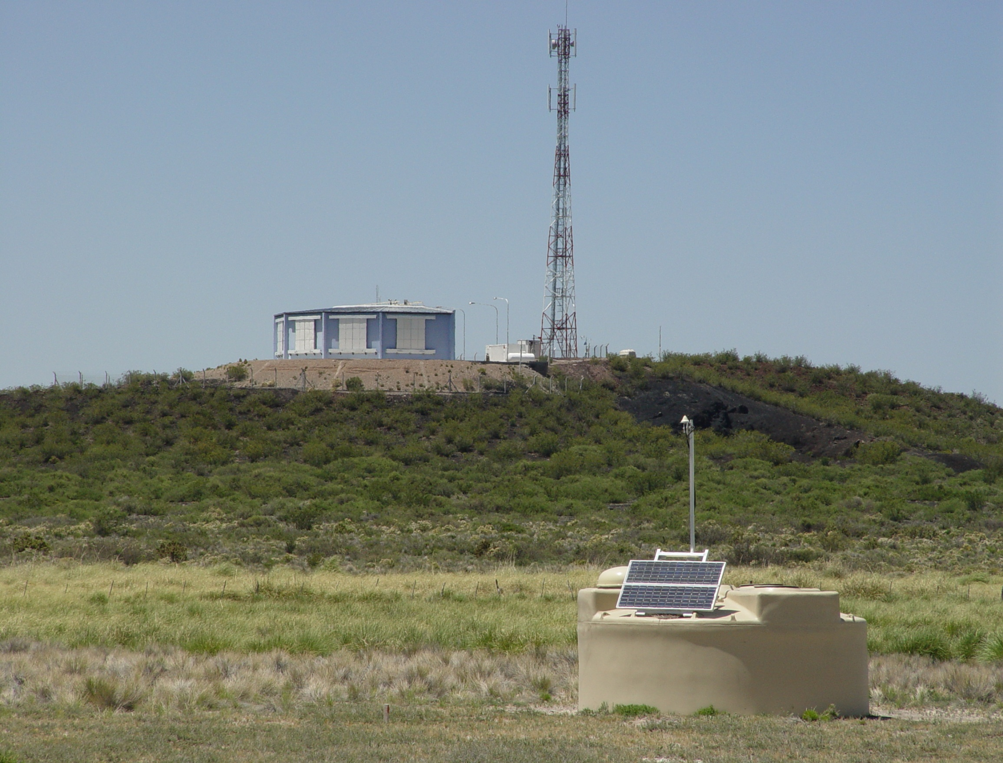
Origin of the Most Energetic Particles in the Universe: New Results from Pierre-Auger
Katsushi Arisaka
UCLA

Slide 2
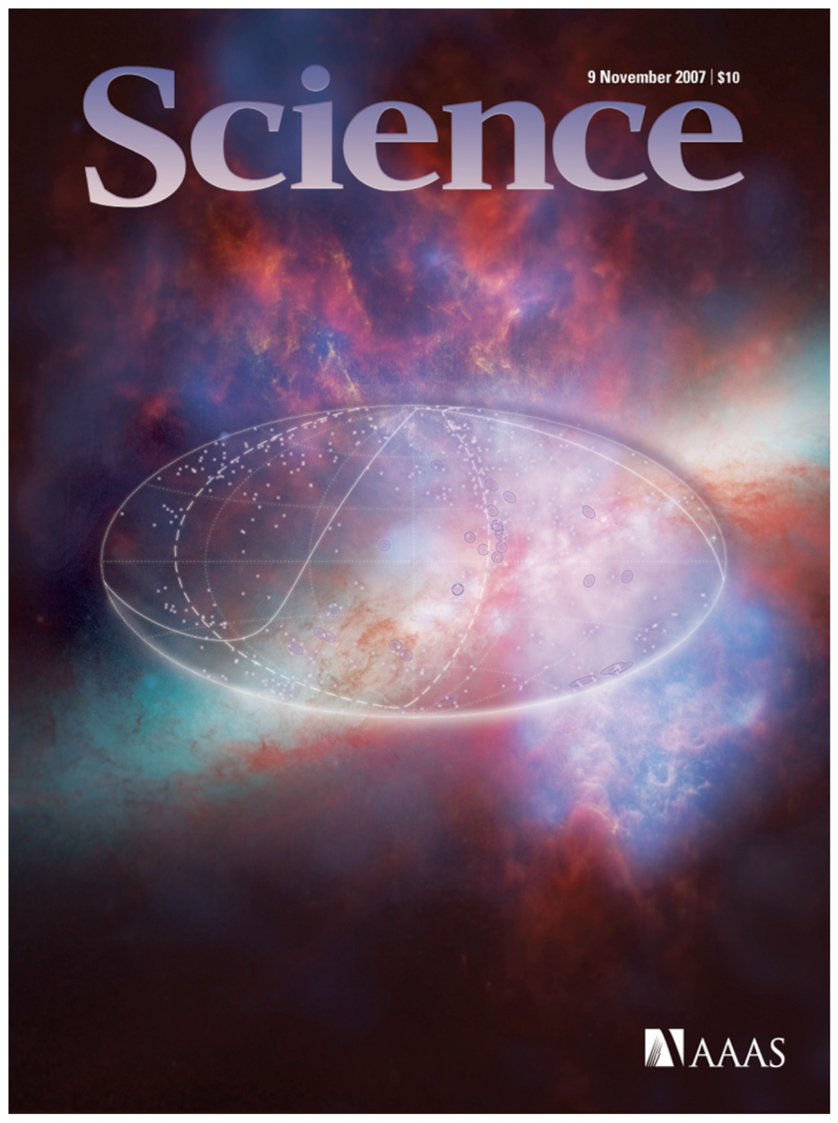

Slide 3
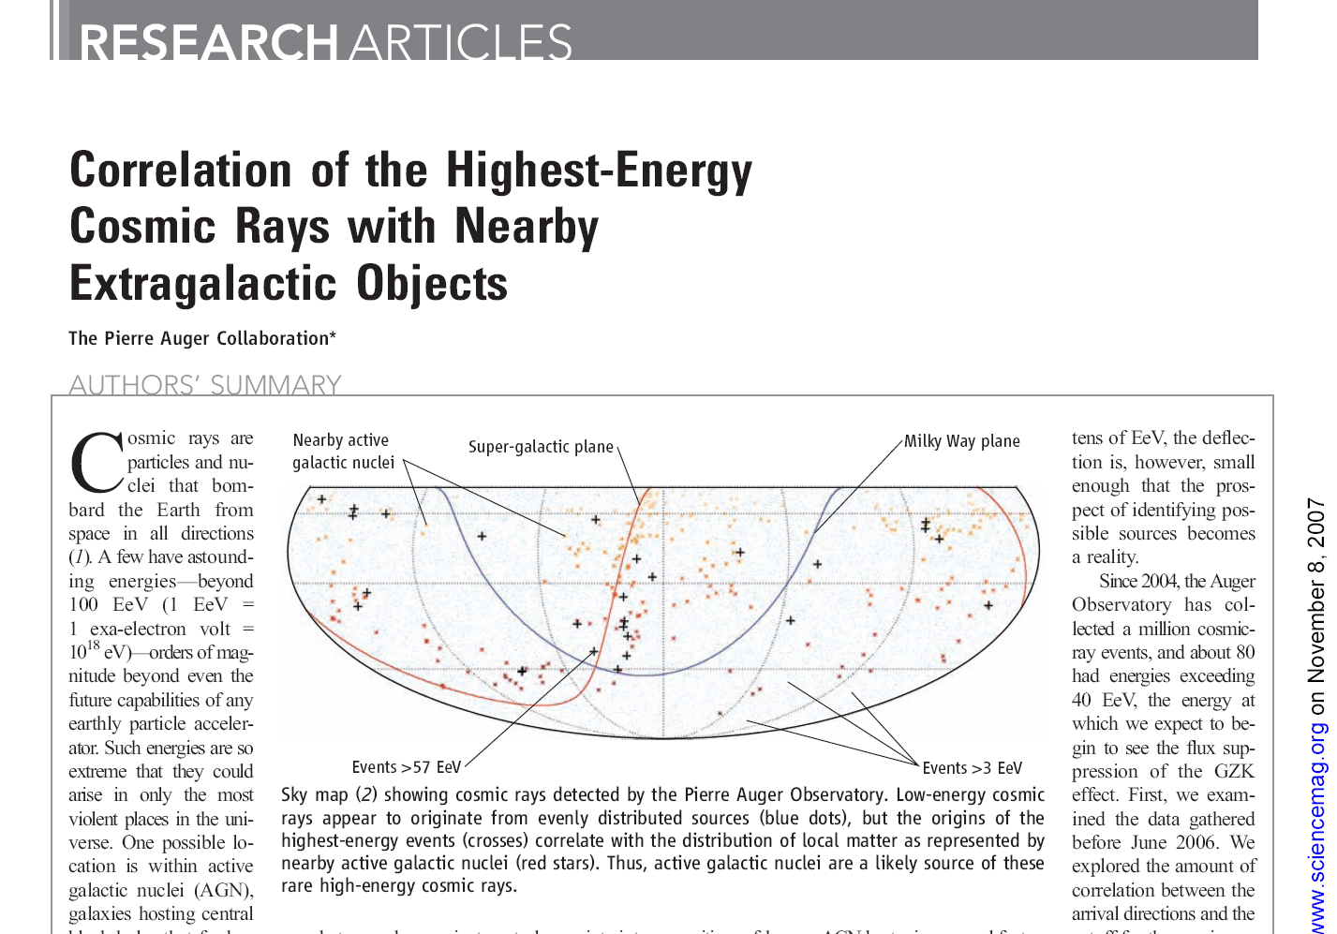

Slide 4
Talk Outline
Scientific Motivation
Top-down vs. Bottom-up
Why is 10²⁰ eV so special?
Pierre Auger Observatory
Previous Experiment – AGASA, HiRes
Pierre Auger Detector
New Results
Energy Spectrum
Any Top-down signal?
Angular Distribution

Slide 5
Scientific Motivation

Slide 6
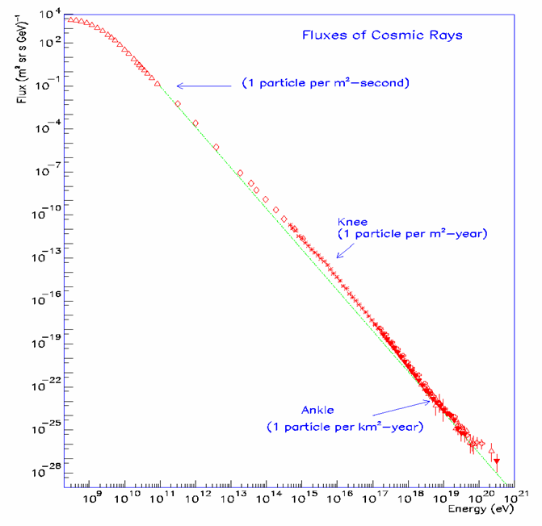
Energy Spectrum of Cosmic Rays
Energy Spectrum ~ E⁻³
The spectrum extends beyond 10²⁰ eV (=100 EeV).
Beyond 10²⁰ eV, Flux is only one particle per km²-century.
LHC
GeV
TeV
PeV
EeV

Slide 7
Particle Physics in Early Universe
Time
(sec)
Temp.
(ºK)
Energy (GeV)
Fundamental
Interaction
10⁻⁴⁵sec
Planck
GUT
10⁻⁴⁰
10³⁰
10¹⁸
GUT
10⁻³⁵
10¹⁵
10⁻³⁰
10²⁵
10¹²
10⁻²⁵
Electro-Weak
1EeV
10⁻²⁰
10²⁰
1PeV
10⁻¹⁵
10¹⁵
1TeV
EW
10⁻¹⁰
10⁻⁵
1GeV
1
10¹⁰
1MeV
10⁵ sec
1KeV
Gravitation
Electromagnetic
1 year
10⁵
Strong
Weak
10³
1eV
10⁶
10⁹ year
10⁻³eV
Now
1

Slide 8
Particle Physics in Early Universe
Time
(sec)
Temp.
(ºK)
Energy (GeV)
Big Bang!
10⁻⁴⁵sec
Planck
Super String
10⁻⁴⁰
10³⁰
10¹⁸
Quantum Gravity
GUT
Grand Unification
10⁻³⁵
10¹⁵
Inflation
10⁻³⁰
10²⁵
10¹²
10⁻²⁵
1EeV
10⁻²⁰
10²⁰
1PeV
Super Symmetry
10⁻¹⁵
Dark Matter
10¹⁵
1TeV
EW
10⁻¹⁰
10⁻⁵
1GeV
1
10¹⁰
1MeV
10⁵ sec
1KeV
1 year
10⁵
10³
1eV
10⁶
10⁹ year
10⁻³eV
Now
Dark Energy
1

Slide 9
Particle Physics in Early Universe
Time
(sec)
Temp.
(ºK)
Energy (GeV)
Big Bang!
10⁻⁴⁵sec
Planck
10⁻⁴⁰
10³⁰
10¹⁸
GUT
10⁻³⁵
10¹⁵
Inflation
10⁻³⁰
10²⁵
10¹²
10⁻²⁵
1EeV
10²⁰
UHE Cosmic Rays
10⁻²⁰
1PeV
10⁻¹⁵
Dark Matter
10¹⁵
1TeV
EW
10⁻¹⁰
10⁻⁵
1GeV
Accelerator
1
10¹⁰
1MeV
10⁵ sec
1KeV
1 year
10⁵
10³
1eV
10⁶
Telescope
10⁹ year
10⁻³eV
Now
Dark Energy
1

Slide 10
Top-down or Bottom-up?
Time
(sec)
Temp.
(ºK)
Energy (GeV)
Big Bang!
10⁻⁴⁵sec
Planck
10⁻⁴⁰
10³⁰
10¹⁸
GUT
10⁻³⁵
10¹⁵
10⁻³⁰
10²⁵
10¹²
10⁻²⁵
Gamma Ray Burst
1EeV
UHE Cosmic Rays
10⁻²⁰
10²⁰
Active Galactic Nuclei
1PeV
10⁻¹⁵
Supernova
Neutron Star
Black Holes
10¹⁵
1TeV
EW
10⁻¹⁰
10⁻⁵
1GeV
1
10¹⁰
1MeV
10⁵ sec
1KeV
1 year
10⁵
10³
1eV
10⁶
10⁹ year
10⁻³eV
Now
1

Slide 11
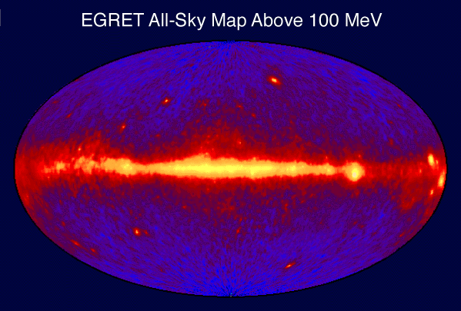
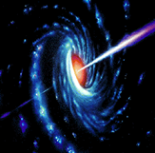
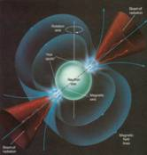
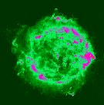
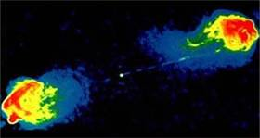
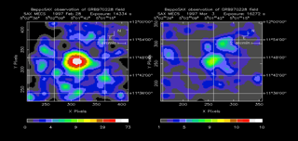
The Extreme Universe
AGN
Pulsar
SNR
Radio Galaxy
GRB
By Rene Ong

Slide 12
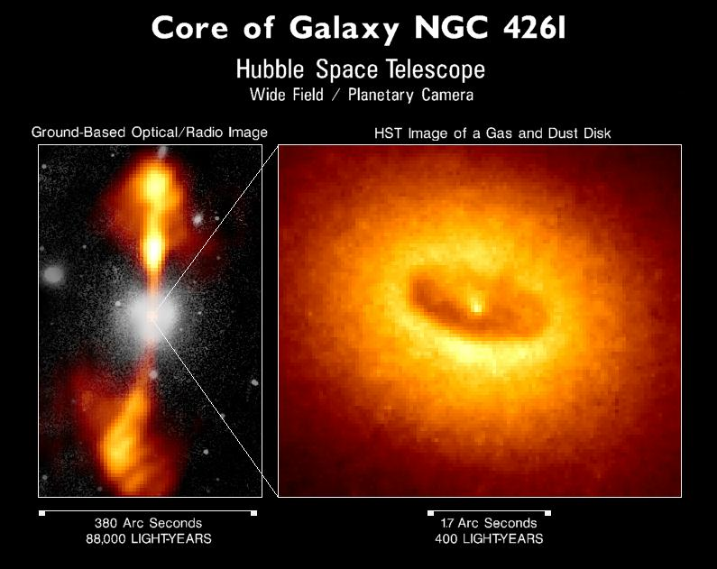

Slide 13
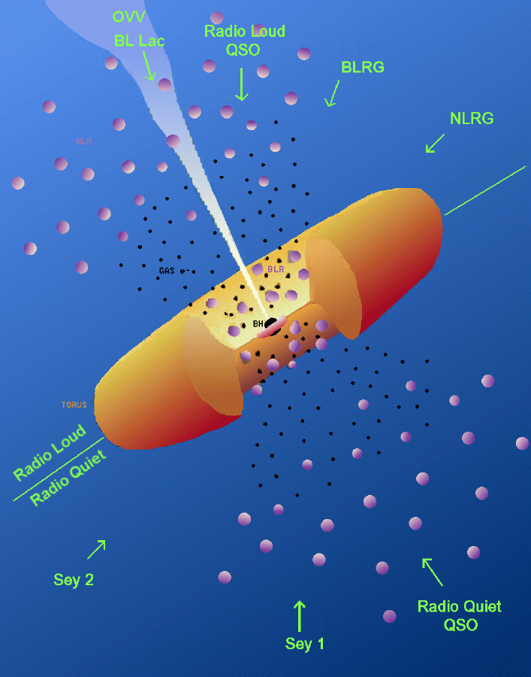
Various AGN
Various classes of AGN are thought to be Super-Massive Black Holes viewed from different angles.
Energetic ones are thought to emit jets and called Blazars (BL Lac is a subcategory)

Slide 14
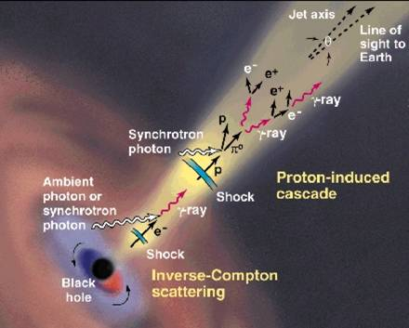
AGN Central Engine

Slide 15
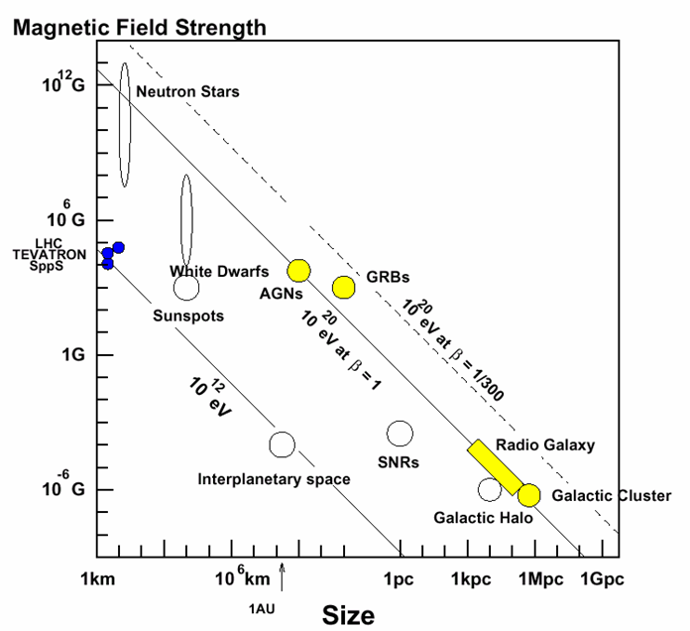
Possible Acceleration Sites
Several possible accelerators in nature up to 10²⁰ eV.
Extremely difficult to accelerate above 10²⁰ eV.
1 pc = 3.26 light year

Slide 16
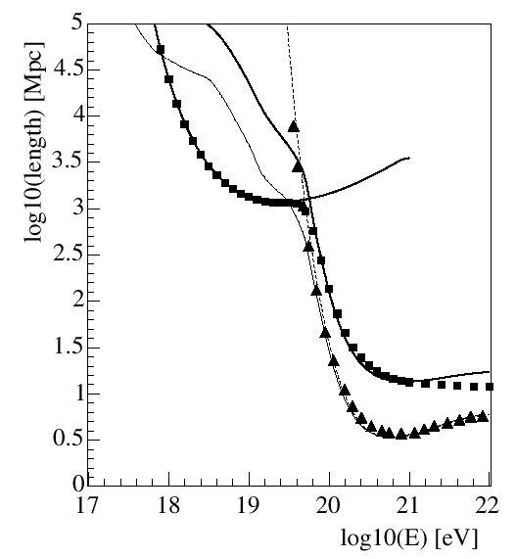
Interaction Length of UHE Protons
Pair
Production
Horizon of Universe ~ 5 Gpc
1Gpc
p + γ (2.7ºK)
Δ
→ p + π’s
GZK Cutoff
Photopion
Loss Length
10Mpc
Interaction
Length
Blasi, astro-ph/0307067

Slide 17
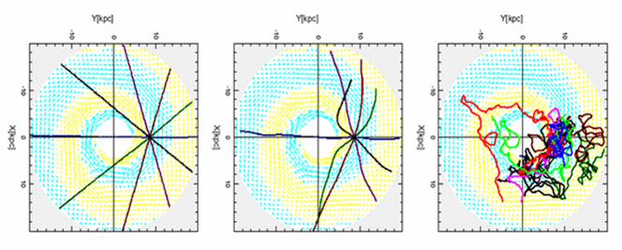
Trajectory of Cosmic Ray Protons in the Galaxy
Magnetic Field in our Galaxy ~ 2 µG
E=10²⁰eV
E=10¹⁹eV
E=10¹⁸eV

Slide 18
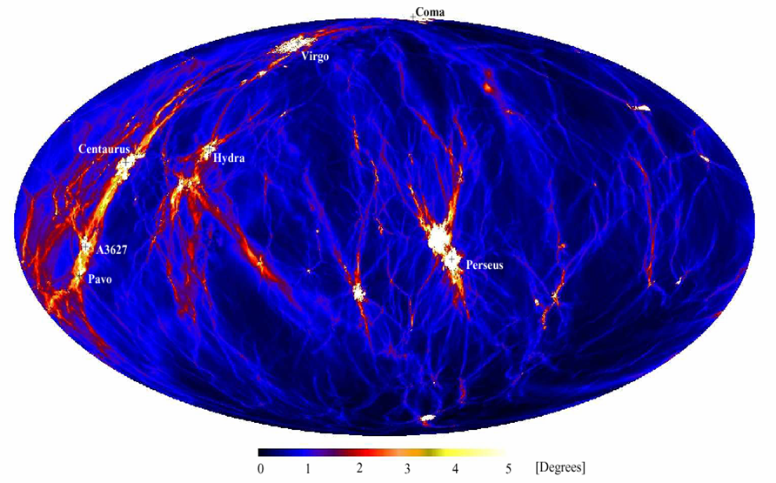
Deflection of Protons >4×10¹⁹eV
Extra Galactic Magnetic Field ~ 1 nG
< 100 Mpc
0º
360º
Dolag, astro-ph/0310902

Slide 19
Why is 10²⁰eV so special?
Nearly impossible to accelerate beyond 10²⁰ eV by nature. → Top-down Mechanism?
Protons cannot travel beyond ~50 Mpc at E > 10²⁰ eV due to interaction with CMB. → GZK Cut-off → Violation of Special Relativity?
Protons can travel straight at E > ~4×10¹⁹ eV. → Charged-Particle Astronomy → New Window of Extreme Universe

Slide 20
Rich Physics and Astronomy
10²¹ eV
?
Top-Down?
GZK?
UHE Neutrinos
10²⁰ eV
Straight Trajectories
Charge Particle Astronomy
UHE Gamma Rays
10¹⁹ eV
Bent by Extra-Galactic B (~nG)
Ankle
10¹⁸ eV
Trapped by Inner-Galactic B (~μG)
Bottom-Up

Slide 21
Past and Ongoing Experiments
AGASA
HiRes
Pierre-Auger

Slide 22
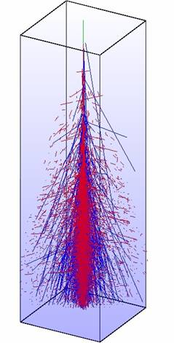
Detection Technique
MC Simulation of 10 EeV (10¹⁹eV) Proton Shower
HiRes
10km
e±
Fluorescence Detector (FD)
~ 27X_{o}
~ 11λ_{I}
μ±
AGASA
Shower Detector (SD)

Slide 23
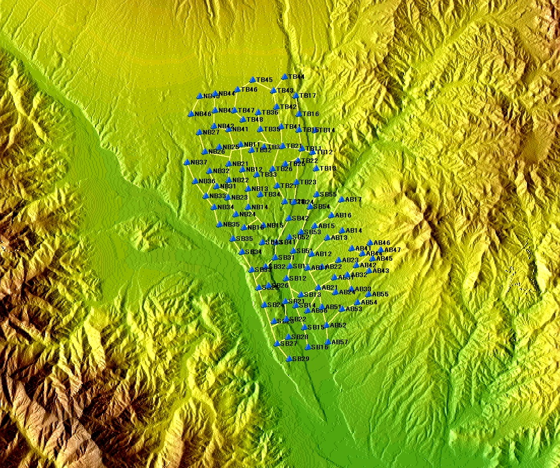
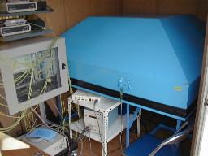
Akeno Giant Air Shower Array
111 Electron Detectors
100 km²
27 Muon Detectors
Operation 1991 - 2004
0 4km
M. Teshima

Slide 24
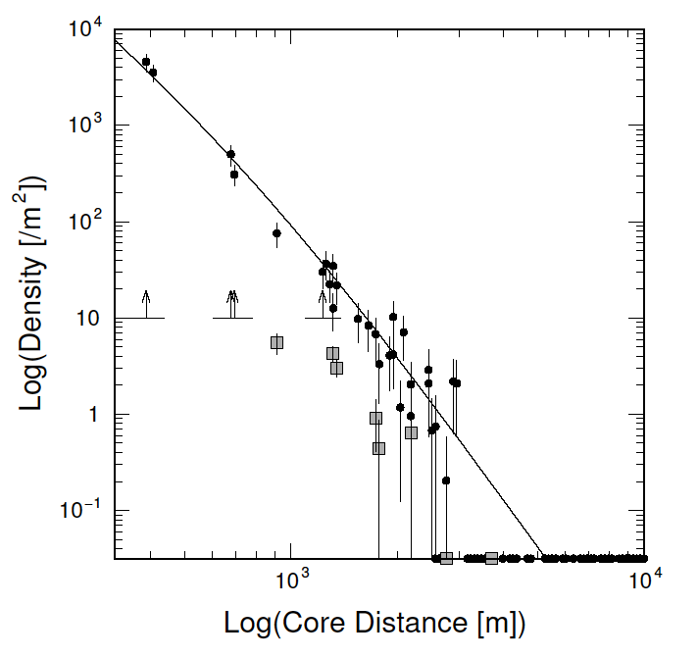
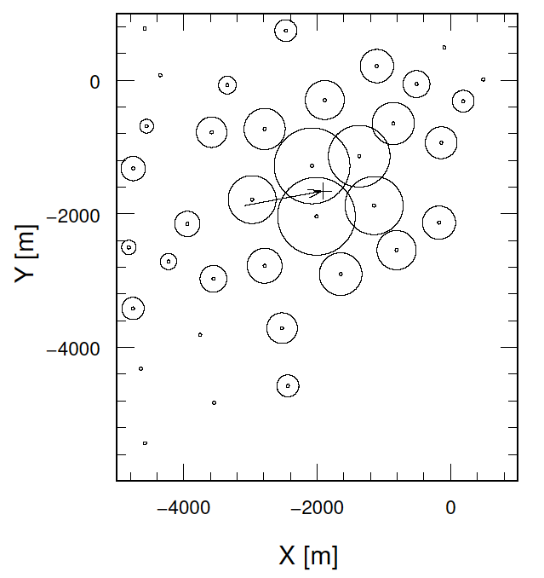
The Highest Energy Event by AGASA
2.5 x10²⁰eV on 10 May 2001
M. Teshima

Slide 25
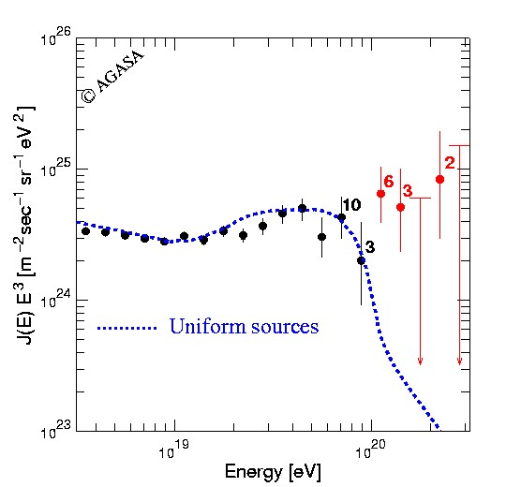
Energy Spectrum by AGASA
Top-down?
Bottom-up
with GZK Cutoff
M. Teshima

Slide 26
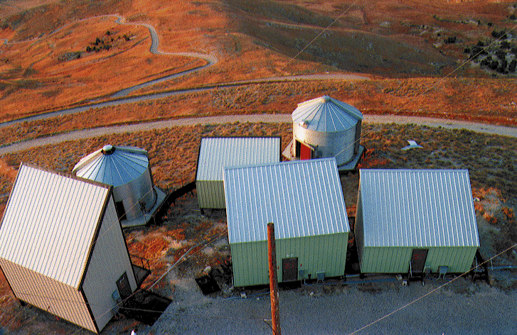
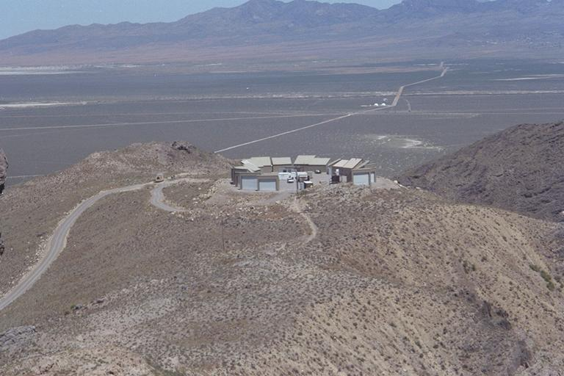
Two HiRes Detectors
HiRes1: Atop Five Mile Hill
21 mirrors, 1 ring (3º<altitude<17º).
HiRes2: Atop Camel’s Back Ridge
12.6 km SW of HiRes1.
42 mirrors, 2 rings (3º<altitude<31º).
G. Thomson

Slide 27
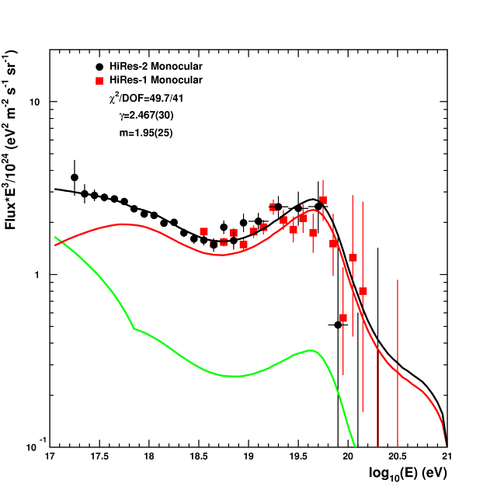
Energy Spectrum by HiRes
(1999-2004)
(1996-2005)
Consistent with
GZK Cutoff !!
Extra-Galactic
Galactic
C. Finley

Slide 28
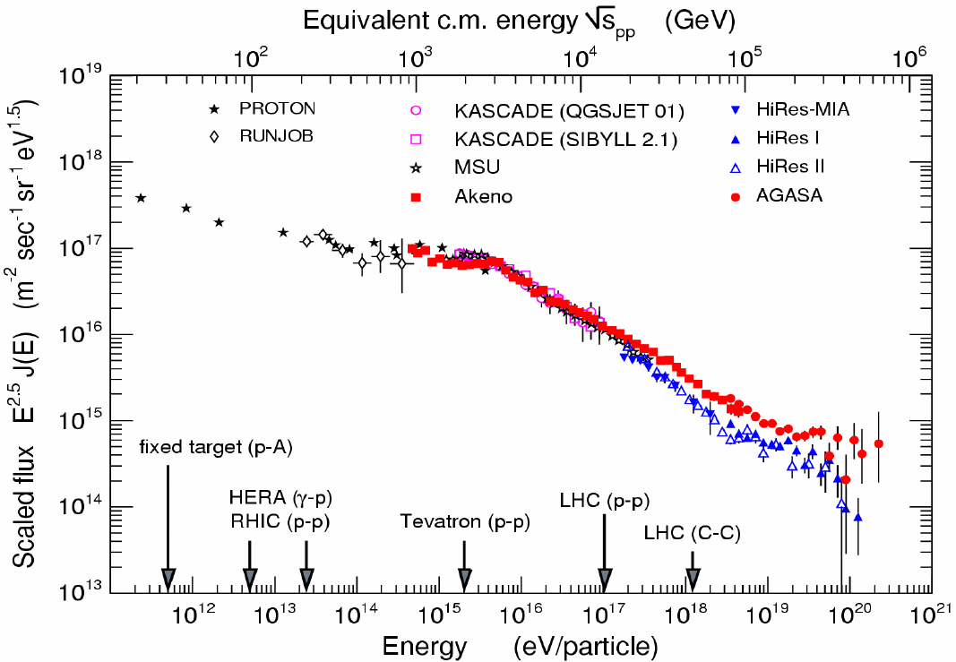
Energy Spectrum
AGASA (SD)
?
HiRes (FD)
Ralph Engel

Slide 29
Detection Technique
MC Simulation of
10¹⁹eV Proton Shower
Pierre-Auger
HiRes
10km
e±
Fluorescence Detector (FD)
~ 27X_{o}
~ 11λ_{I}
μ±
AGASA
Shower Detector (SD)

Slide 30
SD vs. FD
SD (Shower Detector) - AGASA
Pros: Operational all the time
Cons: Sparse sampling at the tail of Shower
FD (Fluorescence Detector) - HiRes
Pros: Totally calorimetric energy measurement
Cons: ~10% duty factor (only at moonless night)
Pierre-Auger utilizes both!

Slide 31
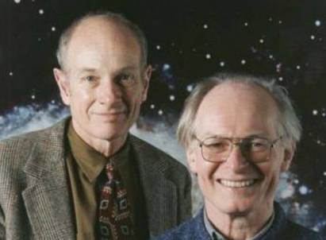
Pierre Auger Collaboration
17 Countries
50 Institutions
~370 Scientists
Italy Argentina
Czech Republic Australia
France Brazil
Germany Bolivia*
Poland Mexico
Slovenia USA
Spain Vietnam*
United Kingdom
*Associate Countries
Founders
Jim Cronin
Alan Watson

Slide 32
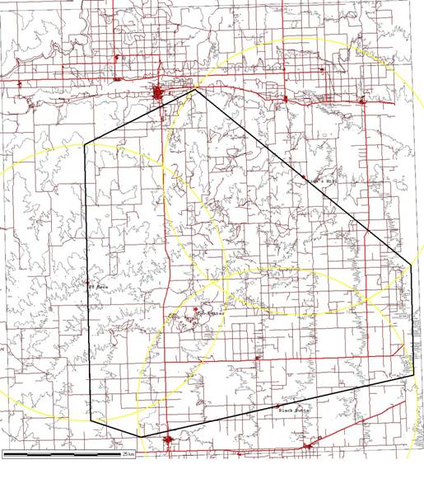
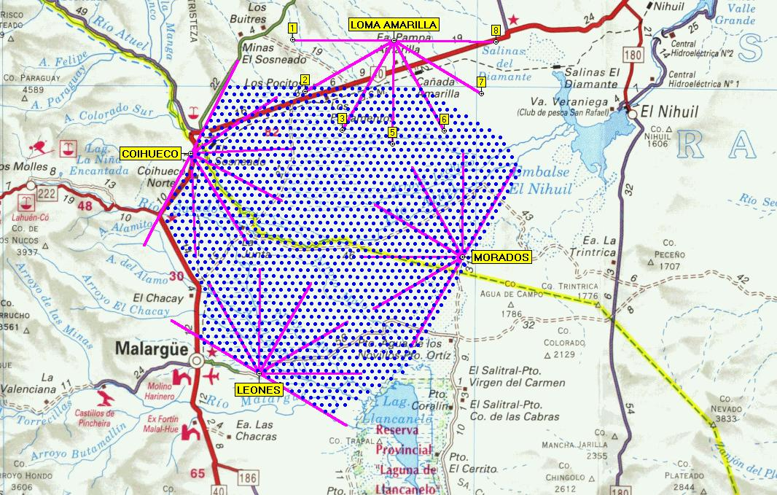
Pierre-Auger Observatory
Northern Auger
in Colorado
N
Southern Auger
in Argentina
S
50km

Slide 33
Southern-Auger in Argentina
Surface Array
1600 Water Tanks
1.5 km spacing
3100 km²
AGASA
Fluorescence Detectors
4 Telescope Sites
6 Telescopes per Site
24 Telescopes Total
50km

Slide 34
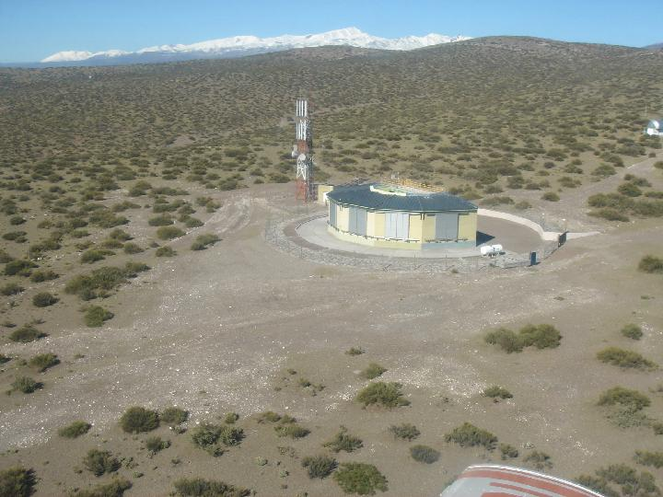

Slide 35
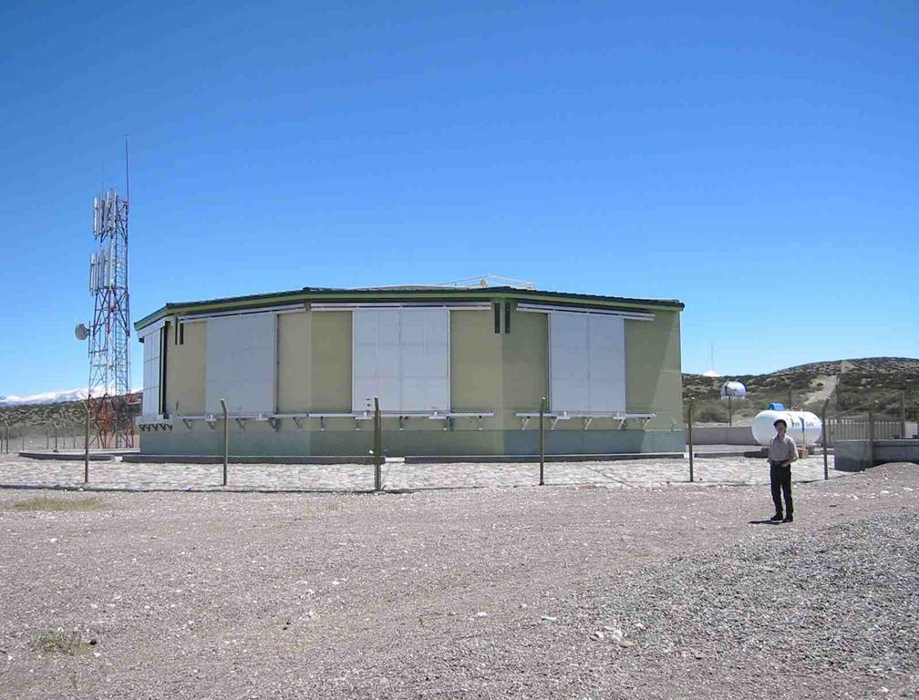

Slide 36
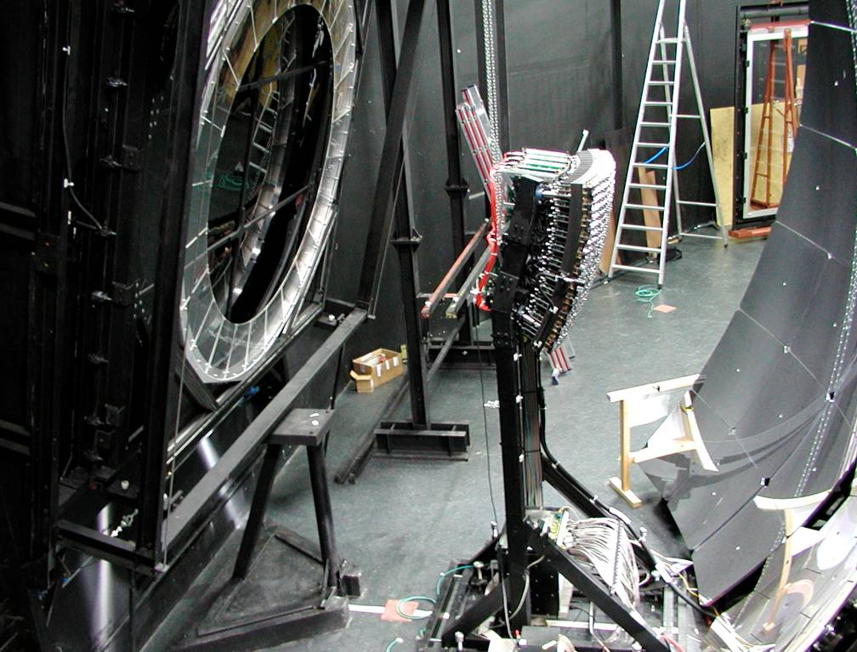
Optical
Shutter
UV-Filter 300-400 nm
Camera 440 PMTs
11 m² Mirror
corrector lens
Corrector Ring

Slide 37
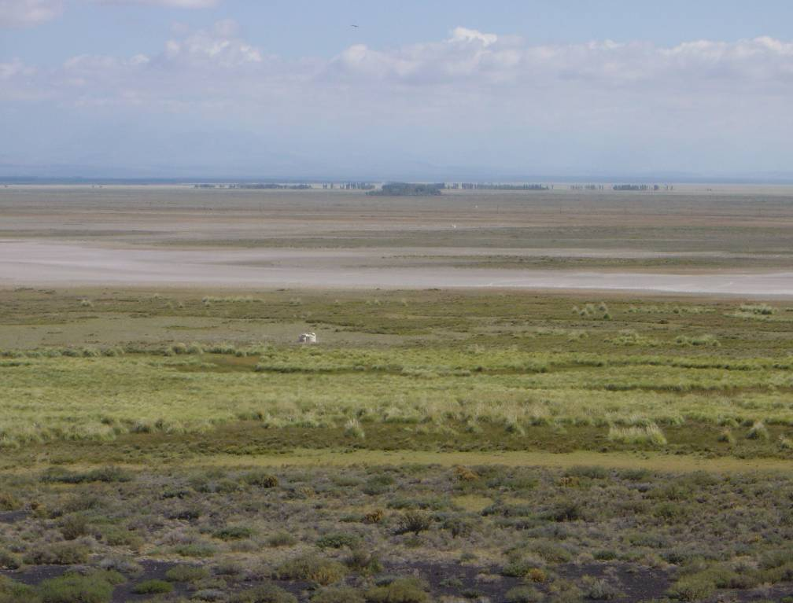
Tanks aligned seen from Los Leones

Slide 38
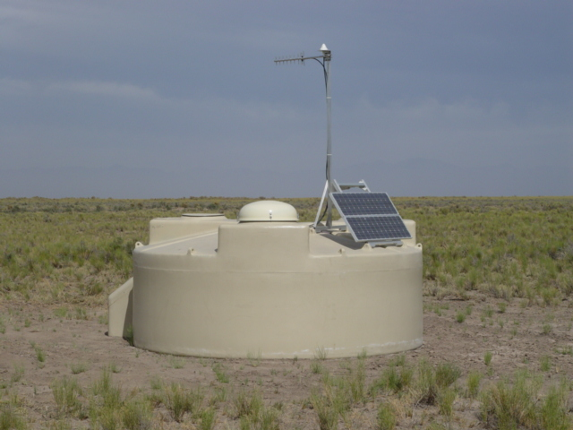
Water Tank on Site
Real water tank under operation at Malargue

Slide 39
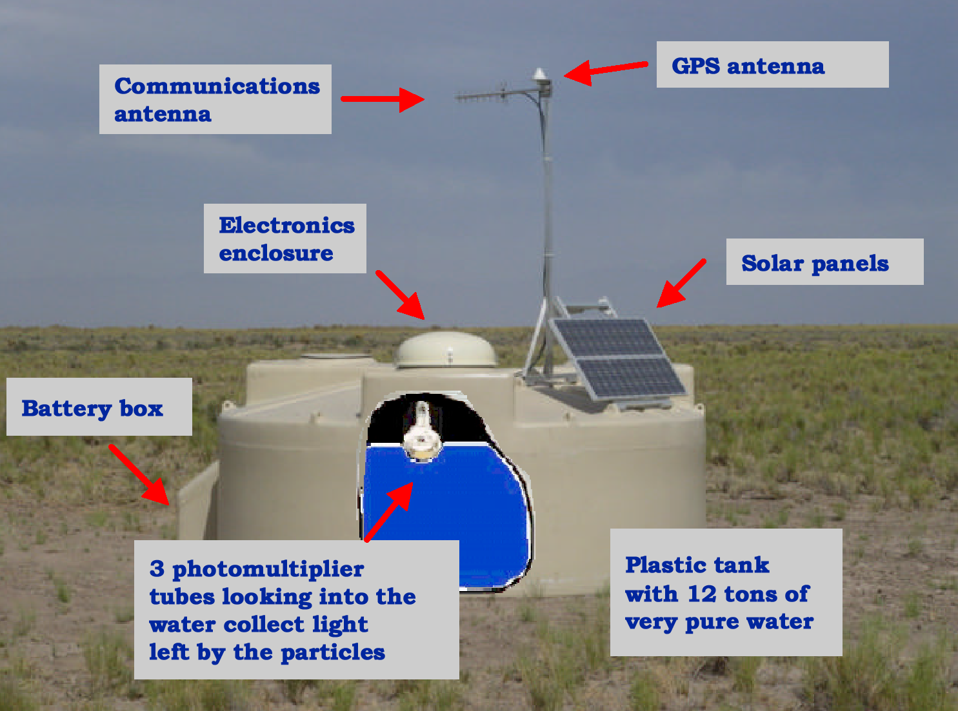

Slide 40
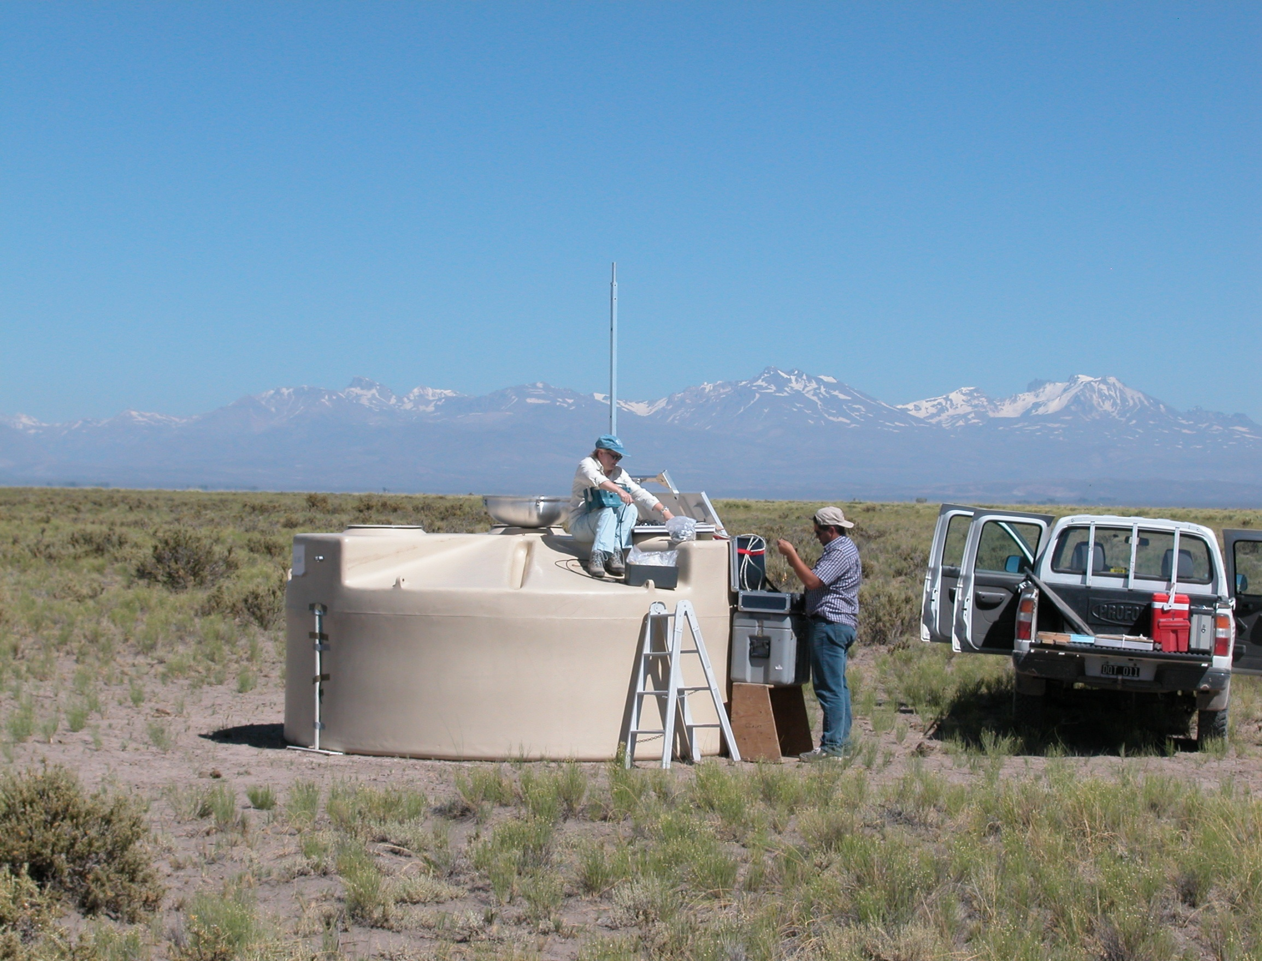
Checking Electronics

Slide 41
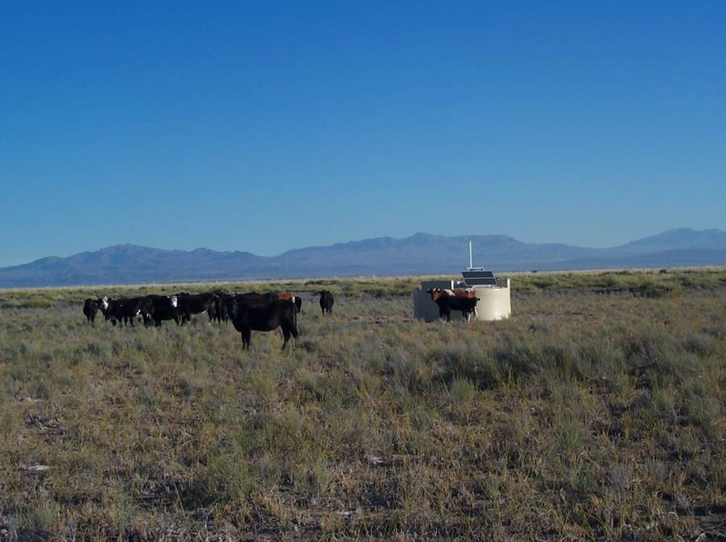
Surface Detector inspection by residents of the Pampa

Slide 42
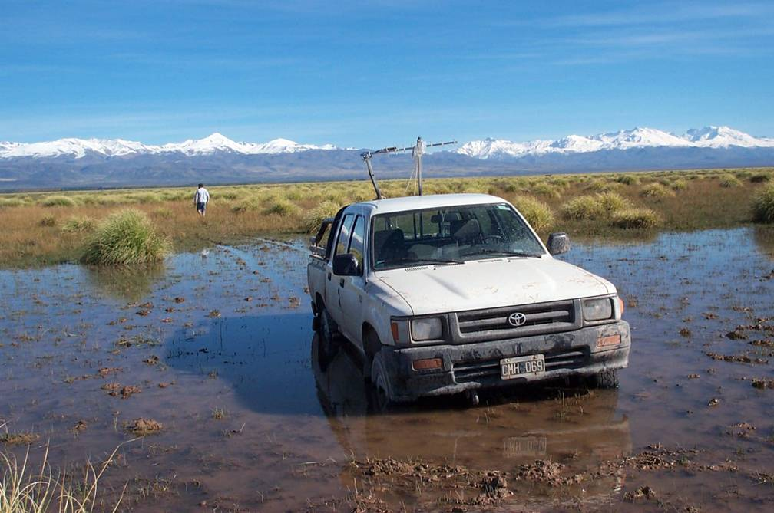
Don’t get stuck!

Slide 43
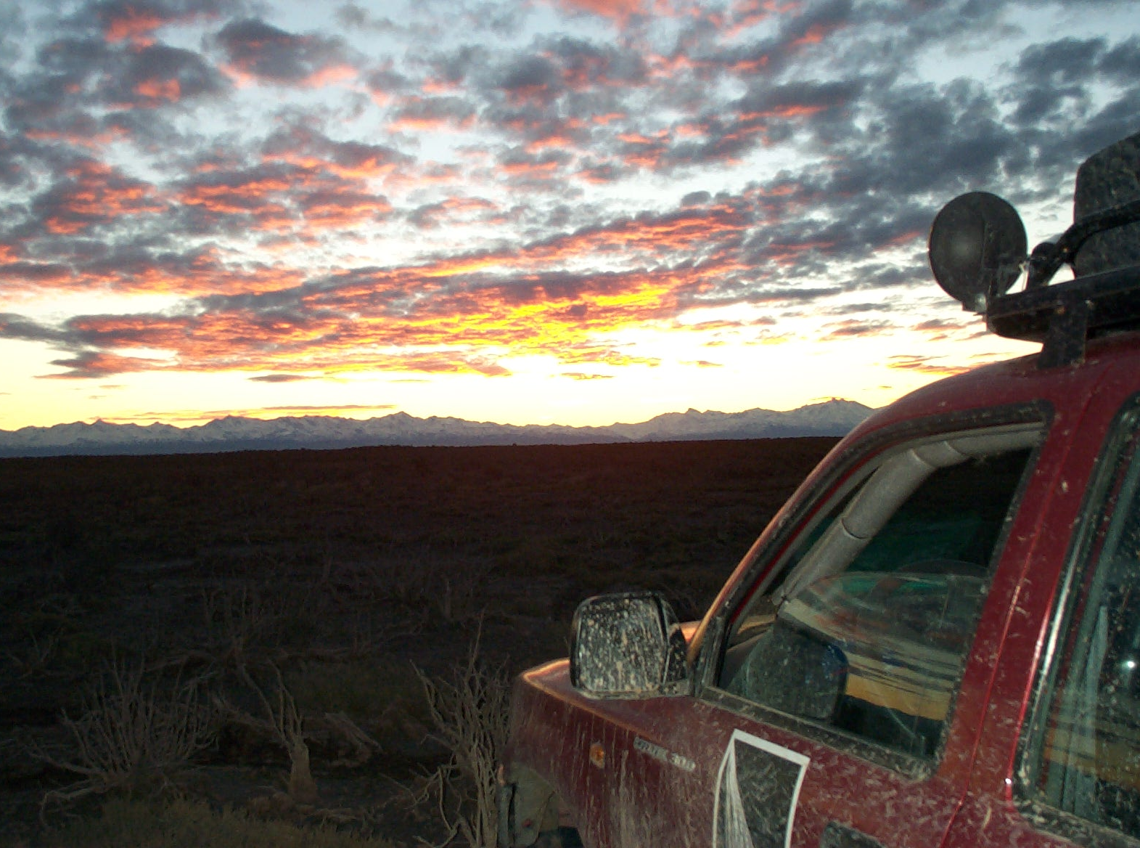
Beautiful Sunset on the Andes

Slide 44
Lively Life in Malargue

Slide 45
Southern-Auger in Argentina
50km

Slide 46
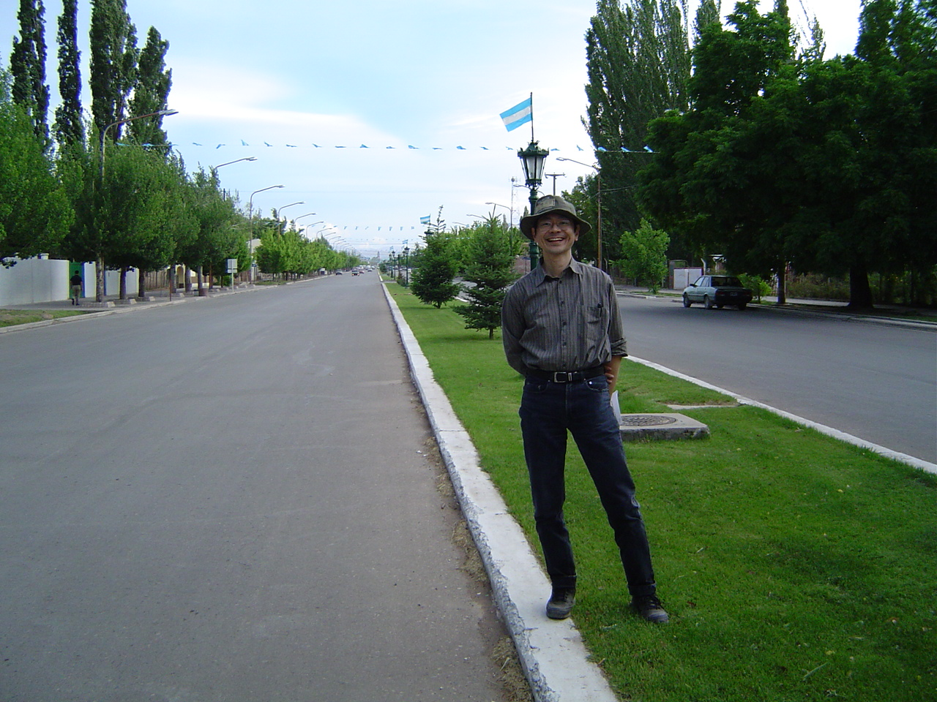
Entrance of City of Malargue

Slide 47
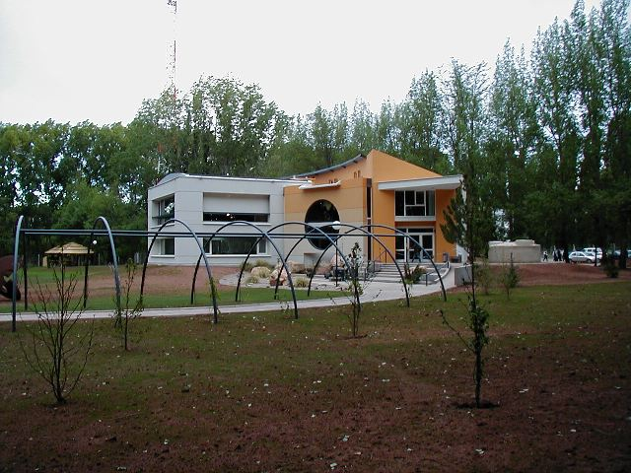
Auger Office Building

Slide 48
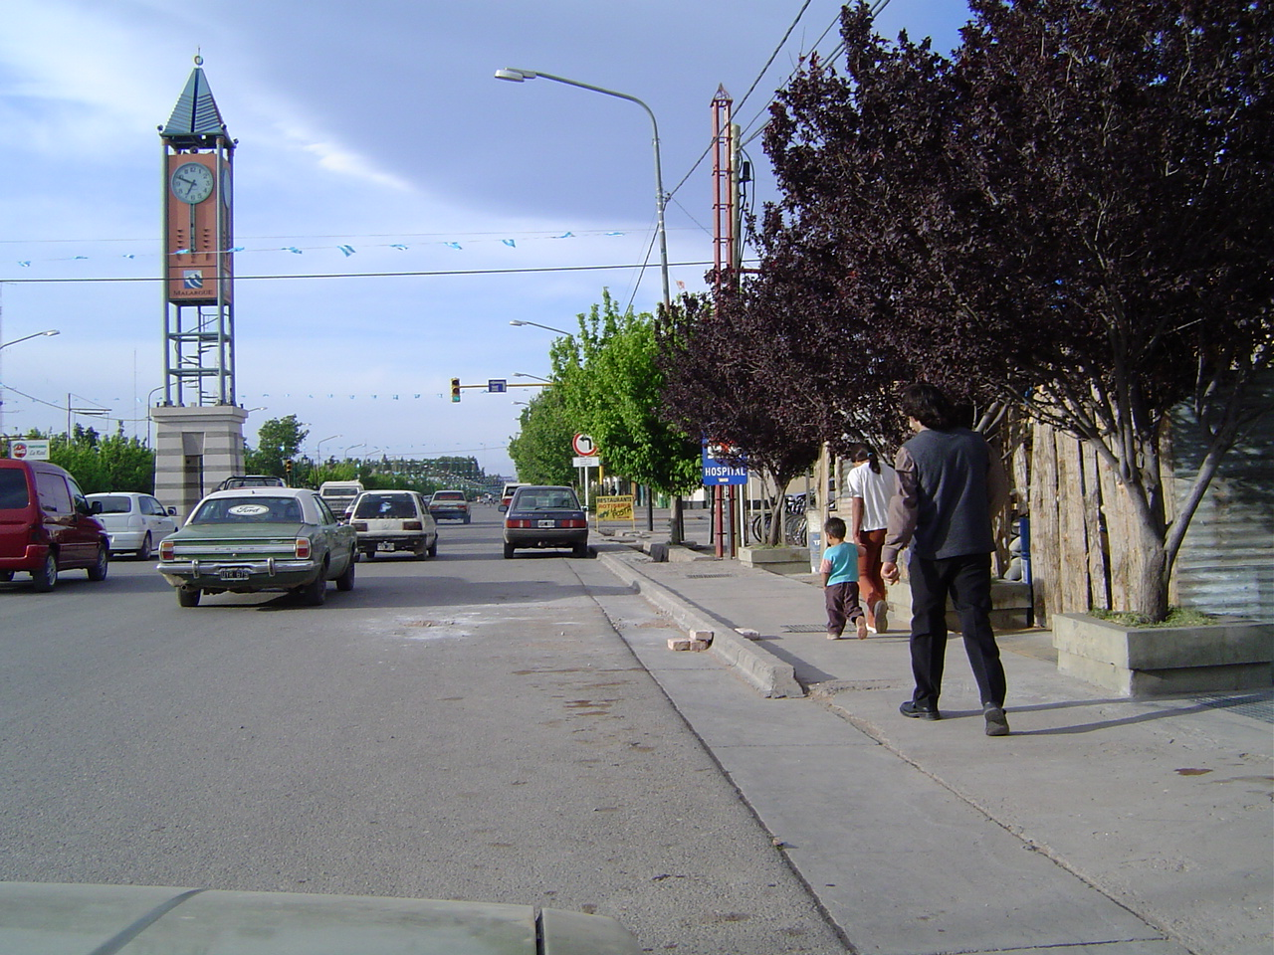
Center of City

Slide 49
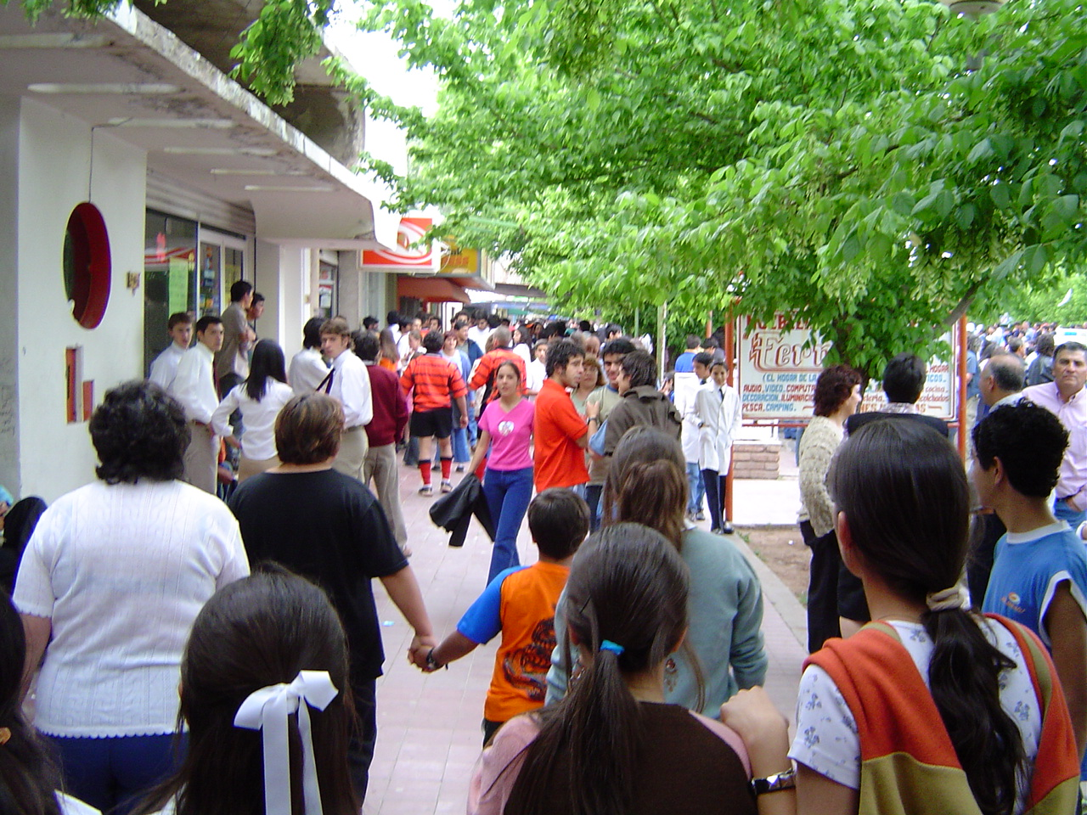
Annual Festival

Slide 50
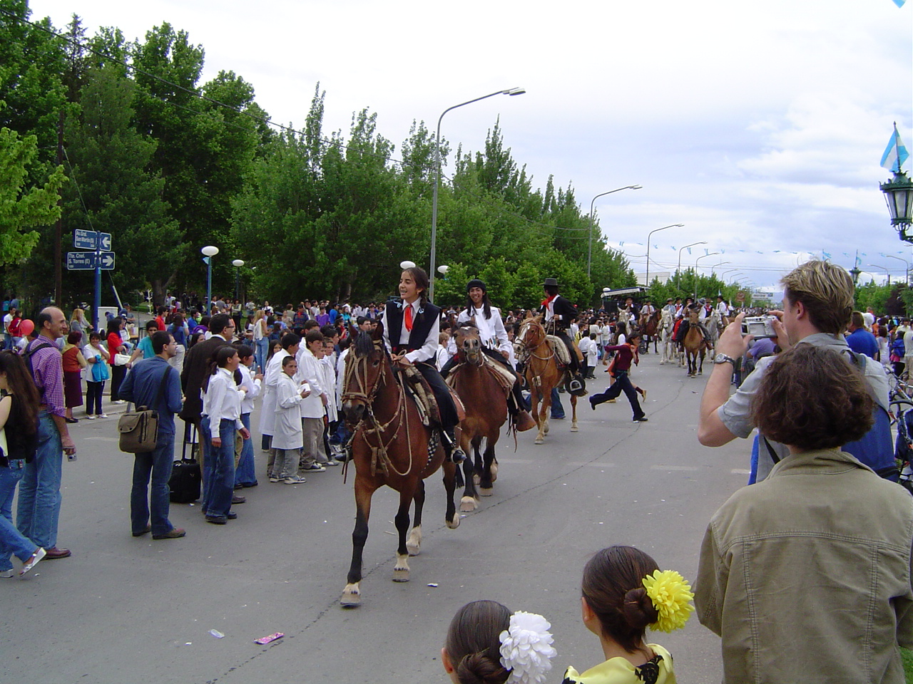

Slide 51
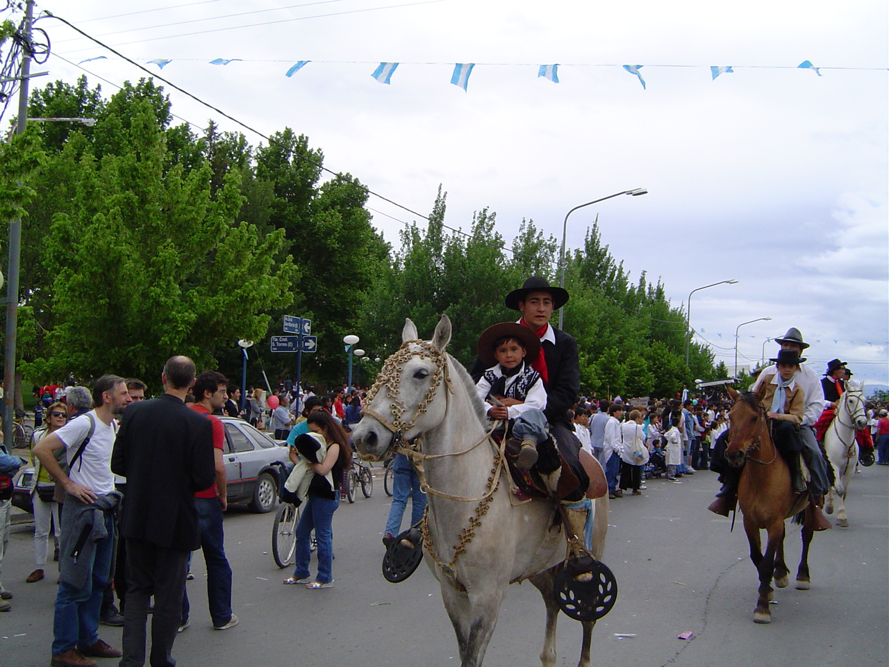

Slide 52
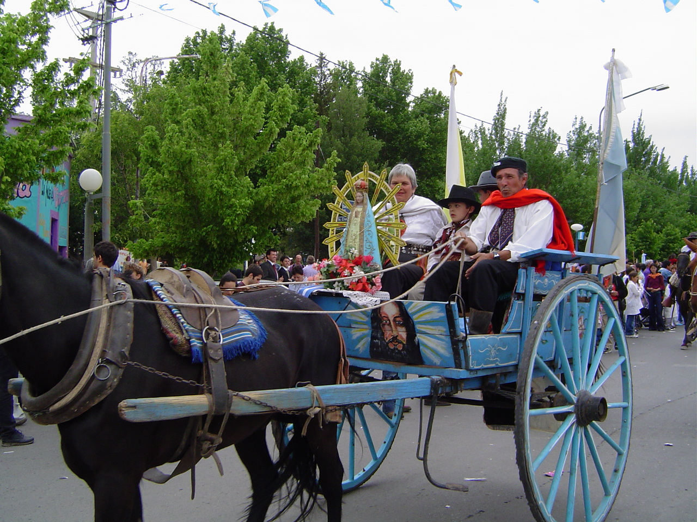

Slide 53
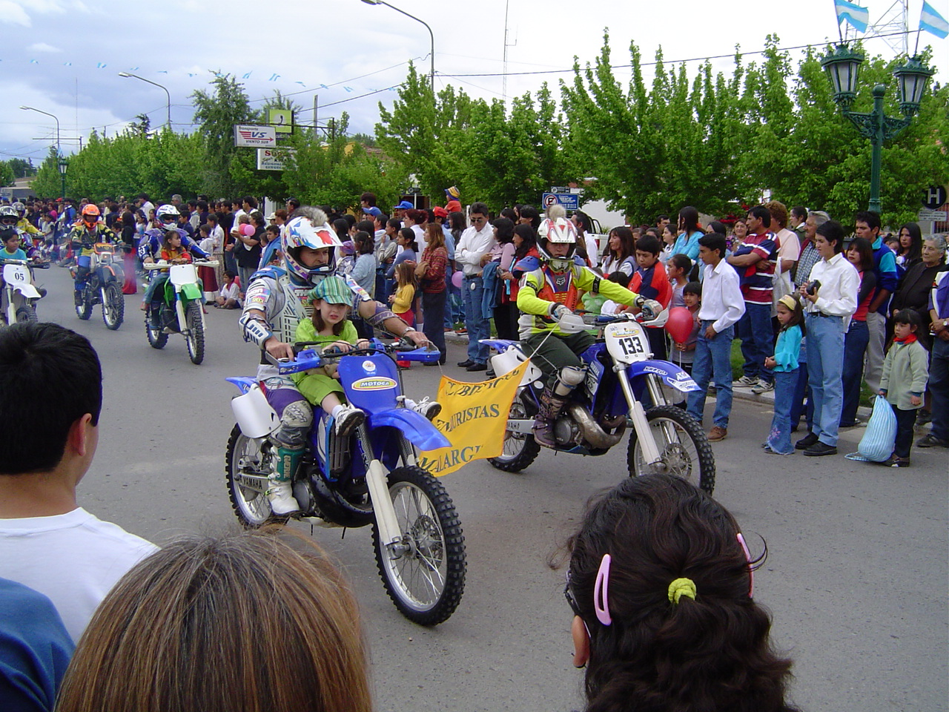

Slide 54
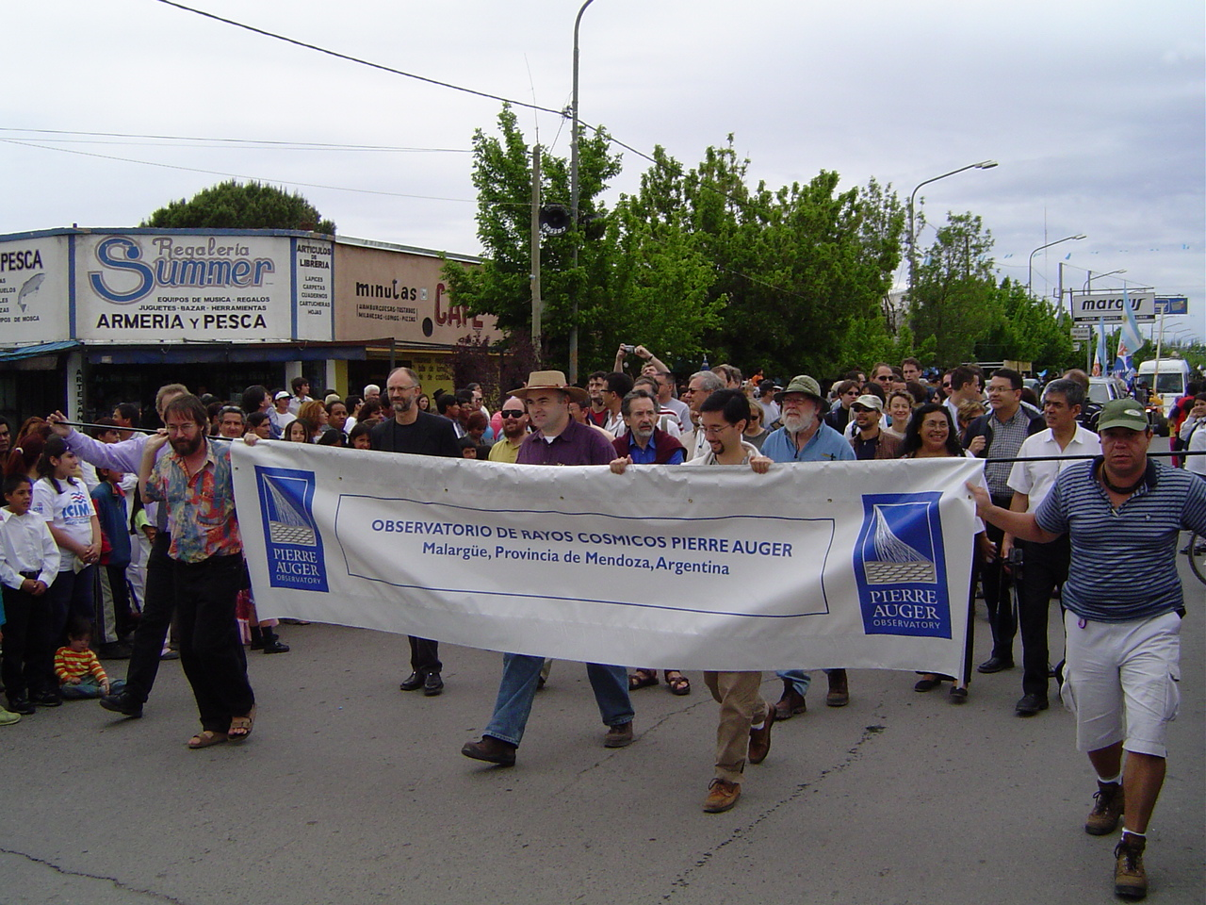

Slide 55
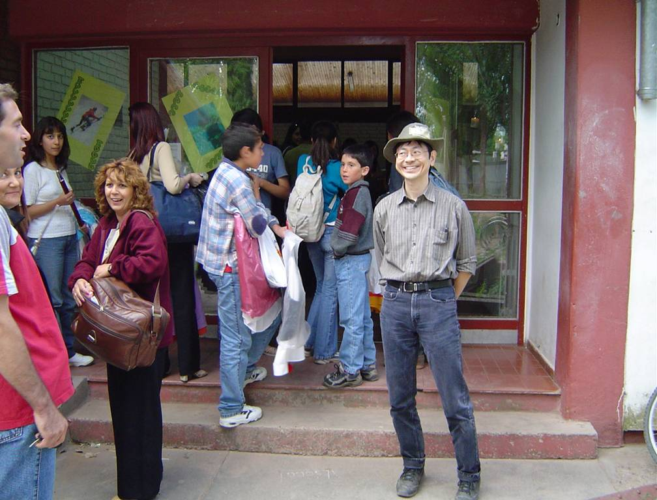
Visiting a local high school…
Exposition of the World Culture

Slide 56


Slide 57


Slide 58
UCLA Contributions

Slide 59
UCLA Pierre-Auger Group
Name | Position | Responsibility | Active Year
Katsushi Arisaka | Professor | P.I. | 1998 - present
William Slater | Professor | MC Simulation | 1998 - 2006
Graciela Gelmini | Professor | Theory | 2002 - present
Alex Kusenko | Professor | Theory | 2002 - present
Matthew Malkan | Professor | AGN Astronomy | 2007 - present
Arun Tripathi | Postdoc | Data analysis | 1998 - 2006
Chris Jillings | Postdoc | PMT testing | 1999 - 2002
Dmitry Semikoz | Postdoc | Theory | 2002 - 2005
Oleg Kalashev | Postdoc | Theory | 2005 - 2006
Tohru Ohnuki | PhD | Angular Distribution | 2001 - 2006
David Barnhill | PhD | Photon limit | 2001 - 2007
Joong Lee | PhD | Energy Spectrum | 2002 - 2007
Matthew Healy | PhD | Mass Composition | 2003 - present
Pedram Boghrat | UCLA Grad | Angular Distribution | 2004 - 2007
Weichung Ooi | UCLA Grad | Angular Distribution | 2004 - 2005
Artin Teymourian | UCLA Grad | Corellation with AGN | 2006
Antoine Calvez | UCLA Grad (NSF REU) | Angular Distribution | 2004 - 2005
Jacob Ribnik | UCLA undergrad | Compsition study, Dach job system | 2004
Eitan Anzenber | From UCSC | Correlation with GRB with SWIFT data | 2005
Adrian Cheng | UCLA undergrad | Search for Thread-like clustering | 2005
Justin Young | UCLA undergrad | Neutrino detection | 2005
Ryan Reece | NSF REU | Fluorescence Photon Yield | 2005
Adam Lopez | UCLA CARE | Quantum Efficiency Measurement | 2005
Daniel Maronde | UCLA undergrad | Collection Efficiency | 2005
Alfonso Vergara | UCLA undergrad | Collection Efficiency | 2005
Sourpouhi Bedikian | NSF REU | Correlation with AGN | 2005
Joshua Moody | UCLA undergrad | Mass Composition study by Muon LDF | 2006
Umi Yamamoto | From Tokyo | Correlation with AGN | 2006
Tyler Dawson | UCLA undergrad | Catalog of Astronomical objects | 2006
Brian Rothaug | UCLA undergrad | Catalog of Astronomical objects | 2006
Min Lu | UCLA undergrad | Mass Composition study by Muon LDF | 2006
and more before 2004….

Slide 60

UCLA PMT Test Facility at STRB in Westwood

Slide 61

PMT Potting Underway at STRB

Slide 62

Malargüe PMT Test Facility

Slide 63

16 PMTs inspected by Arun

Slide 64

Arun scanning the bar code of PMT

Slide 65

David in Control

Slide 66

PMT Test Facility
PMTs Assembled by Tohru and Federico

Slide 67

Barbeque Party at UCLA Lab at Malargüe

Slide 68


Slide 69

Federico

Slide 70
UCLA Contributions
Detector Construction 1999 - 2004
Development of new PMT
Testing of all PMT
Data Taking and Calibration 2003 - 2006
Detector calibration
Monitoring the long term stability
Software Development 2004 - 2007
Detector simulation
Standard software package (DPA)
Physics Analyses 2004 – Now
Energy Spectrum
Composition
Angular Distribution

Slide 71

Event Simulation (10¹⁹ eV)
Green: e+ e-
Red: Muons

Slide 72

Event Simulation (10¹⁹ eV)
Green: e+ e-
Red: Muons

Slide 73

10¹⁹ eV event observed by all detectors

Slide 74

Southern Auger as of Nov. 2007
1501 Water Tanks (out of 1600)
~ 30 x AGASA
50km

Slide 75
Comparison of Integrated Aperture
~ 5 x AGASA
~1.5 x HiRes

Slide 76
Energy Spectrums
Arun Tripathi
Joong Lee (PhD)
Oleg Kalashev

Slide 77

Energy Spectrum × E³ (SD+MC Energy)
Auger
AGASA
HiRes
SD + MC Energy

Slide 78

Energy Spectrum × E³ (FD Energy)
AGASA
Auger
HiRes
FD Energy

Slide 79

Energy Spectrum × E³ (fit by proton injection)
AGASA
Auger
HiRes
Arisaka, et al, astro-ph/0709.3390

Slide 80
Summary of Energy Spectrum
Energy spectrum based on SD+MC Energy is similar to AGASA.
a hint of Super-GZK events?
but not as many as AGASA observed.
Energy spectrum based on FD Energy is consistent with HiRes.
fits reasonably well with the GZK cutoff.
Injection spectrum of 1/E^{2.6}.
So far, the spectrum is consistent with GZK Cutoff.

Slide 81
Any Signal from Big Bang? Looking for UHE Photons
David Barnhill (PhD)
Graciela Gelmini

Slide 82
What is Dark Matter?
Super Heavy
Dark Matter

Slide 83

Possibility of photons in AGASA data
AGASA Data
γ from SHDM
proton from SHDM
Bottom
up Proton
Gelmini, et al, astro-ph/0506128

Slide 84

Risetime vs. Log(E)
Photon
Proton (Sibyll)
Proton (QGS)
Iron (Sibyll)
Iron (QGS)
Real Data

Slide 85


Photon Limit Results
Fraction Limit
Flux Limit

Slide 86
Summary of Photon Flux Limit
The combination of the following assumptions is disfavored.
AGASA-like energy spectrum is correct.
There are extra Super-GZK events (> 10²⁰ eV).
These Super-GZK events are from the decay of Super Heavy Dark Matters.
Most likely
No Top-down component, at least, majority of UHE cosmic rays are the Bottom-ups.

Slide 87
Angular Distributions
Tohru Ohnuki (PhD)
Pedram Boghrat
Antoine Calvez
Artin Teymourian

Slide 88

Clustering of UHECR (>40 EeV) by AGASA
6 doublets and 1 triplet within 2.5º cone (out of 56 events)

Slide 89

AGASA Auto-Correlation
2.5º
40 EeV

Slide 90

HiRes Correlation with BL Lacs
0.6º
Gorbunov et al., astro-ph 0406654

Slide 91

Angular Resolution of Auger SD
AGASA
1 – 3 EeV
3 – 10 EeV
> 10 EeV
HiRes (Stereo)

Slide 92

Sky Maps (>6 EeV, < 75º)

Slide 93

Sky Maps (>30 EeV, < 60º)

Slide 94


Auger Auto-correlation (>40 EeV, < 60º)
EeV

Slide 95

Sky Map of Astronomical Objects
Mrk421
H1426+428
M87
Mrk501
1ES1959+6450
G.C.
1ES2344+514

Slide 96




Auger – BL Lac Correlation
>6 EeV, < 60º
>6 EeV, < 75º
>10 EeV, < 60º
>10 EeV, < 75º

Slide 97
Then breaking news from Argentina Group in May, 2006

Slide 98

AGN (z <0.018) & Auger Events (E > 56 EeV)
M87
12 /15 correlate !

Slide 99


AGN Correlation
Significance is Maximum at
Opening Angle < 3.1º
z < 0.018 ( < 75 Mpc)
E > 56 EeV

Slide 100
Argentina Group’s Discovery
Veron-Cetty 12th edition catalog of AGN
Total 85,221 quasars, 21,737 AGN, 1,122 BL Lac
Within 100 Mpc, 694 AGN, only 4 BL Lacs
Identified via optical observations, including recent SDSS
Correlation with cosmic rays maximized at
Z < 0.018 ( < 75 Mpc, 472 AGN)
θ < 3.1°
E > 56 EeV
Probability
p = 21% for each correlation
12 out of 15 UHECR correlate. (only expect 3.2 / 15)
P ~ 10⁻⁶ but a posteriori

Slide 101
Independent Sequential Test
June 2006
Auger collaboration agreed to freeze the cuts and analysis procedure.
Agreed to publish, once CL > 99% was realized for the new independent data set.
August 31, 2007
8 / 13 new events correlated. (2.7 / 13 expected)
A priori (unbiased) isotropic probability ~ 0.17%
This a priori analysis establishes the anisotropy of the UHE Cosmic Rays with at least 99% CL.
Submitted a paper to “Science”

Slide 103

AGN Correlation in galactic coordinates

Slide 104
AGN Correlation in galactic coordinates
Blue color: Exposure
472 AGN (z < 0.018)
Virgo
Cluster
Centaurus A
Centaurus
Cluster
Galactic
Center
Galactic Plane
28 Cosmic Rays
(E > 56 EeV, θ < 3.1º)
Super Galactic Plane

Slide 105

Universe within 60 Mpc (200 M light year)
30 Mpc

Slide 106



Centaurus A (4 Mpc, 12 M light year)
2 Cosmic Rays correlated.
Infrared
Radio + Optical images
X-ray

Slide 107

Scan over all the data (E > 56 EeV)
New Minimum
Old Minimum

Slide 108
Summary
Correlation with AGN established at >99% CL.
Z < 0.018 ( < 75 Mpc)
θ < 3 - 5°
E ~> 60 EeV
The first evidence of extra galactic origin of cosmic rays.
It could be a correlation with Large Scale Structure (or other sources with similar distribution.)
Beginning of UHE Charged-particle Astronomy.

Slide 109
Are the protons or heavy elements?
Matt Healy (PhD)
David Barnhill

Slide 110
Risetime vs. Log(E)
Photon
Proton (Sibyll)
Proton (QGS)
Iron (Sibyll)
Iron (QGS)
Real Data

Slide 111

Risetime
Proton (Sibyll)
Proton (QGS)
Real Data
Iron (Sibyll)
Fit to data
Iron (QGS)
Slope = -4.2 ± 4.4

Slide 112

Elongation Rate (Preliminary)
Proton (Sibyll)
Proton (QGS)
Fluorescence Detector
Iron (Sibyll)
Iron (QGS)
Surface Detector

Slide 113
Another Talk Next Week
High Energy Seminar
Wednesday, November 21
Knudsen 4-134
“What are these UHE Cosmic Rays?”

Slide 114
Conclusions
The extra galactic origin of UHE cosmic rays has been established at 99% CL.
Strong correlation with nearby AGN ( < 80 Mpc)
Or something else which follows the super-galactic structure.
Birth of “UHE Charged Particle Astronomy”
Need more investigation.
Are they protons or heavy elements?
Who accelerates? What is the mechanism of acceleration?
Magnetic field effect: Our Galaxy or at the origin??
More statistics and experiments will follow.
5 x more data by 2012.
Auger-North (~ 3 x Auger-South), EUSO (~ 10 x Auger).

Slide 115
Special thanks to all my collaborators at UCLA!
Name | Position | Responsibility | Active Year
Katsushi Arisaka | Professor | P.I. | 1998 - present
William Slater | Professor | MC Simulation | 1998 - 2006
Graciela Gelmini | Professor | Theory | 2002 - present
Alex Kusenko | Professor | Theory | 2002 - present
Matthew Malkan | Professor | AGN Astronomy | 2007 - present
Arun Tripathi | Postdoc | Data analysis | 1998 - 2006
Chris Jillings | Postdoc | PMT testing | 1999 - 2002
Dmitry Semikoz | Postdoc | Theory | 2002 - 2005
Oleg Kalashev | Postdoc | Theory | 2005 - 2006
Tohru Ohnuki | PhD | Angular Distribution | 2001 - 2006
David Barnhill | PhD | Photon limit | 2001 - 2007
Joong Lee | PhD | Energy Spectrum | 2002 - 2007
Matthew Healy | PhD | Mass Composition | 2003 - present
Pedram Boghrat | UCLA Grad | Angular Distribution | 2004 - 2007
Weichung Ooi | UCLA Grad | Angular Distribution | 2004 - 2005
Artin Teymourian | UCLA Grad | Corellation with AGN | 2006
Antoine Calvez | UCLA Grad (NSF REU) | Angular Distribution | 2004 - 2005
Jacob Ribnik | UCLA undergrad | Compsition study, Dach job system | 2004
Eitan Anzenber | From UCSC | Correlation with GRB with SWIFT data | 2005
Adrian Cheng | UCLA undergrad | Search for Thread-like clustering | 2005
Justin Young | UCLA undergrad | Neutrino detection | 2005
Ryan Reece | NSF REU | Fluorescence Photon Yield | 2005
Adam Lopez | UCLA CARE | Quantum Efficiency Measurement | 2005
Daniel Maronde | UCLA undergrad | Collection Efficiency | 2005
Alfonso Vergara | UCLA undergrad | Collection Efficiency | 2005
Sourpouhi Bedikian | NSF REU | Correlation with AGN | 2005
Joshua Moody | UCLA undergrad | Mass Composition study by Muon LDF | 2006
Umi Yamamoto | From Tokyo | Correlation with AGN | 2006
Tyler Dawson | UCLA undergrad | Catalog of Astronomical objects | 2006
Brian Rothaug | UCLA undergrad | Catalog of Astronomical objects | 2006
Min Lu | UCLA undergrad | Mass Composition study by Muon LDF | 2006
and more before 2004….

Slide 116
AGN Correlation in galactic coordinates
Blue color: Exposure
472 AGN (z < 0.018)
Virgo
Cluster
Centaurus A
Centaurus
Cluster
Galactic
Center
Galactic Plane
28 Cosmic Rays
(E > 56 EeV, θ < 3.1º)
Super Galactic Plane

