Slide 1
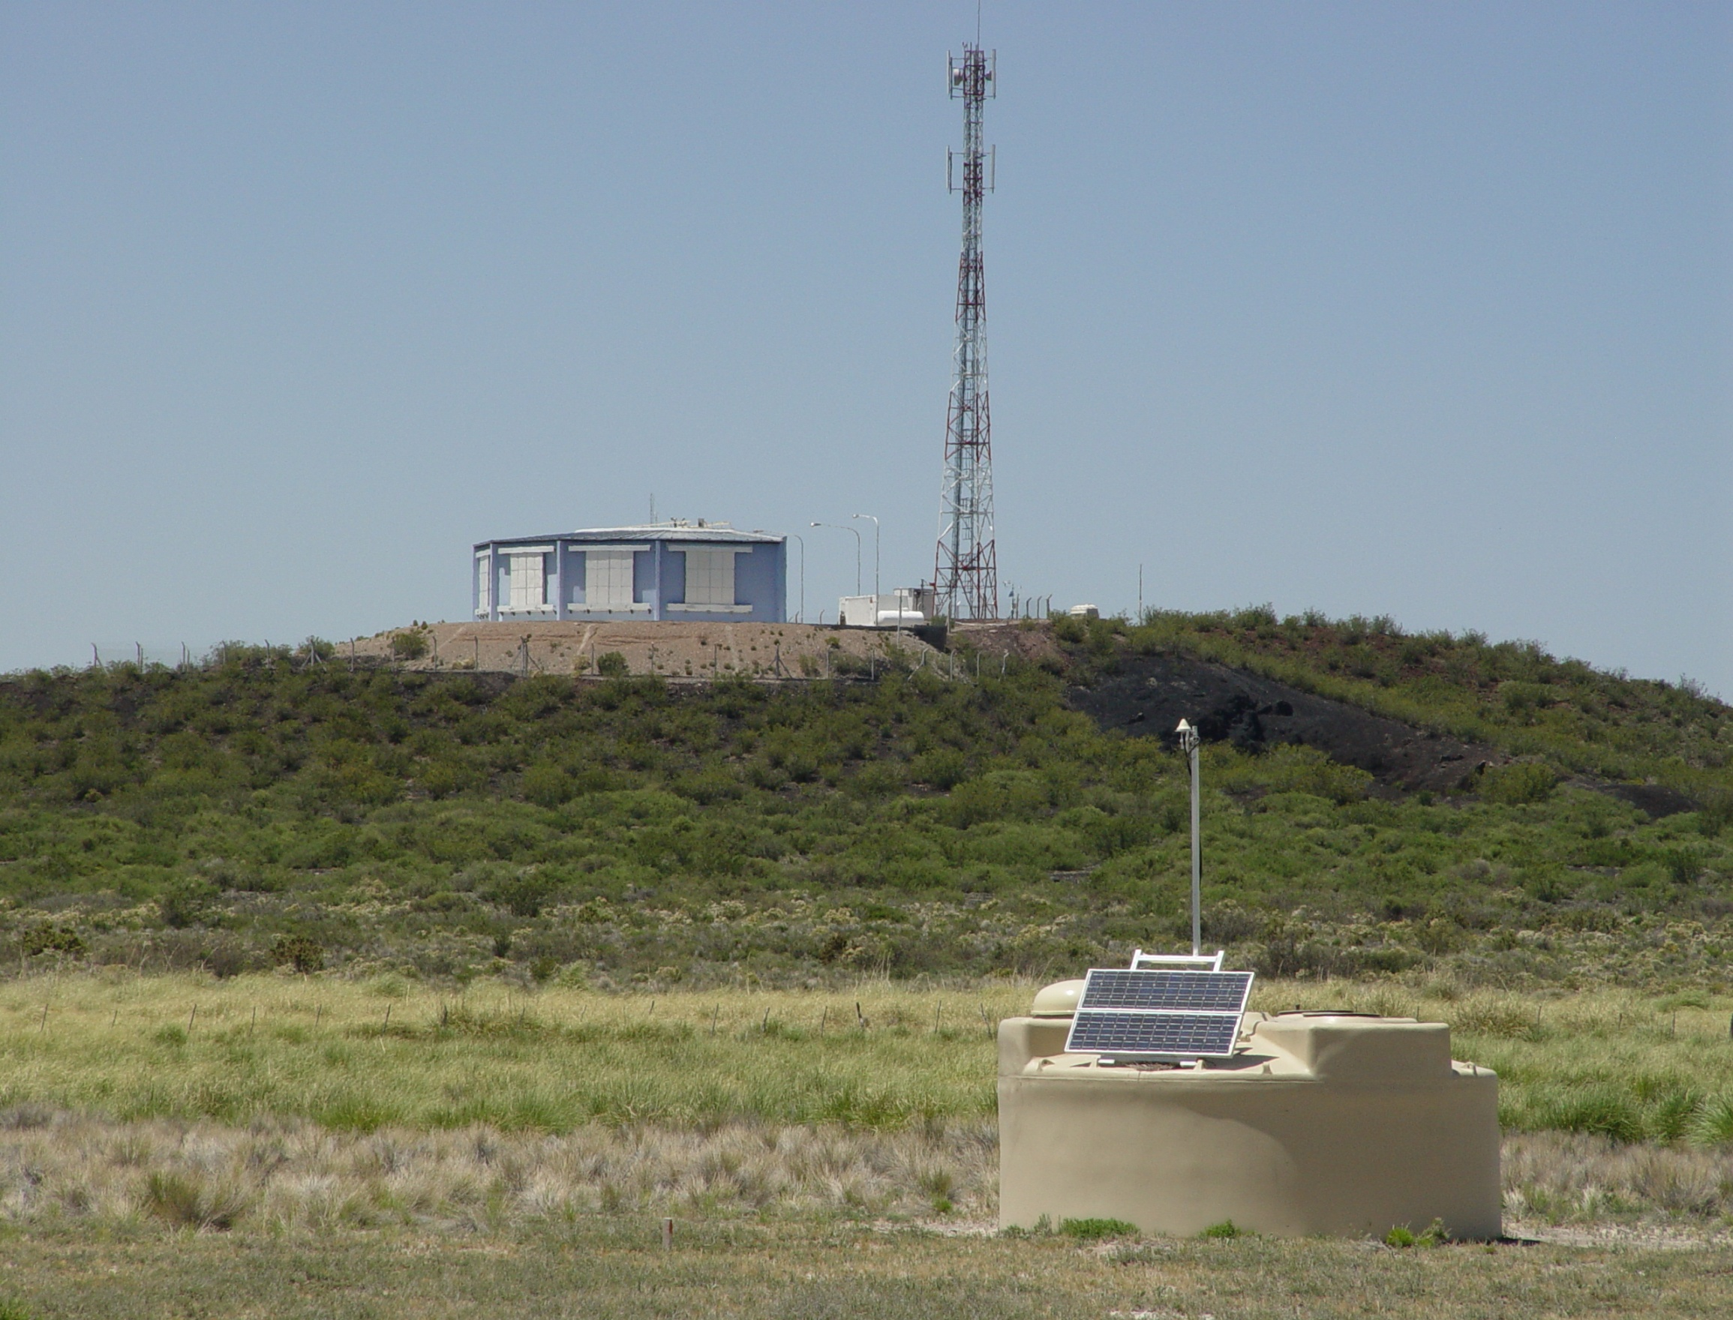
Origin of the Ultra High Energy Cosmic Rays: New Results from Pierre-Auger
Katsushi Arisaka
UCLA

Slide 2
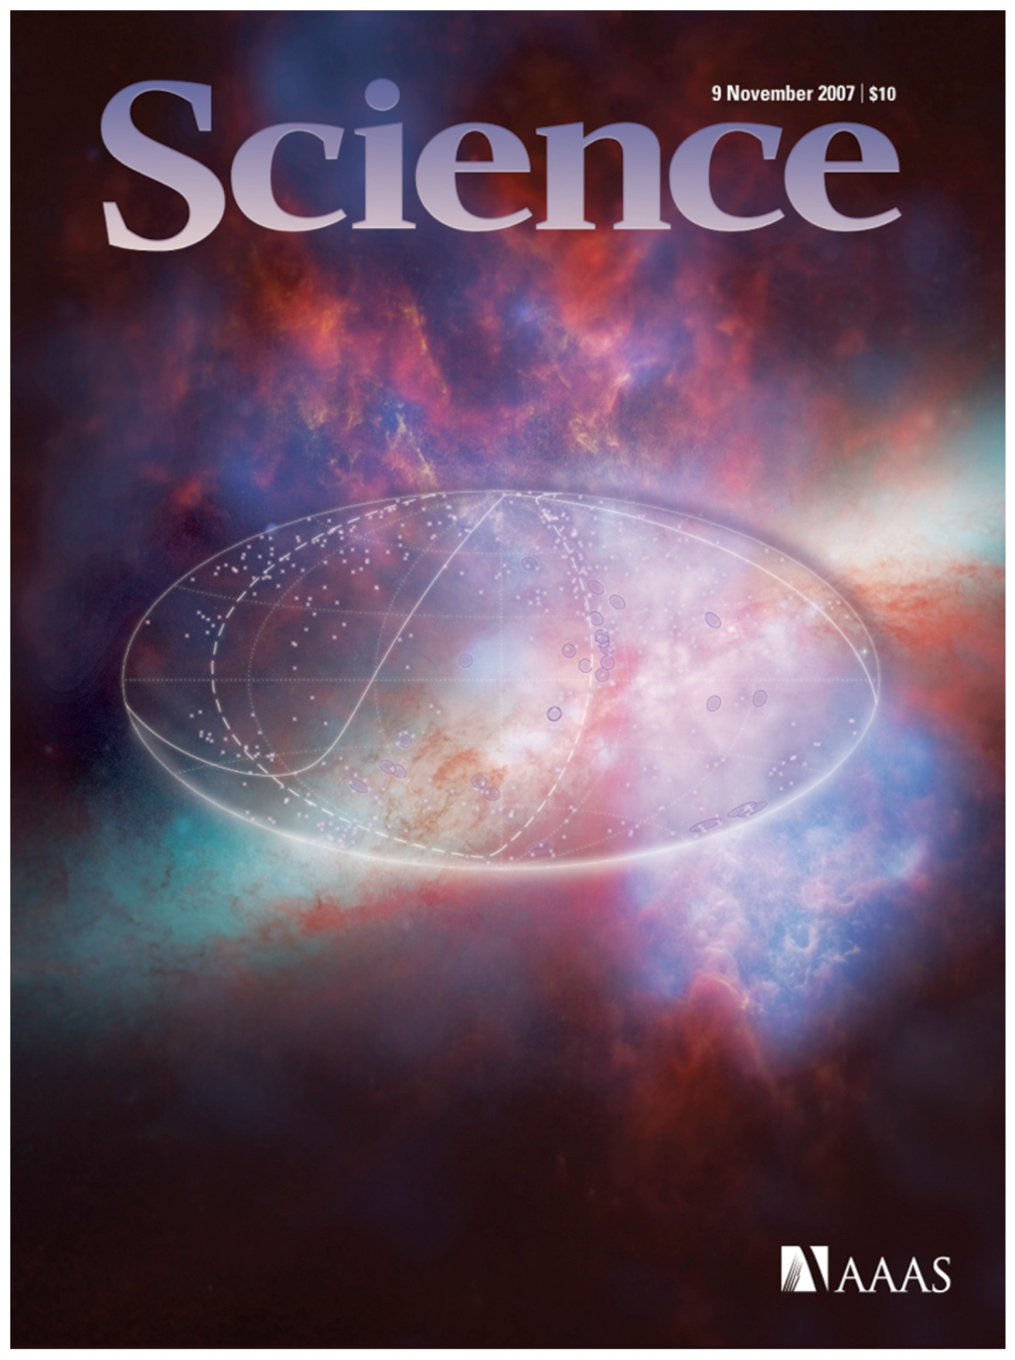

Slide 3
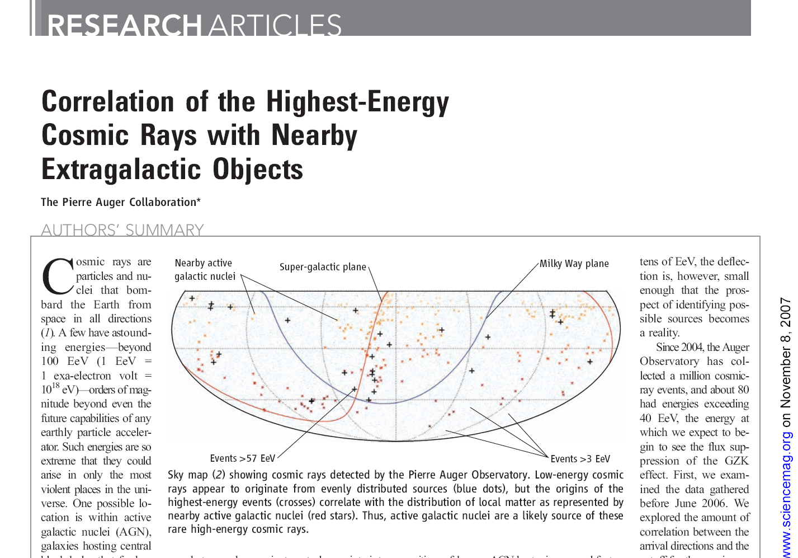

Slide 4
Talk Outline
Scientific Motivation
Top-down vs. Bottom-up
Why is 10²⁰ eV so special?
Pierre Auger Observatory
Previous Experiment – AGASA, HiRes
Pierre Auger Detector
New Results
Energy Spectrum
Any Top-down signal?
Angular Distribution
Future Prospects
Are they irons?
Auger-North

Slide 5
Scientific Motivation

Slide 6
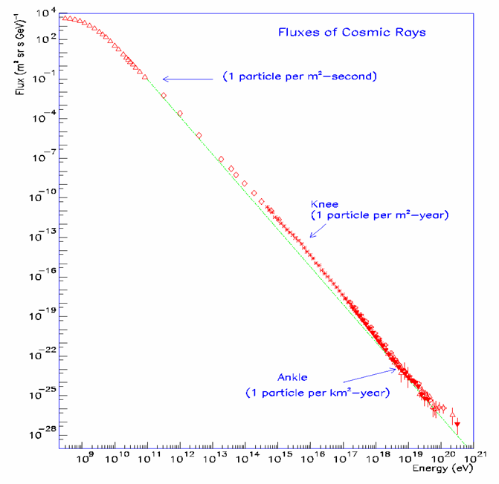
Energy Spectrum of Cosmic Rays
Energy Spectrum ~ E⁻³
The spectrum extends beyond 10²⁰ eV (=100 EeV).
Beyond 10²⁰ eV, Flux is only one particle per km²-century.
LHC
GeV
TeV
PeV
EeV

Slide 7
Particle Physics in Early Universe
Time
(sec)
Temp.
(ºK)
Energy (GeV)
Fundamental
Interaction
10⁻⁴⁵sec
Planck
GUT
10⁻⁴⁰
10³⁰
10¹⁸
GUT
10⁻³⁵
10¹⁵
10⁻³⁰
10²⁵
10¹²
10⁻²⁵
Electro-Weak
1EeV
10⁻²⁰
10²⁰
1PeV
10⁻¹⁵
10¹⁵
1TeV
EW
10⁻¹⁰
10⁻⁵
1GeV
1
10¹⁰
1MeV
10⁵ sec
1KeV
Gravitation
Electromagnetic
1 year
10⁵
Strong
Weak
10³
1eV
10⁶
10⁹ year
10⁻³eV
Now
1

Slide 8
Particle Physics in Early Universe
Time
(sec)
Temp.
(ºK)
Energy (GeV)
Big Bang!
10⁻⁴⁵sec
Planck
Super String
10⁻⁴⁰
10³⁰
10¹⁸
Quantum Gravity
GUT
Grand Unification
10⁻³⁵
10¹⁵
Inflation
10⁻³⁰
10²⁵
10¹²
10⁻²⁵
1EeV
10⁻²⁰
10²⁰
1PeV
Super Symmetry
10⁻¹⁵
Dark Matter
10¹⁵
1TeV
EW
10⁻¹⁰
10⁻⁵
1GeV
1
10¹⁰
1MeV
10⁵ sec
1KeV
1 year
10⁵
10³
1eV
10⁶
10⁹ year
10⁻³eV
Now
Dark Energy
1

Slide 9
Particle Physics in Early Universe
Time
(sec)
Temp.
(ºK)
Energy (GeV)
Big Bang!
10⁻⁴⁵sec
Planck
10⁻⁴⁰
10³⁰
10¹⁸
GUT
10⁻³⁵
10¹⁵
Inflation
10⁻³⁰
10²⁵
10¹²
10⁻²⁵
1EeV
10²⁰
UHE Cosmic Rays
10⁻²⁰
1PeV
10⁻¹⁵
Dark Matter
10¹⁵
1TeV
EW
10⁻¹⁰
10⁻⁵
1GeV
Accelerator
1
10¹⁰
1MeV
10⁵ sec
1KeV
1 year
10⁵
10³
1eV
10⁶
Telescope
10⁹ year
10⁻³eV
Now
Dark Energy
1

Slide 10
Top-down or Bottom-up?
Time
(sec)
Temp.
(ºK)
Energy (GeV)
Big Bang!
10⁻⁴⁵sec
Planck
10⁻⁴⁰
10³⁰
10¹⁸
GUT
10⁻³⁵
10¹⁵
10⁻³⁰
10²⁵
10¹²
10⁻²⁵
Gamma Ray Burst
1EeV
UHE Cosmic Rays
10⁻²⁰
10²⁰
Active Galactic Nuclei
1PeV
10⁻¹⁵
Supernova
Neutron Star
Black Holes
10¹⁵
1TeV
EW
10⁻¹⁰
10⁻⁵
1GeV
1
10¹⁰
1MeV
10⁵ sec
1KeV
1 year
10⁵
10³
1eV
10⁶
10⁹ year
10⁻³eV
Now
1

Slide 11
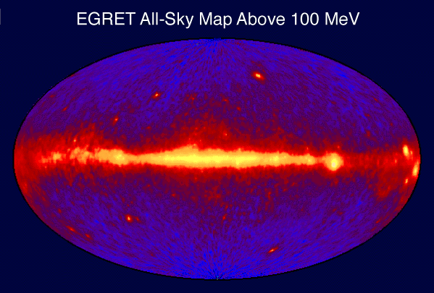
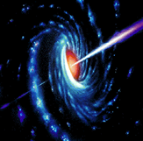
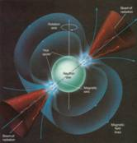
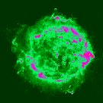
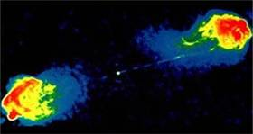
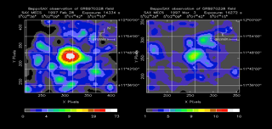
The Extreme Universe
AGN
Pulsar
SNR
Radio Galaxy
GRB

Slide 12
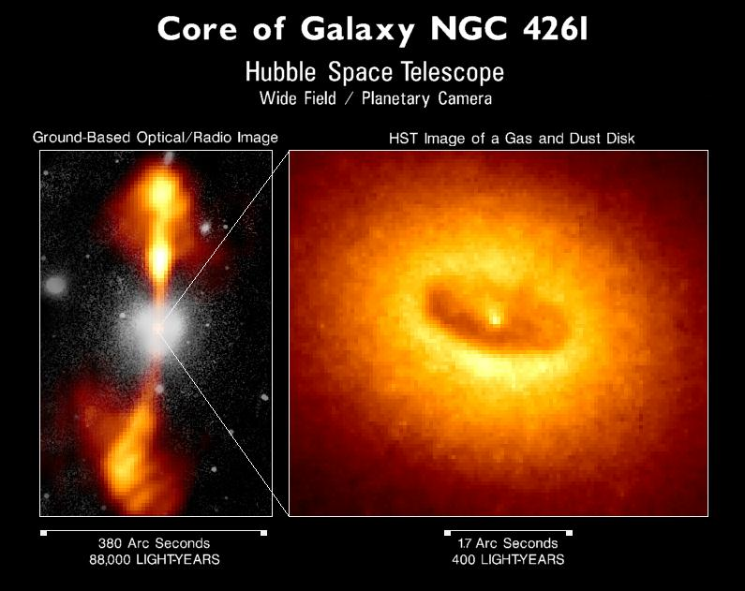

Slide 13
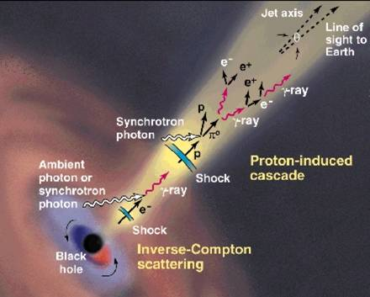
AGN Central Engine

Slide 14
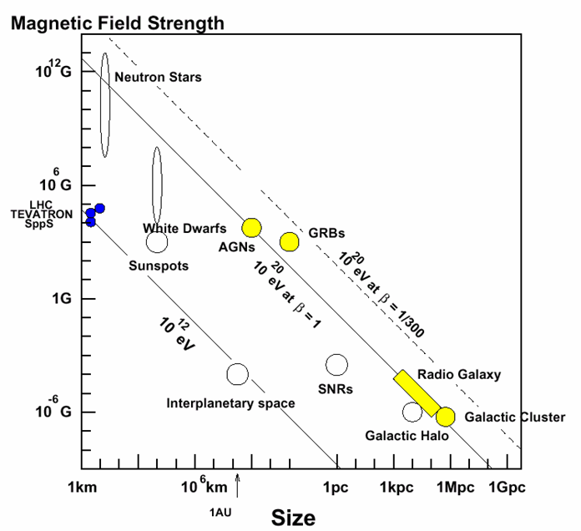
Possible Acceleration Sites
Several possible accelerators in nature up to 10²⁰ eV.
Extremely difficult to accelerate above 10²⁰ eV.
1 pc = 3.26 light year

Slide 15
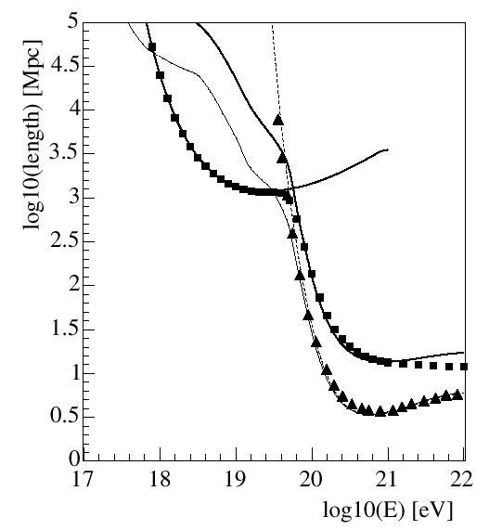
Interaction Length of UHE Protons
Pair
Production
Horizon of Universe ~ 5 Gpc
1Gpc
p + γ (2.7ºK)
Δ
→ p + π’s
GZK Cutoff
Photopion
Loss Length
10Mpc
Interaction
Length
Blasi, astro-ph/0307067

Slide 16
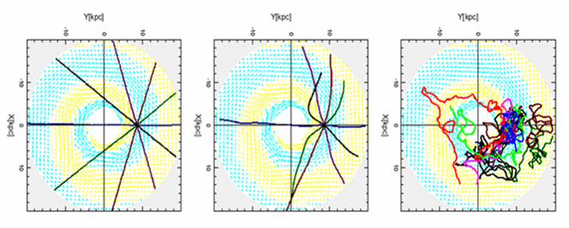
Trajectory of Cosmic Ray Protons in the Galaxy
Magnetic Field in our Galaxy ~ 2 µG
E=10²⁰eV
E=10¹⁹eV
E=10¹⁸eV

Slide 17
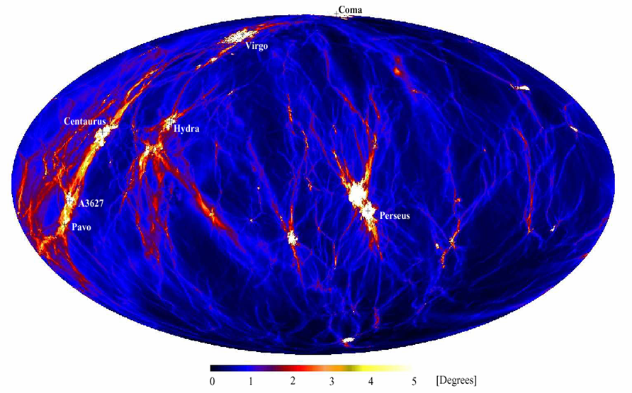
Deflection of Protons >4×10¹⁹eV
Extra Galactic Magnetic Field ~ 1 nG
< 100 Mpc
0º
360º
Dolag, astro-ph/0310902

Slide 18
Why is 10²⁰eV so special?
Nearly impossible to accelerate beyond 10²⁰ eV by nature. → Top-down Mechanism?
Protons cannot travel beyond ~50 Mpc at E > 10²⁰ eV due to interaction with CMB. → GZK Cut-off → Violation of Special Relativity?
Protons can travel straight at E > ~4×10¹⁹ eV. → Charged-Particle Astronomy → New Window of Extreme Universe

Slide 19
Rich Physics and Astronomy
10²¹ eV
?
Top-Down?
GZK?
UHE Neutrinos
10²⁰ eV
Straight Trajectories
Charge Particle Astronomy
UHE Gamma Rays
10¹⁹ eV
Bent by Extra-Galactic B (~nG)
Ankle
10¹⁸ eV
Trapped by Inner-Galactic B (~μG)
Bottom-Up

Slide 20
Past and Ongoing Experiments
AGASA
HiRes
Pierre-Auger

Slide 21
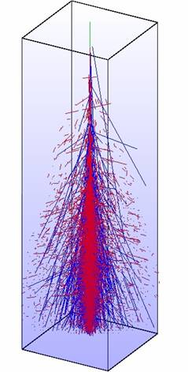
Detection Technique
MC Simulation of 10 EeV (10¹⁹eV) Proton Shower
HiRes
10km
e±
Fluorescence Detector (FD)
~ 27X_{o}
~ 11λ_{I}
μ±
AGASA
Shower Detector (SD)

Slide 22
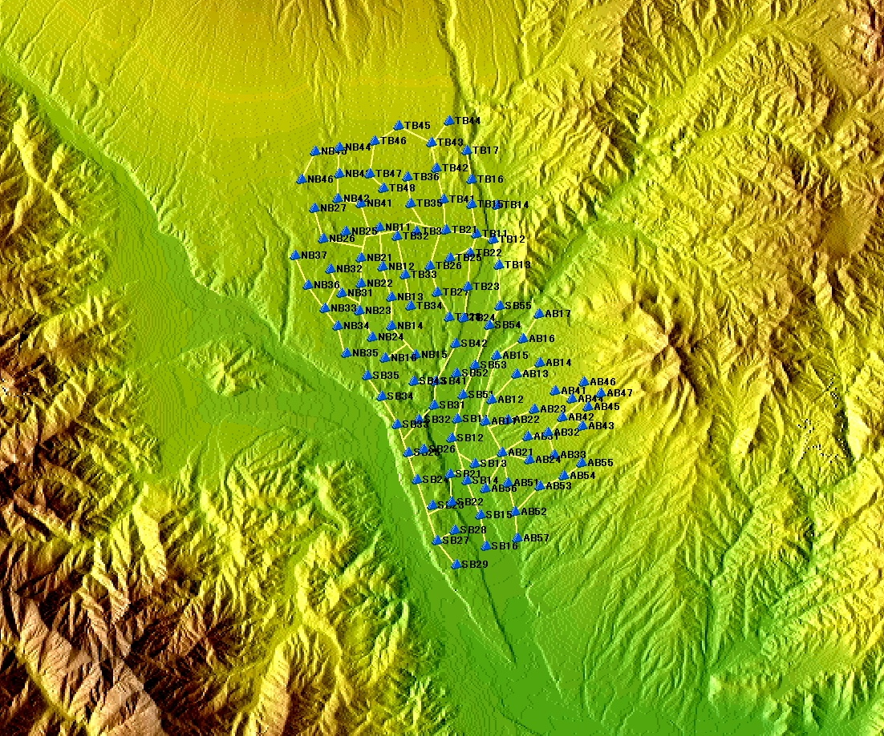
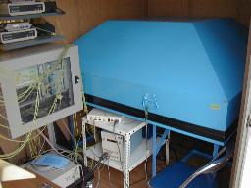
Akeno Giant Air Shower Array
111 Electron Detectors
100 km²
27 Muon Detectors
Operation 1991 - 2004
0 4km
M. Teshima

Slide 23
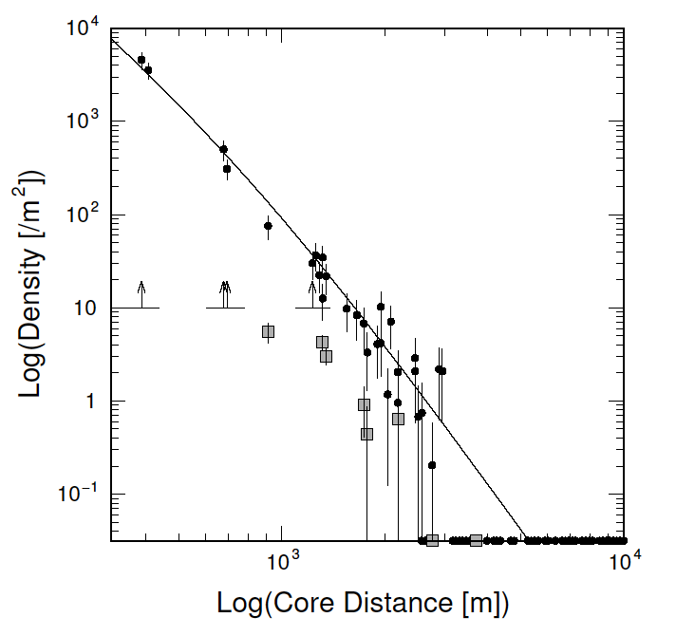
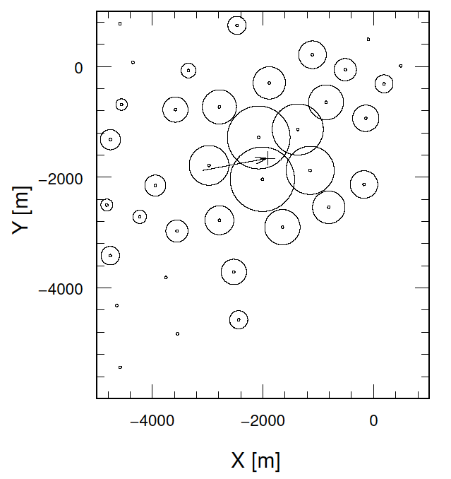
The Highest Energy Event by AGASA
2.5 x10²⁰eV on 10 May 2001
M. Teshima

Slide 24
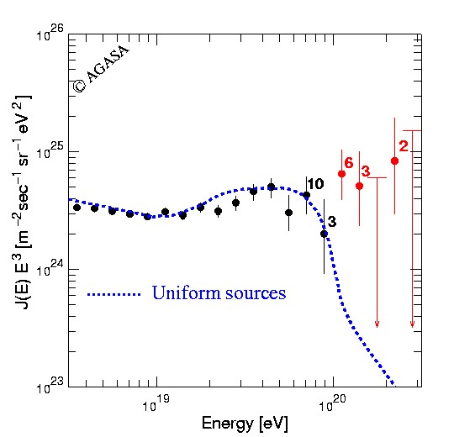
Energy Spectrum by AGASA
Top-down?
Bottom-up
with GZK Cutoff
M. Teshima

Slide 25
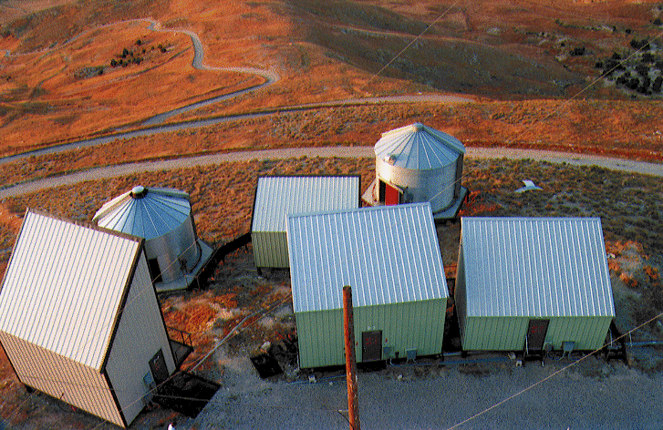
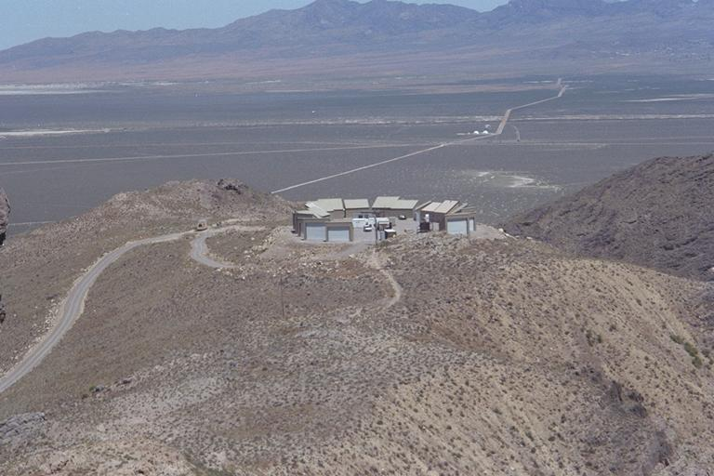
Two HiRes Detectors
HiRes1: Atop Five Mile Hill
21 mirrors, 1 ring (3º<altitude<17º).
HiRes2: Atop Camel’s Back Ridge
12.6 km SW of HiRes1.
42 mirrors, 2 rings (3º<altitude<31º).
G. Thomson

Slide 26
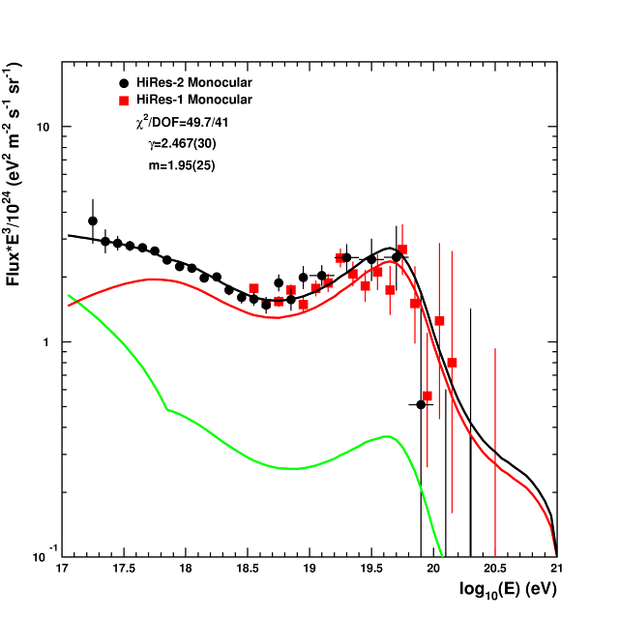
Energy Spectrum by HiRes
(1999-2004)
(1996-2005)
Consistent with
GZK Cutoff !!
Extra-Galactic
Galactic
C. Finley

Slide 27
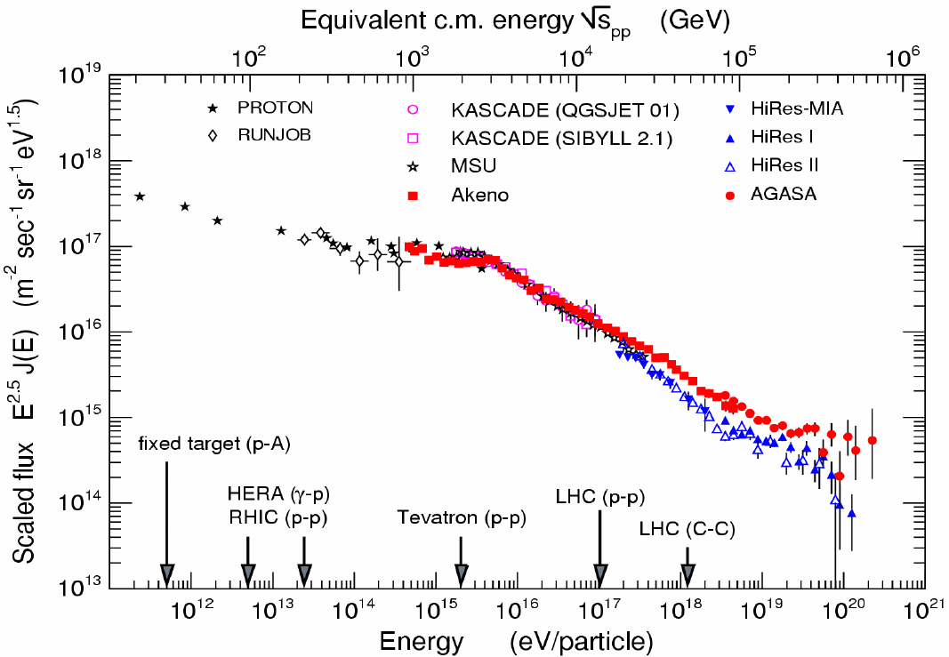
Energy Spectrum
AGASA (SD)
?
HiRes (FD)
Ralph Engel

Slide 28
Detection Technique
MC Simulation of
10¹⁹eV Proton Shower
Pierre-Auger
HiRes
10km
e±
Fluorescence Detector (FD)
~ 27X_{o}
~ 11λ_{I}
μ±
AGASA
Shower Detector (SD)

Slide 29
SD vs. FD
SD (Shower Detector) - AGASA
Pros: Operational all the time
Cons: Sparse sampling at the tail of Shower
FD (Fluorescence Detector) - HiRes
Pros: Totally calorimetric energy measurement
Cons: ~10% duty factor (only at moonless night)
Pierre-Auger utilizes both!

Slide 30
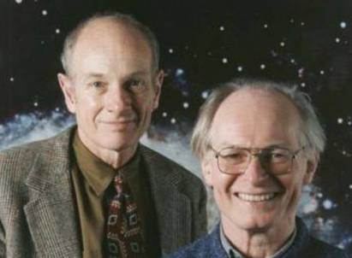
Pierre Auger Collaboration
17 Countries
50 Institutions
~370 Scientists
Italy Argentina
Czech Republic Australia
France Brazil
Germany Bolivia*
Poland Mexico
Slovenia USA
Spain Vietnam*
United Kingdom
*Associate Countries
Founders
Jim Cronin
Alan Watson

Slide 31
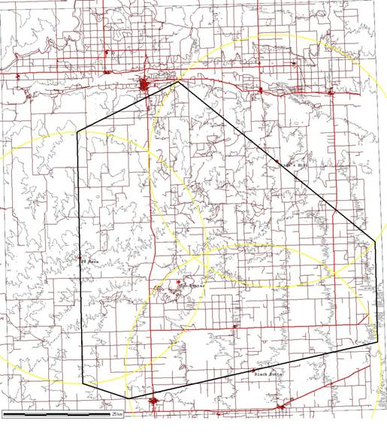
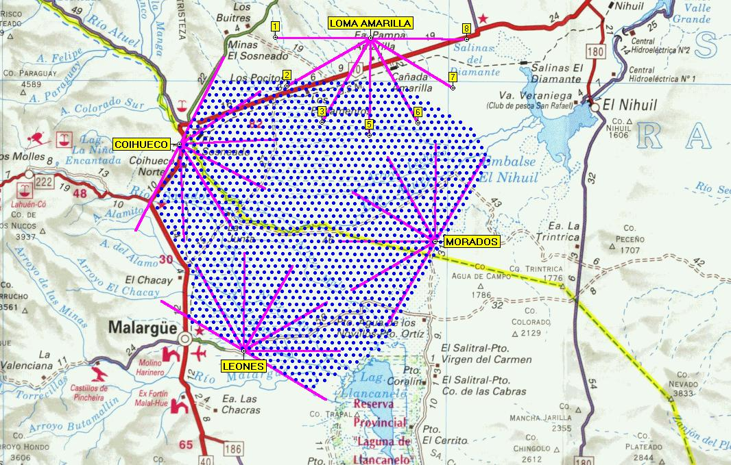
Pierre-Auger Observatory
Northern Auger
in Colorado
N
Southern Auger
in Argentina
S
50km

Slide 32
Southern-Auger in Argentina
Surface Array
1600 Water Tanks
1.5 km spacing
3100 km²
AGASA
Fluorescence Detectors
4 Telescope Sites
6 Telescopes per Site
24 Telescopes Total
50km

Slide 33
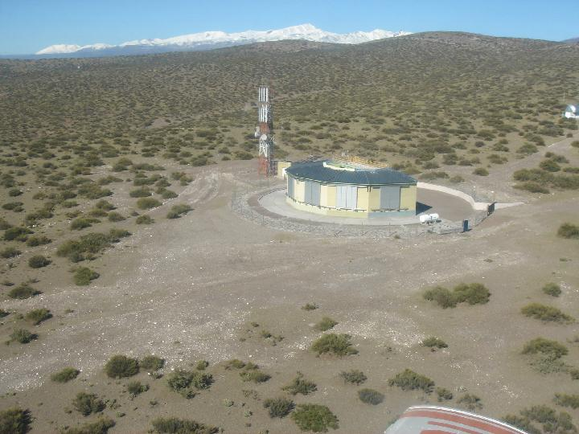

Slide 34
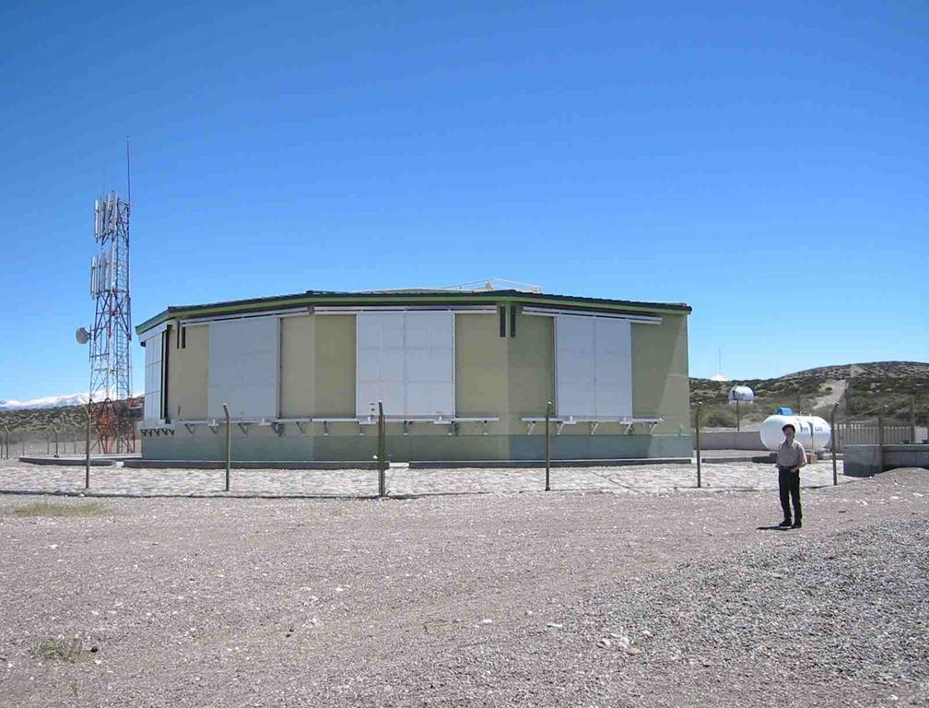

Slide 35
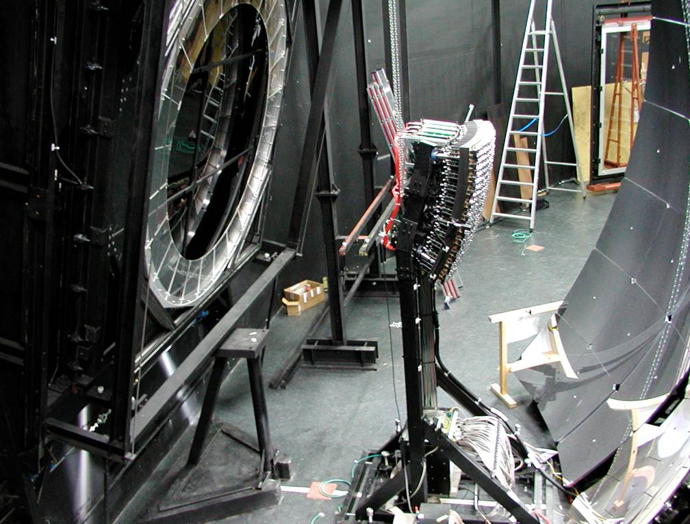
Optical
Shutter
UV-Filter 300-400 nm
Camera 440 PMTs
11 m² Mirror
corrector lens
Corrector Ring

Slide 36
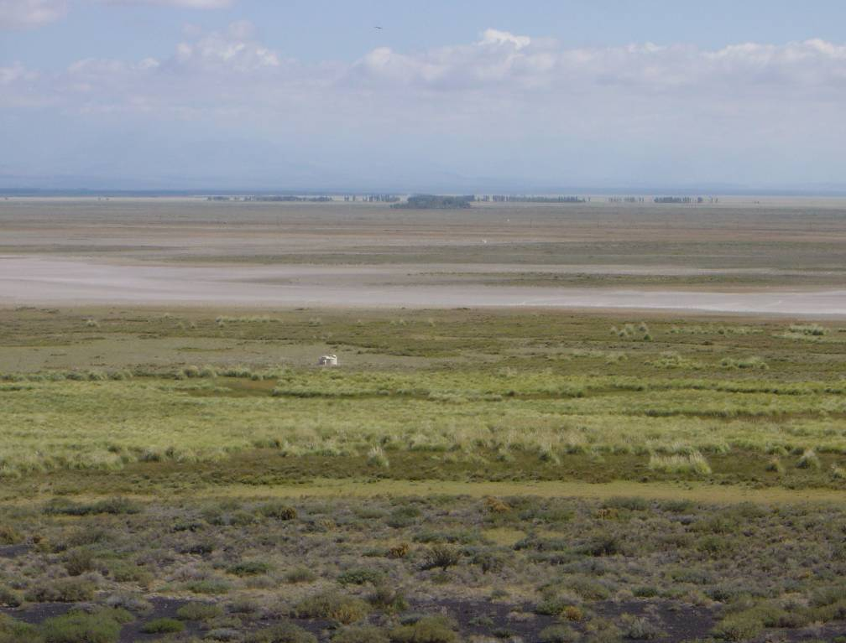
Tanks aligned seen from Los Leones

Slide 37
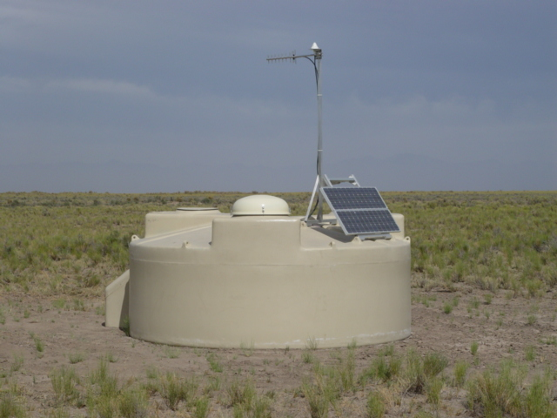
Water Tank on Site
Real water tank under operation at Malargue

Slide 38
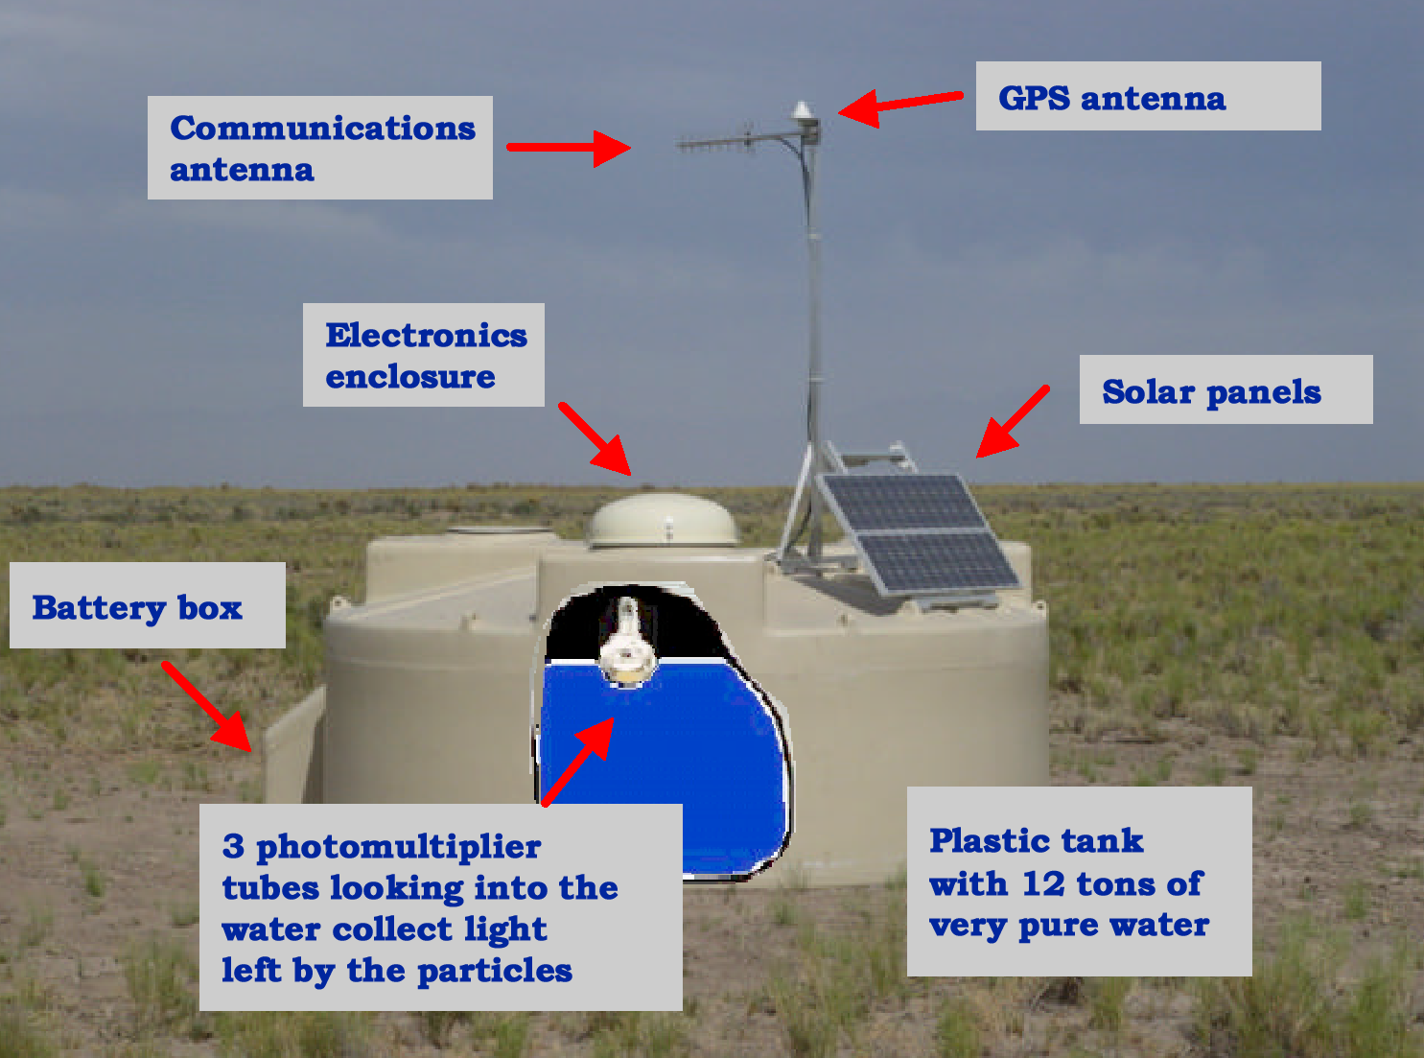

Slide 39
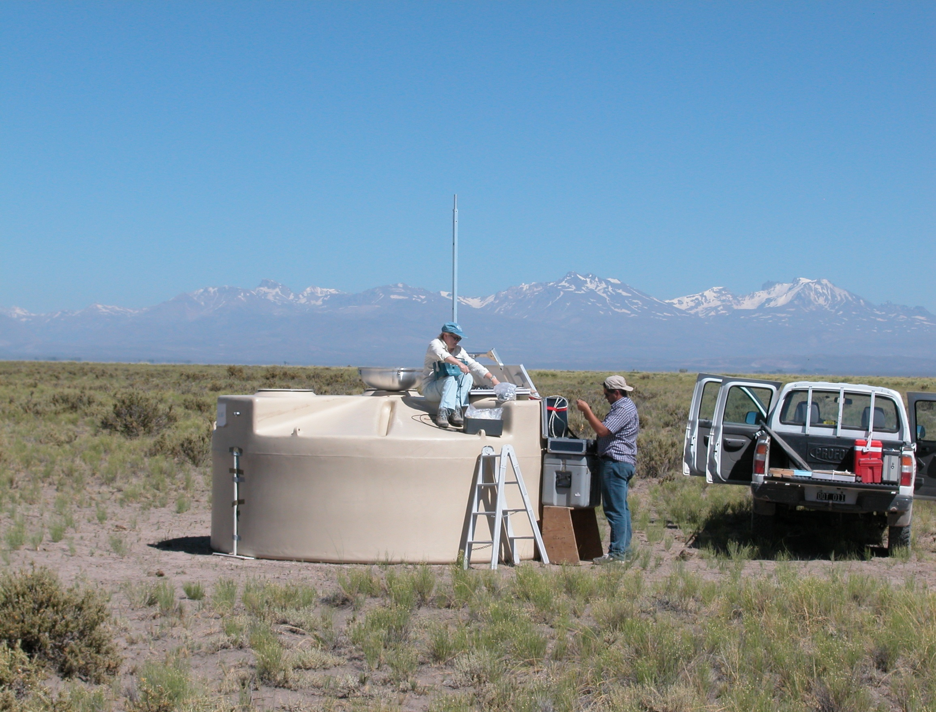
Checking Electronics

Slide 40
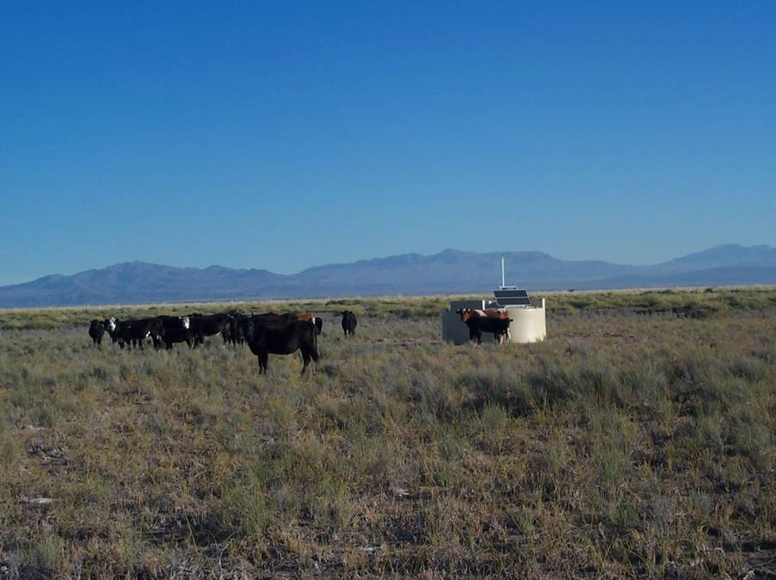
Surface Detector inspection by residents of the Pampa

Slide 41
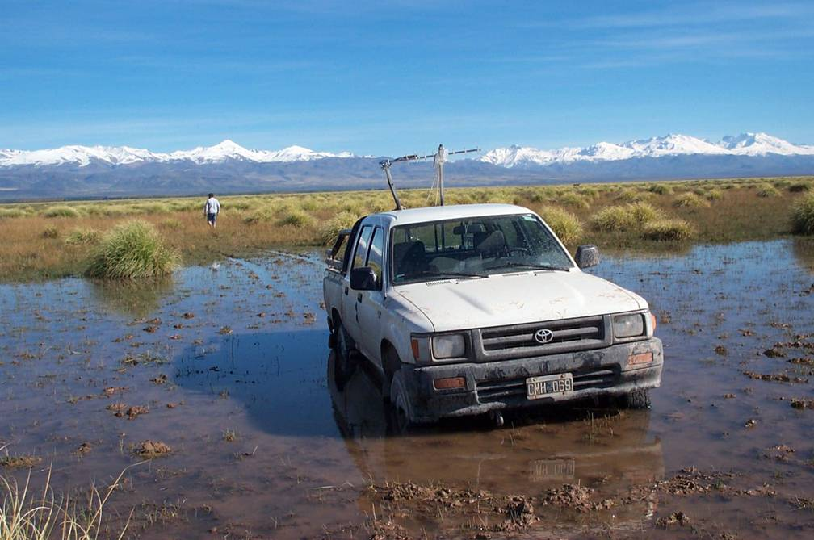
Don’t get stuck!

Slide 42
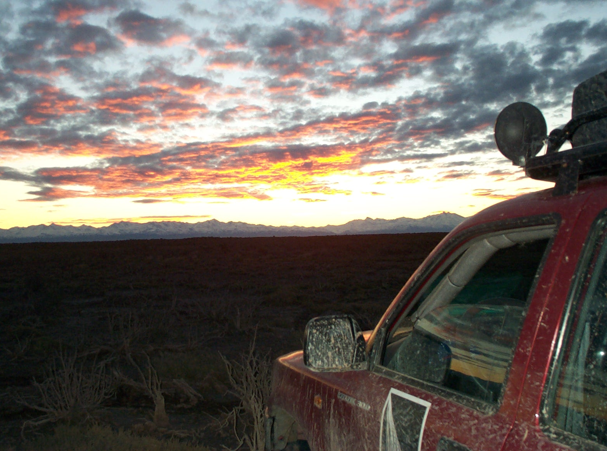
Beautiful Sunset on the Andes

Slide 43
UCLA Pierre-Auger Group
Name | Position | Responsibility | Active Year
Katsushi Arisaka | Professor | P.I. | 1998 - present
William Slater | Professor | MC Simulation | 1998 - 2006
Graciela Gelmini | Professor | Theory | 2002 - present
Alex Kusenko | Professor | Theory | 2002 - present
Matthew Malkan | Professor | AGN Astronomy | 2007 - present
Arun Tripathi | Postdoc | Data analysis | 1998 - 2006
Chris Jillings | Postdoc | PMT testing | 1999 - 2002
Dmitry Semikoz | Postdoc | Theory | 2002 - 2005
Oleg Kalashev | Postdoc | Theory | 2005 - 2006
Tohru Ohnuki | PhD | Angular Distribution | 2001 - 2006
David Barnhill | PhD | Photon limit | 2001 - 2007
Joong Lee | PhD | Energy Spectrum | 2002 - 2007
Matthew Healy | PhD | Mass Composition | 2003 - present
Pedram Boghrat | UCLA Grad | Angular Distribution | 2004 - 2007
Weichung Ooi | UCLA Grad | Angular Distribution | 2004 - 2005
Artin Teymourian | UCLA Grad | Corellation with AGN | 2006
Antoine Calvez | UCLA Grad (NSF REU) | Angular Distribution | 2004 - 2005
Jacob Ribnik | UCLA undergrad | Compsition study, Dach job system | 2004
Eitan Anzenber | From UCSC | Correlation with GRB with SWIFT data | 2005
Adrian Cheng | UCLA undergrad | Search for Thread-like clustering | 2005
Justin Young | UCLA undergrad | Neutrino detection | 2005
Ryan Reece | NSF REU | Fluorescence Photon Yield | 2005
Adam Lopez | UCLA CARE | Quantum Efficiency Measurement | 2005
Daniel Maronde | UCLA undergrad | Collection Efficiency | 2005
Alfonso Vergara | UCLA undergrad | Collection Efficiency | 2005
Sourpouhi Bedikian | NSF REU | Correlation with AGN | 2005
Joshua Moody | UCLA undergrad | Mass Composition study by Muon LDF | 2006
Umi Yamamoto | From Tokyo | Correlation with AGN | 2006
Tyler Dawson | UCLA undergrad | Catalog of Astronomical objects | 2006
Brian Rothaug | UCLA undergrad | Catalog of Astronomical objects | 2006
Min Lu | UCLA undergrad | Mass Composition study by Muon LDF | 2006
and more before 2004….

Slide 44
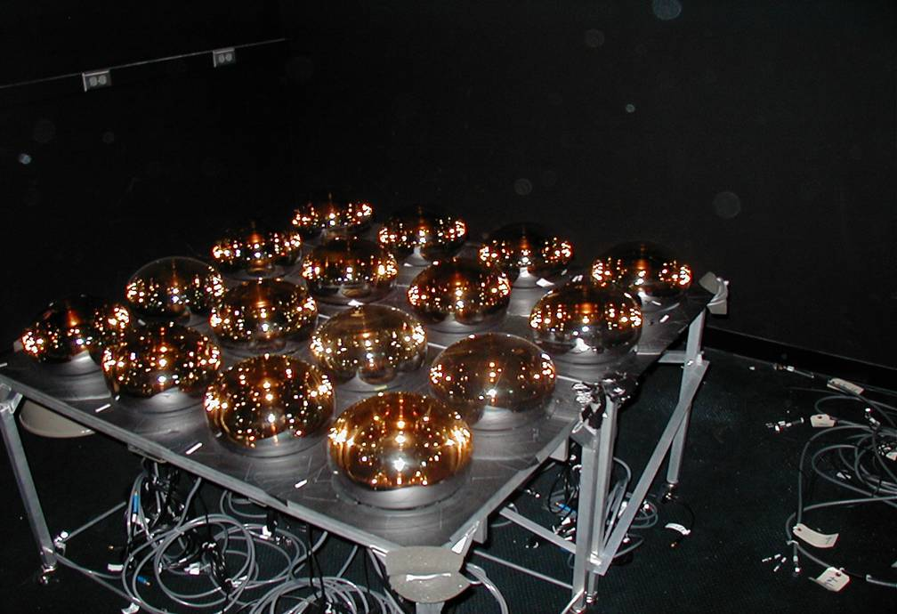
UCLA PMT Test Facility at STRB in Westwood

Slide 45
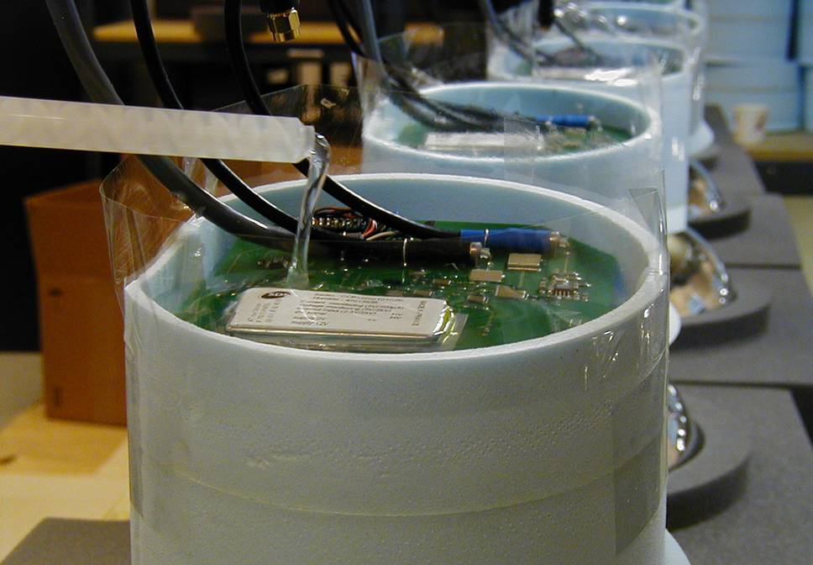
PMT Potting Underway at STRB

Slide 46
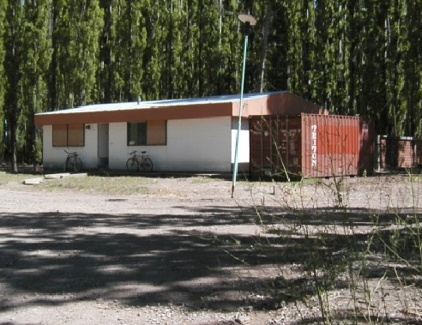
Malargüe PMT Test Facility

Slide 47
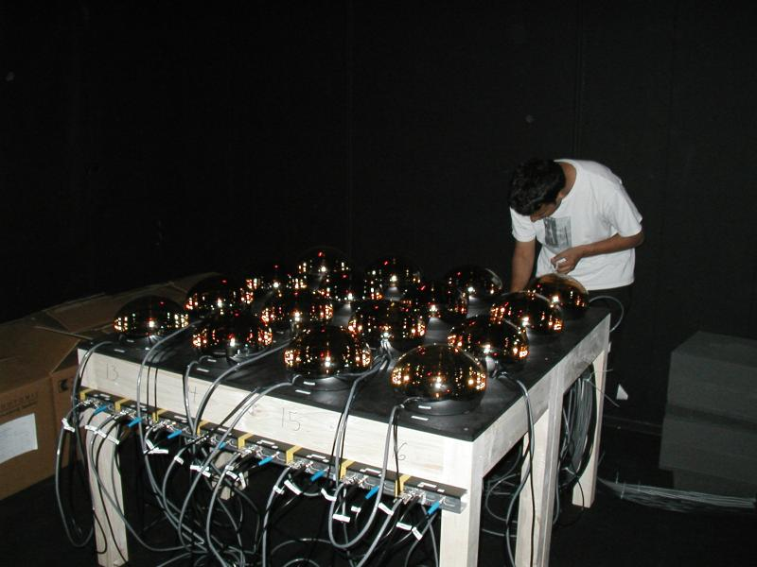
16 PMTs inspected by Arun

Slide 48
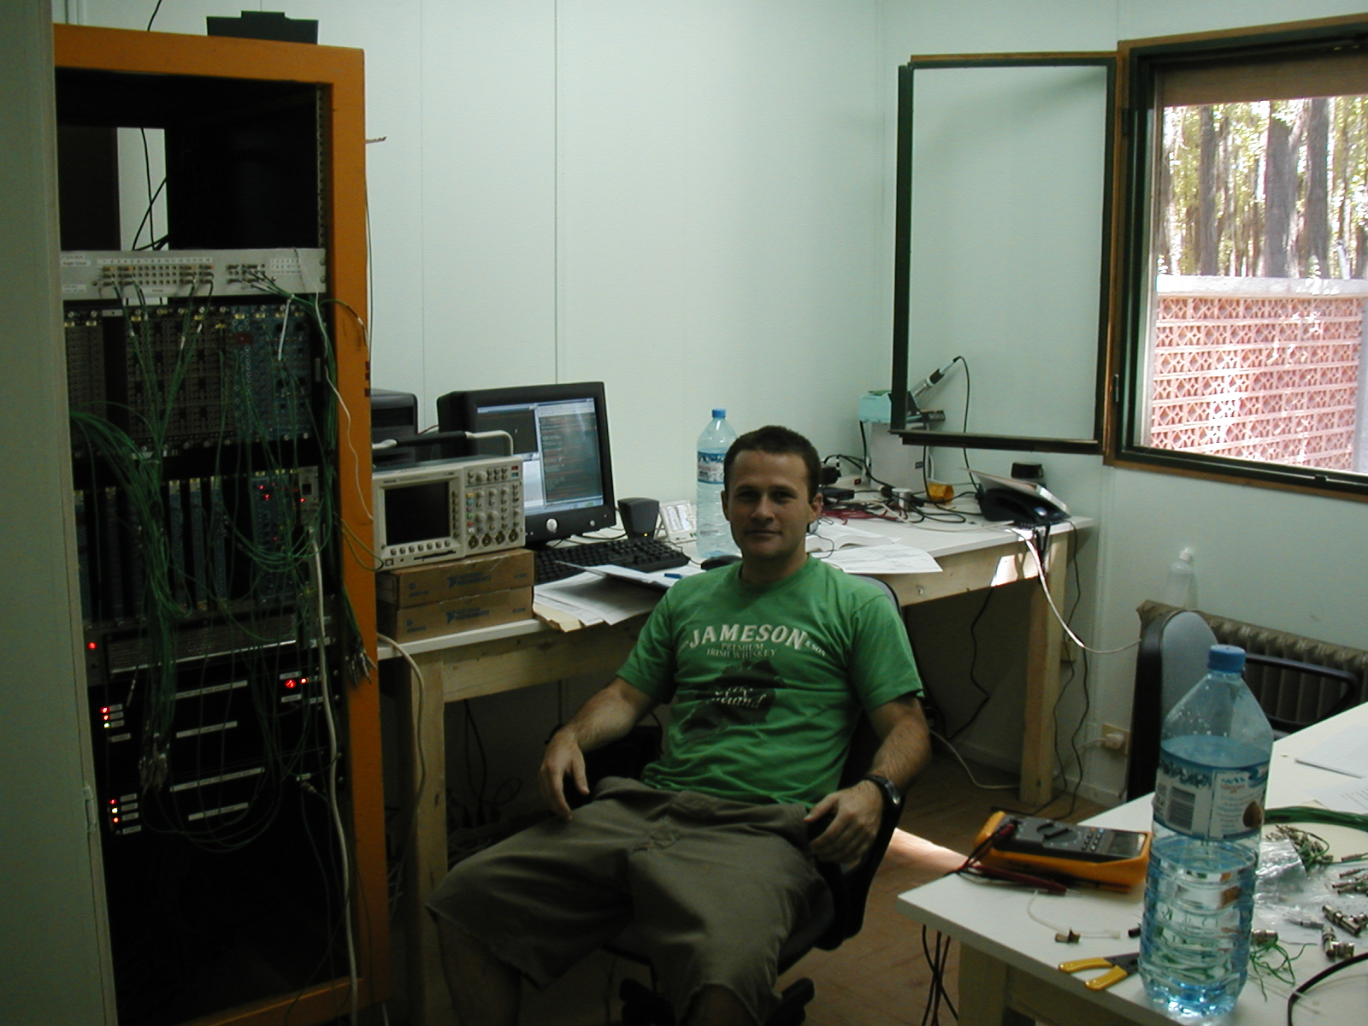
David in Control

Slide 49
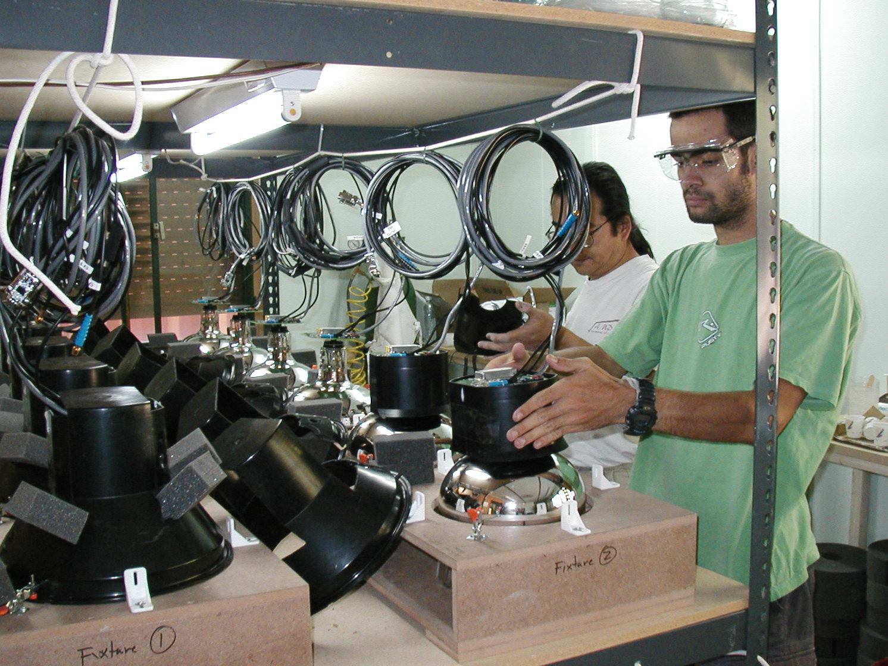
PMT Test Facility
PMTs Assembled by Tohru and Federico

Slide 50
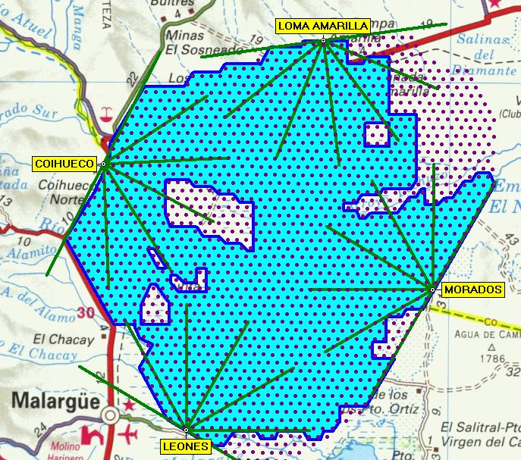
Southern Auger as of Nov. 2007
1501 Water Tanks (out of 1600)
~ 30 x AGASA
50km

Slide 51
Comparison of Integrated Aperture
~ 5 x AGASA
~1.5 x HiRes

Slide 52
Energy Determination

Slide 53
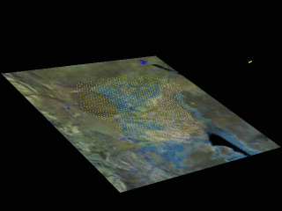
Event Simulation (10¹⁹ eV)
Green: e+ e-
Red: Muons

Slide 54
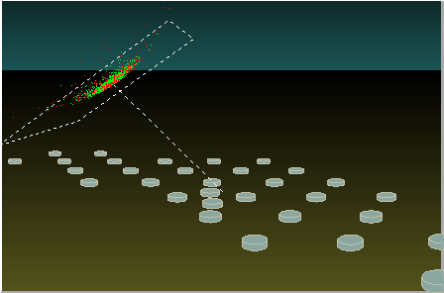
Event Simulation (10¹⁹ eV)
Green: e+ e-
Red: Muons

Slide 55
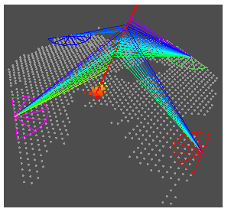
10¹⁹ eV event observed by all detectors

Slide 56
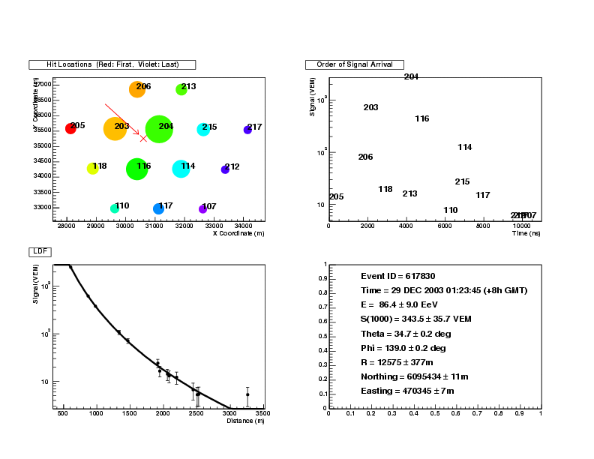
A Typical Event (“Young” Shower, Zenith~35º)
Lateral Distribution Function
204
204
203
203
~7×10¹⁹eV
116
~8×10¹⁹eV
116
S(1000)
S(1000)
114
114
206
215
217

Slide 57

A Typical Event (“Young” Shower, Zenith~35º)
EM
203
EM
(nsec)
204
EM
EM
Lateral Distribution Function
Muon
204
Muon
215
203
~7×10¹⁹eV
116
S(1000)
114
206
215
217
217
Muon
Muon

Slide 58


A Typical Inclined Event (“Old” Shower, Zenith~72º)
Muon
Muon
Direct
Cherenkov
on PMT 1
Lateral Distribution Function
~6×10¹⁹eV

Slide 59

S(1000) at 38º vs. FD Energy
S(1000) at 38º
50
1 EeV
10 EeV
100 EeV

Slide 60

Summary of S(1000) at 38º and 10 EeV
(VEM)
Proton
50
FD Average (σ = ±30%)
Proton, SIBYLL (AIRES)
Proton, QGSJET (AIRES)
Proton, GEISHA, QGSJET (CORSIKA)
Proton, FLUKA, QGSJET (CORSIKA)
Proton, GEISHA, QGSJET2 (CORSIKA)
Proton, FLUKA, QGSJET2 (CORSIKA)
Iron, SIBYLL (AIRES)
Iron, QGSJET (AIRES)
Fixed Beta
Iron
Proton, SIBYLL (AIRES)
Proton, QGSJET (AIRES)
Proton, GEISHA, QGSJET (CORSIKA)
Proton, FLUKA, QGSJET (CORSIKA)
Proton, GEISHA, QGSJET2 (CORSIKA)
Proton, FLUKA, QGSJET2 (CORSIKA)
Iron, SIBYLL (AIRES)
Iron, QGSJET (AIRES)
Floating Beta
34
SD+MC Average (σ = ±18%)

Slide 61
Energy Spectrums

Slide 62

Energy Spectrum × E³ (SD+MC Energy)
Auger
AGASA
HiRes
SD + MC Energy

Slide 63

Energy Spectrum × E³ (FD Energy)
AGASA
Auger
HiRes
FD Energy

Slide 64

Energy Spectrum × E³ (fit by proton injection)
AGASA
Auger
HiRes
Arisaka, et al, astro-ph/0709.3390

Slide 65
Summary of Energy Spectrum
Energy spectrum based on SD+MC Energy is similar to AGASA.
a hint of Super-GZK events?
but not as many as AGASA observed.
Energy spectrum based on FD Energy is consistent with HiRes.
fits reasonably well with the GZK cutoff.
Injection spectrum of 1/E^{2.6}.
So far, the spectrum is consistent with GZK Cutoff.

Slide 66
Any Signal from Big Bang? Looking for UHE Photons

Slide 67
What is Dark Matter?
Super Heavy
Dark Matter

Slide 68

Possibility of photons in AGASA data
AGASA Data
γ from SHDM
proton from SHDM
Bottom
up Proton
Gelmini, et al, astro-ph/0506128

Slide 69

Risetime vs. Log(E)
Photon
Proton (Sibyll)
Proton (QGS)
Iron (Sibyll)
Iron (QGS)
Real Data

Slide 70


Photon Limit Results
Fraction Limit
Flux Limit

Slide 71
Summary of Photon Flux Limit
The combination of the following assumptions is disfavored.
AGASA-like energy spectrum is correct.
There are extra Super-GZK events (> 10²⁰ eV).
These Super-GZK events are from the decay of Super Heavy Dark Matters.
Most likely
No Top-down component, at least, majority of UHE cosmic rays are the Bottom-ups.

Slide 72
Angular Distributions

Slide 73

Angular Resolution of Auger SD
AGASA
1 – 3 EeV
3 – 10 EeV
> 10 EeV
HiRes (Stereo)

Slide 74

Clustering of UHECR (>40 EeV) by AGASA
6 doublets and 1 triplet within 2.5º cone (out of 56 events)

Slide 75

AGASA Auto-Correlation
2.5º
40 EeV

Slide 76

HiRes Correlation with BL Lacs
0.6º
Gorbunov et al., astro-ph 0406654

Slide 77

Sky Maps (>6 EeV, < 75º)

Slide 78

Sky Maps (>30 EeV, < 60º)

Slide 79

Sky Map of Astronomical Objects
Mrk421
H1426+428
M87
Mrk501
1ES1959+6450
G.C.
1ES2344+514

Slide 80
Then breaking news from Argentina Group in May, 2006

Slide 81

AGN (z <0.018) & Auger Events (E > 56 EeV)
M87
12 /15 correlate !

Slide 82


AGN Correlation
Significance is Maximum at
Opening Angle < 3.1º
z < 0.018 ( < 75 Mpc)
E > 56 EeV

Slide 83
Argentina Group’s Discovery
Veron-Cetty 12th edition catalog of AGN
Total 85,221 quasars, 21,737 AGN, 1,122 BL Lac
Within 100 Mpc, 694 AGN, only 4 BL Lacs
Identified via optical observations, including recent SDSS
Correlation with cosmic rays maximized at
Z < 0.018 ( < 75 Mpc, 472 AGN)
θ < 3.1°
E > 56 EeV
Probability
p = 21% for each correlation
12 out of 15 UHECR correlate. (only expect 3.2 / 15)
P ~ 10⁻⁶ but a posteriori

Slide 84
Independent Sequential Test
June 2006
Auger collaboration agreed to freeze the cuts and analysis procedure.
Agreed to publish, once CL > 99% was realized for the new independent data set.
August 31, 2007
8 / 13 new events correlated. (2.7 / 13 expected)
A priori (unbiased) isotropic probability ~ 0.17%
This a priori analysis establishes the anisotropy of the UHE Cosmic Rays with at least 99% CL.
Submitted a paper to “Science”

Slide 86

AGN Correlation in galactic coordinates

Slide 87
AGN Correlation in galactic coordinates
Blue color: Exposure
472 AGN (z < 0.018)
Virgo
Cluster
Centaurus A
Centaurus
Cluster
Galactic
Center
Galactic Plane
28 Cosmic Rays
(E > 56 EeV, θ < 3.1º)
Super Galactic Plane

Slide 88

Universe within 60 Mpc (200 M light year)
30 Mpc

Slide 89



Centaurus A (4 Mpc, 12 M light year)
2 Cosmic Rays correlated.
Infrared
Radio + Optical images
X-ray

Slide 90

Scan over all the data (E > 56 EeV)
New Minimum
Old Minimum

Slide 91
Summary
Correlation with AGN established at >99% CL.
Z < 0.018 ( < 75 Mpc)
θ < 3 - 5°
E ~> 60 EeV
The first evidence of extra galactic origin of cosmic rays.
It could be a correlation with Large Scale Structure (or other sources with similar distribution.)
Beginning of UHE Charged-particle Astronomy.

Slide 92
Are the protons or heavy elements?

Slide 93
Risetime vs. Log(E)
Preliminary
Photon
Proton (Sibyll)
Proton (QGS)
Iron (Sibyll)
Iron (QGS)
Real Data

Slide 94

Risetime
Preliminary
Proton (Sibyll)
Proton (QGS)
Real Data
Iron (Sibyll)
Fit to data
Iron (QGS)
Slope = -4.2 ± 4.4

Slide 95

Elongation Rate
Preliminary
Proton (Sibyll)
Proton (QGS)
Fluorescence Detector
Iron (Sibyll)
Iron (QGS)
Surface Detector

Slide 96

Energy Loss Length of Proton (UCLA Simulation)
Pair
Production
Photopion
Red Shift
p + γ (2.7ºK)
Δ
→ p + π’s
Total

Slide 97

Energy Loss Length of Fe (UCLA Simulation)
Pair
Production
Red Shift
Photopion
Total (p)
Photo
Disintegration
Total (Fe)

Slide 98

Fit to Spectrum
Protons
High Iron
Low Iron

Slide 99
Auger-North

Slide 100

Auger-North in Colorado State
Colorado State
Auger
-North

Slide 101

Auger-North
Total area: 10,000 km²
~3 x Auger-South
4000 surface detector
1 mile (1.6 km) spacing
Lamar

Slide 102
Comparison of Integrated Aperture

Slide 103
Comparison of Integrated Aperture

Slide 104
Conclusions
The extra galactic origin of UHE cosmic rays has been established at 99% CL.
Strong correlation with nearby AGN ( < 80 Mpc)
Or something else which follows the super-galactic structure.
Birth of “UHE Charged Particle Astronomy”
Need more investigation.
Are they protons or heavy elements?
Who accelerates? What is the mechanism of acceleration?
Magnetic field effect: Our Galaxy or at the origin??
More statistics and experiments will follow.
5 x more data by 2012.
Auger-North (~ 3 x Auger-South), EUSO (~ 10 x Auger).

Slide 105
AGN Correlation in galactic coordinates
Blue color: Exposure
472 AGN (z < 0.018)
Virgo
Cluster
Centaurus A
Centaurus
Cluster
Galactic
Center
Galactic Plane
28 Cosmic Rays
(E > 56 EeV, θ < 3.1º)
Super Galactic Plane

