Slide 1
MAX
Multi-ton Argon Xenon
Katsushi Arisaka
University of California, Los Angeles
Department of Physics and Astronomy
arisaka@physics.ucla.edu

Slide 2






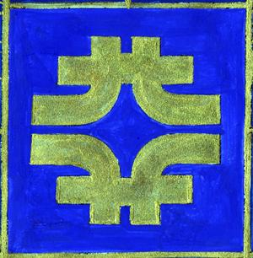













MAX - Multi-ton Argon & Xenon
MAX Collaboration = XENON + DarkSide
UMass Amherst, Arizona State University
Augustana College, Black Hills State University
Coimbra University, Columbia University
Fermilab, University of Houston, INAF, LNGS
MIT, University of Münster, University of Notre Dame
Princeton University, Rice University, Temple University
UCLA, Univesity of Virginia, Waseda University
University of Zürich

Slide 3
G2 and G3 facilities at DUSEL
defined by PASAG
 | G2 | G3
Sensitivity | < 10⁻⁴⁶ cm² | < 10⁻⁴⁷ cm²
Target Mass | ~ 1 Ton | ~ 10 Ton
Cost | $15M - $20M | ~ $50M

Slide 4
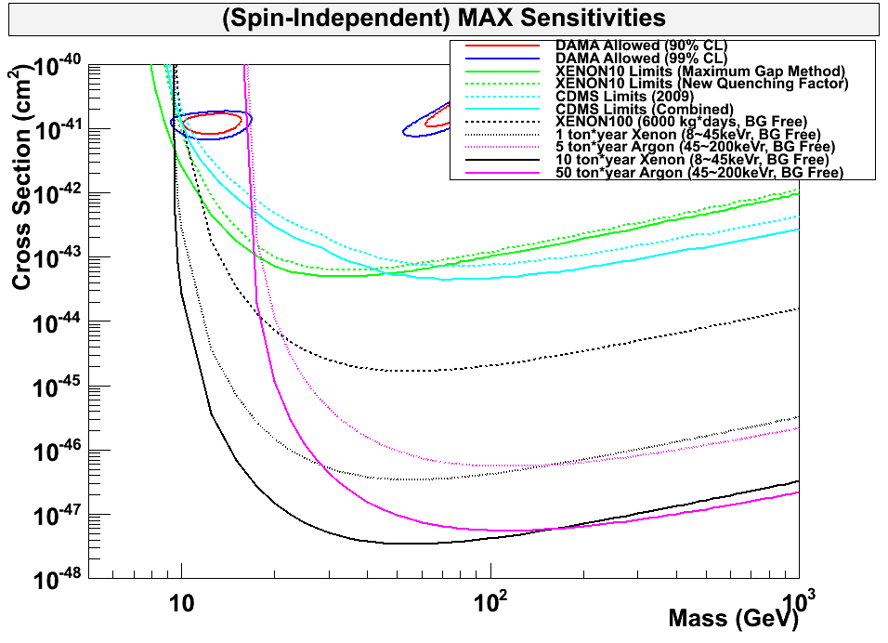
90% CL Limits of SI Cross Section
DAMA
XENON10
CDMS
XENON100
G2
Ar 5 ton
Xe 1 ton
Ar 50 ton
G3
Xe 10 ton

Slide 5
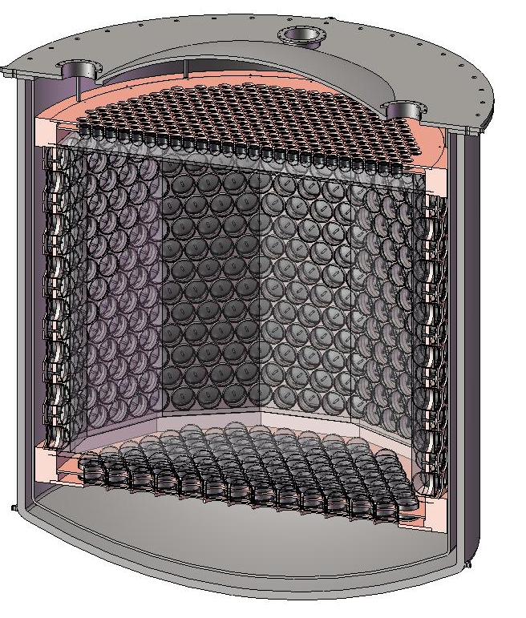
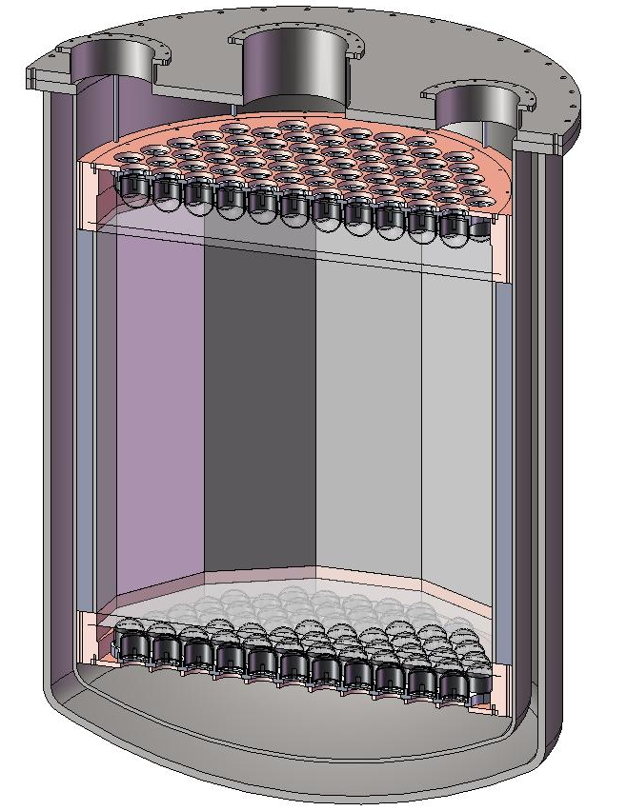
MAX G2 Detector
⁴⁰Ar
10 ton
(5 ton)
Xe
2 ton (1 ton)
= XENON1T
2 m
1 m
3” QUPID x 121 (Top)
3” QUPID x 121 (Bottom)
3” QUPID x 595 (Top)
6” QUPID x 825 (Side/Bottom)

Slide 6
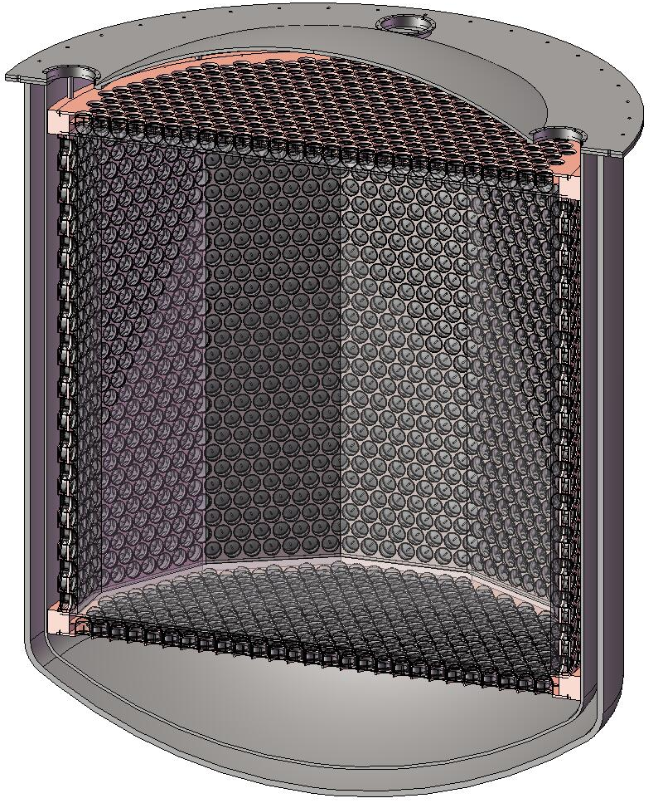
MAX G3 Detector
⁴⁰Ar
70 ton
(50 ton)
Xe
20 ton
(10 ton)
4m
2 m
3” QUPID x 595 (Top)
6” QUPID x 825 (Side/Bottom)
6” QUPID x 3746

Slide 7
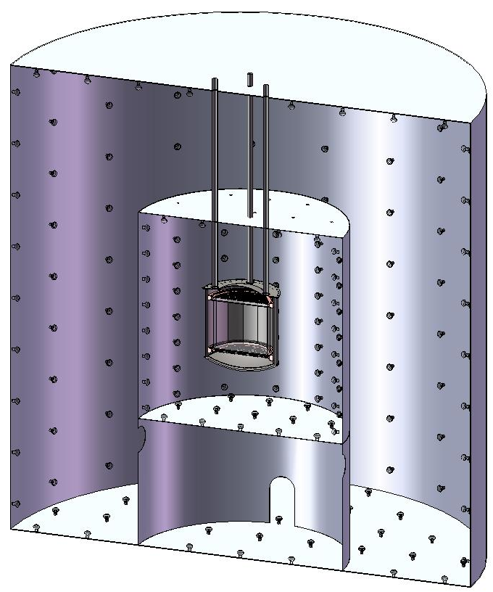
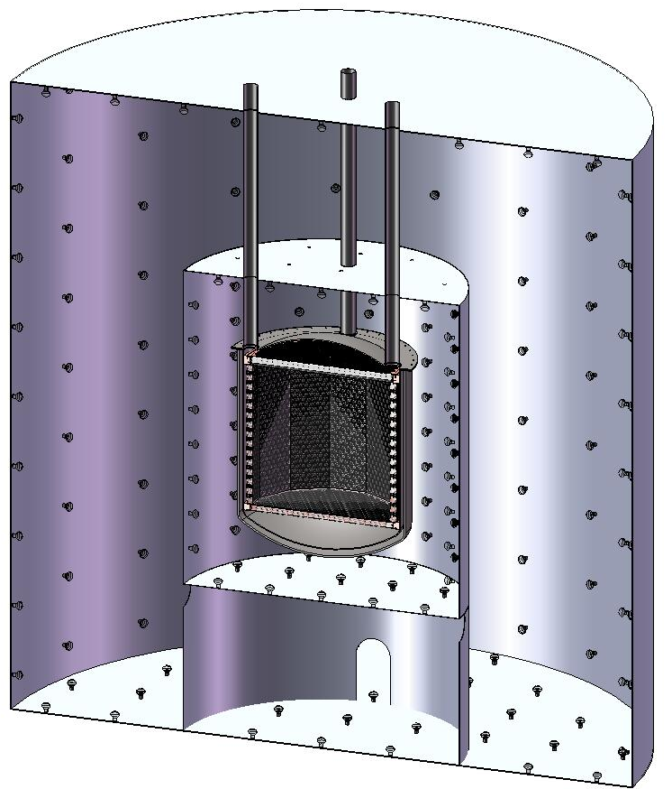
MAX Shielding Structure
Xe 20 ton (10 ton)
⁴⁰Ar 70 ton (50 ton)
Xe
Ar
Liquid
Scinti
Liquid
Scinti
Water Tank
Water Tank
8 m
18 m

Slide 8
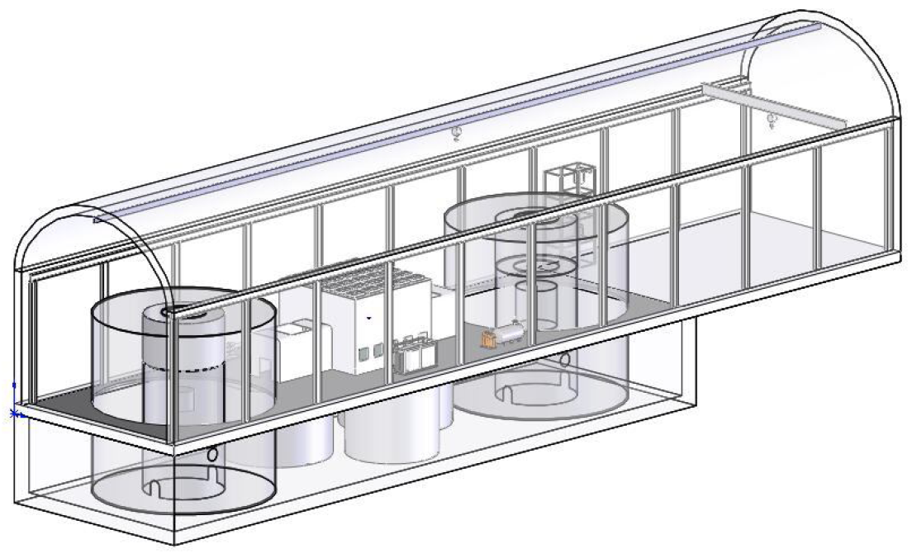
MAX Facility at DUSEL
Ar 70 ton
(50 ton)
Xe 20 ton
(10 ton)
Liquid Scintillator
(8 m ϕ x 8 m H )
Water Tank
(18 m ϕ x 18 m H)
Liquid Scintillator
(8 m ϕ x 8 m H )

Slide 9
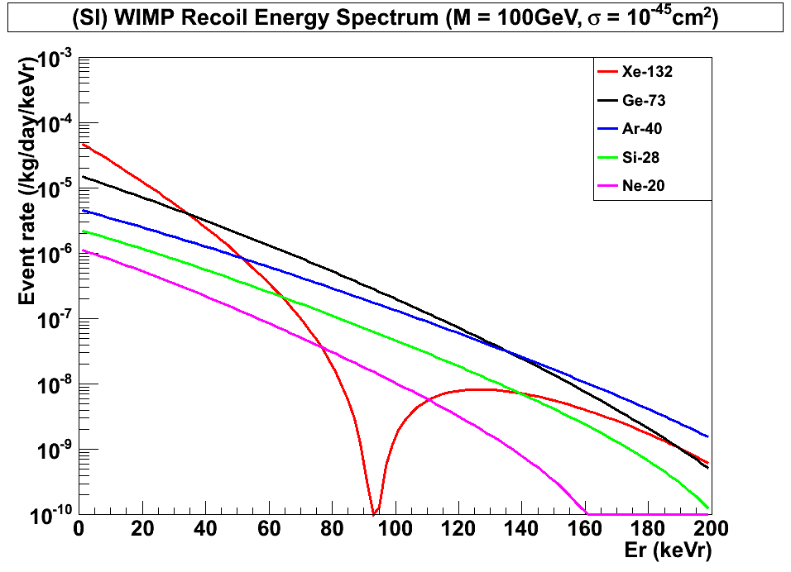
(SI) WIMP Energy Spectrum for Various Targets
(Cross Section = 10⁻⁴⁵cm²)
Xe-132
Ar-40
Ge-73
Si-28
Ne-20

Slide 10
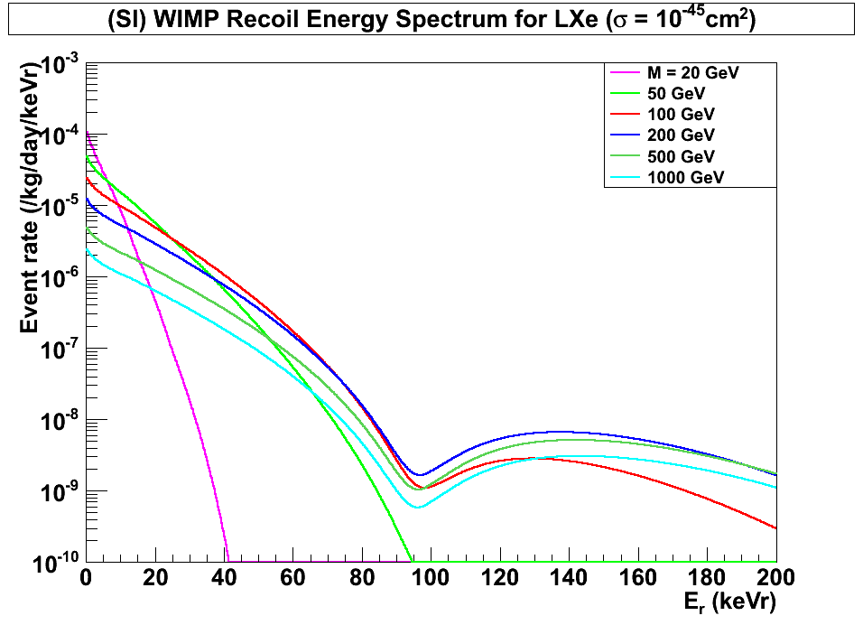
(SI) WIMP Energy Spectrum for LXe
(Cross Section = 10⁻⁴⁵cm²)
Xenon
7 keVr
45 keVr
200 GeV
100 GeV
500 GeV
1000 GeV
20 GeV
50 GeV

Slide 11
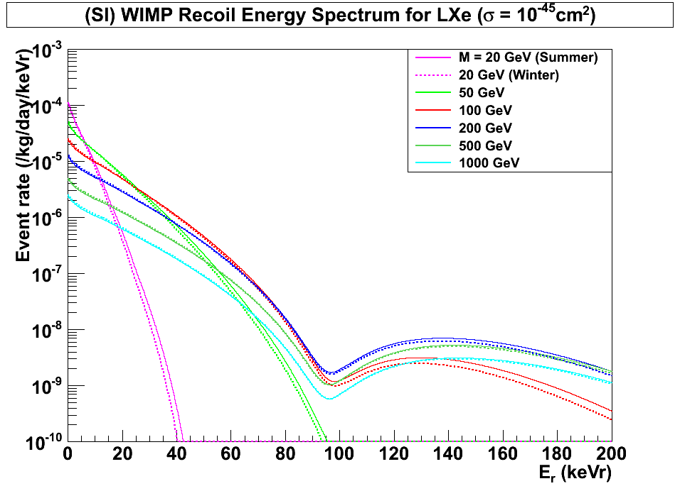
(SI) WIMP Energy Spectrum for LXe
(Cross Section = 10⁻⁴⁵cm²)
Xenon
7 keVr
45 keVr
200 GeV
100 GeV
500 GeV
1000 GeV
20 GeV
Winter
Summer
50 GeV

Slide 12
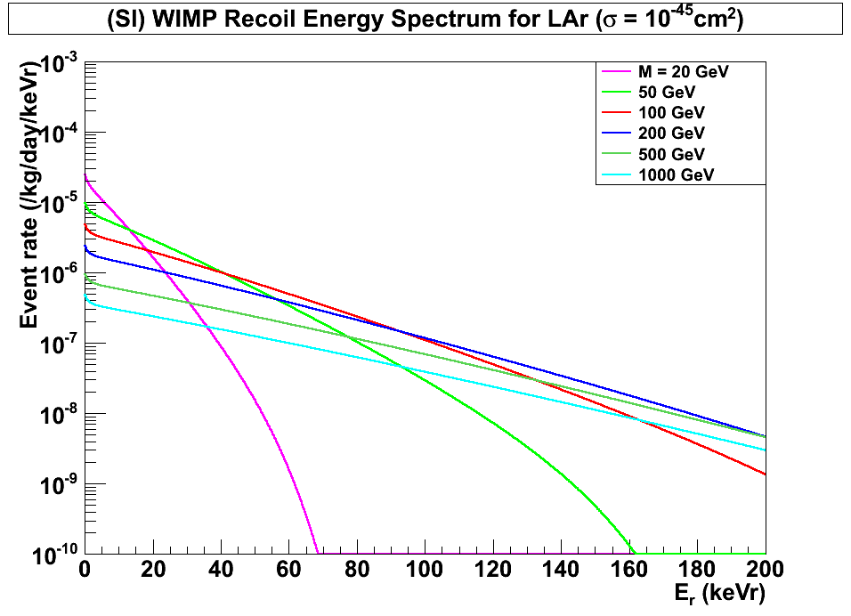
(SI) WIMP Energy Spectrum for LAr
(Cross Section = 10⁻⁴⁵cm²)
Argon
(w/ pulse shaping)
45 keVr
200 keVr
100 GeV
500 GeV
1000 GeV
200 GeV
20 GeV
50 GeV

Slide 13
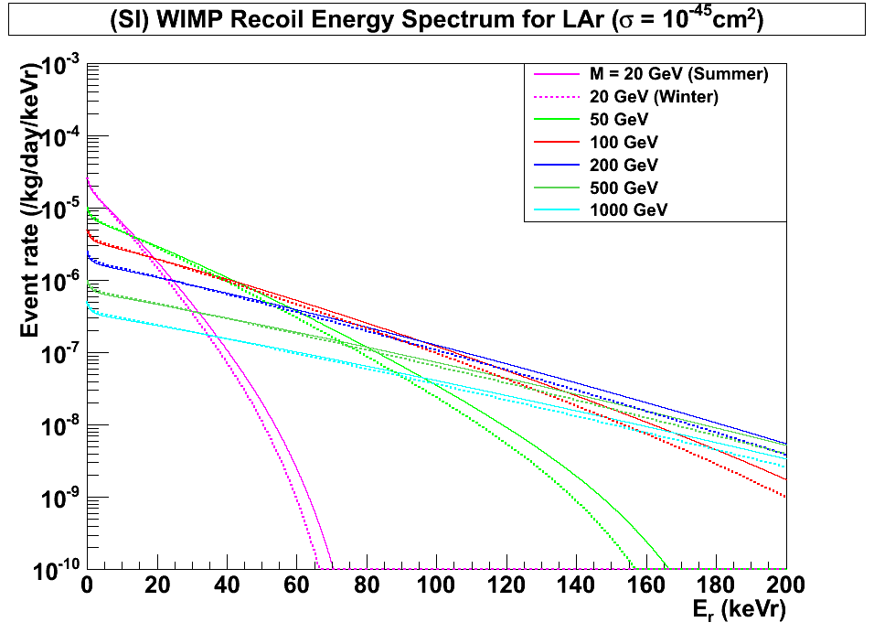
(SI) WIMP Energy Spectrum for LAr
(Cross Section = 10⁻⁴⁵cm²)
Argon
(w/ pulse shaping)
45 keVr
200 keVr
100 GeV
500 GeV
1000 GeV
200 GeV
20 GeV
50 GeV
Winter
Summer

Slide 14
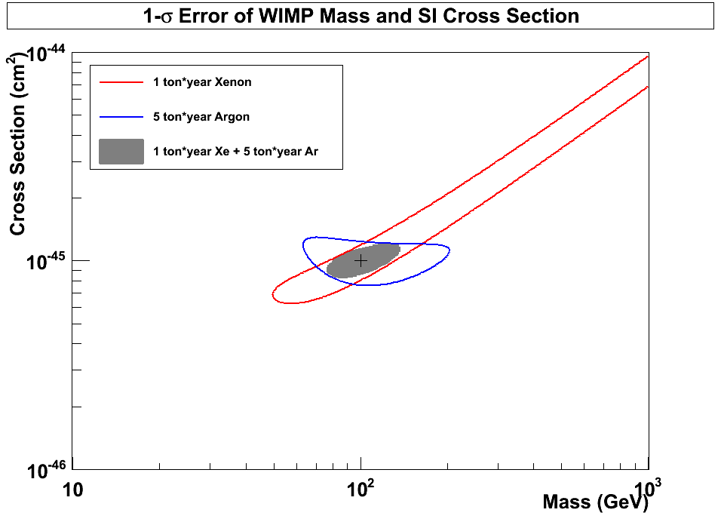
1-σ Error of WIMP Mass vs SI Cross Section
(10 ton*year Xe and 50 ton*year Ar)
10⁻⁴⁵
(40% eff.)
(80% eff.)
Xenon
(56 events)
10⁻⁴⁶
10⁻⁴⁶ cm²
Argon
(42 events)
G3
100 GeV
10⁻⁴⁷

Slide 15
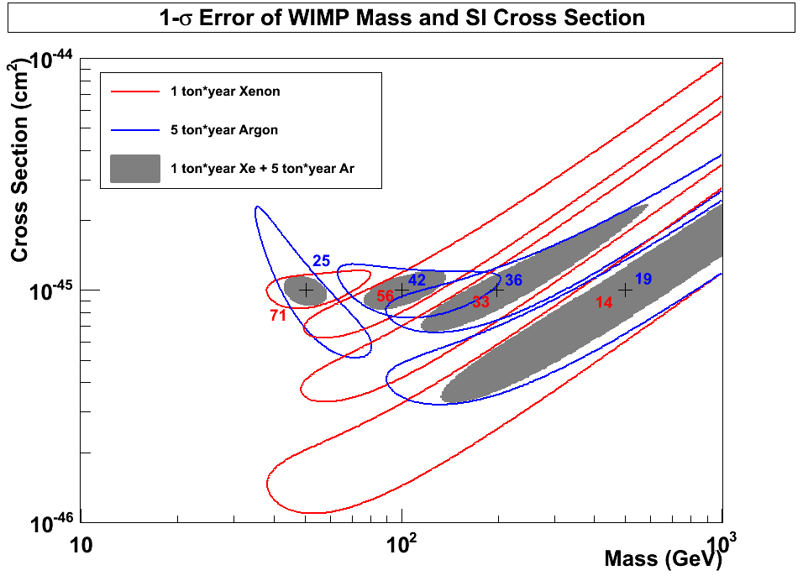
1-σ Error of WIMP Mass vs SI Cross Section
(10 ton*year Xe and 50 ton*year Ar)
10⁻⁴⁵
Argon
50 GeV
100 GeV
200 GeV
500 GeV
10⁻⁴⁶
10⁻⁴⁶ cm²
Xenon
G3
10⁻⁴⁷

Slide 16
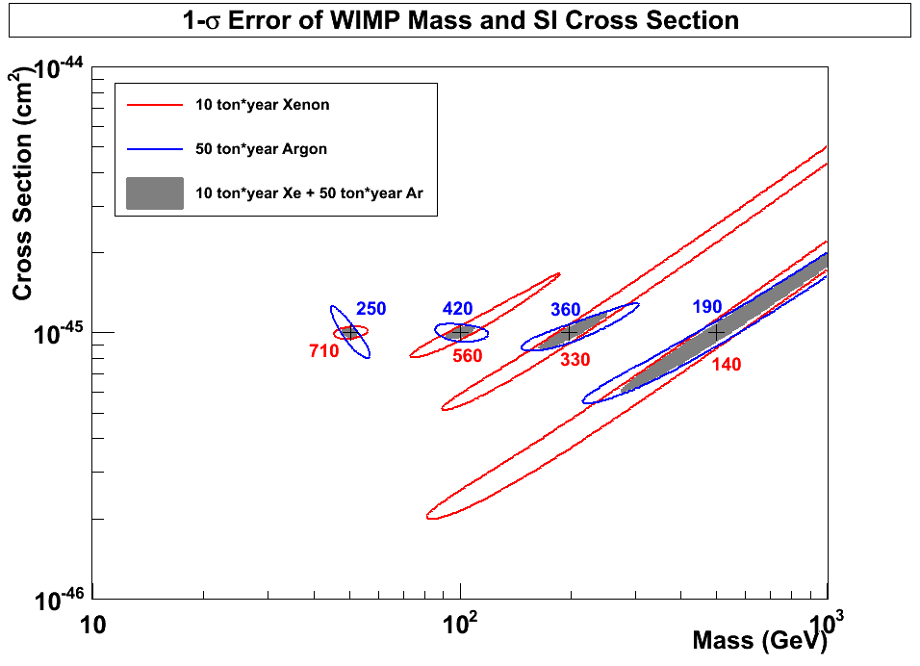
1-σ Error of WIMP Mass vs SI Cross Section
(10 ton*year Xe and 50 ton*year Ar)
50 GeV
100 GeV
200 GeV
500 GeV
Argon
10⁻⁴⁵ cm²
Xenon
G3

Slide 17
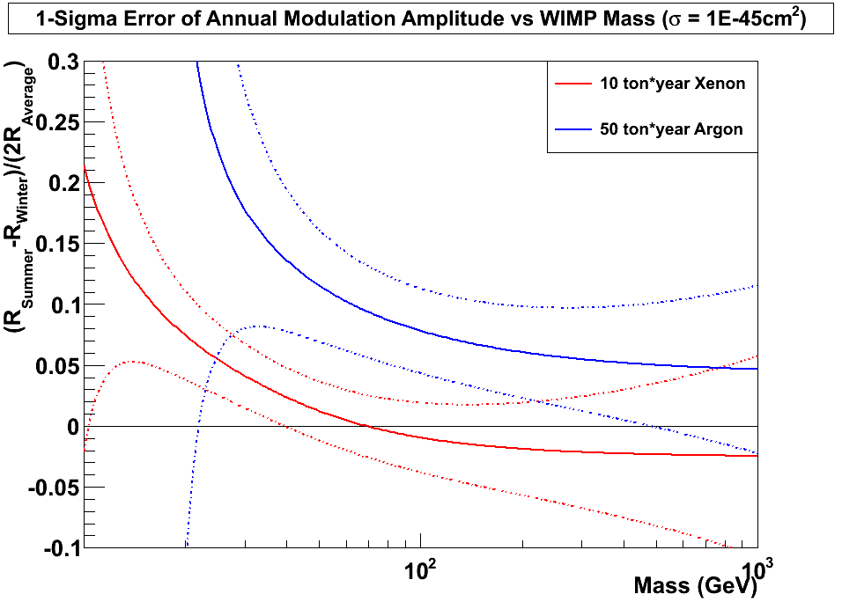
±1σ Error of Annual Modulation Amplitude vs WIMP Mass
(10 ton*year Xe and 50 ton*year Ar, Cross Section = 10⁻⁴⁵cm²)
10⁻⁴⁵ cm²
Argon
Xenon

Slide 18
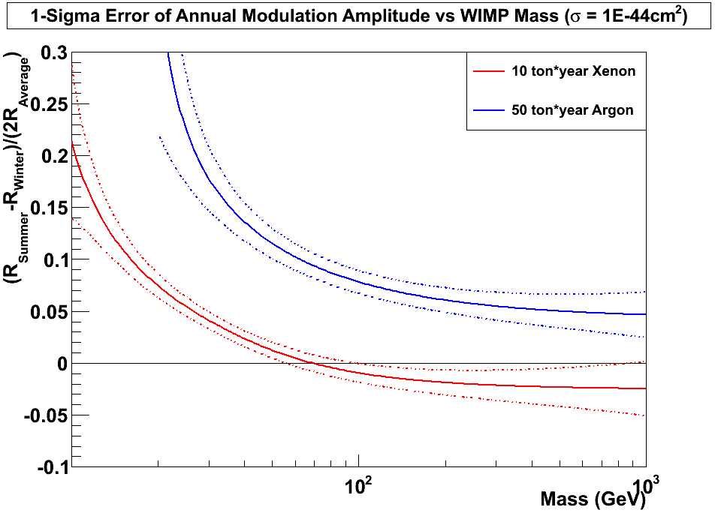
±1σ Error of Annual Modulation Amplitude vs WIMP Mass
(10 ton*year Xe and 50 ton*year Ar, Cross Section = 10⁻⁴⁴cm²)
10⁻⁴⁴ cm²
Argon
Xenon

Slide 19
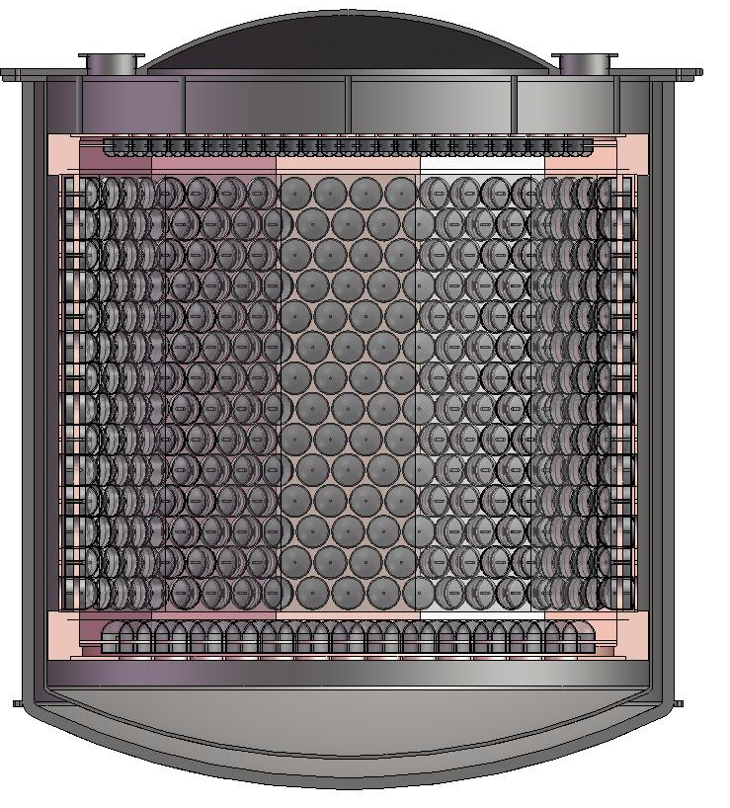
Xe 10 ton (Ar 5 ton) Detector Structure
Xe 20 ton
(or Ar 10 ton)
1.9m
Xe10 ton
(or Ar 5 ton)
Top: 3” QUPID x 595
Side: 6” QUPID x 672
Bottom: 6” QUPID x 163
20 cm
2.1m

Slide 20
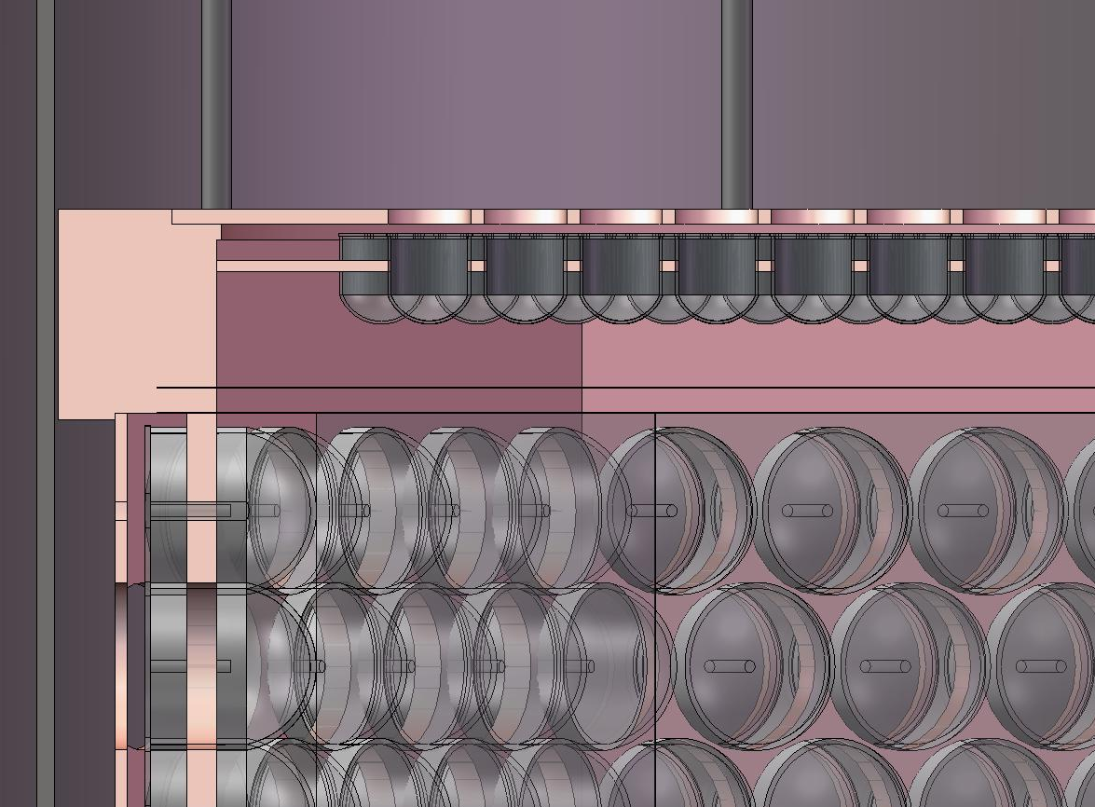
Xe 10 ton (Ar 5 ton) Top-Corner
3” QUPID
Gas Xe (Ar)
Mesh Wire
Liquid Xe (Ar)
6” QUPID

Slide 21
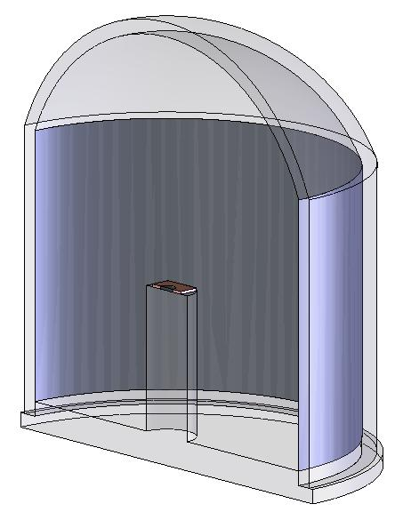
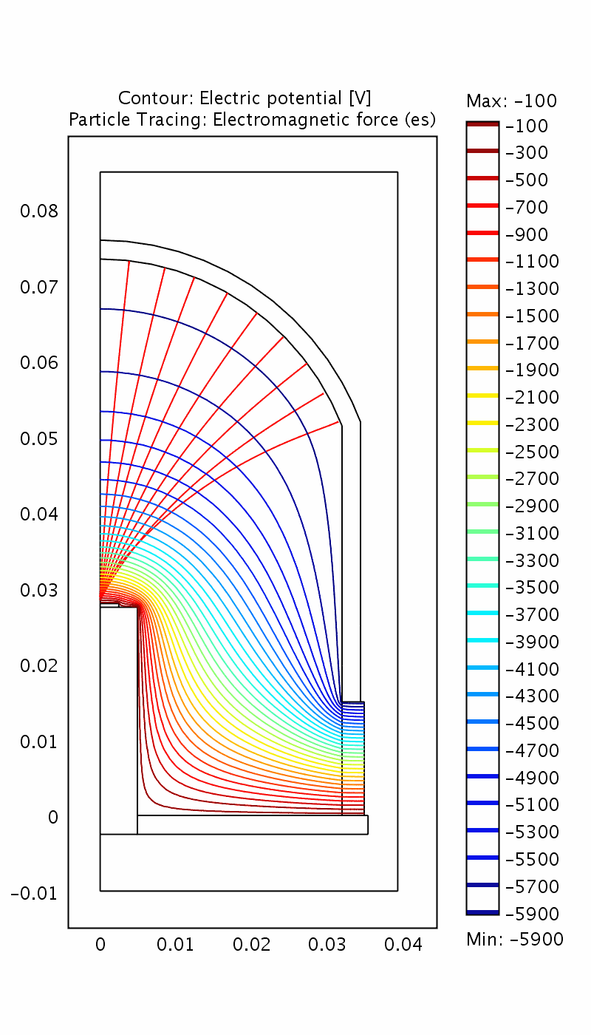
QUPID (QUartz Photon Intensifying Detector)
Photo Cathode
(-6 kV)
Photo Cathode
(-6 kV)
Quartz
Al coating
APD (0 V)
Quartz
APD (0 V)
Quartz
US Patent (No. 5374826) pending.

Slide 22
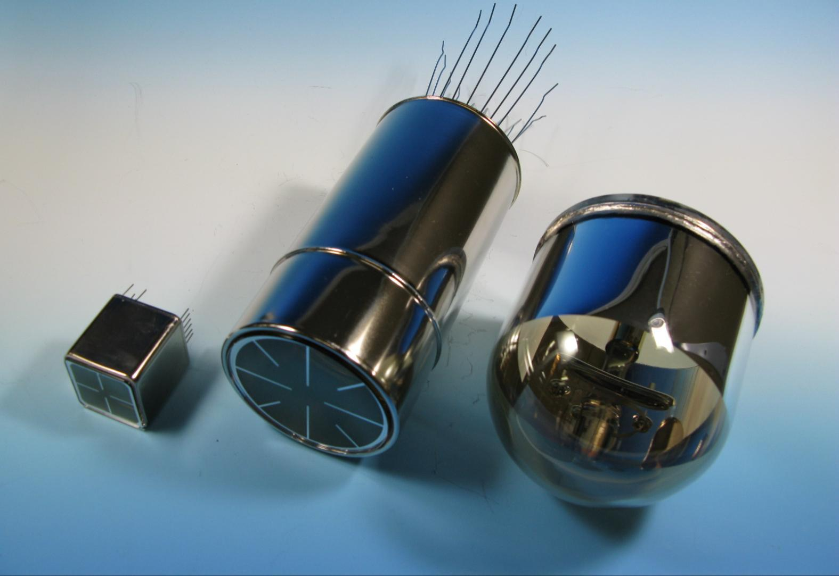
Comparison of Low-radioactive
Photon Detectors from Hamamatsu
R8520
1 inch
R8778
2 inch
QUPID
3 inch
XENON1Ton
DarkSide50
MAX
XENON10
XENON100
LUX
(XMASS)

Slide 23
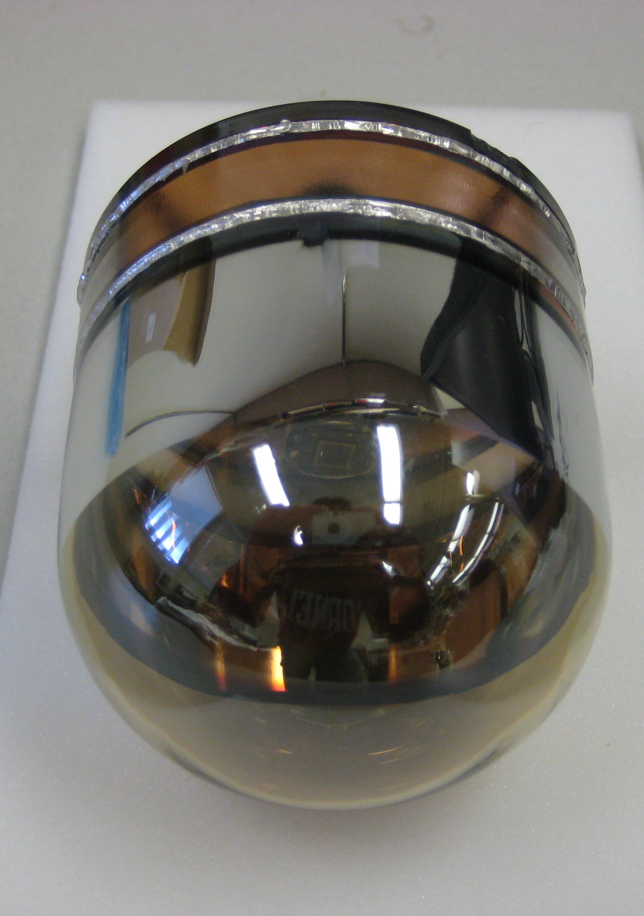
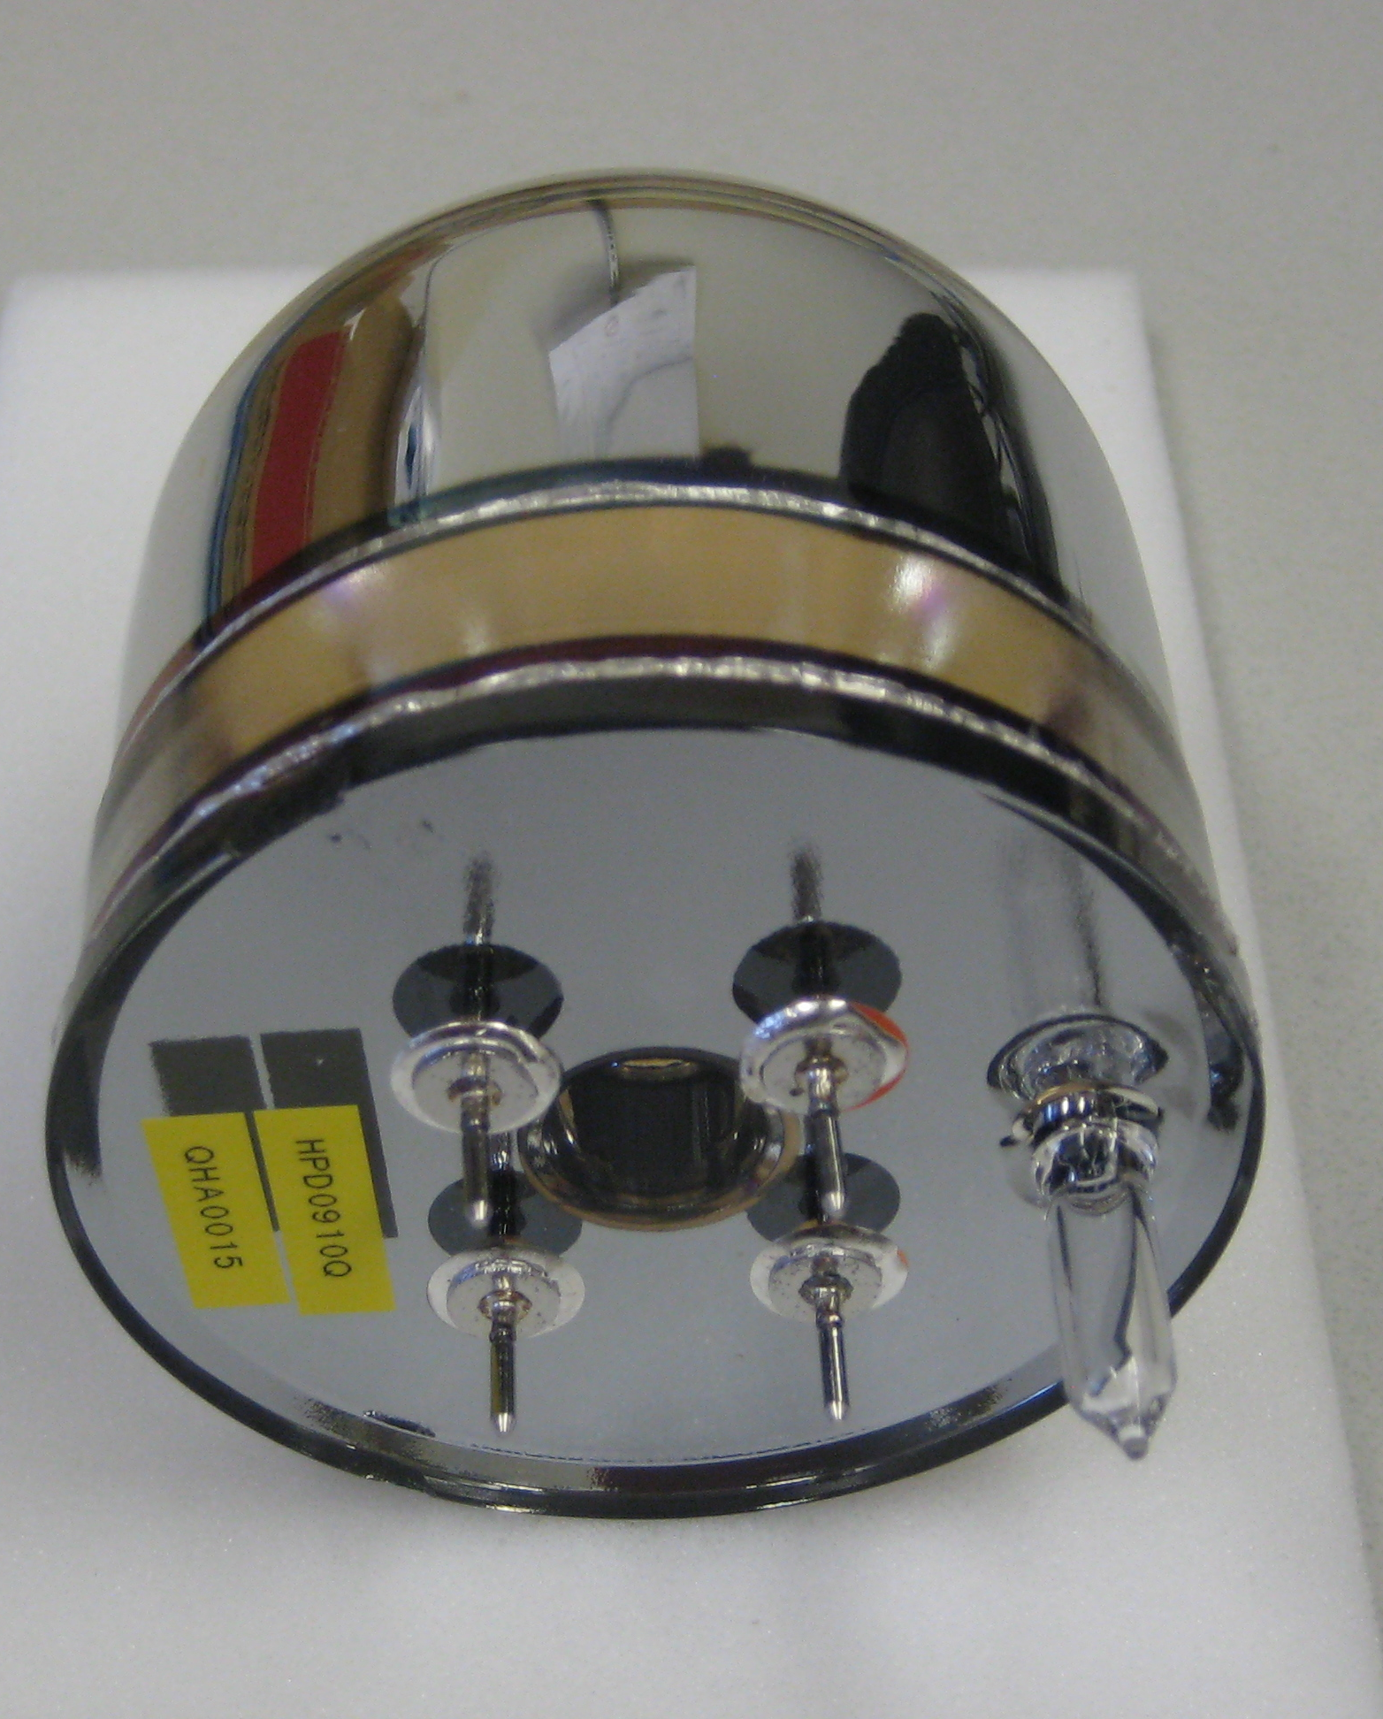
New 3” QUPID (Production Version)

Slide 24
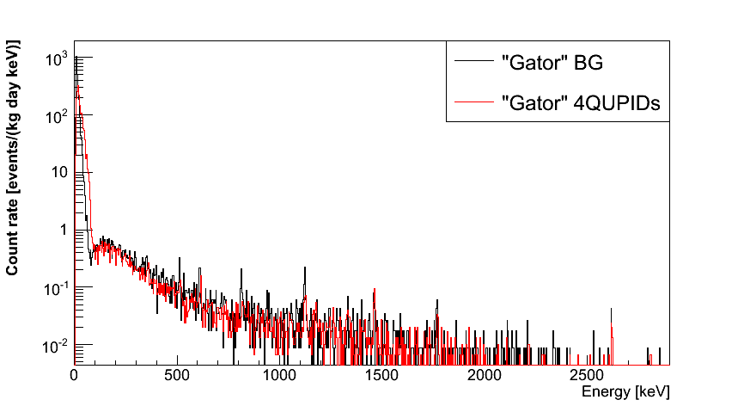
Spectrum of QUPIDs and Background
(4 QUPIDs x 1 month data)
QUPIDs are invisible!
 | 90% CL
²³⁸U | < 0.36 mBq
²³²Th | < 0.30 mBq
⁶⁰Co | 0.12 ± 0.06 mBq
⁴⁰K | < 1.96 mBq
No QUPID
4 QUPIDs
11/16/12
Katsushi Arisaka, UCLA
24

Slide 25
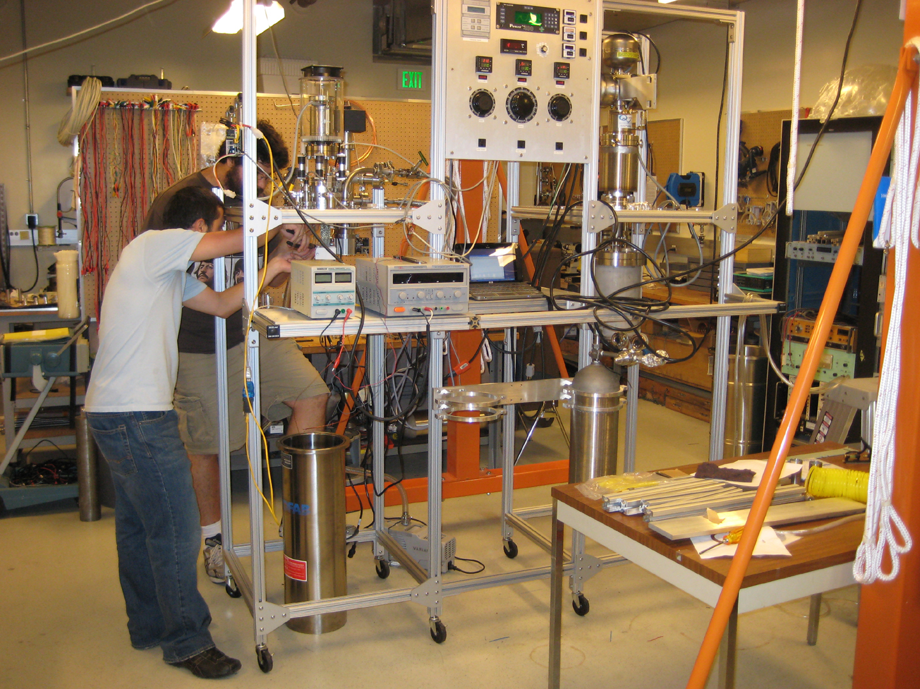
Cryogenic System at UCLA (Hanguo Wang’s Lab)

Slide 26
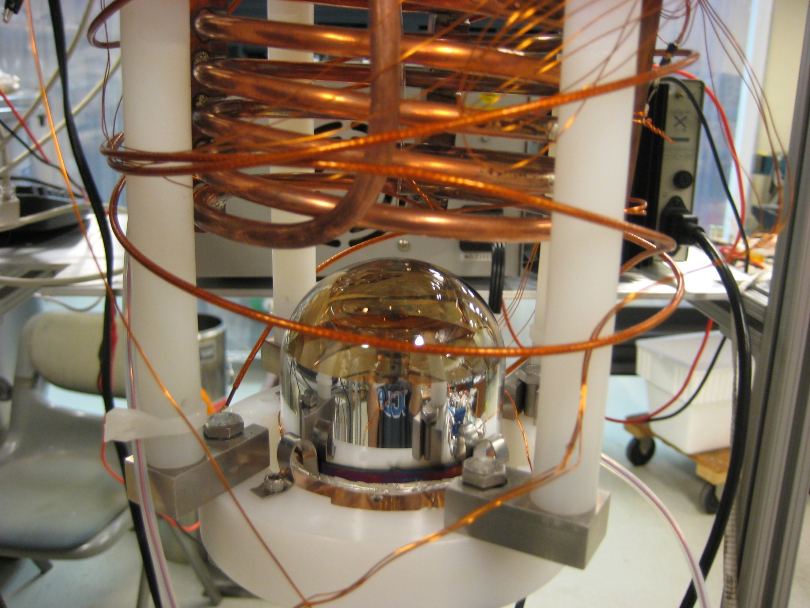
Qupid Pictures
QUPID in the Cooling System

Slide 27
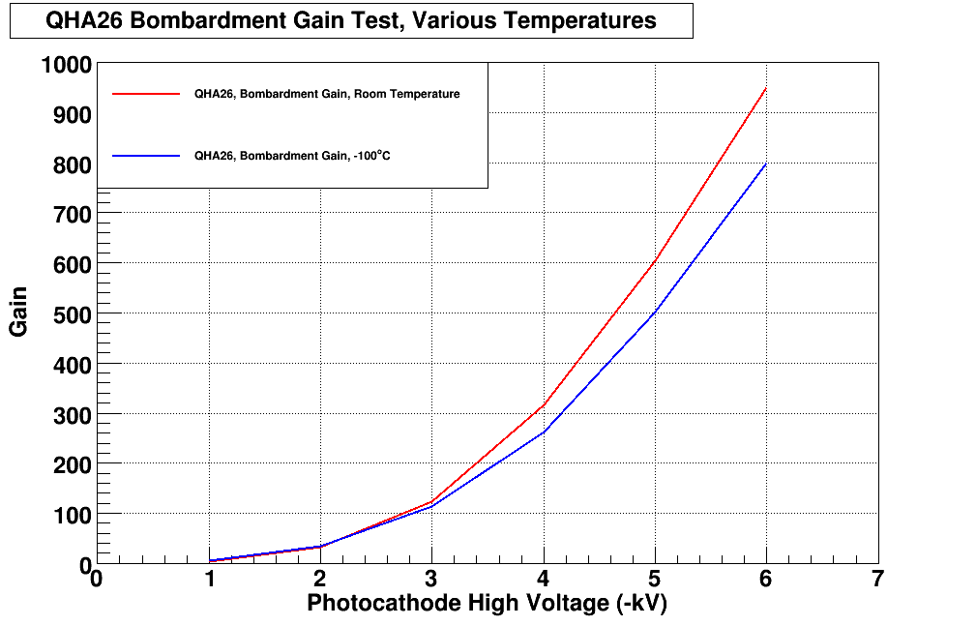
Electron Bombardment Gain (QHA26)
G = 800
25 ºC
-100 ºC

Slide 28
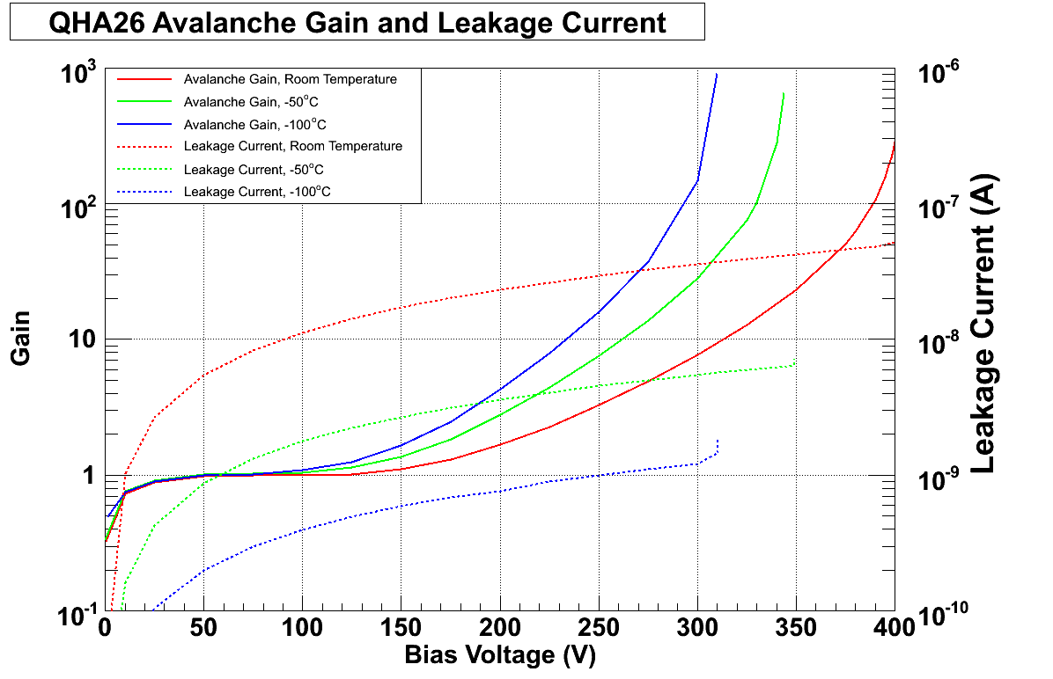
APD Gain and Leakage (QHA26)
-100 ºC
-50 ºC
G = 200
25 ºC
Gain
25 ºC
-50 ºC
Leakage Current
-100 ºC

Slide 29
Systematic Diagram of MAX Readout
MAX Detector
APD Receiver
500 MHz Digitizer
Low Range ( < 100 keV)
QUPID
G = 800 x 200 = 160,000
Amp
X 40
FADC
500 MHz
12 Bits
10 nF
(1 kV)
Coax Cable (2m)
FPGA
APD
FADC
500 MHz
12 Bits
10 MΩ
100 kΩ
High Range ( < 4 MeV)
6kV
(Photocathode)
- 430 V
(APD Bias)
8 ch / board
8 ch / board

Slide 30
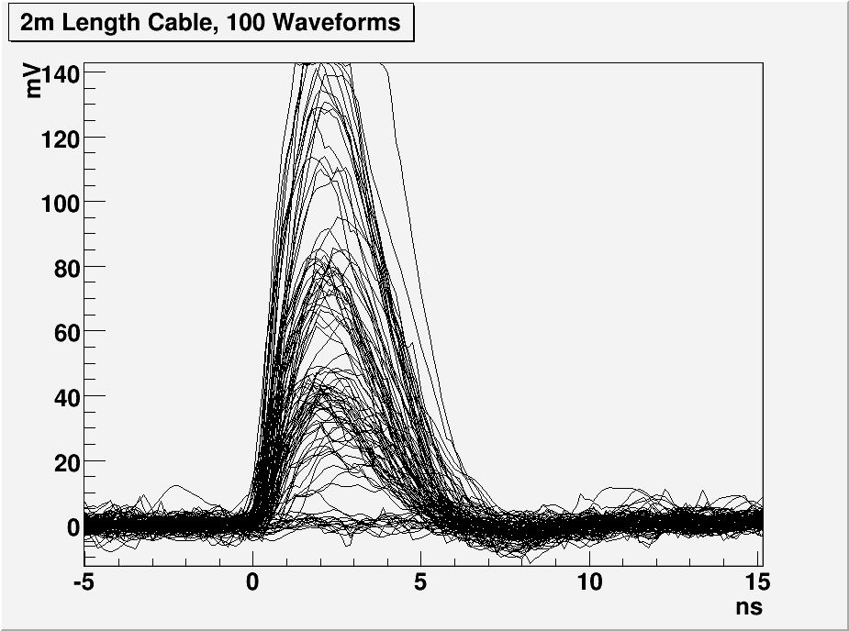
1, 2 and 3 PE Distribution with 2m cable
3 PE
2 PE
1 PE

Slide 31
Summary of QUPID
Extremely low radioactivity: < 1 mBq
  < 0.1 neutron / year
  < 10 times lower than conventional low radioactive PMTs.
Large diameter: 3 inch
  6 inch is also under investigation.
Special Photocathode: Bialkali LT
  > 30 % QE at 170 – 450 nm
  Low resistivity even at Liquid Ar temperature (- 185 ºC)
True photon counting.
  1, 2, 3… photoelectron peaks clearly visible.
  100% collection efficiency.
Simple HV supply.
  Common HV (-6 kV) for all QUPIDs
  Resister chain not necessary
Currently under operation in Liquid Xenon at UCLA!

Slide 32
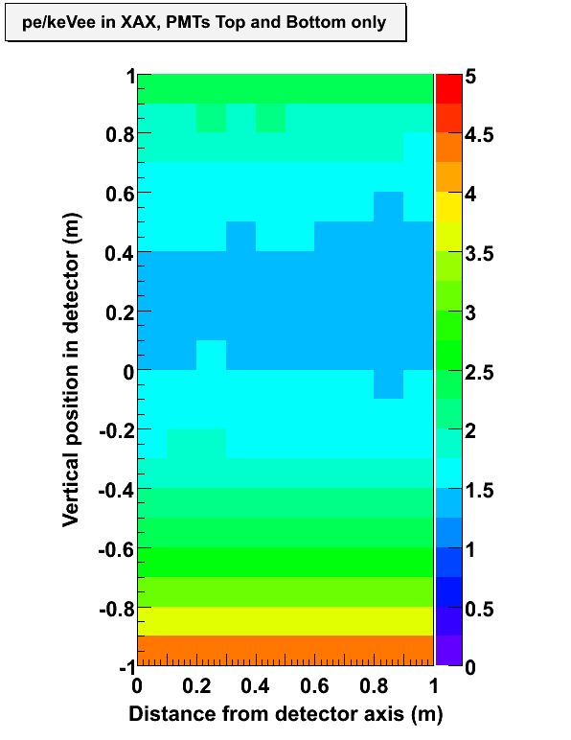
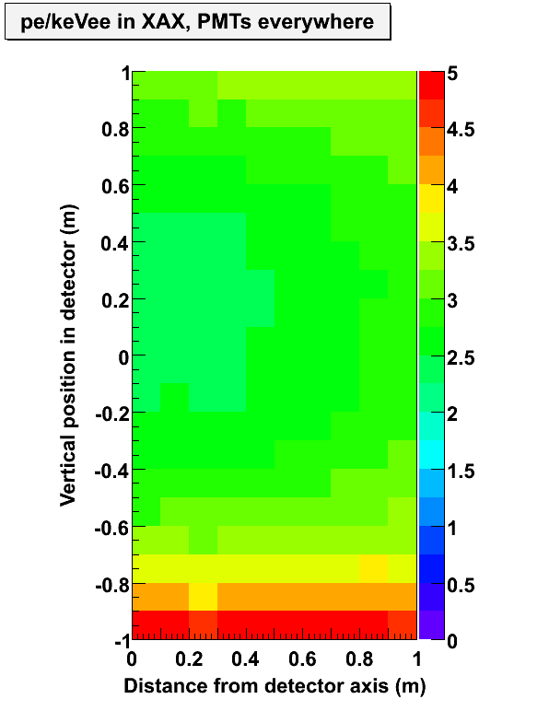
Expected No. of Photoelectrons per keV in Xe 10 ton
(Abs. Length = 10 m, Scat. Length = 50 cm, QE = 30%)
PTFE on Side Wall (Reflectivity = 98%)
QUPIDs on Side Wall
~ 1.5 pe/keV
~ 3 pe/keV

Slide 33
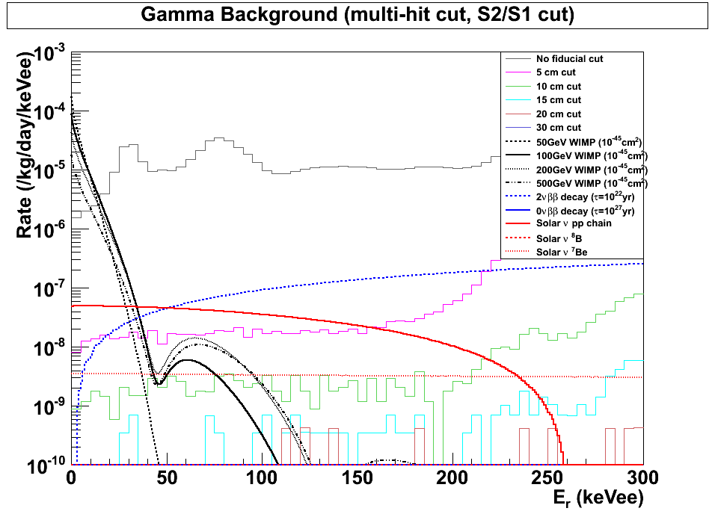
Xe 10 ton Gamma Background
(After Multi-hit Cut and S2/S1 Cut)‏
γ BG (0 cm shield)
100 GeV WIMP (10⁻⁴⁵ cm²)
2ν DBD (10²² yrs)
pp Solar Neutrino
γ BG (5 cm shield)
Be7 Solar Neutrino
02/25/10
Katsushi Arisaka, UCLA
33

Slide 34
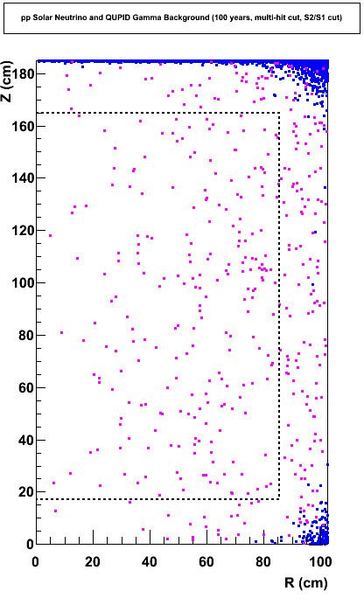
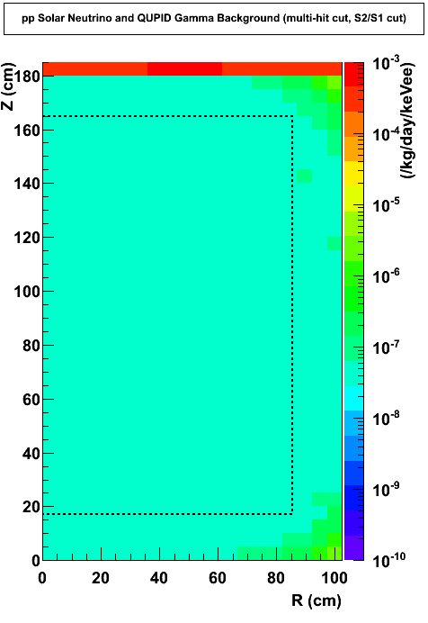
Expected Background from Gammas and pp Solar Neutrinos
(100 Year, Multi-hit Cut, S2/S1 Cut)‏
γ’s from QUPID
2.3γ /10 ton-year
(pp solar neutrino)
5 × 10^{–8} DRU
Xenon
10 ton
XENON100
02/25/10
Katsushi Arisaka, UCLA
34

Slide 35
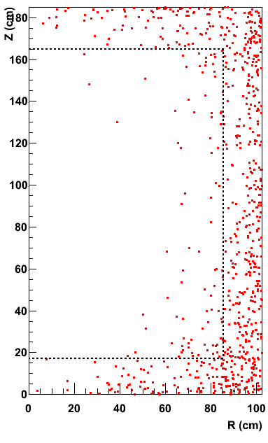
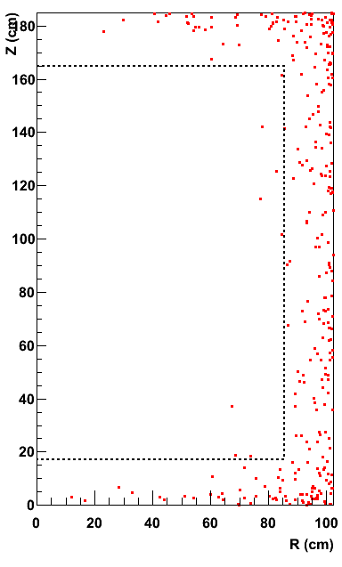
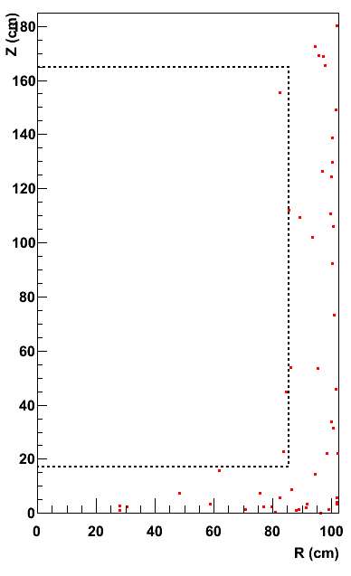
Xe 10 ton Neutron Background (100 Years)
1/8
1/4
Before Cuts
Multi Hit Cut
Liquid Scinti. Veto
0.81 n / year
0.10 n / year
0.03 n / year
Xenon
10 ton

Slide 36
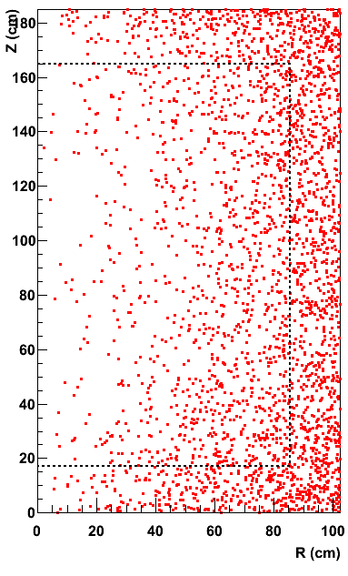
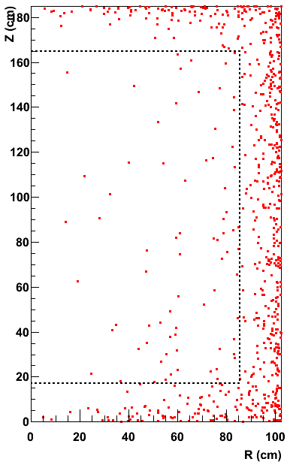
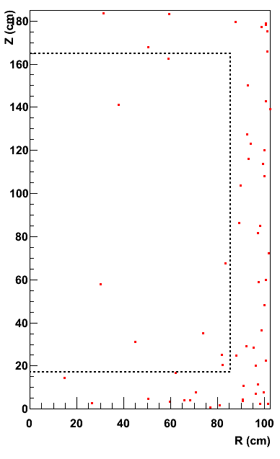
Ar 5 ton Neutron Background (100 Years)
1/17
1/8
Before Cuts
Multi Hit Cut
Liquid Scinti. Veto
13.3 n / year
0.78 n / year
0.10 n / year
Argon
5 ton

Slide 37
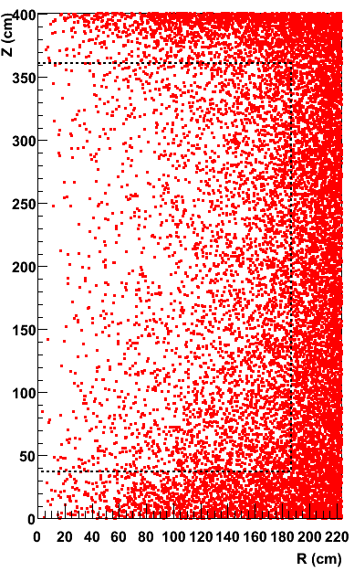
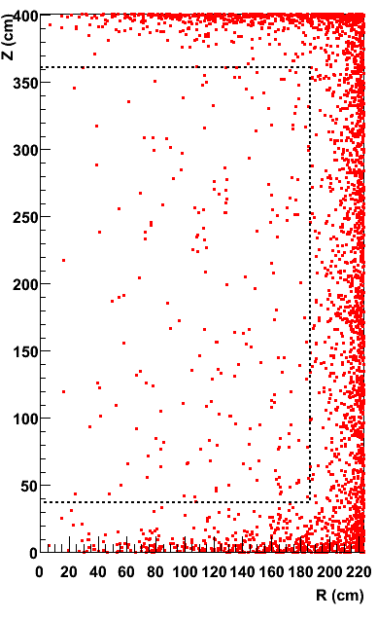
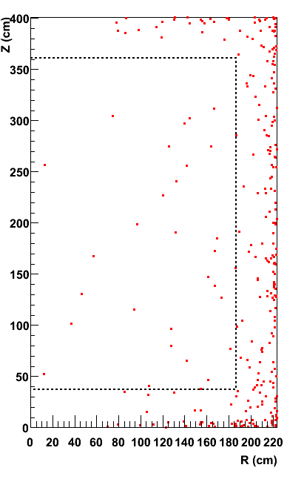
Ar 50 ton Neutron Background (100 Years)
1/20
1/6
Before Cuts
Multi Hit Cut
Liquid Scinti. Veto
42 n / year
2.1 n / year
0.39 n / year
Argon
50 ton

Slide 38
Summary of MAX G2/G3 & XAX
 |  | MAX G2 |  | MAX G3 |  | XAX
 |  | Xenon | Argon | Xenon | Argon | ^{129/131}Xe | ¹³⁶Xe (80%)
Dimension
 | Detector Size | 1m x 1m | 2m x 2m | 2m x 2m | 4m x 4m | 2m x 2m
 | Total Mass | 2.2 ton | 10 ton | 20 ton | 70 ton | 13 ton | 7 ton
 | Fiducial Mass | 1.1 ton | 5 ton | 10 ton | 50 ton | 6 ton | 4 ton
QUPID
 | Top | 121 (3") | 595 (3") | 595 (3") | 661 (6") | 595 (3")
 | Side | 0 | 672 (6") | 672 (6") | 2423 (6") | 672 (6")
 | Bottom | 121 (3") | 163 (6") | 163 (6") | 661 (6") | 163 (6")
No.WIMP / year (10⁻⁴⁵ cm²)
 | Mass = 20 GeV | 23 | – | 230 | – | 138 | 92
 | 50 GeV | 71 | 25 | 710 | 250 | 426 | 284
 | 100 GeV | 56 | 42 | 560 | 420 | 336 | 224
 | 200 GeV | 33 | 36 | 330 | 360 | 198 | 132
 | 500 GeV | 14 | 19 | 140 | 190 | 84 | 56
Backgrounds / year
 | Gammas | 0.07 | 0.00 | 0.01 | 0.00 | 0.07 | 0.01
 | Neutrons (w/o LS) | 0.10 | 0.78 | 0.10 | 2.1 | 0.10 | 0.00
 | Neutrons (w/ LS) | 0.03 | 0.10 | 0.03 | 0.39 | 0.03 | 0.00
Neutrinos / year
 | 0ν DBD (10²⁷ yr) | 0.4 | – | 3.3 | – | – | 30
 | pp-solar | – | – | – | – | 2500 | –
 | Supernova (10 kpc) | 11 | 14 | 95 | 141 | 56 | 39

Slide 39
Conclusions
MAX is the ideal G3 dual detectors at DUSEL.
  10 Ton Xenon + 50 Ton Argon (fiducial)
  ~5 events each / year at 10⁻⁴⁷ cm²
If the cross sections is > 10⁻⁴⁶ cm², precise determination of WIMP mass and cross section is possible.
  Two independent energy spectrums by Xenon & Argon
  Two independent annual modulations by Xenon & Argon
4π coverage by QUPID ensures high photon yield with no radioactivity.
  ~3 pe/ keV, < 1 mBq, < 0.1 neutron/year
  First applications on XENON 1ton and Darkside 50kg underway
  QUPID has been operated in Liquid Xenon successfully!

