Slide 1
Dark Matter Searches by Liquid Xenon and Argon TPC XENON100, DarkSide50, XENON1Ton, MAX and XAX
Katsushi Arisaka
University of California, Los Angeles
Department of Physics and Astronomy
arisaka@physics.ucla.edu

Slide 2
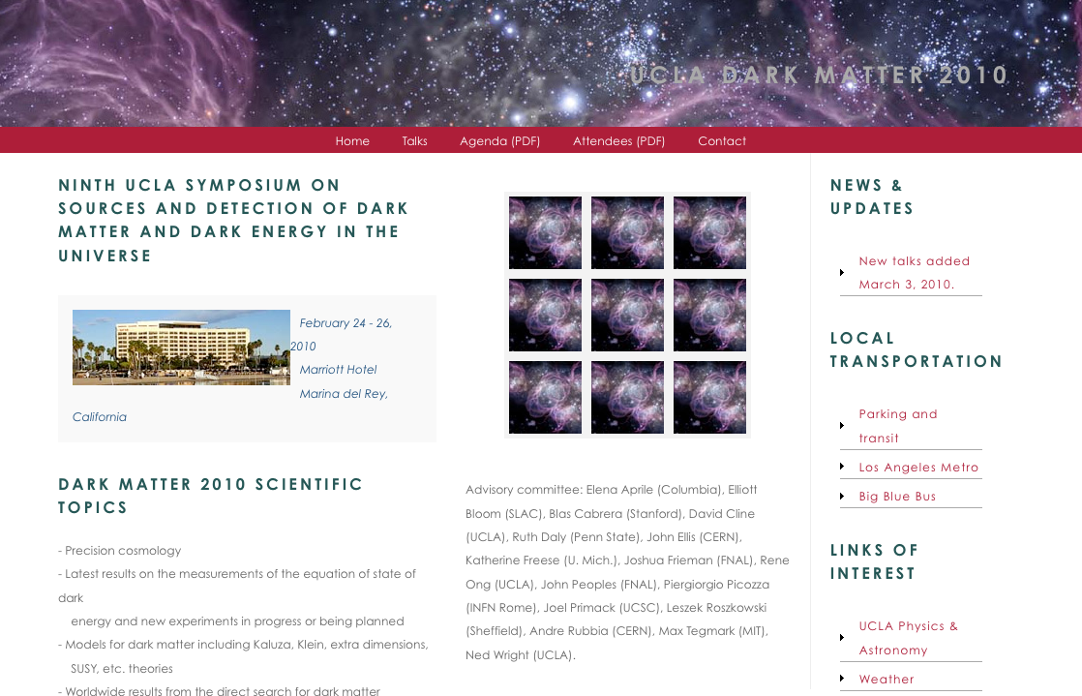
UCLA DM2010 Conference

Slide 3
Talk Outline
Introduction
What is Dark Matter? How to detect?
CDMS vs. XENON
XENON100
Detector System
Current Status, Preliminary Results
QUPID
Radiation Free Photon Detectors
Future Multi-ton Detectors
XENON1T and DarkSide50
MAX and XAX

Slide 4
Introduction

Slide 5
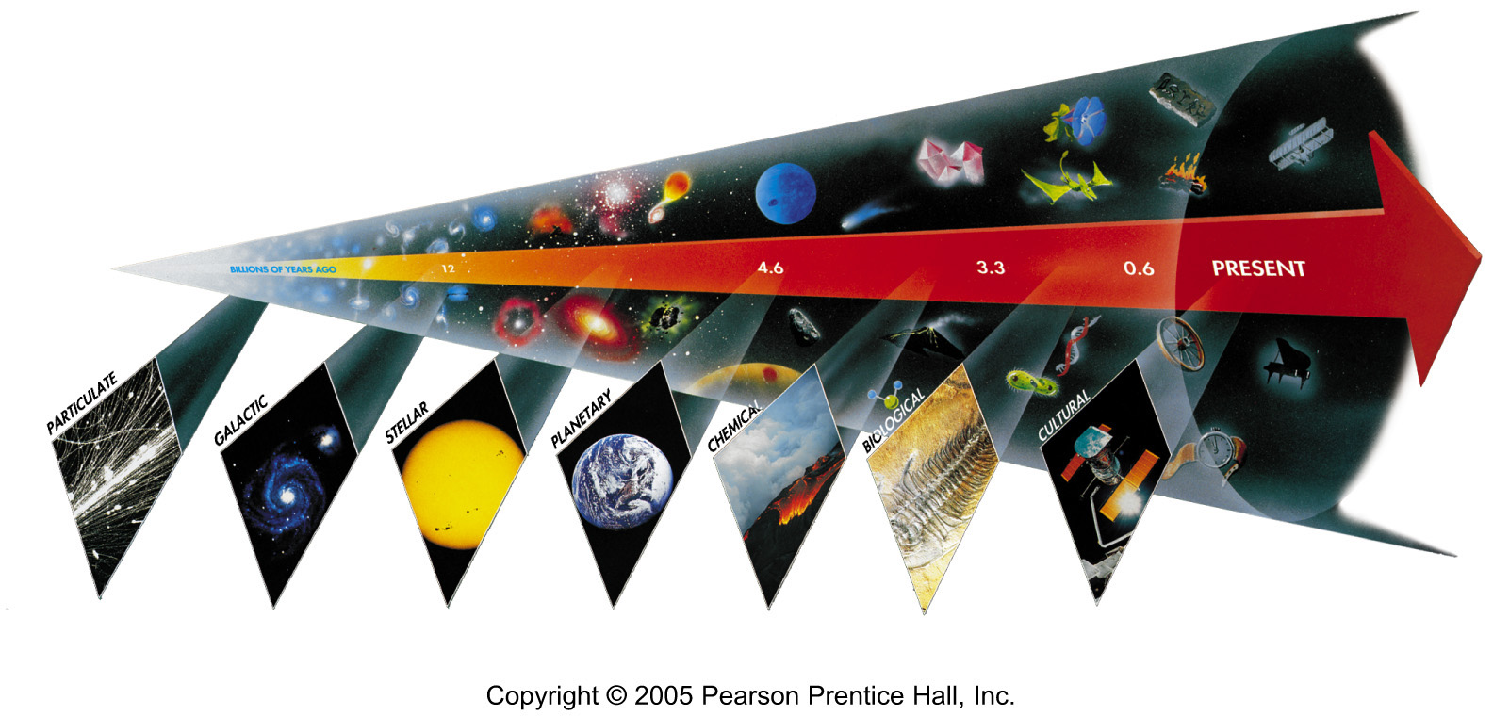
Seven Phases of Cosmic Evolution
14 billion years ago
Origin of
Particles
Origin of
Structure
Origin of
Life
Origin of
Consciousness

Slide 6
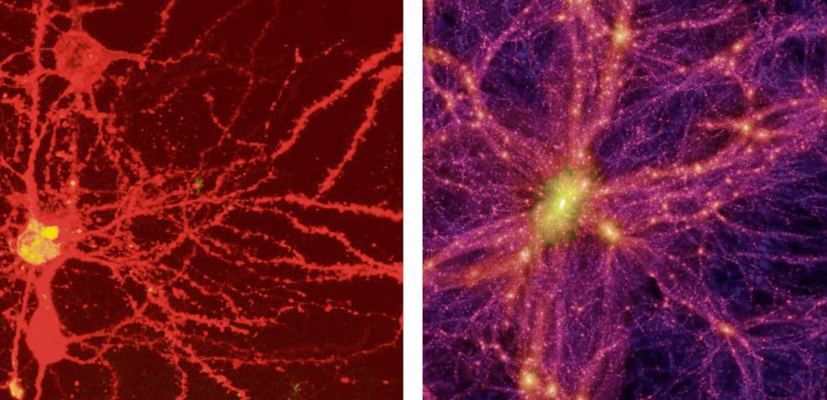
Brain Universe
100 Billions Neurons
100 Billions Galaxies
New York Times 8/21/2006

Slide 7
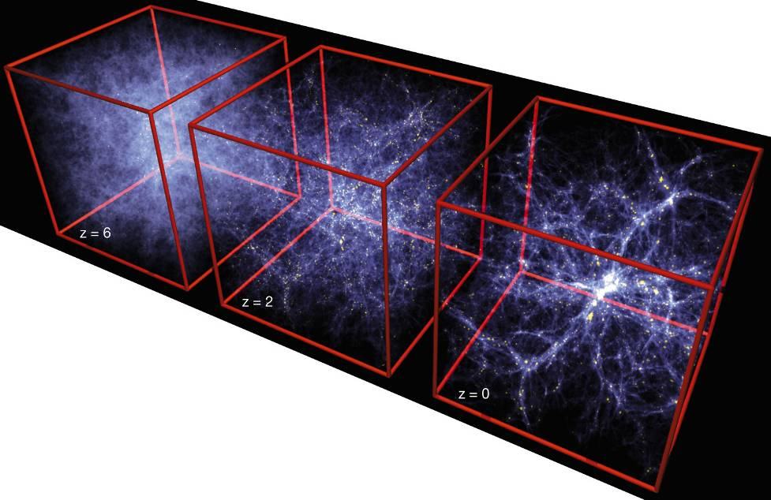
Formation of Structure in the Universe
Dark Matter is required!

Slide 8
“Fossils” from the Earliest Universe
Time
(sec)
Temp.
(ºK)
Energy (GeV)
10⁻⁴⁵sec
The Big Bang!
Planck
10⁻⁴⁰
10³⁰
10¹⁸
Gravitational Wave
GUT
10⁻³⁵
10¹⁵
GUT Particle
(Super Heavy Dark Matter)
10⁻³⁰
10²⁵
10¹²
10⁻²⁵
10⁹
10⁻²⁰
10²⁰
Decoupling of “Fossils”
1PeV
10⁻¹⁵
10¹⁵
1TeV
EW
Neutralino
(Cold Dark Matter)
10⁻¹⁰
10⁻⁵
1GeV
1
10¹⁰
1MeV
Relic Neutrino
(Hot Dark Matter)
10⁵ sec
1KeV
1 year
10⁵
10³
1eV
10⁶
10⁹ year
10⁻³eV
Now
1

Slide 9
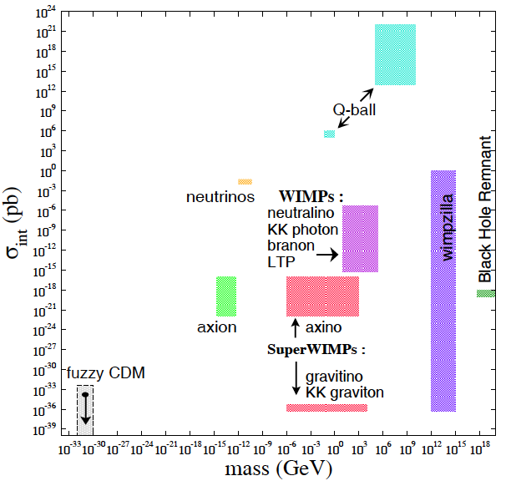
What is Dark Matter?

Slide 10
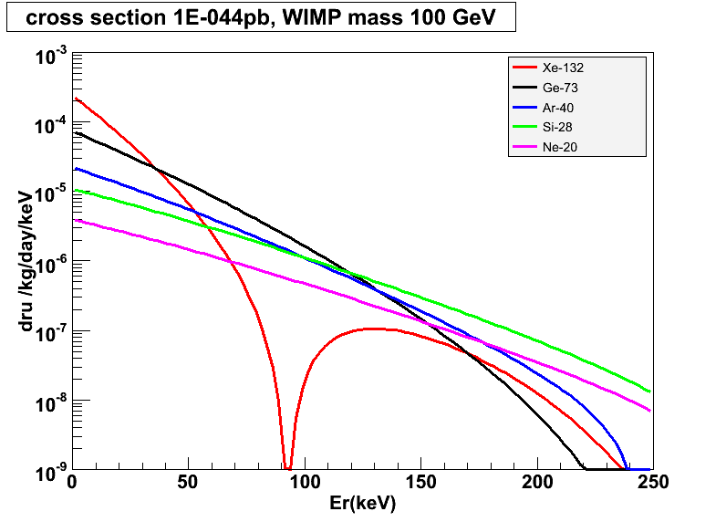
Target Mass Dependence of WIMP Cross Section
10⁻⁴⁴ cm²
Xe-132
Ar-40
Ge-73
Si-28
Ne-20

Slide 11
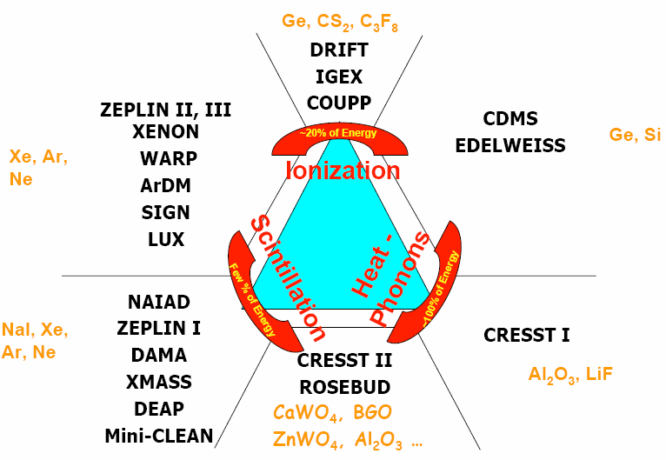
Detection Technique

Slide 12
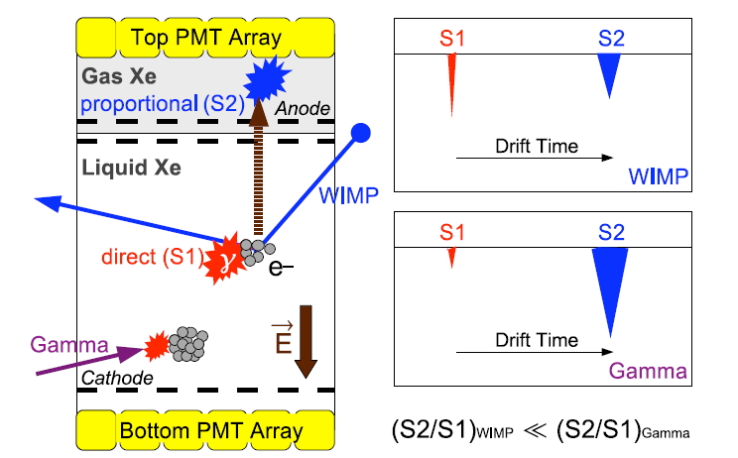
Double-Phase Noble Liquids

Slide 13
XENON10 Detector

Slide 14
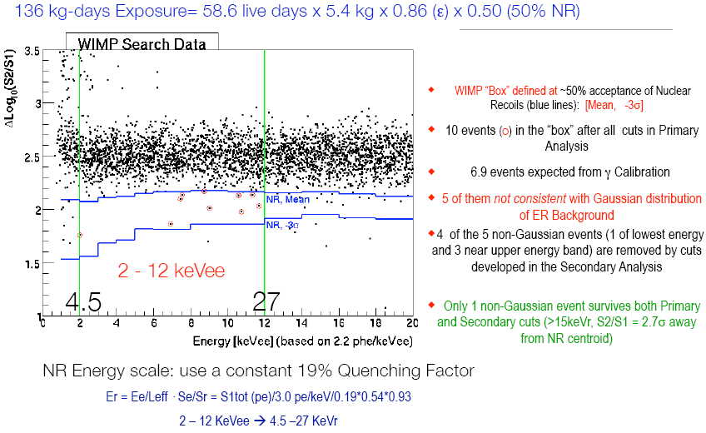
XENON10 Results (2007)

Slide 15
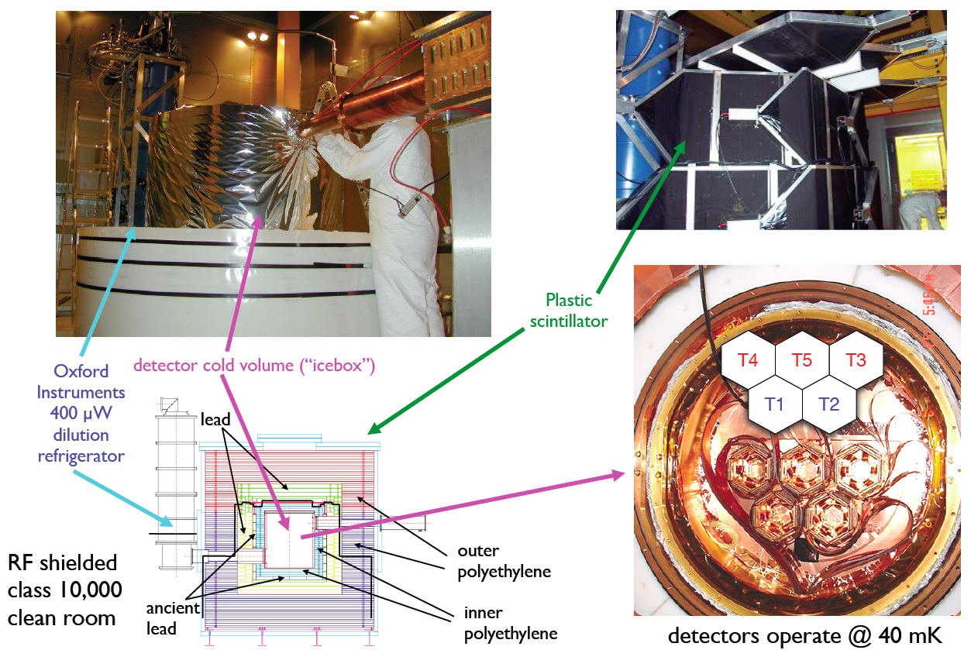
CDMS-II in Soudan

Slide 16
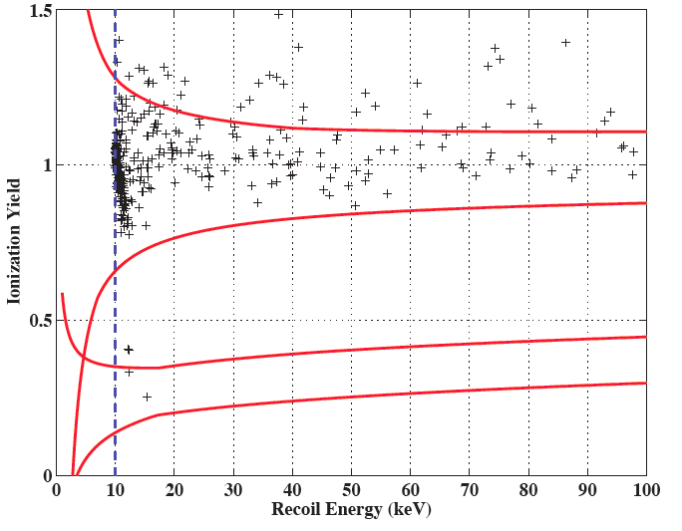
CDMS-II New Results
194 kg-days exposure = 4.4 kg x 139 day x 0.33 (eff.)
2 event observed!
(0.8 surface BG
+ 0.1 neutron BG)

Slide 17
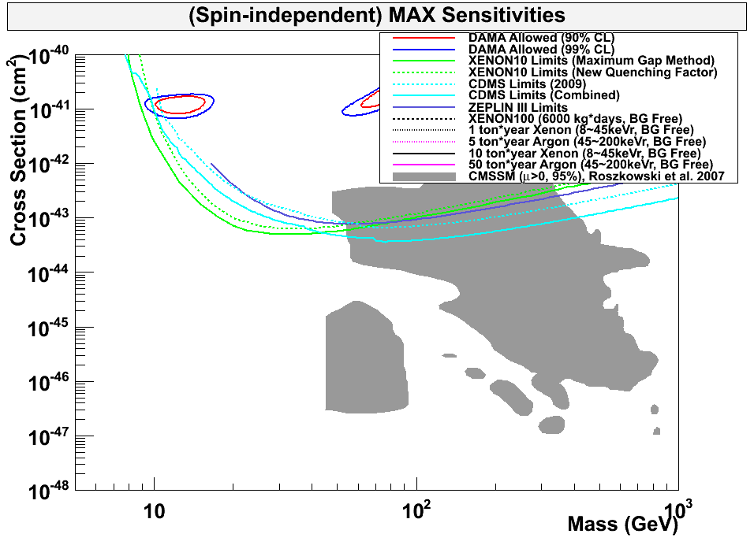
90% CL Limits of SI Cross Section
DAMA
ZEPLIN III
XENON10
CDMS-II

Slide 18

90% CL Limits of SI Cross Section
DAMA
ZEPLIN III
XENON10
CDMS-II
XENON100

Slide 19
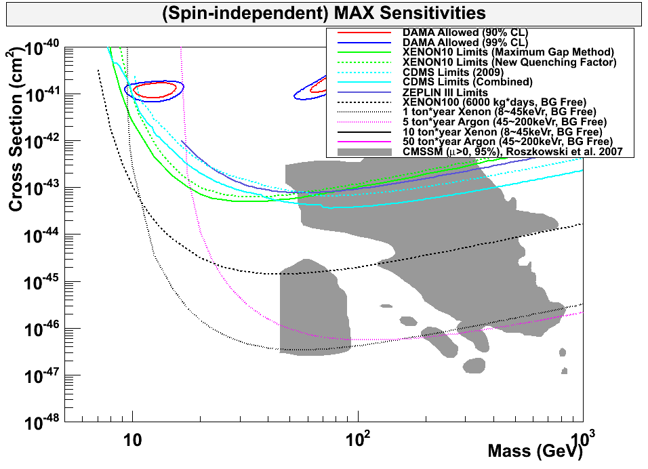
90% CL Limits of SI Cross Section
DAMA
ZEPLIN III
XENON10
CDMS-II
XENON100
MAX–G2
Ar 5 ton
Xe 1 ton

Slide 20
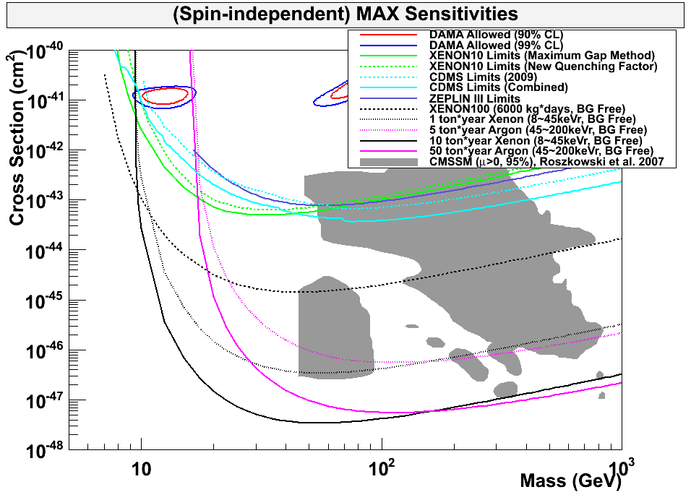
90% CL Limits of SI Cross Section
DAMA
ZEPLIN III
XENON10
CDMS-II
XENON100
MAX–G2
Ar 5 ton
Xe 1 ton
MAX–G3
Ar 50 ton
Xe 10 ton

Slide 21
Comparison of Xenon Detector Size
G3
XAX, MAX-G3
20 ton (10 ton)
G2
XENON1ton,
MAX-G2
2 ton (1 ton)
G1
2 m
XENON100
170 kg
(30 kg)
ZEPLIN-II
31 kg
(7.2 kg)
XENON10
14 kg
(5.4 kg)
1 m
1 m
15cm
30cm
14cm
30 cm
20 cm
30 cm
1 m
2 m
2007
2007
2010
2014
2018

Slide 22
XENON100
XENON100
170 kg
(50 kg)
30cm
60cm
30 cm

Slide 23

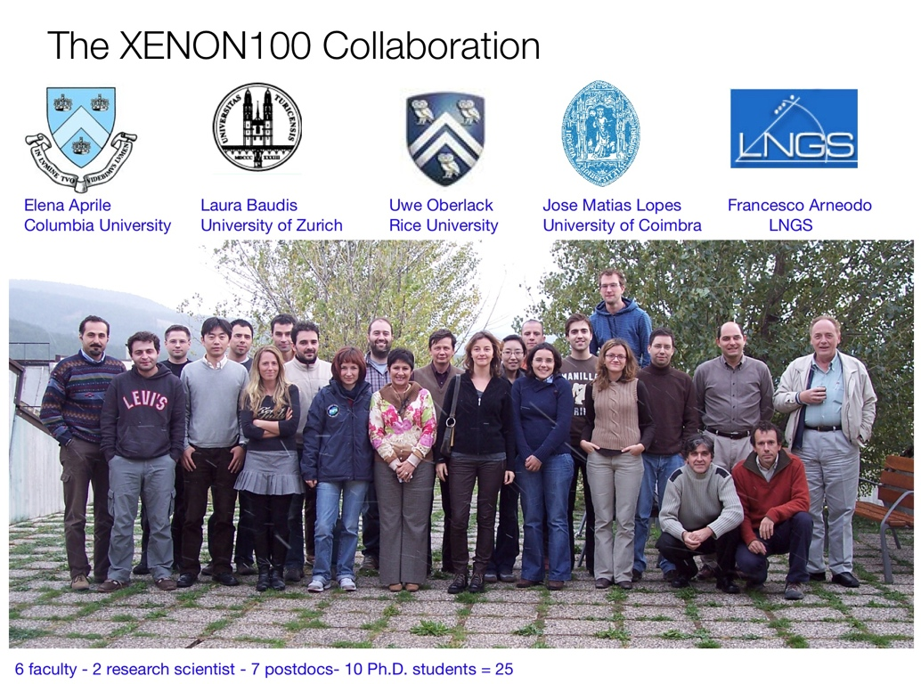
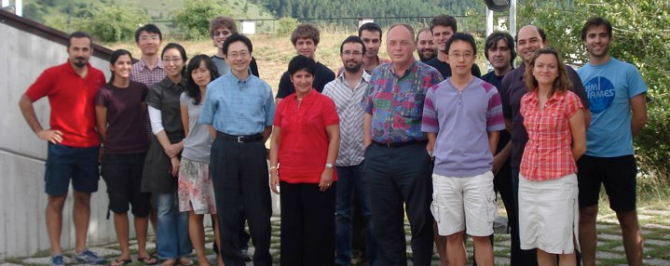
XENON100 Collaboration
DOE + NSF
NSF
NSF
Switzerland
Portugal
Italy
Katsushi Arisaka
David Cline
Hanguo Wang
UCLA
h

Slide 24
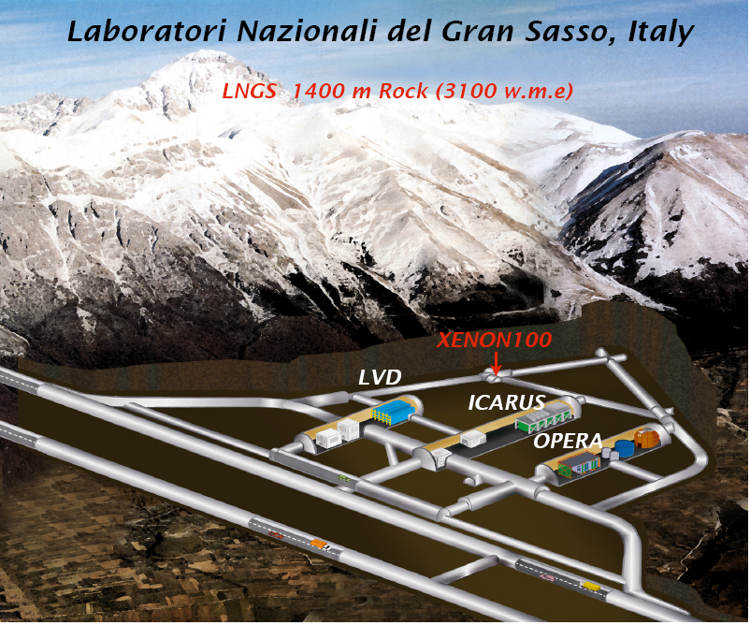
WARP

Slide 25
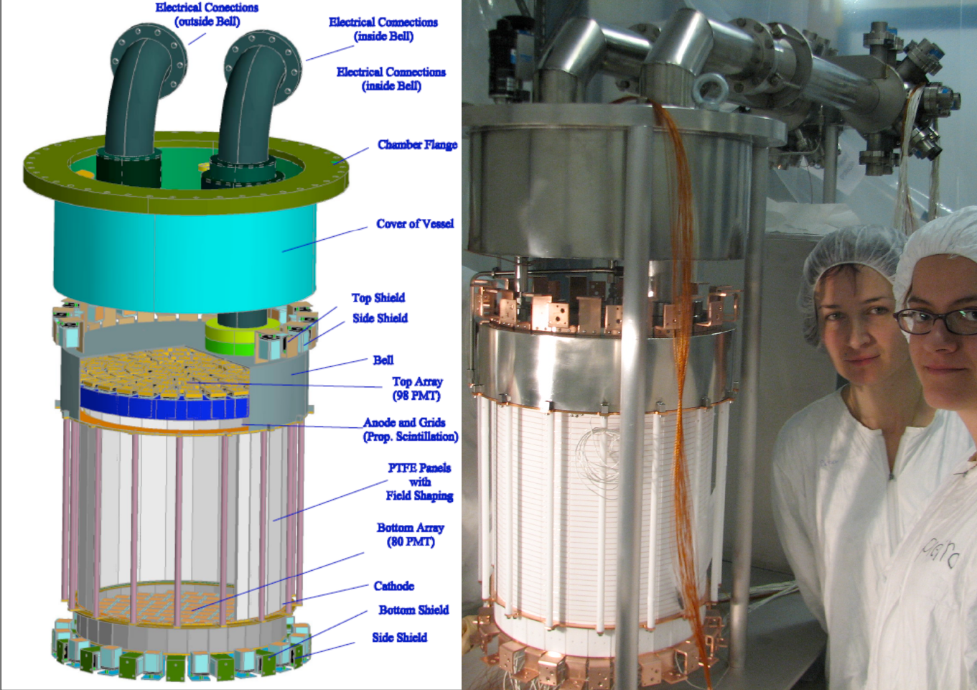
XENON100 Detector
170 kg
(30 kg)

Slide 26
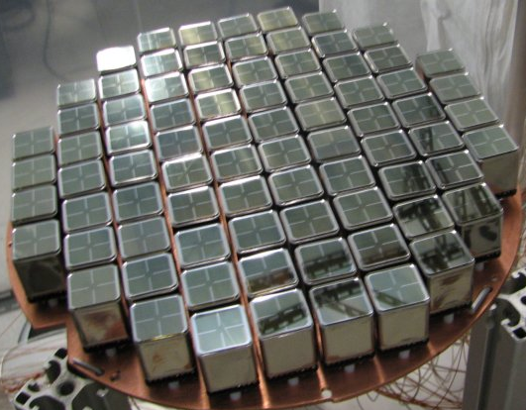
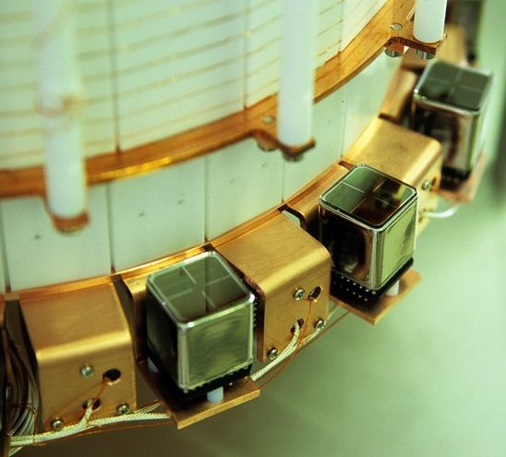
PMT Arrays
242 Hamamatsu R8520 PMTs 1"x1", optimized for response @ Xe scintillation light (175 nm)
Low radioactivity ( ~ <1 mBq/PMT)
Top Array
98 PMTs
~23% QE
Active Veto
64 PMTs
~23% QE
Bottom Array
80 PMTs
~33% QE

Slide 27
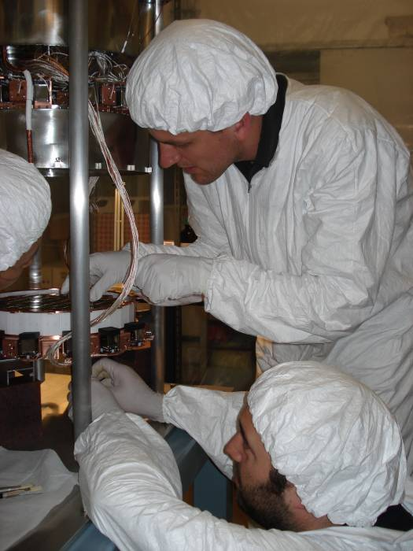
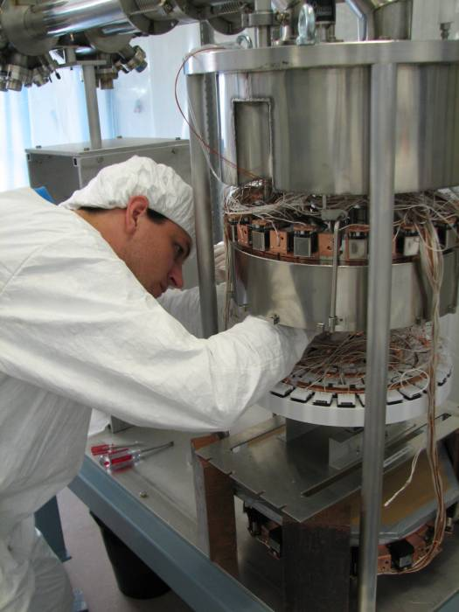
XENON100 Detector
Ethan Brown

Slide 28
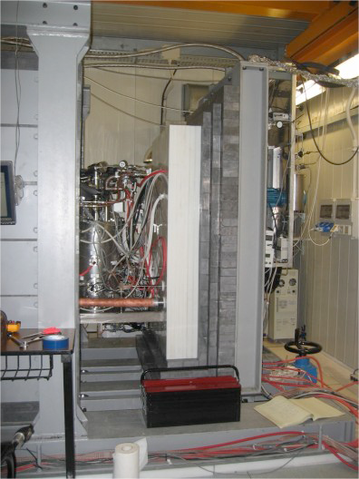
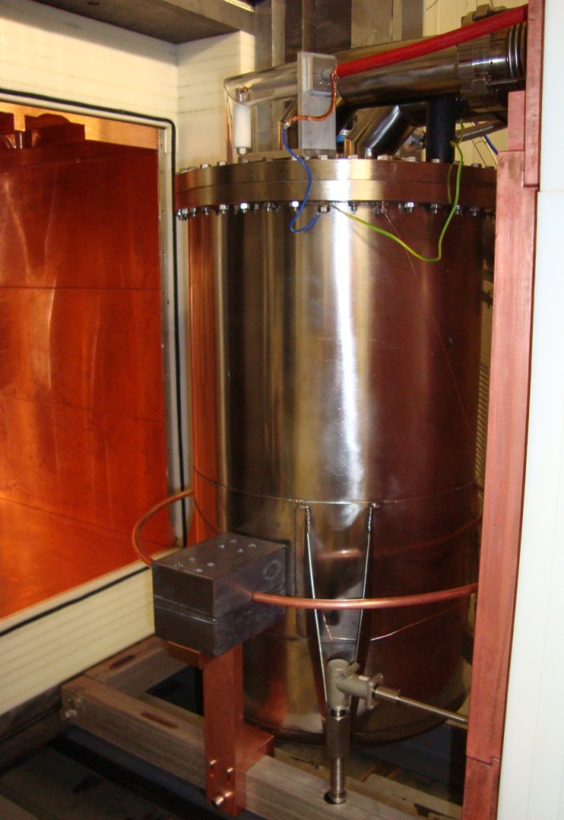
XENON10 (2006 - 2007)
XENON100 (2008 ~ )
Notes:
28

Slide 29
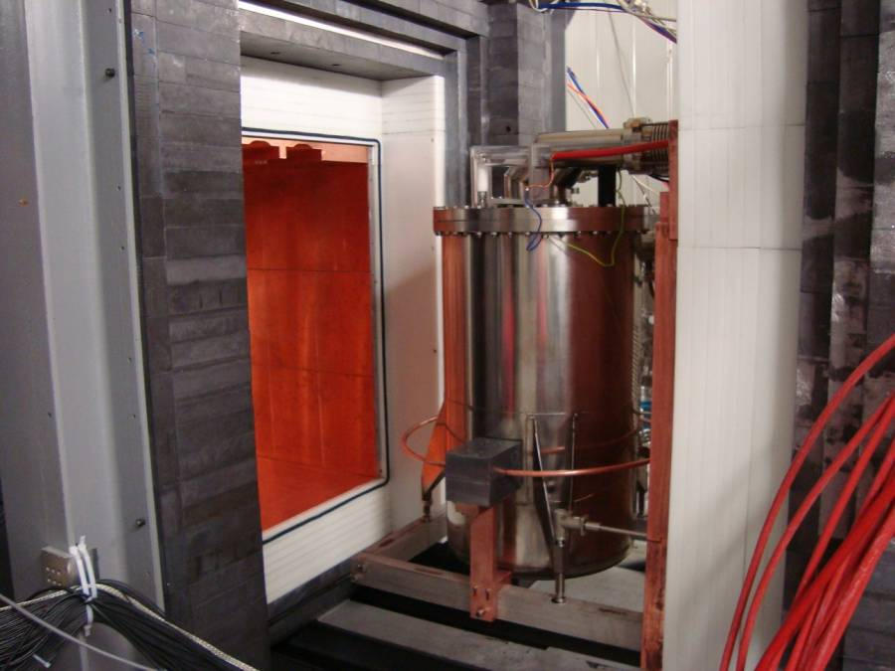
Pb
(20cm)
Poly
(20cm)
Cu
(5cm)
Pb
(20cm)
Poly
(20cm)
Cu
(5cm)

Slide 30
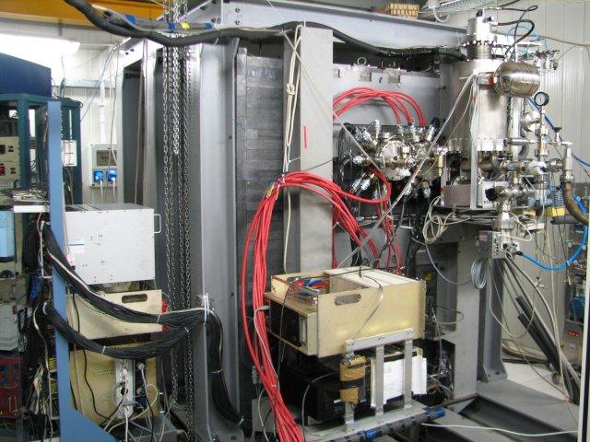
Cooling
Tower
DAQ
Preamp

Slide 31
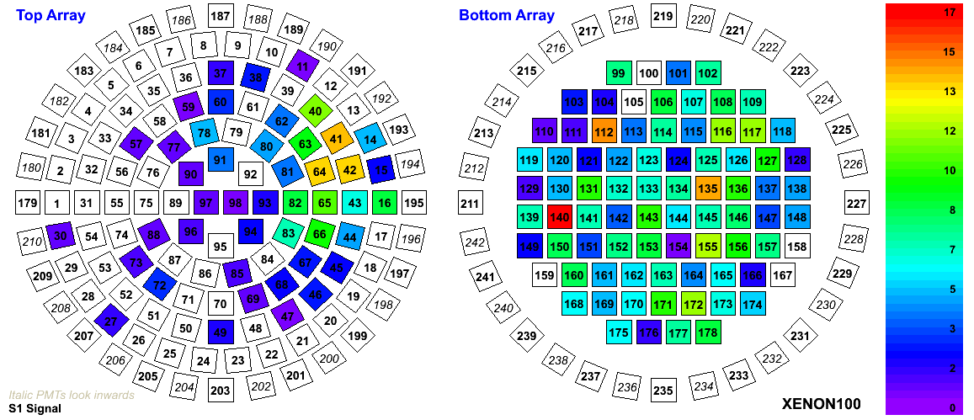
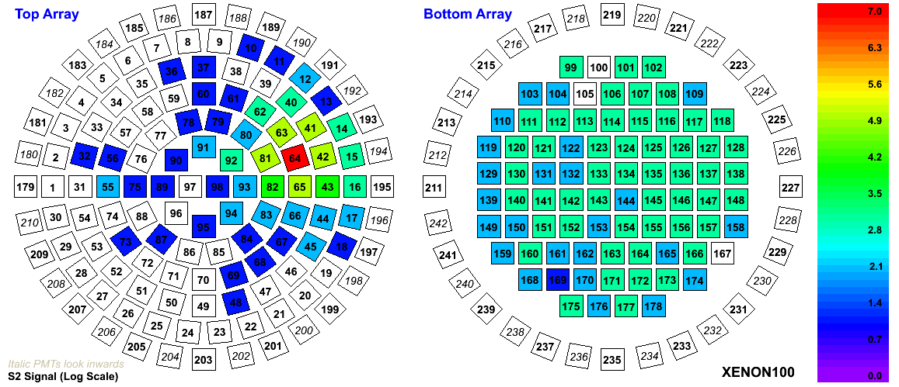
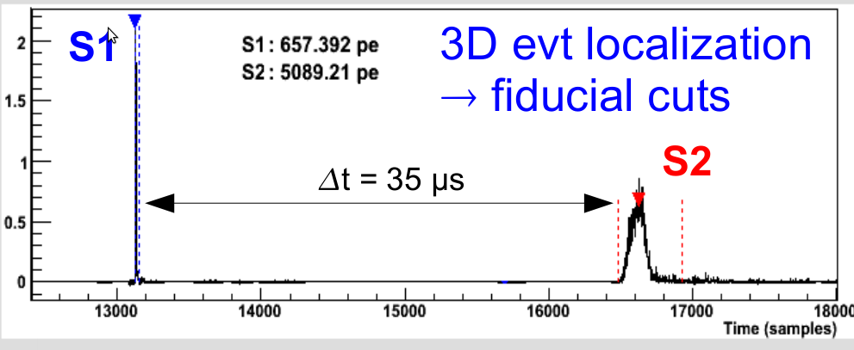
A Typical Event
S1
S2

Slide 32
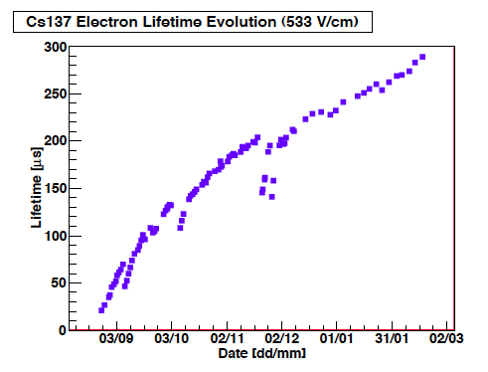
Electron Life Time
from the bottom
(30 cm drift)
2009
2010

Slide 33
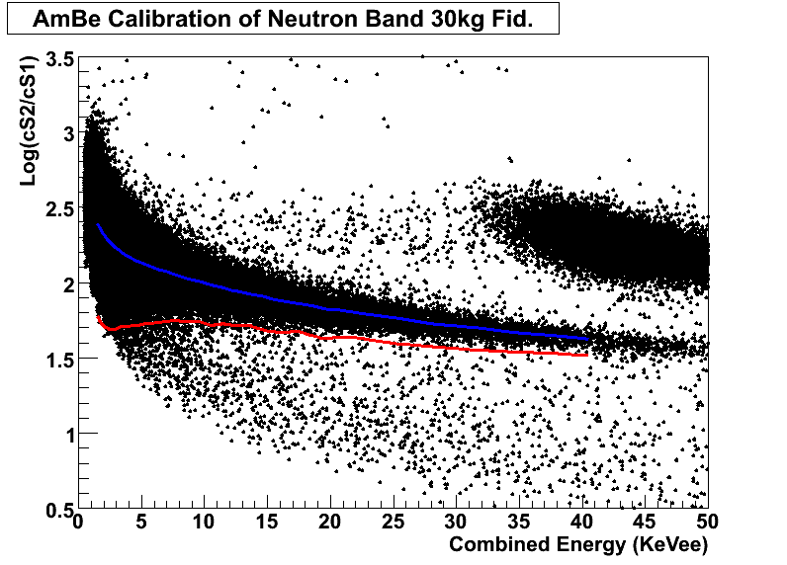
AmBe Neutron Band
Elastic DM
Inelastic DM
Ave.
Ave. – 3σ

Slide 34
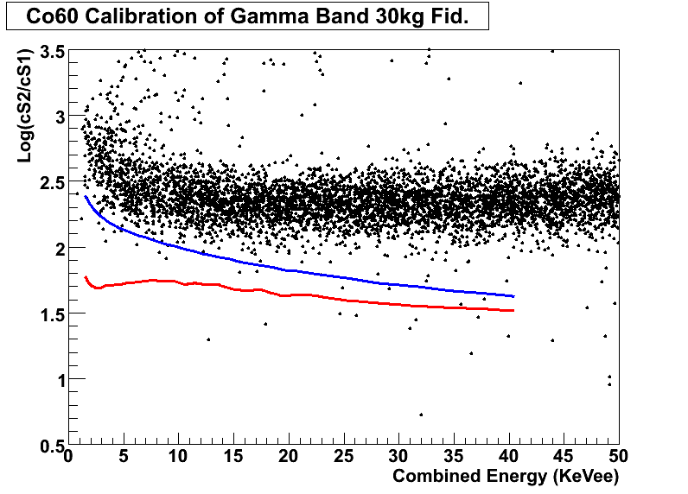
Co60 Gamma Band
0.5%
Ave.
Ave. – 3σ
Elastic DM
Inelastic DM
S2/S1 rejection = 99.5%
(Same as XENON10)

Slide 35
Status of XENON100
Purity of Xenon has achieved the design goal.
Actual Goal
Light Yield: 3.2 > 3 pe/keV
Electron Drift Time: 300  > 300 μs
Krypton 85: 50 - 100 < 100 ppt
Radon: 1.1 ± 0.4 < 2 Bq/m³
Serious calibration runs under way.
Neutrons: AmBe
Surface gammas: Co-60, Cs-137
Internal gammas : Kr-83m (9 keV, 32 keV)
Physics data taking started on January 15!

Slide 36
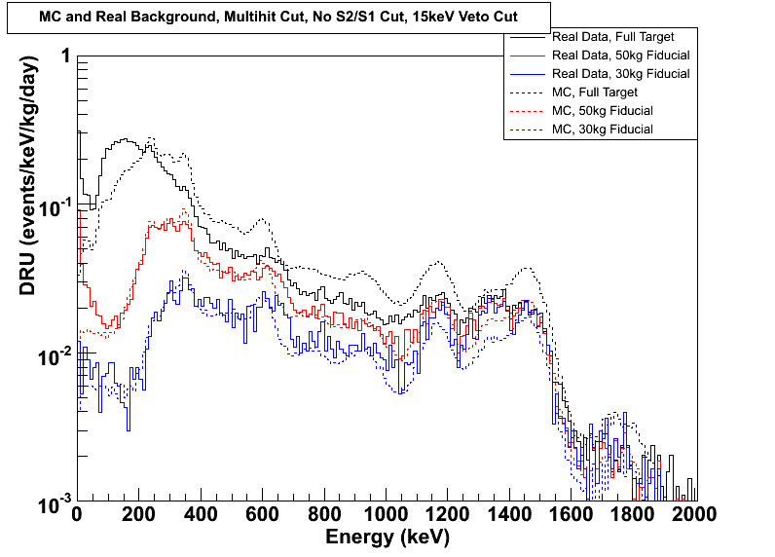
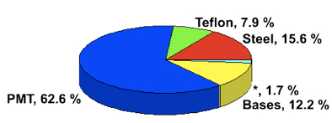
Energy Spectrum of Real Data vs. MC
XENON10 (5,4 kg, 0.6 DRU)
Full target (63 kg)
MC flux is multiplied by 0.75
50 kg
30 kg
7 mDRU

Slide 37
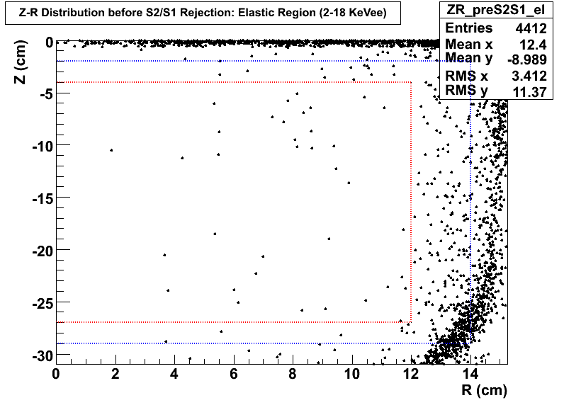
Z-R Distribution for Elastic Range before S2/S1 Cut
Before S2/S1 Cut
(2 – 18 keVee)
35 events
(7 mDRU)
30 kg
50 kg
10.6 days

Slide 38
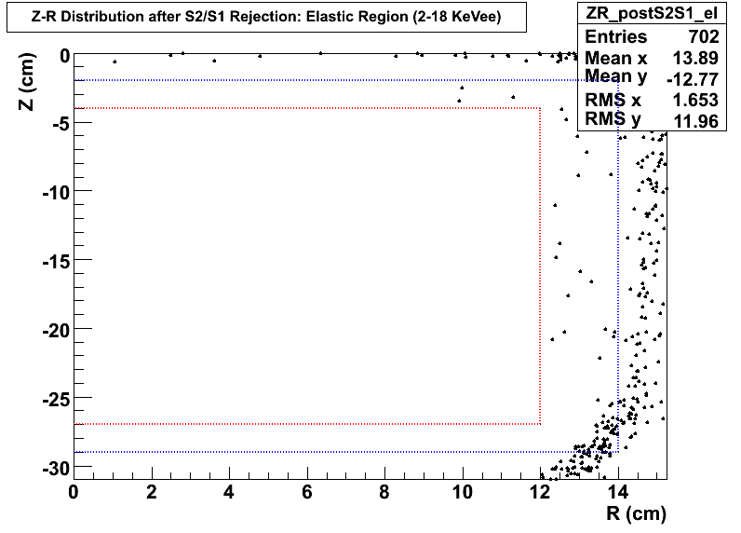
Z-R Distribution for Elastic Range after S2/S1 Cut
After S2/S1 Cut (99.5% Rejection)
(2 – 18 keVee)
0.17 BG expected
30 kg
50 kg
10.6 days

Slide 39
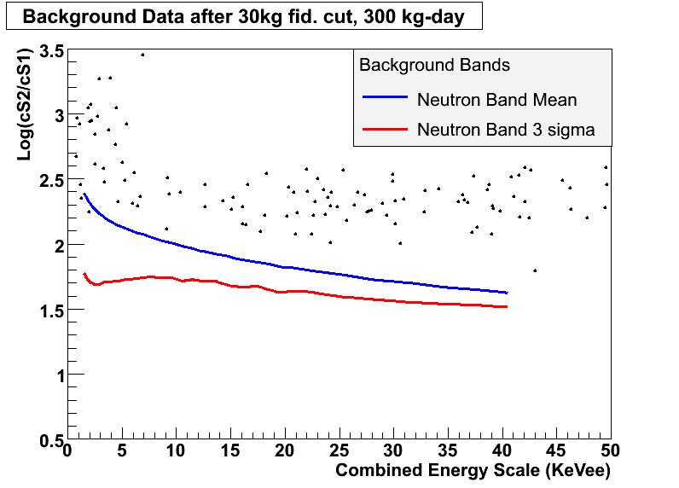
LogS2/S1 Real Data for 0-50 KeVee
35 events
(7 mDRU)
0.17 BG expected
Ave.
Ave. – 3σ
Elastic DM
Inelastic DM
10.6 days

Slide 40
Comparison of CDMS, XENON10 and XENON100
Fiducial Mass
Live days
Efficiency
Effective Exposure
Relative exposure (over CDMS-II)‏
No. of Observed Events
No. of Gamma BG (before S2/S1 cut)‏
No. of Gamma BG (before S2/S1 cut)‏
S2/S1 Rejection Efficiency
No. of Expected Gamma BG (after S2/S1 cut)‏
kg
days
kg-days
Events
DRU
Events
Events
CDMS-II
4.4
139
0.317
194
1.00
2
0.80
XENON10
5.4
58.6
0.43
136
0.70
10
0.6
816
0.005
4.08
XENON100
(now)
30
10.6
0.4
127
0.65
0.007
35
0.005
0.17
XENON100
(Sept, 2010)
30
200
0.4
2400
12.4
?
0.007
700
0.005
3.5
Katsushi Arisaka, UCLA
40

Slide 41
90% CL Limits of SI Cross Section
DAMA
ZEPLIN III
XENON10
CDMS
XENON100 (Sept, 2010)

Slide 42
QUPID

Slide 43
Where backgrounds come from?
Cosmic Rays
Underground or
Under high mountains
Radio Activities
(U, Th, K…)
XDNON100
Detector
Water Tank
(Liquid Scintillator)
Photon detectors are the major source of backgrounds.

Slide 44
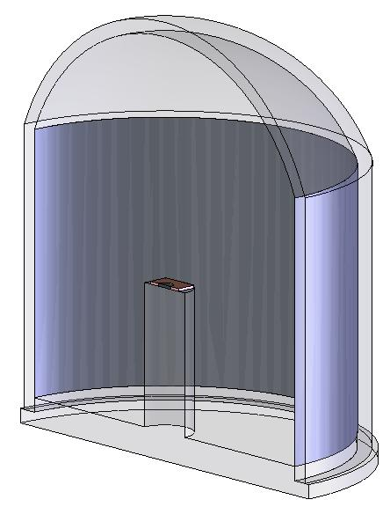
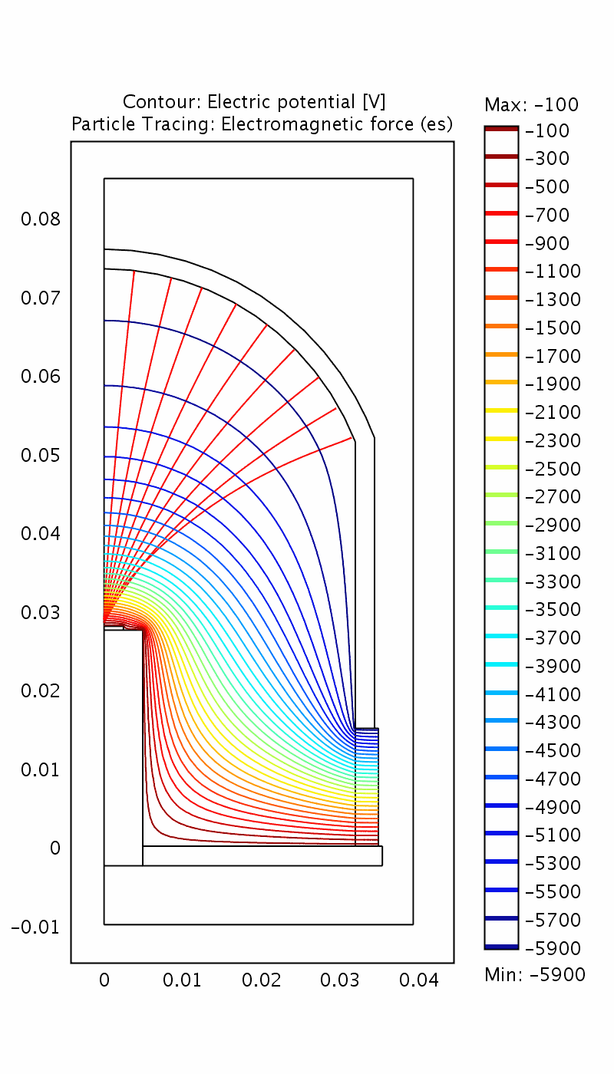
QUPID (QUartz Photon Intensifying Detector)
Photo Cathode
(-6 kV)
Photo Cathode
(-6 kV)
Quartz
Al coating
APD (0 V)
Quartz
APD (0 V)
Quartz
Made by Synthetic Silica only.
US Patent (No. 5374826) pending.

Slide 45
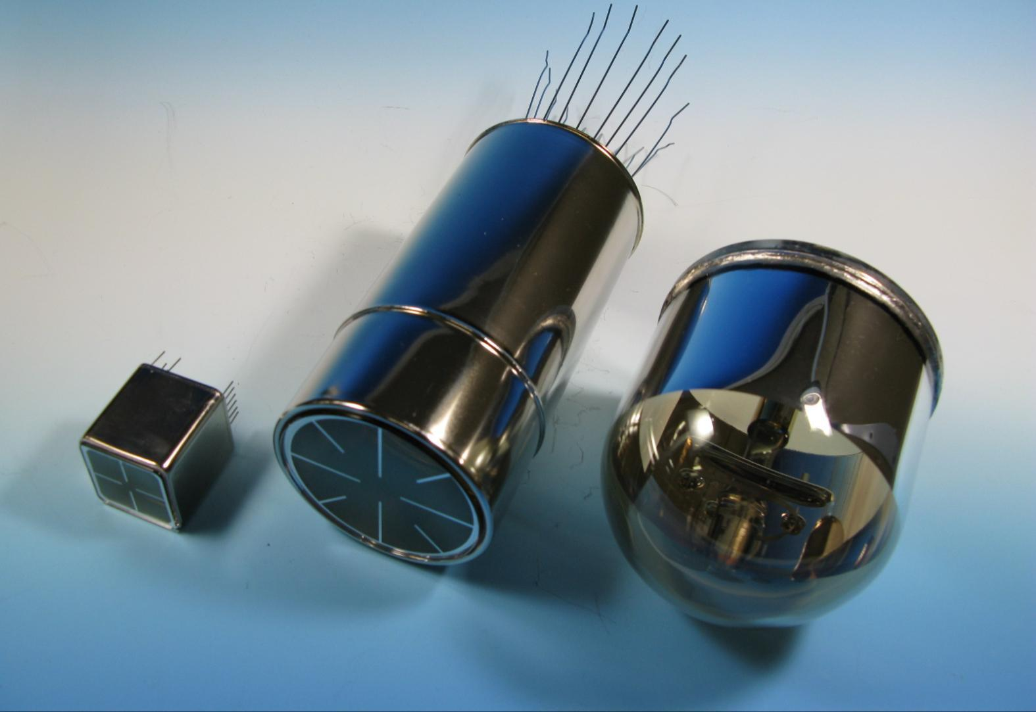
Comparison of Low-radioactive Photon Detectors from Hamamatsu
R8520
1 inch
R8778
2 inch
QUPID
3 inch
XENON1Ton
DarkSide50
MAX
XENON10
XENON100
LUX
(XMASS)

Slide 46
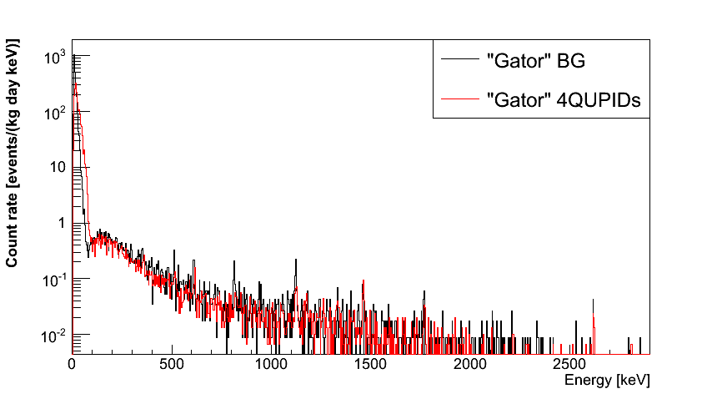
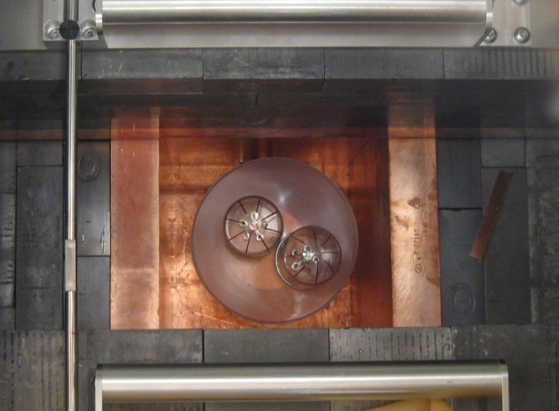
Spectrum of QUPIDs and Background (4 QUPIDs x 1 month data)
 | 90% CL
²³⁸U | < 0.36 mBq
²³²Th | < 0.30 mBq
⁶⁰Co | 0.12 ± 0.06 mBq
⁴⁰K | < 1.96 mBq
No QUPID
4 QUPIDs
11/16/12
Katsushi Arisaka, UCLA
46

Slide 47
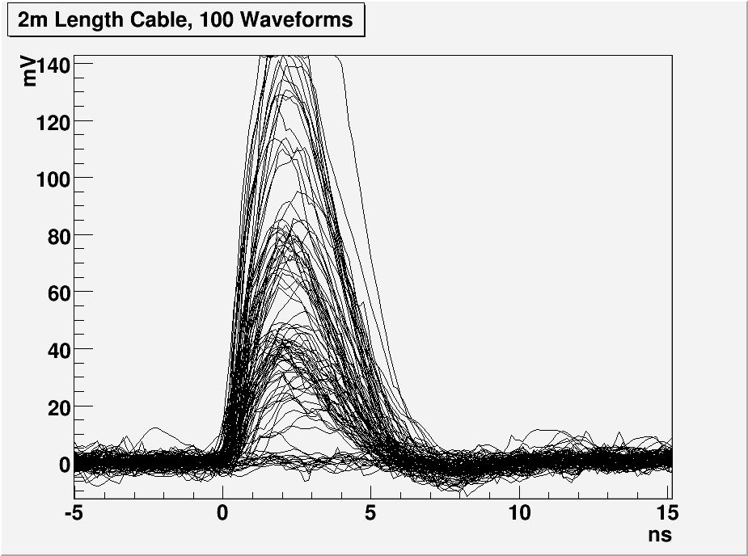
1, 2 and 3 PE Distribution with 2m cable
G = 800 × 200
= 160,000
3 PE
2 PE
1 PE

Slide 48
Summary of QUPID
Extremely low radioactivity: < 1 mBq
< 0.1 neutron / year
<< 10 times lower than conventional low radioactive PMTs.
Large diameter: 3 inch
6 inch is also under investigation.
Special Photocathode: Bialkali LT
> 30 % QE at 170 – 450 nm
Low resistivity even at Liquid Ar temperature (- 185 ºC)
True photon counting.
1, 2, 3… photoelectron peaks clearly visible.
100% collection efficiency.
Simple HV supply.
Common HV (-6 kV) for all QUPIDs
Resister chain not necessary
The first successful operation in Liquid Xenon at UCLA!

Slide 49
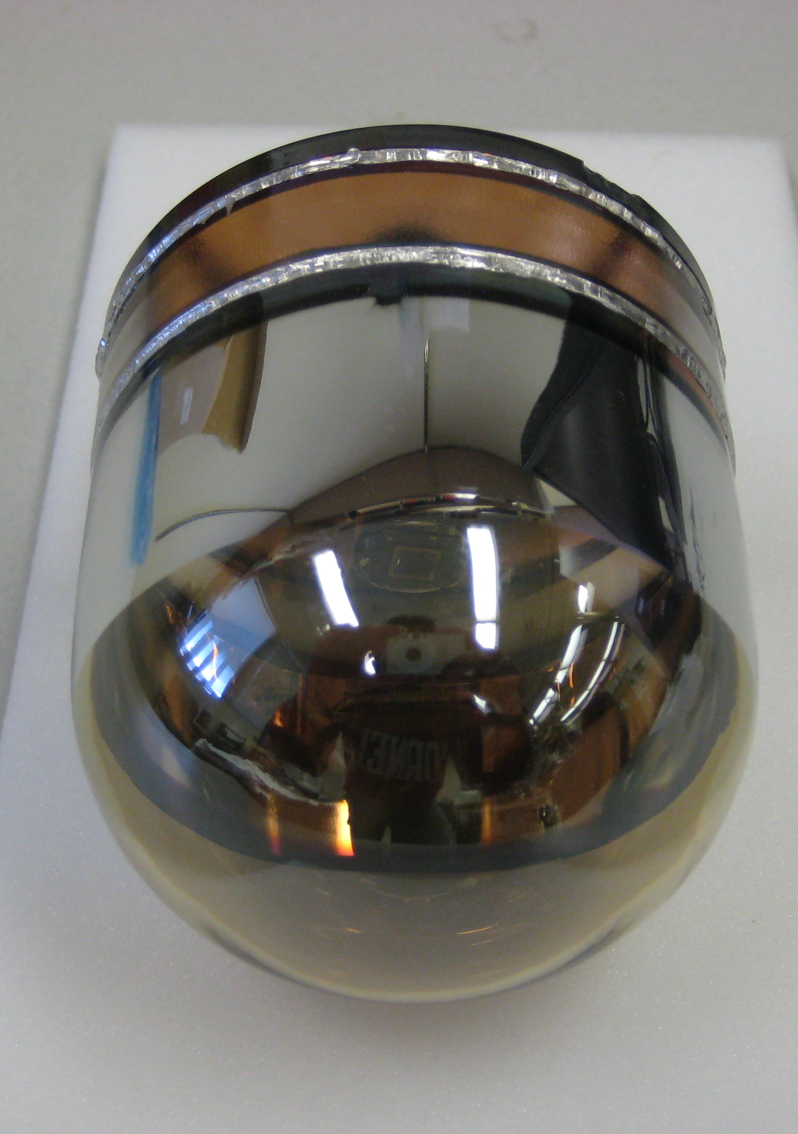
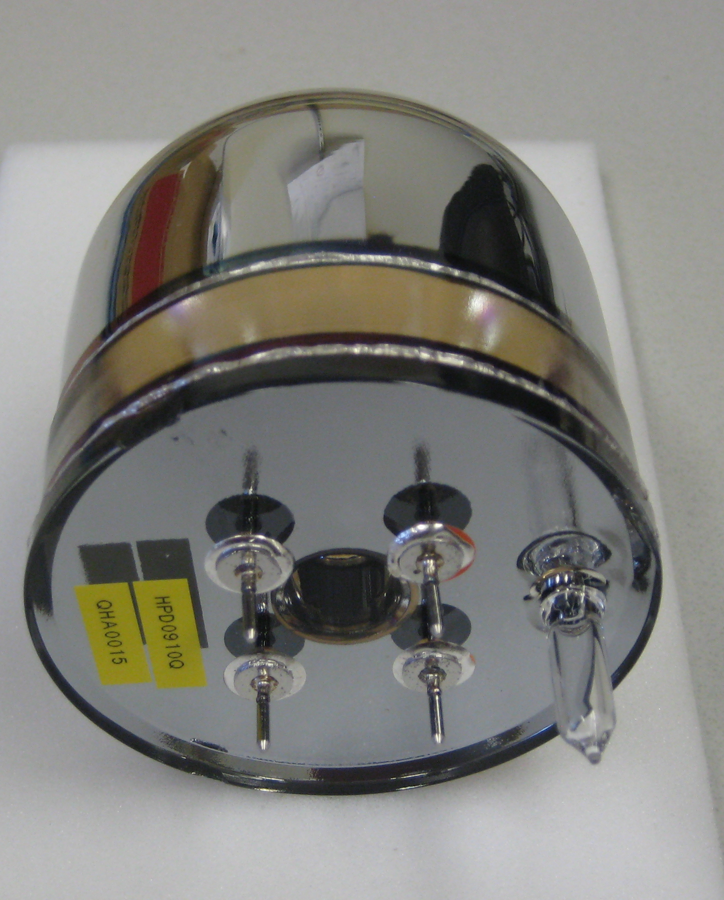
New 3” QUPID (Production Version)

Slide 50
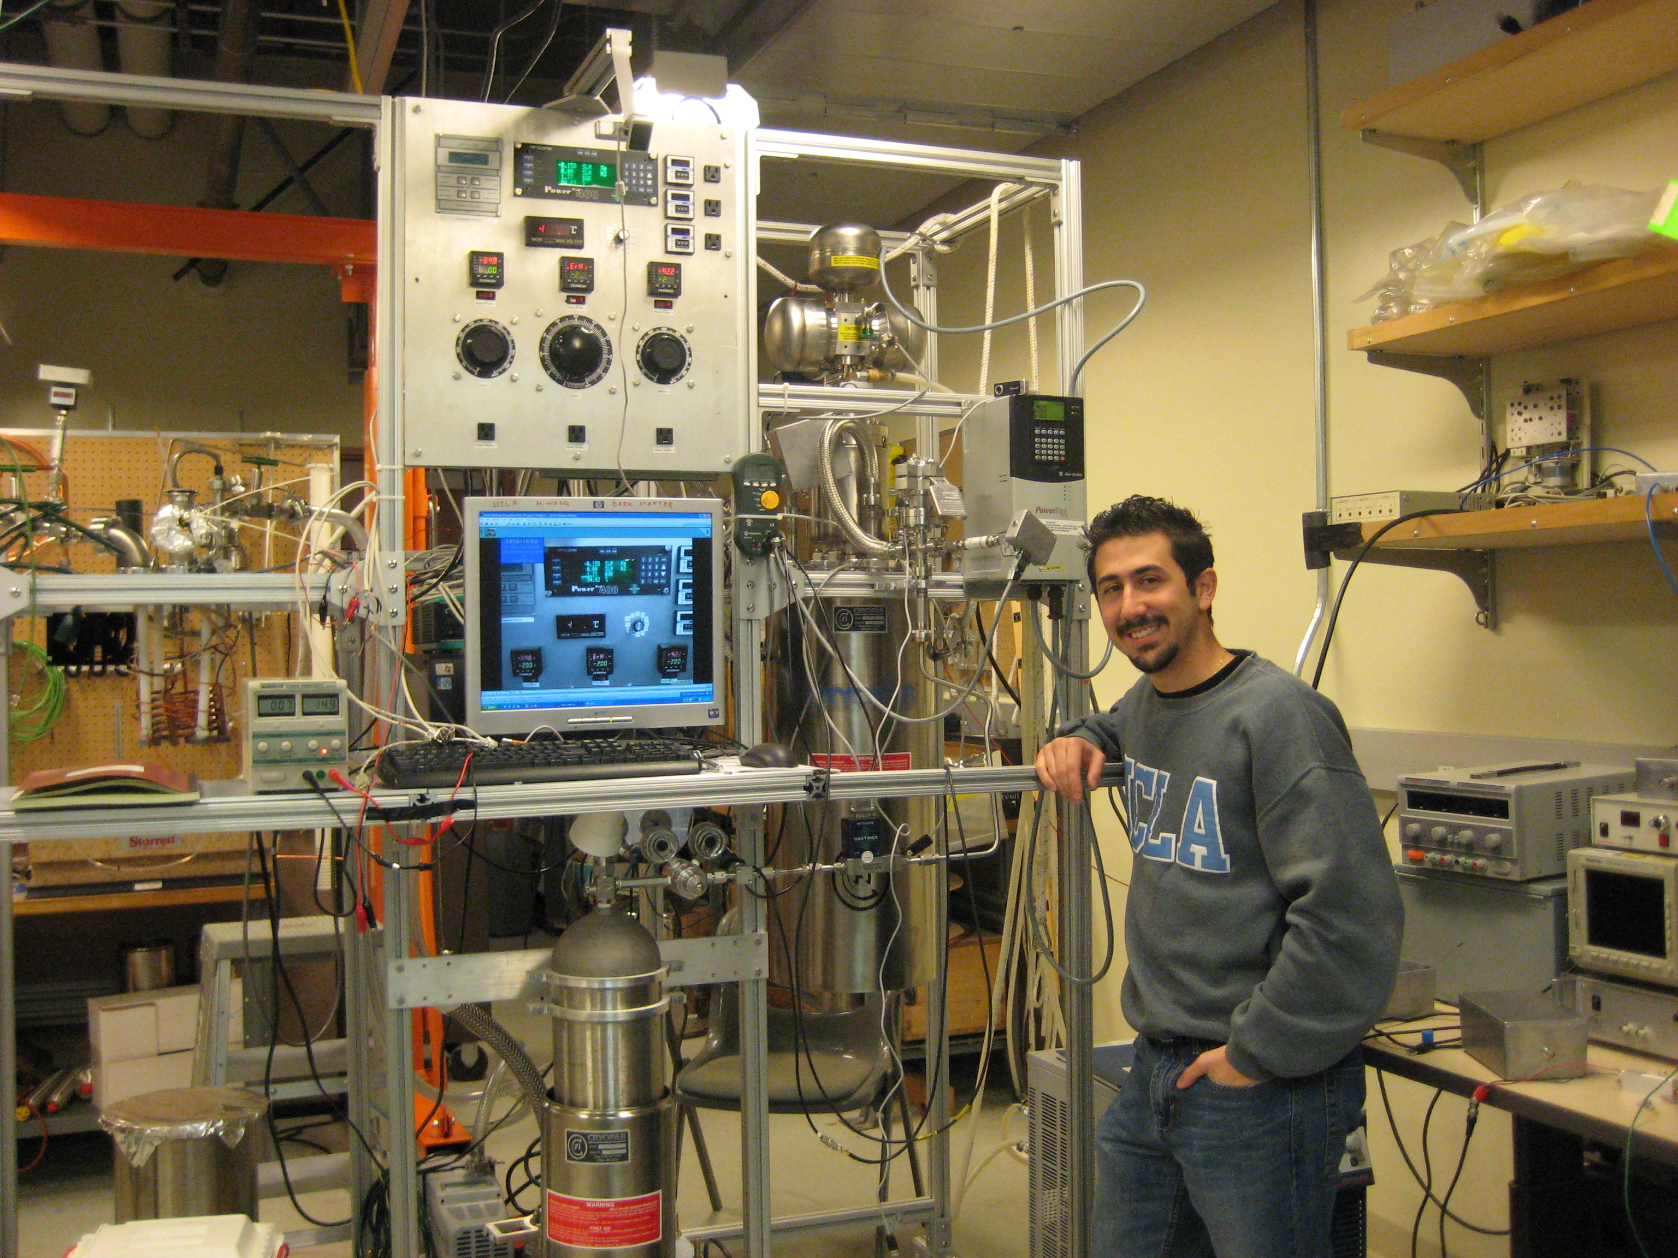
Cryogenic System at UCLA (Hanguo Wang’s Lab)
Liquid Xe
Nitrogen
Artin Teymourian

Slide 51
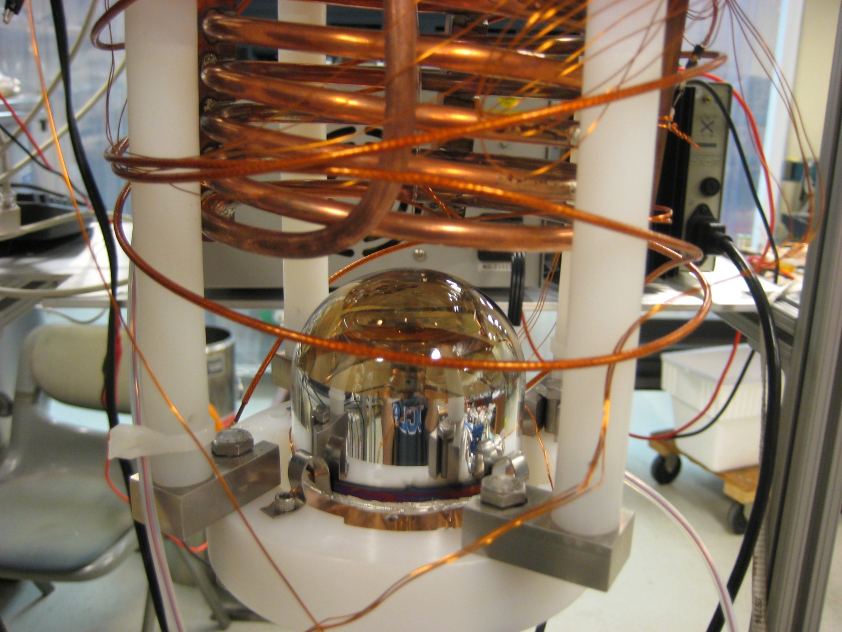
Qupid Pictures
QUPID in the Cooling System

Slide 52
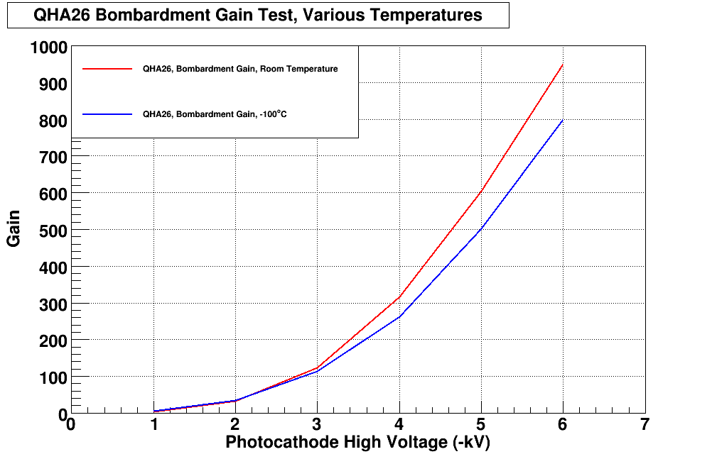
Electron Bombardment Gain (QHA26)
G = 800
25 ºC
-100 ºC

Slide 53
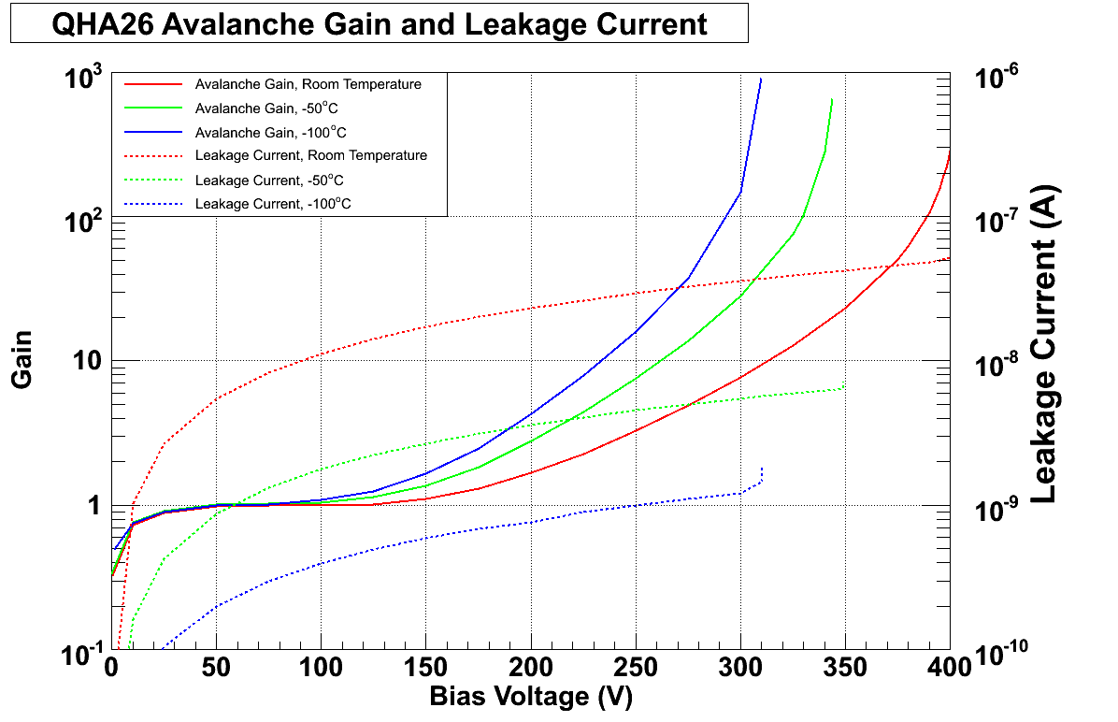
APD Gain and Leakage (QHA26)
-100 ºC
-50 ºC
G = 200
25 ºC
Gain
25 ºC
-50 ºC
Leakage Current
-100 ºC

Slide 54
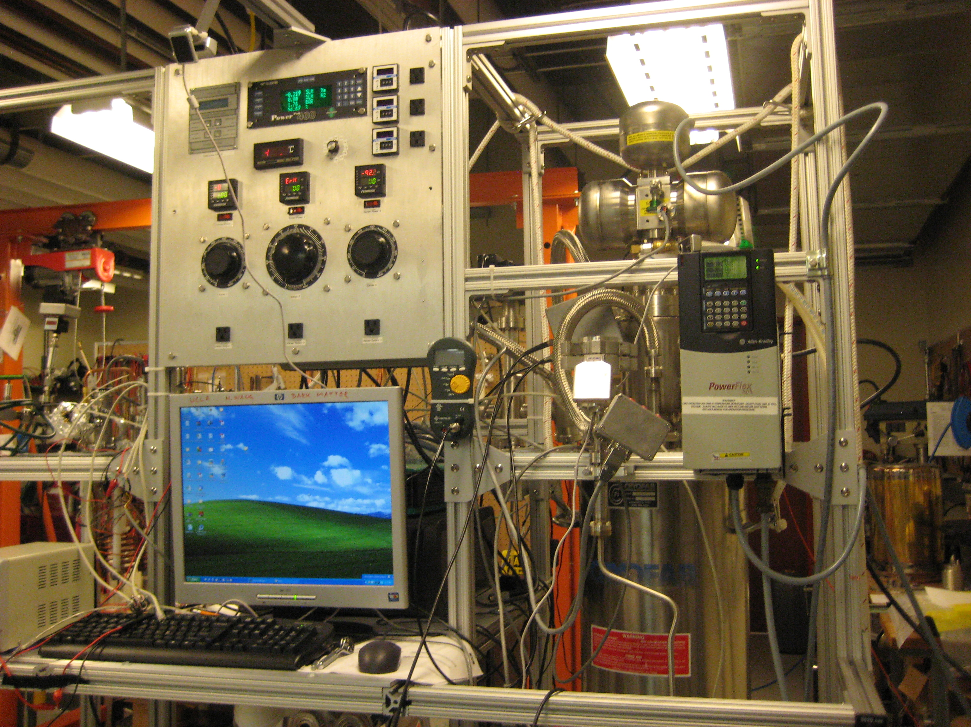
Cryogenic System at UCLA (Hanguo Wang’s Lab)
QUPID
in Liquid Xe

Slide 55

The first Scintillating lights detected by QUPID from ⁵⁷Co in Liquid Xenon
Threshold

Slide 56

The first Scintillating lights detected by QUPID from ⁵⁷Co in Liquid Xenon
1 PE
Threshold
2 PE
3 PE

Slide 57
XENON1T
G2
XENON1ton,
MAX
2 ton (1 ton)
XENON100
170 kg
(50 kg)
30cm
60cm
1 m
30 cm
1 m

Slide 58

XENON 1ton Structure
3” QUPID
(121 top,
121 bottom)
Titanium Vessel
(5 mm x 2)
Acrylic Spacer
(5 cm)
PTFE
(5 mm)

Slide 59

XENON 1Ton
Xe 2.12 ton
Xe 1.07 Ton
10 cm

Slide 60

XENON 1ton Top Corner

Slide 61

XENON 1ton with Water Tank Shielding
Water Tank
(11 m ϕ x 11 m H)

Slide 62

Gamma Background (After Multi-hit Cut and S2/S1 Cut)
0 cm cut
WIMP (10⁻⁴⁵ cm²)
2ν DBD (10²² yrs)
5 cm cut
pp Solar Neutrino
10 cut
Be7 Solar Neutrino

Slide 63


Expected Backgrounds in XENON 1Ton (100 Year, Multi-hit Cut)
XENON100
XENON100
0.07 γ / year
0.1 n / year
1.1 ton
1.1 ton

Slide 64
DarkSide 50

Slide 65

DarkSide 50 with 19 + 19 QUPIDs
50 kg of ³⁹Ar depleted Argon (33 kg fiducial)
19 + 19 = 38 QUPID
Liquid Scintillator Active Veto

Slide 66

DarkSide Collaboration

Slide 67
Properties of Noble Liqud
 | Unit | Neon | Argon | Xenon
Z |  | 10 | 18 | 54
A |  | 20 | 40 | ~132
Liquid Density | g/cc | 1.21 | 1.4 | 3.06
Energy Loss (dE/dX) | MeV/cm | 1.4 | 2.1 | 3.8
Radiation Length | cm | 24 | 14 | 2.8
Collision Length | cm | 80 | 80 | 34
Boiling Temperature | ºK | 27.1 | 87.3 | 165
Scintillation Wavelength | nm | 85 | 125 | 175
Scintillation | photon/keV | 30 | 40 | 46
Ionization | e-/keV | 46 | 42 | 64
Decay time (Fast Component) | nsec | 19 | 7 | 4
Decay time (Slow Component) | nsec | 1500 | 1600 | 27
Isotope |  | No | ³⁹Ar (1 Bq/kg) | ¹³⁶Xe
Price | $ /ton | $90k | $2k | ~$1M
Single Phase Experiments |  | CLEAN | DEAP, CLEAN | XMASS
Double Phase Experiments |  |  | WARP, ArDM, DarkSide, MAX, XAX | ZEPLIN, LUX, XMASS, XENON, MAX, XAX

Slide 68

Pulse Shaping Discrimination by Ar

Slide 69

Princeton Prototype Plant for Depleted Argon:
Achieved 0.5 kg/day (depletion >25), 15 kg accumulated.

Slide 70
MAX and XAX

Slide 71

DUSEL ($750M project by NSF)

Slide 72

XAX by UCLA Group (Aug, 2008)

Slide 73
Original Concept of XAX
WIMP
WIMP (Spin even)
Double Beta Decay
WIMP (Spin odd)
Solar Neutrino
⁴⁰Ar
70 ton
(50 ton)
^{129/131}Xe
12 ton
(6 ton)
¹³⁶Xe
7 ton
(4 ton)
1.2 m
2 m
4 m

Slide 74
G2 and G3 facilities at DUSEL
defined by PASAG (Oct, 2009)
 | G2 | G3
Sensitivity | < 10⁻⁴⁶ cm² | < 10⁻⁴⁷ cm²
Target Mass | ~ 1 Ton | ~ 10 Ton
Cost | $15M - $20M | ~ $50M

Slide 75

Supports on both Xe and Ar

Slide 76




















MAX - Multi-ton Argon & Xenon
MAX Collaboration = XENON + DarkSide
Elena Aprile Christiano Galbiati
UMass Amherst, Arizona State University
Augustana College, Black Hills State University
Coimbra University, Columbia University
Fermilab, University of Houston, INAF, LNGS
MIT, University of Münster, University of Notre Dame
Princeton University, Rice University, Temple University
UCLA, Univesity of Virginia, Waseda University
University of Zürich

Slide 77
90% CL Limits of SI Cross Section
DAMA
ZEPLIN III
XENON10
CDMS
XENON100
MAX–G2
Ar 5 ton
Xe 1 ton

Slide 78
90% CL Limits of SI Cross Section
DAMA
ZEPLIN III
XENON10
CDMS
XENON100
MAX–G2
Ar 5 ton
Xe 1 ton
MAX–G3
Ar 50 ton
Xe 10 ton

Slide 79


MAX – G3 Detector
⁴⁰Ar
70 ton
(50 ton)
Xe
20 ton
(10 ton)
4m
2 m
3” QUPID x 595 (Top)
6” QUPID x 825 (Side/Bottom)
6” QUPID x 3746

Slide 80

Xe 10 ton Detector Structure
Xe 20 ton
(or Ar 10 ton)
1.9m
Xe10 ton
(or Ar 5 ton)
20 cm
Top: 3” QUPID x 595
Side: 6” QUPID x 672
Bottom: 6” QUPID x 163
2.1m

Slide 81

Xe 10 ton Top-Corner
3” QUPID
Gas Xe (Ar)
Mesh Wire
Liquid Xe (Ar)
6” QUPID

Slide 82


MAX Shielding Structure
Xe 20 ton (10 ton)
⁴⁰Ar 70 ton (50 ton)
Xe
Ar
Liquid
Scinti
Liquid
Scinti
Water Tank
Water Tank
8 m
18 m

Slide 83

MAX Facility at DUSEL
Ar 70 ton
(50 ton)
Xe 20 ton
(10 ton)
Liquid Scintillator
(8 m ϕ x 8 m H )
Water Tank
(18 m ϕ x 18 m H)
Liquid Scintillator
(8 m ϕ x 8 m H )

Slide 84

(SI) WIMP Energy Spectrum for Various Targets (Cross Section = 10⁻⁴⁵cm²)
Xe-132
Ar-40
Ge-73
Si-28
Ne-20

Slide 85

(SI) WIMP Energy Spectrum for LXe (Cross Section = 10⁻⁴⁵cm²)
Xenon
8 keVr
45 keVr
200 GeV
100 GeV
500 GeV
1000 GeV
20 GeV
50 GeV

Slide 86

(SI) WIMP Energy Spectrum for LAr (Cross Section = 10⁻⁴⁵cm²)
Argon
(w/ pulse shaping)
45 keVr
200 keVr
100 GeV
500 GeV
1000 GeV
200 GeV
20 GeV
50 GeV

Slide 87

1-σ Error of WIMP Mass vs SI Cross Section (10 ton*year Xe and 50 ton*year Ar)
10⁻⁴⁵
(40% eff.)
(80% eff.)
Xenon
(56 events)
10⁻⁴⁶
10⁻⁴⁶ cm²
Argon
(42 events)
G3
100 GeV
10⁻⁴⁷

Slide 88

1-σ Error of WIMP Mass vs SI Cross Section (10 ton*year Xe and 50 ton*year Ar)
50 GeV
100 GeV
200 GeV
500 GeV
Argon
10⁻⁴⁵ cm²
Xenon
G3

Slide 89

(SI) WIMP Energy Spectrum for LXe (Cross Section = 10⁻⁴⁵cm²)
Xenon
8 keVr
45 keVr
200 GeV
100 GeV
500 GeV
1000 GeV
20 GeV
Winter
Summer
50 GeV

Slide 90

(SI) WIMP Energy Spectrum for LAr (Cross Section = 10⁻⁴⁵cm²)
Argon
(w/ pulse shaping)
45 keVr
200 keVr
100 GeV
500 GeV
1000 GeV
200 GeV
20 GeV
50 GeV
Winter
Summer

Slide 91

±1σ Error of Annual Modulation Amplitude vs WIMP Mass (10 ton*year Xe and 50 ton*year Ar, Cross Section = 10⁻⁴⁵cm²)
10⁻⁴⁵ cm²
Argon
Xenon

Slide 92

±1σ Error of Annual Modulation Amplitude vs WIMP Mass (10 ton*year Xe and 50 ton*year Ar, Cross Section = 10⁻⁴⁴cm²)
10⁻⁴⁴ cm²
Argon
Xenon

Slide 93

±1σ Error of Annual Modulation Amplitude for various WIMP velocities (50 ton*year Ar, Cross Section = 10⁻⁴⁴cm²)
10⁻⁴⁴ cm²
Argon
170 km/s
195 km/s
220 km/s
245 km/s
270 km/s

Slide 94


Expected Background from Gammas and pp Solar Neutrinos (100 Year, Multi-hit Cut, S2/S1 Cut)‏
γ’s from QUPID
XENON100
2.3 ν /10 ton-year
(pp solar neutrino)
5 × 10^{–8} DRU
Xenon
10 ton
02/25/10
Katsushi Arisaka, UCLA
94

Slide 95



Xe 10 ton Neutron Background (100 Years)
1/8
1/4
Before Cuts
Multi Hit Cut
Liquid Scinti. Veto
0.81 n / year
0.10 n / year
0.03 n / year
Xenon
10 ton

Slide 96



Ar 50 ton Neutron Background (100 Years)
1/20
1/6
Before Cuts
Multi Hit Cut
Liquid Scinti. Veto
42 n / year
2.1 n / year
0.39 n / year
Argon
50 ton

Slide 97
Summary of MAX G2/G3 & XAX
 |  | MAX G2 |  | MAX G3 |  | XAX
 |  | Xenon | Argon | Xenon | Argon | ^{129/131}Xe | ¹³⁶Xe (80%)
Dimension
 | Detector Size | 1m x 1m | 2m x 2m | 2m x 2m | 4m x 4m | 2m x 2m
 | Total Mass | 2.2 ton | 10 ton | 20 ton | 70 ton | 13 ton | 7 ton
 | Fiducial Mass | 1.1 ton | 5 ton | 10 ton | 50 ton | 6 ton | 4 ton
QUPID
 | Top | 121 (3") | 595 (3") | 595 (3") | 661 (6") | 595 (3")
 | Side | 0 | 672 (6") | 672 (6") | 2423 (6") | 672 (6")
 | Bottom | 121 (3") | 163 (6") | 163 (6") | 661 (6") | 163 (6")
No.WIMP / year (10⁻⁴⁵ cm²)
 | Mass = 20 GeV | 23 | – | 230 | – | 138 | 92
 | 50 GeV | 71 | 25 | 710 | 250 | 426 | 284
 | 100 GeV | 56 | 42 | 560 | 420 | 336 | 224
 | 200 GeV | 33 | 36 | 330 | 360 | 198 | 132
 | 500 GeV | 14 | 19 | 140 | 190 | 84 | 56
Backgrounds / year
 | Gammas | 0.07 | 0.00 | 0.01 | 0.00 | 0.07 | 0.01
 | Neutrons (w/o LS) | 0.10 | 0.78 | 0.10 | 2.1 | 0.10 | 0.00
 | Neutrons (w/ LS) | 0.03 | 0.10 | 0.03 | 0.39 | 0.03 | 0.00
Neutrinos / year
 | 0ν DBD (10²⁷ yr) | 0.4 | – | 3.3 | – | – | 30
 | pp-solar | – | – | – | – | 2500 | –
 | Supernova (10 kpc) | 11 | 14 | 95 | 141 | 56 | 39

Slide 98
Conclusions
XENON100 running extremely well.
Already comparable sensitivity as XENON10 and CDMS-II in 10 days (30 kg fiducial).
Background is 100 times lower than XENON10.
By September, > 10 times larger exposure than CDMS-II.
QUPID successfully developed.
The first signals in Liquid Xenon.
Mass production (6 QUPID/day) almost ready.
Based on QUPUID, the future multi-ton Xe/Ar detectors designed and proposed.
XENON 1ton and DarkSide 50 at Gran Sasso.
MAX G3 (Xe 10 ton + Ar 50 ton) at DUSEL.

Slide 99
90% CL Limits of SI Cross Section
DAMA
ZEPLIN III
XENON10
CDMS
XENON100
MAX–G2
Ar 5 ton
Xe 1 ton
MAX–G3
Ar 50 ton
Xe 10 ton

