Slide 1
MAX + LZD = G3 Detector and Physics
Katsushi Arisaka
University of California, Los Angeles
Department of Physics and Astronomy
arisaka@physics.ucla.edu

Slide 2
Talk Outline
G3 Detector Concept
Xenon 10 Ton + Argon 50 Ton (Fiducial)
Physics sensitivities
Mass and Cross Section by Energy spectrum
WIMP Velocity by annual Modulation
Mechanical Design
Status of QUPID
New Photo cathode
Operation in Liquid Xenon

Slide 3
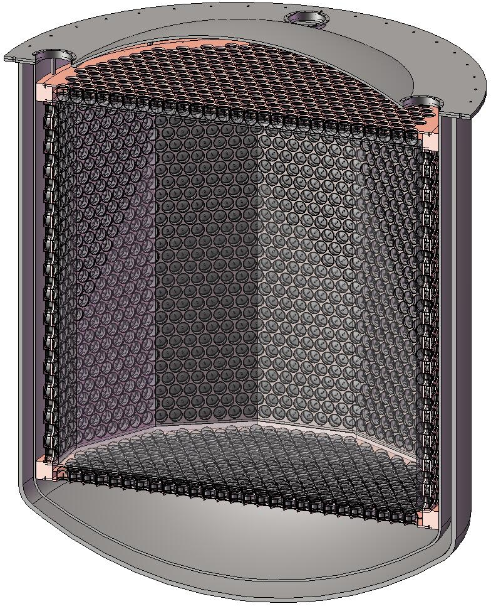
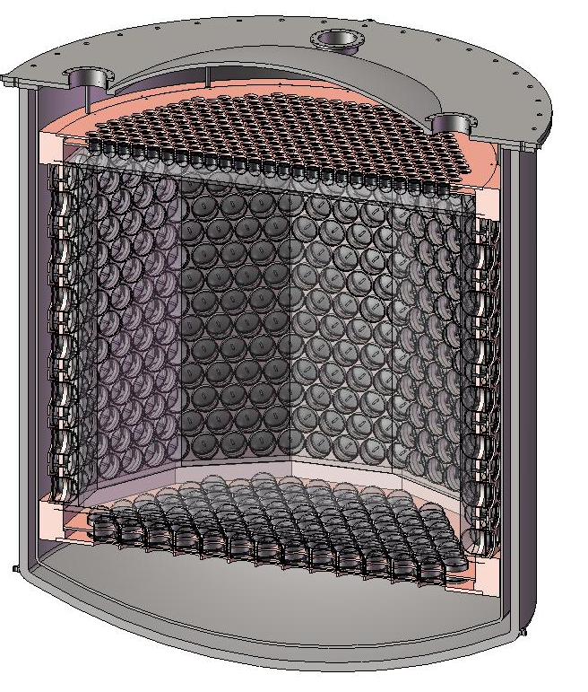
MAX – G3 Detector (from UCLA DM2010)
⁴⁰Ar
70 ton
(50 ton)
Xe
20 ton
(10 ton)
4m
2 m
3” QUPID x 595 (Top)
6” QUPID x 825 (Side/Bottom)
6” QUPID x 3746

Slide 4
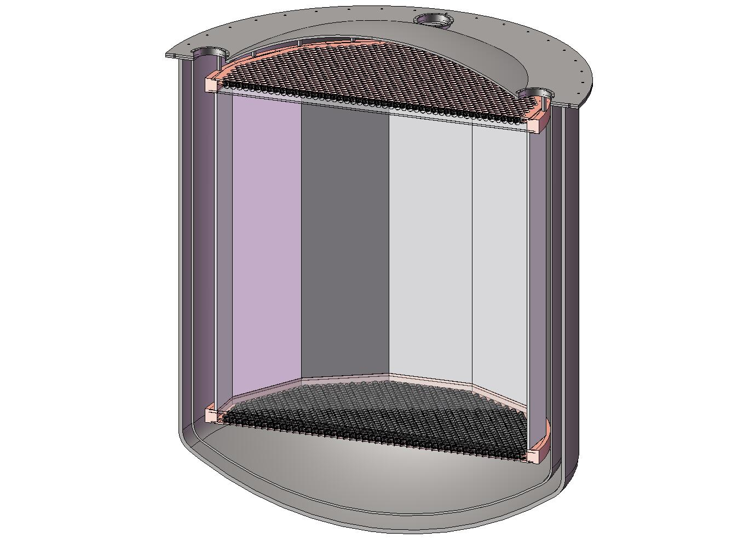
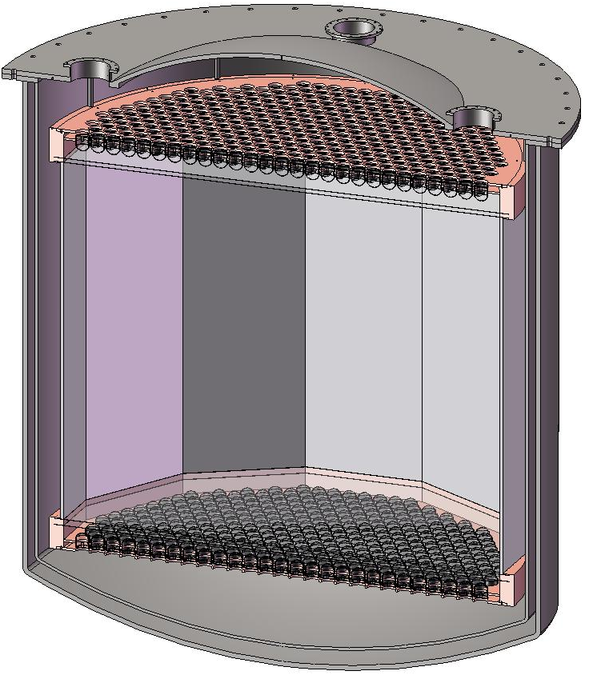
MAX+LZD = G3 Detector (at DUSEL)
⁴⁰Ar
70 ton
(50 ton)
Xe
20 ton
(10 ton)
4m
2 m
3” QUPID x 595 (Top)
3” QUPID x 595 (Bottom)
3” QUPID x 2644 (Top)
3” QUPID x 2644 (Bottom)

Slide 5
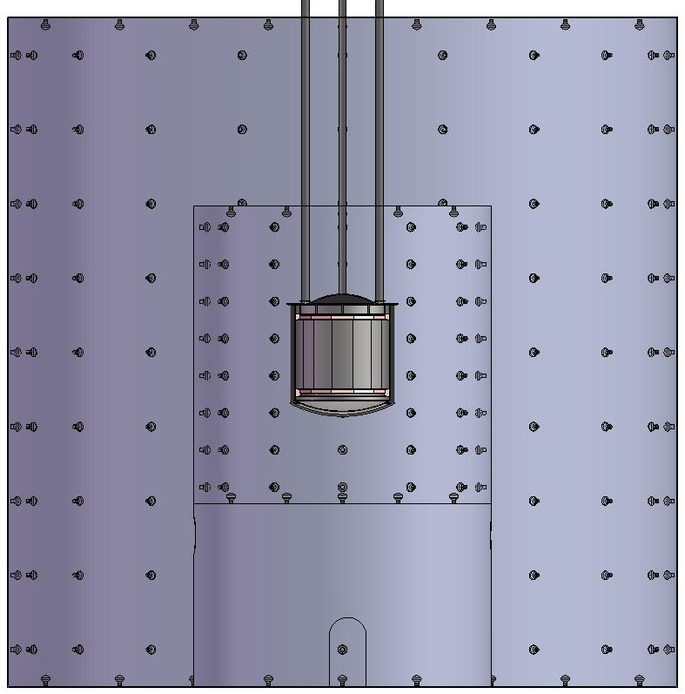
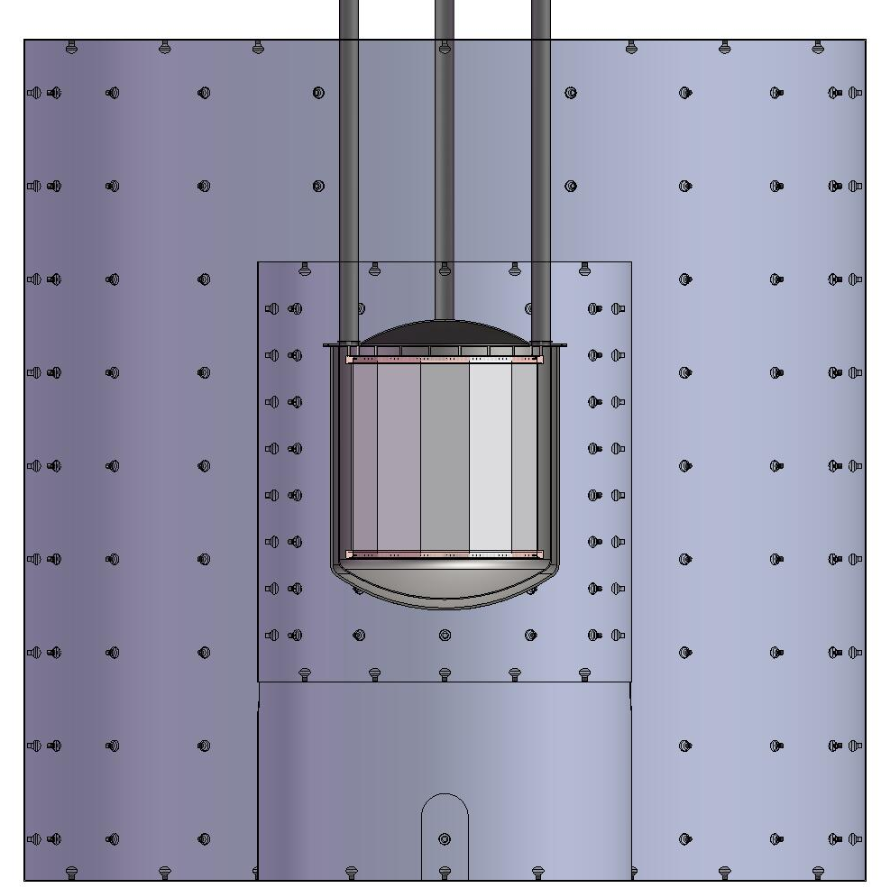
MAX+LZD = G3 Shielding Structure
Xe
20 ton
(10 ton)
⁴⁰Ar
70 ton
(50 ton)
18 m
Liquid
Scinti
Water Tank
Water Tank
8 m
18 m

Slide 6
Physics Sensitivities

Slide 7
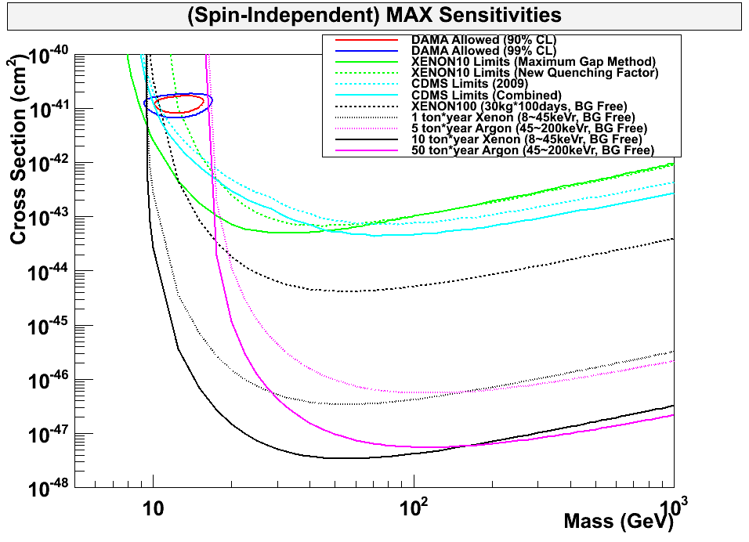
90% CL Limits of SI Cross Section
DAMA
XE10
CDMS
XE100
G2
Ar 5ton
Xe 1ton
Ar 50ton
G3
Xe 10ton

Slide 8
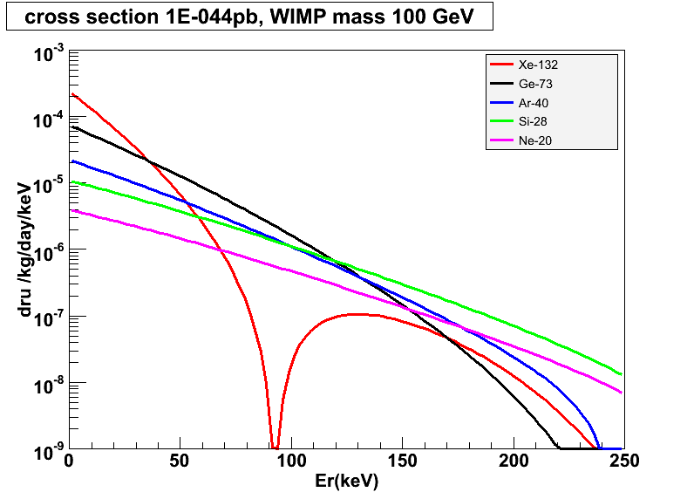
Target Mass Dependence of WIMP Cross Section
10⁻⁴⁴ cm²
Xe-132
Ar-40
Ge-73
Si-28
Ne-20

Slide 9
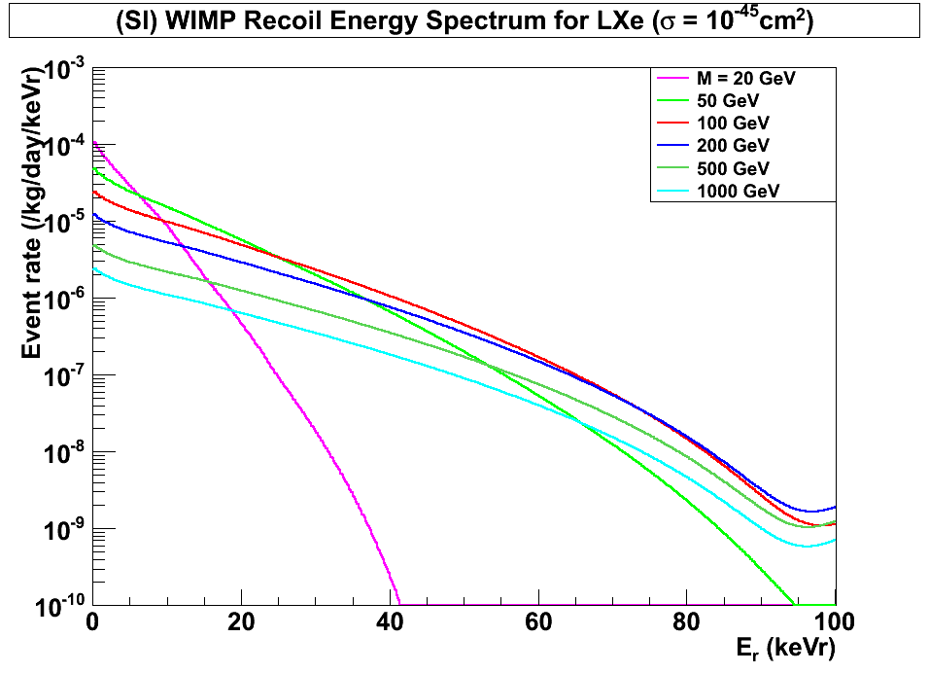
(SI) WIMP Energy Spectrum for LXe (Cross Section = 10⁻⁴⁵cm²)
Xenon
7 keVr
45 keVr
200 GeV
100 GeV
500 GeV
1000 GeV
20 GeV
50 GeV

Slide 10
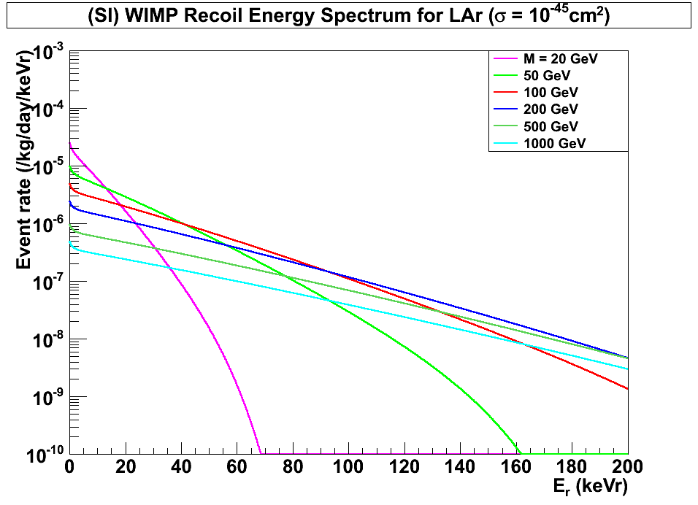
(SI) WIMP Energy Spectrum for LAr (Cross Section = 10⁻⁴⁵cm²)
Argon
45 keVr
200 keVr
100 GeV
500 GeV
1000 GeV
200 GeV
20 GeV
50 GeV

Slide 11
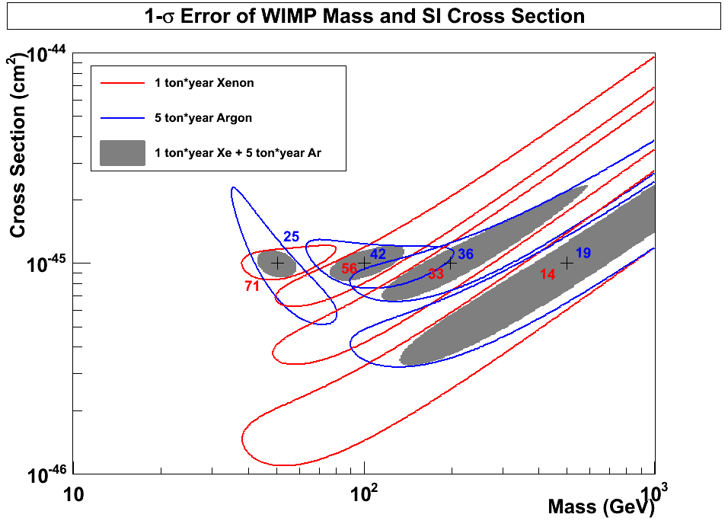
1-σ Error of WIMP Mass vs SI Cross Section (10 ton*year Xe and 50 ton*year Ar)
10⁻⁴⁵
50 GeV
100 GeV
200 GeV
500 GeV
10⁻⁴⁶
10⁻⁴⁶ cm²
G3
10⁻⁴⁷

Slide 12
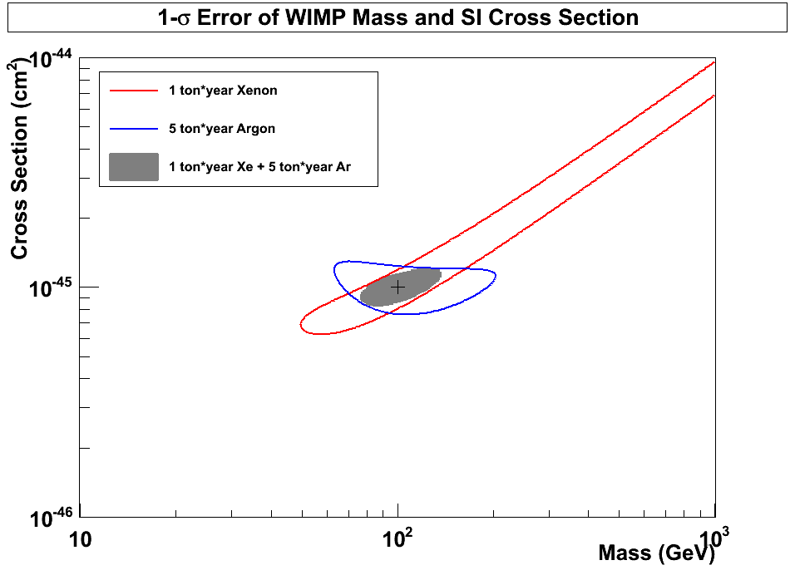
1-σ Error of WIMP Mass vs SI Cross Section (10 ton*year Xe and 50 ton*year Ar)
10⁻⁴⁵
Xenon
(56 events)
10⁻⁴⁶
10⁻⁴⁶ cm²
Argon
(42 events)
G3
100 GeV
10⁻⁴⁷

Slide 13
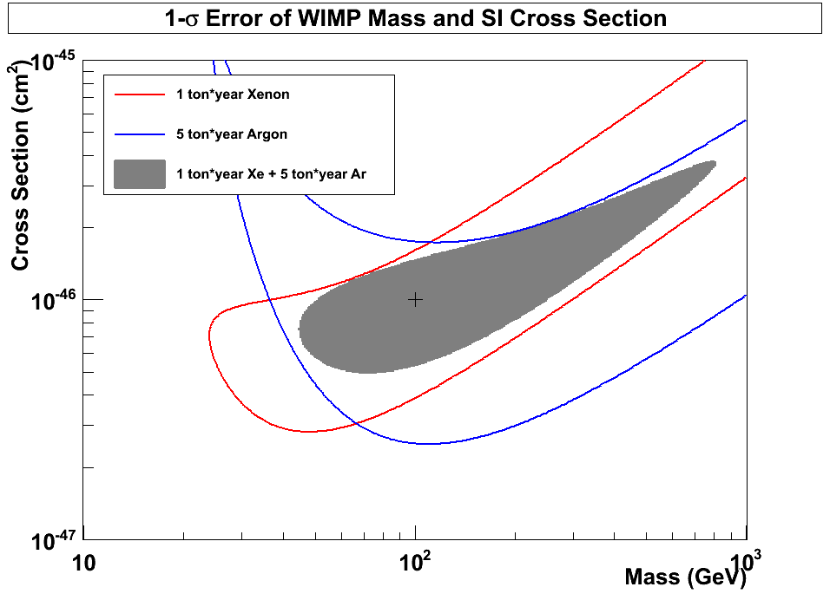
1-σ Error of WIMP Mass vs SI Cross Section (10 ton*year Xe and 50 ton*year Ar)
10⁻⁴⁶
Xenon
(5.6 events)
10⁻⁴⁷
10⁻⁴⁷ cm²
Argon
(4.2 events)
G3
100 GeV
10⁻⁴⁸

Slide 14
Xenon 10 ton Detector (2m x 2m)

Slide 15
Xenon 10 Ton Detector Structure
Top: 3” QUPID x 595
Bottom: 3” QUPID x 595

Slide 16
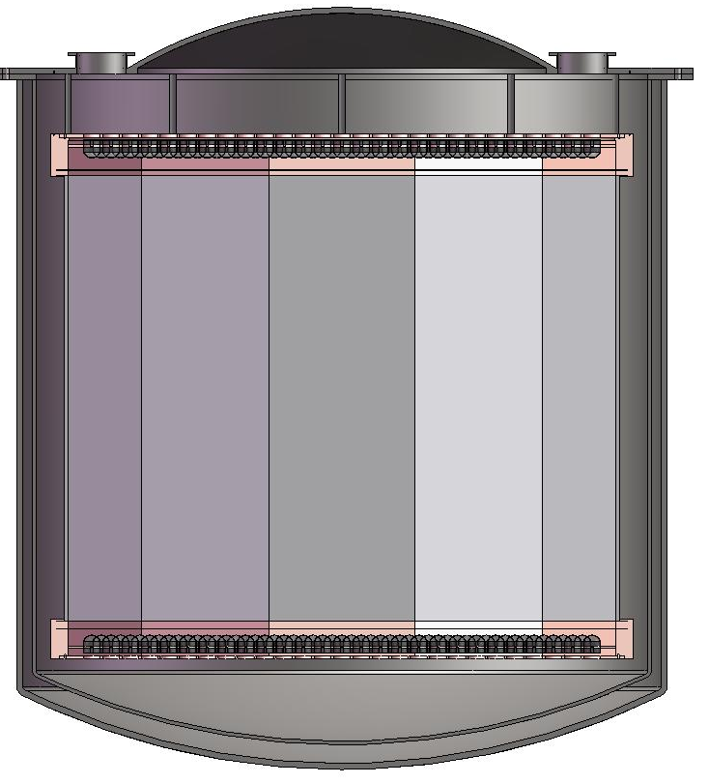
Xenon 10 Ton Detector Structure
Top: 3” QUPID x 595
Bottom: 3” QUPID x 595
1.84m
2.1m

Slide 17
Xenon 10 Ton Detector Structure
Xe 20 ton
Xe 10 ton
20 cm

Slide 18
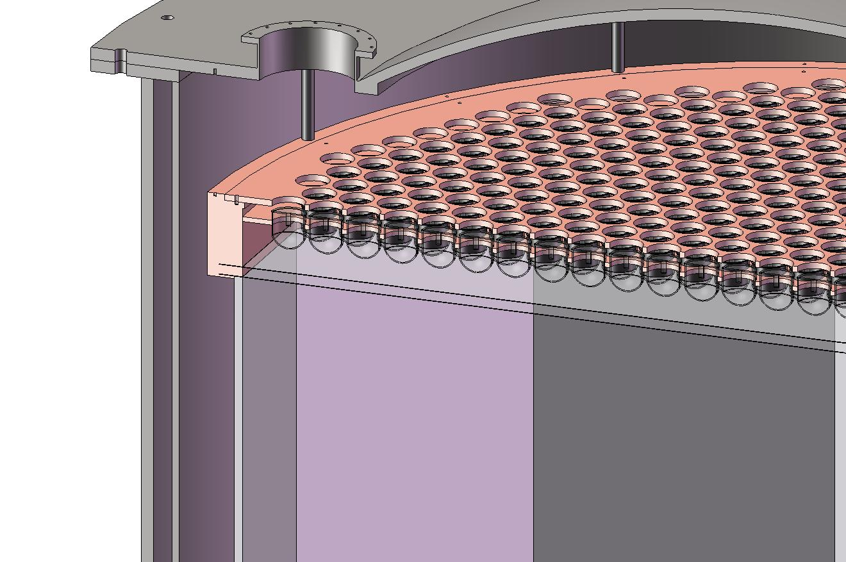
Xenon 10 Ton Top corner

Slide 19
Argon 50 ton Detector (4m x 4m)

Slide 20
Argon 50 ton Detector Structure
Top: 3” QUPID x 2644
Bottom: 3” QUPID x 2644
Total: 3” QUPID x 5288

Slide 21
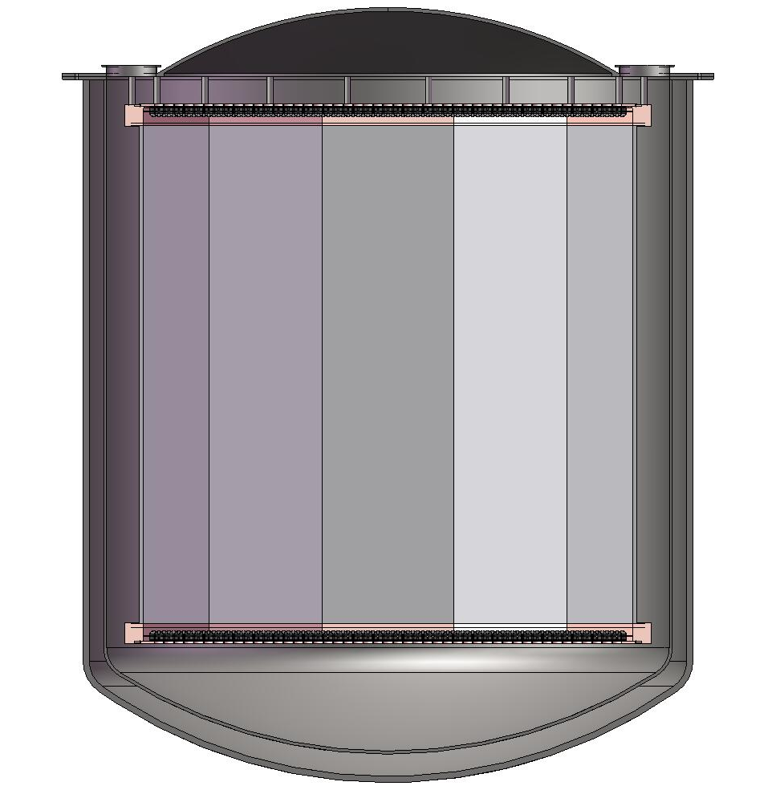
Argon 50 ton Detector Structure
4 m
Top: 3” QUPID x 2644
Bottom: 3” QUPID x 2644
Total: 3” QUPID x 5288
4m

Slide 22
Argon 50 ton Detector Structure
Ar 74 ton
Ar 47 ton
40 cm

Slide 23
Status of QUPID

Slide 24
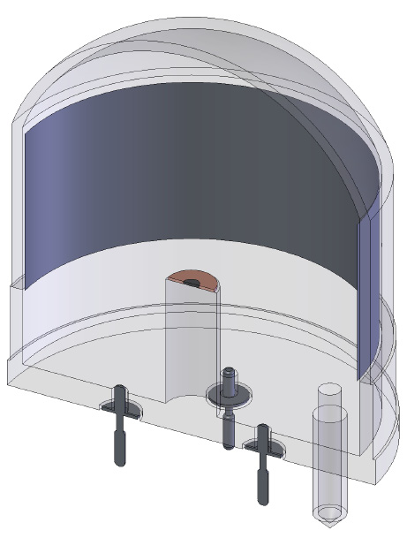
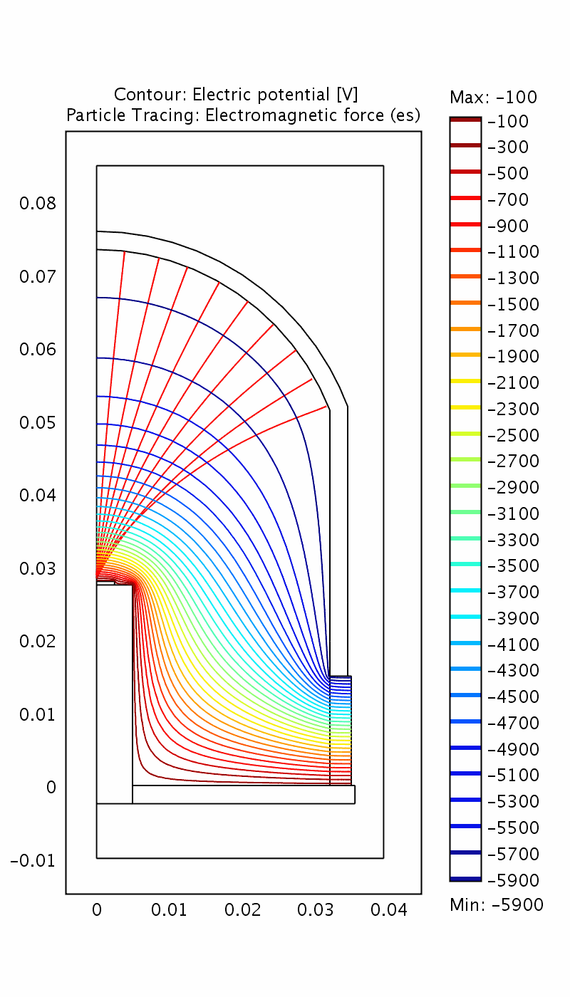
New QUPID (Production Version)
Photo Cathode (-6 kV)
Photo Cathode
(-6 kV)
Quartz
Al coating
APD (0 V)
APD (0 V)
Quartz

Slide 25
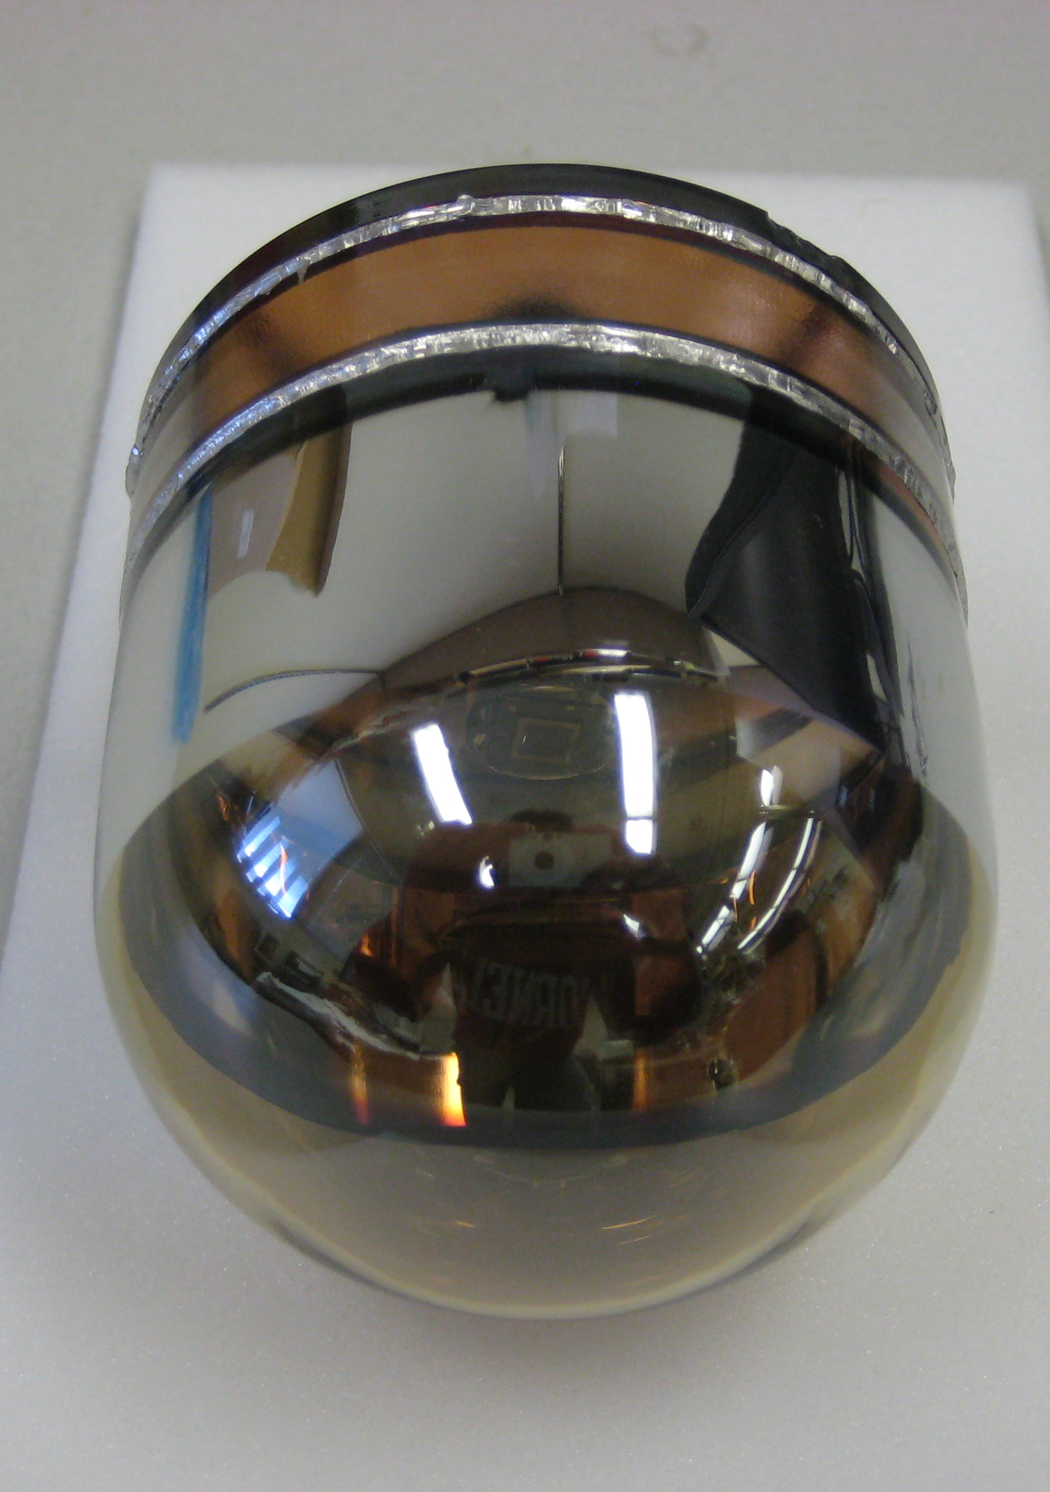
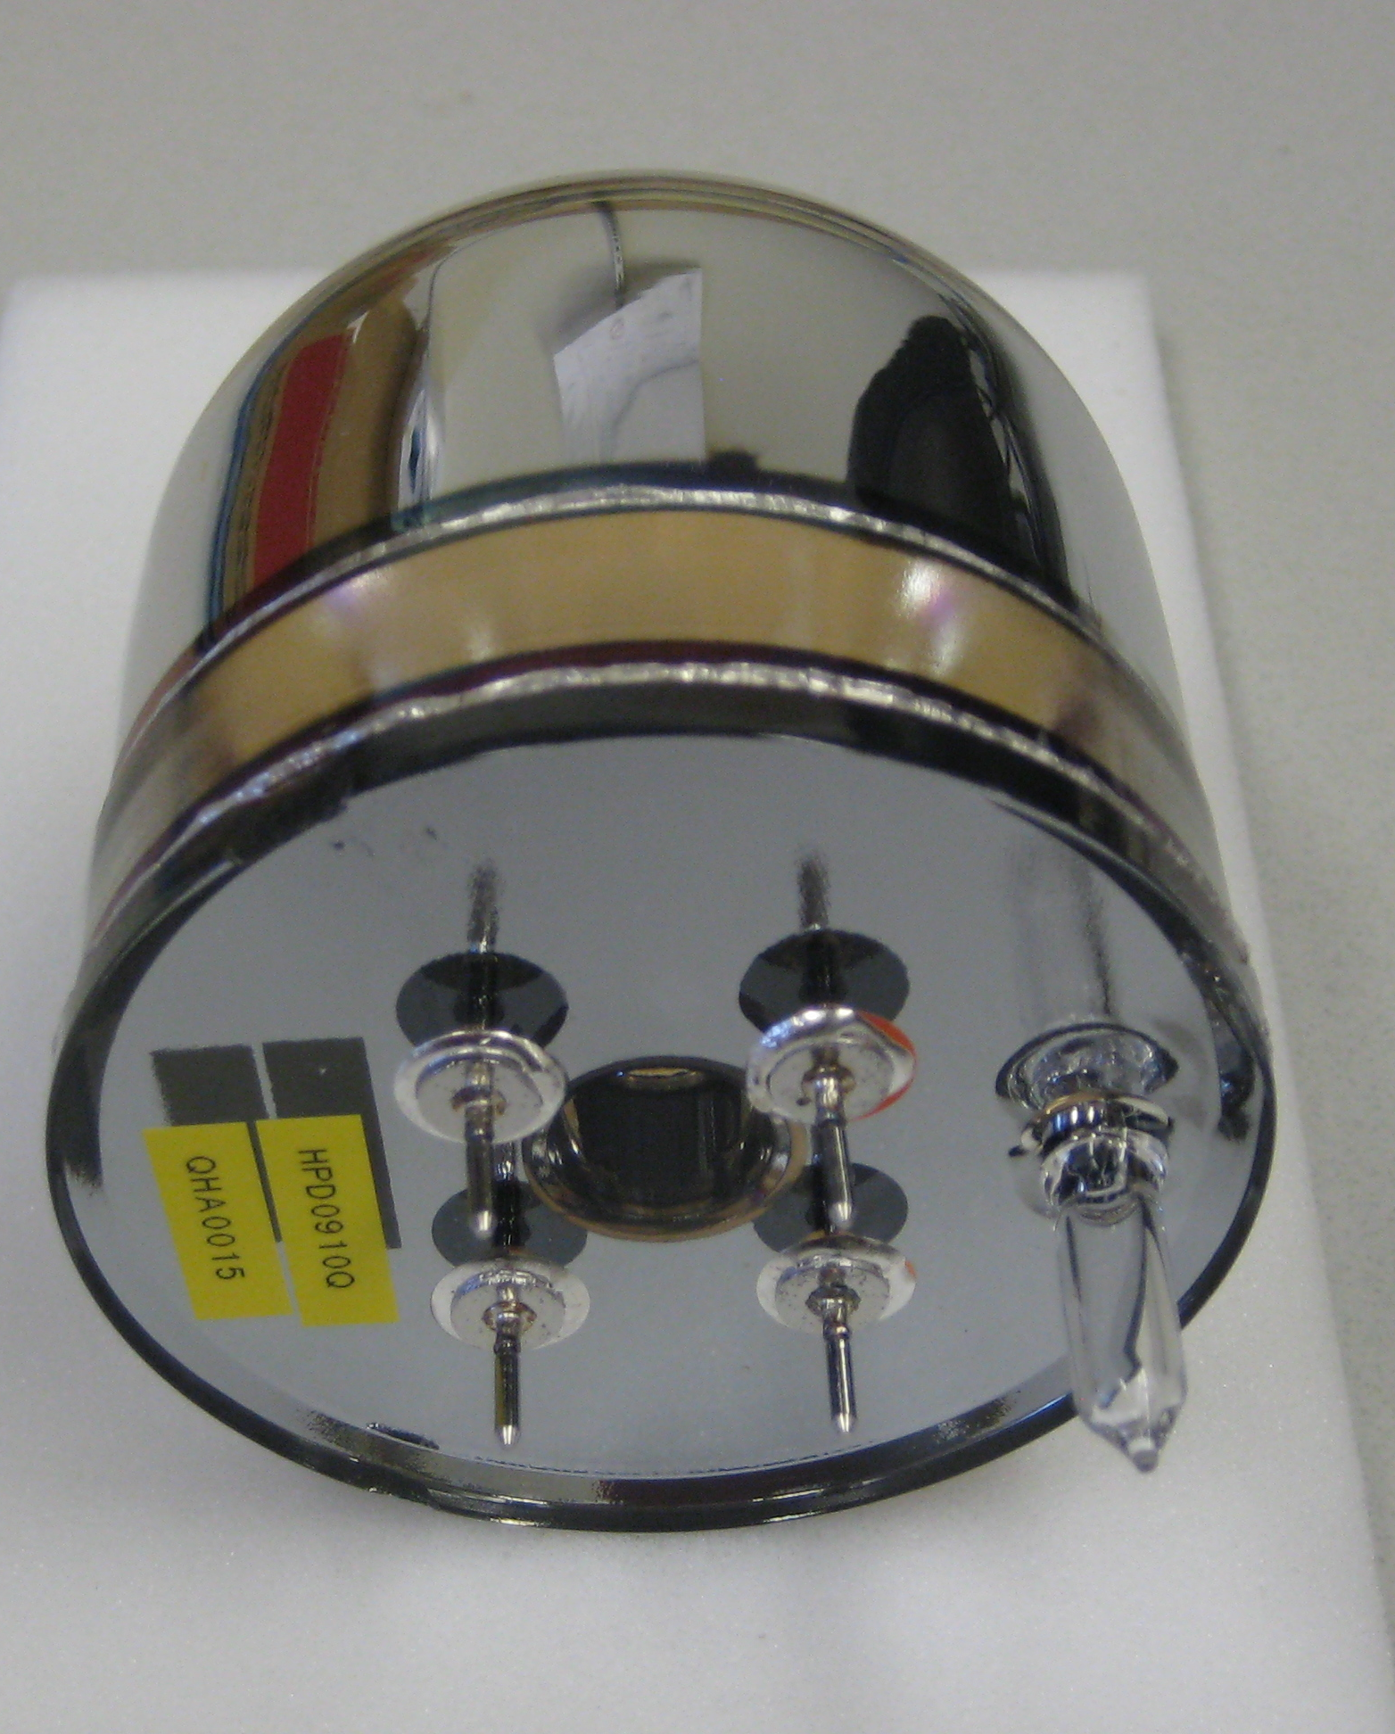
New 3” QUPID (Production Version)

Slide 26
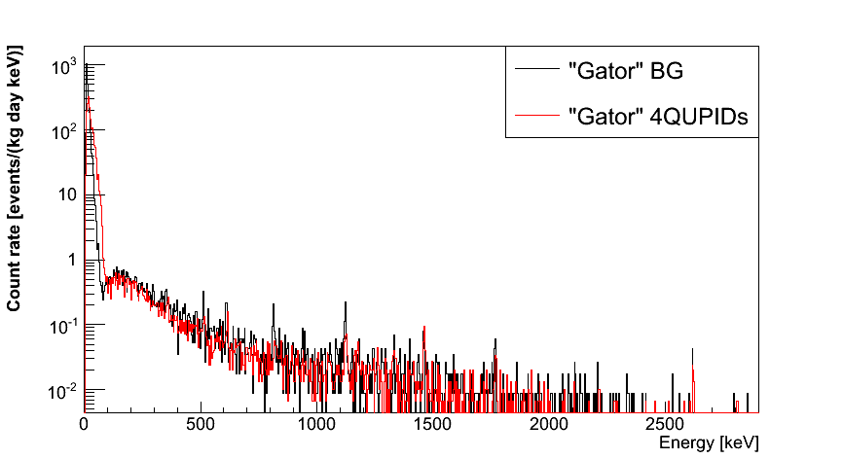
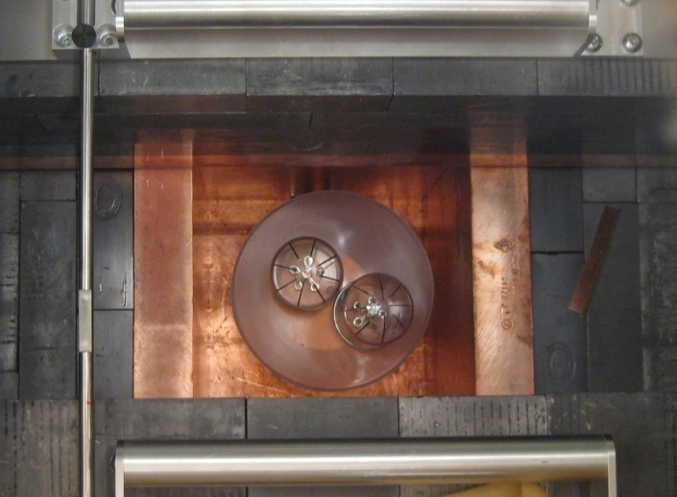
Spectrum of QUPIDs and Background (4 QUPIDs x 1 month data)
 | 90% CL
²³⁸U | < 0.36 mBq
²³²Th | < 0.30 mBq
⁶⁰Co | 0.12 ± 0.06 mBq
⁴⁰K | < 1.96 mBq
No QUPID
4 QUPIDs
11/18/12
Katsushi Arisaka, UCLA
26

Slide 27
Quantum Efficiency (QHA63, 64)
Xenon
11/18/12
Katsushi Arisaka, UCLA
27

Slide 28
Cathode current with -5% non-linearity
QUPID
R8778
R8520
Argon
Xenon

Slide 29
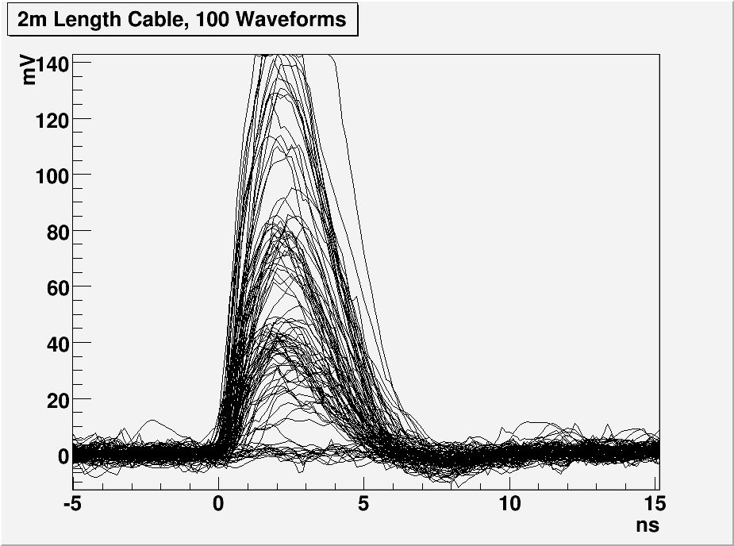
1, 2 and 3 PE Distribution with 2m cable
G = 800 × 200
= 160,000
3 PE
2 PE
1 PE

Slide 30
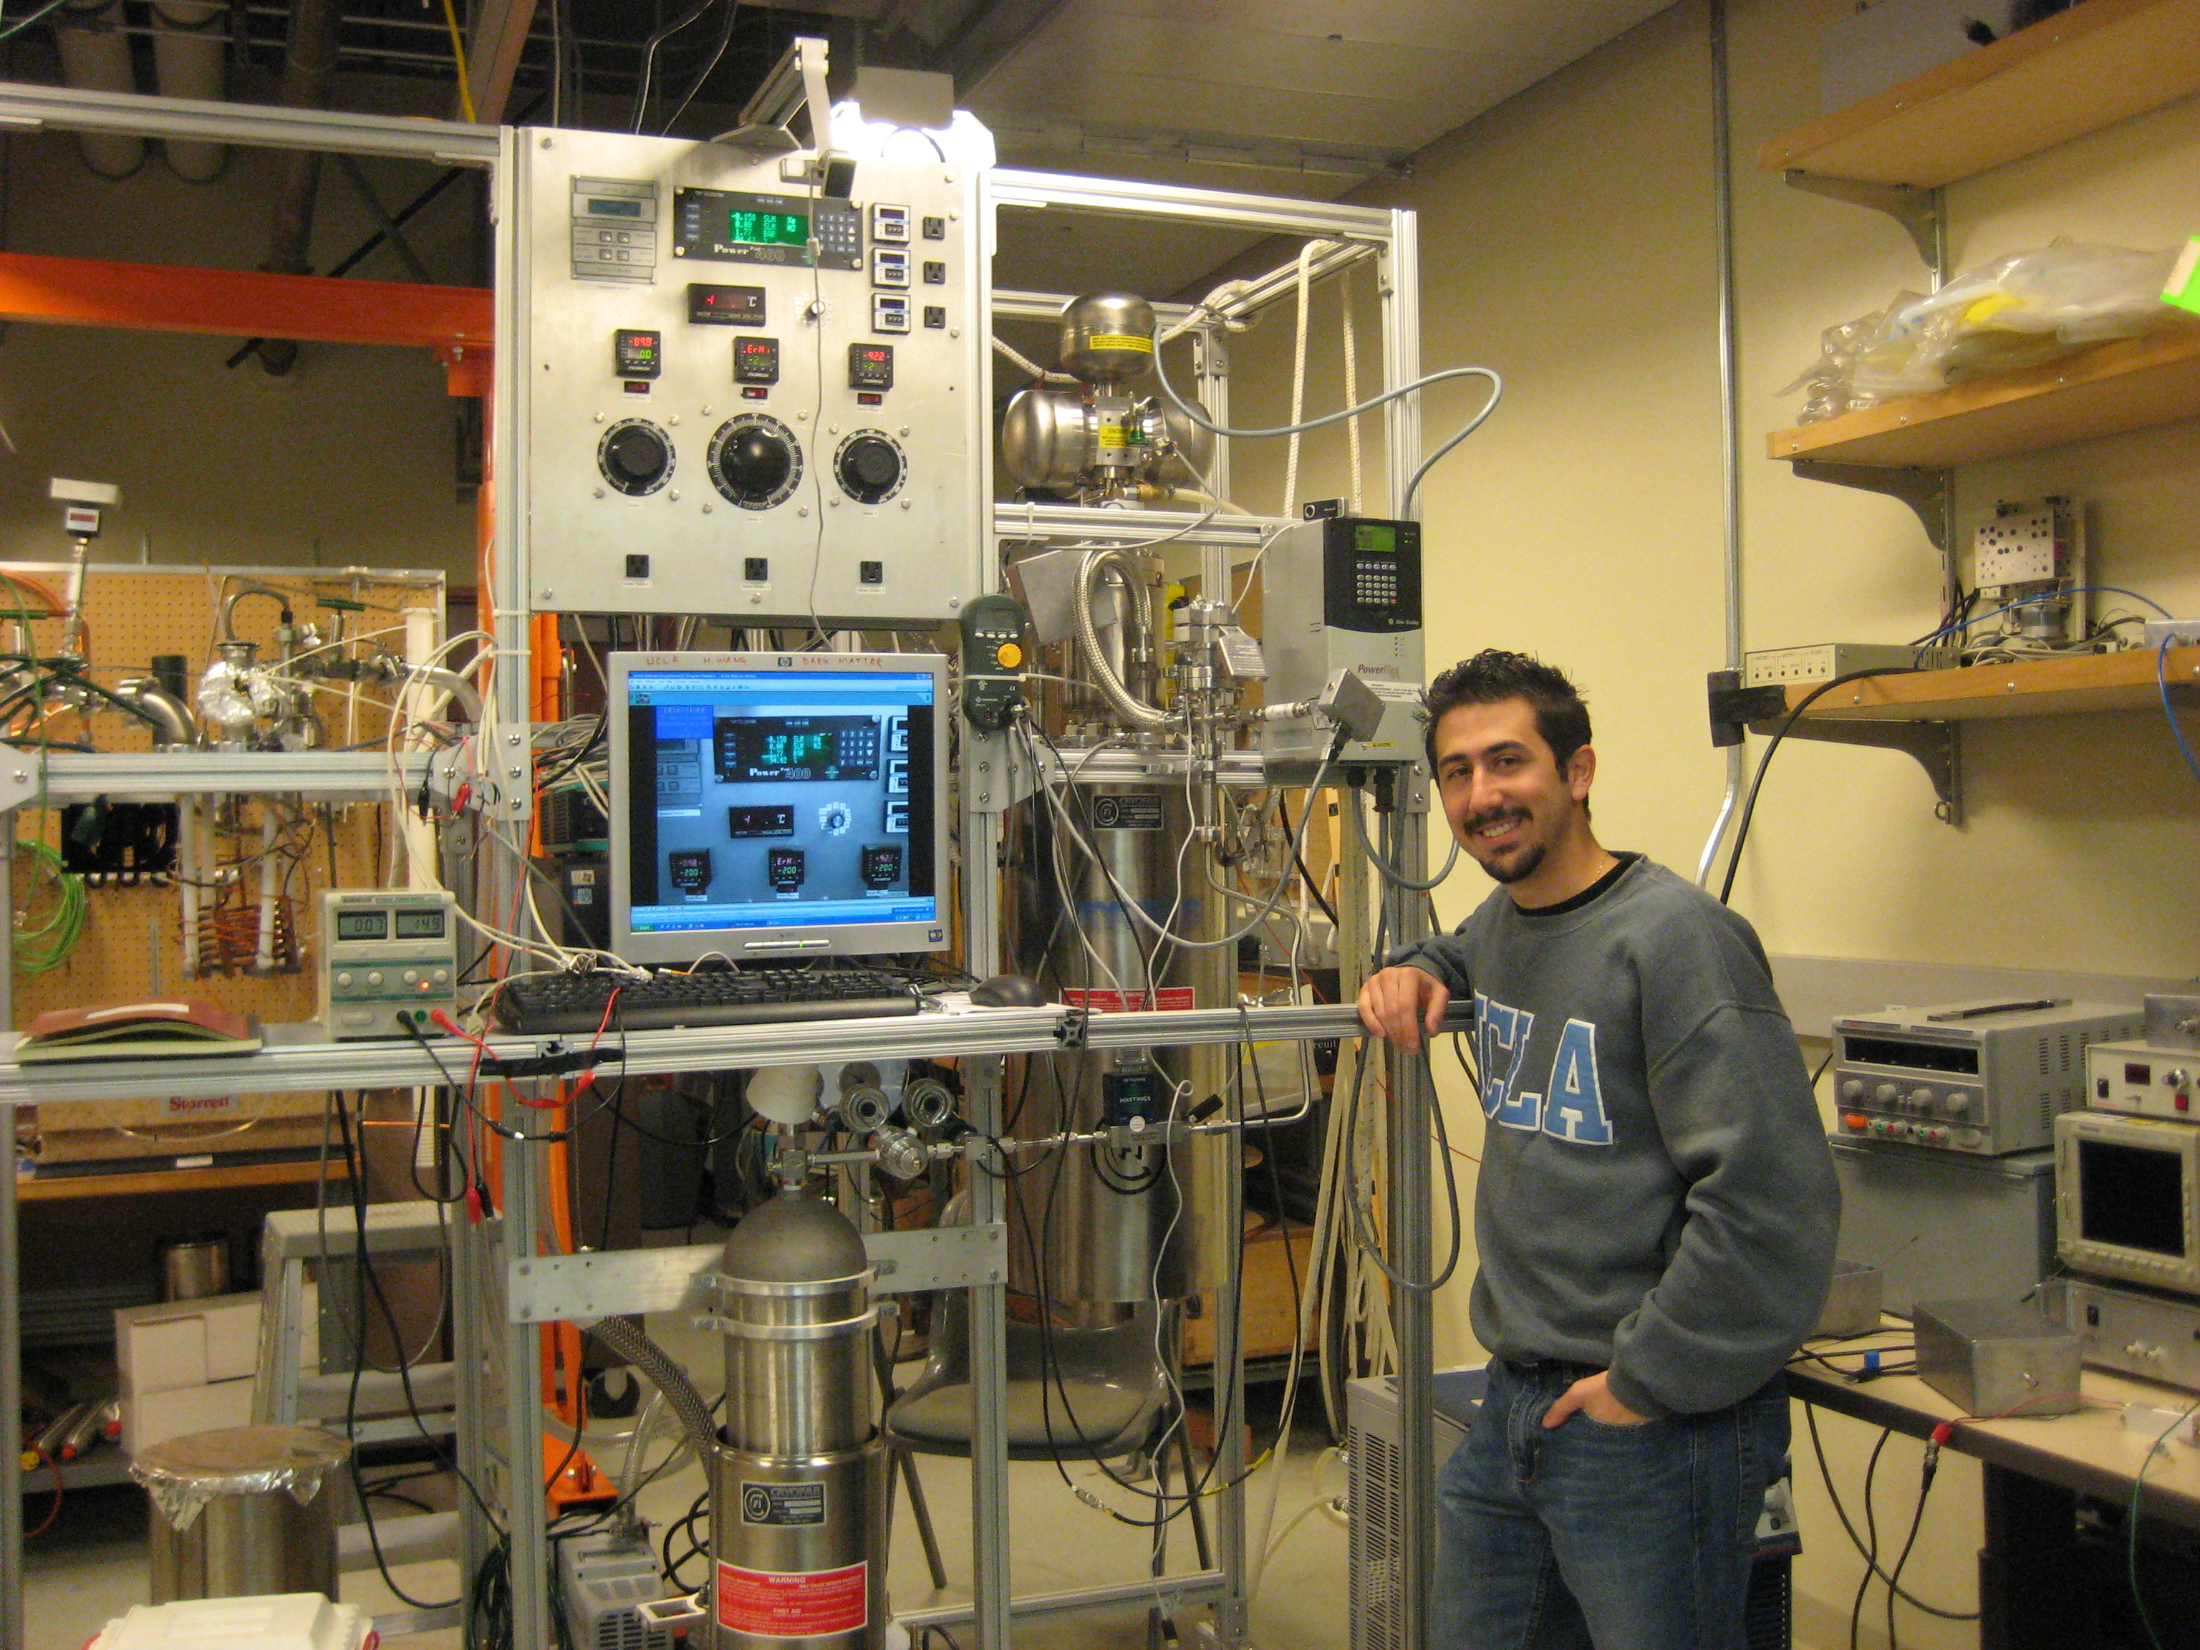
Cryogenic System at UCLA (Hanguo Wang’s Lab)
Liquid Xe
Nitrogen
Artin Teymourian

Slide 31
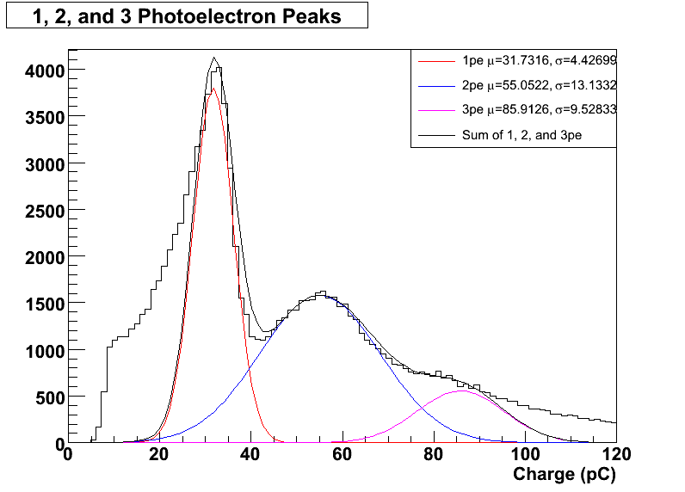
The first Scintillating lights detected by QUPID from ⁵⁷Co in Liquid Xenon
1 PE
Threshold
2 PE
3 PE

Slide 32
Summary of QUPID
Extremely low radioactivity: < 1 mBq
< 0.1 neutron / year
< 10 times lower than conventional low radioactive PMTs.
Large diameter: 3 inch
Special Photocathode: Bialkali LT
46 % QE at 178 nm
Low resistivity even at Liquid Ar temperature (- 185 ºC)
True photon counting.
1, 2, 3… photoelectron peaks clearly visible.
100% collection efficiency.
Simple HV supply.
Common HV (-6 kV) for all QUPIDs
Resister chain not necessary
Successful operation in Liquid Xenon at UCLA

Slide 33
Conclusions
MAX + LZD = “G3”
Xenon 10 Ton + Argon 50 Ton (Fiducial)
3” QUPID at top/bottom only
Physics sensitivities:
~ 5 events / year / detector, if 100 GeV,10⁻⁴⁷ cm²
Mass and Cross Section by Energy Spectrum
WIMP Velocity by Annual Modulation
QUPID development nearly complete
> 45% QE by new photocathode
Operation in Liquid Xenon/Argon underway

