Slide 1
Why are we here?
Origin of the Universe and Life
Prof. Katsushi Arisaka
University of California, Los Angeles
Department of Physics and Astronomy
arisaka@physics.ucla.edu

Slide 2
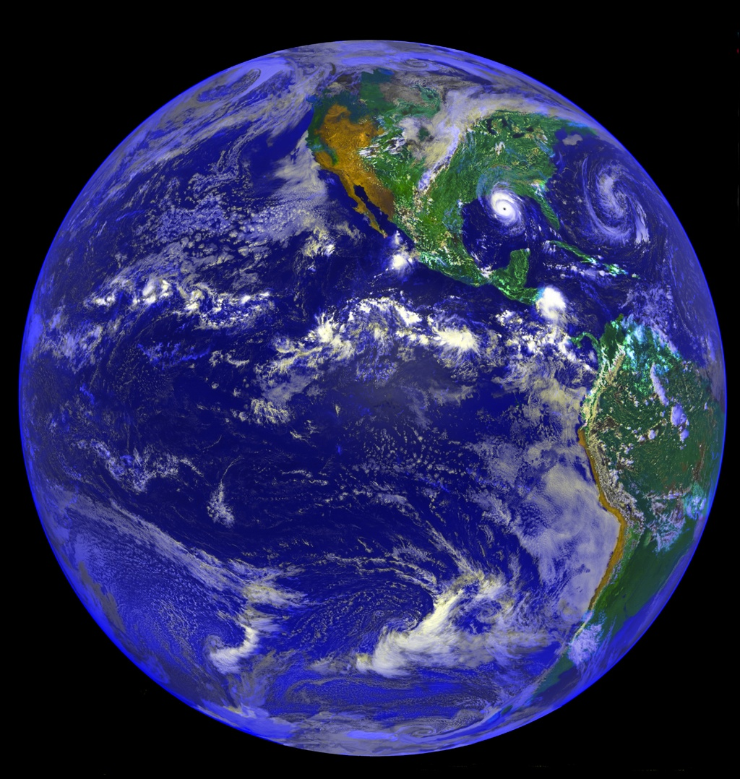
Why are we here?

Slide 3
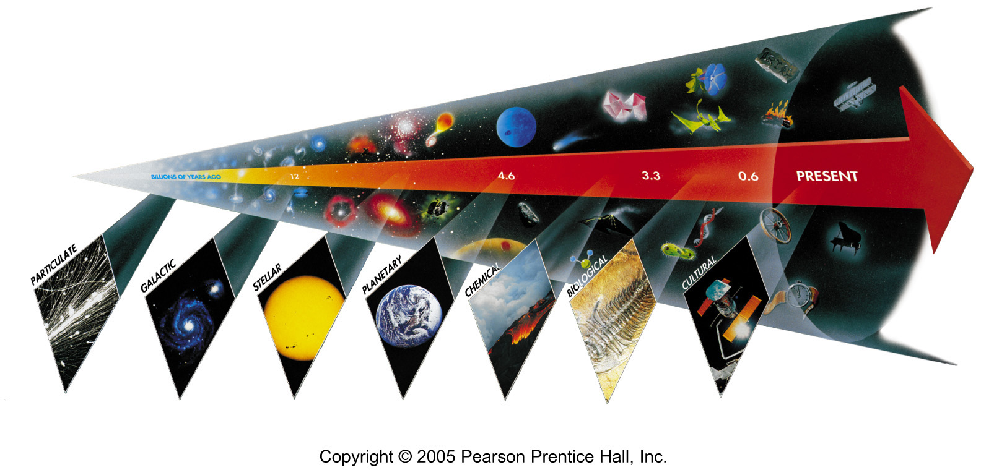
Seven Phases of Cosmic Evolution
14 billion years ago
Origin of
Particles
Origin of
Structure
Origin of
Life
Origin of
Consciousness

Slide 4
Talk Outline
Prof. Katsushi Arisaka 2:00 – 3:20
  Origin of Universe - Cosmology
  Origin of Particles - Particle Physics
  Evolution of Universe - Astronomy
Daniel Aharoni 3:30 – 5:00
  Origin of Life - Molecular Biology
  Origin of Consciousness - Neuroscience

Slide 5
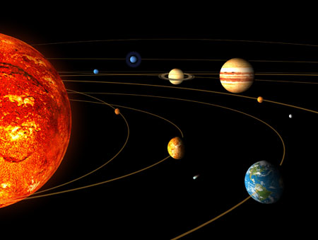
v
Solar System
Sun
Earth

Slide 6
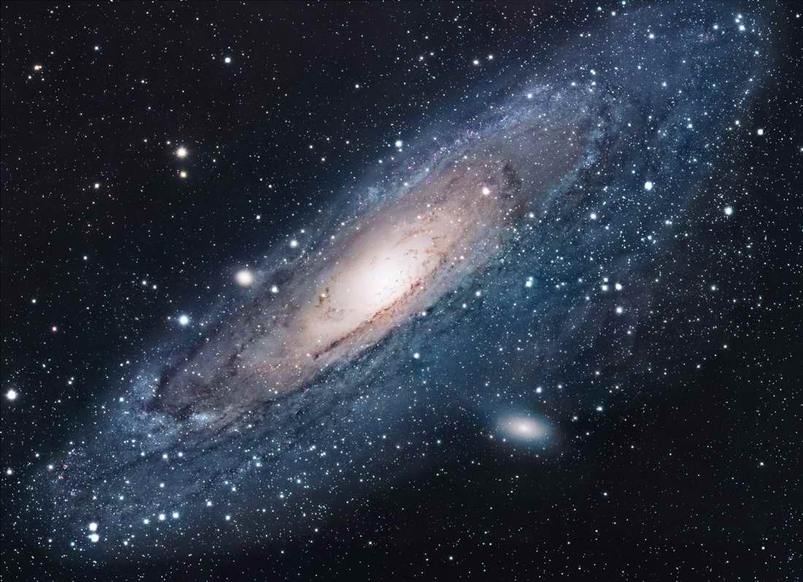
Andromeda
~100 Billions Stars in a Galaxy

Slide 7
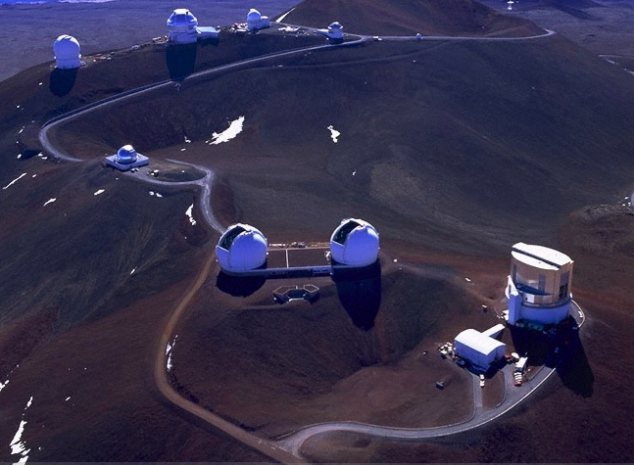
Keck Telescope
Mauna Kea at Hawaii (4200m)
Subaru Telescope

Slide 8
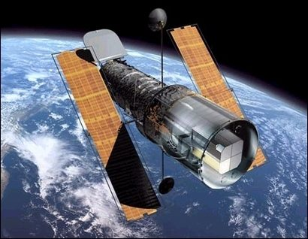
Hubble Telescope

Slide 9
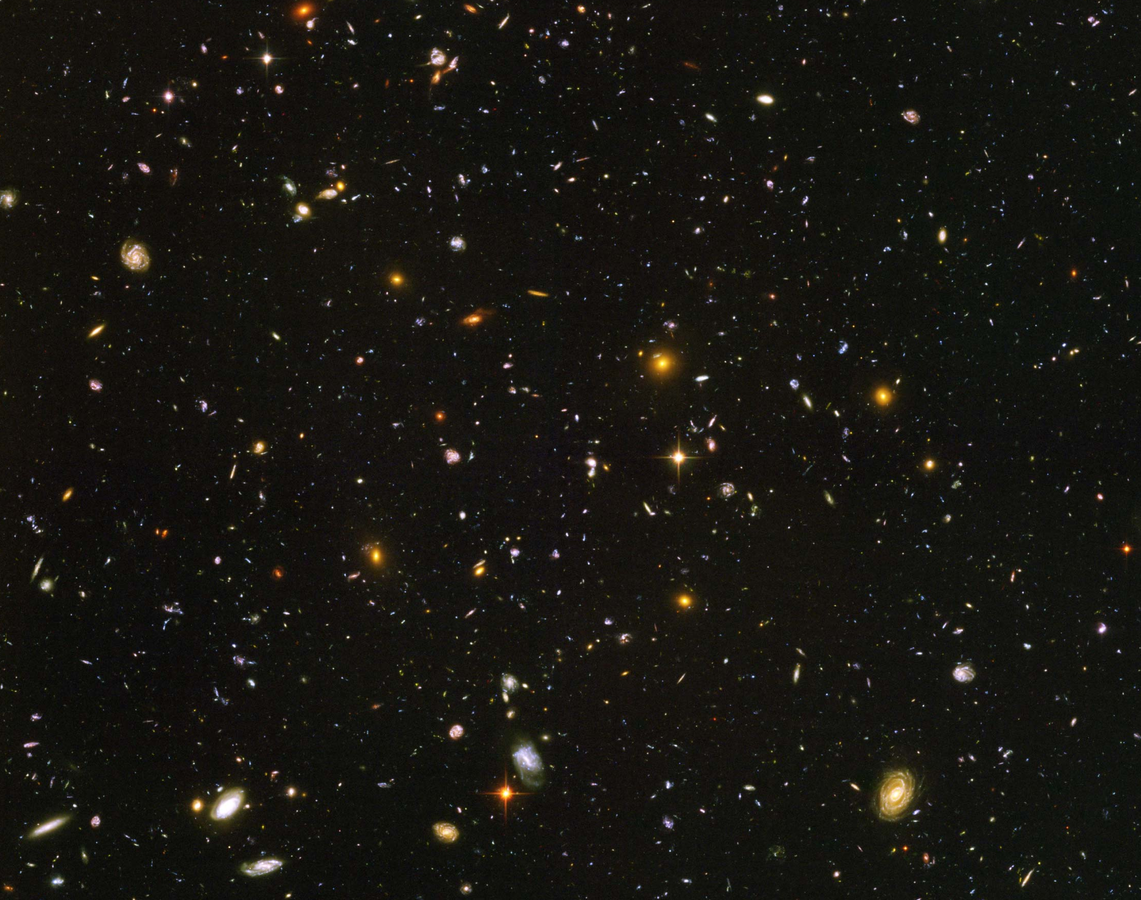
Hubble Deep Field
~100 Billion Galaxies

Slide 10
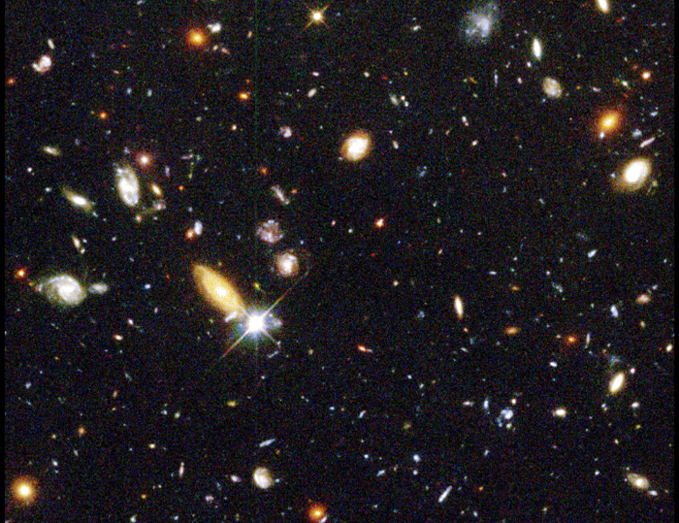
13 billion light years away
(90% of speed of light)

Slide 11
Hubble’s Law:
Expansion of the Universe
Horizon
of Universe
Big Bang!
Sun/Earth
14 Billon
Light Years
Moving Away
at Speed of Light

Slide 12
Expansion of Universe
Size
Size of Universe
Beginning
Today
Time

Slide 13
Temperature of Universe
Temperature
Temperature = 1/Size
2.7ºK
Beginning
Today
Size

Slide 14
Particle Physics
Purpose:
  To understand the most elementary particles in nature.
  To understand the most fundamental physics laws = interaction among elementary particles.
How?
  Study the shortest distance = The highest energy (= the highest temperature)
The best way to understand the earliest stage of the Universe

Slide 15
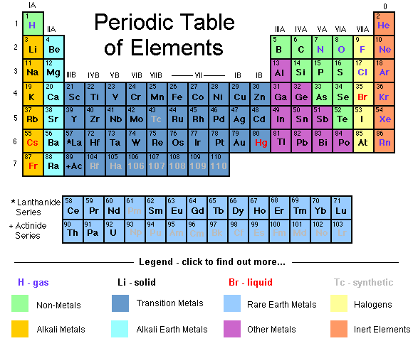
Periodic Table of Elements (1900)

Slide 16
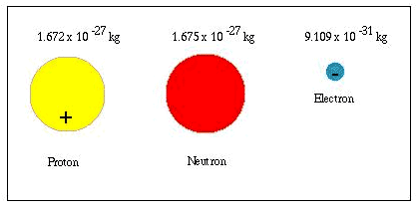
Elementary Particles (1930)
Electron
Proton
Neutron
Avogadro Number = 1 g / 1.762 x 10⁻²⁷ kg = 6 x 10²³

Slide 17
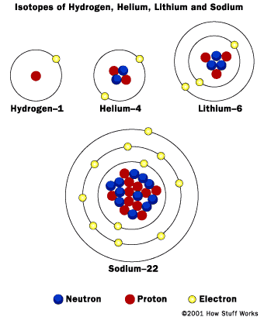
Atoms

Slide 18
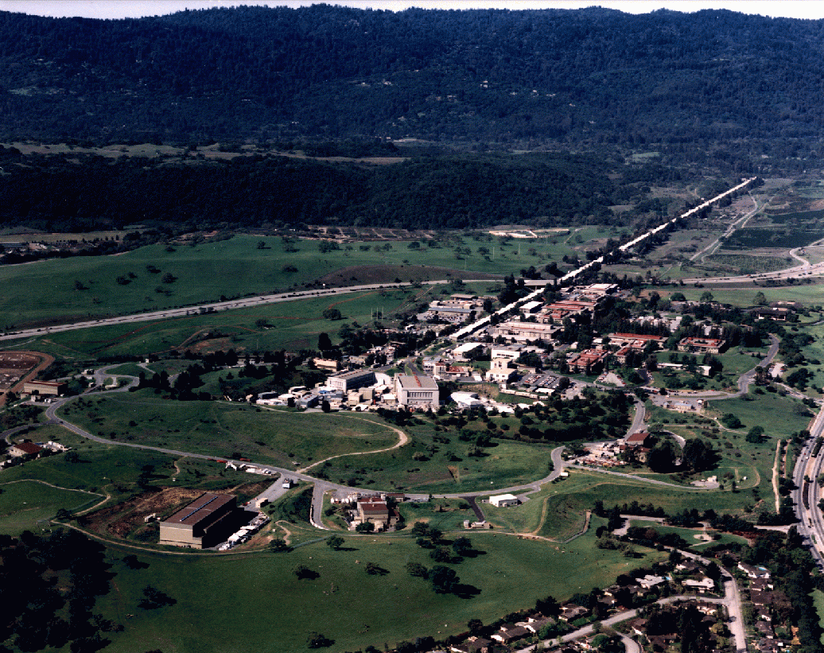
SLAC
(Stanford Linear Accelerator Center)
1 mile long
e⁺ + e⁻

Slide 19
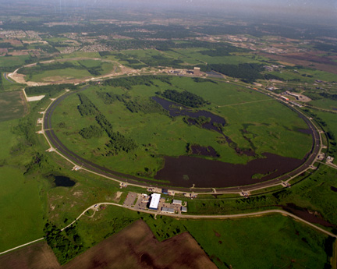
Fermi Lab near Chicago
6km Circumference
1+1=2 TeV
p + p⁻

Slide 20
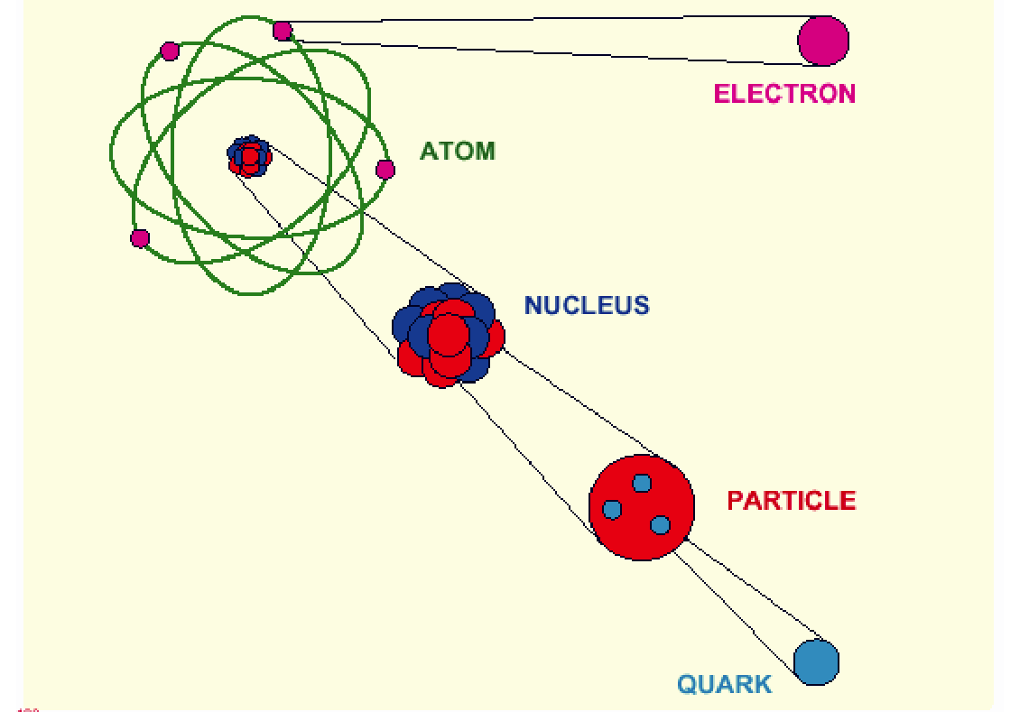
Elementary Particles (1970)
10⁻¹⁰ m
10⁻¹⁴ m
Proton, Neutron
10⁻¹⁵ m
< 10⁻¹⁸ m

Slide 21
Quark Model
Proton
Neutron
u
u
u
d
d
d
+ 2/3 + 2/3 – 1/3 = 1
+ 2/3 – 1/3 – 1/3 = 0

Slide 22
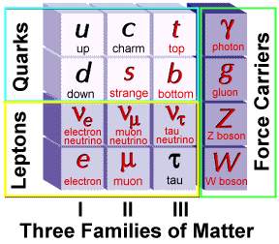
Elementary Particles (2000)
Charge
+2/3
-1/3
0
-1
Fermion Boson
Charge
0
0
0
±1
+ Anti-particles

Slide 23
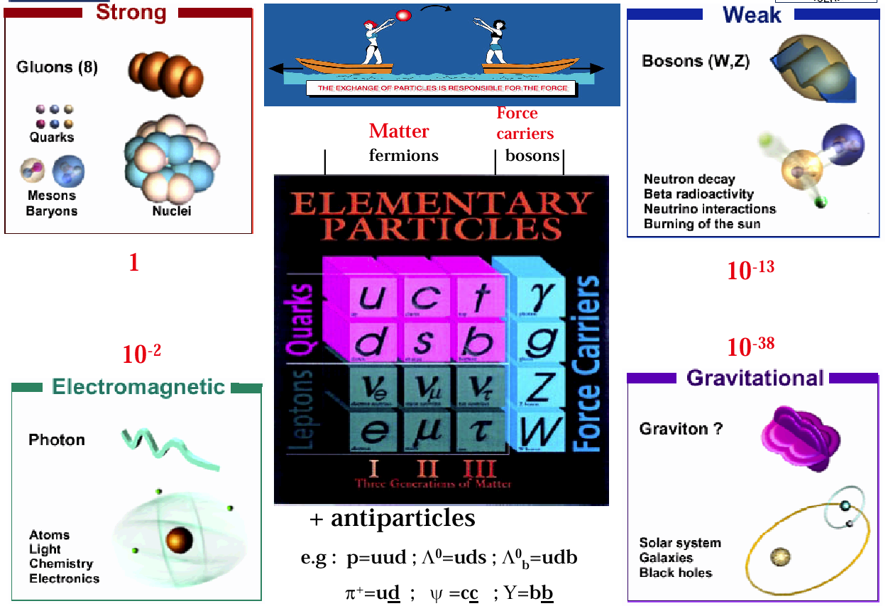
Elementary Particles and Forces

Slide 24
Power of Electric Force
Electric Force is responsible for
  Electrons’ trajectory around a nuclei
  Molecular structure
  Structure of any life (like your body), building, bridge etc…
    Structure of anything larger than a nuclei but smaller than the mountain.
  How your brain works
  Mechanism behind computer, TV, car etc…
  …

Slide 25
Power of Gravity
Gravity is responsible for
  Your staying on the ground
  Trajectory of a ball
  Orbit of Satellite, moon…
  Formation of the solar system
  Formation of the Galaxy
  …
Gravity is very, very weak compared to Electric Force.
  N = (Electric force) / (Gravity) = 10³⁹

Slide 26
Power of Strong Force
Strong Force is responsible for
  Structure of the nuclei
    How protons and neutrons are bound together
  Nuclear fission
    Nuclear power plant
    Atomic bomb
  Nuclear fusion
    Sun’s energy

Slide 27
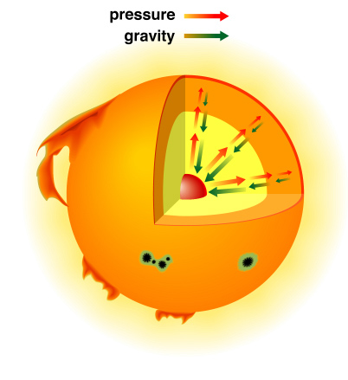
The Solar Interior
Hydrogen Gas

Slide 28
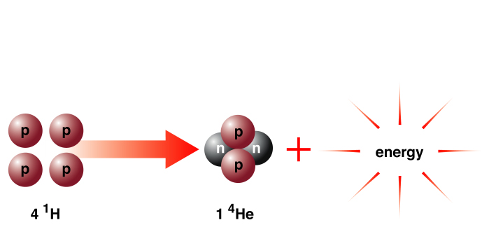
Solar Energy
E = mC²
m_{4p} > m_{He}

Slide 29
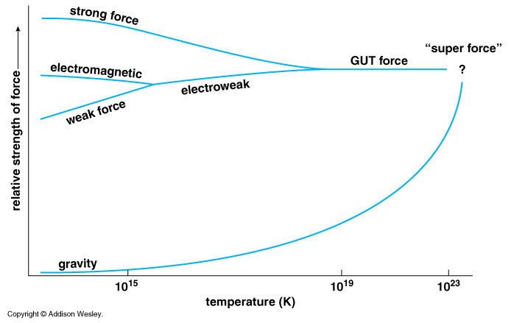
Unification of Forces
??
Electro-Weak Unification
100 GeV
10¹⁶ GeV
10¹⁹ GeV
10²⁹
10³²

Slide 30
Unification of Forces
Grand Unification
100 GeV
10¹⁶ GeV
10¹⁹ GeV
10³²
10²⁹
10³²
10²⁹

Slide 31
Unification of Forces
Planck Epoch
100 GeV
10¹⁶ GeV
10¹⁹ GeV
10²⁹
10³²

Slide 32
Hubble Deep Field
Physicists’ View of Early Universe
Fiat lux
Let there be light

Slide 33
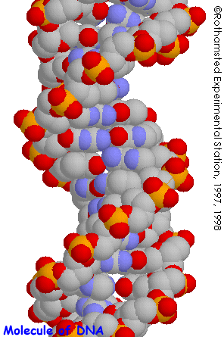
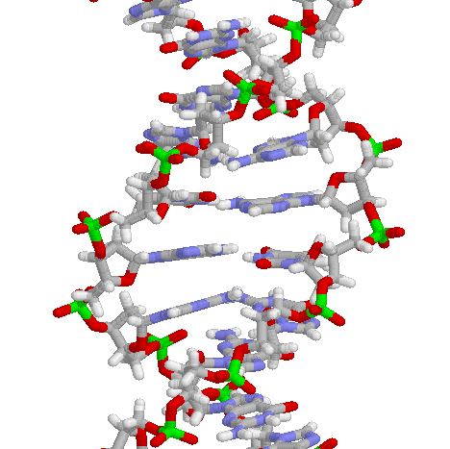
Structure of DNA

Slide 34
Symmetry Breaking
Time
0
Simple
1B years
2
3
4
b
s
µ⁻
W⁺
5
γ
c
Symmetry
Break Down
ν_{e}
τ⁺
d
6
d
Zº
τ⁻
ν_{e}
e⁺
e⁻
7
u
u
ν_{µ}
8
b
ν_{µ}
µ⁺
s
W⁺
c
9
10
11
12
Complex
13
14

Slide 35
The Beginning
Everything was the same ↔ Perfect symmetry.
  All the particles are the same as photons.
  All four forces are the same.
The Universe was 10 dimension.
  3 Space Flattened
  1 Time
  3 Strong Force
  6 2 Weak Compacitified
  1 Electro-Magnetic

Slide 36
Seven Phases of Cosmic Evolution
14 billion years ago
Origin of
Particles

Slide 37
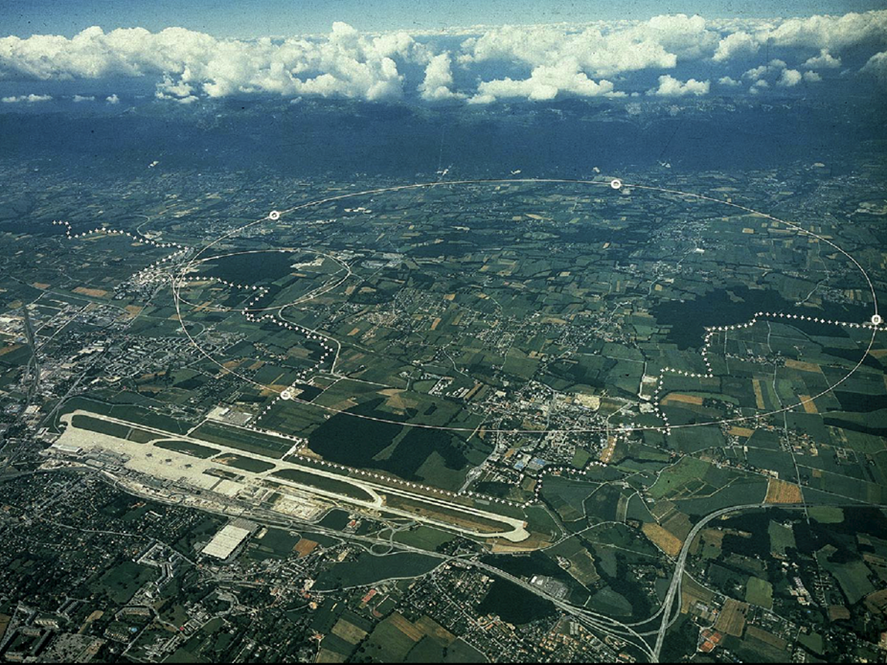
CERN and LHC in Geneva
27km Circumference
7+7=14 TeV

Slide 38
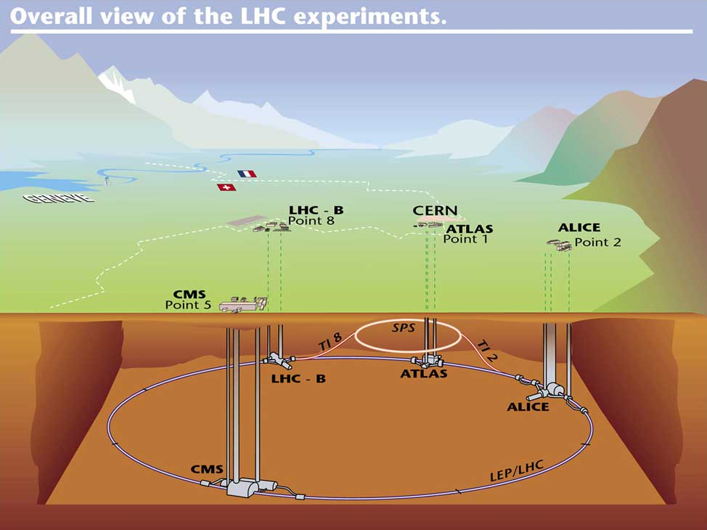

Slide 39
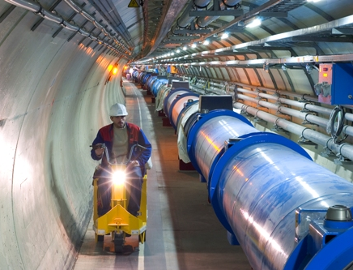
LHC Tunnel with Magnets

Slide 40
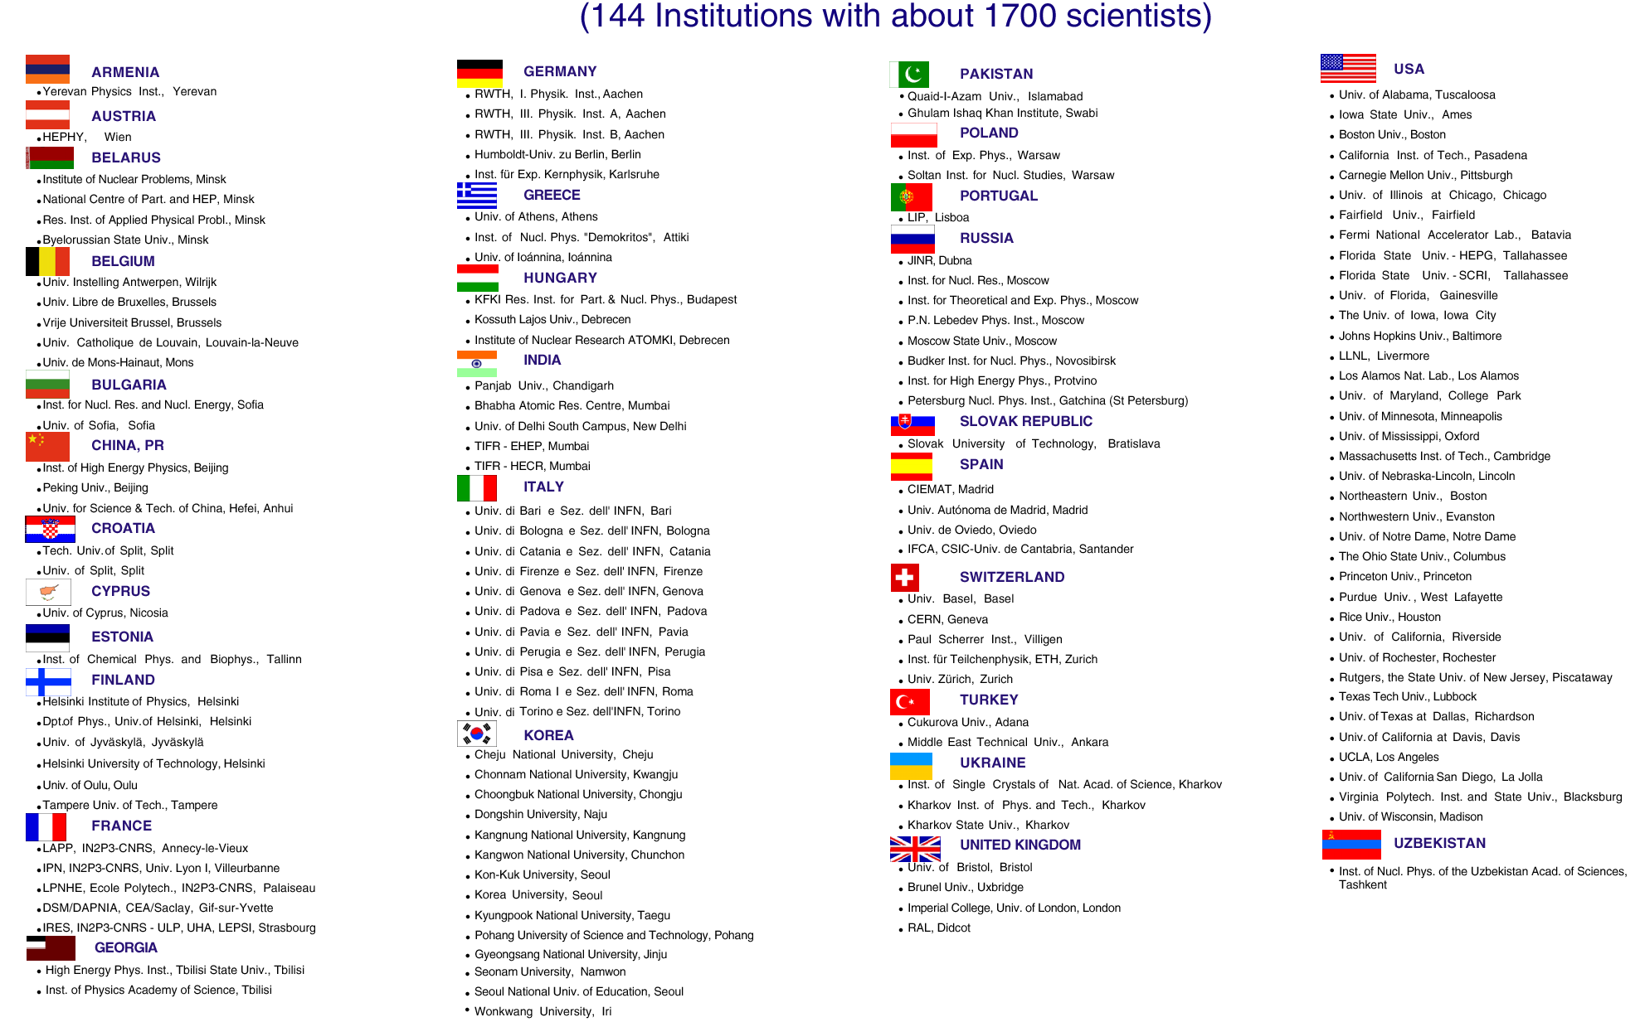
CMS Collaboration (1993 ~)

Slide 41
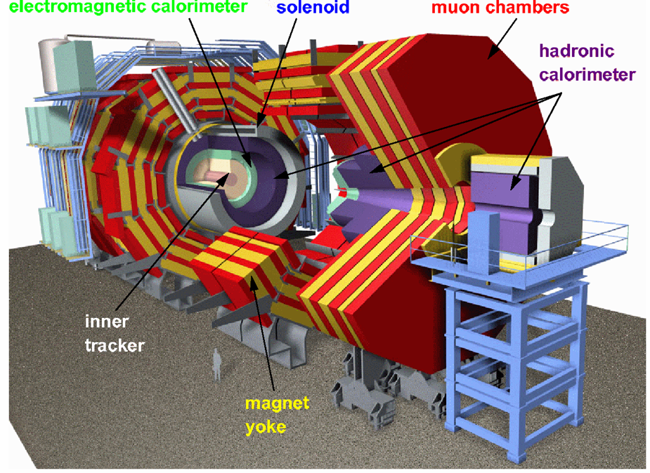
CMS

Slide 42
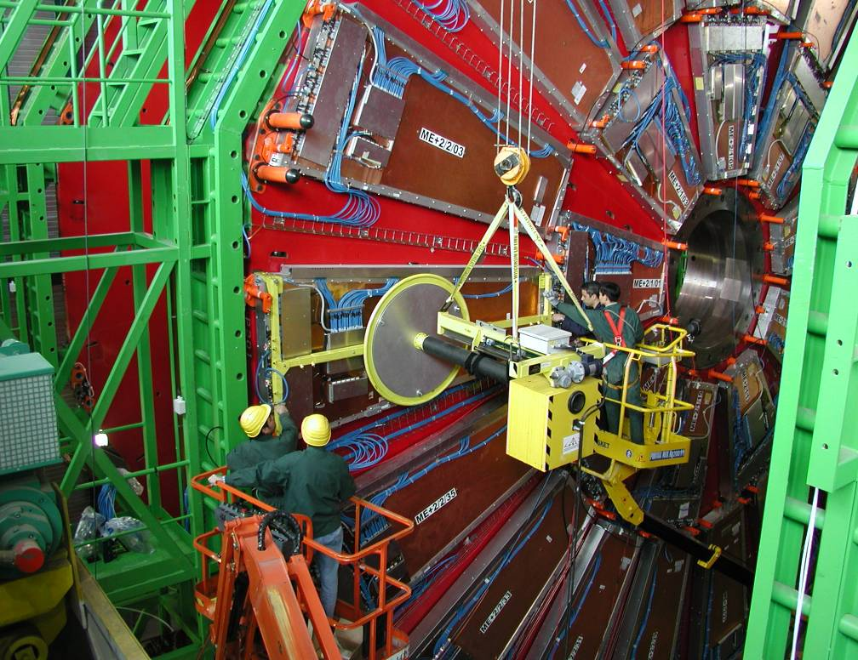
Installing muon Detectors

Slide 43
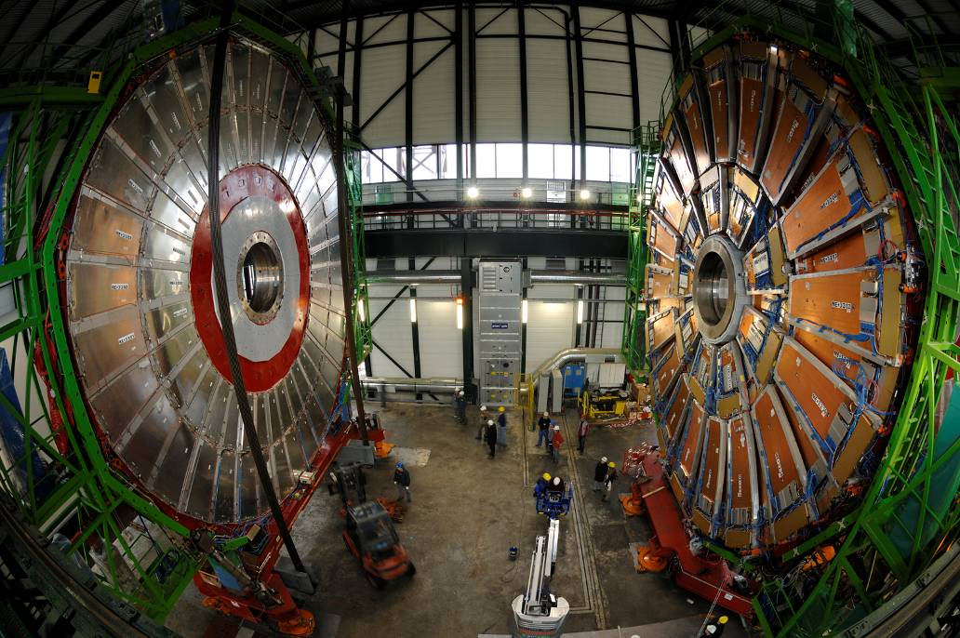

Slide 44
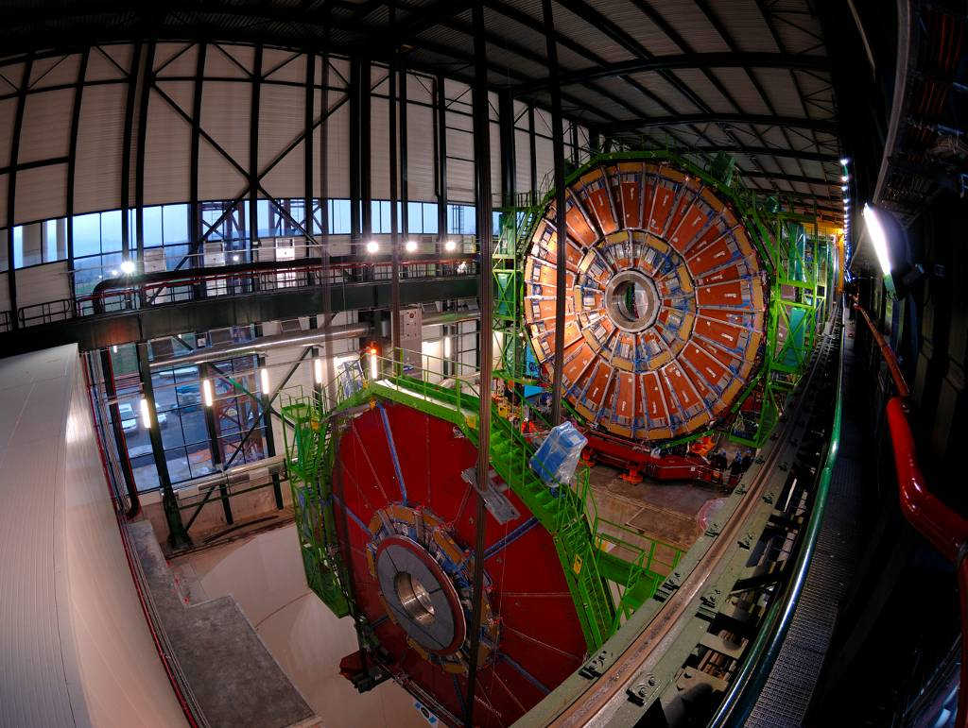

Slide 45
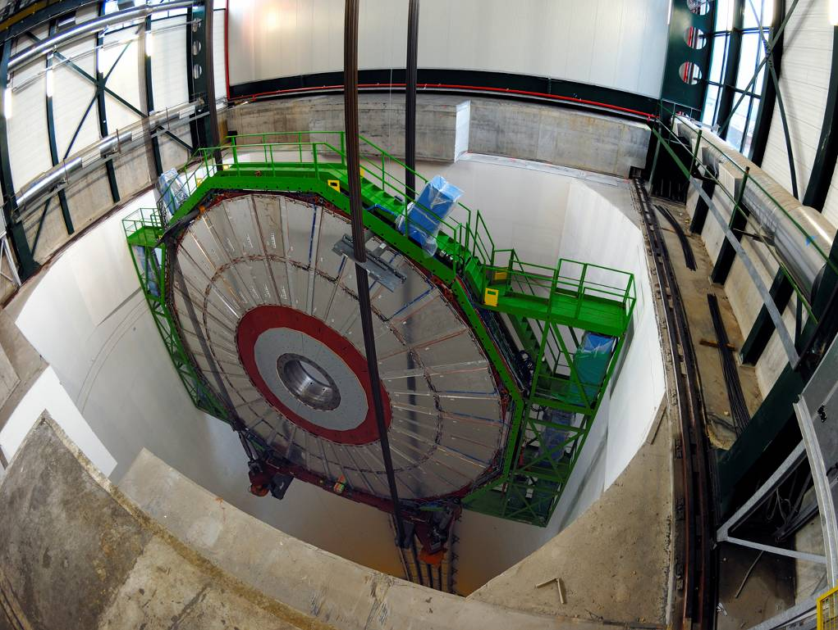

Slide 46
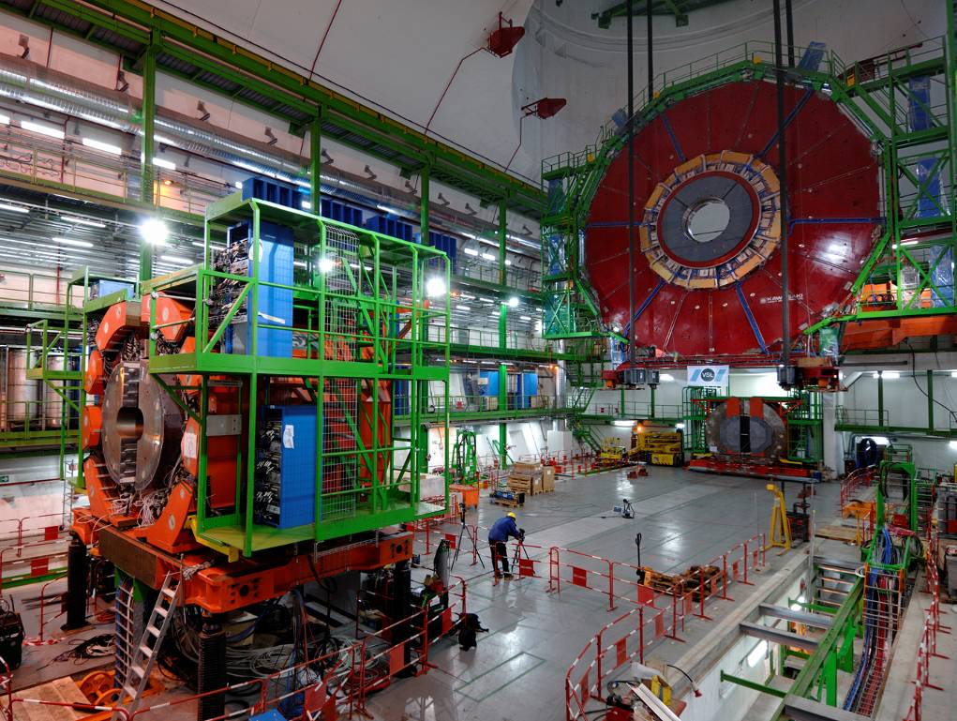

Slide 47
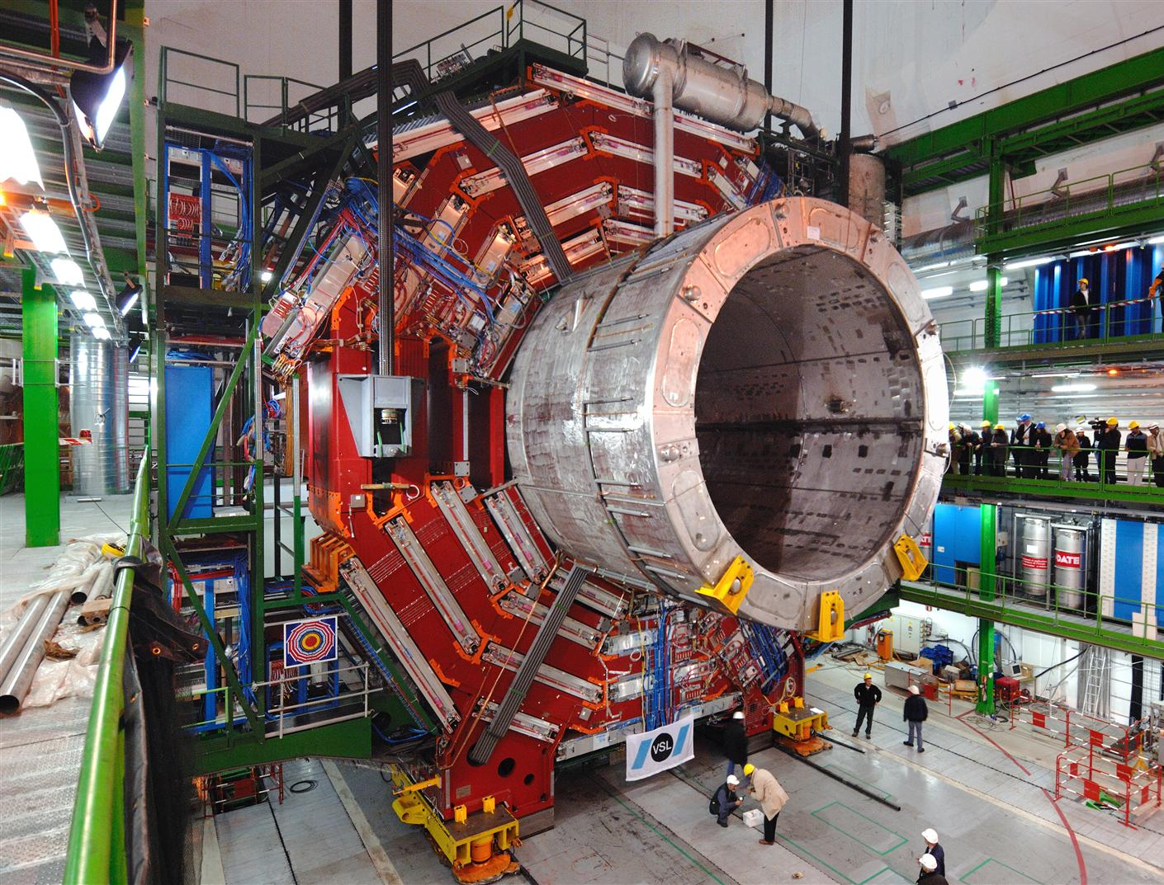

Slide 48
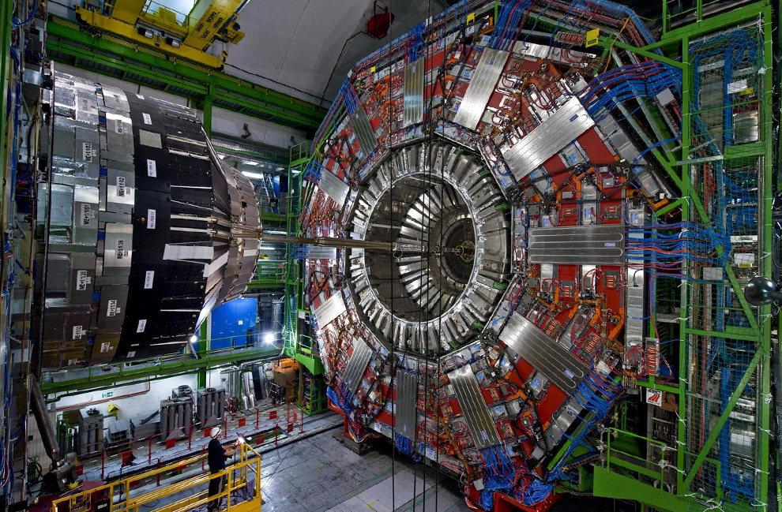

Slide 49
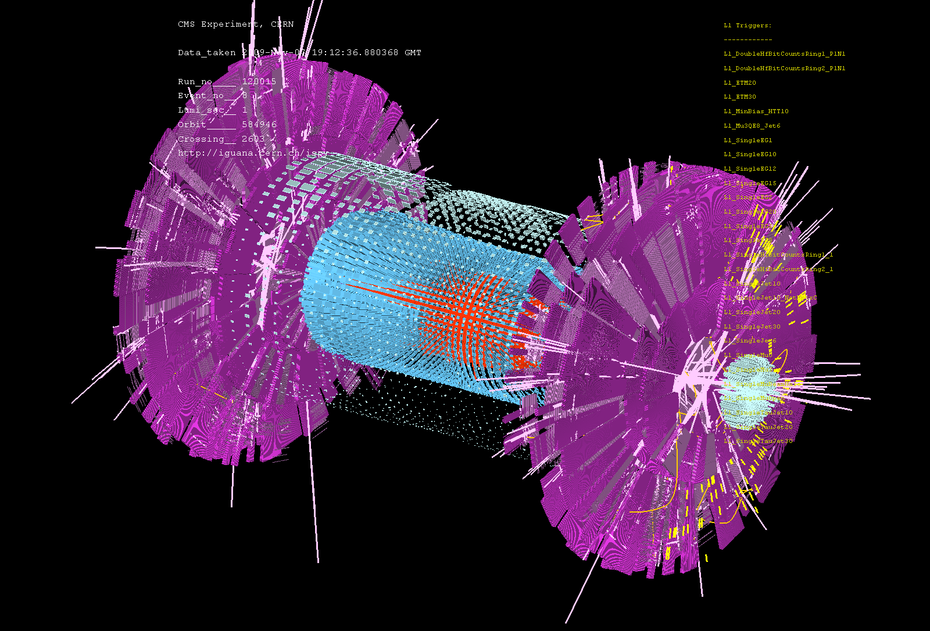
First Event at LHC – Recreation of the Big Bang! (Nov 7, 2009)

Slide 50
Seven Phases of Cosmic Evolution
14 billion years ago
Origin of
Particles
Origin of
Structure

Slide 51
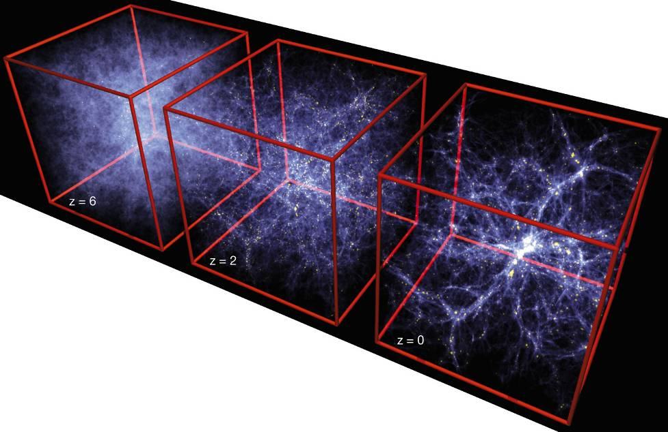
Formation of Structure in the Universe
Early Universe
Dark Matter is required!
Now

Slide 52
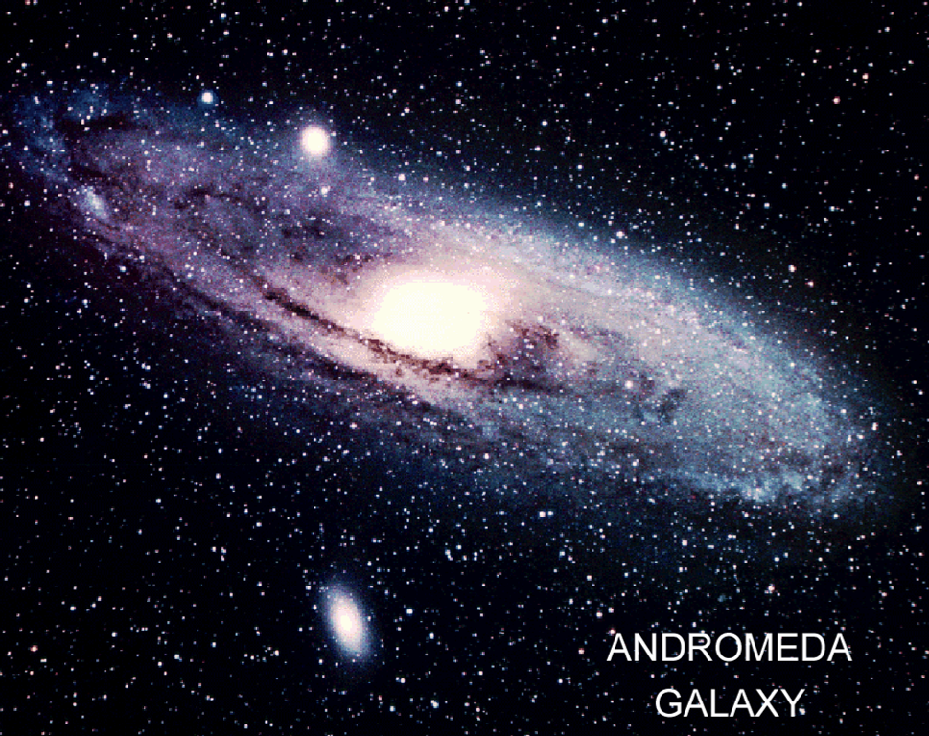
Dark Matter is required!

Slide 53
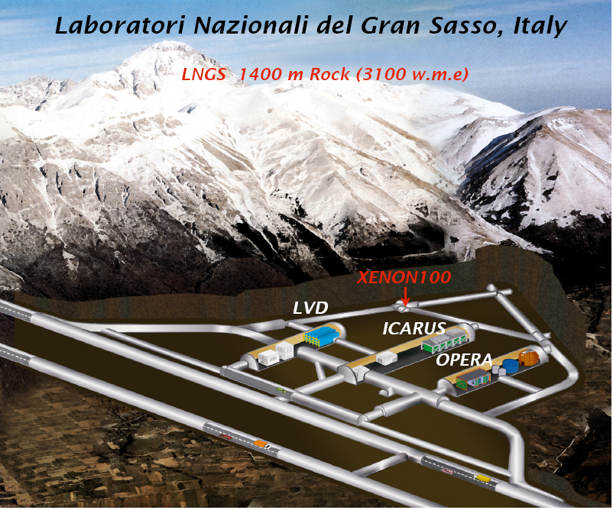
WARP

Slide 54
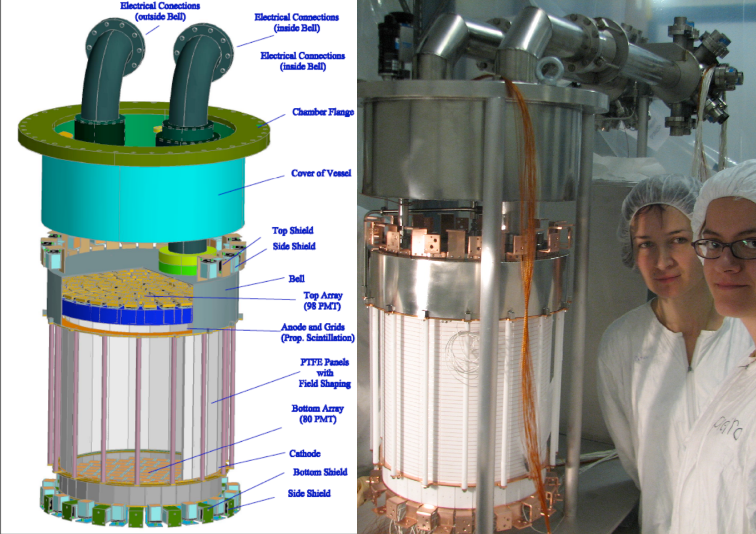
XENON100 Detector

Slide 55
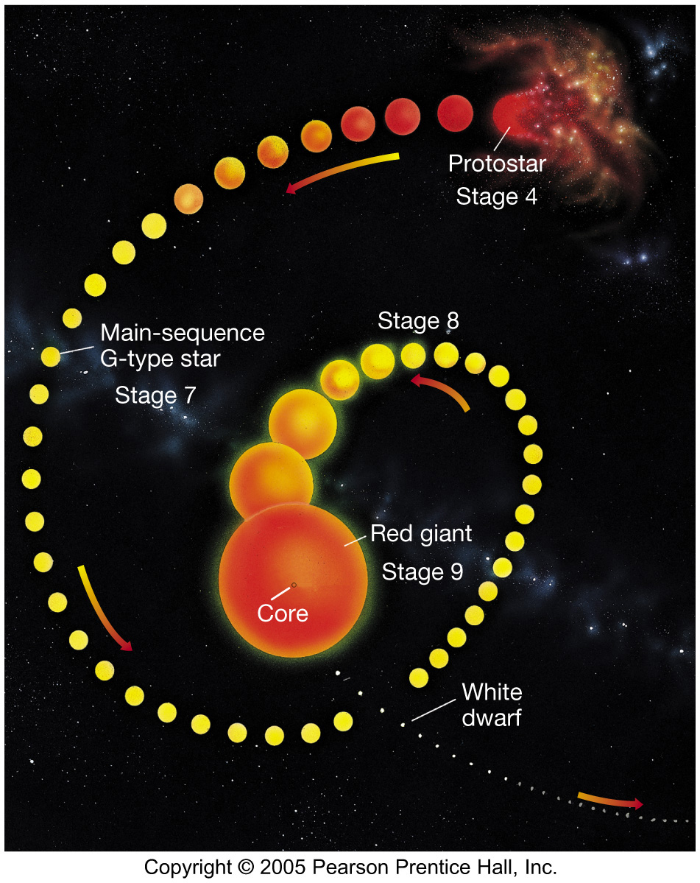
5
Evolution of a Star like Sun
4.6B years ago
Now
~5B years later

Slide 56
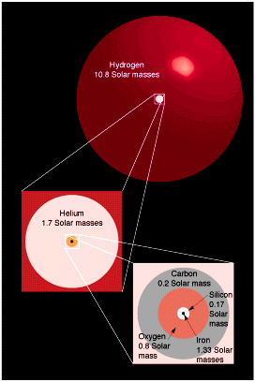
Nuclear Burning in High Mass Stars
(20 times solar mass star)
Hydrogen 10⁷ year
Helium 10⁶ year
Carbon 10³ year
Oxygen 1 year
Neon
Magnesium
Silicon 1 week
Iron < 1 day
Supernova explosion!

Slide 57
Origin of Elements
Hydrogen, Helium
  From “Big Bang”
Carbon – Oxygen – Iron
  From “Nuclear fusion” at massive stars (> 8 M_{sun} )
Heavier than Iron (Cu, Au, Pt, Pb…)
  From “Supernova”

Slide 58
We are made from “stardust”

Slide 59
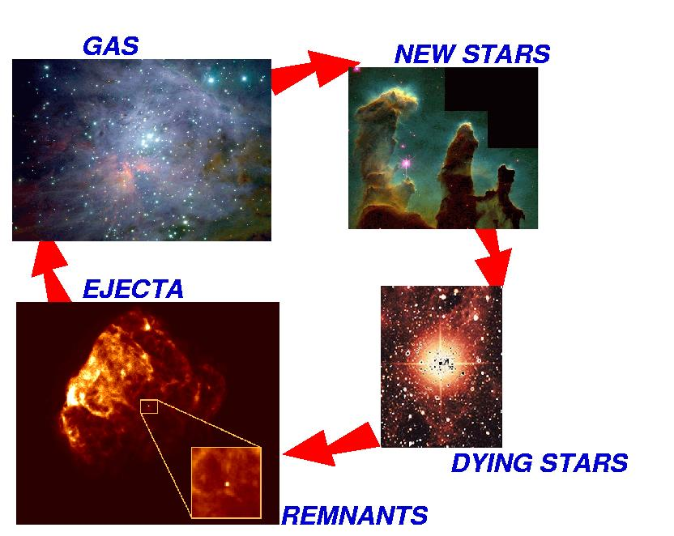
Star’s Life Cycle
Big Bang! (14 B years ago)
Sun (4.6 B years ago)

Slide 60
v
Solar System (4.6 B years ago)
Sun
Earth

Slide 61
Now we are here!

Slide 62
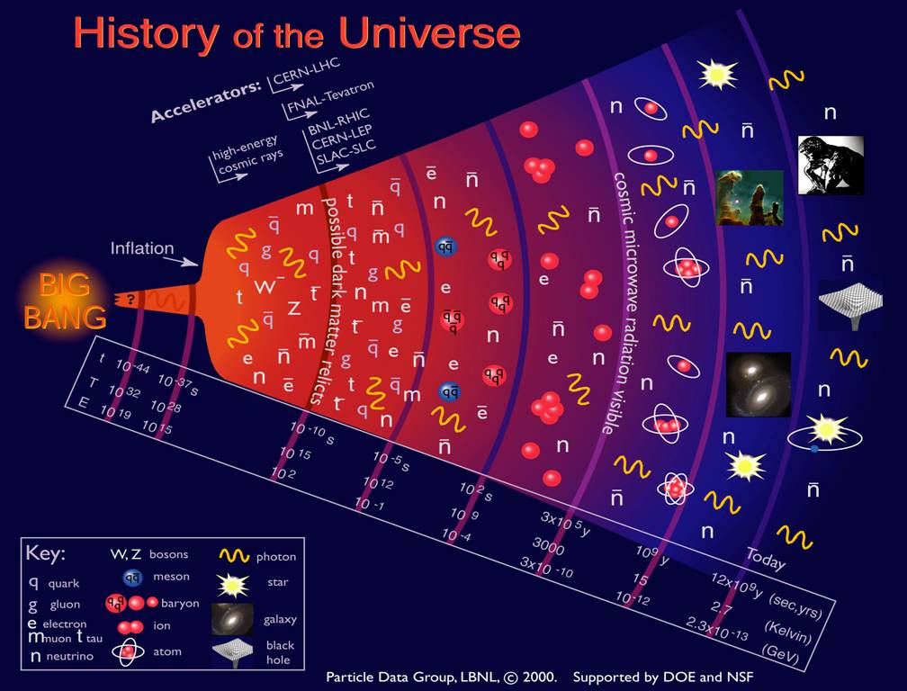

Slide 63
Are there more than
one Universe?

Slide 64
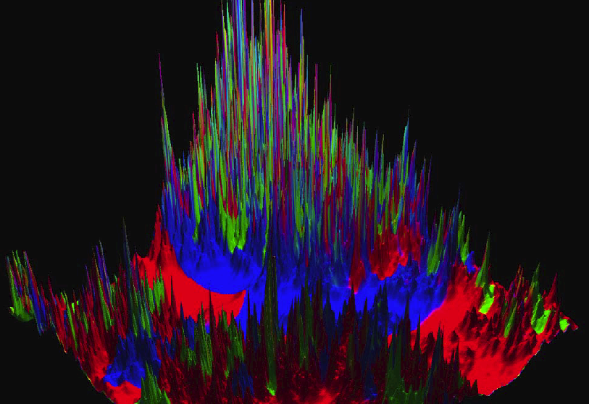
Linde’s Multiverse
by Chaotic Inflation

Slide 65
There may be ~100 Billion Universes.

Slide 66
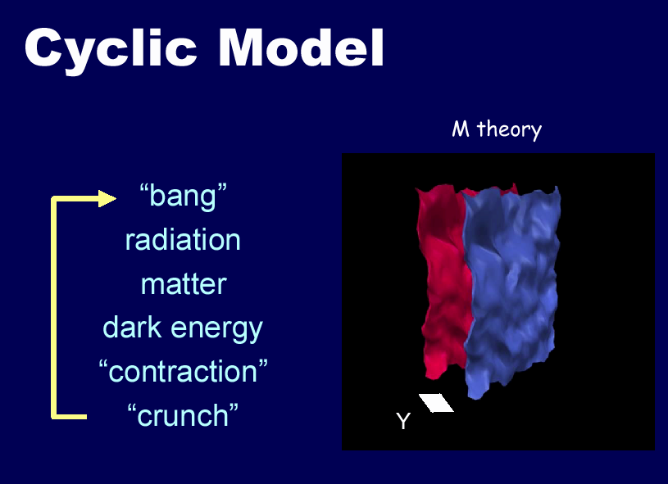
Shadow
Universe
Our
Universe

Slide 67
Seven Phases of Cosmic Evolution
14 billion years ago
Origin of
Particles
Origin of
Structure
Origin of
Life
Origin of
Consciousness

