Slide 1
Advanced Optical Microscopes and their Applications to Neuroscience
Katsushi Arisaka
(with Laurent Bentolila)
University of California, Los Angeles
Department of Physics and Astronomy

Slide 2
Outline
Introduction
Observations of Nature
Principle of Microscopes (Laurent Bentolila)
Advanced Microscopes
Super resolution (Laurent Bentolila)
High-speed
Applications to Neuroscience
High-speed motion and action potentials
Neural networks
Future directions
Voltage sensing dyes
Optical Excitation

Slide 3
Introduction

Slide 4
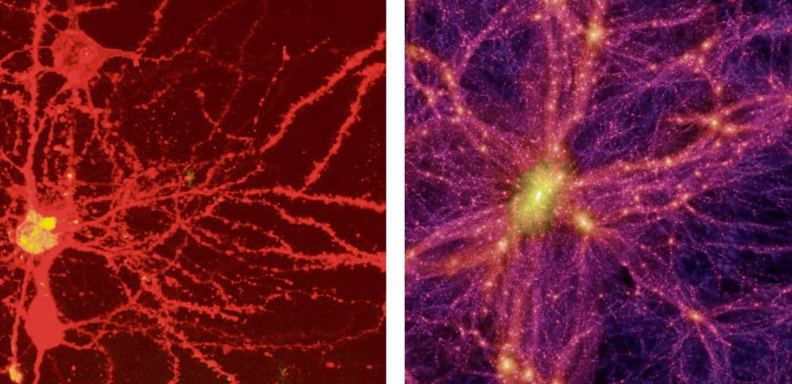
Brain Universe
100 Billions Neurons
100 Billions Galaxies
New York Times 8/21/2006

Slide 5
Observation of Natures

Slide 6
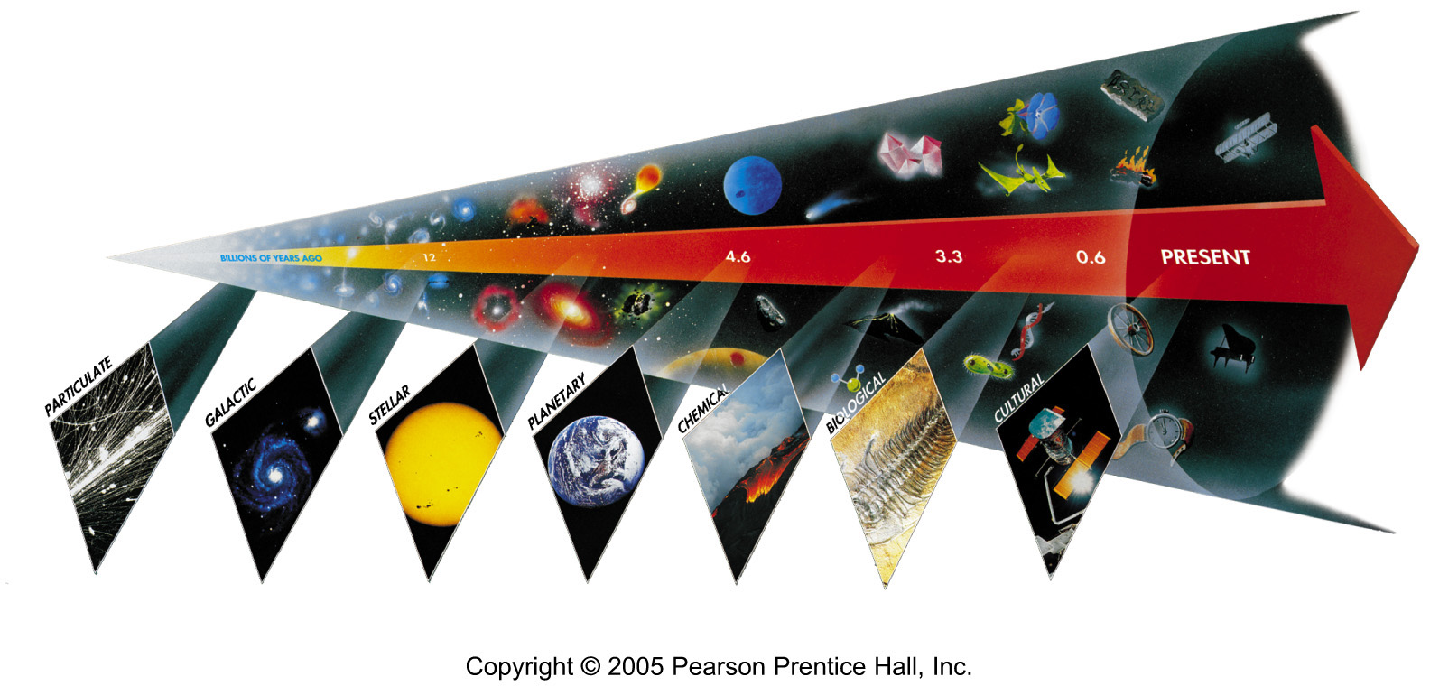
Seven Phases of Cosmic Evolution
14 billion years ago
Origin of
Particles
Origin of
Structure
Origin of
Life
Origin of
Consciousness

Slide 7
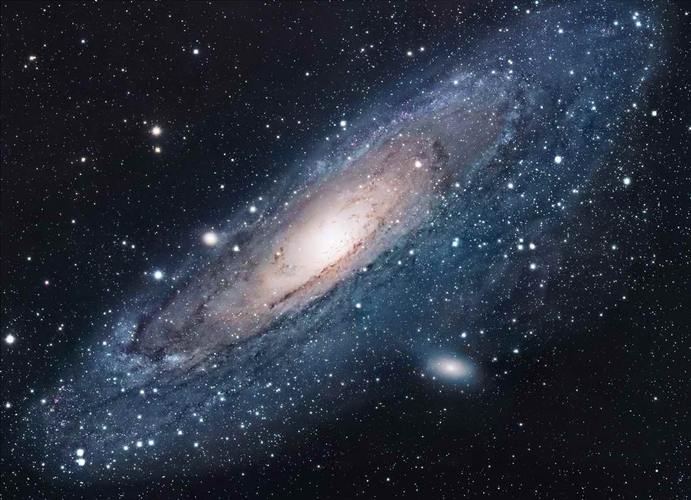
Andromeda
~100 Billions Stars in a Galaxy

Slide 8
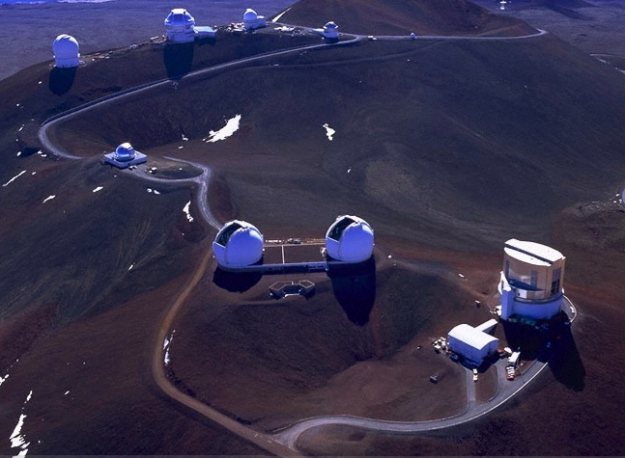
Keck Telescope
Mauna Kea at Hawaii (4200m)
Subaru Telescope

Slide 9
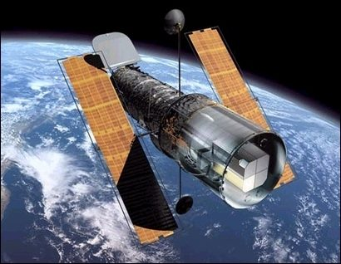
Hubble Telescope

Slide 10
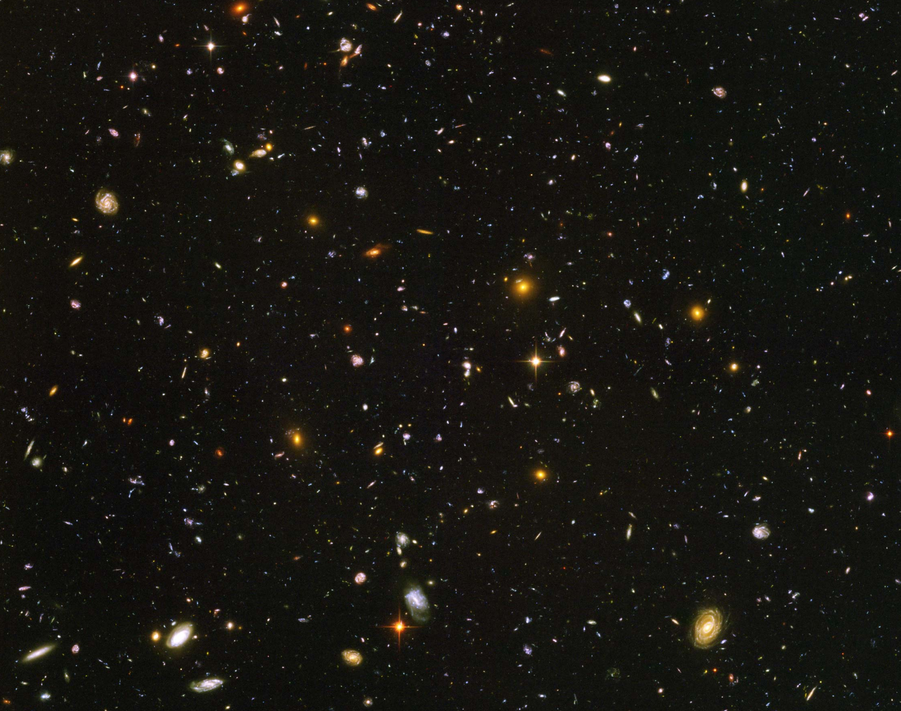
Hubble Deep Field
~100 Billion Galaxies

Slide 11
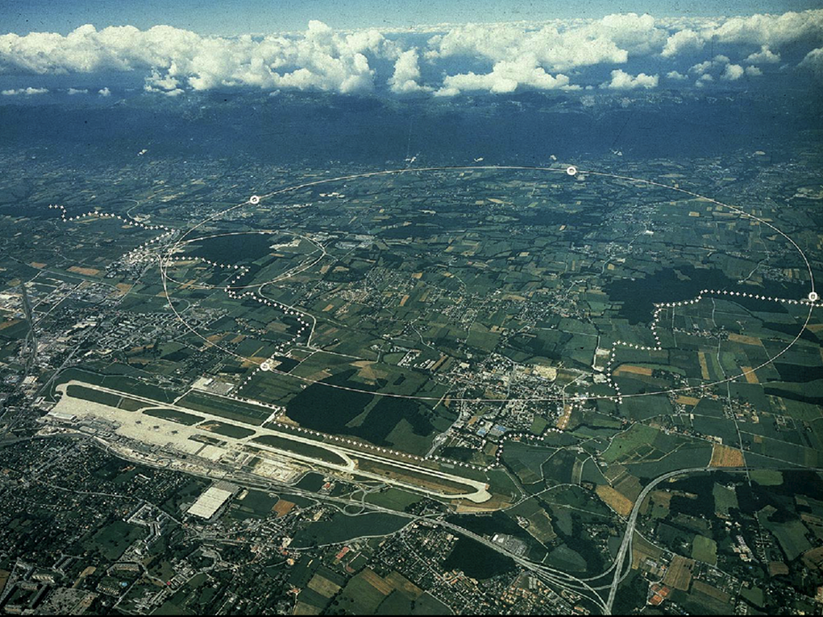
CERN and LHC in Geneva
27km Circumference
7+7=14 TeV

Slide 12
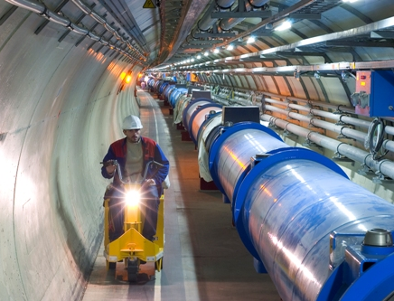
LHC Tunnel with Magnets

Slide 13
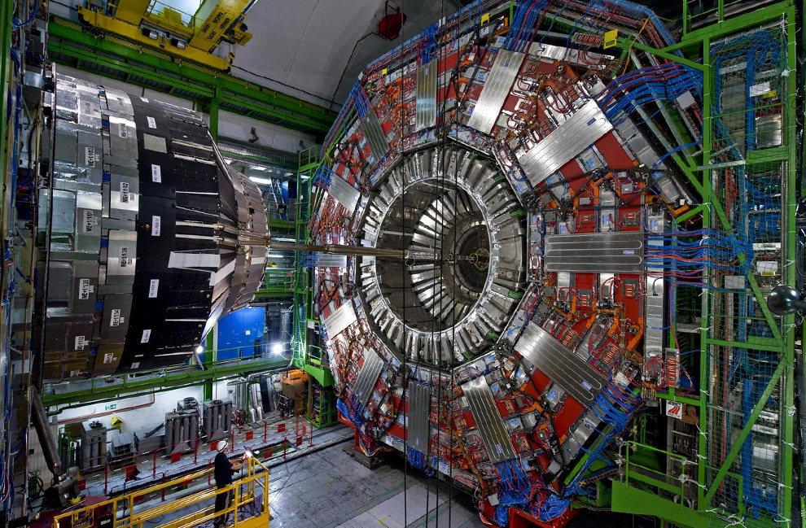

Slide 14
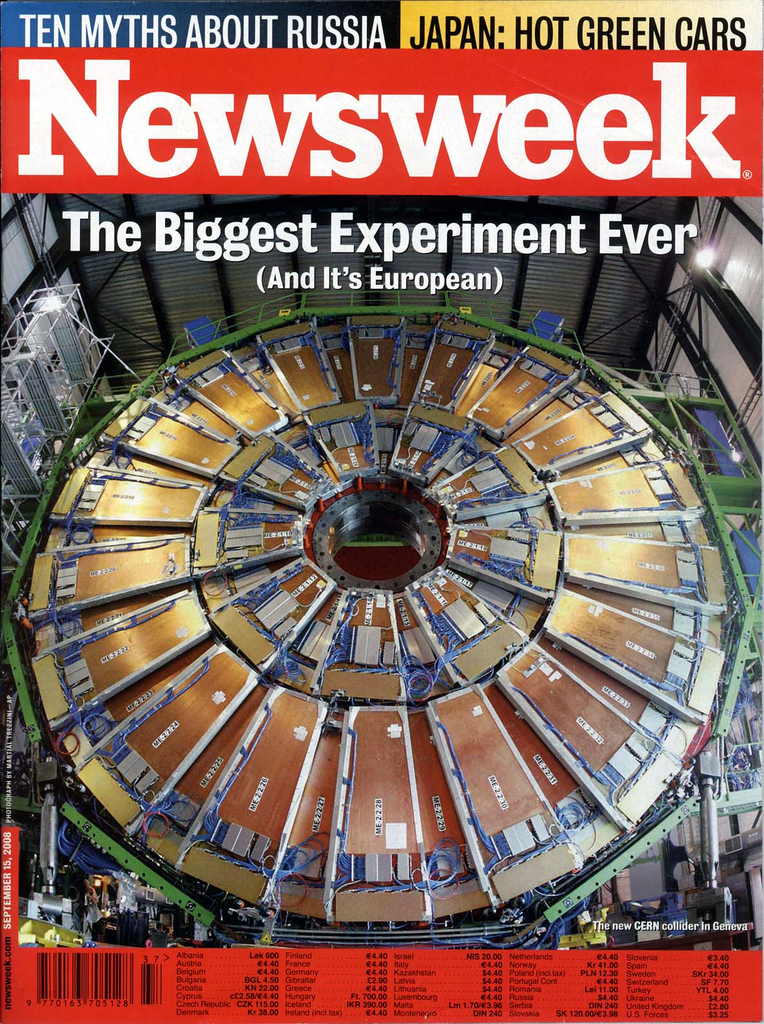
Particle detectors
constructed
at Westwood,
now at LHC, CERN
Sept 15, 2008 Issue

Slide 15
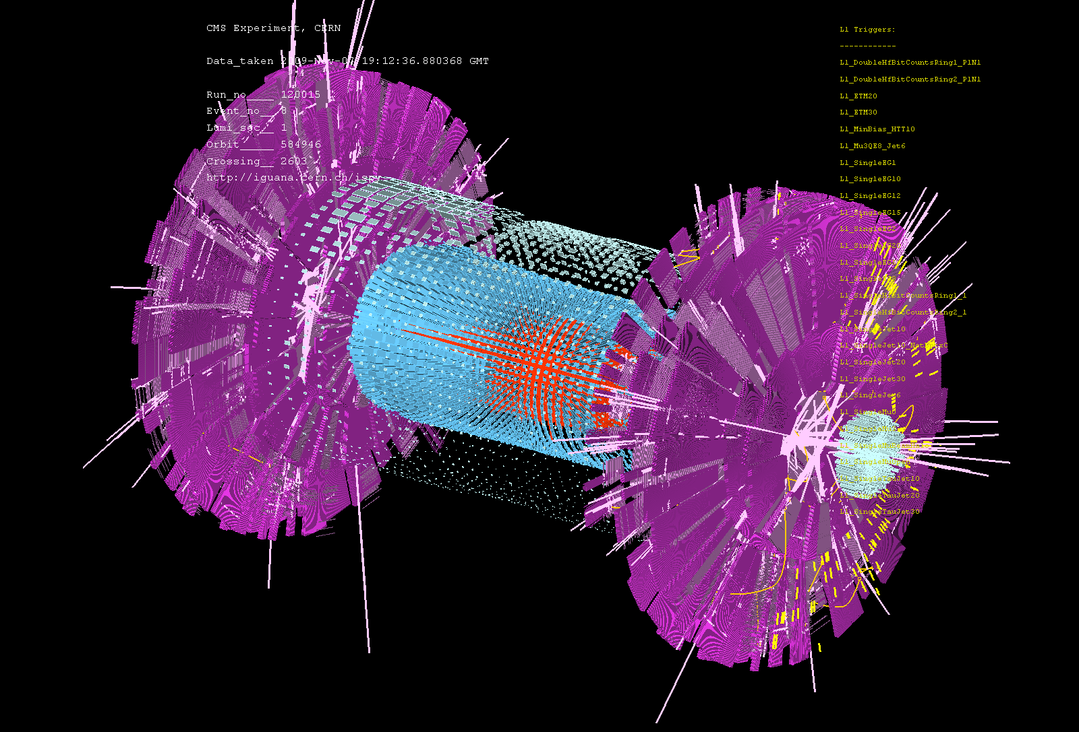
CMS Detector
First Event at LHC – Recreation of the Big Bang! (Nov 7, 2009)

Slide 16
Seven steps of cosmic evolution
Spontaneous Symmetry Breaking
14B years ago
Simple
Coherent Complex System

Slide 17
What is Life?
Emergent Property
Strongly-interacting, complex system
~10⁴ of different proteins in one cell
~10¹⁴ cells in one life
~10¹¹ neurons in our brain, ~10¹⁴ connections
Continuous, countless “symmetry breaking” towards coherent states
Origin of life
Evolution of life
Growth from a single cell to a multi-cell body
Learning and memory

Slide 18
How to observe the Life and Consciousness ?
We must look for “Live Life”
Exactly the same way as we look for the “Origin of Universe”
Telescope ↔ Microscope
Take advantages of the state of art “Photon Detectors” in particle physics.

Slide 19
Seven steps of cosmic evolution
Spontaneous Symmetry Breaking
14B years ago
Accelerator
Telescope
Microscope

Slide 20
Principle of Optical Microscopes

Slide 21
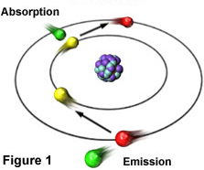
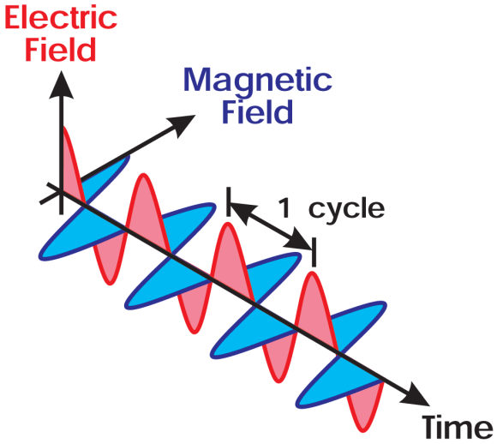
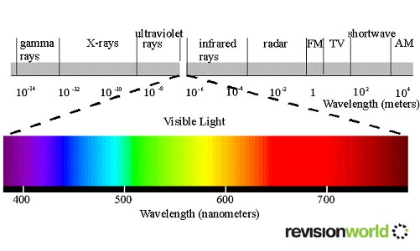
A Brief Overview of the Physics of Light
Origin of a Light Wave: When the valence electrons of atoms absorb energy, they are lifted from a ground level to more energetic states. After a very short time, the electrons drop back to ground level, releasing the energy in the form of a photon, an energy quantum associated with an electromagnetic wave.
Properties of a Light Wave:
has an electric vector E and a magnetic vector B.
has an wave length λ, an amplitude and polarity (E).
High energy photon = shorter λ = Bluer color
Low energy photon = longer λ = redder color
= “wave length”
Color Vision of the Human Eye:
Violet 410 nm
Blue 475 nm
Green 530 nm
Yellow 580 nm
Red 670 nm
Direction of Propagation
= natural white light

Slide 22
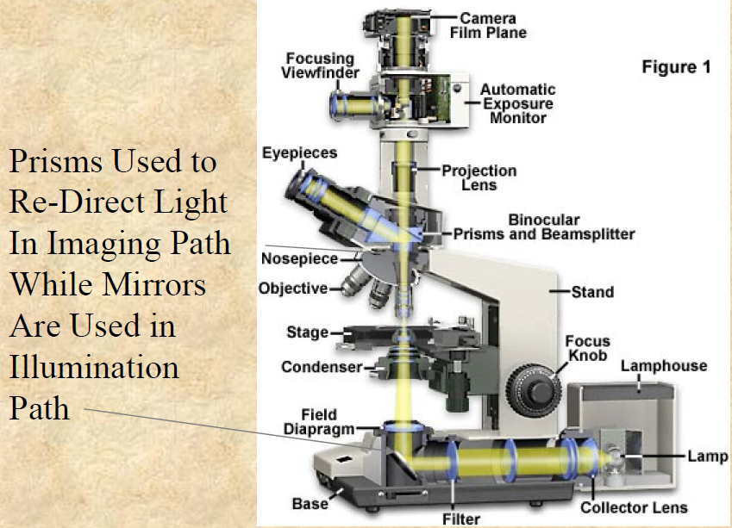
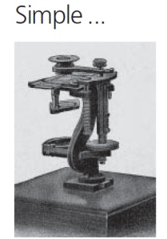
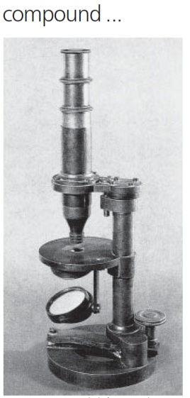
Modern Microscope Component Identification
1847
1857

Slide 23
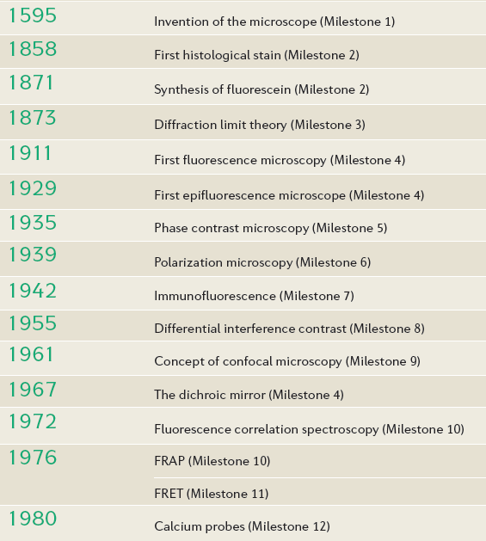
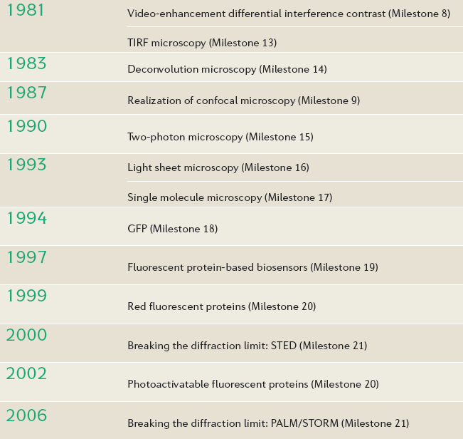
Light Microscopy Timeline
http://www.nature.com/milestones/light-microscopy

Slide 24
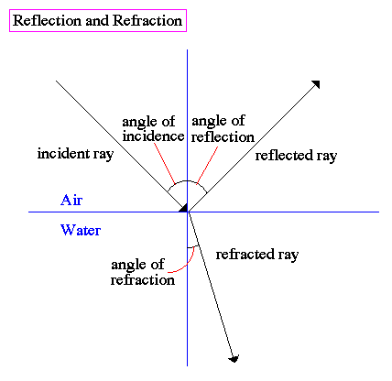
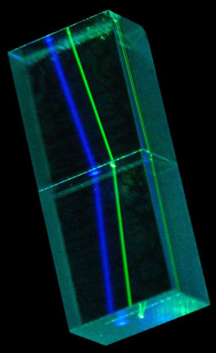
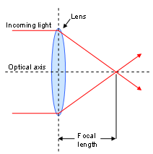
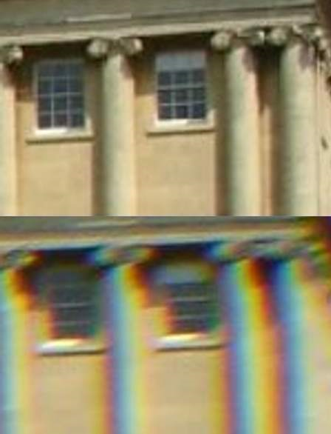
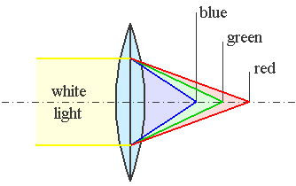
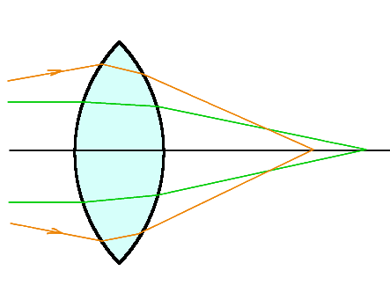
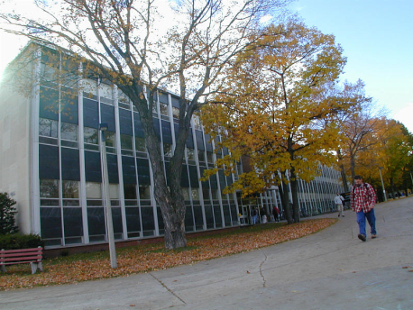
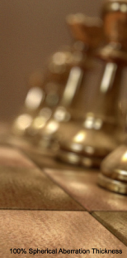
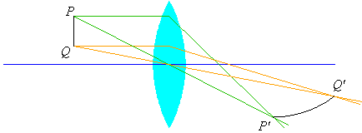
Some Properties of Lenses
Refraction: When a beam of light passes between substances with different refractive indices, such as air (n=1) into water (n=1.333), it is bent in a characteristic fashion (wavelength dependant).
Focal plane
Focal Length:
Chromatic: Apo
Lens Aberrations & Corrections :
Spherical: Fluorite
Curvature of Field: Plan

Slide 25
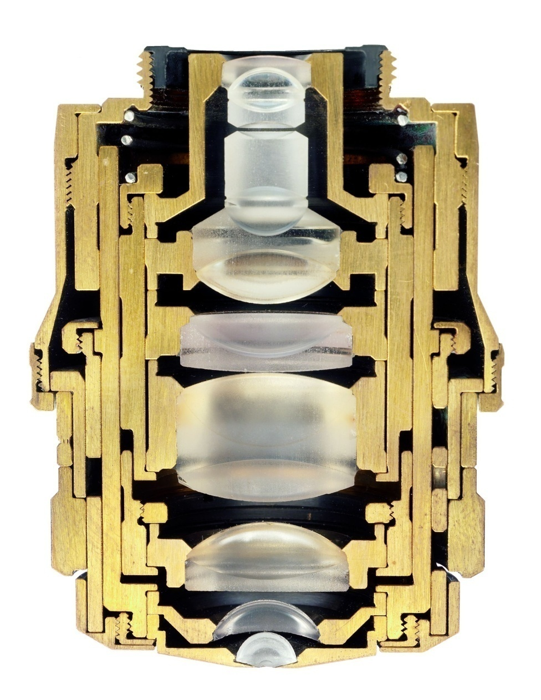
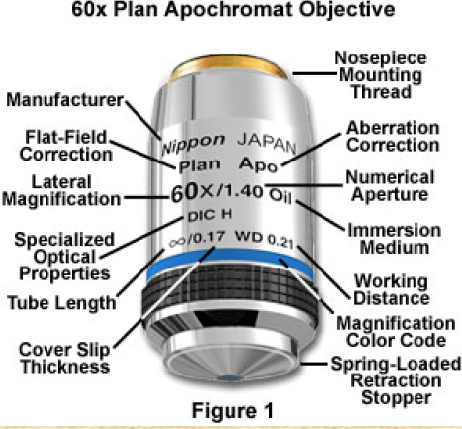
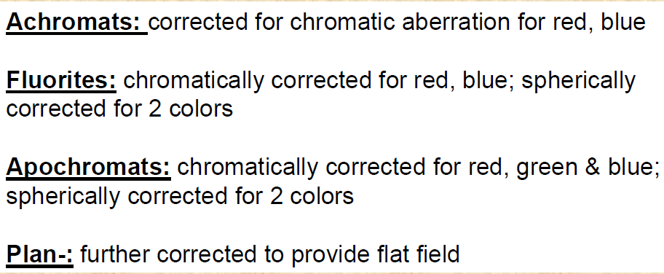
Key Component: the Objective
Objective Design Criteria Most Critical for Fluorescence:
Numerical Aperture
Immersion choices
Magnification
Transmission UV/Vis/IR
Chromatic Correction
Coverslip vs Chamber
Optical Correction
Working Distance
Example: Planapo 100x/1.30 oil
Notes:
microscope objectives and their impact on fluorescence imaging.
While we won’t have time to review all the criteria used in the design of an objective lens, we wanted to touch on three characteristics that are important in fluorescence imaging.
We will touch on the characteristics of:
Magnification
Numerical Aperture
Immersion choices relative to the refractive index of the media your cells/tissue are embedded
(This is a cross section of a Plan-Apochromat 100x/ 1.30 oil immersion objective may serve to illustrate such a complex lens system. The tolerances in the manufacture of the most highly corrected objectives is so critical, even the slightest hit to the objective can throw those lenses out of alignment. Please keep that in mind the next time you crash an object into the stage/slide on your microscope.
Please treat them with great care !

Slide 26
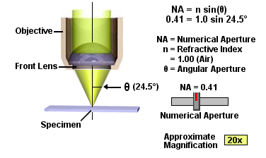
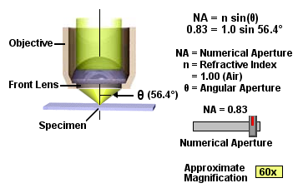
Some Functional Parameters of the Microscope Objectives
Numerical Aperture (NA): Light-gathering ability of the objective (NA=n.sinθ).
Thus, the NA is directly related to the resolving power of the lens.
Resolution: Defined as the smallest distance between two points on a specimen that can still be distinguished as two separate entities.
R = 0.61λ/ΝΑ
Magnification: Product of the magnifications of objective and ocular.

Slide 27
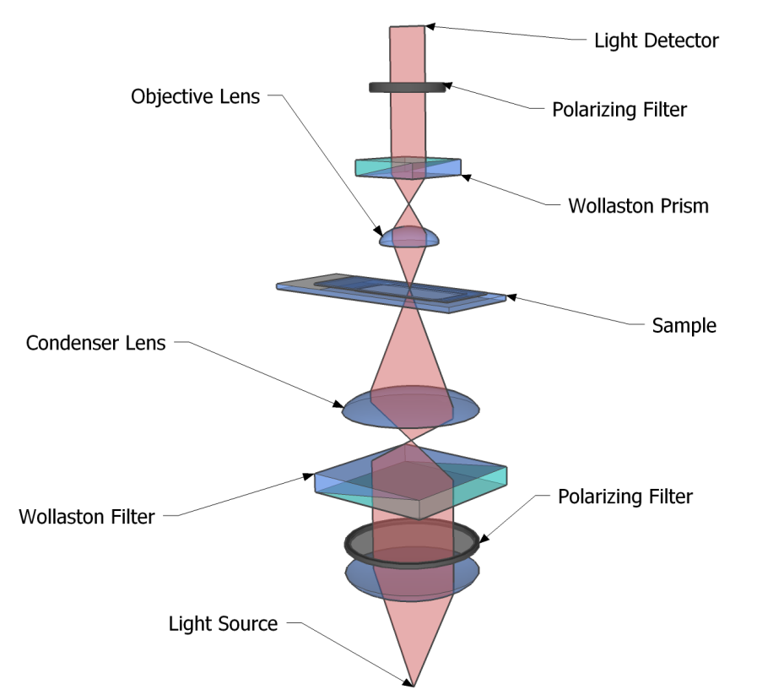
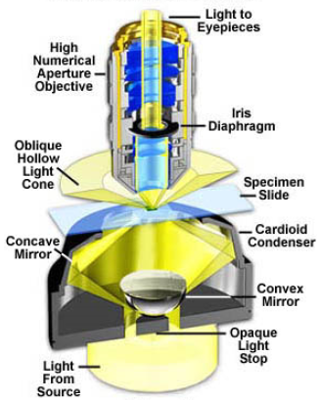
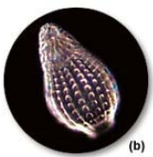
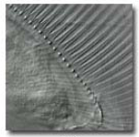
Specialized Types of Light Microscopes (Unstained Specimens)
Differential Interference Contrast (DIC)
Darkfield Illumination

Slide 28
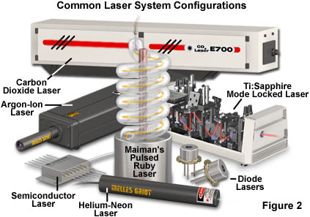
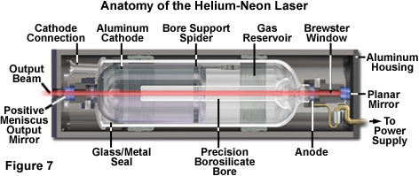
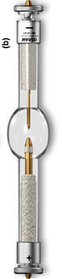
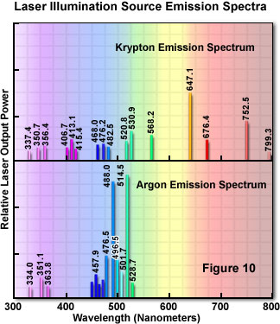
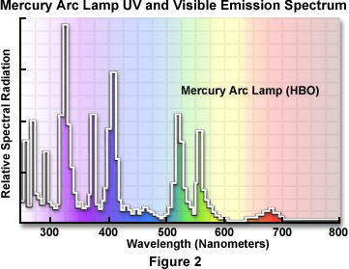
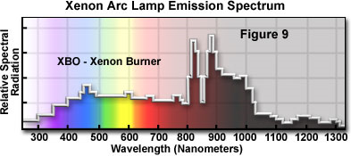
Common Light Sources
Arc lamp

Slide 29
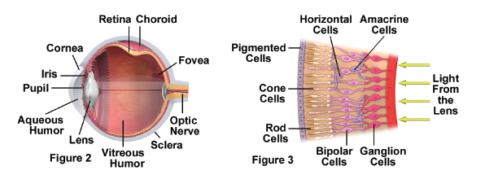
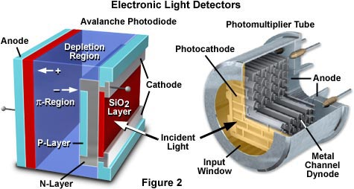
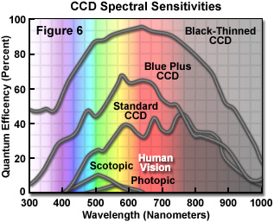
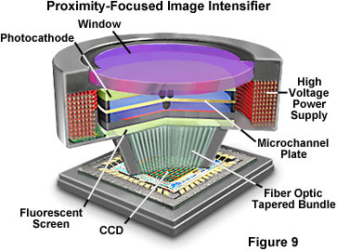
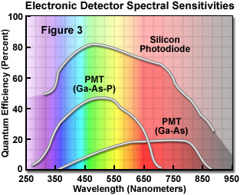
The Light Detectors
APD
PMT
Human eye
Interline
Resolution
Speed
Back
illuminated
EMCCD
Sensitivity
ICCD

Slide 30
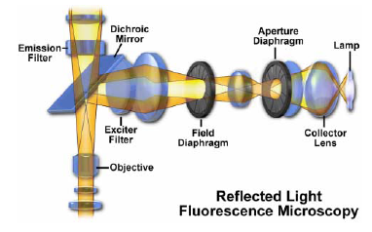
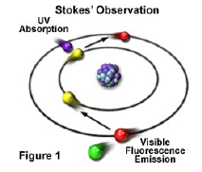


The Fluorescence Microscope (Stained Specimens)
In fluorescence, a molecule is excited to higher energy states by radiation of specific wavelengths
Imaging detector
Light Sources
Spectral Filters
Fluorescing dye
(Fluorophore)

Slide 31





GFP (Green Fluorescent Protein)
Chalfie, Shimura,Tsien

Slide 32



Emission of Quantum Dot
Shimon Weiss (Chemistry)
CdSe
InP
InAs
2.1nm
4.6nm
460
560
730
1030
1770
Wavelength (nm)

Slide 33

Electronic Transitions: Jablonski Diagram
}
S₂
(second excited
singlet state)
Vibrational
sublevels
INTERNAL CONVERSION (10⁻¹² sec)
S₁
(first excited
singlet state)
INTERSYSTEM
CROSSING
T₁
(first excited
triplet state)
FLUORESCENCE
(10⁻⁸ sec)
ABSORPTION
(10⁻¹⁵ sec)
NON-RADIATIVE
DECAY
PHOSPHORE-
SCENCE (>10⁻⁶ sec)
hν_{a1}
hν_{a2}
hν_{F1}
hν_{F2}
hν_{F2}
S₀
(ground
singlet state)
Notes:
Note: Electron is excited from an occupied molecular orbital (HOMO) by hva to a higher electronic state (LUMO)
Kic:fast, radiationless
Light emission: hv_{f}
S0, S1: singlet states→ antiparallel spins (Pauli exclusion principle)
T1 (triplet): parallel spins; more stable states, long-lived
Main points:
1. Franck-Condon principle: the nuclei are stationary during electronic transitions, therefore, excitation occurs to vibrationally-excited levels of the excited electronic state.
2. Emission occurs from the lowest vibrational level of the lowest excited singlet state because relaxation from excited vibrational levels (internal conversion) is much faster than emission (10⁻¹²s).
3. Stokes shift: emission is always of lower energy than absorption due to nuclearrelaxation in the excited state (CHECK).
4. Mirror image rule: emission spectra are mirror images of the lowest energy absorption band.
Lennard-Jones potential diagram??? The L-J diagram helps to bring home the point about the Stokes shift by linking the length of the emission arrow to the degree of nuclear relaxation that occurs in the excited state before emission. If the internuclear coordinates of the excited state are much different from those of the ground state (very different vibrational levels), then the Stokes shift is large. This diagram also helps illustrate the concept that the probability of the transition between the zeroth level of either the ground or excited state and the various vibrational levels of the excited or ground state, respectively, depends on the overlap of the square of the wavefunctions of the energy levels. Once the concept of the overlap of wavefunctions has been introduced it is not difficult to explain the mirror image rule, because the form of the wavefunction in any vibrational level of the excited state is quite similar to its form in the ground state, and thus probabilities are comparable in excitation and emission (if 0-->2 for S0-S1, then 0-->2 for S1-->S0 transition)

Slide 34


Principle of Confocal Microscopy
Focused + out-of-focus light
Non-confocal
Confocal
Out-of-focus light suppressed
An aperture (detection pinhole) allows 3D optical sectioning and suppression of out-of-focus light
Sample is scanned with point laser beam in the x- and y-directions.
The sample is moved along the optical axis (z-direction)

Slide 35
Advanced Microscopes

Slide 36
Super Resolution

Slide 37



Optical Diffraction Limit
Lens
800 nm
Problem:
α
α
250 nm
Abbe (1873), Arch. Mikroskop. Anat. 9, 413
d
PSF
d?
PSF > d

Slide 38



Microscopy at the Nanoscale: Stimulated Emission Depletion (STED)
1st physical concept to break the diffraction barrier in far-field fluorescence microscopy (Stefan Hell)

Slide 39
Summary: STED Resolution
Not limited any more by the wavelength of light!
Just depends on the level of fluorescence depletion.
Practically, diffraction unlimited resolution (lateral resolution < 90 nm)
1st physical concept to break the diffraction barrier in far-field fluorescence microscopy with visible light and regular lenses!
Light microscopy at the nanoscale = nanoscopy!
New law; a modification of Abbe’s law:
First STED microscope in the USA!
V. Westphal & S.W. Hell (2005) Phys. Rev. Lett, 94, 143903.
confocal
STED
STED
STED
A threefold improvement in resolution along the x/y focal plan
→ 9 effective scanning spots created out of 1 !
STED
STED
STED
STED
STED
STED

Slide 40

Application of STED
Farahani, Schibler and Bentolila (2010) Microscopy: Science, Technology, Applications and Education, Vol. II, pp 1539-1547.

Slide 41




Saturated Structured-Illumination Microscopy (SSIM)
Conventional
SIM
Gustafsson MGL. (2005) PNAS102:13081–86
SSIM
Use Moire pattern effect to detect diffraction limited objects.
A resolution of 100 nm in the lateral direction and 300 nm in the axial direction has been achieved.

Slide 42



Photo-activated Localization Microscopy (PALM)
Same concept as STORM but different Dyes (FPs: EoS and Dronpa)
Shroff et al, (2007) PNAS 104:20308
Activate Eos with 405
Image activated Eos with 488
Activate Eos
Continue to image all Eos
5) Deactivate all Dronpa with strong 488
6) Activate Dronpa with 405
7) Image activated Dronpa
8) Continue to image all Dronpa
Cytoskeletal α-actinin and adhesion complex localized vinculin

Slide 43








Stochastic Optical Reconstruction Microscopy (STORM)
B-SC-1 cell, Microtubules stained with anti-β tubulin Cy3 / Alexa 647 secondary antibody
5 μm
500 nm
5 μm
5 μm
1 μm
200 nm
█ Cy3 / Alexa 647: Clathrin, █ Cy2 / Alexa 647: Microtubule
Bates et al, Science 317, 1749 – 1753 (2007)

Slide 44
FLIM (Fluorescence Life time Imaging)

Slide 45
Protein Folding by single pair Förster Resonant Energy Transfer (spFRET)

Slide 46


Förster Resonant Energy Transfer (FRET)
nm → nsec

Slide 47


Fluorescence Lifetime Imaging (FLIM)
Principle
Each fluorescent dye has its own lifetime in the excited state
In live cells, fluorescence lifetime is affected by the local environment
FLIM is insensitive to fluctuations in fluorochrome concentration
and excitation light intensity
It is based on time-correlated single photon counting technology
Applications
Mapping of local environment such as pH, oxygen, ion concentrations,
intracellular signal transduction, FRET, and membrane potential
Lifetime of chlorophyll (Living Diatomee)
Confocal image
FLIM image

Slide 48
High-speed Microscopes

Slide 49




Single Molecule Imaging
January 2006
Shimon Weiss (Chemistry)
It will permit to track multicolor qdot-labeled proteins in live cells virtually background-free
The H33D detector attaches to a standard fluorescence microscope
Nano Technology
Particle Physics Detector
Laser

Slide 50

Principle of High-speed Bio Imaging
Wide Field
Confocal
Sample
Sample
Pinhole
CCD + FADC (10 – 50 MHz)
PMT + FADC (10 – 50 MHz)
CMOS [ FADC (50 MHz) * 100 ]
[ HAPD + FADC (1 GHz) ] * 64

Slide 51
How to speed up microscopes
All the existing microscopes are limited by the narrow bandwidth of readout.
Just one channel of FADC (Flash Analog to Digital Converter) running at 10 – 50 MHz
So-called Video Rate (30 frame/sec)
The first step is to adopt multiple channels of FADC for massive parallel processing.
Like high energy experiments (such as LHC)
In addition, we need Single Photon Sensitivity with high Quantum Efficiency.

Slide 52

Micron 1.3M-Pixel CMOS Sensor
2 μsec/row
2 msec/frame
(10 bits, 66MHz)

Slide 53
Photron FASTCAM SA-1
5000 frame per sec
(200 nsec/row)

Slide 54

Gold nano particle (40nm) attached to Transferrin Receptor (TfR) on Cancer Cell
Manuel Penichet (Oncology), John Miao (Physics)
10,000 frame/sec

Slide 55
Mean Squire Displacement <r²> of TfR on a Human Multiple Myeloma Cell vs. Time
?
Type A
Brownian Motion
Type B

Slide 56

Arisaka’s Campus-wide Collaborations on High-Speed Bio-imaging
Dept. of Physics & Astronomy
(Dolores Bozovic, Mayank Mehta)
Dept. of Electrical Engineering
(Bahram Jalali)
Industrial Partners
(Hamamatsu Photonics,
Photron, Leica)
Dept. of Chemistry & Biochemistry
(Shimon Weiss)
California Nano Systems Institute
(CNSI, Laurent Bentolila)
Dept. of Surgical Oncology
(Manuel Penichet)
Dept. of Neurology & Neurobiology
(Carlos Portera-Cailliau,
Jack Feldman, Tom Otis)

Slide 57

User-shared Core Facility of High-speed Microscopes at CNSI
CNSI (California Nano Systems Institute)

Slide 58

Feb 17 (Thu)

Slide 59




Nikon Microscope TE200E with TIRF at CNSI
Laurent Bentolila (CNSI)
5k – 500k fps
CMOS Camera
Photron SA-1

Slide 60
Image Intensified CMOS Camera
Photron
MCP
(Micro Channel Plate)
CMOS Camera
(> 1,000 frame/sec)
GaAsP Photocathode
(50% QE)
Multi-channel
High-speed Digitization

Slide 61

High-speed Confocal Microscope with ICMOS at CNSI
(1,000 frame/s)
ICMOS Camera
(Photron SV200i)
Leica Microscope
Confocal Spinner
(Yokogawa CSU-X1)
EMCCD Camera
(Ando iXon 897)

Slide 62


Yokogawa CSU-X1
ICMOS
Camera
2,000 fps

Slide 63
Frame Rate vs. Resolution
1 µsec
CMOS (SA-1)
ICMOS (SV200i)
10 µsec
Frame Rate (frame/sec)
100 µsec
New Systems
64-beam MMM
Confocal Scanner
(Yokogawa CSU-X1)
CCD (Neuro-SMQ)
1 msec
Conventional
4-beam MMM
EMCCD
(iXon 897)
10 msec
CCD (ORCA)
Video Rate
(Response of human eyes)
10 x 10
100 x 100
No. of Pixels (in X-Y)
1000 x 1000

Slide 64
6D Bio-Imaging
Ideally observation of Live cells requires the detection of photon intensity ( I ) in 6 dimension: I (x, y, z, λ, τ, T)
x:
y:
z: Location in depth
λ: Wave length of emitted photons
τ: Time delay of emitted photons after excitation
T: Frame rate.
Photo-detectors have lower dimension:
PMT: I(T) at 50 MHz
CCD: I(x, y, T) at 30 Hz
CMOS: I(x, y, T) at 5 kHz
Therefore, “compactification of extra dimension” is required.

Slide 65
Applications to Neuroscience

Slide 66
Brain Universe
100 Billions Neurons
100 Billions Galaxies
New York Times 8/21/2006

Slide 67

Ca²⁺ Signal in cultivated Rat’s Brain by Confocal Microscope

Slide 68
Comparison of Imaging

Slide 69
High-speed observations

Slide 70
Neural Networks for Breathing
~300 neurons in rat’s brain (pre-Botzinger Cells) responsible for breathing
Nature by Naohiro Koshiya (1999)
Jack Feldman (Neurobiology)

Slide 71

High-speed Ca²⁺ Imaging of pre-Botzinger Cells of Rats
Jack Feldman (Neurobiology)
1,000 frame/sec

Slide 72

Sensory Input and Decision Making in Brain

Slide 73

Human Eyes
~100M photo receptors
540M years ago（Cambria explosion）

Slide 74

Human Ears
~10,000 Hair Cells
~50M years ago

Slide 75
Anatomy of Inner Ear
Dolores Bozovic (Physics)
Human auditory system
Cross-section of the cochlear
Hair bundle
Molecular mechano-transduction machinery
Meredith LeMasurier and Peter G. Gillespie, Neuron, Vol. 48,2005

Slide 76



Hair cell, bullfrog sacculus
A. J. Hudspeth, Rockefeller University
Hudspeth, A. J. & Gillespie, P. G., Neuron 12:1-9 (1994).

Slide 77

CMOS Camera
(Photron SA-1)
EMCCD Camera
(Andor iXon 897)
Microscopes
Objective
Dolores Bozovic’s Lab (Physics)

Slide 78

Mechanical Motion of Hair Cells in Inner Ear
Dolores Bozovic, Lea Fredrickson (Physics)
1,000 frame/sec

Slide 79
Neural Networks

Slide 80










Nature vs. Nurture
Nature
Nurture

Slide 81


The Cerebral Cortex
Conscious
7
2/3
4
5
Unconscious
6
Thalamus
Subcortical areas

Slide 82

Assembly of rat’s cortical circuits during development
How/when do neurons establish networks? → Symmetry Breaking
Carlos Portera-Cailliau (Neurology)
Miller, 1981

Slide 83


Mutiphoton Microscope
Conventional
Confocal
Two Photon Excitation
500 – 600 nm
500 – 600 nm
440 nm
880 nm

Slide 84

Absorption of light
1mm
1cm

Slide 85

Neural Network in Vivo 3D image by two photon microscope

Slide 86

Neural Network 3D image by two photon microscope
Cortical neurons in a fixed, 100 um-thick brain slice from a transgenic mouse with sparse neuronal GFP expression. Left: Mosaic of 81 high-resolution image stacks acquired on a 2-photon laser-scanning microscope, part of a larger data set spanning several consecutive brain slices. Right: Individual stack from this data set, containing a GFP-expressing cortical layer 2/3 pyramidal neuron. Its dendritic (cyan) and axonal (magenta) compartments were identified and traced within the 3D data containing many other neuronal structures, some of which appear to make contact with the highlighted cell. Images: Miguel Vaz Afonso.

Slide 87

Spatio-Temporal Excitation-Emission Multiplexing (STEM) Microscope
80 MHz
(100 fs pulse)
Adrian Cheng (Physics)
4 Beams
240 frame/sec
0 ns
+3 ns
+6 ns
+9 ns
1 kHz
16 kHz
HAPD #1
HAPD #2

Slide 88










Surgery to Open a Cranial window
Prof. Carlos Portera-Cailliau

Slide 89



In vivo calcium imaging of neuronal activity

Slide 90


Slide 91
UCLA Newsroom on January 11, 2011

Slide 92
Future Directions

Slide 93

Virtual Reality Experiment on Awake Rats
Olfactory
Stimulator
Mayank Mehta
Daniel Aharoni
Bernard Willers
(Physics)

Slide 94

GRIN-based Two photon excitation Endoscope
Mark Schnitzer (Stanford)

Slide 95


GRIN 2PE Endoscope
Mark Schnitzer (Stanford)

Slide 96



Optogenetic Excitation of Neurons
Karl Deisseroth (Stanford)
Excitation by
Channelrhodopsin-2
(ChR2)
Inhabitation by
Halorhodopsin
(NpHR)

Slide 97
Outer world vs. Inner word
Outer world : Five senses → Manipulate by Virtual Reality
Vision
Sound
Touch
Smell
Taste
Inner world → Manipulate by Photo Excitation of single neurons
Neural network in brain
Establish direct link between Inner world & Outer world
Control outer world – Virtual reality
Control inner world – Neural reality

Slide 98


Voltage Sensing Dye by FRET
Tom Otis (Neurobiology)
DPA
DiO

Slide 99

Voltage Sensing Dye
Tom Otis (Neurobiology)

Slide 100



LCOS (Liquid Crystal on Silicon) for SLM (Spatial Light Modulator)
Hamamatsu
Optical Tweezers

Slide 101

Ca²⁺ Signal in cultivated Rat’s Brain by Confocal Microscope
SLM + Voltage Sensing
Photo Excitation

Slide 102
Summary

Slide 103
Seven Phases of Cosmic Evolution
14 billion years ago
Origin of
Particles
Origin of
Structure
Origin of
Life
Origin of
Consciousness

Slide 104
Seven steps of cosmic evolution
Spontaneous Symmetry Breaking
14B years ago
Simple
Coherent Complex System

Slide 105
Seven steps of cosmic evolution
Spontaneous Symmetry Breaking
14B years ago
Accelerator
Telescope
Microscope

Slide 106
Four Major Science
Origin of Particles
Particle Physics
Origin of Universe
Cosmology
Origin of Life
Molecular Biology
Origin of Consciousness
Neurophysics

Slide 107
Concluding Remarks
Life, in particular, our brain is a complex system in 4 dimensional space-time.
Emergent property
Strongly interacting
Countless “spontaneous symmetry breakings” during the evolutional and developing process of life
Fully controlled experiments by “Virtual Reality” under way.
Outer world (environment) vs. Inner world (brain)
“Super-resolution high-speed 4D imaging” may reveal the fundamental principle of the most complex system in nature – our brain.
How can life overcome thermal fluctuation?
Networks in a cell and between cells (neurons)

