Slide 1
How I manage to teach physics in English to 500 students who have no interest
Katsushi Arisaka
University of California, Los Angeles
Department of Physics and Astronomy
arisaka@physics.ucla.edu

Slide 2
Outline
Overview 5 min.
Example of my lectures 20 min.
The very first lecture
The lecture on “Eclectic Circuits”
Technical details 15 min.
Open discussion 10 min.
Total 40 + 10 min.

Slide 3
Brief Introduction to Katsushi Arisaka
PhD from Tokyo Univ. in 1985
Particle physics – Kamiokande Neutrino Experiment
Thesis Advisor – Toshi Koshiba, Nobel prize in 2002
Came to the US with no English training
Failed English class as an undergrad student!
Professor of Physics at UCLA since 1988
Research on both Particle Physics & Neuroscience
Teaching “Electricity and Magnetism”
to life science majors (mostly pre-med students) who hate physics
~500 students per year for > 10 years
In addition, honors classes (top ~10% students)
In 2010, awarded the campus-wide ”Distinguished Teaching Award”

Slide 5
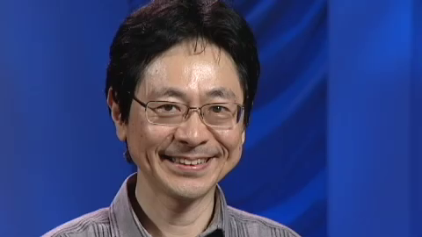
Interview on “teaching honors students”

Slide 6
A message from a student a few days ago
Dear Professor Arisaka,
As I am sitting here studying for my final, I am just overwhelmed with how grateful I am that I was given the opportunity to take Physics 6B with you this quarter. I just wanted to let you know how much I enjoyed your Physics 6B course throughout this entire quarter! As a Life Science student, I am completely intimidated by the world of physics and tend to perform poorly in all of my physics efforts. Your class is the first physics class I have ever taken that I have thoroughly enjoyed- and actually performed decently as a student!!! I am going to highly recommend you to all of my friends that share my same fear of physics! I sincerely appreciate all of your enthusiasm and encouragement. I have never had a professor care as deeply about their students as you do- and every single one of your students feels the same! I think THAT in itself is the highest testament of your teaching credibility. You are without a doubt the BEST physics professor at UCLA as well as one of my favorite professors I have ever had! Thank you for your hard work and dedication to the class. Thank you for your constant support and words of encouragement. I honestly cannot express how grateful I am that I was able to take a class with you!
Again, thank you so very much! If only UCLA had more Professor Arisaka's on staff!!!! I hope you have a wonderful spring break!

Slide 7
Another message from a student a few days ago
Hi Professor,
I just wanted to send this email to thank you for a truly wonderful quarter and excellent class. Before this quarter, I was not really interested in physics and came into this course with caution. However, I did not expect to enjoy this class so much and learn so many things not only about physics but about nature and the world around us. I sincerely hope that I will be able to take another course with you at some point in my life and highly recommend you to anyone that asks!
In addition, given the recent events in Japan and the other countries, I really hope that all of your families and friends are safe and healthy and express my well wishes to all of them.
Thank you again for such an amazing class!
> 10 mails like this, shortly after the last lecture

Slide 8
Key points of today’s talk
How to create the excitement of learning physics, when students actually hate it?
Time is short, but even within 10 weeks, there is a way to accomplish the mission.
It is NOT a question of English, but a question of communication skills with students.

Slide 9
Important Goals
Connect the topics with students’ own daily life and their interests
Instructor's personal relation with students
Define the concrete goal of learning clearly
Ultimate purpose : Change their life and their way of thinking forever.

Slide 10
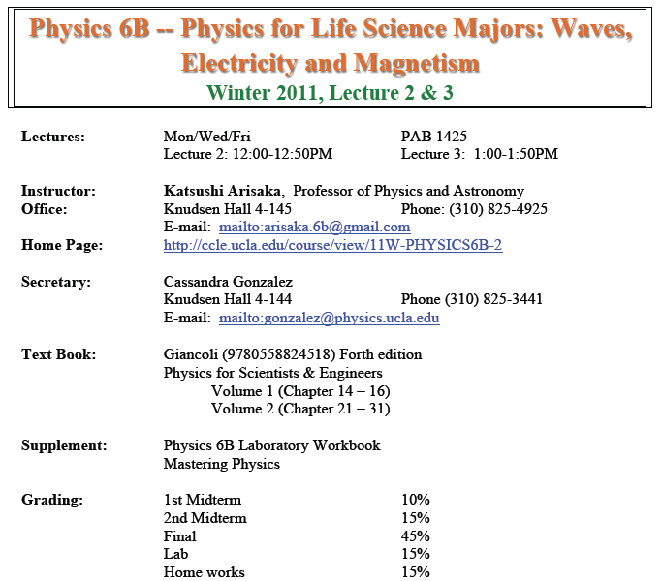

Slide 11
The Very First Lecture (Jan 3)
Connect physics with student’s their own interests
Show instructor’s own excitement in physics

Slide 12
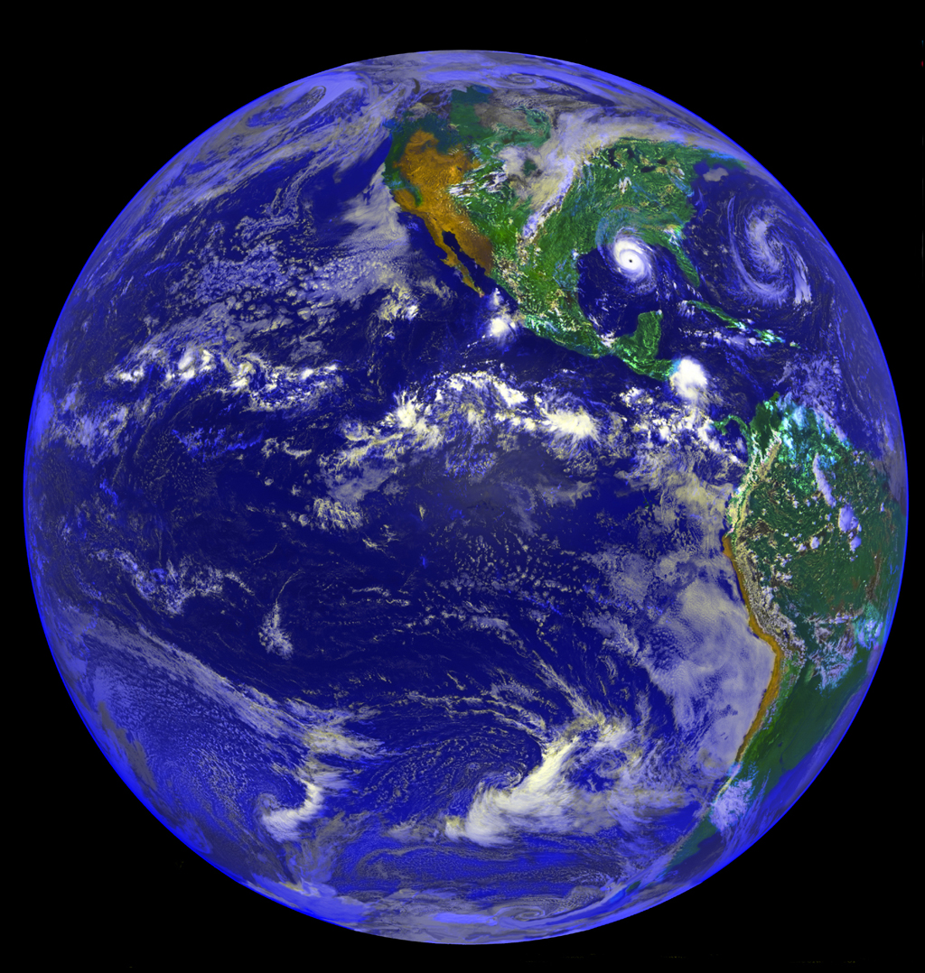
Why are we here?

Slide 13
Central Theme
Why are we here?
Origin of Ourselves History
Origin of Life Biology
Origin of the Solar System Astronomy
…
Origin of Atoms Particle Physics
Origin of the Universe Cosmology
What is the most fundamental laws in nature?

Slide 14
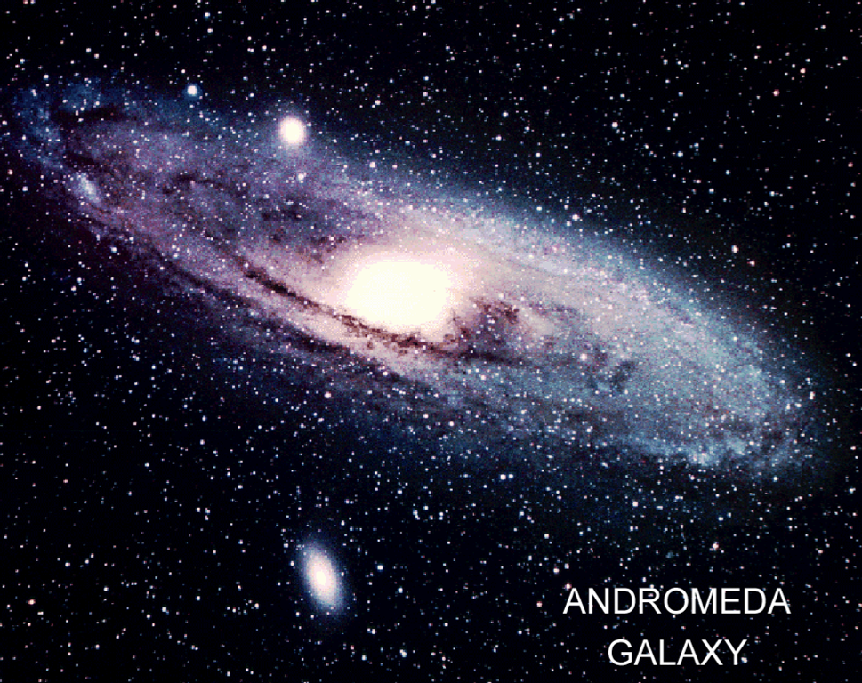
~100 Billions Stars in a Galaxy

Slide 15
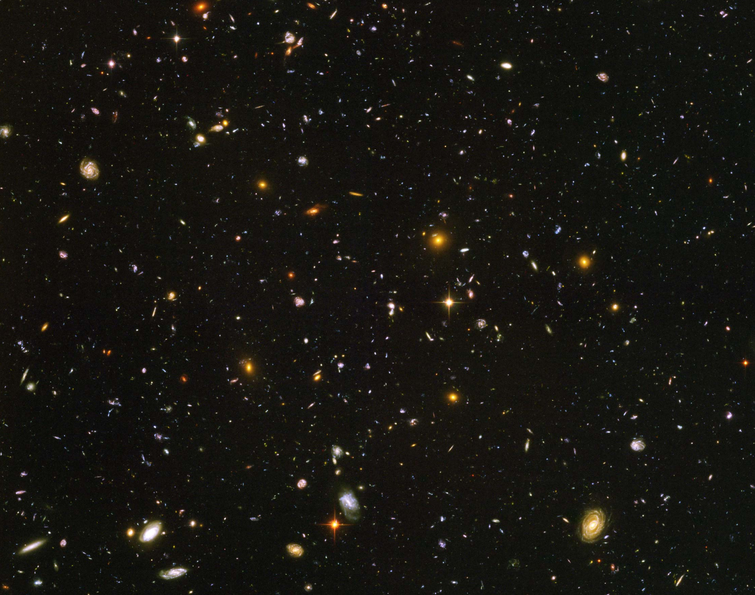
Hubble Deep Field
~100 Billion Galaxies

Slide 16
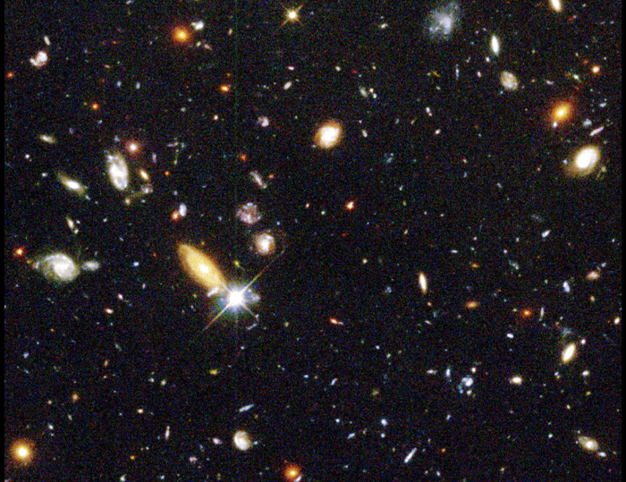
Red shift
up to ~10

Slide 17
Hubble’s Law: Expansion of the Universe
Horizon
of Universe
Big Bang!
Sun/Earth
14 Billon
Light Years
Moving Away
at Speed of Light

Slide 18
Hubble Deep Field
Physicists’ View of Early Universe
Fiat lux
Let there be light

Slide 19
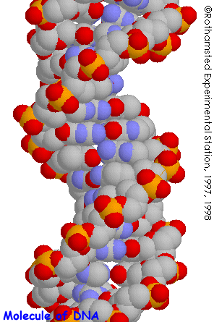
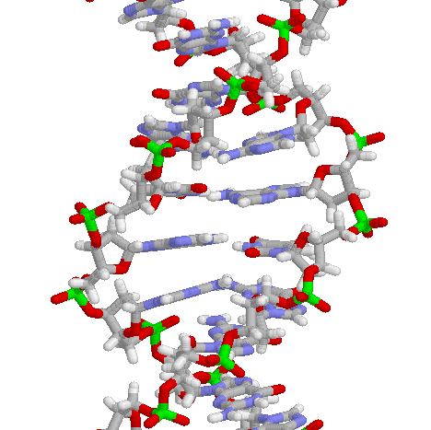
Structure of DNA

Slide 20
Symmetry Breaking
Time
0
Simple
1B years
2
3
4
5
Symmetry
Break Down
6
7
8
9
10
11
12
Complex
13
14

Slide 21
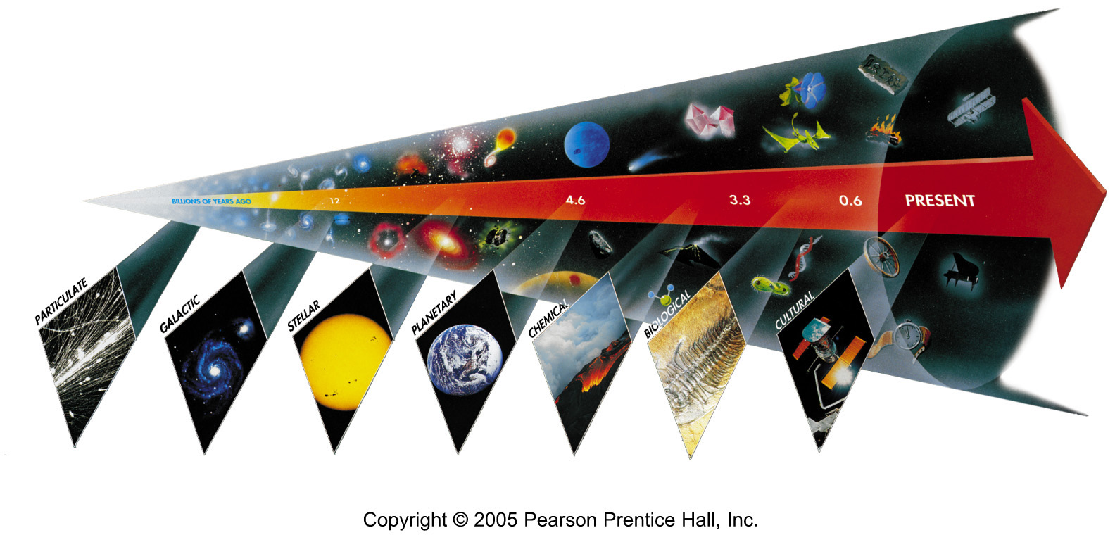
Seven Phases of Cosmic Evolution
14 billion years ago
Origin of
Particles
Origin of
Structure
Origin of
Life
Origin of
Consciousness

Slide 22
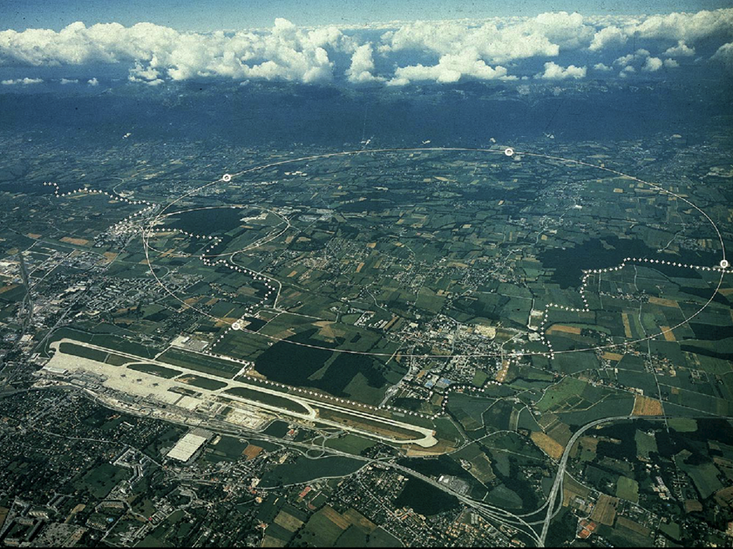
CERN and LHC in Geneva
27km Circumference
7+7=14 TeV

Slide 23
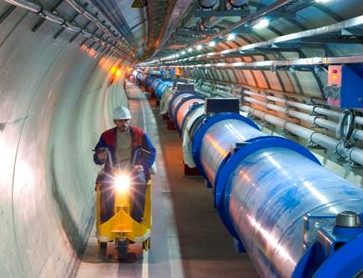
LHC Tunnel with Magnets

Slide 24
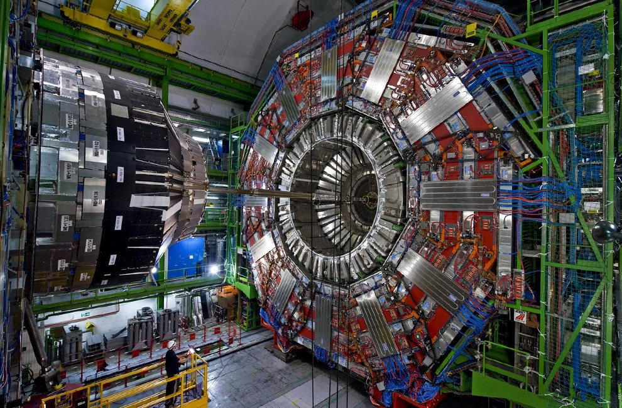

Slide 25
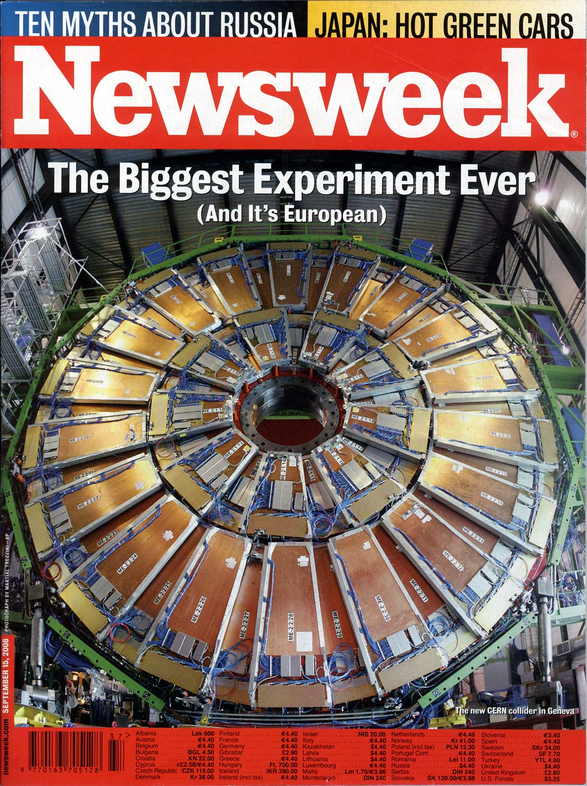
Particle detectors
constructed at UCLA
Now at LHC, CERN
Sept 15, 2008 Issue

Slide 26
Seven Phases of Cosmic Evolution
14 billion years ago
Origin of
Particles
Origin of
Structure
Origin of
Life
Origin of
Consciousness

Slide 27
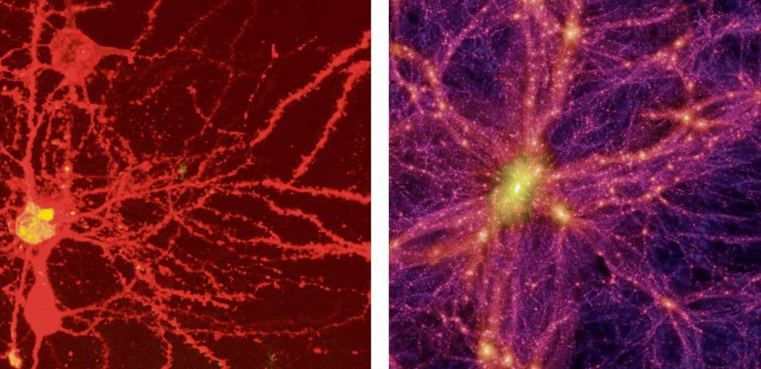
Brain Universe
100 Billions Neurons
100 Billions Galaxies
New York Times 8/21/2006

Slide 28
Lecture on Electric Circuits (Feb 18)
Connect “boring circuits” to
The most advanced computer system – IBM’s Watson
The most advanced circuits in nature – our own brain
Introduce my own researches when appropriate:
Brain imaging by high-speed optical microscopes

Slide 30
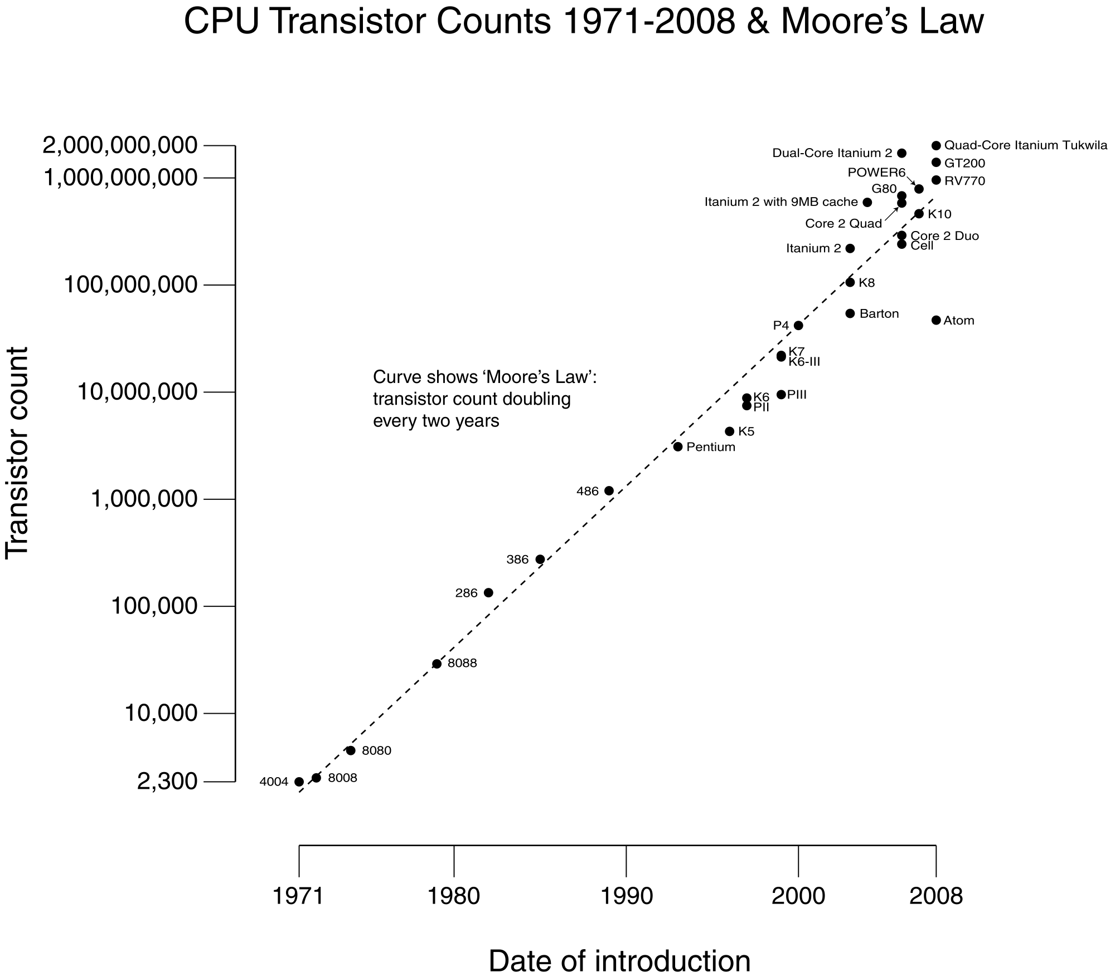
Transistors in Computer
Watson
Watson
#CPUs : 2880 CPU
(~ 10¹² Transistors)
Speed : 3.5 GHz
RAM : 16 TByte

Slide 31
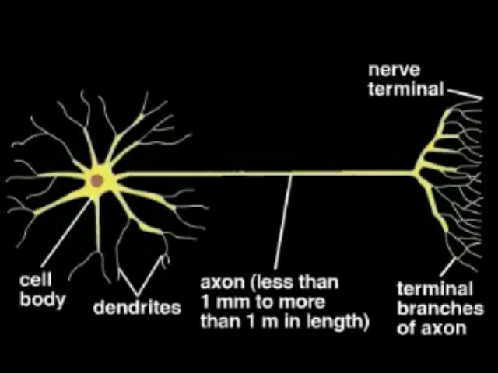

Slide 32
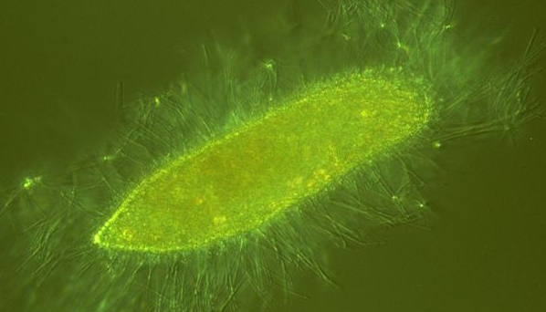
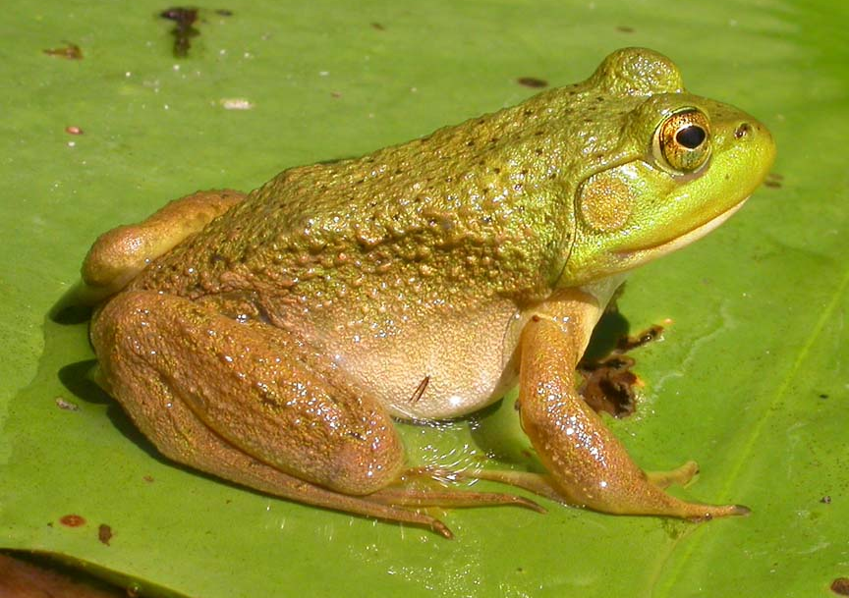
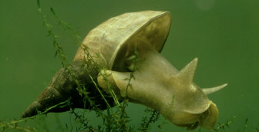
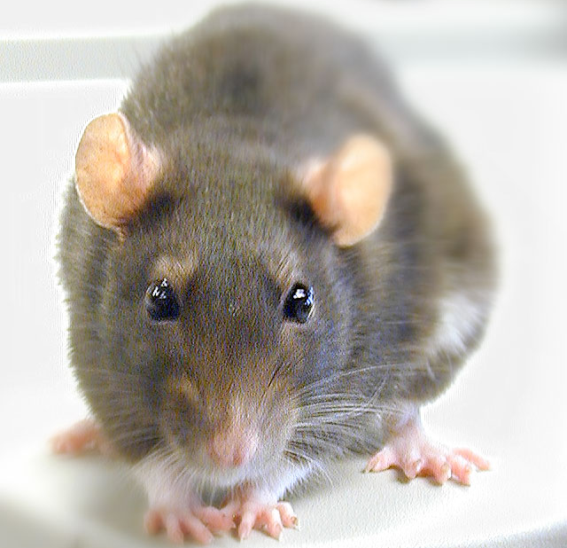
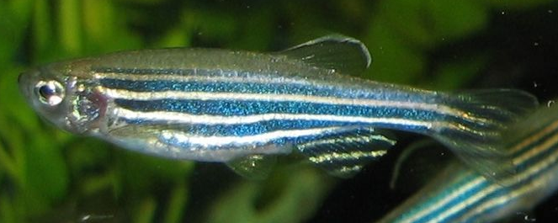
From No Brain to Big Brain
Paramecium (Single Cell)
Bullfrog (~10⁷ neurons)
Lymnaea (~1,000 neurons)
Zebrafish (~10,000 neurons)
Rat (~10⁸ neurons)

Slide 33
Neurons in Brain
Human
Rat
Flog
Human
~ 10¹¹ neurons
~ 10¹⁴ connections
Speed : 1 kHz
Fish

Slide 34
Computer vs. Brain
 | Computer | Human Brain
Key Unit | Transistor | Neuron
No. of units | ~ 10⁹ | ~ 10¹¹
Connection | Copper Wire | Axon + Dendrite
No. of Connections | ~ 10¹⁰ | ~ 10¹⁴
Signal Carrier | Electrons | Ions (Na+, Ca+, K+)
Clock Speed | ~ 1 GHz | ~ 1 kHz
Method | Sequential | Parallel Processing

Slide 35
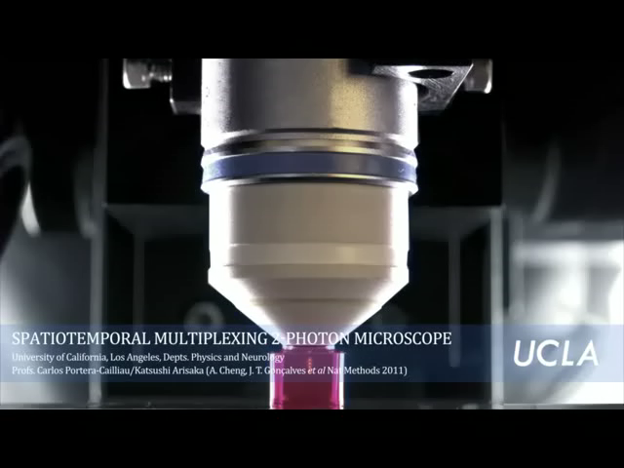
Arisaka’s high-speed Microscope

Slide 36
UCLA Newsroom on January 11, 2011

Slide 37
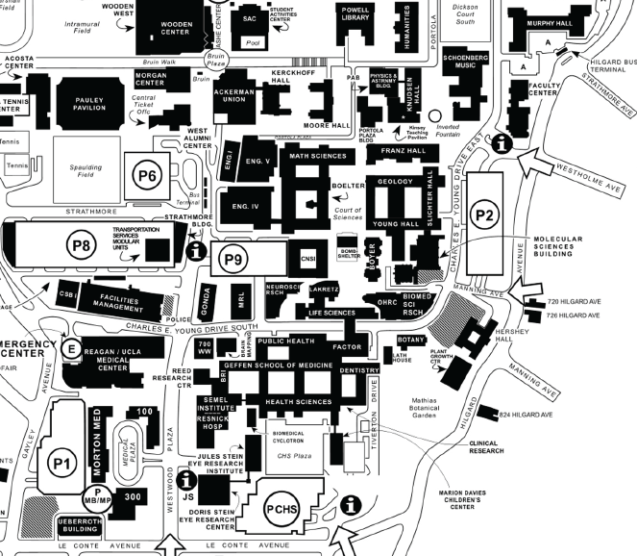
Arisaka’s Campus-wide Collaborations on High-Speed Bio-imaging
Dept. of Physics & Astronomy
(Dolores Bozovic, Mayank Mehta)
Dept. of Electrical Engineering
(Bahram Jalali)
Industrial Partners
(Hamamatsu Photonics,
Photron, Leica)
Dept. of Chemistry & Biochemistry
(Shimon Weiss)
California Nano Systems Institute
(CNSI, Laurent Bentolila)
Dept. of Surgical Oncology
(Manuel Penichet)
Dept. of Neurology & Neurobiology
(Carlos Portera-Cailliau,
Jack Feldman, Tom Otis)

Slide 38
Some Technical Details
Easy-to-follow lecture style
Complete lecture notes & Webcasts
Massive e-mail distribution for intense personal communication (every day)
Special office hours for students below average.
Extensive sample exams and review sessions
Only conceptual questions in the exams

Slide 39
1. Lecture Organization
Always quick review of the previous lecture in the first 5 minutes (to refresh their brains.)
At least one eye-catching demonstration before introduction of a new concept of the day (to get the maximum attention from the students).
Only one new important concept per lecture (that is the maximum students can absorb.)
Absolutely minimum mathematical derivation on a black board (to emphasize physics.)
Enormous examples from daily life and bio/medical examples in class, usually every 5 minutes

Slide 40
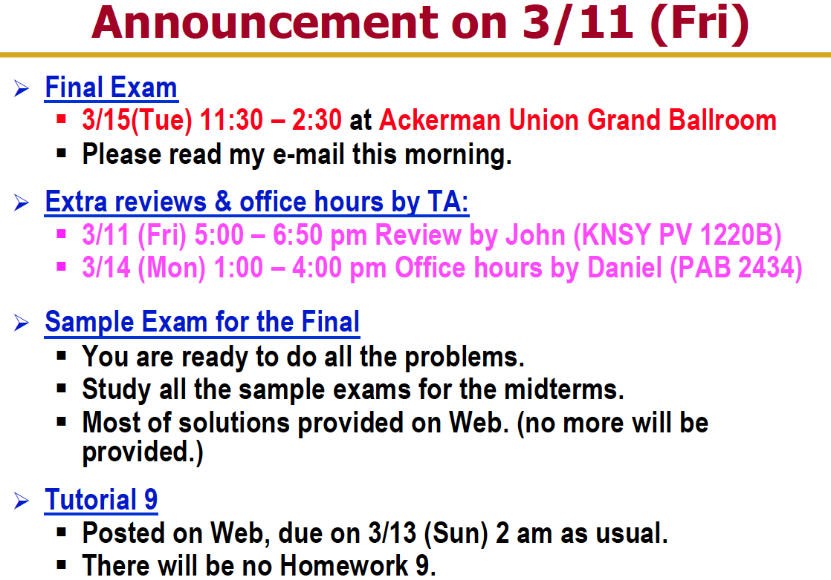
An example of announcement

Slide 41
2. Lecture Note & Webcasts
Students can purchase the complete lecture notes at the beginning of the 10 week course.
Only ~60% of textbook covered.
Summary of the materials
Webcasting all the lectures

Slide 42
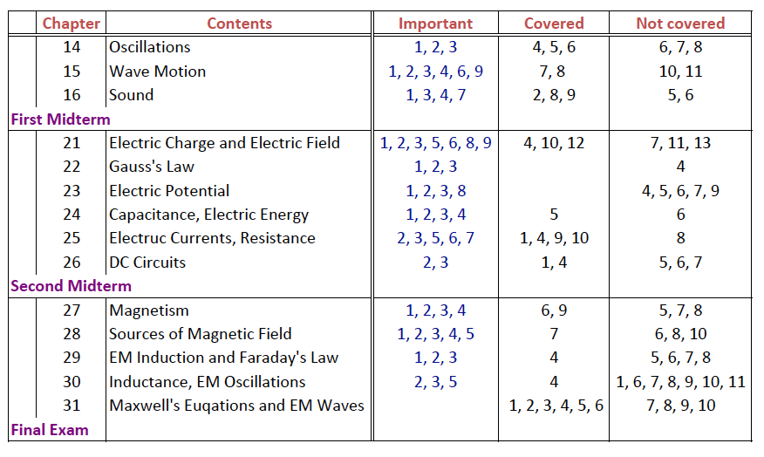
Covered chapters in Textbook

Slide 43
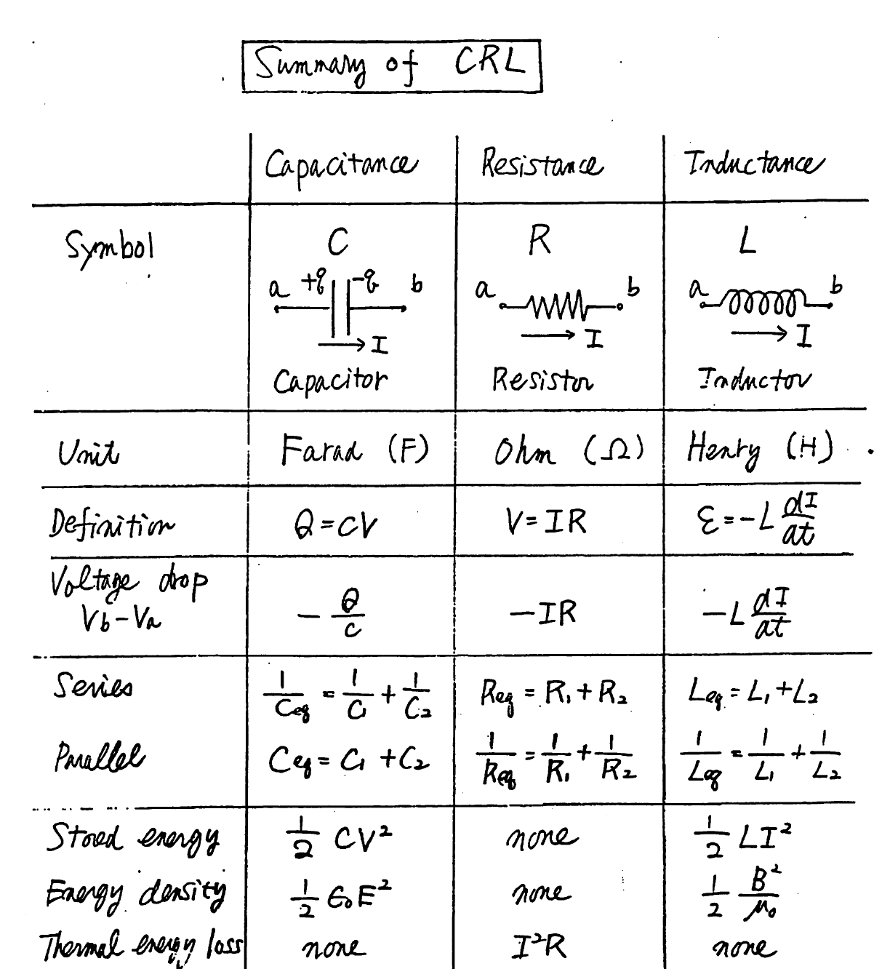

Slide 45
3. E-mails
Administrative information
Home work assignment.
Information for the exams
Summary of today’s lecture
Preview of the next lecture

Slide 48
4. Special Office Hours
Open special office hours only for the students below average in the midterm.
Teach them “how to learn physics by themselves”
Critical thinking.
Become honest to his/her own understanding level

Slide 49
5. Sample Exams and Review Sessions
Sample Exams:
Extremely long, challenging sample exams, based on the real exams in the past.
Extensive Review Sessions.
Two hours (x 3 time slots) for the first midterm
Two sessions of two hours (x 3 time slots) for the second midterm and the final exam
Focusing on the sample exam problems

Slide 50
6. Exams
Very similar to the sample exams.
Only conceptual questions
All the answers must be derived from the most fundamental laws of nature, such as Newton’s law or Maxwell equations by themselves.
No cheat sheet, no calculator, nothing allowed in the exam, except their own brains and pencil.
Memorization is the essential part, because students cannot memorize the abstract concepts and equations unless they understand.
Once they understand, they will never forget.

Slide 51
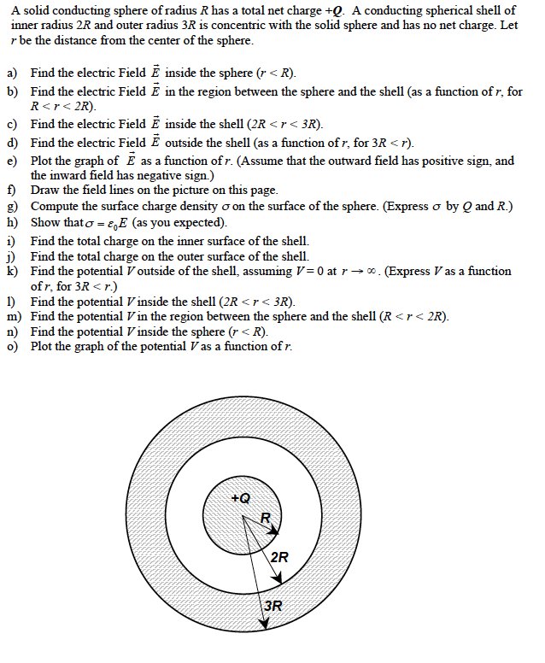
Sample Exam Problem

Slide 52
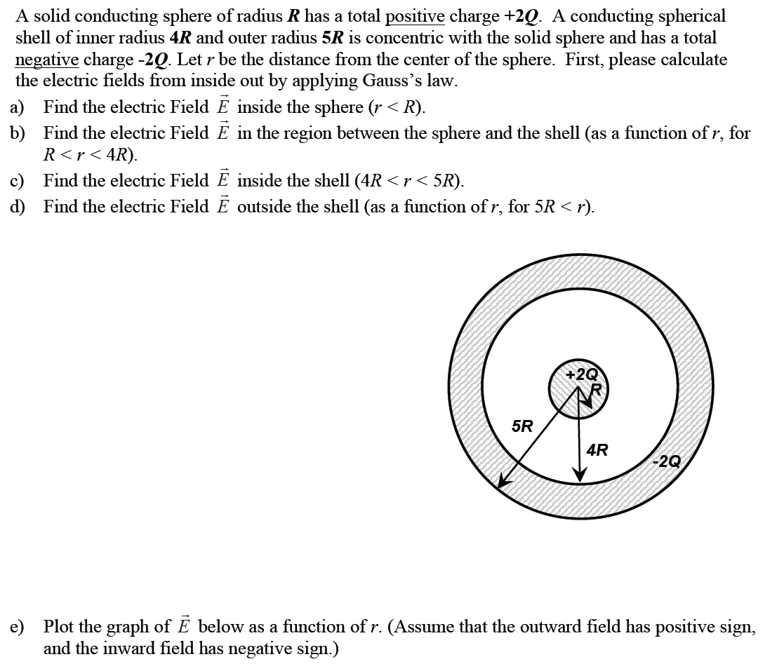
Real Exam Problem

Slide 53
Summary
It is NOT a question of English, but a question of communication skills with students.
There are several technical details which appear effective on communications.
E-mails, office hours, review sessions….
The most important aspect:
Enjoy teaching
Propagate your excitement
Show that you care students.

Slide 54
Web Links of Winter 2011 Class
Physics 6B
https://ccle.ucla.edu/course/view/11W-PHYSICS6B-2
Physics 89 (Honors class)
https://ccle.ucla.edu/course/view/11W-PHYSICS89-1
This presentation
http://home.physics.ucla.edu/~arisaka/Teaching/

