Slide 1
Exploring the Origin of Consciousness by high-speed Optical Microscopes
Katsushi Arisaka
University of California, Los Angeles
Department of Physics and Astronomy

Slide 2
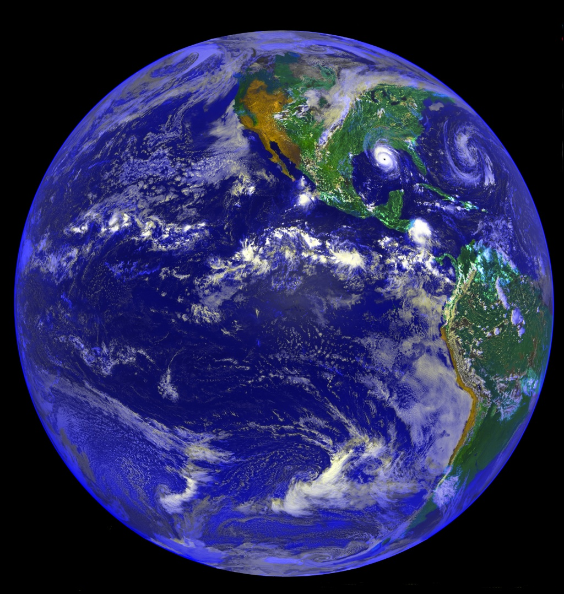
Why are we here?

Slide 3
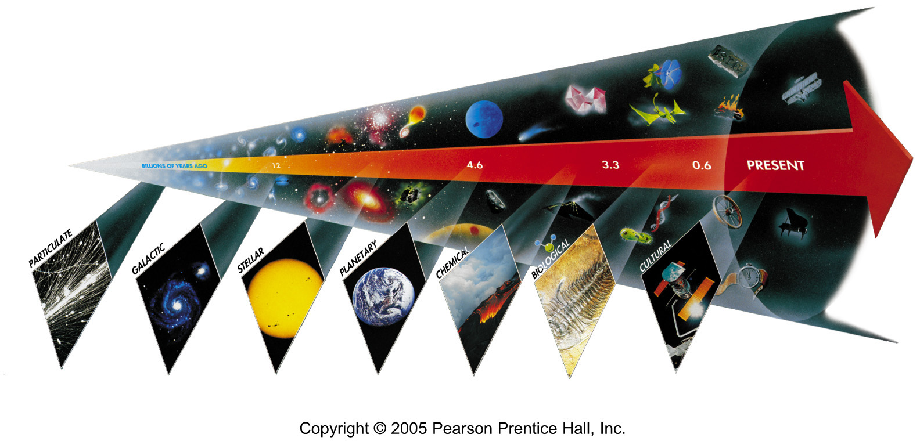
Seven Phases of Cosmic Evolution
14 billion years ago
Origin of
Particles
Origin of
Structure
Origin of
Life
Origin of
Consciousness

Slide 4
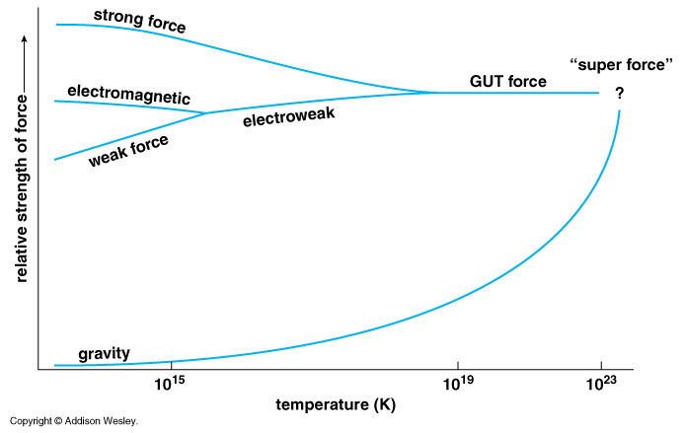
Unification of Forces
Planck Epoch
100 GeV
10¹⁶ GeV
10¹⁹ GeV
10²⁹
10³²

Slide 5
Hubble Deep Field
Physicists’ View of Early Universe
Fiat lux
Let there be light

Slide 6
Hubble Deep Field
Physicists’ View of Early Universe
Lorentz Invariance
Local Gauge Invariance

Slide 7
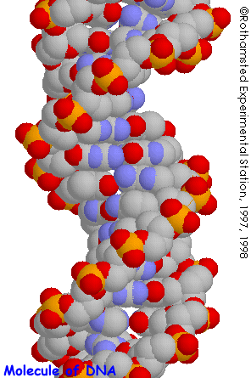
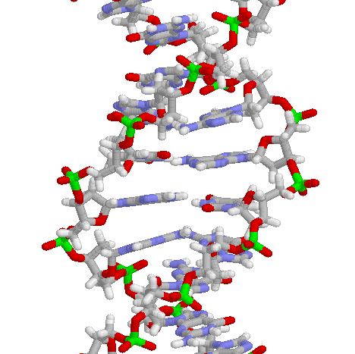
Structure of DNA

Slide 8
Symmetry Breaking
Time
0
Simple
1B years
2
3
4
b
s
µ⁻
W⁺
γ
5
ν_{e}
c
Symmetry
Break Down
τ⁺
d
τ⁻
ν_{e}
6
d
e⁺
Zº
u
ν_{µ}
e⁻
7
u
s
8
b
ν_{µ}
µ⁺
W⁺
c
9
10
11
12
13
Complex
14

Slide 9
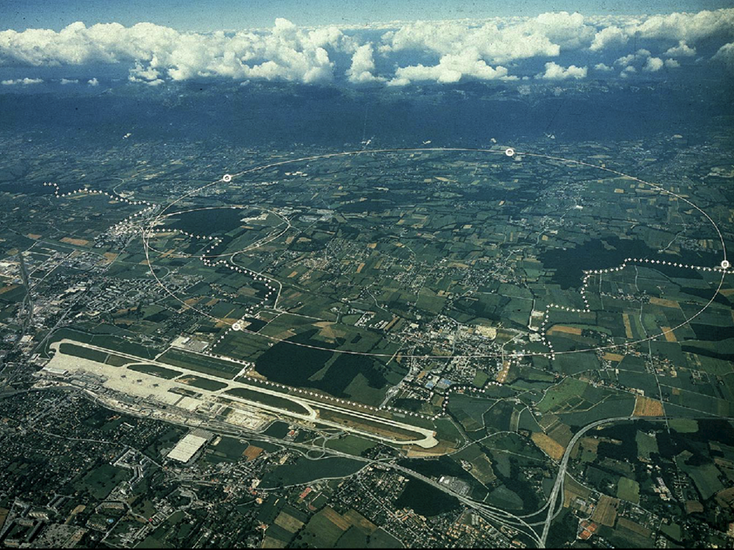
CERN and LHC in Geneva
27km Circumference
7+7=14 TeV

Slide 10
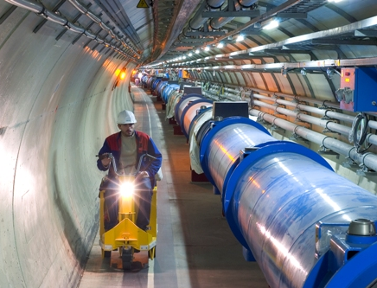
LHC Tunnel with Magnets

Slide 11
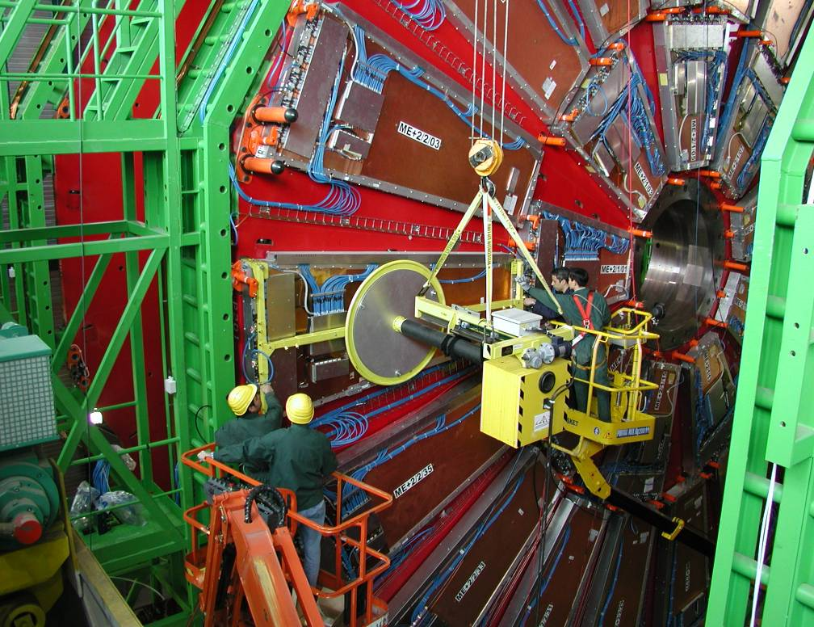
Installing muon Detectors

Slide 12
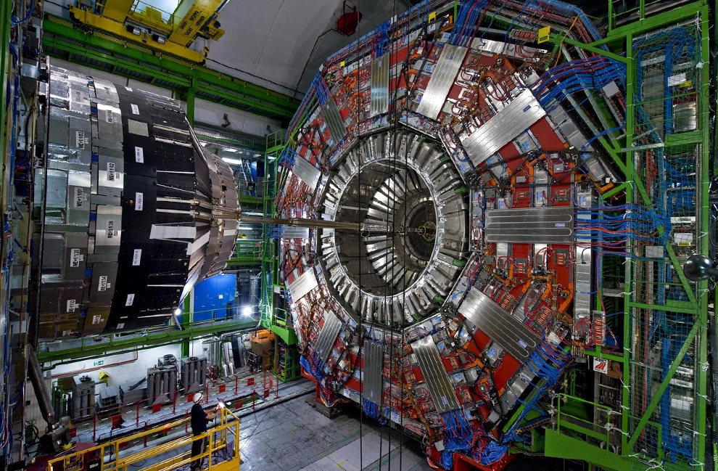

Slide 13
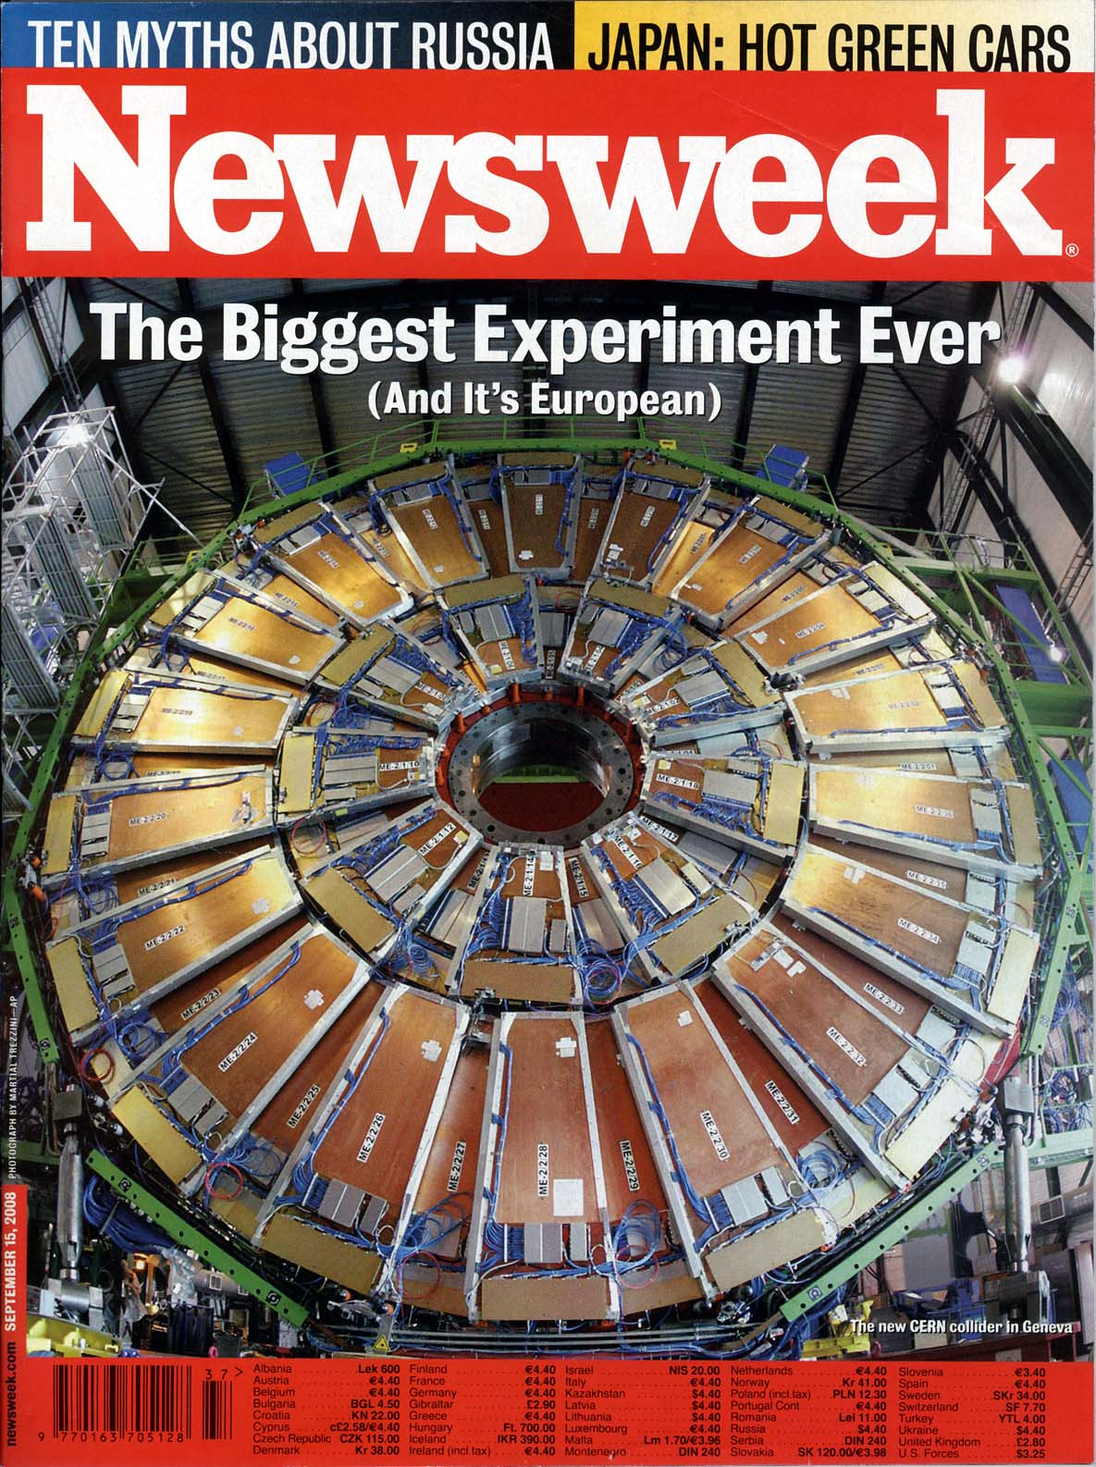
Sept 15, 2008
CMS End-cap Muon Chamber
made at Westwood
in 1999 - 2005

Slide 14
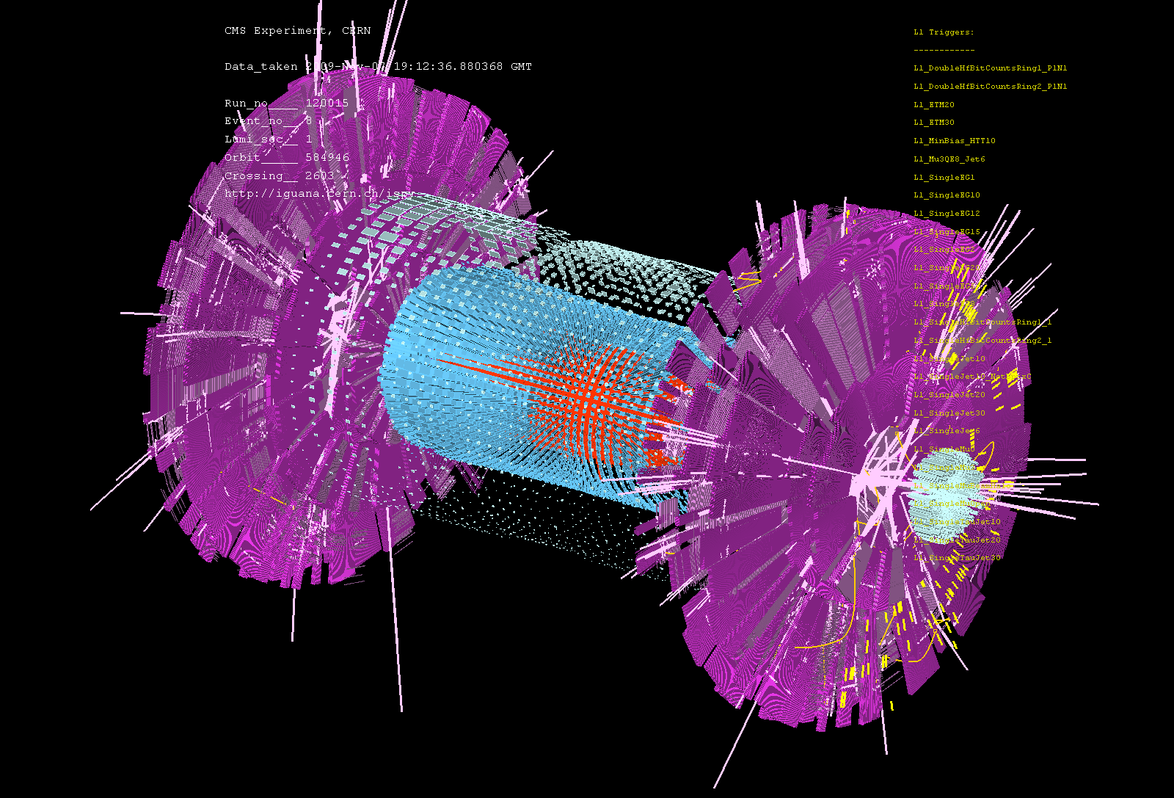
CMS Detector
First Event at LHC – Recreation of the Big Bang! (Nov 7, 2009)

Slide 15
Seven steps of cosmic evolution
Spontaneous Symmetry Breaking
14B years ago
Accelerator
Telescope
Microscope

Slide 16
How to observe the Life and Consciousness ?
We must look for “Live Life”
Exactly the same way as we look for the “Origin of Universe”
Telescope ↔ Microscope
Take advantages of the state of art “Photon Detectors” in particle physics.

Slide 17
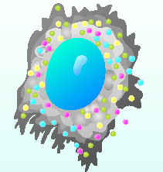
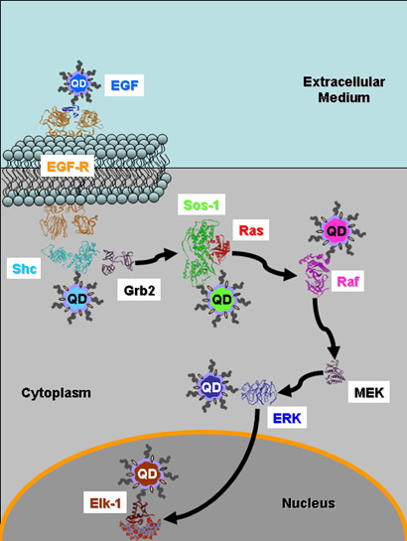
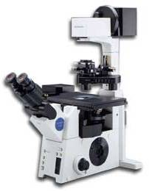
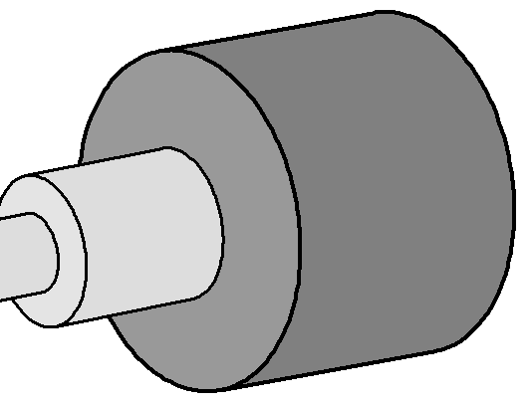
Single Molecule Imaging
January 2006
Shimon Weiss (Chemistry)
It will permit to track multicolor qdot-labeled proteins in live cells virtually background-free
The H33D detector attaches to a standard fluorescence microscope
Nano Technology
Particle Physics Detector
Laser

Slide 18
How to speed up microscopes
All the existing microscopes are limited by the narrow bandwidth of readout.
  Just one channel of FADC (Flash Analog to Digital Converter) running at 10 – 50 MHz
  So-called Video Rate (30 frame/sec)
The first step is to adopt multiple channels of FADC for massive parallel processing.
  Like high energy experiments (such as LHC)
  In addition, we need Single Photon Sensitivity with high Quantum Efficiency.

Slide 19
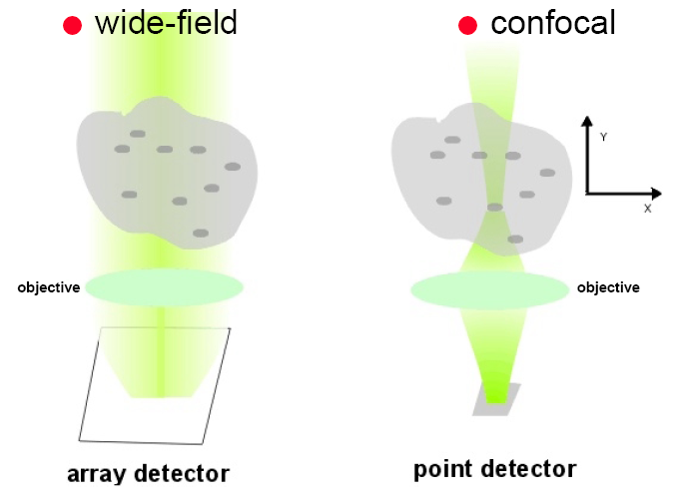
Principle of High-speed Bio Imaging
Wide Field
Confocal
Sample
Sample
Pinhole
CCD + FADC (10 – 50 MHz)
PMT + FADC (10 – 50 MHz)
CMOS [ FADC (50 MHz) * 100 ]
[ HAPD + FADC (1 GHz) ] * 64

Slide 20
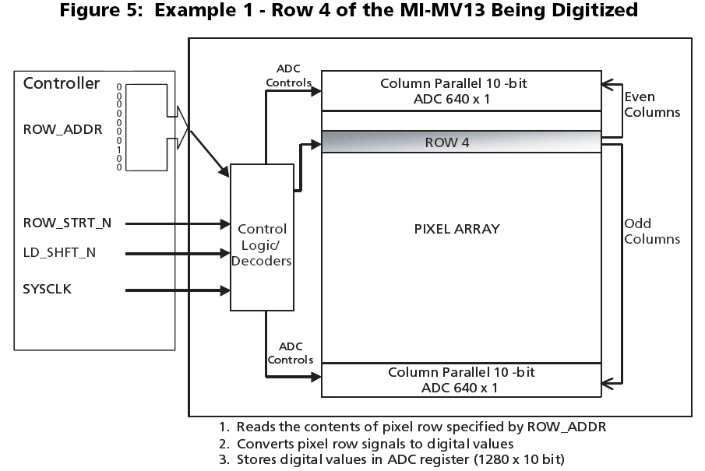
Micron 1.3M-Pixel CMOS Sensor
2 μsec/row
2 msec/frame
(10 bits, 66MHz)

Slide 21
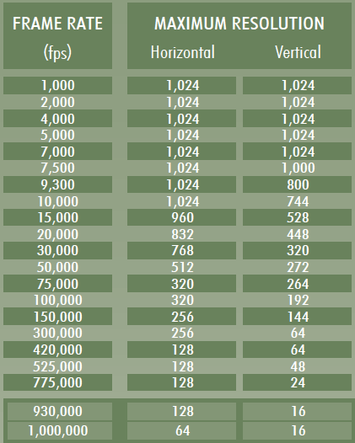
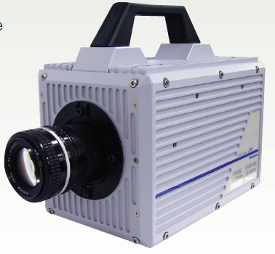
Photron SA-5 CMOS Camera

Slide 22
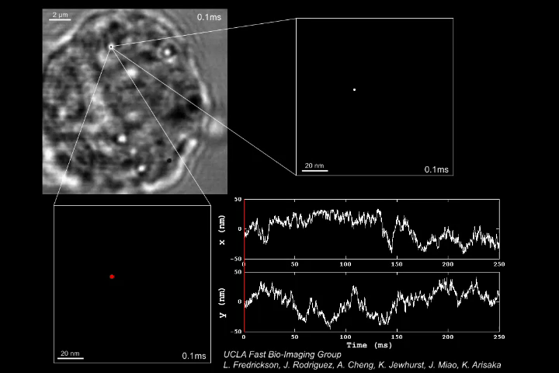
Gold nano particle (40nm) attached to Transferrin Receptor (TfR) on Cancer Cell
Prof. Manuel Penichet (Oncology)
(10, 000 frame/sec)

Slide 23
Mean Squire Displacement <r²> of TfR on a Human Multiple Myeloma Cell vs. Time
?
Type A
Brownian Motion
Type B

Slide 24
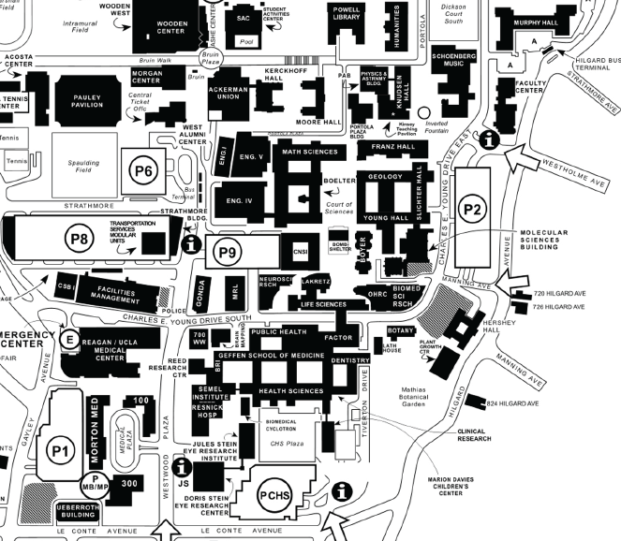
Arisaka’s Campus-wide Collaborations on High-Speed Bio-imaging
Dept. of Physics & Astronomy
(Dolores Bozovic, Mayank Mehta)
Dept. of Electrical Engineering
(Bahram Jalali)
Industrial Partners
(Hamamatsu Photonics,
Photron, Leica)
Dept. of Chemistry & Biochemistry
(Shimon Weiss)
California Nano Systems Institute
(CNSI, Laurent Bentolila)
Dept. of Surgical Oncology
(Manuel Penichet)
Dept. of Neurology & Neurobiology
(Carlos Portera-Cailliau,
Jack Feldman, Tom Otis)

Slide 25
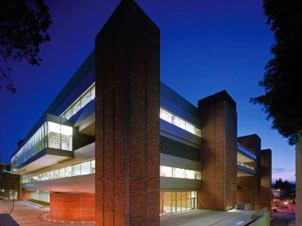
User-shared Core Facility of High-speed Microscopes at CNSI
4D Nano Biophysics

Slide 26
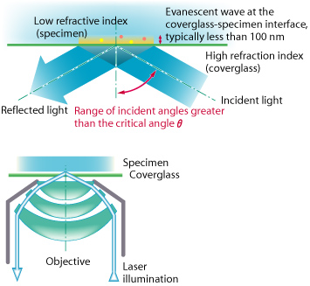
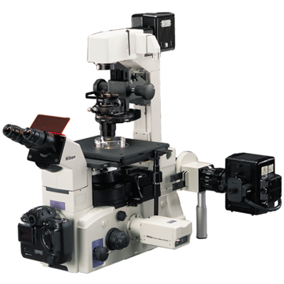
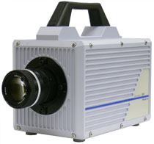
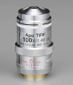
Nikon Microscope TE200E with TIRF at CNSI
Laurent Bentolila (CNSI)
5k – 500k fps
CMOS Camera
Photron SA-1

Slide 27
Principle of ICMOS
Photron
MCP
(Micro Channel Plate)
CMOS Camera
(> 1,000 frame/sec)
CMOS Camera
GaAsP Photocathode
(50% QE)
Multi-channel
High-speed Digitization

Slide 28
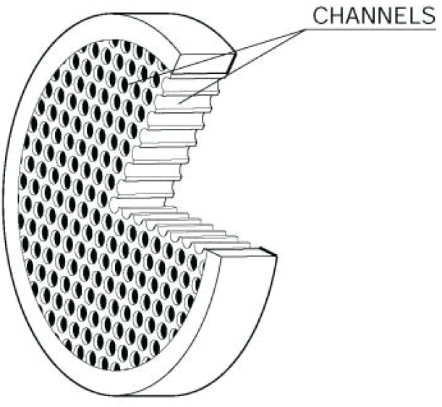
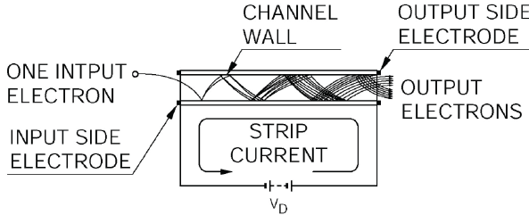
MCP (Micro Channel Plate)
( 5 – 10 μm ϕ)
Gain = 100 - 1000

Slide 29
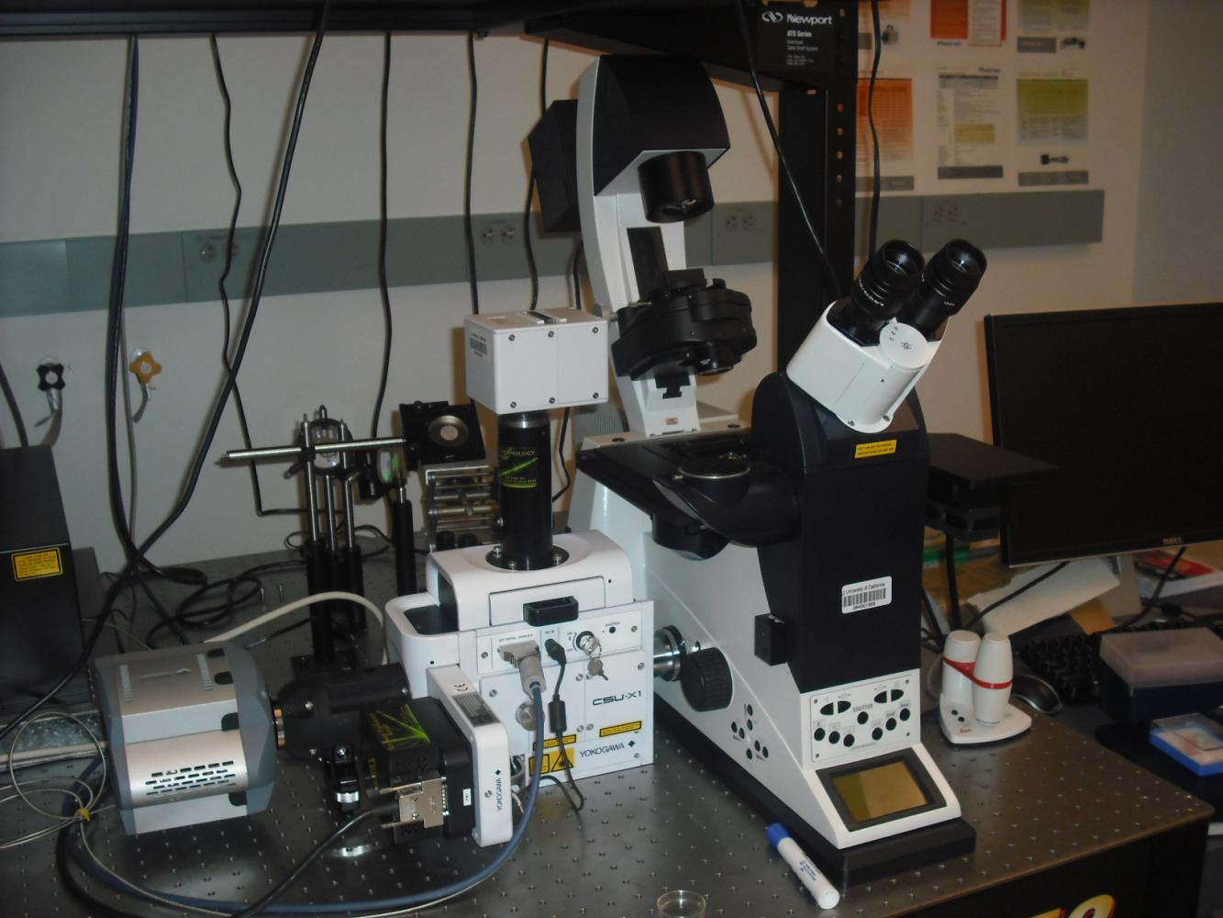
High-speed Confocal Microscope with ICMOS at CNSI
(1,000 frame/s)
ICMOS Camera
(Photron SV200i)
Leica Microscope
Confocal Spinner
(Yokogawa CSU-X1)
EMCCD Camera
(Ando iXon 897)
Laurent Bentolila (CNSI)

Slide 30
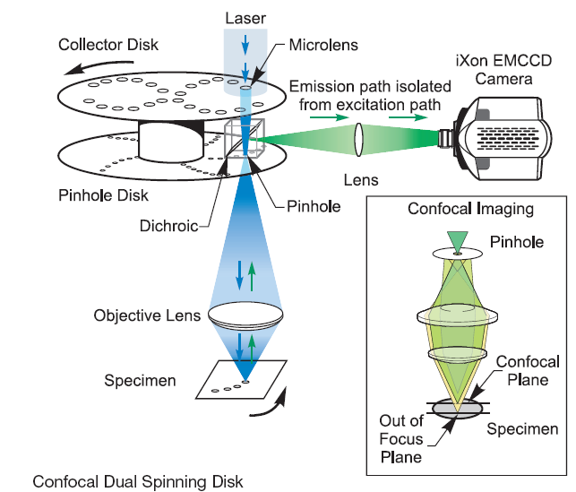
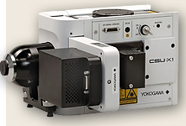
Yokogawa CSU-X1
ICMOS
Camera
2,000 fps

Slide 31
Frame Rate vs. Resolution
1 µsec
CMOS (SA-1)
ICMOS (SV200i)
10 µsec
Frame Rate (frame/sec)
100 µsec
New Systems
64-beam MMM
Confocal Scanner
(Yokogawa CSU-X1)
CCD (Neuro-SMQ)
1 msec
Conventional
4-beam MMM
EMCCD
(iXon 897)
10 msec
CCD (ORCA)
Video Rate
(Response of human eyes)
10 x 10
100 x 100
No. of Pixels (in X-Y)
1000 x 1000

Slide 32
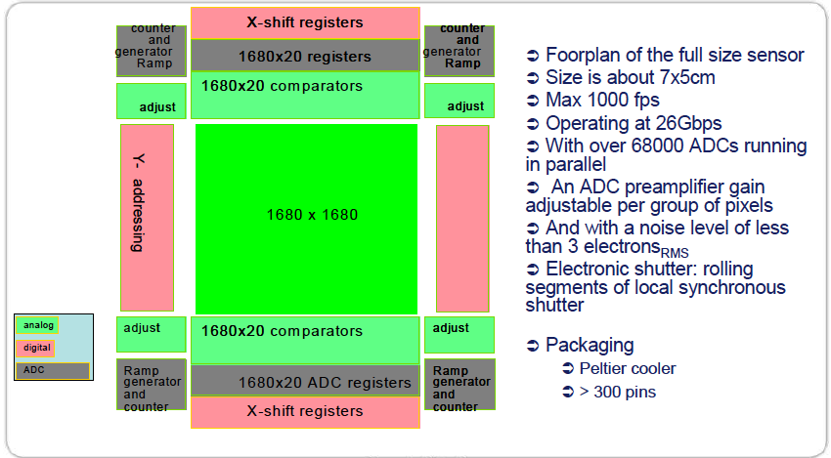
E2V-Caeleste scientific-CMOS (in development)

Slide 33
Origin of Consciousness

Slide 34
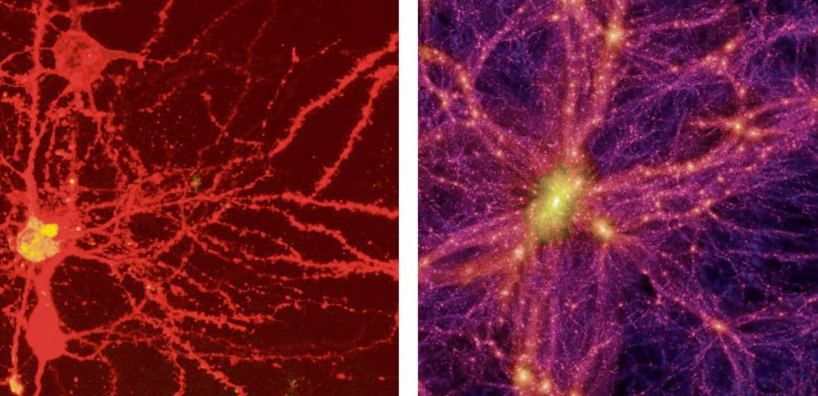
Brain Universe
100 Billions Neurons
100 Billions Galaxies
New York Times 8/21/2006

Slide 35
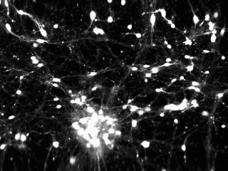
Ca²⁺ Signal in cultivated Rat’s Brain by Confocal Microscope
Andrew Charles (Neurobiology)
15 frame/sec

Slide 36
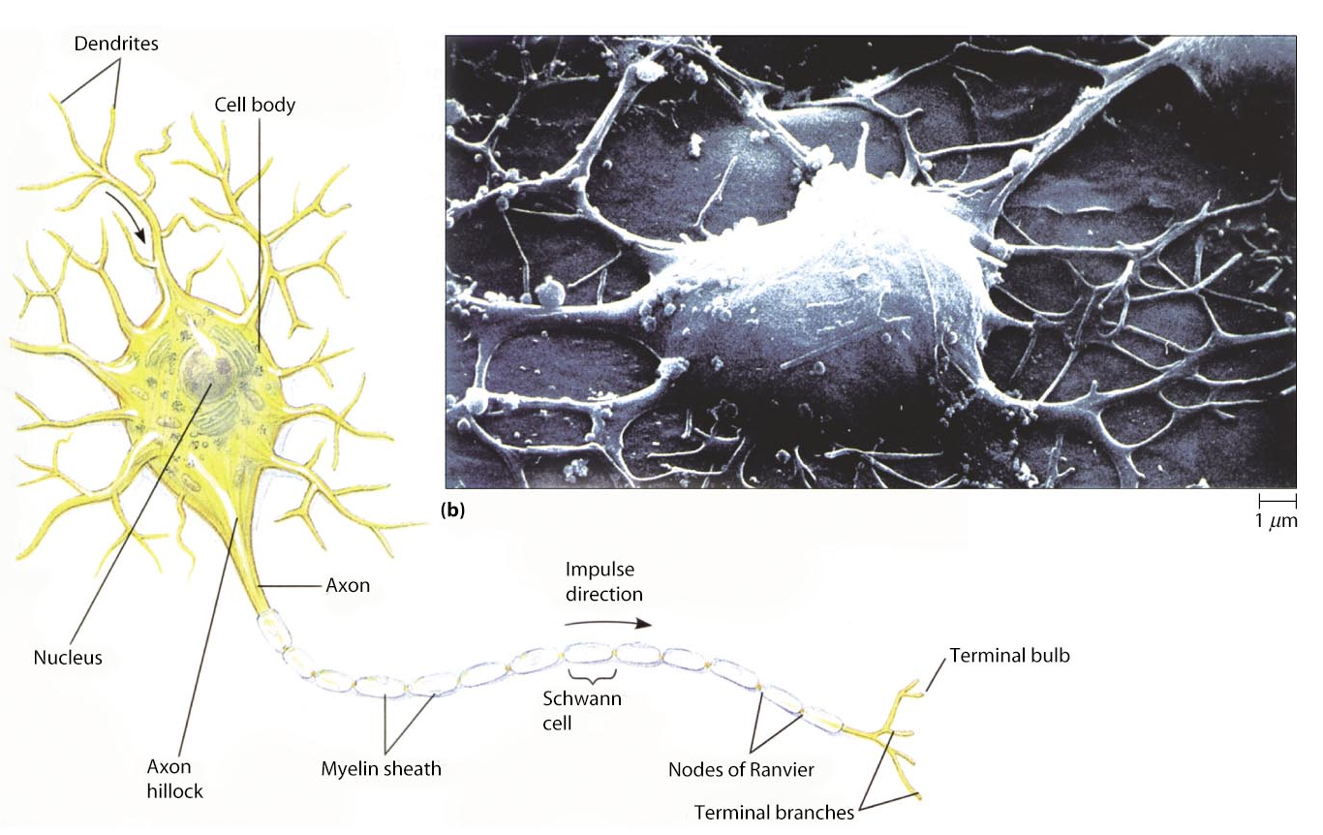
Neurons
Each Neuron has ~1,000 connections (10¹¹ x 1000 = 10¹⁴）
~micrometer scale

Slide 38
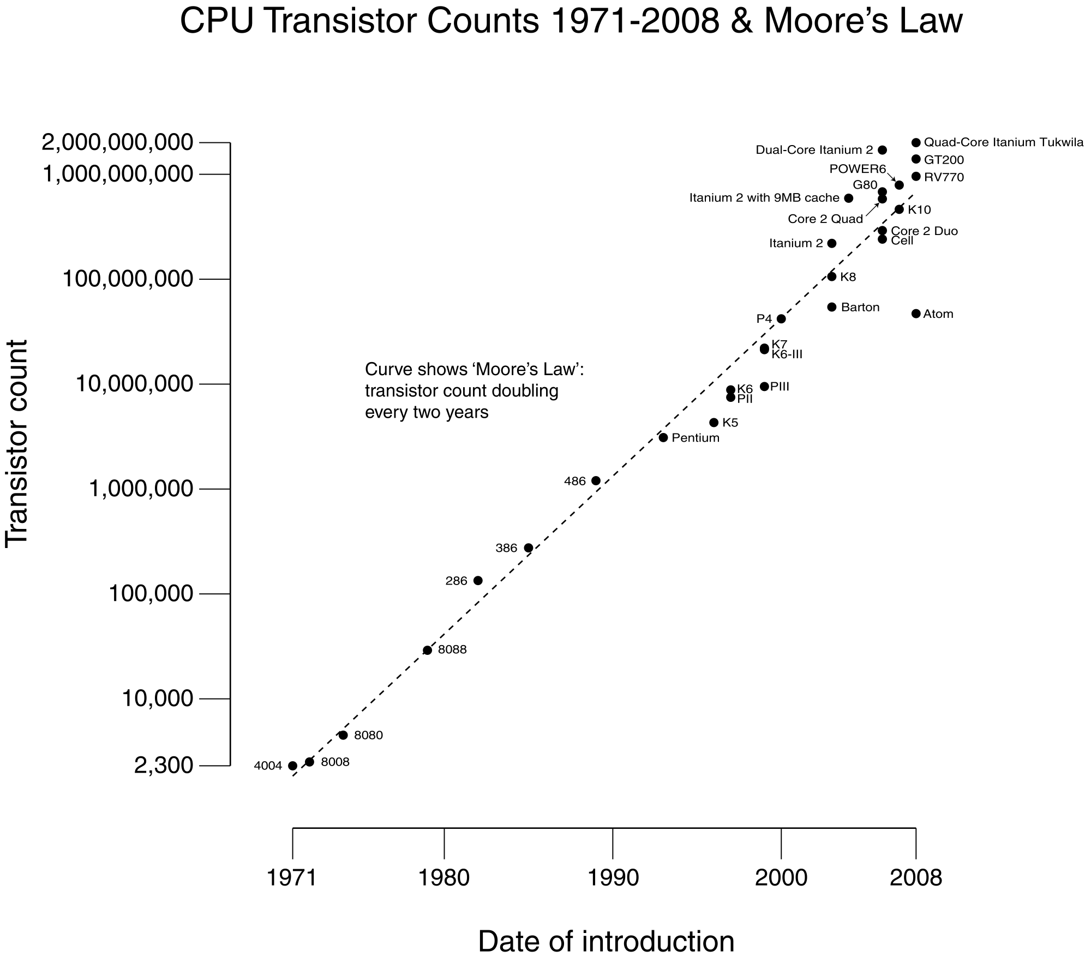
“Moore’s Law” Transistors in Computer
Watson
Watson
#CPUs : 2880 CPU
(~ 10¹² Transistors)
Speed : 3.5 GHz
RAM : 16 TByte

Slide 39
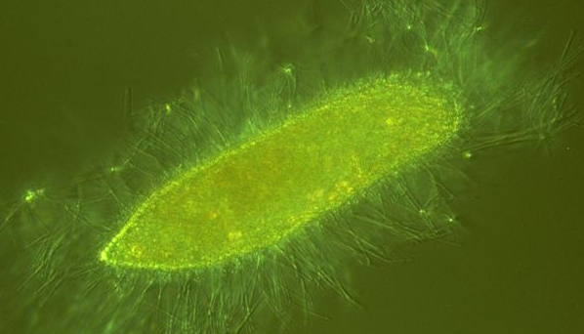
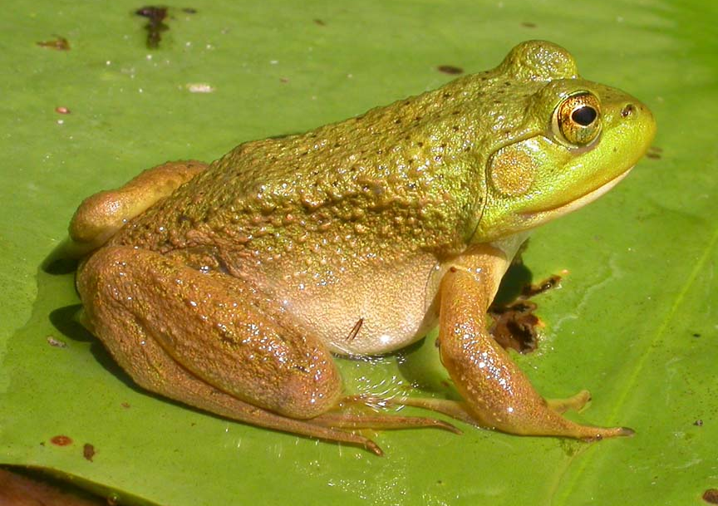
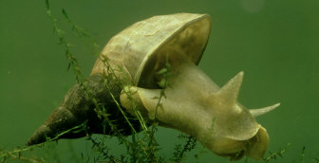
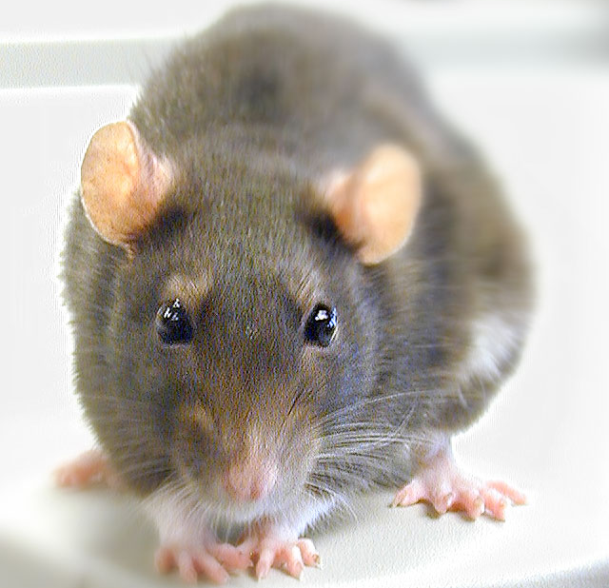
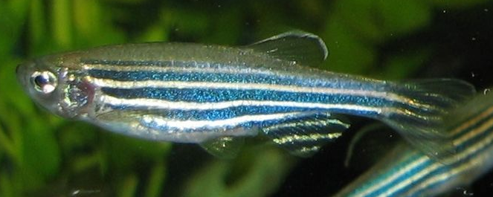
From No Brain to Big Brain
Paramecium (Single Cell)
Bullfrog (~10⁷ neurons)
Lymnaea (~1,000 neurons)
Zebrafish (~10,000 neurons)
Rat (~10⁸ neurons)

Slide 40
Neurons in Brain
Human
Rat
Flog
Human
~ 10¹¹ neurons
~ 10¹⁴ connections
Speed : 1 kHz
Fish

Slide 41
Computer vs. Brain
 | Computer (Watson) | Human Brain
Key Unit | Transistor | Neuron
No. of units | ~ 10⁹ (~10¹²) | ~ 10¹¹
Connection | Copper Wire | Axon + Dendrite
No. of Connections | ~ 10¹⁰ (~10¹³) | ~ 10¹⁴
Signal Carrier | Electrons | Ions (Na+, Ca+, K+)
Clock Speed | ~ 1 GHz | ~ 1 kHz
Method | Sequential | Parallel Processing

Slide 42
Neural Networks for Breathing
~300 neurons in rat’s brain (pre-Botzinger Cells) responsible for breathing
Nature by Naohiro Koshiya (1999)
Jack Feldman (Neurobiology)

Slide 43
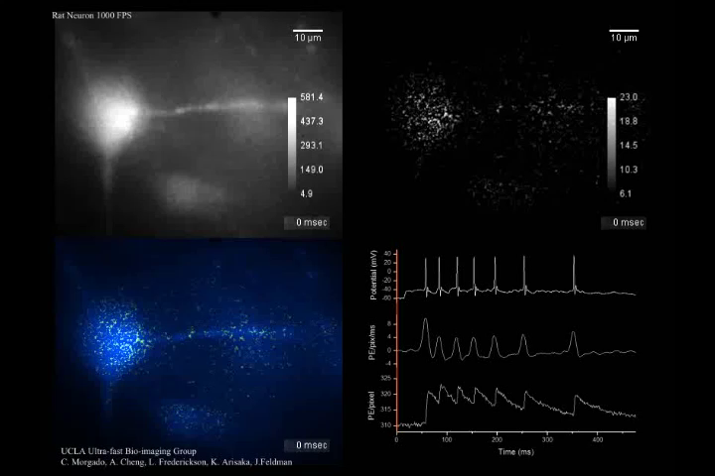
High-speed Ca²⁺ Imaging of pre-Botzinger Cells of Rats
Prof. Jack Feldman (Neurobiology)
(1, 000 frame/sec)

Slide 44
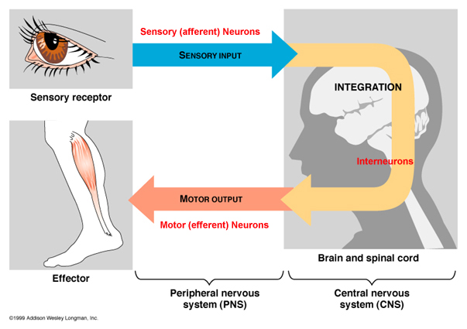
Sensory Input and Decision Making in Brain

Slide 45
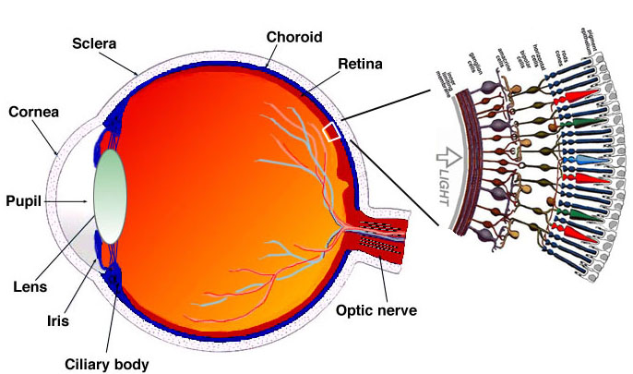
Human Eyes
~100M photo receptors
540M years ago（Cambria explosion）

Slide 46
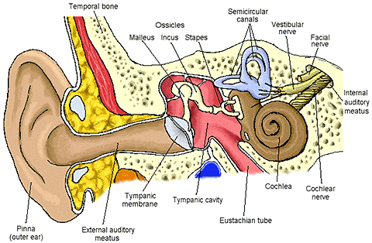
Human Ears
~10,000 Hair Cells
~50M years ago

Slide 47
Anatomy of Inner Ear
Dolores Bozovic (Physics)
Human auditory system
Cross-section of the cochlear
Hair bundle
Molecular mechano-transduction machinery
Meredith LeMasurier and Peter G. Gillespie, Neuron, Vol. 48,2005

Slide 48
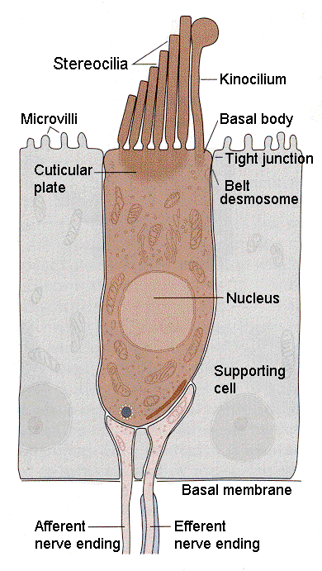
Simultaneous observation of entire process
Mechanical Motion
Ca²⁺ Intake
Action Potential Propagation
in Hair Cell
Receptor in Synapse
Action Potential Propagation
Into Dendrite

Slide 49
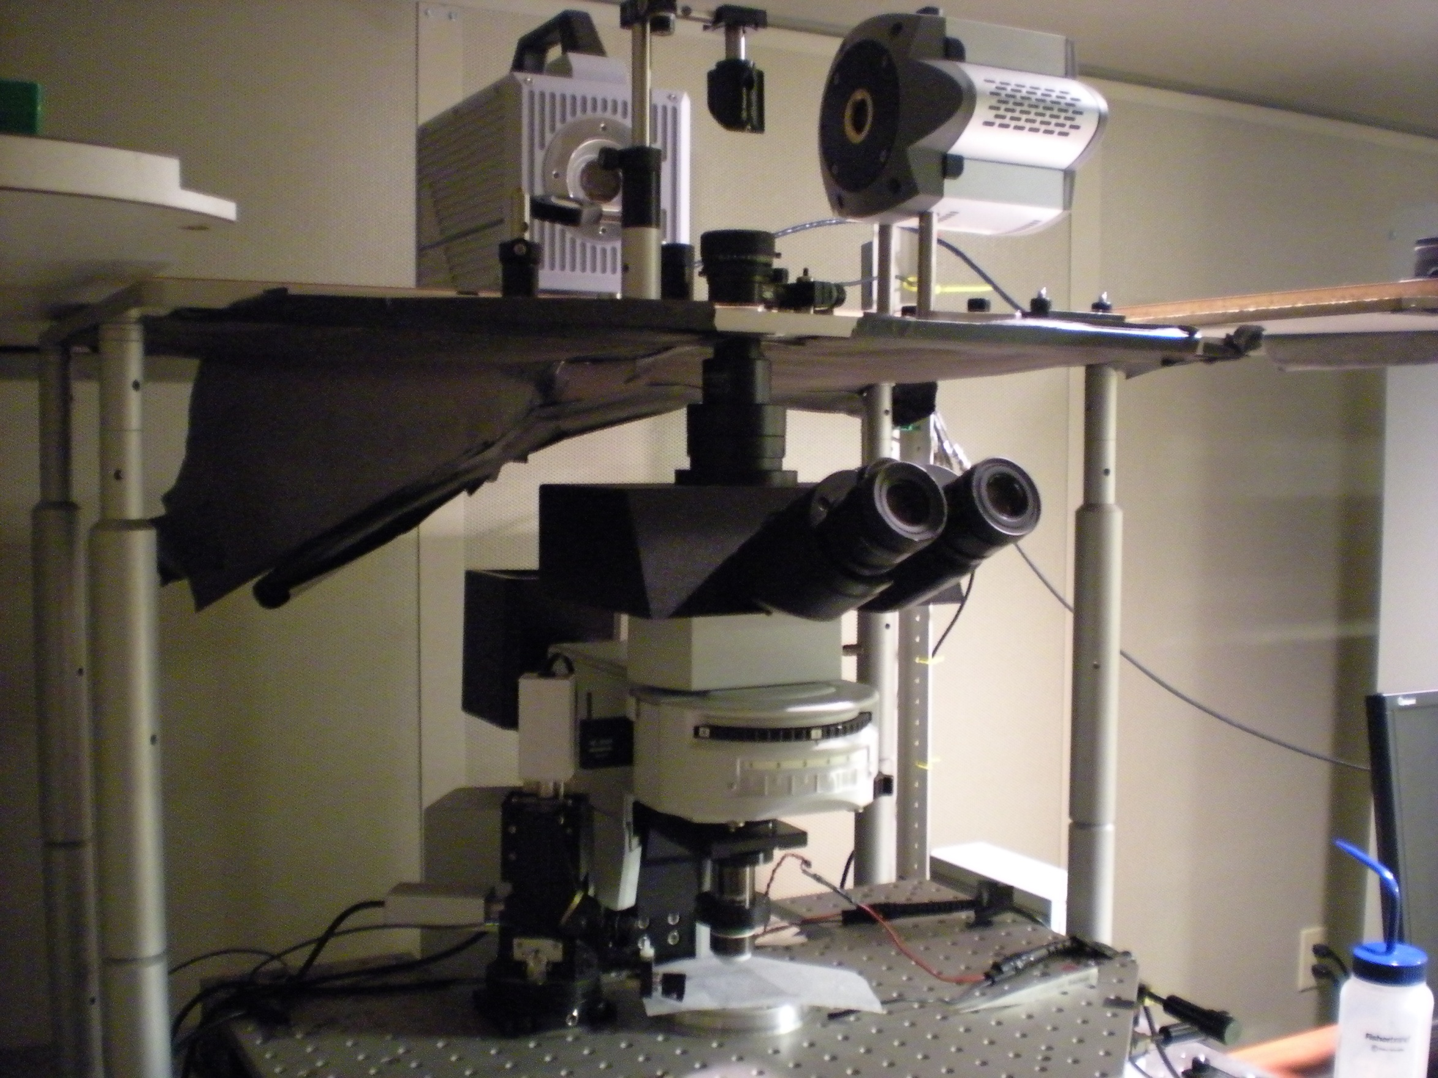
CMOS Camera
(Photron SA-1)
EMCCD Camera
(Andor iXon 897)
Microscopes
Objective
Dolores Bozovic’s Lab (Physics)

Slide 50
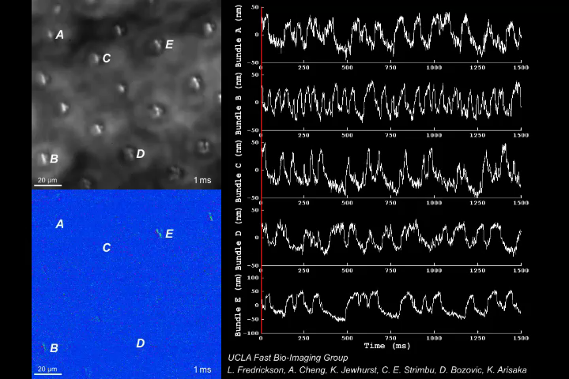
Mechanical Motion of Hair Cells in Inner Ear
Prof. Dolores Bozovic (Physics)
(1, 000 frame/sec)

Slide 51
Mystery of Hearing
Extremely wide dynamic range in amplitude.
  10⁶ compressed to 100
  Smallest amplitude is 0.3 nm
Extremely wide frequency range.
  20 Hz – 20 kHz
    Dynamic range of 1000
    Corresponding to 10⁶ in k
  Selectivity of 0.2%
    up to 5 kHz
  How can the brain handle up to 20 kHz?
    miss match to the speed of action potential of 1 kHz

Slide 52
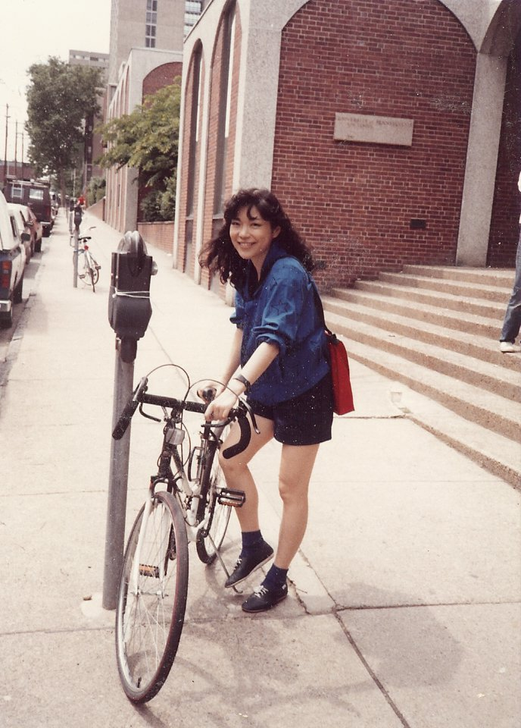
How can I recognize a woman so far away?
Genetically encoded?
Learning and memory?

Slide 53
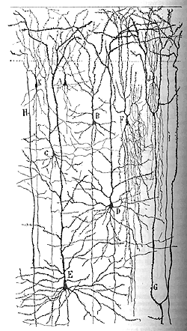








Nature vs. Nurture
Nature
Nurture

Slide 54


The Cerebral Cortex
Conscious
7
2/3
4
5
Unconscious
6
Thalamus
Subcortical areas

Slide 55

Assembly of rat’s cortical circuits during development
How/when do neurons establish networks? → Symmetry Breaking
Carlos Portera-Cailliau (Neurology)
Miller, 1981

Slide 56


Mutiphoton Microscope
Conventional
Confocal
Two Photon Excitation
500 – 600 nm
500 – 600 nm
440 nm
880 nm

Slide 57
Principle of High-speed Bio Imaging
Wide Field
Confocal
Sample
Sample
Pinhole
CCD + FADC (10 – 50 MHz)
PMT + FADC (10 – 50 MHz)
CMOS [ FADC (50 MHz) * 100 ]
[ HAPD + FADC (1 GHz) ] * 64

Slide 58



Hamamatsu Hybrid APD
Single Channel HAPD
64 Channel HAPD
+ Readout
Motohiro Suyama
(Hamamatsu)
Xavier Michalet
Shimon Weiss
(Chemistry)

Slide 59

Quantum Efficiency of UBA, GaAsP and GaAs
50% QE

Slide 60

1, 2, 3 … Photo-electron Distribution
True photon counting
2
3
4
1
5
6 Photo-electrons

Slide 61


Decay Time Measurement by HAPD
Pulse Shape
Decay Time
FWHM = 1.5 ns
Time Resolution = 80 psec
No after pulse

Slide 62

Spatio-Temporal Excitation-Emission Multiplexing (STEM) Microscope
80 MHz
(100 fs pulse)
Adrian Cheng (Physics)
Carlos Portera-Cailliau (Neurology)
4 Beams
240 frame/sec
0 ns
+3 ns
+6 ns
+9 ns
1 kHz
16 kHz
HAPD #1
HAPD #2

Slide 63



In vivo calcium imaging of neuronal activity

Slide 64
150 μm deep
Adrian Cheng
(Physics)
Tiago Goncalves,
Peyman Golshani,
Carlos Portera-Cailliau (Neurology)
3D Structure of
Barrel Cortex
of Mouse

Slide 65

In vivo calcium imaging of Barrel Cortex of Mouse
Beam 1
(0 ns)
Barrel Cortex
Layer 2/3
150 μm deep
240 fps
Raw Data
(x3 faster
than real)
Beam 2
(+3 ns)
Beam 3
(+6 ns)
Beam 4
(+9 ns)
300 μm

Slide 66

In vivo calcium imaging of Barrel Cortex of Mouse
Barrel Cortex
Layer 2/3
150 μm deep
After averaging
(x3 faster
than real)
58 neurons
(~100 billons neurons
in our brain)
300 μm

Slide 67
In vivo calcium imaging of layer 2/3 neurons in barrel cortex with STEM
Adrian Cheng (Physics)

Slide 68
90 μm
120 μm
150 μm
180 μm
Adrian Cheng
(Physics)
Tiago Goncalves,
Peyman Golshani,
Carlos Portera-Cailliau (Neurology)
3D Structure of
Barrel Cortex
of Mouse

Slide 69

Simultaneous in vivo calcium imaging in 4 axial planes
Barrel Cortex
Layer 2/3
60 fps
(x3 faster
than real)
Beam 1
Beam 2
Beam 3
Beam 4

Slide 70


Simultaneous in vivo calcium imaging of neuronal activity in 4 axial planes with STEM
Adrian Cheng (Physics)

Slide 71
UCLA Newsroom on January 11, 2011

Slide 72
Block Diagram of Multi-beam Confocal Microscope
64 ch Photon Detector
8 ch Digitizer x 8
4 ch DAQ System x 16
FADC
FADC
FPGA
CPU
FADC
Fiber
Bundle
Encoder
Box
64 ch
HAPD
Pre
Amp
FADC
Memory
FADC
FADC
FPGA
CPU
Dichroic Filter
Box
FADC
FADC
Memory
Beam
Splitter
Ti:Sa Laser
xyz
Beam
Scanner
Timing
Position Controller
Objective Lens
10 TB
RAID
Sample Scanner

Slide 73
Future Directions
- Virtual Reality -

Slide 74

How can we recognize
and memorize the space?
Mayank Mehta (Physics, Neurology)
Tetrodes

Slide 75

Activity of (excitatory) pyramidal neurons in CA1 depends on rat’s position: place cells
Mayank Mehta (Physics, Neurology)
Hippocampus has a cognitive map of space

Slide 76

Learning and Memory by Hippocampus
Motion Direction
After learning
Before learning
Mayank Mehta (UCLA)

Slide 77
Origin of the Brain
Brains were evolved for animals to predict necessary motions for survival.
  Find preys
  Escape away from predators
  Find mates for sex
A brain “consciously” makes the best decision at a given time.
Complex activities of brains are the results of evolution of life.

Slide 78

Virtual Reality Experiment on Awake Rats
Olfactory
Stimulator
Mayank Mehta
(Physics)
funded by Keck
Foundation ($1M)

Slide 79

A rat running in a Virtual Reality

Slide 80



Optogenetic Excitation of Neurons
Karl Deisseroth (Stanford)
Excitation by
Channelrhodopsin-2
(ChR2)
Inhabitation by
Halorhodopsin
(NpHR)

Slide 81
Outer world vs. Inner word
Outer world : Five senses → Manipulate by Virtual Reality
  Vision
  Sound
  Touch
  Smell
  Taste
Inner world → Manipulate by Photo Excitation of single neurons
  Neural network in brain
Establish direct link between Inner world & Outer world
  Control outer world – Virtual reality
  Control inner world – Neural reality

Slide 82
The Origin of Consciousness
Our brains are making enormous parallel processing “unconsciously” all the time.
  Image processing
  Language
  Recognition of space-time
“Consciousness” is merely the outcome of the decision making processes which have been performed unconsciously.
  Language and logics are just left-over from the past.
  We realize what we said only after we spoke.

Slide 83
Summary

Slide 84
Seven Phases of Cosmic Evolution
14 billion years ago
Origin of
Particles
Origin of
Structure
Origin of
Life
Origin of
Consciousness

Slide 85
Four Major Science
Origin of Particles
Particle Physics
Origin of Universe
Cosmology
Origin of Life
Molecular Biology
Origin of Consciousness
Neurophysics

Slide 86
Future of Ultra High-speed Bio Imaging
Origin of Life:
  Networks of molecules in/on a cell
  Competition against Brownian : 10 – 100 nm / 1 msec
Origin of Consciousness:
  Neural networks
  Action potentials: 1 msec
> 1,000 frame/sec with nano second time stamp.
  Gated Image Intensified CMOS
  Super-PIAS (GHz Photon-counting Imager)
  6D Imaging by Streak-CMOS Camera

Slide 87
Concluding Remarks
“Life” is a complex system in 4 dimensional space-time.
  Emergent property
  Strongly interacting
Countless “spontaneous symmetry breakings” during the evolutional and developing process of life
Fully controlled experiments by “Virtual Reality” under way.
  Outer world (environment) vs. Inner world (brain)
“Ultra high-speed optical imaging” may reveal the fundamental principle of the brain function such as consciousness.

Slide 88
Thanks to all the Collaborators!
Scientific Objectives | Department | Prime PI | Other Senior Person | Grad Students | Sample | High-speed Microscopes | Funding | Activities
Neurophysics (Virtual Reality) | Physics & Astronomy, Neurology | Mayank Mehta |  | Daniel Aharoni, Bernard Willers | Rat | 2PE, Tetrode | Keck Foundation | 2009 - Now
Hair cell motion | Physics & Astronomy | Dolores Bozovic |  | Lea Fredrickson | Frog | CMOS | NSF MRI | 2007 - Now
Neutral Networks | Physics & Astronomy | Katsushi Arisaka | Luis Beltran-Parrazal | Adrian Cheng | Zebrafish | 2PE, Conforcal | NSF MRI | 2008 - 2009
Single Molecule | Chemistry | Shimon Weiss | Xavier Michalet, Adrian Cheng | Daniel Aharoni | Cells | 64ch FCS, ALEX | NIH R01 | 2006 - Now
TfR tracking on Cancer cells | Oncology, Physics & Astronomy | Manuel Penichet, John Miao | Gustavo Helguera, Jose Rodriguez |  | Cells | CMOS, ICMOS | (NSF MRI shared) | 2007 - 2008
Neural networks for breathing | Neurobiology | Jack Feldman | Consuelo Morgado | Adrian Cheng | Rat | ICMOS, Confocal | (NSF MRI shared) | 2007 - 2008
Neural networks (Voltage sensing dyes) | Neurobiology | Tom Otis |  | Bernard Willers | Sliced Brain | ICMOS, 2PE | NIH Rec. Act | 2009 - Now
Development of neural networks | Neurology | Carlos Portera-Cailliau | Adrian Cheng, Tiago Goncalves | Phuc Hoang | Mouse | 2PE | NIH Rec. Act | 2008 - Now
High-speed Imaging Flow Cytometer | Electrical Engineering | Bahram Jalali |  |  | Cells | ICMOS |  | 2009 - Now
Core facility of High-speed Bio-imaging | CNSI | Shimon Weiss | Laurent Bentolila |  | Anything | CMOS, ICMOS, EMCCD | CNSI internal | 2008 - Now
Multi-channel HAPD, LCOS | Hamamatsu | Suyama Motohiro |  |  |  | 2PE, EMCCD | EMCCD, LCOS donated | 2006 - Now
CMOS Cemera | Photron | Tak Takimizu |  |  |  | CMOS, ICMOS | 3 CMOS donated | 2007 - Now
High-speed Microscope | Nikon, Leica | Jeff Huber, Thomas Zhapf |  |  |  | CMOS, ICMOS, 2PE | Microscope discounted | 2009 - Now

