Slide 1
Dark Matter Programs at UCLA
Katsushi Arisaka
University of California, Los Angeles
Department of Physics and Astronomy
arisaka@physics.ucla.edu

Slide 2
UCLA Dark Matter Programs
Direct Search
David Cline, Katsushi Arisaka, Hanguo Wang
Xe : ZEPLIN-II → XENON100 → XENON 1Ton
Ar : DarkSide50 → DarkSide 5Ton
G3 : MAX, XAX
Indirect Search
Rene Ong VERITAS → GAPS
Vladimir Vassiliev VERITAS → CTA
David Saltzberg ANITA
Theory
Graciela Gelmini DAMA/CoGeNT
Alex Kusenko Sterile Neutrino

Slide 3
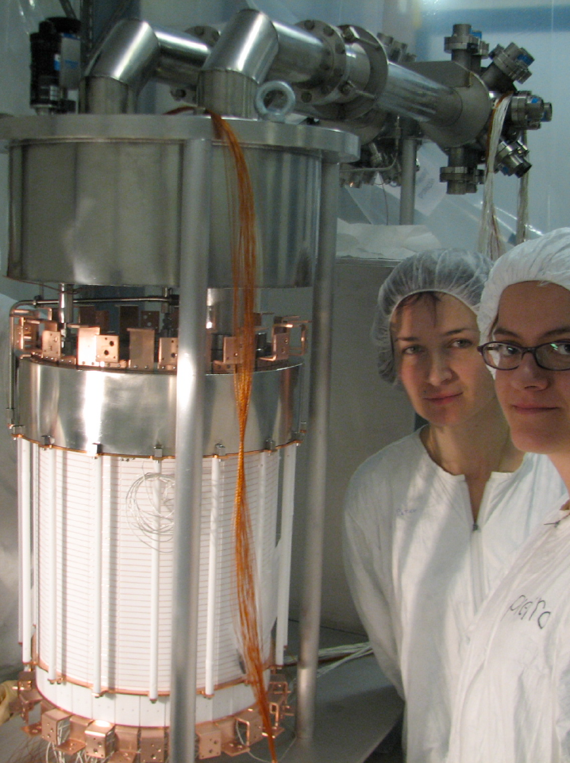
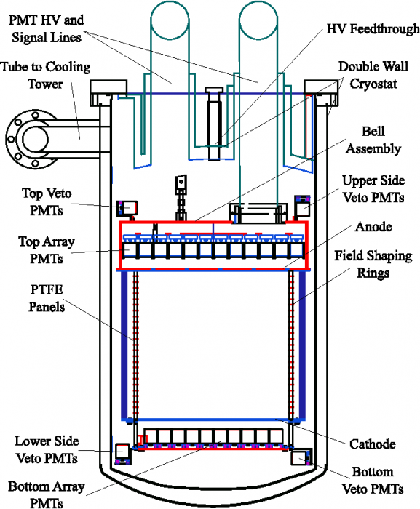
XENON100 Detector
162 kg
(48 kg)

Slide 4
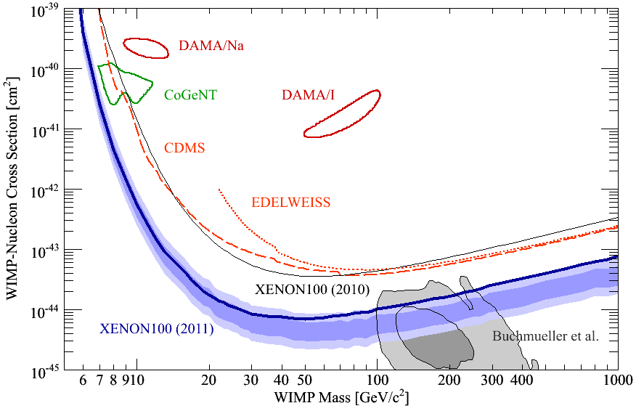
90% CL Limits of SI Cross Section
100 days, 48 kg, 3 events

Slide 5
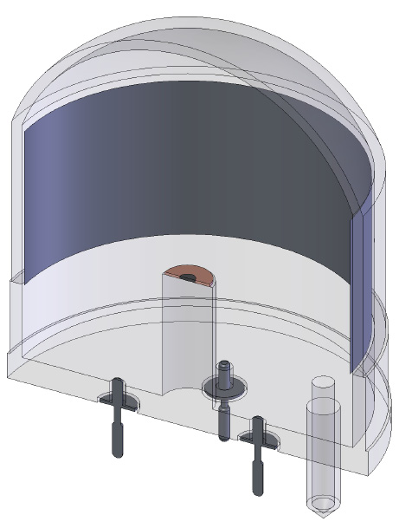
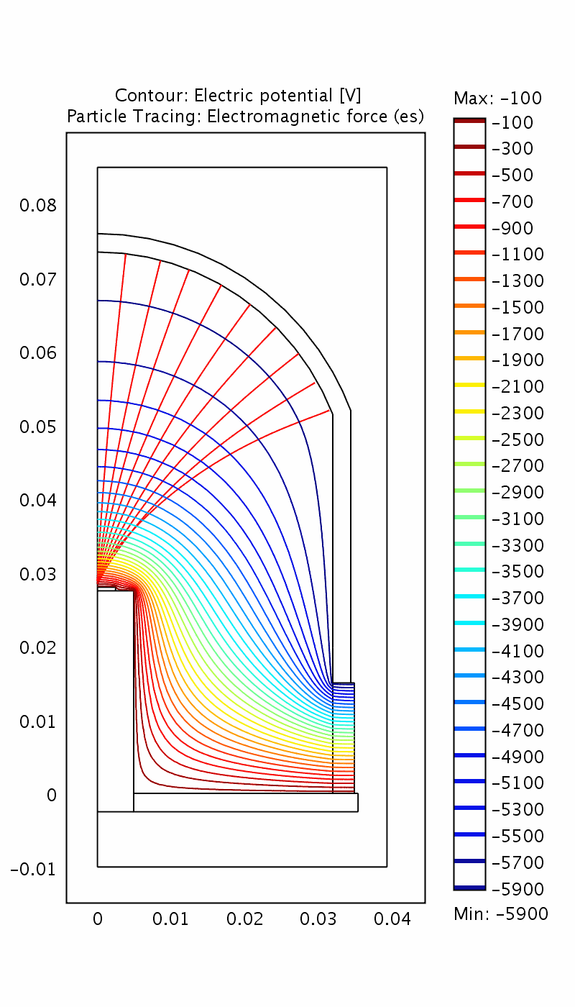
QUPID (QUartz Photon Intensifying Detector)
Katsushi Arisaka, Hanguo Wang
Photo Cathode
(-6 kV)
Photo Cathode
(-6 kV)
Quartz
Al coating
APD (0 V)
APD (0 V)
Quartz

Slide 6
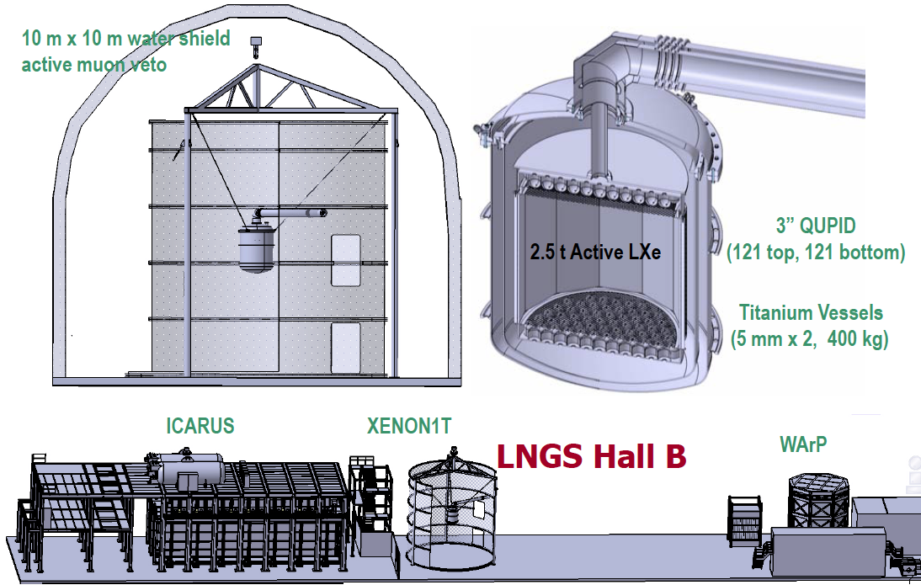
XENON1T
Katsushi Arisaka, Hanguo Wang

Slide 7
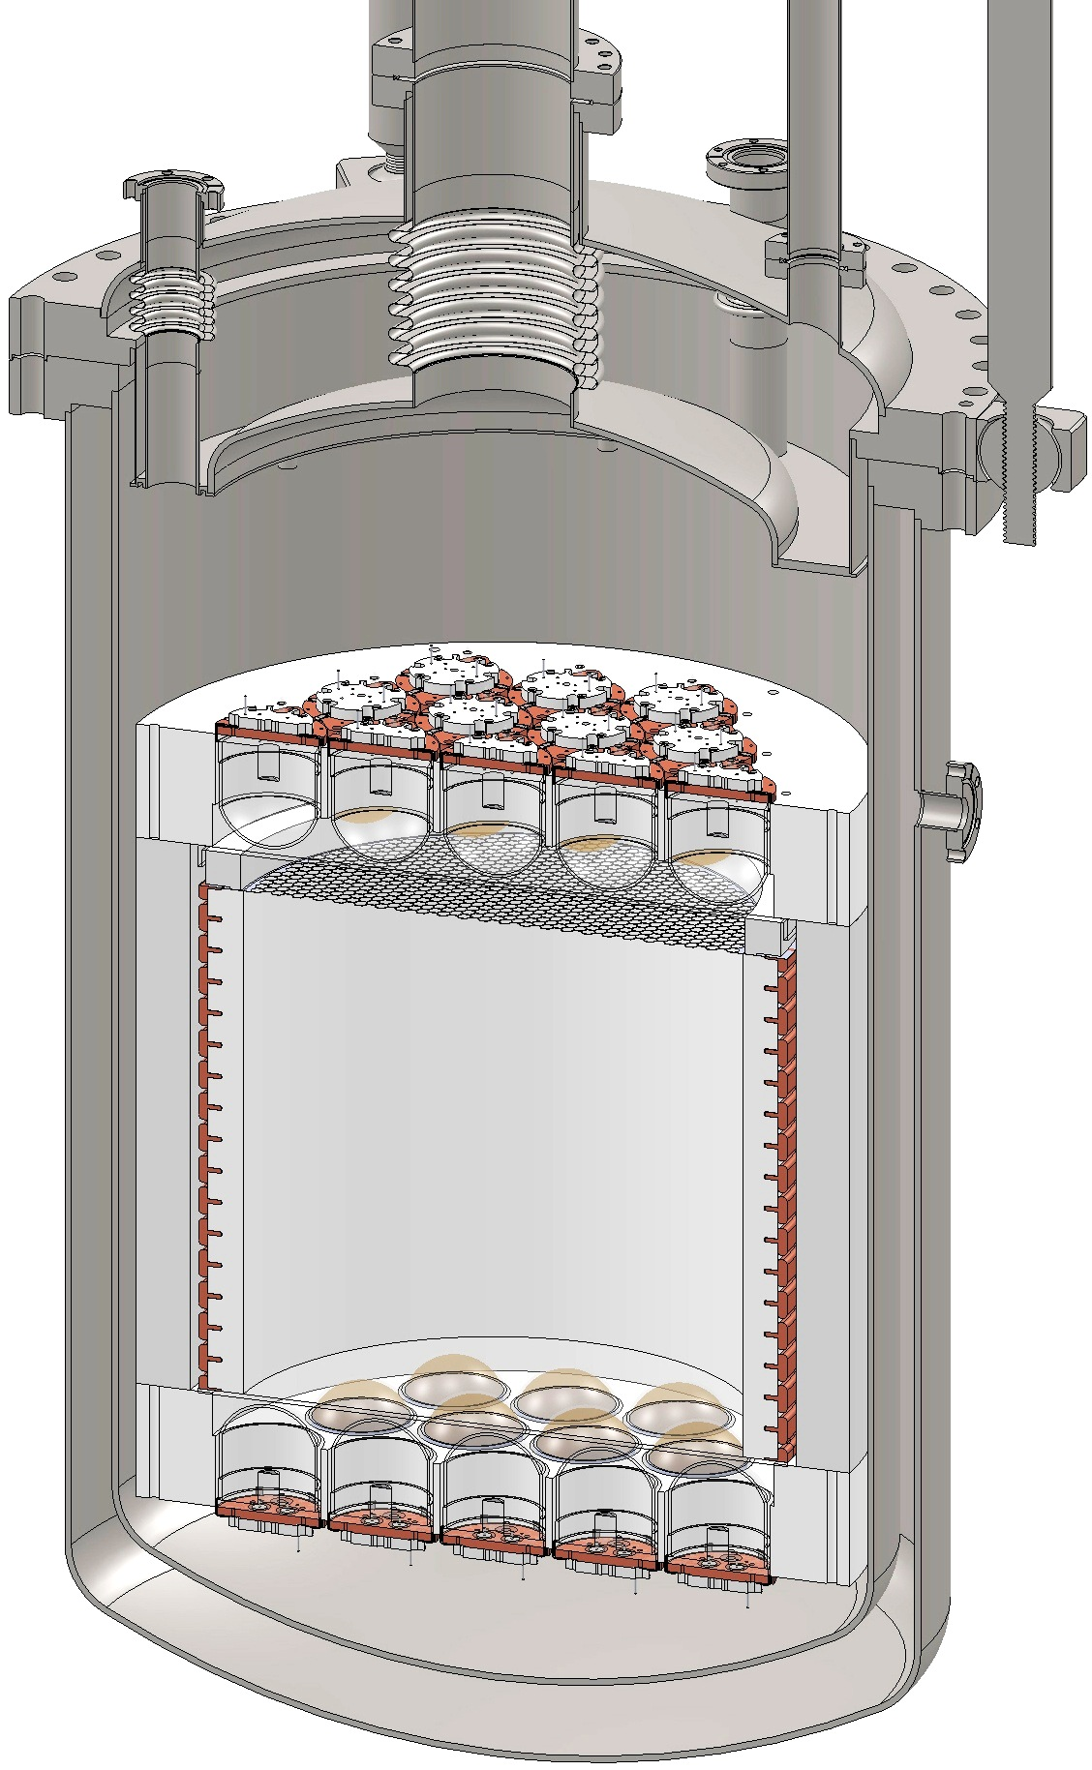
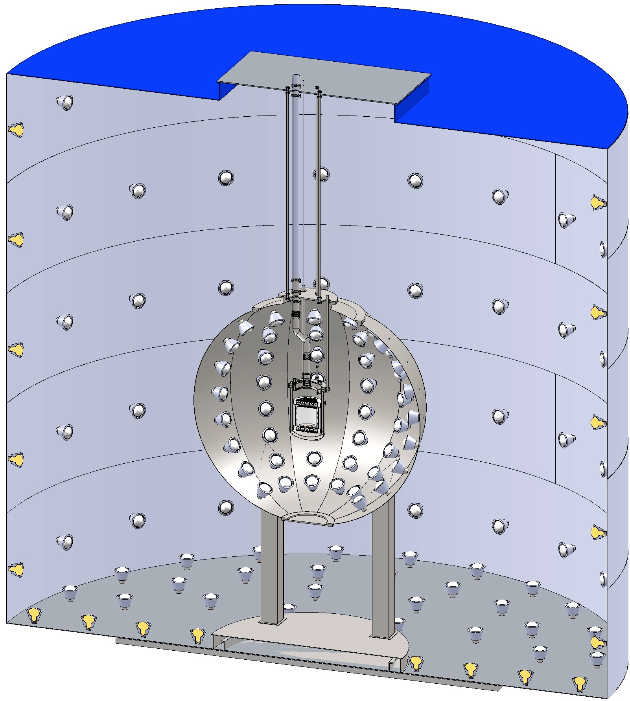
DarkSide 50 kg → 5 Ton
Hanguo Wang
CTF Water Tank
3” QUPID
(19 top + 19 bottom)
Liquid
Scintillator
Depleted Ar
(50 kg)

Slide 8
90% CL Limits of SI Cross Section
G1
G2
G3

Slide 9
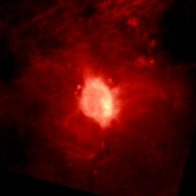
Indirect WIMP Detection
Rene Ong, Vladimir Vassiliev
Telescopes
γ
VERITAS,
HESS, Fermi …
WIMP
Annihilation
(e.g. GC)
ν
IceCube
χ
Cosmic Ray Expts
W⁺/Z/H/q
decreasing
background
e⁻
ATIC, Fermi …
?
e⁺
Pamela, AMS
χ
W⁻/Z/h/q
p
HEAT, Pamela,
AMS
d
GAPS
Notes:
9

Slide 10
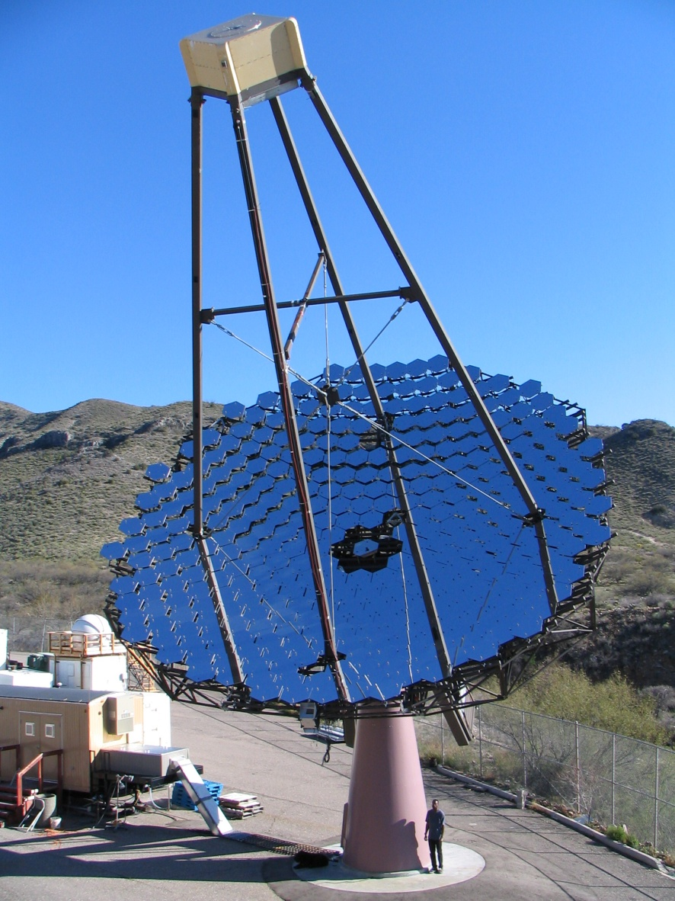
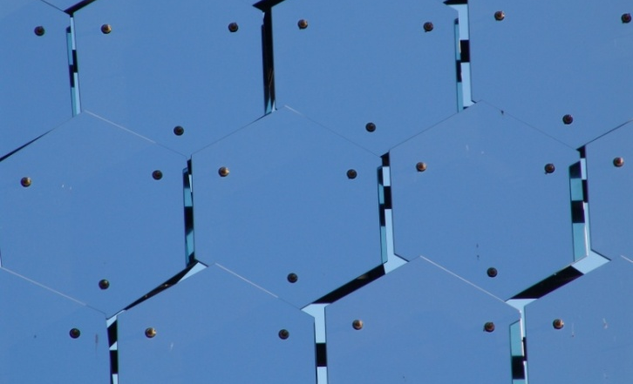
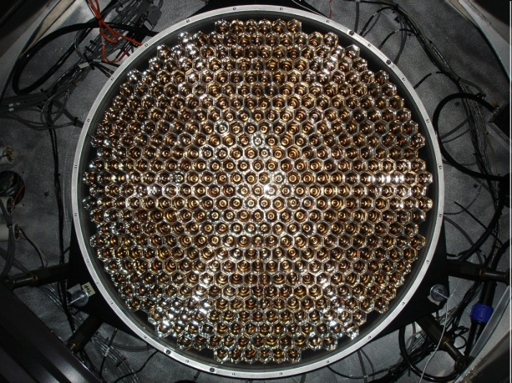
VERITAS
Rene Ong, Vladimir Vassiliev
350 Mirror Facets
12m reflector, f1.0 optics
500 pixel Camera

Slide 11
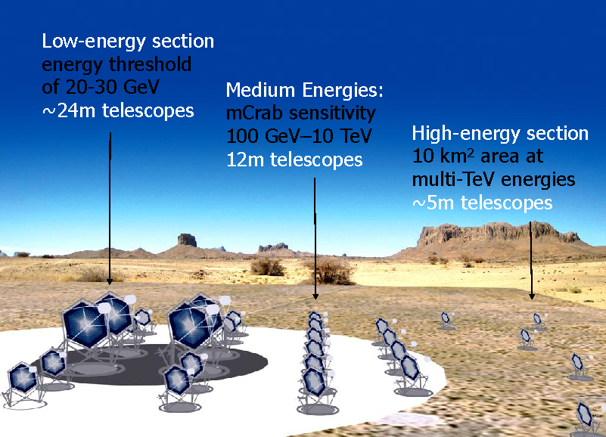
Cherenkov Telescope Array
Vladimir Vassiliev

Slide 12
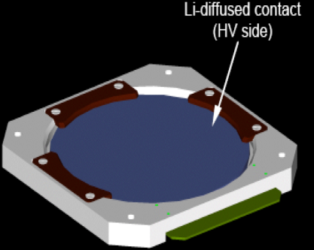
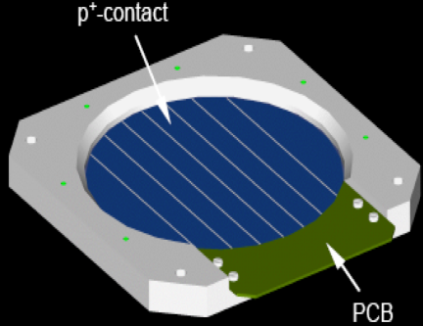
GAPS Concept
Rene Ong
~4m
TOF
GAPS consists of two detectors
(acceptance ~2.7 m²sr):
Si(Li) Detector (target and tracker):
Si(Li) tracker:13 layers of Si(Li) wafers
relatively low Z material
good X-ray resolution
circular modules segmented into 8 strips → 3D particle tracking
270 per layer (total: ~3500)
timing: ~50 ns
dual channel electronics 5-200 keV: X-rays (resolution:~2 keV) 0.1-200 MeV: charged particle
Time of flight and anticoincidence shield:
plastic scintillator with PMTs surrounds tracker
track charged particles, dE/dX
velocity measurement
anticoincidence for charged particles
~4m
~3m
tracker
LD Balloon flight in 2015 ?

Slide 13
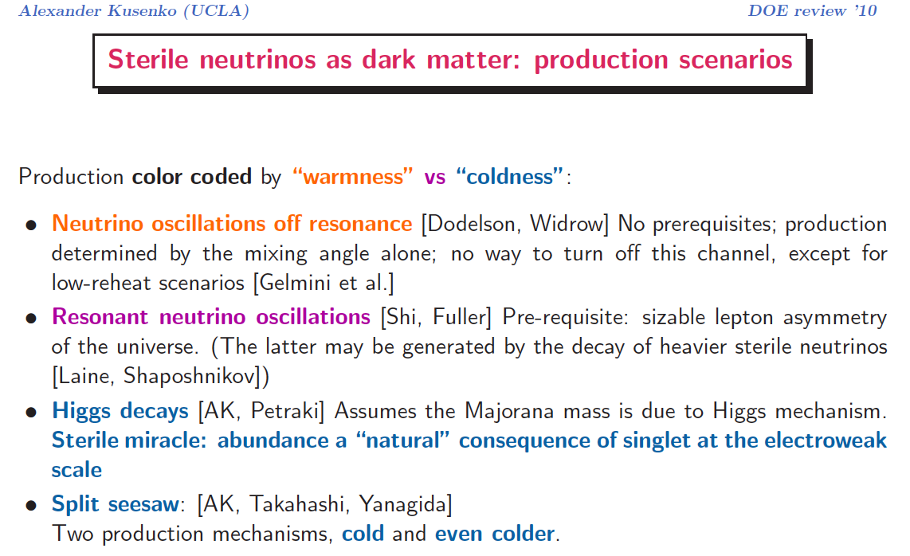
Sterile Neutrinos
Alex Kusenko

Slide 14
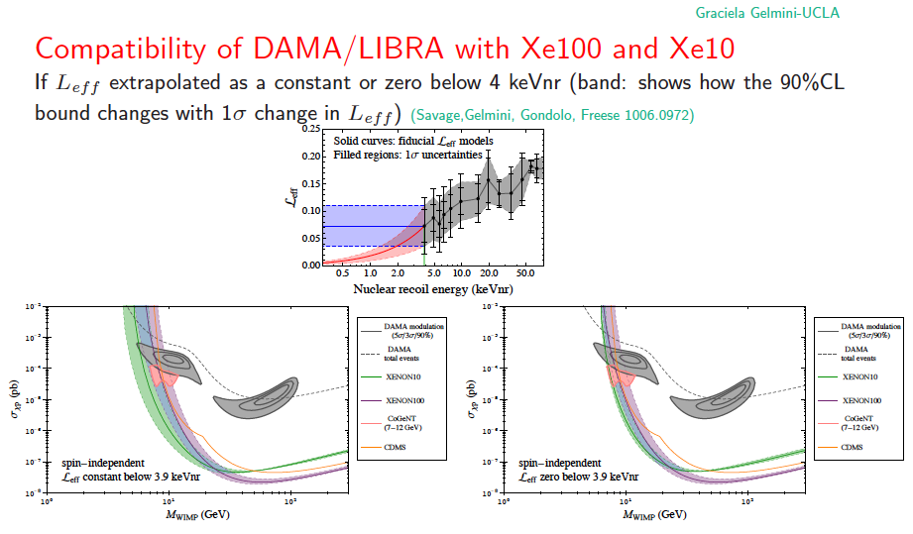
DAMA/LIBRA vs. XENON100
Graciela Gelmini

Slide 15
UCLA Dark Matter Programs
Direct Search
David Cline, Katsushi Arisaka, Hanguo Wang
Xe : ZEPLIN-II → XENON100 → XENON 1Ton
Ar : DarkSide50 → DarkSide 5Ton
G3 : MAX, XAX
Indirect Search
Rene Ong VERITAS → GAPS
Vladimir Vassiliev VERITAS → CTA
David Saltzberg ANITA
Theory
Graciela Gelmini DAMA/CoGeNT
Alex Kusenko Sterile Neutrino

