Slide 1
Direct WIMP Detection with Noble Liquids
Katsushi Arisaka
University of California, Los Angeles
Department of Physics and Astronomy
arisaka@physics.ucla.edu

Slide 2
Talk Outline
Introduction
Properties of Xenon & Argon
G1
XENON100 - new results
DarkSide 50
G2
XENON 1 Ton
G3
LZD and MAX
Xenon 10 Ton + Argon 50 Ton

Slide 3
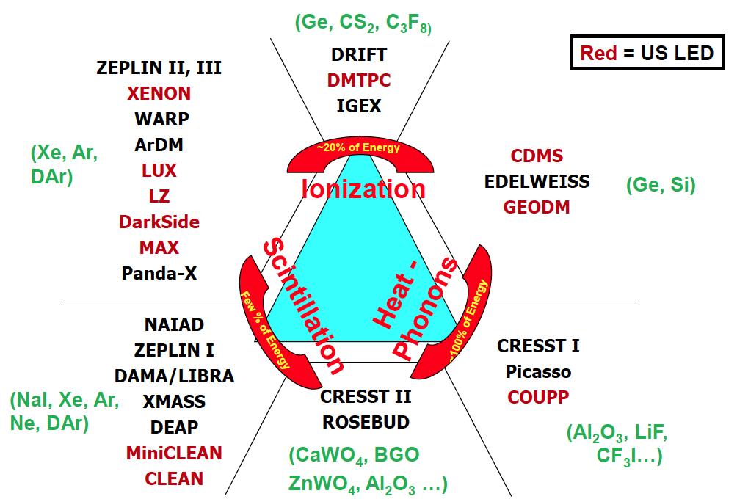
Detection Technique
Double
Phase
Single
Phase

Slide 4
Properties of Noble Liqud
 | Unit | Neon | Argon | Xenon
Z |  | 10 | 18 | 54
A |  | 20 | 40 | ~132
Liquid Density | g/cc | 1.21 | 1.4 | 3.06
Energy Loss (dE/dX) | MeV/cm | 1.4 | 2.1 | 3.8
Radiation Length | cm | 24 | 14 | 2.8
Collision Length | cm | 80 | 80 | 34
Boiling Temperature | ºK | 27.1 | 87.3 | 165
Scintillation Wavelength | nm | 85 | 125 | 178
Scintillation | photon/keV | 30 | 40 | 46
Ionization | e-/keV | 46 | 42 | 64
Decay time (Fast Component) | nsec | 19 | 7 | 4
Decay time (Slow Component) | nsec | 1500 | 1600 | 26
Isotope |  | No | ³⁹Ar (1 Bq/kg) | ¹³⁶Xe
Price | $ /ton | $90k | ~$2k | ~$1M
Single Phase Experiments |  | CLEAN | DEAP, CLEAN | XMASS
Double Phase Experiments |  |  | WARP, ArDM, DarkSide, MAX | ZEPLIN, XENON, MAX LUX, LZD

Slide 5
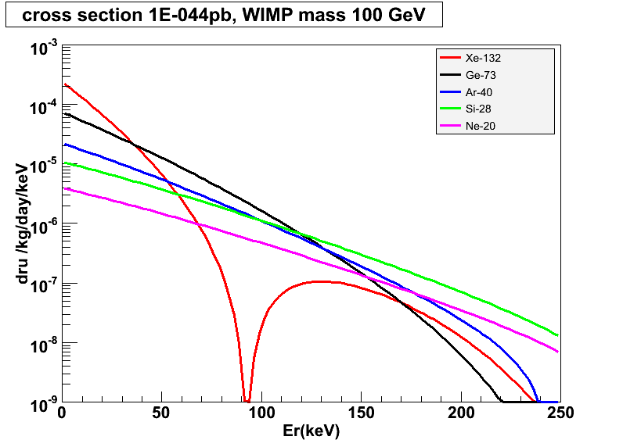
Target Mass Dependence of WIMP Cross Section
10⁻⁴⁴ cm²
Xe-132
Ar-40
Ge-73
Si-28
Ne-20

Slide 6
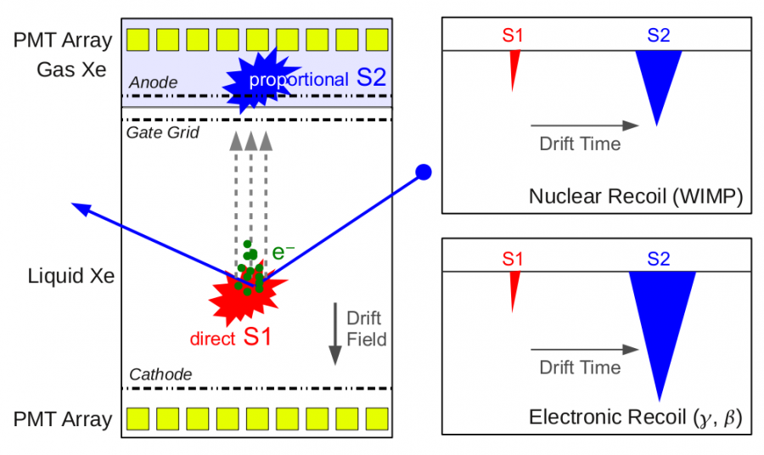
Double-Phase Noble Liquids

Slide 7
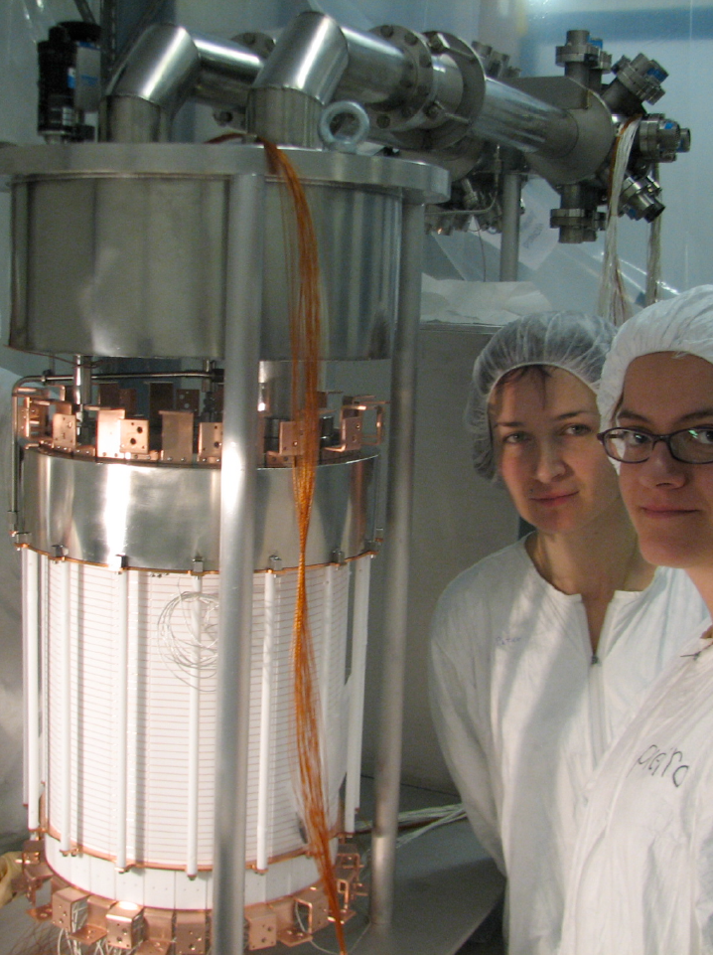
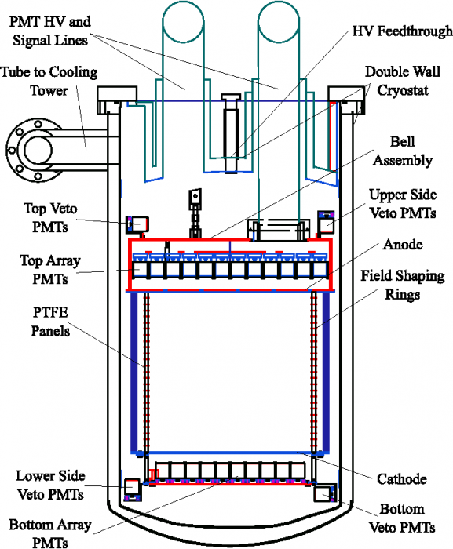
XENON100 Detector
161 kg
(48 kg)

Slide 8
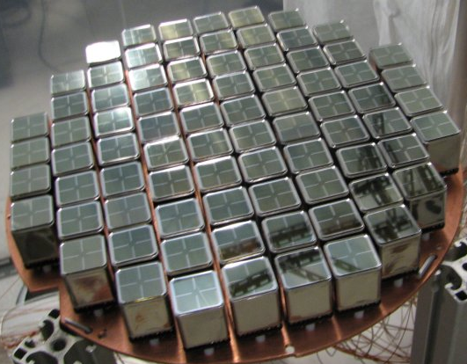
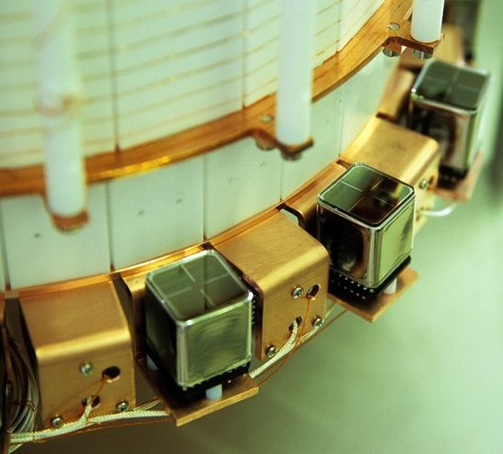
PMT Arrays
242 Hamamatsu R8520 PMTs 1"x1", optimized for response @ Xe scintillation light (178 nm)
Low radioactivity ( ~ <1 mBq/PMT)
Top Array
98 PMTs
~23% QE
Bottom Array
80 PMTs
~33% QE
Active Veto
64 PMTs
~23% QE

Slide 9
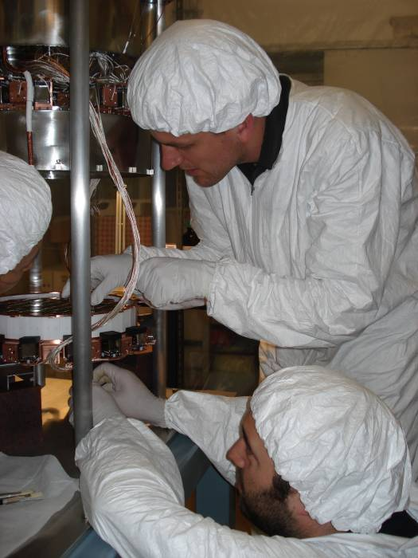
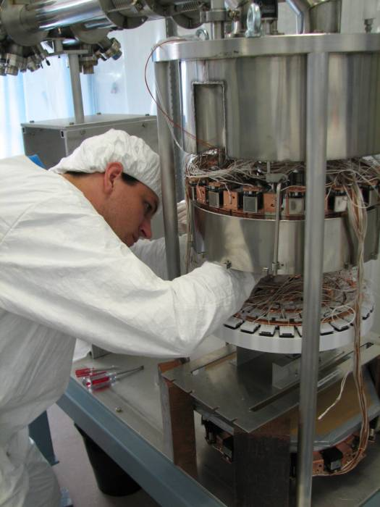
XENON100 Detector

Slide 10
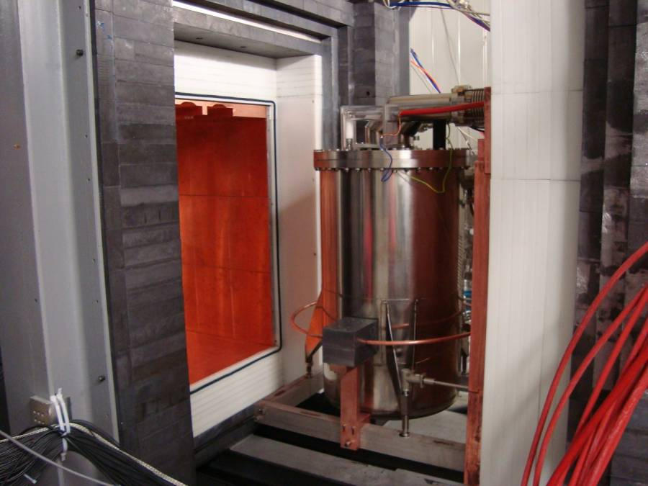
Pb
(20cm)
Poly
(20cm)
Cu
(5cm)
Pb
(20cm)
Poly
(20cm)
Cu
(5cm)

Slide 11
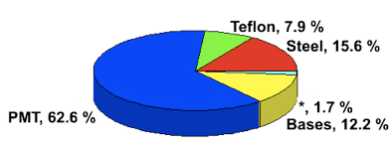
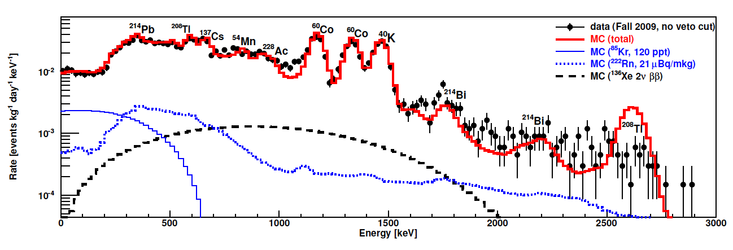
Energy Spectrum of Real Data vs. MC
Surface Backgrounds
arXiv:1101.3866
MC Total
⁸⁵Kr
²²²Rn
¹³⁶Xe

Slide 12
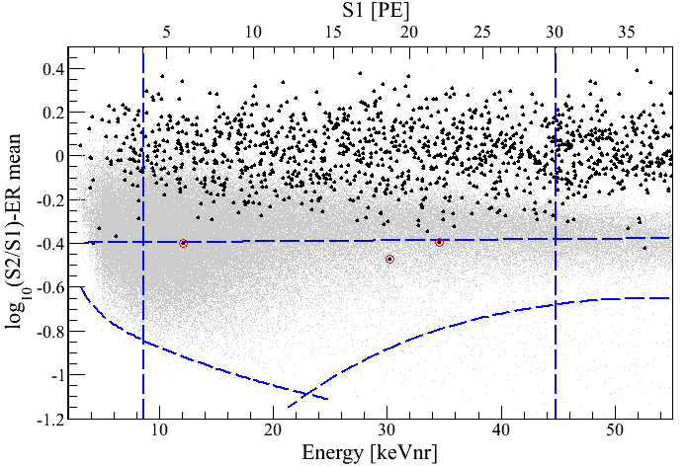
Log(S2/S1) vs. Energy
100.9 days, 48 kg
arXiv:1104.2549
S1 = 4 PE
γ backgrounds
S1 = 30 PE
99.75% rejection for γ
Neutron band
(Acceptace ~40%)
3 events
(1.8 ± 0.6 expected)
-3 σ
8.4 keV_{nr}
44.6 keV_{nr}
S2 = 300 PE

Slide 13
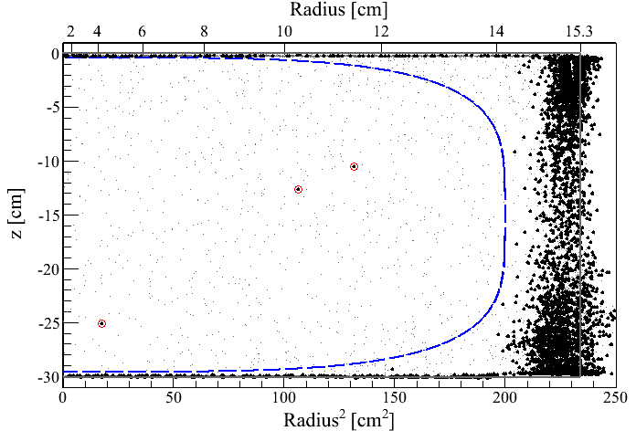
Event distribution in z vs. R²
100.9 days, 8.4 – 44.6 keV_{nr}
48 kg
3 events
(1.8 ± 0.6 expected)

Slide 14
Log(S2/S1) vs. Energy
11 keV_{nr}

Slide 15
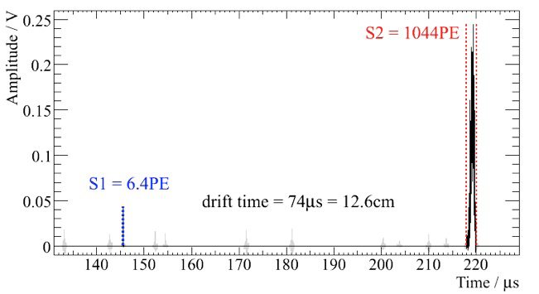
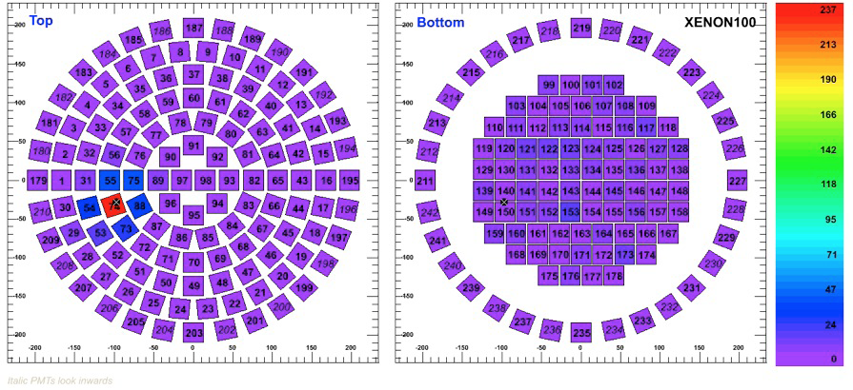
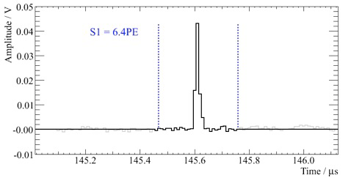
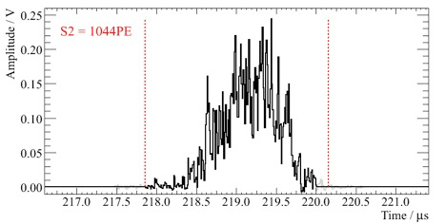
Single Scatter Nuclear Recoil Event Candidate
11 keV_{nr}
Top
Bottom

Slide 16
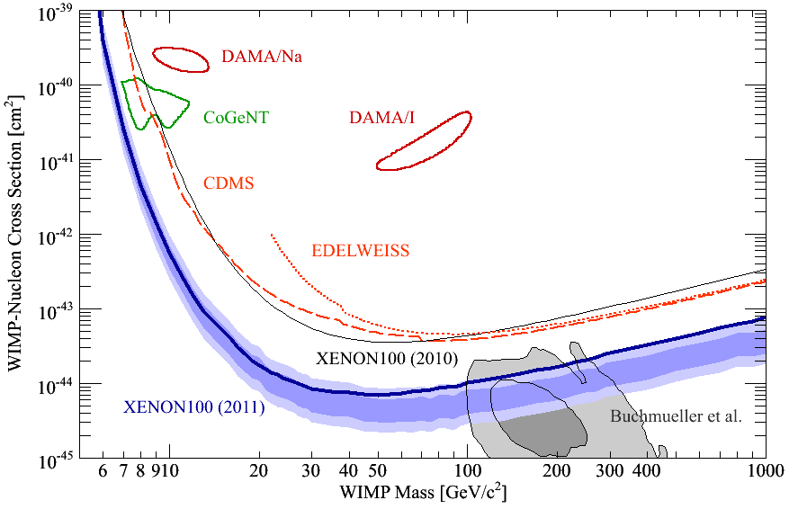
90% CL Limits of SI Cross Section
arXiv:1104.2549
CMSSM

Slide 17
Comparison of Xenon Detector Size
G3
MAX, LZD
20 ton (10 ton)
G2
XENON 1ton
2.4 ton (1 ton)
G1
2 m
XENON100
161 kg
(48 kg)
ZEPLIN-II
31 kg
(7.2 kg)
XENON10
14 kg
(5.4 kg)
1 m
1 m
15cm
30cm
14cm
30 cm
20 cm
30 cm
1 m
2 m
2007
2007
2010
2014
2019

Slide 18
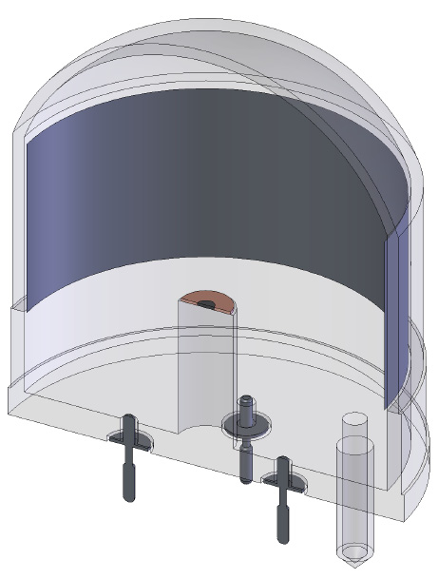
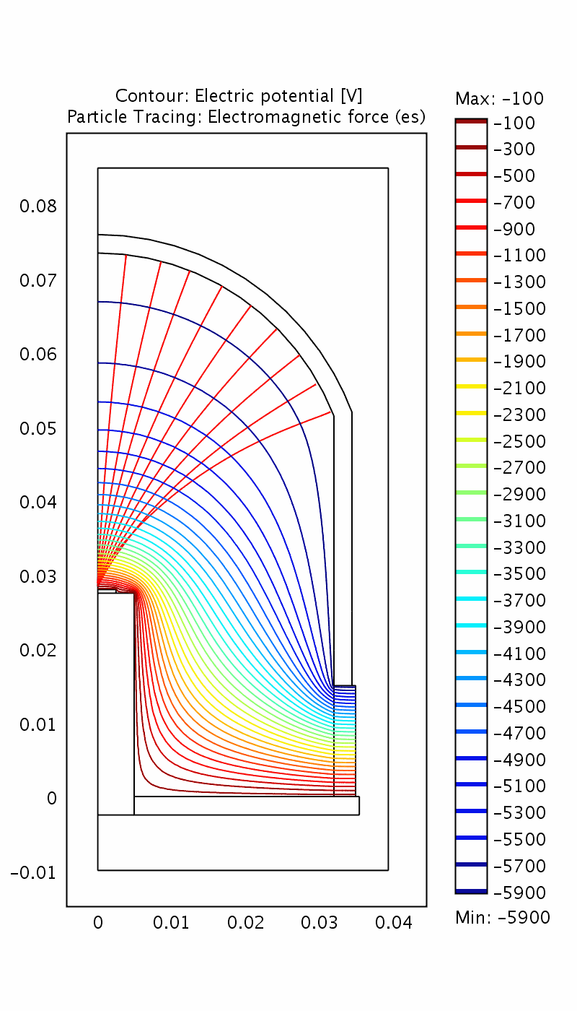
QUPID (QUartz Photon Intensifying Detector)
Photo Cathode
(-6 kV)
Photo Cathode
(-6 kV)
Quartz
Al coating
APD (0 V)
APD (0 V)
Quartz
Artin Teymourian’s talk

Slide 19
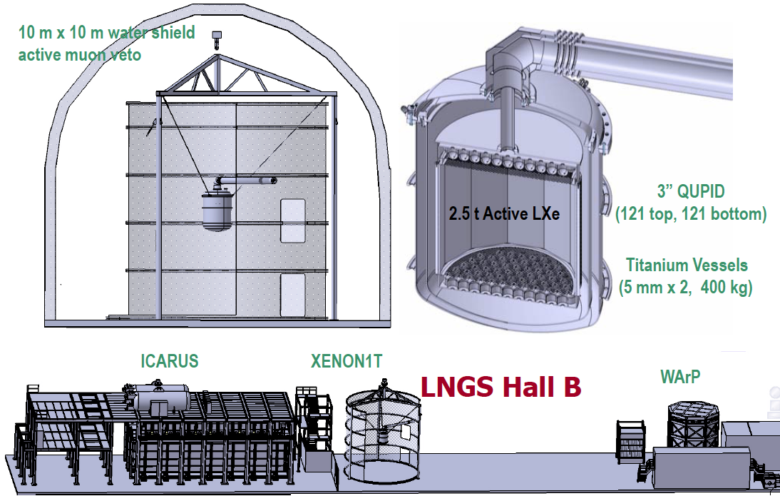
XENON1T

Slide 20
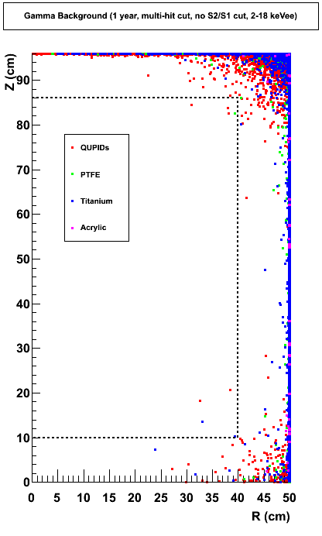
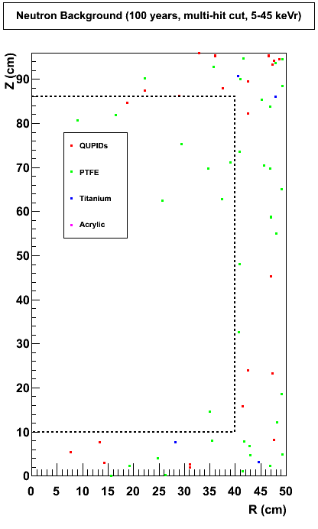
Expected Backgrounds in XENON 1Ton (100 Year, Multi-hit Cut)
XENON100
XENON100
0.07 γ / year
0.1 n / year
1.1 ton
1.1 ton

Slide 21
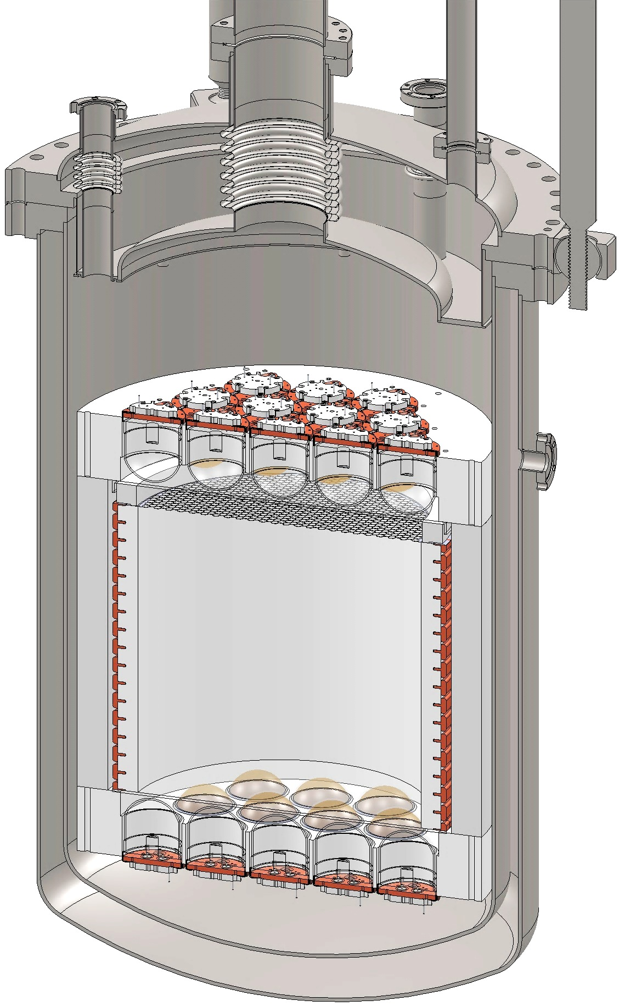
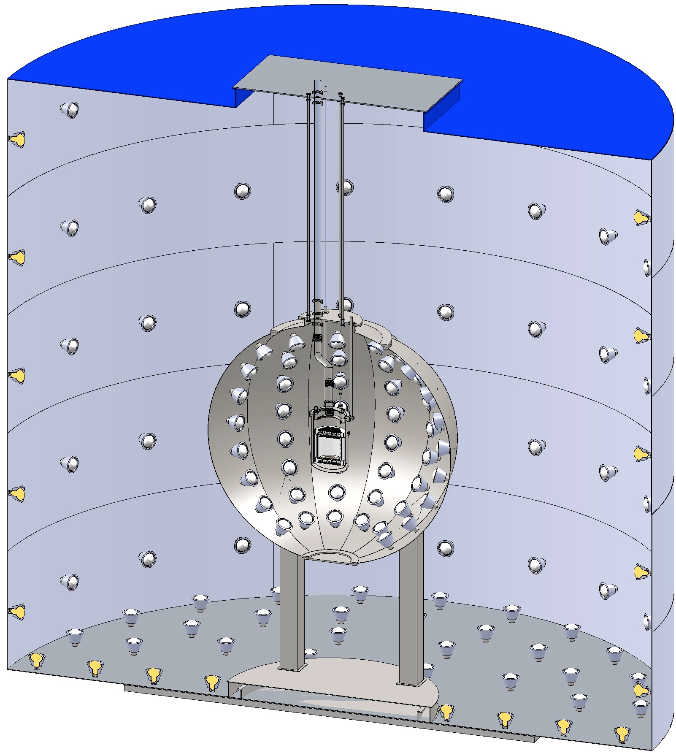
DarkSide 50 kg → 5 Ton
CTF Water Tank
3” QUPID
(19 top + 19 bottom)
Liquid
Scintillator
Depleted Ar
(50 kg)

Slide 22
G1
CMSSM
G2
G3

Slide 23
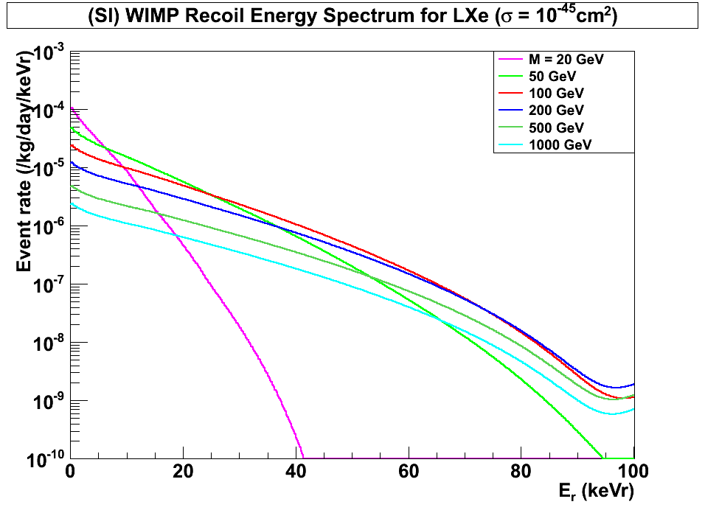
(SI) WIMP Energy Spectrum for LXe (Cross Section = 10⁻⁴⁵cm²)
Xenon
8 keVr
45 keVr
200 GeV
100 GeV
500 GeV
1000 GeV
20 GeV
50 GeV

Slide 24
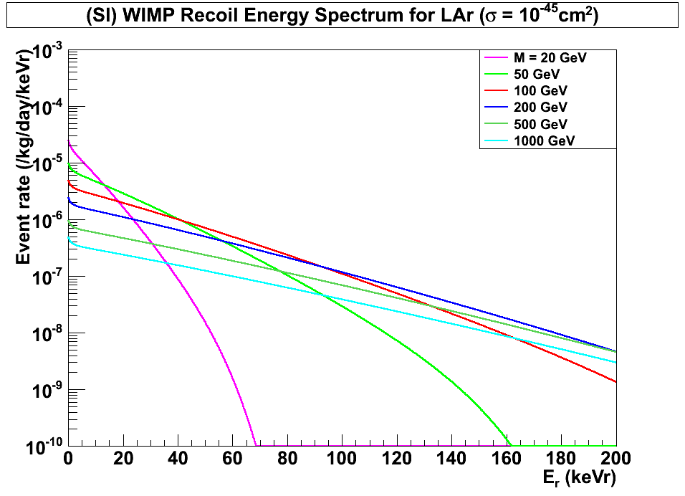
(SI) WIMP Energy Spectrum for LAr (Cross Section = 10⁻⁴⁵cm²)
Argon
30 keVr
200 keVr
100 GeV
500 GeV
1000 GeV
200 GeV
20 GeV
50 GeV

Slide 25
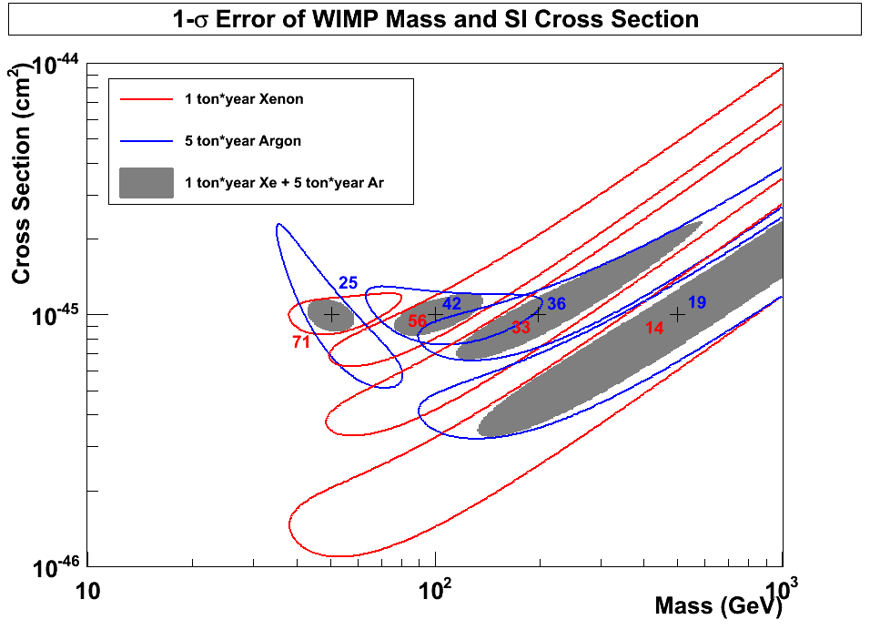
1-σ Error of WIMP Mass vs SI Cross Section (10 ton*year Xe and 50 ton*year Ar)
10⁻⁴⁵
10
50
10
50
Argon
50 GeV
100 GeV
200 GeV
500 GeV
10⁻⁴⁶
10⁻⁴⁶ cm²
Xenon
G3
10⁻⁴⁷

Slide 26
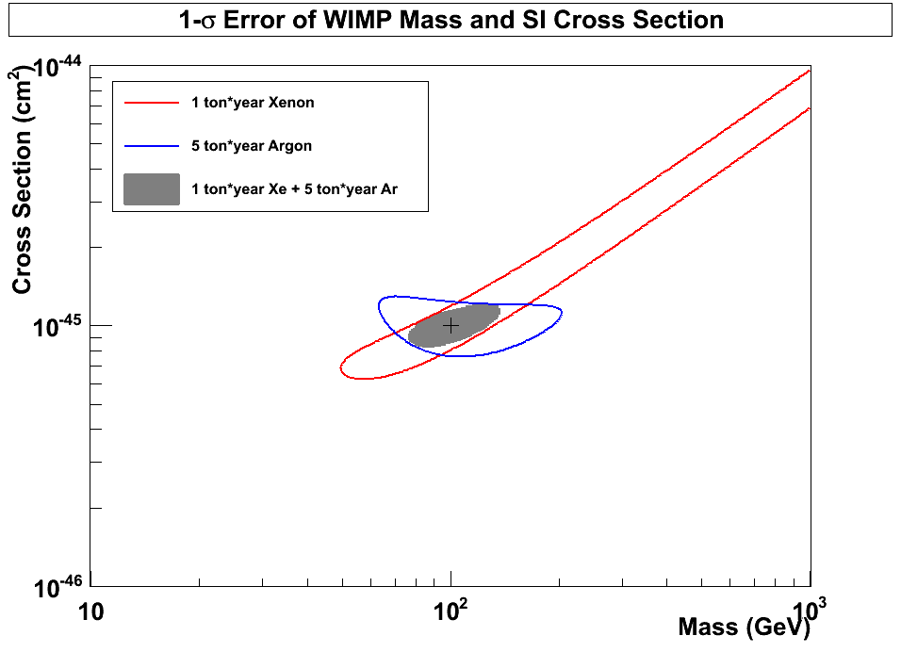
1-σ Error of WIMP Mass vs SI Cross Section (10 ton*year Xe and 50 ton*year Ar)
10⁻⁴⁵
10
50
Xenon
(56 events)
10
50
10⁻⁴⁶
10⁻⁴⁶ cm²
Argon
(42 events)
G3
100 GeV
10⁻⁴⁷

Slide 27
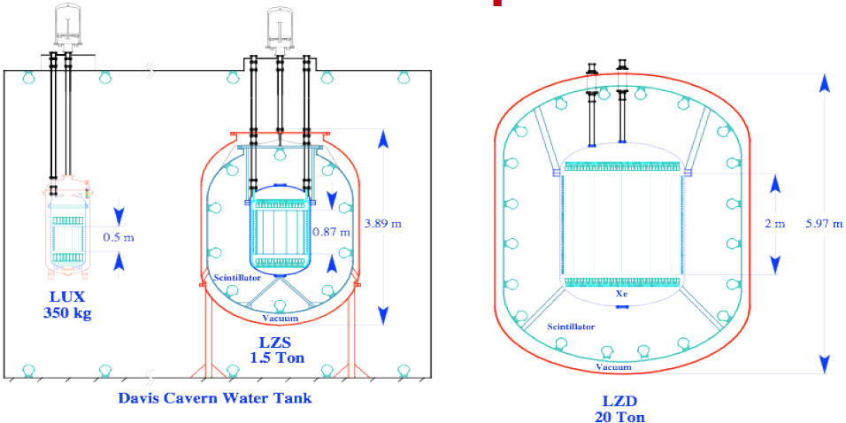
LUX and LZD

Slide 28
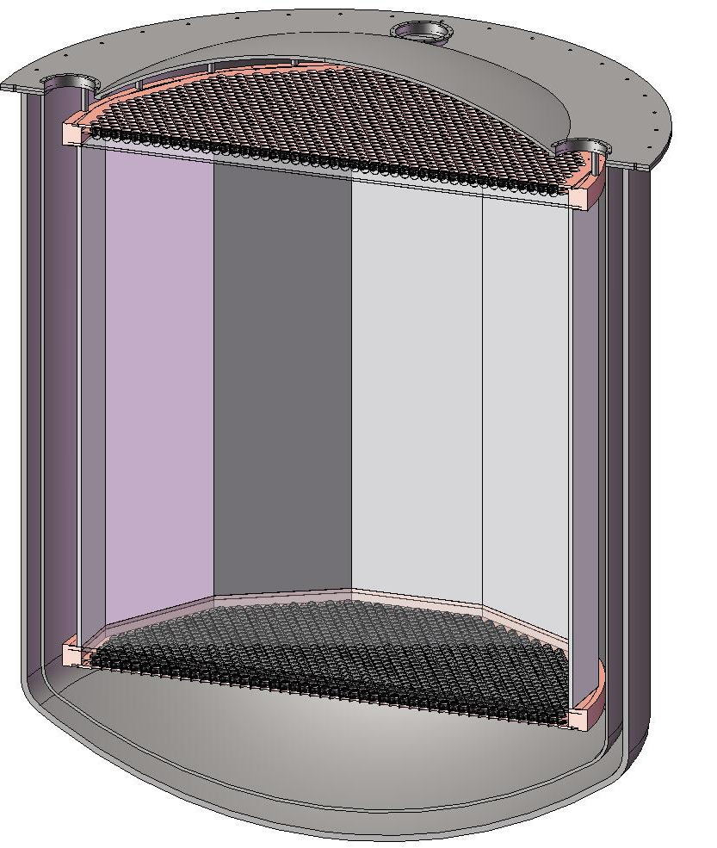
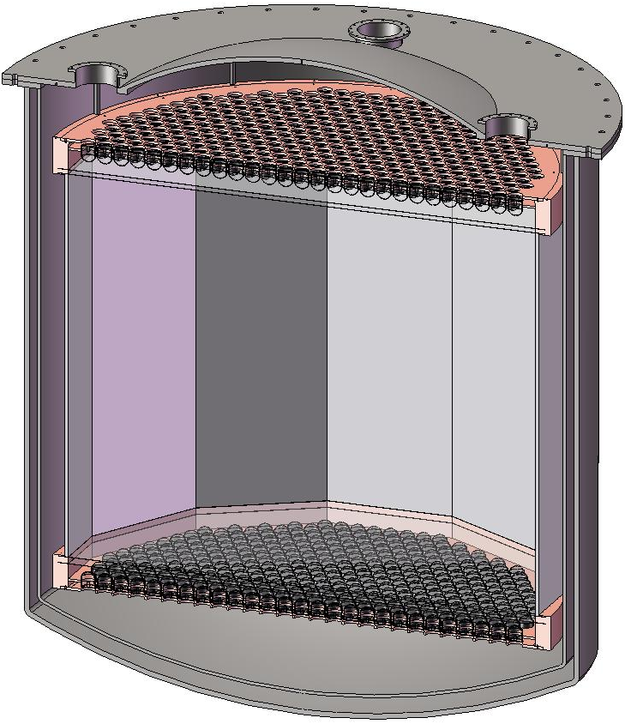
MAX+LZD = G3 Detector
⁴⁰Ar
70 ton
(50 ton)
Xe
20 ton
(10 ton)
4m
2 m
3” QUPID x 595 (Top)
3” QUPID x 595 (Bottom)
3” QUPID x 2644 (Top)
3” QUPID x 2644 (Bottom)

Slide 29
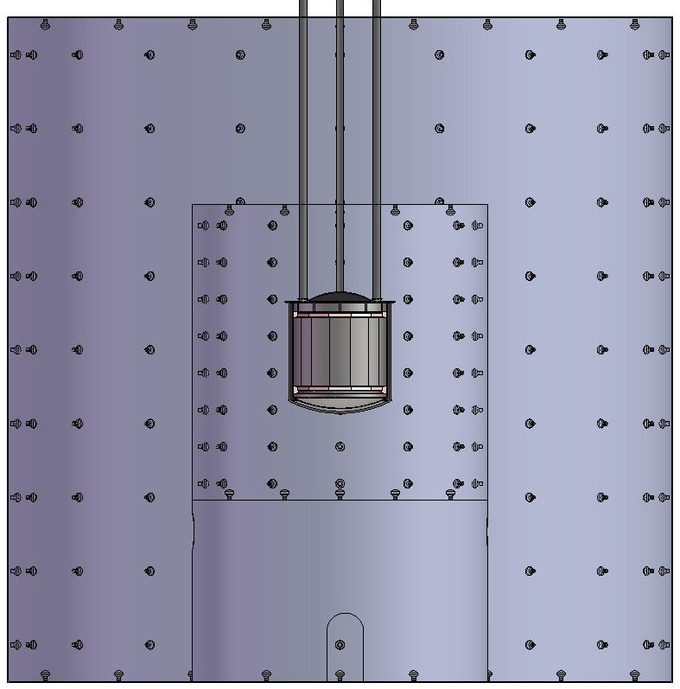
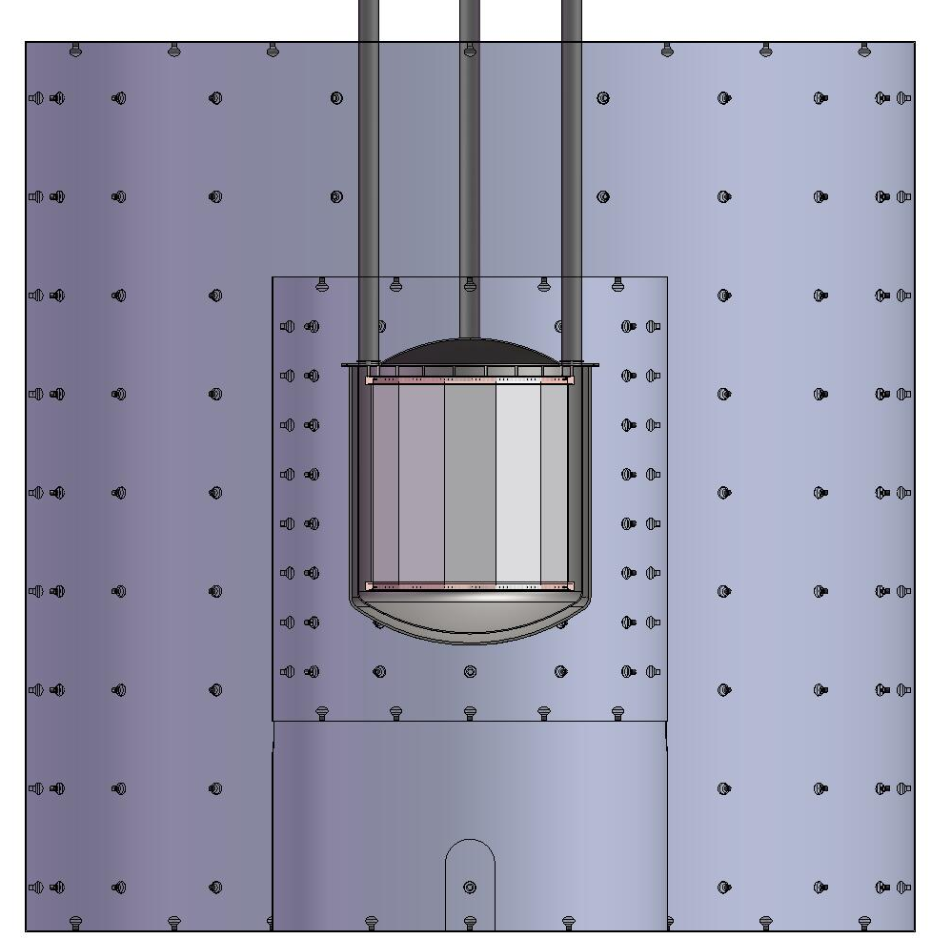
MAX+LZD = G3 Shielding Structure
Xe
20 ton
(10 ton)
⁴⁰Ar
70 ton
(50 ton)
18 m
Liquid
Scinti
Liquid
Scinti
Water Tank
Water Tank
8 m
18 m

Slide 30
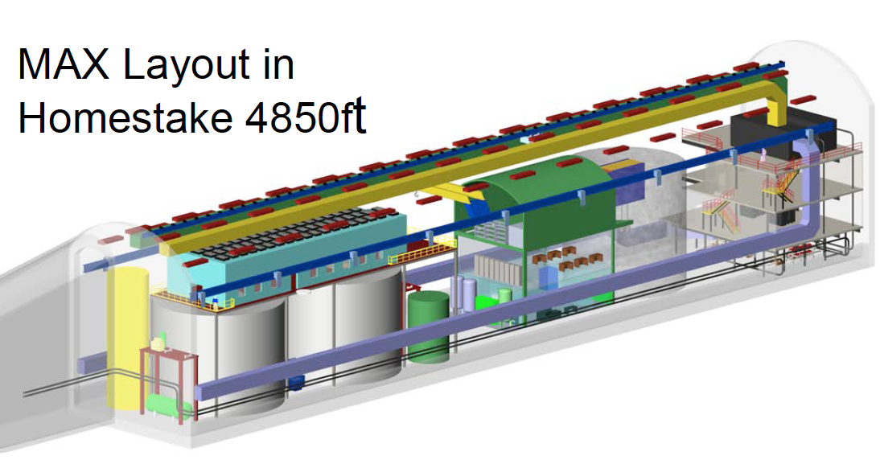
G3 (MAX) at DUSEL
⁴⁰Ar
70 ton
(50 ton)
Xe
20 ton
(10 ton)

Slide 31
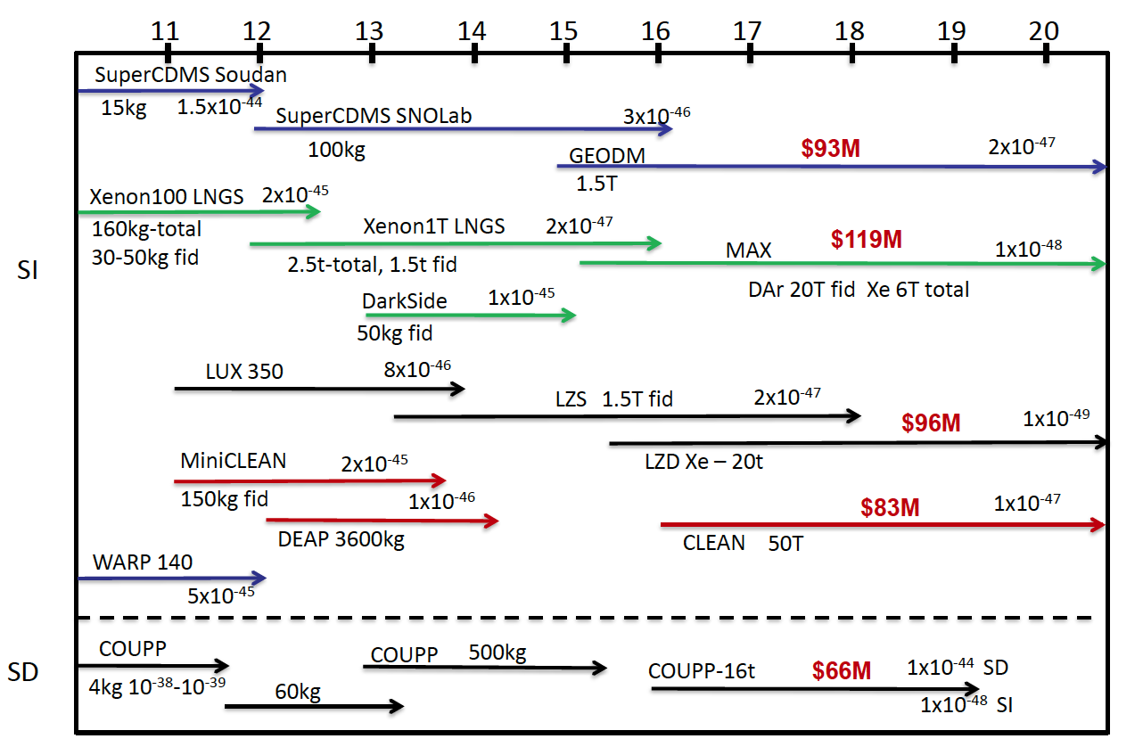
Projected Sensitivity
2010
Xe
Ar
G3 = Xe (10T) + Ar (50T)
Xe
Ar

Slide 32
Conclusions
XENON100 new results announced.
3 event observed (1.8 ± 0.6 events expected)
< 7 x 10⁻⁴⁵ cm² (at 50 GeV)
< 2 x 10⁻⁴⁵ cm² by the end of 2011 expected.
Future multi-ton Xe/Ar detectors designed and proposed.
XENON 1T and DarkSide 50 / 5T at Gran Sasso.
G3 = MAX + LZD (Xe 10T + Ar 50T) at DUSEL.

