Slide 1
Direct WIMP Detection by Noble Liquids :
XENON100 and Beyond
Katsushi Arisaka
University of California, Los Angeles
Department of Physics and Astronomy
arisaka@physics.ucla.edu

Slide 2
Talk Outline
Introduction
  Why Noble Liquid?
  Single Phase vs. Double Phase
  Xenon – XMASS, LUX, XENON100
  Argon – DEAP/CLEAN, WARP, DarkSide50
G1 : XENON100
  New Results
Future Directions
  G2 : XENON 1 Ton
  G3 : LZD and MAX (Xenon 10 Ton + Argon 50 Ton)
XAX and Neutrino Physics
  Solar neutrino
  Double beta decay
  Supernova neutrino

Slide 3
Introduction

Slide 4
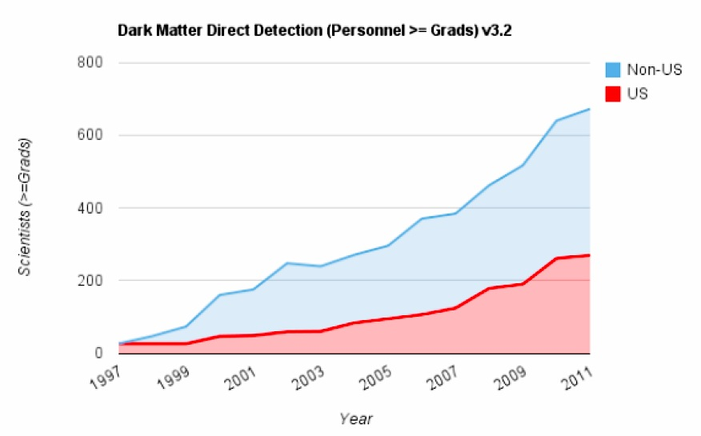
Growth of Direct Detection Community

Slide 5
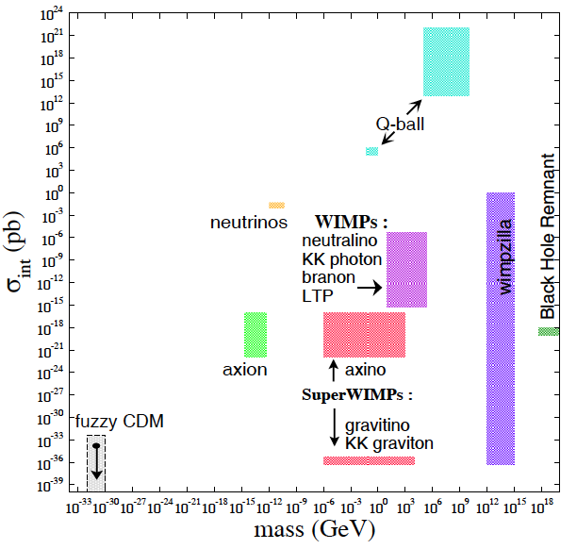
What is Dark Matter?

Slide 6
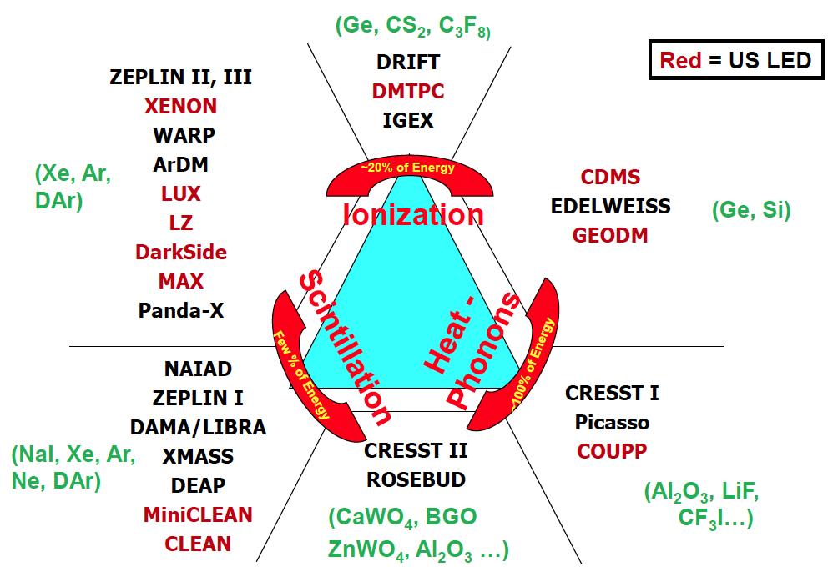
Detection Technique
Double
Phase
Gamma Ray
(Ge, Si)
Single
Phase
Neutron
WIMP

Slide 7
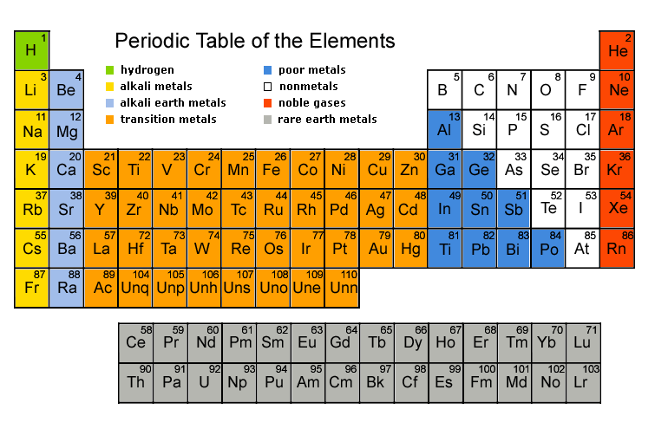
Noble Gases

Slide 8
Properties of Noble Liqud
 | Unit | Neon | Argon | Xenon
Z |  | 10 | 18 | 54
A |  | 20 | 40 | ~132
Liquid Density | g/cc | 1.21 | 1.4 | 3.06
Energy Loss (dE/dX) | MeV/cm | 1.4 | 2.1 | 3.8
Radiation Length | cm | 24 | 14 | 2.8
Collision Length | cm | 80 | 80 | 34
Boiling Temperature | ºK | 27.1 | 87.3 | 165
Scintillation Wavelength | nm | 85 | 125 | 178
Scintillation | photon/keV | 30 | 40 | 46
Ionization | e-/keV | 46 | 42 | 64
Decay time (Fast Component) | nsec | 19 | 7 | 4
Decay time (Slow Component) | nsec | 1500 | 1600 | 26
Isotope |  | No | ³⁹Ar (1 Bq/kg) | ¹³⁶Xe
Price | $ /ton | $90k | ~$2k | ~$1M
Single Phase Experiments |  | CLEAN | DEAP/CLEAN | XMASS
Double Phase Experiments |  |  | WARP, ArDM, DarkSide, MAX | ZEPLIN, XENON, MAX LUX, LZD

Slide 9
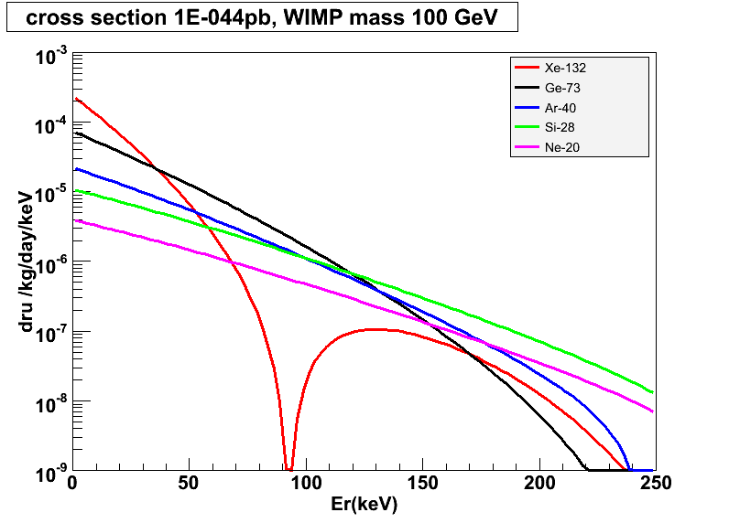
Target Mass Dependence of WIMP Cross Section
10⁻⁴⁴ cm²
Xe-132
Ar-40
Ge-73
Si-28
Ne-20

Slide 10
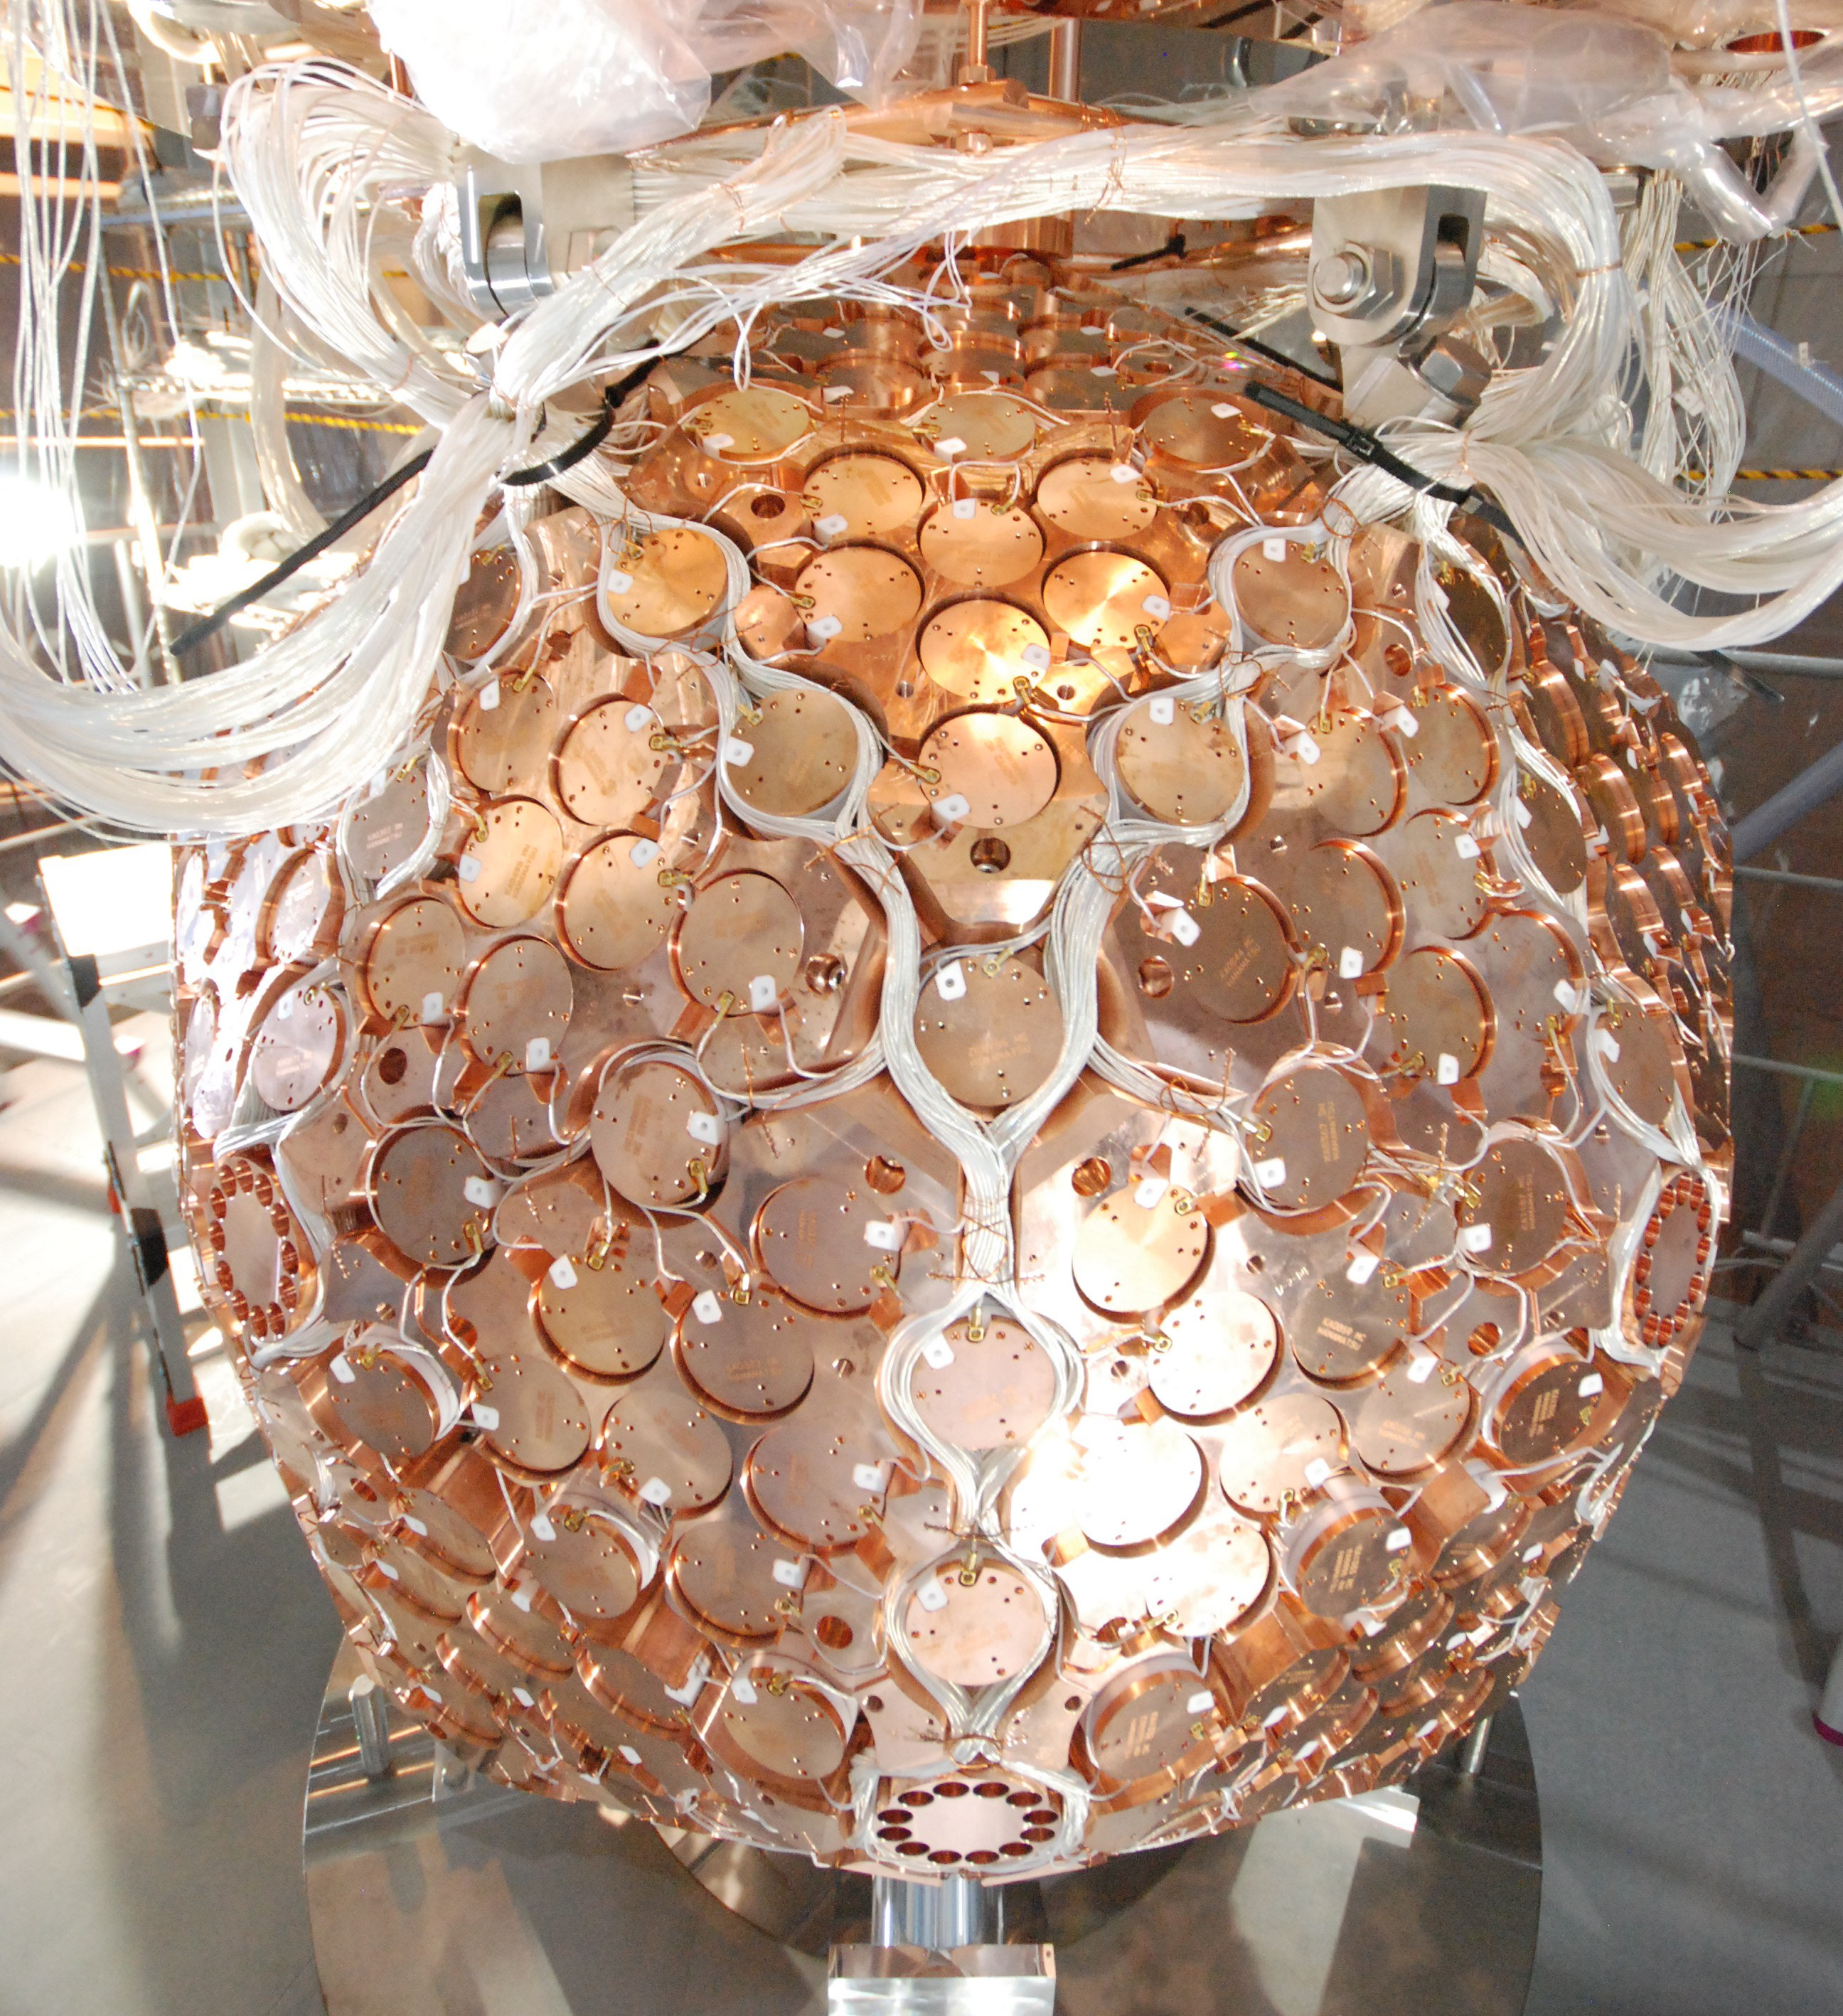
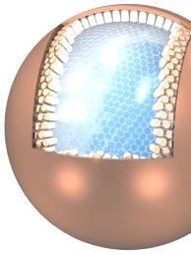

XMASS (Single Phase Xe)
100kg Prototype
（FV:30kg、30cm）
800kg Detector
（FV:100kg、80cm）
20ton Detector
（FV:10ton、2.5m）
R&D
Dark Matter
Solar neutrino
Dark Matter
completed
2011 〜
Future

Slide 11
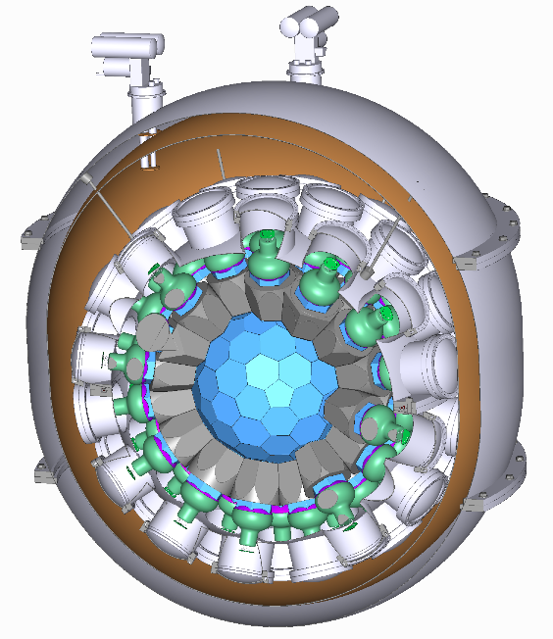
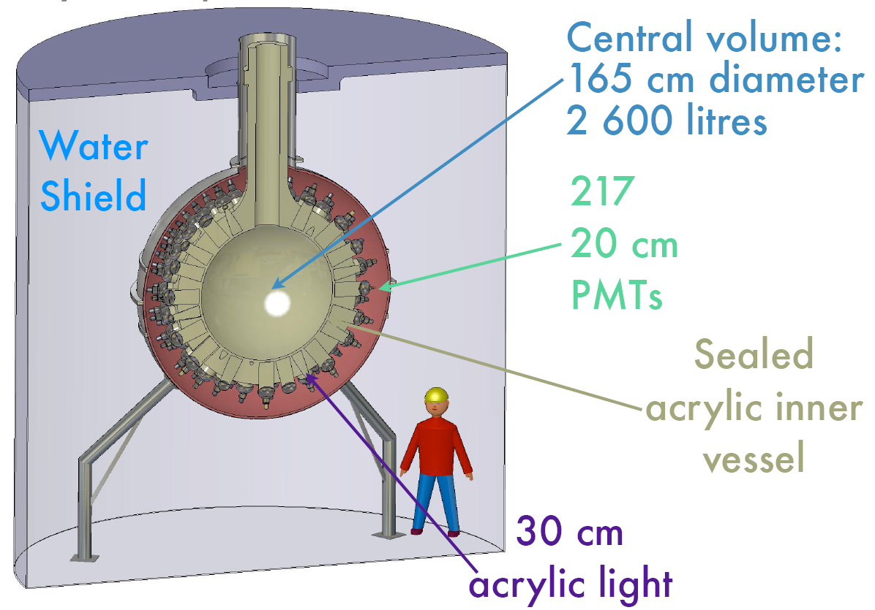

DEAP/CLEAN (Single Phase Ar/Ne)
360 kg Mini-CLEAN
3.6 ton DEAP/CLEAN

Slide 12
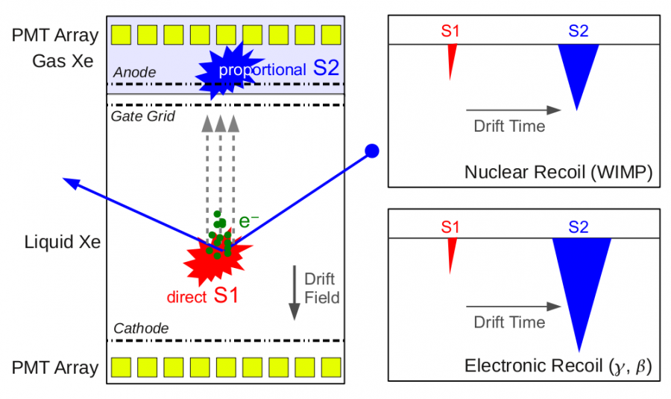
Double-Phase Noble Liquids

Slide 13
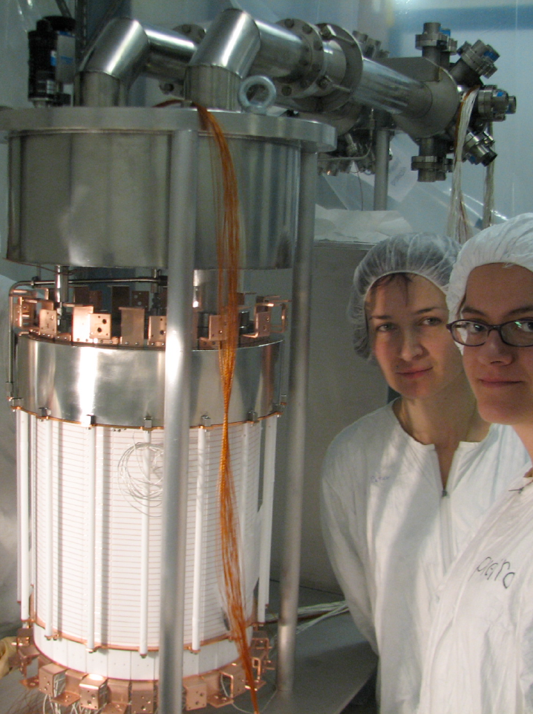
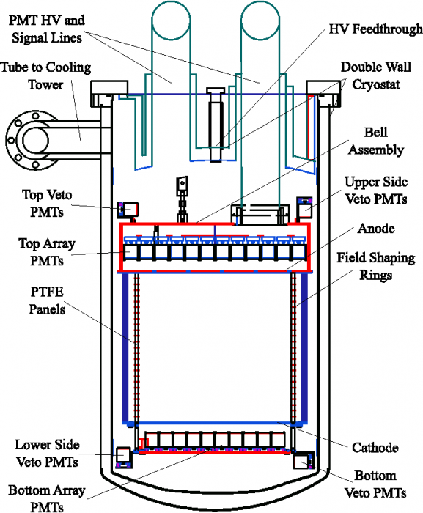
XENON100 (Double phase Xenon)
161 kg
(48 kg)

Slide 14
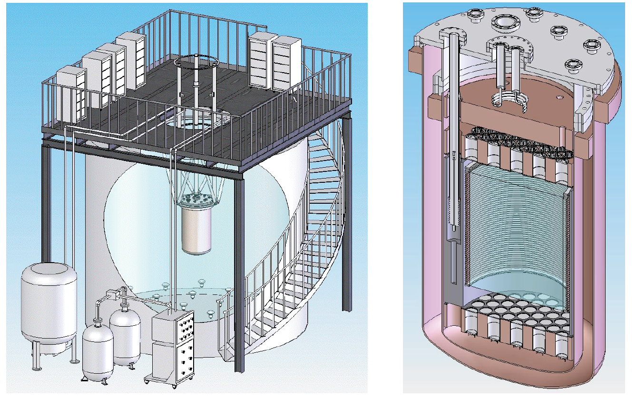
LUX 350 kg (Double phase Xenon)
60 cm
350 kg
(100 kg)

Slide 15
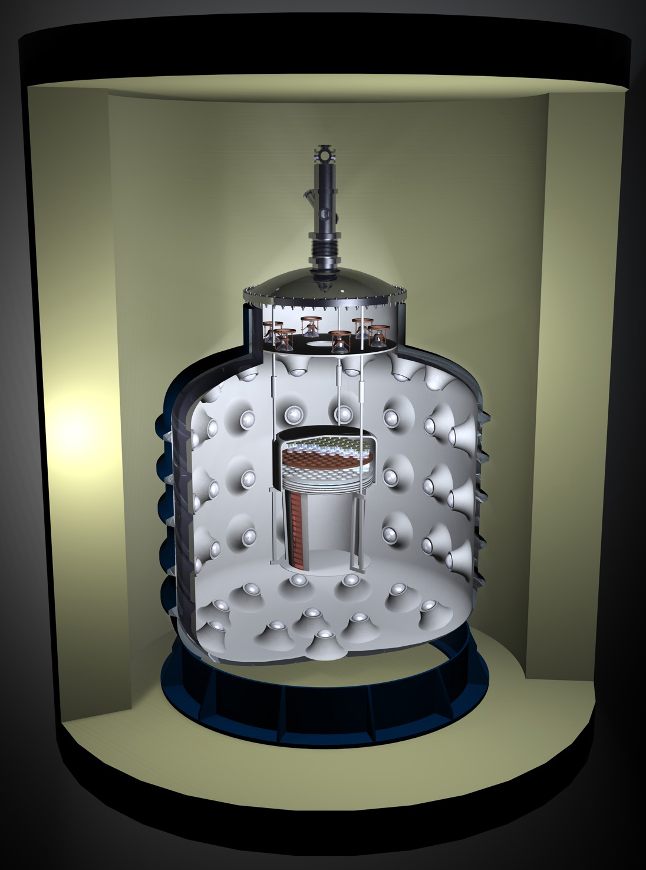
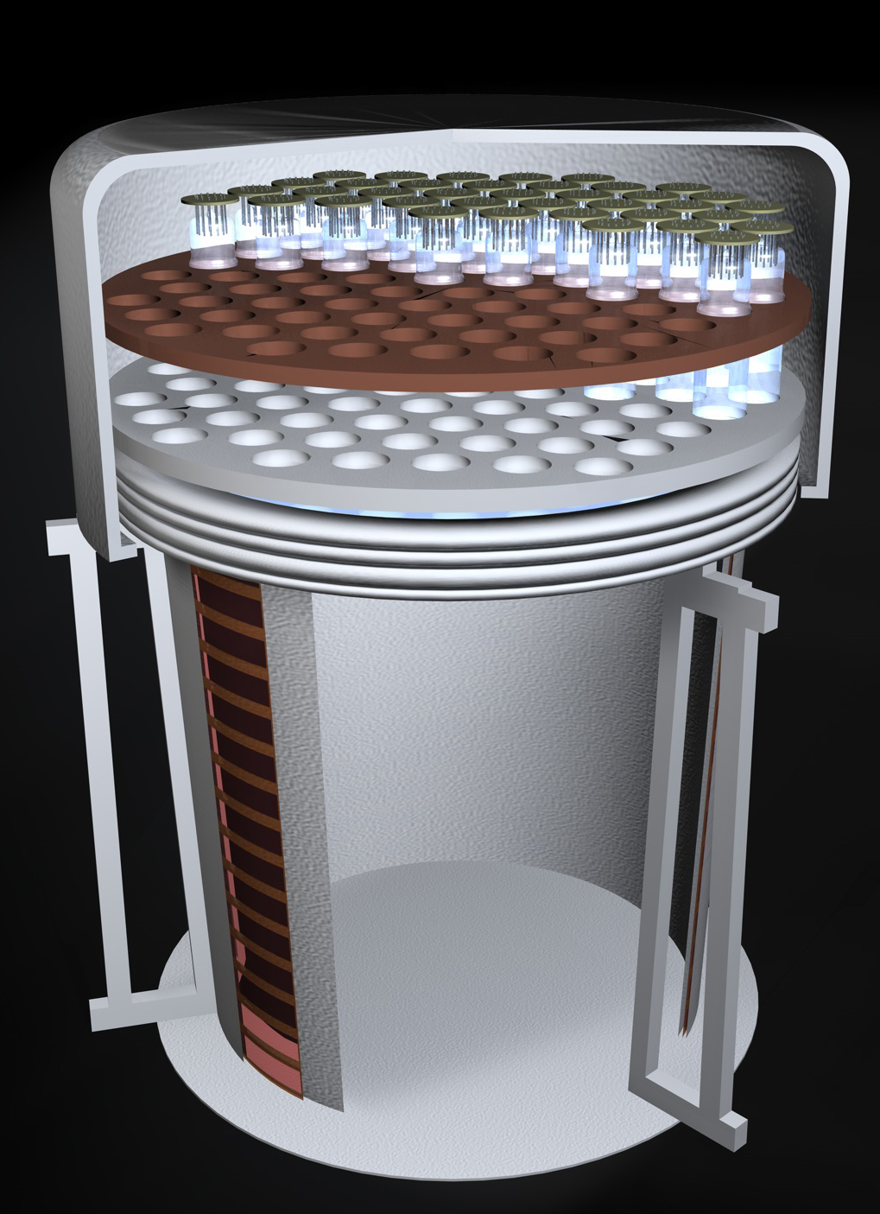
WARP 140 kg (Double Phase Argon)
140 kg
(100 kg)
60cm

Slide 16
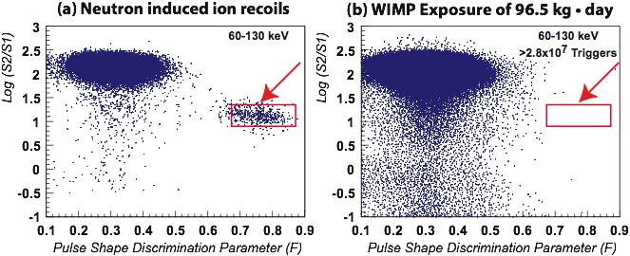
Pulse Shaping Discrimination by Ar
(First WARP Results)
Gamma
Gamma from ³⁹Ar
Neutron

Slide 17
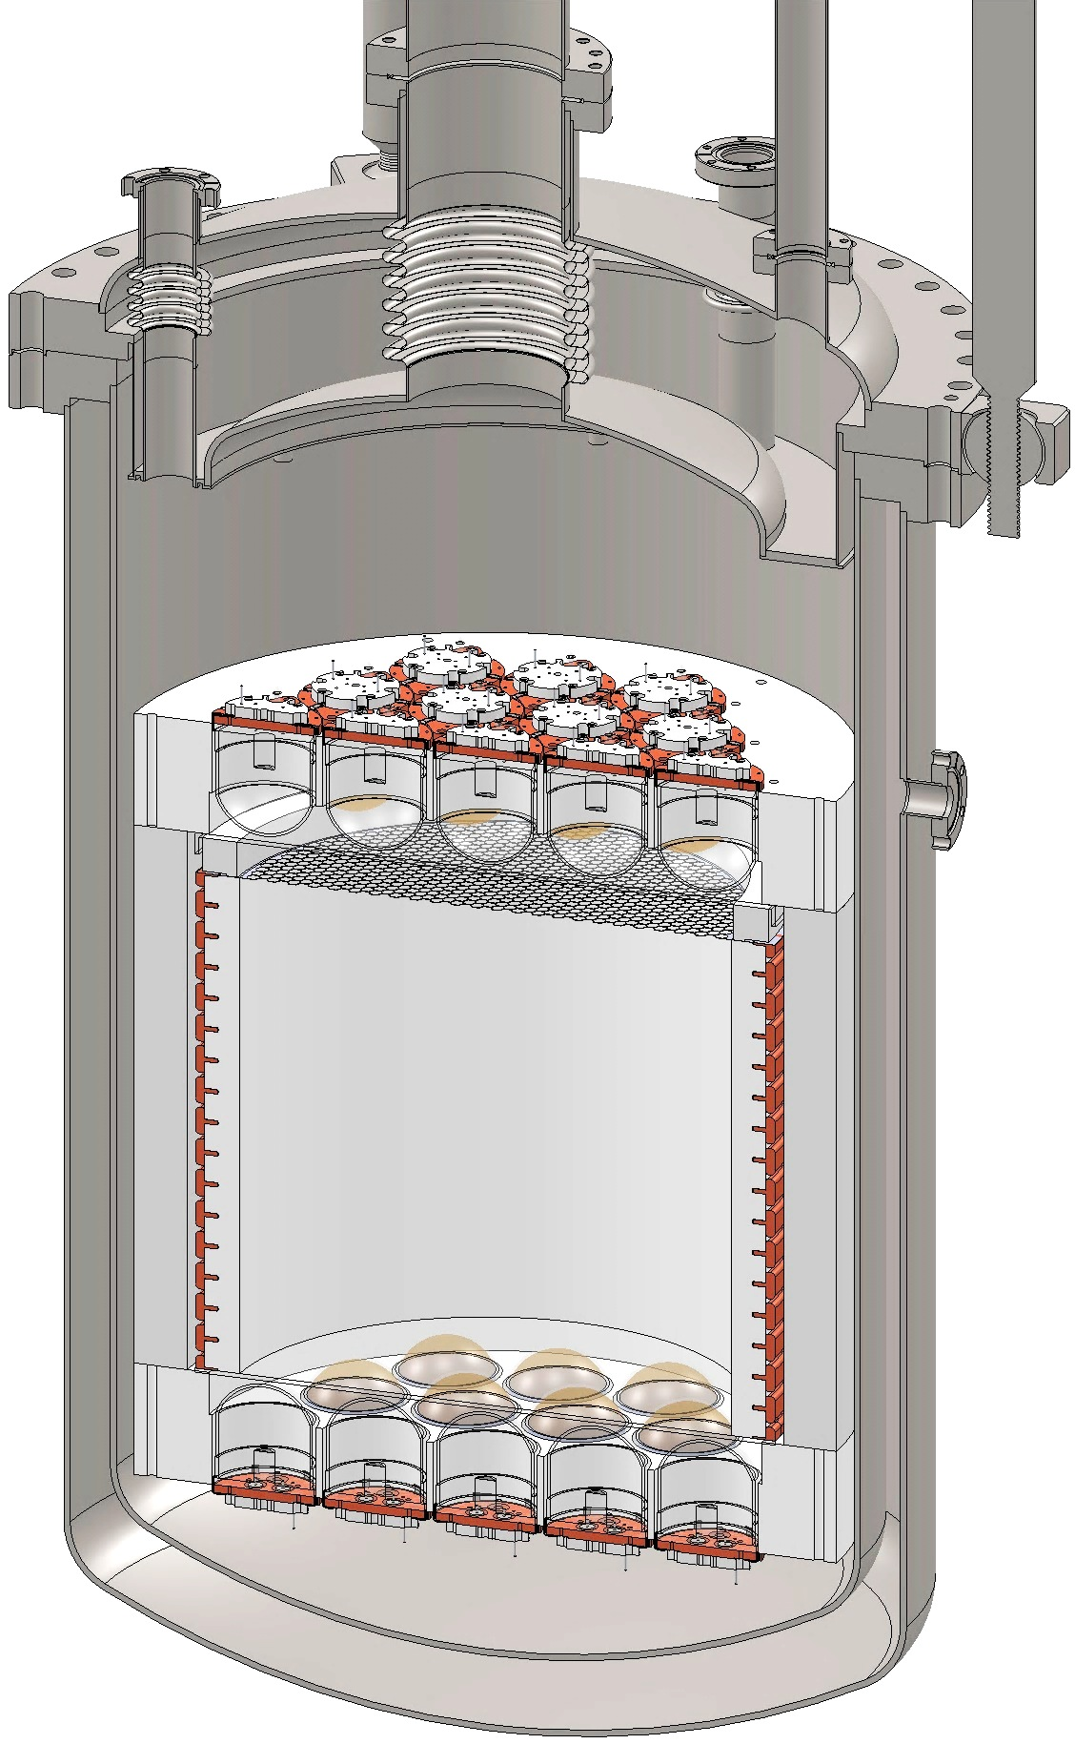
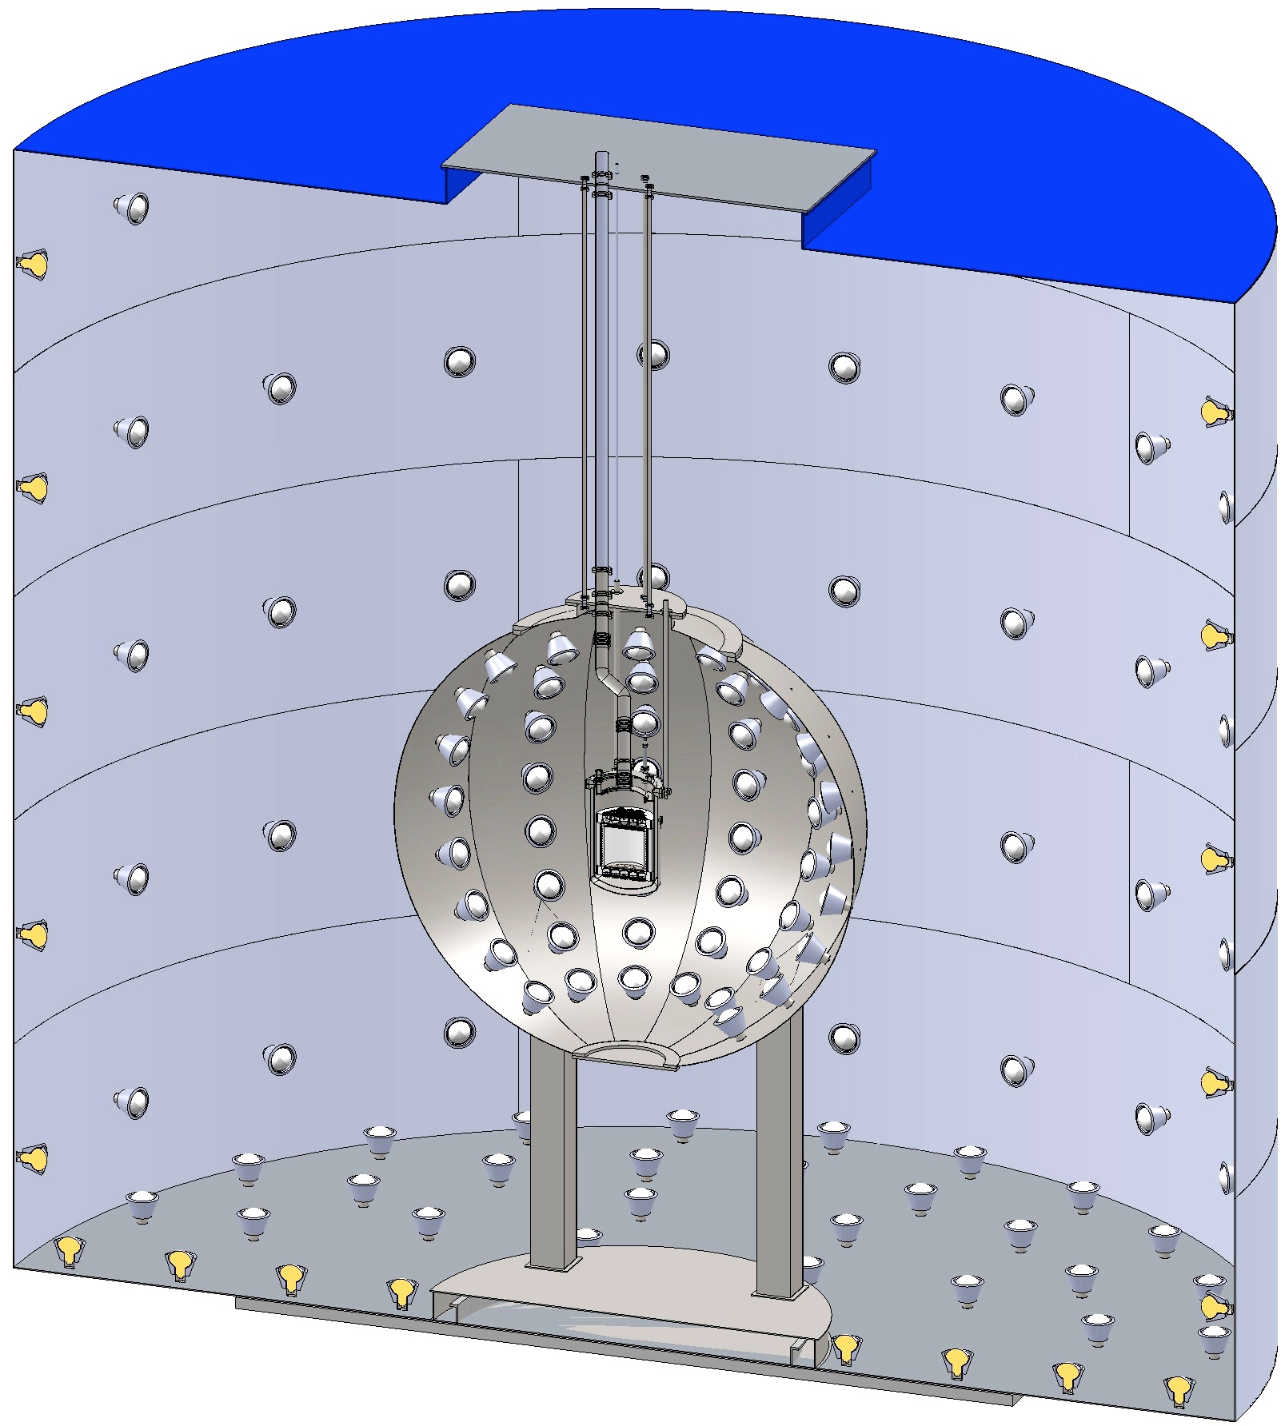
DarkSide 50 kg (Double phase Argon)
CTF Water Tank
3” QUPID
(19 top + 19 bottom)
Liquid
Scintillator
Depleted Ar
(50 kg)

Slide 18
Comparison of G1 Experiments
Experiment Name | Location |  | Mass |  |  | Photon Detector
 |  | Target | Total | Fiducial | Phase | Type | Location | Size | Radioactivity
 |  |  | (kg) | (kg) |  |  |  | (inch) | (mBq /piece) | (mBq /cm²)
XENON100 | Gran Sasso | Xe | 162 | 48 | Double | R8520 | Top/Bot. | 1 | 1 | 0.2
XMASS | Kamioka | Xe | 800 | 100 | Single | R8778Hex | 4π | 2 | 5 | 0.2
LUX | DUSEL | Xe | 350 | 100 | Double | R8778 | Top/Bot. | 2 | 20 | 0.8
Mini-CLEAN | SNO | Ar | 360 | 100 | Single | 8" PMT | 4π | 8 | 500 | 1.5
WARP | Gran Sasso | Ar | 140 | 100 | Double | 3" PMT | Top | 3 | 200 | 4.4
DarkSide 50 | Gran Sasso | Ar | 60 | 50 | Double | 3” QUPID | Top/Bot. | 3 | 1 | 0.02

Slide 19
Single Phase vs. Double Phase
 | Single Phase | Double Phase
HV for electron drift | Not required | Required (~1 kV/cm)
O₂ / H₂O impurity | Not critical | Critical
Energy threshold | 20 PE | 4 PE
Sensitivity for low mass WIMP | > 20 GeV | > 5 GeV
Position resolution | ~ 10 cm | ~ 2 mm
Gamma rejection by S2/S1 | No | Yes (> 99.5%)
Neutron rejection by Multi-hit cut | No | Yes

Slide 20
Xenon vs. Argon
Xenon
  5 times more sensitive (per unit mass)
    due to A² dependence.
  Expensive
    ~$1M / ton
  Limited by pp-chain solar neutrino
    ~0.2 event /ton/year
  Ideal for mass range of 10 – 100 GeV
    Spectrum is independent from mass
Argon
  Free from gamma background
    > 10⁶ rejection by pulse shaping
  Inexpensive
  Ideal for mass range of 20 – 200 GeV
    Insensitive to low mass < 10 GeV

Slide 21
XENON100

Slide 22
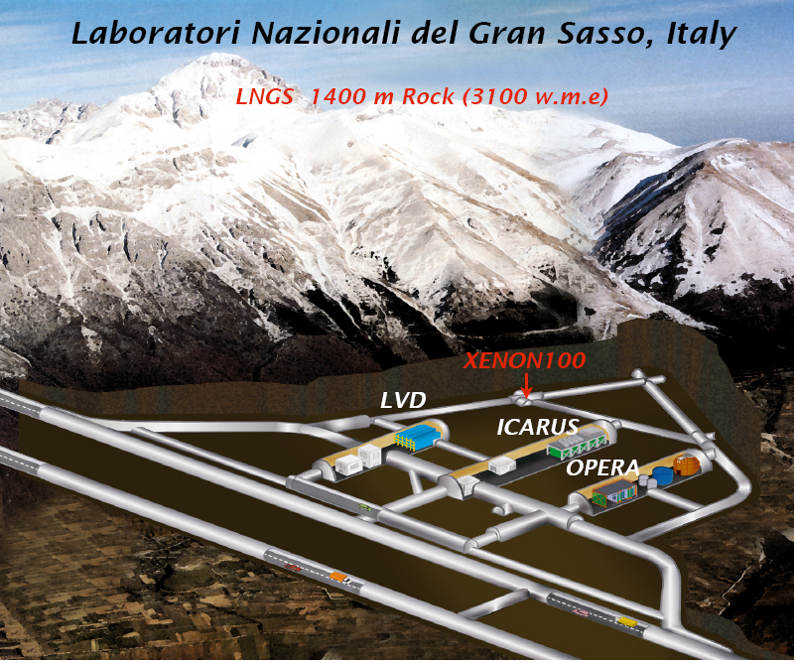
WARP

Slide 23
XENON100 Detector
161 kg
(48 kg)

Slide 24
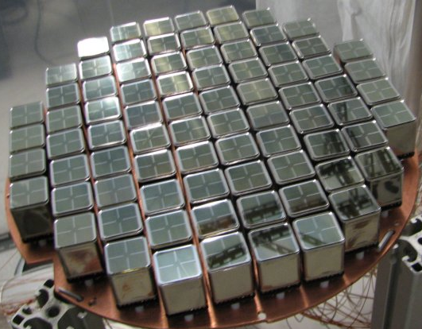
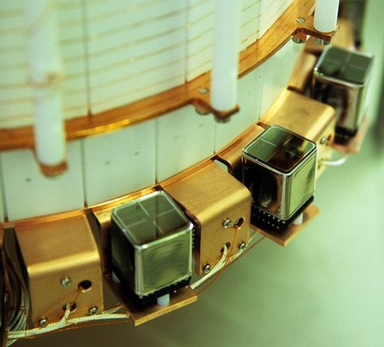
PMT Arrays
242 Hamamatsu R8520 PMTs
1"x1", optimized for response @ Xe scintillation light (178 nm)
Low radioactivity ( ~ <1 mBq/PMT)
Top Array
98 PMTs
~23% QE
Bottom Array
80 PMTs
~33% QE
Active Veto
64 PMTs
~23% QE

Slide 25
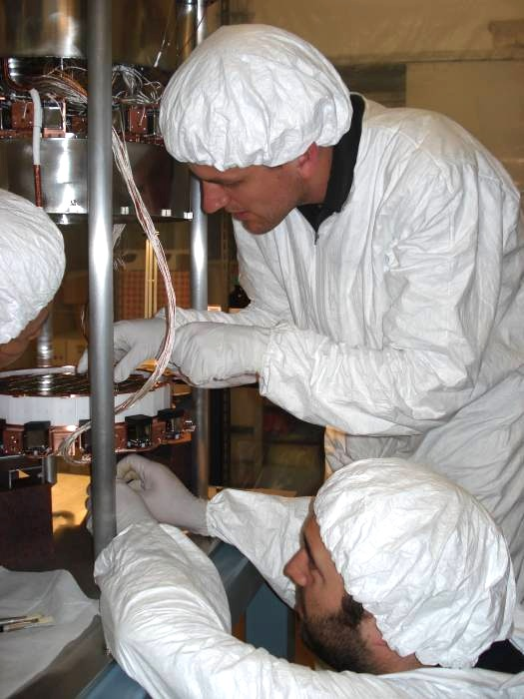
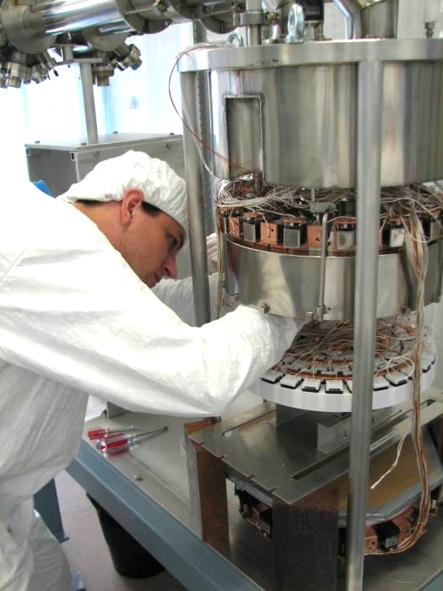
XENON100 Detector

Slide 26
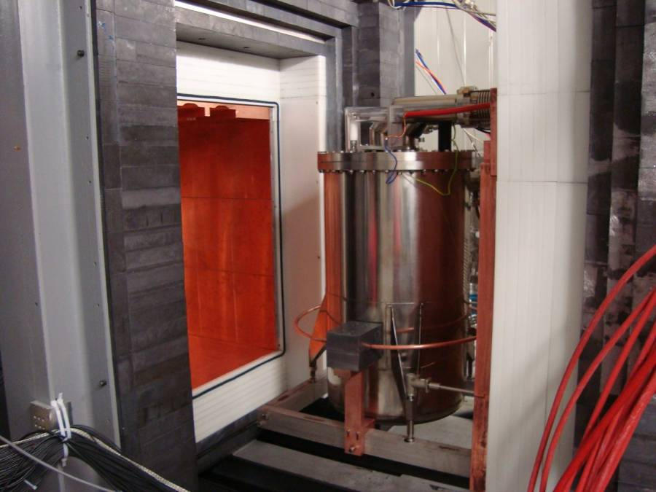
Pb
(20cm)
Poly
(20cm)
Cu
(5cm)
Pb
(20cm)
Poly
(20cm)
Cu
(5cm)

Slide 27
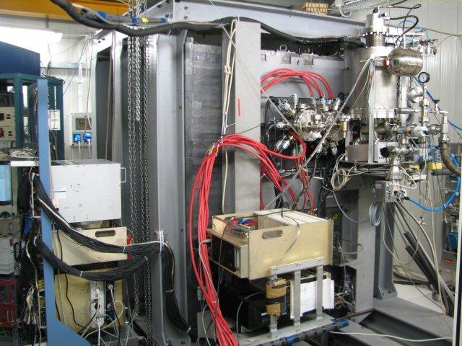
Cooling
Tower
DAQ
Preamp

Slide 28
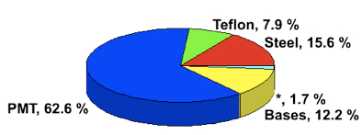
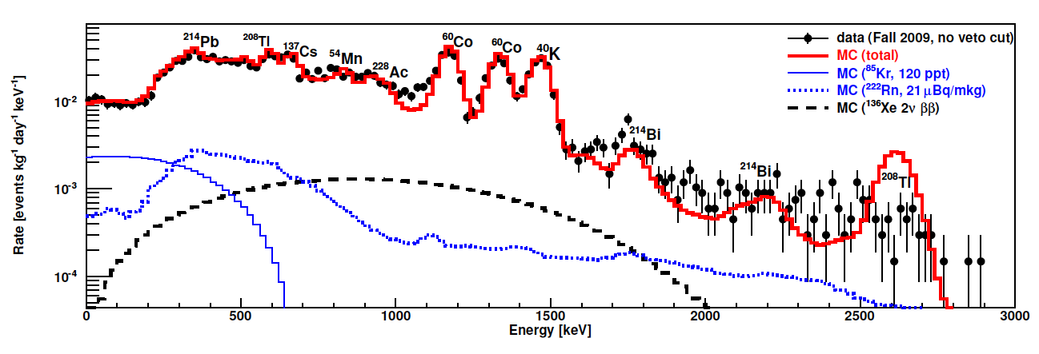
Energy Spectrum of Real Data vs. MC
Surface Backgrounds
arXiv:1101.3866
MC Total
⁸⁵Kr
²²²Rn
¹³⁶Xe Double Beta Decay

Slide 29
Level of Backgrounds (before S2/S1 cut)
before fiducial cut
after fiducial cut

Slide 30
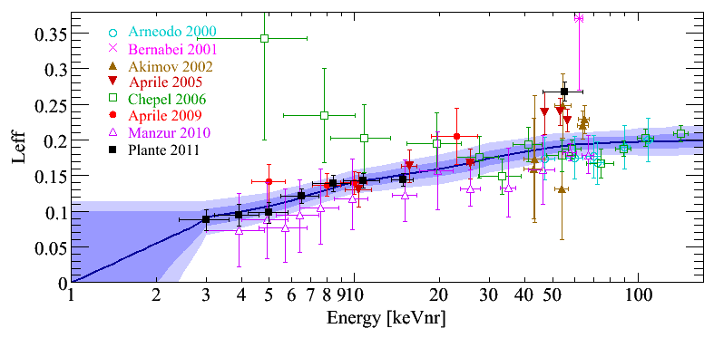
New L_{eff} vs. Energy
Leff : Relative scintillation efficiency for nuclear recoils to 122 keV gamma rays (at zero electric field)
arXiv:1104.2587

Slide 31
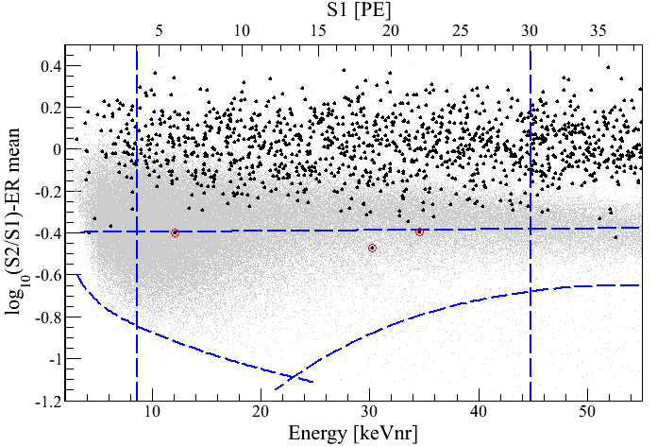
Log(S2/S1) vs. Energy
100.9 days, 48 kg
arXiv:1104.2549
S1 = 4 PE
γ backgrounds
S1 = 30 PE
99.75% rejection for γ
Neutron band
(Acceptace 30 – 40%)
3 events
(1.8 ± 0.6 expected)
-3 σ
8.4 keV_{nr}
44.6 keV_{nr}
S2 = 300 PE

Slide 32
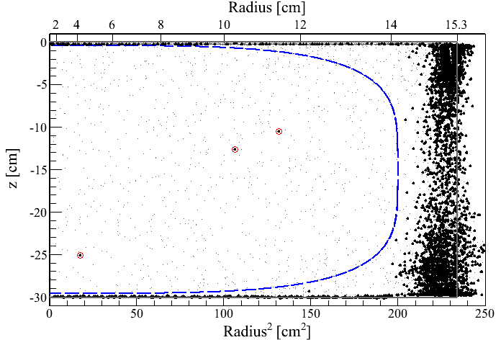
Event distribution in z vs. R²
100.9 days, 8.4 – 44.6 keV_{nr}
48 kg
3 events
(1.8 ± 0.6 expected)

Slide 33
Log(S2/S1) vs. Energy
11 keV_{nr}

Slide 34
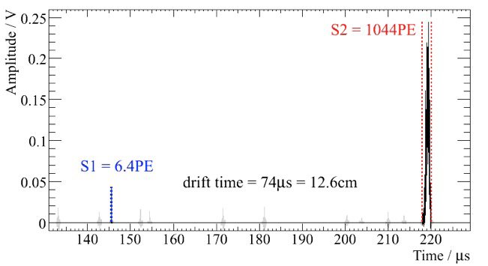
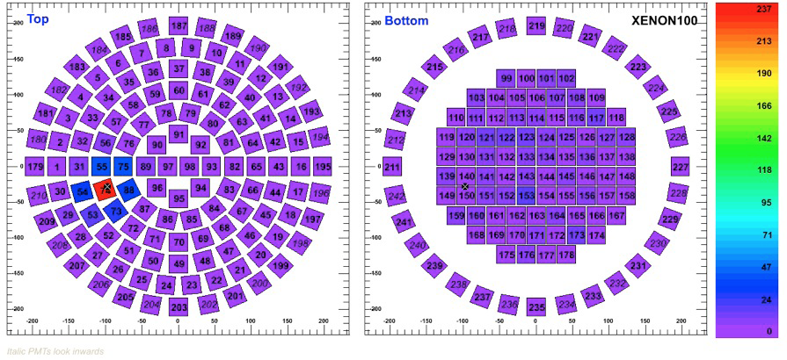
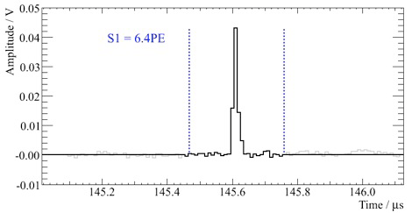
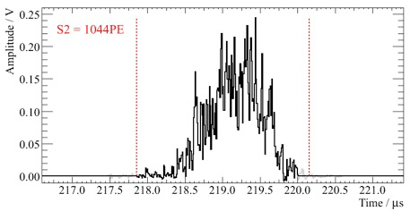
Single Scatter Nuclear Recoil Event Candidate
11 keV_{nr}
Top
Bottom

Slide 35
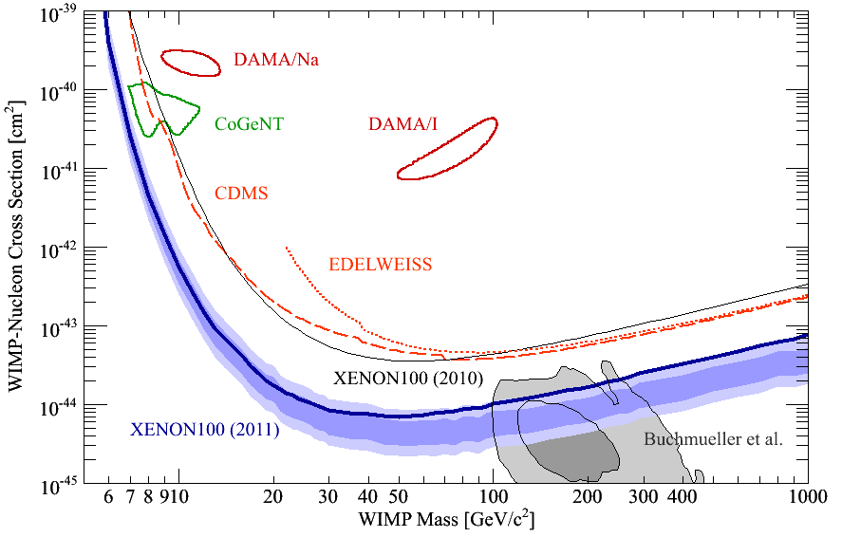
90% CL Limits of SI Cross Section (April, 2011)
arXiv:1104.2549
CMSSM

Slide 36
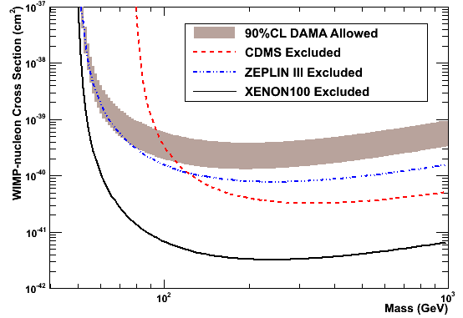
Inelastic Dark Matter
arXiv:1104.3121
DAMA Allowed
ZEPLIN III
CDMS
XENON100
δ = 120 keV

Slide 37
Summary of XENON100
Purity of Xenon has achieved the design goal.
  Actual Goal
  Light Yield: 2.2 > 2 pe/keVee
  Electron Drift Time: 400 > 300 μs
  Krypton 85: 80 < 100 ppt
  Radon: 1.1 < 2 Bq/m³
100 days of data published.
  3 event observed (1.8 +- 0.6 events expected)
    Contaminated by ⁸⁵Kr at ~ 700 ppt → 1.1 events
  < 7 x 10⁻⁴⁵ cm² at 50 GeV arXiv:1104.2549
  Low mass (7-10 GeV) WIMP unlikely.
  Inelastic DM excluded. arXiv:1104.3121
Data taking continues.
  ⁸⁵Kr reduced to < 80 ppt
  < 2 x 10⁻⁴⁵ cm² by the end of 2011 expected.

Slide 38
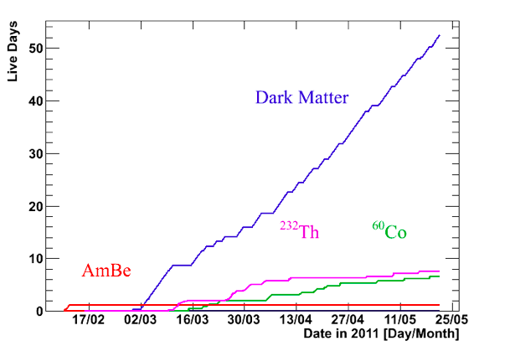
XENON100 data taking in 2011
March
April
May

Slide 39
Future Directions

Slide 40
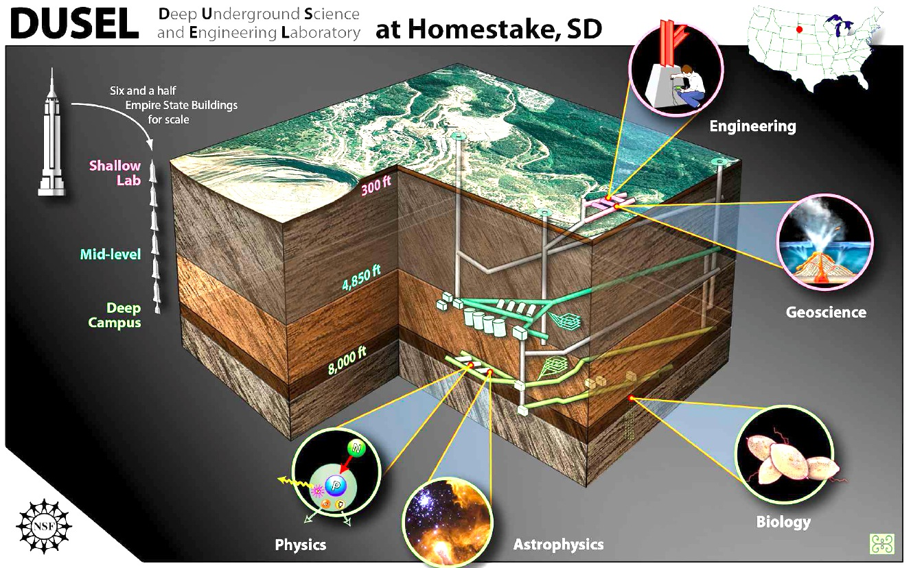
DUSEL started in 2007 (~$1B project by NSF)

Slide 41
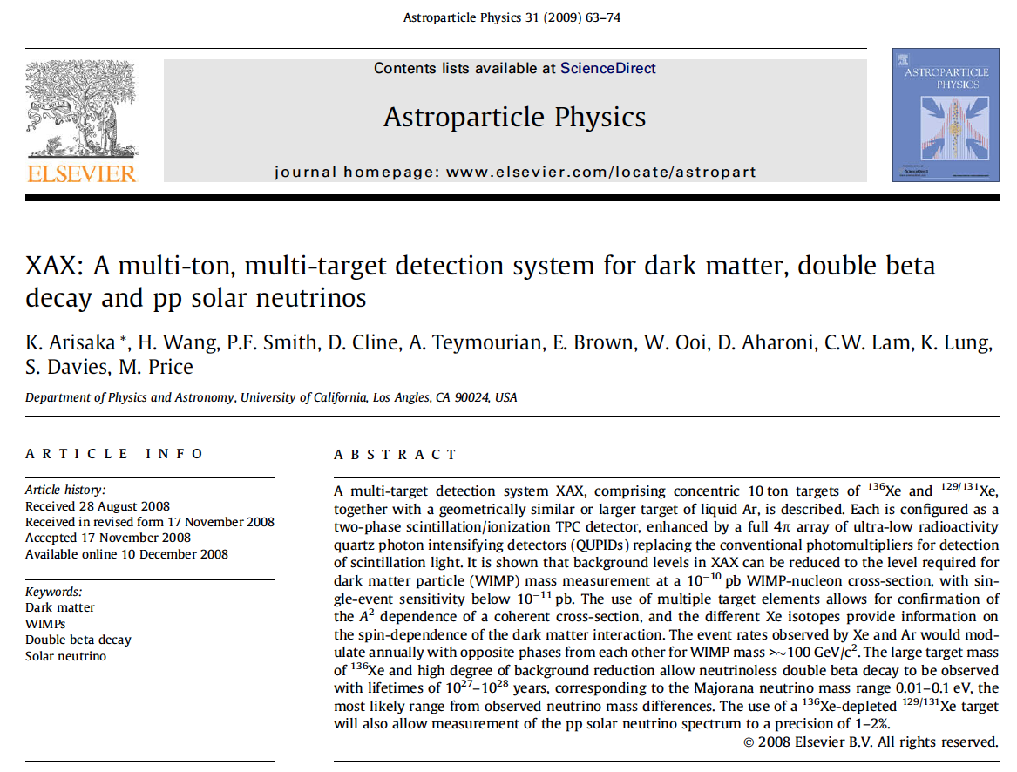
XAX by UCLA Group (2008)
arXiv:0808.3968

Slide 42
XAX (Xenon-Argon-Xenon)
Water Tank Veto
WIMP (Spin even)
Double Beta Decay
WIMP (Spin odd)
Solar Neutrino
WIMP (Spin even)
12 m
¹³⁶Xe
7 ton
(4 ton)
⁴⁰Ar
70 ton
(50 ton)
^{129/131}Xe
12 ton
(6 ton)
1.2 m
2 m
4 m
12 m
14 m

Slide 43
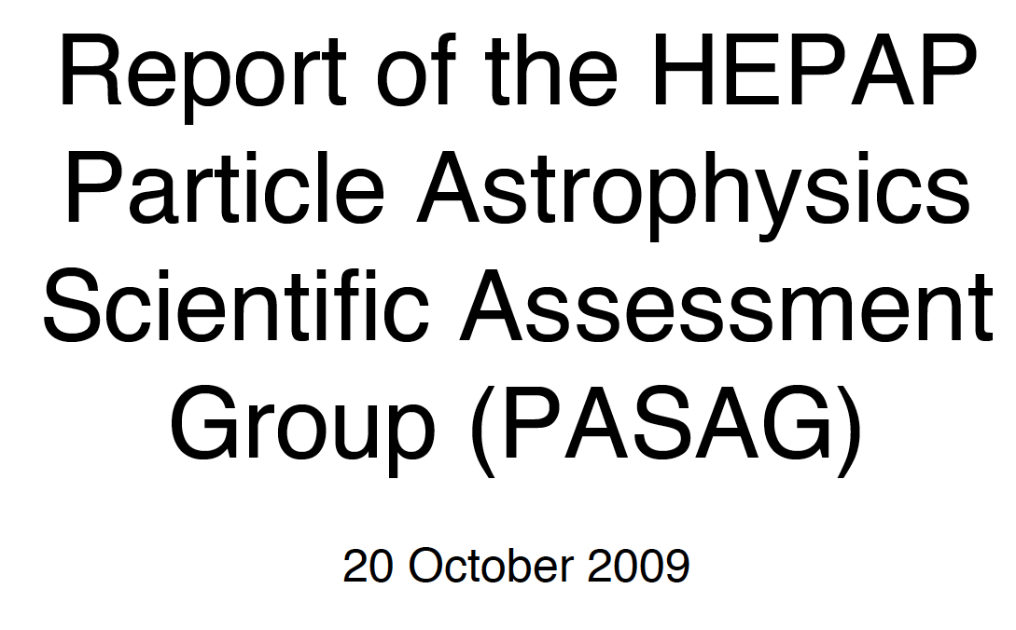
PASAG Report (2009)

Slide 44
G2 and G3 facilities defined by PASAG (2009)
 | G1 | G2 | G3
Sensitivity | < 10⁻⁴⁴ cm² | < 10⁻⁴⁶ cm² | < 10⁻⁴⁷ cm²
Target Mass | 10 – 100 kg | ~ 1 Ton | ~ 10 Ton
Cost | $1M – 5M | $10 – 20M | ~ $100M

Slide 45
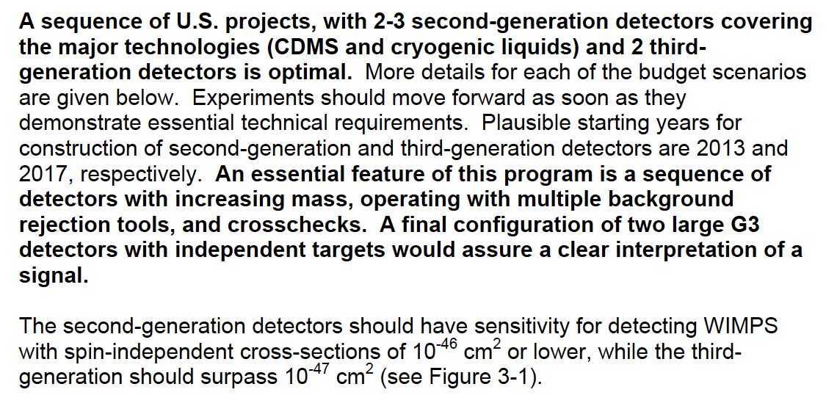
Supports on G2 and G3 Detectors

Slide 46
Comparison of Xenon Detector Size
G3
MAX, LZD, XAX
20 ton (10 ton)
G2
XENON 1ton
2.4 ton (1 ton)
G1
2 m
XENON100
161 kg
(48 kg)
ZEPLIN-II
31 kg
(7.2 kg)
XENON10
14 kg
(5.4 kg)
1 m
1 m
15cm
30cm
14cm
30 cm
20 cm
30 cm
1 m
2 m
2007
2007
2010
2014
2019

Slide 47
G1
CMSSM
G2
G3

Slide 48
Where backgrounds come from?
Cosmic Rays
Underground or
Under high mountains
XDNON100
Radio Activities
(U, Th, K…)
Detector
Water Tank
(Liquid Scintillator)
Photon detectors are the major source of backgrounds.

Slide 49
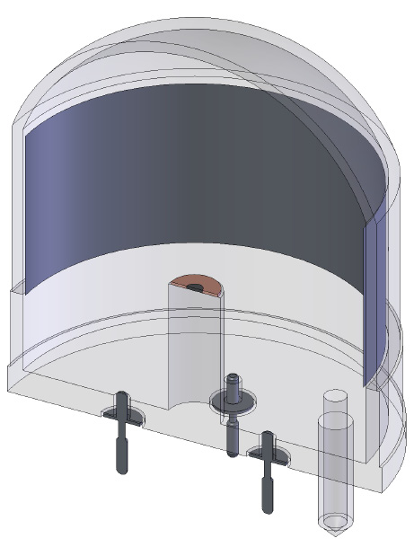
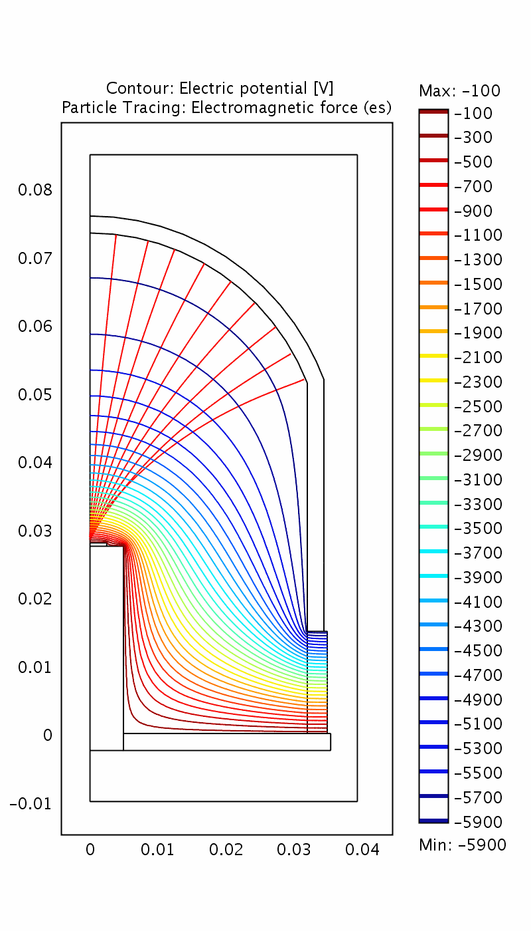
QUPID (QUartz Photon Intensifying Detector)
arXiv:1103.3689
Photo Cathode
(-6 kV)
Photo Cathode
(-6 kV)
Quartz
Al coating
APD (0 V)
APD (0 V)
Quartz

Slide 50
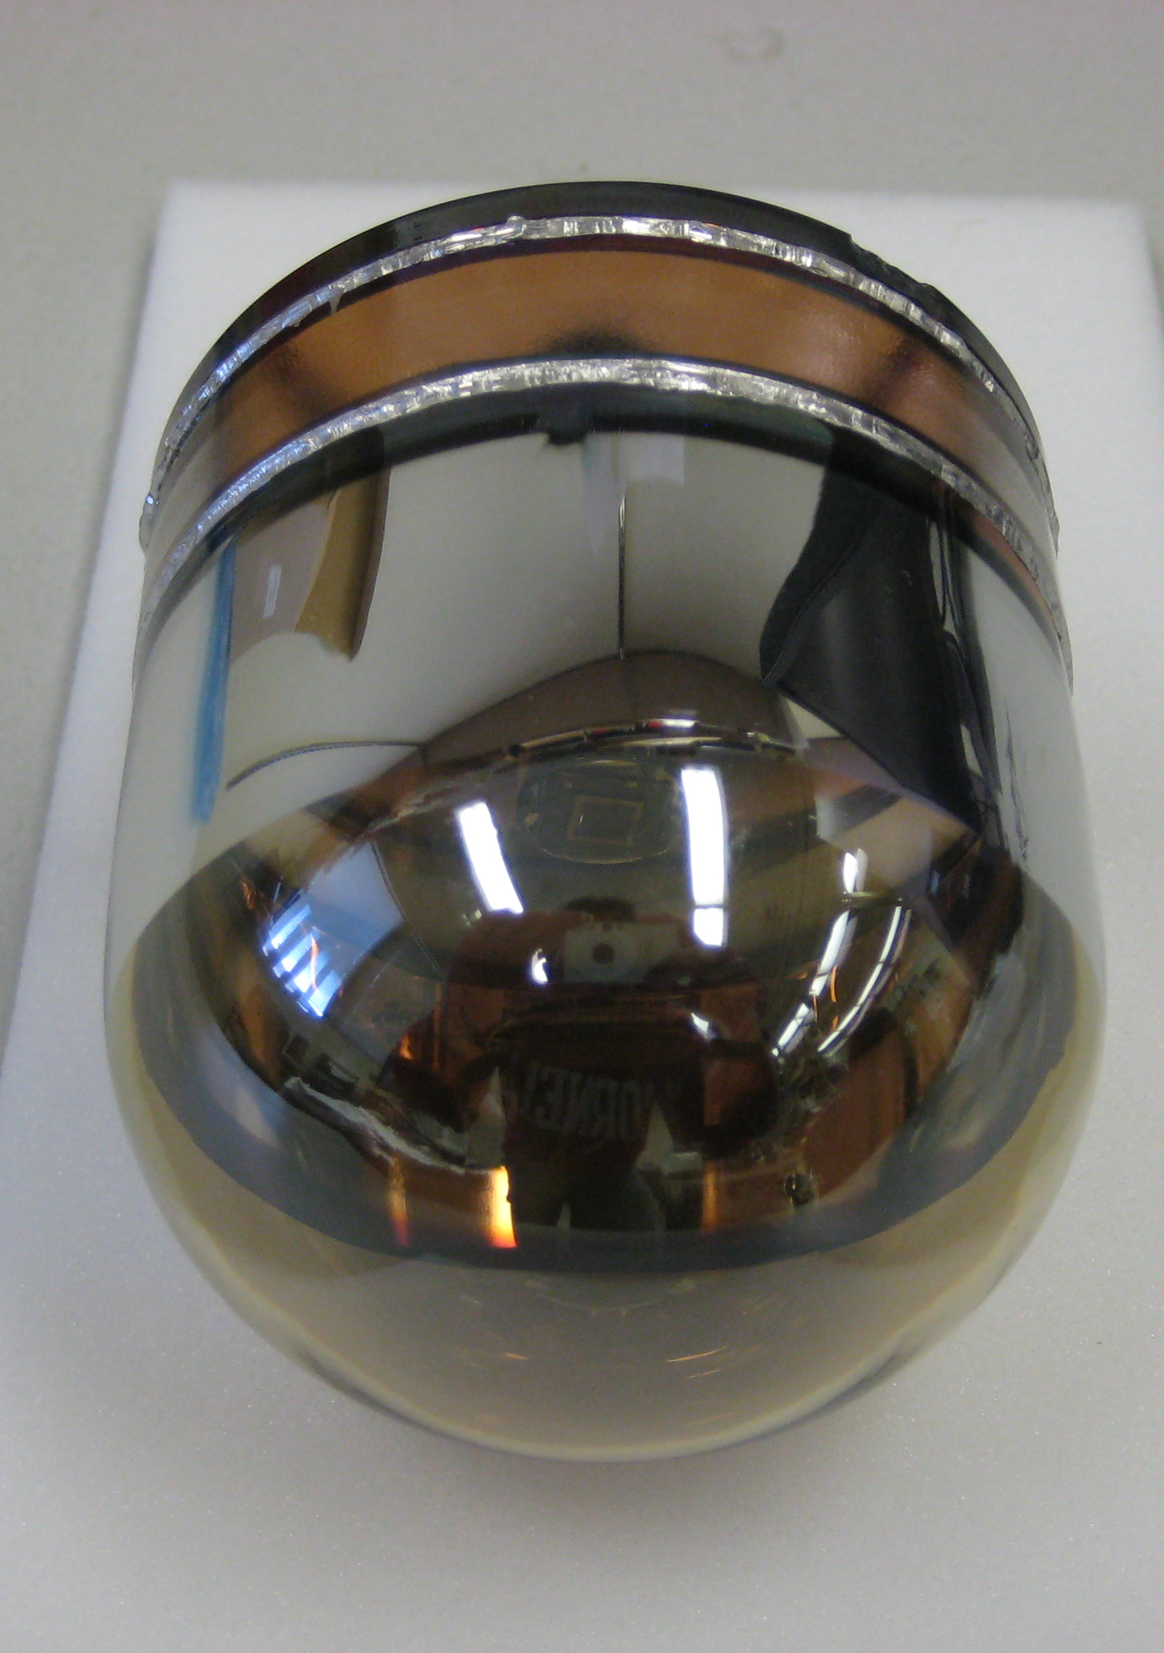
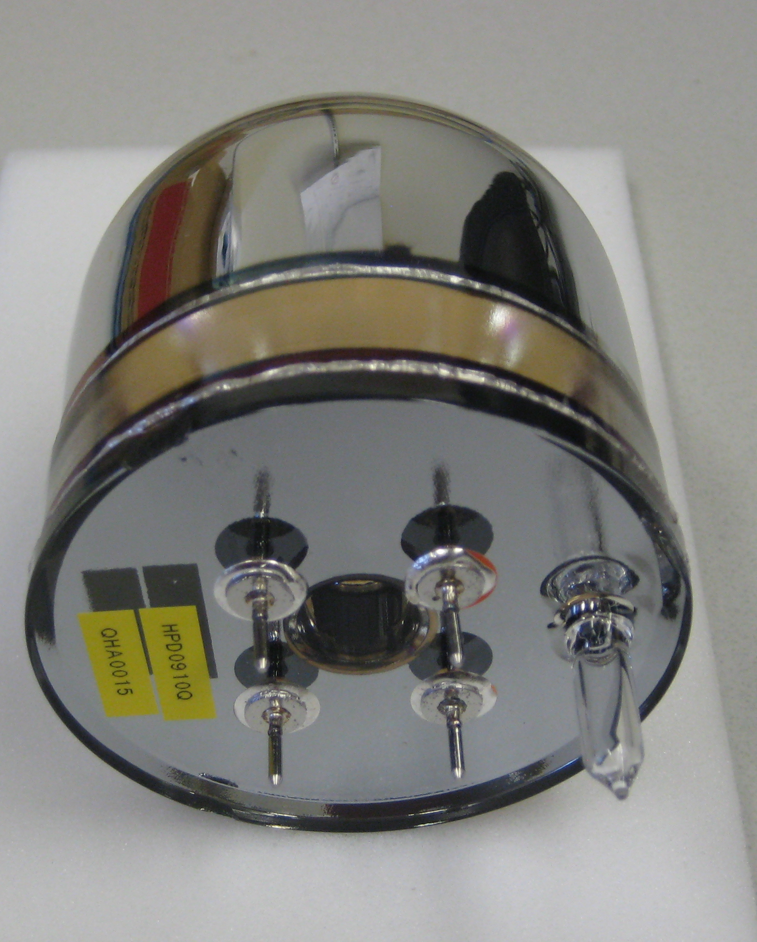
New 3” QUPID (Production Version)

Slide 51
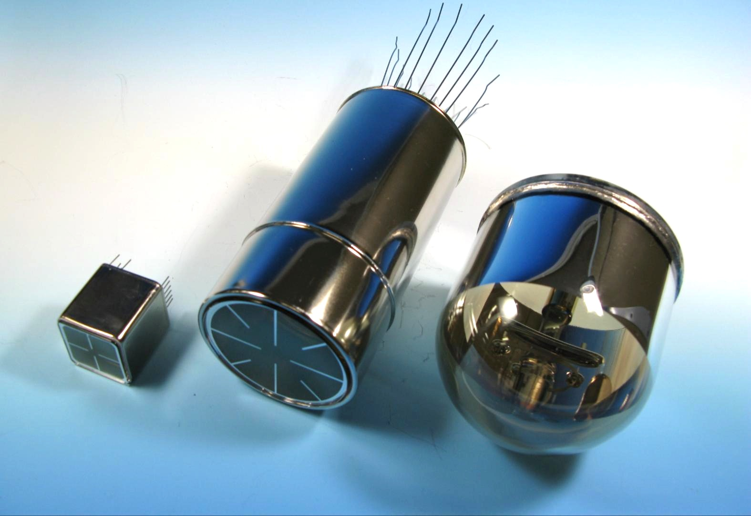
Comparison of Low-radioactive
Photon Detectors from Hamamatsu
R8520
1 inch
R8778
2 inch
QUPID
3 inch
DarkSide50
XENON1Ton
MAX, XAX
XENON10
XENON100
LUX
(XMASS)

Slide 52
QE of two types of QUPID
Xenon (178 nm)
Argon + TPB (420 nm)

Slide 53
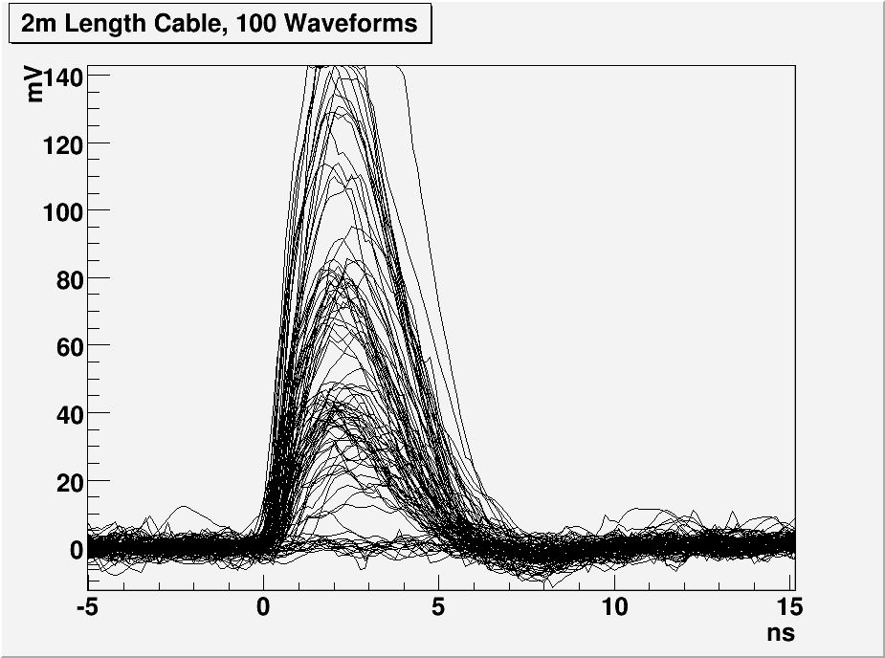
1, 2 and 3 PE Distribution with 2m cable
3 PE
2 PE
1 PE

Slide 54
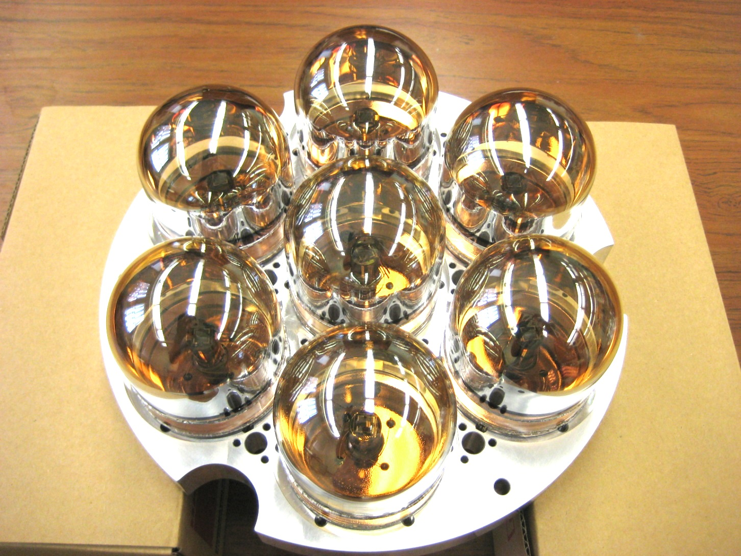
7 QUPID Array on Base Plate at UCLA

Slide 55
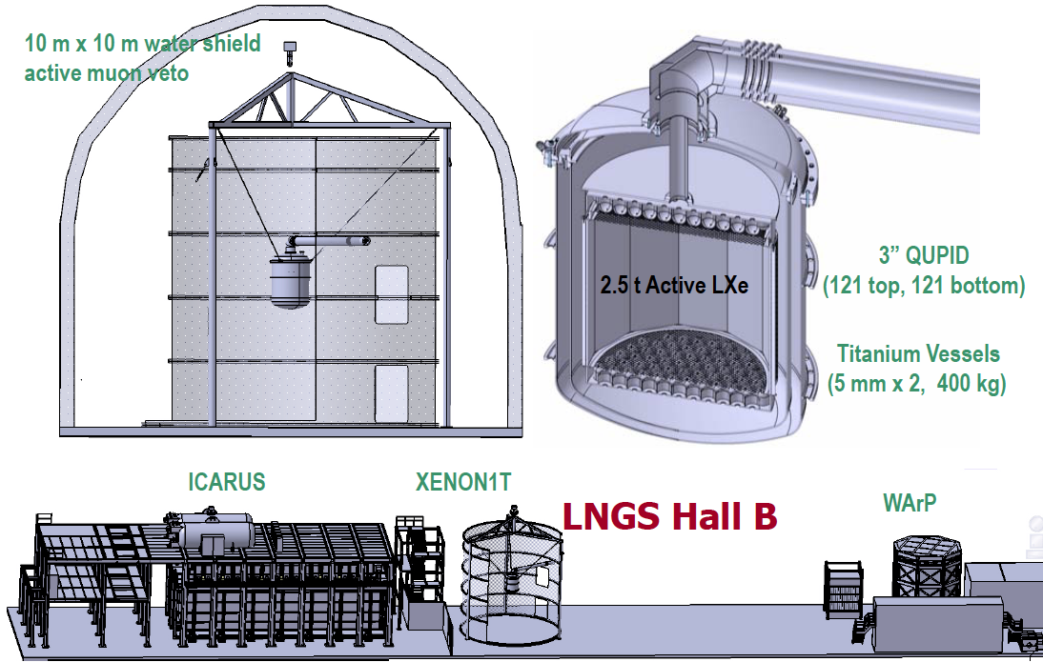
XENON1T (G2)

Slide 56
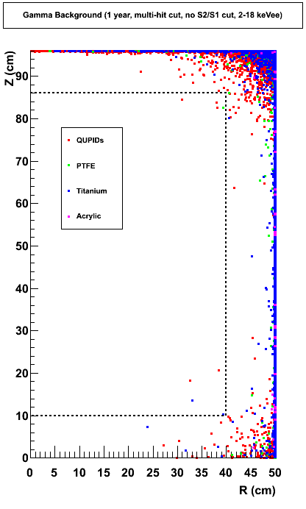

Expected Backgrounds in XENON 1Ton
(100 Year, Multi-hit Cut)
XENON100
XENON100
0.07 γ / year
0.1 n / year
1.1 ton
1.1 ton

Slide 57


MAX Detector (G3)
⁴⁰Ar
70 ton
(50 ton)
Xe
20 ton
(10 ton)
4m
2 m
3” QUPID x 595 (Top)
3” QUPID x 595 (Bottom)
3” QUPID x 2644 (Top)
3” QUPID x 2644 (Bottom)

Slide 58


MAX (G3) Shielding Structure
Xe
20 ton
(10 ton)
⁴⁰Ar
70 ton
(50 ton)
18 m
Liquid
Scinti
Liquid
Scinti
Water Tank
Water Tank
8 m
18 m

Slide 59

MAX at DUSEL
⁴⁰Ar
70 ton
(50 ton)
Xe
20 ton
(10 ton)

Slide 60

US Dark Matter Programs
2010
Xe
Ar
G3 = Xe (10T) + Ar (50T)
Xe
Ar

Slide 61



Xe 10 ton Neutron Background (100 Years)
1/8
1/4
Before Cuts
Multi Hit Cut
Liquid Scinti. Veto
0.81 n / year
0.10 n / year
0.03 n / year
Xenon
10 ton

Slide 62



Ar 50 ton Neutron Background (100 Years)
1/20
1/6
Before Cuts
Multi Hit Cut
Liquid Scinti. Veto
42 n / year
2.1 n / year
0.39 n / year
Argon
50 ton

Slide 63

(SI) WIMP Energy Spectrum for LXe
(Cross Section = 10⁻⁴⁵cm²)
Xenon
8 keVr
45 keVr
200 GeV
100 GeV
500 GeV
1000 GeV
20 GeV
50 GeV

Slide 64

(SI) WIMP Energy Spectrum for LAr
(Cross Section = 10⁻⁴⁵cm²)
Argon
(w/ pulse shaping)
40 keVr
200 keVr
100 GeV
500 GeV
1000 GeV
200 GeV
20 GeV
50 GeV

Slide 65

1-σ Error of WIMP Mass vs SI Cross Section
(10 ton*year Xe and 50 ton*year Ar)
50 GeV
100 GeV
200 GeV
500 GeV
Argon
10⁻⁴⁵ cm²
Xenon
G3

Slide 66

1-σ Error of WIMP Mass vs SI Cross Section
(10 ton*year Xe and 50 ton*year Ar)
10⁻⁴⁵
10
50
10
50
Argon
50 GeV
100 GeV
200 GeV
500 GeV
10⁻⁴⁶
10⁻⁴⁶ cm²
Xenon
G3
10⁻⁴⁷

Slide 67

1-σ Error of WIMP Mass vs SI Cross Section
(10 ton*year Xe and 50 ton*year Ar)
10⁻⁴⁵
10
50
Xenon
(56 events)
10
50
10⁻⁴⁶
10⁻⁴⁶ cm²
Argon
(42 events)
G3
100 GeV
10⁻⁴⁷

Slide 68

1-σ Error of WIMP Mass vs SI Cross Section
(10 ton*year Xe and 50 ton*year Ar)
10⁻⁴⁶
10
50
Xenon
(5.6 events)
10
50
10⁻⁴⁷
10⁻⁴⁷ cm²
Argon
(4.2 events)
G3
100 GeV
10⁻⁴⁸

Slide 69
Neutrino Physics

Slide 70

Energy Spectrum (Natural Xe)
arXiv:0808.3968
100 GeV WIMP (10⁻⁴⁴ cm²)
2ν DBD (10²² yrs)
pp Solar
Be7 Solar
0ν DBD (10²⁷ yrs)
B8 Solar

Slide 71
XAX (Xenon-Argon-Xenon)
arXiv:0808.3968
Water Tank Veto
WIMP (Spin even)
Double Beta Decay
WIMP (Spin odd)
Solar Neutrino
WIMP (Spin even)
12 m
¹³⁶Xe
7 ton
(4 ton)
⁴⁰Ar
70 ton
(50 ton)
^{129/131}Xe
12 ton
(6 ton)
1.2 m
2 m
4 m
12 m
14 m

Slide 72
Neutrino-less
Double Beta Decay

Slide 73

¹³⁶Xe Double Beta Decay and Gamma Background
(1 mBq / QUPID, 2m Xenon Detector)
0 cm
2ν DBD (10²² yrs)
10 cm
20 cm
30 cm
40 cm
50 cm
0ν DBD (10²⁷ yrs)
B8 Solar Neutrino

Slide 74

Double Beta Decay Experiments
EXO200
CANDLES III
EXO 1Ton
No. of Backgrounds (/year)
10²⁵ yrs
10²⁶ yrs
10²⁷ yrs
10²⁸ yrs
CUORE I
NEMO3 (Mo)
XENON1T
CUORE III
Cuoricino
XAX (Natural)
Super-NEMO (Se)
GERDA I
GERDA III
XAX (Enriched)
CUORE II
COBRA
EXO 1Ton
(Ba tag)
NEMO3
(Se)
GERDA II
Mass (kg)

Slide 75
Solar Neutrino Detection

Slide 76

Solar Neutrino (by XMASS group)
M. Nakahata

Slide 77

Sular Neutrino Detection
M. Yamashita

Slide 78

Solar Neutrino Study by XMASS Group
M. Nakahata

Slide 79
Summary

Slide 80
G1
CMSSM
G2
G3

Slide 81

Detection of Cosmic Radiation
Larger Volume
Lower Threshold
2020
JEM-EUSO
2010
Pierre-Auger
ICECUBE
2000
HiRes
AGASA
AMANDA
1990
Cosmic Ray
LBNE (Water)
Neutrino
Super-K
IMB
Kamiokande
MAX / XAX
XENON1T
Future
XENON100
Dark Matter
Ongoing
CDMS-II
XENON10
Past

Slide 82


XAX vs. Super-K
XAX
Liquid Xenon (20 ton)
Super-K
Pure Water (50,000 ton)
2 m
40 m
Energy Threshold = 5 keV
3” QUPID x 4,000
Energy Threshold = 5 MeV
20” PMT x 11,200

Slide 83
Conclusions
XENON100 new results announced.
  3 event observed (1.8 ± 0.6 events expected)
  < 7 x 10⁻⁴⁵ cm² (at 50 GeV WIMP mass)
  < 2 x 10⁻⁴⁵ cm² by the end of 2011 expected
Future multi-ton Xe/Ar detectors designed and proposed.
  G2 : XENON 1T and DarkSide 50 / 5T at Gran Sasso.
  G3 : MAX + LZD (Xe 10T + Ar 50T) at DUSEL
XAX is an ultimate general purpose detector with ~ 5 keV threshold.
  Double beta decay
  Solar (pp-chain) and supernova neutrinos

