Slide 1
Why are we here?
Origin of Universe and Ourselves
Katsushi Arisaka
University of California, Los Angeles
Department of Physics and Astronomy
arisaka@physics.ucla.edu

Slide 2
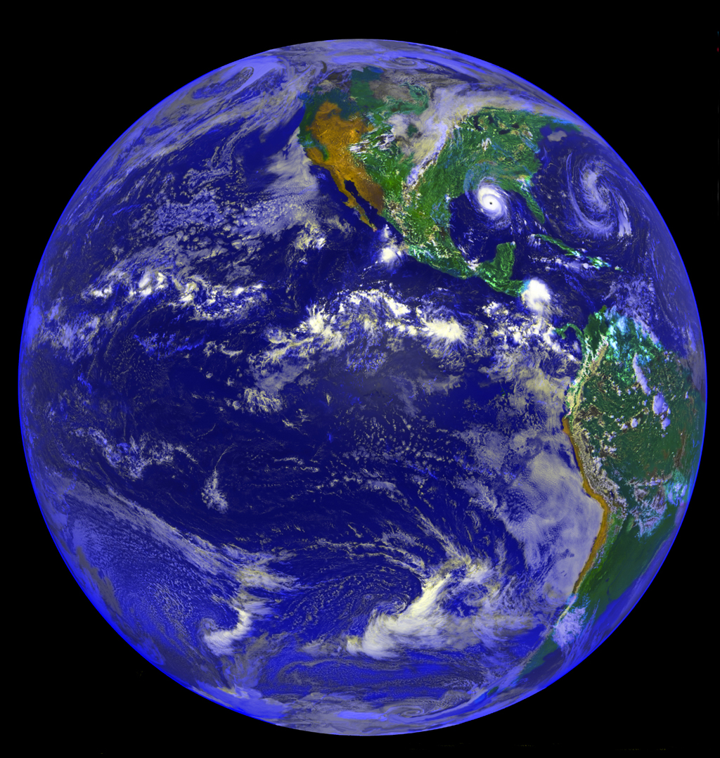
Why are we here?

Slide 3
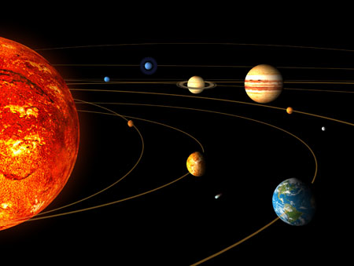
v
Solar System
Sun
Earth

Slide 4
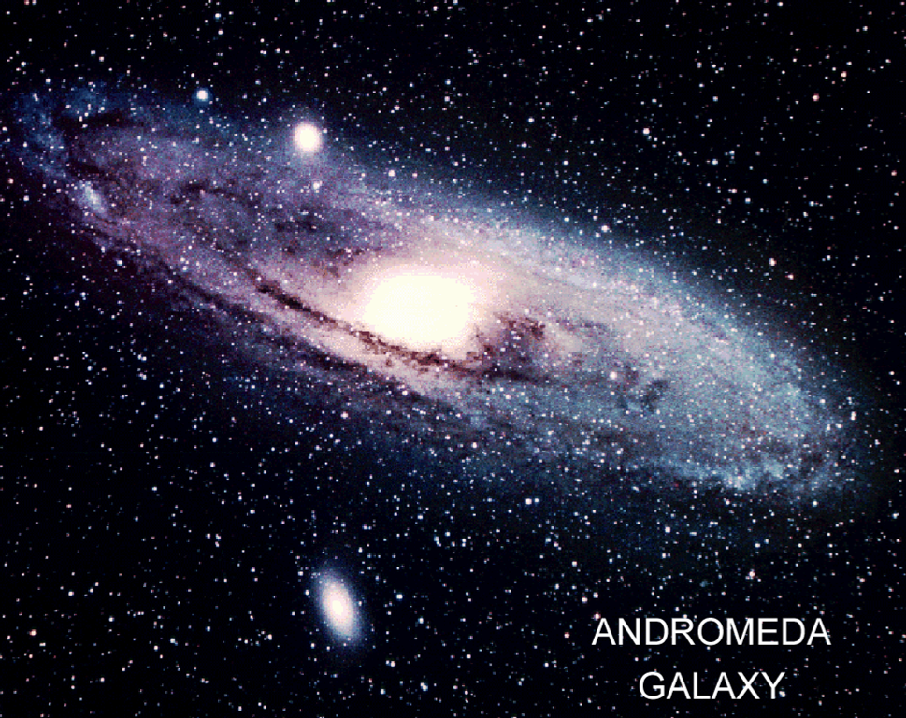
~100 Billions Stars in a Galaxy

Slide 5
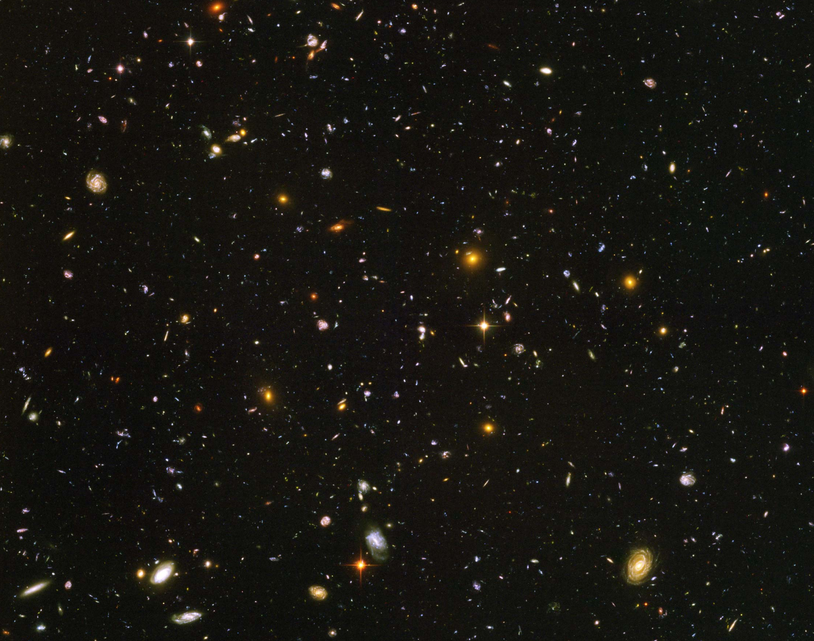
Hubble Deep Field
~100 Billion Galaxies

Slide 6
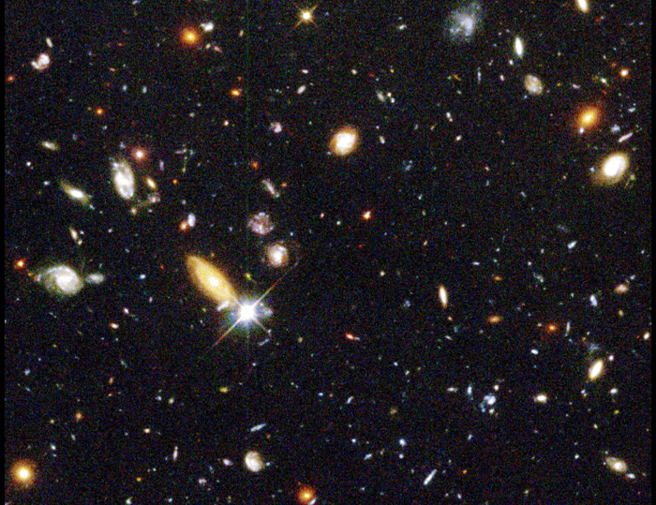
Red shift
up to ~10

Slide 7
Hubble’s Law:
Expansion of the Universe
Horizon
of Universe
Big Bang!
Sun/Earth
14 Billon
Light Years
Moving Away
at Speed of Light

Slide 8
Expansion of Universe
Size
Size of Universe
∝ √ Time
Beginning
Today
Time

Slide 9
Temperature of Universe
Temperature
Temperature = 1/Size
2.7ºK
Beginning
Today
Size

Slide 10
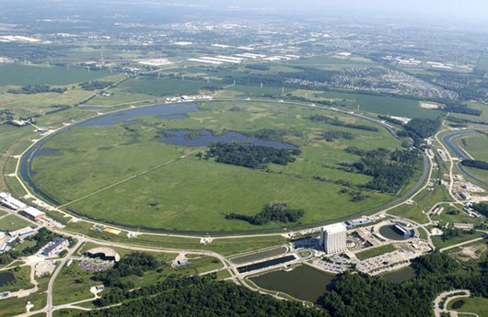
Tevatron at Fermi Lab near Chicago (1980 – 2010)
6km Circumference

Slide 11
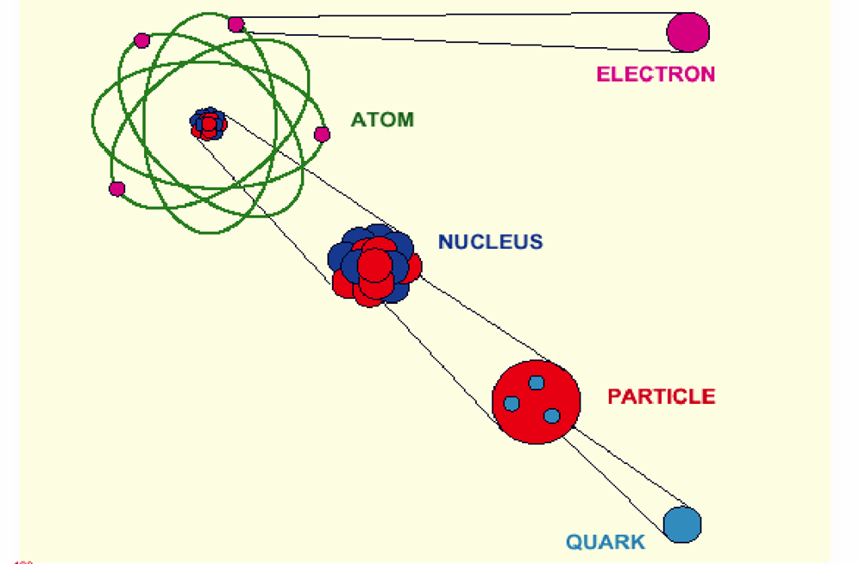
Elementary Particles

Slide 12
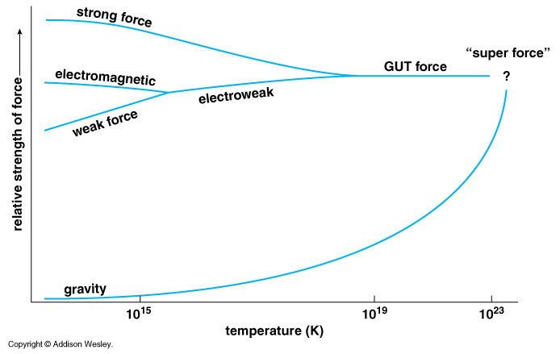
Unification of Four Forces
Grand Unification
10³²
10²⁹
10³²
Now
10²⁹

Slide 13
Unification of Four Forces
Plank Epoch
Now
10²⁹
10³²
Big Bang

Slide 14
Hubble Deep Field
Physicists’ View of Early Universe
Fiat lux
Let there be light

Slide 15
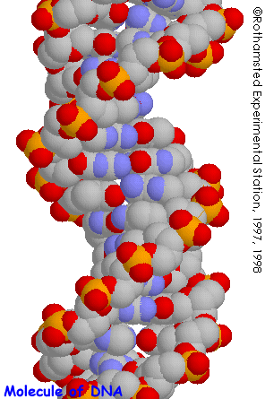
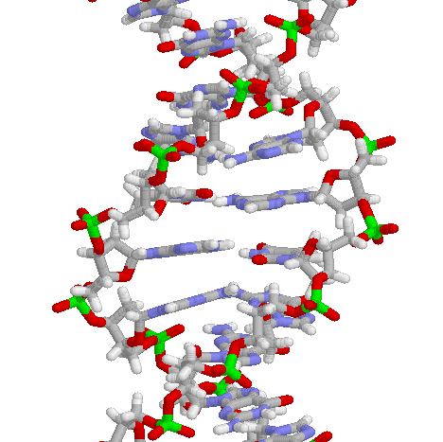
Structure of DNA

Slide 16
Symmetry Breaking
Time
0
Simple
1B years
2
3
4
5
Symmetry
Break Down
6
7
8
9
10
11
12
Complex
13
14

Slide 17
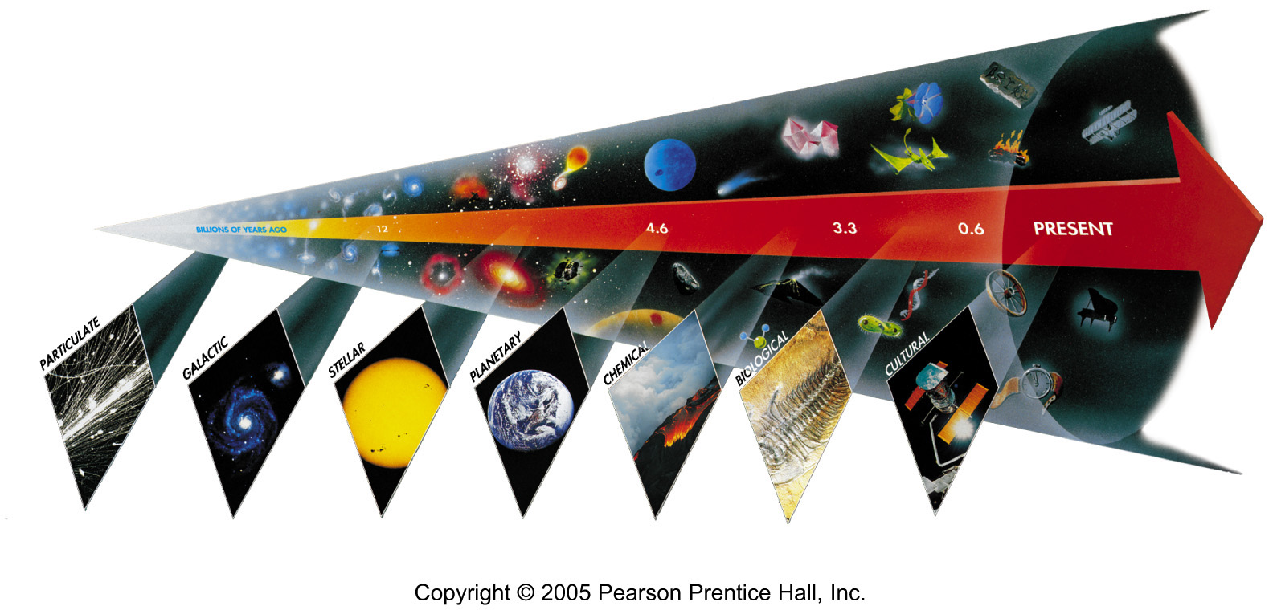
Seven Phases of Cosmic Evolution
Spontaneous Symmetry Breaking
14 billion years ago
Origin of
Particles

Slide 18
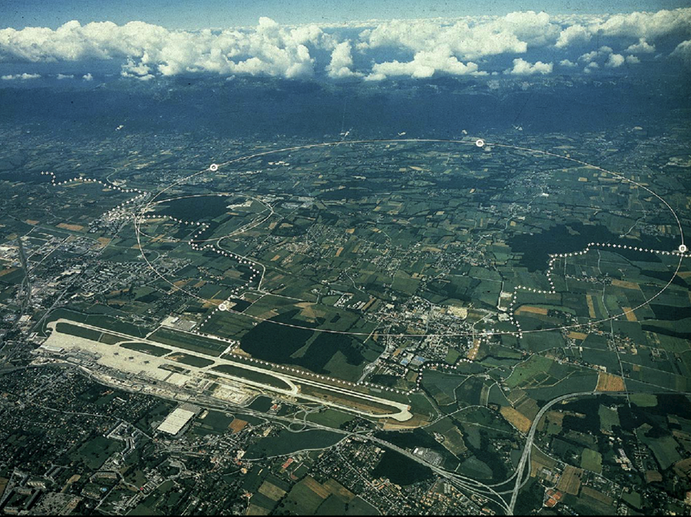
CERN and LHC in Geneva
27km Circumference

Slide 19
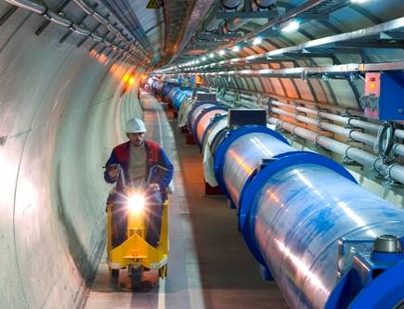
LHC Tunnel with Magnets

Slide 20
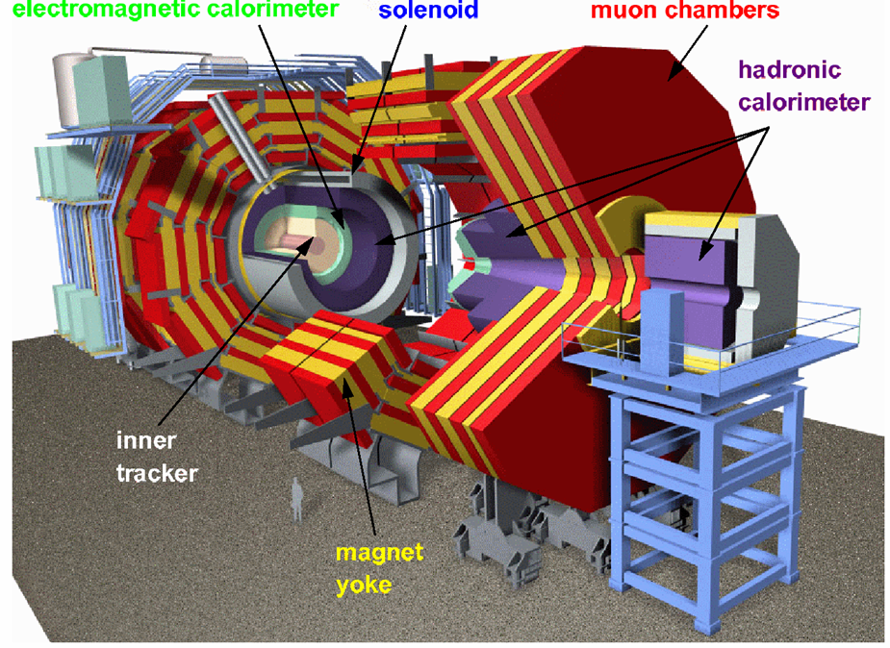
CMS

Slide 21
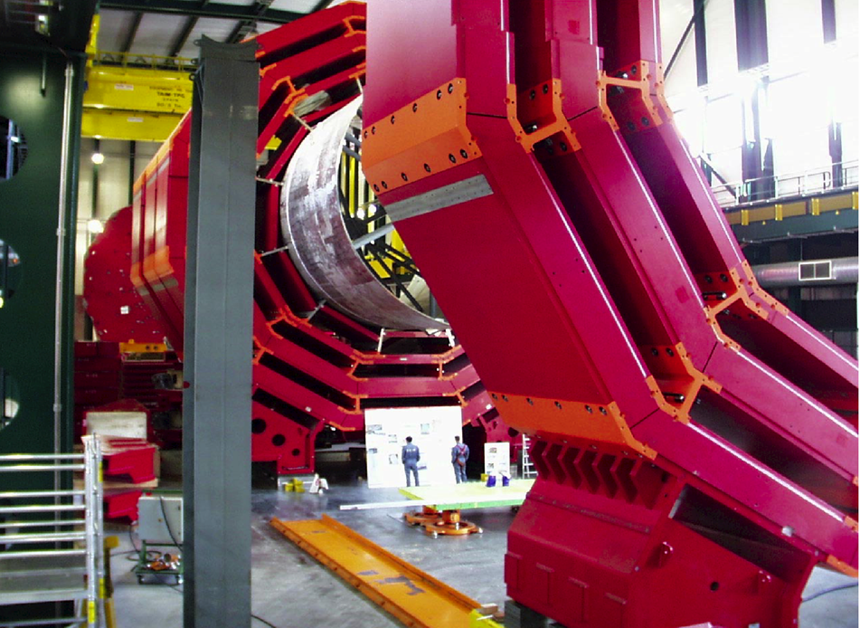
CMS Barrel Yoke

Slide 22
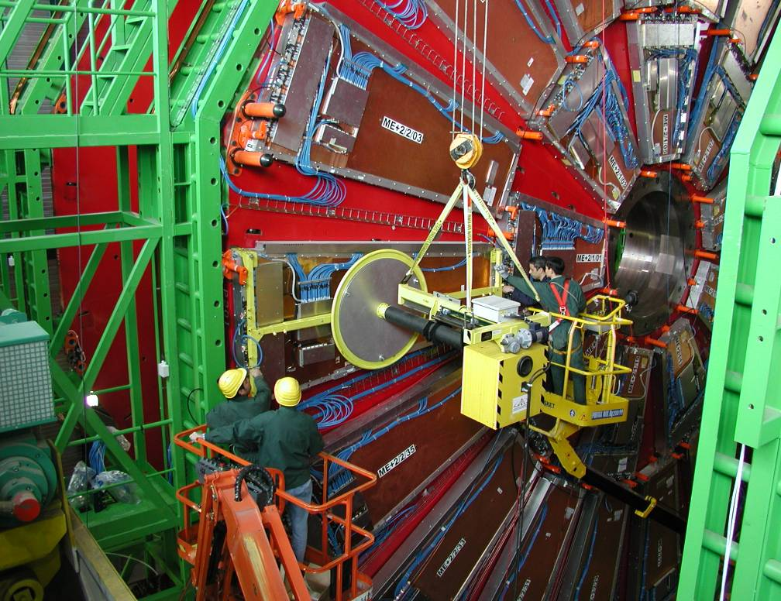
Installing muon Detectors

Slide 23
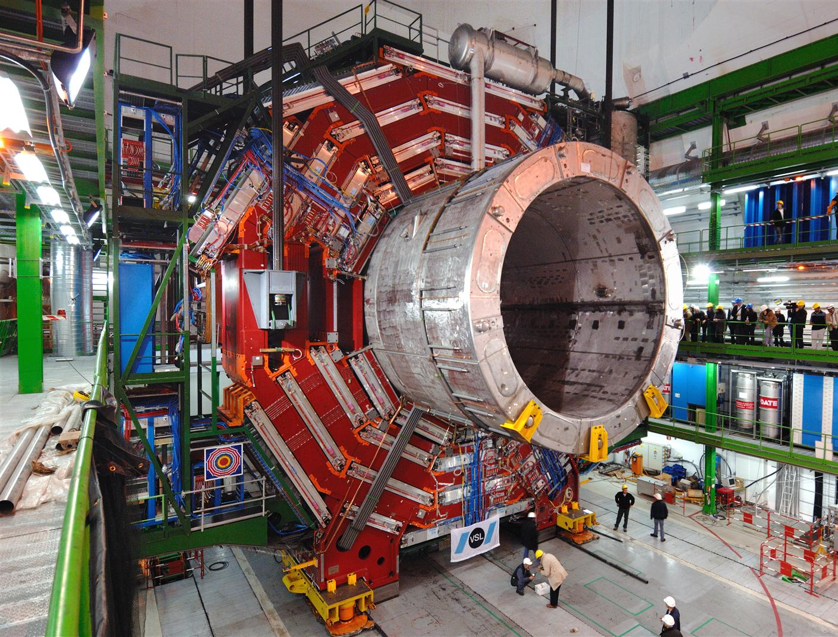

Slide 24
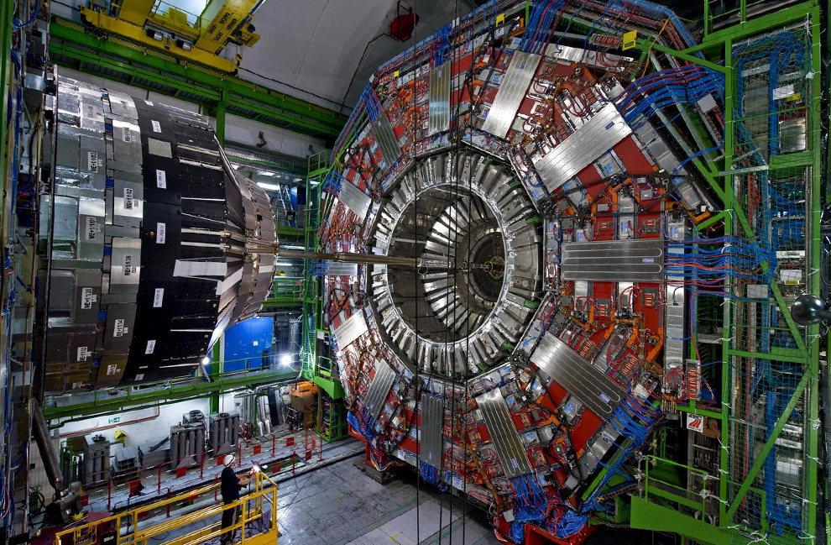

Slide 25
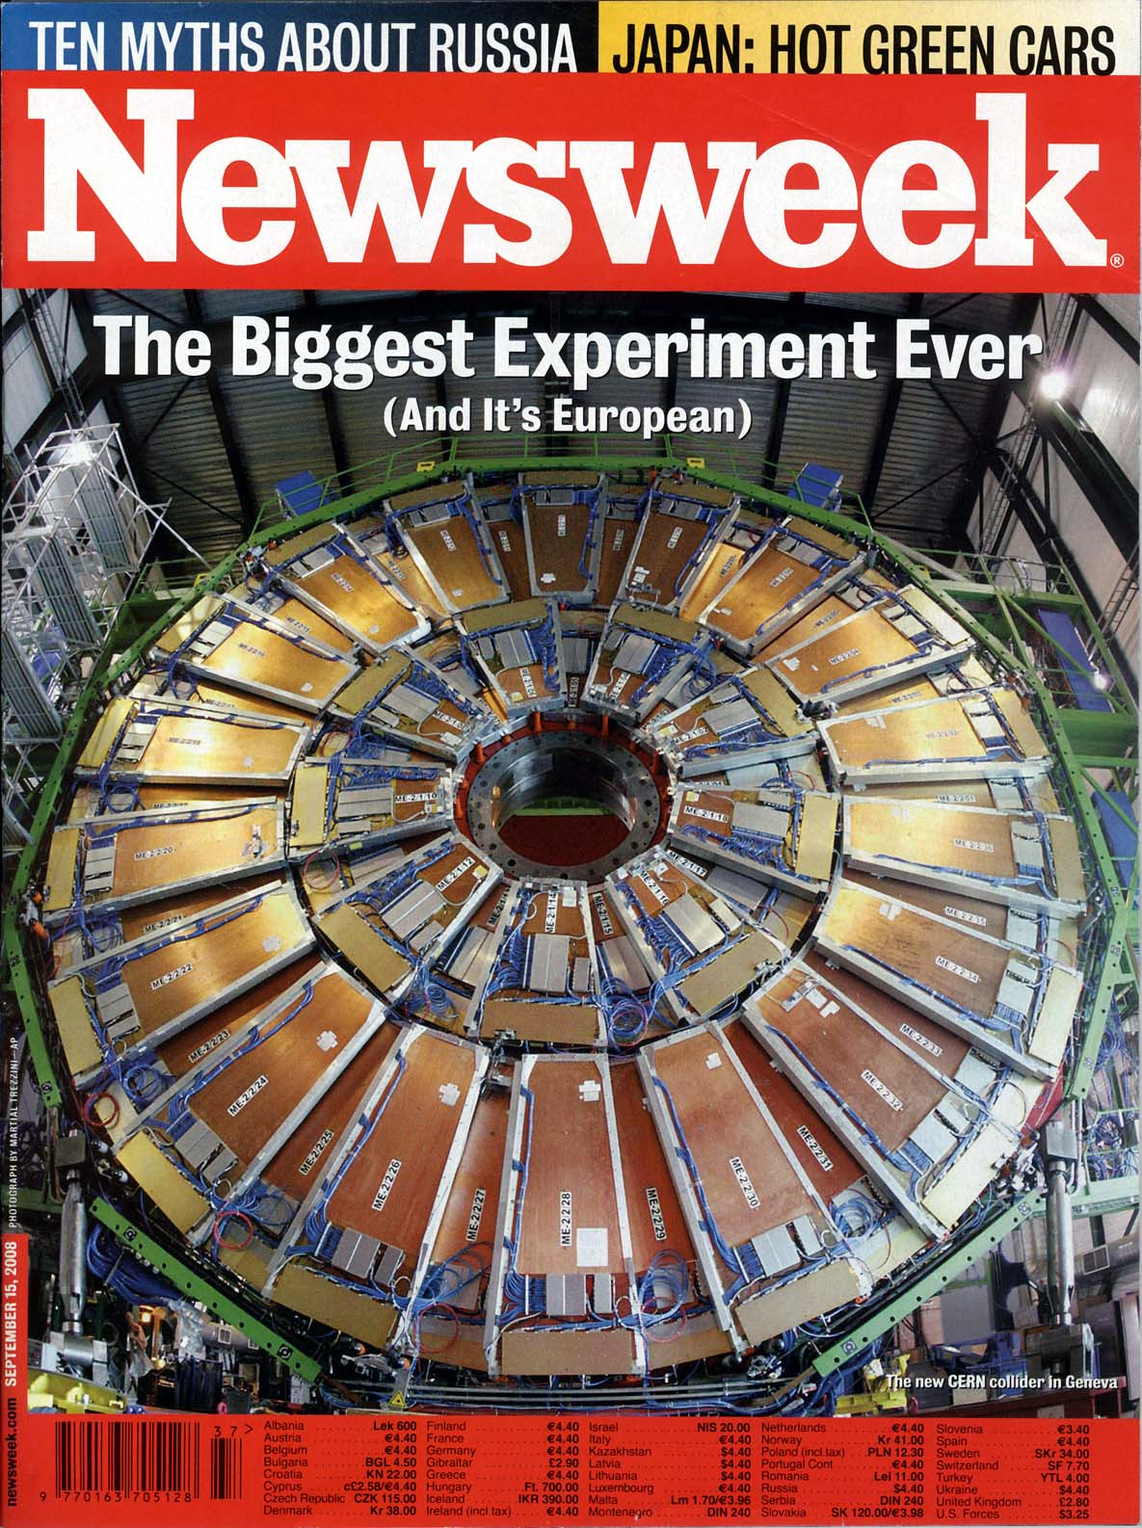
Particle detectors
constructed
at Westwood,
now at LHC, CERN
Sept 15, 2008 Issue

Slide 26
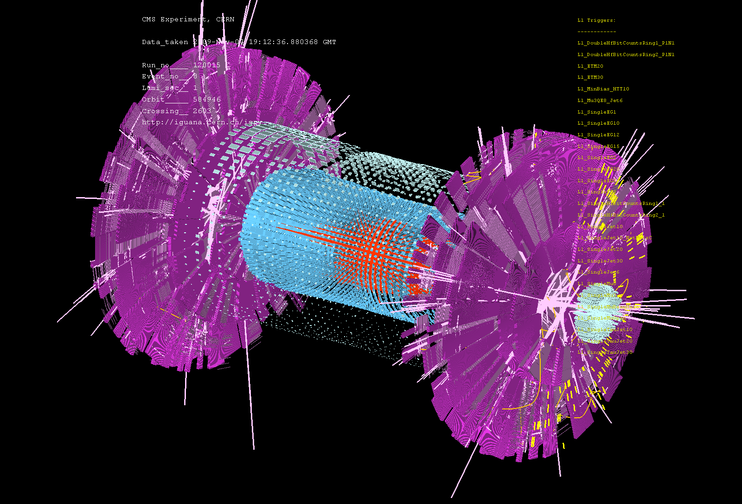
First Event at LHC – Recreation of the Big Bang! (Nov 7, 2009)

Slide 27
Seven Phases of Cosmic Evolution
Spontaneous Symmetry Breaking
14 billion years ago
Origin of
Particles
Origin of
Structure

Slide 28
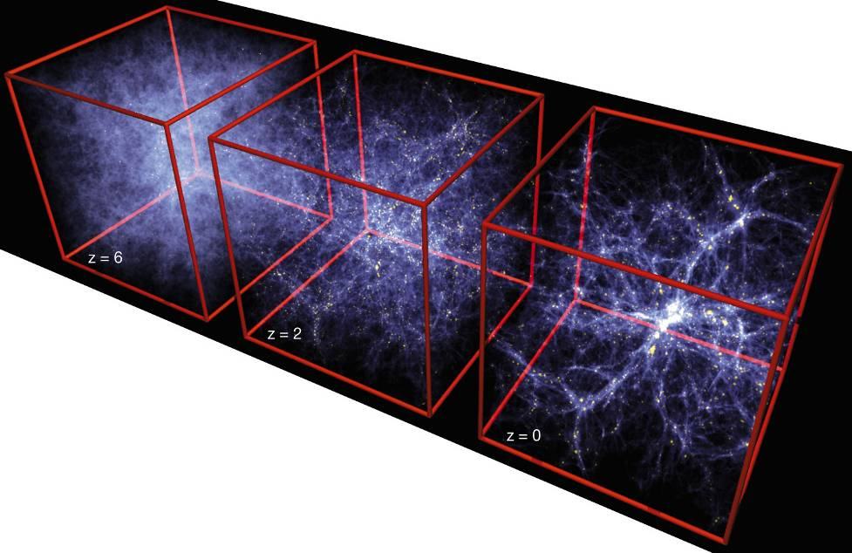
Formation of Structure in the Universe
Dark Matter is required!

Slide 29
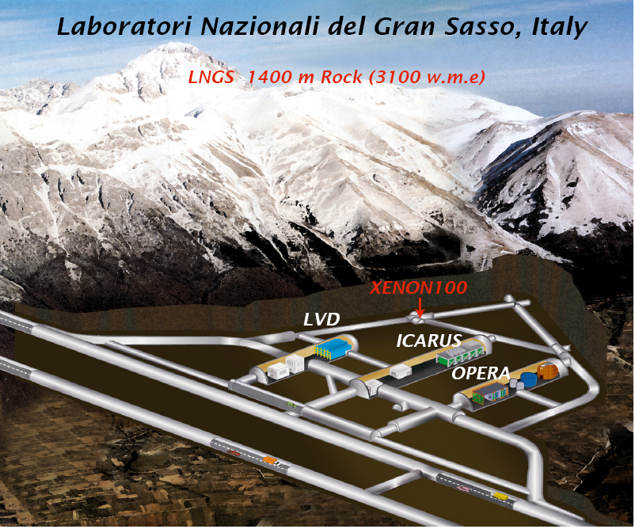
WARP

Slide 30
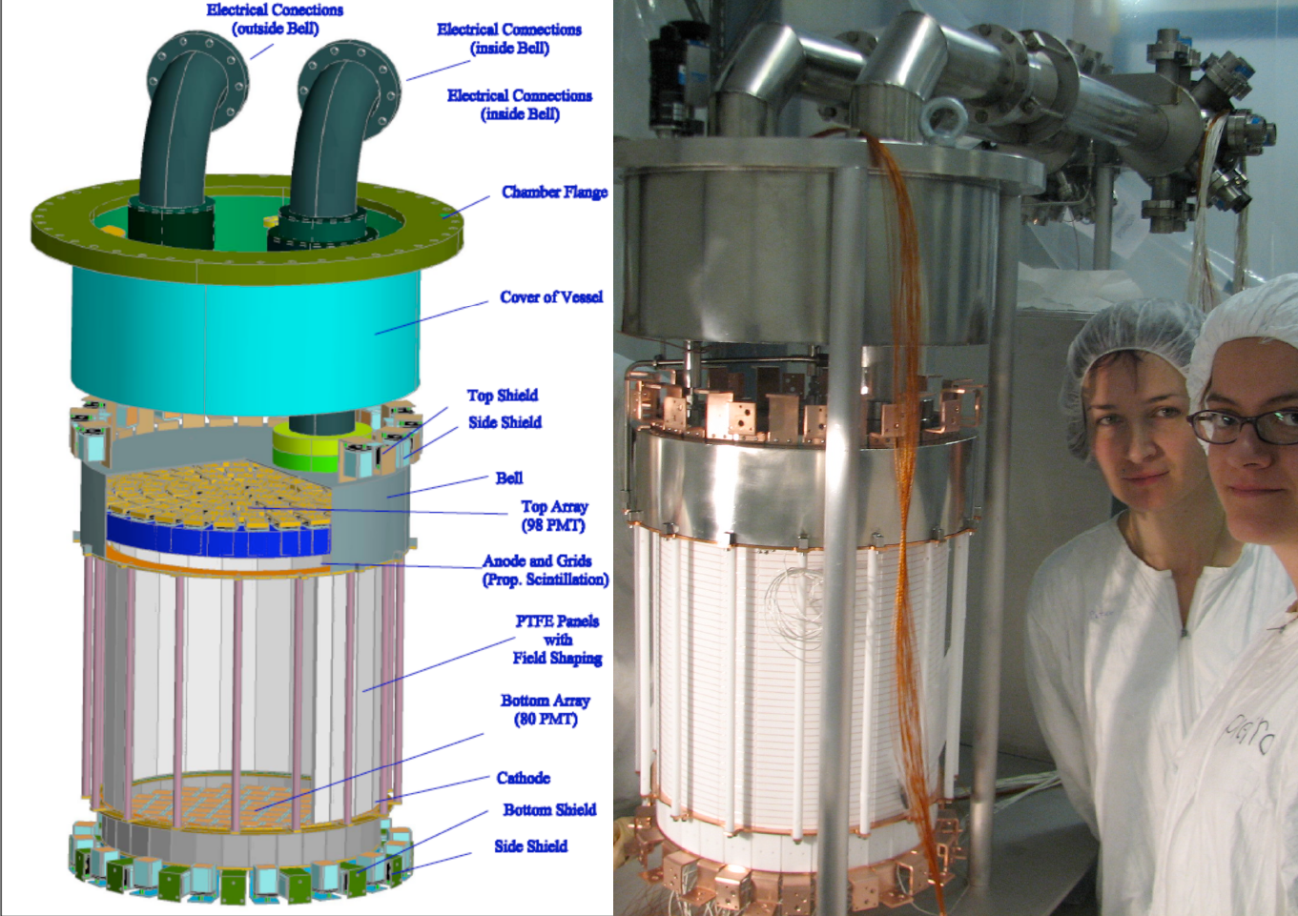
XENON100 Detector
170 kg
(50 kg)

Slide 31
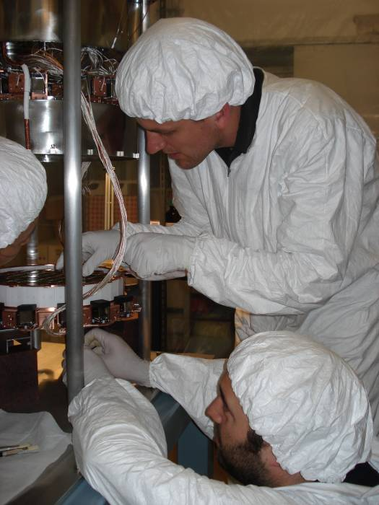
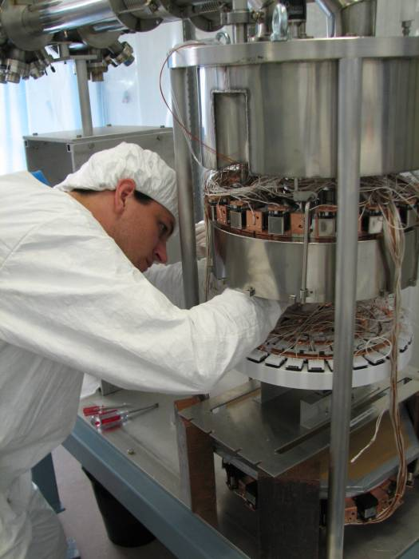
XENON100 Detector (2009)
Ethan Brown
(UCLA Student)

Slide 32
Seven Phases of Cosmic Evolution
Spontaneous Symmetry Breaking
14 billion years ago
Origin of
Particles
Origin of
Structure
Origin of
Life

Slide 33
v
Solar System (4.6 B years ago)
Sun
Earth

Slide 34
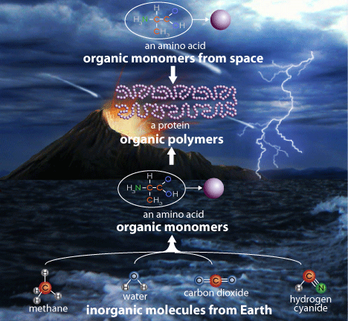
Organic Polymers (4.5B → 4B years)

Slide 35
How to observe the “Origin of Life”
Exactly the same way as we look for the “Origin of Universe”
Telescope ↔ Microscope
We must look for “Live Life”
Take advantages of the state of art “Photon Detectors” in particle physics.

Slide 36
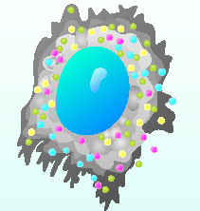
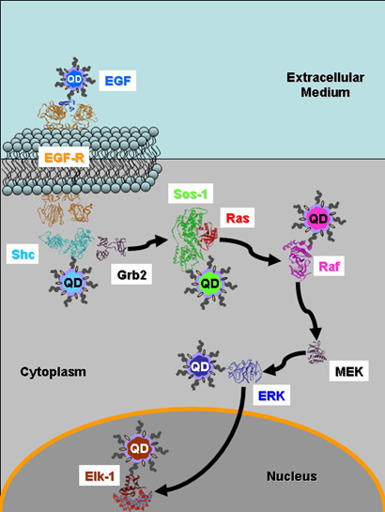
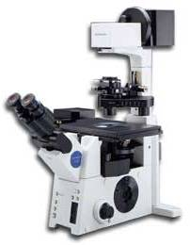
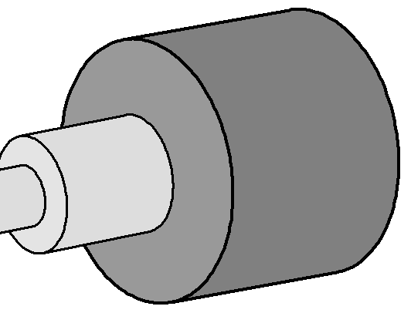
Single Molecule Imaging
Nano Technology
It will permit to track multicolor qdot-labeled proteins in live cells virtually background-free
The H33D detector attaches to a standard fluorescence microscope
Particle Physics Detector
Laser

Slide 37
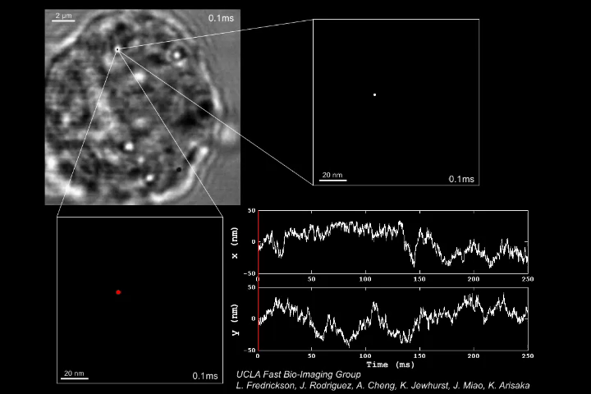
Gold nano particle (40nm) attached to Transferrin Receptor (TfR) on Cancer Cell
Prof. Manuel Penichet (Oncology)
(10, 000 frame/sec)

Slide 38
Seven Phases of Cosmic Evolution
Spontaneous Symmetry Breaking
14 billion years ago
Origin of
Particles
Origin of
Structure
Origin of
Life
Origin of
Consciousness

Slide 39
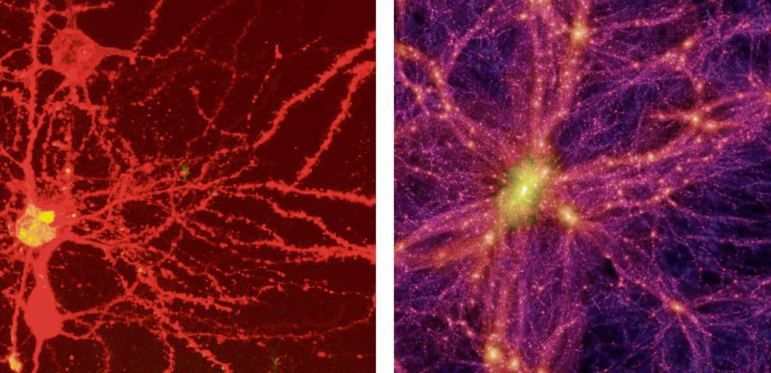
Brain Universe
100 Billions Neurons
100 Billions Galaxies
New York Times 8/21/2006

Slide 40
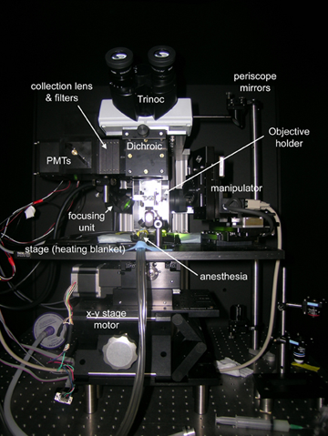
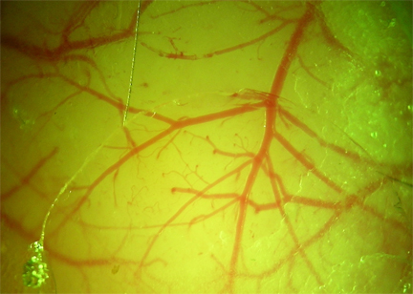
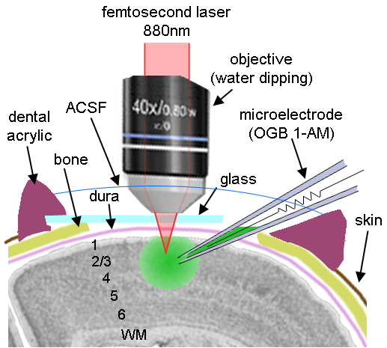
In vivo calcium imaging of neuronal activity

Slide 41
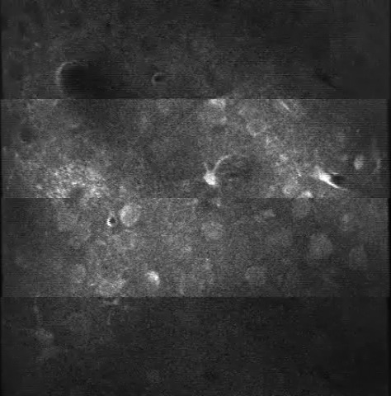
In vivo calcium imaging of Barrel Cortex of Mouse
Beam 1
(0 ns)
Barrel Cortex
Layer 2/3
150 μm deep
240 fps
Raw Data
(x3 faster
than real)
Beam 2
(+3 ns)
Beam 3
(+6 ns)
Beam 4
(+9 ns)
300 μm

Slide 42

In vivo calcium imaging of Barrel Cortex of Mouse
Barrel Cortex
Layer 2/3
150 μm deep
After averaging
(x3 faster
than real)
58 neurons
(~100 billons neurons
in our brain)
300 μm

Slide 43
Seven Phases of Cosmic Evolution
Spontaneous Symmetry Breaking
14 billion years ago
Origin of
Particles
Origin of
Structure
Origin of
Life
Origin of
Consciousness

Slide 44
Why are we here?

Slide 45
There may be ~100 Billion Universes.

Slide 46
Four Major Science
Origin of Particles
Particle Physics
Origin of Universe
Cosmology
Origin of Life
Molecular Biology
Origin of Consciousness
Neurophysics

