Slide 1
The Ultimate Dark Matter Observatory: . Science Cases and Challenges
Katsushi Arisaka
University of California, Los Angeles
Department of Physics and Astronomy
arisaka@physics.ucla.edu

Slide 2
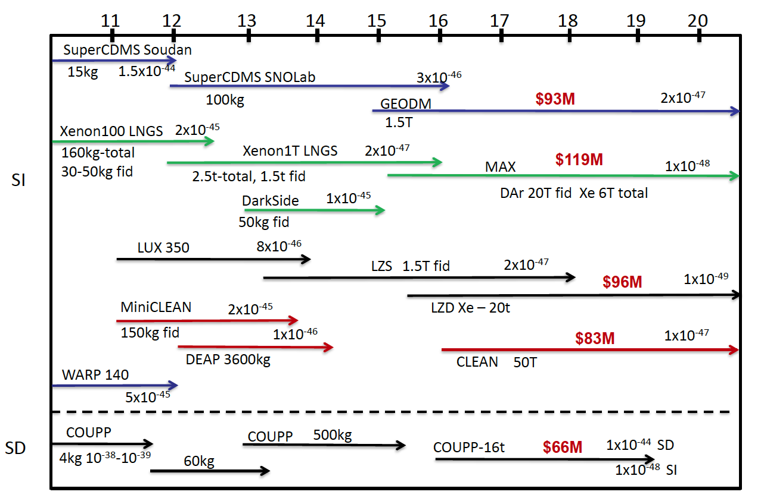
US Dark Matter Programs
2010
Ge
Xe
Ar
Xe
Ar
CF₃I

Slide 3
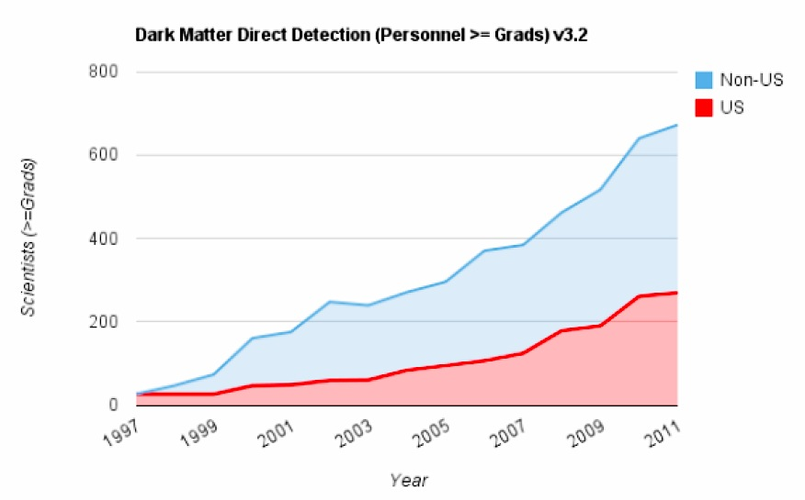
Growth of Direct Detection Community

Slide 4
How to approach dark matter?
Direct Search
X q → X q
XENON, DarkSide…
LHC
Indirect Search
q q → X X
X X → v v
ATLAS, CMS
Fermi, IceCube…

Slide 5
How to approach dark matter?
Technology
(Experimentalists)
Pure Materials
Photon Detectors…
Science
(Theorists)
Funding
(Agencies)
SUSY,
Extra Dimensions
…
DOE, NSF…

Slide 6
Talk Outline
Scientific Cases
Origin of the Universe and Mass
Detection Methods
Noble Liquid and TPC
XENON100 and 1T
Sensitivities
SUSY, Extra Dimensions…
Comparison with LHC, Indirect searches
Ultimate G3 Observatory
Xenon vs. Argon
Technological challenges
Neutrino Physics

Slide 7
G1
CMSSM
G2
G3

Slide 8
Scientific Cases

Slide 9
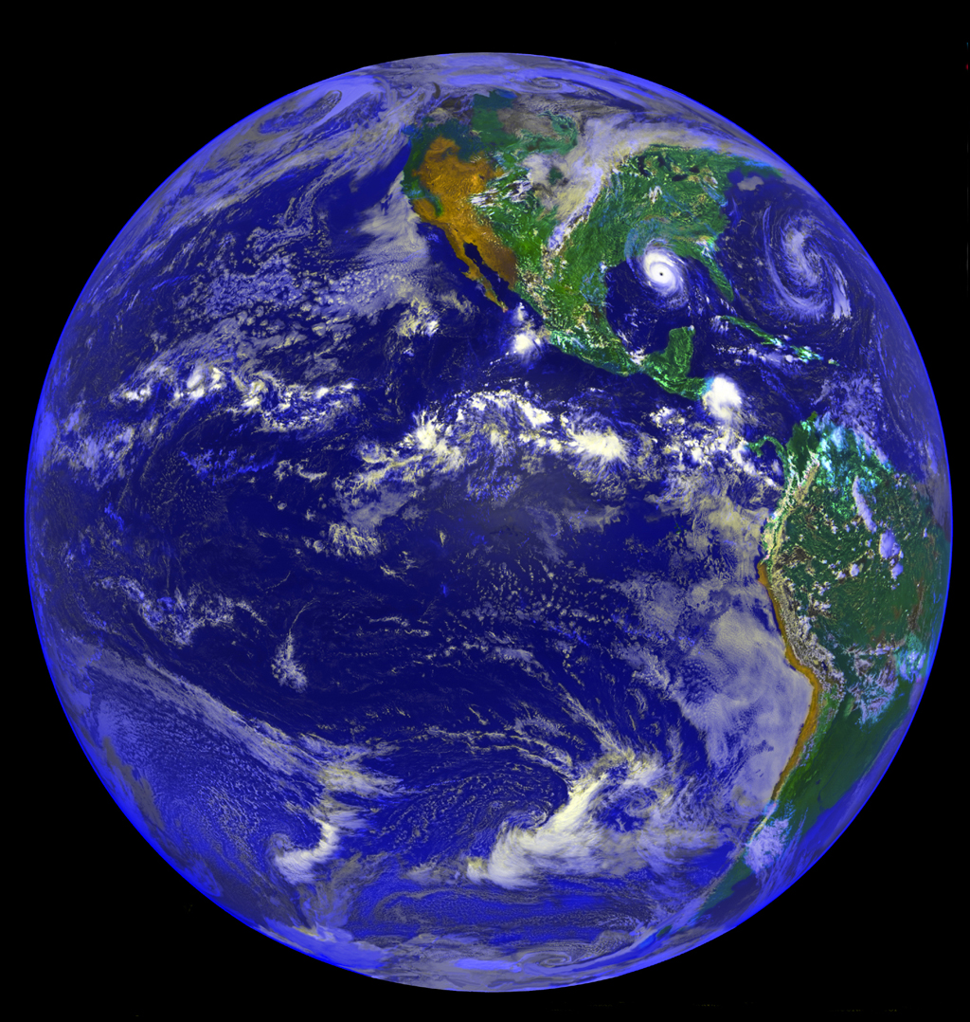
Why are we here?

Slide 10
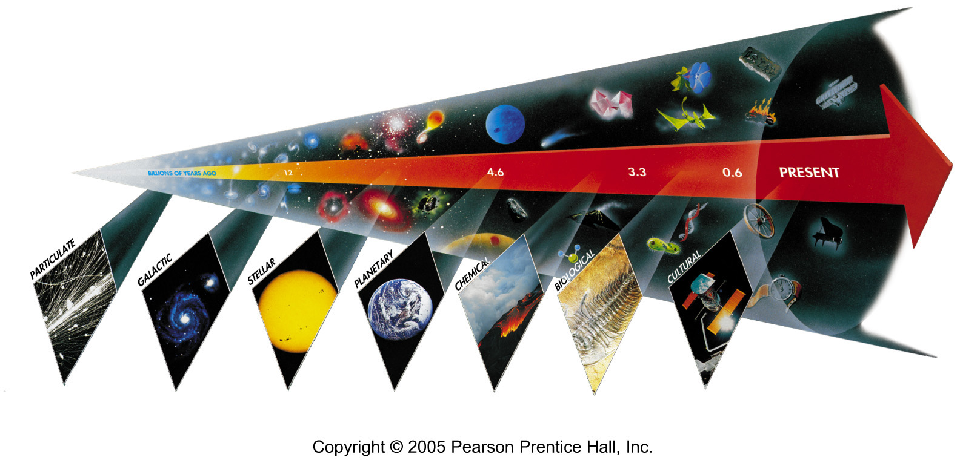
Seven Phases of Cosmic Evolution
14 billion years ago

Slide 11
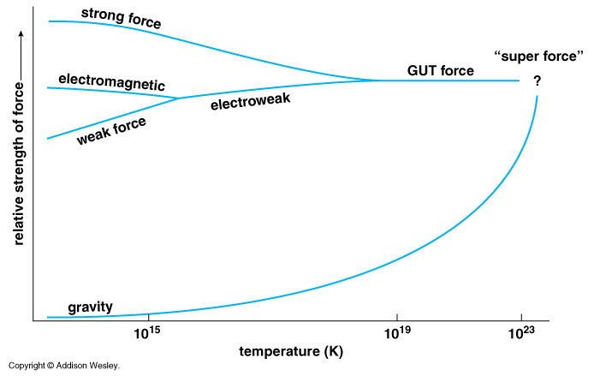
Unification of Forces
Grand Unification
100 GeV
10¹⁶ GeV
10¹⁹ GeV
10³²
10²⁹
10³²
10²⁹

Slide 12
Unification of Forces
Plank Epoch
100 GeV
10¹⁶ GeV
10¹⁹ GeV
10²⁹
10³²

Slide 13
Hubble Deep Field
Physicists’ View of Early Universe
Fiat lux
Let there be light

Slide 14
Hubble Deep Field
Physicists’ View of Early Universe
Lorentz Invariance
Local Gauge Invariance

Slide 15
Symmetry Breaking
Time
(sec)
Temp.
(ºK)
Energy (GeV)
10⁻⁴⁵sec
Simple
10⁻⁴⁰
10³⁰
10¹⁸
10⁻³⁵
10¹⁵
10⁻³⁰
10²⁵
10¹²
10⁻²⁵
10⁹
Symmetry
Break Down
10⁻²⁰
10²⁰
1PeV
10⁻¹⁵
10¹⁵
1TeV
b
10⁻¹⁰
1GeV
s
µ⁻
W⁺
10⁻⁵
γ
c
10¹⁰
ν_{e}
τ⁺
1
1MeV
Zº
d
τ⁻
ν_{e}
d
e⁺
10⁵ sec
1KeV
ν_{µ}
e⁻
1 year
u
u
s
10⁵
Complex
ν_{µ}
10³
1eV
b
µ⁺
10⁶
W⁺
c
10⁹ year
10⁻³eV
1

Slide 16
The Beginning
Everything was the same ↔ Perfect symmetry.
All the particles are the same as photons.
All four forces are the same.
The Universe was 10 dimension.
3 Space Flattened
1 Time
3 Strong Force
6 2 Weak Compacitified
1 Electro-Magnetic

Slide 17
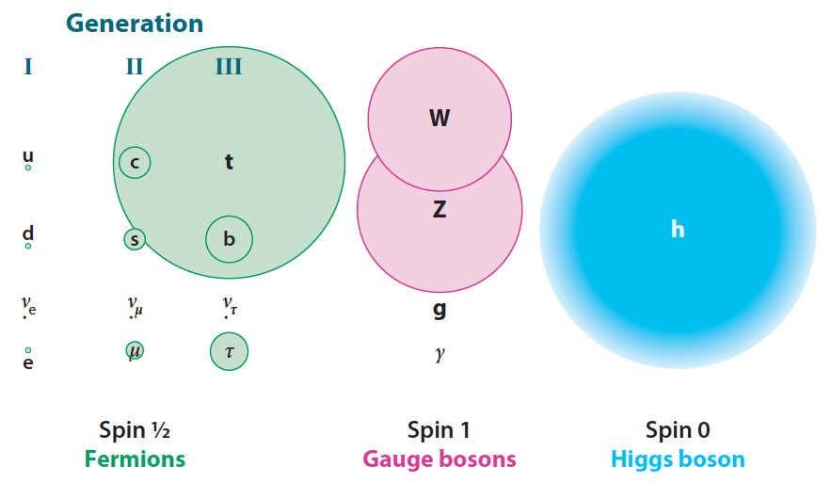
Mass of Particles

Slide 18
Mystery of the Mass (since 1970)
How to create mass from energy?
While maintaining the initial symmetry
Spontaneous Symmetry Breaking
Particle mass << Plank Mass
MeV – GeV 10¹⁹ GeV
Why so many particles (Generations) with different masses?
Energy → Mass

Slide 19
Spontaneous Symmetry Breaking - Higgs Mechanism -
Energy
y
Vacuum
Energy
x
Mass

Slide 20
Spontaneous Symmetry Breaking - Higgs Mechanism -
Energy
y
Vacuum
Energy
x
Mass

Slide 21
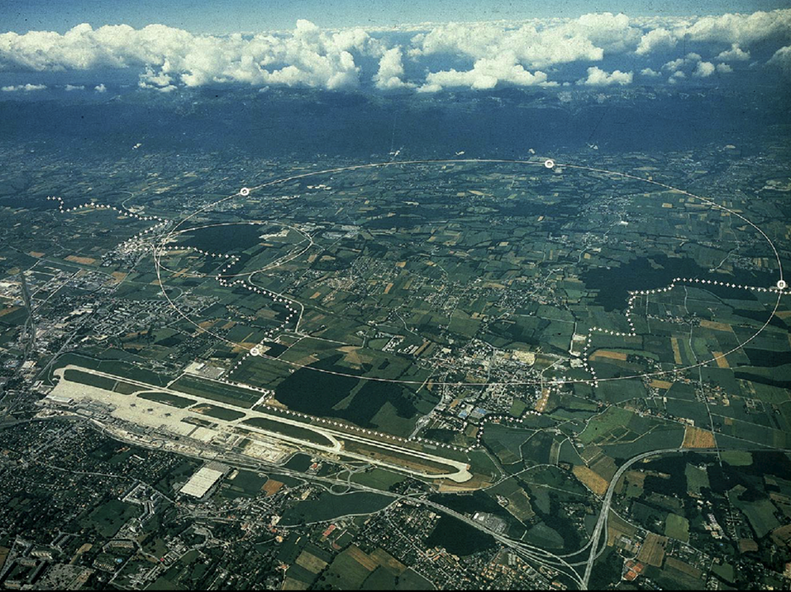
CERN and LHC in Geneva
27km Circumference
7+7=14 TeV

Slide 22
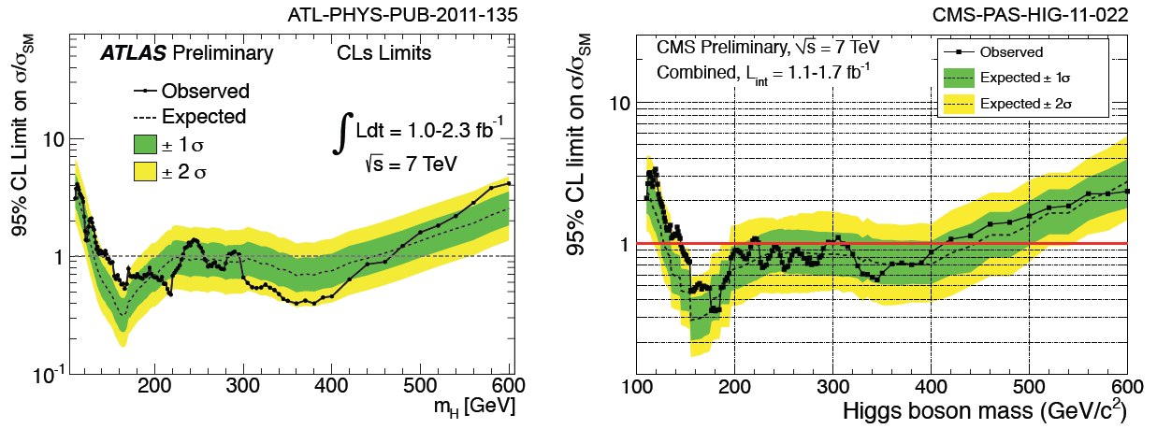
LHC Higgs search results
Results from the LHC Higgs Cross Section WG by R. Tanaka
145 - 466 GeV excluded.

Slide 23
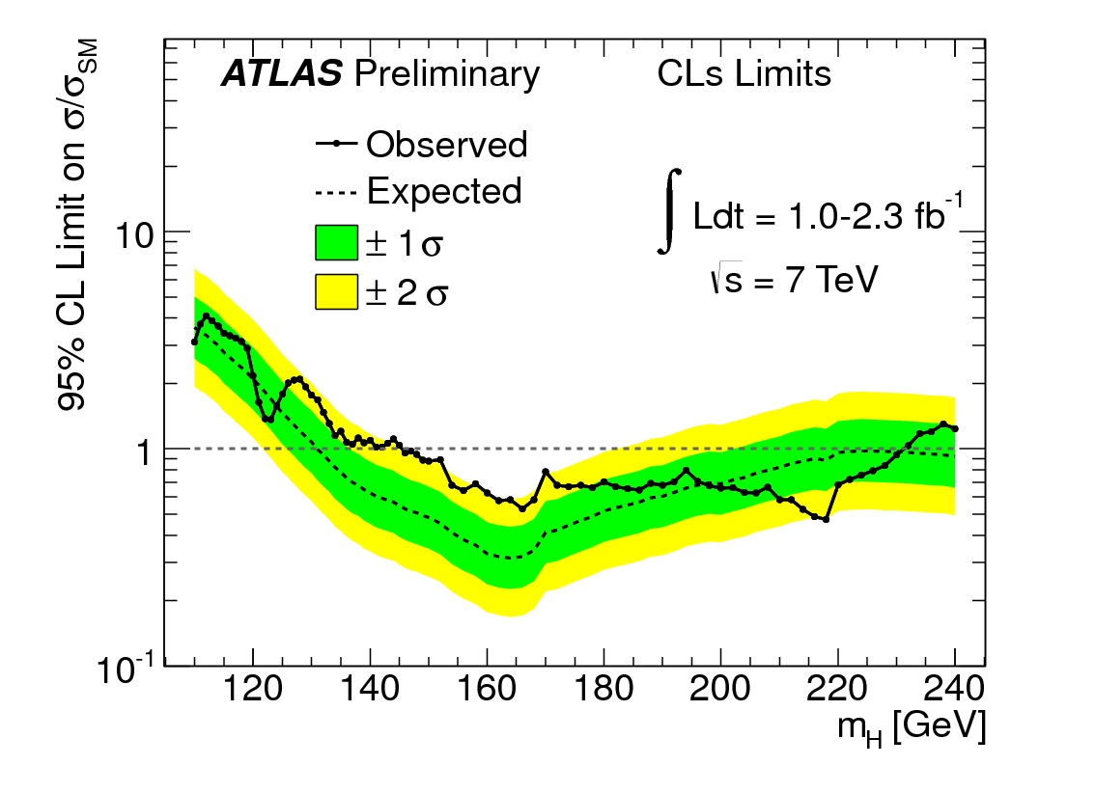
LHC Higgs search results
120 - 145 GeV promising
145 - 466 GeV excluded.

Slide 24
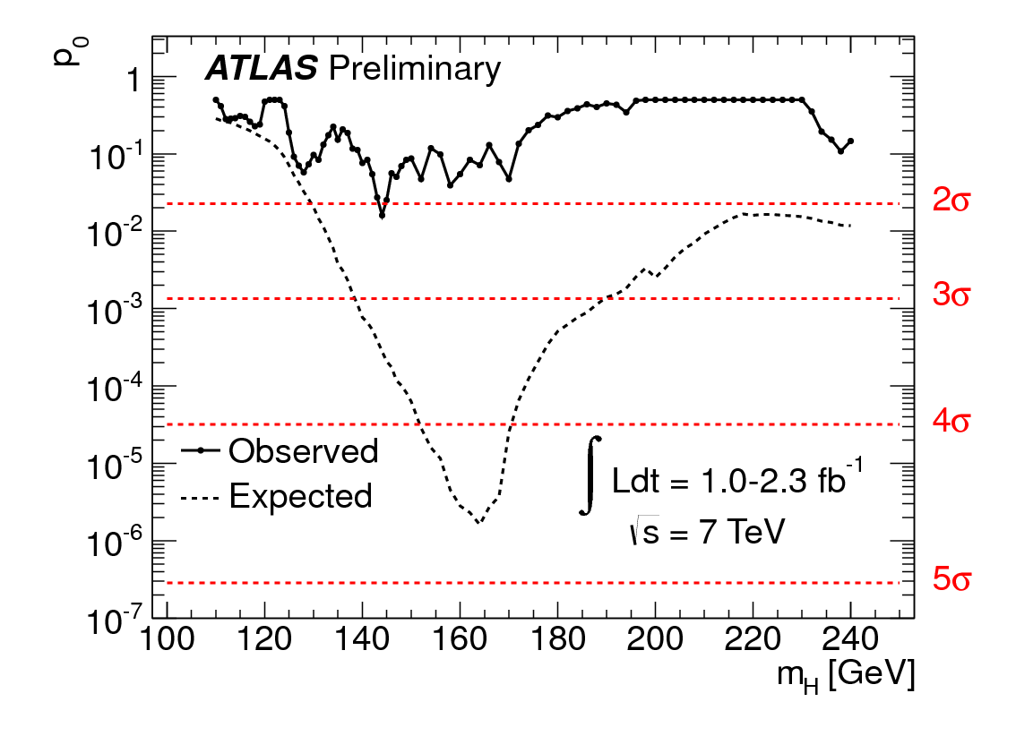
LHC Higgs search results
120 - 145 GeV promising

Slide 25
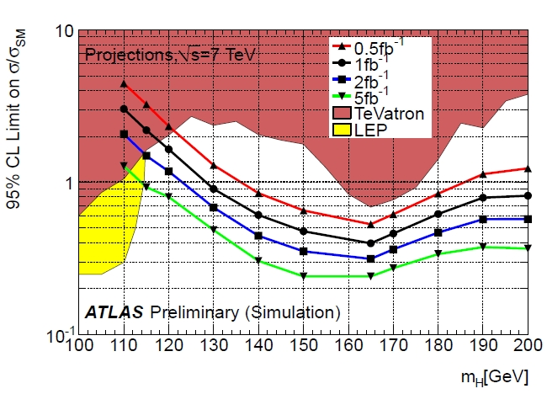
Predicted Sensitivity to Higgs
120 - 145 GeV

Slide 26
Seven Phases of Cosmic Evolution
Spontaneous Symmetry Breaking
14 billion years ago
Origin of
Particles
Origin of
Structure

Slide 27
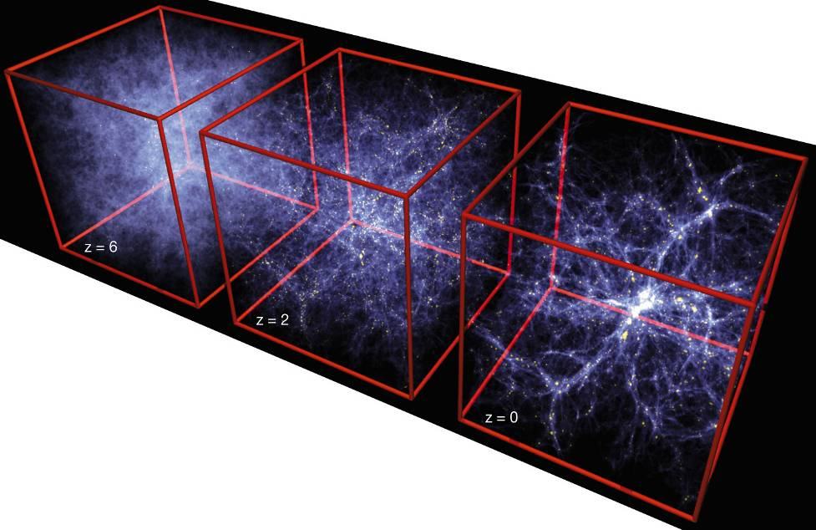
Formation of Structure in the Universe
Dark Matter is required!

Slide 28
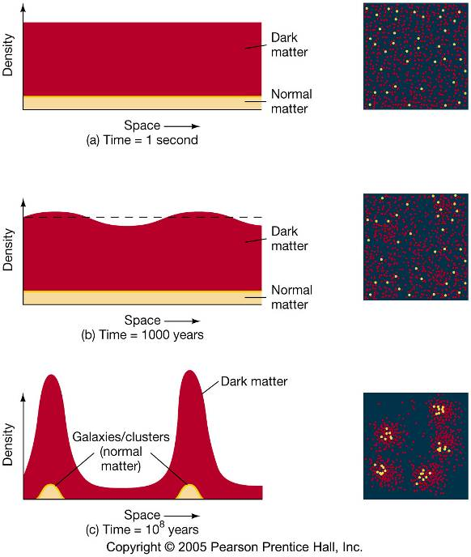
Evolution of Large Structure

Slide 29
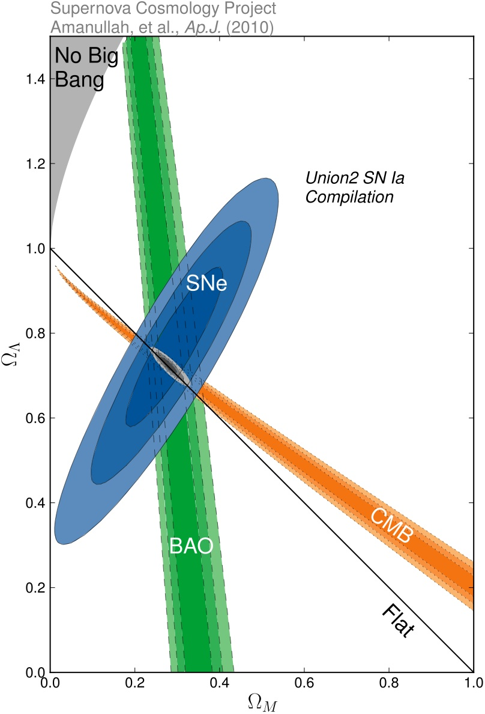
Density of Our Universe
Ω_{Total}=Ω_{Λ}+Ω_{Matter} =1.0
Universe is Flat.
⇒ Inflation
74% is Dark Energy.
⇒ Accelerating
Ω_{Λ}
Ω_{Matter}

Slide 30
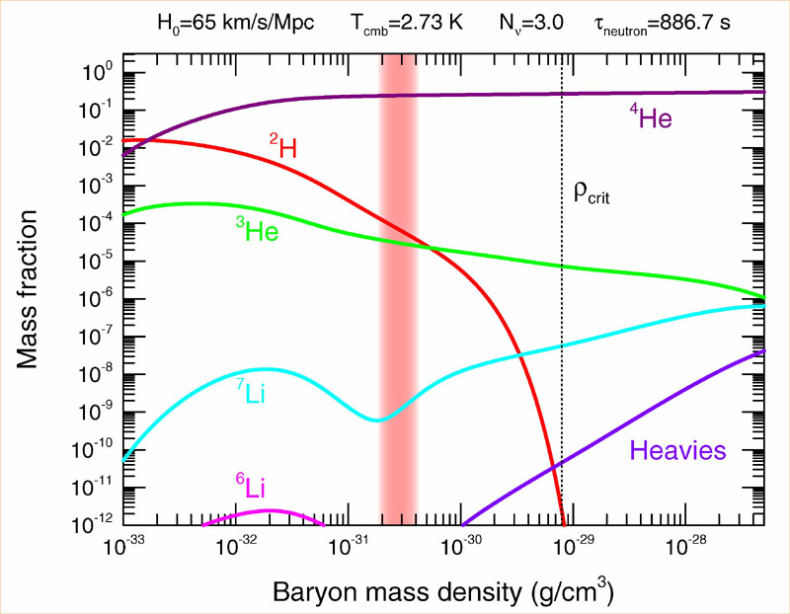
Abundance vs. Density
D
0.03 < Ω_{Baryon}< 0.05

Slide 31
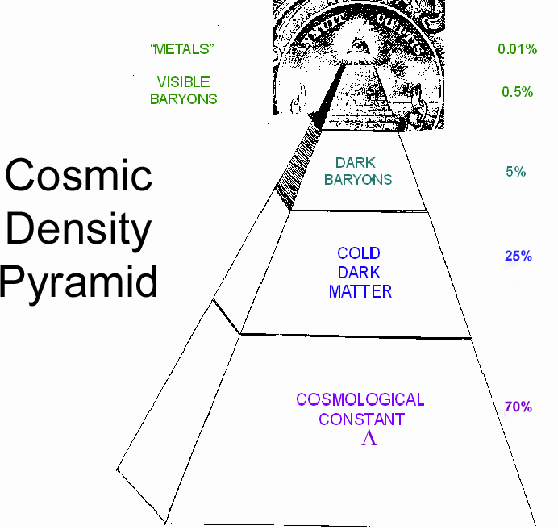
Cosmic Pyramid
Metal
0.01%
Star
0.4%
Baryonic Matter
0.5%
Gas,
Dust
4%
Dark
Matter
23%
Dark Energy
73%

Slide 32
Relation between Temperature and Time
T: Temperature
t : time
Temperature
130 GeV
130 MeV
1.3 MeV
130 keV
10⁻¹⁰
10⁻⁴
1
100
Time (sec)

Slide 33
Time = 10⁻¹⁰ sec, Temp.= 10^{15 o}K (~100 GeV)
Electro-weak Unification
Electro-Magnetic force = Weak force
The highest energy we can study by the accelerators
b
s
µ⁻
W⁺
γ
c
ν_{e}
τ⁺
d
τ⁻
ν_{e}
d
e⁺
Zº
e⁻
u
ν_{µ}
u
s
b
ν_{µ}
µ⁺
W⁺
c
Horizon
~ 3 cm

Slide 34
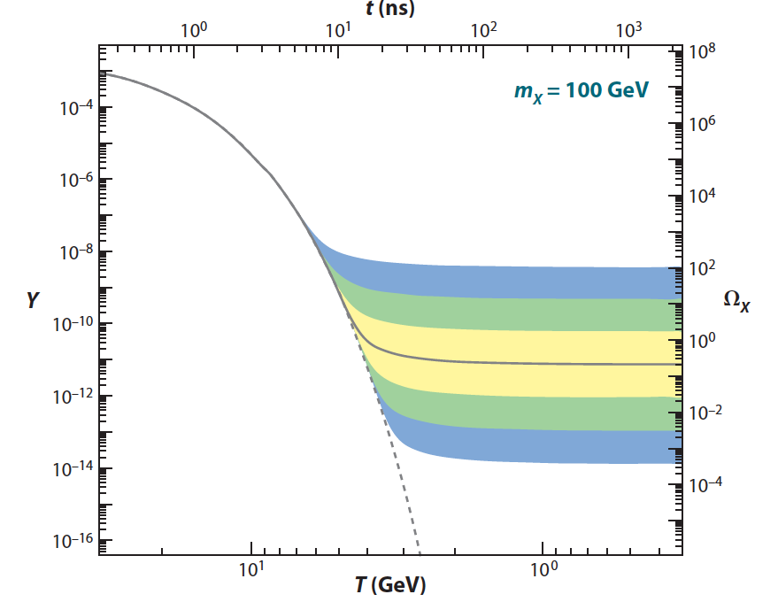
Relic Density vs. Time
Comoving
Number
Density
Feng Ann. Rev. Astro. Astrophys. 2010.48:495-545

Slide 35
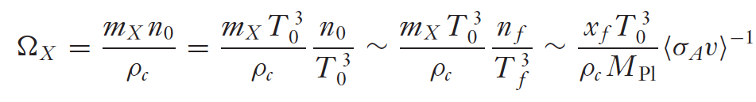
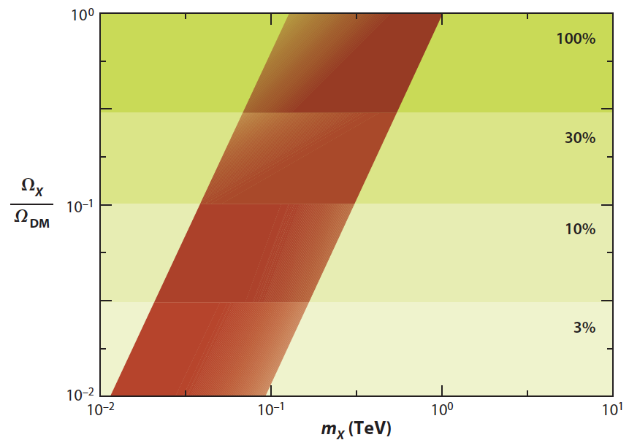

WIMP Miracle
0.1 – 1TeV
Ω_{X} ∞ M_{X}²
M_{X} ~ 0.1-1TeV
σ_{A} ~ pb

Slide 36
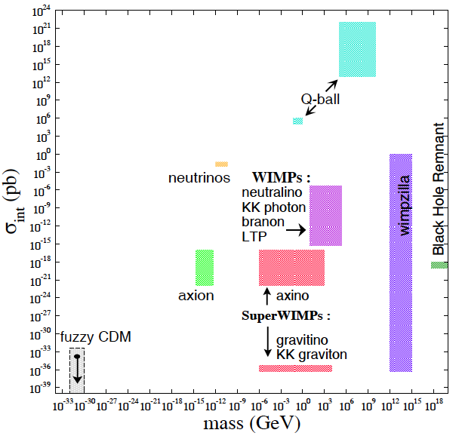
What is Dark Matter?

Slide 37
Detection Methods

Slide 38
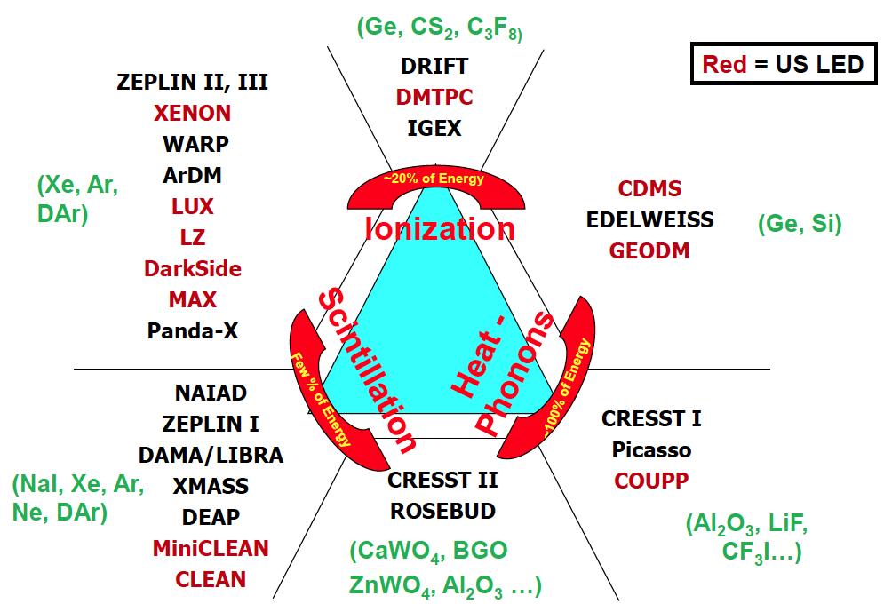
Detection Technique
Double
Phase
Gamma Ray
(Ge, Si)
Single
Phase
Neutron
WIMP

Slide 39
Properties of Noble Liqud
 | Unit | Neon | Argon | Xenon
Z |  | 10 | 18 | 54
A |  | 20 | 40 | ~132
Liquid Density | g/cc | 1.21 | 1.4 | 3.06
Energy Loss (dE/dX) | MeV/cm | 1.4 | 2.1 | 3.8
Radiation Length | cm | 24 | 14 | 2.8
Collision Length | cm | 80 | 80 | 34
Boiling Temperature | ºK | 27.1 | 87.3 | 165
Scintillation Wavelength | nm | 85 | 125 | 178
Scintillation | photon/keV | 30 | 40 | 46
Ionization | e-/keV | 46 | 42 | 64
Decay time (Fast Component) | nsec | 19 | 7 | 4
Decay time (Slow Component) | nsec | 1500 | 1600 | 26
Isotope |  | No | ³⁹Ar (1 Bq/kg) | ¹³⁶Xe
Price | $ /ton | $90k | ~$2k | ~$1M
Single Phase Experiments |  | CLEAN | DEAP/CLEAN | XMASS
Double Phase Experiments |  |  | WARP, ArDM, DarkSide, MAX | ZEPLIN, XENON, MAX LUX, LZD

Slide 40
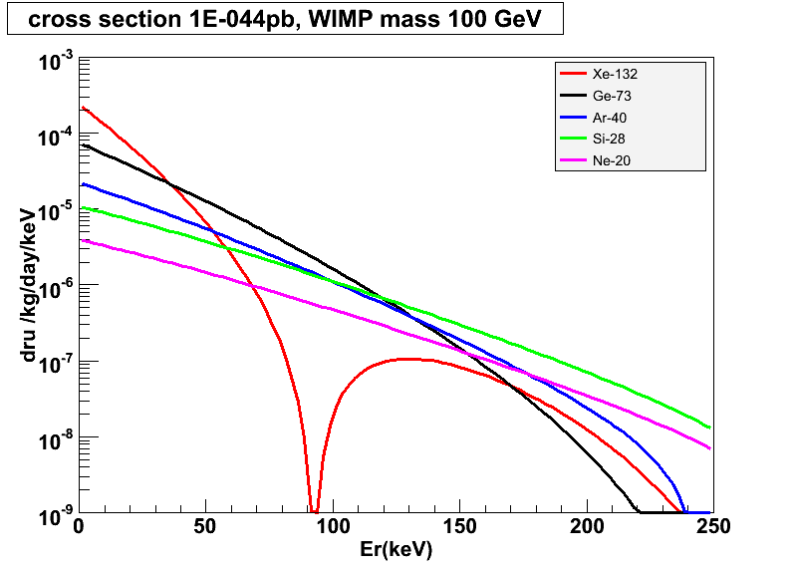
Target Mass Dependence of WIMP Cross Section
10⁻⁴⁴ cm²
Xe-132
Ar-40
Ge-73
Si-28
Ne-20

Slide 41
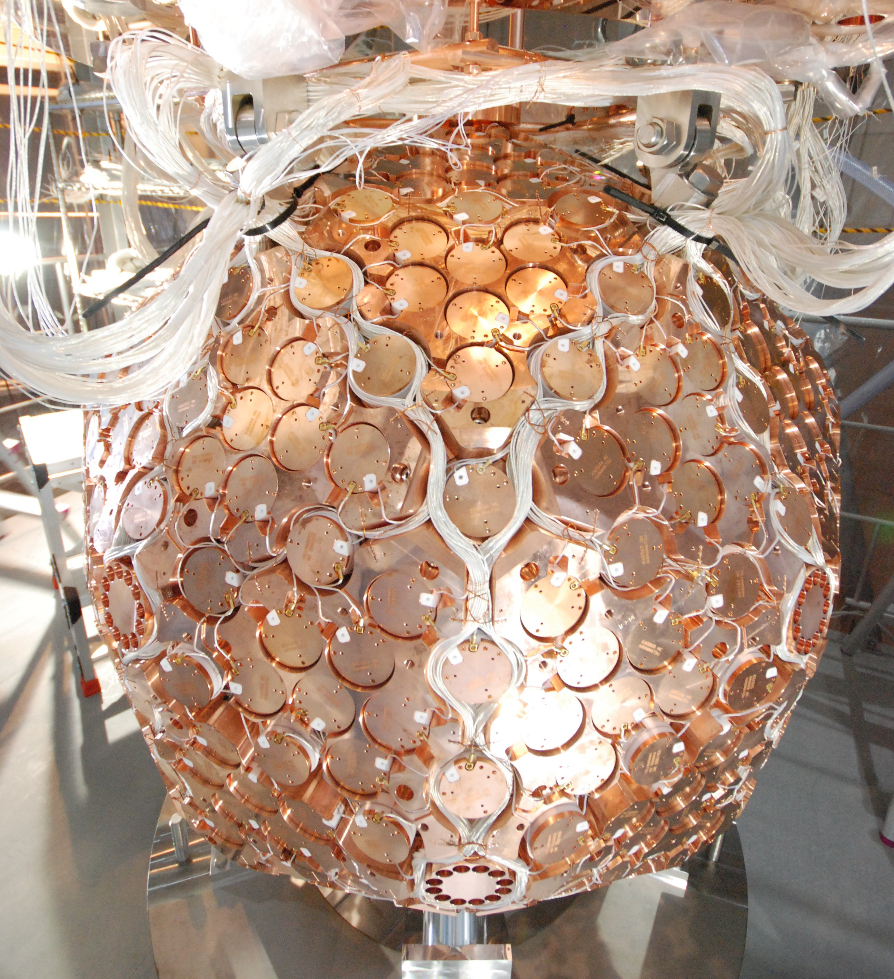
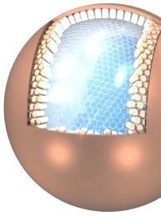

XMASS (Single Phase Xe)
100kg Prototype
（FV:30kg、30cm）
800kg Detector
（FV:100kg、80cm）
20ton Detector
（FV:10ton、2.5m）
R&D
Dark Matter
Solar neutrino
Dark Matter
completed
2011 〜
Future

Slide 42
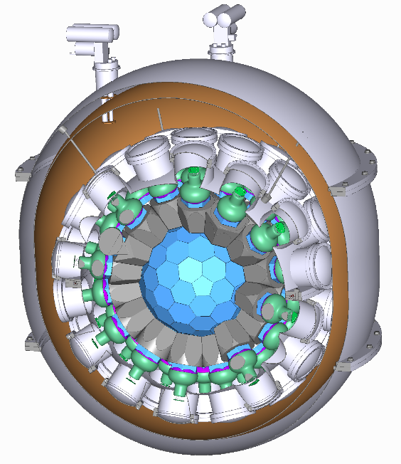
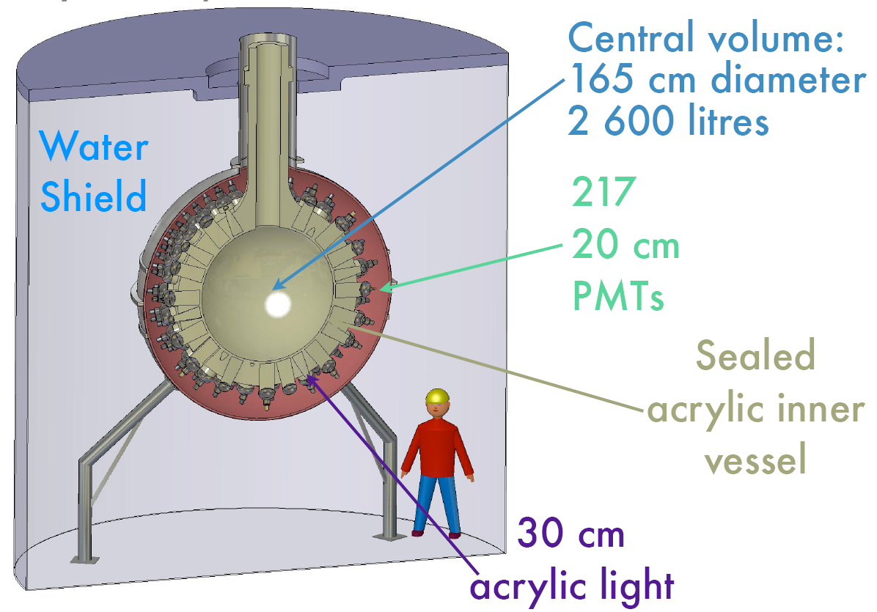

DEAP/CLEAN (Single Phase Ar/Ne)
360 kg Mini-CLEAN
3.6 ton DEAP/CLEAN

Slide 43
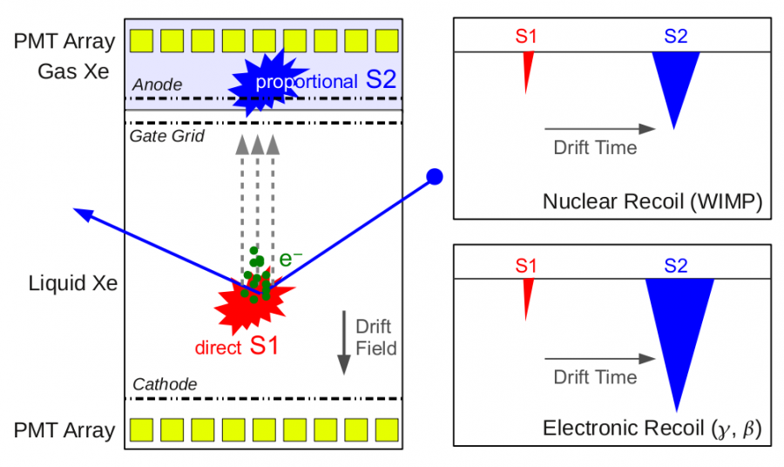
Double-Phase Noble Liquids

Slide 44
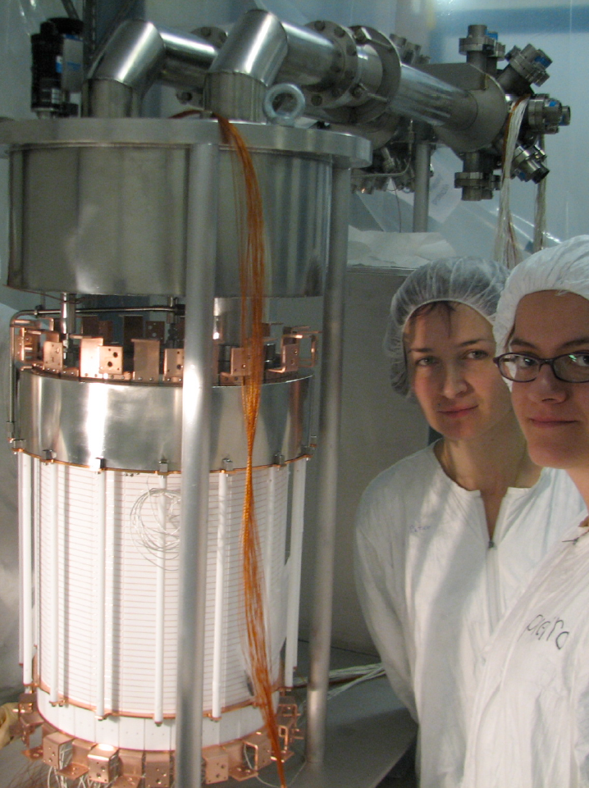
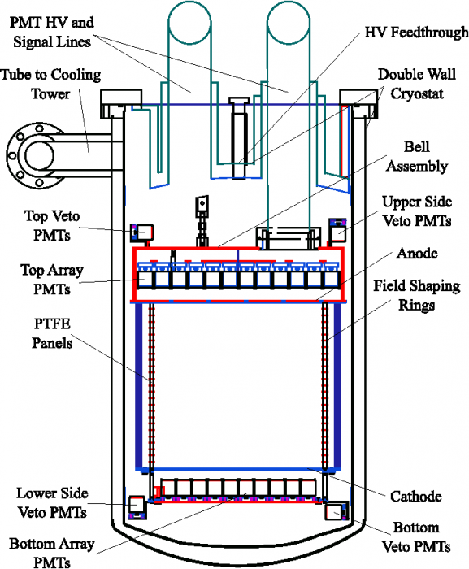
XENON100 Detector(Double phase Xenon)
161 kg
(48 kg)

Slide 45
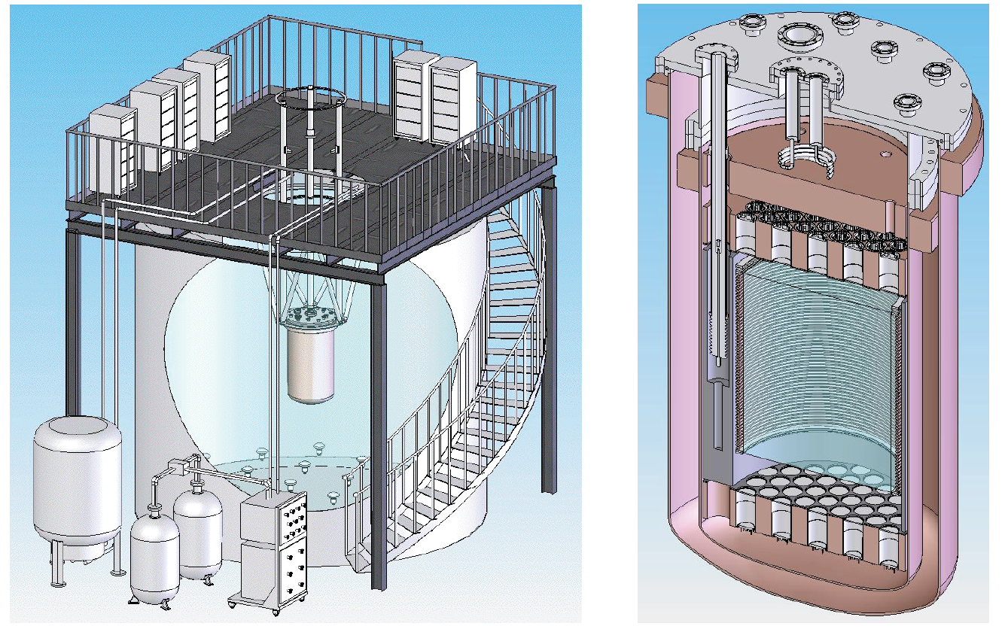
LUX 300 kg (Double phase Xenon)
60 cm
350 kg
(100 kg)

Slide 46
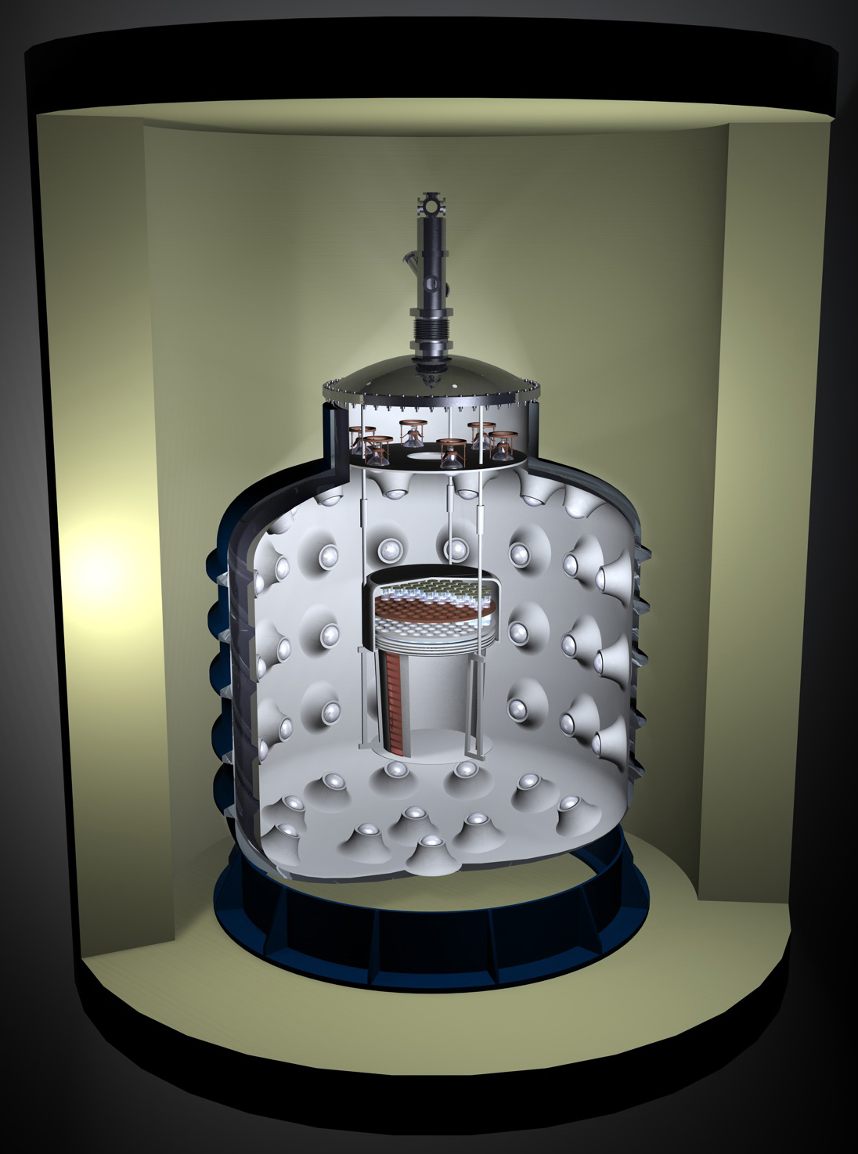
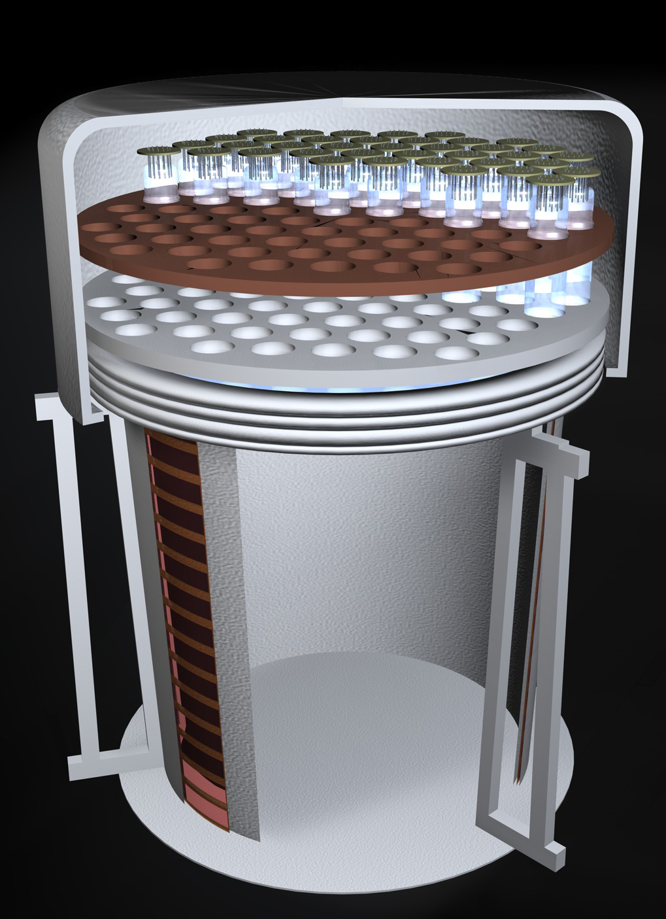
WARP 140 kg (Double Phase Argon)
140 kg
(100 kg)
60cm

Slide 47
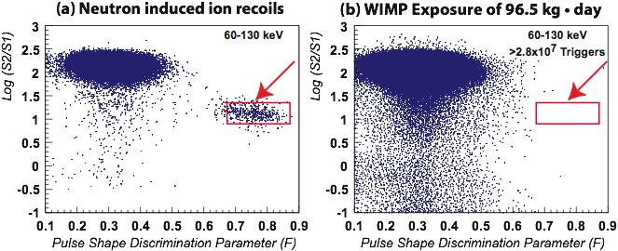
Pulse Shaping Discrimination by Ar

Slide 48
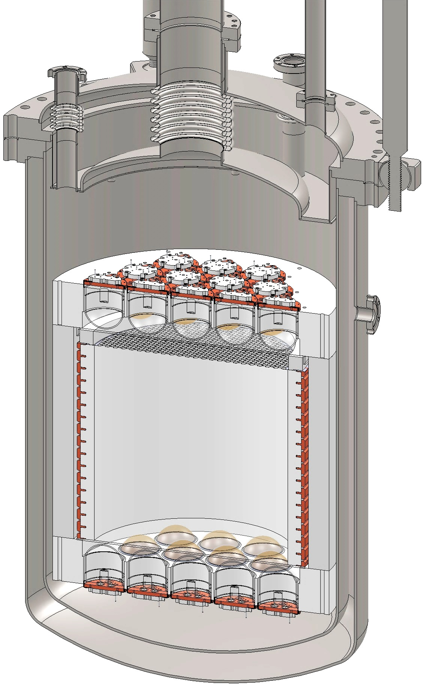
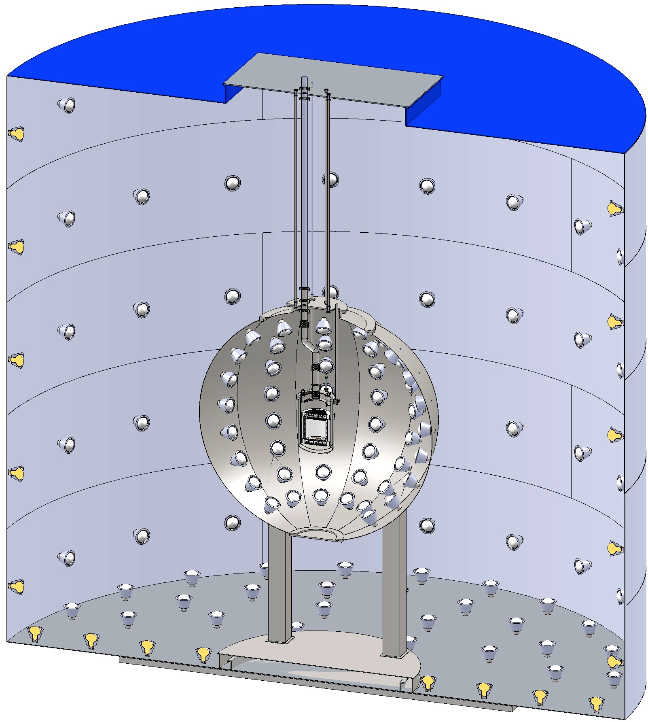
DarkSide 50 kg (Double phase Argon)
CTF Water Tank
3” QUPID
(19 top + 19 bottom)
Liquid
Scintillator
Depleted Ar
(50 kg)

Slide 49
Comparison of G1 Experiments
Experiment Name | Location |  | Mass |  |  | Photon Detector
 |  | Target | Total | Fiducial | Phase | Type | Location | Size | Radioactivity
 |  |  | (kg) | (kg) |  |  |  | (inch) | (mBq /piece) | (mBq /cm²)
XENON100 | Gran Sasso | Xe | 162 | 48 | Double | R8520 | Top/Bot. | 1 | 1 | 0.2
XMASS | Kamioka | Xe | 800 | 100 | Single | R8778Hex | 4π | 2 | 5 | 0.2
LUX | DUSEL | Xe | 350 | 100 | Double | R8778 | Top/Bot. | 2 | 20 | 0.8
Mini-CLEAN | SNO | Ar | 360 | 100 | Single | 8" PMT | 4π | 8 | 500 | 1.5
WARP | Gran Sasso | Ar | 140 | 100 | Double | 3" PMT | Top | 3 | 200 | 4.4
DarkSide 50 | Gran Sasso | Ar | 60 | 50 | Double | 3” QUPID | Top/Bot. | 3 | 1 | 0.02

Slide 50
Single Phase vs. Double Phase
 | Single Phase | Double Phase
HV for electron drift | Not required | Required (~1 kV/cm)
O₂ / H₂O impurity | Not critical | Critical
Energy threshold | 20 PE | 4 PE
Sensitivity for low mass WIMP | > 20 GeV | > 5 GeV
Position resolution | ~ 10 cm | ~ 2 mm
Gamma rejection by S2/S1 | No | Yes (> 99.5%)
Neutron rejection by Multi-hit cut | No | Yes

Slide 51
Summary on “Xenon vs. Argon”
Xenon
5 times more sensitive (per unit mass)
due to A² dependence.
Ideal for mass range of 10 – 100 GeV
Spectrum is independent from mass
Expensive
~$1M / ton
Limited by
pp-chain solar neutrino : 0.1 event / ton-year
¹³⁶Xe Double beta decay: 0.1 event / ton-year
⁸⁵Kr : 1 ppt → 0.2 event / ton-year
Argon
Free from gamma background
> 10⁶ rejection by pulse shaping
Ideal for mass range of 20 – 200 GeV
Insensitive to low mass < 10 GeV
³⁹Ar is the major source of radioactivity

Slide 52
XENON100 The 1st G1 Experiment

Slide 53
XENON100 Detector
161 kg
(48 kg)

Slide 54
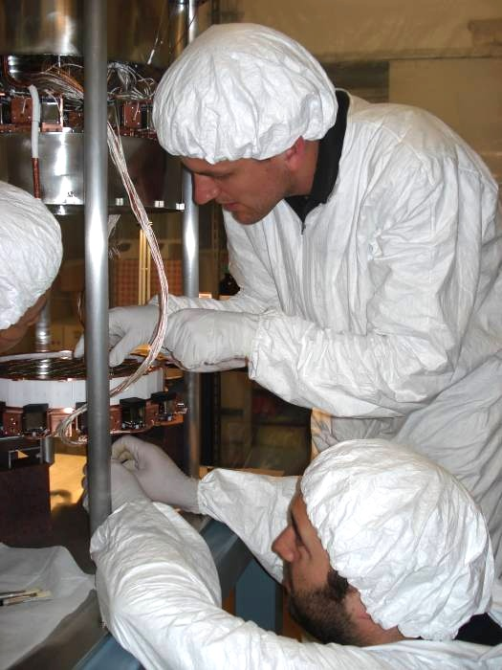
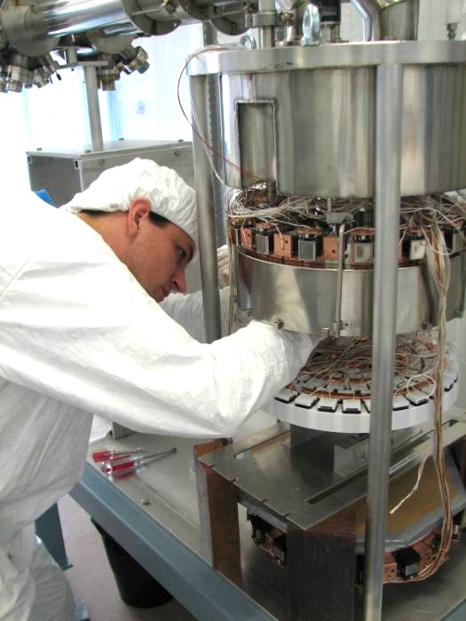
XENON100 Detector

Slide 55
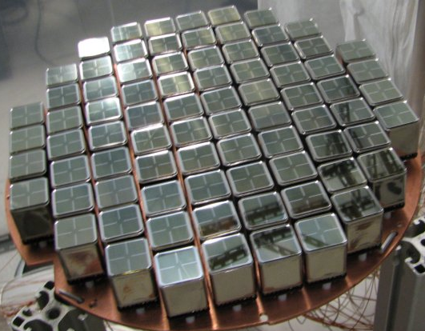
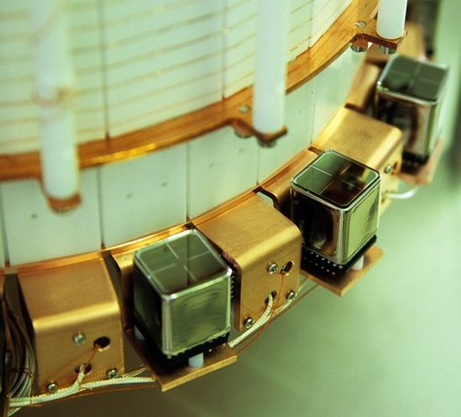
PMT Arrays
242 Hamamatsu R8520 PMTs 1"x1", optimized for response @ Xe scintillation light (178 nm)
Low radioactivity ( ~ <1 mBq/PMT)
Top Array
98 PMTs
~23% QE
Bottom Array
80 PMTs
~33% QE
Active Veto
64 PMTs
~23% QE

Slide 56
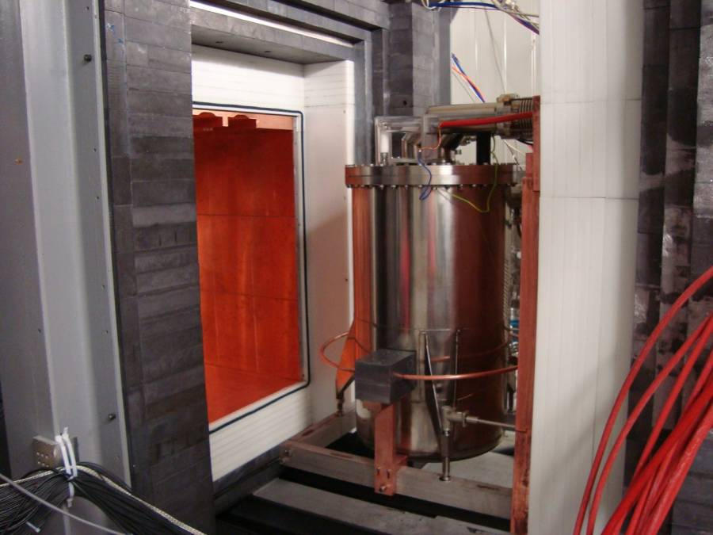
Pb
(20cm)
Poly
(20cm)
Cu
(5cm)
Pb
(20cm)
Poly
(20cm)
Cu
(5cm)

Slide 57
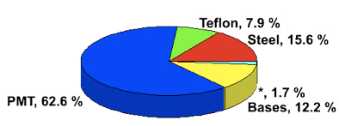
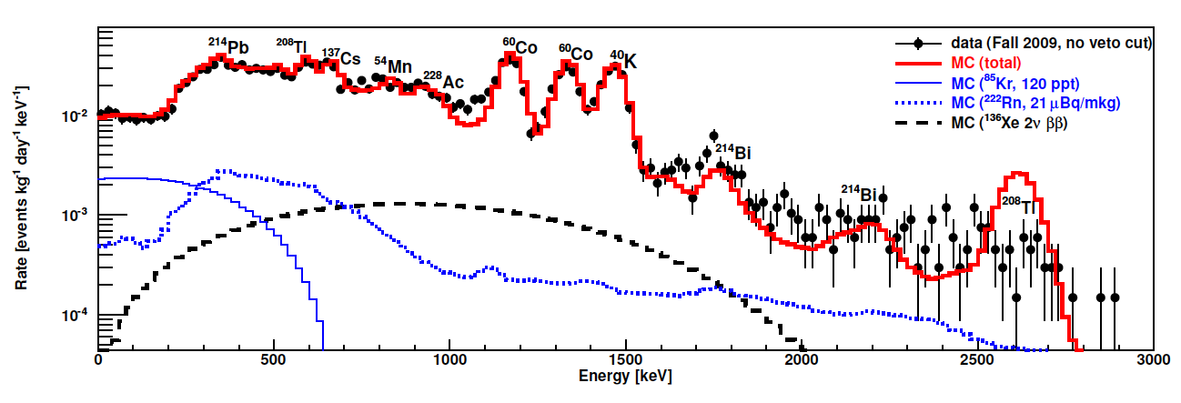
Energy Spectrum of Real Data vs. MC
Surface Backgrounds
arXiv:1101.3866
MC Total
⁸⁵Kr
²²²Rn
¹³⁶Xe Double Beta Decay

Slide 58
Level of Backgrounds (before S2/S1 cut)
before fiducial cut
after fiducial cut

Slide 59
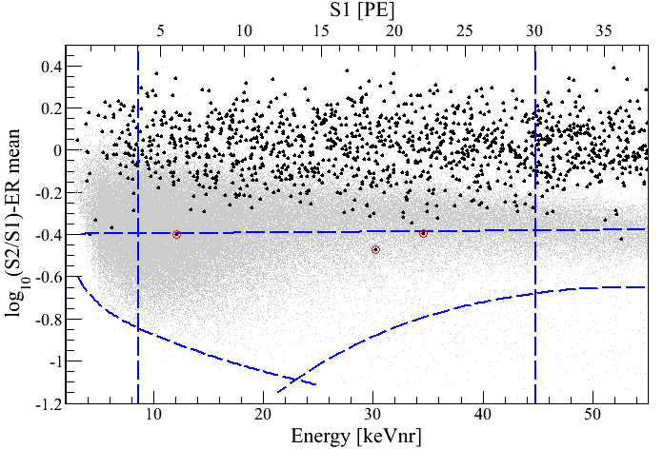
Log(S2/S1) vs. Energy
100.9 days, 48 kg
arXiv:1104.2549
S1 = 4 PE
γ backgrounds
S1 = 30 PE
99.75% rejection for γ
Neutron band
(Acceptance 30 – 40%)
3 events
(1.8 ± 0.6 expected)
-3 σ
8.4 keV_{nr}
44.6 keV_{nr}
S2 = 300 PE

Slide 60
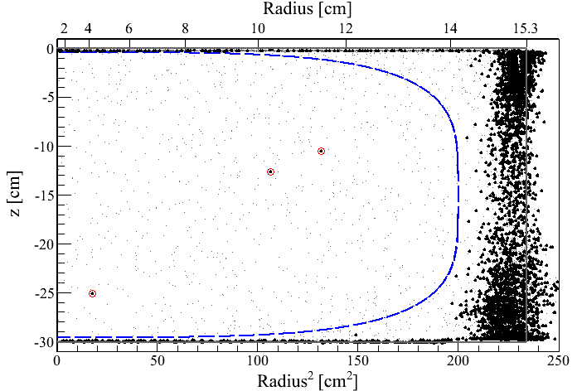
Event distribution in z vs. R²
100.9 days, 8.4 – 44.6 keV_{nr}
48 kg
3 events
(1.8 ± 0.6 expected)

Slide 61
Log(S2/S1) vs. Energy
11 keV_{nr}

Slide 62
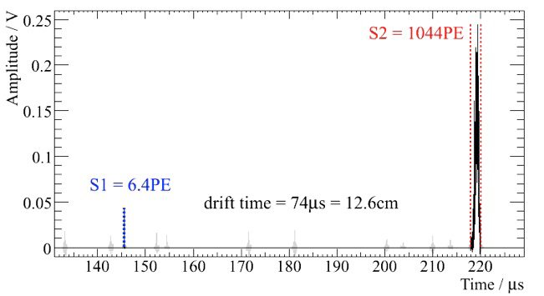
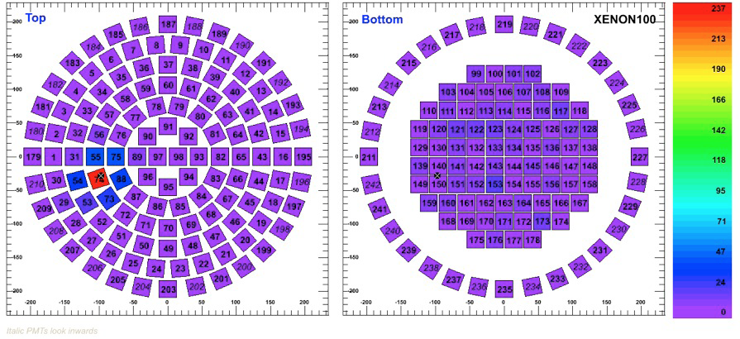
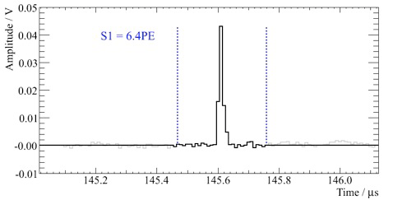
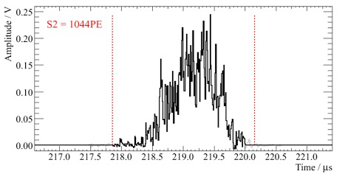
Single Scatter Nuclear Recoil Event Candidate
11 keV_{nr}
Top
Bottom

Slide 63
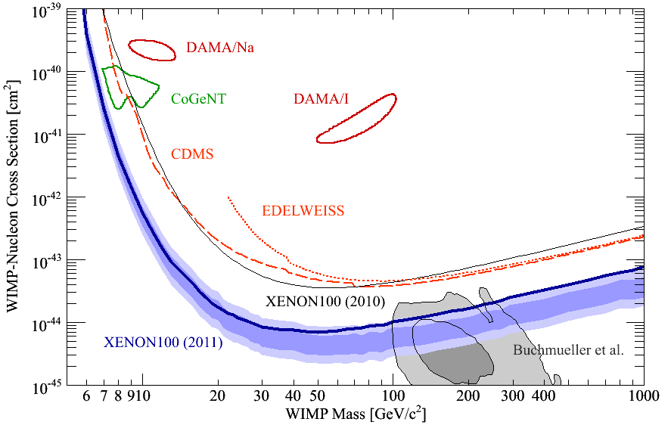
90% CL Limits of SI Cross Section (April, 2011)
arXiv:1104.2549
CMSSM

Slide 64
Summary of XENON100
Purity of Xenon has achieved the design goal.
Actual Goal
Light Yield: 2.2 > 2 pe/keVee
Electron Drift Time: 400 > 300 μs
Krypton 85: 80 < 100 ppt
Radon: 1.1 < 2 Bq/m³
100 days of data published.
3 event observed (1.8 +- 0.6 events expected)
Contaminated by ⁸⁵Kr at ~ 700 ppt → 1.1 events
< 7 x 10⁻⁴⁵ cm² at 50 GeV arXiv:1104.2549
Low mass (7-10 GeV) WIMP unlikely.
Inelastic DM excluded. arXiv:1104.3121
Data taking continues.
⁸⁵Kr reduced to < 80 ppt
< 2 x 10⁻⁴⁵ cm² by the end of 2011 expected.

Slide 65
XENON1T The 1st G2 Experiment

Slide 66
G1
CMSSM
G2
G3
XENON1T

Slide 67
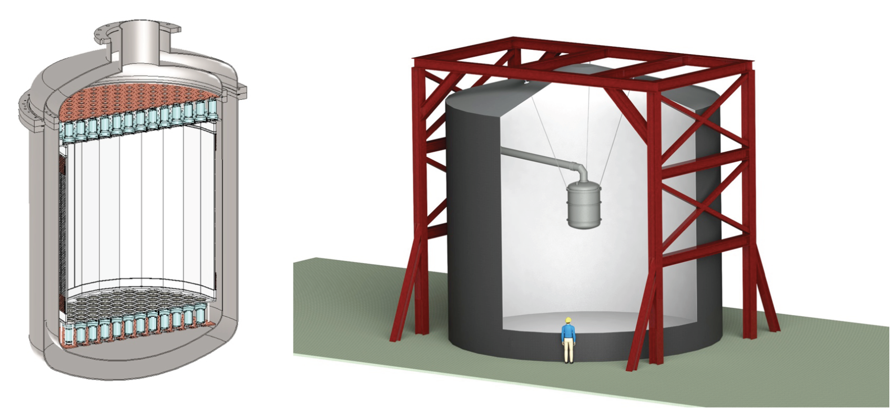
XENON1T (G2) at LNGS
Xe
(2.2 Ton)
Water Tank

Slide 68


XENON1T Detector Structure

Slide 69

Electric Field of TPC

Slide 70

Key Parameters of XENON1T

Slide 71

XENON1T Cryogenic System

Slide 72

XENON1T at LNGS Hall B

Slide 73

Expected Backgrounds vs. Self-shielding cut

Slide 74

Expected Backgrounds and Sensitivity

Slide 75

XENON1T – Responsibility and Cost
DOE + NSF

Slide 76

XENON1T – US Responsibility

Slide 77

XENON1T – Schedule

Slide 78
SUSY and Extra Dimensions

Slide 79

SUSY Neutralino

Slide 80

SUSY Particles and Neutralino
Spin 1/2 1 0

Slide 81
SUSY Particles and Neutralino
Super Symmetry
Neutralino
Spin 1/2 1 0 0 1/2 1/2

Slide 82


Hierarchy Problem
Higgs mass
SM :
SUSY :
or : new physics at the energy scale of Λ ~ 1 TeV

Slide 83

John Ellis

Slide 84

John Ellis

Slide 85

Mass Spectra at the best fit points (before LHC)
CMSSM
NUHM1
Buchmueller et al arXiv: 0808.4218

Slide 86

mSUGRA m_{1/2} vs. m₀
M_{x} ~ 0.4 * M_{1/2}
Feng Ann. Rev. Astro. Astrophys. 2010.48:495-545

Slide 87

SI Cross Section vs. Mass
CMSSM
CMSSM
LHC
Pre
2011
2012
2015
G1
XENON100
2011
2012
G2
XENON1T
2017
G3
Buchmueller et al arXiv:1106.2529

Slide 88

SI Cross Section vs. Mass
CMSSM
NUHM1
XENON1T
XENON1T
VSMSSM
mSUGRA
XENON1T
XENON1T
Buchmueller et al arXiv:1106.2529

Slide 89

SI Cross Section vs. Mass
LHC
Pre
2011
Excluded by
XENON100
XENON100
XENON100
well-tempered
2011
2012
2011
Stop
co-annihilations
2012
Excluded
By LHC
Slepton
co-annihilations
XENON1T
2017
XENON1T
Heavy Higgs
Resonance
2017
Ferina et al arXiv:1104.3573

Slide 90

M_{1/2} vs. M₀ & μ
Excluded by XENON100
Excluded by LHC
Ferina et al arXiv:1104.3573

Slide 91

M_{1/2} vs. M₀
LHC
LHC
CMSSM
NUHM1
LHC
LHC
VSMSSM
mSUGRA
Buchmueller et al arXiv:1106.2529

Slide 92

CMSSM m_{1/2} vs. m₀
Profumo arXiv:1105.5162

Slide 93

CMSSM m_{1/2} vs. m₀
XENON1T
IceCube
XENON100
Profumo arXiv:1105.5162

Slide 94

CMSSM m_{1/2} vs. m₀
Stau
Coannihilation
Focus
Point
XENON100
Bulk
Profumo arXiv:1105.5162

Slide 95

CMSSM m_{1/2} vs. m₀
XENON100

Slide 96
mSUGRA m_{1/2} vs. m₀
Most likely

Slide 97

KK particles in Extra Dimensions

Slide 98
Photon
Extra
Dimensions
KK Photon
Bulk
Our 3D Space
(= Brane)

Slide 99
Origin of Mass in Extra Dimensions
E = mc² → m = E/c²
Mass can be generated as kinetic energy in extra dimensions.
Origin on mass
Dark matter is running in the extra dimensions
Gravity can escape into the extra dimensions.
Why gravity is so small
Origin of dark energy

Slide 100

^{Paul Steinhardt}
Shadow
Universe
Our
Universe

Slide 101


Mass Spectrum of the first KK level
Similar to the SUSY mass spectrum
KK Photon
KK Photon
Cheng 2002 arXiv:hep-ph/0205314v1

Slide 102

Allowed Region of Minimum Universal Extra Dimensions
WMAP constraint
Kakizaki 2006

Slide 103


Ωh² vs. m_{KK}
ν⁽¹⁾
B⁽¹⁾
Berone et al Phys. Rep. 2005

Slide 104

Predicted Cross Section of Kaluza-Klein Dark Matter
G1
XENON100
2011
2012
G2
XENON1T
Feng Ann. Rev. Astro. Astrophys. 2010.48:495-545

Slide 105

Discovery Potential by LHC
Cheng 2002 arXiv:hep-ph/0205314v1

Slide 106

Sensitivity to KK particles
WMAP
WMAP
LHC
XENON1T
XENON1T
XENON100
XENON100
My favorite
Arrenberg 2008

Slide 107
Summary on “Science Cases”
XENON program (~$10M) is extremely timely and competitive to LHC (~$10B)
XENON100 ~ Current LHC
XENON1T ~ Future LHC
If new physics at 100 – 1000 GeV (as it should be), both LHC and XENON1T will discover WIMPs.
SUSY - Neutralino
Extra Dimensions – KK particles
By combining LHC and XENON1T, we have a better chance to untangle large parameter spaces.

Slide 108
Ultimate Detectors

Slide 109
G1
CMSSM
G2
G3

Slide 110
Target Mass Dependence of WIMP Cross Section
10⁻⁴⁴ cm²
Xe-132
Ar-40
Ge-73
Si-28
Ne-20

Slide 111

(SI) WIMP Energy Spectrum for LXe (Cross Section = 10⁻⁴⁵cm²)
Xenon
7 keVr
45 keVr
200 GeV
100 GeV
500 GeV
1000 GeV
20 GeV
50 GeV

Slide 112

(SI) WIMP Energy Spectrum for LAr (Cross Section = 10⁻⁴⁵cm²)
Argon
45 keVr
200 keVr
100 GeV
500 GeV
1000 GeV
200 GeV
20 GeV
50 GeV

Slide 113
G1
CMSSM
G2
50 GeV
100 GeV
200 GeV
500 GeV
G3

Slide 114

1-σ Error of WIMP Mass vs SI Cross Section (1 ton*year Xe and 5 ton*year Ar)
50 GeV
100 GeV
200 GeV
500 GeV
10⁻⁴⁵ cm²
G2

Slide 115

1-σ Error of WIMP Mass vs SI Cross Section (1 ton*year Xe and 5 ton*year Ar)
Xenon
(56 events)
10⁻⁴⁵ cm²
Argon
(42 events)
G2
100 GeV

Slide 116

1-σ Error of WIMP Mass vs SI Cross Section (1 ton*year Xe and 5 ton*year Ar)
Xenon
(5.6 events)
10⁻⁴⁶ cm²
Argon
(4.2 events)
G2
100 GeV

Slide 117
1-σ Error of WIMP Mass vs SI Cross Section (10 ton*year Xe and 50 ton*year Ar)
10⁻⁴⁵
Xenon
(56 events)
10⁻⁴⁶
10⁻⁴⁶ cm²
Argon
(42 events)
G3
100 GeV
10⁻⁴⁷

Slide 118

(SI) WIMP Energy Spectrum for LXe (Cross Section = 10⁻⁴⁵cm²)
Xenon
7 keVr
45 keVr
200 GeV
100 GeV
500 GeV
1000 GeV
20 GeV
50 GeV

Slide 119

(SI) WIMP Energy Spectrum for LAr (Cross Section = 10⁻⁴⁵cm²)
Argon
45 keVr
200 keVr
100 GeV
500 GeV
1000 GeV
200 GeV
20 GeV
50 GeV

Slide 120

±1σ Error of Annual Modulation Amplitude vs WIMP Mass (10 ton*year Xe and 50 ton*year Ar, Cross Section = 10⁻⁴⁵cm²)
G3
50
Argon
Xenon

Slide 121

DUSEL at Homestake, started in 2007

Slide 122
XAX (Xenon-Argon-Xenon)
arXiv:0808.3968
Water Tank Veto
WIMP (Spin even)
Double Beta Decay
WIMP (Spin odd)
Solar Neutrino
WIMP (Spin even)
12 m
¹³⁶Xe
7 ton
(4 ton)
⁴⁰Ar
70 ton
(50 ton)
^{129/131}Xe
12 ton
(6 ton)
1.2 m
2 m
4 m
12 m
14 m

Slide 123
G2 and G3 facilities defined by PASAG (2009)
 | G1 | G2 | G3
Sensitivity | < 10⁻⁴⁴ cm² | < 10⁻⁴⁶ cm² | < 10⁻⁴⁷ cm²
Target Mass | 10 – 100 kg | ~ 1 Ton | ~ 10 Ton
Cost | $1M – 5M | $10 – 20M | ~ $100M

Slide 124
Comparison of Xenon Detector Size
G3
MAX, LZD, XAX
20 ton (10 ton)
G2
XENON 1ton
2.5 ton (1 ton)
G1
2 m
XENON100
161 kg
(48 kg)
ZEPLIN-II
31 kg
(7.2 kg)
XENON10
14 kg
(5.4 kg)
1 m
1 m
15cm
30cm
14cm
30 cm
20 cm
30 cm
1 m
2 m
2007
2007
2010
2014
2019

Slide 125

DarkSide 5T (G2) at LNGS
CTF Water Tank
Liquid
Scintillator
2 m
⁴⁰Ar
10 ton
(5 ton)

Slide 126

MAX (G3) (at DUSEL)
⁴⁰Ar
20 ton
Xe
6 ton

Slide 127

LUX and LZD (at DUSEL)
G1
G2
G3

Slide 128

DARWIN in Europe (LNGS?)
Ar
20 ton
(10 ton)
Xe
8 ton
(5 ton)

Slide 129


MAX+LZD = “Ultimate G3” Detector (at DUSEL)
⁴⁰Ar
70 ton
(50 ton)
Xe
20 ton
(10 ton)
4m
2 m
3” QUPID x 595 (Top)
3” QUPID x 595 (Bottom)
3” QUPID x 2644 (Top)
3” QUPID x 2644 (Bottom)

Slide 130


MAX+LZD = “Ultimate G3” Detector (at DUSEL)
Xe 20 ton (10 ton)
⁴⁰Ar 70 ton (50 ton)
Xe
Ar
Liquid
Scinti
Liquid
Scinti
Water Tank
Water Tank
8 m
18 m

Slide 131
US Dark Matter Programs
2010
Xe
Ar
G3 = Xe (10T) + Ar (50T)
Xe
Ar

Slide 132
Technological Challenges

Slide 133
Where backgrounds come from?
External
Detector materials
Internal impurity
Cosmic Rays
Underground or
Under high mountains
Radio Activities
(U, Th, K…)
Detector
Water Tank
(Liquid Scintillator)

Slide 134


QUPID (QUartz Photon Intensifying Detector)
arXiv:1103.3689
Photo Cathode
(-6 kV)
Photo Cathode
(-6 kV)
Quartz
Al coating
APD (0 V)
APD (0 V)
Quartz

Slide 135

Comparison of Low-radioactive Photon Detectors from Hamamatsu
R8520
1 inch
R8778
2 inch
QUPID
3 inch
DarkSide50
XENON1Ton
MAX, XAX
XENON10
XENON100
LUX
(XMASS)

Slide 136
QE of two types of QUPID
Xenon (178 nm)
Argon + TPB (420 nm)

Slide 137

1, 2 and 3 PE Distribution with 2m cable
3 PE
2 PE
1 PE

Slide 138


Expected Background from Gammas and pp Solar Neutrinos (100 Year, Multi-hit Cut, S2/S1 Cut)‏
γ’s from QUPID
XENON100
2 γ /10 ton-year
(pp solar neutrino
+ 2v double beta decay)
5 × 10^{–8} DRU
Xenon
10 ton
02/25/10
Katsushi Arisaka, UCLA
138

Slide 139



Xe 10 ton Neutron Background (100 Years)
1/8
1/4
Before Cuts
Multi Hit Cut
Liquid Scinti. Veto
0.81 n / year
0.10 n / year
0.03 n / year
Xenon
10 ton

Slide 140



Ar 50 ton Neutron Background (100 Years)
1/20
1/6
Before Cuts
Multi Hit Cut
Liquid Scinti. Veto
42 n / year
2.1 n / year
0.39 n / year
Argon
50 ton

Slide 141

Princeton Prototype Plant for Depleted Argon:

Slide 142
Technological Challenges
External Backgrounds
Deep underground – LNGS, SNOLab, DUSEL
4 m water shielding
Detector Materials
Photon detectors – QUPID
Cryostat – Titanium
Others – Copper, PTFE
Purity of Liquid Xe/Ar
Radon
⁸⁵K (0.5 ppt in Xe) – 1 event / 10 ton-year
³⁹Ar (in Ar) – Depleted Ar from underground
Physics Backgrounds (in Xe)
pp-chain solar neutrinos – 1 event / 10 ton-year
Double beta decays from ¹³⁶Xe – 1 event / 10 ton-year
Neutron Vetos
B (or Gd) doped Liquid Scintillator

Slide 143
Some Remarks
Xenon is optimum up to 1 Ton scale
Largest discovery potential
Background ~ 1 / ton-year
Good sensitivity to low mass WIMP
At > 10 ton scale, Argon is more appealing
No gamma ray backgrounds
Mass determination up to 200 GeV
Large annual modulation

Slide 144
Neutrino Physics
Neutrinoless Double Beta Decay
pp-chain Solar Neutrino
Supernova Neutrino

Slide 145

Energy Spectrum (Natural Xe)
arXiv:0808.3968
100 GeV WIMP (10⁻⁴⁴ cm²)
2ν DBD (10²² yrs)
pp Solar
Be7 Solar
0ν DBD (10²⁷ yrs)
B8 Solar

Slide 146
XAX (Xenon-Argon-Xenon)
arXiv:0808.3968
Water Tank Veto
WIMP (Spin even)
Double Beta Decay
WIMP (Spin odd)
Solar Neutrino
WIMP (Spin even)
12 m
¹³⁶Xe
7 ton
(4 ton)
⁴⁰Ar
70 ton
(50 ton)
^{129/131}Xe
12 ton
(6 ton)
1.2 m
2 m
4 m
12 m
14 m

Slide 147

Double Beta ββ(0ν) Decay
ΔL = 2 Process
Majorana Neutrino ν = ν
Right-handed current in weak interaction
Majoron emission
SUSY particle exchange
ββ(0ν) : 2n → 2p+2e⁻
p
n
W⁻
e⁻
ν_{eR}
h
ν_{M}
ν_{eL}
h
W⁻
e⁻
n
p
(Q_{ββ} ~ MeV)

Slide 148

Neutrino Mass Differences
Normal Scheme
Inverted Scheme
(50 meV)²
(9 meV)²
Laurent SIMARD, LAL - Orsay

Slide 149

Sensitivity of Neutrinoless Double Beta Decay
to Neutrino Mass
Normal Scheme
Inverted Scheme
DBD
Life Time
10²⁶ yr
10²⁷ yr
10²⁸ yr
Cosmology
Cosmology
(Figure from C. Giunti)
Laurent SIMARD, LAL - Orsay

Slide 150

¹³⁶Xe Double Beta Decay and Gamma Background
(1 mBq / QUPID, 2m Xenon Detector)
0 cm
2ν DBD (10²² yrs)
10 cm
20 cm
30 cm
40 cm
50 cm
0ν DBD (10²⁷ yrs)
B8 Solar Neutrino

Slide 151

Double Beta Decay Experiments
EXO200
CANDLES III
EXO 1Ton
No. of Backgrounds (/year)
10²⁵ yrs
10²⁶ yrs
10²⁷ yrs
10²⁸ yrs
CUORE I
NEMO3 (Mo)
XENON1T
CUORE III
Cuoricino
XAX (Natural)
Super-NEMO (Se)
GERDA I
GERDA III
XAX (Enriched)
CUORE II
COBRA
EXO 1Ton
(Ba tag)
NEMO3
(Se)
GERDA II
Mass (kg)

Slide 152

Solar Neutrino (by XMASS group)
M. Nakahata

Slide 153

Sular Neutrino Detection
M. Yamashita

Slide 154

Solar Neutrino Study by XMASS Group
M. Nakahata

Slide 155

Horowitz, Coakley, Mckinsey 2003

Slide 156
Neutrinos from a Supernova
Assumptions:
10 kpc away.
Total energy radiated in neutrinos = 3*10⁵³ ergs
Equal partition of energy among the 6 neutrinos
Temperatures of neutrinos:
k_{B}T = 3.5 MeV
k_{B}T = 5 MeV
k_{B}T = 6~8 MeV

Slide 157

Energy Spectrum of SN Nuclei Scattering
Xenon
Argon
Neon

Slide 158

Temperature Dependence of Energy Spectrum
Xenon
10 MeV
8 MeV
6 MeV
4 MeV

Slide 159

Temperature Dependence of Energy Spectrum
Argon
³⁹Ar Background (after S2/S1 cut)
10 MeV
4 MeV
6 MeV
8 MeV
³⁹Ar Background
(after S2/S1, 95% depleted)
No pulse
shape cut
Pulse
shape cut

Slide 160




Estimate of Total Energy vs. Temperature
Xenon
(1 Ton)
Argon
(5 Ton)
2σ
G2
2σ
1σ
1σ
Xenon
(10 Ton)
Argon
(50 Ton)
G3

Slide 161
Summary

Slide 162
“Ultimate G3” Detector (at DUSEL)
Xe 20 ton (10 ton)
⁴⁰Ar 70 ton (50 ton)
Xe
Ar
Liquid
Scinti
Liquid
Scinti
Water Tank
Water Tank
8 m
18 m

Slide 163
US Dark Matter Programs
2010
Xe
Ar
G3 = Xe (10T) + Ar (50T)
Xe
Ar

Slide 164
G1
CMSSM
G2
G3

Slide 165
Dark Matter Experiments
XENON10
Theoretical
Prediction
XENON100
XENON 1T
G3 (10 ton)

Slide 166

Detection of Cosmic Radiation
Larger Volume
Lower Threshold
2020
JEM-EUSO
2010
Pierre-Auger
ICECUBE
2000
HiRes
AGASA
AMANDA
1990
Cosmic Ray
LBNE (Water)
Neutrino
Super-K
IMB
Kamiokande
G3
XENON1T
Future
XENON100
Dark Matter
Ongoing
CDMS-II
XENON10
Past

Slide 167
Conclusions
Science cases
Stronger than ever - SUSY, Extra Dimensions…
Competitive and complementary to LHC
Extremely timely
Technical challenges
Xe-G1 (100 kg) well demonstrated by XENON100
New photon detector (QUPID) developed
Radioactivity (³⁹Ar, ⁸⁵Kr, Rn) major challenges
Future directions
G2 : XENON 1T and DarkSide 50 / 5T at Gran Sasso.
G3 : MAX + LZD (Xe 10T + Ar 50T) at DUSEL

Slide 168
Katsushi’s Speculations
2012 LHC (ATLAS+CMS) announces
120 GeV Higgs (at 3σ)
2016 XENON1T announces
Observation of 5 WIMP signals (> 200 GeV)
2021 G3 (Xe+Ar) and LHC jointly confirm
Extra Dimensions
WIMP = 600 GeV KK Photon (Δ = 5%)
No SUSY
Katsushi happily retires at age 65.

