Slide 1
Origin of the Universe,
Particles and Structure
Katsushi Arisaka
University of California, Los Angeles
Department of Physics and Astronomy
arisaka@physics.ucla.edu

Slide 2
Talk Outline
Last week: Bio-imaging and Neuro-physics
  Part I ~30 min.
    Introduction to High-speed Bio-imaging
    Single Molecule: Origin of Life
  Part II ~30 min.
    Neurophysics: Origin of Consciousness
Today: Particle Physics & Cosmology
  Part I ~30 min.
    Introduction to Cosmology: Origin of Universe
    CMS at CERN: Origin of Particles
  Part II ~30 min.
    Detection of Dark Matter: Origin of Structure in Universe
  Lab Tour ~10 min.

Slide 3
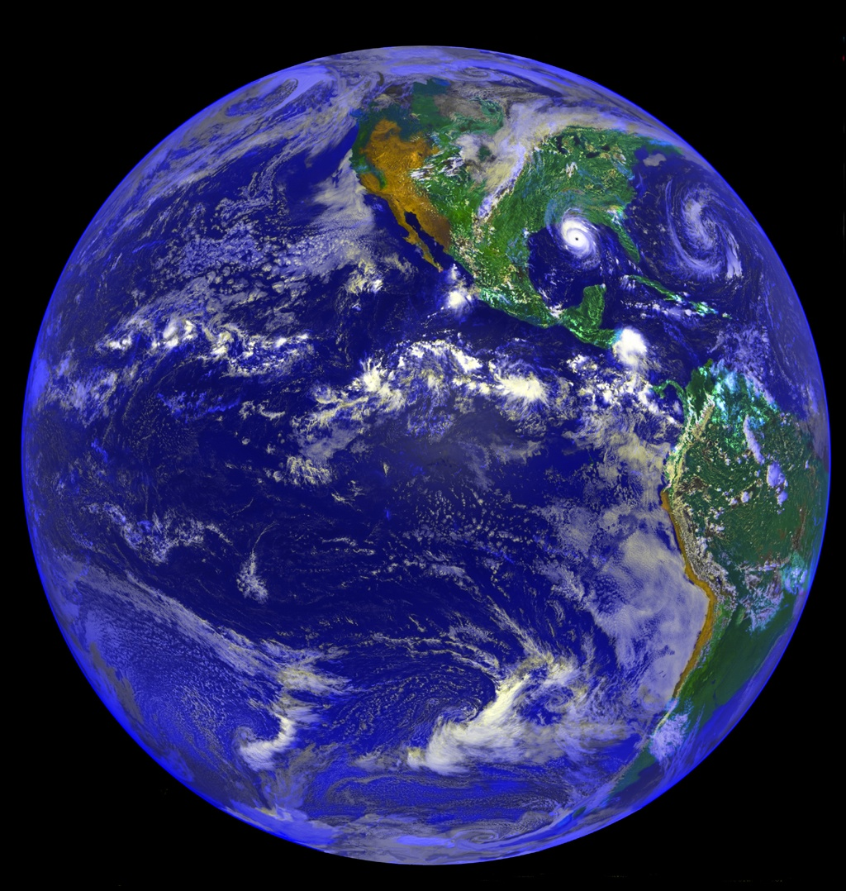
Why are we here?

Slide 4
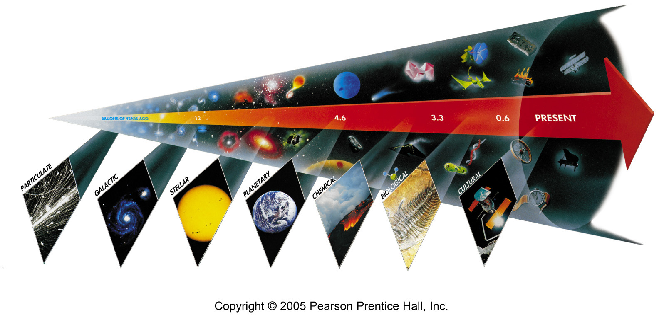
Seven Phases of Cosmic Evolution
Spontaneous Symmetry Breaking
14B years ago
Simple
Coherent Complex System

Slide 5
Seven Phases of Cosmic Evolution
Spontaneous Symmetry Breaking
14B years ago
Origin of
Particles
Origin of
Structure
Origin of
Life
Origin of
Consciousness

Slide 6
Seven Phases of Cosmic Evolution
Spontaneous Symmetry Breaking
14B years ago
Accelerator
Telescope
Microscope

Slide 7
Part I
Introduction to Cosmology

Slide 8
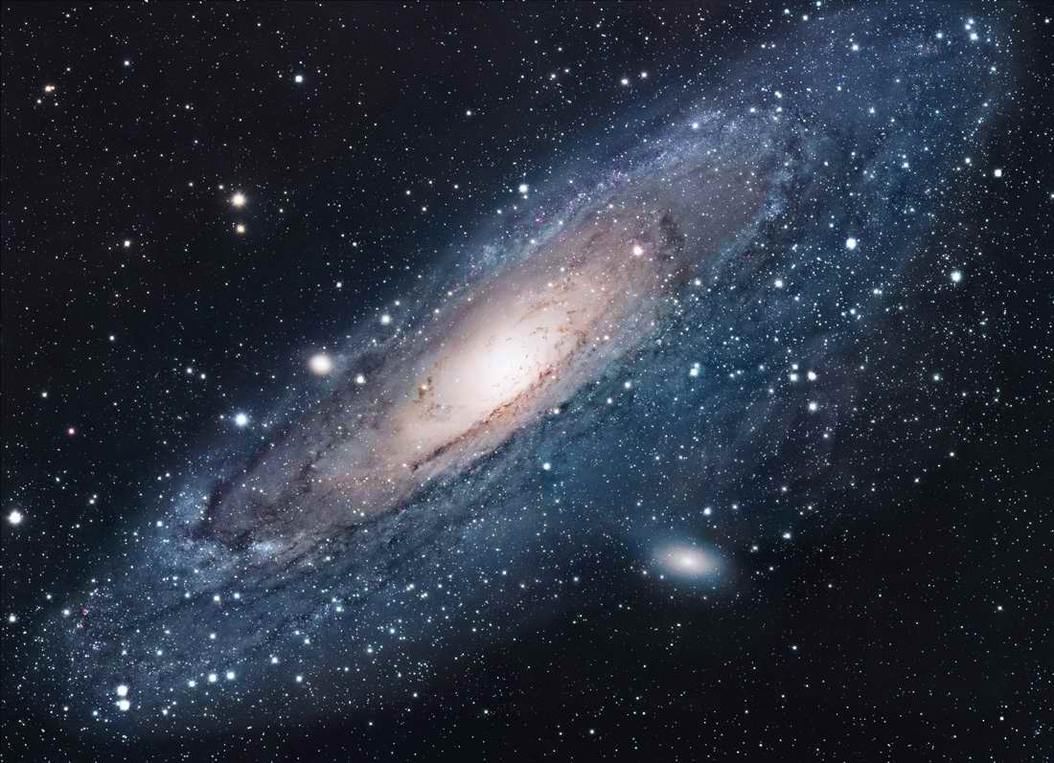
Andromeda
~100 Billions Stars in a Galaxy

Slide 9
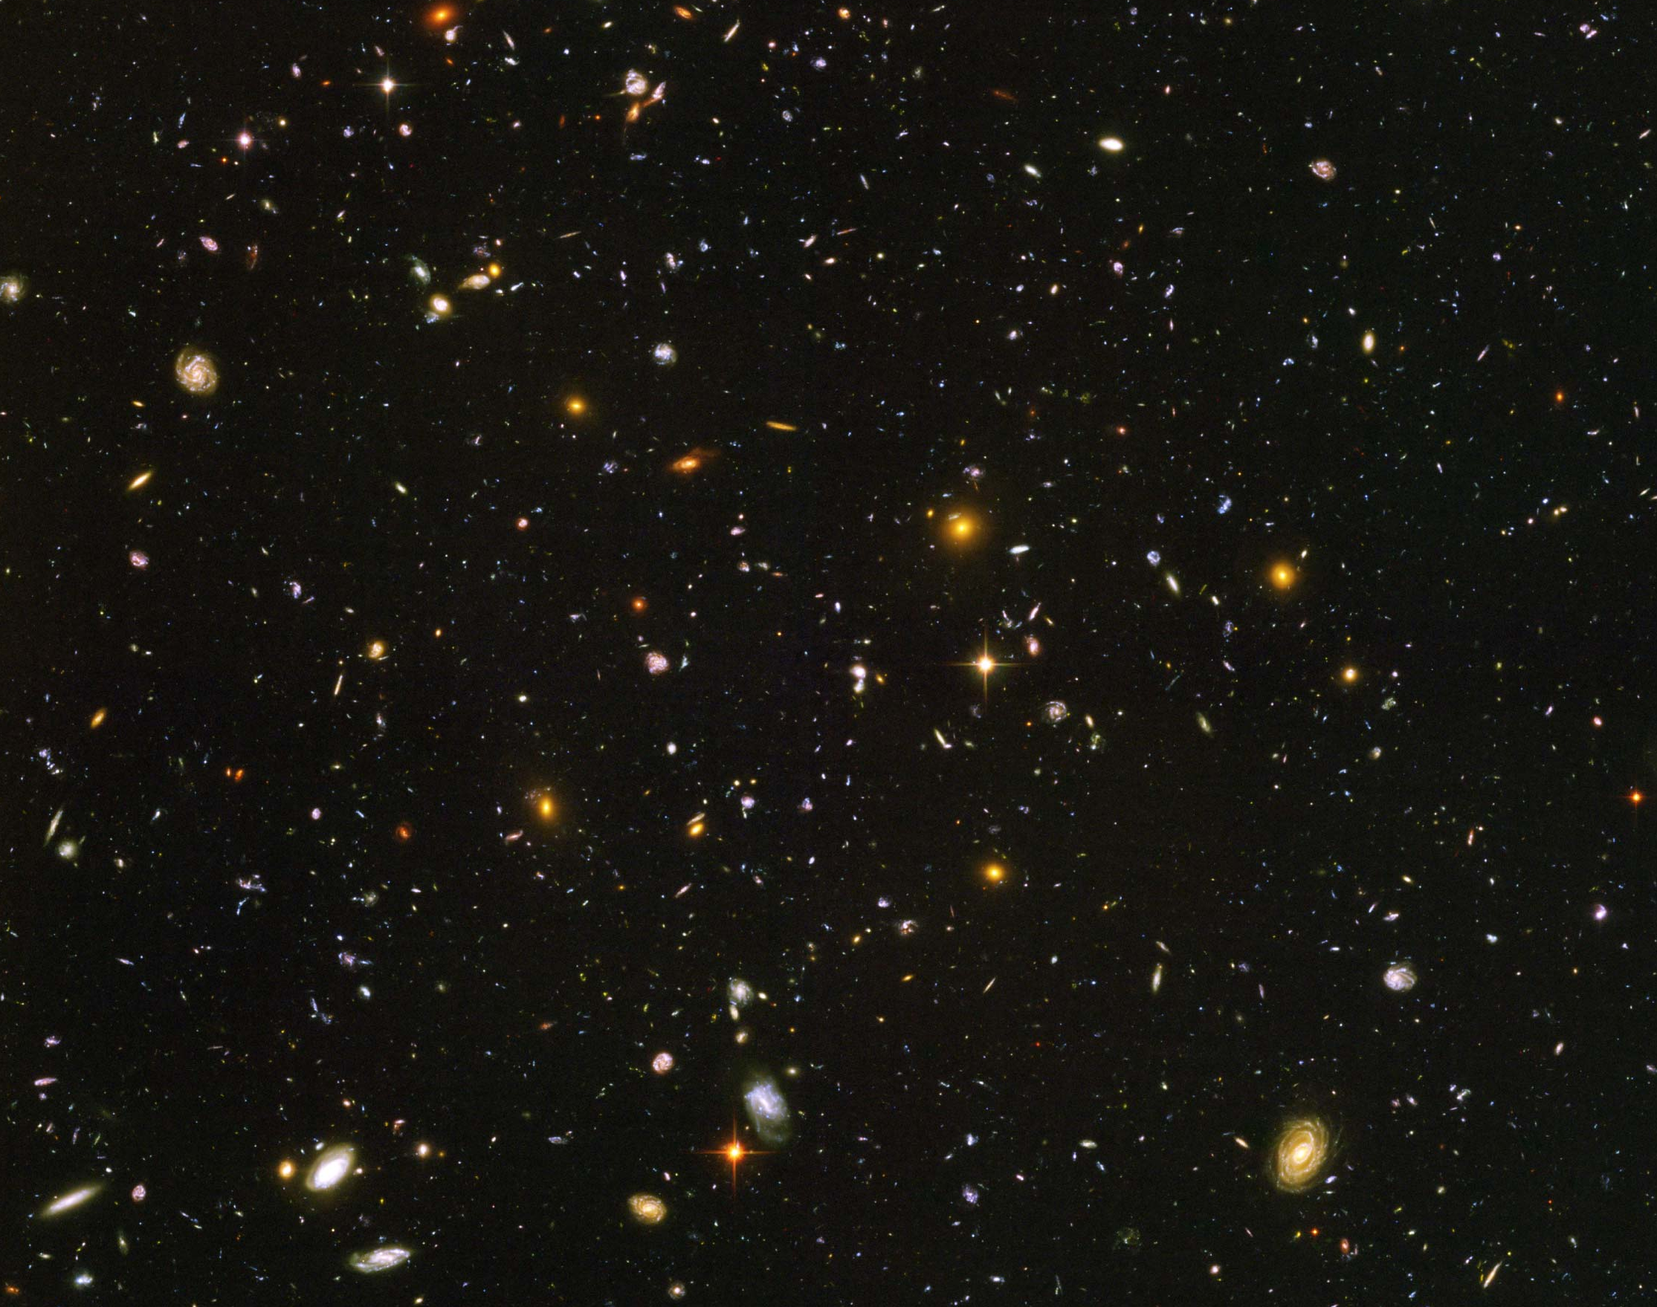
Hubble Deep Field
~100 Billion Galaxies

Slide 10
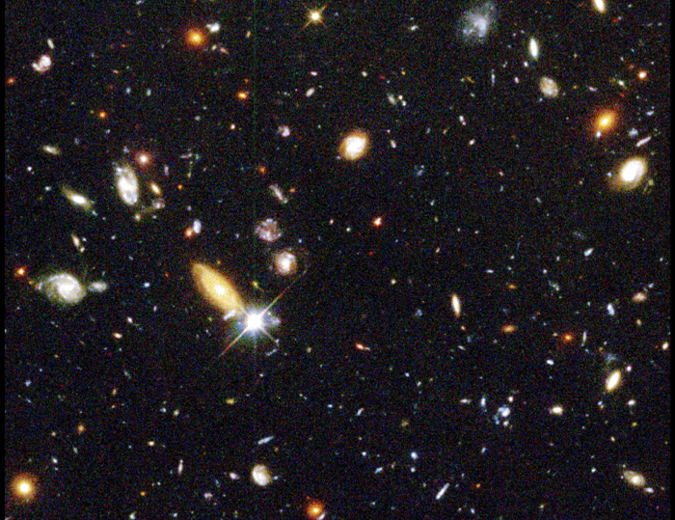
Red shift
up to ~10

Slide 11
Hubble’s Law:
Expansion of the Universe
Horizon
of Universe
Big Bang!
Sun/Earth
14 Billon
Light Years
Moving Away
at Speed of Light

Slide 12
Expansion of Universe
Size
Size of Universe
∝ √ Time
Horizon
∝ cT
Beginning
Today
Time

Slide 13
Temperature of Universe
Temperature
Temperature = 1/Size
2.7ºK
Beginning
Today
Size

Slide 14
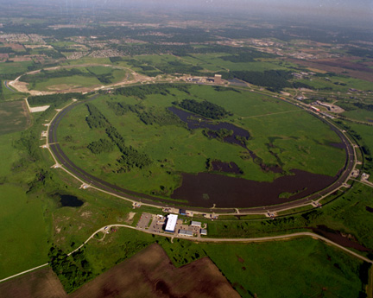
Fermi Lab near Chicago
6km Circumference
1+1=2 TeV
p + p⁻

Slide 15
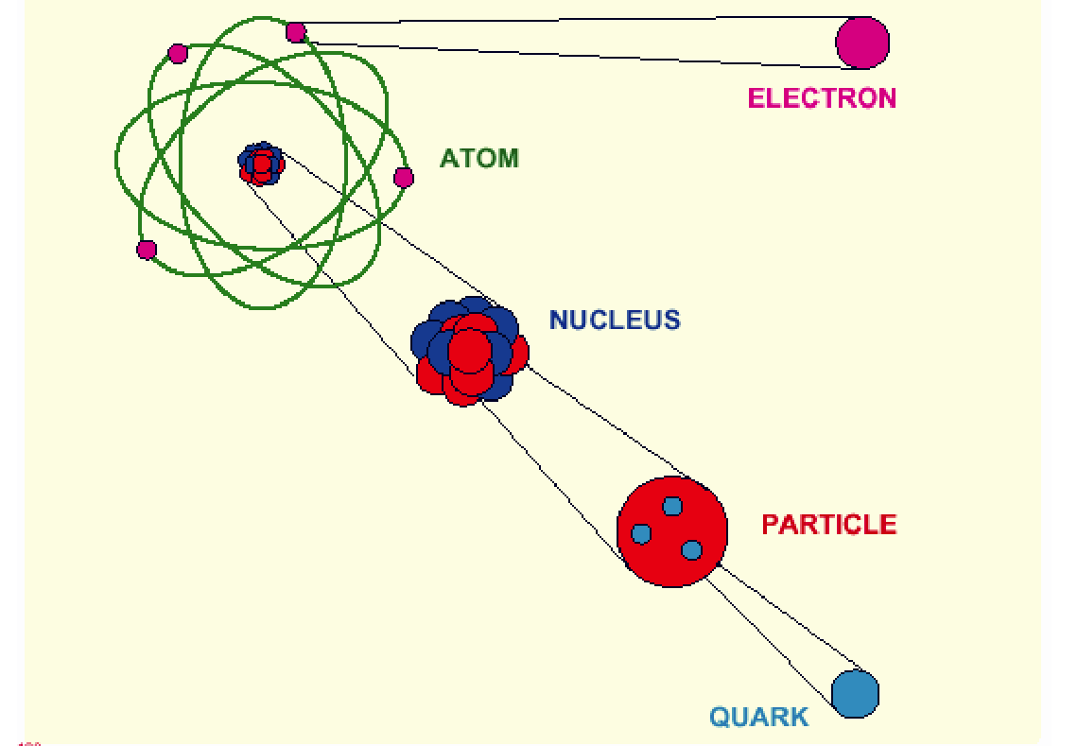
Elementary Particles (~1970)

Slide 16
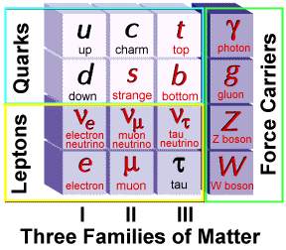
Elementary Particles
Charge
+2/3
-1/3
0
-1
Fermion Boson
Charge
0
0
0
±1
+ Anti-particles

Slide 17
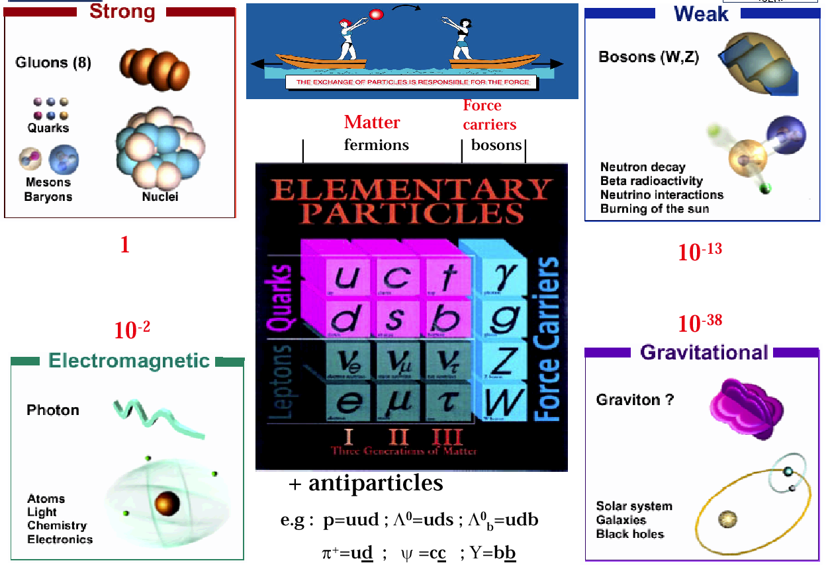
Elementary Particles and Forces

Slide 18
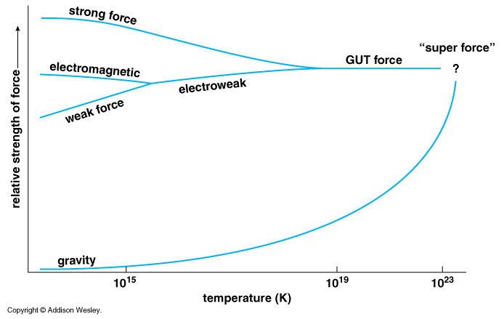
Unification of Forces
??
Electro-Weak Unification
100 GeV
10¹⁶ GeV
10¹⁹ GeV
10²⁹
10³²

Slide 19
Unification of Forces
Grand Unification
100 GeV
10¹⁶ GeV
10¹⁹ GeV
10³²
10²⁹
10³²
10²⁹

Slide 20
Unification of Forces
Planck Epoch
100 GeV
10¹⁶ GeV
10¹⁹ GeV
10²⁹
10³²

Slide 21
Hubble Deep Field
Physicists’ View of Early Universe
Fiat lux
Let there be light

Slide 22
Hubble Deep Field
Physicists’ View of Early Universe
Lorentz Invariance
Local Gauge Invariance

Slide 23
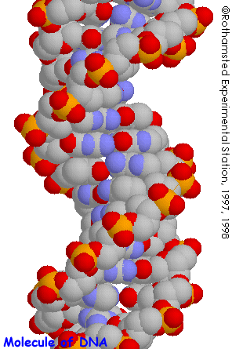
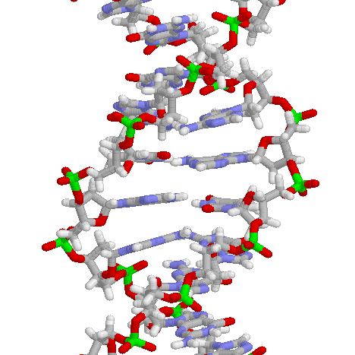
Structure of DNA

Slide 24
Symmetry Breaking
Time
0
Simple
1B years
2
3
4
b
s
µ⁻
W⁺
5
γ
c
Symmetry
Break Down
ν_{e}
τ⁺
d
6
d
Zº
τ⁻
ν_{e}
e⁺
e⁻
7
u
u
ν_{µ}
8
b
ν_{µ}
µ⁺
s
W⁺
c
9
10
11
12
Complex
13
14

Slide 25
The Beginning (at t = 0)
Everything was the same ↔ Perfect symmetry.
  All the particles are the same as photons.
  All four forces are the same.
The Universe was 10 dimension.
  3 Space Flattened
  1 Time
  3 Strong Force
  6 2 Weak Compacitified
  1 Electro-Magnetic

Slide 26
CMS at LHC

Slide 27
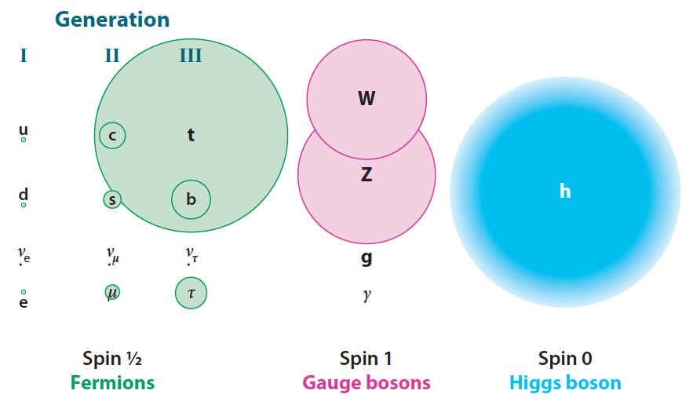
Mass of Particles (at t = 0.1 ns)

Slide 28
Mystery of the Mass (since 1970)
How to create mass from energy?
  While maintaining the initial symmetry
  Spontaneous Symmetry Breaking
Particle mass << Plank Mass
MeV – GeV 10¹⁹ GeV
Why so many particles (Generations) with different masses?
Energy → Mass

Slide 29
Spontaneous Symmetry Breaking
- Higgs Mechanism -
Energy
y
Vacuum
Energy
x
Mass

Slide 30
Spontaneous Symmetry Breaking
- Higgs Mechanism -
Energy
y
Vacuum
Energy
x
Mass

Slide 31
Spontaneous Symmetry Breaking
- Higgs Mechanism -
Energy
y
Vacuum
Energy
x
Mass

Slide 32
The Five Largest Mysteries in Nature
Time
Origin of Universe
0
Big Bang!
LHC (CMS)
1B years
First Galaxy formed
Origin of Particles
2
3
Origin of Structure
4
5
6
7
8
9
Solar System formed
10
First life on the Earth
Origin of Life
11
Eukaryotic Cell
12
13
Plants, Fish…
14
Homo sapiens
Human Brain
We were born.

Slide 33
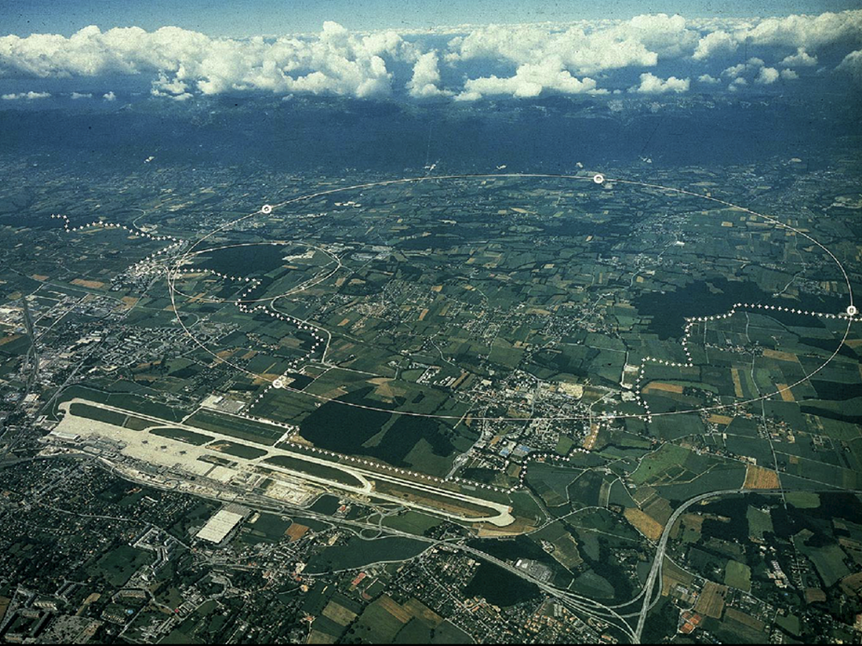
CERN and LHC in Geneva
27km Circumference
7+7=14 TeV

Slide 34
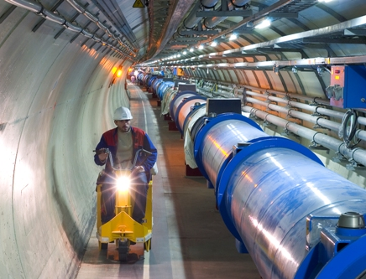
LHC Tunnel with Magnets

Slide 35
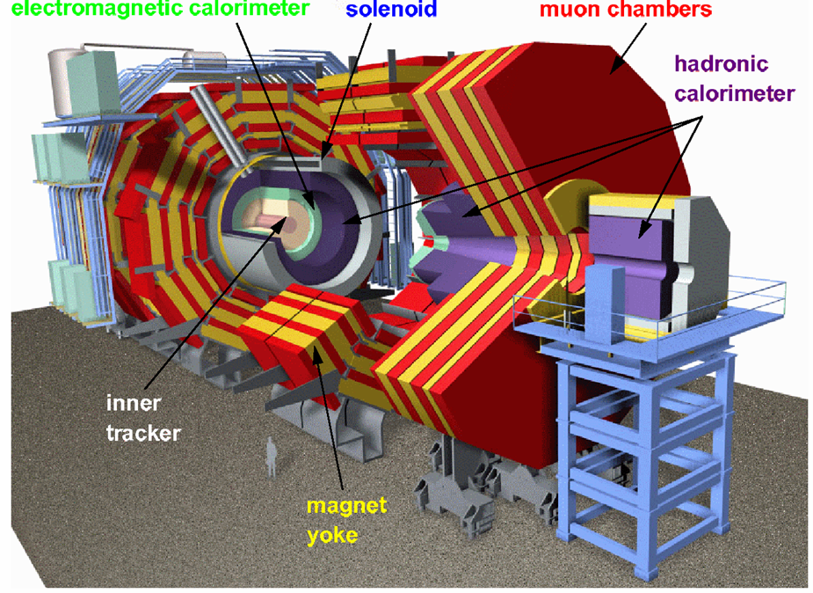
CMS

Slide 36
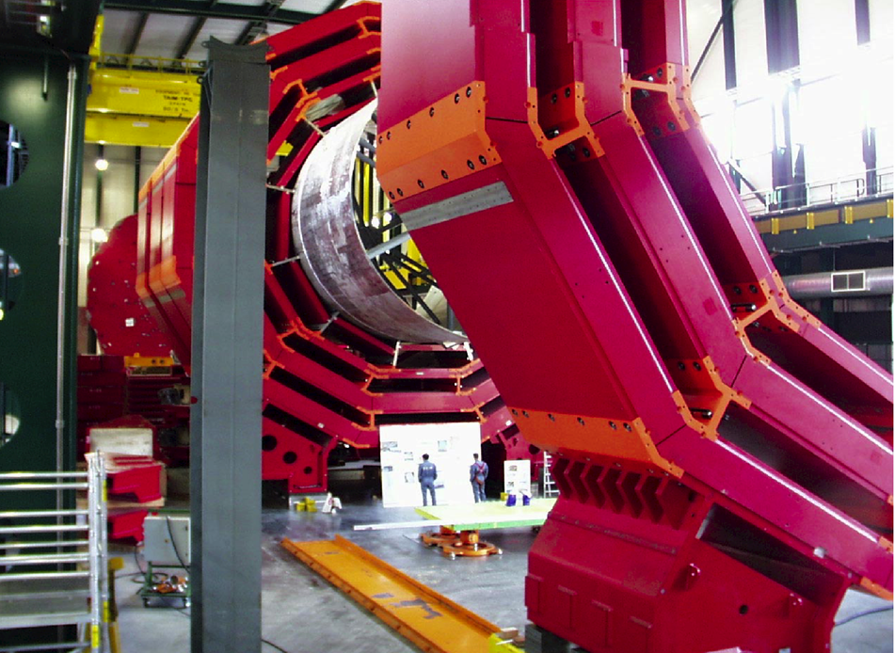
CMS Barrel Yoke

Slide 37
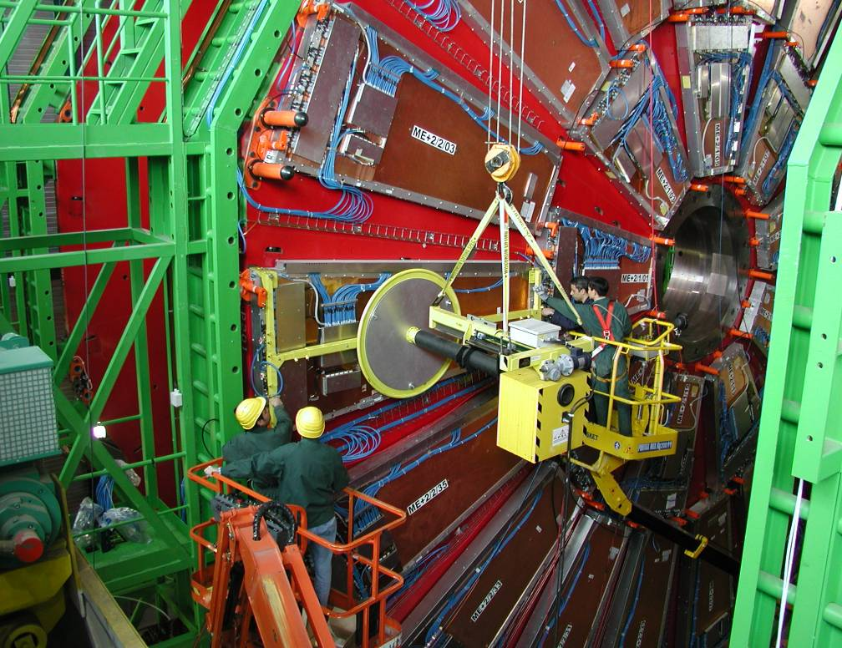
Installing muon Detectors

Slide 38
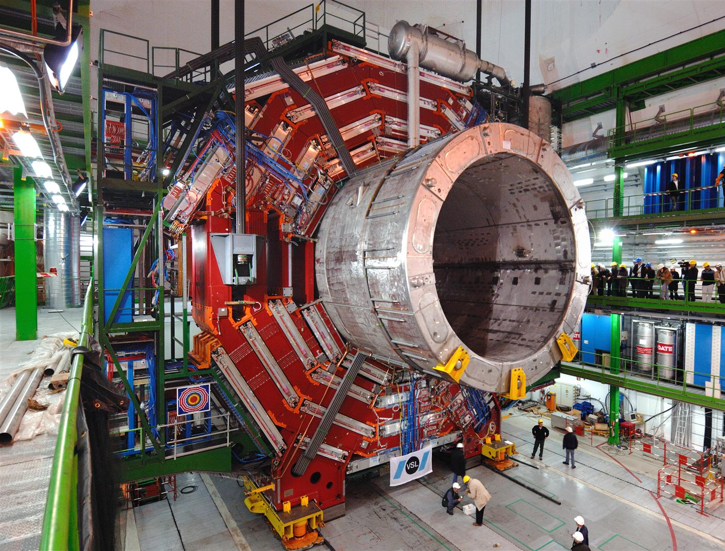

Slide 39
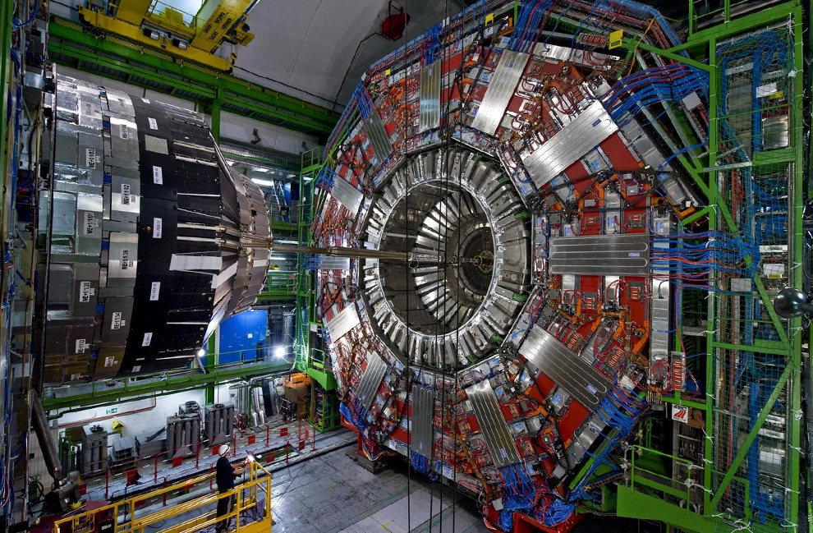

Slide 40
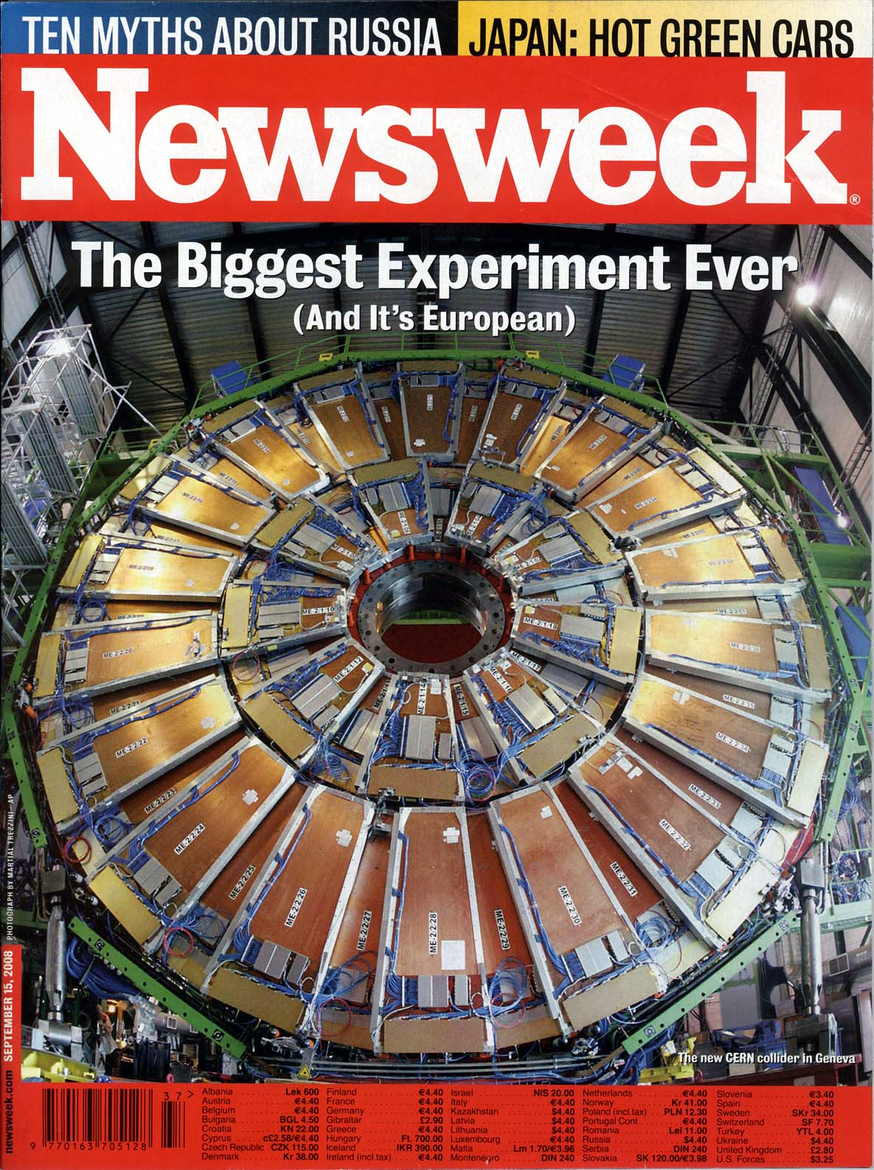
Particle detectors
constructed
at Westwood,
now at LHC, CERN
Sept 15, 2008 Issue

Slide 41
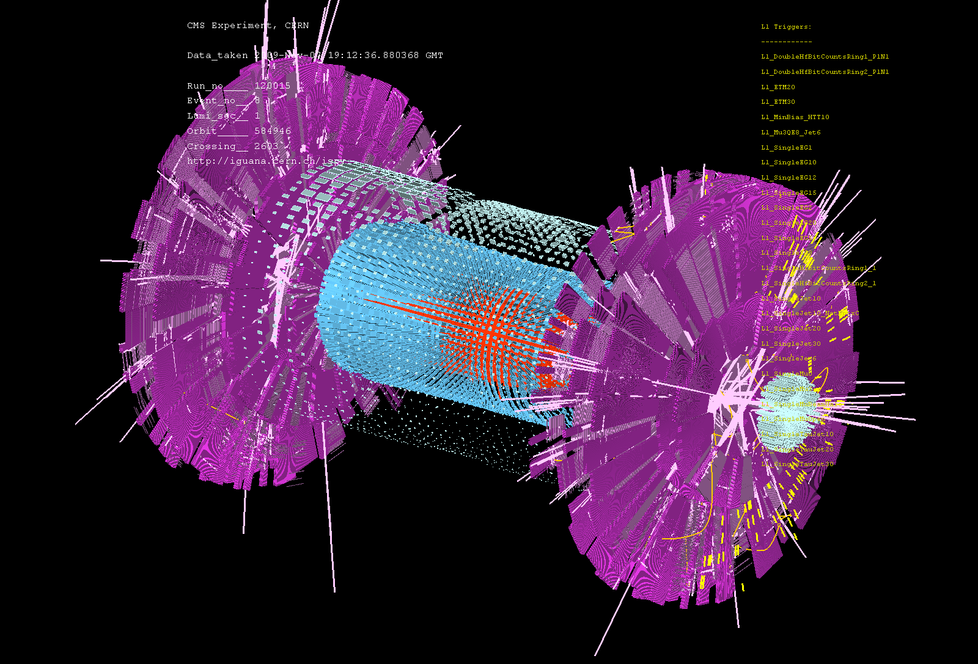
First Event at LHC – Recreation of the Big Bang! (Nov 7, 2009)

Slide 42
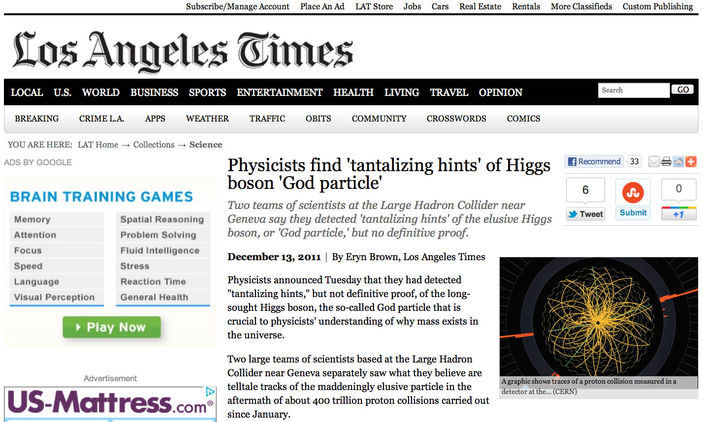

Slide 43
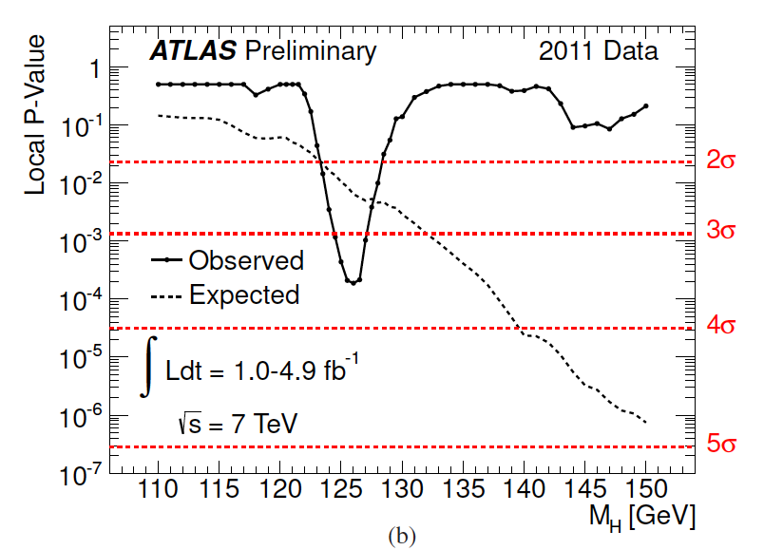
ATLAS Higgs Results

Slide 44
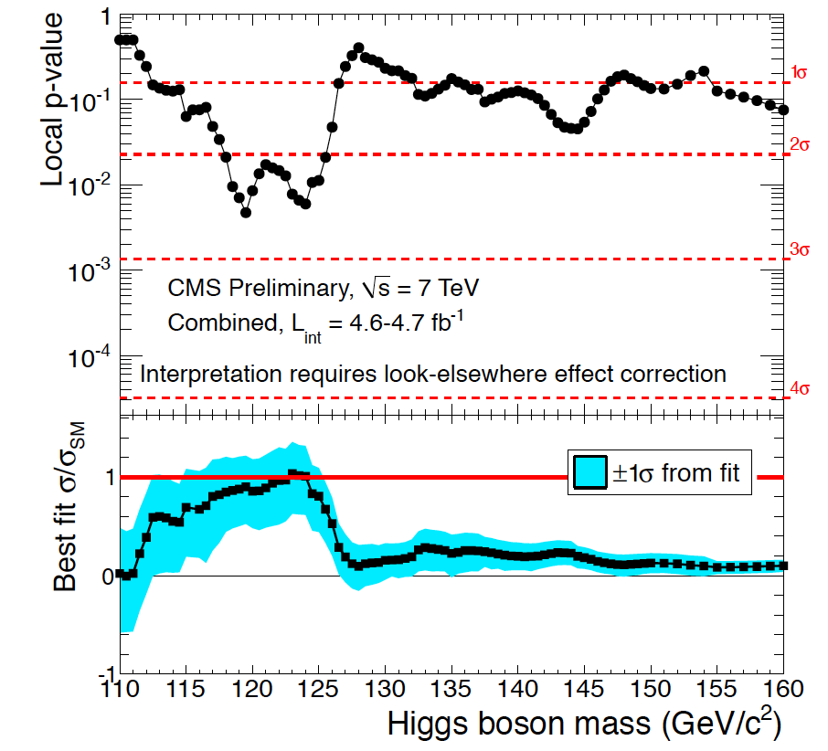
CMS Higgs Results

Slide 45
Dark Matter and Dark Energy

Slide 46
“Fossils” from the Earliest Universe
Time
(sec)
Temp.
(ºK)
Energy (GeV)
10⁻⁴⁵sec
The Big Bang!
Planck
10⁻⁴⁰
10³⁰
10¹⁸
GUT
Gravitational Wave
10⁻³⁵
10¹⁵
GUT Particle
10⁻³⁰
10²⁵
10¹²
10⁻²⁵
10⁹
10⁻²⁰
10²⁰
Decoupling of “Fossils”
1PeV
10⁻¹⁵
10¹⁵
1TeV
EW
Neutralino
(Cold Dark Matter)
10⁻¹⁰
10⁻⁵
1GeV
1
10¹⁰
1MeV
Relic Neutrino
(Hot Dark Matter)
10⁵ sec
1KeV
1 year
10⁵
CMB
10³
1eV
10⁶
10⁹ year
10⁻³eV
Now
1

Slide 47
Cosmic Microwave Background (CMB)
Matter-Radiation Decoupling
Time
(sec)
Temp.
(ºK)
Energy (GeV)
10⁻⁴⁵sec
Planck
10⁻⁴⁰
10³⁰
10¹⁸
GUT
10⁻³⁵
10¹⁵
10⁻³⁰
10²⁵
10¹²
10⁻²⁵
10⁹
10⁻²⁰
10²⁰
1PeV
10⁻¹⁵
Time = 300,000 years
10¹⁵
1TeV
EW
10⁻¹⁰
Temperature = 3,000 ºK
10⁻⁵
1GeV
Energy = 0.3 eV
1
10¹⁰
1MeV
Z = 1,100
10⁵ sec
1KeV
1 year
10⁵
10³
Matter-Radiation
Decoupling ⇒ CMB
1eV
10⁶
10⁹ year
10⁻³eV
Now
1

Slide 48
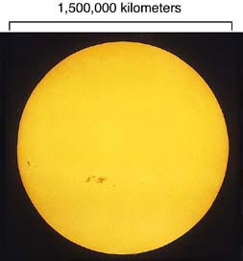

Slide 49
Cosmic Microwave Background
(Discovered in 1964)
T=300,000 years
after the Big Bang
Temperature
=3,000ºK
z=1,100
Sun/Earth
Transparent
Today:
3000ºK/1,100
=2.7ºK
Opaque

Slide 50
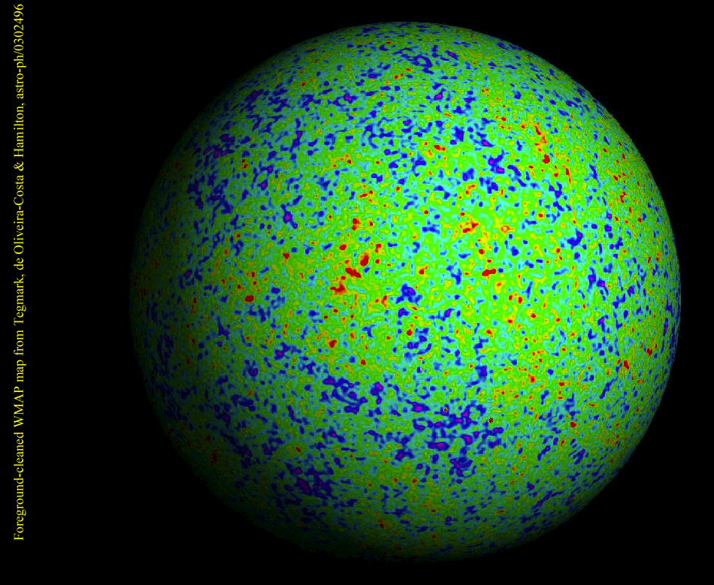
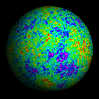
WMAP
Ned Wright

Slide 51
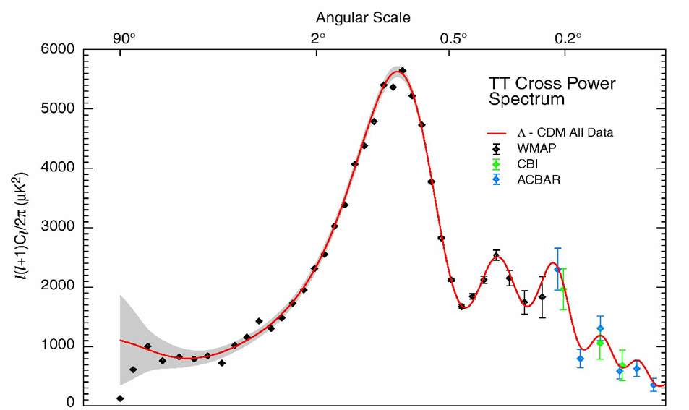

WMAP Power Spectrum
Universe is Flat.
  ⇒ Inflation

Slide 52
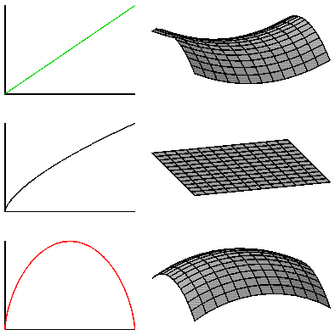
Geometry of the Universe
Open Ω<1
Flat Ω=1
(predicted by
Inflation)
Closed Ω>1

Slide 53
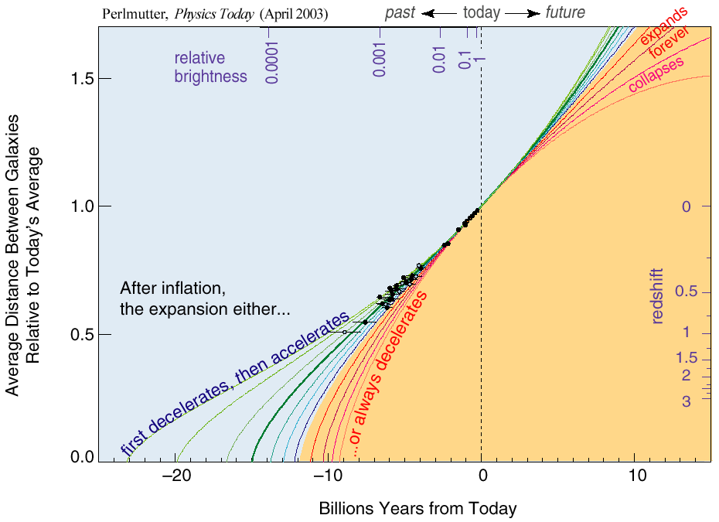
The Accelerating Universe （1998）
Ω_{Λ}= 0.7

Slide 54
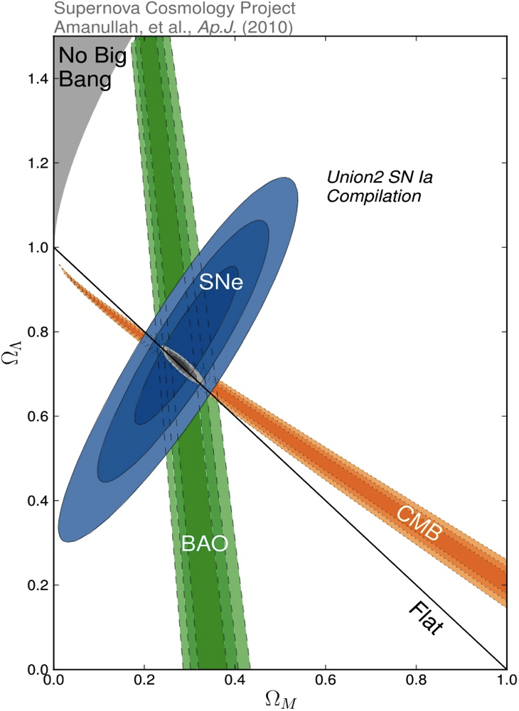
Density of Our Universe
Ω_{Total}=Ω_{Λ}+Ω_{Matter} =1.0
Universe is Flat.
  ⇒ Inflation
73% is Dark Energy.
  ⇒ Accelerating
Ω_{Λ}
  Ω_{M}= 27%
Ω_{Matter}

Slide 55
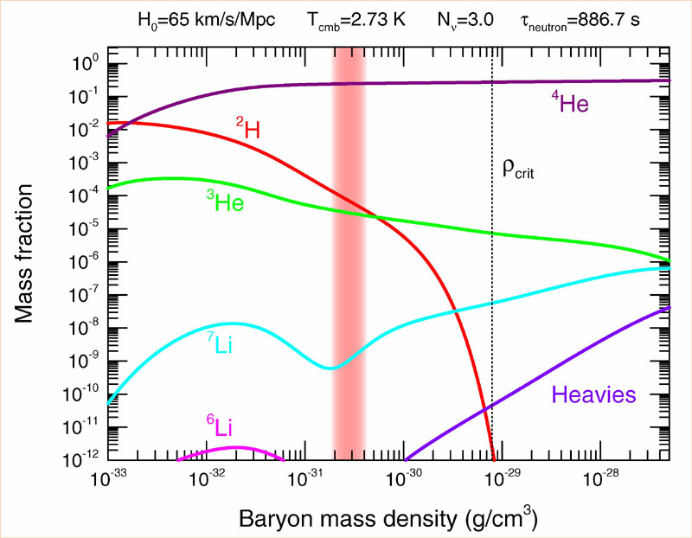
Abundance vs. Density
D
  Ω_{Baryon}= 4.6%

Slide 56
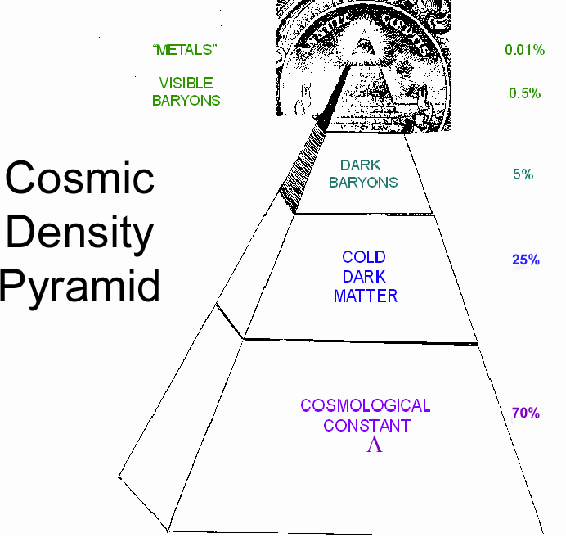
Cosmic Pyramid
Metal
0.01%
Star
0.4%
Baryonic Matter
0.5%
Gas,
Dust
4.2%
Dark
Matter
23%
Dark Energy
73%

Slide 57
Part II
Search for Dark Matter

Slide 58
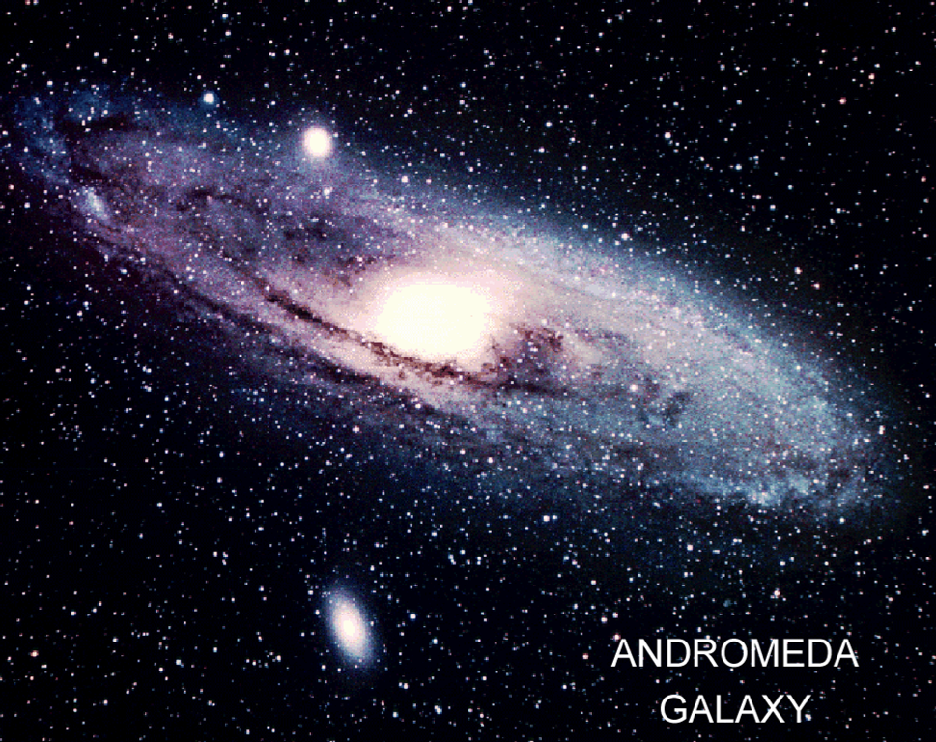
Dark Matter is required!

Slide 59
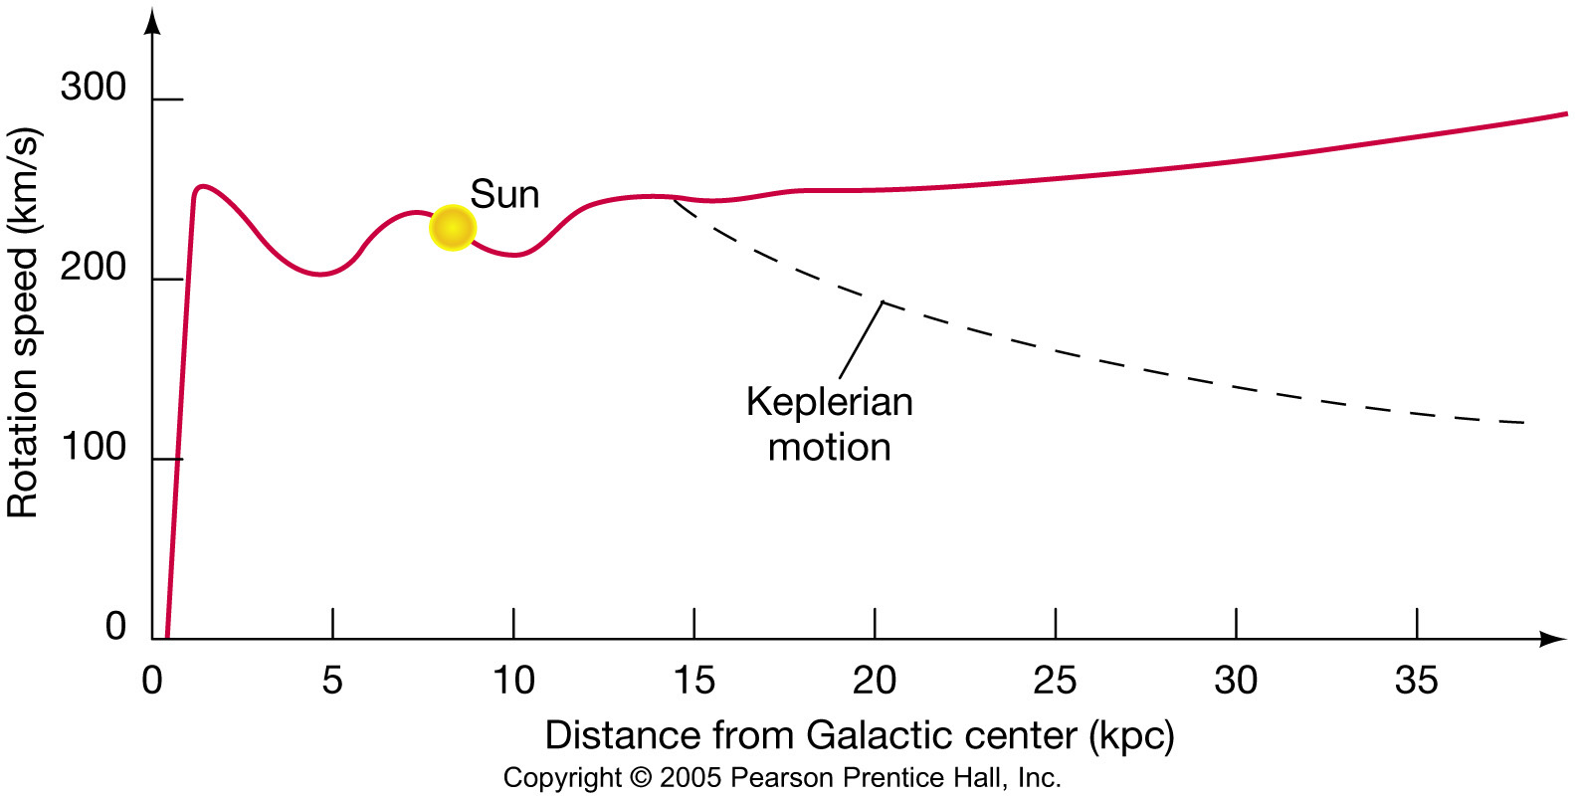
Rotational Velocity of Galaxies
With uniformly distributed Dark Matter
Sun
Without Dark Matter

Slide 60
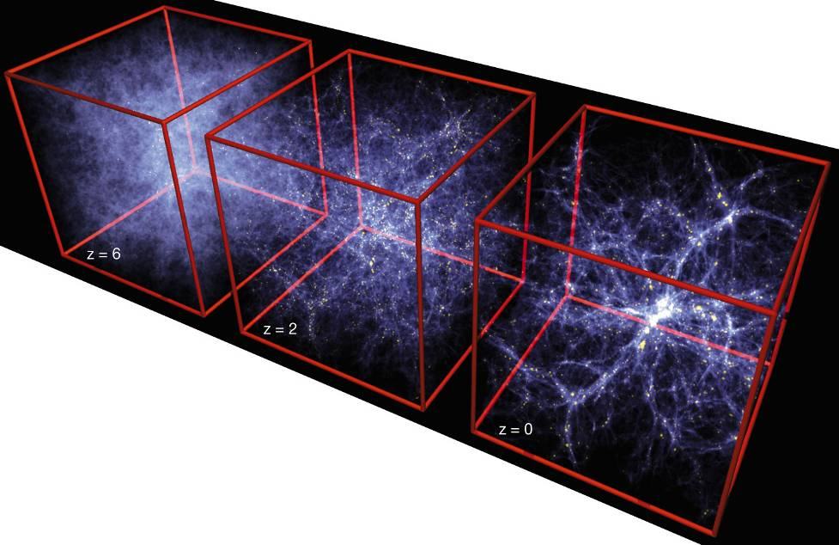
Formation of Structure in the Universe
Dark Matter is required!

Slide 61
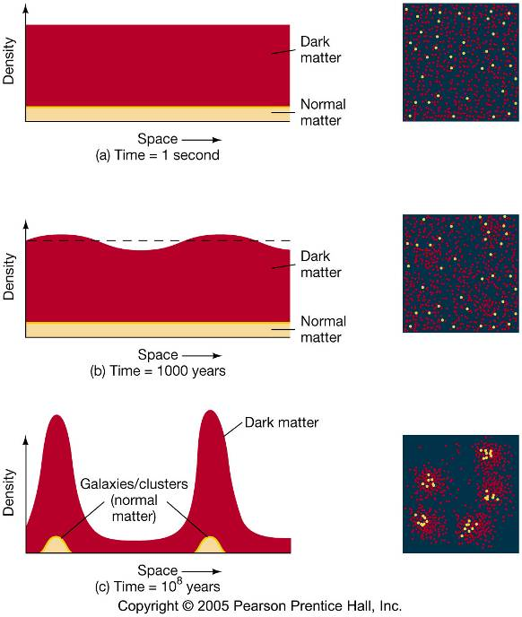
Evolution of Large Structure

Slide 62
The Five Largest Mysteries in Nature
Time
Origin of Universe
0
Big Bang!
1B years
First Galaxy formed
Origin of Particles
2
3
Dark Matter
Origin of Structure
4
5
6
7
8
9
Solar System formed
10
First life on the Earth
Origin of Life
11
Eukaryotic Cell
12
13
Plants, Fish…
14
Homo sapiens
Human Brain
We were born.

Slide 63
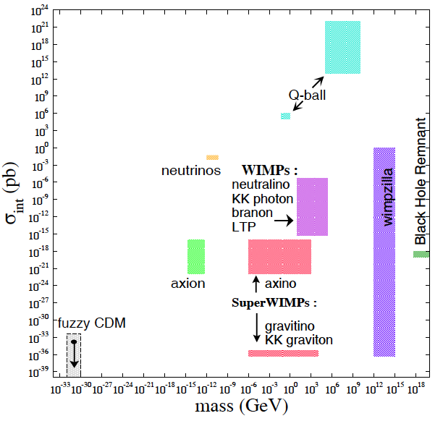
What is Dark Matter?

Slide 64
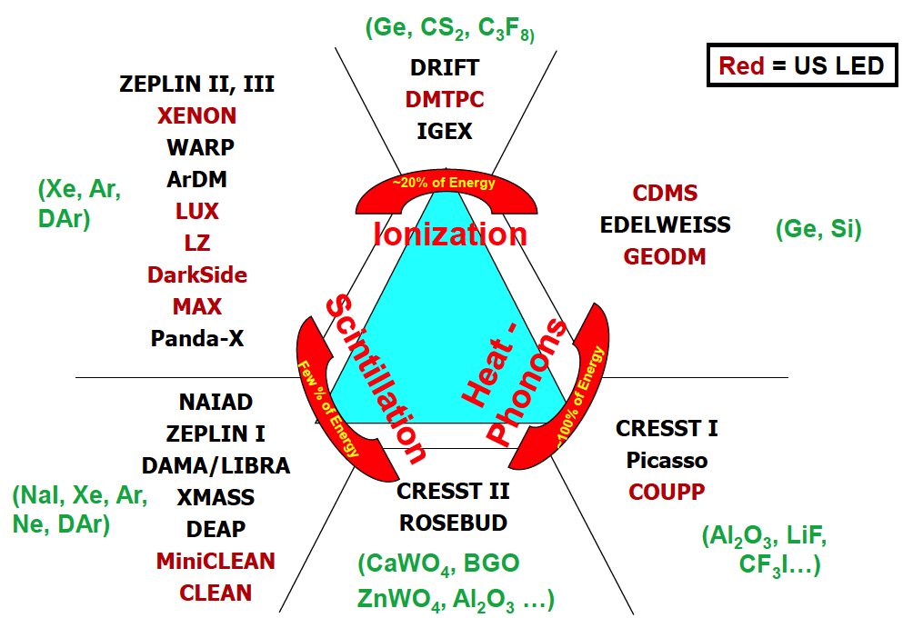
Detection Technique
Double
Phase
Gamma Ray
(Ge, Si)
Single
Phase
Neutron
WIMP

Slide 65
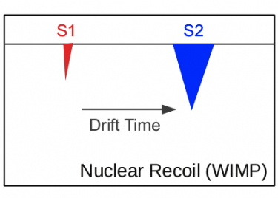
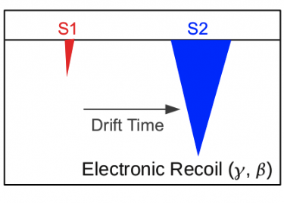
Double-Phase Noble Liquids

Slide 66
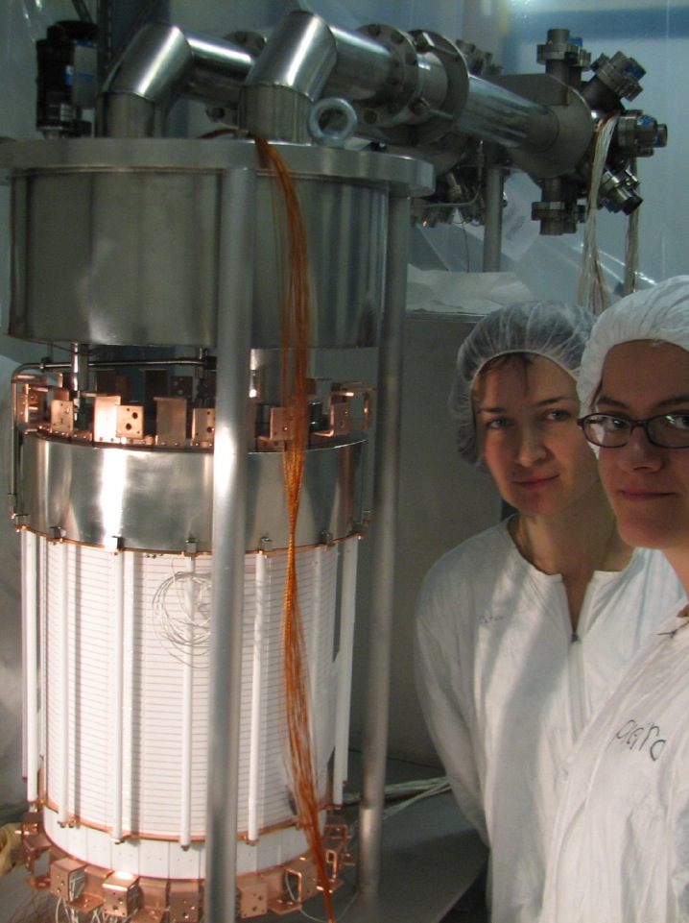
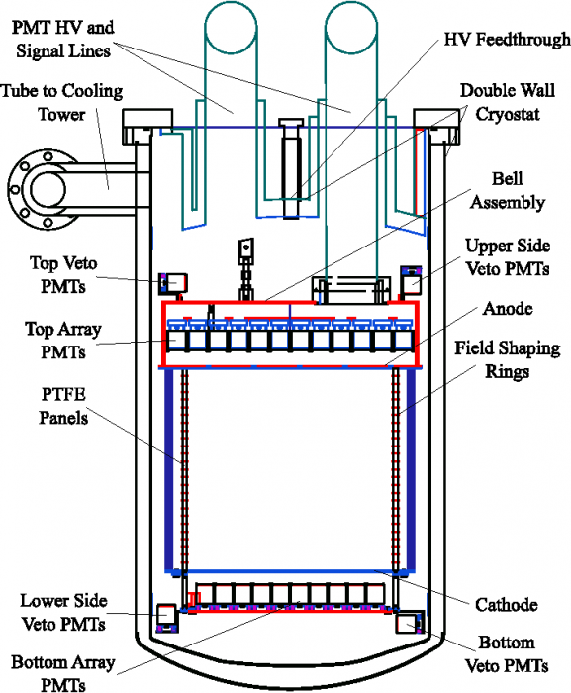
XENON100 Detector
161 kg
(48 kg)

Slide 67
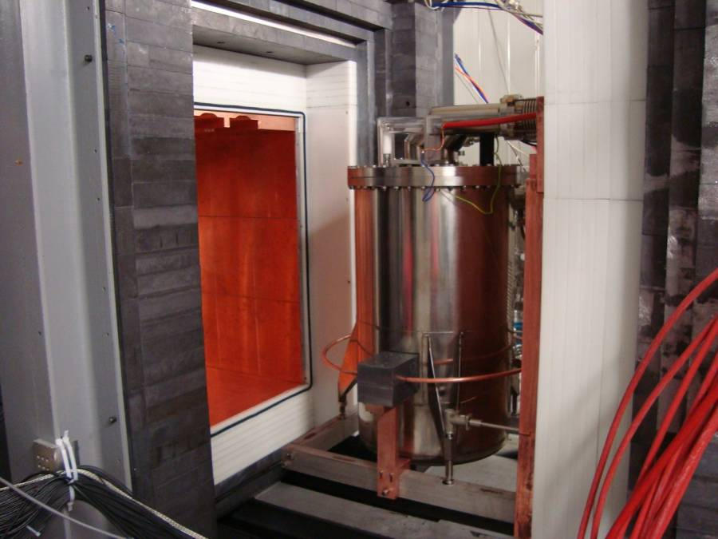
Pb
(20cm)
Poly
(20cm)
Cu
(5cm)
Pb
(20cm)
Poly
(20cm)
Cu
(5cm)

Slide 68
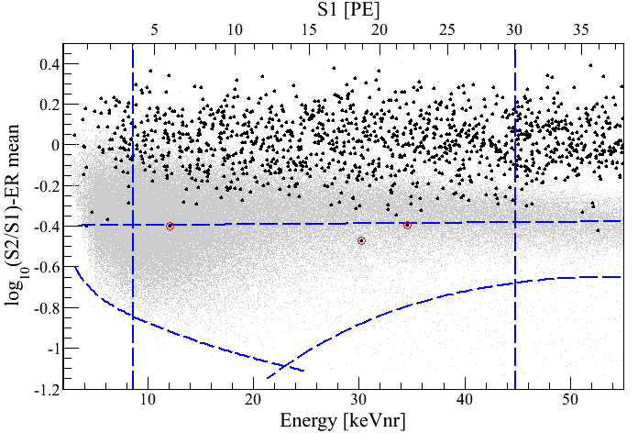
Log(S2/S1) vs. Energy
100.9 days, 48 kg
arXiv:1104.2549
S1 = 4 PE
γ backgrounds
S1 = 30 PE
99.75% rejection for γ
Neutron band
(Acceptance 30 – 40%)
3 events
(1.8 ± 0.6 expected)
-3 σ
8.4 keV_{nr}
44.6 keV_{nr}
S2 = 300 PE

Slide 69
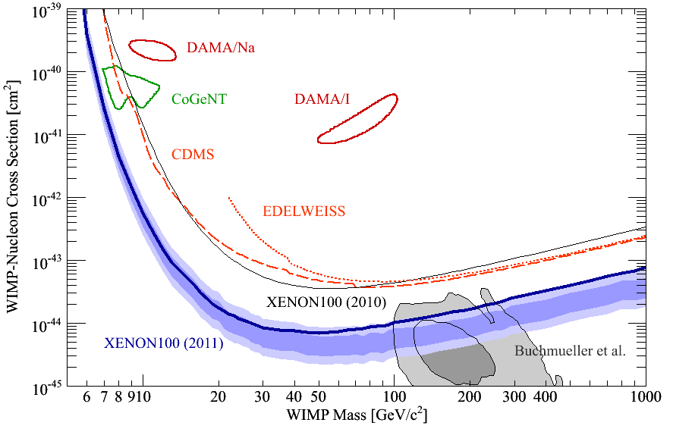
90% CL Limits of SI Cross Section (April, 2011)
arXiv:1104.2549
CMSSM

Slide 70
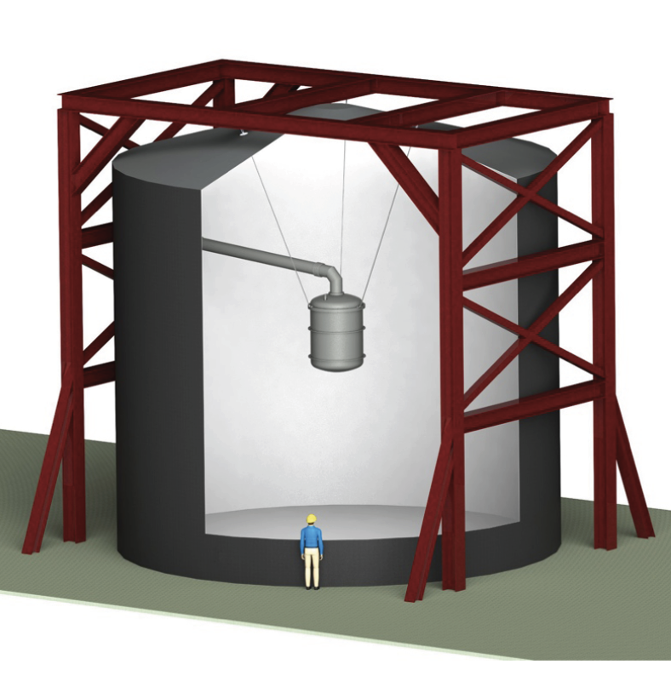
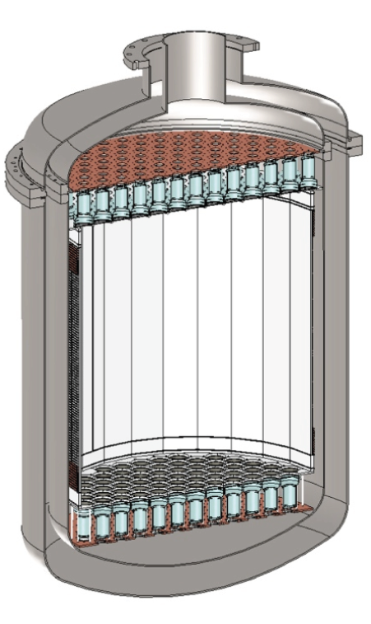
XENON1T (G2) at LNGS
1 m
Xe
(2.2 Ton)
Water Tank

Slide 71
G1
CMSSM
G2
G3
XENON1T

Slide 72
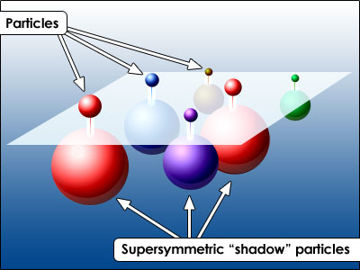
SUSY Neutralino

Slide 73

SUSY Particles and Neutralino
Spin 1/2 1 0

Slide 74
SUSY Particles and Neutralino
Super Symmetry
Neutralino
Spin 1/2 1 0 0 1/2 1/2

Slide 75



Hierarchy Problem
Higgs mass
SM :
SUSY :
or : new physics at the energy scale of Λ ~ 1 TeV

Slide 76

John Ellis

Slide 77

Mass Spectra at the best fit points (before LHC)
CMSSM
NUHM1
Buchmueller et al arXiv: 0808.4218

Slide 78

SI Cross Section vs. Mass
CMSSM
CMSSM
LHC
Pre
2011
2012
2015
G1
XENON100
2011
2012
G2
XENON1T
2017
G3
Buchmueller et al arXiv:1106.2529

Slide 79

KK particles in Extra Dimensions

Slide 80
Photon
Extra
Dimensions
KK Photon
Bulk
Our 3D Space
(= Brane)

Slide 81
Origin of Mass in Extra Dimensions
E = mc² → m = E/c²
Mass can be generated as kinetic energy in extra dimensions.
    Origin on mass
    Dark matter is running in the extra dimensions
Gravity can escape into the extra dimensions.
    Why gravity is so small
    Origin of dark energy

Slide 82


Mass Spectrum of the first KK level
Similar to the SUSY mass spectrum
Δ = (m_{l} – m_{γ})/m_{γ}
KK Photon
KK Photon
Cheng 2002 arXiv:hep-ph/0205314v1

Slide 83

Predicted Cross Section of Kaluza-Klein Dark Matter
0
G1
XENON100
Δ
2011
2012
0.5
G2
XENON1T
Feng Ann. Rev. Astro. Astrophys. 2010.48:495-545

Slide 84

Sensitivity to KK particles
WMAP
0.5
LHC
0.1
0.05
XENON1T
XENON100
Δ = (m_{l} – m_{γ})/m_{γ}
0.01
My favorite
Arrenberg 2008

Slide 85
Summary on “Science Cases”
XENON program (~$10M) is extremely timely and competitive to LHC (~$10B)
  XENON100 ~ Current LHC
  XENON1T ~ Future LHC
If new physics at 100 – 1000 GeV (as it should be), LHC and/or XENON1T will discover WIMPs.
  SUSY - Neutralino
  Extra Dimensions – KK photon
By combining LHC and XENON1T, we have a better chance to untangle large parameter spaces.

Slide 86
G2 & G3 Detectors

Slide 87
G2 and G3 facilities defined by PASAG (2009)
 | G1 | G2 | G3
Sensitivity | < 10⁻⁴⁴ cm² | < 10⁻⁴⁶ cm² | < 10⁻⁴⁷ cm²
Target Mass | 10 – 100 kg | ~ 1 Ton | ~ 10 Ton
Cost | $1M – 5M | $10 – 20M | ~ $100M

Slide 88
Comparison of Xenon Detector Size
G3
MAX, LZD
20 ton (10 ton)
G2
XENON 1ton
2.5 ton (1 ton)
G1
2 m
XENON100
161 kg
(48 kg)
ZEPLIN-II
31 kg
(7.2 kg)
XENON10
14 kg
(5.4 kg)
1 m
1 m
15cm
30cm
14cm
30 cm
20 cm
30 cm
1 m
2 m
2007
2007
2010
2015
2020

Slide 89
XENON1T (G2) at LNGS
1 m
Xe
(2.2 Ton)
Water Tank

Slide 90

XENON1T – US Responsibility
~$5M
~$3M

Slide 91


DarkSide 50 (G1) at LNGS
CTF Water Tank
Liquid
Scintillator
30 cm
Depleted Ar
(50 kg)

Slide 92

DarkSide 5T (G2) at LNGS
CTF Water Tank
Liquid
Scintillator
2 m
⁴⁰Ar
7 ton
(5 ton)

Slide 93

1-σ Error of WIMP Mass vs SI Cross Section
(1 ton*year Xe and 5 ton*year Ar)
Xenon
(56 events)
10⁻⁴⁵ cm²
Argon
(42 events)
G2
100 GeV

Slide 94
Where backgrounds come from?
External
Detector materials
Internal impurity
Cosmic Rays
Underground or
Under high mountains
Radio Activities
(U, Th, K…)
Detector
Water Tank
(Liquid Scintillator)

Slide 95



QUPID (QUartz Photon Intensifying Detector)
arXiv:1103.3689
Photo Cathode
(-6 kV)
Photo Cathode
(-6 kV)
Quartz
Al coating
APD (0 V)
APD (0 V)
Quartz

Slide 96

Comparison of Low-radioactive
Photon Detectors from Hamamatsu
R8520
1 inch
R8778
2 inch
QUPID
3 inch
DarkSide50
XENON1Ton
MAX, XAX
XENON10
XENON100
LUX
(XMASS)

Slide 97

Cryogenic System at UCLA (Hanguo Wang’s Lab)
Artin Teymourian

Slide 98

Full Liquid Xenon System
Control Panel
Recirculation Rack
Xenon Bottle
Recirculation Pump
Getter

Slide 99

Mechanical Samples on Base plate

Slide 100
Some Remarks
Xenon is optimum up to 1 Ton scale
  Largest discovery potential
  Background ~ 1 / ton-year
  Good sensitivity to low mass WIMP
At > 10 ton scale, Argon is more appealing
  No gamma ray backgrounds
  Mass determination up to 200 GeV
  Large annual modulation

Slide 101

MAX (G3) (at DUSEL)
⁴⁰Ar
20 ton
Xe
6 ton

Slide 102


MAX+LZD = “Ultimate G3” Detector (at DUSEL)
Xe 20 ton (10 ton)
⁴⁰Ar 70 ton (50 ton)
Xe
Ar
Liquid
Scinti
Liquid
Scinti
Water Tank
Water Tank
8 m
18 m

Slide 103
LHC
Pre
2011
2012
2015
G1
CMSSM
G2
G3

Slide 104
Conclusions
Science cases
  Stronger than ever - SUSY, Extra Dimensions…
  Competitive and complementary to LHC
  Extremely timely
Technical challenges
  Xe-G1 (100 kg) well demonstrated by XENON100
  New photon detector (QUPID) developed
  Radioactivity (³⁹Ar, ⁸⁵Kr, Rn) major challenges
Future directions
  G2 : XENON 1T and DarkSide 50 / 5T at Gran Sasso.
  G3 : MAX + LZD (Xe 10T + Ar 50T) at DUSEL

Slide 105
Katsushi’s Speculations
2012 LHC (ATLAS+CMS) announces
  124 GeV Higgs (at 5σ)
2016 XENON1T announces
  Observation of 10 WIMP signals (> 200 GeV)
2021 G3 (Xe+Ar) and LHC jointly confirm
  Extra Dimensions
  WIMP = 600 GeV KK Photon (Δ = 5%)
  No SUSY
  Katsushi happily retires at age 65.

