Slide 1
MAX
Multi-Ton Argon & Xenon
Katsushi Arisaka
University of California, Los Angeles
Department of Physics and Astronomy
arisaka@physics.ucla.edu

Slide 2






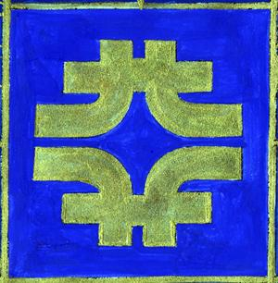












MAX - Multi-ton Argon & Xenon
MAX Collaboration = DarkSide + XENON
UMass Amherst, Arizona State University,
Augustana College, Black Hills State University,
Coimbra University, Columbia University, Fermilab,
University of Houston, INAF, LNG, MIT, University of Münster, University of Notre Dame, Princeton University, Rice University, Temple University, UCLA, University of Virginia,
University of Zürich

Slide 3
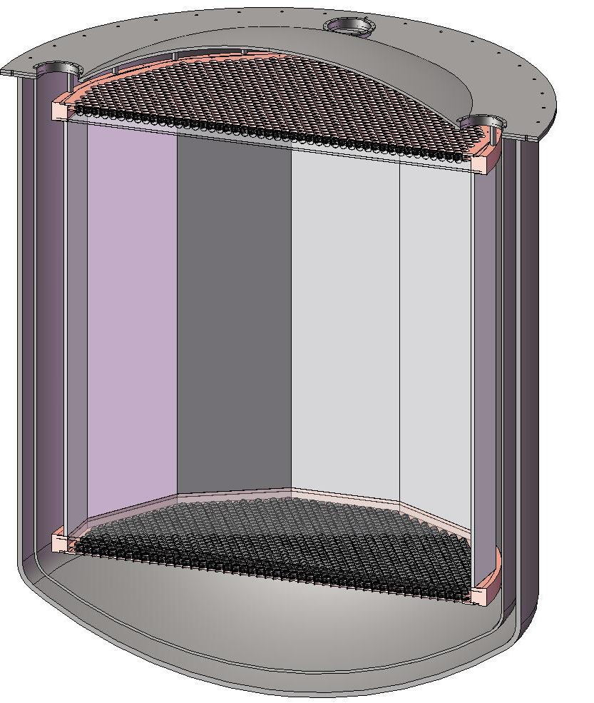
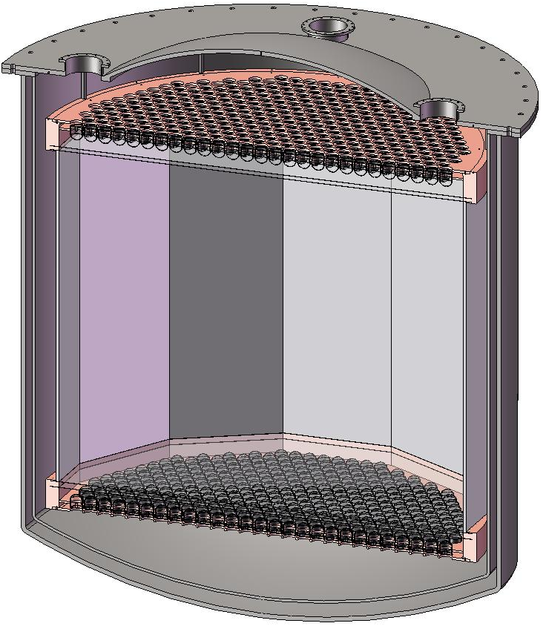
MAX G3 Detector (at DUSEL)
⁴⁰Ar
70 ton
(50 ton)
Xe
20 ton
(10 ton)
4m
2 m
Katsushi Arisaka, UCLA
3

Slide 4
Roadmap to MAX
2012
2013
2014
2015
2016
2017
2018
2019
2020
Gran Sasso
DUSEL
MAX
XENON100
XENON 1T
Xe 10T
(Paul Scovell)
(Elena Aprile)
Ar 50T
DarkSide50
DarkSide 5T
(Luca Grandi, Frank Calaprice)
G1
G2
G3
Katsushi Arisaka, UCLA
4

Slide 5
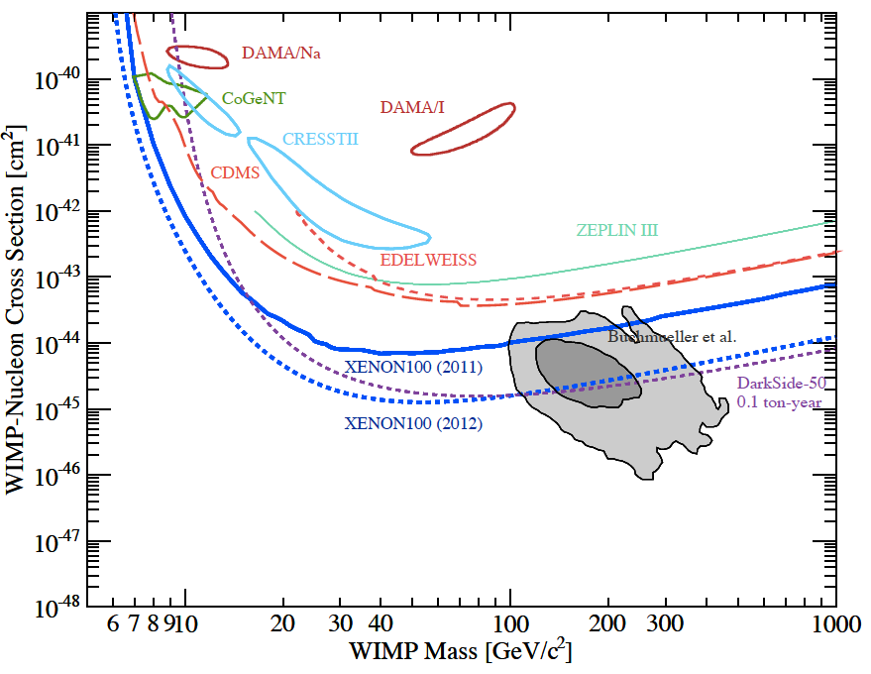
G1
CMSSM
F-SU(5)

Slide 6
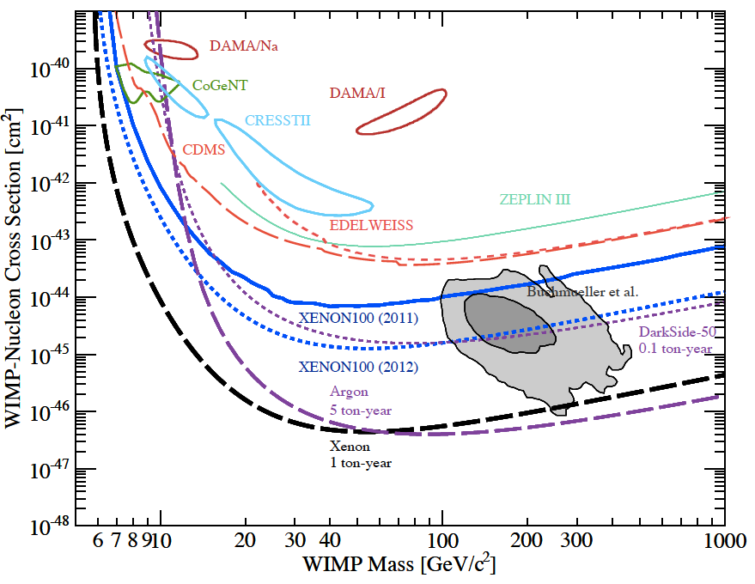
G1
CMSSM
G2
F-SU(5)

Slide 7
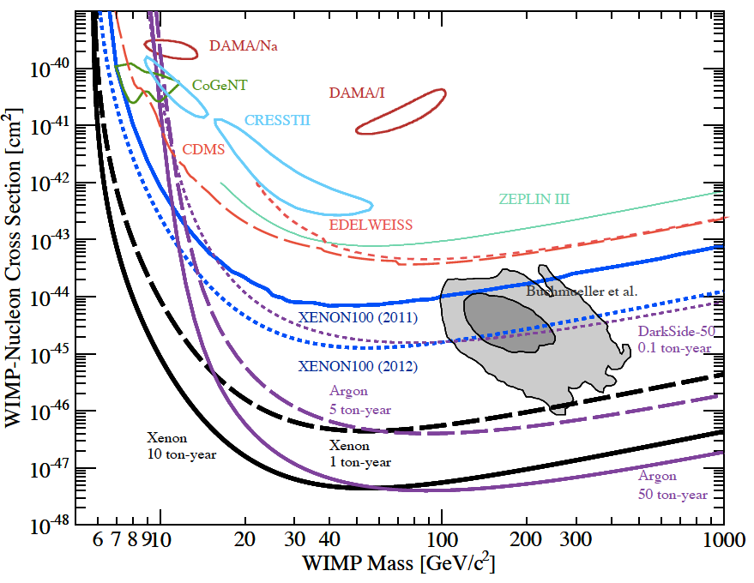
G1
CMSSM
G2
F-SU(5)
G3
Xenon
10 ton-year
Argon
50 ton-year

Slide 8
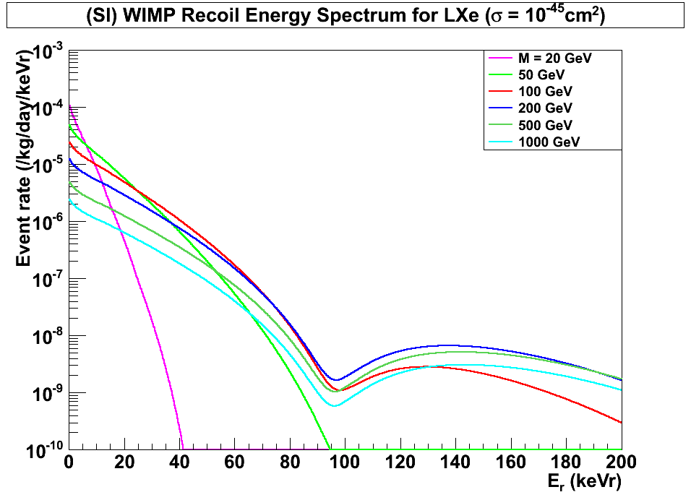
(SI) WIMP Energy Spectrum for LXe
(Cross Section = 10⁻⁴⁵cm²)
Xenon
8 keVr
45 keVr
200 GeV
100 GeV
500 GeV
1000 GeV
20 GeV
50 GeV
Katsushi Arisaka, UCLA
8

Slide 9
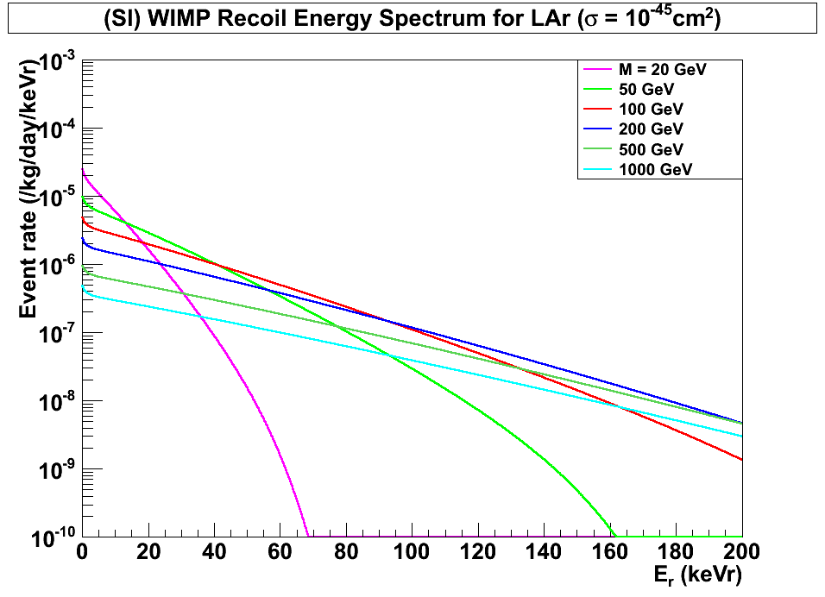
(SI) WIMP Energy Spectrum for LAr
(Cross Section = 10⁻⁴⁵cm²)
Argon
(w/ pulse shaping)
40 keVr
200 keVr
100 GeV
500 GeV
1000 GeV
200 GeV
20 GeV
50 GeV
Katsushi Arisaka, UCLA
9

Slide 10
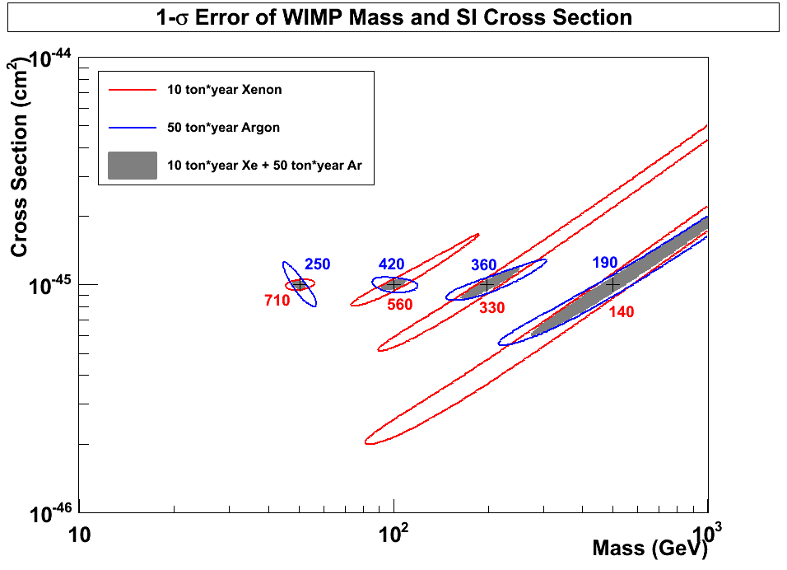
1-σ Error of WIMP Mass vs SI Cross Section
(10 ton*year Xe and 50 ton*year Ar)
50 GeV
100 GeV
200 GeV
500 GeV
Argon
10⁻⁴⁵ cm²
Xenon
Katsushi Arisaka, UCLA
10

Slide 11
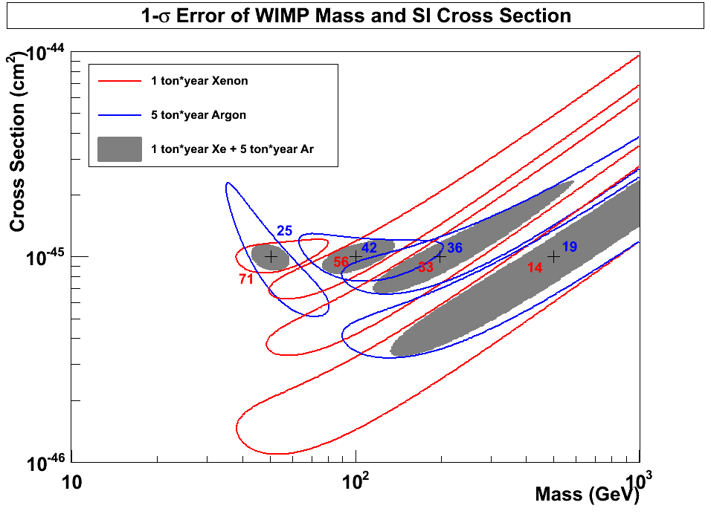
1-σ Error of WIMP Mass vs SI Cross Section
(10 ton*year Xe and 50 ton*year Ar)
10⁻⁴⁵
10
50
10
50
Argon
50 GeV
100 GeV
200 GeV
500 GeV
10⁻⁴⁶
10⁻⁴⁶ cm²
Xenon
10⁻⁴⁷
Katsushi Arisaka, UCLA
11

Slide 12
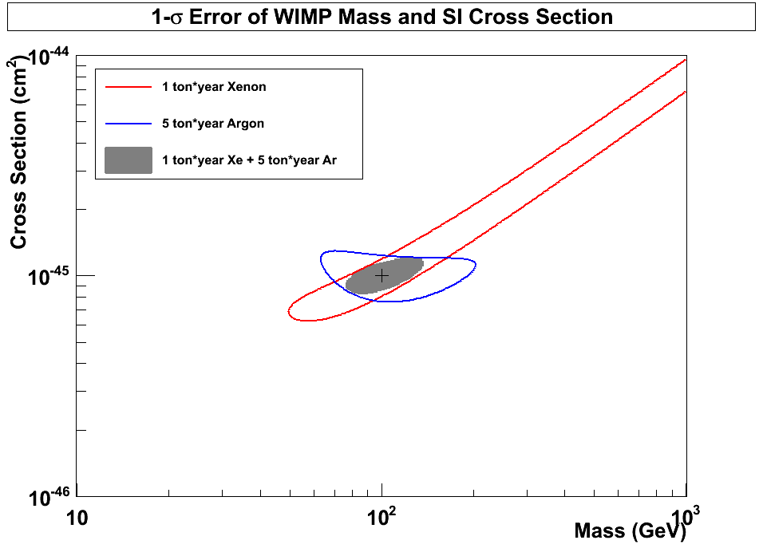
1-σ Error of WIMP Mass vs SI Cross Section
(10 ton*year Xe and 50 ton*year Ar)
10⁻⁴⁵
10
50
Xenon
(56 events)
10
50
10⁻⁴⁶
10⁻⁴⁶ cm²
Argon
(42 events)
100 GeV
10⁻⁴⁷
Katsushi Arisaka, UCLA
12

Slide 13
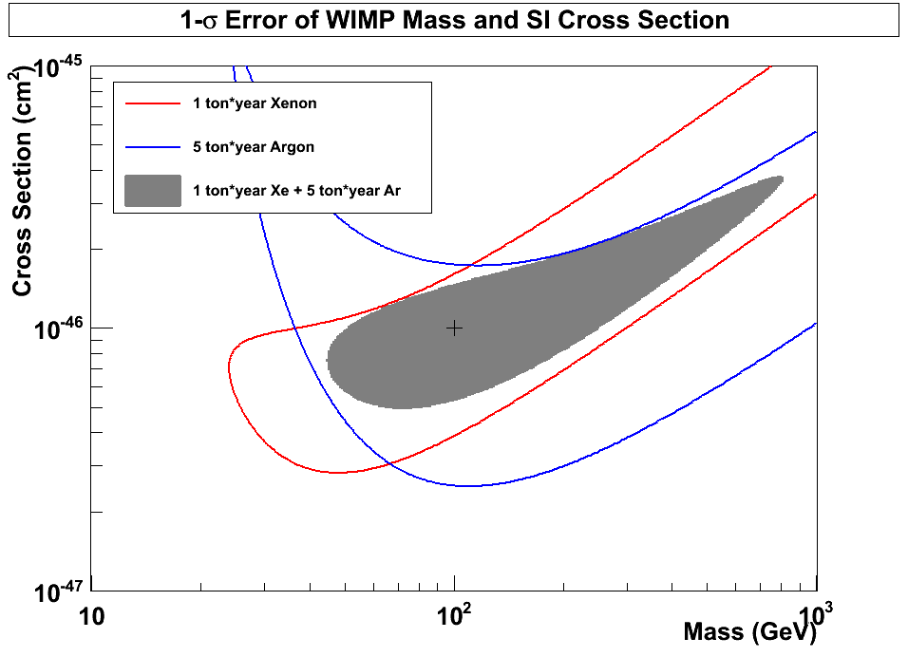
1-σ Error of WIMP Mass vs SI Cross Section
(10 ton*year Xe and 50 ton*year Ar)
10⁻⁴⁶
10
50
Xenon
(5.6 events)
10
50
10⁻⁴⁷
10⁻⁴⁷ cm²
Argon
(4.2 events)
100 GeV
10⁻⁴⁸
Katsushi Arisaka, UCLA
13

Slide 14
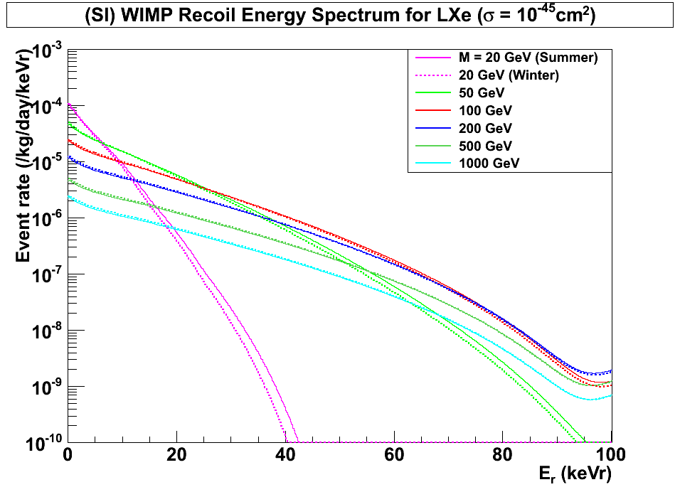
(SI) WIMP Energy Spectrum for LXe
(Cross Section = 10⁻⁴⁵cm²)
Xenon
8 keVr
45 keVr
200 GeV
100 GeV
500 GeV
1000 GeV
20 GeV
50 GeV
Summer
Winter
Katsushi Arisaka, UCLA
14

Slide 15
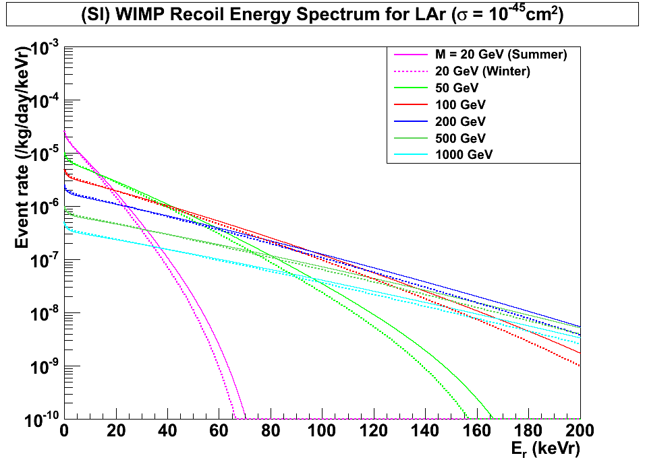
(SI) WIMP Energy Spectrum for LAr
(Cross Section = 10⁻⁴⁵cm²)
Argon
45 keVr
200 keVr
100 GeV
500 GeV
1000 GeV
200 GeV
20 GeV
50 GeV
Summer
Winter
Katsushi Arisaka, UCLA
15

Slide 16
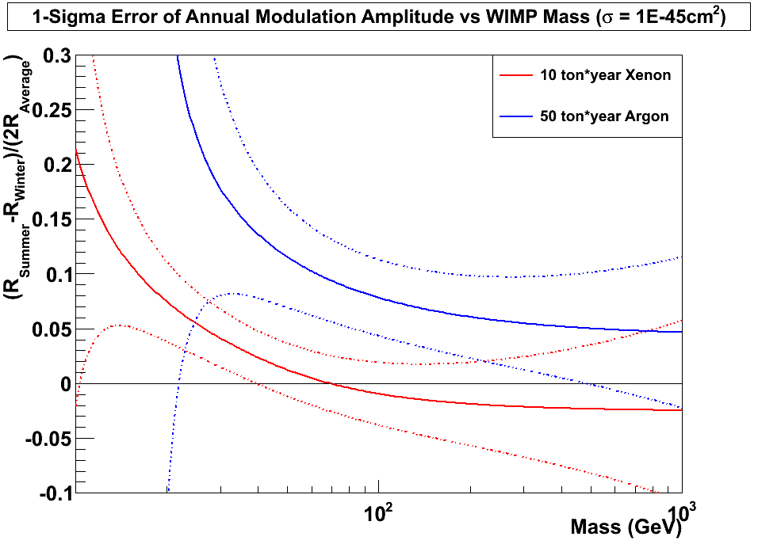
±1σ Error of Annual Modulation Amplitude vs WIMP Mass
(10 ton*year Xe and 50 ton*year Ar, Cross Section = 10⁻⁴⁵cm²)
10⁻⁴⁵ cm²
Argon
Xenon
±1σ
±1σ
10
Katsushi Arisaka, UCLA
16

Slide 17
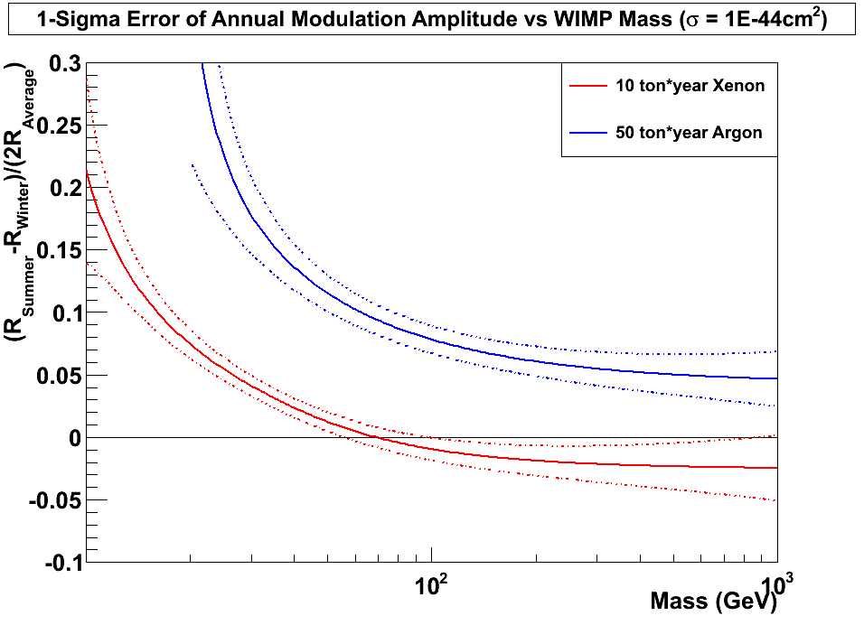
±1σ Error of Annual Modulation Amplitude vs WIMP Mass
(10 ton*year Xe and 50 ton*year Ar, Cross Section = 10⁻⁴⁴cm²)
10⁻⁴⁴ cm²
Argon
Xenon
10
Katsushi Arisaka, UCLA
17

Slide 18
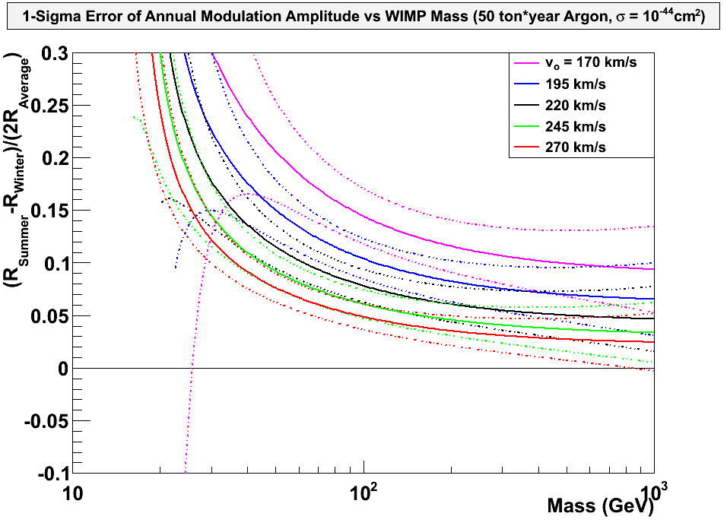
±1σ Error of Annual Modulation Amplitude for various WIMP velocities
(50 ton*year Ar, Cross Section = 10⁻⁴⁴cm²)
10⁻⁴⁴ cm²
Argon
V₀ =
170 km/s
195 km/s
220 km/s
245 km/s
270 km/s

Slide 19
Technological Challenges
External Backgrounds
  Deep underground – DUSEL 4850 ft
  > 5 m water shielding – Water Tank (15 m)
Detector Materials
  Photon Detectors – QUPID
  Cryostat – Titanium
  Others – Copper, PTFE…
Purity of Liquid Xe/Ar
  Radon (< 0.3 mBq / ton)
  ³⁹Ar (> 100 depletion) – Depleted Ar
  ⁸⁵K (< 0.2 ppt in Xe) – 1 event / 10 ton-year
Physics Backgrounds in Xe
  pp-chain solar neutrinos – 1 event / 10 ton-year
  2v Double beta decays from ¹³⁶Xe – 1 event / 10 ton-year
Neutron Active Veto
  Boron doped Liquid Scintillator
Katsushi Arisaka, UCLA
19

Slide 20
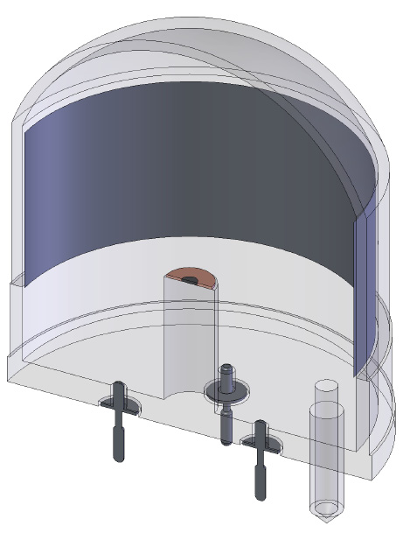
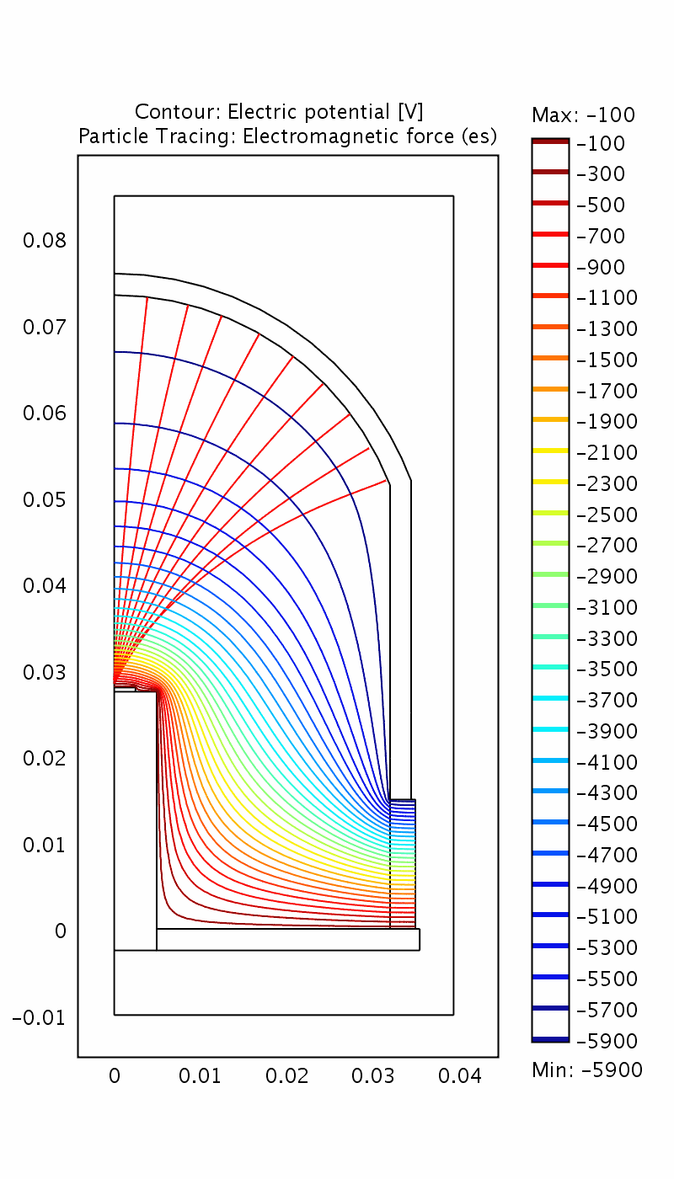
QUPID (QUartz Photon Intensifying Detector)
Photo Cathode
(-6 kV)
arXiv:1103.3689
Photo Cathode
(-6 kV)
Quartz
Al coating
APD (0 V)
APD (0 V)
Quartz
Katsushi Arisaka, UCLA
20

Slide 21
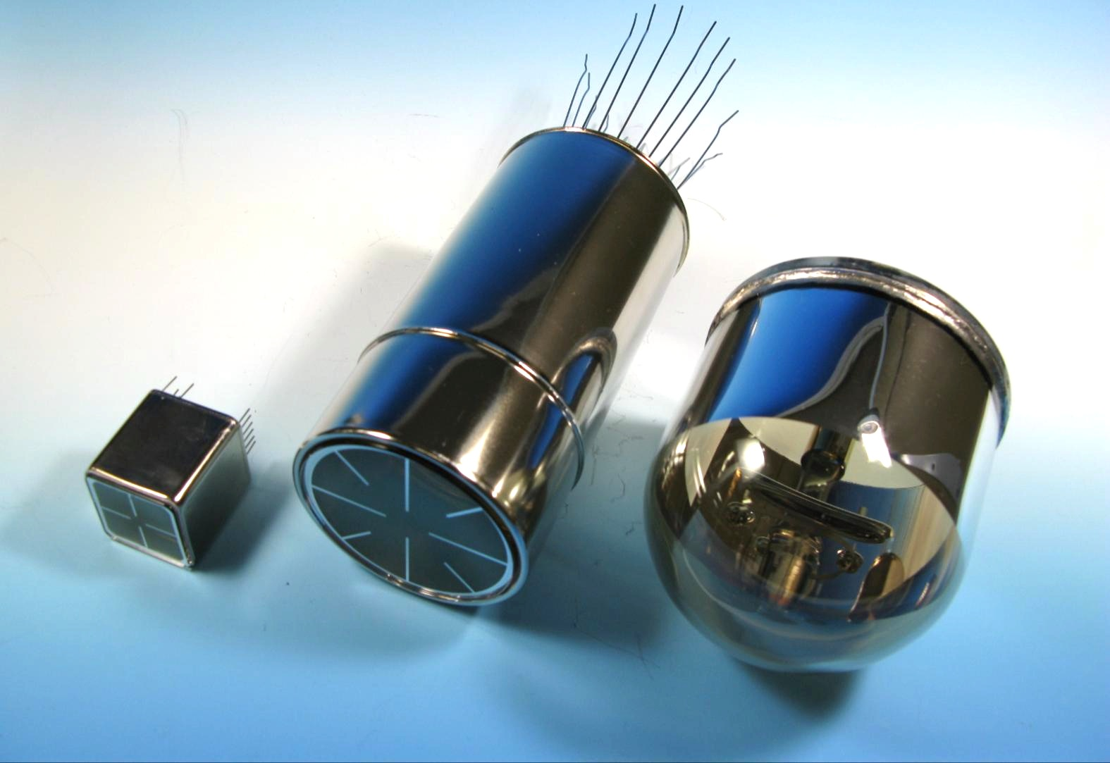
Comparison of Low-radioactive
Photon Detectors from Hamamatsu
R8520
1 inch
R8778
2 inch
QUPID
3 inch
~ 1 mBq
~ 10 mBq
< 0.3 mBq
DarkSide50
XENON1T
MAX, XAX
XENON10
XENON100
LUX
(XMASS)

Slide 22
QE of two types of QUPID
Xenon (178 nm)
Argon + TPB (420 nm)
Katsushi Arisaka, UCLA
22

Slide 23
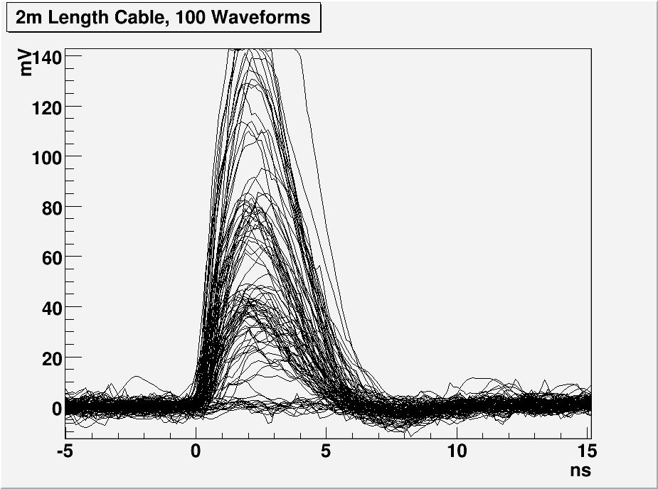
1, 2 and 3 PE Distribution with 2 m cable
G = 800 × 200
= 160,000
3 PE
TTS = 160 ps (FWHM)
2 PE
1 PE
Katsushi Arisaka, UCLA
23

Slide 24
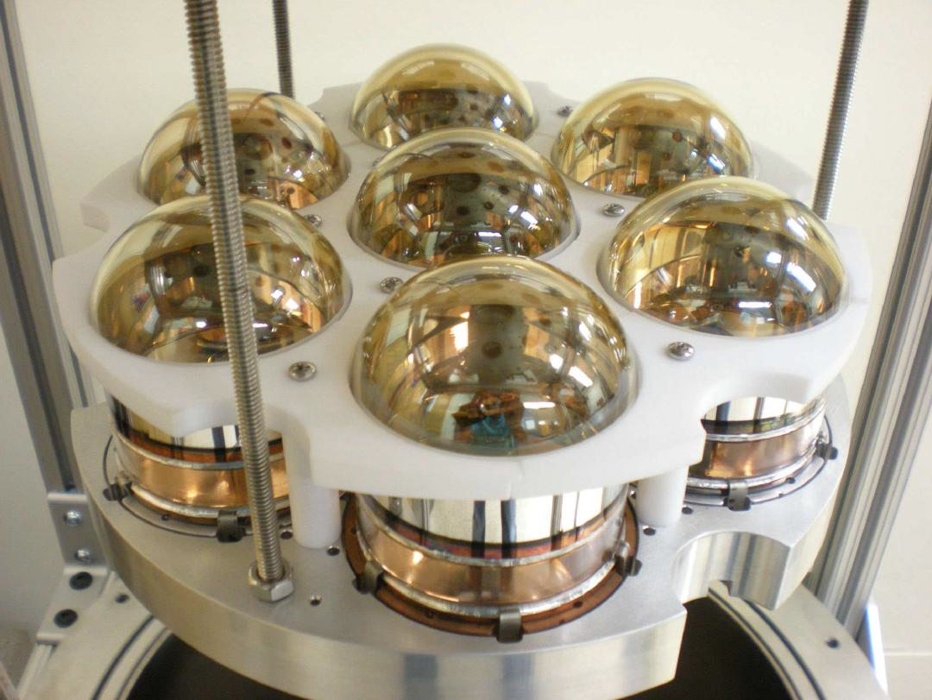
7 QUPID with Holder
Tested in both Xe and Ar at UCLA
Ready for DarkSide 10

Slide 25
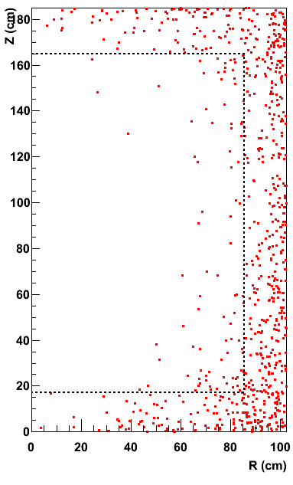
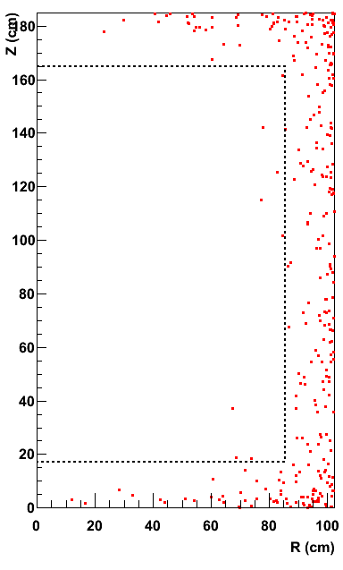
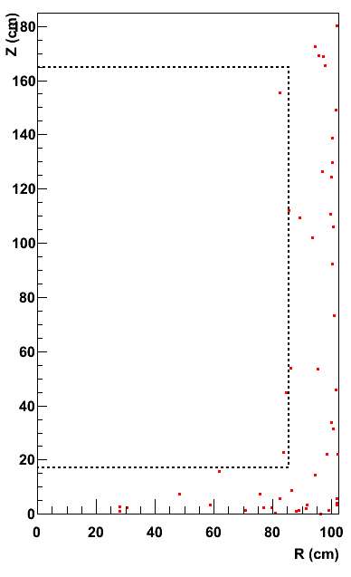
Xe 10 ton Neutron Background (100 Years)
arXiv:1107.1295
1/8
1/4
Before Cuts
Multi Hit Cut
Liquid Scinti. Veto
0.81 n / year
0.10 n / year
0.03 n / year
Xenon
10 ton
Katsushi Arisaka, UCLA
25

Slide 26
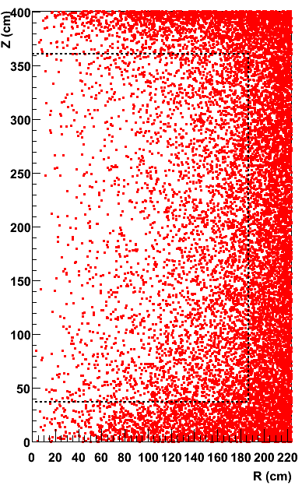
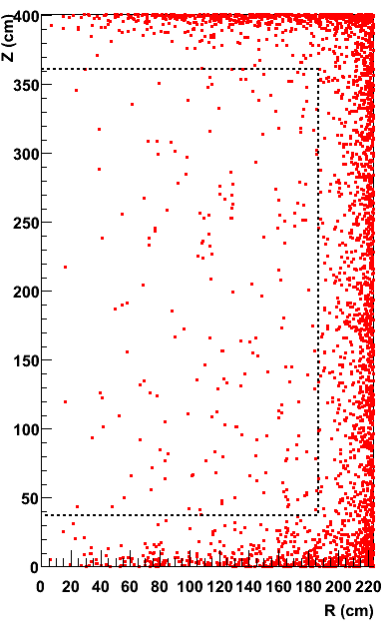
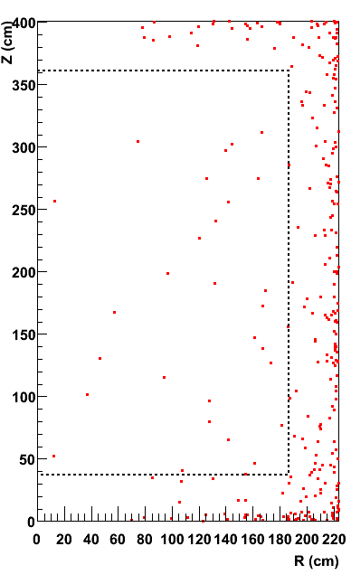
Ar 50 ton Neutron Background (100 Years)
arXiv:1107.1295
1/20
1/6
Before Cuts
Multi Hit Cut
Liquid Scinti. Veto
42 n / year
2.1 n / year
0.39 n / year
Argon
50 ton
Katsushi Arisaka, UCLA
26

Slide 27
XAX (Xenon-Argon-Xenon)
arXiv:0808.3968
WIMP (Spin even)
Double Beta Decay
WIMP (Spin odd)
pp Solar Neutrino
WIMP (Spin even)
⁴⁰Ar
70 ton
(50 ton)
^{129/131}Xe
12 ton
(6 ton)
¹³⁶Xe
7 ton
(4 ton)
1.2 m
2 m
4 m

Slide 28
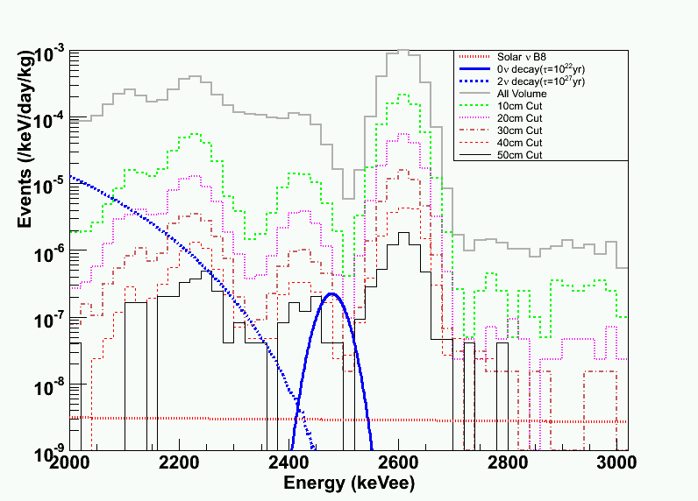
¹³⁶Xe Double Beta Decay and Gamma Background
(1 mBq / QUPID, 2m Xenon Detector)
0 cm
2ν DBD (2 x 10²¹ yrs)
(10²² yrs)
10 cm
20 cm
30 cm
40 cm
50 cm
0ν DBD (10²⁷ yrs)
B8 Solar Neutrino

Slide 29
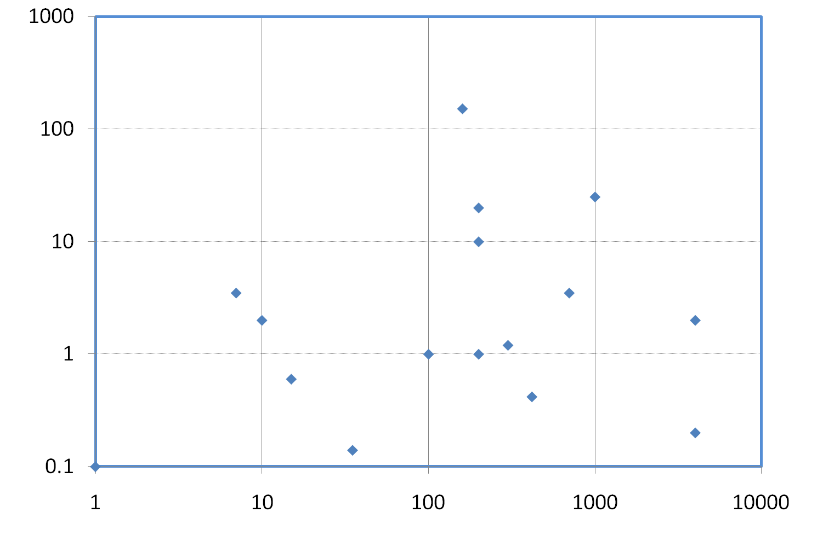
Double Beta Decay Experiments
(with 0.1 mBq QUPID)
EXO200
CANDLES III
EXO 1Ton
No. of Backgrounds (/year)
10²⁵ yrs
10²⁶ yrs
10²⁷ yrs
10²⁸ yrs
CUORE I
NEMO3 (Mo)
XENON1T
CUORE III
Cuoricino
XAX (Natural)
Super-NEMO (Se)
GERDA I
GERDA III
XAX (Enriched)
CUORE II
COBRA
EXO 1Ton
(Ba tag)
NEMO3
(Se)
GERDA II
Mass (kg)

Slide 30
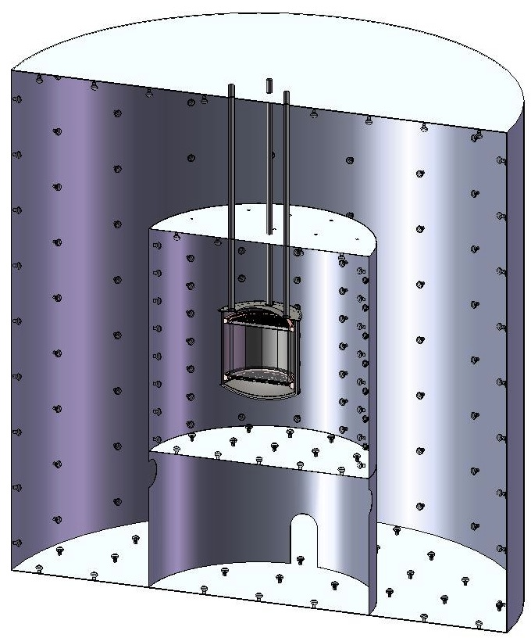
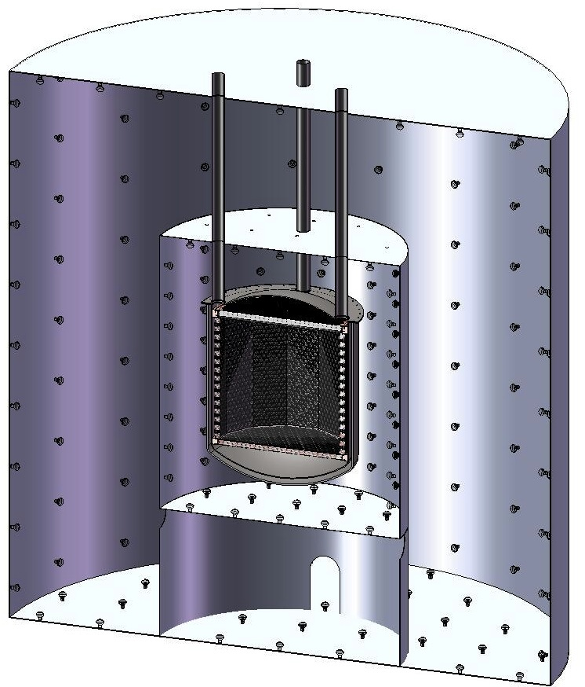
MAX G3 Detector (at DUSEL)
Xe 20 ton (10 ton)
⁴⁰Ar 70 ton (50 ton)
Xe
Ar
Liquid
Scinti
Liquid
Scinti
Water Tank
Water Tank
6 m
15 m

Slide 31
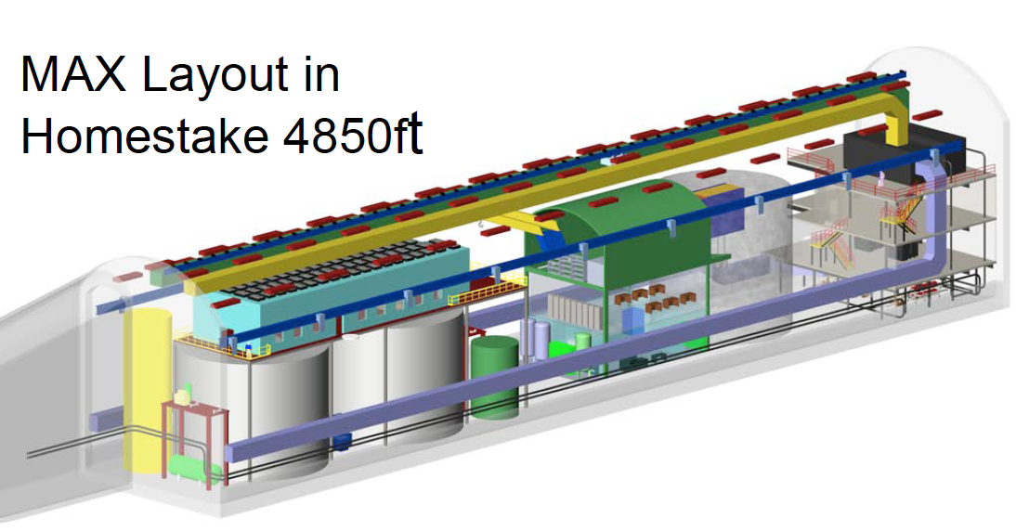
MAX G3 Detector (at DUSEL)
⁴⁰Ar
70 ton
(50 ton)
Xe
20 ton
(10 ton)

Slide 32
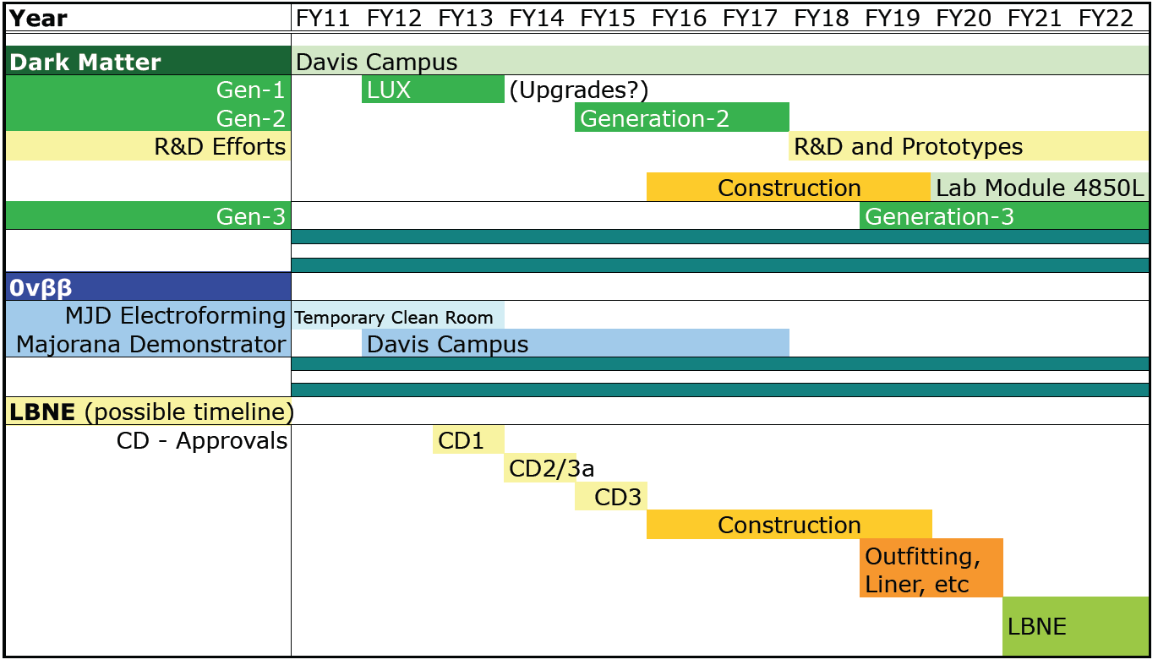
Schedule at DUSEL
Kevin Lesko

Slide 33
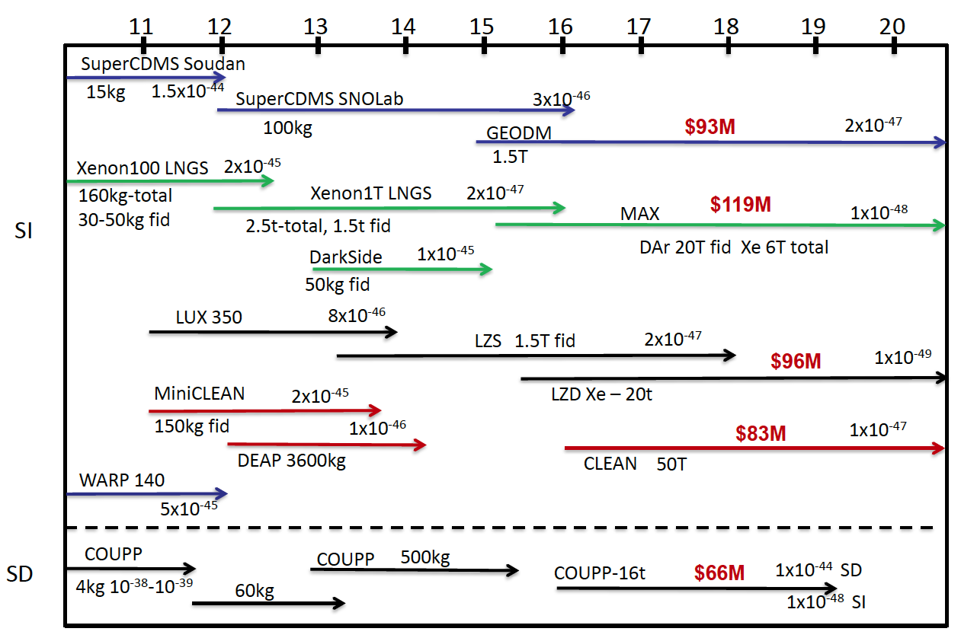
US Dark Matter Programs
2010
Xe
Ar
G3 = Xe (10T) + Ar (50T)
Xe
Ar

Slide 34
Conclusions
MAX
  10 Ton Xe + 50 Ton Ar at DUSEL
  Joint efforts by XENON and DarkSide collaborations (currently at LNGS towards G2)
Science cases
  Sensitivity down to 10⁻⁴⁸ cm²
  Precision measurements if > 10⁻⁴⁶ cm²
  Possibility to combine with 0v Double Beta Decays → XAX

