Slide 1
Why are we here? Origin of Universe and Ourselves
Katsushi Arisaka
University of California, Los Angeles
Department of Physics and Astronomy
arisaka@physics.ucla.edu

Slide 2
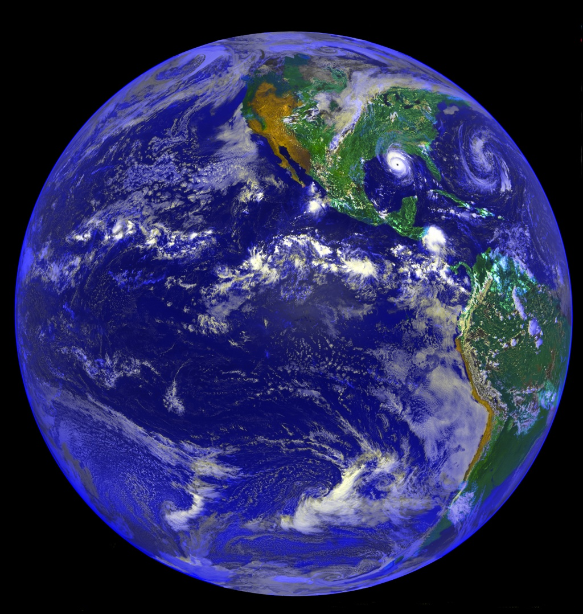
Why are we here?

Slide 3
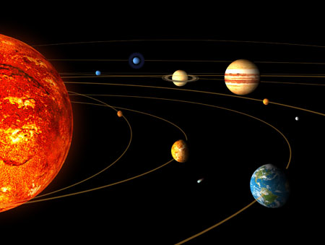
v
Solar System
Sun
Earth

Slide 4
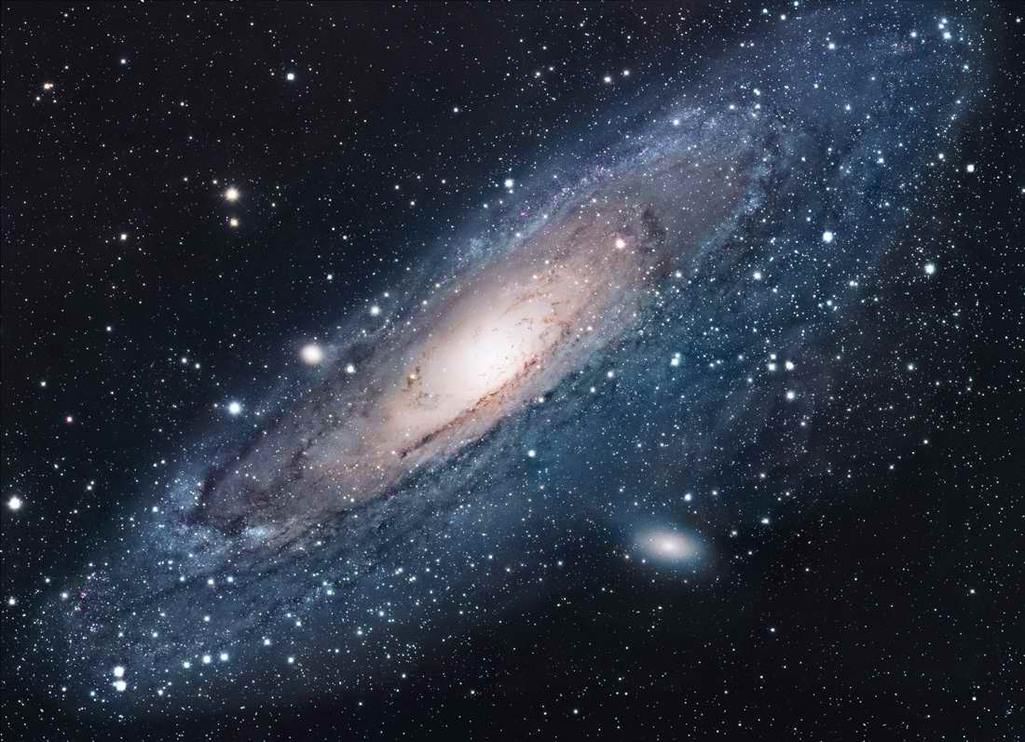
Andromeda
~100 Billions Stars in a Galaxy

Slide 5
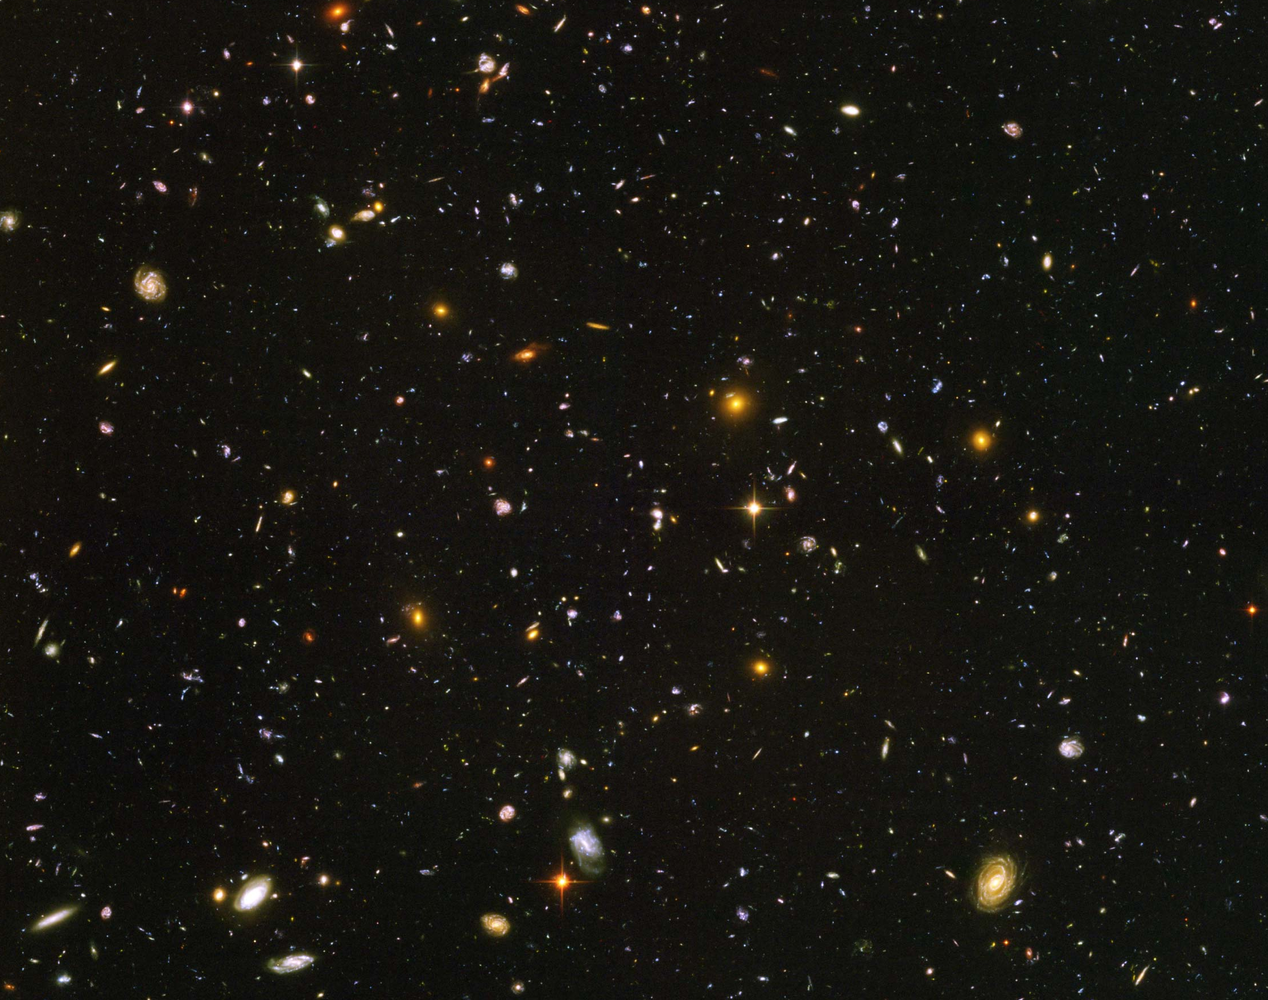
Hubble Deep Field
~100 Billion Galaxies

Slide 6
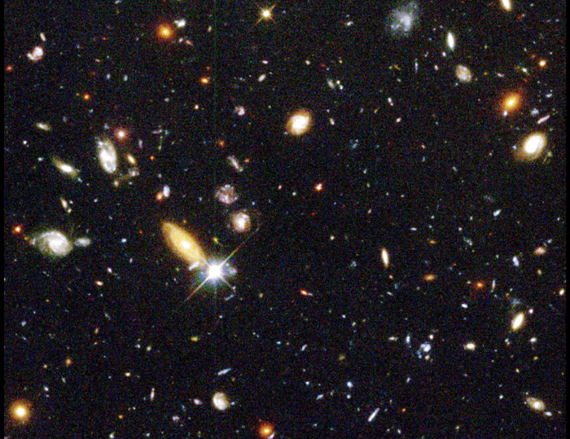
13 billion light years away
(90% of speed of light)

Slide 7
Hubble’s Law: Expansion of the Universe
Horizon
of Universe
Big Bang!
Sun/Earth
14 Billon
Light Years
Moving Away
at Speed of Light

Slide 8
Hubble Deep Field
Physicists’ View of Early Universe
Fiat lux
Let there be light

Slide 9
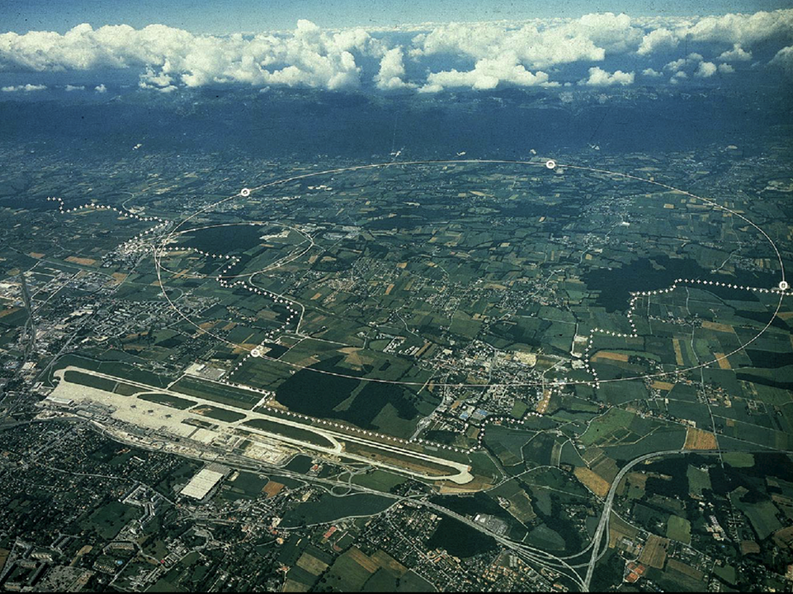
CERN and LHC in Geneva
27 km Circumference

Slide 10
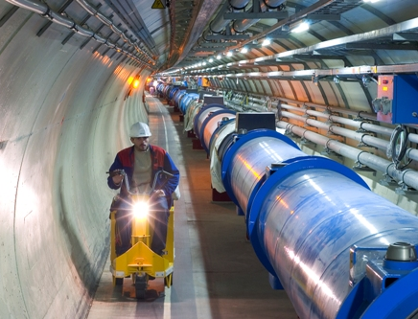
LHC Tunnel with Magnets

Slide 11

CMS Collaboration (1993 ~)

Slide 12
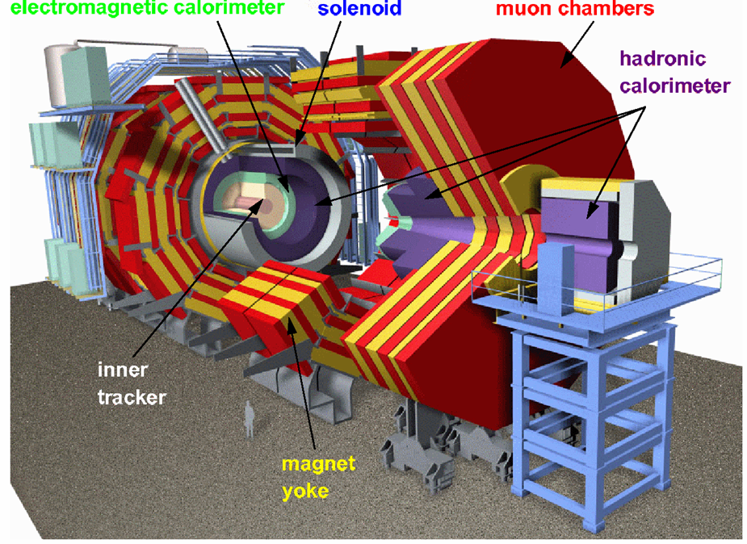
CMS

Slide 13
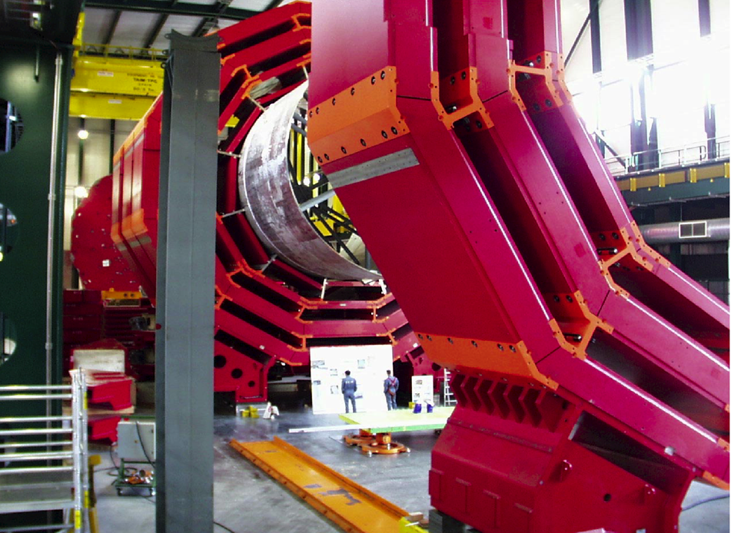
CMS Barrel Yoke

Slide 14
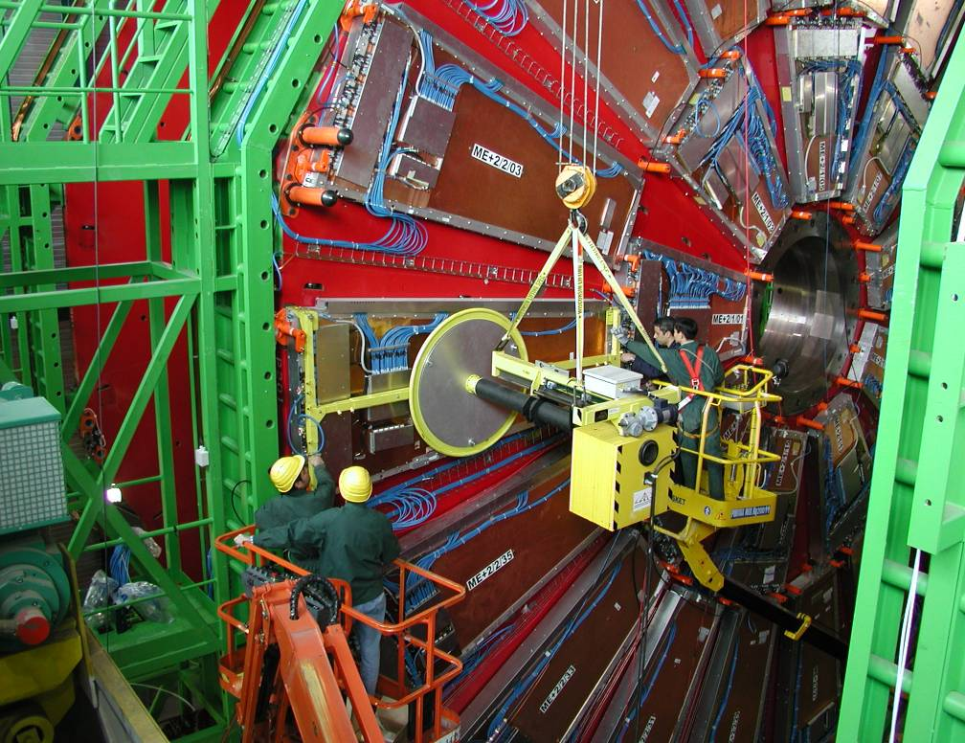
Installing muon Detectors

Slide 15
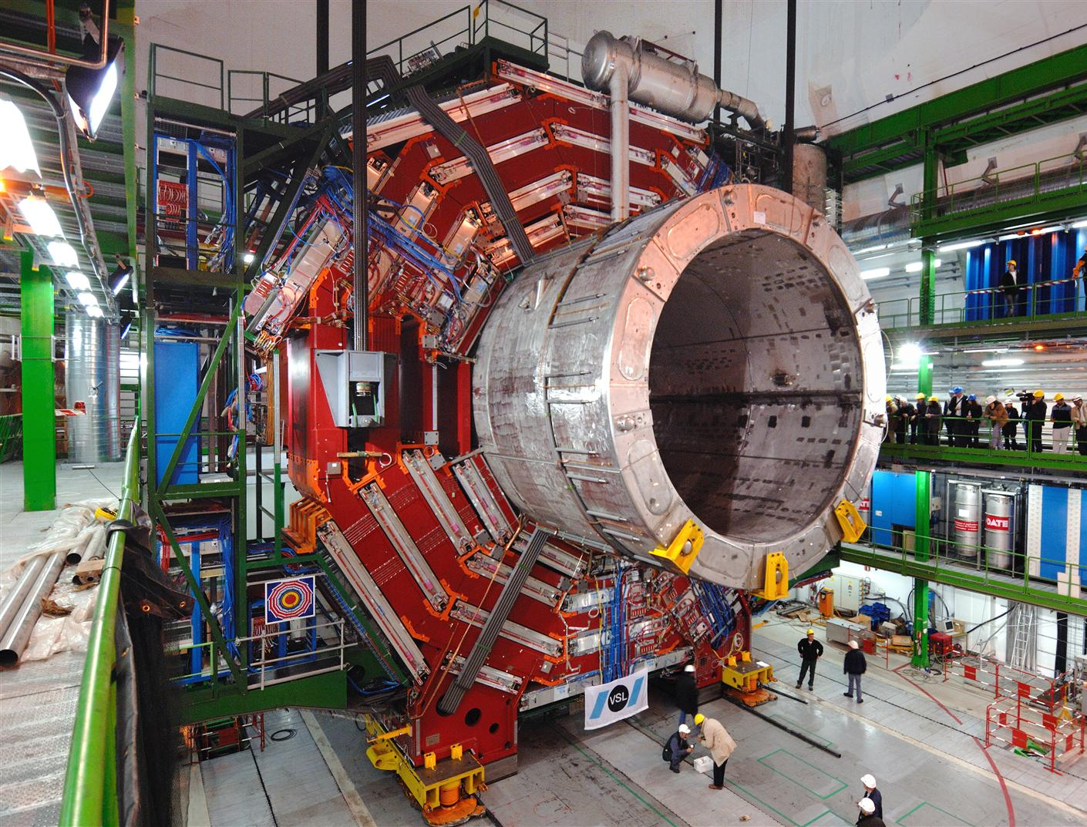

Slide 16
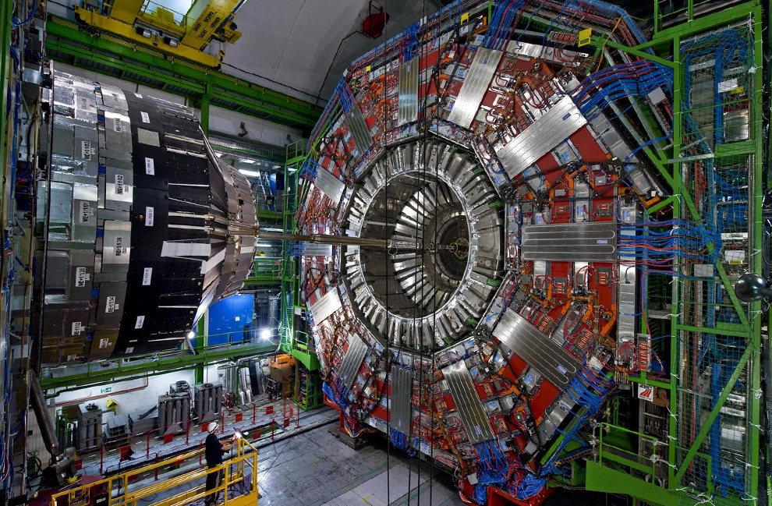

Slide 17
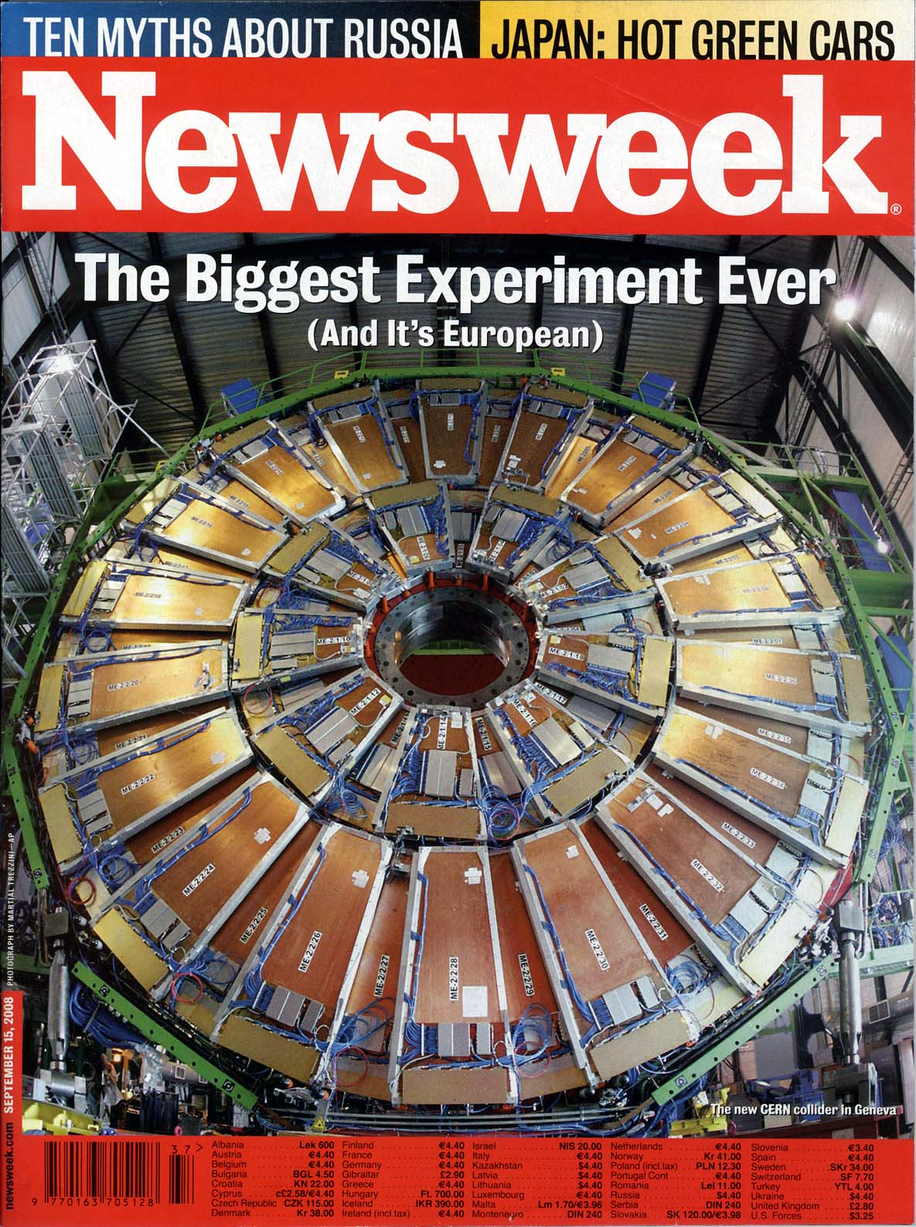
Particle detectors
constructed
at Westwood,
now at LHC, CERN
Sept 15, 2008 Issue

Slide 18
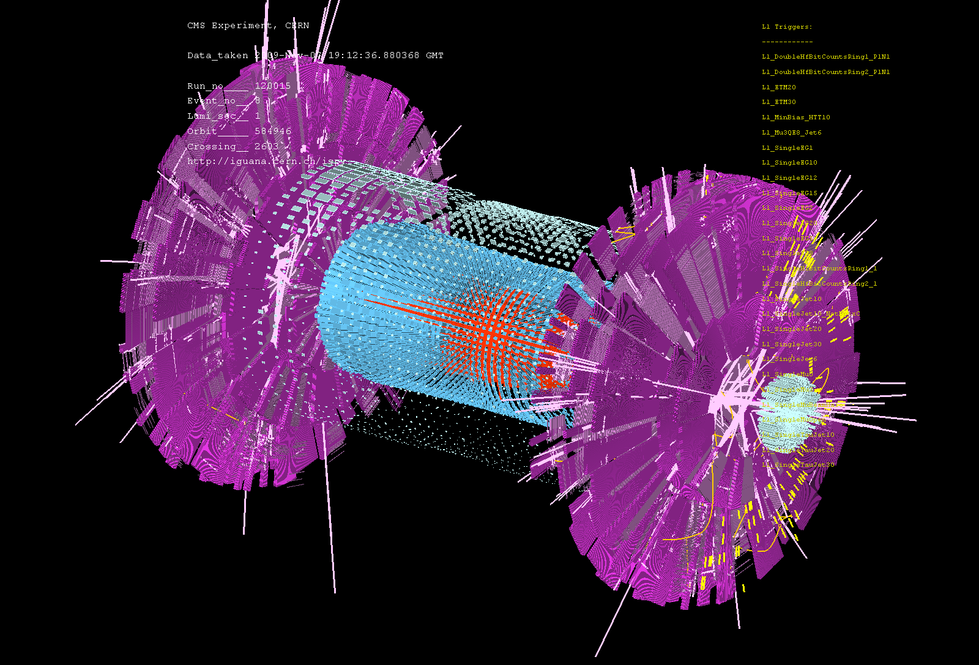
First Event at LHC – Recreation of the Big Bang! (Nov 7, 2009)

Slide 19
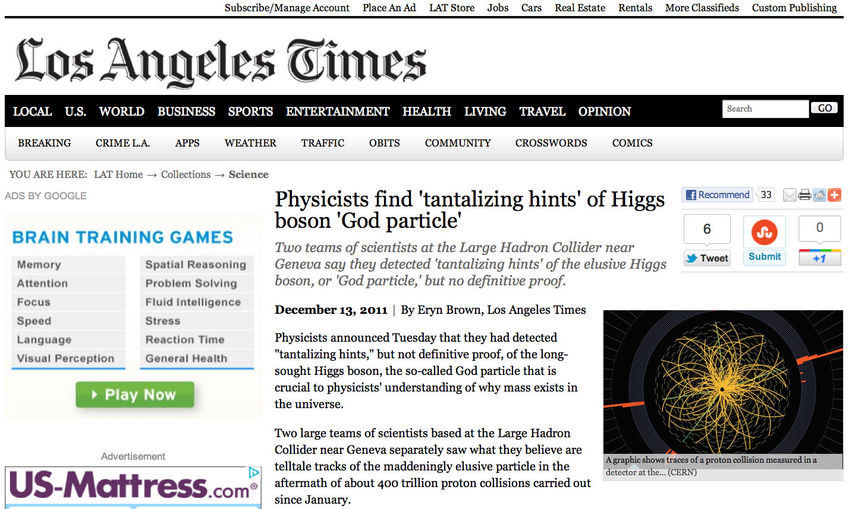

Slide 20
Why are we here?

Slide 21
Are there more than
one Universe?

Slide 22
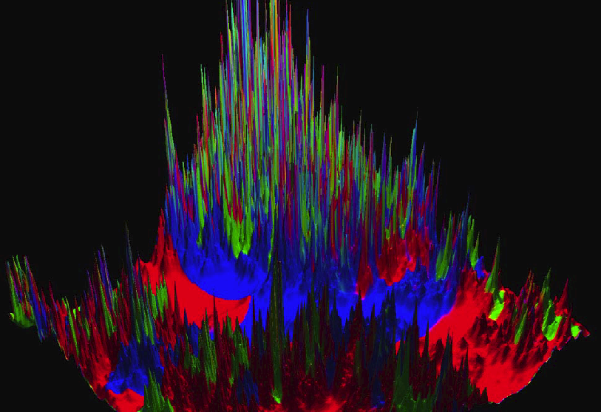
Linde’s Multiverse by Chaotic Inflation

Slide 23
There may be ~100 Billion Universes.

