Slide 1
Detection of Dark Matter
.
Science Cases and Challenges
Katsushi Arisaka
University of California, Los Angeles
Department of Physics and Astronomy
arisaka@physics.ucla.edu

Slide 2
UCLA DM2012 Conference

Slide 3
Talk Outline
Scientific Cases
  Origin of the Universe and Mass
Detection Methods
  Noble Liquid and TPC
  XENON100 and 1T
Sensitivities
  SUSY, Extra Dimensions…
  Comparison with LHC, Indirect searches
Ultimate G3 Observatory
  Xenon vs. Argon
  Technological challenges

Slide 4
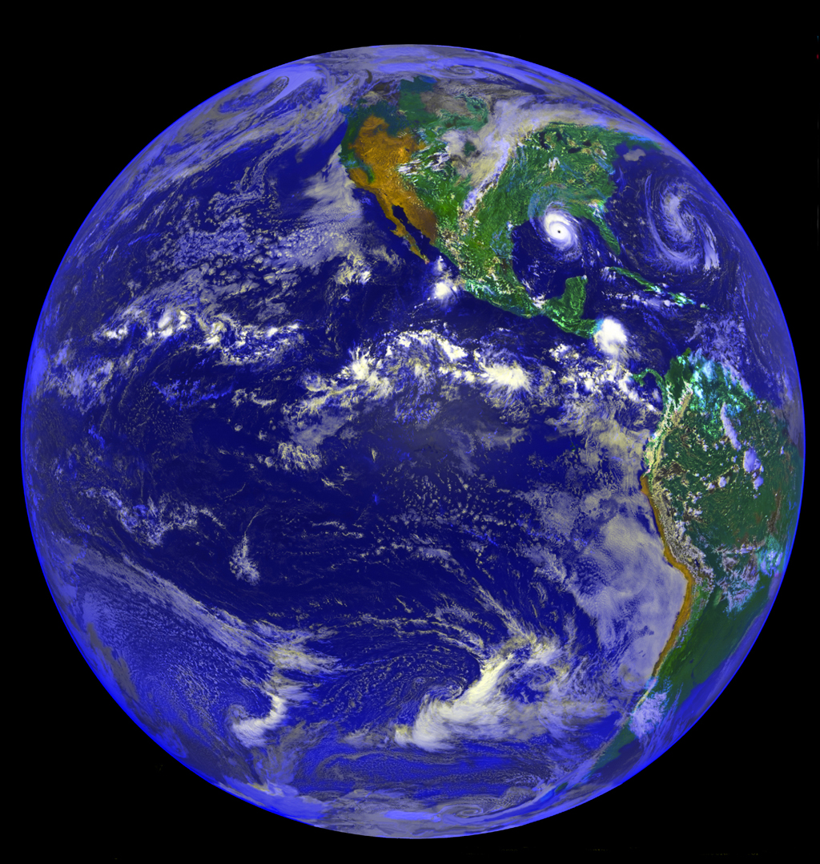
Why are we here?

Slide 5
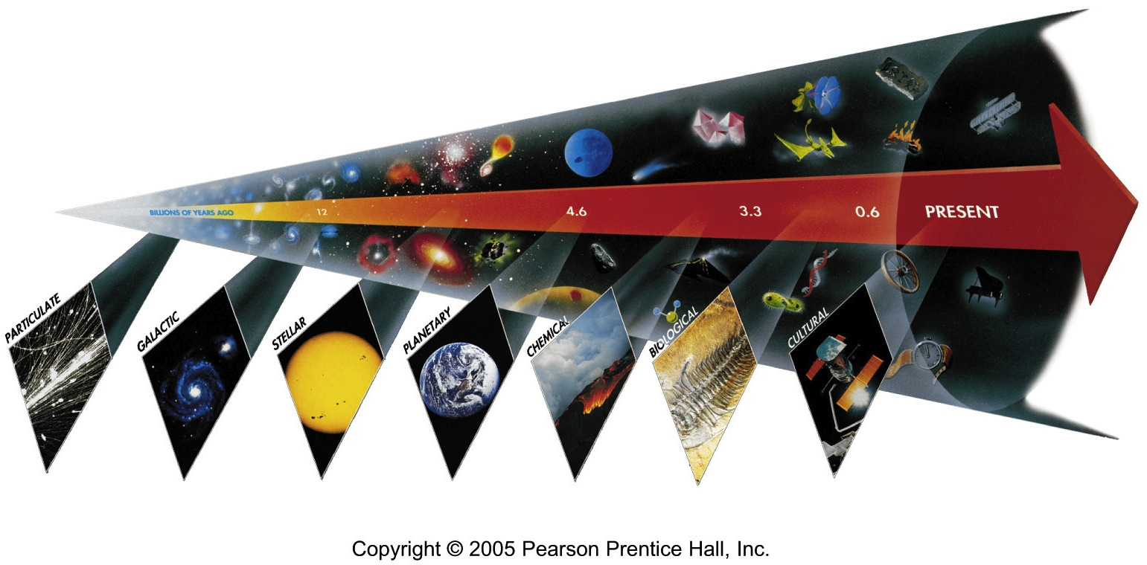
Seven Phases of Cosmic Evolution
14 billion years ago

Slide 6
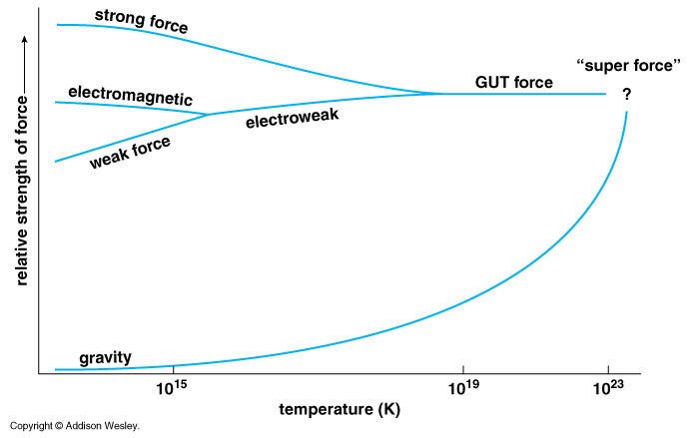
Unification of Forces
??
Electro-Weak Unification
100 GeV
10¹⁶ GeV
10¹⁹ GeV
10²⁹
10³²

Slide 7
Unification of Forces
Grand Unification
100 GeV
10¹⁶ GeV
10¹⁹ GeV
10³²
10²⁹
10³²
10²⁹

Slide 8
Unification of Forces
Planck Epoch
100 GeV
10¹⁶ GeV
10¹⁹ GeV
10²⁹
10³²

Slide 9
Hubble Deep Field
Physicists’ View of Early Universe
Fiat lux
Let there be light

Slide 10
Hubble Deep Field
Physicists’ View of Early Universe
Lorentz Invariance
Local Gauge Invariance

Slide 11
Symmetry Breaking
Time
(sec)
Temp.
(ºK)
Energy (GeV)
10⁻⁴⁵sec
Simple
10⁻⁴⁰
10³⁰
10¹⁸
10⁻³⁵
10¹⁵
10⁻³⁰
10²⁵
10¹²
10⁻²⁵
10⁹
Symmetry
Break Down
10⁻²⁰
10²⁰
1PeV
10⁻¹⁵
10¹⁵
1TeV
b
10⁻¹⁰
1GeV
s
µ⁻
W⁺
10⁻⁵
γ
c
10¹⁰
ν_{e}
τ⁺
1
1MeV
Zº
d
τ⁻
ν_{e}
d
e⁺
10⁵ sec
1KeV
ν_{µ}
e⁻
1 year
u
u
s
10⁵
Complex
ν_{µ}
10³
1eV
b
µ⁺
10⁶
W⁺
c
10⁹ year
10⁻³eV
1

Slide 12
The Beginning (at T = 0)
Everything was the same ↔ Perfect symmetry.
  All the particles are the same as photons.
  All four forces are the same.
The Universe was 10 dimension.
  3 Space Flattened
  1 Time
  3 Strong Force
  6 2 Weak Compacitified
  1 Electro-Magnetic

Slide 13
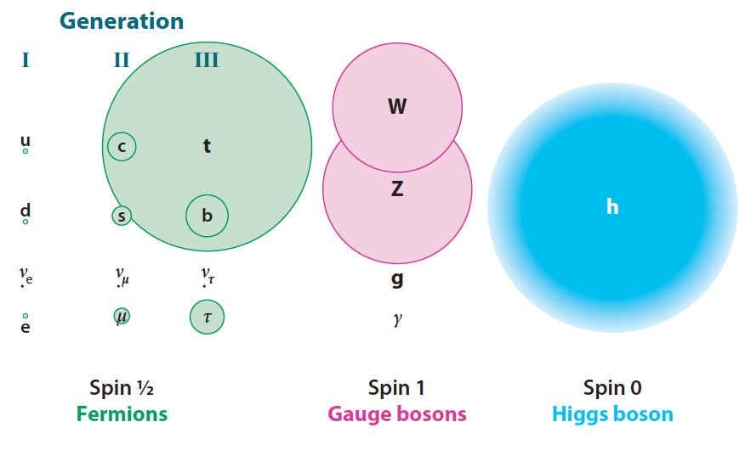
Mass of Particles (at T = 0.1 ns)

Slide 14
Mystery of the Mass (since 1970)
How to create mass from energy?
  While maintaining the initial symmetry
  Spontaneous Symmetry Breaking
Particle mass << Plank Mass
MeV – GeV 10¹⁹ GeV
Why so many particles (Generations) with different masses?
Energy → Mass

Slide 15
Spontaneous Symmetry Breaking
- Higgs Mechanism -
Energy
y
Vacuum
Energy
x
Mass

Slide 16
Spontaneous Symmetry Breaking
- Higgs Mechanism -
Energy
y
Vacuum
Energy
x
Mass

Slide 17
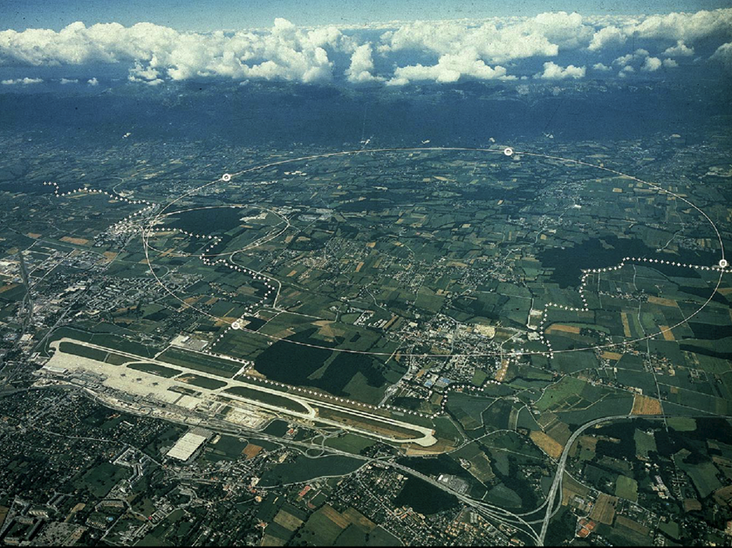
CERN and LHC in Geneva
27km Circumference
7+7=14 TeV

Slide 18
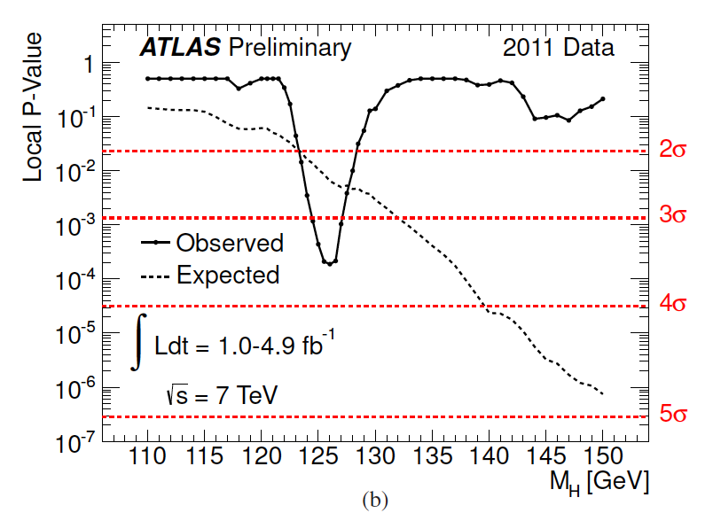
ATLAS Higgs Results

Slide 19
Seven Phases of Cosmic Evolution
Spontaneous Symmetry Breaking
14 billion years ago
Origin of
Particles
Origin of
Structure

Slide 20
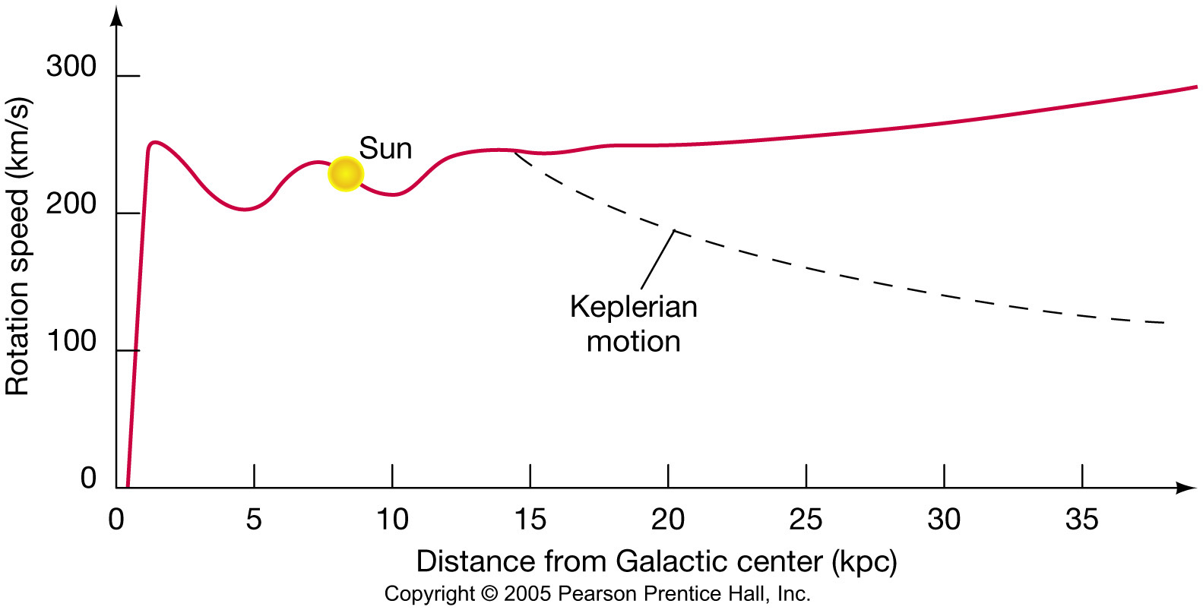
Rotational Velocity of Galaxies
With uniformly distributed Dark Matter
Sun
Without Dark Matter

Slide 21
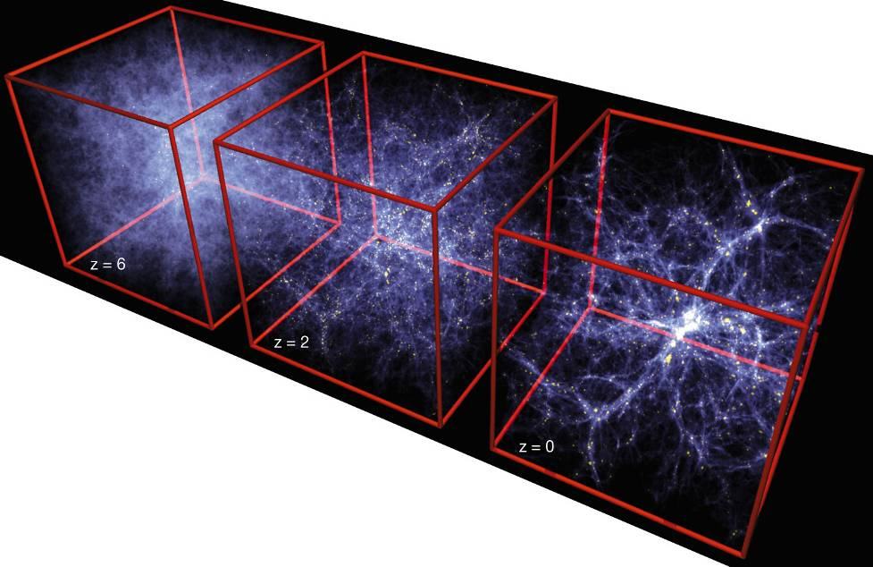
Formation of Structure in the Universe
Dark Matter is required!

Slide 22
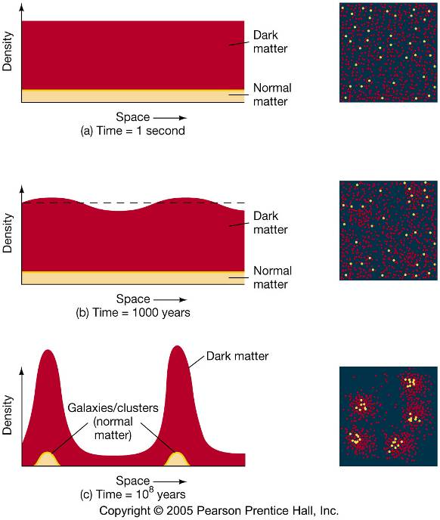
Evolution of Large Structure

Slide 23
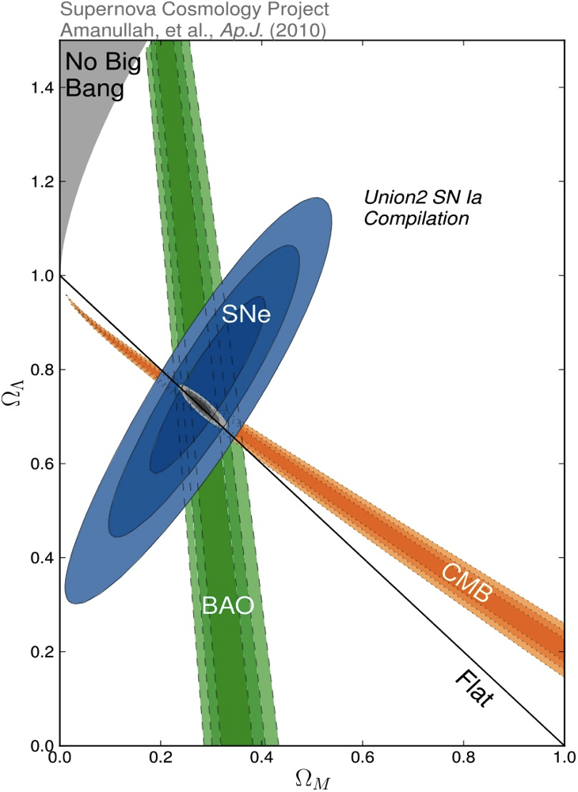
Density of Our Universe
Ω_{Total}=Ω_{Λ}+Ω_{Matter} =1.0
Universe is Flat.
  ⇒ Inflation
73% is Dark Energy.
  ⇒ Accelerating
Ω_{Λ}
  Ω_{M}= 27%
Ω_{Matter}

Slide 24
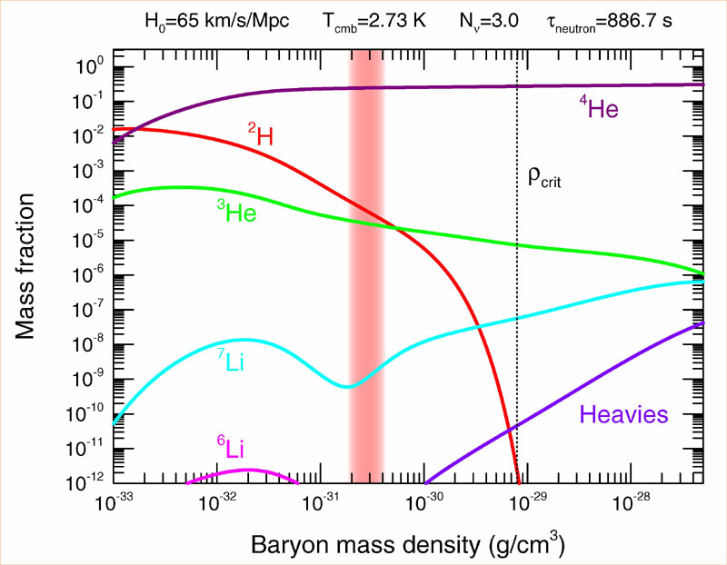
Abundance vs. Density
D
  Ω_{Baryon}= 4.6%

Slide 25
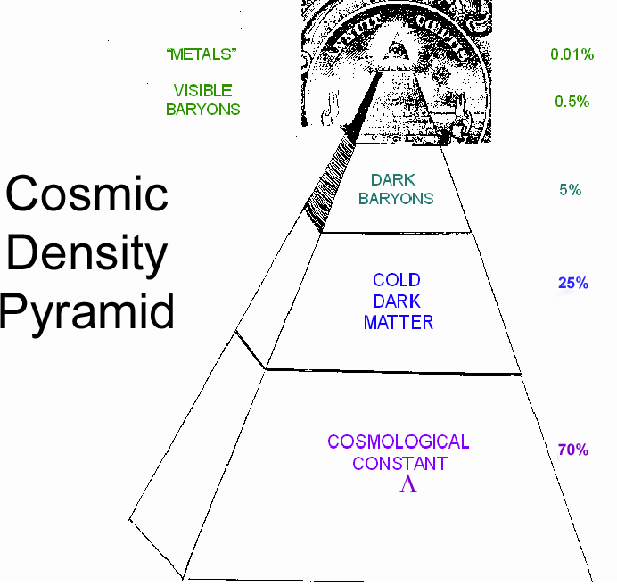
Cosmic Pyramid
Metal
0.01%
Star
0.4%
Baryonic Matter
0.5%
Gas,
Dust
4.2%
Dark
Matter
23%
Dark Energy
73%

Slide 26
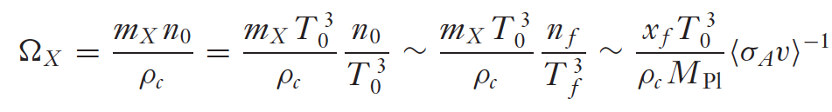
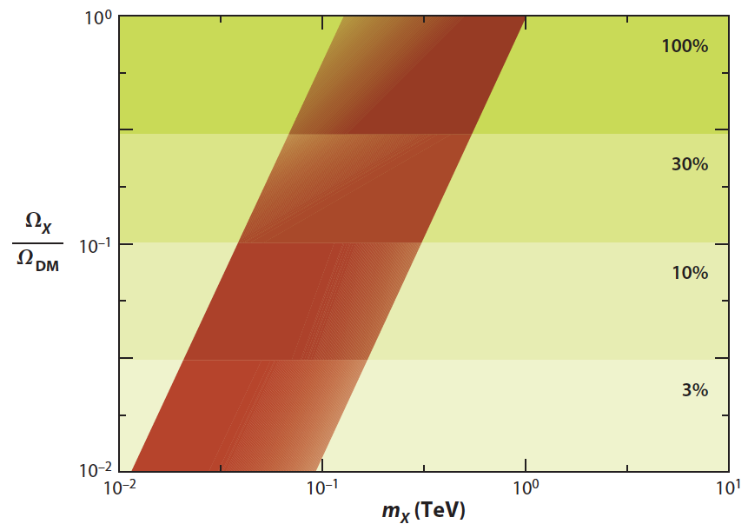

WIMP Miracle
0.1 – 1TeV
Ω_{X} ∞ M_{X}²
M_{X} ~ 0.1-1TeV
σ_{A} ~ pb

Slide 27
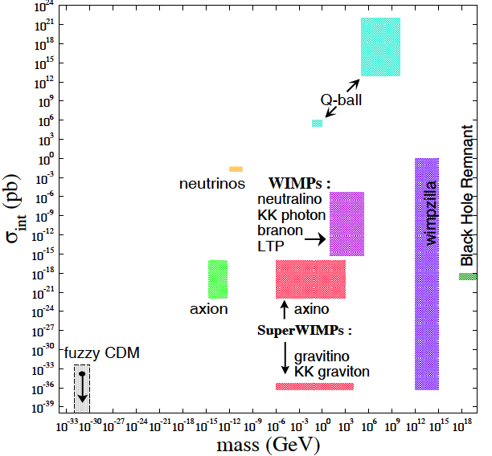
What is Dark Matter?

Slide 28
How to approach dark matter?
Direct Search
X q → X q
XENON, DarkSide…
LHC
Indirect Search
q q → X X
X X → v v
ATLAS, CMS
Fermi, IceCube…

Slide 29
Direct Detection Methods

Slide 30
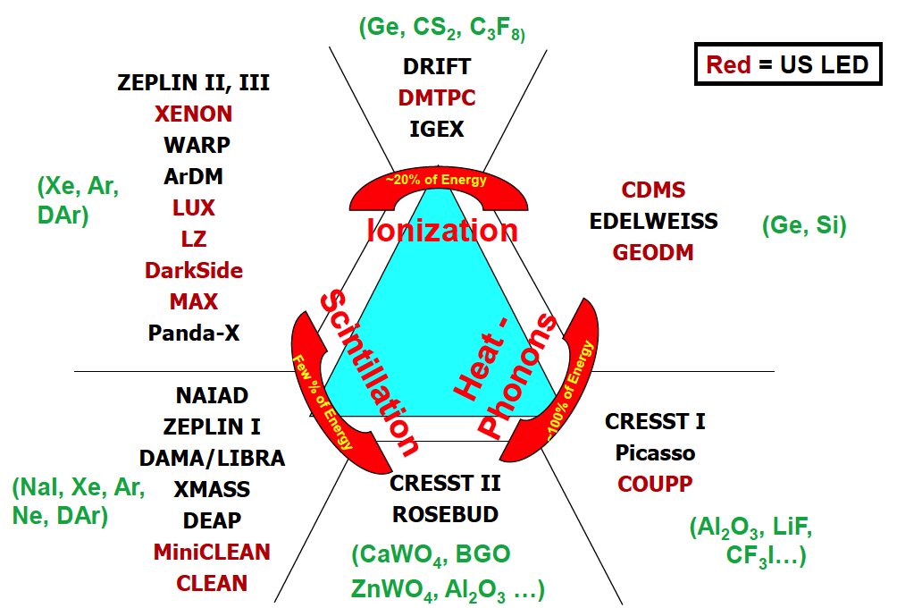
Detection Technique
Double
Phase
Gamma Ray
(Ge, Si)
Single
Phase
Neutron
WIMP

Slide 31
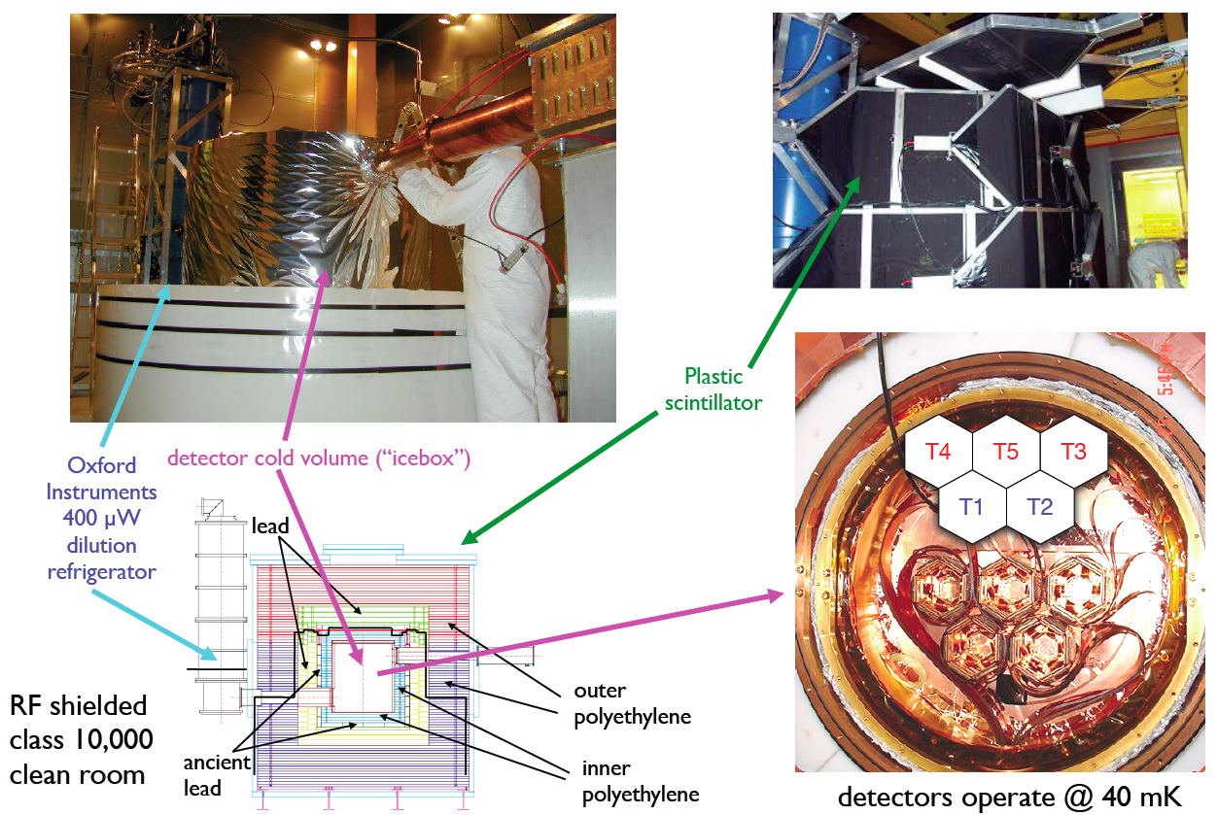
CDMS-II in Soudan

Slide 32
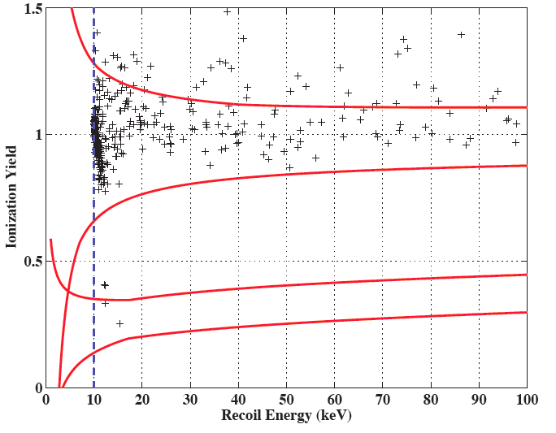
CDMS-II New Results
194 kg-days exposure = 4.4 kg x 139 day x 0.33 (eff.)
2 event observed!
(0.8 surface BG
+ 0.1 neutron BG)

Slide 33
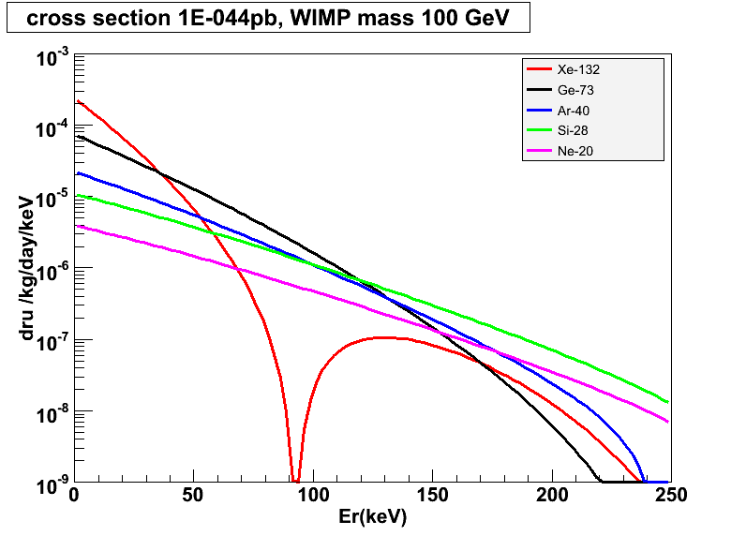
Target Mass Dependence of WIMP Cross Section
10⁻⁴⁴ cm²
Xe-132
Ar-40
Ge-73
Si-28
Ne-20

Slide 34
Properties of Noble Liqud
 | Unit | Neon | Argon | Xenon
Z |  | 10 | 18 | 54
A |  | 20 | 40 | ~132
Liquid Density | g/cc | 1.21 | 1.4 | 3.06
Energy Loss (dE/dX) | MeV/cm | 1.4 | 2.1 | 3.8
Radiation Length | cm | 24 | 14 | 2.8
Collision Length | cm | 80 | 80 | 34
Boiling Temperature | ºK | 27.1 | 87.3 | 165
Scintillation Wavelength | nm | 85 | 125 | 178
Scintillation | photon/keV | 30 | 40 | 46
Ionization | e-/keV | 46 | 42 | 64
Decay time (Fast Component) | nsec | 19 | 7 | 4
Decay time (Slow Component) | nsec | 1500 | 1600 | 26
Isotope |  | No | ³⁹Ar (1 Bq/kg) | ¹³⁶Xe
Price | $ /ton | $90k | ~$2k | ~$1M
Single Phase Experiments |  | CLEAN | DEAP/CLEAN | XMASS
Double Phase Experiments |  |  | WARP, ArDM, DarkSide, MAX | ZEPLIN, XENON, MAX LUX, LZD

Slide 35
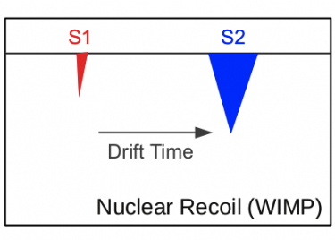
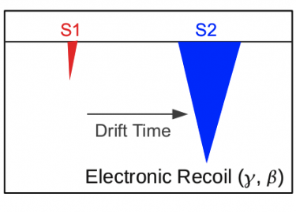
Double-Phase Noble Liquids

Slide 36
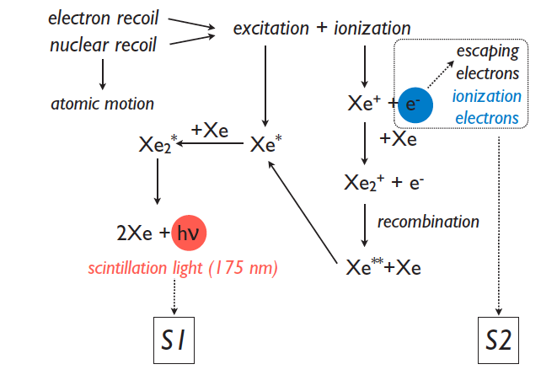
S1 and S2
Manzur 2010

Slide 37
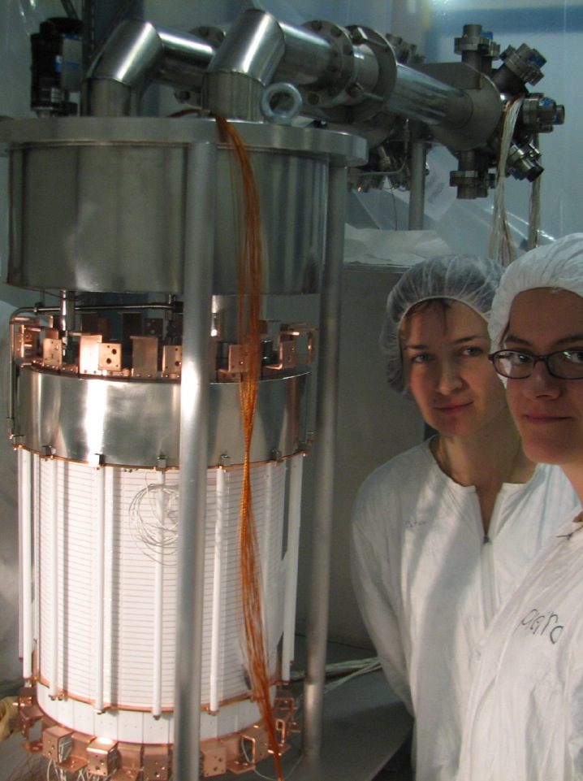
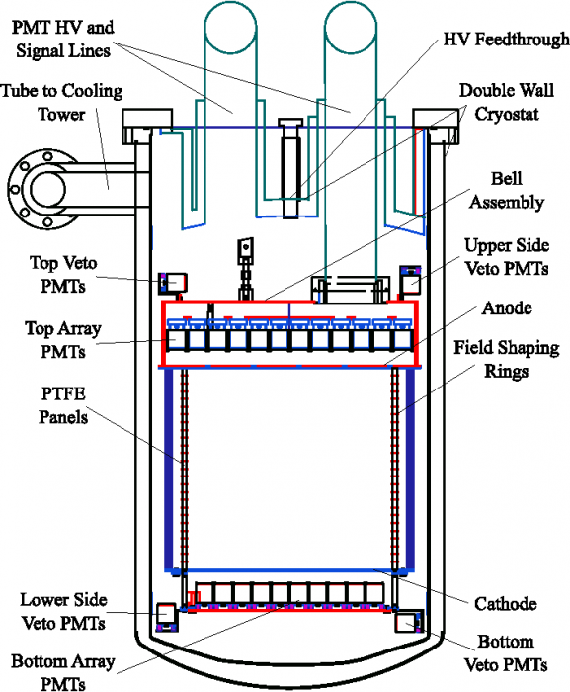
XENON100 Detector
161 kg
(48 kg)

Slide 38
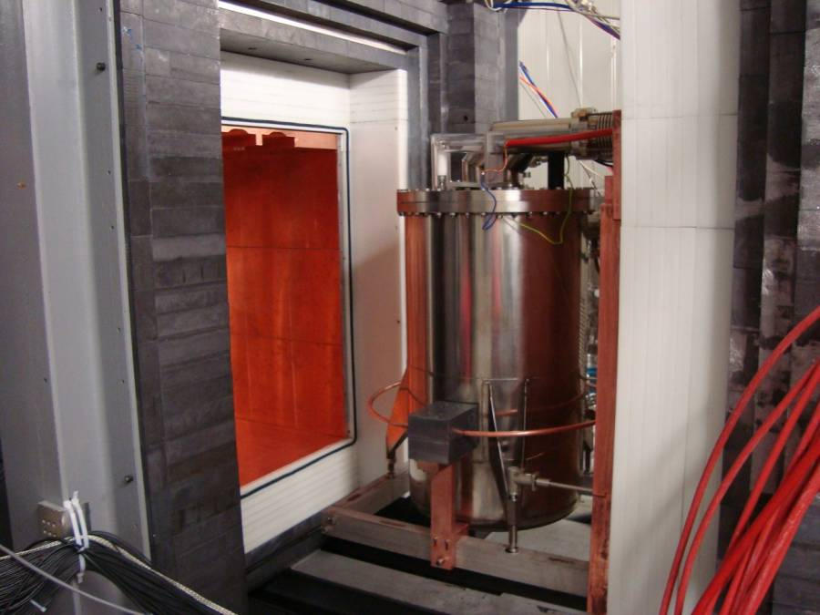
Pb
(20cm)
Poly
(20cm)
Cu
(5cm)
Pb
(20cm)
Poly
(20cm)
Cu
(5cm)

Slide 39
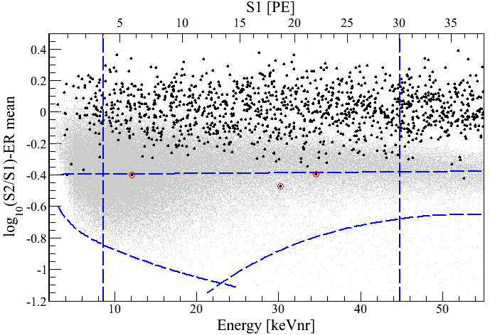
Log(S2/S1) vs. Energy
100.9 days, 48 kg
arXiv:1104.2549
S1 = 4 PE
γ backgrounds
S1 = 30 PE
99.75% rejection for γ
Neutron band
(Acceptance 30 – 40%)
3 events
(1.8 ± 0.6 expected)
-3 σ
8.4 keV_{nr}
44.6 keV_{nr}
S2 = 300 PE

Slide 40
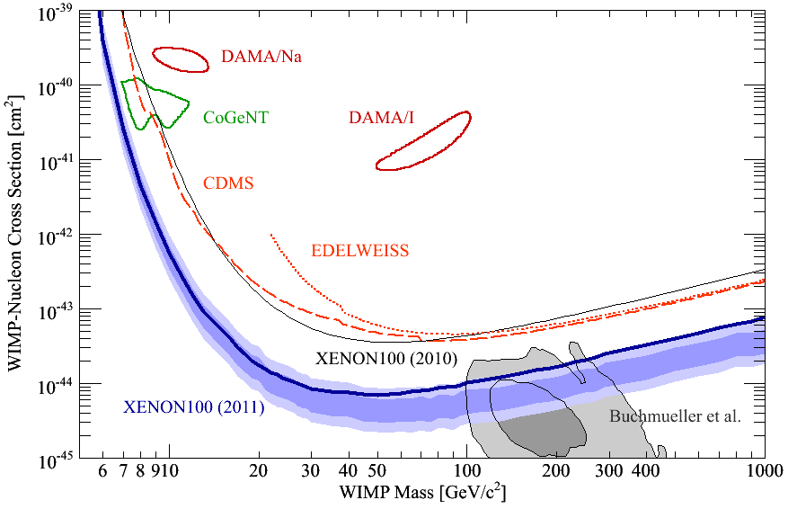
90% CL Limits of SI Cross Section (April, 2011)
arXiv:1104.2549
CMSSM

Slide 41
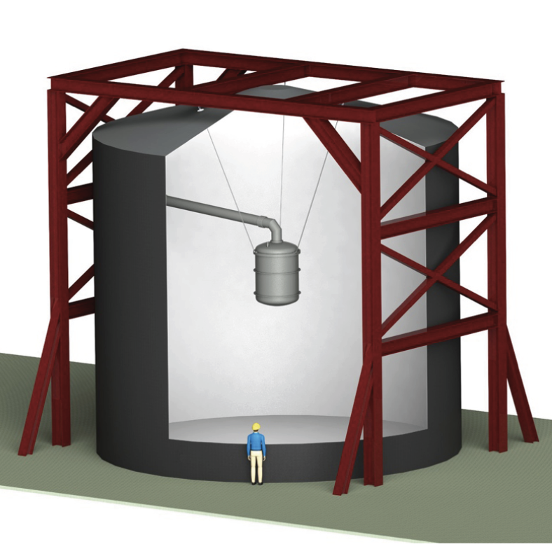
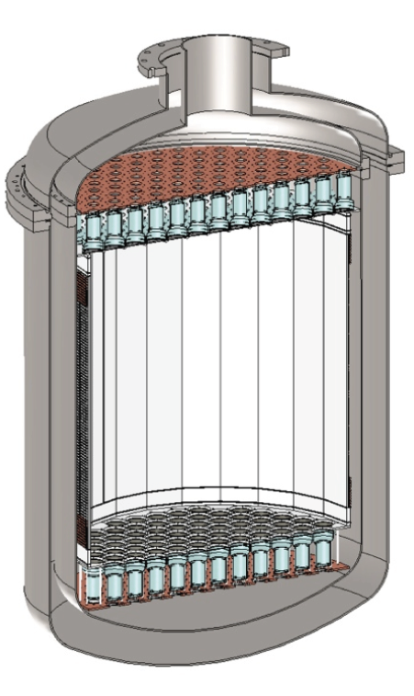
XENON1T (G2) at LNGS
1 m
Xe
(2.2 Ton)
Water Tank

Slide 42
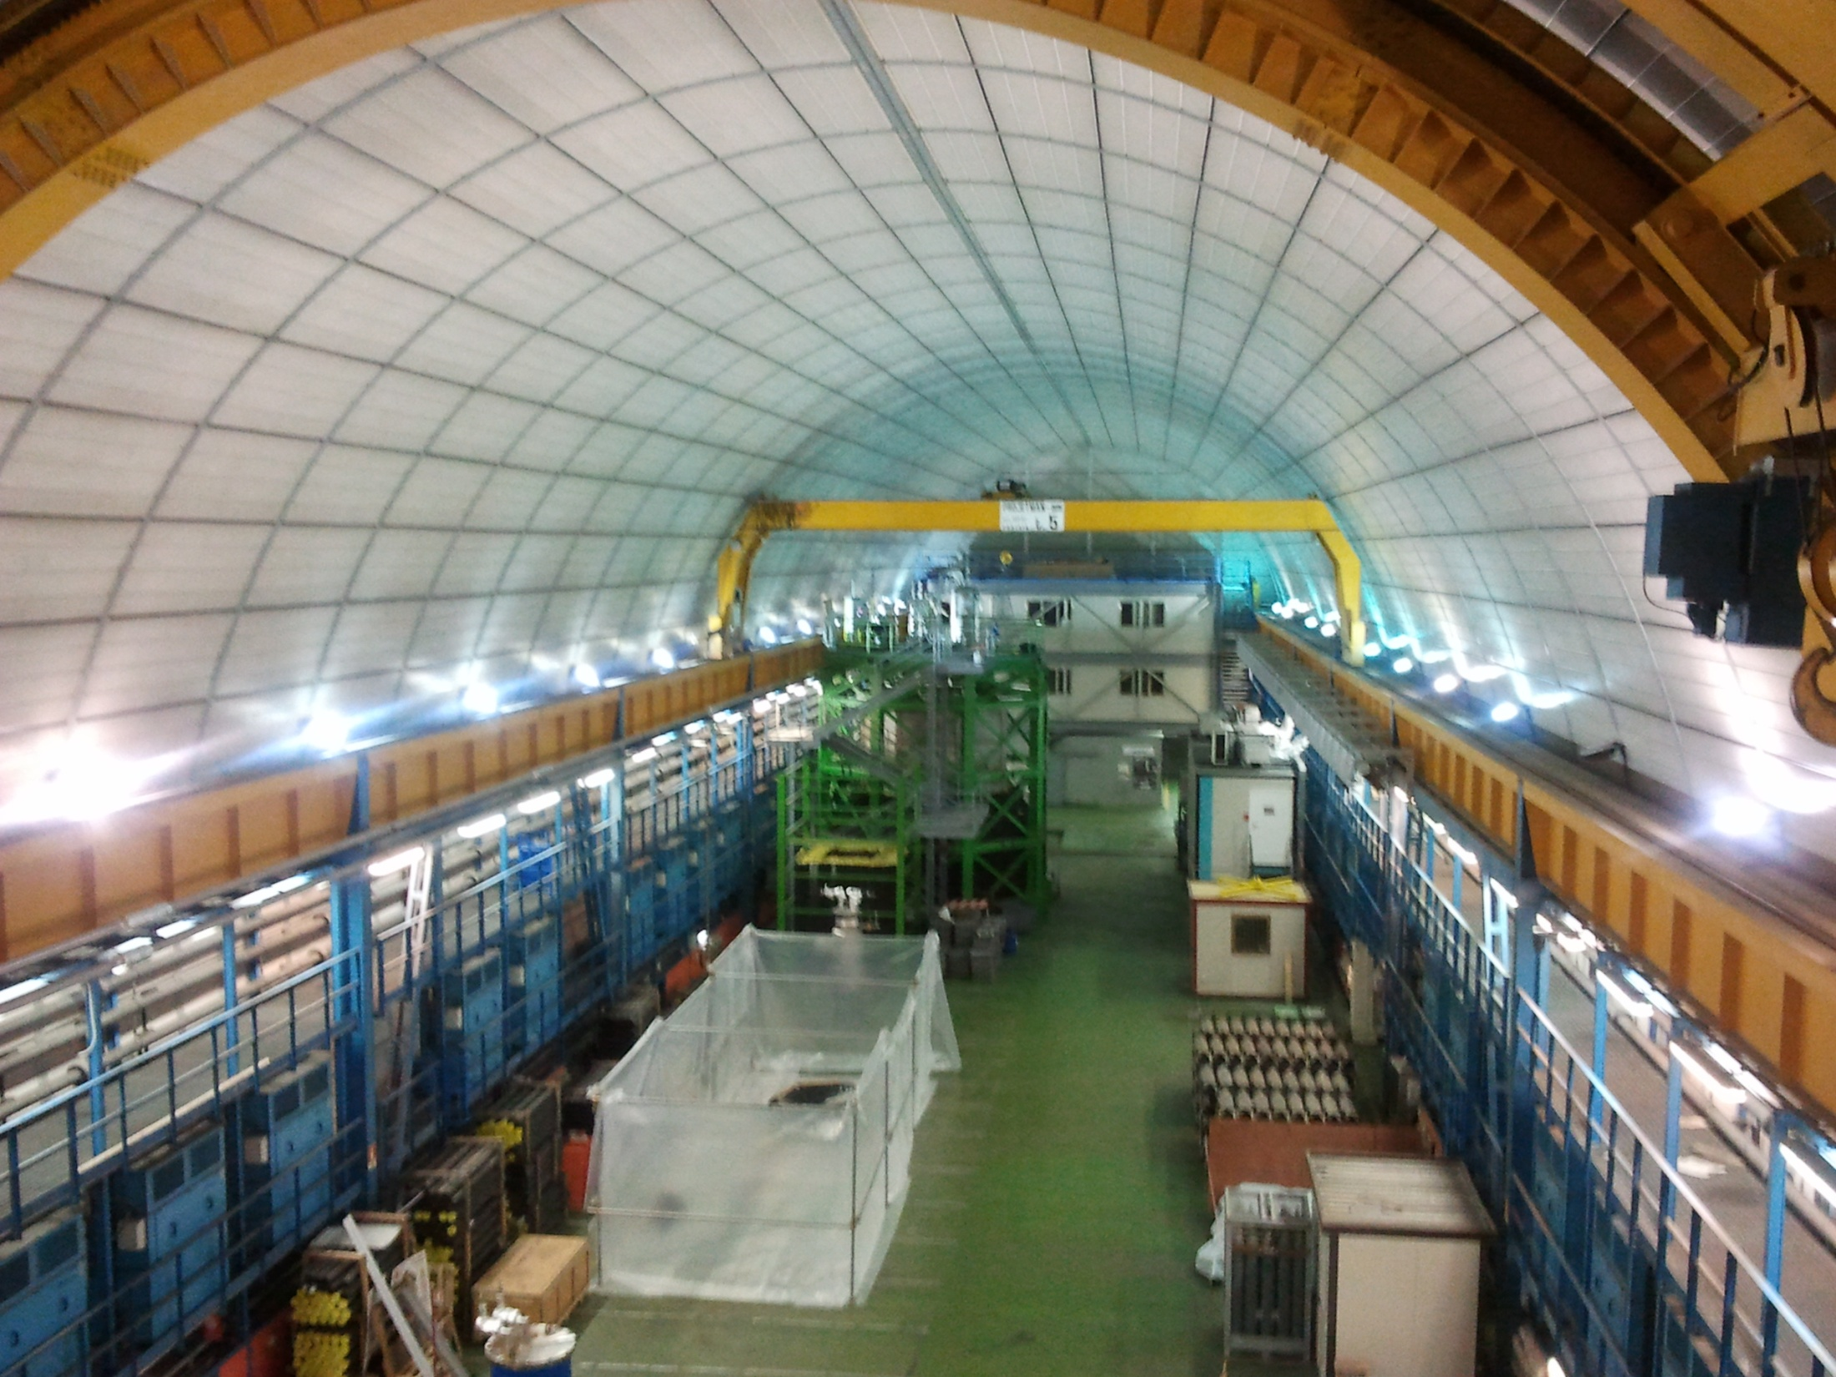

LNGS UnderGround lab – Hall B

Slide 43
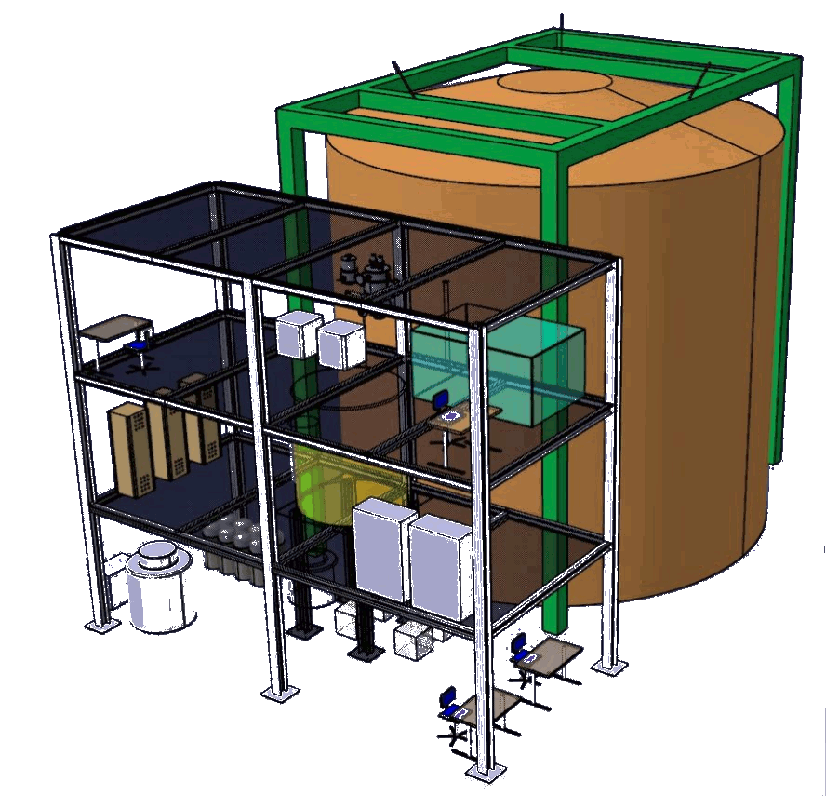
LNGS UnderGround lab – Hall B

Slide 44
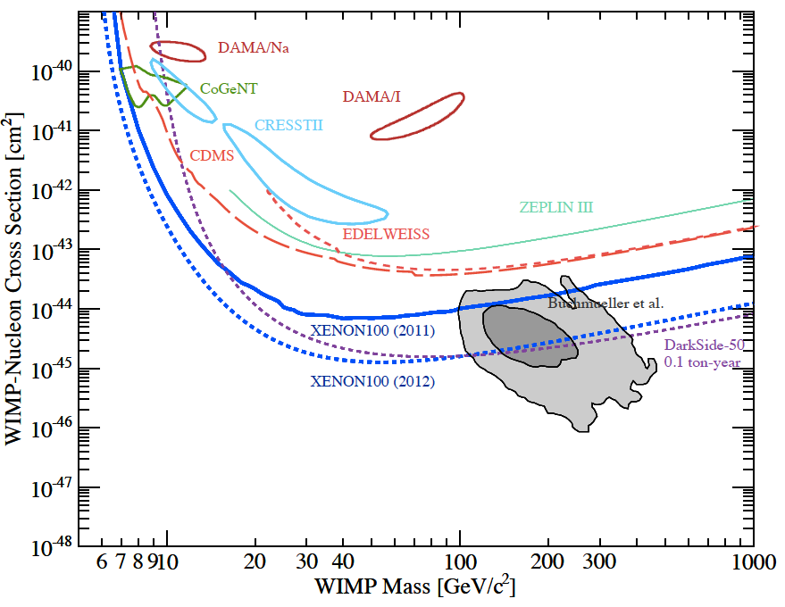
G1
CMSSM

Slide 45
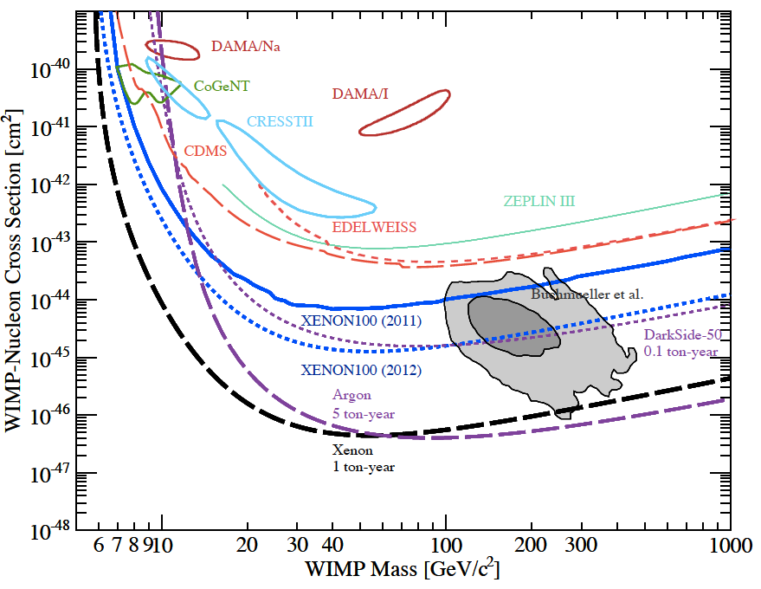
G1
CMSSM
XENON1T

Slide 46
SUSY and
Extra Dimensions

Slide 47
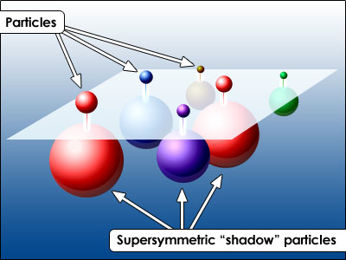
SUSY Neutralino

Slide 48
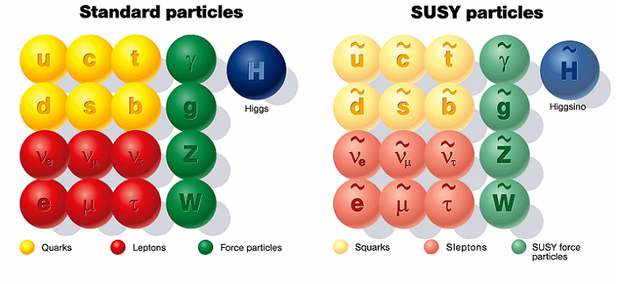
SUSY Particles and Neutralino
Spin 1/2 1 0

Slide 49
SUSY Particles and Neutralino
Super Symmetry
Neutralino
Spin 1/2 1 0 0 1/2 1/2

Slide 50
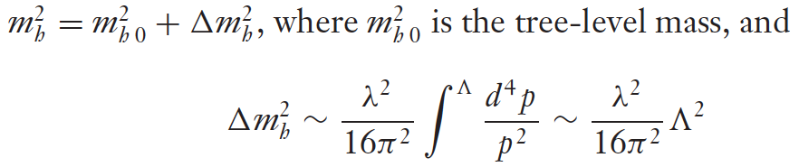


Hierarchy Problem
Higgs mass
SM :
SUSY :
or : new physics at the energy scale of Λ ~ 1 TeV

Slide 51
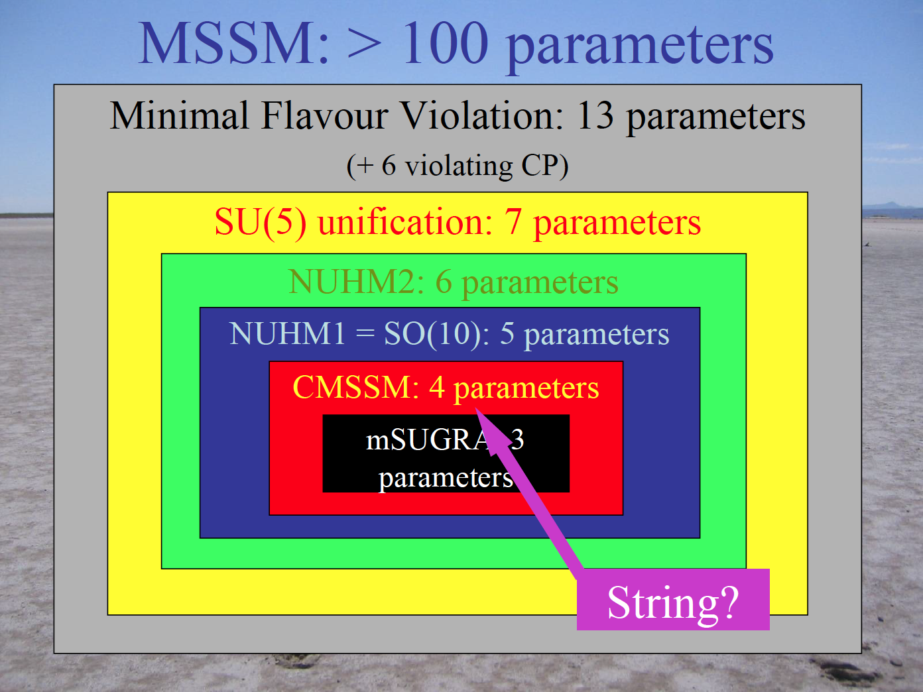
John Ellis

Slide 52
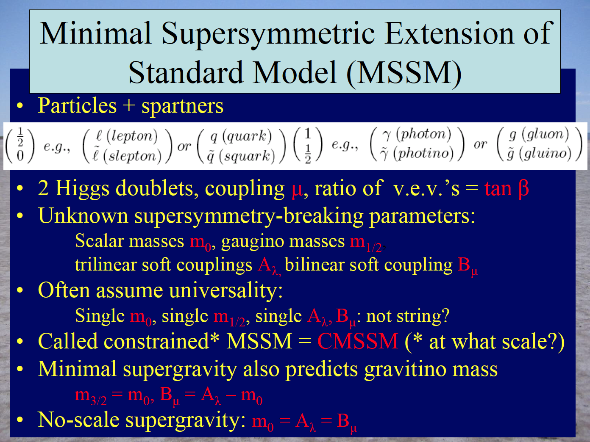
John Ellis

Slide 53
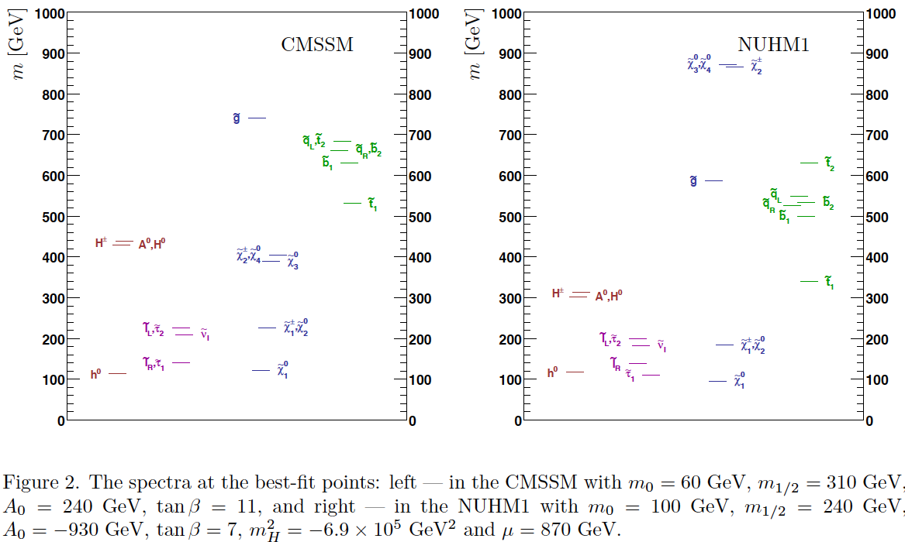
Mass Spectra at the best fit points (before LHC)
CMSSM
NUHM1
Buchmueller et al arXiv: 0808.4218

Slide 54
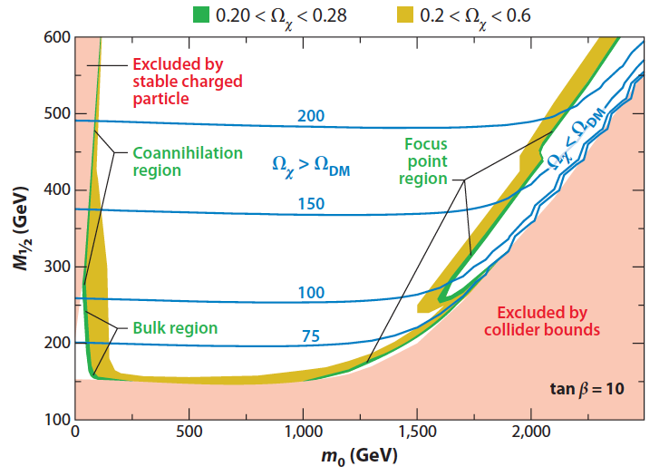
mSUGRA m_{1/2} vs. m₀
M_{x} ~ 0.4 * M_{1/2}
Feng Ann. Rev. Astro. Astrophys. 2010.48:495-545

Slide 55
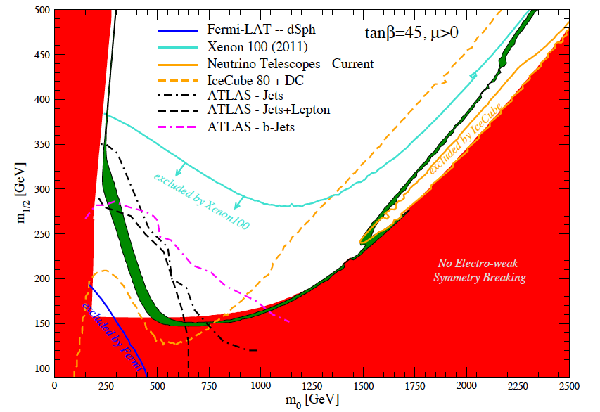
CMSSM m_{1/2} vs. m₀
Allowed Region
Stau
Coannihilation
Focus
Point
XENON100
Bulk
Profumo arXiv:1105.5162

Slide 56
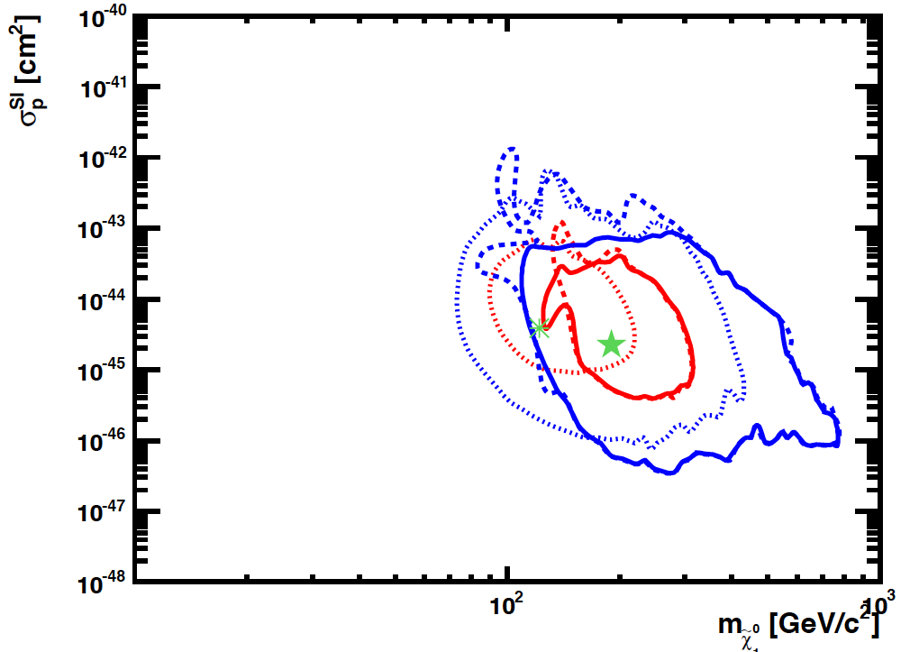
SI Cross Section vs. Mass
CMSSM
CMSSM
LHC
Pre
2011
2012
2015
G1
XENON100
2011
2012
G2
XENON1T
2017
G3
Buchmueller et al arXiv:1106.2529

Slide 57
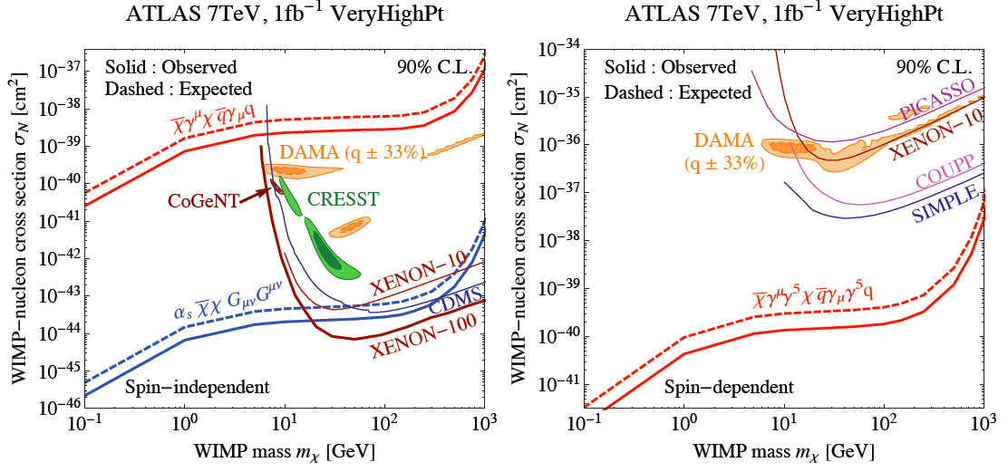
Limit from Mono-jet analysis
Fox et al arXiv:11094398

Slide 58
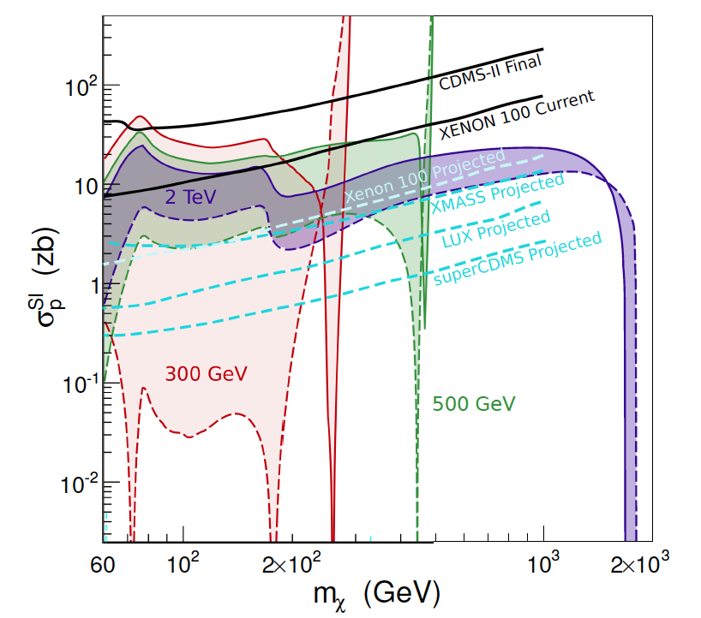
Sfermion Mass Dependence
XENON100
(2012)
XENON 1T
Feng arXiv:1009.3934v2

Slide 59
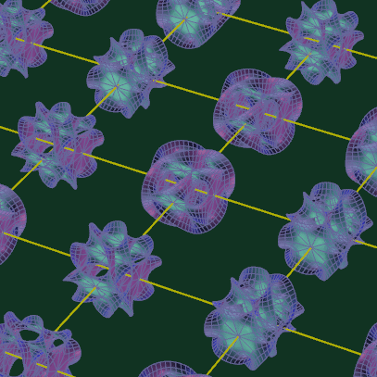
KK particles in Extra Dimensions

Slide 60
Photon
Extra
Dimensions
KK Photon
Bulk
Our 3D Space
(= Brane)

Slide 61
Origin of Mass in Extra Dimensions
E = mc² → m = E/c²
Mass can be generated as kinetic energy in extra dimensions.
    Origin on mass
    Dark matter is running in the extra dimensions
Gravity can escape into the extra dimensions.
    Why gravity is so small
    Origin of dark energy

Slide 62
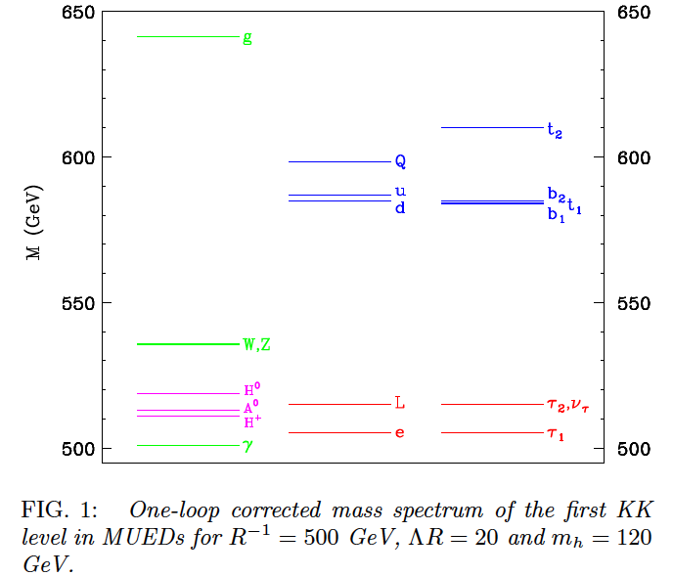
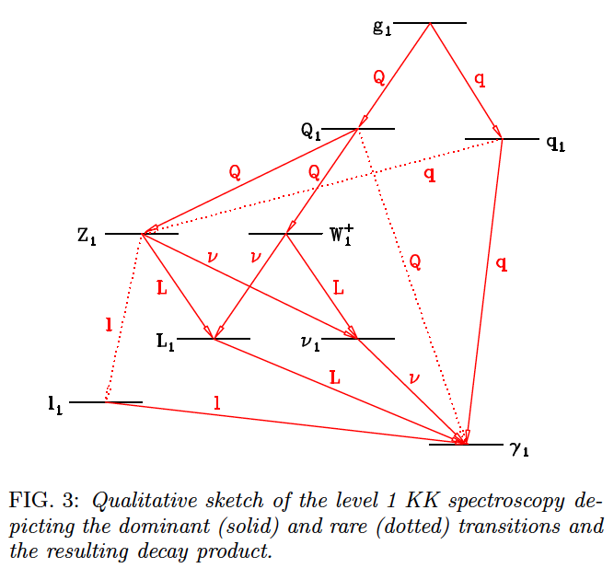
Mass Spectrum of the first KK level
Similar to the SUSY mass spectrum
Δ = (m_{l} – m_{γ})/m_{γ}
KK Photon
KK Photon
Cheng 2002 arXiv:hep-ph/0205314v1

Slide 63
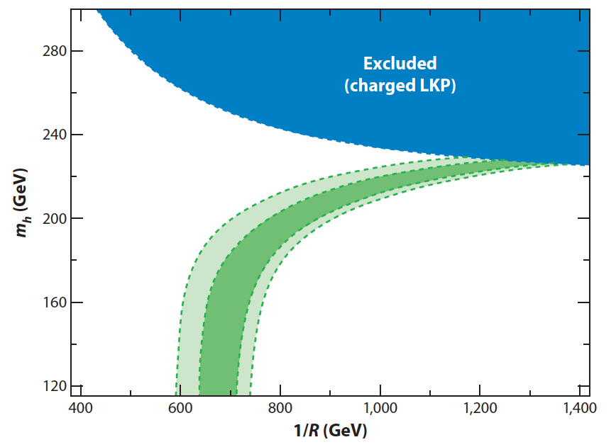
Allowed Region of
Minimum Universal Extra Dimensions
WMAP constraint
Kakizaki 2006

Slide 64
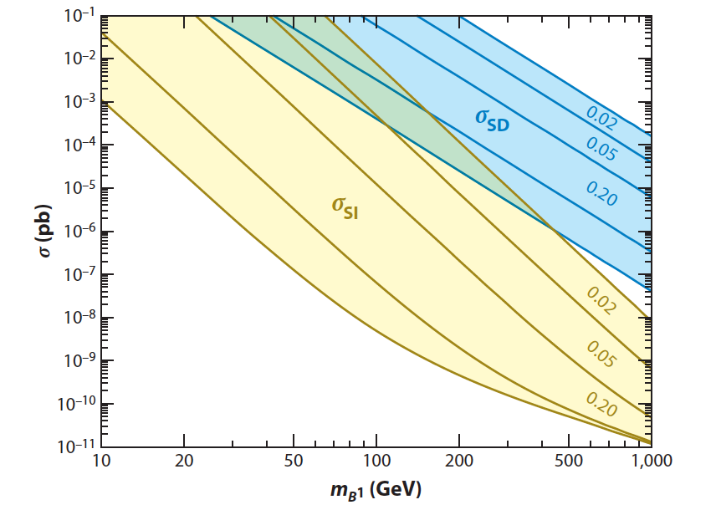
Predicted Cross Section of Kaluza-Klein Dark Matter
0
G1
XENON100
Δ
2011
2012
0.5
G2
XENON1T
Feng Ann. Rev. Astro. Astrophys. 2010.48:495-545

Slide 65
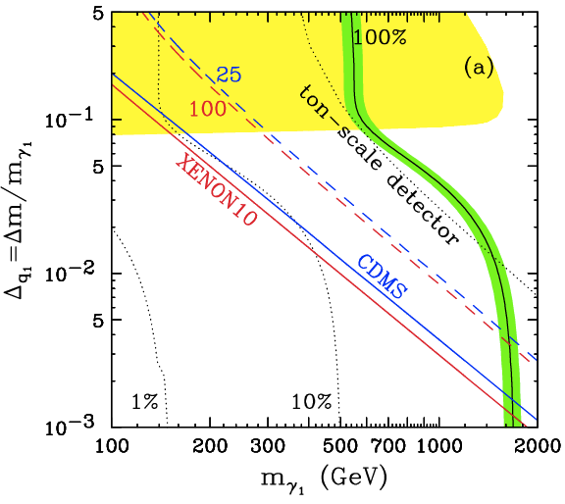
Sensitivity to KK particles
WMAP
0.5
LHC
0.1
0.05
XENON1T
XENON100
Δ = (m_{l} – m_{γ})/m_{γ}
0.01
My favorite
Arrenberg 2008

Slide 66
Summary on “Science Cases”
XENON program (~$10M) is timely and competitive to LHC (~$10B)
  XENON100 ~ Current LHC
  XENON1T ~ Future LHC
If new physics at 100 – 1000 GeV (as it should be), LHC and/or XENON1T will discover WIMPs.
  SUSY - Neutralino
  Extra Dimensions – KK photon
By combining LHC and XENON1T, we have a better chance to untangle large parameter spaces.

Slide 67
G2 & G3 Detectors

Slide 68
G2 and G3 facilities defined by PASAG (2009)
 | G1 | G2 | G3
Sensitivity | < 10⁻⁴⁴ cm² | < 10⁻⁴⁶ cm² | < 10⁻⁴⁷ cm²
Target Mass | 10 – 100 kg | ~ 1 Ton | ~ 10 Ton
Cost | $1M – 5M | $10 – 20M | ~ $100M

Slide 69
Comparison of Xenon Detector Size
G3
MAX, LZD
20 ton (10 ton)
G2
XENON 1ton
2.5 ton (1 ton)
G1
2 m
XENON100
161 kg
(48 kg)
ZEPLIN-II
31 kg
(7.2 kg)
XENON10
14 kg
(5.4 kg)
1 m
1 m
15cm
30cm
14cm
30 cm
20 cm
30 cm
1 m
2 m
2007
2007
2010
2015
2020

Slide 70
Roadmap to MAX
2012
2013
2014
2015
2016
2017
2018
2019
2020
Gran Sasso
DUSEL
MAX
XENON100
XENON 1T
Xe 10T
(Paul Scovell)
(Elena Aprile)
Ar 50T
DarkSide50
DarkSide 5T
(Luca Grandi, Frank Calaprice)
G1
G2
G3
Katsushi Arisaka, UCLA
70

Slide 71
XENON1T (G2) at LNGS
1 m
Xe
(2.2 Ton)
Water Tank

Slide 72
LNGS UnderGround lab – Hall B

Slide 73
LNGS UnderGround lab – Hall B

Slide 74


DarkSide 50 (G1) at LNGS
CTF Water Tank
Liquid
Scintillator
30 cm
Depleted Ar
(50 kg)

Slide 75

DarkSide 5T (G2) at LNGS
CTF Water Tank
Liquid
Scintillator
2 m
⁴⁰Ar
7 ton
(5 ton)

Slide 76


MAX G3 Detector (at DUSEL)
⁴⁰Ar
70 ton
(50 ton)
Xe
20 ton
(10 ton)
4m
2 m
Katsushi Arisaka, UCLA
76

Slide 77

MAX (G3) (at DUSEL)
⁴⁰Ar
20 ton
Xe
6 ton

Slide 78
G1
CMSSM

Slide 79
G1
CMSSM
G2

Slide 80

G1
CMSSM
G2
G3
Xenon
10 ton-year
Argon
50 ton-year

Slide 81

US Dark Matter Programs
2010
Xe
Ar
G3 = Xe (10T) + Ar (50T)
Xe
Ar

Slide 82
Technological Challenges

Slide 83
Where backgrounds come from?
External
Detector materials
Internal impurity
Cosmic Rays
Underground or
Under high mountains
Radio Activities
(U, Th, K…)
Detector
Water Tank
(Liquid Scintillator)

Slide 84
Technological Challenges
External Backgrounds
  Deep underground – DUSEL 4850 ft
  > 5 m water shielding – Water Tank (15 m)
Detector Materials
  Photon Detectors – QUPID
  Cryostat – Titanium
  Others – Copper, PTFE…
Purity of Liquid Xe/Ar
  Radon (< 0.3 mBq / ton)
  ³⁹Ar (> 100 depletion) – Depleted Ar
  ⁸⁵K (< 0.2 ppt in Xe) – 1 event / 10 ton-year
Physics Backgrounds in Xe
  pp-chain solar neutrinos – 1 event / 10 ton-year
  2v Double beta decays from ¹³⁶Xe – 1 event / 10 ton-year
Neutron Active Veto
  Boron doped Liquid Scintillator
Katsushi Arisaka, UCLA
84

Slide 85



QUPID (QUartz Photon Intensifying Detector)
arXiv:1103.3689
Photo Cathode
(-6 kV)
Photo Cathode
(-6 kV)
Quartz
Al coating
APD (0 V)
APD (0 V)
Quartz

Slide 86

Comparison of Low-radioactive
Photon Detectors from Hamamatsu
R8520
1 inch
R8778
2 inch
QUPID
3 inch
DarkSide50
XENON1Ton
MAX, XAX
XENON10
XENON100
LUX
(XMASS)

Slide 87

7 QUPID with Holder
Tested in both Xe and Ar at UCLA
Ready for DarkSide 10

Slide 88

Princeton Prototype Plant for Depleted Argon:

Slide 89
Summary

Slide 90
LHC
Pre
2011
2012
2015
G1
CMSSM
CMSSM
G2
G3
Xenon
10 ton-year
Argon
50 ton-year

Slide 91
Conclusions
Science cases
  Stronger than ever - SUSY, Extra Dimensions…
  Competitive and complementary to LHC
  Extremely timely
Technical challenges
  Xe-G1 (100 kg) well demonstrated by XENON100
  New photon detector (QUPID) developed
  Radioactivity (³⁹Ar, ⁸⁵Kr, Rn) major challenges
Future directions
  G2 : XENON 1T and DarkSide 50 / 5T at Gran Sasso.
  G3 : MAX + LZD (Xe 10T + Ar 50T) at DUSEL

Slide 92

Detection of Cosmic Radiation
Larger Volume
Lower Threshold
2020
JEM-EUSO
2010
Pierre-Auger
ICECUBE
2000
HiRes
AGASA
AMANDA
1990
Cosmic Ray
LBNE
Neutrino
Super-K
IMB
Kamiokande
G3
XENON1T
Future
XENON100
Dark Matter
Ongoing
CDMS-II
XENON10
Past

