Slide 1
MAX & XAX Dark Matter and Neutrino Observatory based on multi-ton Liquid Xenon and Liquid Argon
Katsushi Arisaka
University of California, Los Angeles
Department of Physics and Astronomy
arisaka@physics.ucla.edu

Slide 2






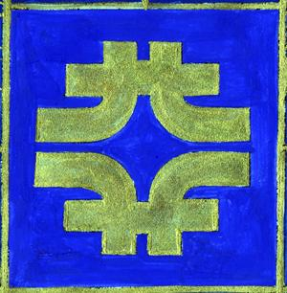












MAX - Multi-ton Argon & Xenon
MAX Collaboration = DarkSide + XENON
UMass Amherst, Arizona State University,
Augustana College, Black Hills State University,
Coimbra University, Columbia University, Fermilab,
University of Houston, INAF, LNG, MIT, University of Münster, University of Notre Dame, Princeton University, Rice University, Temple University, UCLA, University of Virginia,
University of Zürich

Slide 3
Roadmap to MAX
2012
2013
2014
2015
2016
2017
2018
2019
2020
Gran Sasso
DUSEL
MAX
XENON100
XENON 1T
Xe 10T
(Antonio Melgarejo)
(Ran Budnik)
Ar 50T
DarkSide50
DarkSide 5T
(Richard Saldanha)
G1
G2
G3
Katsushi Arisaka, UCLA
3

Slide 4
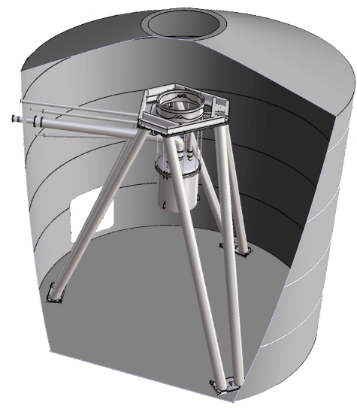
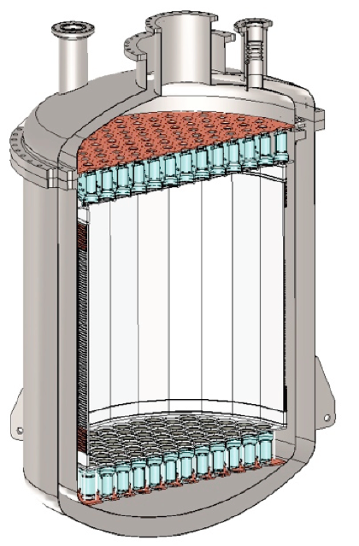
XENON 1T (G2) at Gran Sasso
Ran Budnik’s talk
Xe
2.5 ton
(1 ton)
1 m
10 m
Water
3” PMT x 250

Slide 5
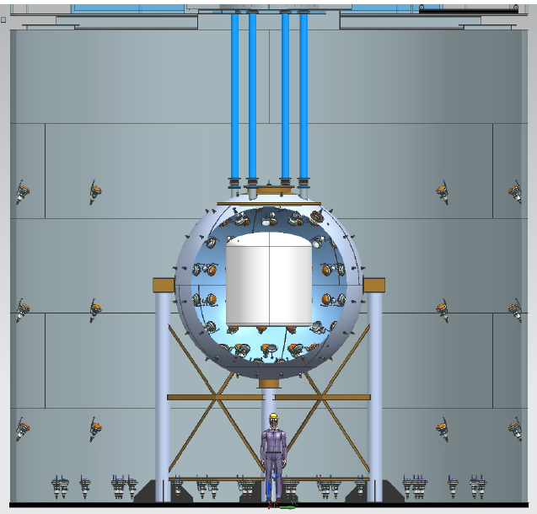
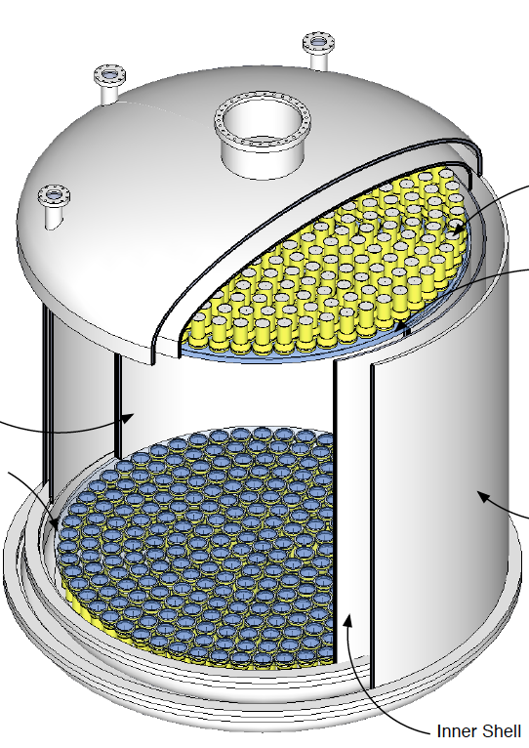
DarkSide 5T (G2) at Gran Sasso
Richard Saldanha’s talk
⁴⁰Ar
5 ton
(3 ton)
Water
2 m
Liq. Scinti.
3” PMT x 600

Slide 6
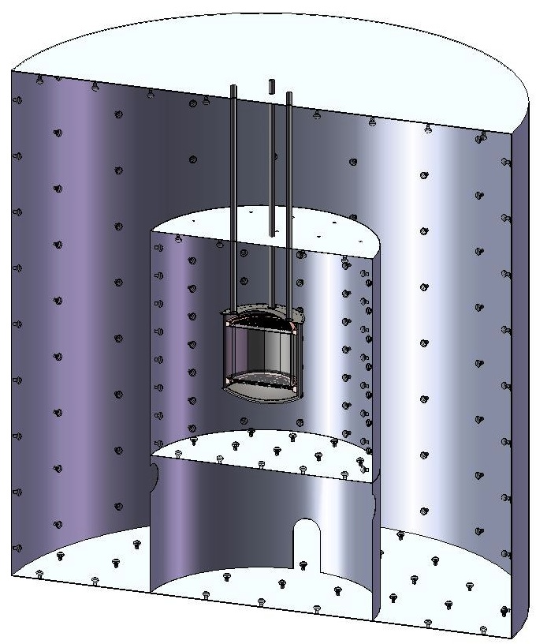
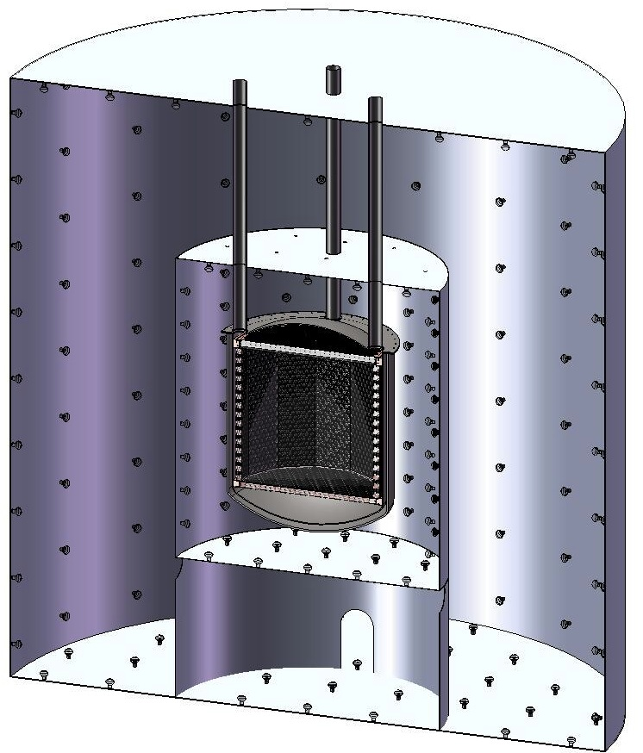
MAX G3 Detector
Xe 20 ton (10 ton)
⁴⁰Ar 70 ton (50 ton)
Xe
Ar
Liquid
Scinti
Liquid
Scinti
Water Tank
Water Tank
6 m
15 m

Slide 7
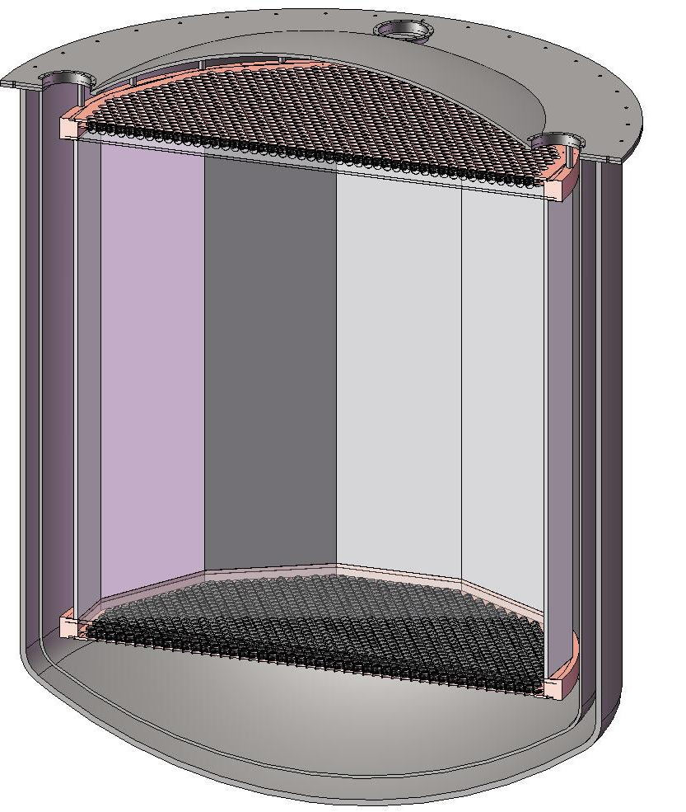
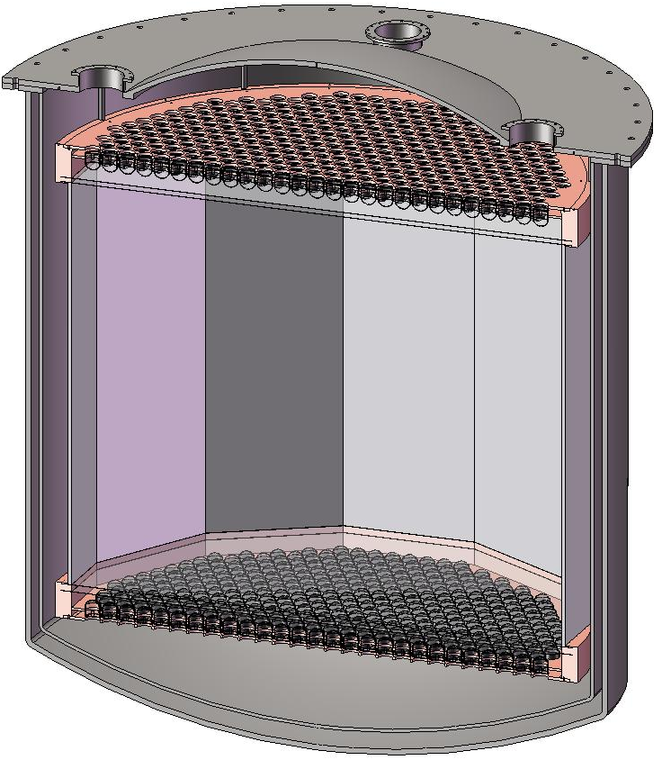
MAX G3 Detector
⁴⁰Ar
70 ton
(50 ton)
Xe
20 ton
(10 ton)
4m
2 m
3” QUPID x 595 (Top)
3” QUPID x 595 (Bottom)
3” QUPID x 2380 (Top)
3” QUPID x 2380 (Bottom)
Katsushi Arisaka, UCLA
7

Slide 8
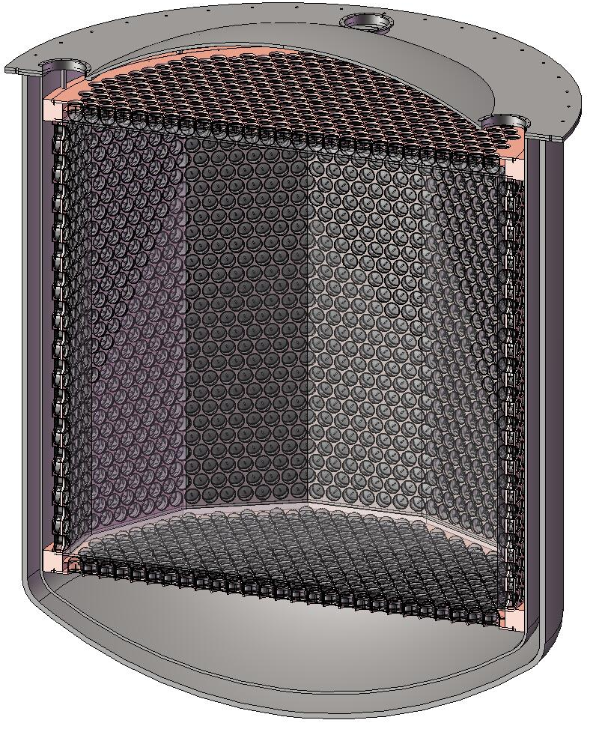
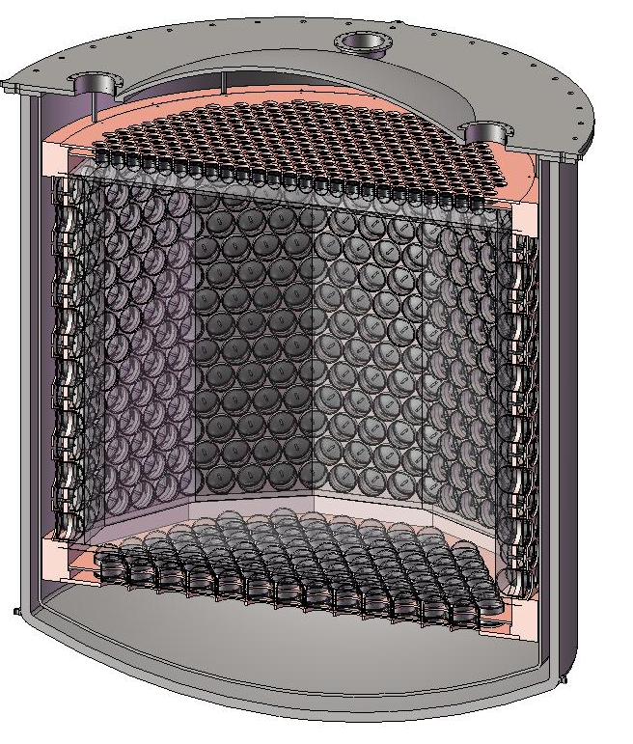
MAX G3 Detector (4π coverage)
⁴⁰Ar
70 ton
(50 ton)
Xe
20 ton
(10 ton)
4m
2 m
3” QUPID x 595 (Top)
6” QUPID x 825 (Side/Bottom)
6” QUPID x 3746

Slide 9
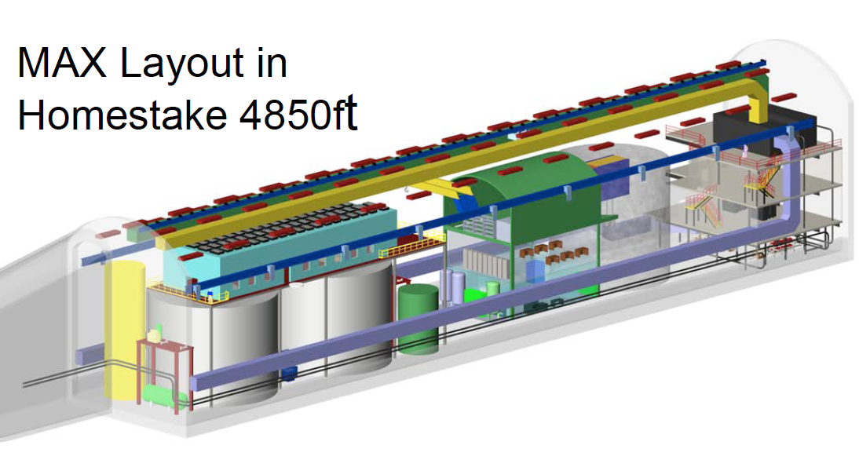
MAX G3 Detector (at DUSEL)
⁴⁰Ar
70 ton
(50 ton)
Xe
20 ton
(10 ton)

Slide 10
G1
CMSSM

Slide 11
G1
CMSSM
G2

Slide 12
G1
CMSSM
G2
Xe
G3
Ar

Slide 13
LHC
Pre
2011
2012
2015
G1
CMSSM
G2
Xe
G3
Ar

Slide 14
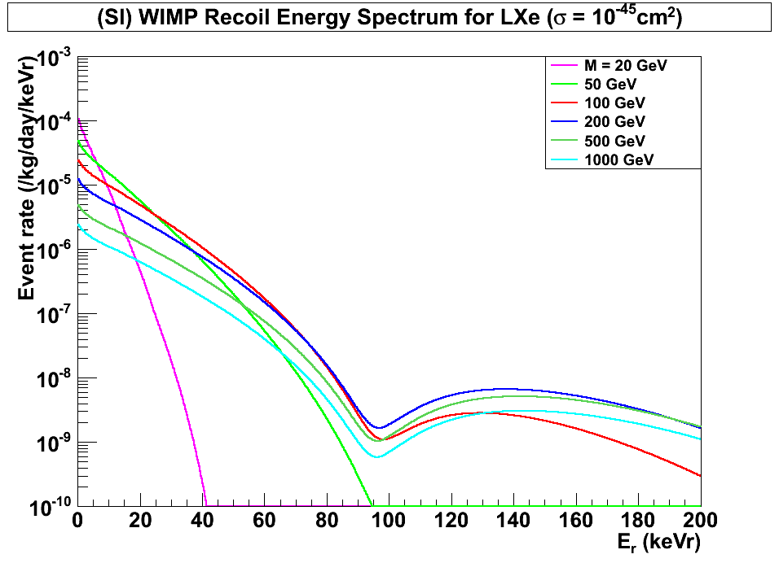
(SI) WIMP Energy Spectrum for LXe (Cross Section = 10⁻⁴⁵cm²)
Xenon
8 keVr
45 keVr
200 GeV
100 GeV
500 GeV
1000 GeV
20 GeV
50 GeV
Katsushi Arisaka, UCLA
14

Slide 15
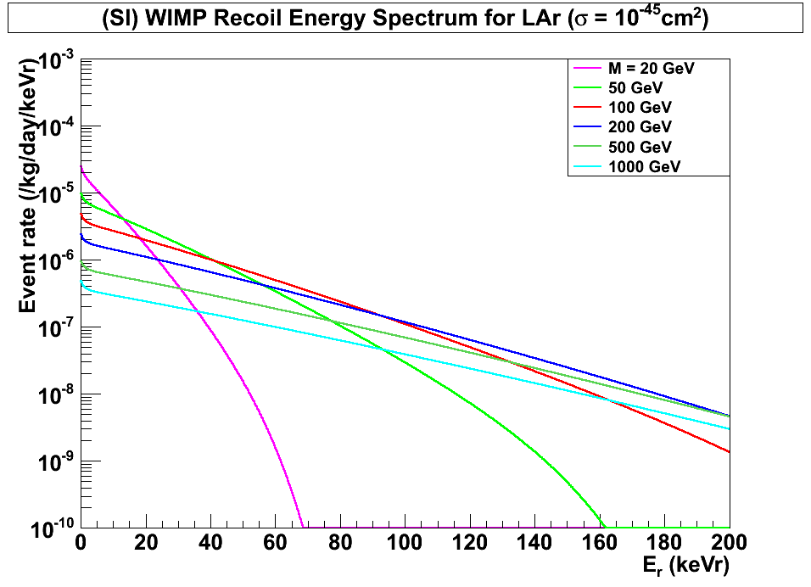
(SI) WIMP Energy Spectrum for LAr (Cross Section = 10⁻⁴⁵cm²)
Argon
(w/ pulse shaping)
40 keVr
200 keVr
100 GeV
500 GeV
1000 GeV
200 GeV
20 GeV
50 GeV
Katsushi Arisaka, UCLA
15

Slide 16
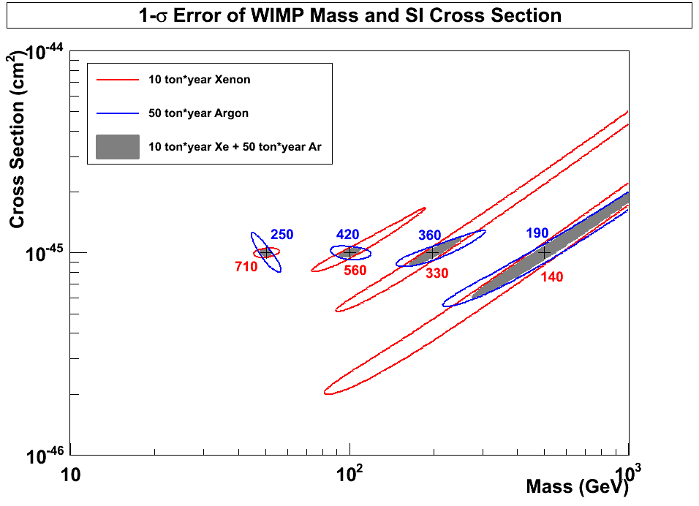
1-σ Error of WIMP Mass vs SI Cross Section (10 ton*year Xe and 50 ton*year Ar)
50 GeV
100 GeV
200 GeV
500 GeV
Argon
10⁻⁴⁵ cm²
Xenon
Katsushi Arisaka, UCLA
16

Slide 17
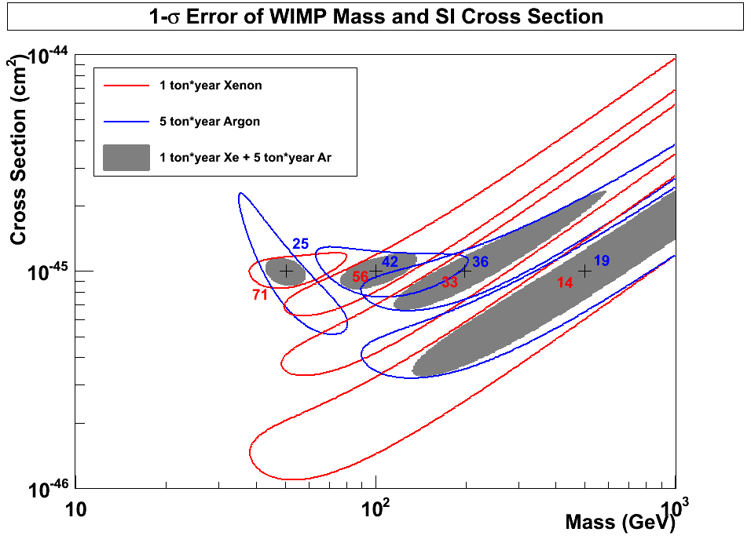
1-σ Error of WIMP Mass vs SI Cross Section (10 ton*year Xe and 50 ton*year Ar)
10⁻⁴⁵
10
50
10
50
Argon
50 GeV
100 GeV
200 GeV
500 GeV
10⁻⁴⁶
10⁻⁴⁶ cm²
Xenon
10⁻⁴⁷
Katsushi Arisaka, UCLA
17

Slide 18
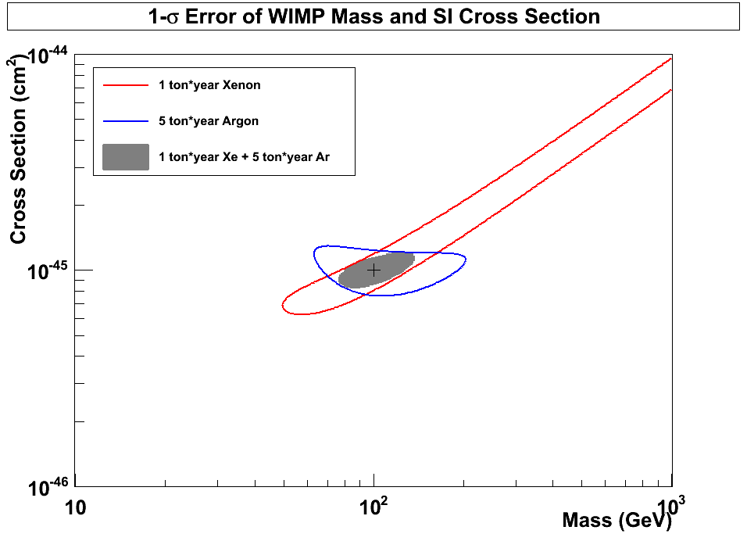
1-σ Error of WIMP Mass vs SI Cross Section (10 ton*year Xe and 50 ton*year Ar)
10⁻⁴⁵
10
50
Xenon
(56 events)
10
50
10⁻⁴⁶
10⁻⁴⁶ cm²
Argon
(42 events)
100 GeV
10⁻⁴⁷
Katsushi Arisaka, UCLA
18

Slide 19
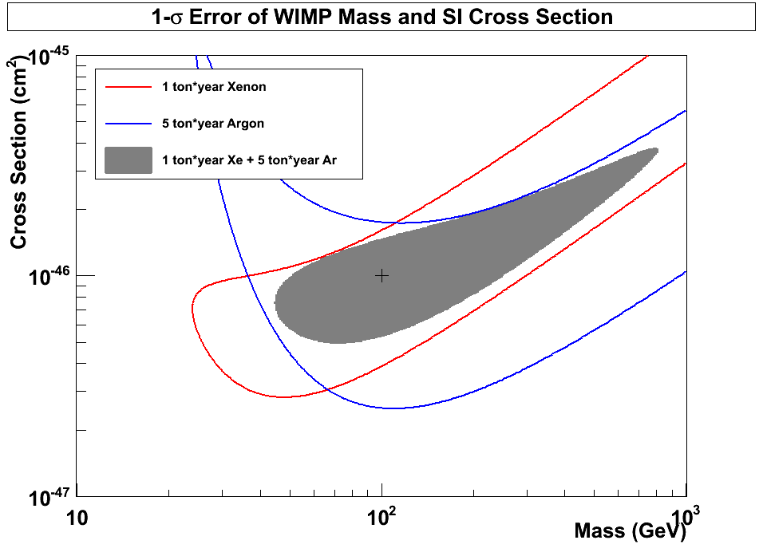
1-σ Error of WIMP Mass vs SI Cross Section (10 ton*year Xe and 50 ton*year Ar)
10⁻⁴⁶
10
50
Xenon
(5.6 events)
10
50
10⁻⁴⁷
10⁻⁴⁷ cm²
Argon
(4.2 events)
100 GeV
10⁻⁴⁸
Katsushi Arisaka, UCLA
19

Slide 20
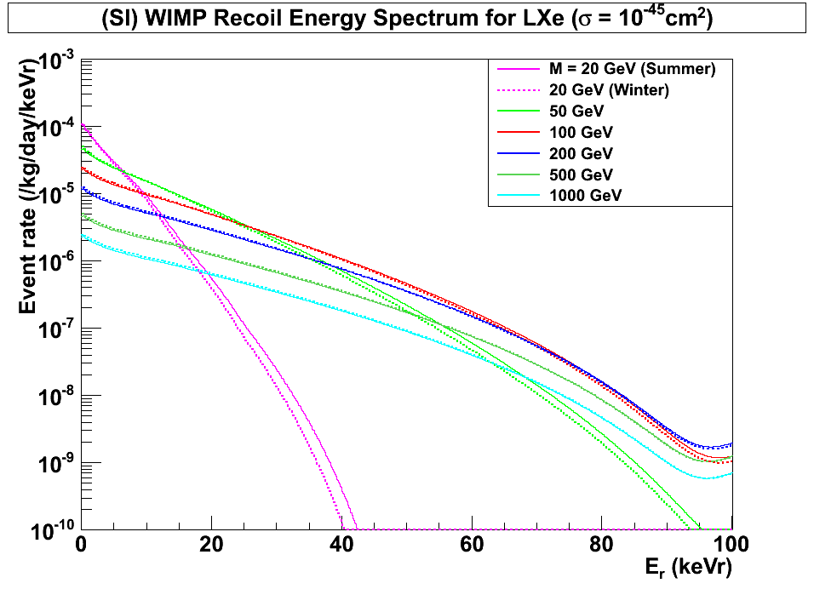
(SI) WIMP Energy Spectrum for LXe (Cross Section = 10⁻⁴⁵cm²)
Xenon
8 keVr
45 keVr
200 GeV
100 GeV
500 GeV
1000 GeV
20 GeV
50 GeV
Summer
Winter
Katsushi Arisaka, UCLA
20

Slide 21
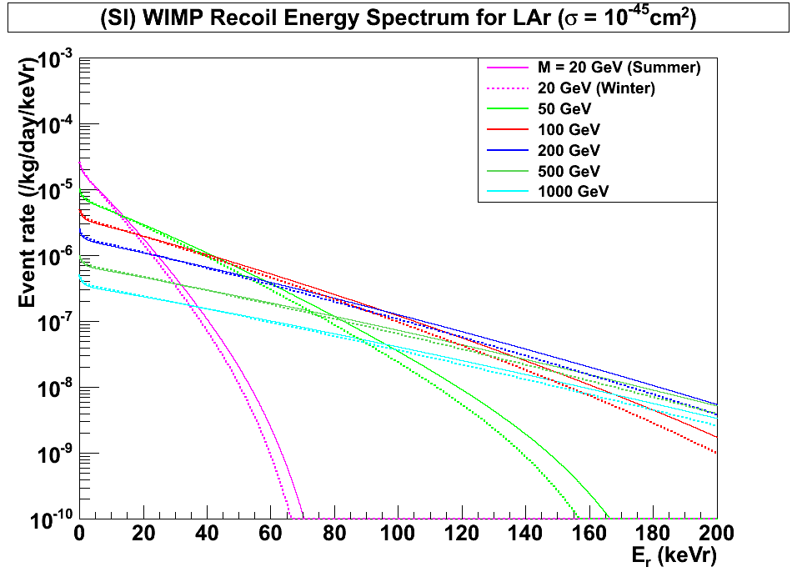
(SI) WIMP Energy Spectrum for LAr (Cross Section = 10⁻⁴⁵cm²)
Argon
40 keVr
200 keVr
100 GeV
500 GeV
1000 GeV
200 GeV
20 GeV
50 GeV
Summer
Winter
Katsushi Arisaka, UCLA
21

Slide 22
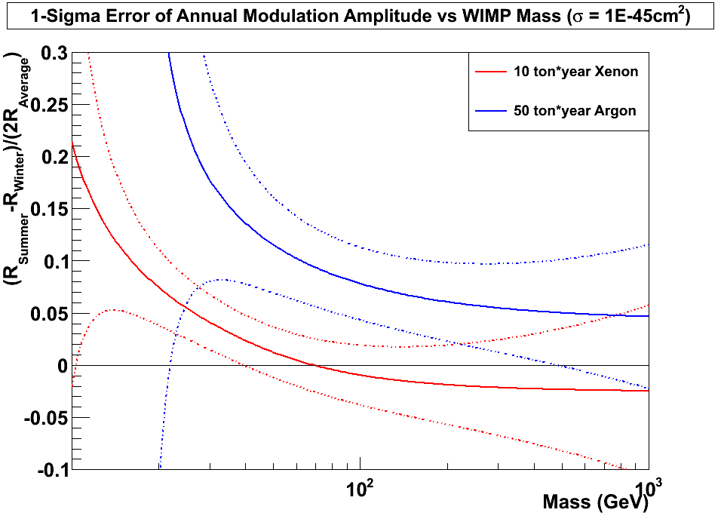
±1σ Error of Annual Modulation Amplitude vs WIMP Mass (10 ton*year Xe and 50 ton*year Ar, Cross Section = 10⁻⁴⁵cm²)
10⁻⁴⁵ cm²
Argon
Xenon
±1σ
±1σ
10
Katsushi Arisaka, UCLA
22

Slide 23
Technological Challenges
External Backgrounds
Deep underground – DUSEL 4850 ft
> 5 m water shielding – Water Tank (15 m)
Detector Materials
Photon Detectors – QUPID
Cryostat – Copper (OHFC)
Others – PTFE, Quartz …
Purity of Liquid Xe/Ar
Radon (< 0.3 mBq / ton)
³⁹Ar (> 100 depletion) – Depleted Ar
⁸⁵K (< 0.2 ppt in Xe) – 1 event / 10 ton-year
Physics Backgrounds in Xe
pp-chain solar neutrinos – 1 event / 10 ton-year
2v Double beta decays from ¹³⁶Xe – 1 event / 10 ton-year
Katsushi Arisaka, UCLA
23

Slide 24
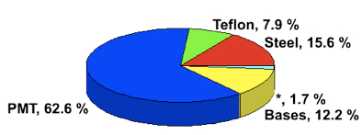
Where backgrounds come from?
Cosmic Rays
Underground or
Under high mountains
XDNON100
Radio Activities
(U, Th, K…)
Xe/Ar
Water Tank
+ Liquid Scintillator
Photon detectors are the major source of backgrounds.

Slide 25
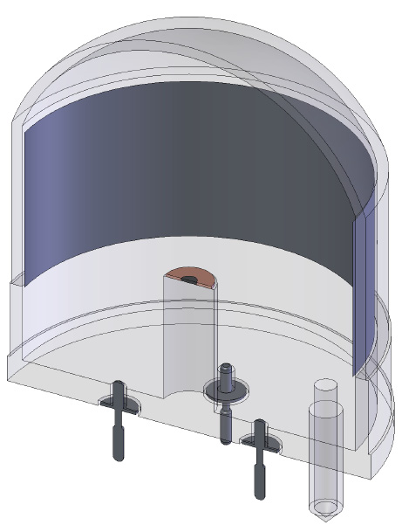
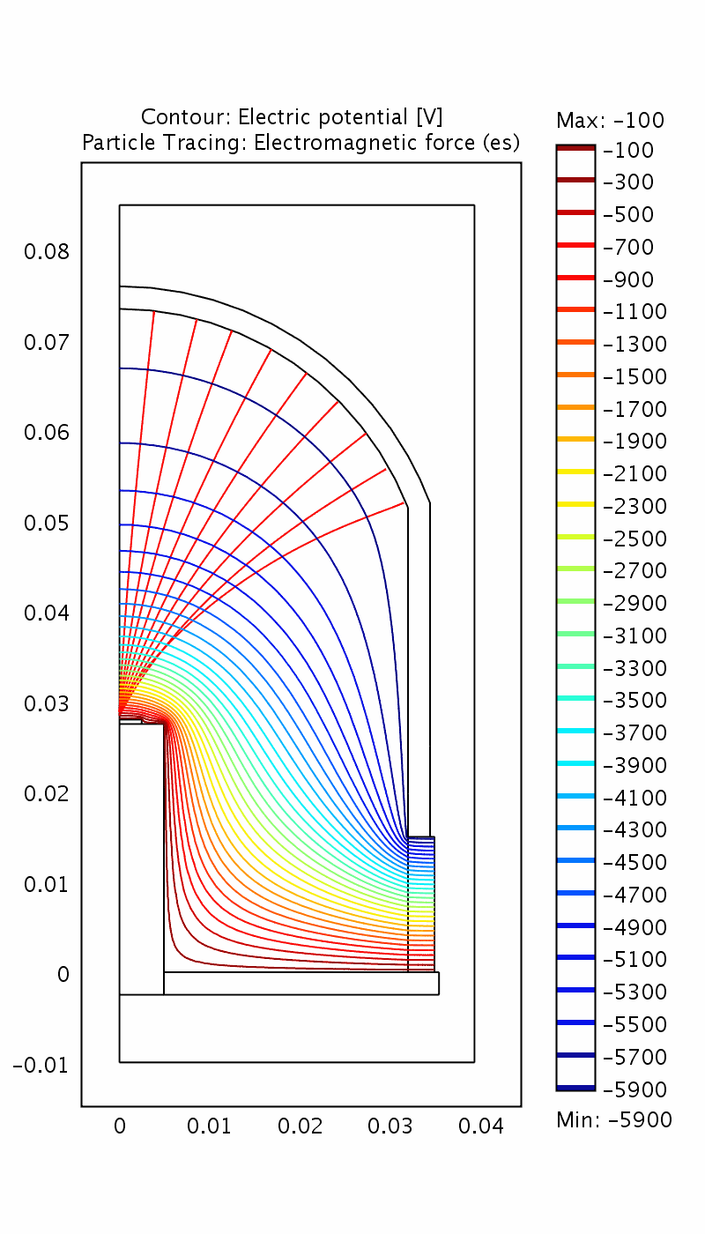
QUPID (QUartz Photon Intensifying Detector)
Photo Cathode
(-6 kV)
arXiv:1103.3689
Photo Cathode
(-6 kV)
Quartz
Al coating
APD (0 V)
APD (0 V)
Quartz
Katsushi Arisaka, UCLA
25

Slide 26
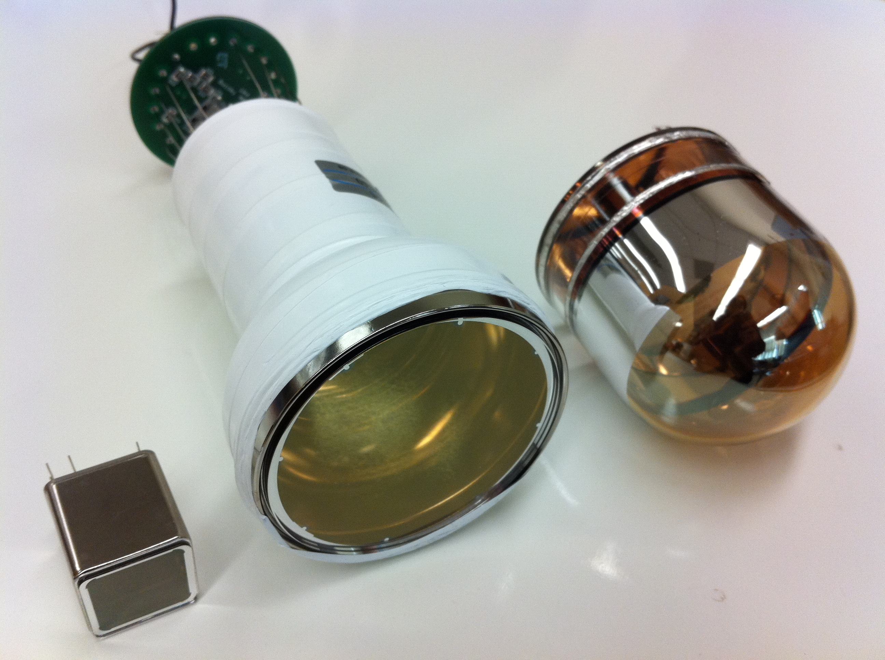
Comparison of Photon Detectors from Hamamatsu
R11065 (Ar)
R11410 (Xe)
3 inch
QUPID
3 inch
MAX
XAX
XENON1T
DarkSide50
R8520
1 inch
XENON10
XENON100
U/Th ~ 0.1 mBq
U/Th ~ 5 mBq
U/Th ~ 1 mBq
Confirmed by ICP/GD-MS

Slide 27
QE of two types of QUPID
Xenon (178 nm)
Argon + TPB (420 nm)
Katsushi Arisaka, UCLA
27

Slide 28
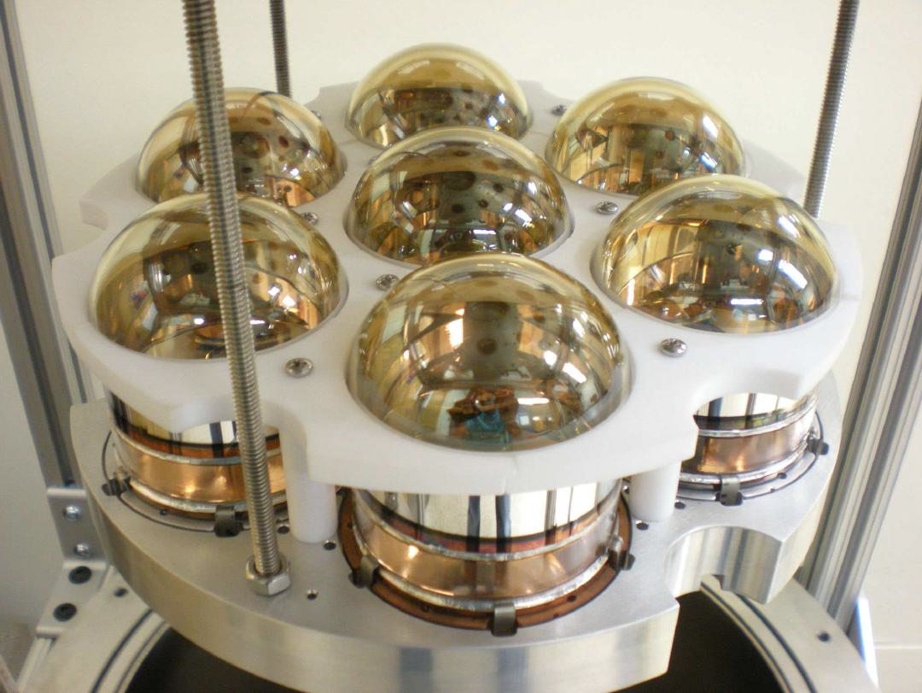
7 QUPID with Holder
Tested in both Xe and Ar at UCLA

Slide 29
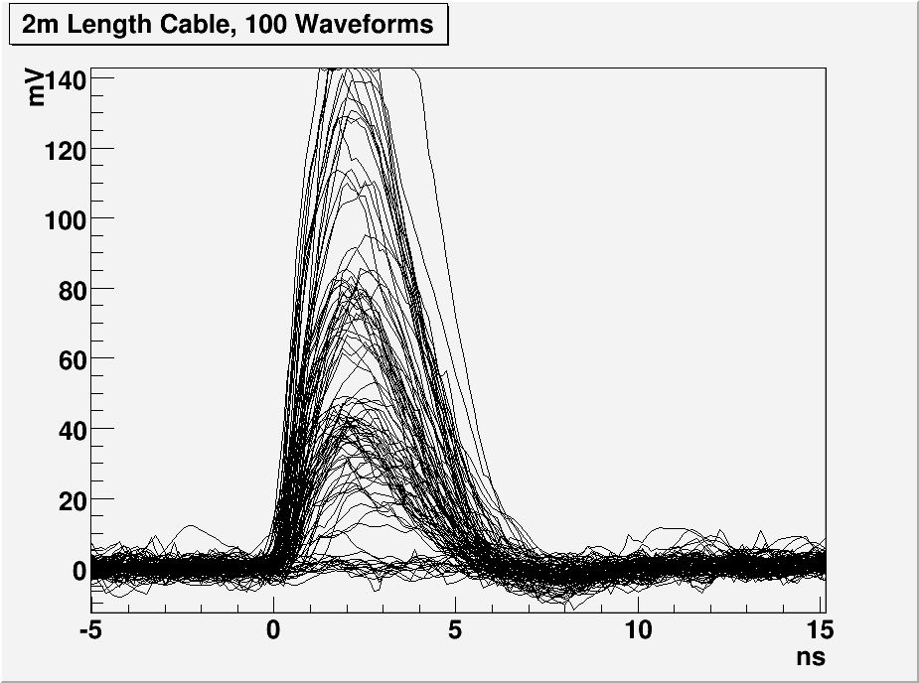
1, 2 and 3 PE Distribution with 2 m cable
3 PE
G = 800 × 200
= 160,000
TTS = 160 ps (FWHM)
2 PE
1 PE
Katsushi Arisaka, UCLA
29

Slide 30
PE Distribution up to 10 kV
2 PE
1 PE
3 PE
4 PE
5 PE

Slide 31
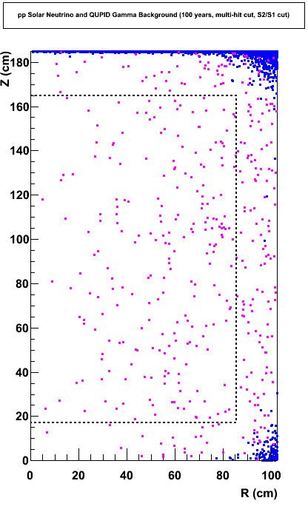
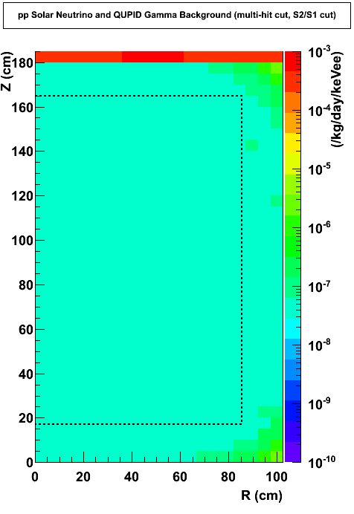
Expected Background from Gammas and pp Solar Neutrinos (100 Year, Multi-hit Cut, S2/S1 Cut)‏
γ’s from QUPID
XENON100
2 γ /10 ton-year
(pp solar neutrino
+ 2v DBD)
5 × 10^{–8} DRU
Xenon
10 ton
Katsushi Arisaka, UCLA
31

Slide 32
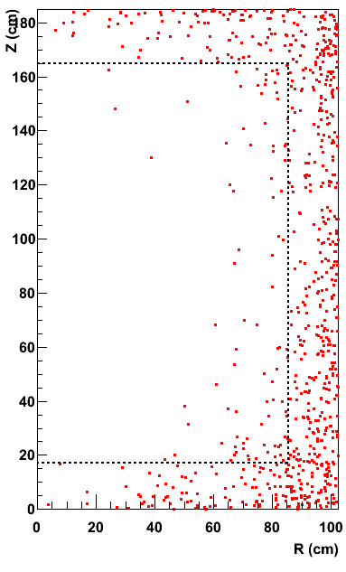
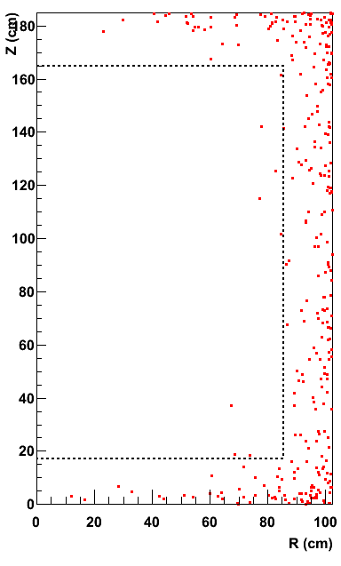
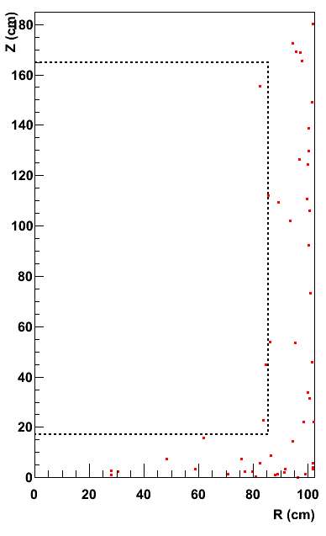
Xe 10 ton Neutron Background (100 Years)
arXiv:1107.1295
1/8
1/4
Before Cuts
Multi Hit Cut
Liquid Scinti. Veto
0.81 n / year
0.10 n / year
0.03 n / year
Xenon
10 ton
Katsushi Arisaka, UCLA
32

Slide 33
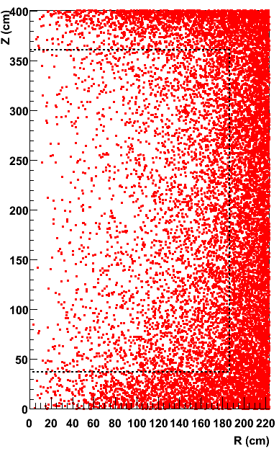
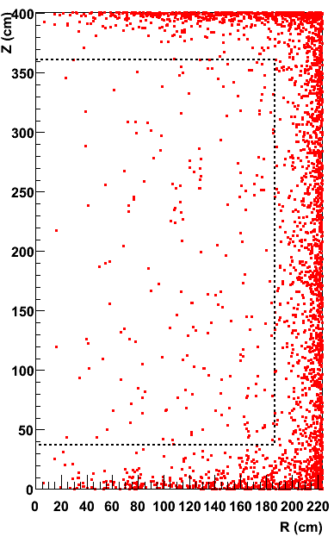
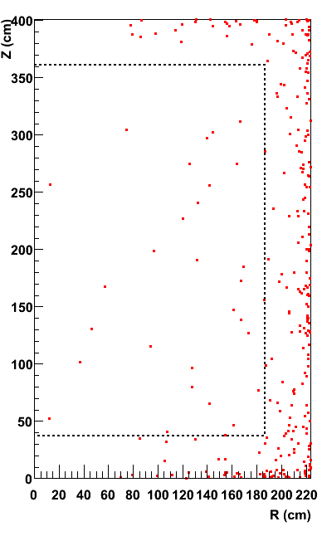
Ar 50 ton Neutron Background (100 Years)
arXiv:1107.1295
1/20
1/6
Before Cuts
Multi Hit Cut
Liquid Scinti. Veto
42 n / year
2.1 n / year
0.39 n / year
Argon
50 ton
Katsushi Arisaka, UCLA
33

Slide 34
XAX (Xenon-Argon-Xenon)
arXiv:0808.3968
WIMP (Spin even)
Double Beta Decay
WIMP (Spin odd)
pp Solar Neutrino
WIMP (Spin even)
⁴⁰Ar
70 ton
(50 ton)
^{129/131}Xe
12 ton
(5 ton)
¹³⁶Xe
8 ton
(5 ton)
1.2 m
2 m
4 m

Slide 35

Concept of Double Layer XAX
0 V
Acrylic Sheet
+ ITO + TPB Coating
Gas Xe
-10 kV
-17.5 kV
TPB + ATO
+ Acrylic Vessel
+ ITO Coating
^{129/131}Xe
12 ton
TPB + ATO
+ Thin Acrylic Sheet
+ ATO + TPB
2 m
¹³⁶Xe
8 ton
-10 kV
Radiation-free
Photon Detectors
(QUPID)
-200 kV
TPB + ITO
Acrylic Sheet
+ ITO Coating
-10 kV
2 m

Slide 36
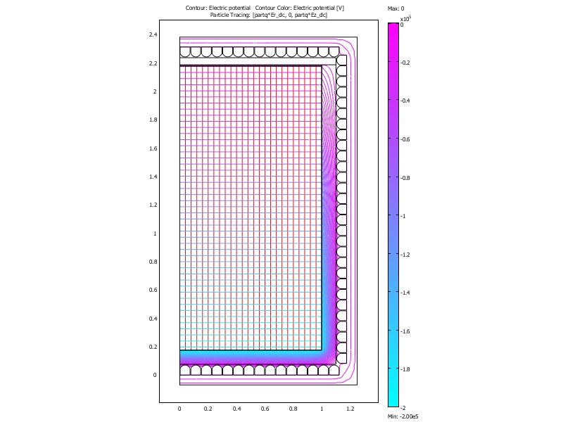
Equipotential lines and Electron Trajectories
0 V
-6 kV
ITO (Indium Tin Oxide)
Transparent Conductive
Coating (~1 kΩ⁄☐)
-13.5 kV
ATO (Antimony Tin Oxide)
Transparent Resistive
Coating (~ 1 GΩ⁄☐)
Electron
Trajectories
ITO (Indium Tin Oxide)
Transparent Conductive
Coating (~1 kΩ⁄☐)
-200 kV
-6kV
0 V

Slide 37
Why Multiple Targets?
Systematic Study of Dark Matter
Precise determination of Mass and Cross section
Xenon vs. Argon
Spin dependence of Cross section
^{129/131}Xe (Spin odd) vs. ^{132/134/136}Xe (Spin even)
Low Energy Neutrino Physics
Neutrino-less Double Beta Decay – τ > 10²⁸ by ¹³⁶Xe
Solar Neutrino – 1% of pp chain flux by ^{129/131}Xe
Supernova Neutrino – 10% of total E_{ν} and T_{ν}

Slide 38
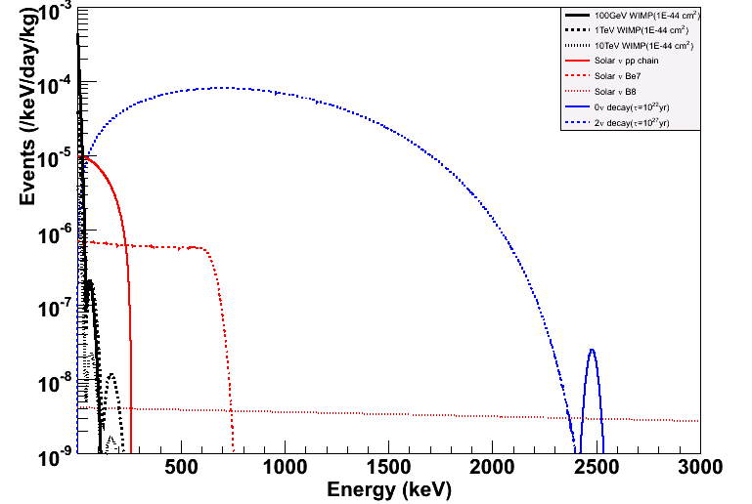
Energy Spectrum (Natural Xe)
arXiv:0808.3968
100 GeV WIMP (10⁻⁴⁴ cm²)
2ν DBD (10²² yrs)
pp Solar
Be7 Solar
0ν DBD (10²⁷ yrs)
B8 Solar

Slide 39
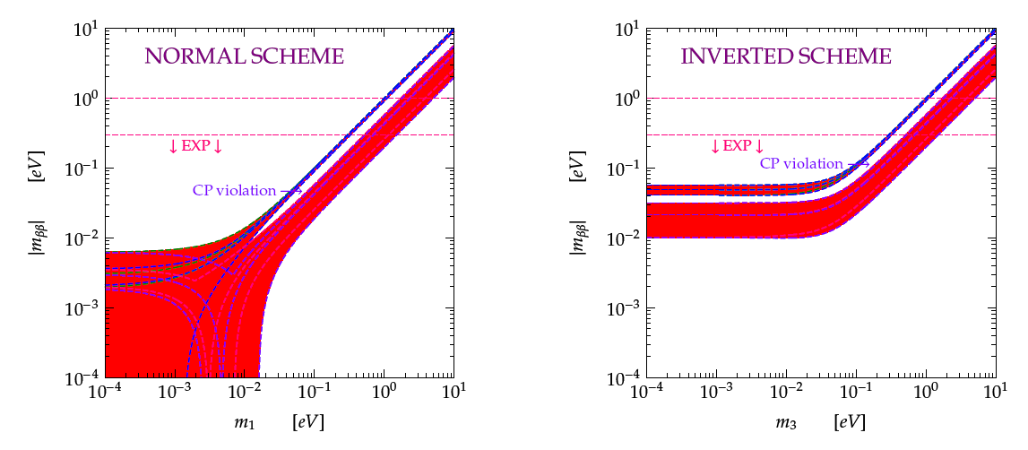
Sensitivity of Neutrinoless Double Beta Decay
to Neutrino Mass
Normal Scheme
Inverted Scheme
DBD
Life Time
10²⁶ yr
10²⁷ yr
10²⁸ yr
Cosmology
Cosmology
(Figure from C. Giunti)

Slide 40
Expected No. of DBD Signals and Backgrounds (10 ton-year of Liquid Xenon, Window = 2479 ± 25 keV)
No. of Background Events
No. of 0-Neutrino DBD Signals
19.2 ton
14.0 ton
9.8 ton
6.6 ton
Self Shielding Cut (cm from wall)
Life Time (Year)

Slide 41
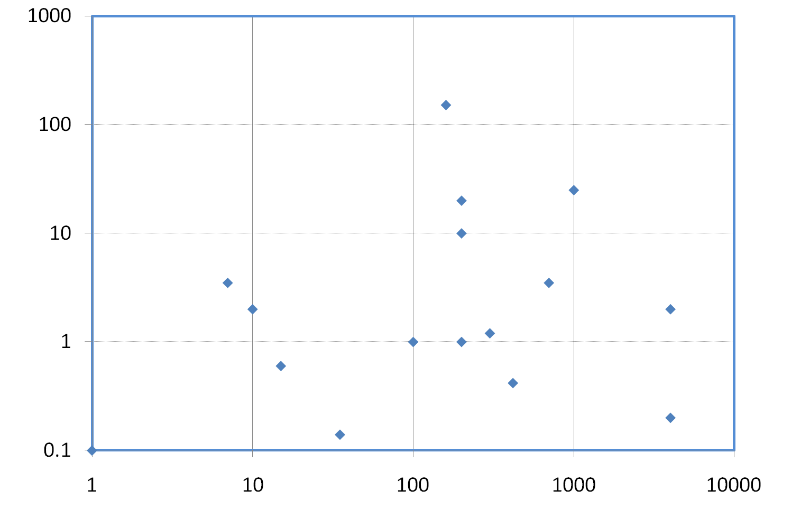
Double Beta Decay Experiments (with <0.03 mBq QUPID)
EXO200
CANDLES III
EXO 1Ton
No. of Backgrounds (/year)
10²⁵ yrs
10²⁶ yrs
10²⁷ yrs
10²⁸ yrs
CUORE I
NEMO3 (Mo)
XENON1T
CUORE III
Cuoricino
XAX (Natural)
Super-NEMO (Se)
GERDA I
GERDA III
XAX (Enriched)
CUORE II
COBRA
EXO 1Ton
(Ba tag)
NEMO3
(Se)
GERDA II
Mass (kg)

Slide 42
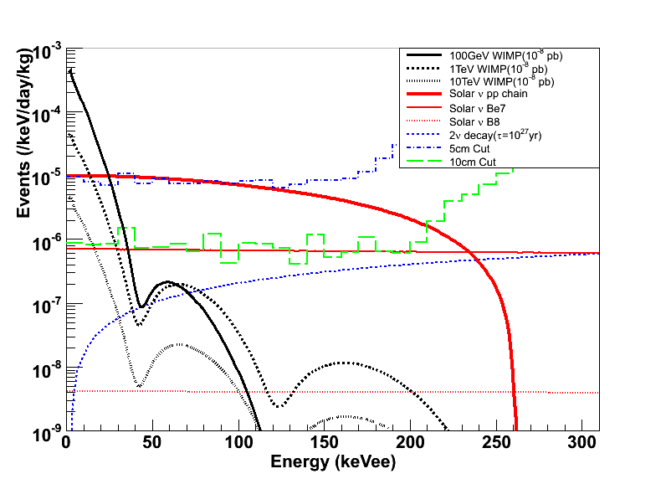
Solar Neutrino Energy Spectrum (¹³⁶ Xe depleted)
100 GeV WIMP (10⁻⁸ pb)
pp Solar Neutrino
γ BG (5 cm cut)
γ BG (10 cm cut)
Be7 Solar Neutrino
2ν DBD (5E21 yrs)
10 TeV
1 TeV
B8 Solar Neutrino
11/16/12
Katsushi Arisaka, UCLA

Slide 43
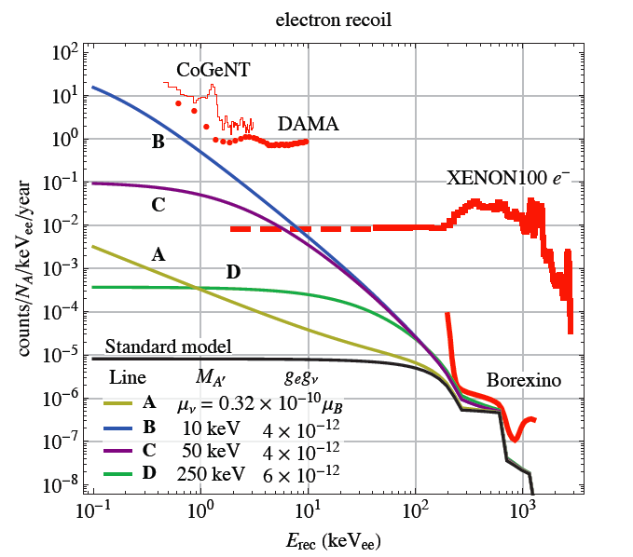
Solar Neutrino with a Magnetic Dipole Moment or a New Light Gauge Boson A’
#events / 10 ton-year
(10 – 200 keVee)
100,000
10,000
1,000
XAX
Harnik, Kopp, arXiv:1202.6703

Slide 44
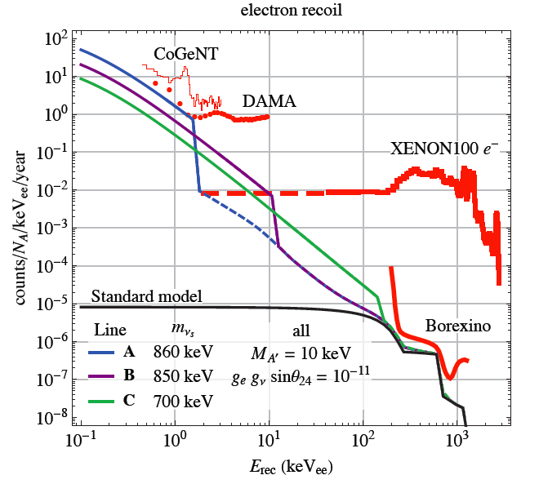
Solar Neutrino with a Heavy Sterile Neutrino
#events / 10 ton-year
(10 – 200 keVee)
100,000
10,000
1,000
XAX
Harnik, Kopp, arXiv:1202.6703

Slide 45
Summary of MAX & XAX
 |  | XENON1T DarkSide G2 |  | MAX |  | XAX
 |  | Xenon | Argon | Xenon | Argon | ^{129/131}Xe | ¹³⁶Xe (80%)
Dimension
 | Detector Size | 1m x 1m | 1..6m x 1.6m | 2m x 2m | 4m x 4m | 2m x 2m
 | Total Mass | 2.2 ton | 5 ton | 20 ton | 70 ton | 12 ton | 8 ton
 | Fiducial Mass | 1.1 ton | 3 ton | 10 ton | 50 ton | 5 ton | 5 ton
QUPID
 | Top | 130 (3") | 300 (3") | 595 (3") | 661 (6") | 595 (3")
 | Side | 0 | 0 | 672 (6") | 2423 (6") | 672 (6")
 | Bottom | 121 (3") | 300 (3") | 163 (6") | 661 (6") | 163 (6")
No.WIMP / year (10⁻⁴⁵ cm²)
 | Mass = 20 GeV | 23 | – | 230 | – | 115 | 115
 | 50 GeV | 71 | 15 | 710 | 250 | 355 | 355
 | 100 GeV | 56 | 25 | 560 | 420 | 280 | 280
 | 200 GeV | 33 | 22 | 330 | 360 | 165 | 165
 | 500 GeV | 14 | 11 | 140 | 190 | 70 | 70
Backgrounds / year
 | Gammas | 0.07 | 0.00 | 0.01 | 0.00 | 0.07 | 0.01
 | Neutrons (w/o LS) | 0.10 | 0.5 | 0.10 | 2.1 | 0.10 | 0.00
 | Neutrons (w/ LS) | – | 0.06 | 0.03 | 0.39 | 0.03 | 0.00
Neutrinos / year
 | 0ν DBD (10²⁷ yr) | 0.4 | – | 3.3 | – | – | 38
 | pp-solar | – | – | – | – | 2500 | –
 | Supernova (10 kpc) | 11 | 8 | 95 | 141 | 48 | 48

Slide 46
Conclusions
MAX
10 Ton Xe + 50 Ton Ar
Consortium between XENON and DarkSide
Sensitivity down to 10⁻⁴⁸ cm²
Precision measurements if > 10⁻⁴⁶ cm²
XAX
5 Ton ¹³⁶Xe + 50 Ton Ar + 5 Ton ^{129/131}Xe
Neutrino-less Double Beta Decay – τ > 10²⁸ by ¹³⁶Xe
Solar Neutrino – 1% of pp chain flux by ^{129/131}Xe.
Supernova Neutrino – 10% of total E_{ν} and T_{ν}

