Slide 1
Vacuum based Photon Detectors
Katsushi Arisaka
University of California, Los Angeles
Department of Physics and Astronomy
arisaka@physics.ucla.edu

Slide 2
Outline
Concept of Photomultiplier
Basic Properties
QE, Gain, Time Response
Imperfect Behavior of PMT
Linearity, Uniformity, Noise…
Other Vacuum Devices
Hybrid PD/APD
Applications
Energy Resolution
Summary

Slide 3
Concept of PMT

Slide 4
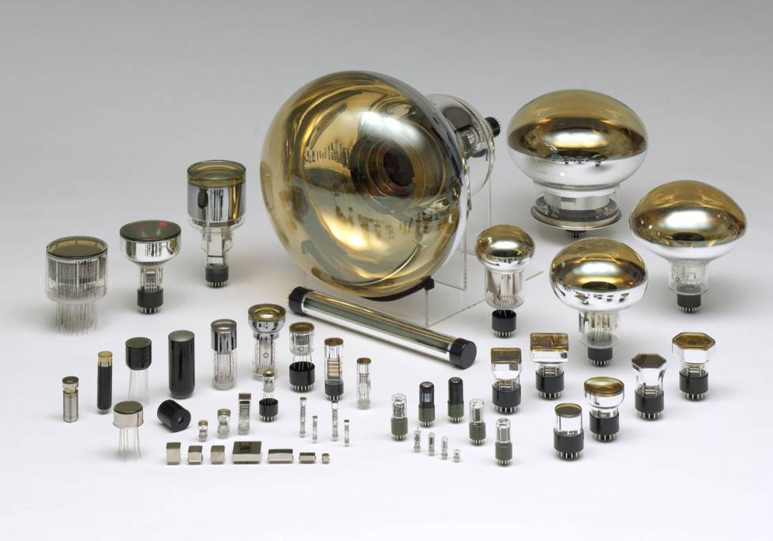
PMT (Photomultiplier Tube)
Notes:
PMT is a vacuum photo-sensor, which converts light into electric signal.
The prime features are high sensitivity and fast time response with large area.
Some of Silicon PD have faster time response, but its effective area is very small like 1mm or less.
PMT has variety of sizes, its range is from 10 mm to 500 mm. There are several shapes such as round, square, hexagonal and cylindrical like this.

Slide 5
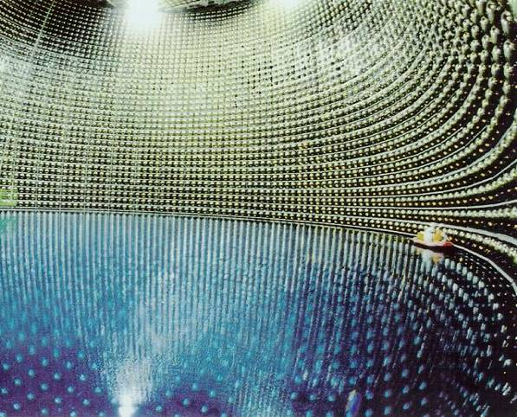
Super-Kamiokande
11,200 of 20” PMTs

Slide 6
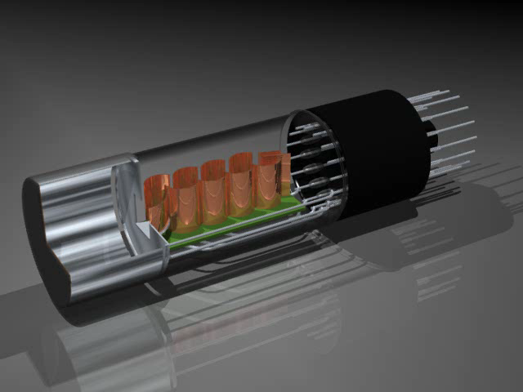

Slide 7



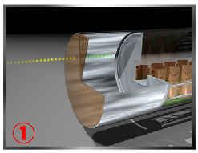
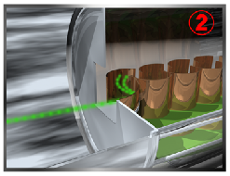
Operation of Head-On Type PMT
signal light->photoelectron
photoelectron->Dy1
electron-> multiplication
cascade multiplication
electric signal from anode
Notes:
This slide shows basic operation of a HEAD-ON PMT. When signal light enters to a photocathode, it emits photoelectron into vacuum.
The photoelectron is accelerated by electric field inside, and then reaches to first Dynode.
The dynode emits secondary electrons, and they are accelerated to next dynode. This process is repeated like this.
Finally electric signal is taken from anode.
Nobody has seen it yet, but you can see how electrons are moving inside of PMT with this movie.

Slide 8
Structure of Linear-focus PMT
Photo Cathode
Second Last
Dynode
First Dynode
QE
δ₁
N_{γ}
CE
δ₃
Photons
δ_{n}
δ₂
G = δ₁⋅δ₂⋅δ₃ ⋅⋅⋅ δ_{n}
E=N_{γ}⋅QE⋅CE⋅G
Glass Window
Mesh Anode
Last Dynode

Slide 9
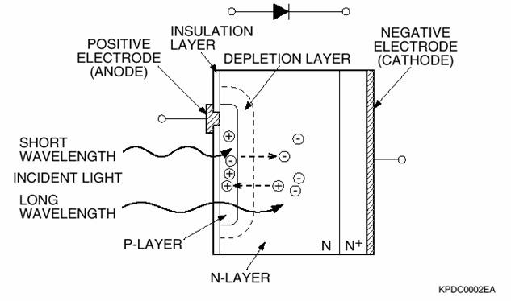
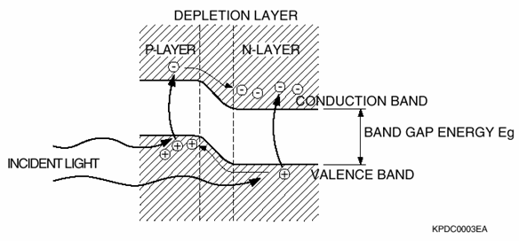
Principle of Silicon Photodiode
Gain = 1.0
QE ~ 100%
Extremely Stable
Large Dynamic Range

Slide 10
FAQ
Why still PMT? Why not Silicon Photodiode?
Intrinsically high gain
Low noise – photon counting
Fast speed
Large area
but
Poor Quantum Efficiency
Bulky
Expensive

Slide 11
Purpose of Photon Detector
Observe all the quantities of photons as accurate as possible.
The number of photons: E
Arrival time of photons: T
Position of photons: X, Y, Z
Primary purpose of vacuum detectors:
Very small number of photons: < 100 photons
Accurate time of photons: < 10 nsec

Slide 12
Basic Properties

Slide 13
Outline
Fundamental Parameters of PMT
Quantum Efficiency (QE)
Photoelectron Collection Efficiency (CE)
Gain (G)
Excess Noise Factor (ENF)
How to Measure These Parameters
Energy Resolution (σ/E)

Slide 14
Quantum Efficiency (QE)

Slide 15
Quantum Efficiency (QE)
Definition:
The single most important quantity

Slide 16
QE curves of 6 types
VUV
UV
Visible
Infra-Red
Notes:
This slide shows QE curves of 6 types of photocathode. Transverse axis is wavelength and vertical axis is QE.
Bialkali is popular, it’s suitable for scintillation counting. Multialkali (S-20) is also popular, it’s suitable for fluorescence detection.
This is called S-25, that is RED enhanced Multialkali, which is used for NOX detector (air pollution monitor).
Blue one is CsTe, which has solar blind characteristic. These 4 types are called alkali photocathode.
On the contrary, this is GaAsP and this is GaAs. These are called semiconductor photocathode.
GaAsP has highest sensitivity from 400nm to 700nm, but there are some demerits such that large size can’t be made and cost is expensive.
In any case, popular photocathode is bialkali and next is Multialkali photocathode.

Slide 17
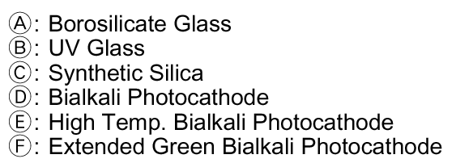
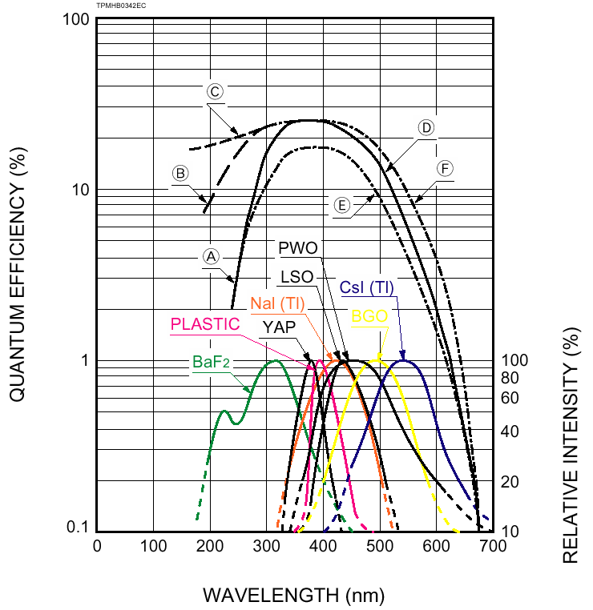
Typical QE
Bialkali:
Sb-Rb-Cs
Sb-K-Cs

Slide 18
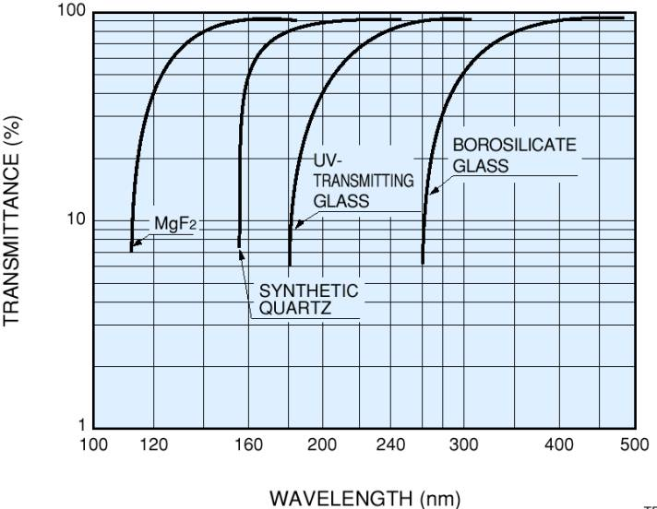
Transmittance of windows
popular
Wavelength is Shorter
More Expensive
VUV
UV
Visible
Notes:
This graph shows transmittance of windows, that is faceplates. Transverse axis is wavelength, vertical axis is transmittance.
These are names of wavelength region. VUV (10-200nm) stands for vacuum ultra violet, UV (200-380nm) is ultra violet, and visible (380-780nm) is visible.
The difference of transmittance appears in VUV and UV region.
This Borosilicate glass is popular one. UV and synthetic quartz window are sometimes used.
Depending on the wavelength of signal light, window is selected, but the cost is more expensive when wavelength is shorter.

Slide 19
FAQ
Why is QE limited to ~40% at best?
Competing two factors:
Absorption of photon
Emission of photo-electrons
Isotropic emission of photo-electrons.

Slide 20
FAQ
How can we measure QE?
Connect all the dynodes and the anode.
Supply more than +100V for 100% collection efficiency.
Measure the cathode current (I_{C}).
Compare I_{C} with that of a reference photon-detector with known QE.

Slide 21
UCLA QE System
Integrating Sphere
Reference PMT
PMT with unknown QE
Source PMT
Monochromator
Xe Lamp

Slide 22
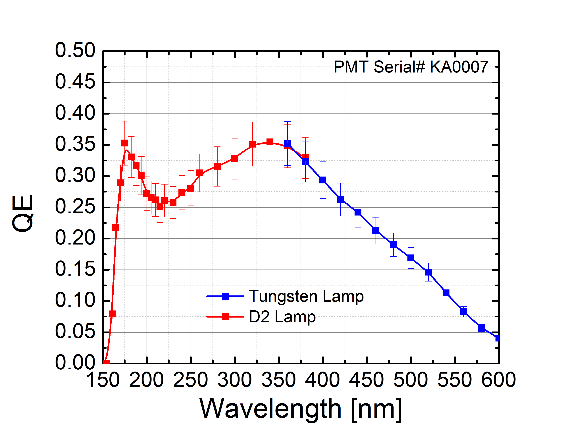
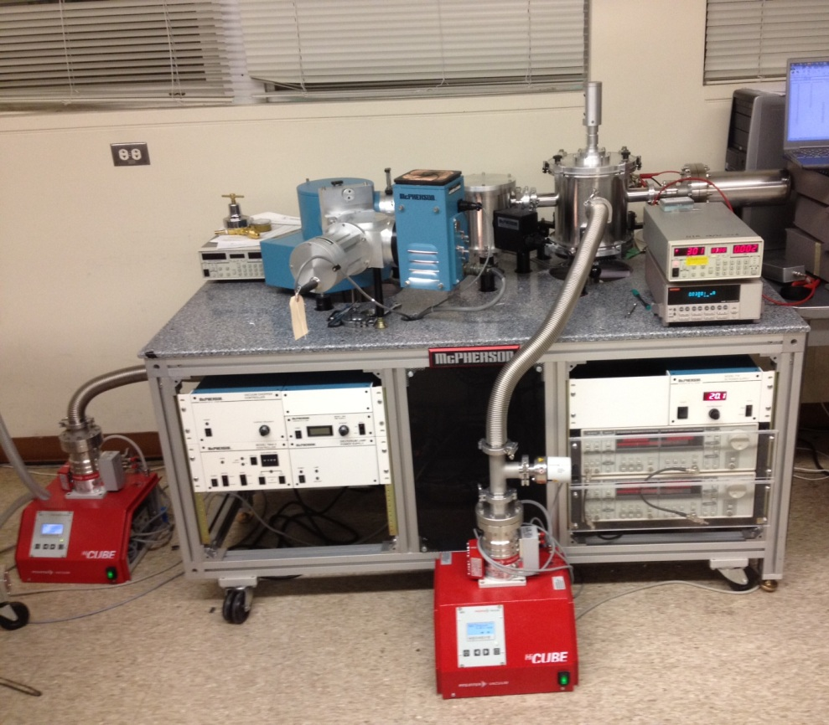
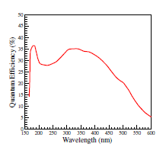
UCLA Vacuum UV QE System
PD
UCLA
Monochromator
PMT
D2 Lamp
W Lamp
Hamamatsu

Slide 23
Propagation Chain of Absolute Calibration of Photon Detectors
Standard Light Beam
Cryogenic Radiometer
Laser(s)
Trap Detector
Monochromator
Pyroelectric Detector
NIST
NIST standard UV Si PD
Light Beam
Scattered Light
us
UV LED
Xe Lamp
Laser(s)
NIST standard UV Si PD
Reference PMT
Real Light Source
Particle Beam
Real experiments
PMTs in our detectors

Slide 24
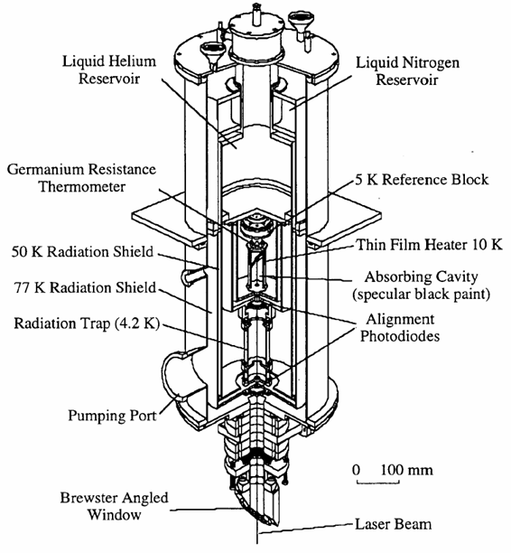
NIST High Accuracy Cryogenic Radiometer (HACR)
Photon energy is converted to heat.
Heat is compared with resistive (Ohmic) heating.
0.021% accuracy at 1mW.
This is the origin of absolute photon intensity.

Slide 25
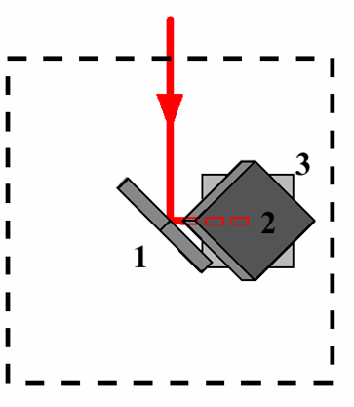
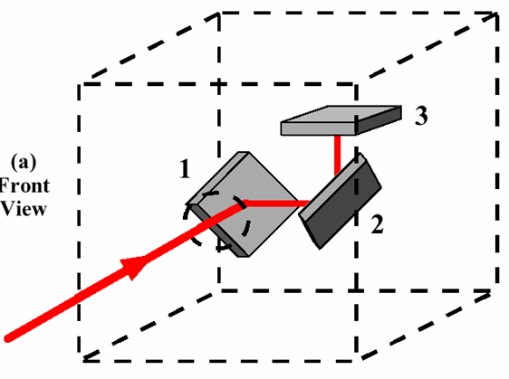
Trap Detector
Front View
Bottom View

Slide 26
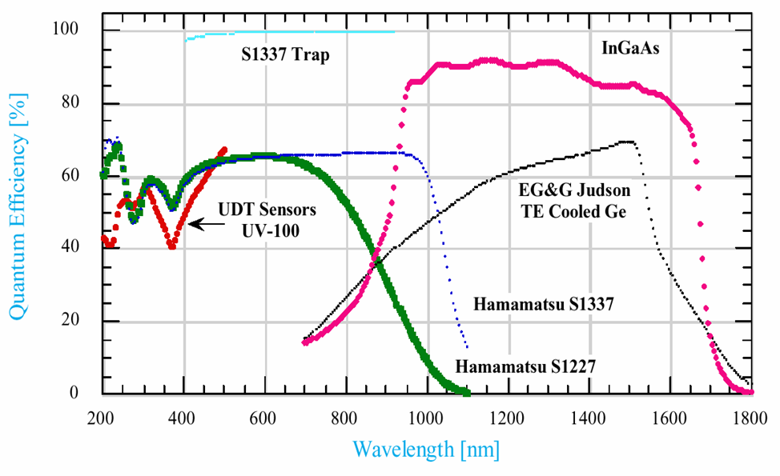
NIST Standards: Quantum efficiencies of typical Si, InGaAs, and Ge photodiodes

Slide 27
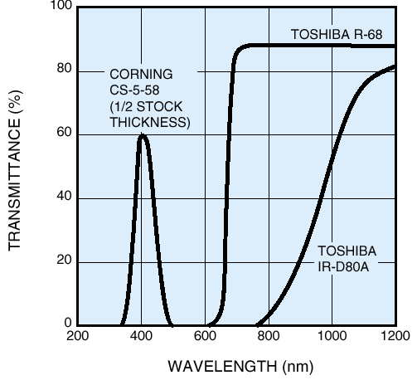
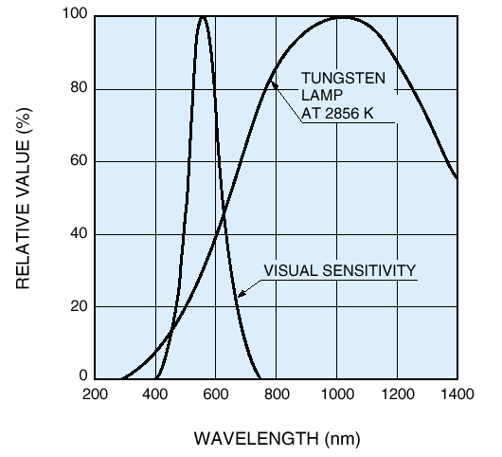
S_{k} (Cathode Sensitivity) and S_{kb} (Cathode Blue Sensitivity)
Filter for S_{kb}
Lump for S_{k}

Slide 28
Collection Efficiency (CE)
Definition

Slide 29
FAQ
How can we measure Collection Efficiency?
Measure the Cathode current (I_{C}).
Add 10⁻⁵ ND filter in front of PMT.
Measure the counting rate of the single PE (S).
Take the ratio of S×1.6×10⁻¹⁹ ×10⁵/I_{C}.

Slide 30
Detective Quantum Efficiency (DQE)
Definition:
Often confused as QE by “Physicists”

Slide 31
FAQ
How can we measure Detective QE?
Use a weak pulsed light source (so that >90% pulse gives the pedestal.)
Measure the counting rate of the single PE (S).
Compare S with that of PMT with known DQE.

Slide 32
Dynode Structure

Slide 33
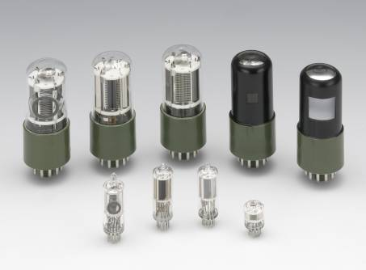
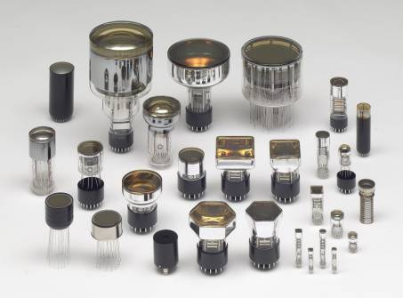
PMT Types
< SIDE-ON TYPE >
< HEAD-ON TYPE >
< SIZE >
1/2 inch & 1-1/8 inch
< Features >
Compact
Relatively Cheap
< SIZE >
3/8 inch ~ 20 inch
< Features >
Variety of sizes, Direct coupling
Notes:
There are 2 types of PMTs. The one is SIDE-ON type, and the other is HEAD-ON type.
The name of SIDE-ON comes from that PMT turns ON when light enters from side direction. There are only 2 sizes, ½ inch and 1-1/8 inch.
The features are compactness, relatively cheap price.
The name of HEAD-ON comes from that PMT turns ON when light enters from the head.
One of the features is variety of sizes, its range is from 3/8 inch to 20 inch.
There is photocathode inside of input window, it’s easy to couple a PMT with signal light.

Slide 34
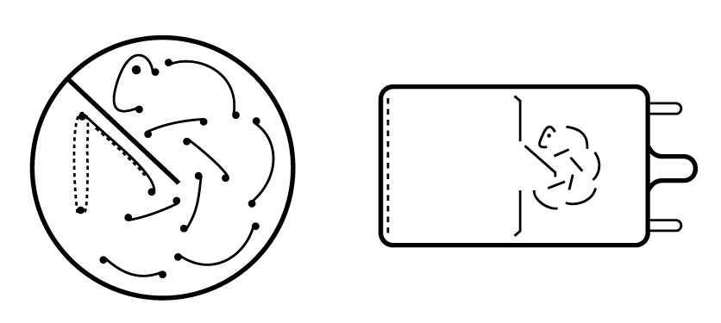
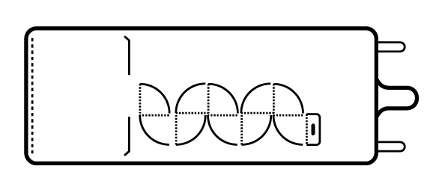
Dynode Structures – Side-on vs. Head-on
CIRCULAR CAGE
Compact
Fast time response
(mainly for
Side-On PMT)
< HEAD-ON >
< SIDE-ON >
BOX & GRID
Good CE
(Good uniformity)
Slow time response
Notes:
There are various dynode structures. Each type has merit and demerit. The dynode structure is selected according to application.
CIRCULAR CAGE : This is most popular dynode for SIDE-ON PMT. Its shape looks like circular cage. Features are compact, fast time response.
BOX & GRID : Its shape looks like a box. As the size is large, it’s easy to collect photoelectron from photocathode.
Therefore, collection efficiency is good. And uniformity is also good. On the contrary, as the size is large, time response is slow.

Slide 35
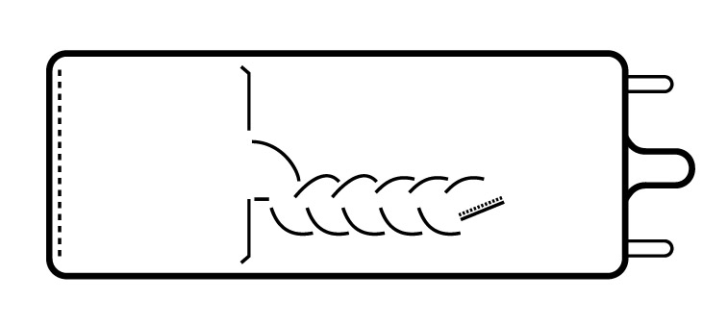
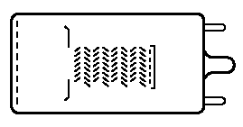
Dynode Structures – Linear Focus vs. Venetian Blind
LINEAR FOCUSED (CC+BOX)
Fast time response
Good pulse linearity
Larger DY1 is used in recent new PMTs (Box & Line)
VENETIAN BLIND
Large dynode area
Better uniformity
Notes:
LINEAR FOCUSED : This is mixture of CIRCULAR CAGE and BOX & GRID. Its features are fast time response and good pulse linearity.
Larger DY1 is used in recent new PMTs, that is called BOX and LINE dynode.
VENETIAN BLIND : This shape looks like blind at the window in the office. Its features are large dynode area and better uniformity.
This dynode is used for 20 inch PMT because of its large dynode area, but this is not popular.

Slide 36
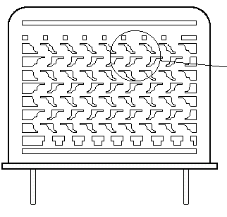
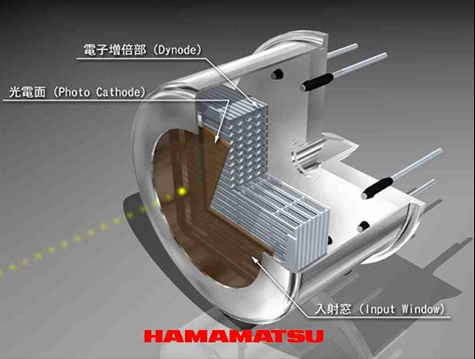
Metal Channel PMT
METAL CHANNEL
PMT with Metal Channel Dynode
TO-8 type PMT
Pitch:1mm
Compact
Fast time response
Position sensitive
16mm in dia.
Notes:
This is relatively new dynode structure, it’s called metal channel dynode. This dynode was developed 15 years ago as a challenge of Hamamatsu.
As the dynode pitch is 1mm, it can be used for a small size PMT. This is cross-section of TO-8 type PMT.
You can see that there are several layers of dynodes stacked together. Its features are compact, fast time response. As the electron trajectory kept inside of 1 line, position sensitive PMT can be made with this dynode. We have variety of multi-anode series with 1 inch square metal package. Our Flat panel PMT is using second generation of metal channel dynode.

Slide 37
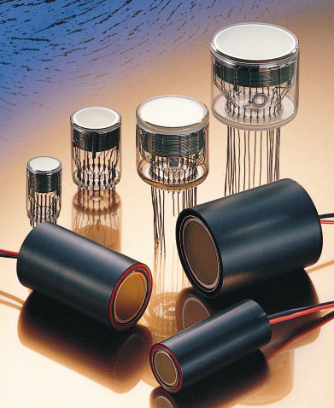
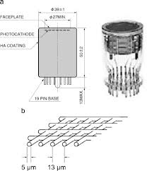
Fine Mesh PMT
Fine Mesh

Slide 38
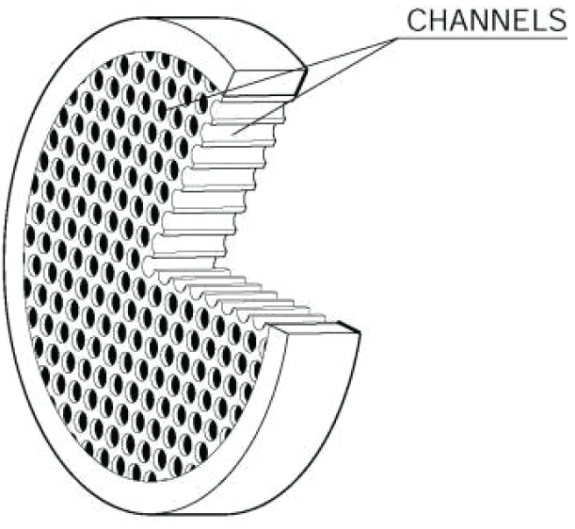
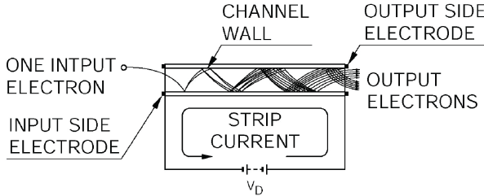
MCP (Micro Channel Plate)
MCP
( 5 – 10 μm ϕ)
Gain = 100 - 1000

Slide 39
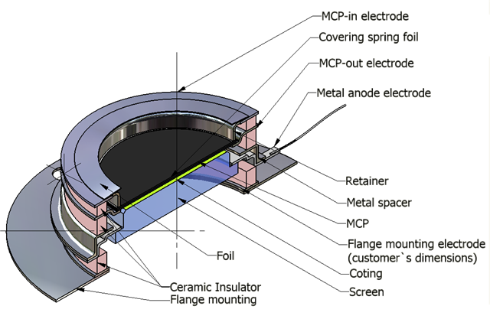
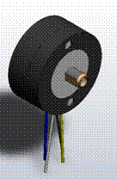
MCP PMT
Image Intensifier
MCP PMT

Slide 40
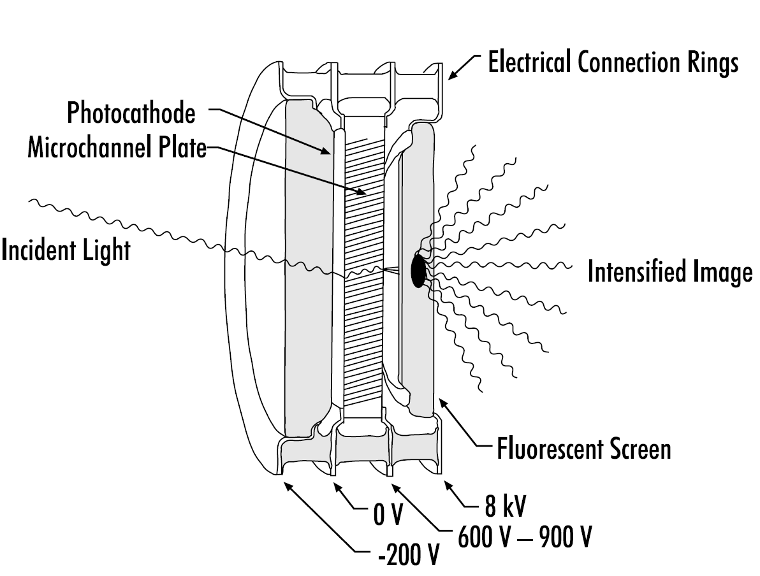
Principle of Image Intensifier
http://www.e-radiography.net/radtech/i/intensifiers.pdf

Slide 41
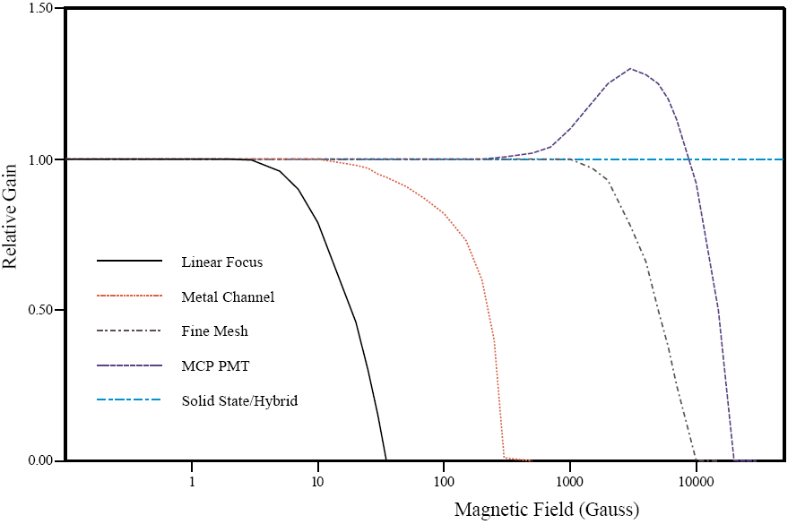
Effect of Magnetic Fields
HPD
APD
Solid
State
MCP
PMT
Linear
Focus
Metal
Channel
Fine
Mesh

Slide 42
Gain of PMT

Slide 43
Structure of Linear-focus PMT
Photo Cathode
Second Last
Dynode
First Dynode
QE
δ₁
N_{γ}
CE
δ₃
Photons
δ_{n}
δ₂
G = δ₁⋅δ₂⋅δ₃ ⋅⋅⋅ δ_{n}
E=N_{γ}⋅QE⋅CE⋅G
Glass Window
Mesh Anode
Last Dynode

Slide 44
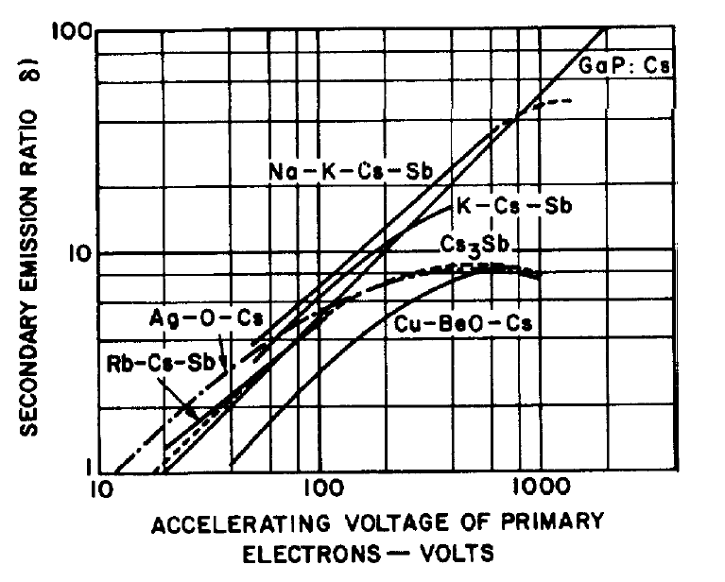
Secondary electron Emission
δ ∝ HV^{0.6}

Slide 45
Gain (G_{P})
Definition by Physicists:
(δ_{i} = Gain of the i-th dynode)

Slide 46
FAQ
How can we measure the Gain (G_{P}) of our definition?
Use a weak pulsed light source (so that >90% pulse gives the pedestal.)
Measure the center of the mass of Single PE charge distribution of the Anode signal (Q_{A}).
Take the ratio of Q_{A}/1.6×10⁻¹⁹ .

Slide 47
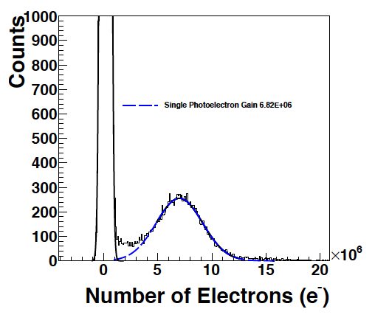
Single PE distribution

Slide 48
Gain (G_{I})
Definition by Industries:
(δ_{i} = Gain of the i-th dynode)

Slide 49
FAQ
How do manufactures measure the real Gain (G_{I})?
Measure the Cathode current (I_{C}).
Add 10⁻⁵ ND filter in front of PMT.
Measure the Anode current (I_{A}).
Take the ratio of I_{A}×10⁵/I_{C}.

Slide 50
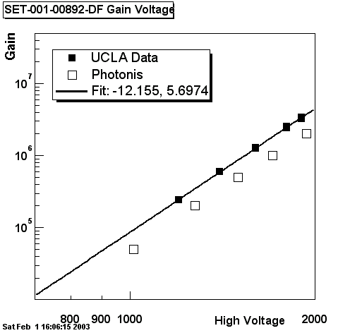
Gain vs. Voltage Curve
Physicists Definition:
G_{P}=δ₁•δ₂•… •δ_{n}
Industries Definition:
G_{I}=CE•δ₁•δ₂•… •δ_{n}
CE=G_{I}/G_{P}~80%.
G_{P} by UCLA
G_{I} by Photonis

Slide 51
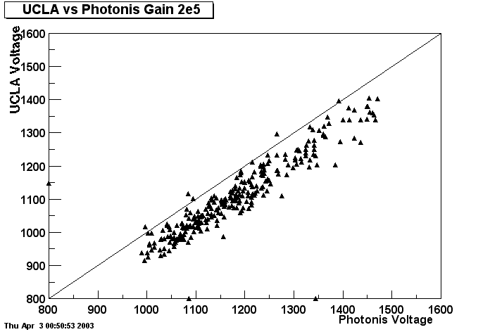
270 Auger-SD PMTs: HV for G=2×10⁵ UCLA vs. Photonis
UCLA
HV varies from PMT to PMT.
Photonis is Higher than UCLA (due to CE).
CE varies from PMT to PMT.
Photonis

Slide 52
FAQ
Why is the Gain so different from PMT to PMT at the fixed HV?
At given HV, each δ may be ±10% different.
Then, Gain could be an order of magnitude different. (G = δ₁⋅δ₂⋅δ₃ ⋅⋅⋅ δ_{n})

Slide 53
FAQ
What is the maximum allowed HV for stable PMT operation?
It can be checked by Dark Current behavior.

Slide 54
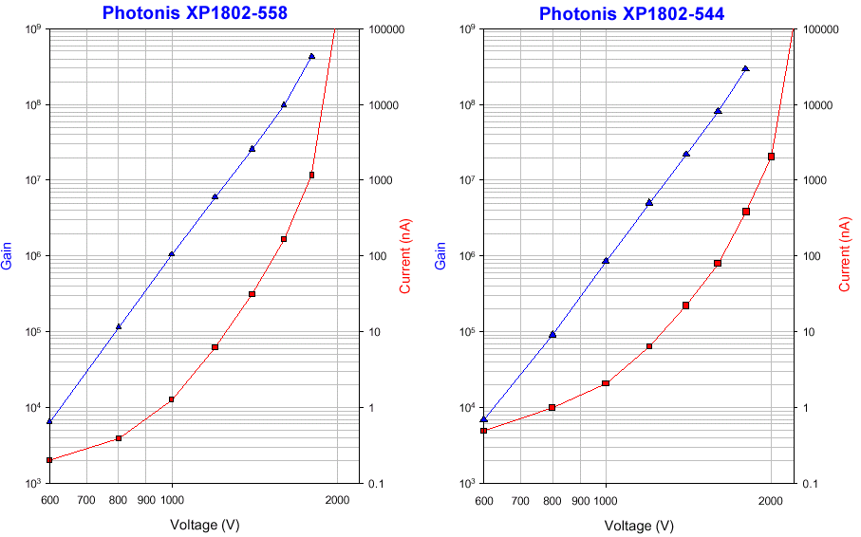
Gain and Dark Current vs. HV
Field
Effect
Thermal
Photoelectron
Emission
Leakage
Current

Slide 55
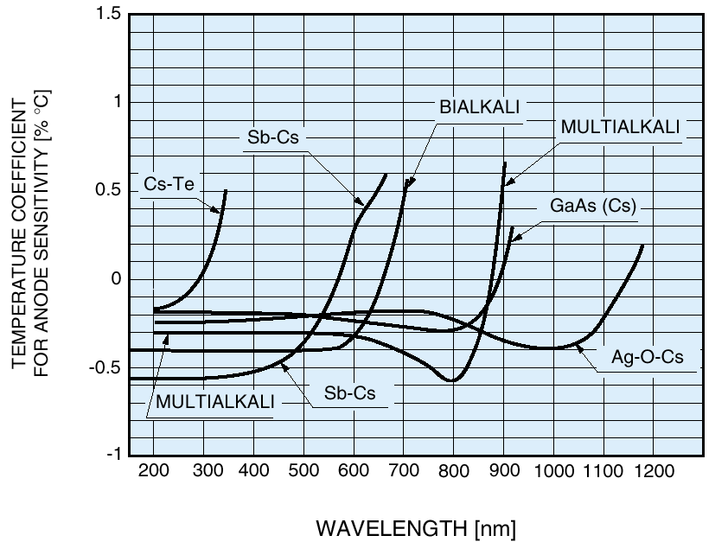
Temperature Dependence of Anode Sensitivity
-0.4%/ºC

Slide 56
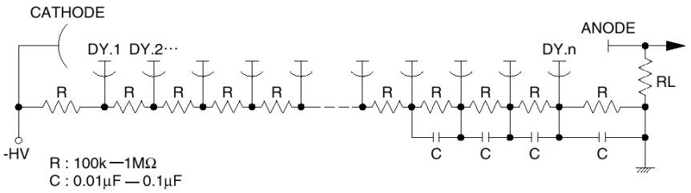
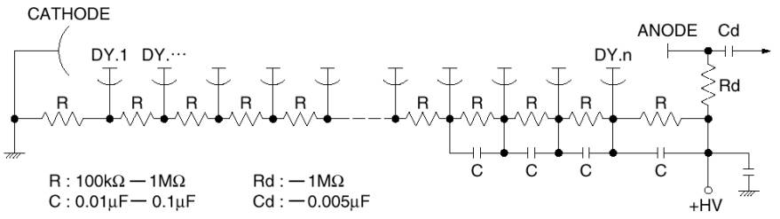
Two Types of Voltage Divider
<-HV Operation>
Pulse operation only
No DC output
<+HV Operation>
Notes:
There are 2 types of voltage dividers. The one is for –HV (negative HV) operation, the other is for +HV (positive HV) operation.
As electron can be accelerated by plus voltage, positive voltage is always applied to anode.
The matter is which side is connected to ground. If anode side is connected to ground, cathode side has to be negative voltage.
If cathode side is connected to ground, anode side has to be positive voltage.
In case of –HV, as anode side is connected to ground, it’s easy to read out signal because there is no potential difference between anode and read out circuit.
In case of +HV, as cathode side is connected to ground, it’s easy to hold a PMT because there is no potential difference between cathode and holder. It results in low noise.
On the contrary, there is potential difference between anode and read out circuit. A coupling capacitor has to be placed between them.
As a results, only pulse output can be obtained. (no DC output) When count rate is high, baseline shift might be occurred.

Slide 57
Time Response

Slide 58
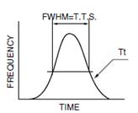
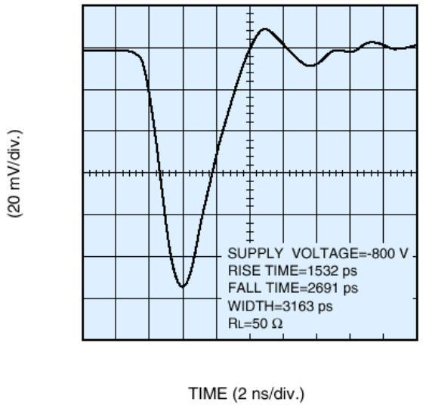
Time Response
RISE TIME
10% to 90%
FALL TIME
90% to 10%
Example of
Waveform
Transit Time
Rise : 1.5 ns
Fall : 2.7 ns
TTS
Transit Time Spread
(Variation of Transit Time)
Notes:
One of PMT prime features is fast time response. This slide shows DELTA FUNCTION LIGHT and its PMT OUTPUT.
There are some definitions for PMT time response.
When pulsed signal light with very narrow width is enters to PMT, it generates output like this.
Rise time is defined as the time interval between 10% to 90% of PMT output.
Fall time is defined as the time interval between 90% to 10%.
Transit time is defined as the time interval between DELTA FUNCTION LIGHT and peak of PMT output.
TTS, it stands for Transit Time Spread, it’s variation of transit time. TTS is defined as the FWHM of TT variation.
In case that a scintillator with fast time response is used or count rate is high, fast time response is required.

Slide 59
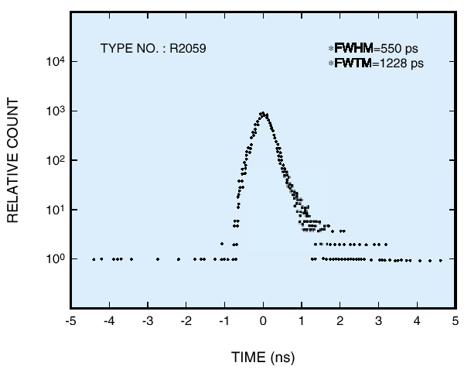
Typical TTS (Transit Time Spread)

Slide 60
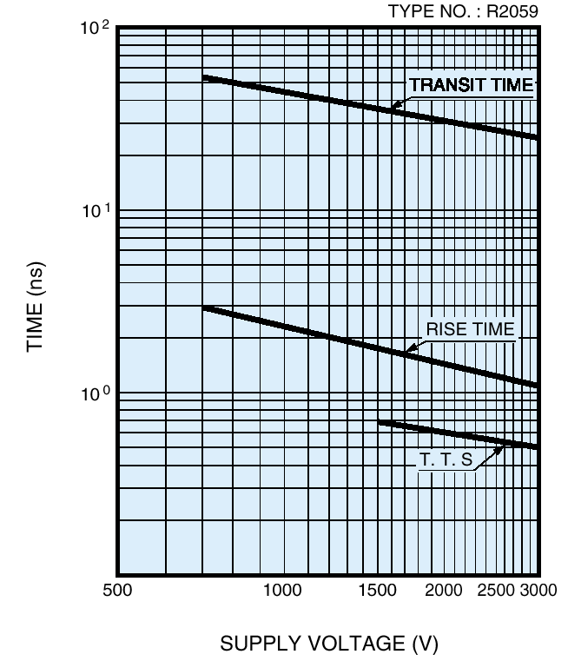
Transit Time vs. HV
Higher Voltage
⇓
Faster Transit Time

Slide 61
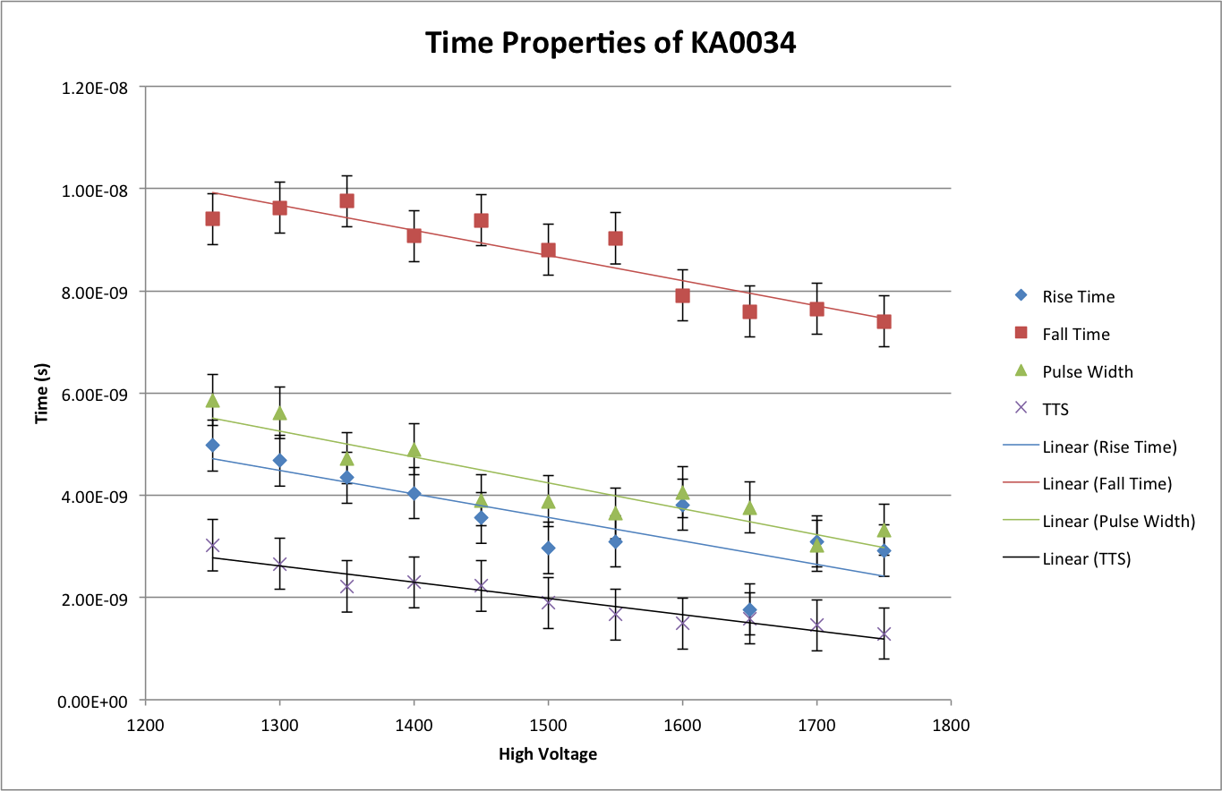
Time Properties (R11410)

Slide 62
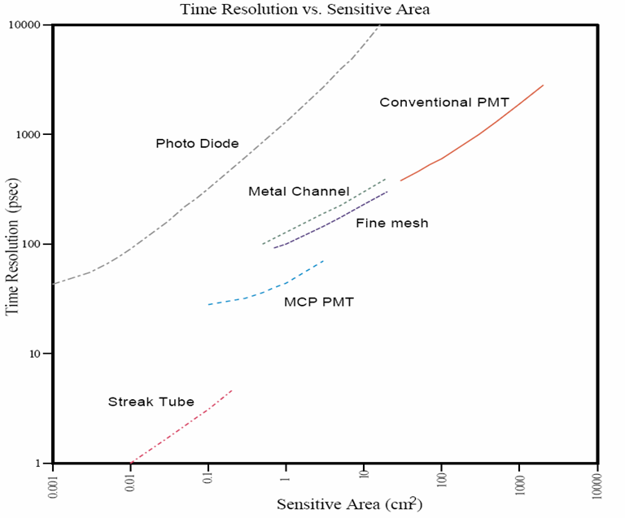
Time Resolution vs. Sensitive Area
HPD
SiPM

Slide 63
Imperfect Behavior of PMT

Slide 64
Uncertainties Specific to PMTs
PMTs are not perfect. There are many issues to be concerned:
Non Linearity
Cathode and Anode Uniformity
Effect of Magnetic Field
Temperature Dependence
Dark Counts
After Pulse
Rate Dependence
Long-term Stability

Slide 65
Linearity

Slide 66
PMT Non Linearity
Non Linearity is the effect of the space charge mainly between the last and the second last dynode.
Photo Cathode
First Dynode
Second Last
Dynode
QE
C_{ol}
δ₁
N_{γ}
δ₃
Photons
δ_{n}
δ₂
Glass Window
Mesh Anode
Last Dynode

Slide 67
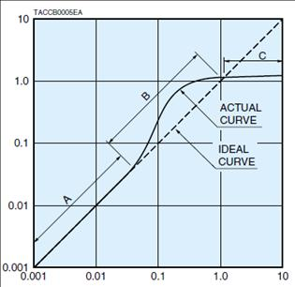

Pulse Linearity
What is Pulse Linearity ?
Relation between radiation energy and PMT output.
Radiation Energy
Light Intensity
Deviation from ideal line (%)
PMT output / peak current (mA)
PMT output
Notes:
What is Pulse Linearity ?? It’s relation between radiation energy and PMT output.
In case that PMT is used for scintillation counting and spectrum of radiation energy is measured, pulse linearity is important characteristic.
PMT output becomes large when radiation energy becomes large. If pulse linearity is not so good, PMT output doesn’t show correct radiation energy.
This graph shows deviation of actual PMT output compared with expected (or ideal) PMT output.

Slide 68

Pulse Linearity
Dim: 1
Bright: 4
Block Diagram for Double-Pulsed Mode
Notes:
This is block diagram for Double-Pulsed Mode to measure pulse linearity. Bright and dim pulsed light sources are used.
When PMT output is small, the ratio between bright and dim is ideal. It’s usually the ratio of 4 to 1.
When PMT output is getting larger while changing the distance between light sources and a PMT, the bright-dim ratio becomes larger like 4.2 or smaller like 3.8.
This means that pulse linearity becomes worse. Pulse linearity depends on type of dynode structure. Linear focus type is good in this view point.

Slide 69

Optimization of Anode Pulse Linearity
(The last 3 stages)

Slide 70




Linearity at different gains
Low gain (1000V)
High gain (1500V)

Slide 71
Uniformity

Slide 72

Anode Uniformity
spot light
Large size of
Incident light
SLIT shape
Incident light
Notes:
This is anode uniformity. Output current from anode is measured while spot light is scanned on photocathode.
HEAD-ON PMT has relatively good uniformity, but SIDE-ON PMT doesn’t have it. This is due to the difference of PMT construction.
SIDE-ON PMT is usually used for spectrometer, and the size of signal light is small in that application.
On the contrary, HEAD-ON PMT is usually used for scintillation counting, the size of signal light (that is size of scintillator) is relatively large.
Therefore, anode uniformity is important characteristics for HEAD-ON PMT.
Fortunately, there is space for focusing in HEAD-ON PMT, we can apply suitable design to improve the uniformity.

Slide 73




Cathode Uniformity (3 inch PMT)

Slide 74




Anode Uniformity (3 inch PMT)

Slide 75

Collection Efficiency (=Anode/Cathode)
(KA0044)

Slide 76
Effect of Magnetic Field

Slide 77
Effect of Magnetic Fields
HPD
APD
Solid
State
MCP
PMT
Linear
Focus
Metal
Channel
Fine
Mesh

Slide 78

Typical Magnetic Field Effect
Earth B-Field

Slide 79


Effect of Magnetic Field on Liner-focus 2” PMT
Hamamatsu 2” PMT (R7281-01)
z
y
x
Earth B-Field

Slide 80

Edge Effect of Magnetic Shields
For effective shielding,
we need extra mu-metal
in front.

Slide 81
Dark Count

Slide 82

Temperature Dependence of Dark Current

Slide 83

Dark Count Rate vs. Temperature

Slide 84
After Pulse

Slide 85

After Pulse (R11410)

Slide 86

After Pulse by Helium
Helium Contaminated PMT from MACRO
> 10%

Slide 87
Long Term Stability

Slide 88

Typical Long-term Stability
From Hamamatsu PMT Handbook

Slide 89
Other Vacuum Devices

Slide 90
Principle of Silicon Photodiode
Gain = 1.0
QE ~ 100%
Extremely Stable
Large Dynamic Range

Slide 91
APD (Avalanche Photodiode)
High Gain (100-1,000), High QE (~70%).
Then, why not replace PMTs?
Drawbacks:
δ <2, ENF>2 ⇒ Effectively QE <35%.
Extremely Sensitive to Temperature and Voltage change.
Difficult to manufacture uniform, large area.

Slide 92
HPD (Hybrid Photodiode)
In vacuum, Silicon Photodiode instead of dynodes.
High Gain (1000-3000), we can count 1-5 photoelectrons.
Then, why not replace PMTs?
Photo Cathode
e⁻
Silicon PD

Slide 93

CMS Detector under 4 Tesla
EM
Hadron
4 Tesla
APD
HPD

Slide 94

CMS HCAL Multi pixel HPD (DEP)
Photocathode (-10 kV)
Fiber-Optic
Window
3.4 mm
e
Ceramic feedthrough
PIN Diode
array
19 channel pixel layout
pixel size: 5.4 mm flat-flat
gap between pixels: 0.04 mm

Slide 95

LHCb experiment
RICH
RICH

Slide 96


The pixel HPD by DEP (for LHCb)
Advantages of this hybrid, pixel structure:
low noise: excellent resolution of single photoelectrons
high channel number/density
DEP, The Netherlands

Slide 97



Hamamatsu Hybrid APD
Single Channel HAPD
64 Channel HAPD
+ Readout

Slide 98

1, 2, 3 … Photo-electron Distribution
True photon counting
2
3
4
1
5
6 Photo-electrons

Slide 99


Decay Time Measurement by HAPD
Pulse Shape
Decay Time
FWHM = 1.5 ns
Time Resolution = 80 psec
No after pulse

Slide 100

Leica HyD Detector for Confocal Microscope
Hamamatsu
Compact HAPD
with GaAsP

Slide 101

8 inch HAPD by Hamamatsu
New release
at NSS 2012

Slide 102


MAX G3 Dark Matter Detector
Xe 20 ton (10 ton)
⁴⁰Ar 70 ton (50 ton)
Xe
Ar
Liquid
Scinti
Liquid
Scinti
Water Tank
Water Tank
6 m
15 m

Slide 103


QUPID (QUartz Photon Intensifying Detector)
Photo Cathode
(-6 kV)
Photo Cathode
(-6 kV)
Quartz
Al coating
APD (0 V)
APD (0 V)
Quartz
Made by Synthetic Silica only.

Slide 104

Production Version QUPID

Slide 105

1, 2 and 3 PE Distribution with 2m cable
G = 800 × 200
= 160,000
3 PE
TTS = 160 ps (FWHM)
2 PE
1 PE

Slide 106

Intevac Electron Bombarded CMOS

Slide 107
EBAPS by Intevac

Slide 108
Energy Resolution

Slide 109
Anode Signal (E)
Definition:
(by Industries)
(by Physicists)
(N_{γ} = No. of Incident Photons)
(N_{pe} = No. of Photo-electrons)

Slide 110
Energy Resolution (σ/E)
In ideal case:
In reality:
Nγ Number of incident photons
QE Quantum Efficiency
CE Collection Efficiency:
ENF Excess Noise Factor (from Dynodes)
ENC Equivalent Noise Charge (Readout Noise)
G Gain

Slide 111
Excess Noise Factor (ENF)
Definition:
In case of PMT:
How to measure:
Set N_{pe} = 10-20 (for nice Gaussian).
Measure σ/E of the Gaussian distribution.
ENF is given by

Slide 112
Single PE Distribution
σ of the single PE distribution is given by
Thus ENF is related to Peak to Valley Ratio.

Slide 113

Single PE Distribution
To see single PE, tune light intensity so that >90% gives pedestal.
If δ₁ >>5, ENF<1.4, Clear single PE can be seen.
The true position is given by the “Center of Mass” including signal below the pedestal.

Slide 114

ENF vs. P/V Ratio of 270 Auger-SD PMTs

Slide 115
FAQ
When should we use PMT, and when should we use Silicon Photodiode?
Depends on intensity of photons.
Depends on speed of signals.

Slide 116
Resolution of Hybrid Photodiode (HPD)
HPD can count 1, 2, 3… PE separately.
δ₁ >1000, ENF=1.0
But it is still suffering from poor QE.
We can never beat the Poisson statistics !
1 pe
NIM A 442 (2000) 164-170
Pedestal
2 pe
3 pe
4 pe
500
200
300
400
600
ADC Channel

Slide 117
Summary Table
 | QE | CE | δ_{i} | ENF | G | ENC | σ/E
Ideal | 1.0 | 1.0 | 1000 | 1.0 | 10⁶ | 0 | √1/N
PMT | 0.35 | 0.9 | 10 | 1.3 | 10⁶ | 200 | √3.8/N
PD | 0.7 | 1.0 | - | 1.0 | 1 | 200 | √1.4/N+(280/N)²
APD | 0.7 | 1.0 | 2 | 2.0 | 100 | 200 | √2.9/N+(2.9/N)²
HPD | 0.5 | 0.9 | 1000 | 1.0 | 10³ | 200 | √2.2/N+(0.4/N)²
HAPD | 0.5 | 0.9 | 1000 | 1.0 | 10⁵ | 200 | √2.2/N
SiPM | 0.7 | 0.4 | 1000 | 1.3 | 10⁶ | 1000 | √4.3/N
VLPC | 0.7 | 1.0 | 1000 | 1.0 | 10⁵ | 200 | √1.4/N

Slide 118
Energy Resolution vs. N_{γ}
HPD
APD
PMT
Photo Diode
Poisson Limit

Slide 119
Resolution (over Poisson Limit)
APD
PD
SiPM
PMT (35% QE)
G-APD
HPD (50% QE)
HAPD
VLPC

Slide 120
Summary

Slide 121
Purpose of Photon Detector
Observe all the quantities of photons as accurate as possible.
The number of photons: E
Arrival time of photons: T
Position of photons: X, Y, Z
Primary purpose of vacuum detectors:
Very small number of photons: < 100 photons
Accurate time of photons: < 10 nsec

Slide 122

Market Price
HPD
SiPM
Silicon

Slide 123
FAQ’s
Why do we have to operate each PMT at different HV?
Why is PMT response non-uniform over surface?
What is the cause of non-linearity?
How stable is PMT? How often should we calibrate? Every minute? Every day??
What external facts could change the Gain of PMT?
What could damage PMTs permanently?

Slide 124
More FAQ’s
What is the source of dark current and dark pulse?
Are they correlated?
Why is PMT still the best for photon counting application?
Why is APD or HPD not widely used?
Then, who uses APD or HPD?
Why is the signal of PMT so fast?

Slide 125
Closing Remarks
PMTs are still used in many applications for good reasons:
Intrinsically high gain
Extremely low noise – photon counting
Fast speed ( < 1 ns)
Large area ( >> 5 inch)
However PMTs are not perfect. There are many issues to be concerned:
Cathode and Anode Uniformity
Non Linearity
Effect of Magnetic Field
Long-term Stability

Slide 126
References
Hamamatsu PMT Handbook
http://sales.hamamatsu.com/assets/applications/ETD/pmt_handbook_complete.pdf
Special thanks to
Yuji Yoshizawa at Hamamatsu Photonics

