Slide 1
Search for Dark Matter: . Science Cases and Challenges
Katsushi Arisaka
University of California, Los Angeles
Department of Physics and Astronomy
arisaka@physics.ucla.edu

Slide 2
What is Dark Matter?
They created and shaped the large scale structure of the Universe.
Without dark matter, we were not here today.
We do not sense them since interactions are so weak.
There are ~10⁷ in this room.
~10¹² will pass you during this talk.

Slide 3
Talk Outline
Evidences of Dark Mater
Astronomy
Cosmology
Dark Matter Candidates
Particle Physics
Detection Methods
Production by LHC
Indirect Observation
Direct Detection – New Results from XENON100
Future Prospects

Slide 4
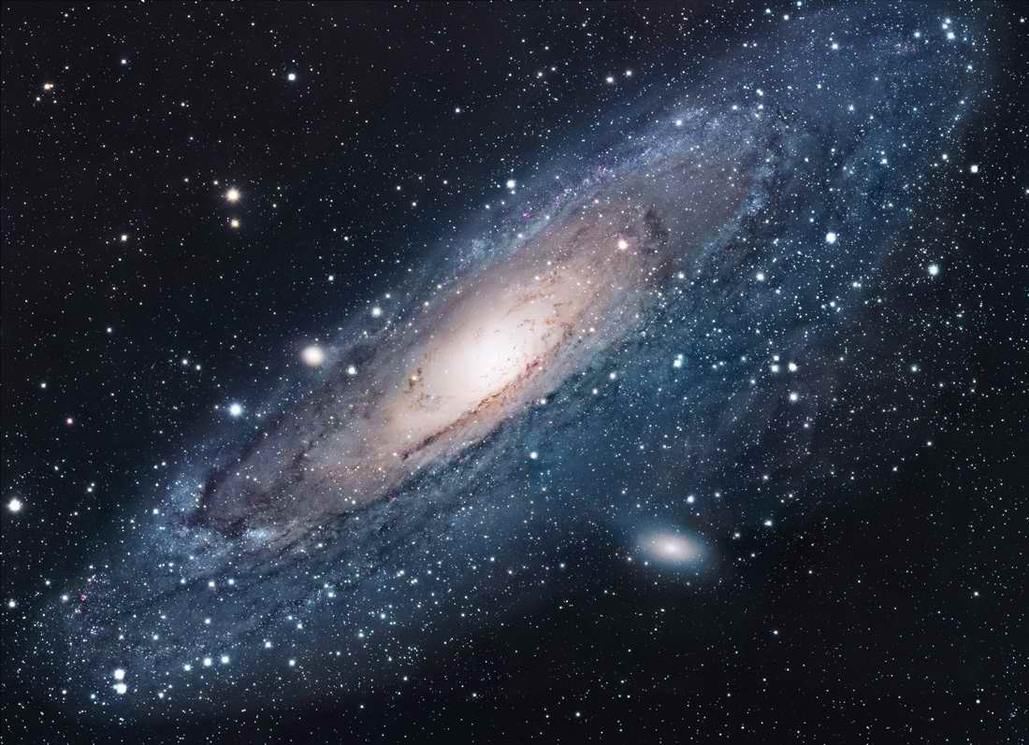
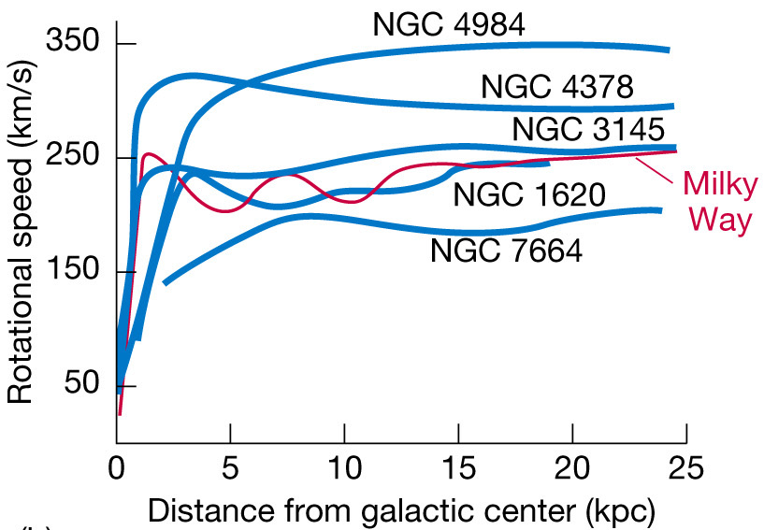
Andromeda Galaxy
known since 1932 (Jan Oort)

Slide 5
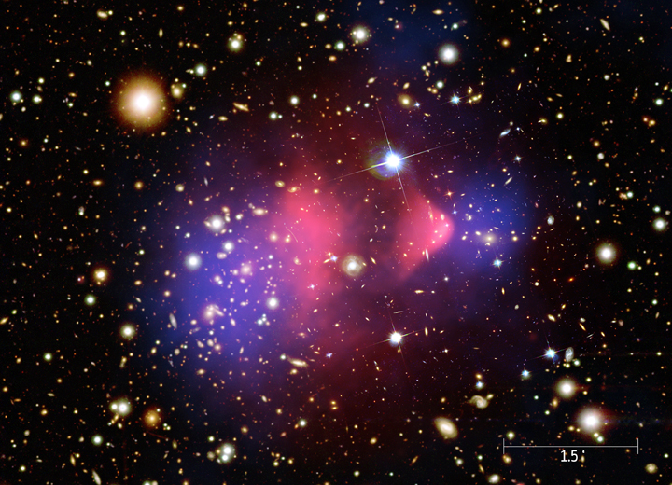
Bullet Cluster
known since 1933 (Fritz Zwicky)
X-ray
(Baryonic)
Weak Lensing (Total Mass)

Slide 6
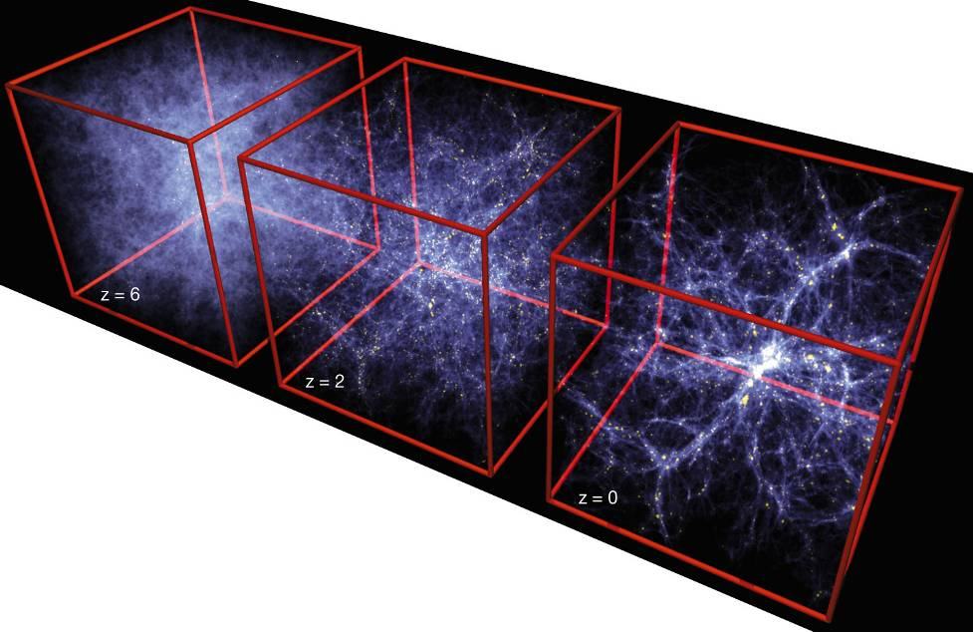
Formation of Structure in the Universe
Dark Matter is required!

Slide 7
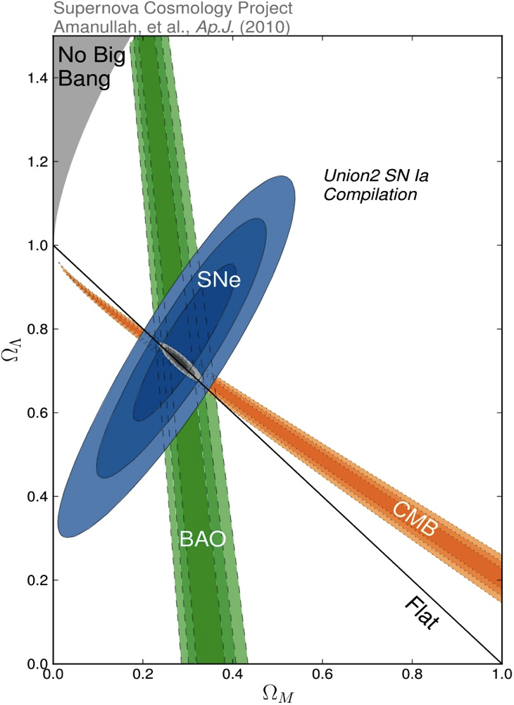
Density of Our Universe
Ω_{Total} = Ω_{Λ}+Ω_{Matter} = 1.0
Universe is Flat.
⇒ Inflation
73% is Dark Energy.
⇒ Accelerating
Ω_{Λ}
Ω_{M}= 27%
Ω_{Matter}

Slide 8
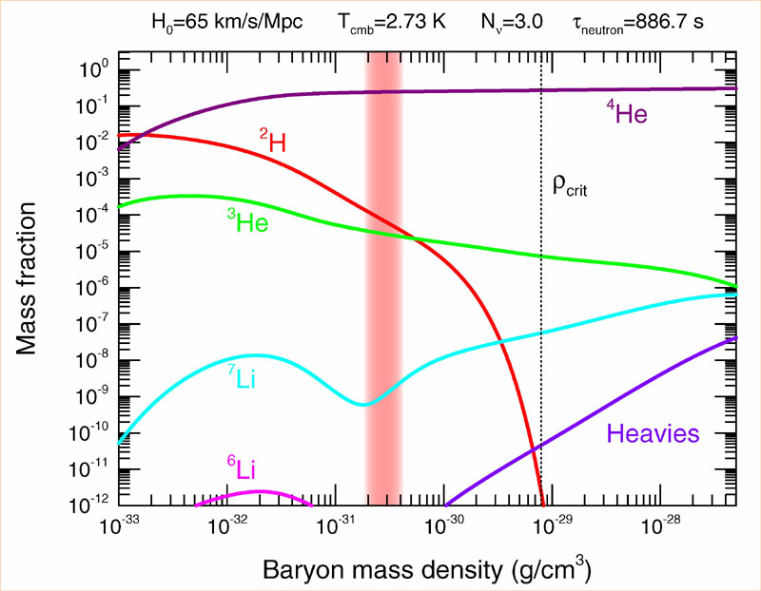
Abundance vs. Density
D
Ω_{Baryon}= 4.6%

Slide 9
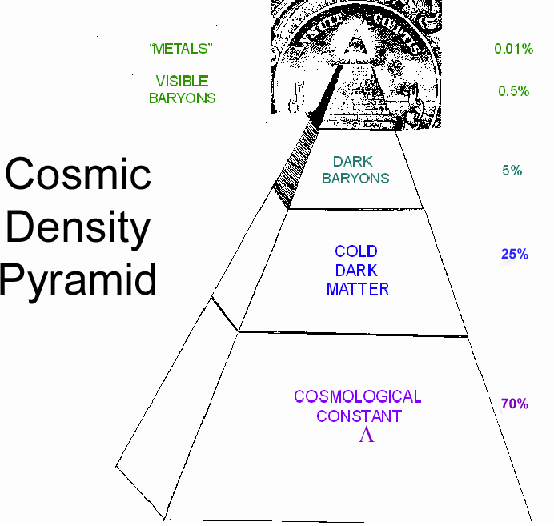
Cosmic Pyramid
Metal
0.03%
Star
0.4%
Baryonic Matter
0.5%
Gas,
Dust
4.2%
Dark
Matter
23%
Dark Energy
73%

Slide 10
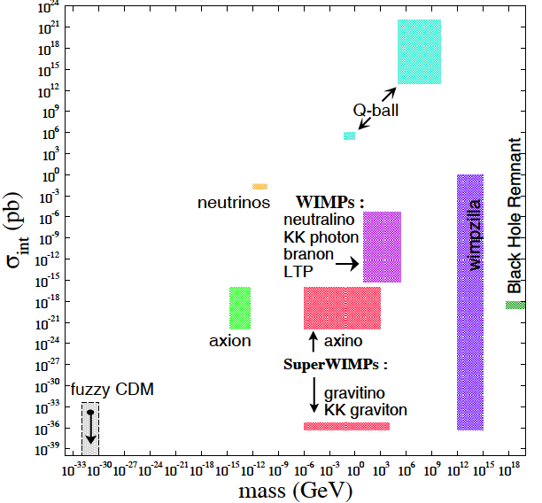
What is Dark Matter?
Alex Kusenko
Roberto Peccei

Slide 11
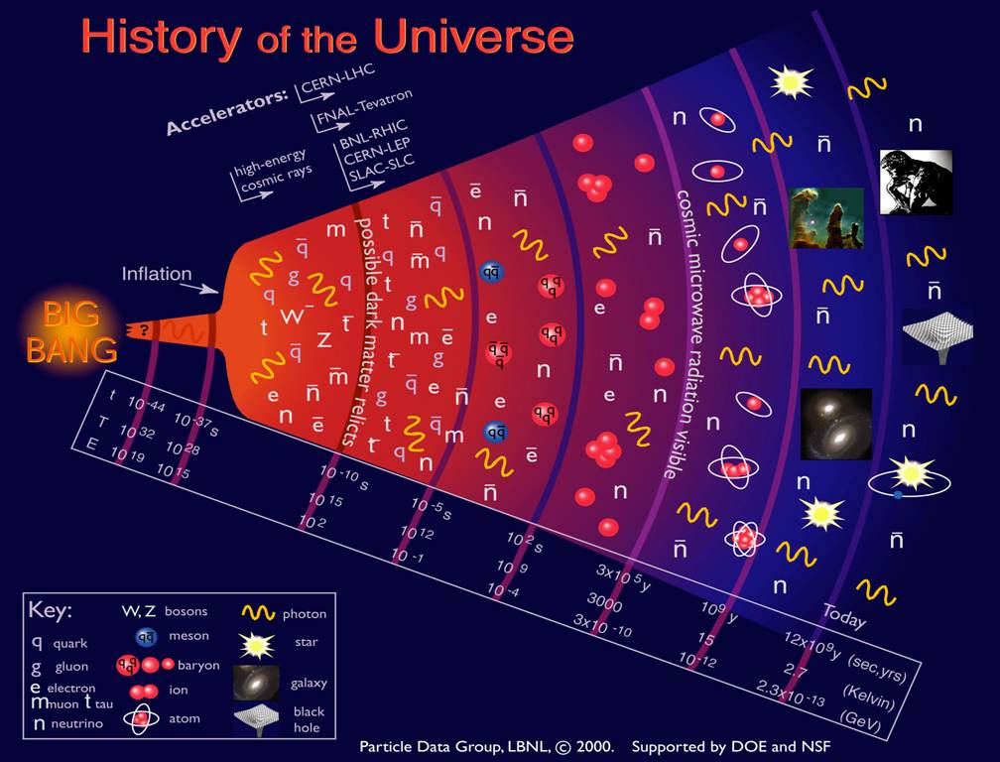

Slide 12
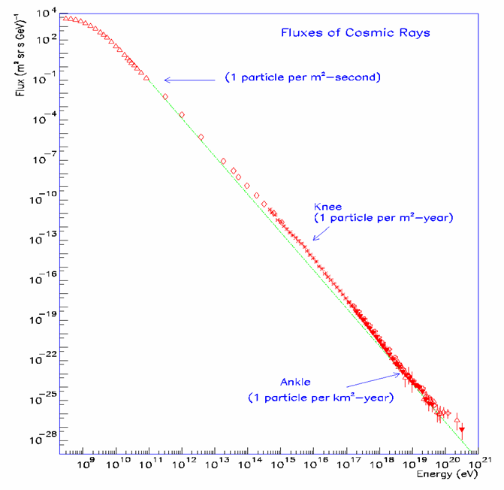
Energy Spectrum of Cosmic Rays
Energy Spectrum ~ E⁻³
The spectrum extends beyond 10²⁰eV (=10¹¹GeV).
Beyond 10²⁰eV, Flux is only one particle per km²-century.
?
GeV
TeV

Slide 13
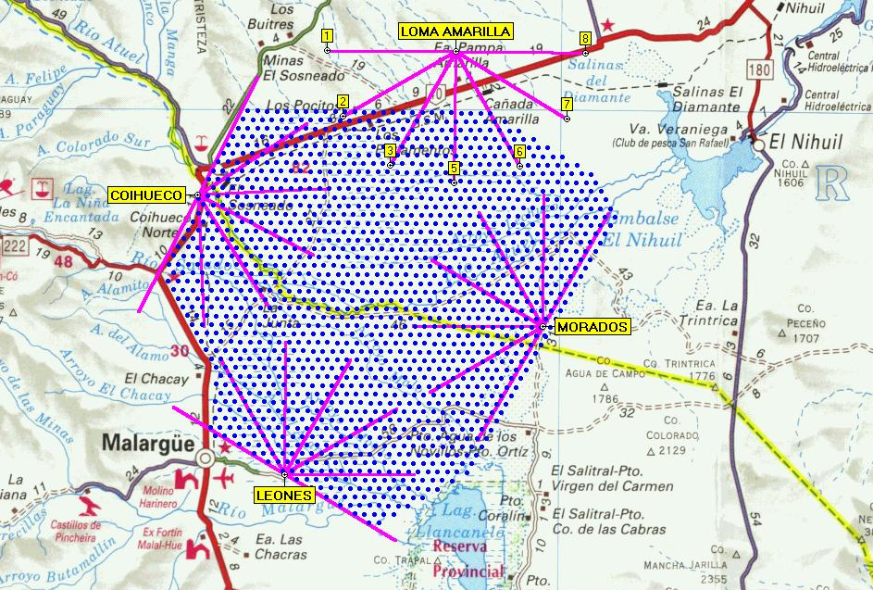
Pierre-Auger in Argentina
Surface Array
1600 Water Tanks
1.5 km spacing
3100 km²
Fluorescence Detectors
4 Telescope Sites
6 Telescopes per Site
24 Telescopes Total
50km

Slide 14
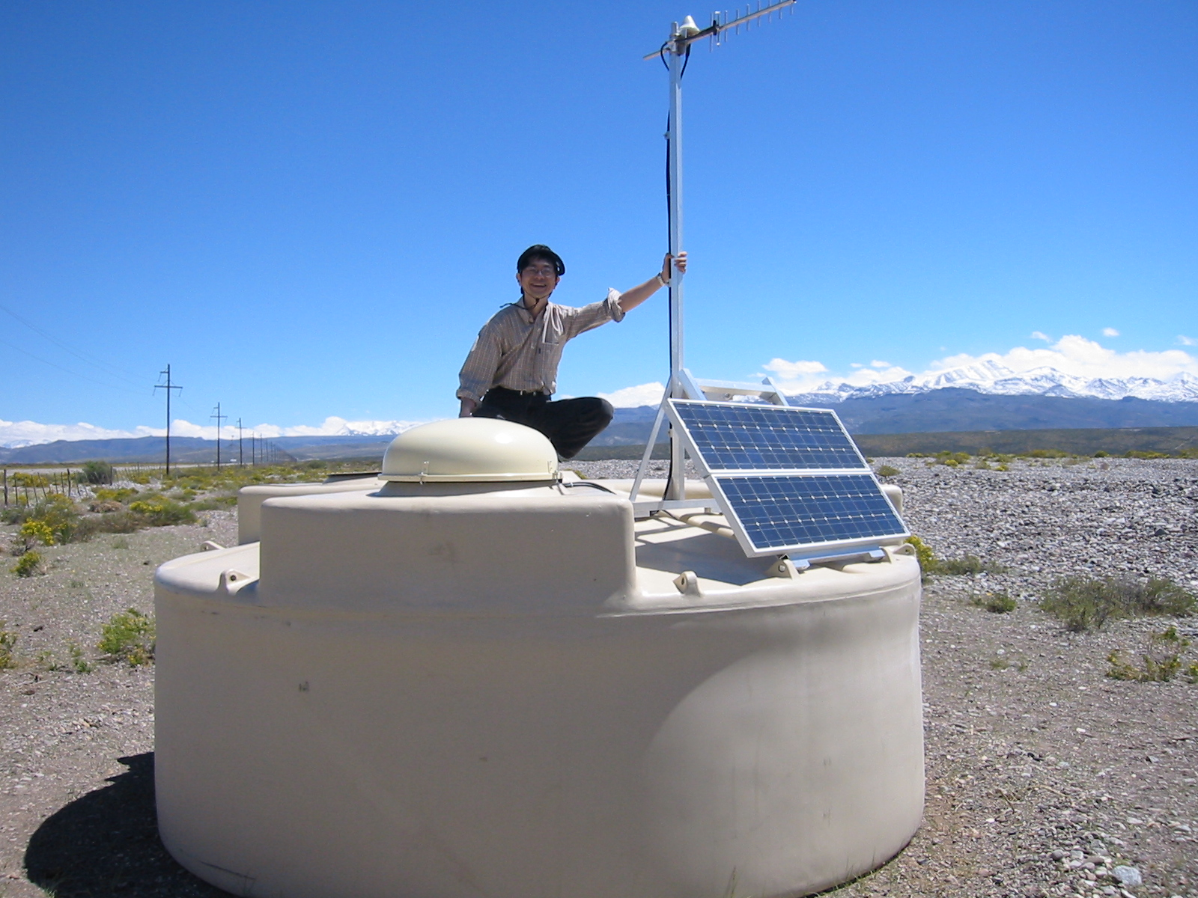
Installing Electronics
Arisaka on top of a water tank

Slide 15
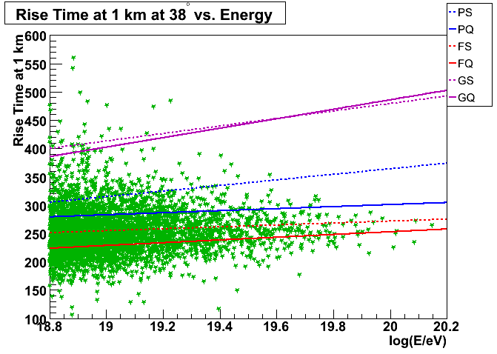
Risetime vs. Log(E)
David Barnhill (PhD) in 2007
Gamma Ray
Proton (Sibyll)
Proton (QGS)
Iron (Sibyll)
Iron (QGS)
No Wimpzilla!
Real Data

Slide 17
Symmetry Breaking
Time
(sec)
Temp.
(ºK)
Energy (GeV)
10⁻⁴⁵sec
Simple
10⁻⁴⁰
10³⁰
10¹⁸
10⁻³⁵
10¹⁵
10⁻³⁰
10²⁵
10¹²
10⁻²⁵
10⁹
Symmetry
Break Down
10⁻²⁰
10²⁰
1PeV
10⁻¹⁵
10¹⁵
1TeV
b
10⁻¹⁰
1GeV
s
µ⁻
W⁺
10⁻⁵
γ
c
10¹⁰
ν_{e}
τ⁺
1
1MeV
Zº
d
τ⁻
ν_{e}
d
e⁺
10⁵ sec
1KeV
ν_{µ}
e⁻
1 year
u
u
s
10⁵
Complex
ν_{µ}
10³
1eV
b
µ⁺
10⁶
W⁺
c
10⁹ year
10⁻³eV
1

Slide 18
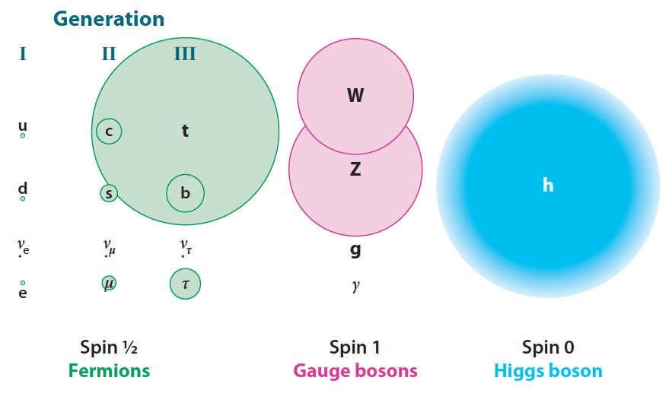
Mass of Particles (at T = 0.1 ns)

Slide 19
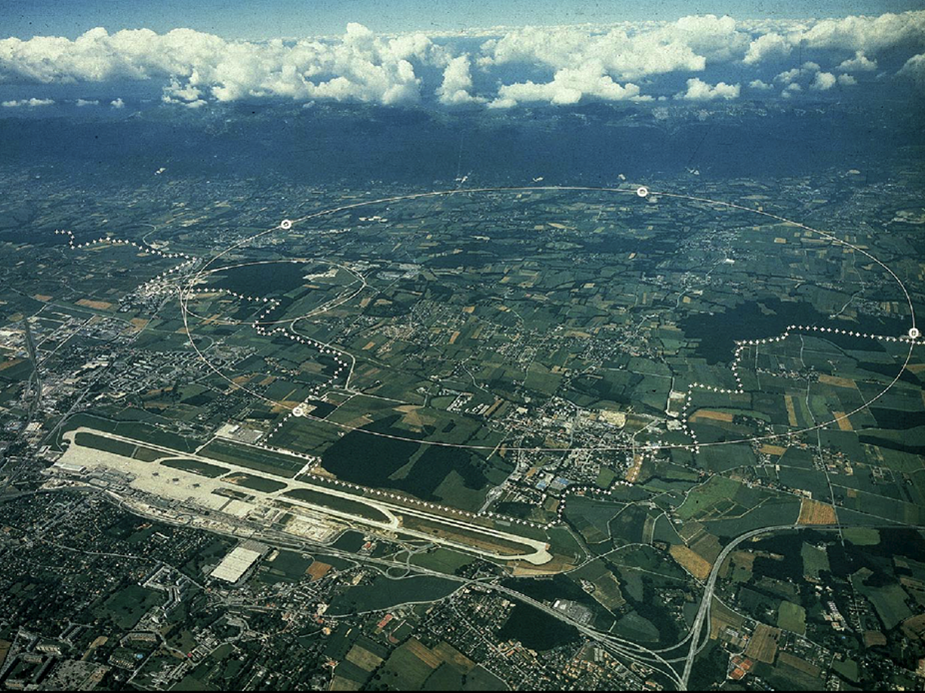
CERN and LHC in Geneva
27km Circumference
7+7=14 TeV

Slide 20
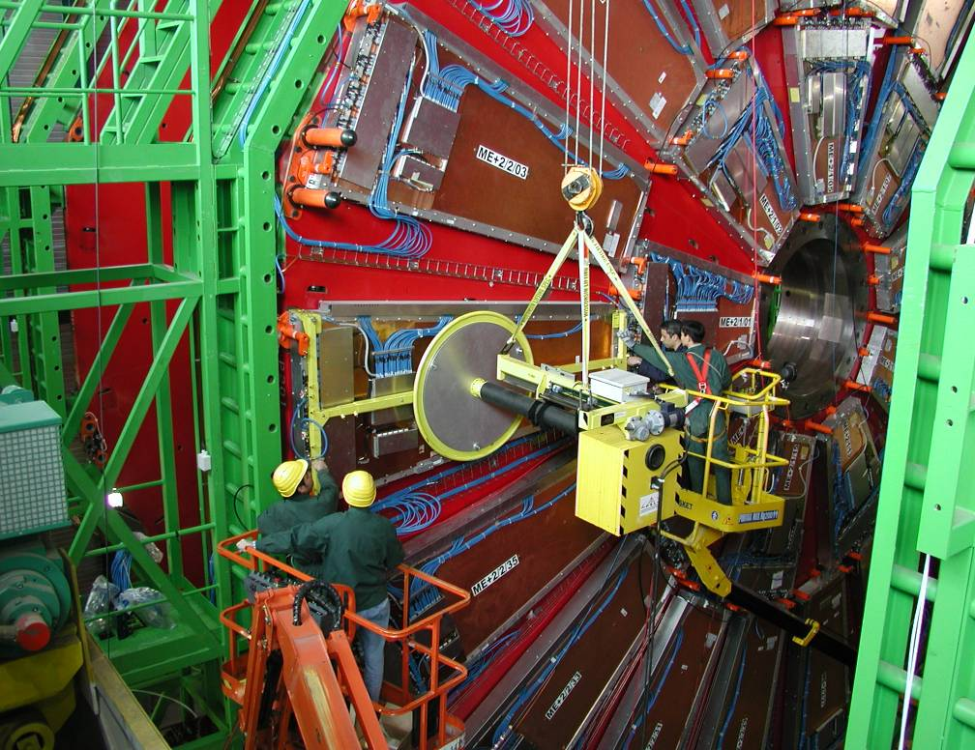
Installing muon Detectors
Muon Detector made at Westwood in 2000 - 2004

Slide 21
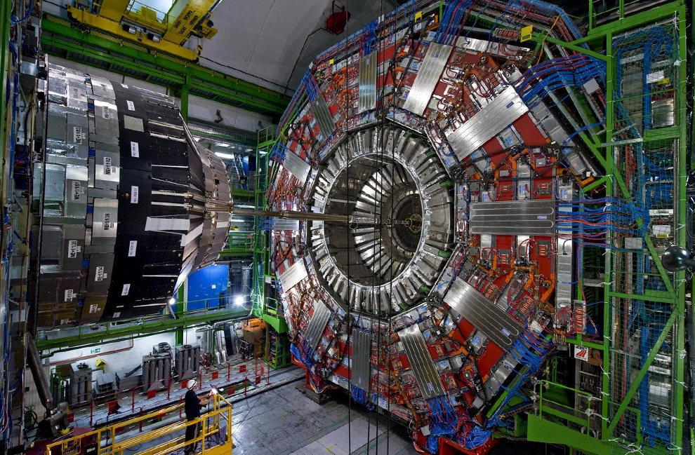

Slide 22
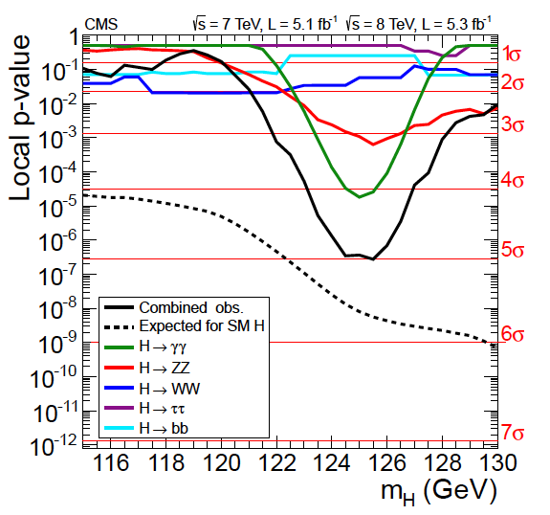
Higgs Discovery by CMS (July 4, 2012)

Slide 23
News release on July 4th !
So What’s next, Bob?

Slide 24
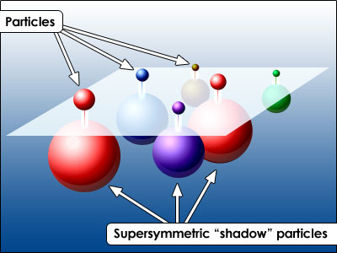
SUSY Neutralino

Slide 25
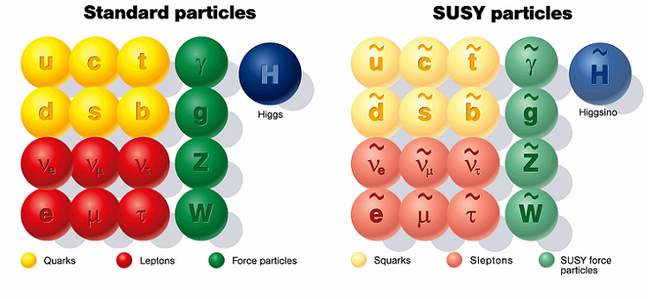
SUSY Particles and Neutralino
Spin 1/2 1 0

Slide 26
SUSY Particles and Neutralino
Super Symmetry
Neutralino
Spin 1/2 1 0 0 1/2 1/2

Slide 27
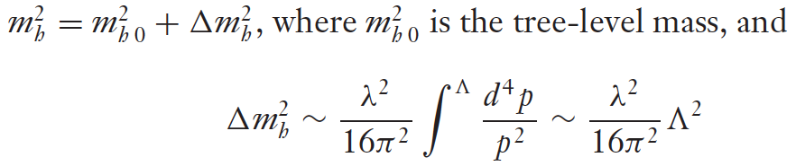


Hierarchy Problem
Higgs mass
SM :
SUSY :
or : new physics at the energy scale of Λ ~ 1 TeV

Slide 28
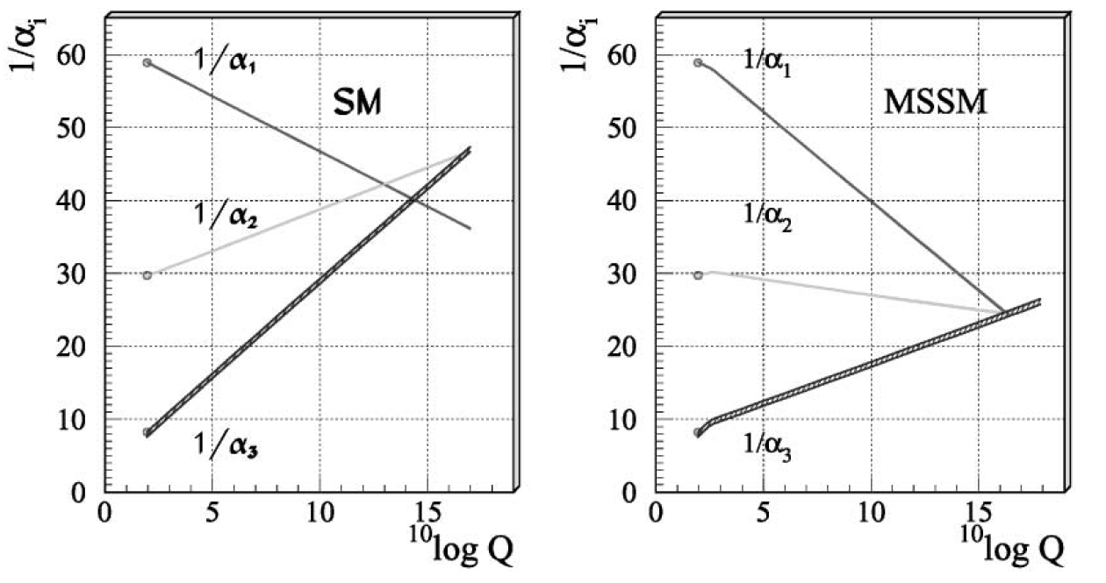
Unification of Coupling Constants
SM
SUSY

Slide 29
What is Dark Matter?

Slide 30
Three Detection Methods
X
X
Indirect
Detection
?
Production
by LHC
SM
SM
Direct
Detection

Slide 31
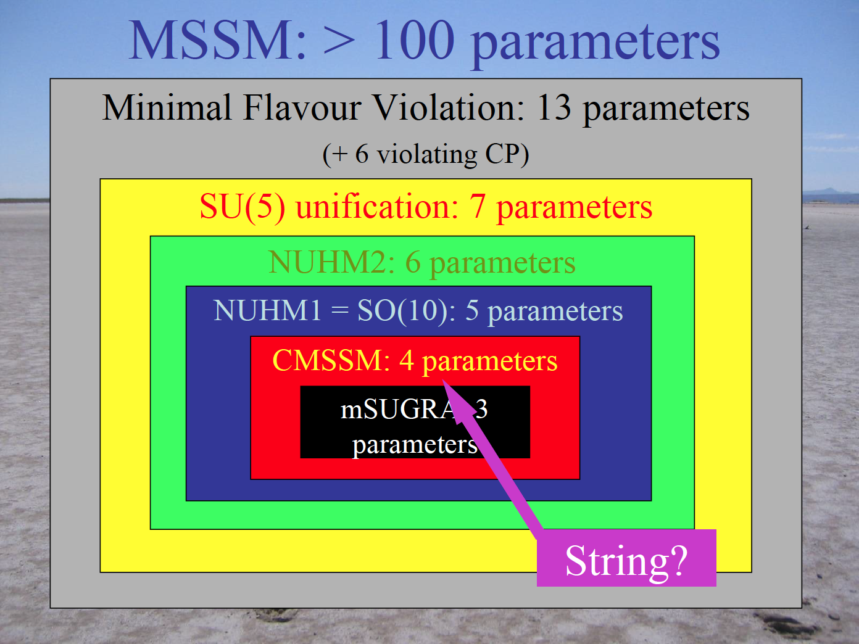
John Ellis

Slide 32
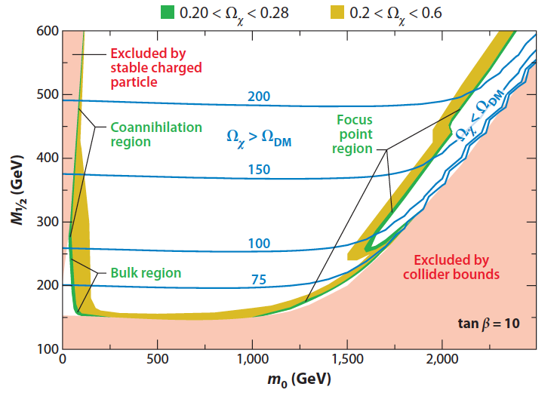
mSUGRA m_{1/2} vs. m₀ (before LHC)
_{Mx =}
_{GeV}
M_{x} ~ 0.4 * M_{1/2}
Feng Ann. Rev. Astro. Astrophys. 2010.48:495-545

Slide 33
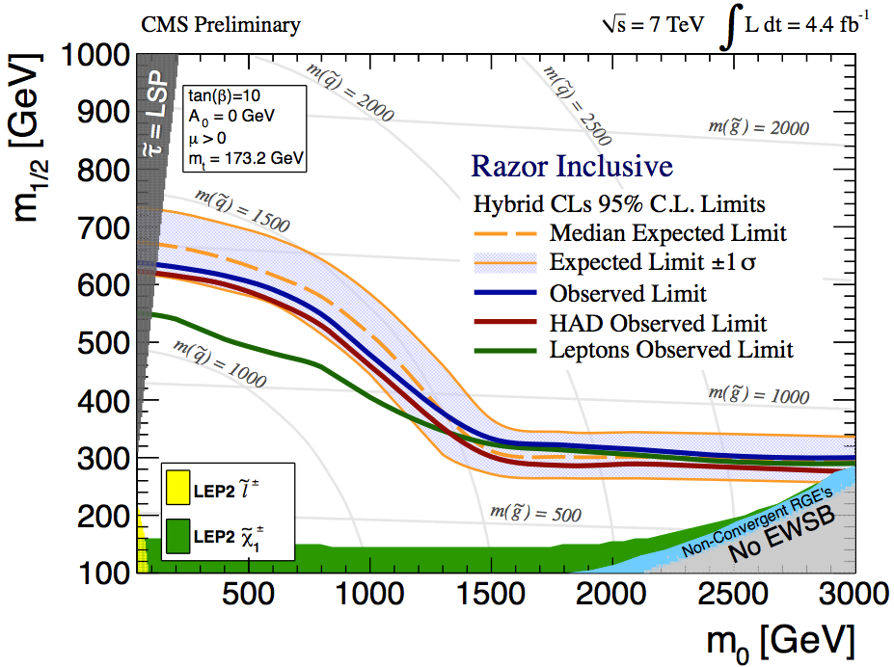
New CMS Results
M_{x} ~ 0.4 * M_{1/2}

Slide 34
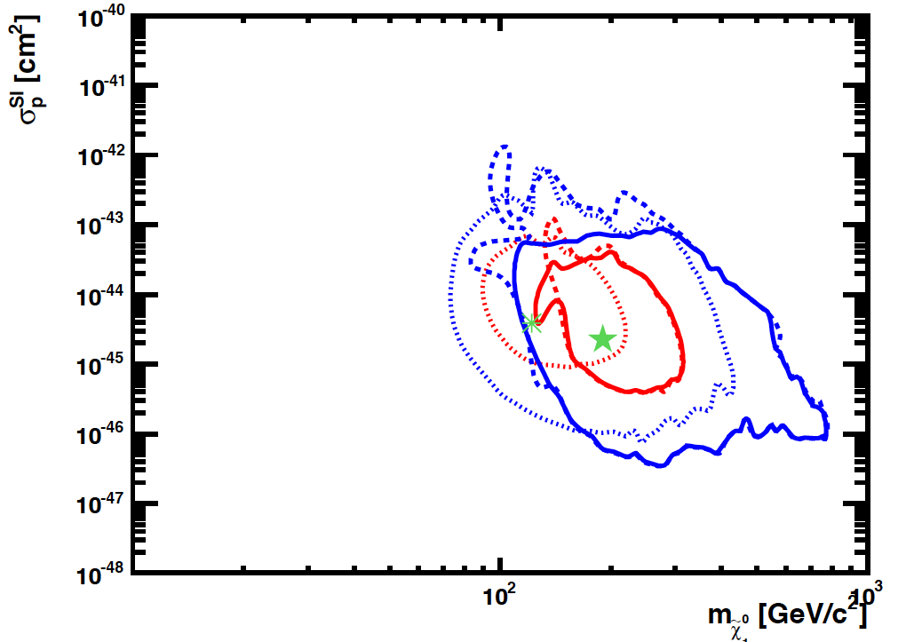
SI Cross Section vs. Mass
CMSSM
CMSSM
LHC
Pre
2011
2012
XENON100
2011
Buchmueller et al arXiv:1106.2529

Slide 35
Three Detection Methods
X
X
Indirect
Detection
?
SM
SM

Slide 36
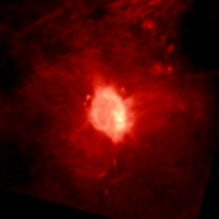
Indirect Detection
Rene Ong
Telescopes
γ
VERITAS, MAGIC,
HESS, Fermi, CTA
WIMP
Annihilation
(e.g. GC)
ν
IceCube, KM3net
Cosmic Ray Expts
χ
W⁺/Z/H/q
decreasing
background
e⁻
ATIC, Fermi …
?
e⁺
Pamela, AMS
χ
W⁻/Z/h/q
p
HEAT, Pamela,
BESS, AMS
d BESS, AMS
GAPS
Notes:
36

Slide 37
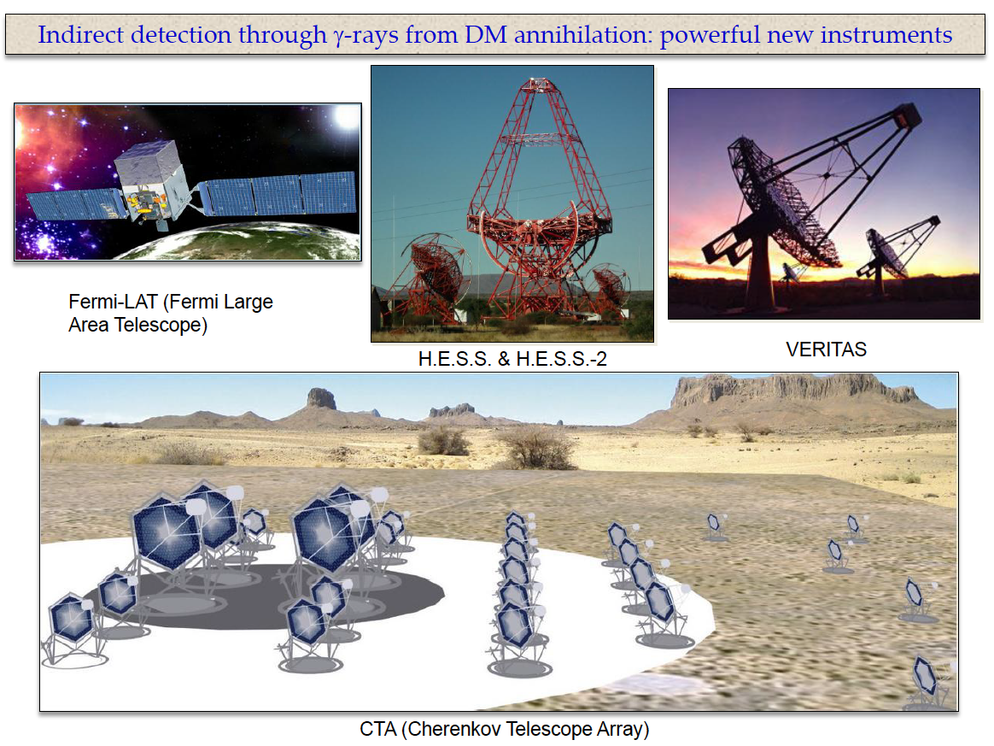
Gamma Ray Telescopes
Rene Ong & Vladimir Vassiliev

Slide 38
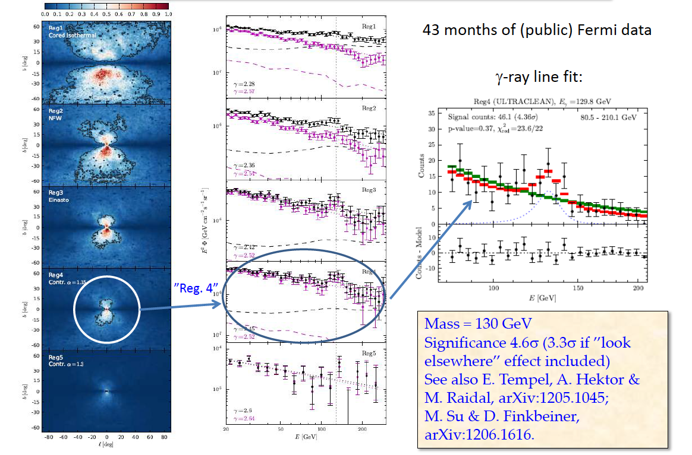
130 GeV Peak by FERMI

Slide 39
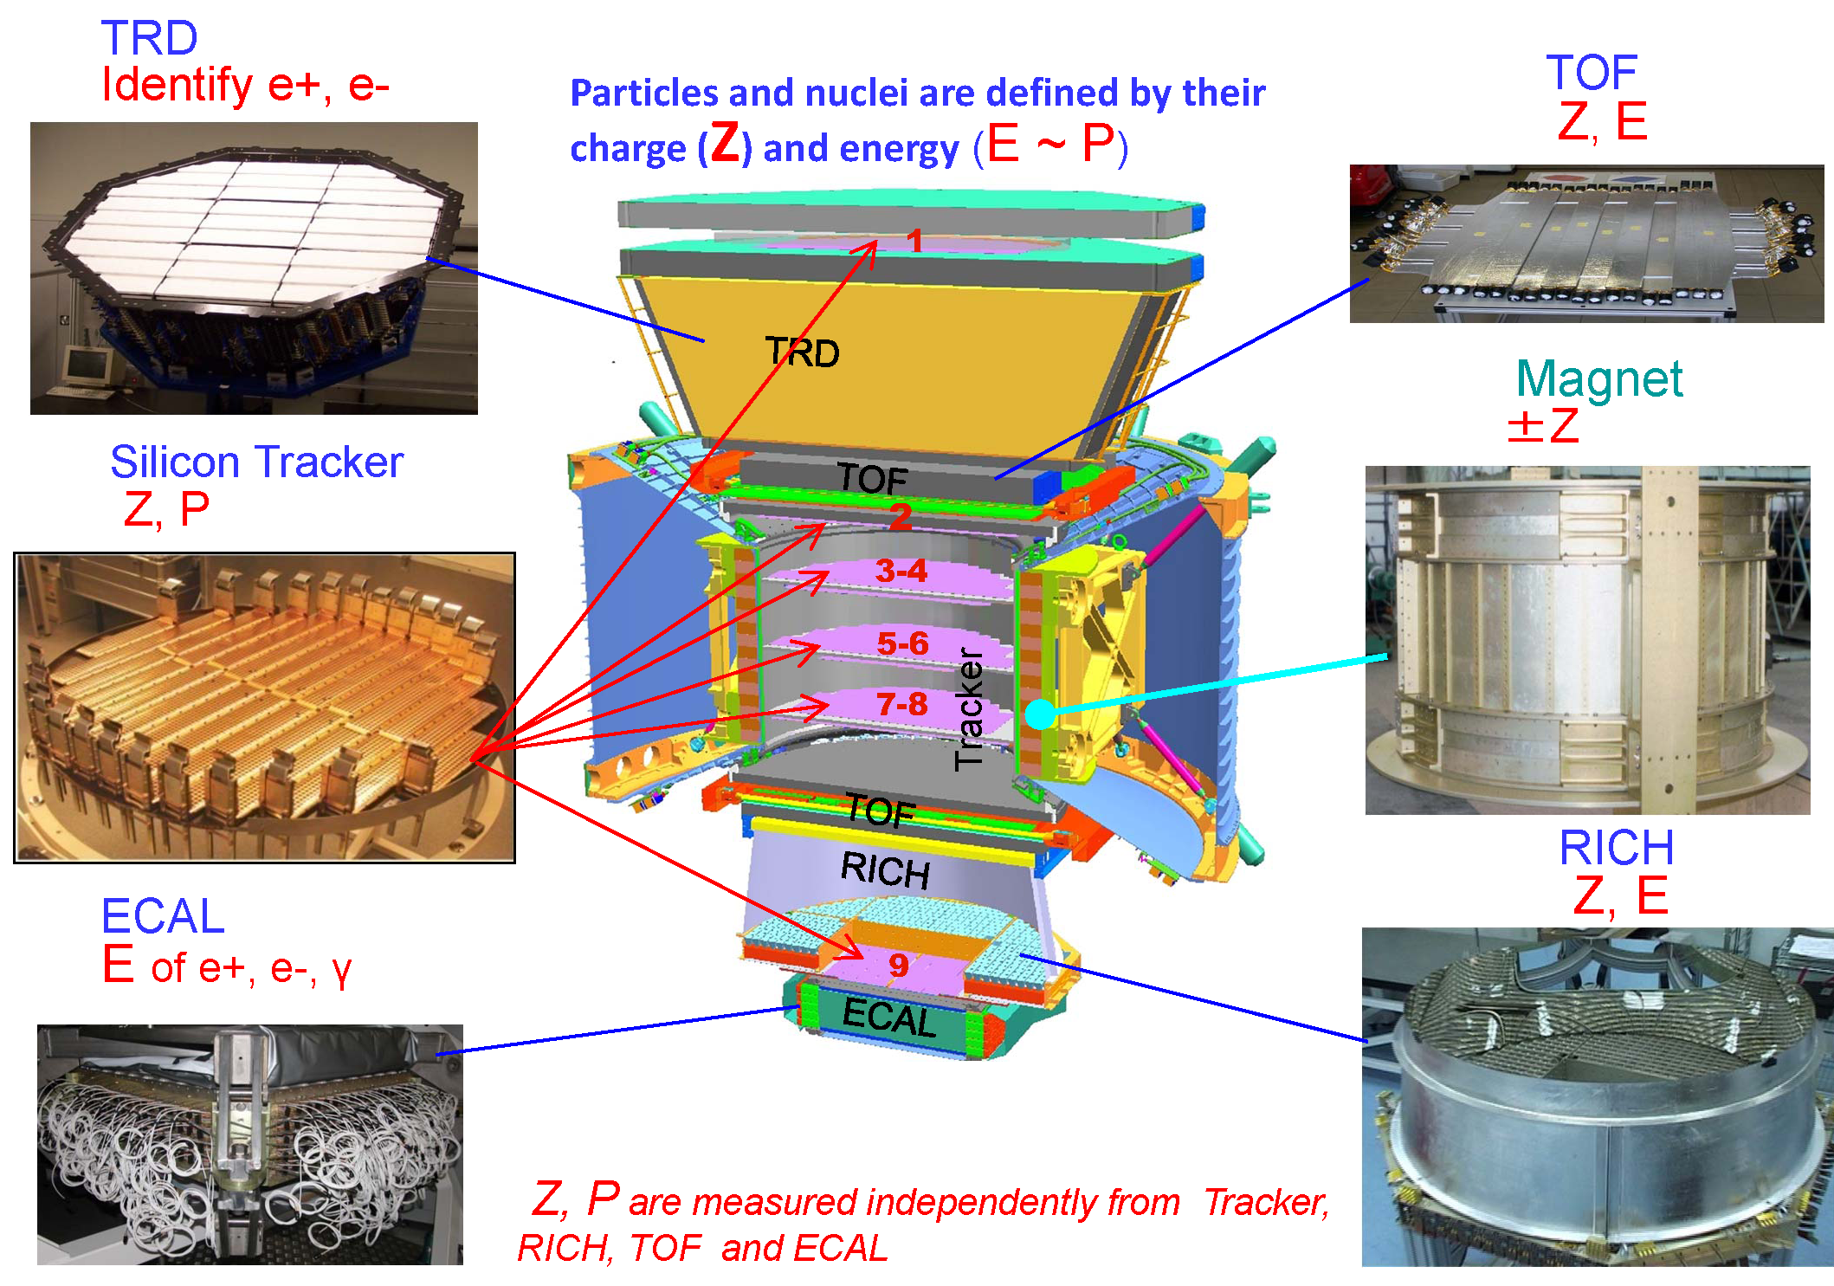
AMS-2
Notes:
39

Slide 40
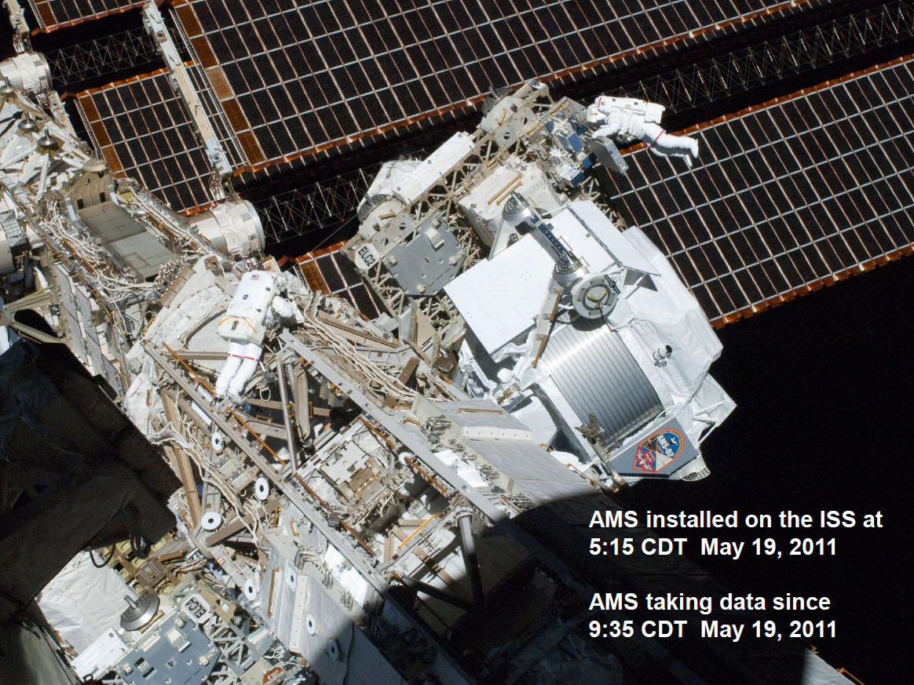

Slide 41
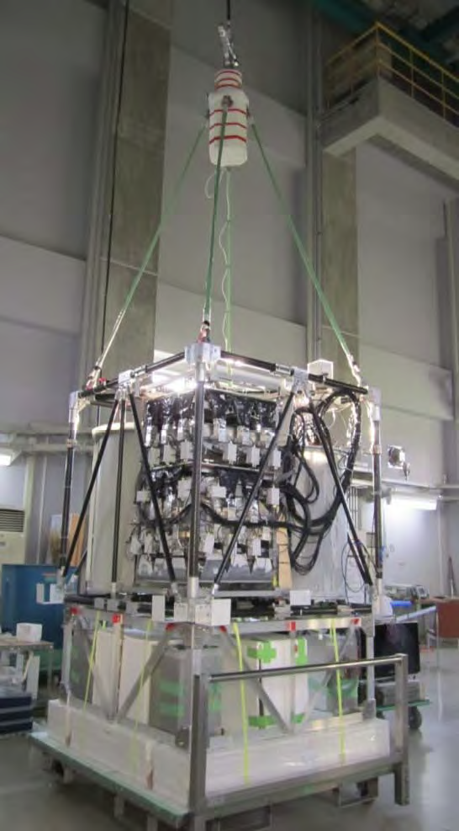
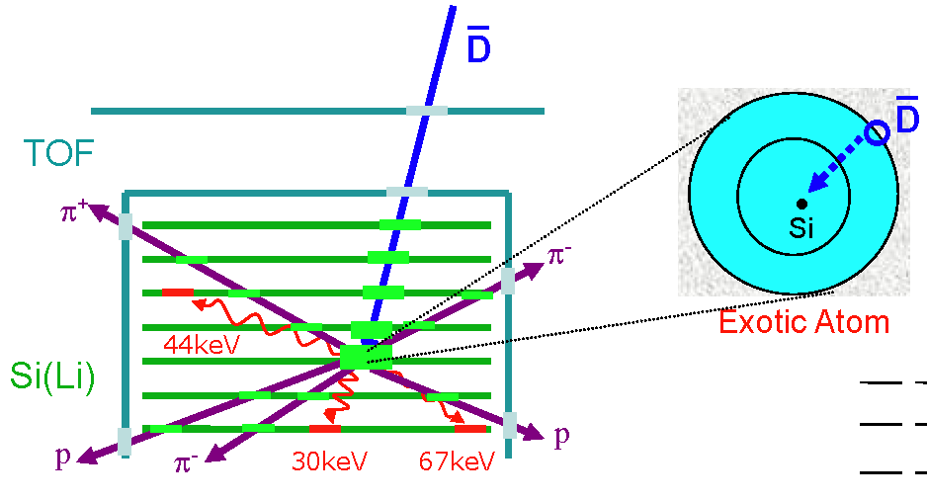
GAPS
Rene Ong
GAPS: Dark Matter search expt.
Anti-D signature
Improve by 10³-10⁴ over BESS
Complementary to AMS

Slide 42
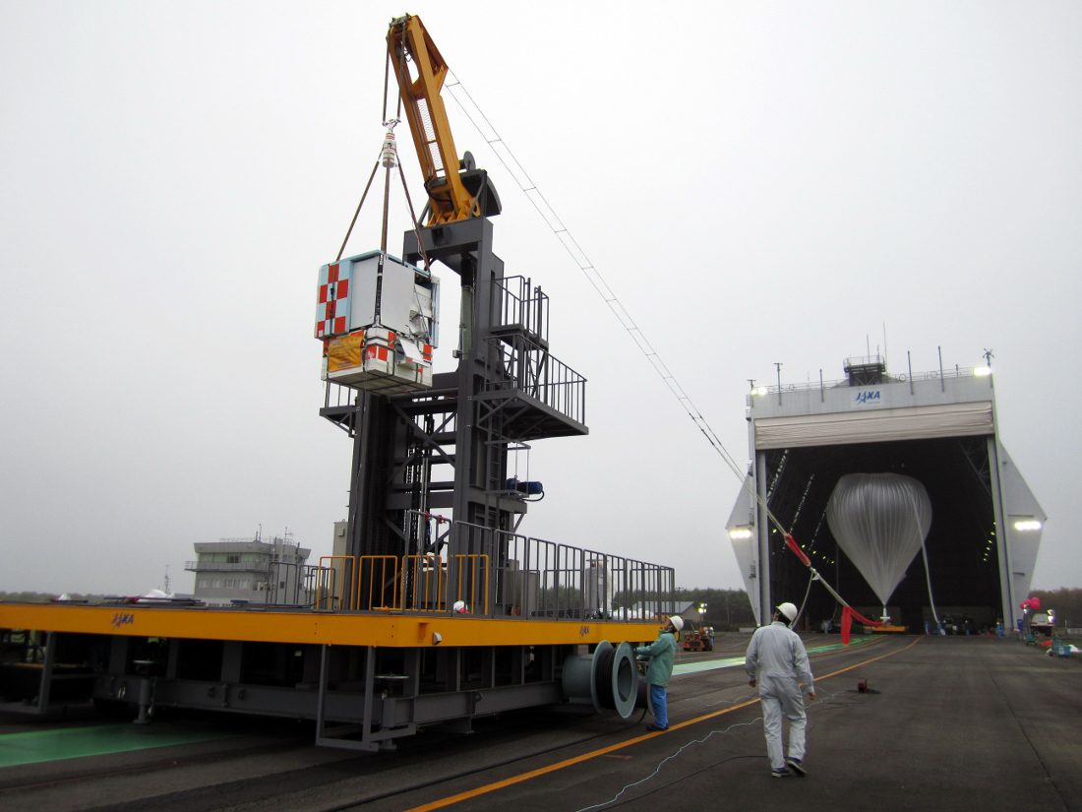
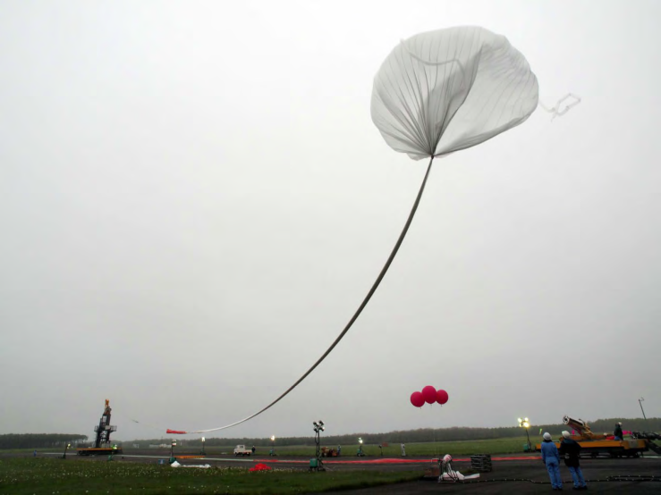
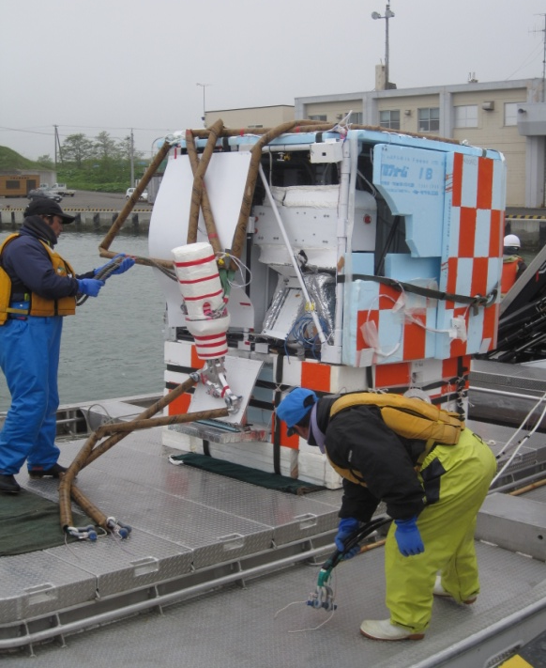
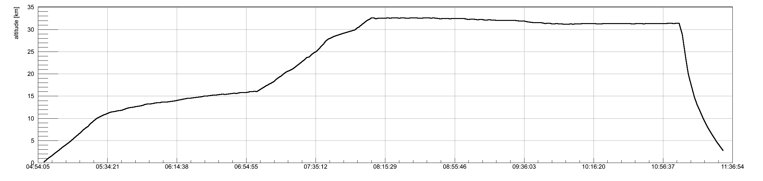
Successful Balloon Flight of pGAPS
(June 3, Taiki Japan)
Rene Ong
Launch
04:55
Recovery
32 km
| 3 hrs |
14 km
Flight Profile
Notes:
42
42

Slide 43
Three Detection Methods
X
X
?
SM
SM
Direct
Detection

Slide 44
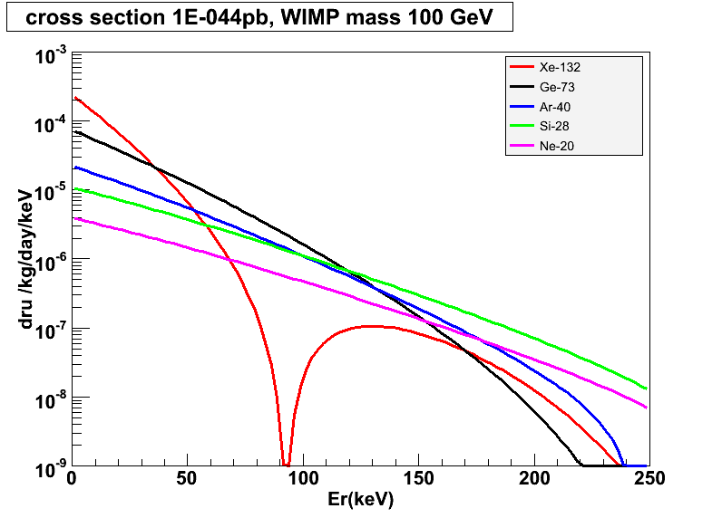
Target Mass Dependence of WIMP Cross Section
10⁻⁴⁴ cm²
Xe-132
Ar-40
Ge-73
Si-28
Ne-20

Slide 45
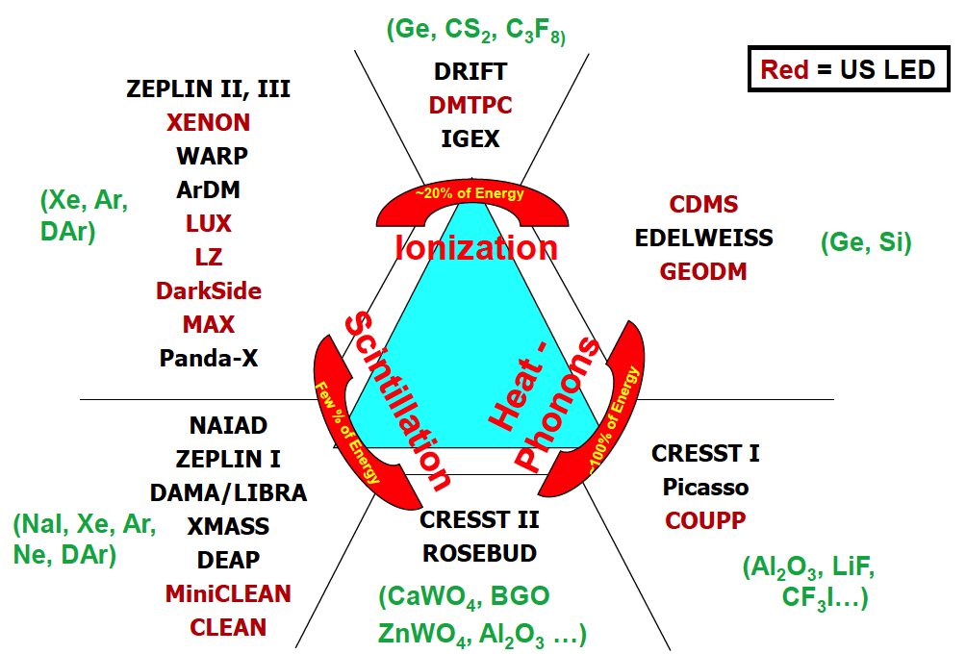
Detection Technique
Double
Phase
Gamma Ray
(Ge, Si)
Single
Phase
Neutron
WIMP

Slide 46
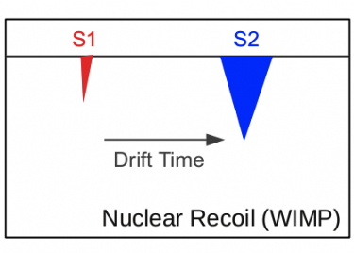
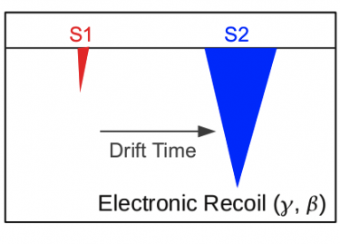
Double-Phase Noble Liquids

Slide 47

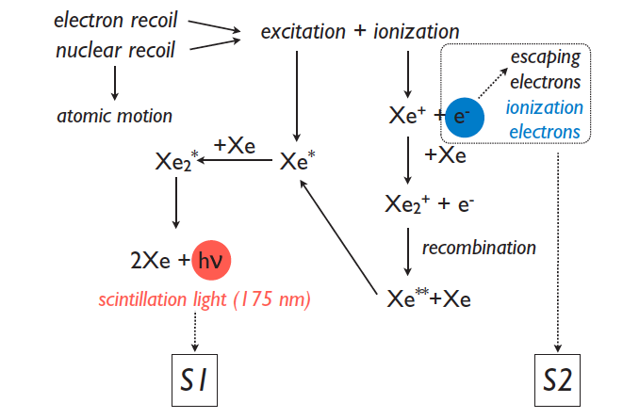
Principle of Double Phase TPC
10 keVnr
5 pe
1000 pe

Slide 48
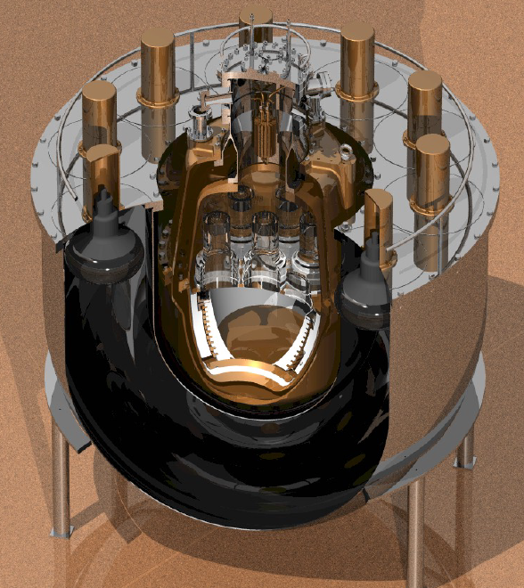
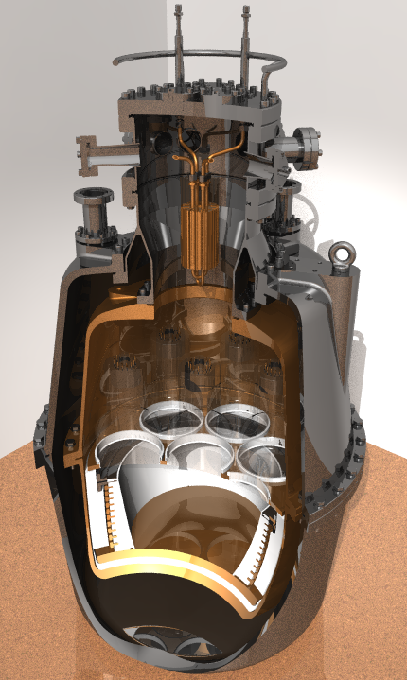
ZEPLIN II with Veto setup
Hanguo Wang & David Cline
Started R&D in early 1990’s
Liquid Scintillator Veto
Internal details

Slide 49
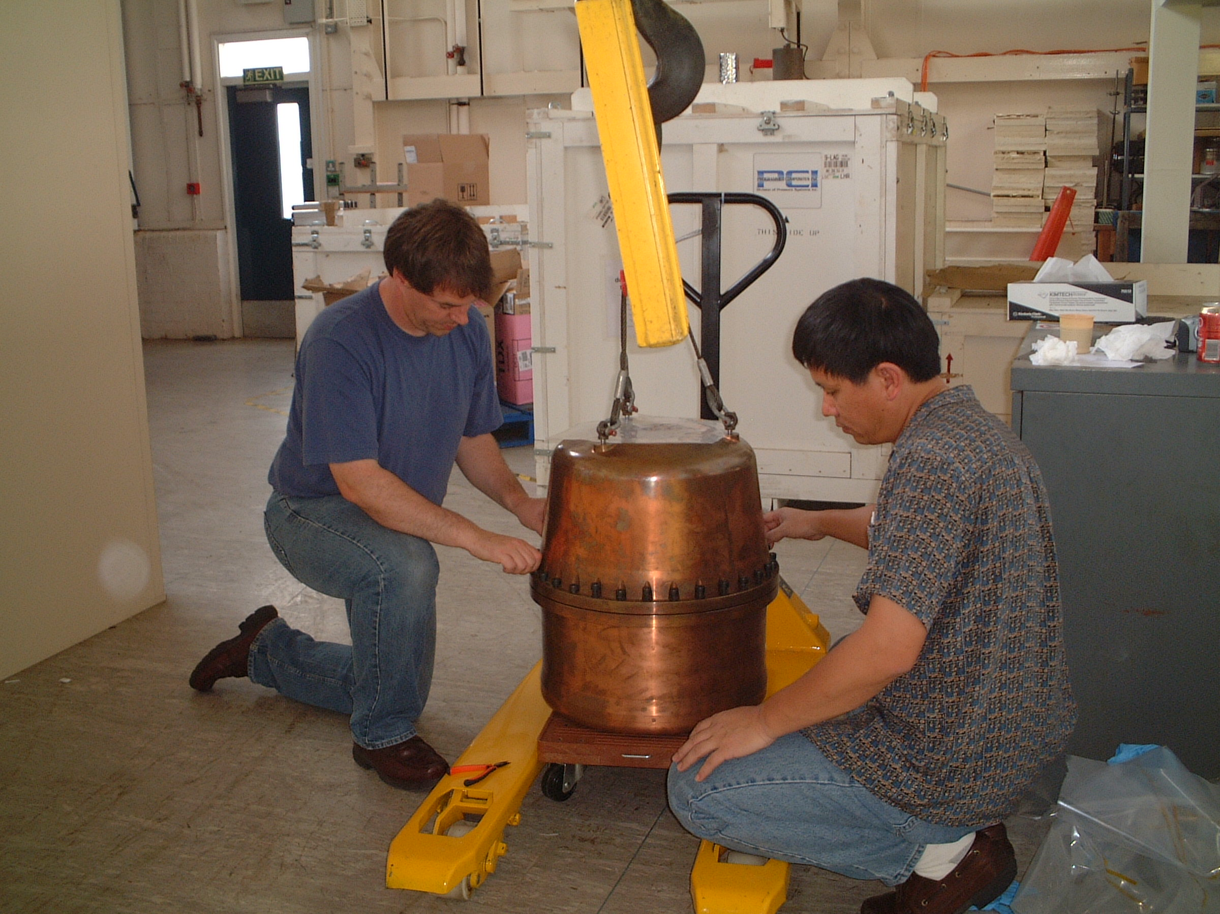
Hanguo Wang closing the ZEPLIN II detector (2004?)

Slide 50
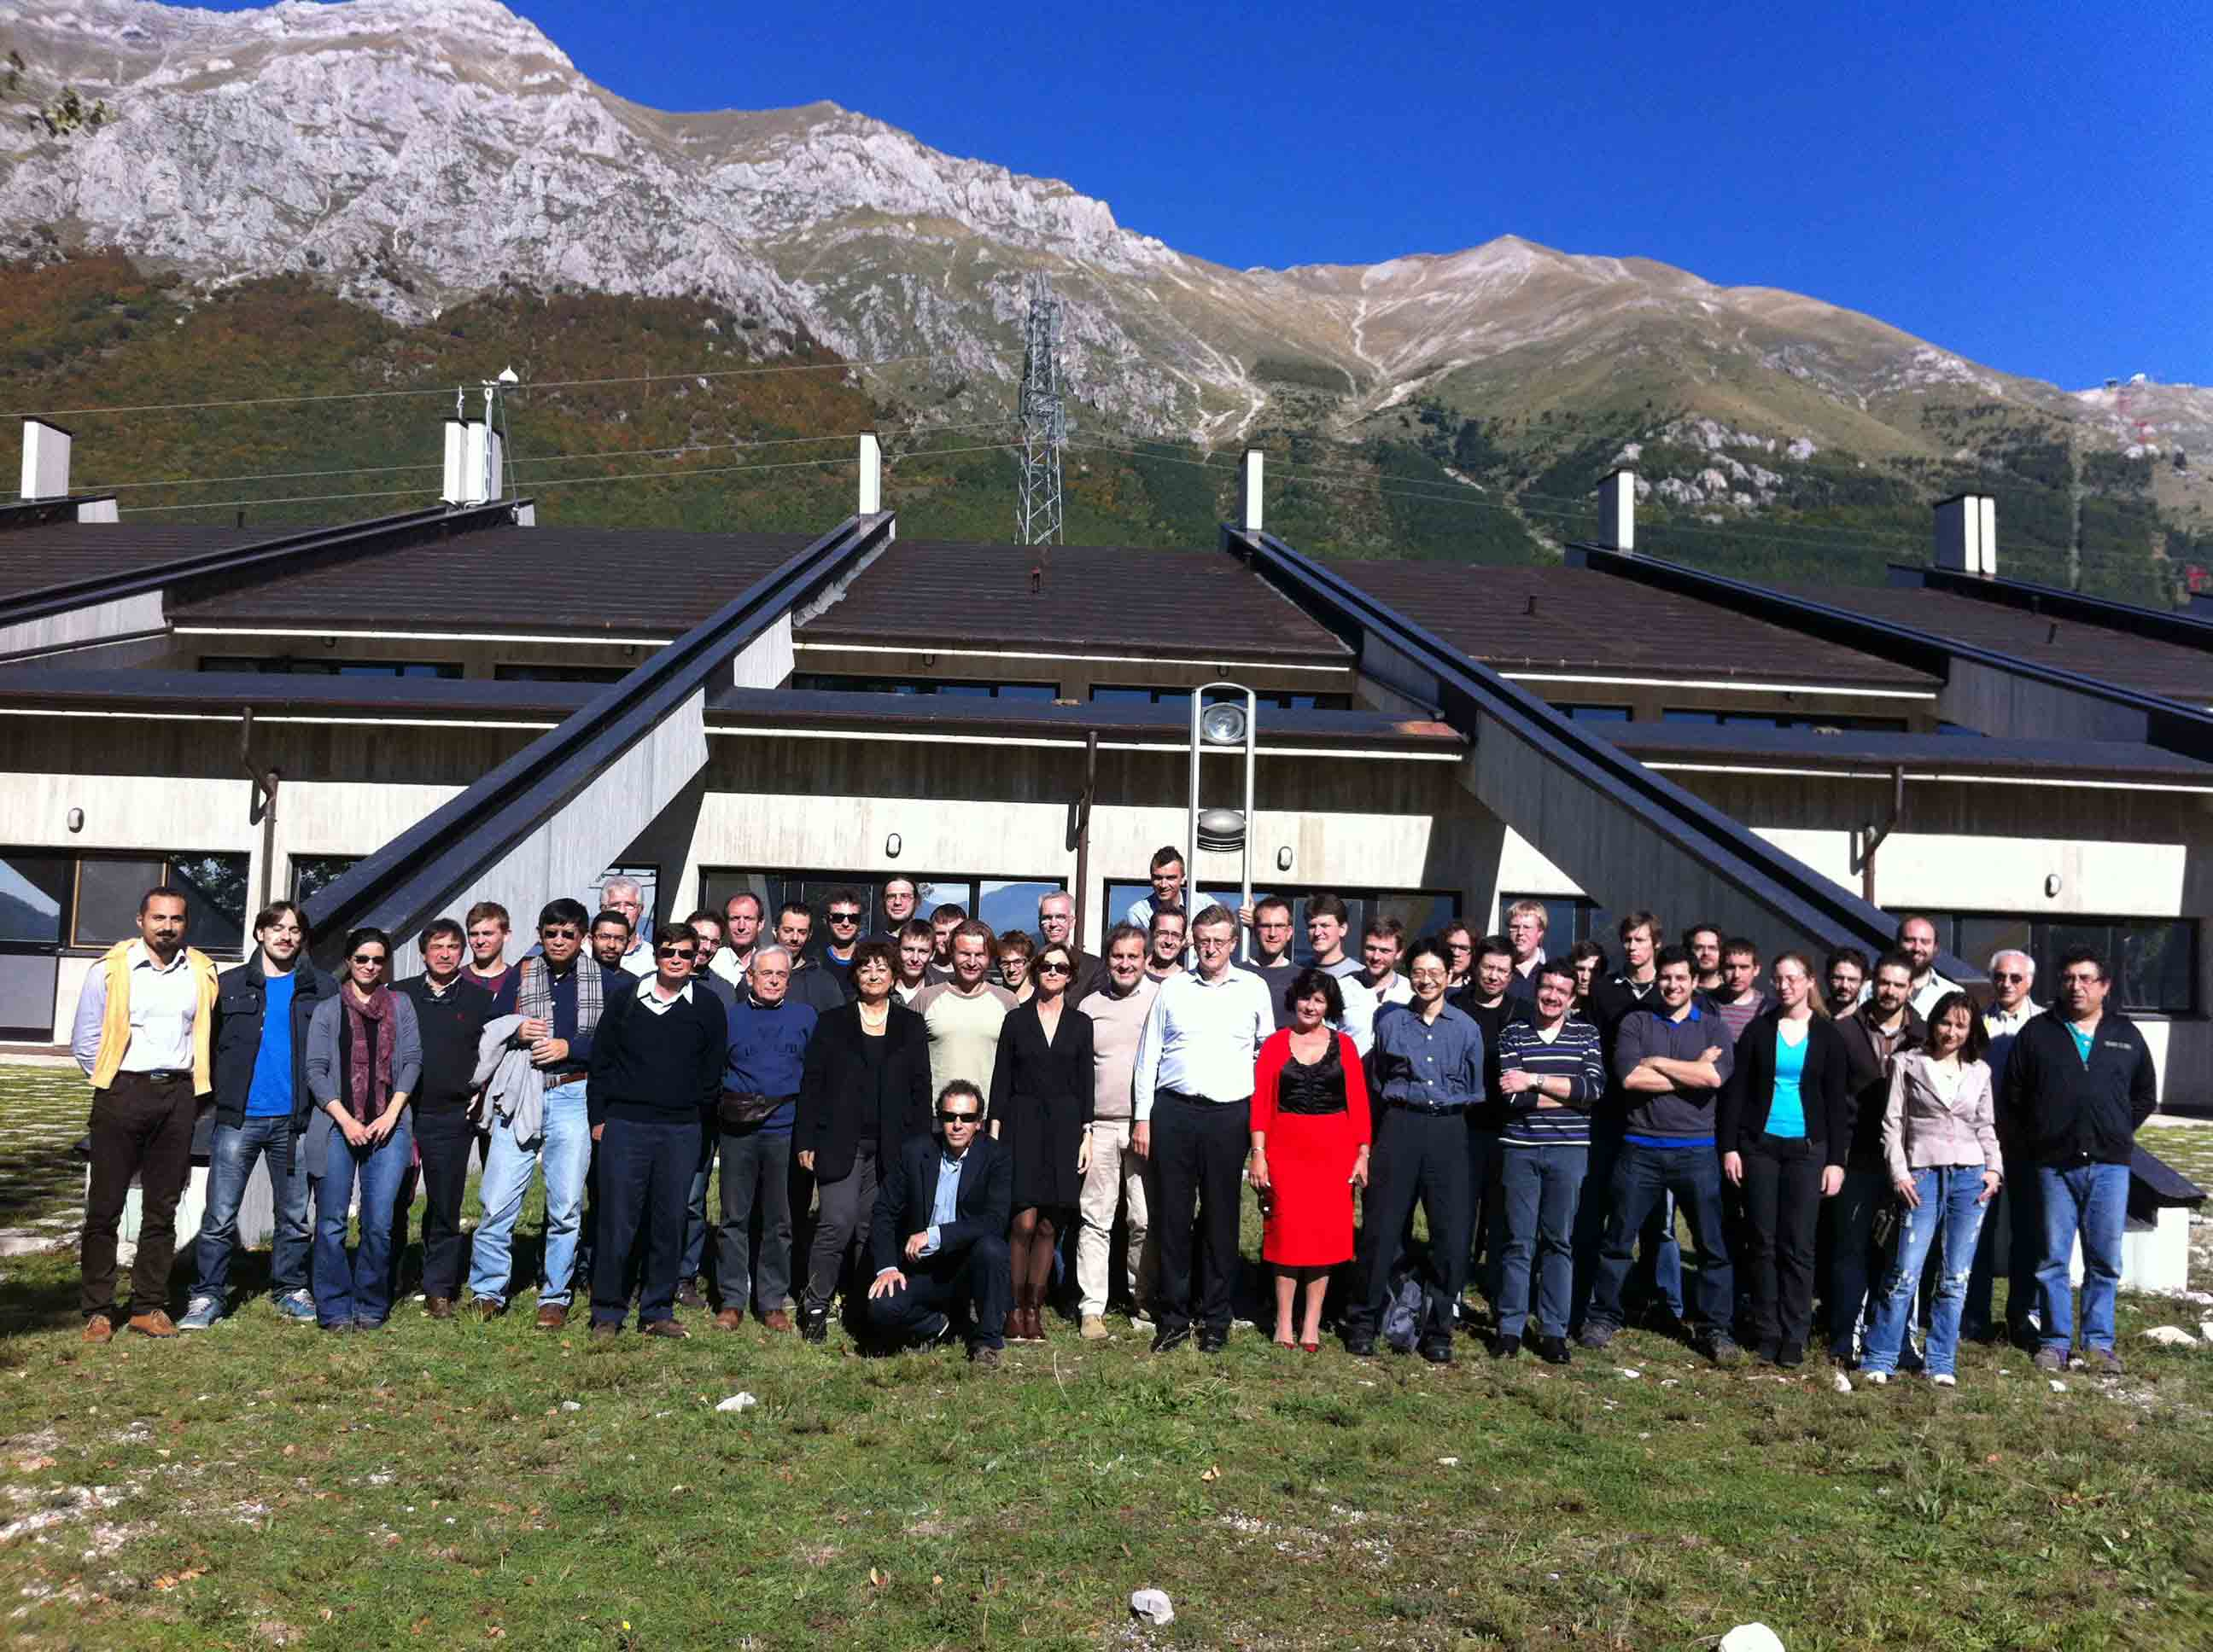

XENON Collaboration at Gran Sasso
UCLA joined in 2008

Slide 51
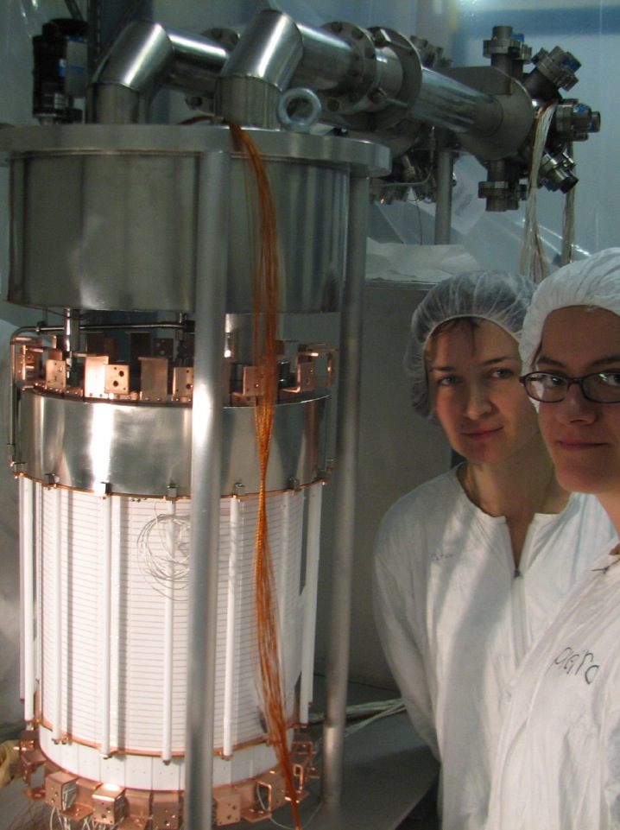
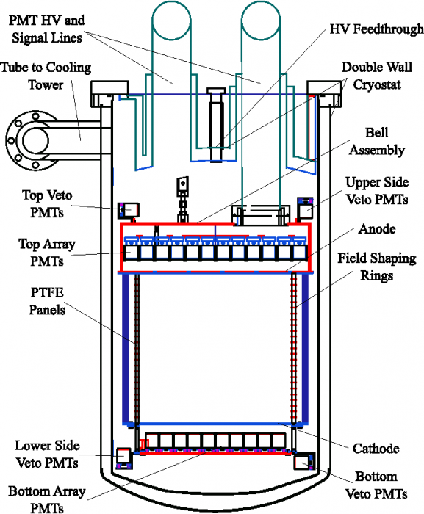
XENON100 Detector
161 kg
(48 kg)

Slide 52
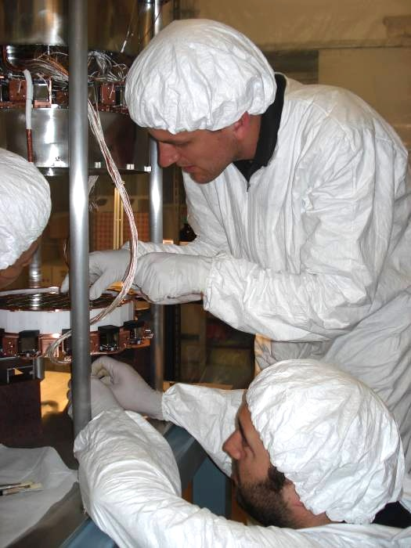
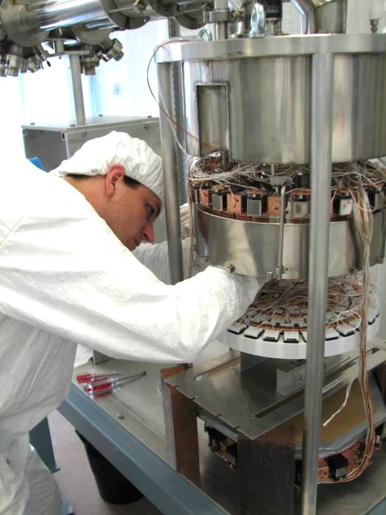
XENON100 Detector
Ethan Brown

Slide 53

Pb
(20cm)
Poly
(20cm)
Cu
(5cm)
Pb
(20cm)
Poly
(20cm)
Cu
(5cm)

Slide 54

Gamma Backgrounds
Kevin Lung
Total MC
Real Data
2νββ
Radon
Krypton
External BG

Slide 55
Gamma Backgrounds
1/100
before fiducial cut
after fiducial cut

Slide 56

⁶⁰Co and AmBe Calibration Data
Gamma (⁶⁰Co)
Neutron (AmBe)

Slide 57

XENON0100 New Results
225 days, 34 kg
6.8 keV_{nr}
32 keV_{nr}
2 events
(1.0 ± 0.2 expected)
Blinded Region
-3 σ
S1 = 3 PE
S1 = 20 PE

Slide 58


Unblinding on July 8
Before
After

Slide 59
XENON0100 New Results
225 days, 34 kg
6.8 keV_{nr}
32 keV_{nr}
2 events
(1.0 ± 0.2 expected)
-3 σ
S1 = 3 PE
S1 = 20 PE

Slide 60

Unblinding results
34 kg
Before S2/S1 cut

Slide 61

90% CL Limits of SI Cross Section (July, 2012)
Graciela Gelmini
arXiv:1104.2549
?
CMSSM

Slide 62

L_{eff} vs. Energy
?

Slide 63

Sheldon is wondering L_{eff} ….

Slide 64
Principle of Double Phase TPC
10 keVnr
L_{eff}
Equivalent
to 2 keVee
Q_{y}
C2
50 e⁻
L_{y}
E1
E2
1000 pe
5 pe

Slide 65
SI Cross Section vs. Mass
CMSSM
CMSSM
LHC
Pre
2011
2012
XENON100
2011
2012
XENON1T
Is Supersymmetry in trouble?
Buchmueller et al arXiv:1106.2529

Slide 66

KK particles in Extra Dimensions

Slide 67

Origin of the Proton Mass
A real proton looks like this…
> 90% of its mass is due to kinetic energy of quarks and gluons.

Slide 68
Photon
Extra
Dimensions
KK Photon
Bulk
Our 3D Space
(= Brane)

Slide 69
Origin of Mass in Extra Dimensions
E = mc² → m = E/c²
Mass can be generated as kinetic energy in extra dimensions.
Origin on mass
Dark matter is running in the extra dimensions
Gravity can escape into the extra dimensions.
Why gravity is so small
Origin of dark energy

Slide 70


Mass Spectrum of the first KK level
Similar to the SUSY mass spectrum
Δ = (m_{l} – m_{γ})/m_{γ}
KK Photon
KK Photon
Cheng 2002 arXiv:hep-ph/0205314v1

Slide 71

Allowed Region of Minimum Universal Extra Dimensions
WMAP constraint
Kakizaki 2006

Slide 72

Predicted Cross Section of Kaluza-Klein Dark Matter
0
XENON100
Δ
2011
2012
XENON1T
0.5
Feng Ann. Rev. Astro. Astrophys. 2010.48:495-545

Slide 73

Sensitivity to KK particles
WMAP
0.5
LHC
0.1
0.05
XENON1T
Δ = (m_{l} – m_{γ})/m_{γ}
XENON100
0.01
My favorite
Arrenberg 2008

Slide 74
What is Dark Matter?

Slide 75

Properties of Axion

Slide 76


Primakoff Conversion

Slide 77

ADMX

Slide 78

CAST at CERN

Slide 79

Status of Axion Search
CAST
IAXO
ADMX

Slide 80

Axion search by XENON using Axio-Electric Effect
XENON100 (Solar Axion)
XENON100 (Super WIMP)
Expected Sensitivity

Slide 81
Comparison of Xenon Detector Size
G3
MAX, LZD
20 ton (10 ton)
G2
XENON1T
2.5 ton (1 ton)
G1
2 m
XENON100
161 kg
(48 kg)
ZEPLIN-II
31 kg
(7.2 kg)
XENON10
14 kg
(5.4 kg)
1 m
1 m
15cm
30cm
14cm
30 cm
20 cm
30 cm
1 m
2 m
2007
2007
2010
2017
2022

Slide 82


XENON 1T (G2) at Gran Sasso
Xe
2.5 ton
(1 ton)
1 m
10 m
Water
3” PMT x 250

Slide 83


DarkSide 5T (G2) at Gran Sasso
Water
10 m
2 m
⁴⁰Ar
5 ton
(3 ton)
Liq. Scinti.
3” PMT x 600

Slide 84
Roadmap to MAX
2012
2013
2014
2015
2016
2017
2018
2019
2020
Gran Sasso
DUSEL
MAX
XENON100
XENON 1T
Xe 10T
Ar 50T
DarkSide50
DarkSide 5T
G1
G2
G3

Slide 85


MAX+LZD = “Ultimate G3” Detector (at DUSEL)
Xe 20 ton (10 ton)
⁴⁰Ar 70 ton (50 ton)
Xe
Ar
Liquid
Scinti
Liquid
Scinti
Water Tank
Water Tank
8 m
18 m

Slide 86
G1
CMSSM

Slide 87
G1
CMSSM
G2

Slide 88
G1
CMSSM
G2
Xe
G3
Ar

Slide 89
LHC
Pre
2011
2012
2015
G1
CMSSM
G2
Xe
G3
Ar

Slide 90

1-σ Error of WIMP Mass vs SI Cross Section (10 ton*year Xe and 50 ton*year Ar)
50 GeV
100 GeV
200 GeV
500 GeV
Argon
10⁻⁴⁵ cm²
Xenon
Katsushi Arisaka, UCLA
90

Slide 91

Where backgrounds come from?
Cosmic Rays
Underground or
Under high mountains
XDNON100
Radio Activities
(U, Th, K…)
Xe/Ar
Water Tank
+ Liquid Scintillator
Photon detectors are the major source of backgrounds.

Slide 92



QUPID (QUartz Photon Intensifying Detector)
arXiv:1103.3689
Photo Cathode
(-6 kV)
Photo Cathode
(-6 kV)
Quartz
Al coating
APD (0 V)
APD (0 V)
Quartz

Slide 93

Comparison of Photon Detectors from Hamamatsu
R11065 (Ar)
R11410 (Xe)
3 inch
QUPID
3 inch
MAX
XAX
XENON1T
DarkSide50
R8520
1 inch
XENON10
XENON100
U/Th ~ 0.1 mBq
U/Th ~ 5 mBq
U/Th ~ 1 mBq

Slide 94

7 QUPID with Holder
Tested in both Xe and Ar

Slide 95

Full Liquid Xenon System
Hanguo Wang’s Lab
Control Panel
Recirculation Rack
Xenon Bottle
Recirculation Pump
Getter

Slide 96
Technological Challenges
External Backgrounds
Deep underground – DUSEL 4850 ft
> 5 m water shielding – Water Tank (15 m)
Detector Materials
Photon Detectors – QUPID
Cryostat – Copper (OHFC)
Others – PTFE, Quartz …
Purity of Liquid Xe/Ar
Radon (< 0.3 mBq / ton)
³⁹Ar (> 100 depletion) – Depleted Ar
⁸⁵K (< 0.2 ppt in Xe) – 1 event / 10 ton-year
Physics Backgrounds in Xe
pp-chain solar neutrinos – 1 event / 10 ton-year
2v Double beta decays from ¹³⁶Xe – 1 event / 10 ton-year

Slide 97
Conclusions
Science Cases
Overwhelming – Astronomy and Cosmology
Beyond Standard Model – SUSY, Extra Dimensions…
Experimental Status
Healthy competition between LHC ($10B) and XENON ($10M)
SUSY is pushed to the corner, or about to be discovered.
Future Direct Searches
G2 : XENON 1T and DarkSide 5T at Gran Sasso.
G3 : MAX (Xe 10T + Ar 50T) at DUSEL

Slide 98
Katsushi’s Speculations in Nov 2011
2012 LHC (ATLAS+CMS) announces
120 GeV Higgs (at 3σ)
125 GeV Higgs (at 5σ)
2017 XENON1T announces
Observation of 10 WIMP signals (> 200 GeV)
2022 G3 (Xe+Ar) and LHC jointly confirm
Extra Dimensions
WIMP = 700 GeV KK Photon (Δ = 5%)
No Supersymmetry
Katsushi happily retires at age 66.

