Slide 1
Origin of the Universe, Particles and Structure
Katsushi Arisaka
University of California, Los Angeles
Department of Physics and Astronomy
arisaka@physics.ucla.edu

Slide 2
Talk Outline
Part I : Particle Physics & Cosmology ~50 min.
Introduction to Cosmology: Origin of Universe
CMS at CERN: Origin of Particles
Detection of Dark Matter: Origin of Structure in Universe
Lab Tour ~15 min.
Part II : Bio-imaging and Neuro-physics ~50 min.
Introduction to High-speed Bio-imaging
Single Molecule: Origin of Life
Neurophysics: Origin of Consciousness

Slide 3
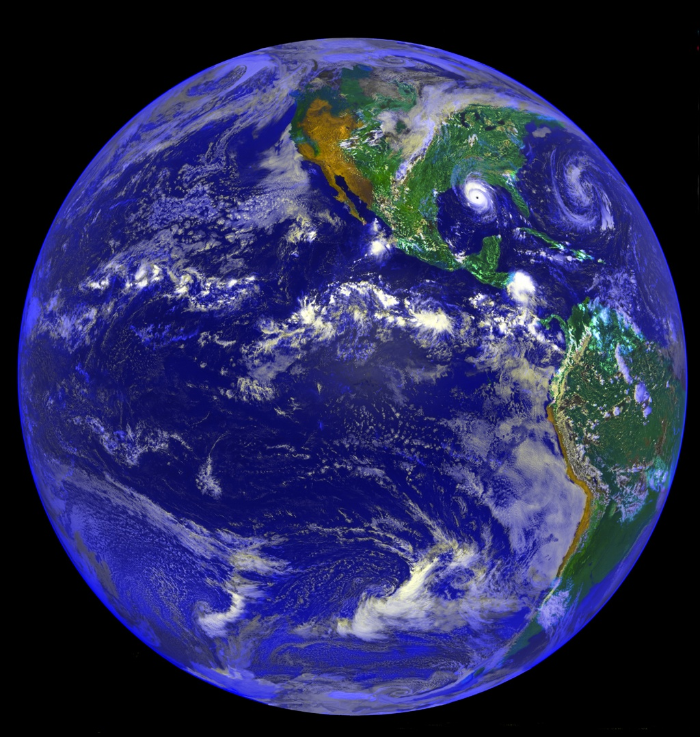
Why are we here?

Slide 4
Introduction to Cosmology

Slide 5
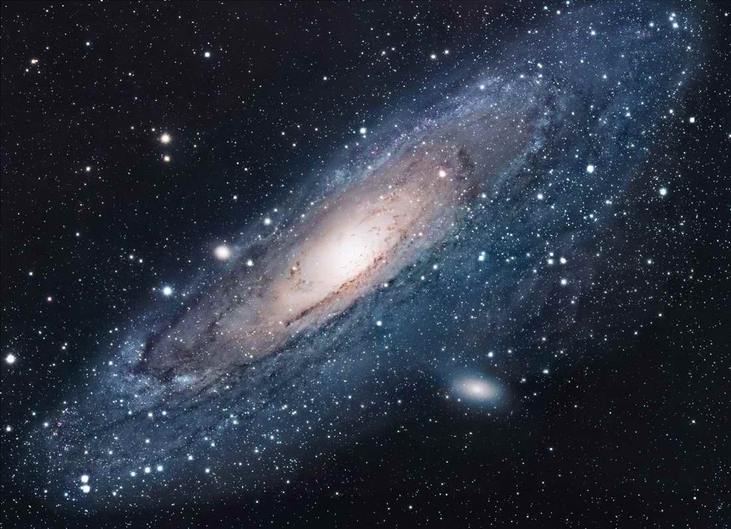
Andromeda
~100 Billions Stars in a Galaxy

Slide 6
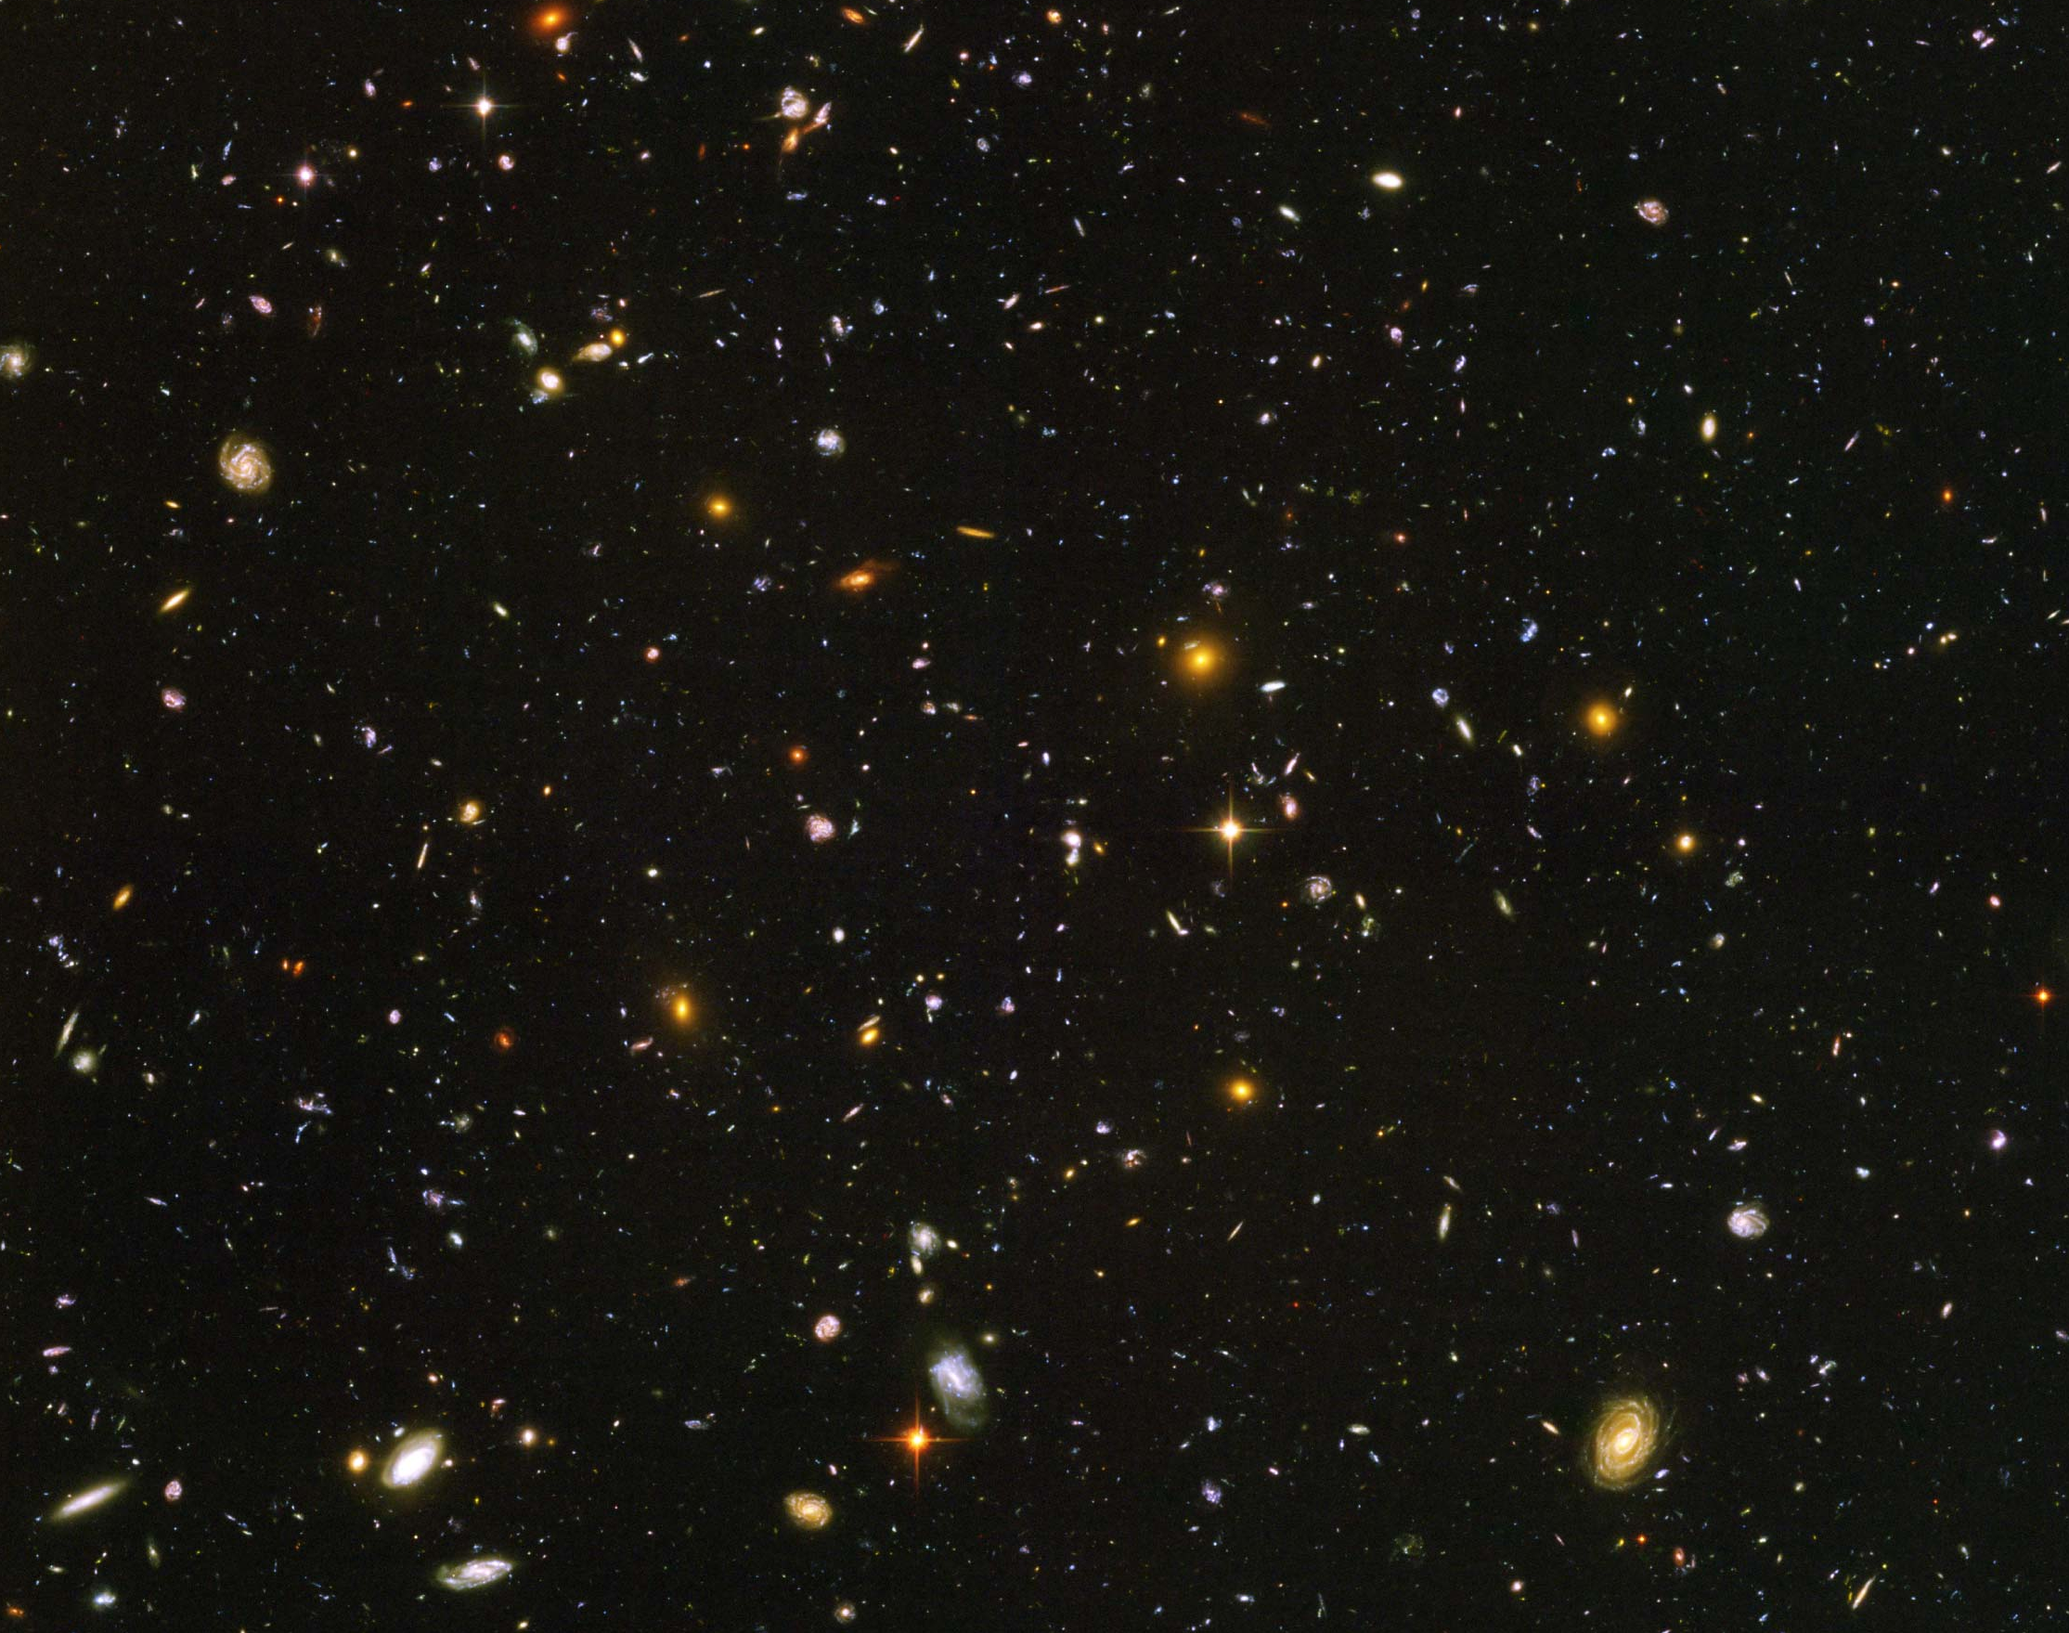
Hubble Deep Field
~100 Billion Galaxies

Slide 7
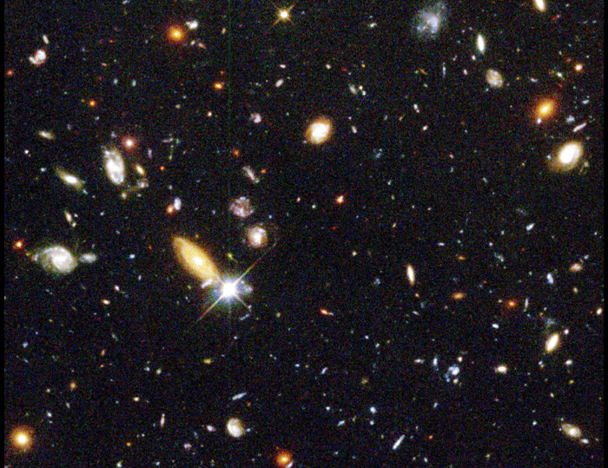
Red shift
up to ~10

Slide 8
Hubble’s Law: Expansion of the Universe
Horizon
of Universe
Big Bang!
Sun/Earth
14 Billon
Light Years
Moving Away
at Speed of Light

Slide 9
Expansion of Universe
Size
Size of Universe
Horizon
Beginning
Today
Time

Slide 10
Temperature of Universe
Temperature
Temperature = 1/Size
2.7ºK
Beginning
Today
Size

Slide 11
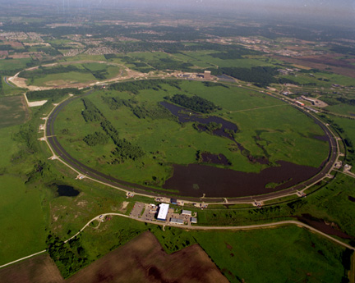
Fermi Lab near Chicago
6km Circumference
1+1=2 TeV
p + p⁻

Slide 12
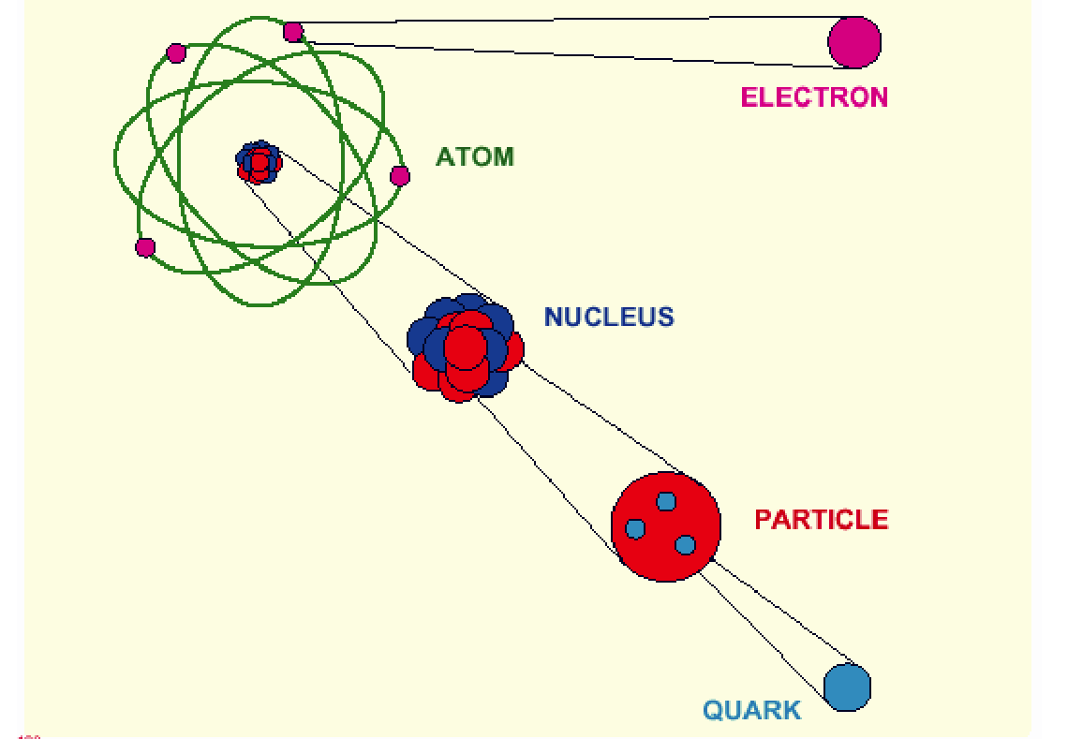
Elementary Particles (~1970)

Slide 13
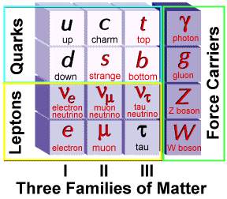
Elementary Particles
Charge
+2/3
-1/3
0
-1
Fermion Boson
Charge
0
0
0
±1
+ Anti-particles

Slide 14
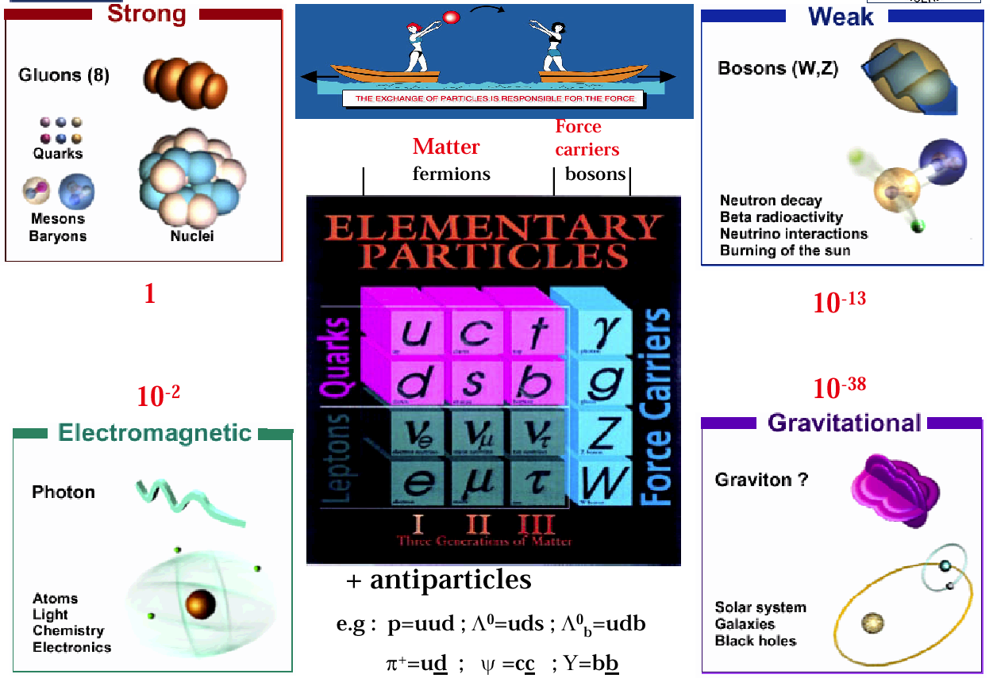
Elementary Particles and Forces

Slide 15
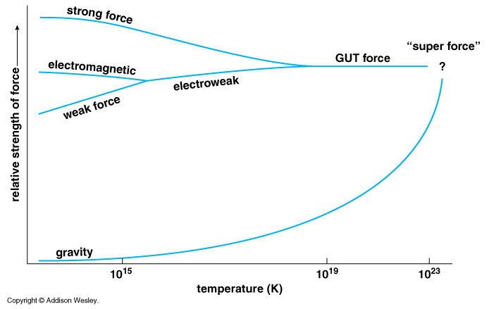
Unification of Forces
??
Electro-Weak Unification
100 GeV
10¹⁶ GeV
10¹⁹ GeV
10²⁹
10³²

Slide 16
Unification of Forces
Grand Unification
100 GeV
10¹⁶ GeV
10¹⁹ GeV
10³²
10²⁹
10³²
10²⁹

Slide 17
Unification of Forces
Planck Epoch
100 GeV
10¹⁶ GeV
10¹⁹ GeV
10²⁹
10³²

Slide 18
Hubble Deep Field
Physicists’ View of Early Universe
Fiat lux
Let there be light

Slide 19
Hubble Deep Field
Physicists’ View of Early Universe
Lorentz Invariance
Local Gauge Invariance

Slide 20
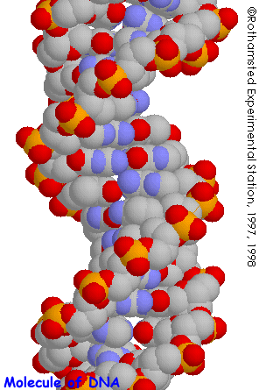
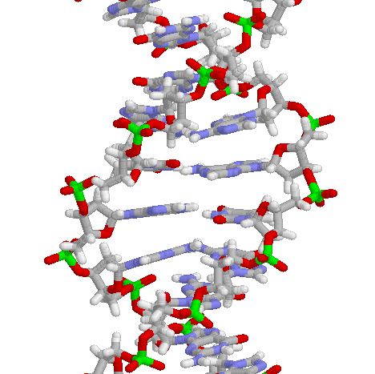
Structure of DNA

Slide 21
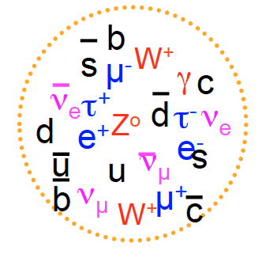
Symmetry Breaking
Time
0
Simple
1B years
2
3
4
5
Symmetry
Break Down
6
7
8
9
10
11
12
Complex
13
14

Slide 22
The Beginning (at t = 0)
Everything was the same →Perfect symmetry.
All the particles are the same as photons.
All four forces are the same.
The Universe was 10 dimension.
3 Space Flattened
1 Time
3 Strong Force
6 2 Weak Compacitified
1 Electro-Magnetic

Slide 23
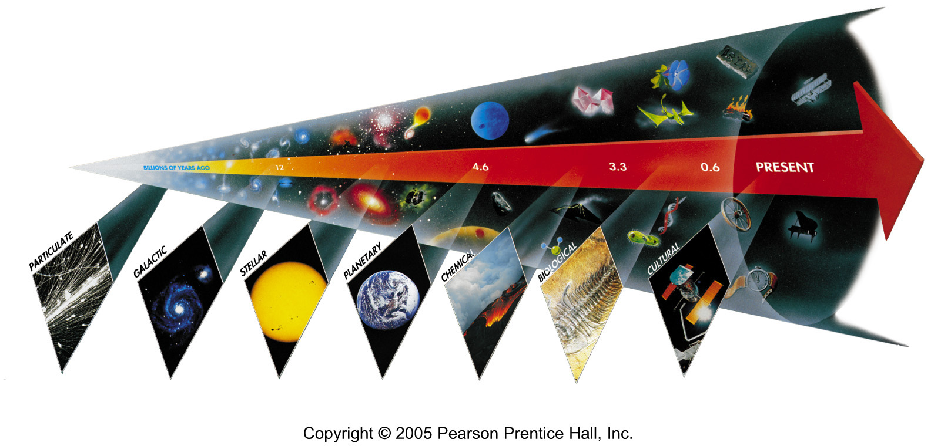
Seven Phases of Cosmic Evolution
Spontaneous Symmetry Breaking
14B years ago
Simple
Coherent Complex System

Slide 24
Seven Phases of Cosmic Evolution
Spontaneous Symmetry Breaking
14B years ago
Origin of
Particles
Origin of
Structure
Origin of
Life
Origin of
Consciousness

Slide 25
CMS at LHC

Slide 26
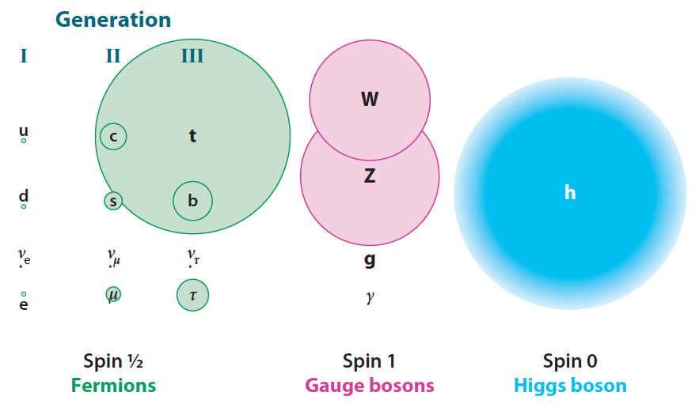
Mass of Particles (at t = 0.1 ns)

Slide 27
Mystery of the Mass (since 1970)
How to create mass from energy?
While maintaining the initial symmetry
Spontaneous Symmetry Breaking
Particle mass << Plank Mass
MeV – GeV 10¹⁹ GeV
Why so many particles (Generations) with different masses?
Energy → Mass

Slide 28
Spontaneous Symmetry Breaking - Higgs Mechanism -
Energy
y
Vacuum
Energy
x
Mass

Slide 29
Spontaneous Symmetry Breaking - Higgs Mechanism -
Energy
y
Vacuum
Energy
x
Mass

Slide 30
Spontaneous Symmetry Breaking - Higgs Mechanism -
Energy
y
Vacuum
Energy
x
Mass

Slide 31
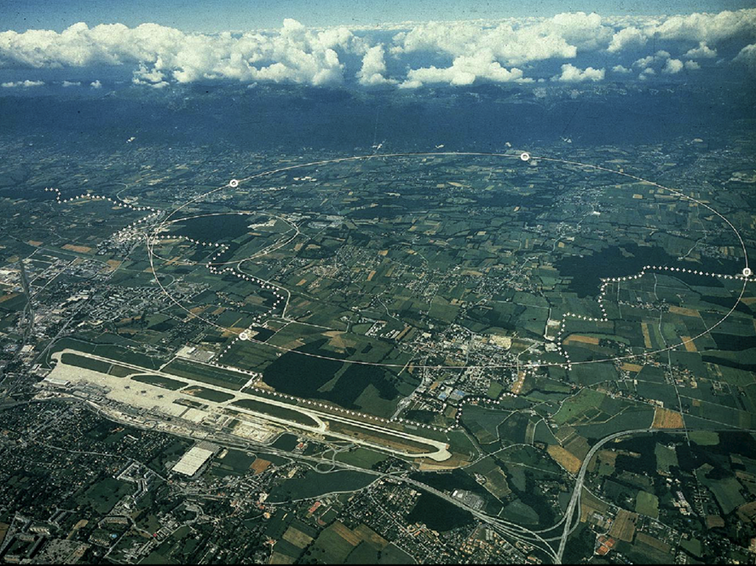
CERN and LHC in Geneva
27km Circumference
7+7=14 TeV

Slide 32
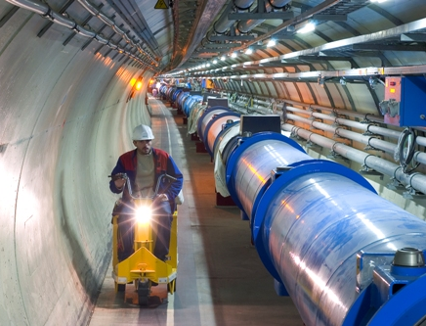
LHC Tunnel with Magnets

Slide 33
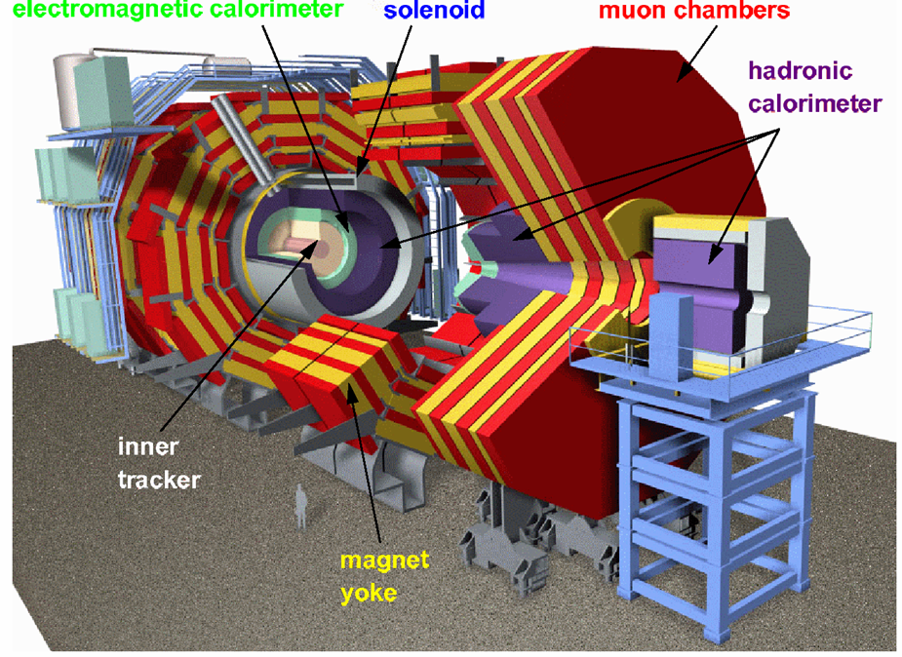
CMS

Slide 34
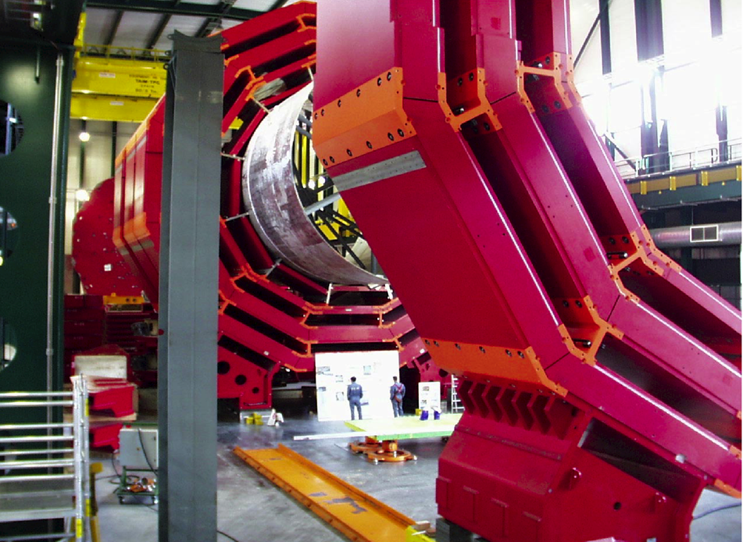
CMS Barrel Yoke

Slide 35
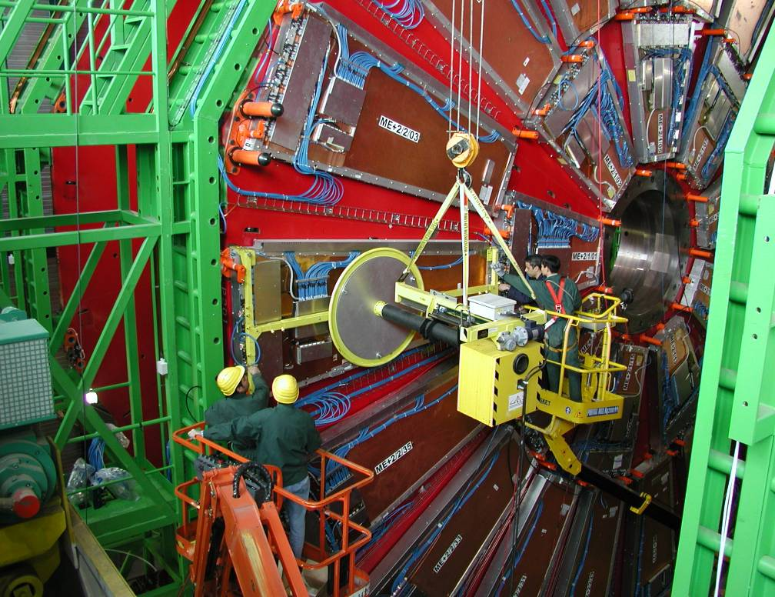
Installing muon Detectors

Slide 36
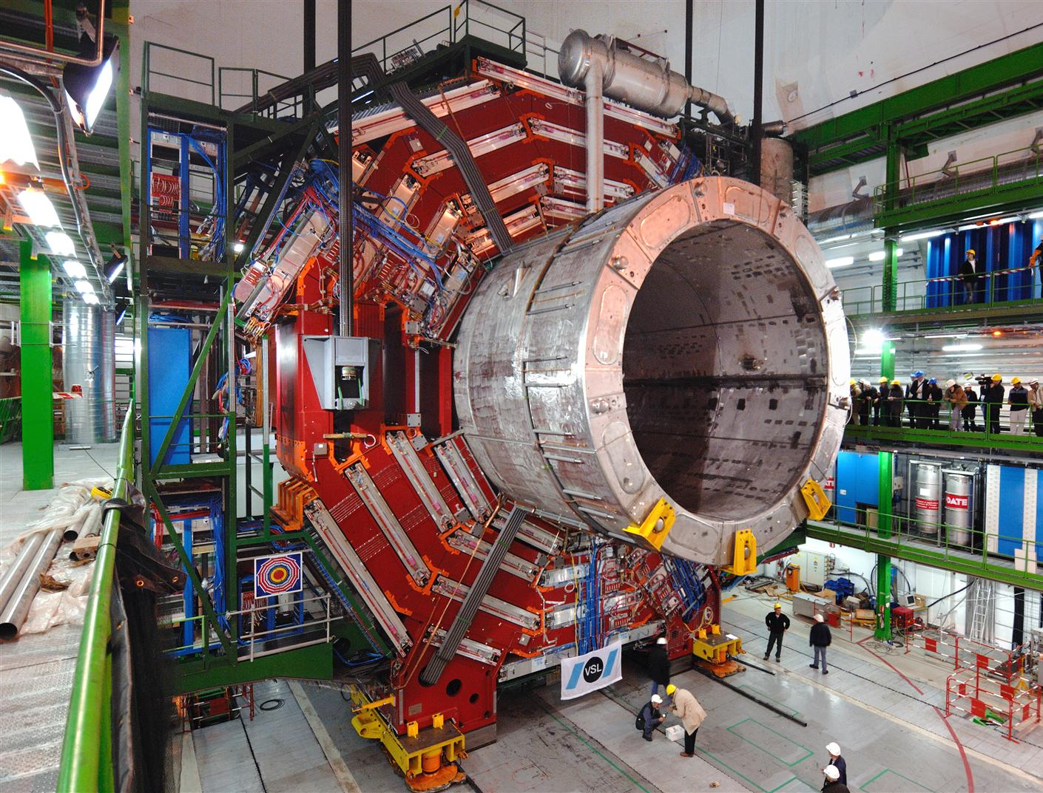

Slide 37
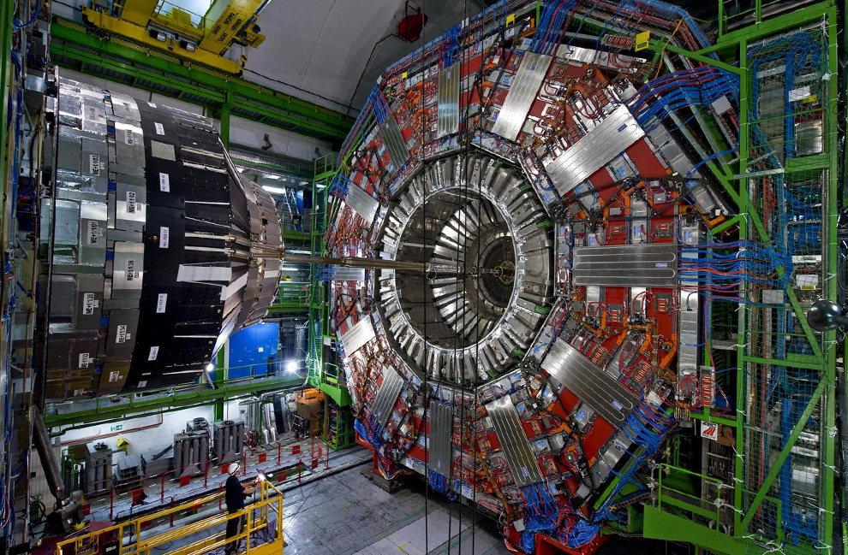

Slide 38
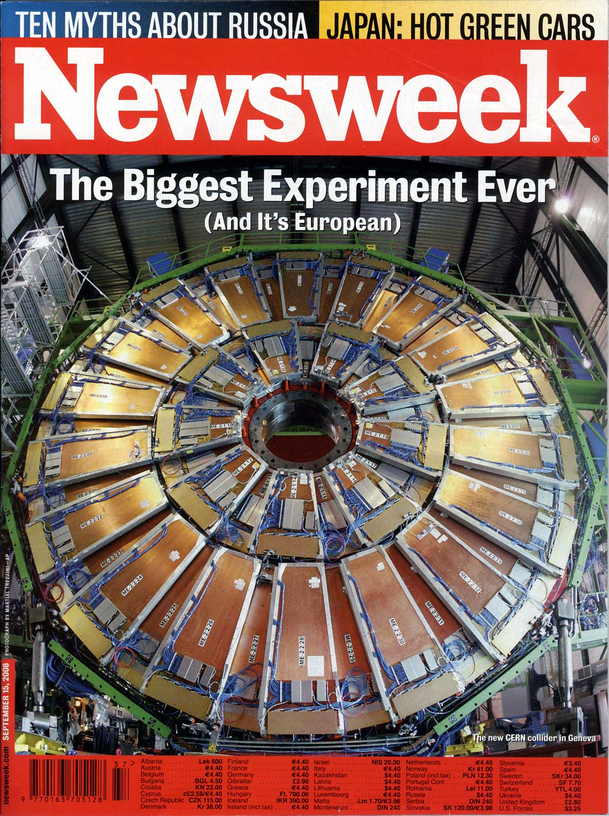
Particle detectors
constructed
at Westwood,
now at LHC, CERN
Sept 15, 2008 Issue

Slide 39
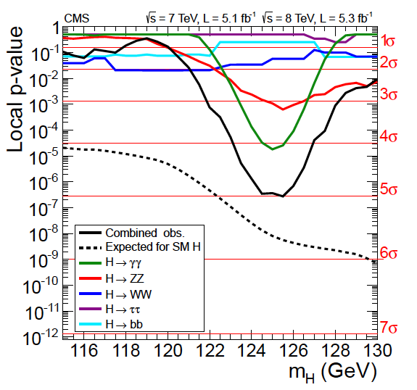
Higgs Discovery by CMS (July 4, 2012)

Slide 40
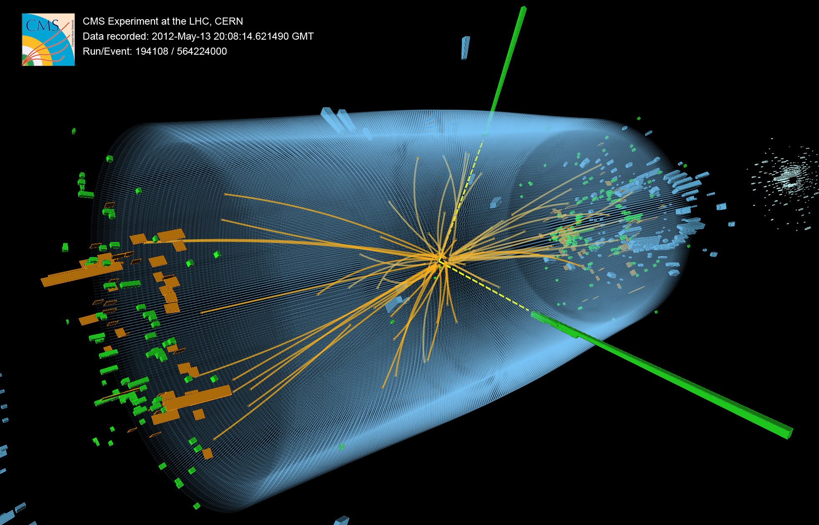
Higgs particle → 2 gamma rays

Slide 41
News release on July 4th !

Slide 42
Dark Matter and Dark Energy

Slide 43
“Fossils” from the Earliest Universe
Time
(sec)
Temp.
(ºK)
Energy (GeV)
10⁻⁴⁵sec
The Big Bang!
Planck
10⁻⁴⁰
10³⁰
10¹⁸
GUT
Gravitational Wave
10⁻³⁵
10¹⁵
GUT Particle
10⁻³⁰
10²⁵
10¹²
10⁻²⁵
10⁹
10⁻²⁰
10²⁰
Decoupling of “Fossils”
1PeV
10⁻¹⁵
10¹⁵
1TeV
EW
Neutralino
(Cold Dark Matter)
10⁻¹⁰
10⁻⁵
1GeV
1
10¹⁰
1MeV
Relic Neutrino
(Hot Dark Matter)
10⁵ sec
1KeV
1 year
10⁵
CMB
10³
1eV
10⁶
10⁹ year
10⁻³eV
Now
1

Slide 44
Cosmic Microwave Background (CMB) Matter-Radiation Decoupling
Time
(sec)
Temp.
(ºK)
Energy (GeV)
10⁻⁴⁵sec
Planck
10⁻⁴⁰
10³⁰
10¹⁸
GUT
10⁻³⁵
10¹⁵
10⁻³⁰
10²⁵
10¹²
10⁻²⁵
10⁹
10⁻²⁰
10²⁰
1PeV
10⁻¹⁵
Time = 300,000 years
10¹⁵
1TeV
EW
10⁻¹⁰
Temperature = 3,000 ºK
10⁻⁵
1GeV
Energy = 0.3 eV
1
10¹⁰
1MeV
Z = 1,100
10⁵ sec
1KeV
1 year
10⁵
10³
Matter-Radiation
Decoupling ⇒ CMB
1eV
10⁶
10⁹ year
10⁻³eV
Now
1

Slide 45
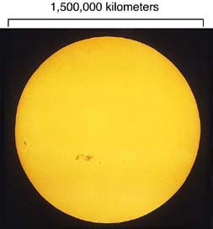

Slide 46
Cosmic Microwave Background (Discovered in 1964)
T=300,000 years
after the Big Bang
Temperature
=3,000ºK
z=1,100
Sun/Earth
Transparent
Today:
3000ºK/1,100
=2.7ºK
Opaque

Slide 47
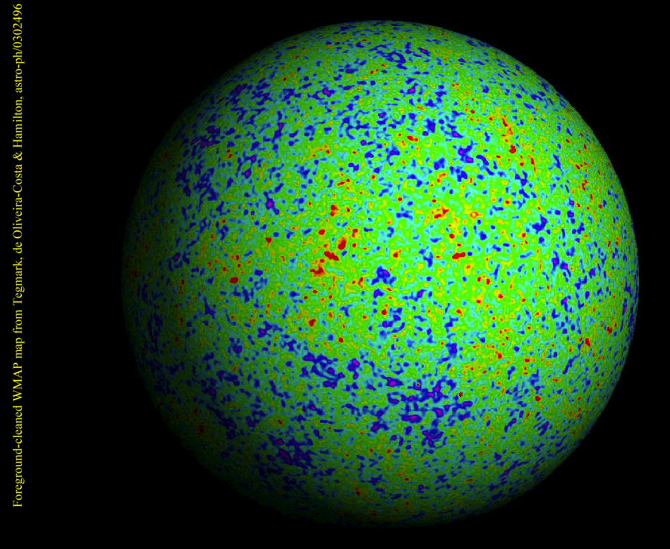
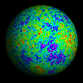
WMAP
Ned Wright

Slide 48
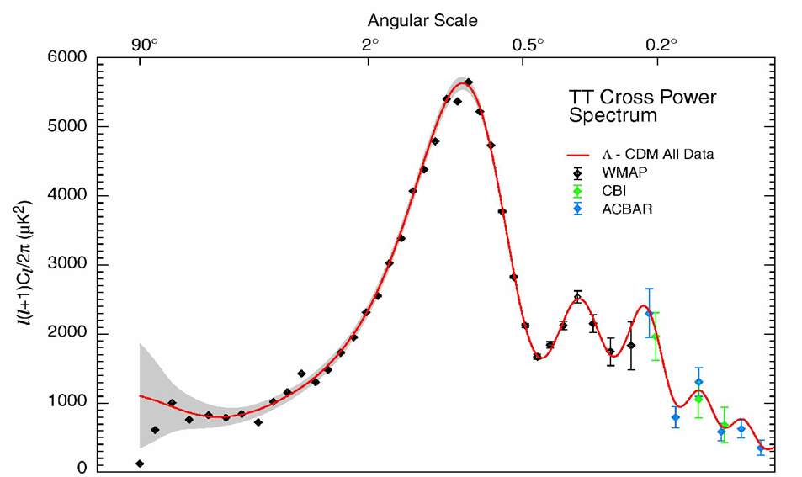

WMAP Power Spectrum
Universe is Flat.
→ Inflation

Slide 49
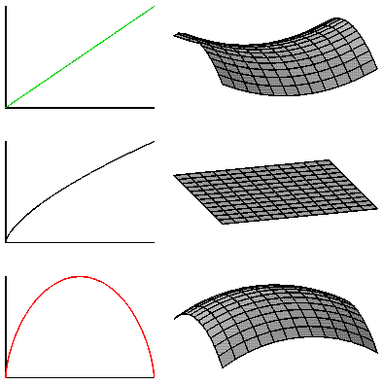
Geometry of the Universe
Open Ω<1
Flat Ω=1
(predicted by
Inflation)
Closed Ω>1

Slide 50
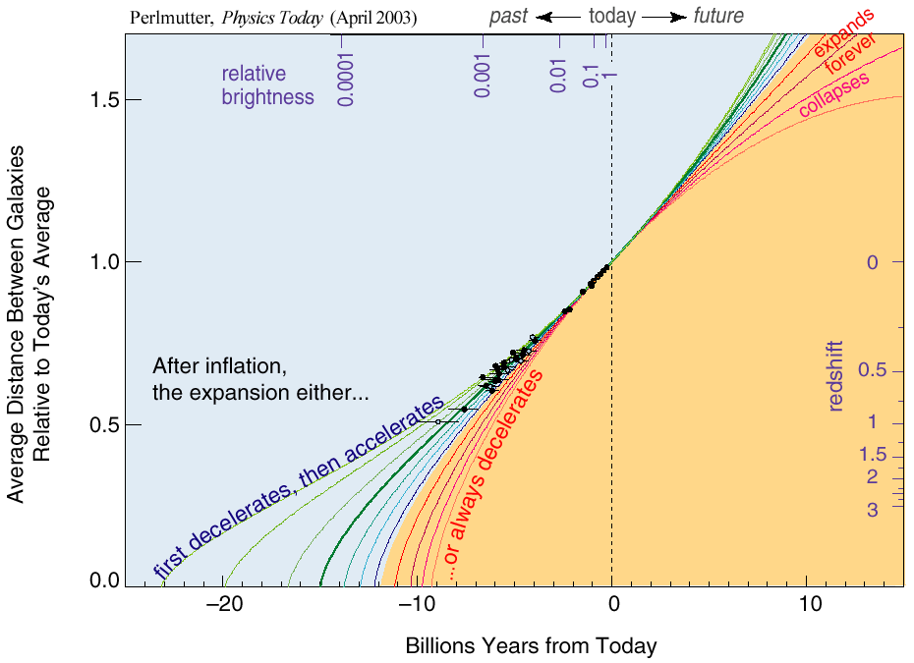
The Accelerating Universe （1998）
Ω_{Λ} = 0.7

Slide 51
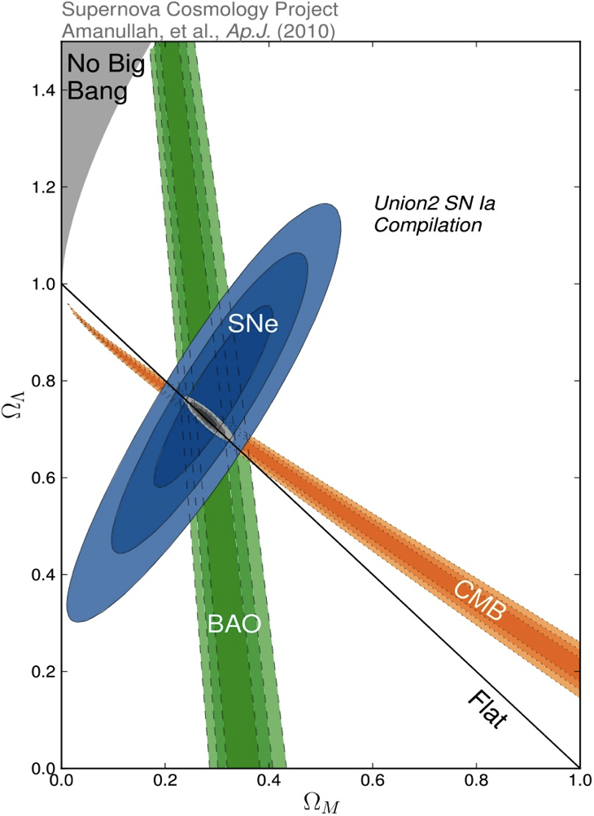
Density of Our Universe
Ω_{Total} = Ω_{Λ}+Ω_{Matter} = 1.0
Universe is Flat.
→Inflation
73% is Dark Energy.
→ Accelerating
Ω_{Λ}
Ω_{M}= 27%
Ω_{Matter}

Slide 52
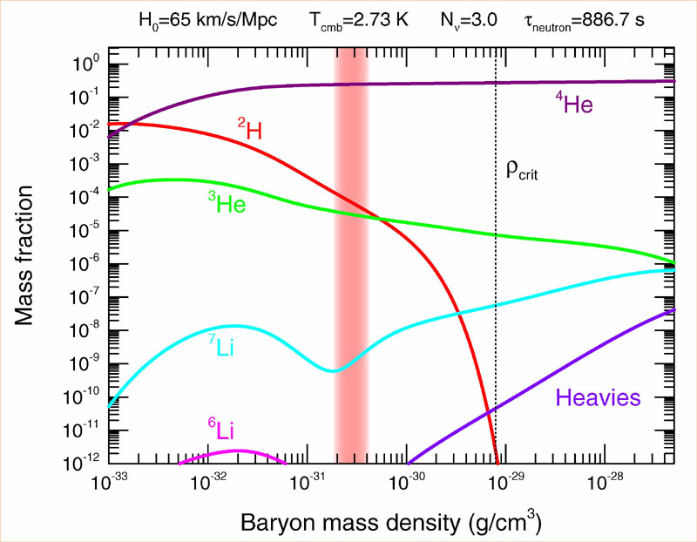
Abundance vs. Density
D
Ω_{Baryon}= 4.6%

Slide 53
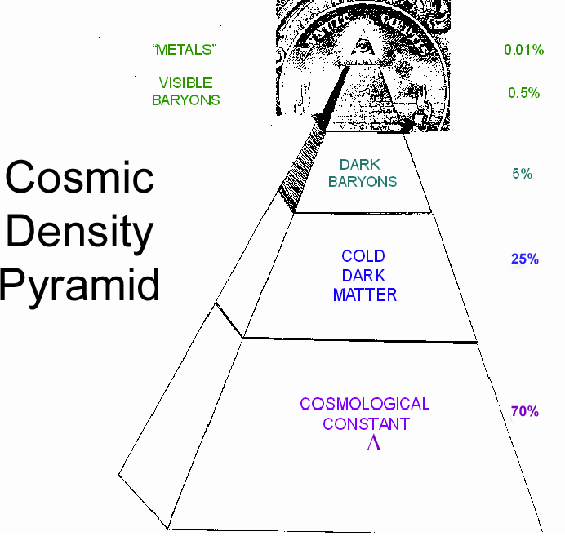
Cosmic Pyramid
Metal
0.03%
Star
0.4%
Baryonic Matter
0.5%
Gas,
Dust
4.2%
Dark
Matter
23%
Dark Energy
73%

Slide 54
Search for Dark Matter

Slide 55
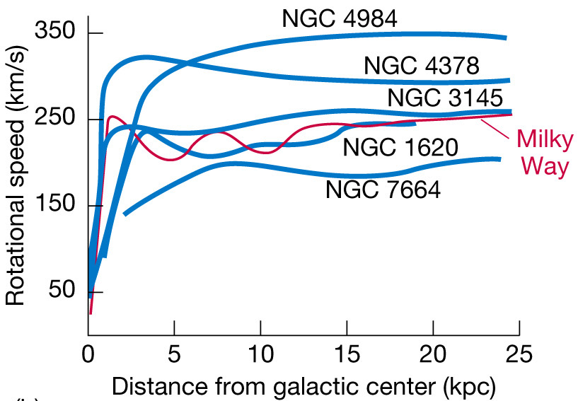
Andromeda Galaxy
known since 1932 (Jan Oort)

Slide 56
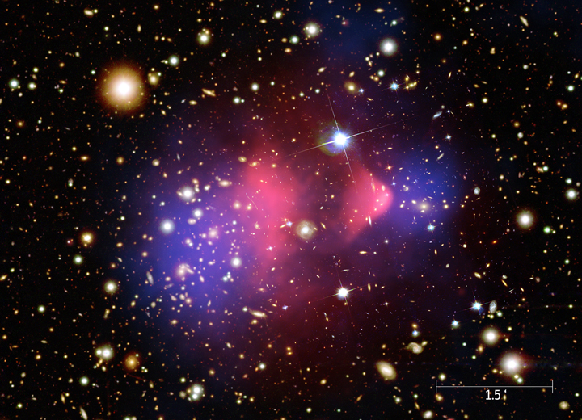
Bullet Cluster
known since 1933 (Fritz Zwicky)
X-ray
(Baryonic)
Weak Lensing (Total Mass)

Slide 57
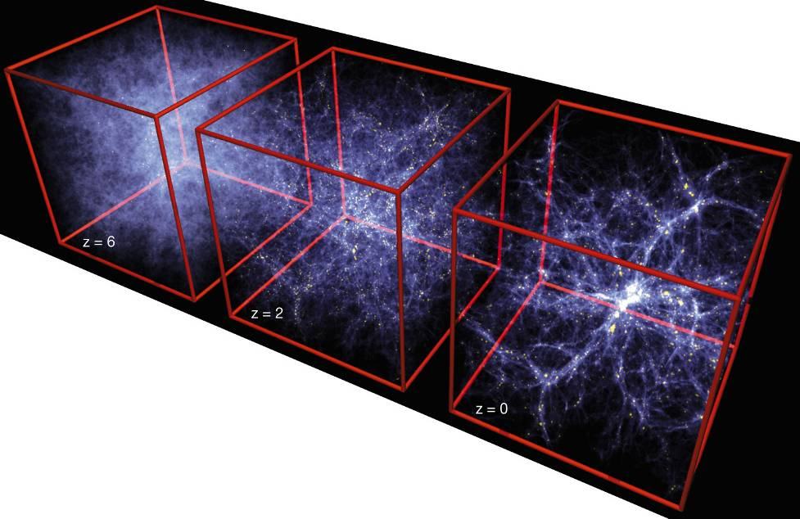
Formation of Structure in the Universe
Dark Matter is required!

Slide 58
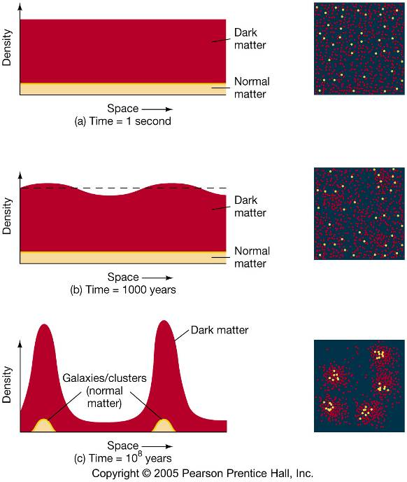
Evolution of Large Structure

Slide 59
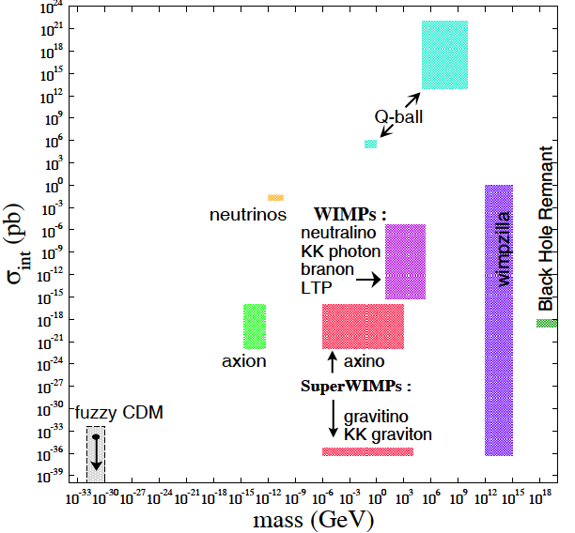
What is Dark Matter?
Alex Kusenko
Roberto Peccei

Slide 60
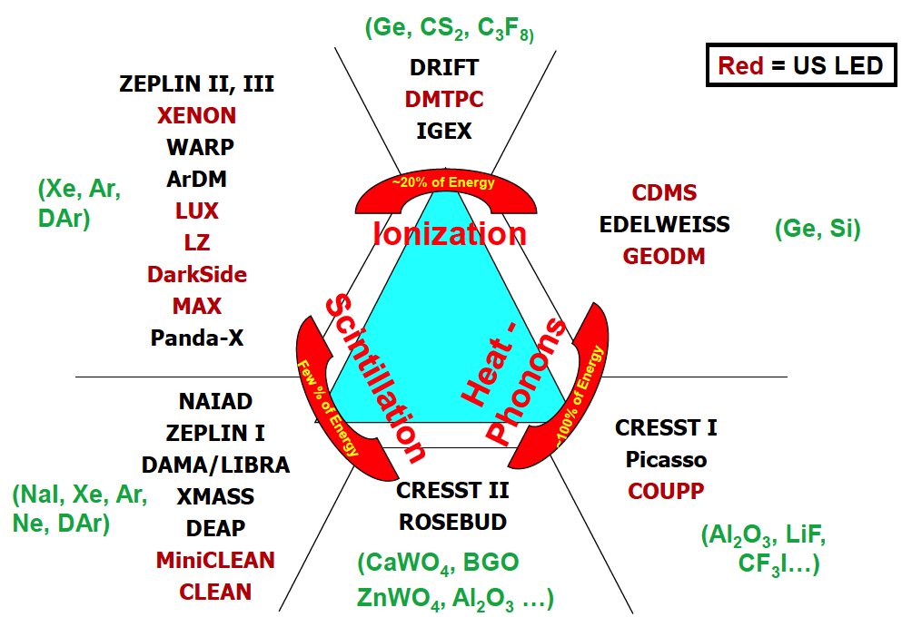
Detection Technique
Double
Phase
Gamma Ray
(Ge, Si)
Single
Phase
Neutron
WIMP

Slide 61
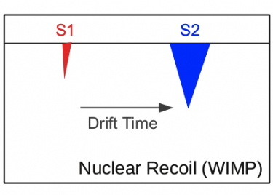
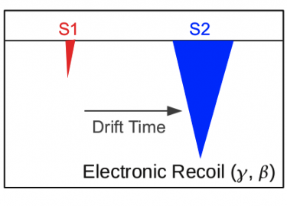
Double-Phase Noble Liquids

Slide 62
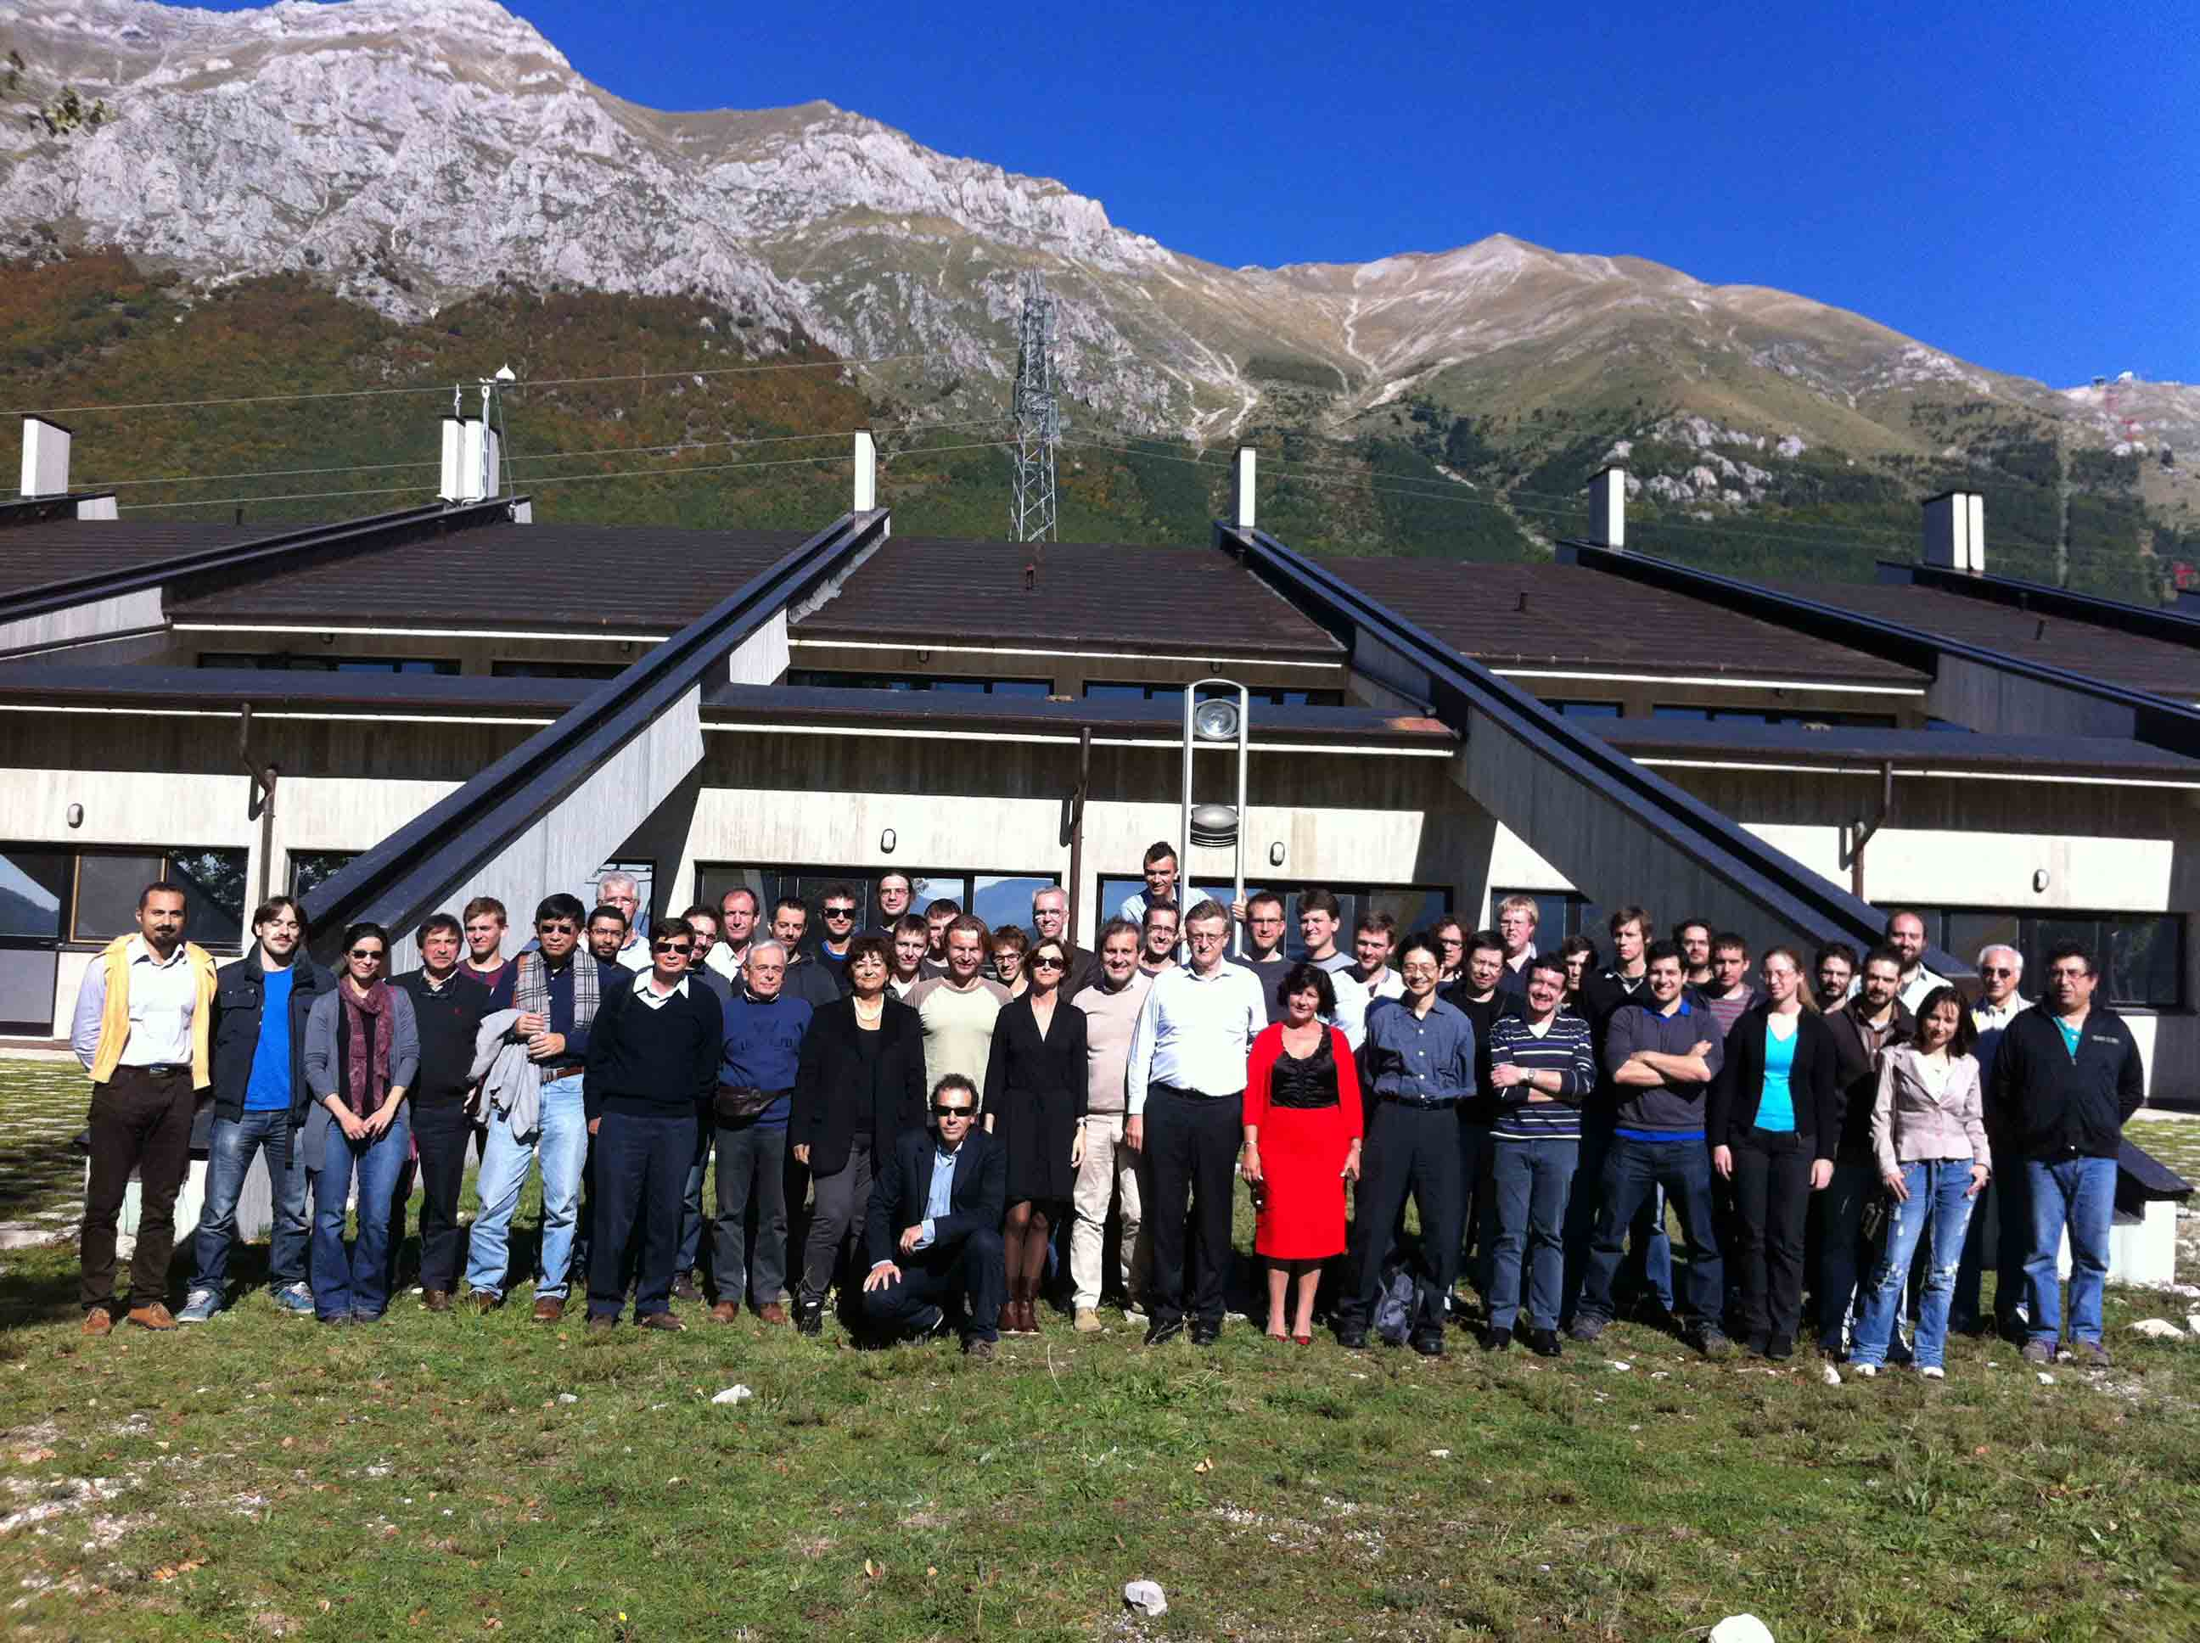

XENON Collaboration at Gran Sasso
UCLA joined in 2008

Slide 63
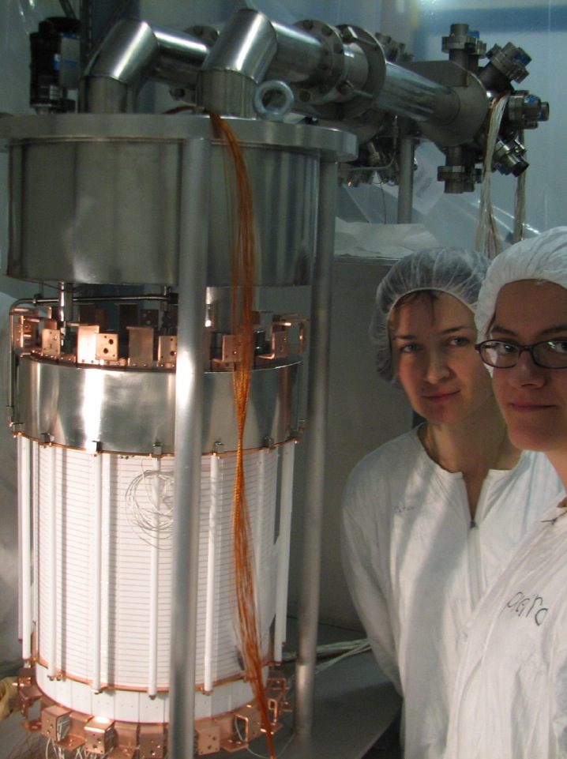
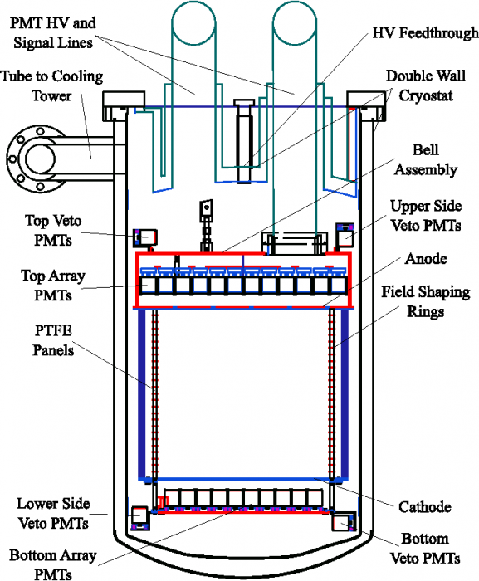
XENON100 Detector
161 kg
(48 kg)

Slide 64
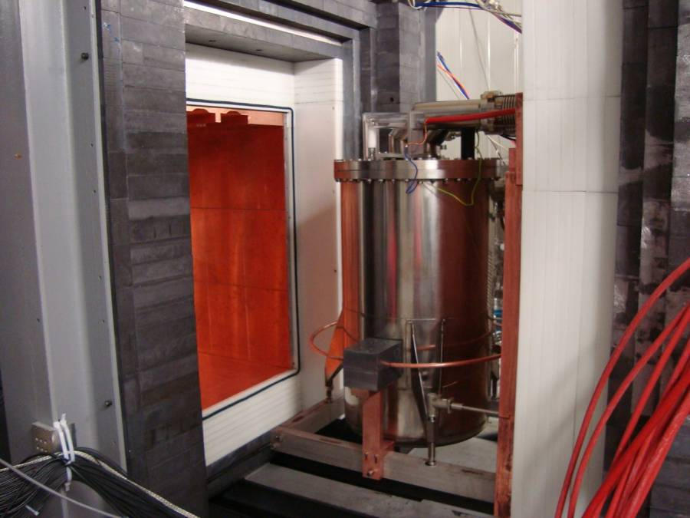
Pb
(20cm)
Poly
(20cm)
Cu
(5cm)
Pb
(20cm)
Poly
(20cm)
Cu
(5cm)

Slide 65
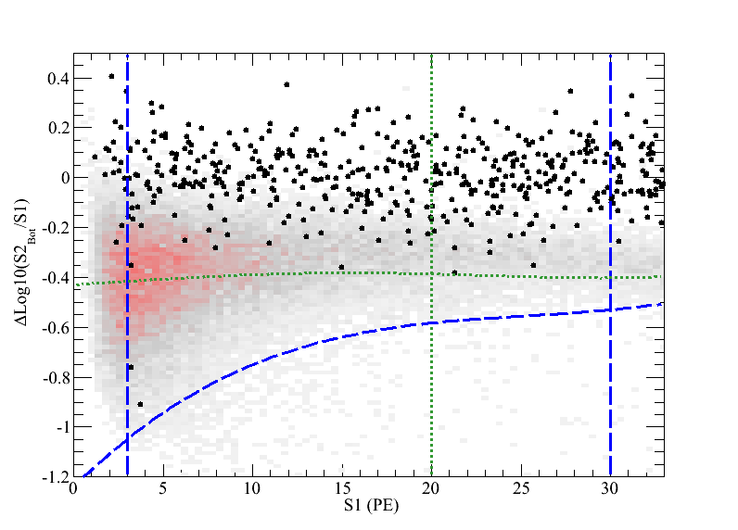
XENON0100 New Results
225 days, 34 kg
6.8 keV_{nr}
32 keV_{nr}
2 events
(1.0 ± 0.2 expected)
-3 σ
S1 = 3 PE
S1 = 20 PE

Slide 66
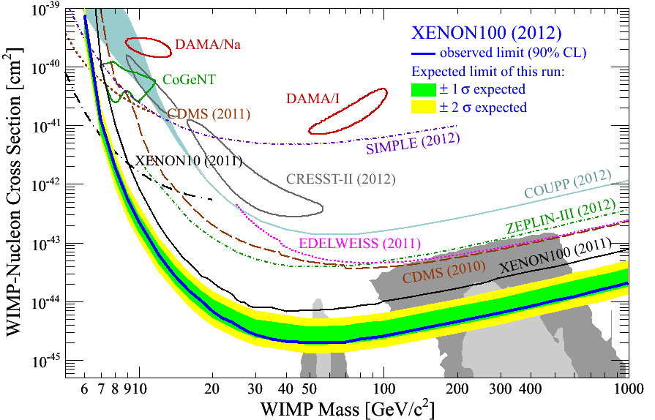
90% CL Limits of SI Cross Section (July, 2012)
arXiv:1104.2549
CMSSM

Slide 67
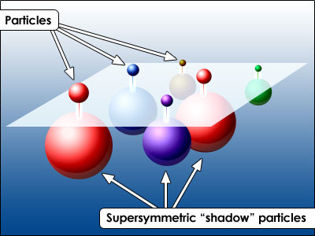
SUSY Neutralino

Slide 68
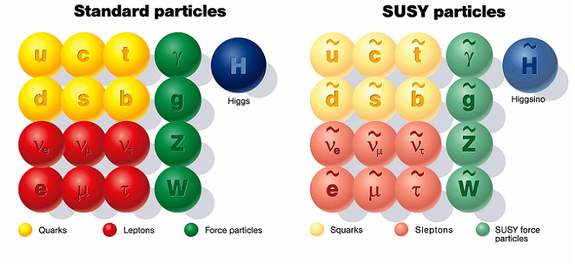
SUSY Particles and Neutralino
Spin 1/2 1 0

Slide 69
SUSY Particles and Neutralino
Super Symmetry
Neutralino
Spin 1/2 1 0 0 1/2 1/2

Slide 70
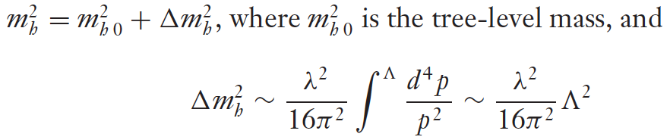


Hierarchy Problem
Higgs mass
SM :
SUSY :
or : new physics at the energy scale of Λ ~ 1 TeV

Slide 71

John Ellis

Slide 72

Mass Spectra at the best fit points (before LHC)
CMSSM
NUHM1
Buchmueller et al arXiv: 0808.4218

Slide 73

SI Cross Section vs. Mass
CMSSM
CMSSM
LHC
Pre
2011
2012
XENON100
2011
2012
XENON1T
Is Supersymmetry in trouble?
Buchmueller et al arXiv:1106.2529

Slide 74

KK particles in Extra Dimensions

Slide 75
Photon
Extra
Dimensions
KK Photon
Bulk
Our 3D Space
(= Brane)

Slide 76
Origin of Mass in Extra Dimensions
E = mc² → m = E/c²
Mass can be generated as kinetic energy in extra dimensions.
Origin on mass
Dark matter is running in the extra dimensions
Gravity can escape into the extra dimensions.
Why gravity is so small
Origin of dark energy

Slide 77


Mass Spectrum of the first KK level
Similar to the SUSY mass spectrum
Δ = (m_{l} – m_{γ})/m_{γ}
KK Photon
KK Photon
Cheng 2002 arXiv:hep-ph/0205314v1

Slide 78

Predicted Cross Section of Kaluza-Klein Dark Matter
0
G1
XENON100
Δ
2011
2012
0.5
G2
XENON1T
Feng Ann. Rev. Astro. Astrophys. 2010.48:495-545

Slide 79

Sensitivity to KK particles
WMAP
0.5
LHC
0.1
0.05
XENON1T
XENON100
Δ = (m_{l} – m_{γ})/m_{γ}
0.01
My favorite
Arrenberg 2008

Slide 80
Summary on “Science Cases”
XENON program (~$10M) is extremely timely and competitive to LHC (~$10B)
XENON100 ~ Current LHC
XENON1T ~ Future LHC
If new physics at 100 – 1000 GeV (as it should be), LHC and/or XENON1T will discover WIMPs.
SUSY - Neutralino
Extra Dimensions – KK photon
By combining LHC and XENON1T, we have a better chance to untangle large parameter spaces.

Slide 81
G2 & G3 Detectors

Slide 82
Comparison of Xenon Detector Size
G3
MAX, LZD
20 ton (10 ton)
G2
XENON 1ton
2.5 ton (1 ton)
G1
2 m
XENON100
161 kg
(48 kg)
ZEPLIN-II
31 kg
(7.2 kg)
XENON10
14 kg
(5.4 kg)
1 m
1 m
15cm
30cm
14cm
30 cm
20 cm
30 cm
1 m
2 m
2007
2007
2010
2015
2020

Slide 83


XENON 1T (G2) at Gran Sasso
Xe
2.5 ton
(1 ton)
1 m
10 m
Water
3” PMT x 250

Slide 84


DarkSide 5T (G2) at Gran Sasso
Water
10 m
2 m
⁴⁰Ar
5 ton
(3 ton)
Liq. Scinti.
3” PMT x 600

Slide 85
Roadmap to MAX
2012
2013
2014
2015
2016
2017
2018
2019
2020
Gran Sasso
DUSEL
MAX
XENON100
XENON 1T
Xe 10T
Ar 50T
DarkSide50
DarkSide 5T
G1
G2
G3

Slide 86


MAX+LZD = “Ultimate G3” Detector (at DUSEL)
Xe 20 ton (10 ton)
⁴⁰Ar 70 ton (50 ton)
Xe
Ar
Liquid
Scinti
Liquid
Scinti
Water Tank
Water Tank
8 m
18 m

Slide 87
G1
CMSSM

Slide 88
G1
CMSSM
G2

Slide 89
G1
CMSSM
G2
Xe
G3
Ar

Slide 90
LHC
Pre
2011
2012
2015
G1
CMSSM
G2
Xe
G3
Ar

Slide 91

Where backgrounds come from?
Cosmic Rays
Underground or
Under high mountains
XDNON100
Radio Activities
(U, Th, K…)
Xe/Ar
Water Tank
+ Liquid Scintillator
Photon detectors are the major source of backgrounds.

Slide 92



QUPID (QUartz Photon Intensifying Detector)
arXiv:1103.3689
Photo Cathode
(-6 kV)
Photo Cathode
(-6 kV)
Quartz
Al coating
APD (0 V)
APD (0 V)
Quartz

Slide 93

Comparison of Photon Detectors from Hamamatsu
R11065 (Ar)
R11410 (Xe)
3 inch
QUPID
3 inch
MAX
XAX
XENON1T
DarkSide50
R8520
1 inch
XENON10
XENON100
U/Th ~ 0.1 mBq
U/Th ~ 5 mBq
U/Th ~ 1 mBq

Slide 94

7 QUPID with Holder
Tested in both Xe and Ar

Slide 95

Full Liquid Xenon System
Hanguo Wang’s Lab
Control Panel
Recirculation Rack
Xenon Bottle
Recirculation Pump
Getter

Slide 96
Conclusions
Science Cases
Overwhelming – Astronomy and Cosmology
Beyond Standard Model – SUSY, Extra Dimensions…
Experimental Status
Healthy competition between LHC ($10B) and XENON ($10M)
SUSY is pushed to the corner, or about to be discovered.
Future Direct Searches
G2 : XENON 1T and DarkSide 5T at Gran Sasso.
G3 : MAX (Xe 10T + Ar 50T) at DUSEL

Slide 97
Katsushi’s Speculations in Nov 2011
2012 LHC (ATLAS+CMS) announces
120 GeV Higgs (at 3σ)
125 GeV Higgs (at 5σ)
2017 XENON1T announces
Observation of 10 WIMP signals (> 200 GeV)
2022 G3 (Xe+Ar) and LHC jointly confirm
Extra Dimensions
WIMP = 700 GeV KK Photon (Δ = 5%)
No Supersymmetry
Katsushi happily retires at age 66.

Slide 98
Seven Phases of Cosmic Evolution
Spontaneous Symmetry Breaking
14B years ago
Simple
Coherent Complex System

Slide 99
Seven Phases of Cosmic Evolution
Spontaneous Symmetry Breaking
14B years ago
Origin of
Particles
Origin of
Structure
Origin of
Life
Origin of
Consciousness

Slide 100
Talk Outline
Part I : Particle Physics & Cosmology ~50 min.
Introduction to Cosmology: Origin of Universe
CMS at CERN: Origin of Particles
Detection of Dark Matter: Origin of Structure in Universe
Lab Tour ~15 min.
Part II : Bio-imaging and Neuro-physics ~50 min.
Introduction to High-speed Bio-imaging
Single Molecule: Origin of Life
Neurophysics: Origin of Consciousness

