Slide 1
Summary of FMS/Jet Meetings
July 31 2014

Slide 2
FMS Meeting: 7/28/14
No formal presentations
Jet Meeting: 7/29/14
Brian Page: Discussion of Di-jet Conveners preview.

Slide 3
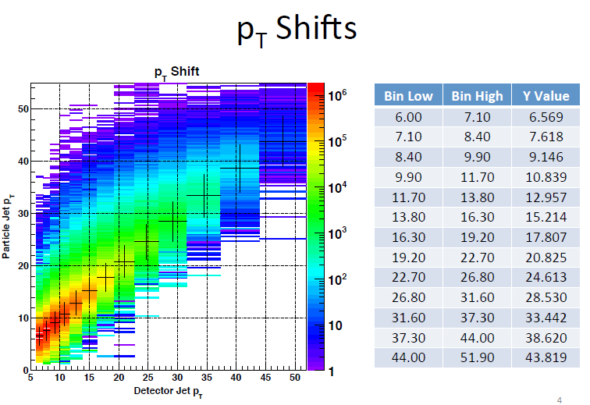
Jet Meeting: 7/29/14
Kevin Atkins: Run 12 Collins Analysis-Calculation of z, pT and jT shifts/Systematic errors

Slide 4
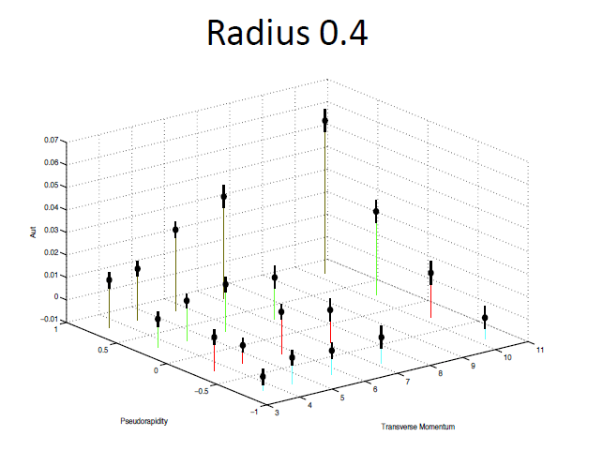
Jet Meeting: 7/29/14
Keith Landry: IFF Analysis, 2009 Data
K/p contamination- probably error in calculation
2D binning: mass/eta/pT
0.07
Asymmetry
PseudoRapidity
Invariant Mass

